Slide 1
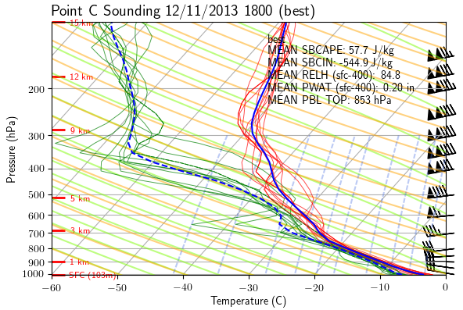
Using ensemble sensitivity analysis towards understanding lake-effect snow morphology and predictability
Seth Saslo
Penn State Dept of Meteorology
Group Meeting 17 Aug 2017

Slide 2
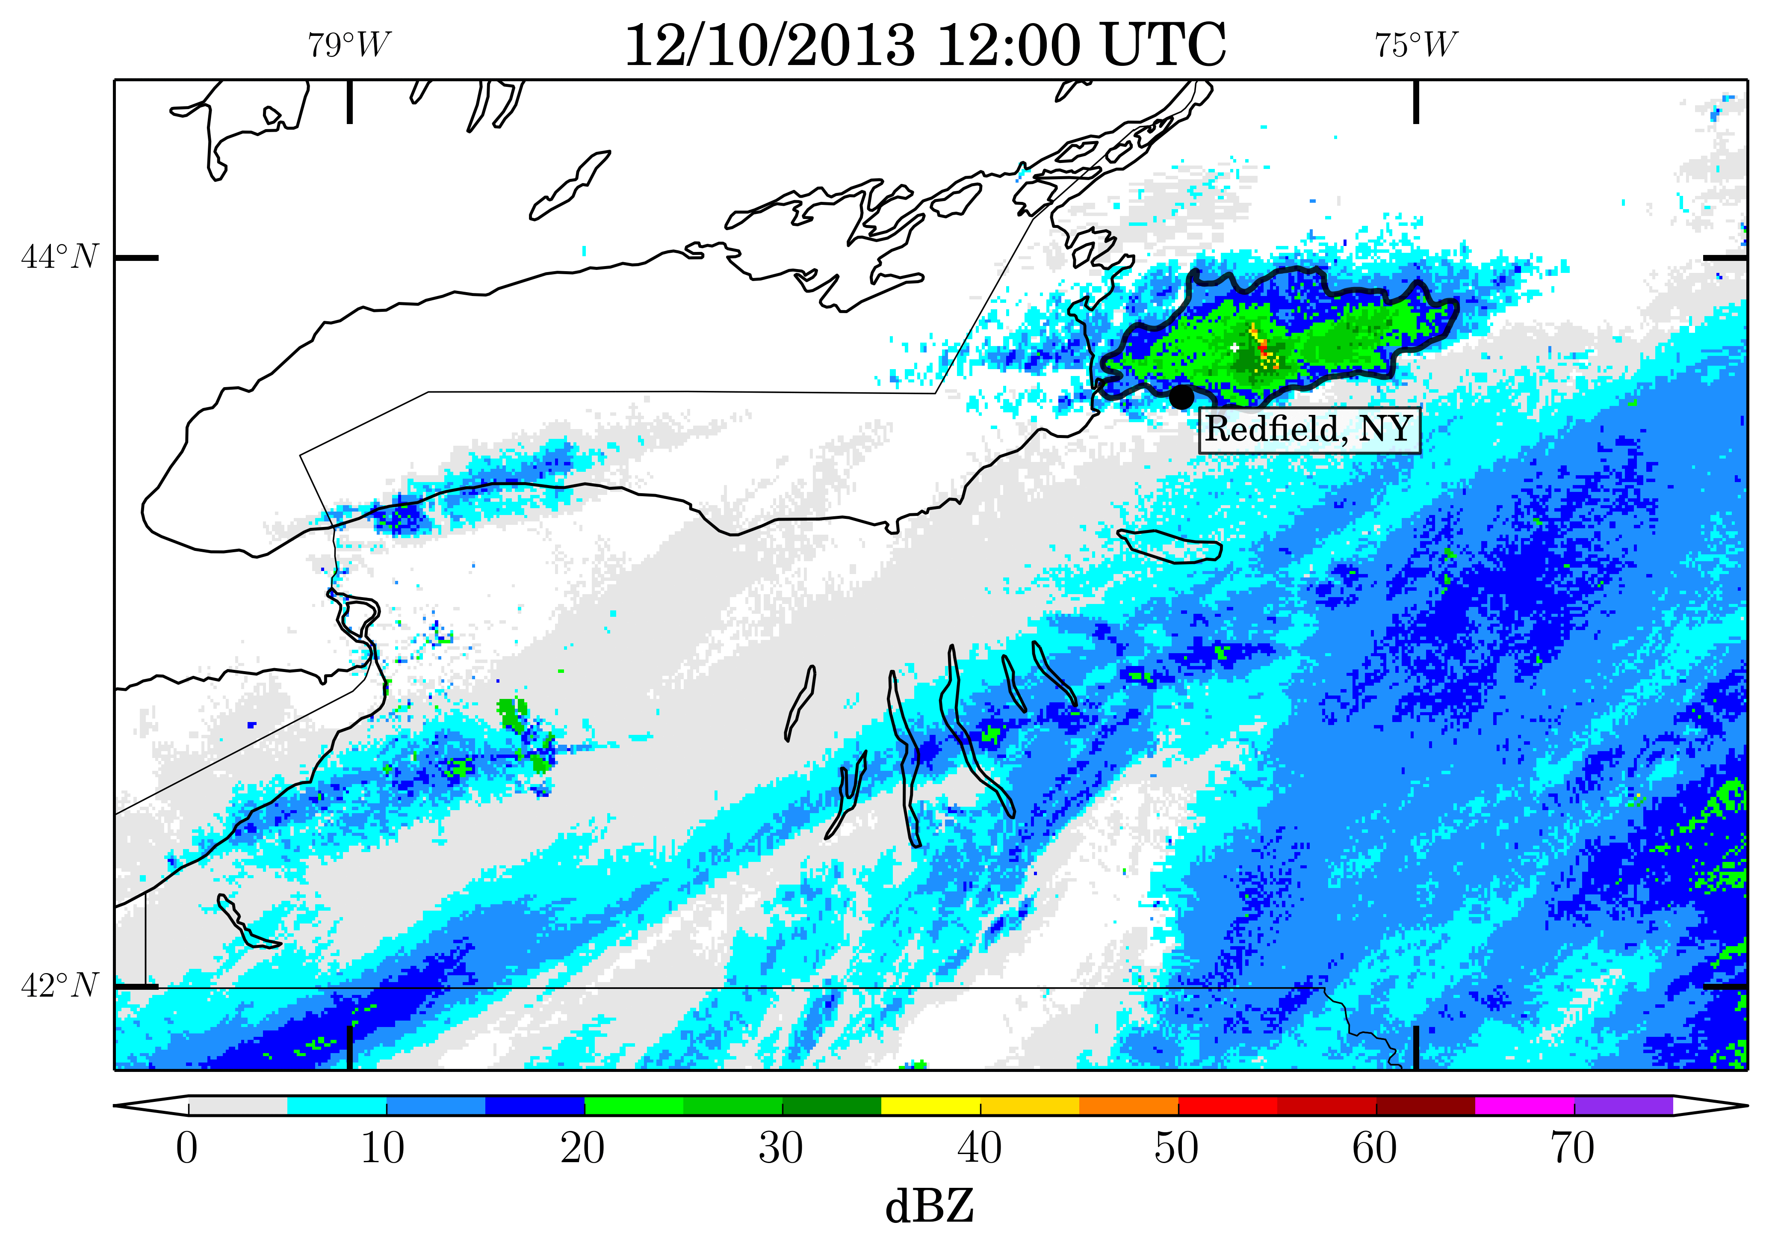
The case study
• Long-lived long-lake-axis parallel (LLAP) lake-effect snow event in December 2013, heavily observed by OWLeS field campaign
• Structure, mode, initiation, inland penetration, and reasons for localized enhancement still serious subjects of study (Campell et al., 2016, Campbell and Steenburgh, 2017; Minder et al., 2015; Welsh et al., 2016; Eipper et al.)

Slide 3
The problem
• Campbell et al. (2016) noted that variations in intensity and other band features, such as mode (clustered vs strongly banded convection) and orientation seemed to coincide with synoptic and perhaps regional shortwaves

Slide 4
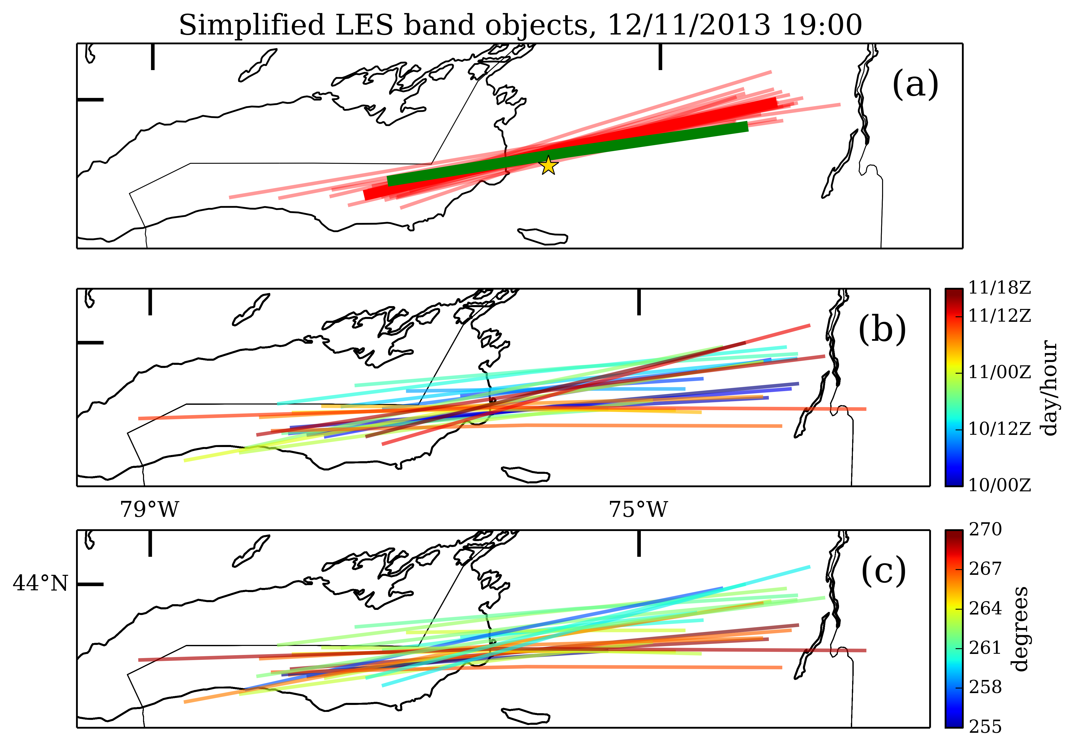
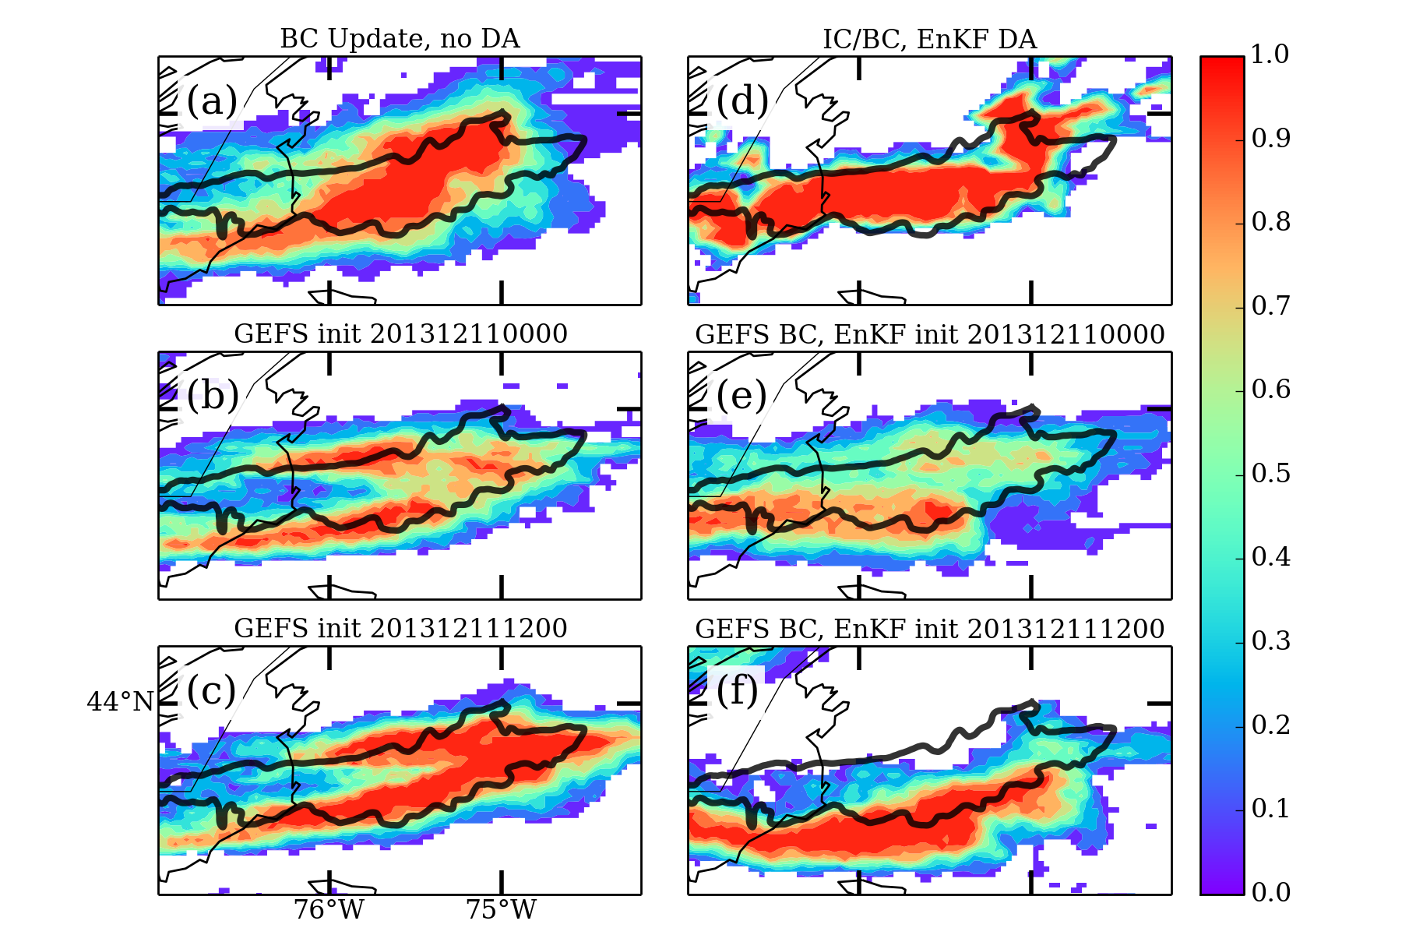
The problem
• Saslo and Greybush (2017) also noted limited timescales of predictability in ensemble simulations of the storm during critical periods in the event

Slide 5
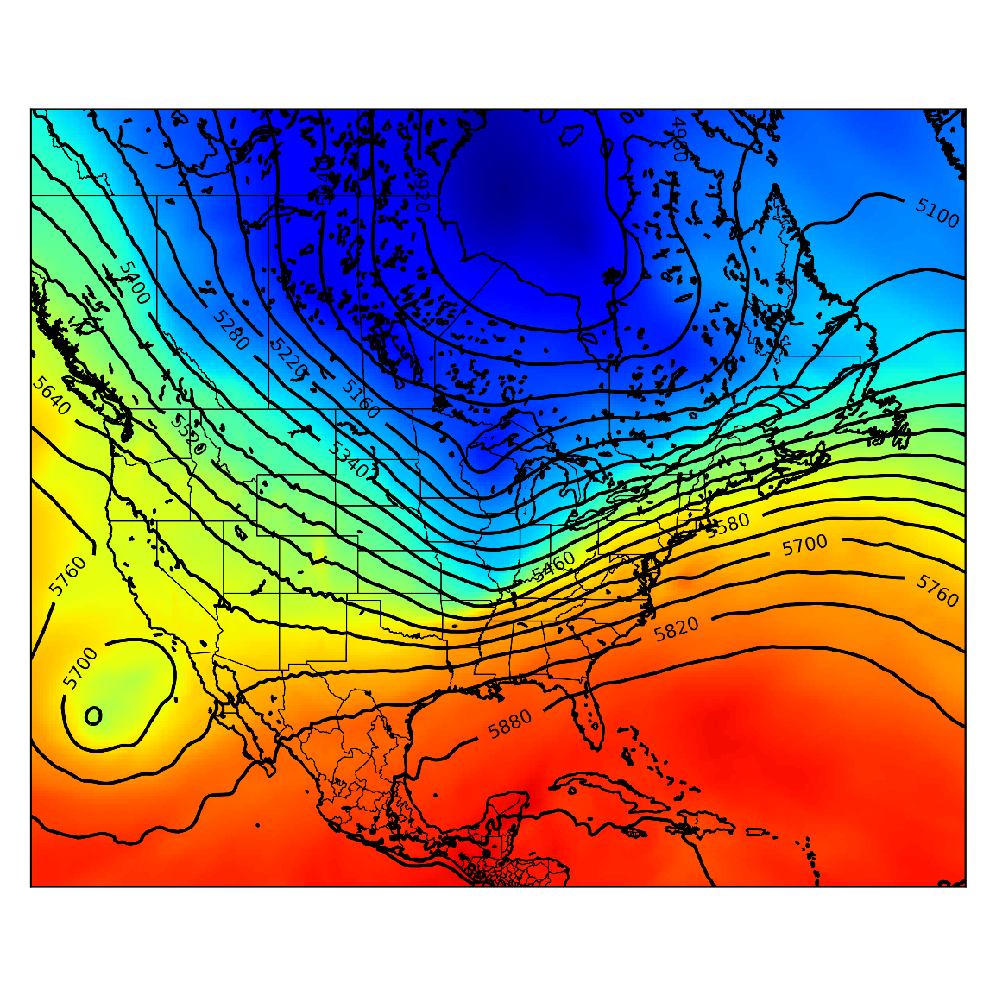
The question
• Can it be shown if these regional instabilities, especially these shortwaves, strongly modulated the event?
• If so, can it be answered and quantified how they did so?

Slide 6
The plan
• Run a large ensemble and identify best- and worst-performing sets of members
• Try to use this ensemble to identify like features in the synoptic and basin-scale environment to see what hypotheses may hold water
• Use 4-D model space to better examine the dynamical processes that may have lead to different simulations
• Hint at predictability based on just how bad some forecasts may or may not be

Slide 7
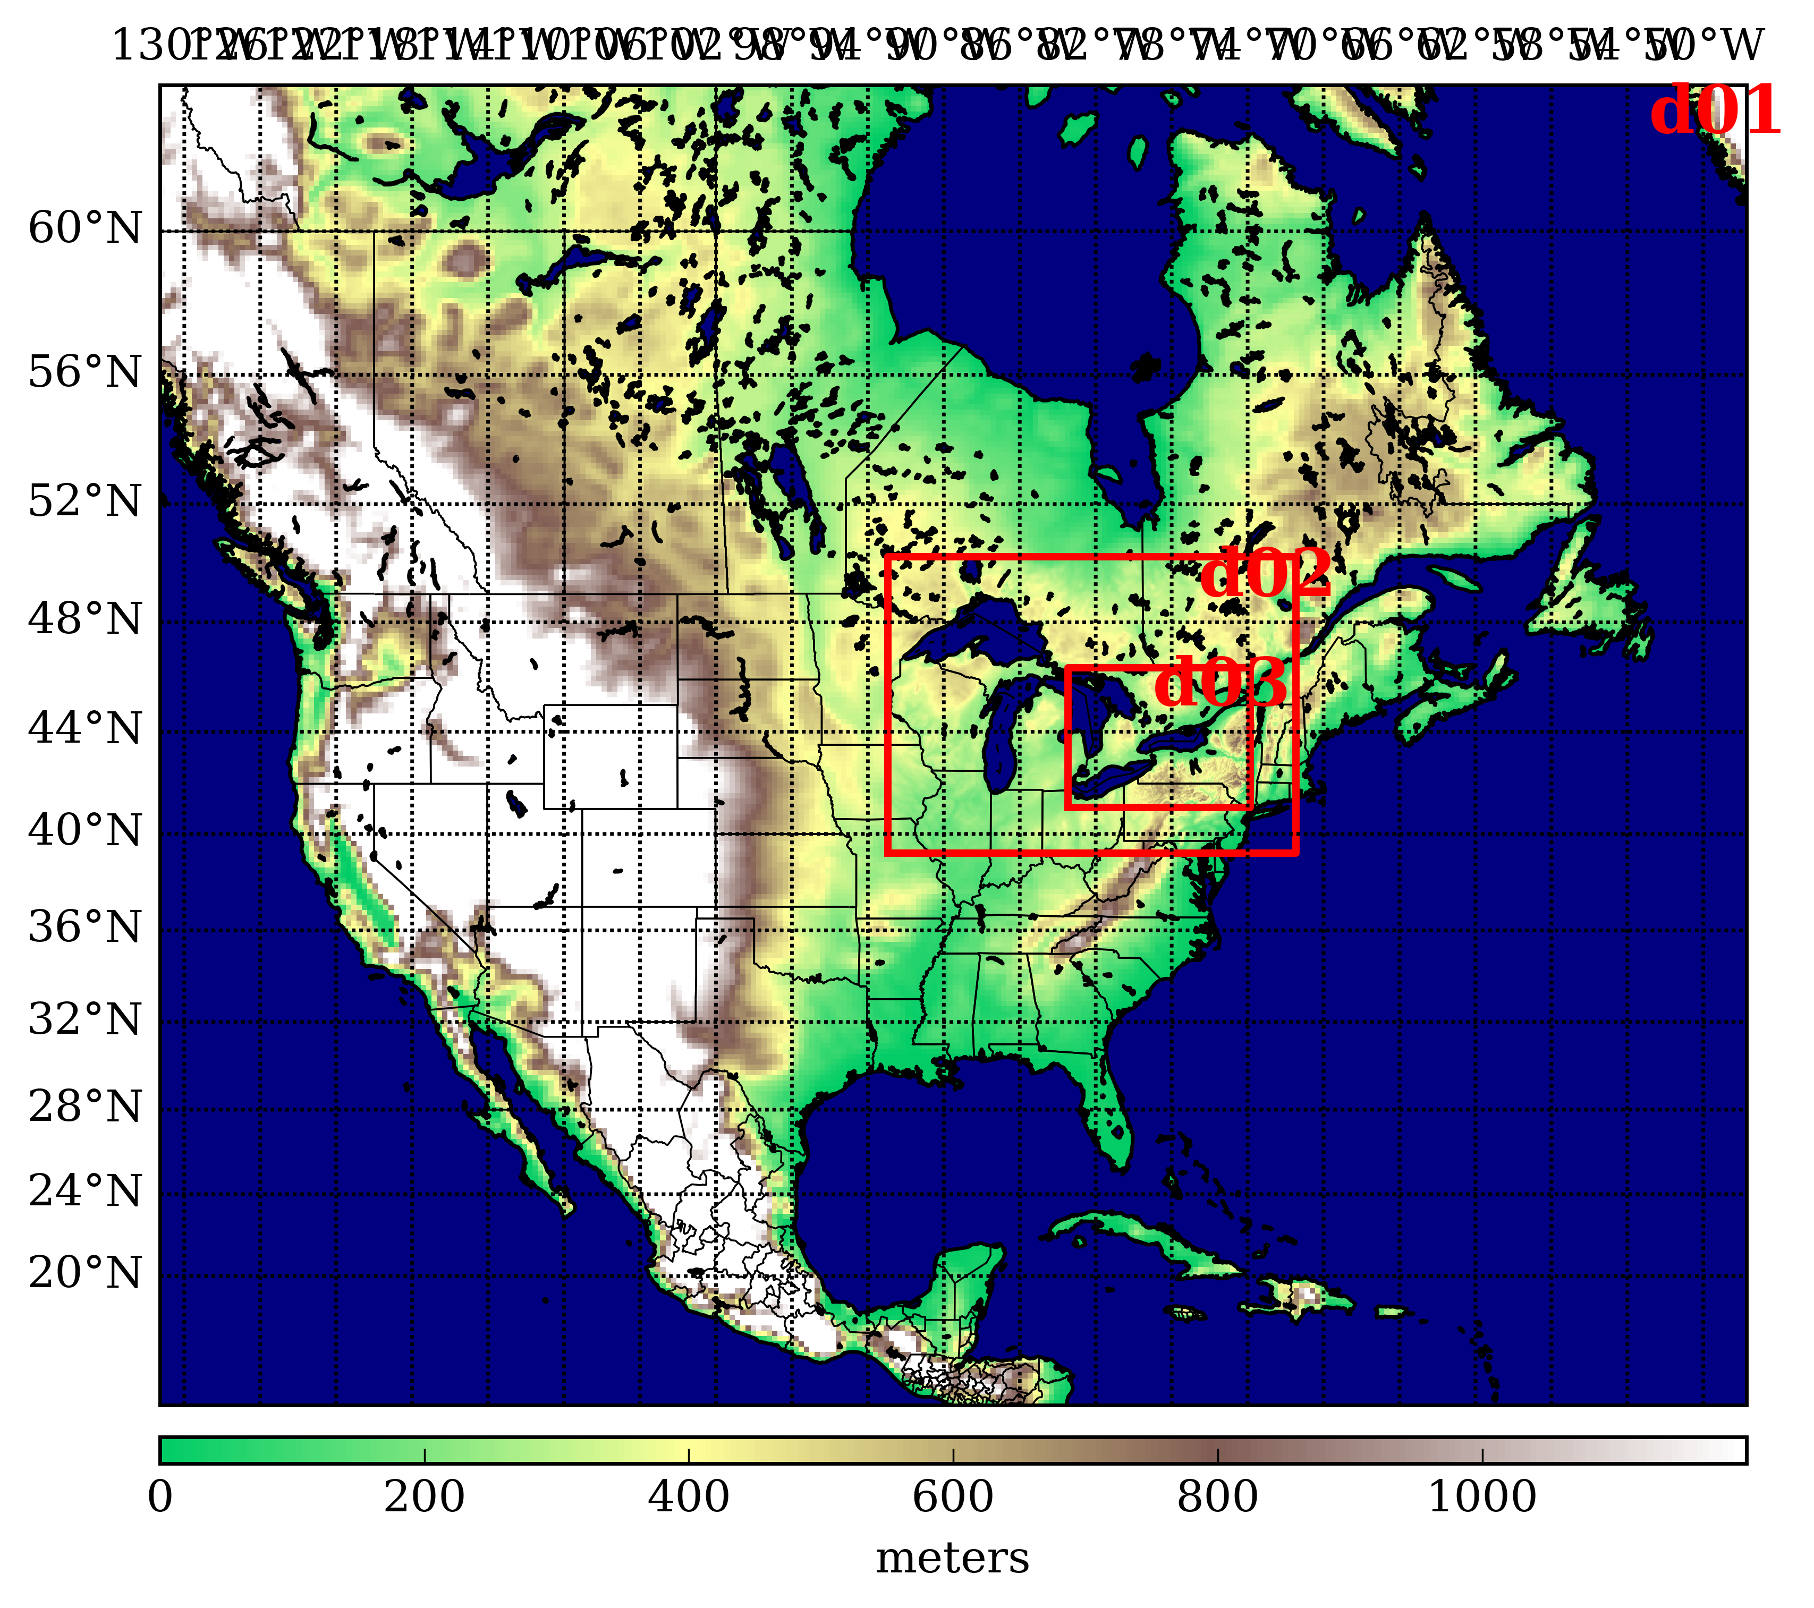
The ensemble
• WRF-ARW 3.7.1, 3 domains 27-9-3 km, fixed physics (Thompson, MYJ)
• Initial condition perturbations using WRFDA CV3, default parameters
• Initialized 12Z 10 Dec 2013 (During frontal passage, 12 hours prior to band organization)
• 48-hour forecast
Note that this won’t really allow for an exploration of model error; this will just be used to better understand the underlying meteorology

Slide 8
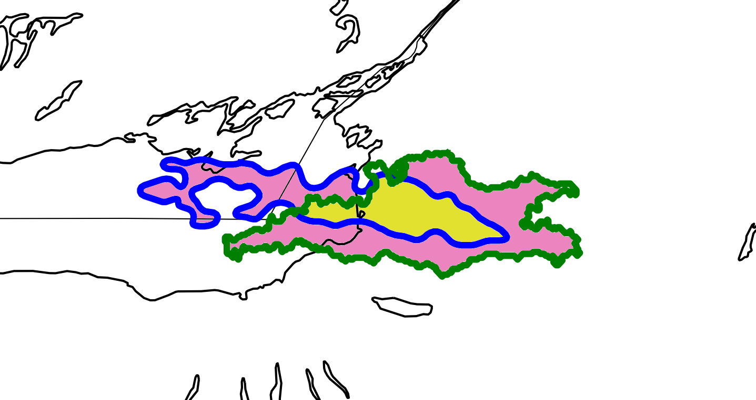
The response variable
• Define response variable as intersecting area minus symmetrical difference.
(Yellow = intersection, pink = symm diff)

Slide 9
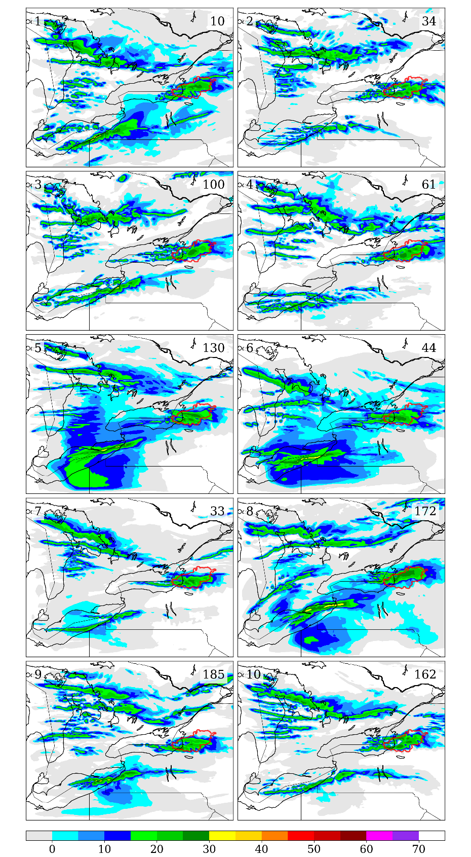
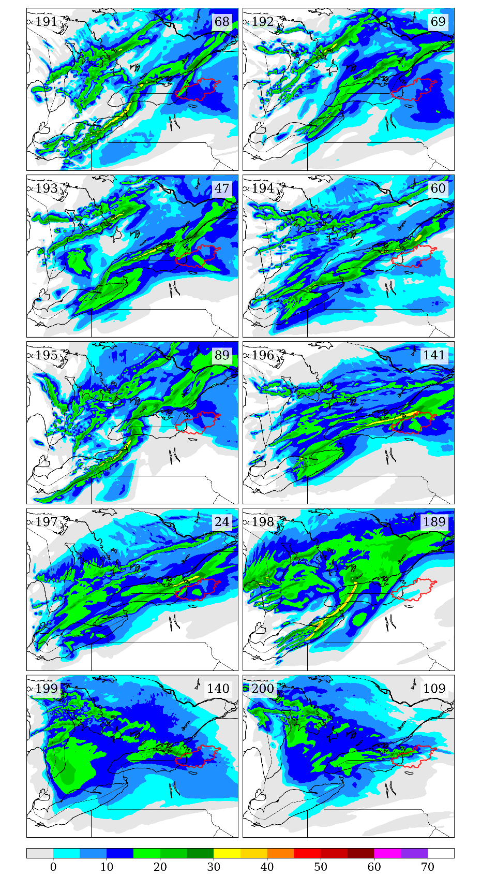
best
worst
Some preliminary results

Slide 10
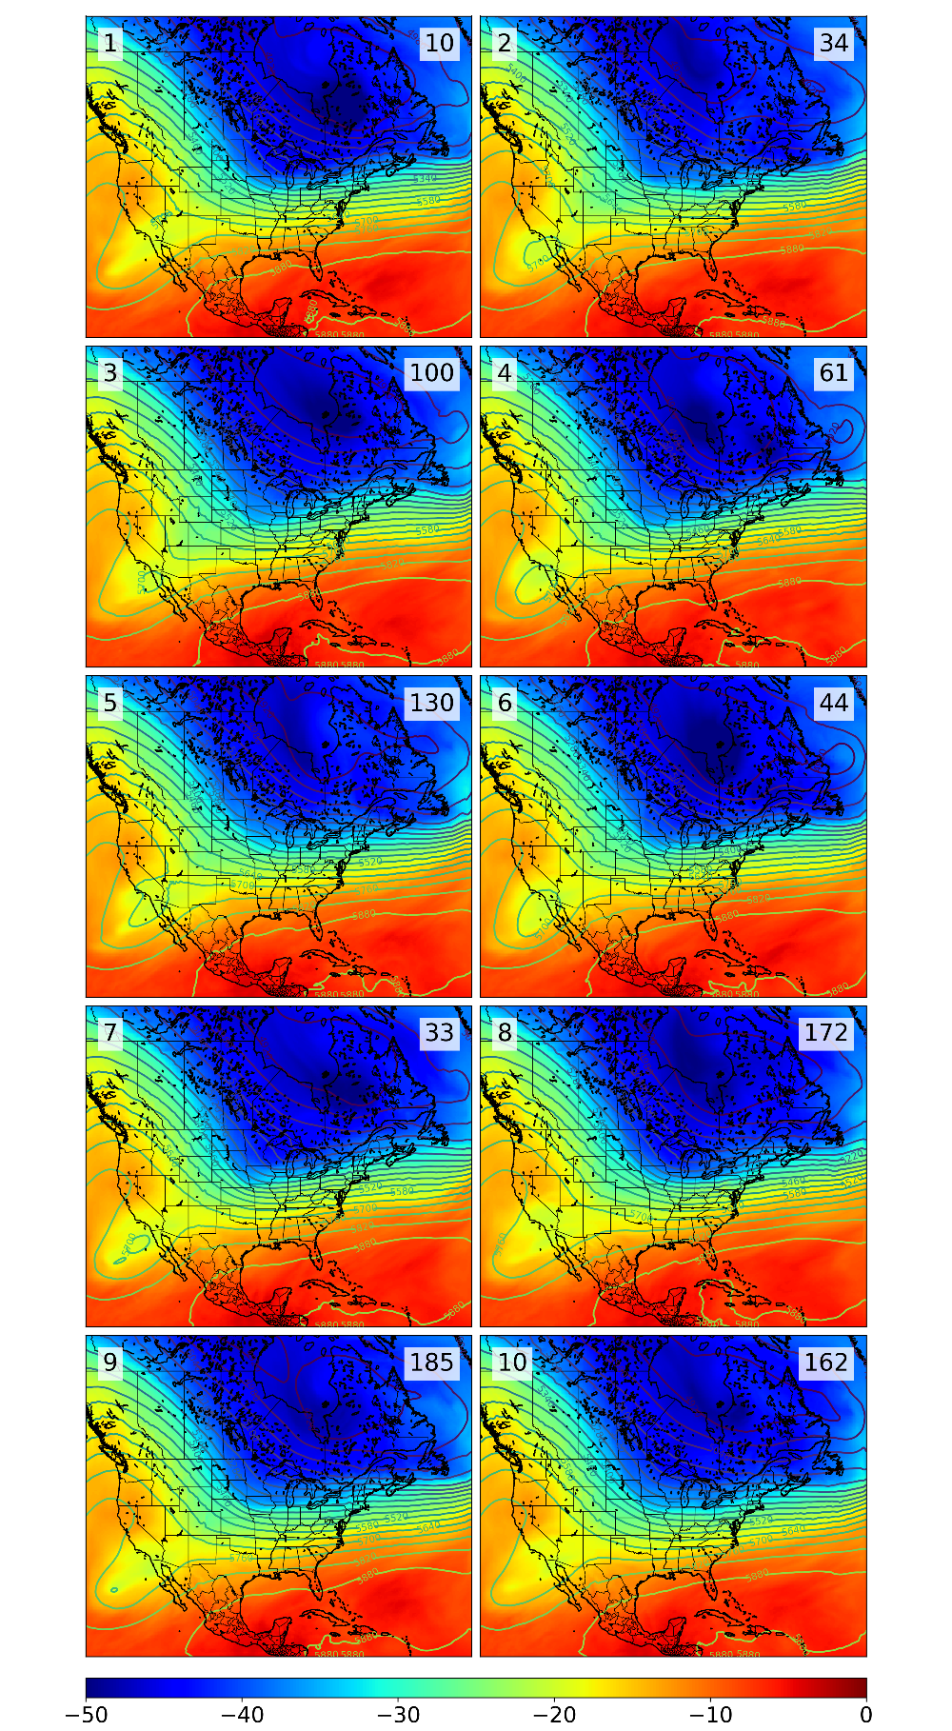
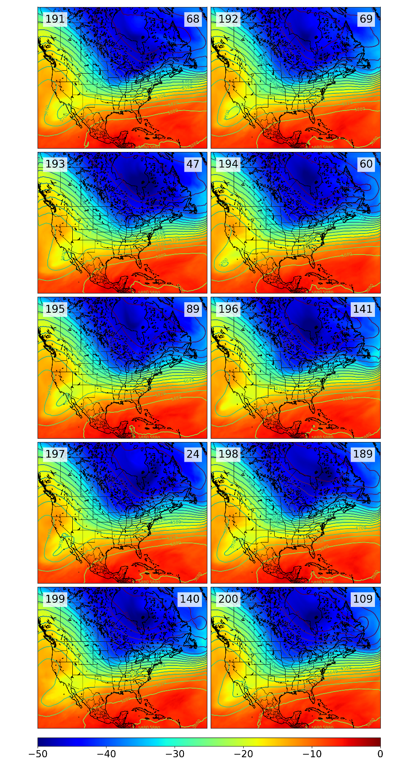

Slide 11
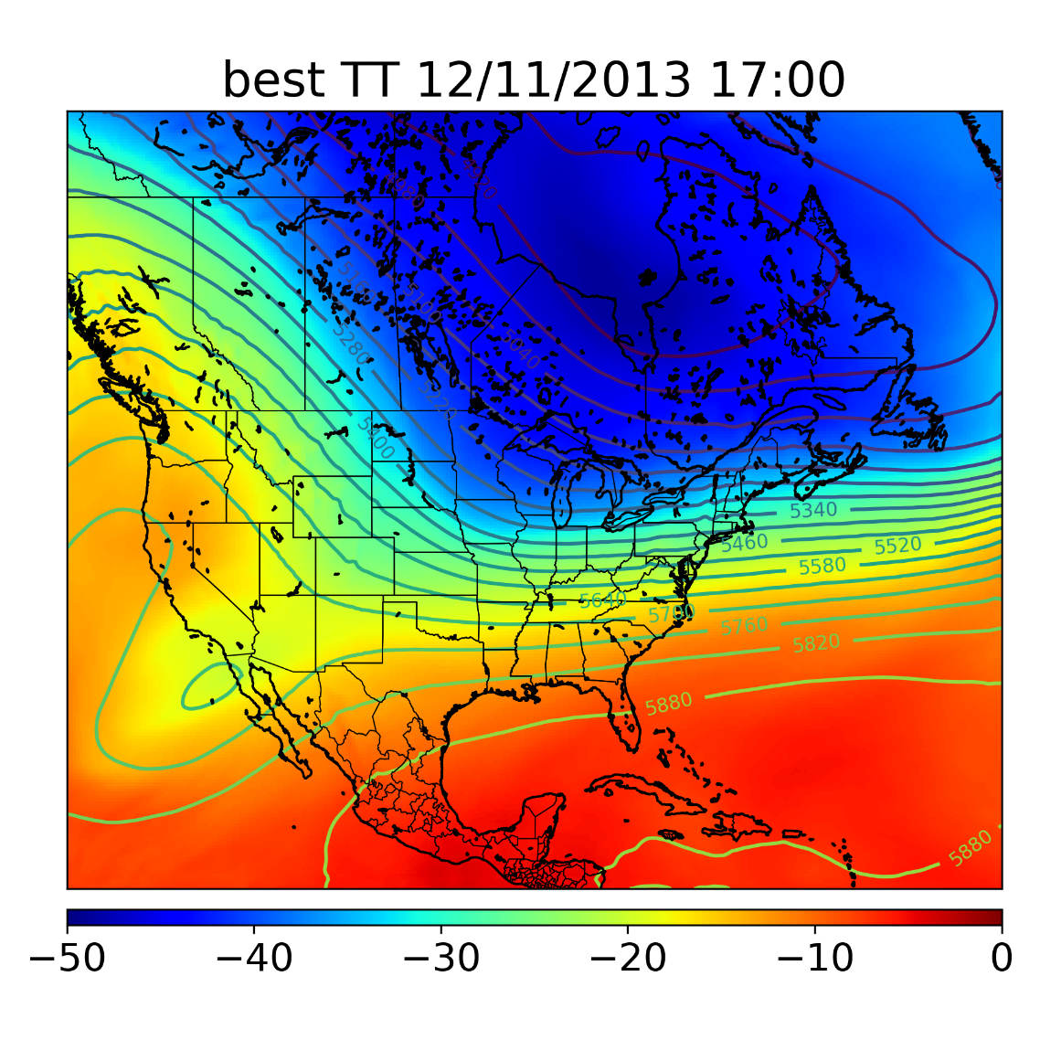
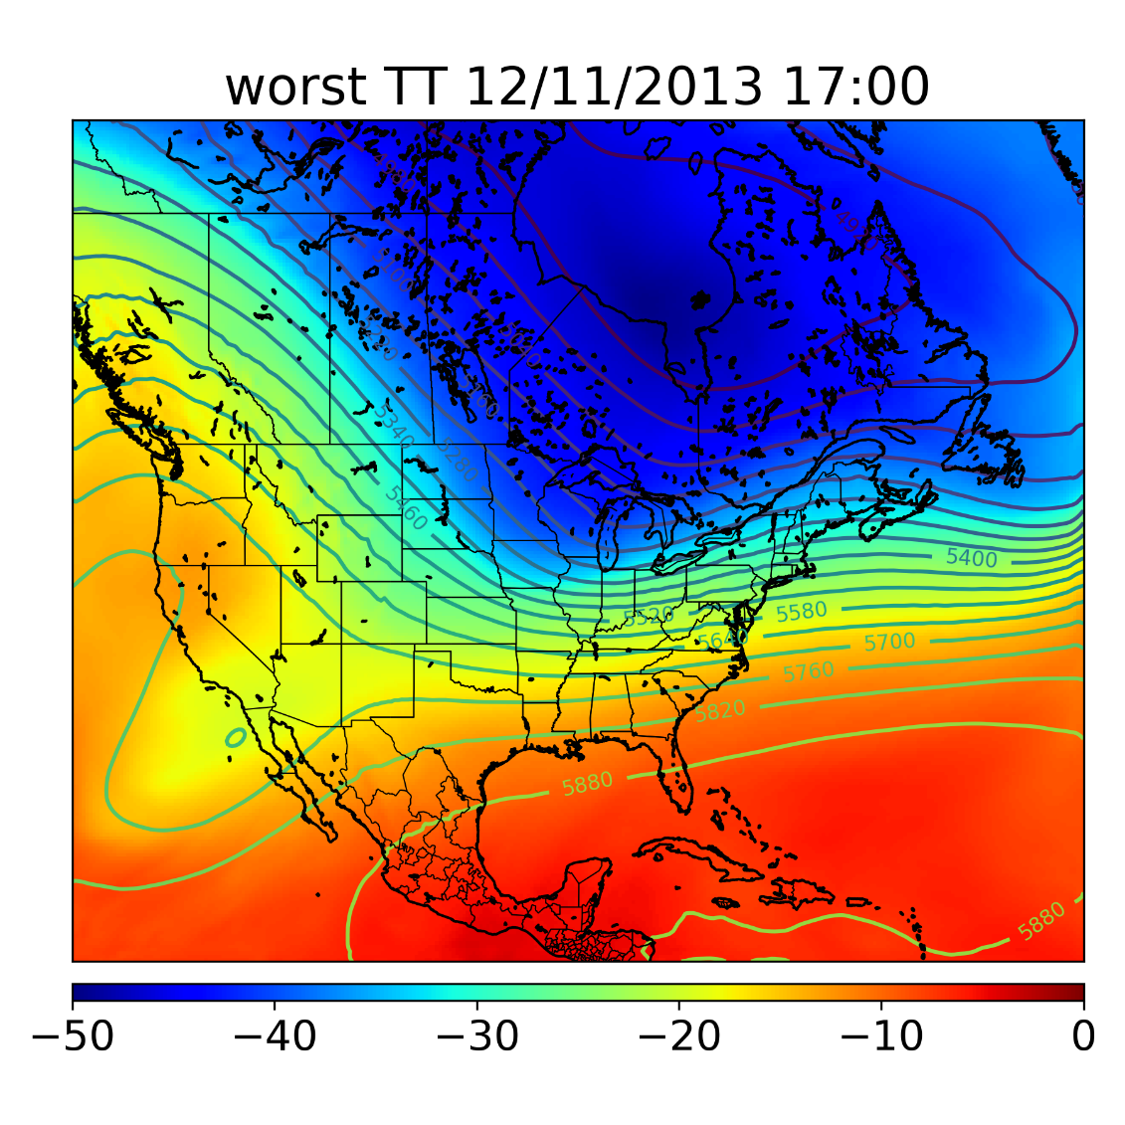
Composite of best/worst 10 members (mean)

Slide 12
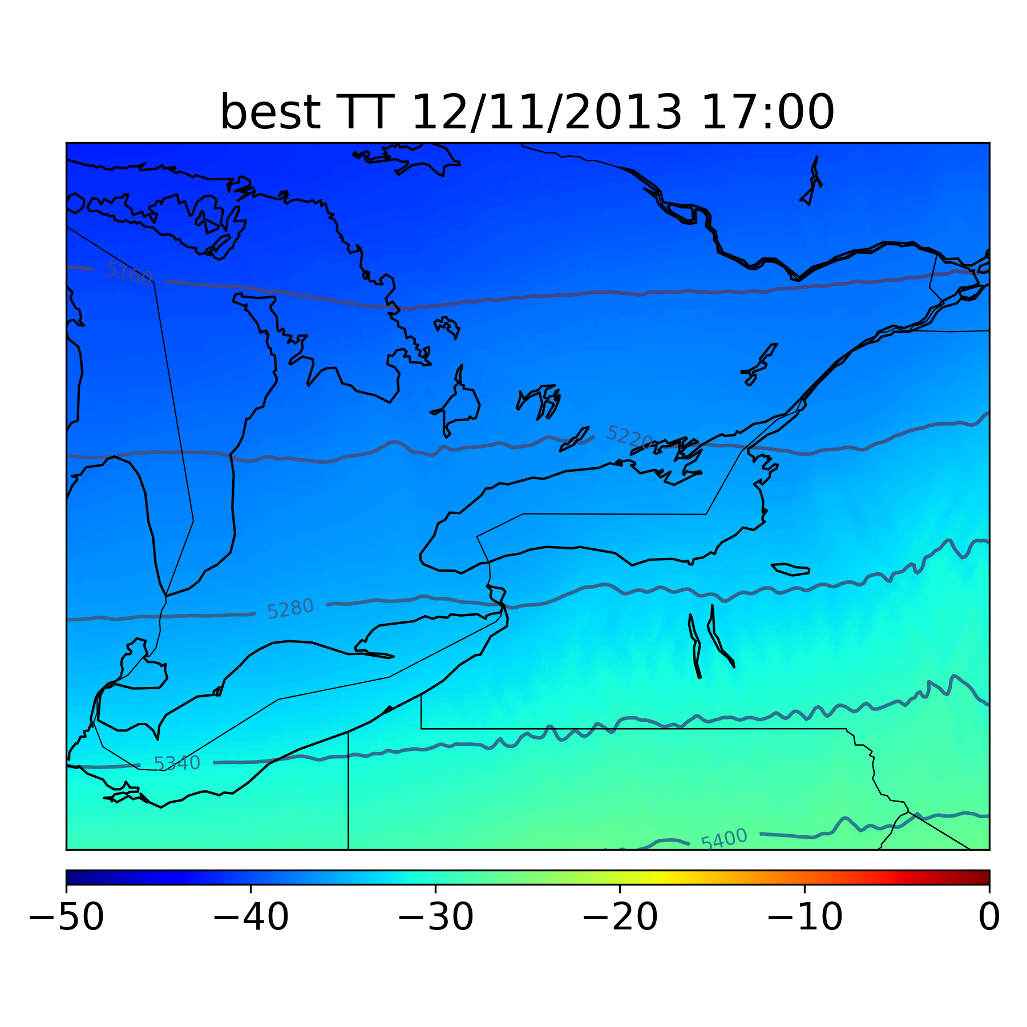
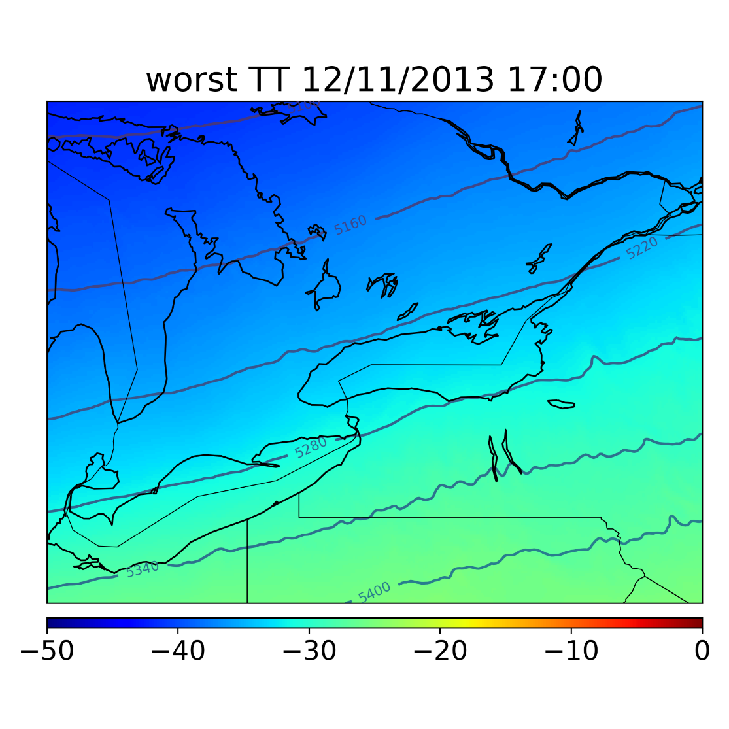
Same 500 heights/temps but domain 3

Slide 13
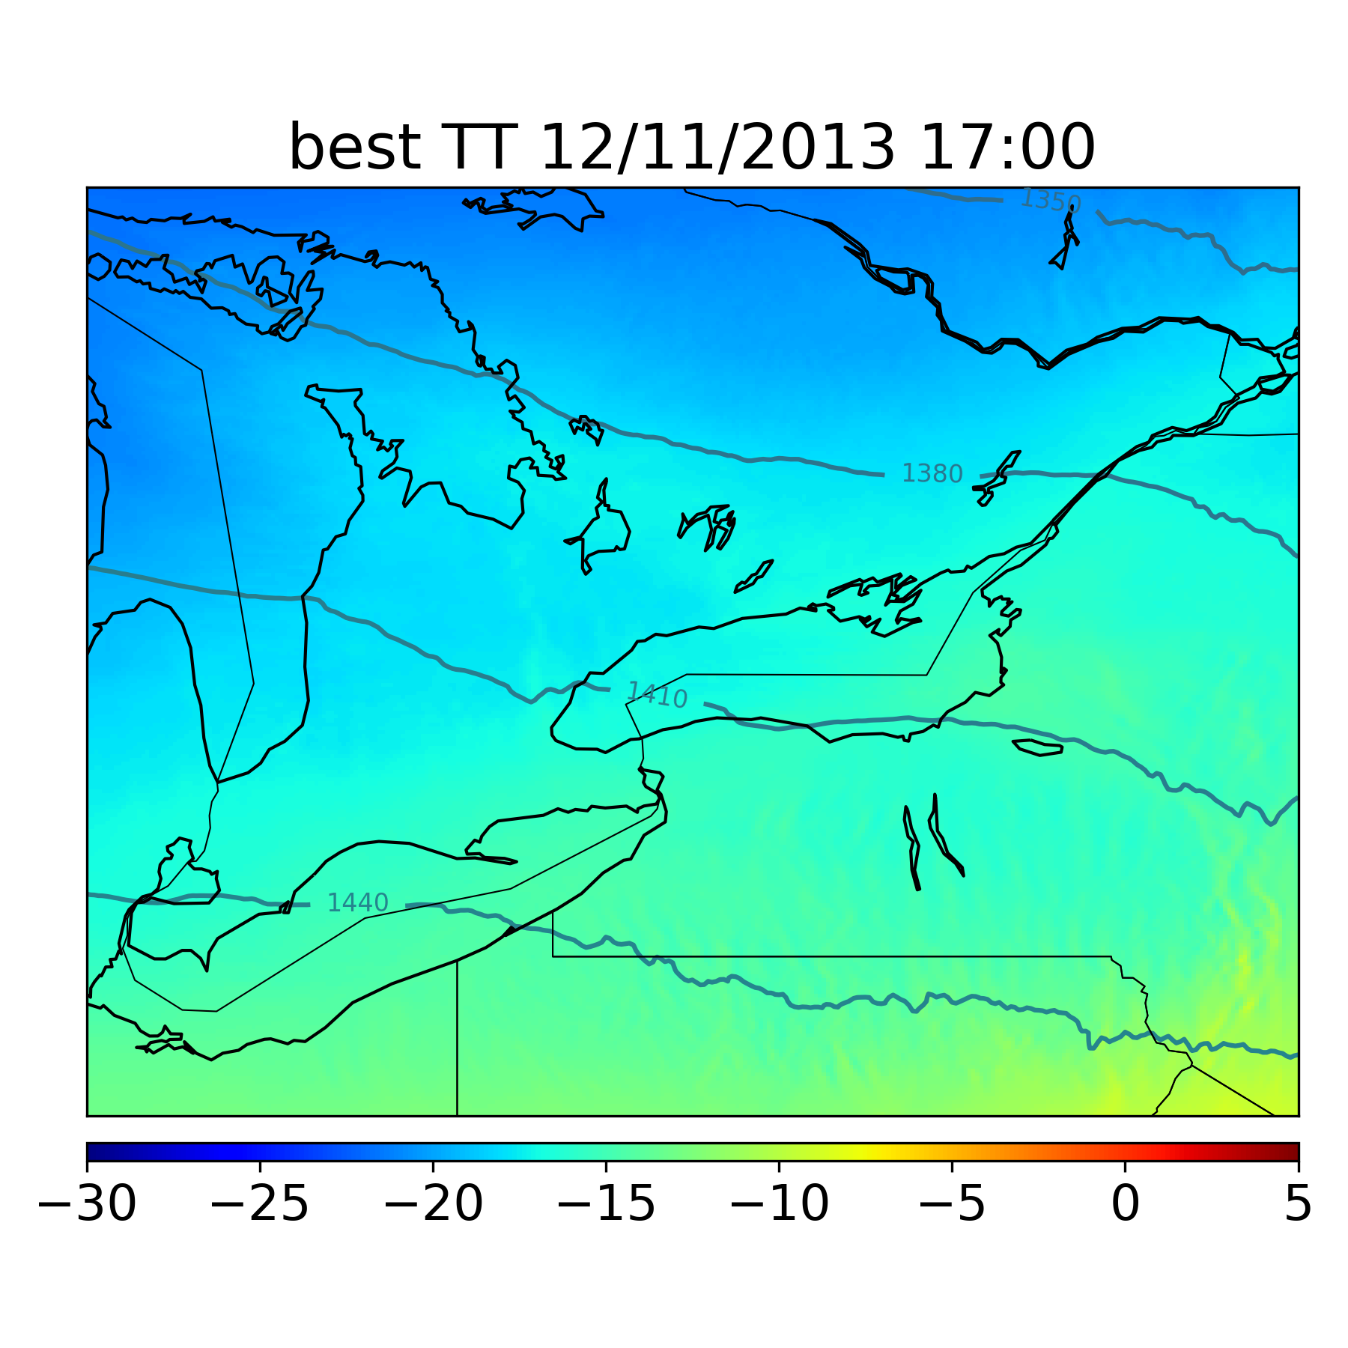
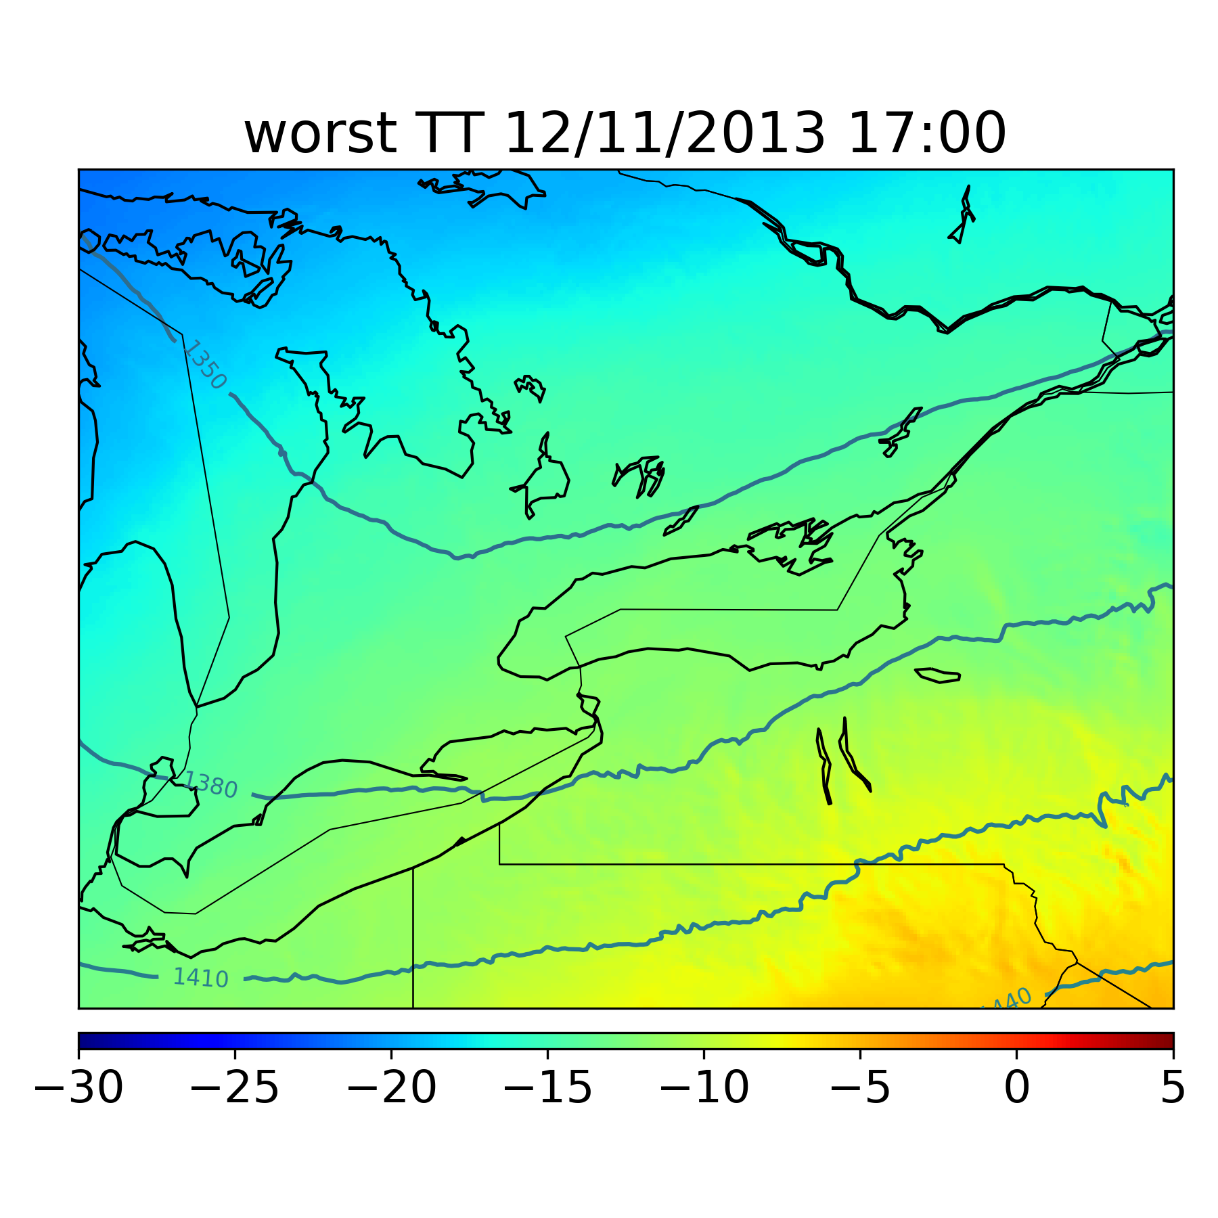
Stronger, colder long-axis flow; note warm plume from Huron

Slide 14
Conclusions
• “Best member” metric seems to be doing a good job identifying members with similar storm structures
• “Worst members” seem to have wildly varying storm structure and may provide useful case studies for predictability of this event
ESA questions and possible future work
• Define “best members” over entire forecast period or only at given forecast hour?
• Choice of response variable
• Cluster analysis based on identified polygon band objects
• Relationship to IC perturbations
• Influence of shortwave activity on LES modification

Slide 15
Acknowledgments
S. J. Greybush
F. Zhang
G. Young
D. Eipper
H. J. Gillespie
The Penn State Department of Meteorology and Institute for CyberScience (ICS) for computational resources used in this ongoing investigation.

