Slide 1


An Ensemble Based Data Assimilation adventure toward capturing the extreme event of Hurricane Patricia (2015)
Robert Nystrom and Fuqing Zhang

Slide 2
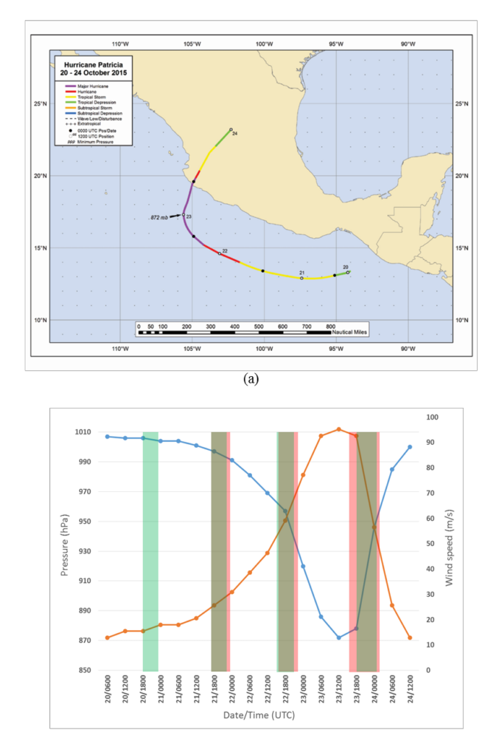
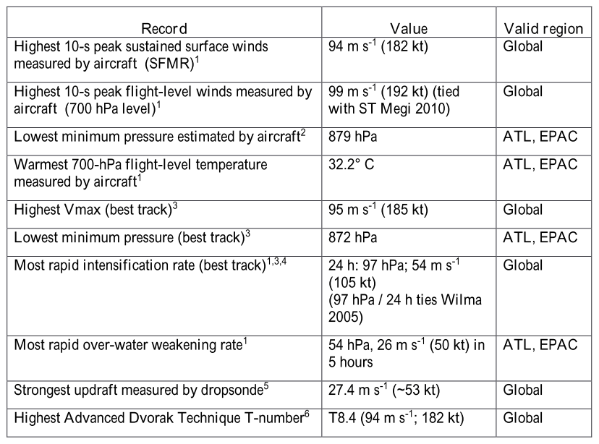
Patricia an extreme event:
Rodgers et al. (2017)
Notes:
-Set records for intensification rate, max intensity and others
-Intensification severely underestimated!!
-point out landfall time
- TCI Field Campaign taking place so lots of observations (green=Global Hawk, red=P3)

Slide 3
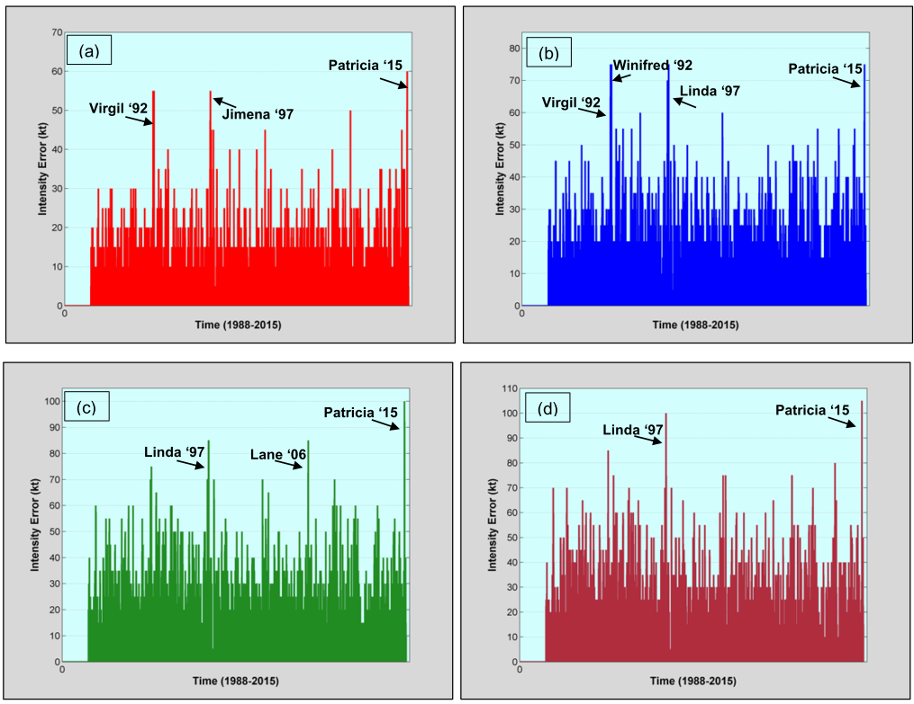
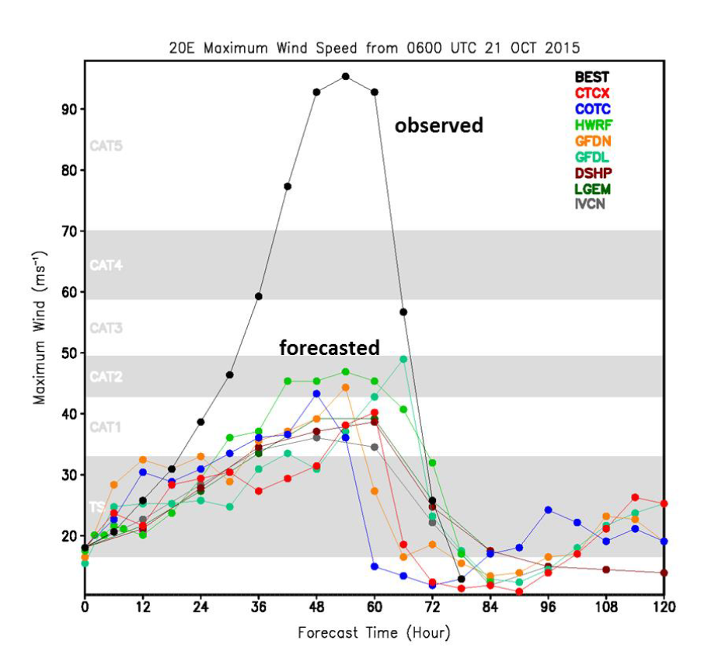
Patricia an extreme event:
All-time Forecast Errors
12 h
24 h
36 h
48 h
Rodgers et al. (2017)
Kimberlain et al. (2016)
Notes:
Huge forecast error!!!

Slide 4
PSU WRF-EnKF Performance
Good News: Track forecasts fairly good, by 18z on the 21st Major Hurricane is forecasted
Bad News: Max intensity is off by at least 70 knots, intensification is delayed significantly
Notes:
-assimilating conventional obs and aircraft radial velocity Sos in a real-time esque setup.

Slide 5
Sensitivity to Cd?
Green and Zhang (2013)
Chen et al. (2017)
^ Reduced C_{d}
Notes:
-Reduced Cd (drag coefficient) at strong wind speeds(greater than ~33 m/s or 64 knots)

Slide 6
Sensitivity to Resolution?
3km
1km
Notes:
-Some sensitivity to resolution, Slightly stronger/quicker intensification rate (e.g. 18z 22nd forecast)

Slide 7
Sensitivity to Resolution and Cd?
3km
1km w/ Chen et al. (2017)
^ Reduced C_{d}
Notes:
-Last forecast nails maximum intensity finally.
After second flight we can capture timing and magnitude of maximum wind speed for Patricia with 3km cycling DA assimilating conventional and aircraft Sos
Still don’t capture weakening before landfall

Slide 8
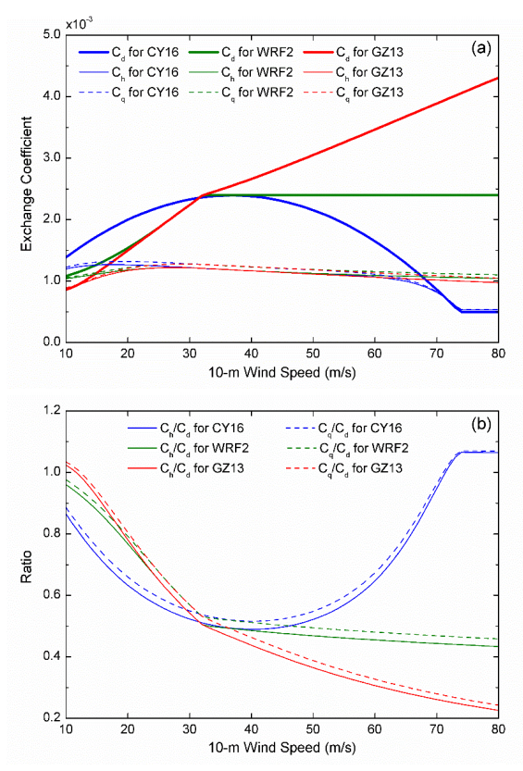
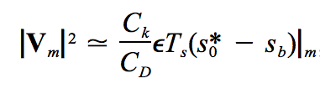
C_{d} differences:
MPI:
Emanuel (1997)
Potential intensity increases w/ C_{k}/C_{d}
Expect stronger storm with lower C_{d}
Chen et al. (2017)

Slide 9
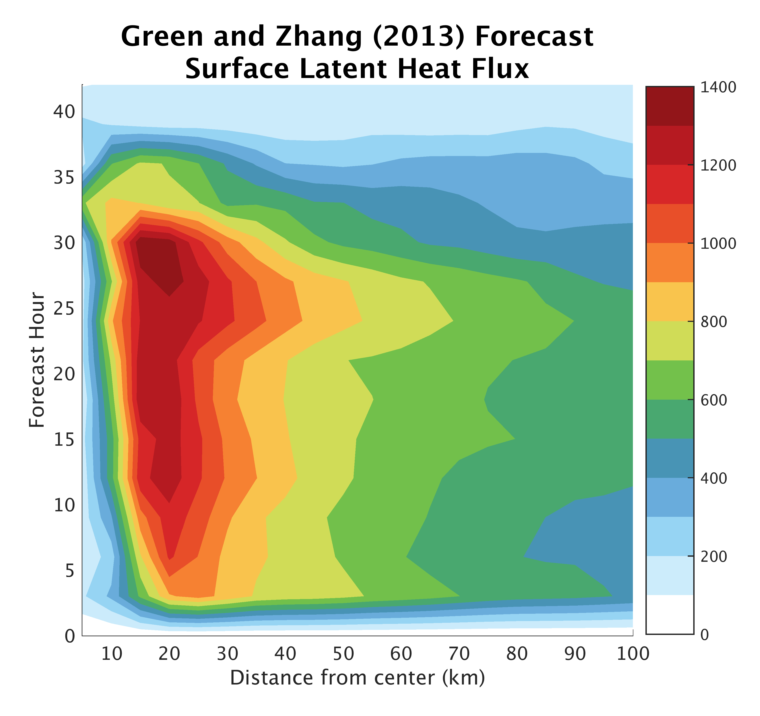
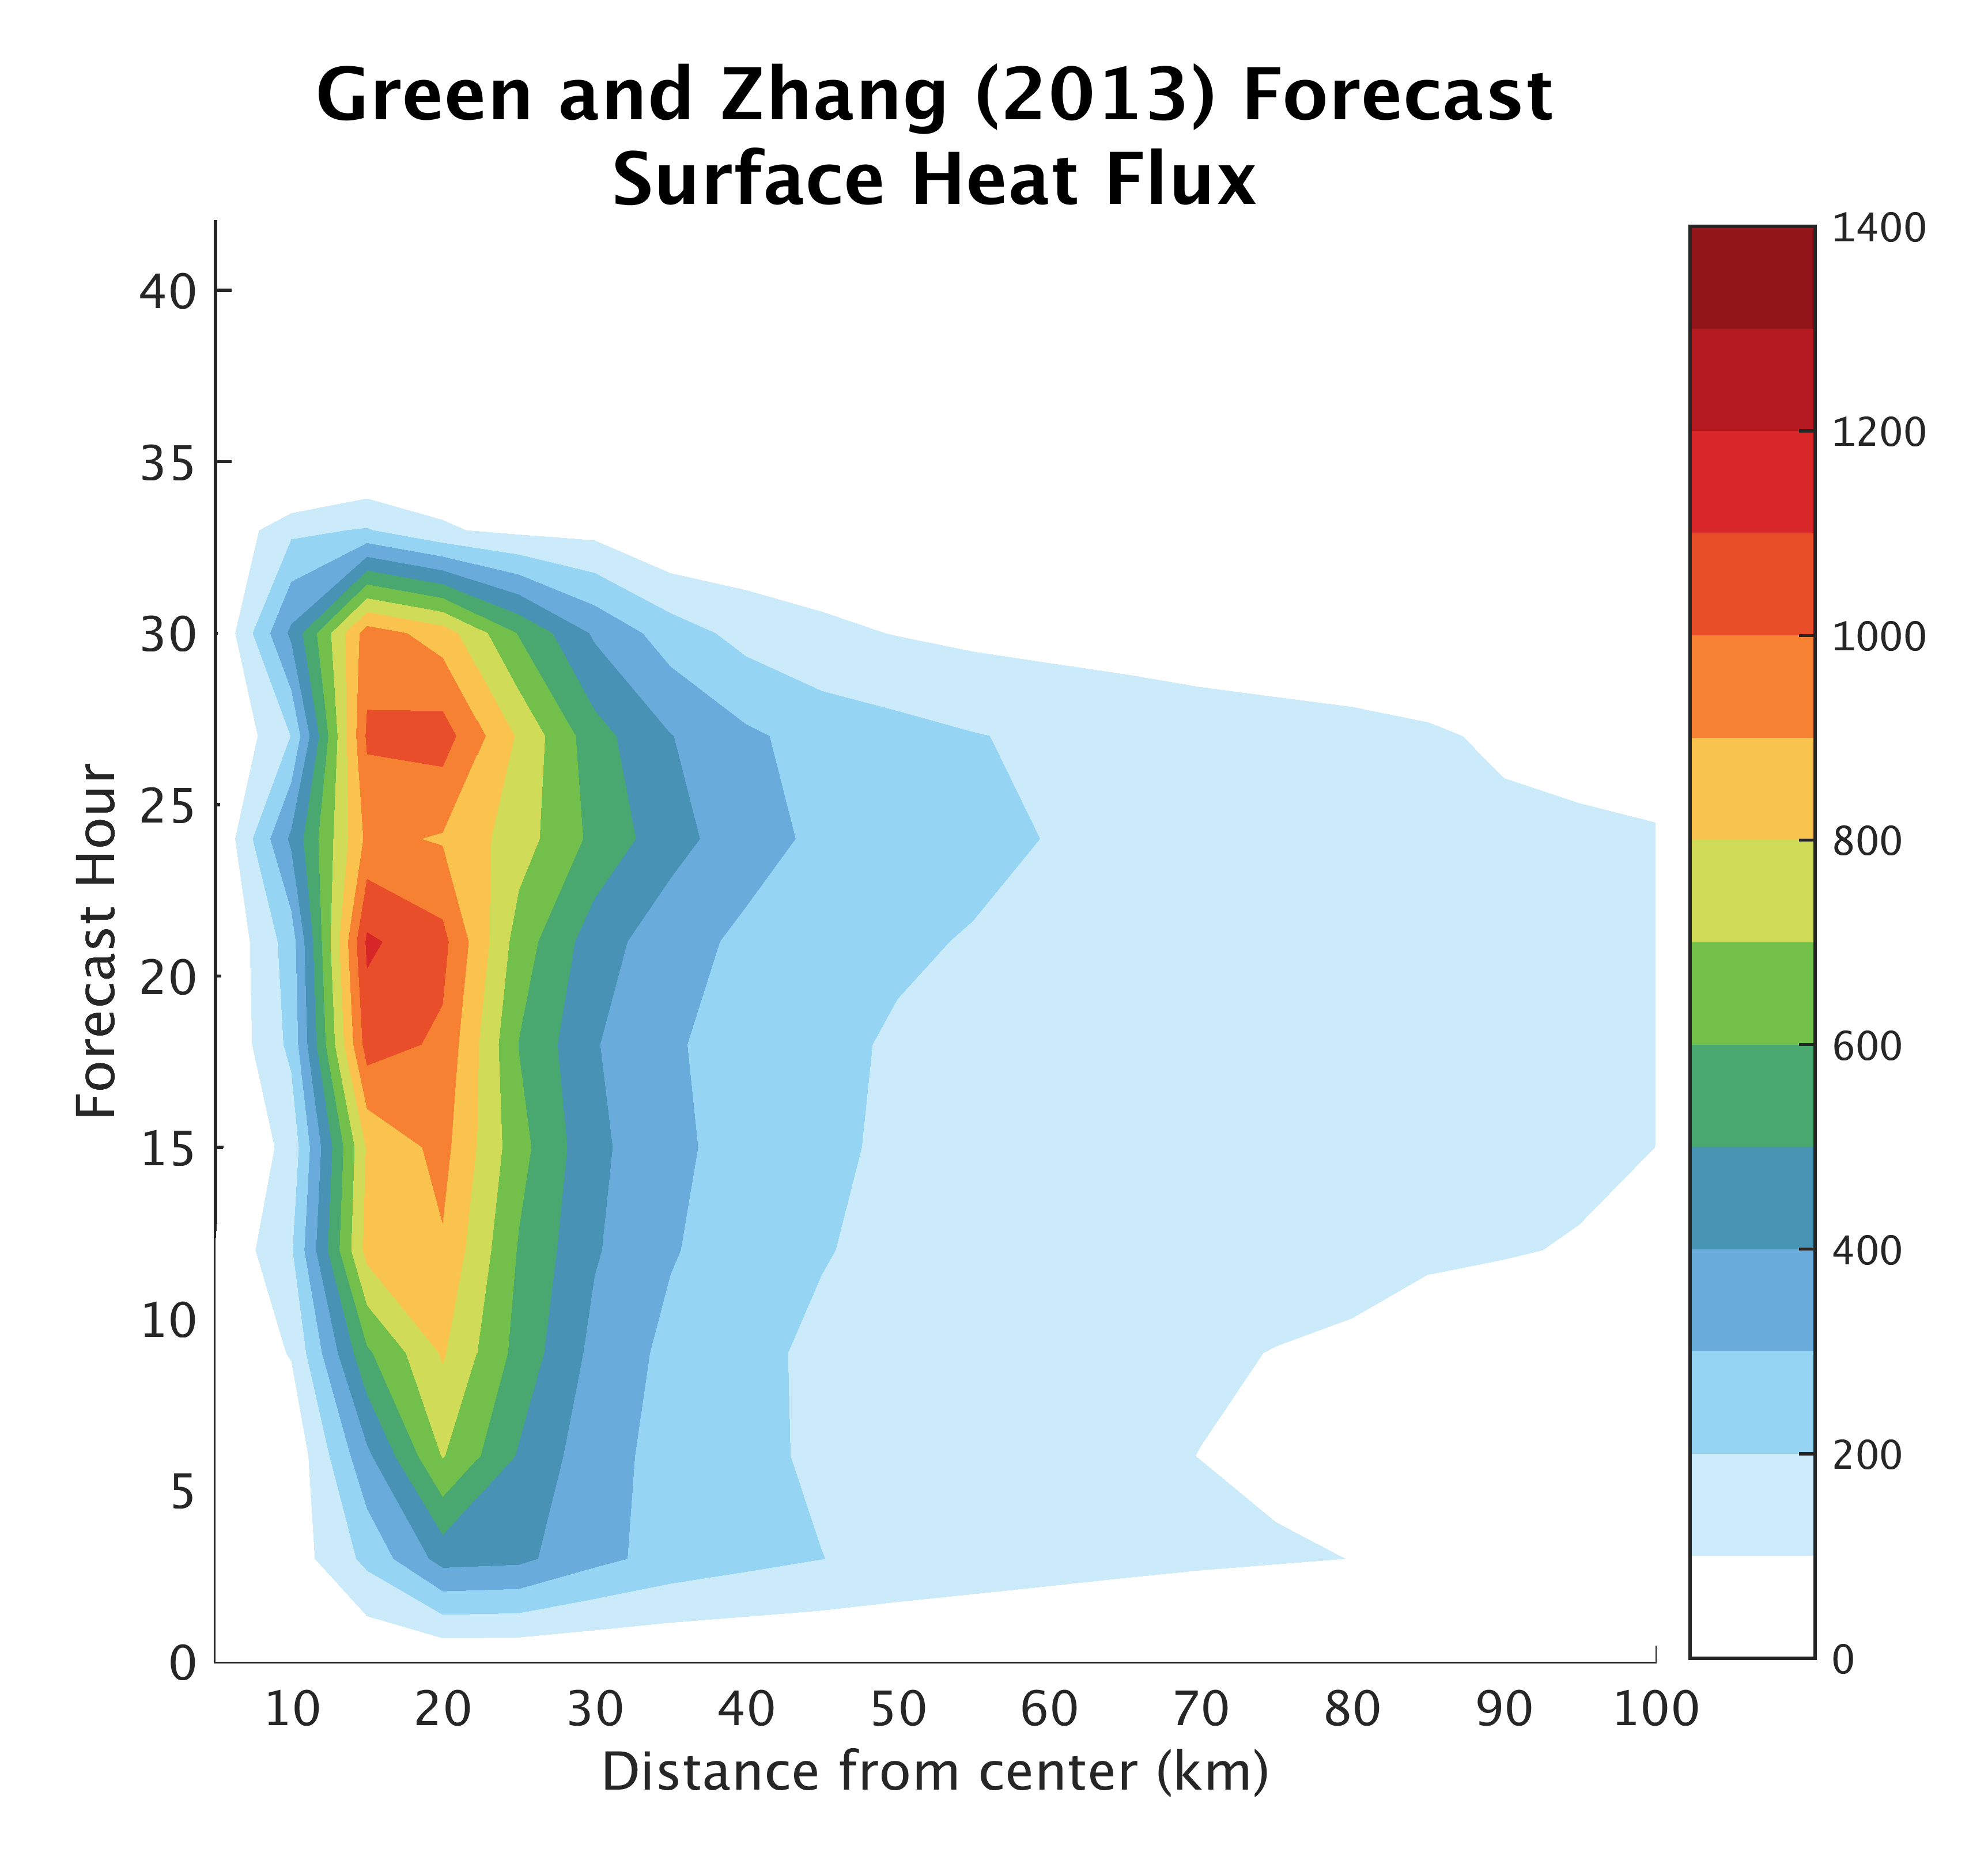
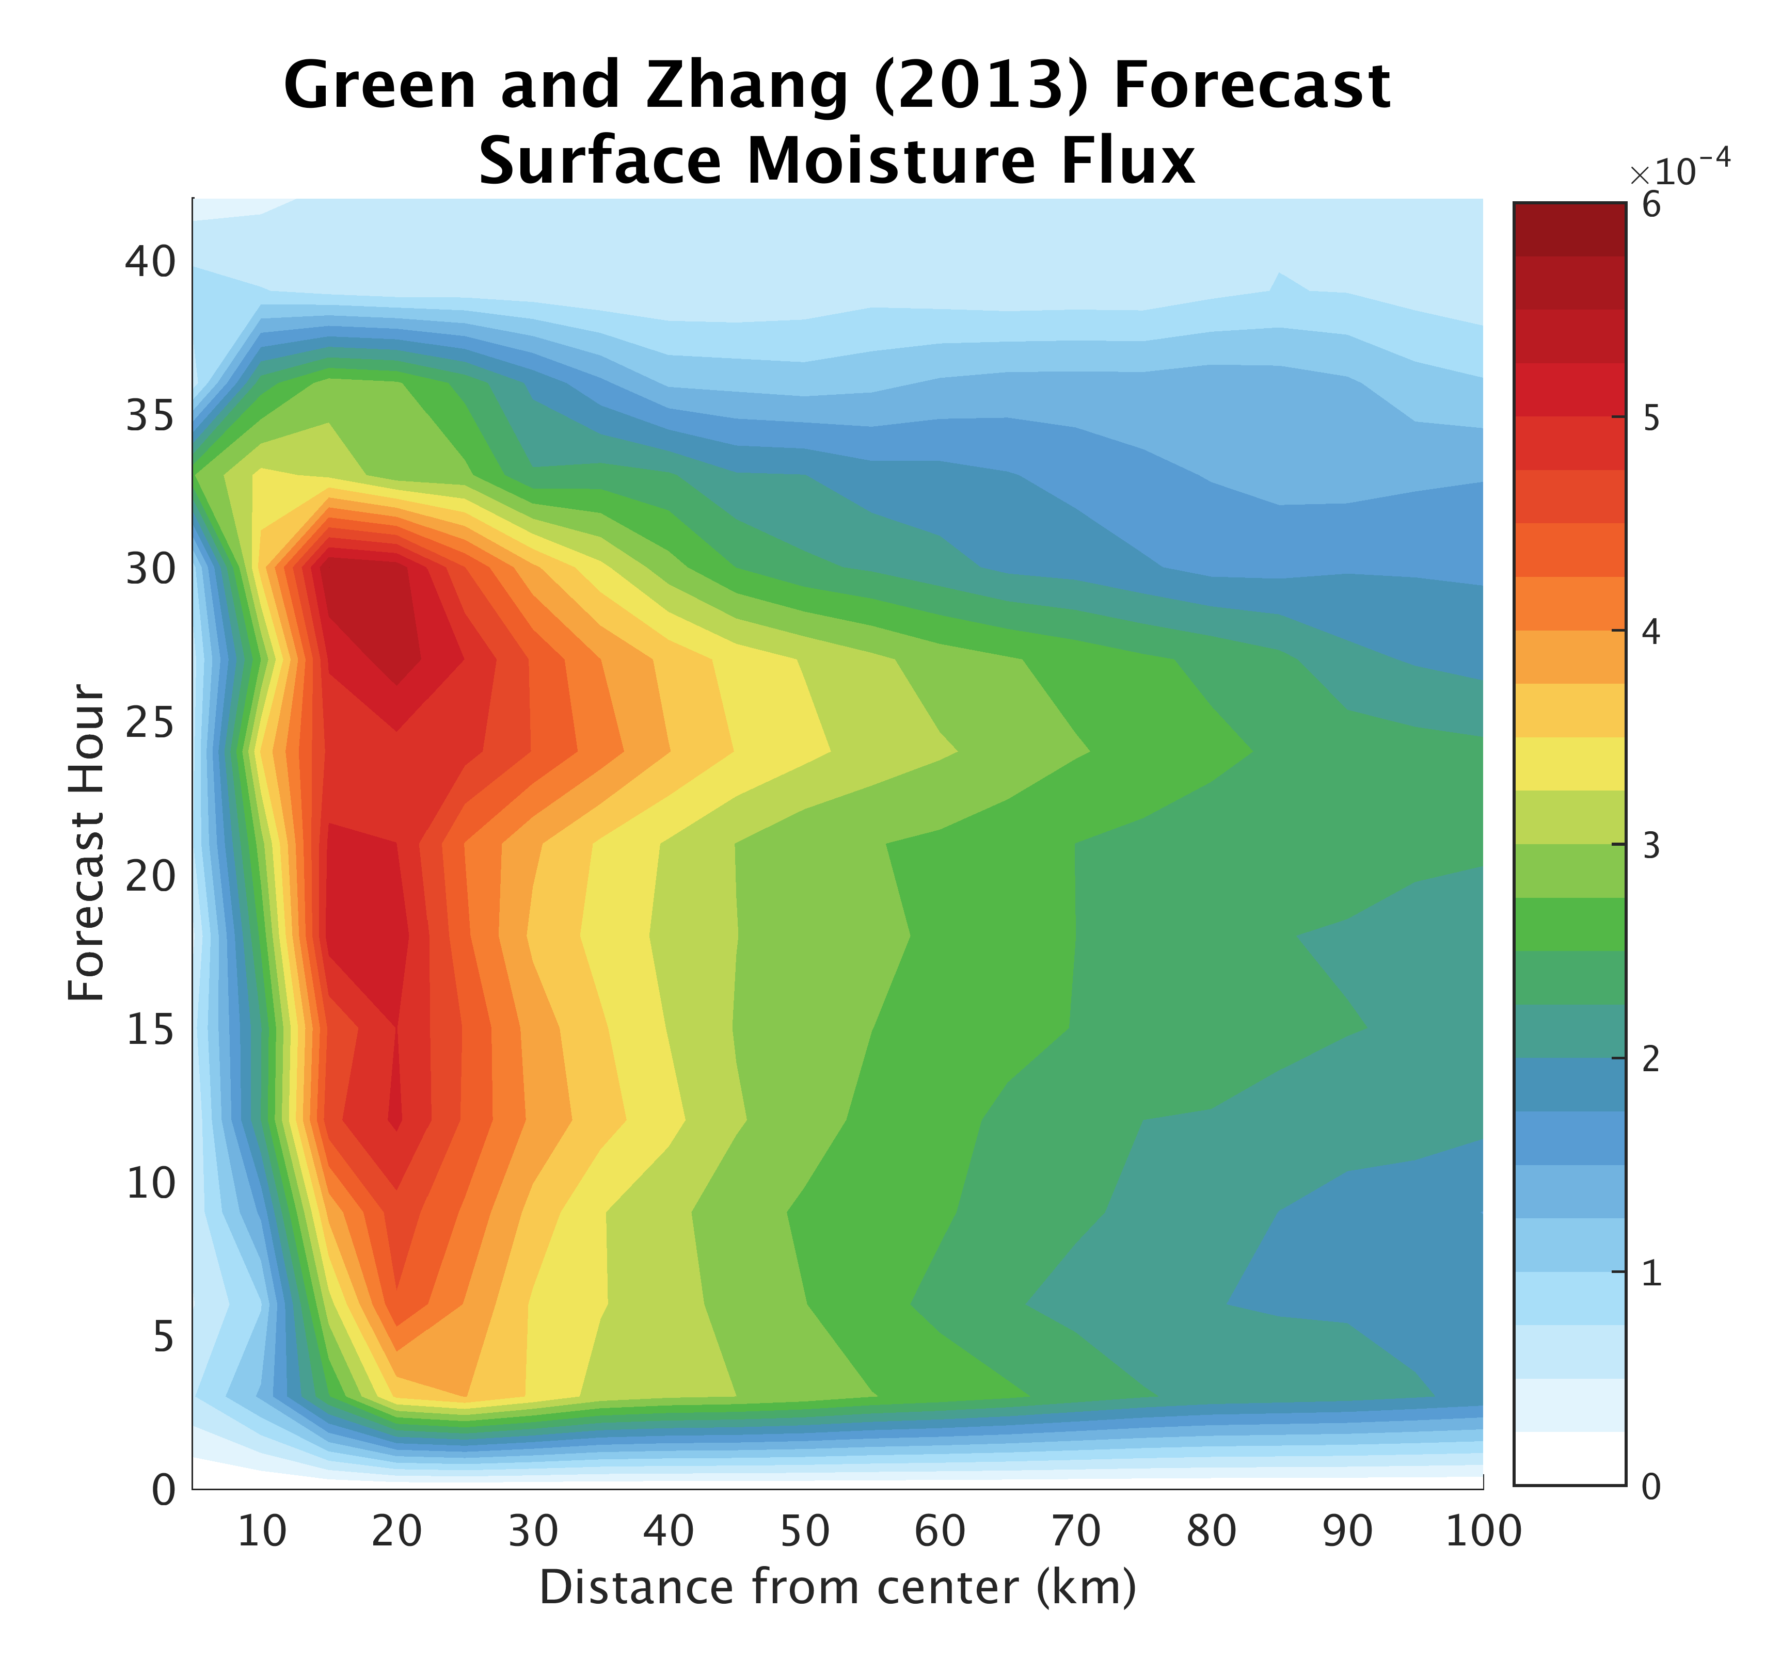
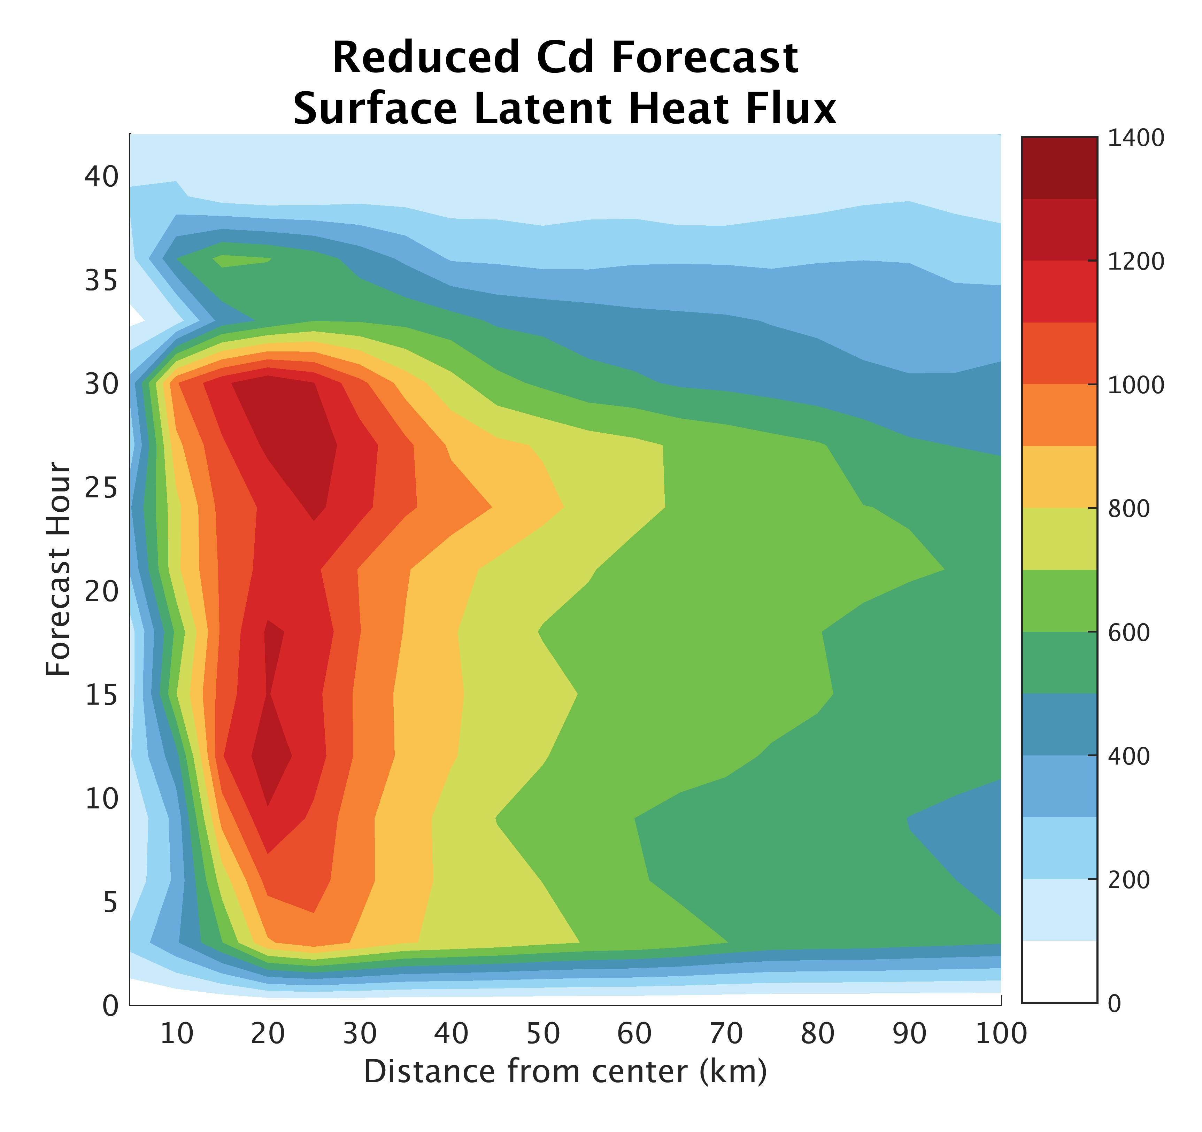
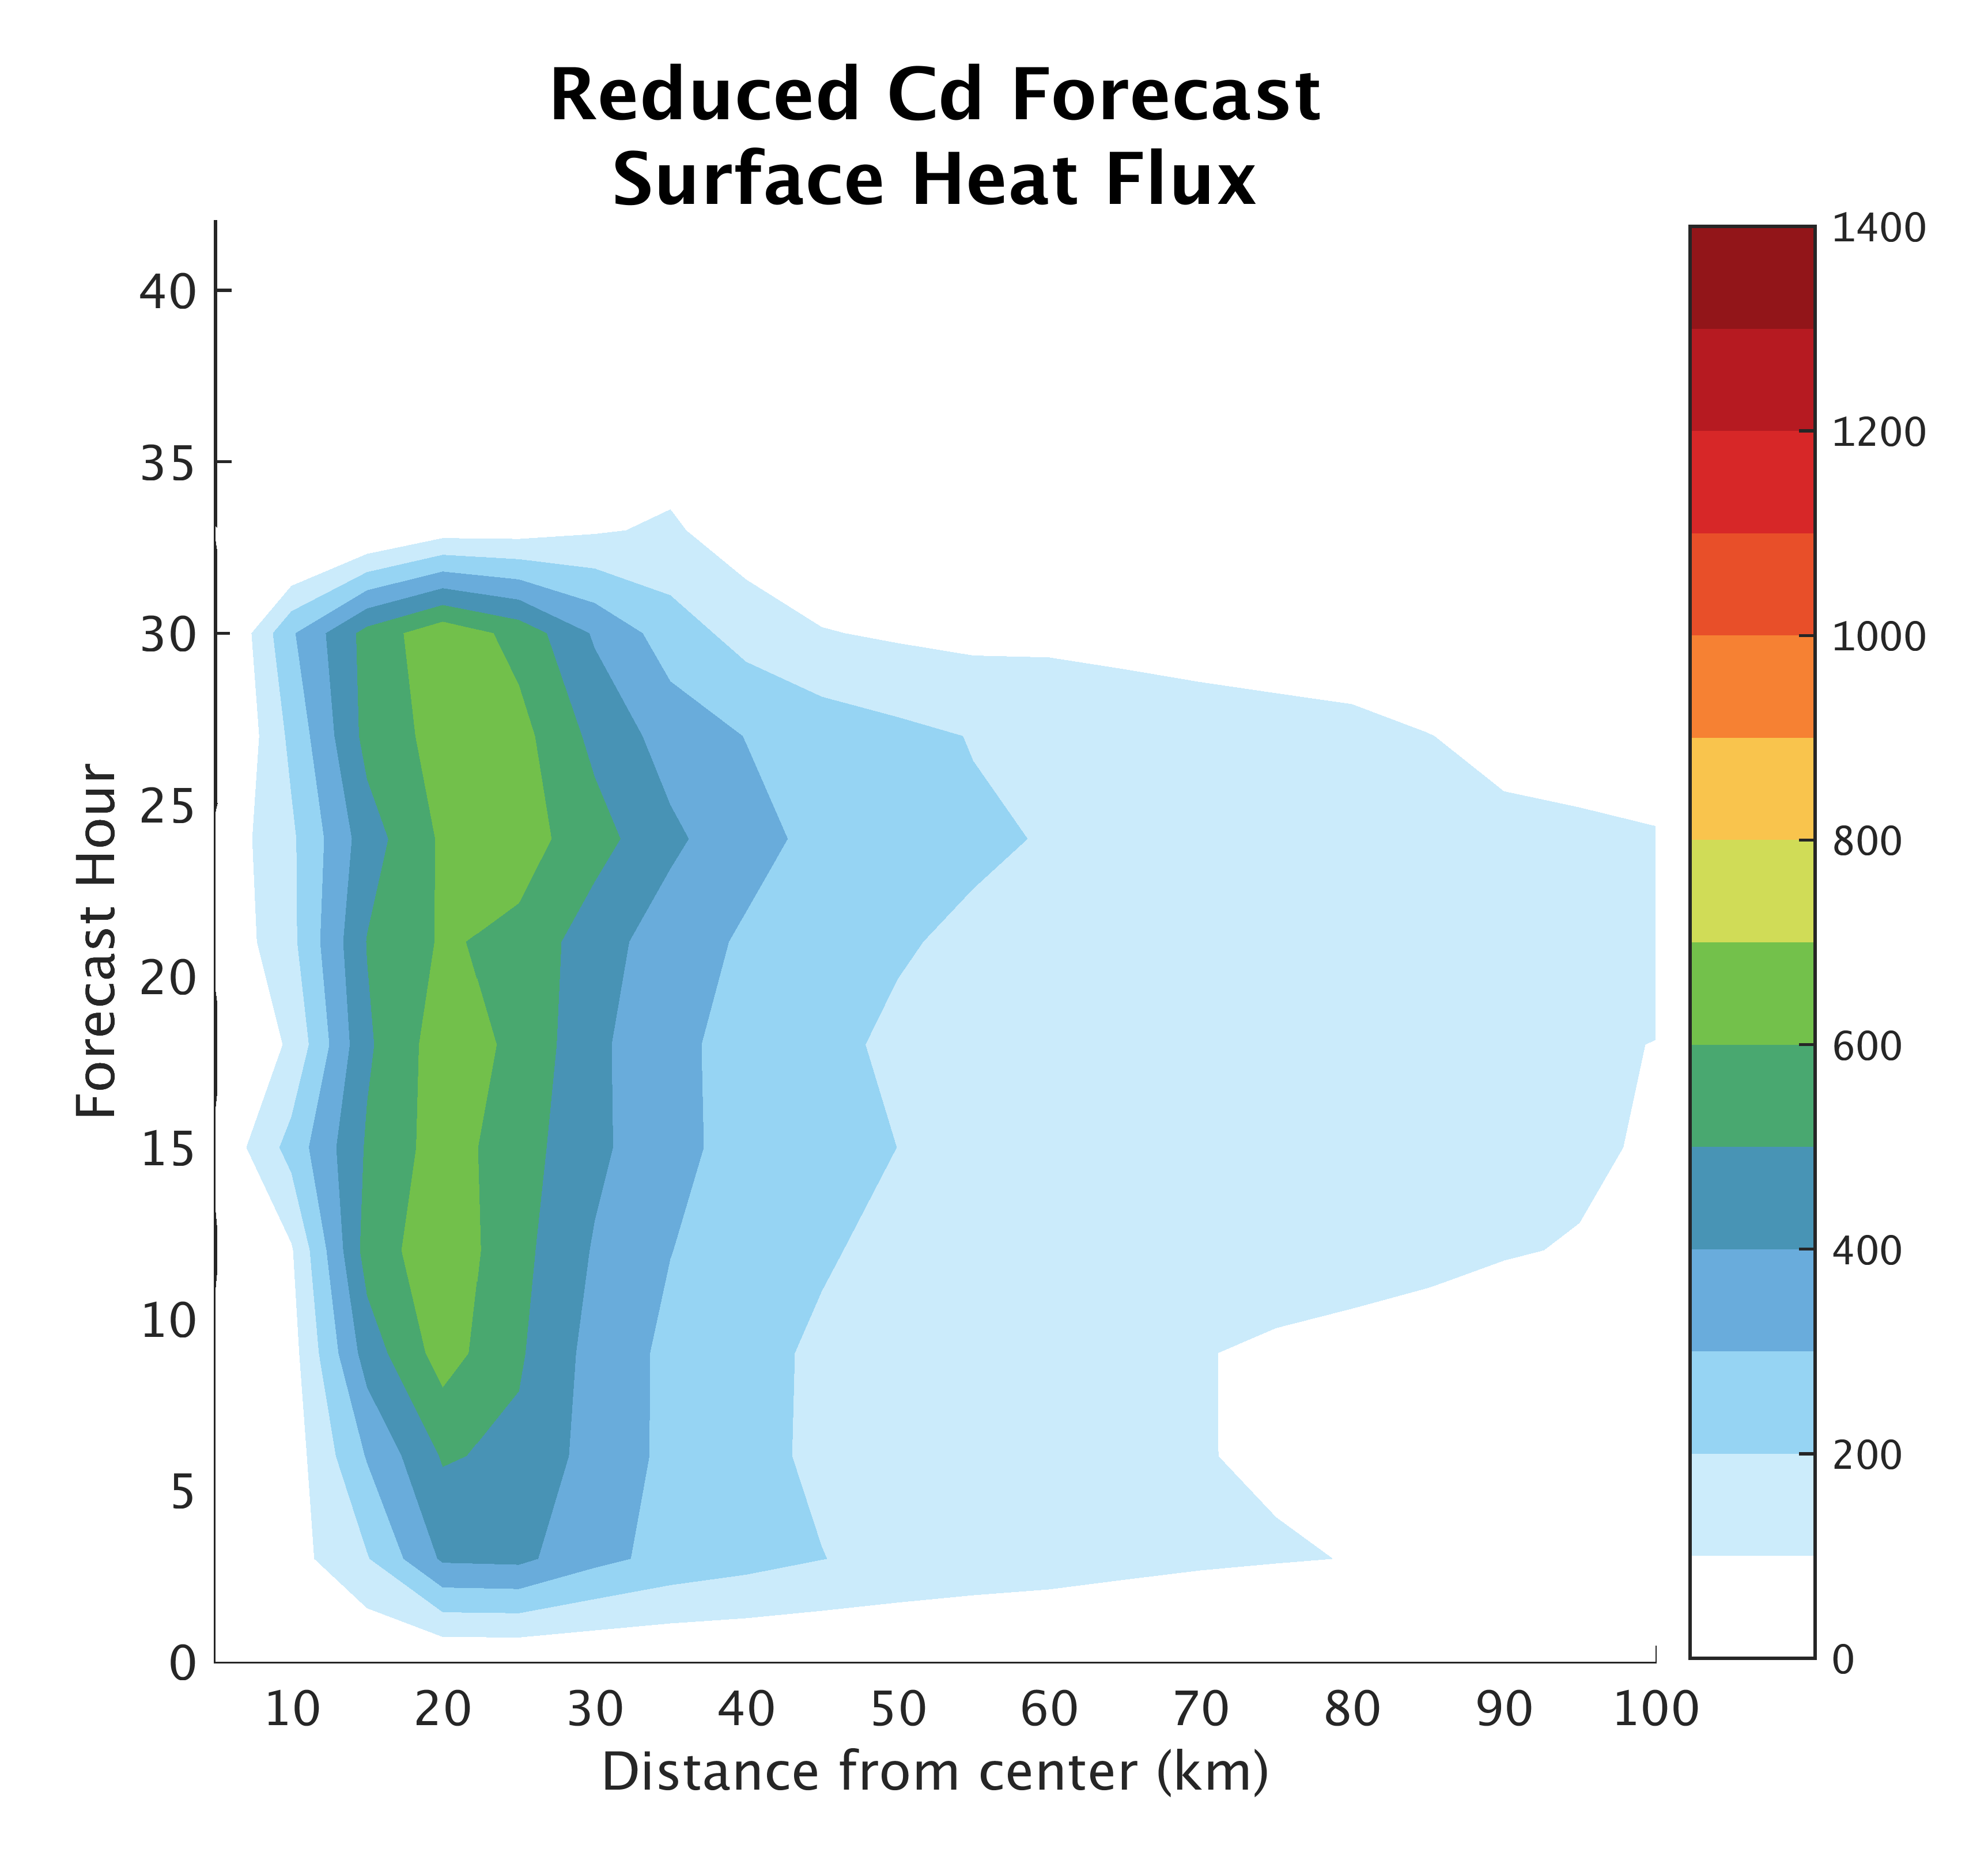
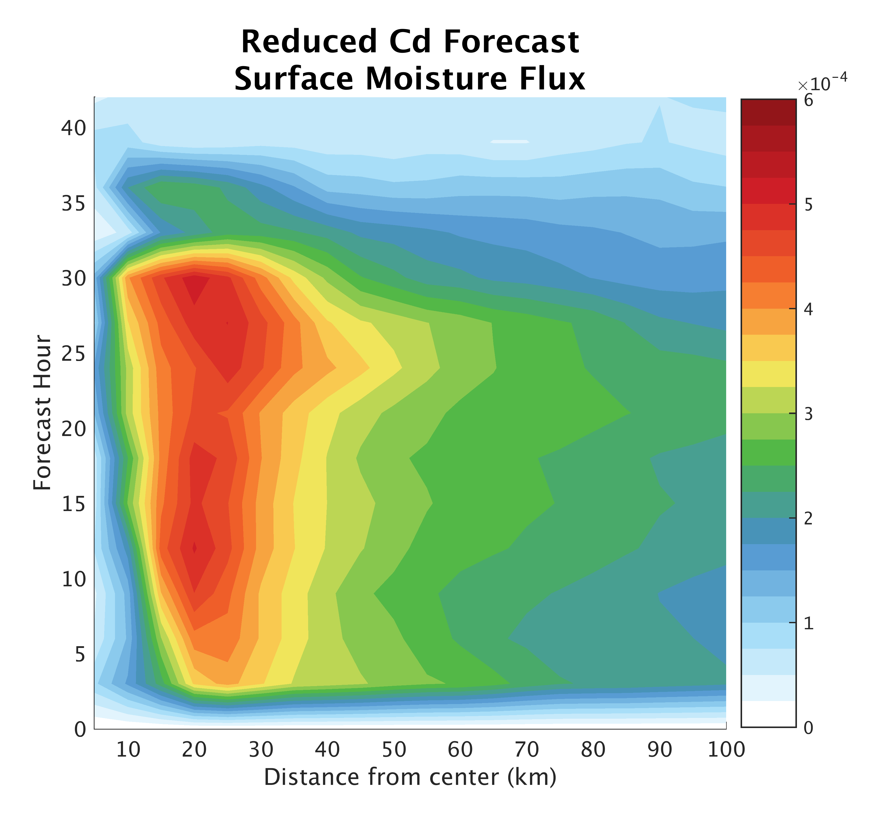
Differences
from Cd:
Notes:
Reduced Cd --> lower sfc latent, sensible, and moisture flux due to smaller difference between the sea sfc and air immediately above it.

Slide 10
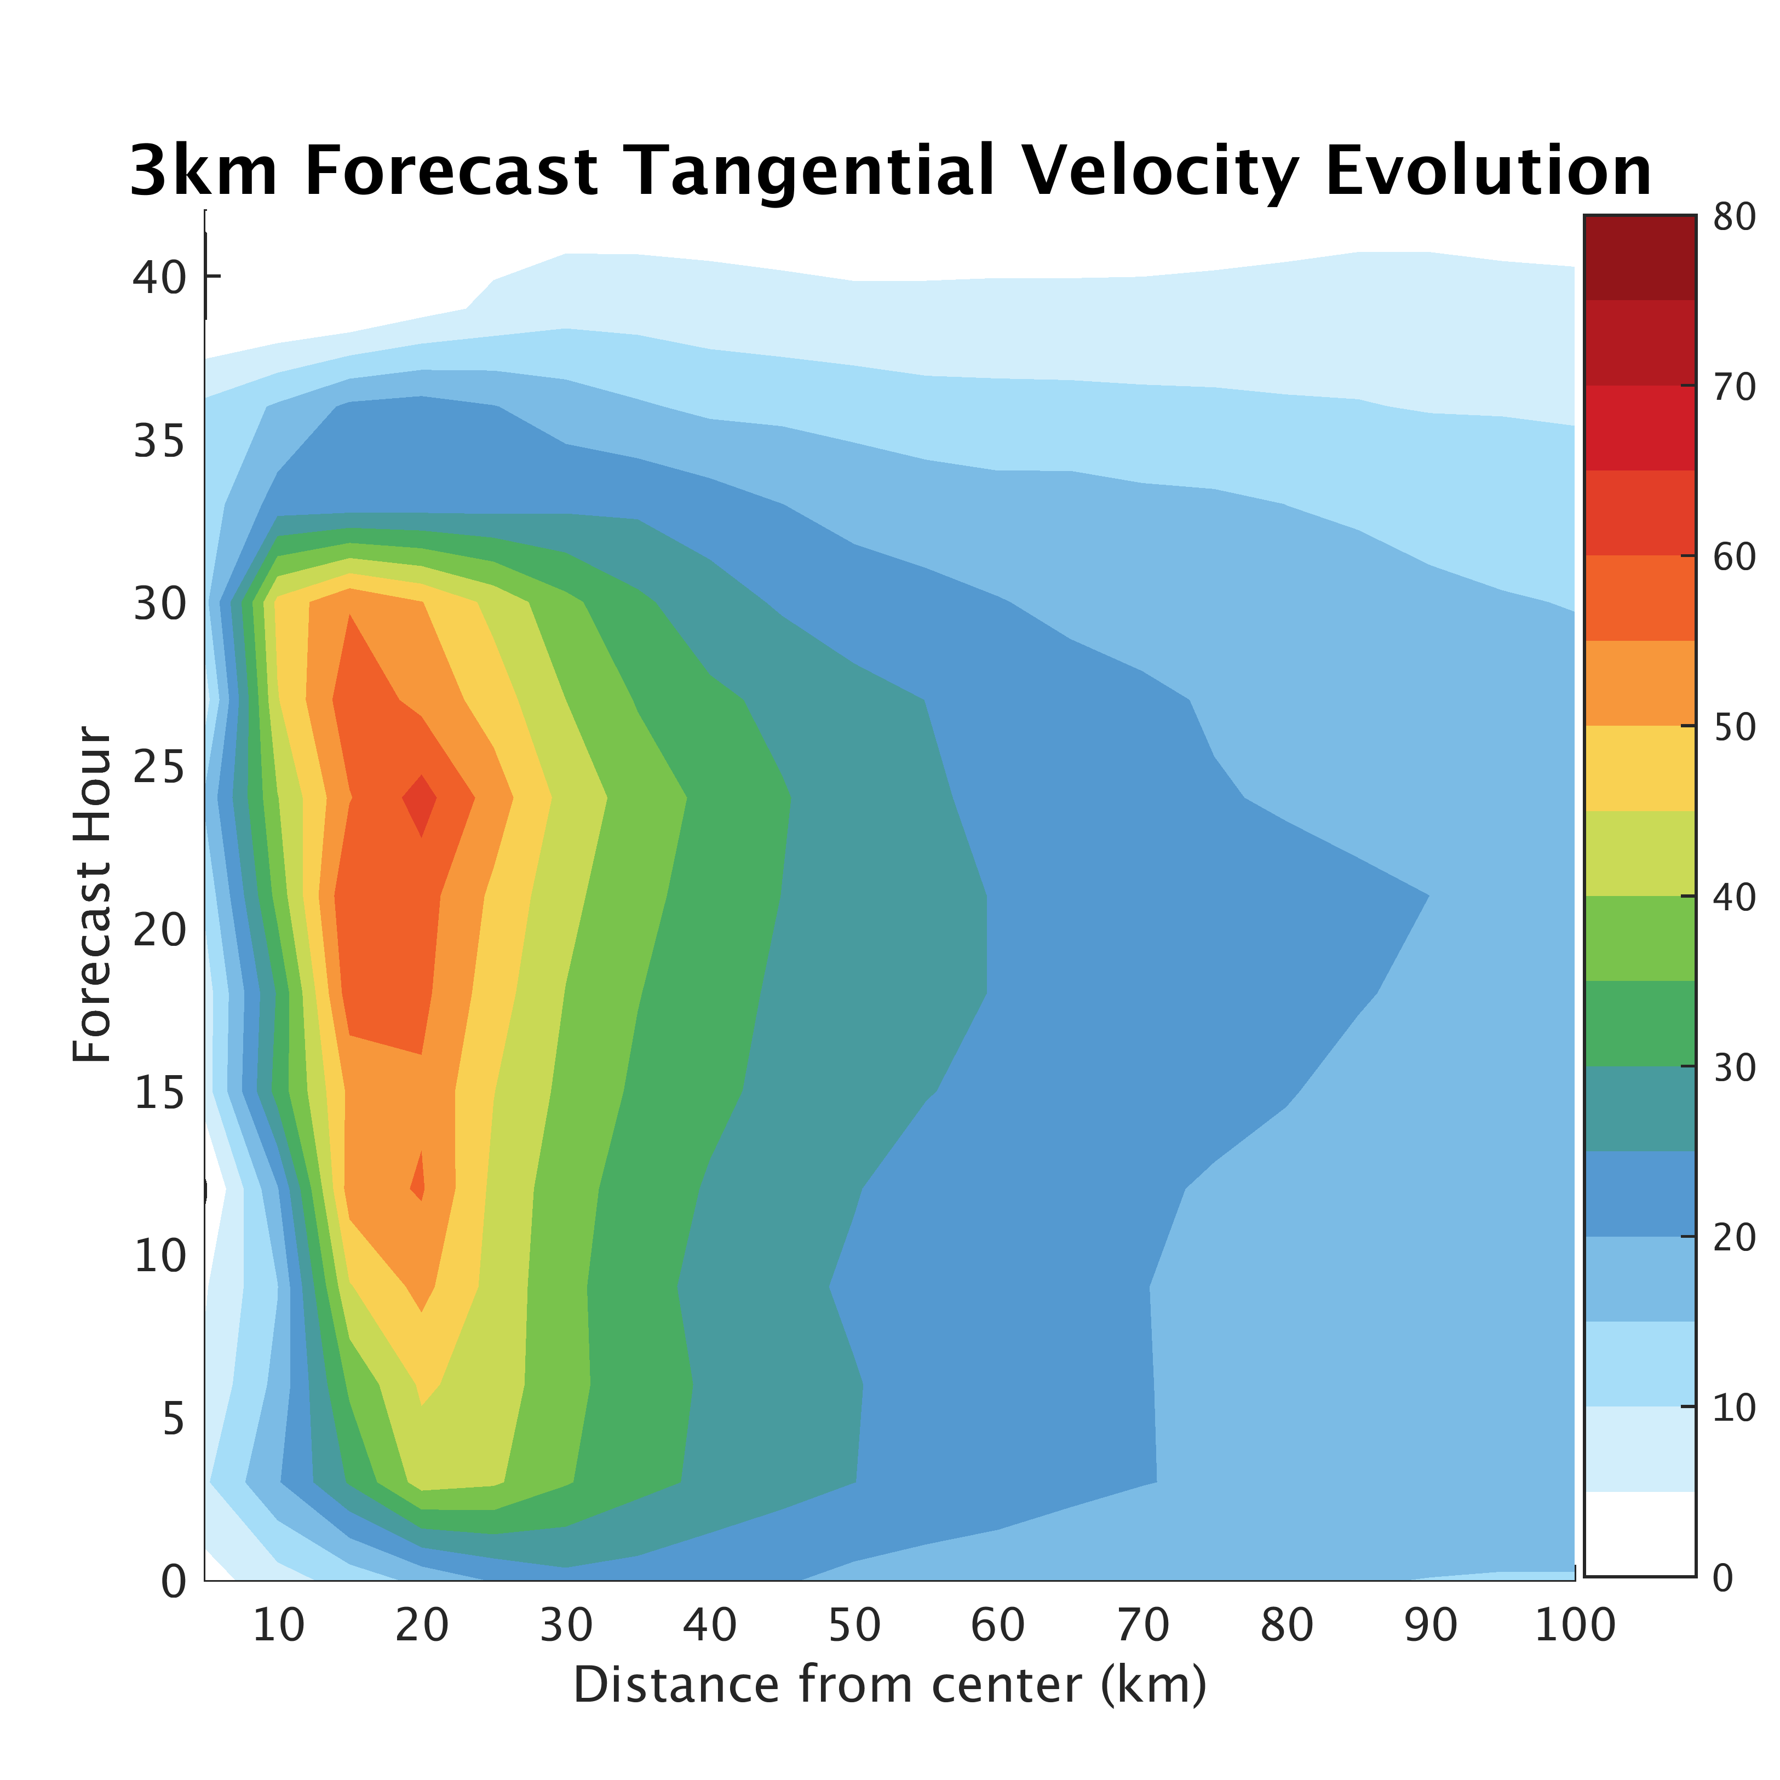
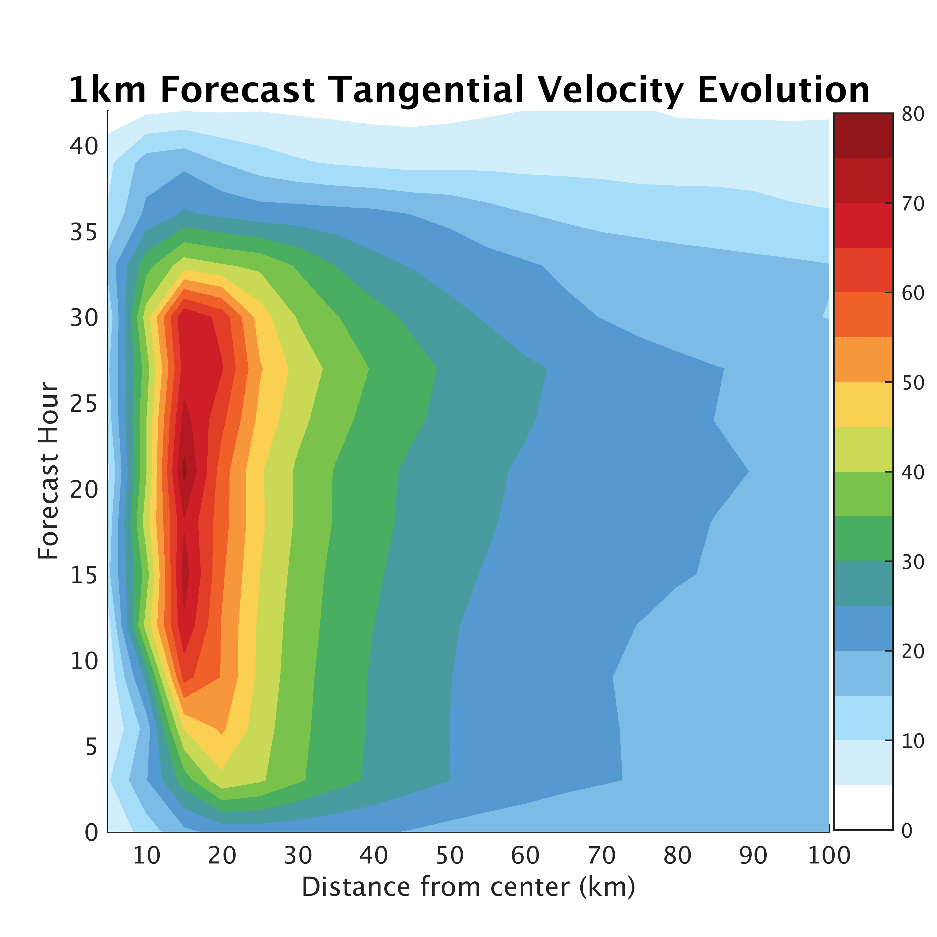
Differences from Resolution:

Slide 11
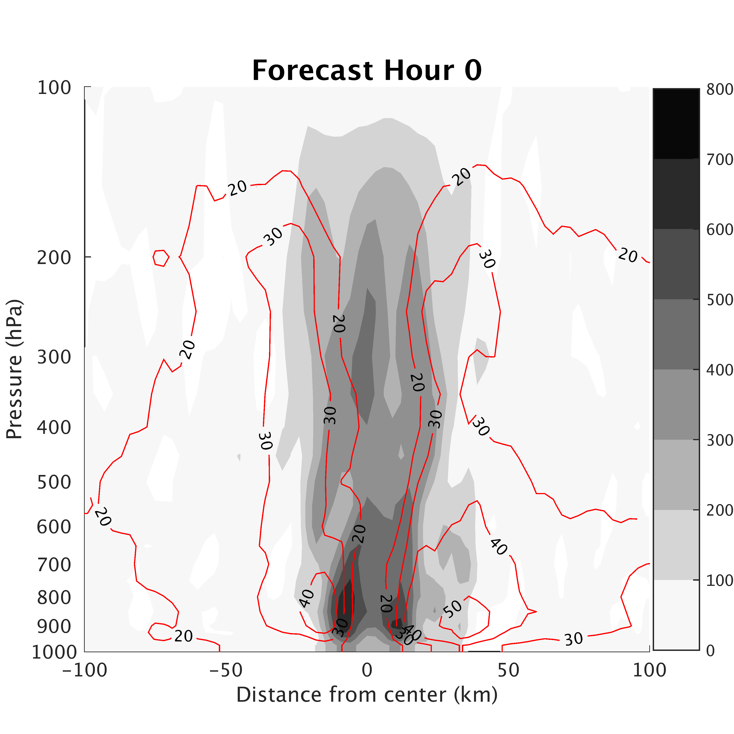
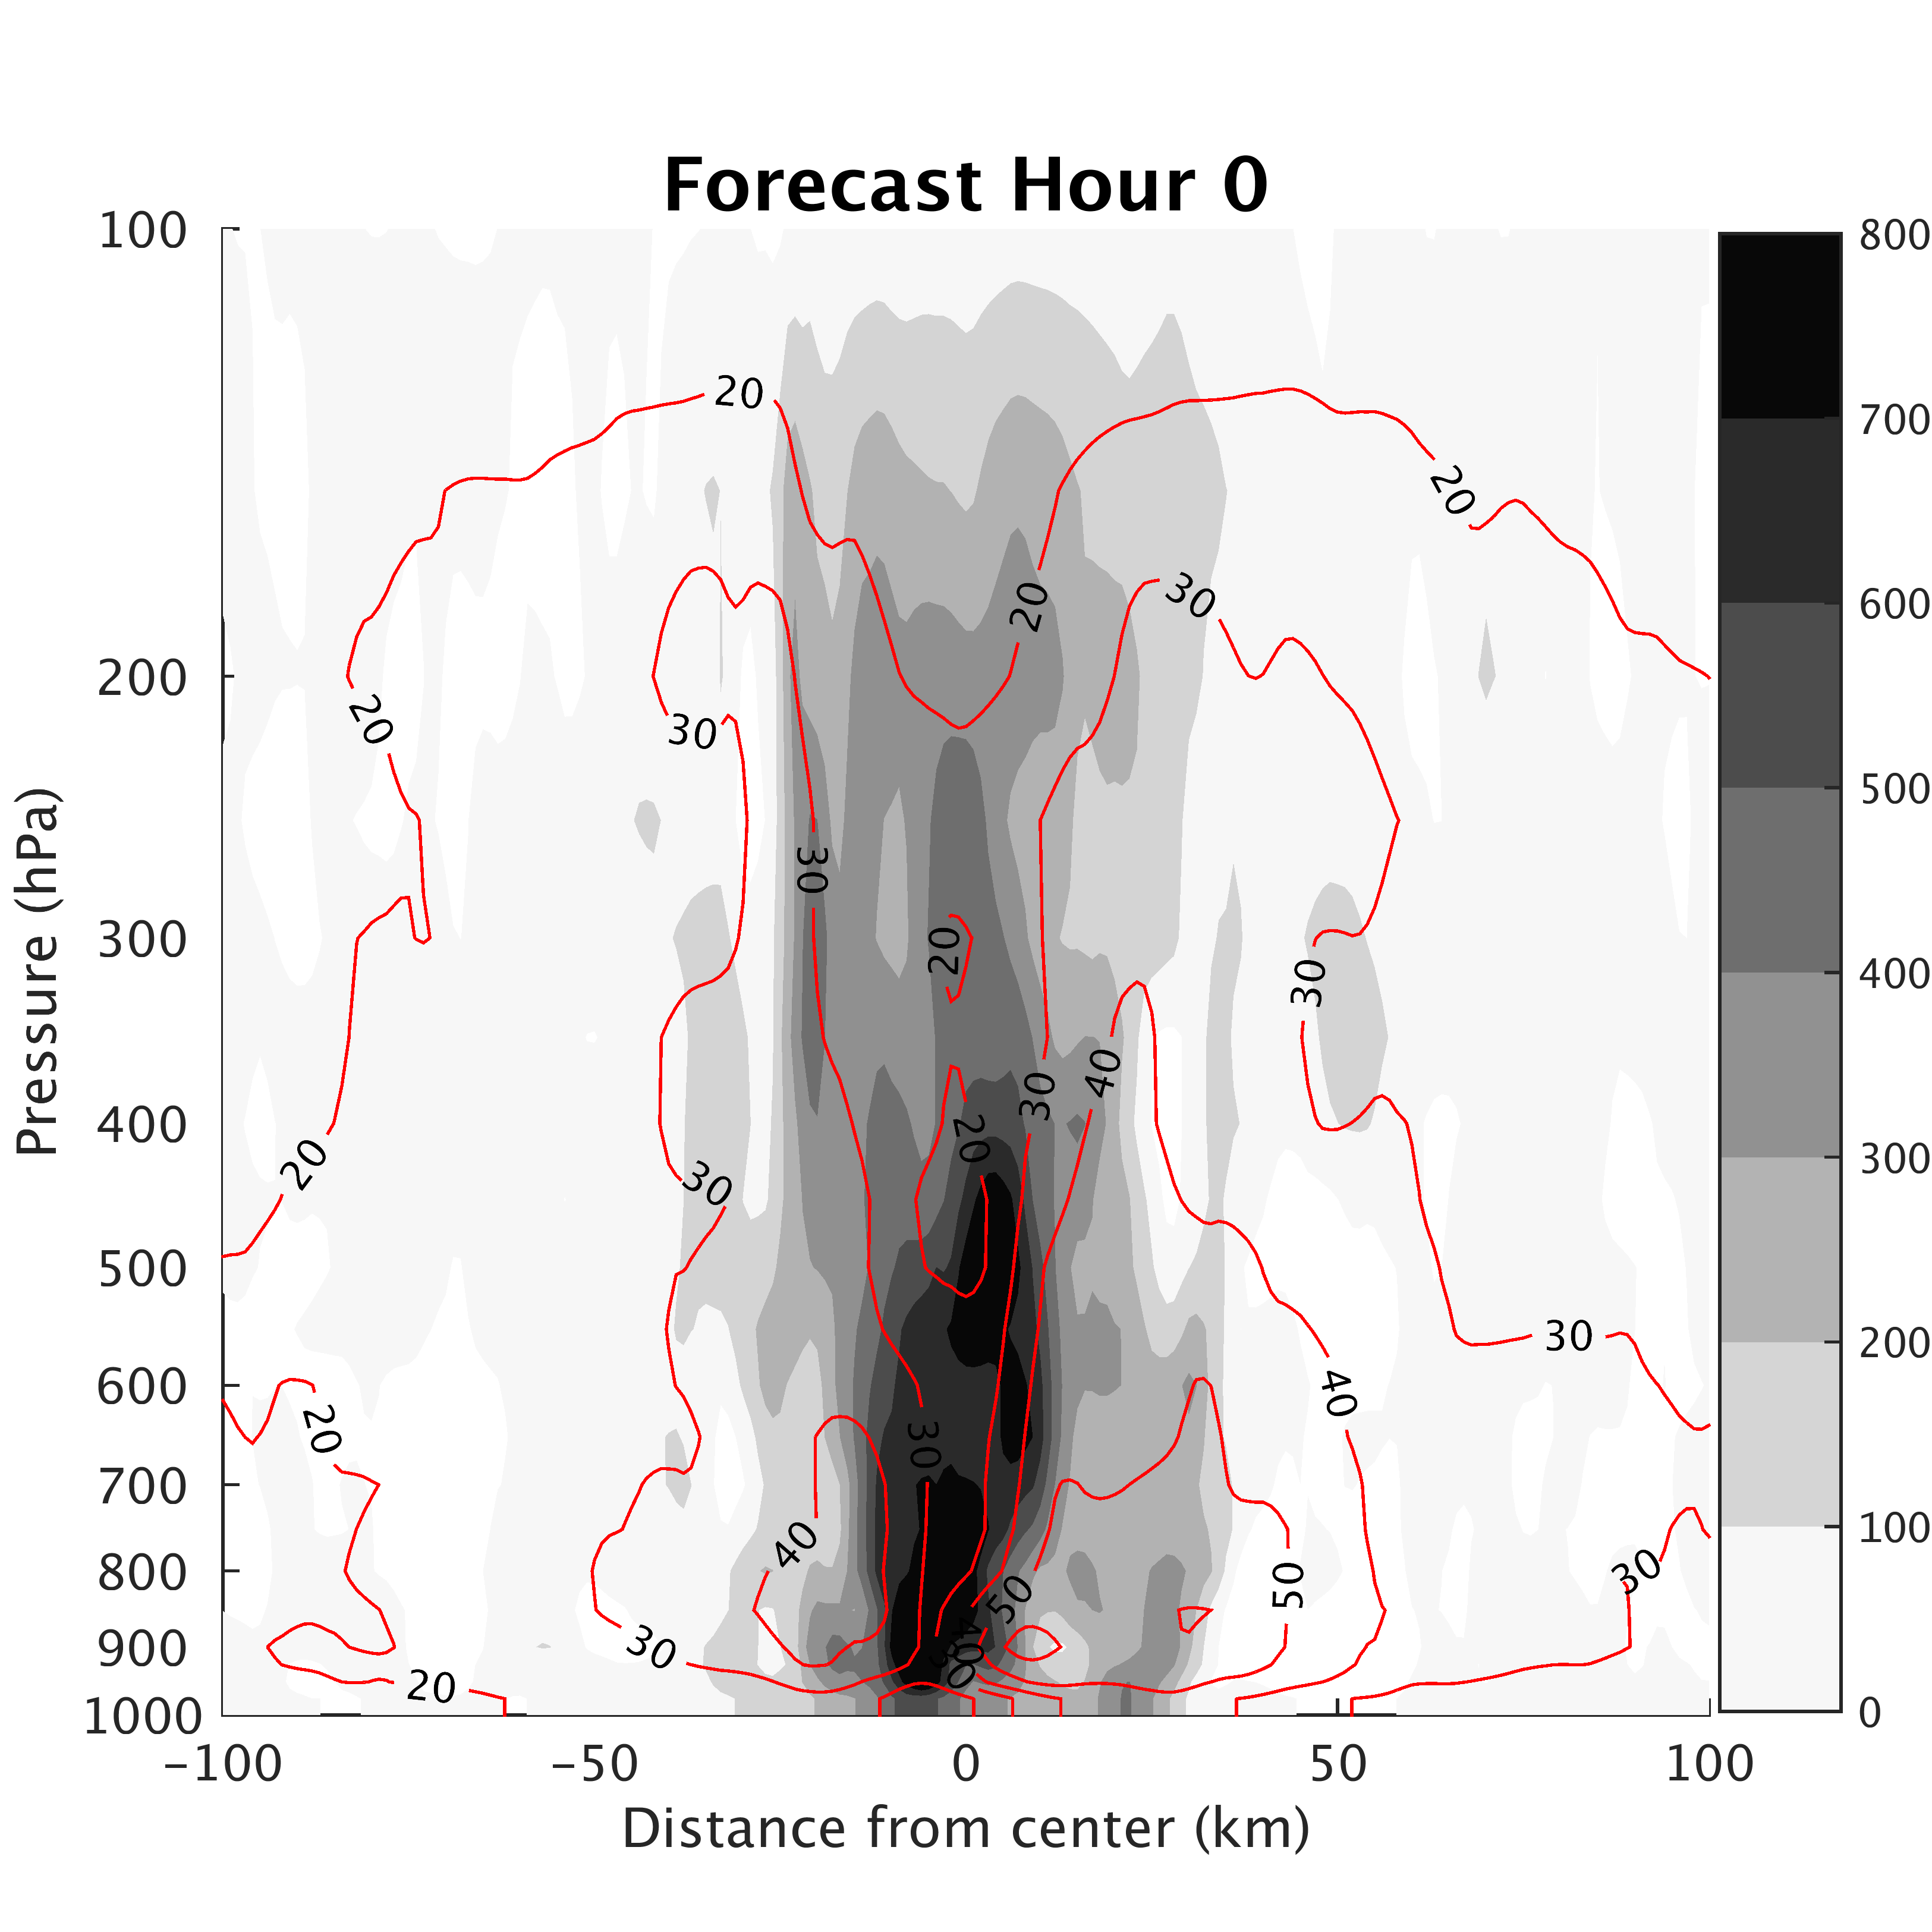
Differences from Resolution:
3-km
1-km
Notes:
Differences even at initial time from how WRF initializes 1km domain

Slide 12
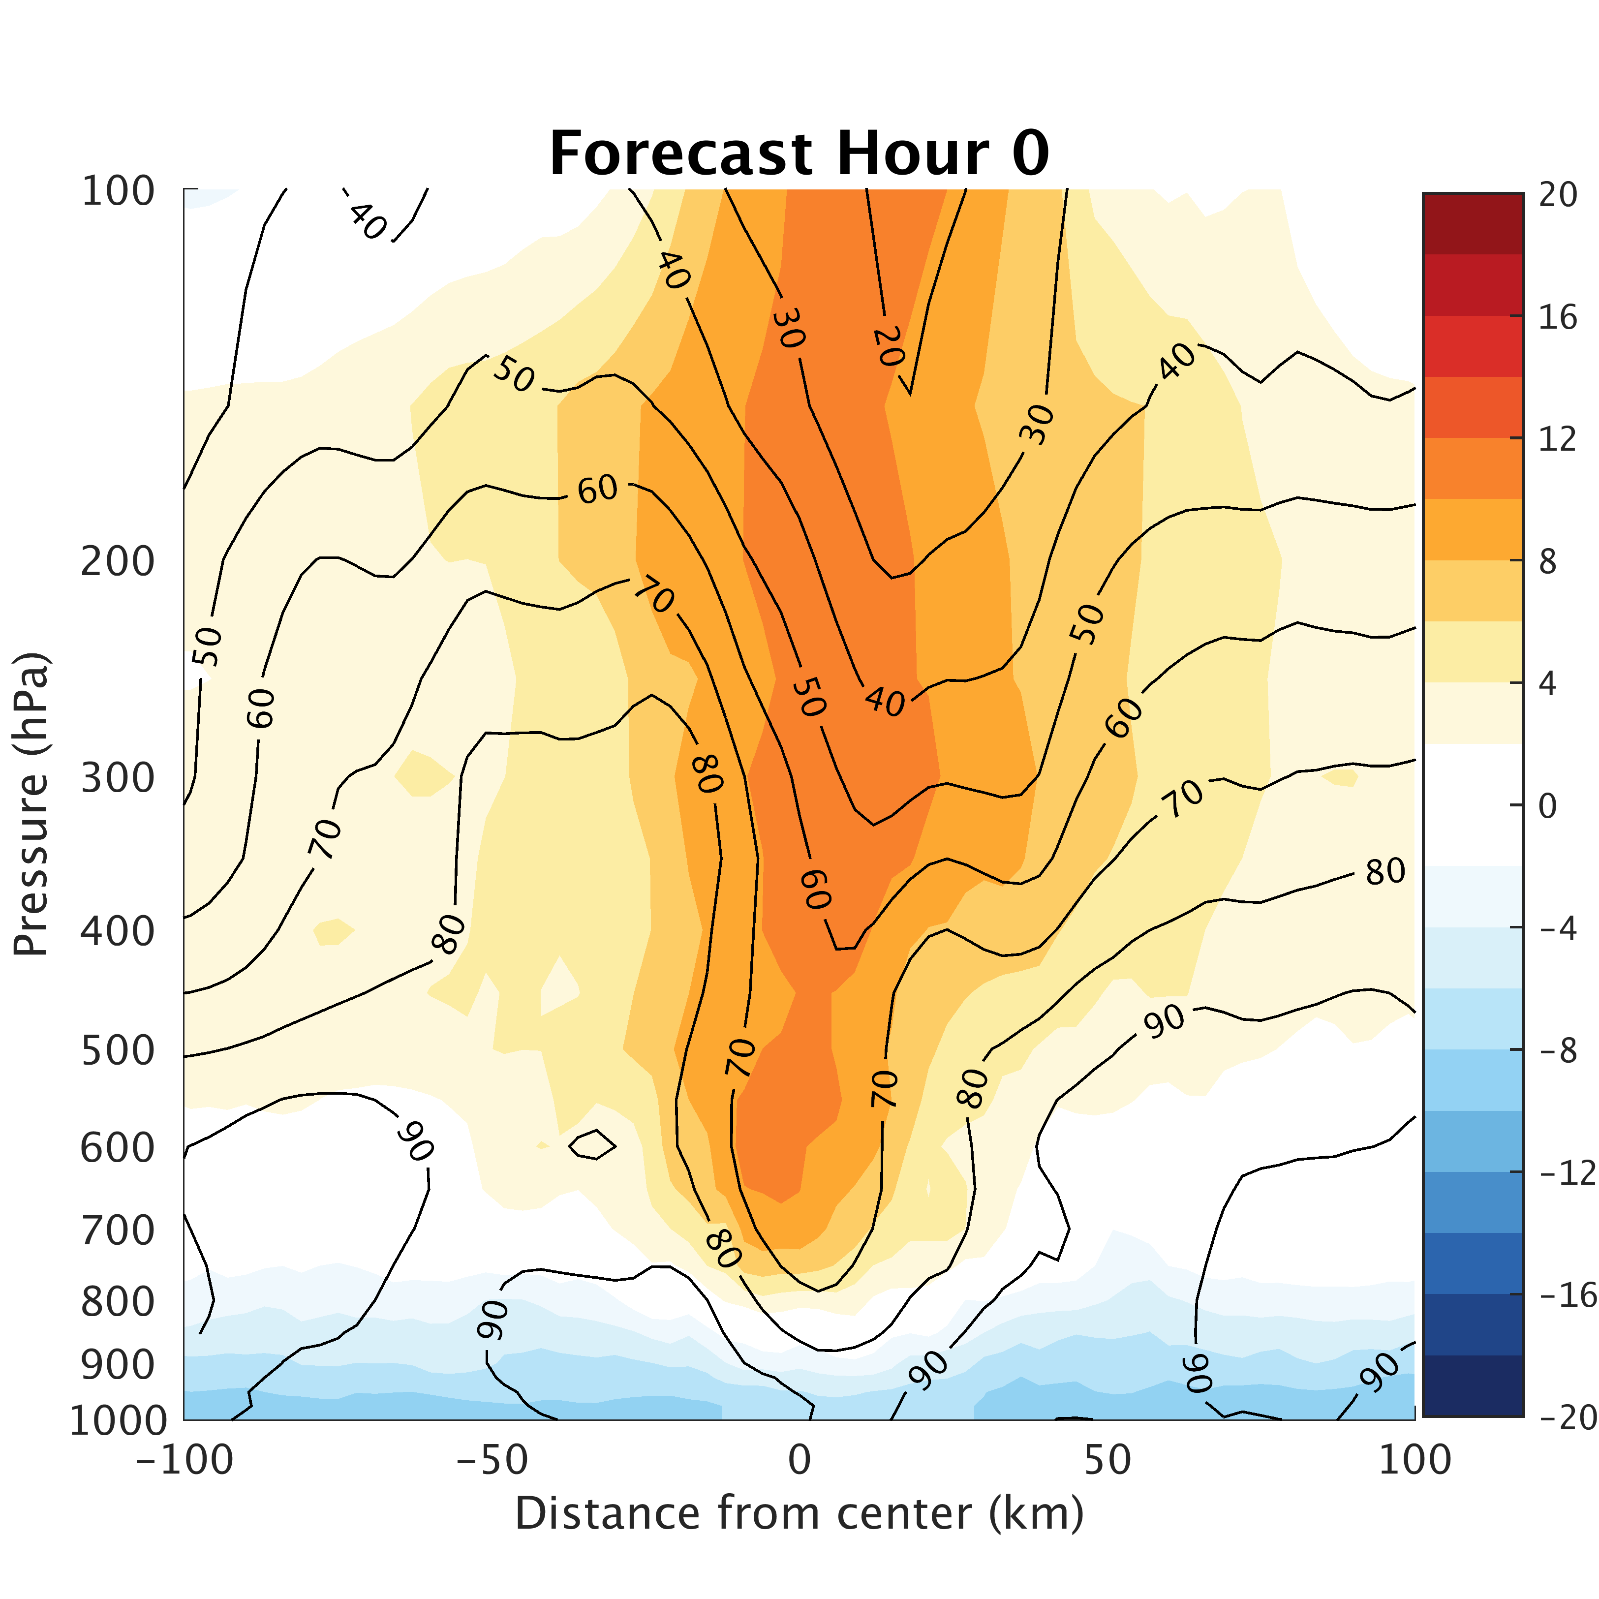
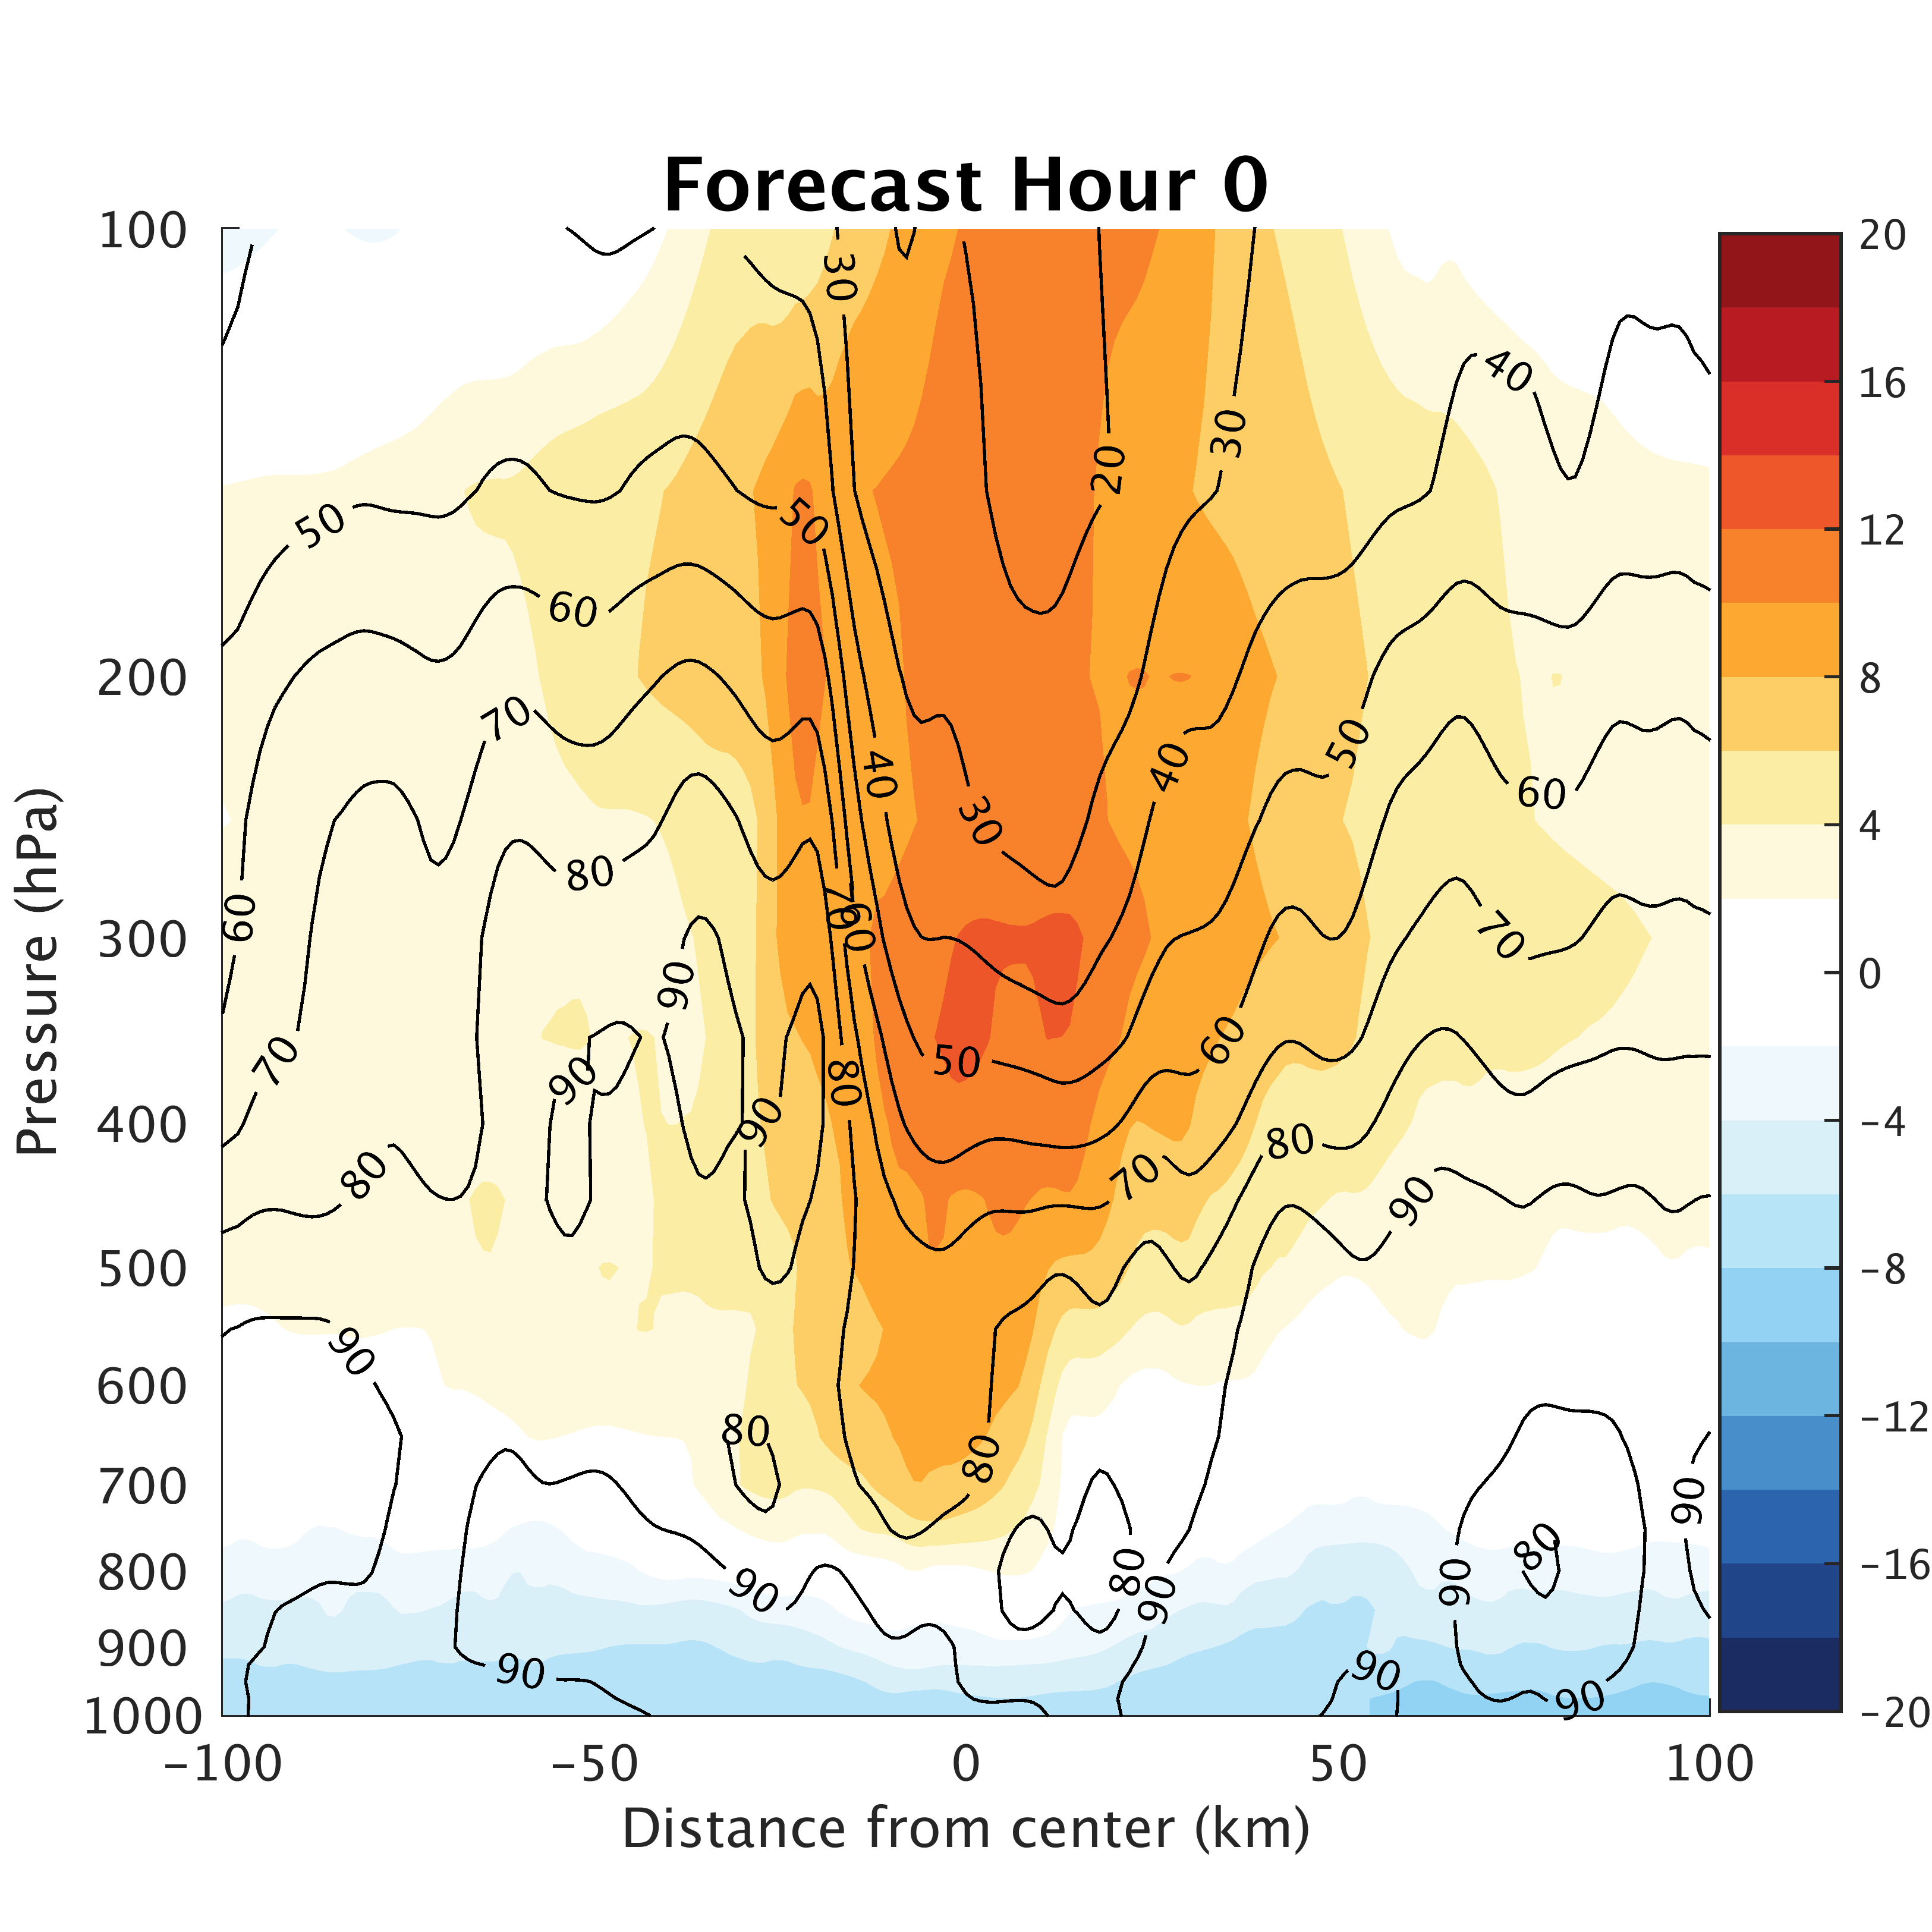
Differences from Resolution:
3-km
1-km
Notes:
Differences even at initial time from how WRF initializes 1km domain

Slide 13
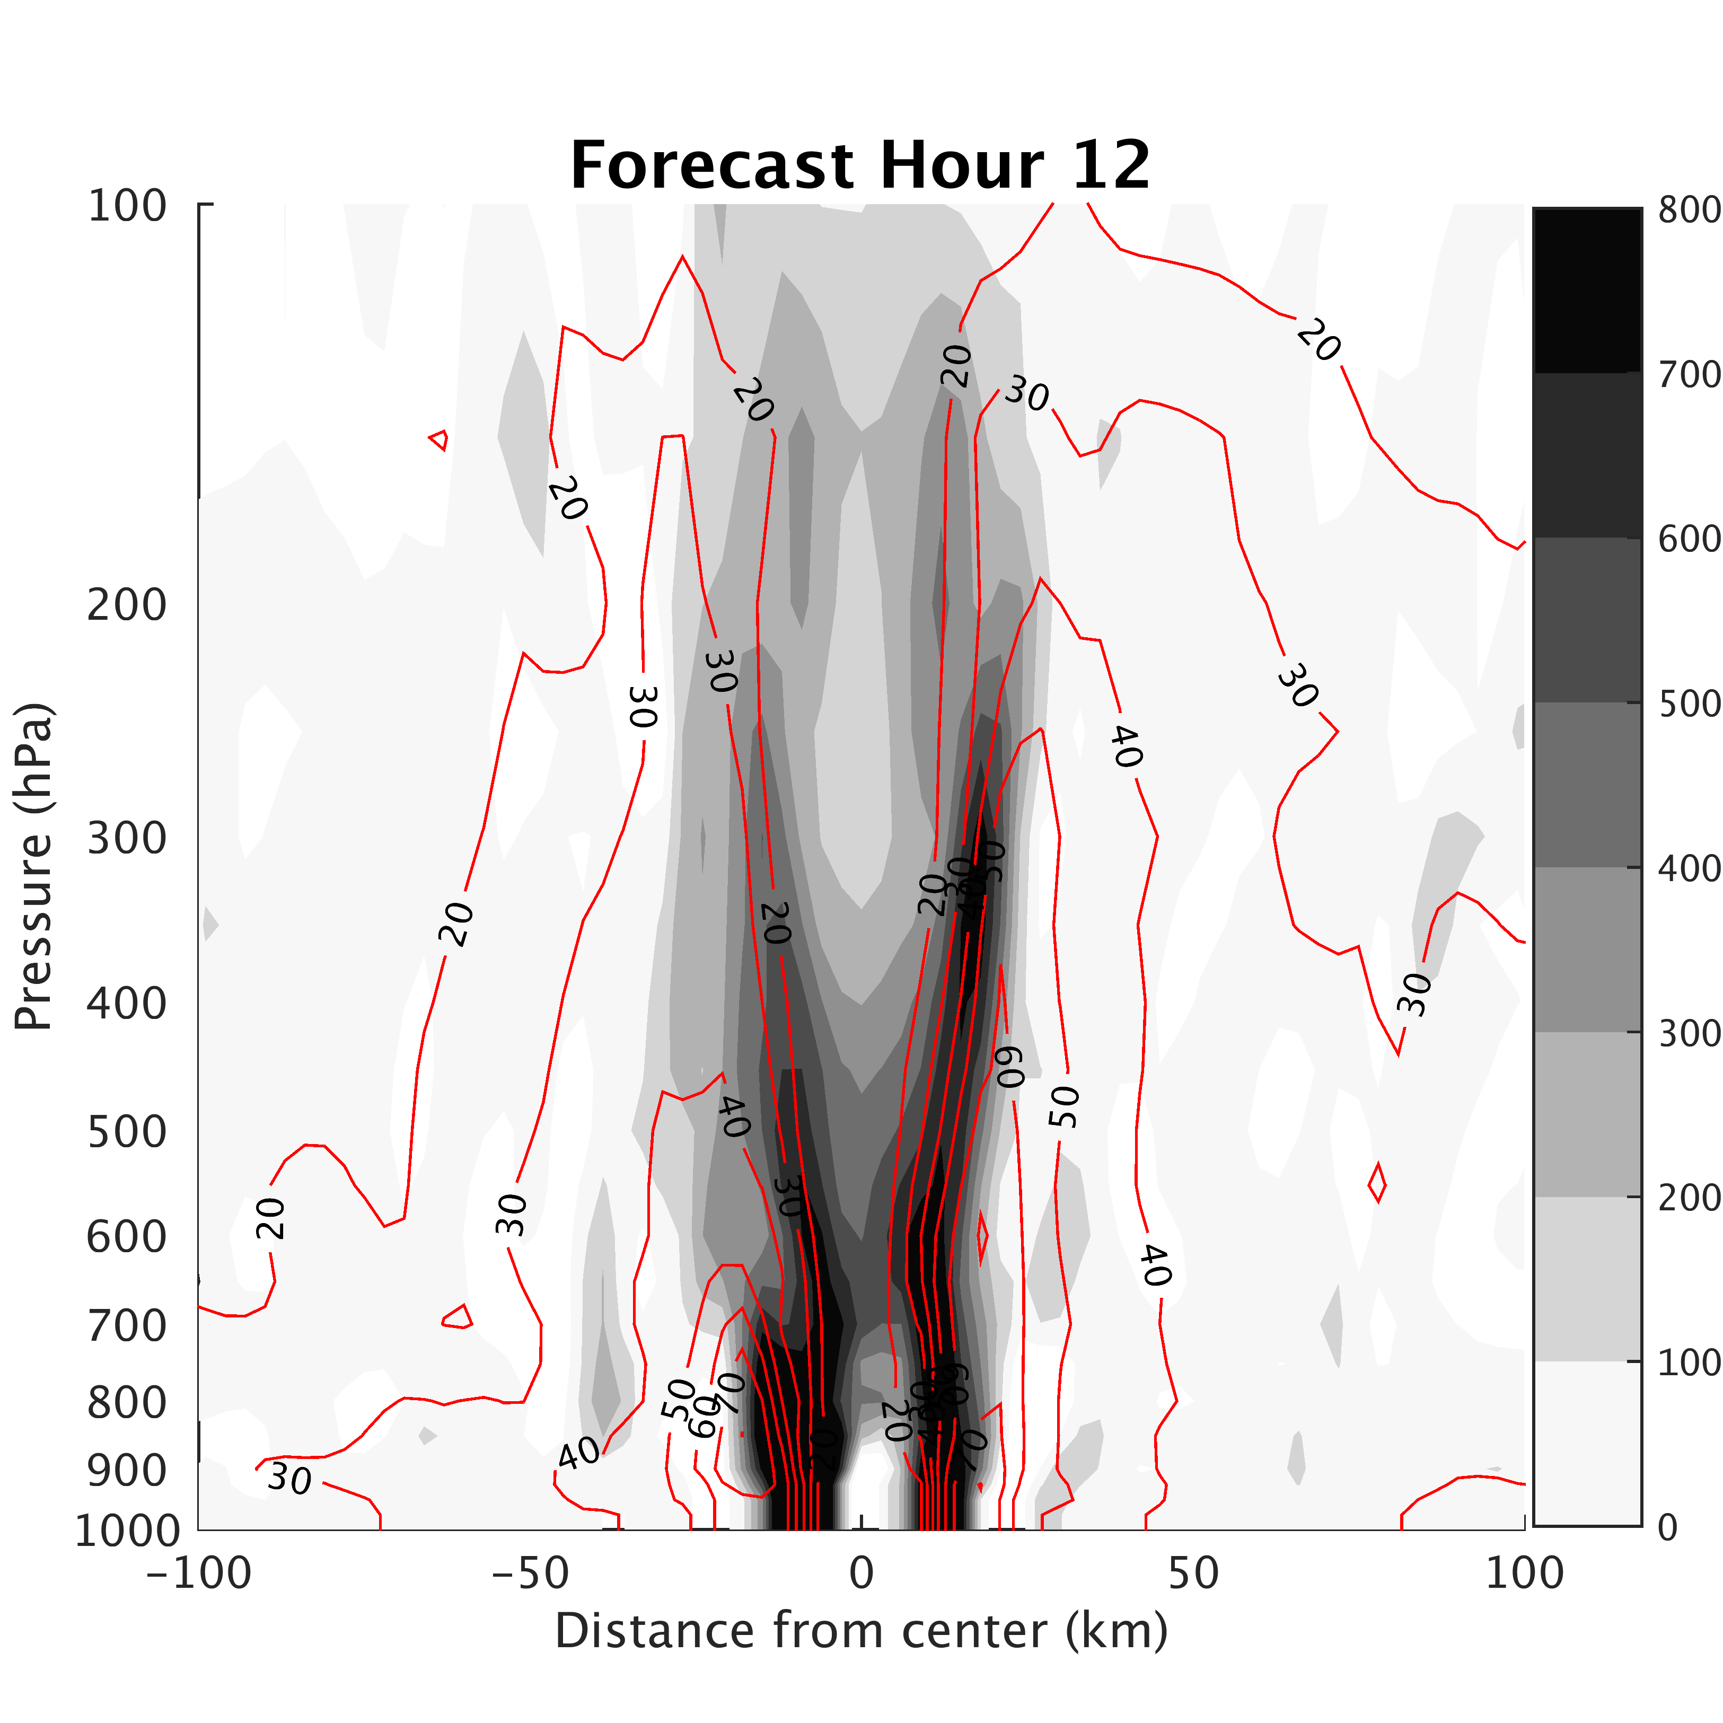
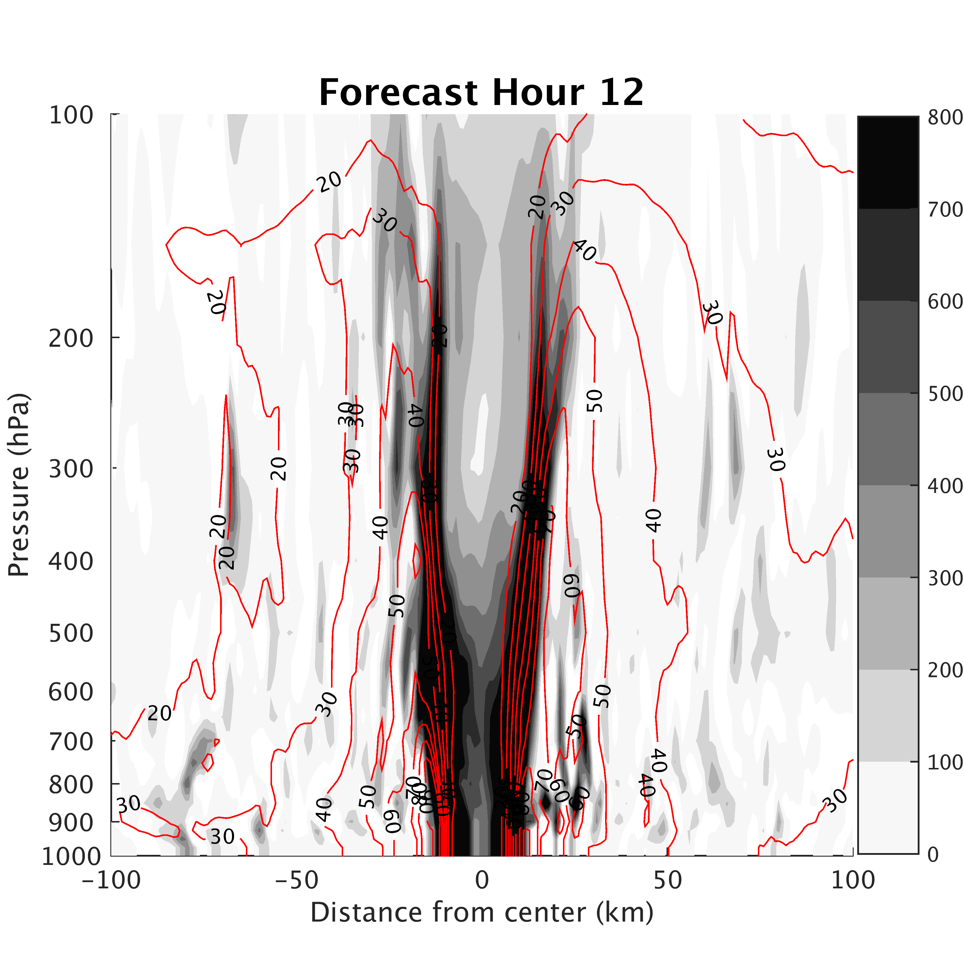
Differences from Resolution:
3-km
1-km
Notes:
Gradients much stronger in 1km simulation already ~10ms⁻¹ stronger

Slide 14
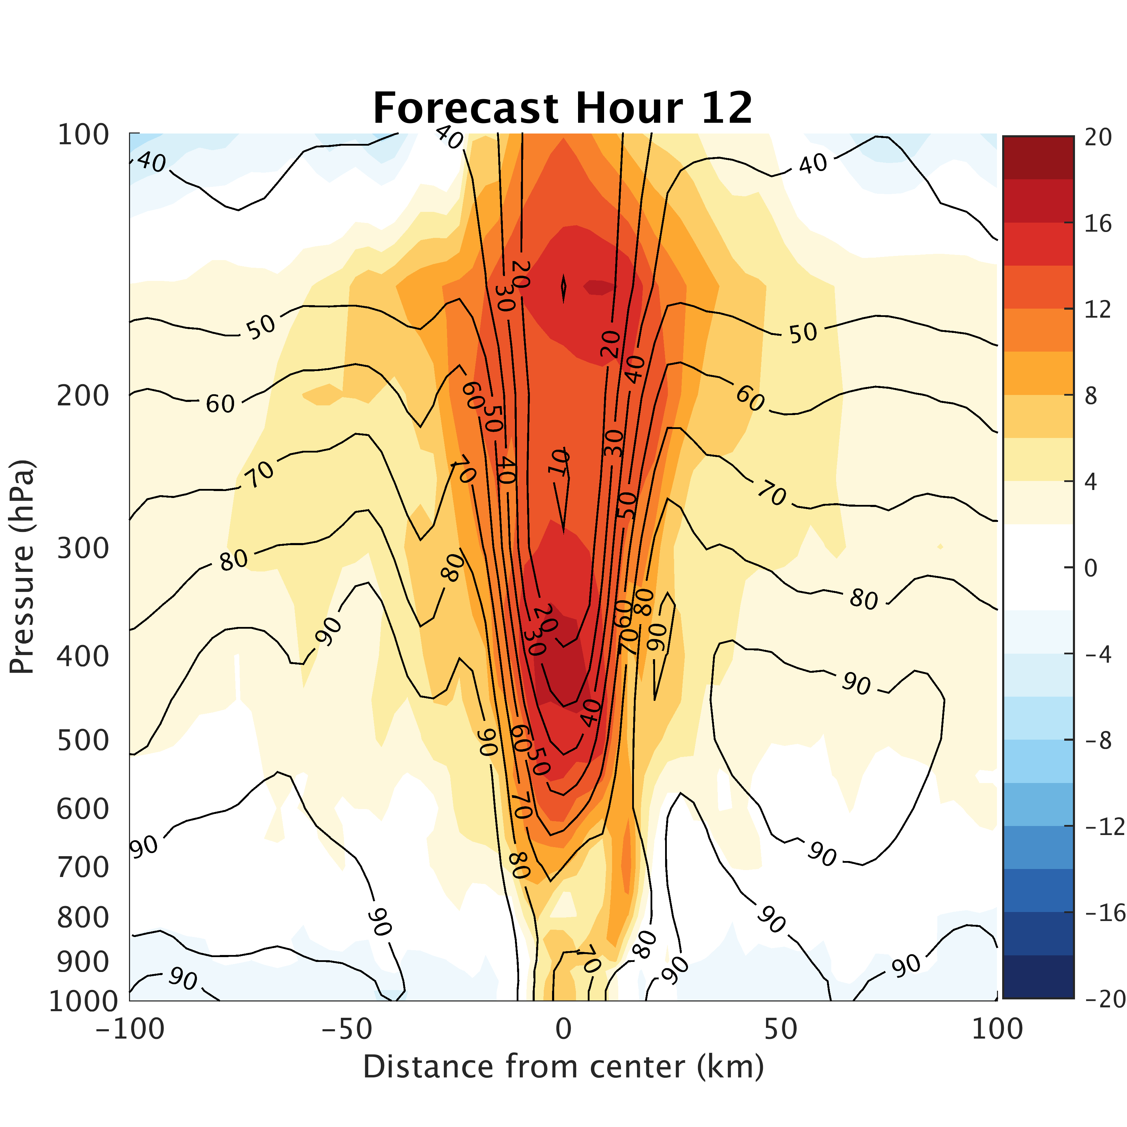
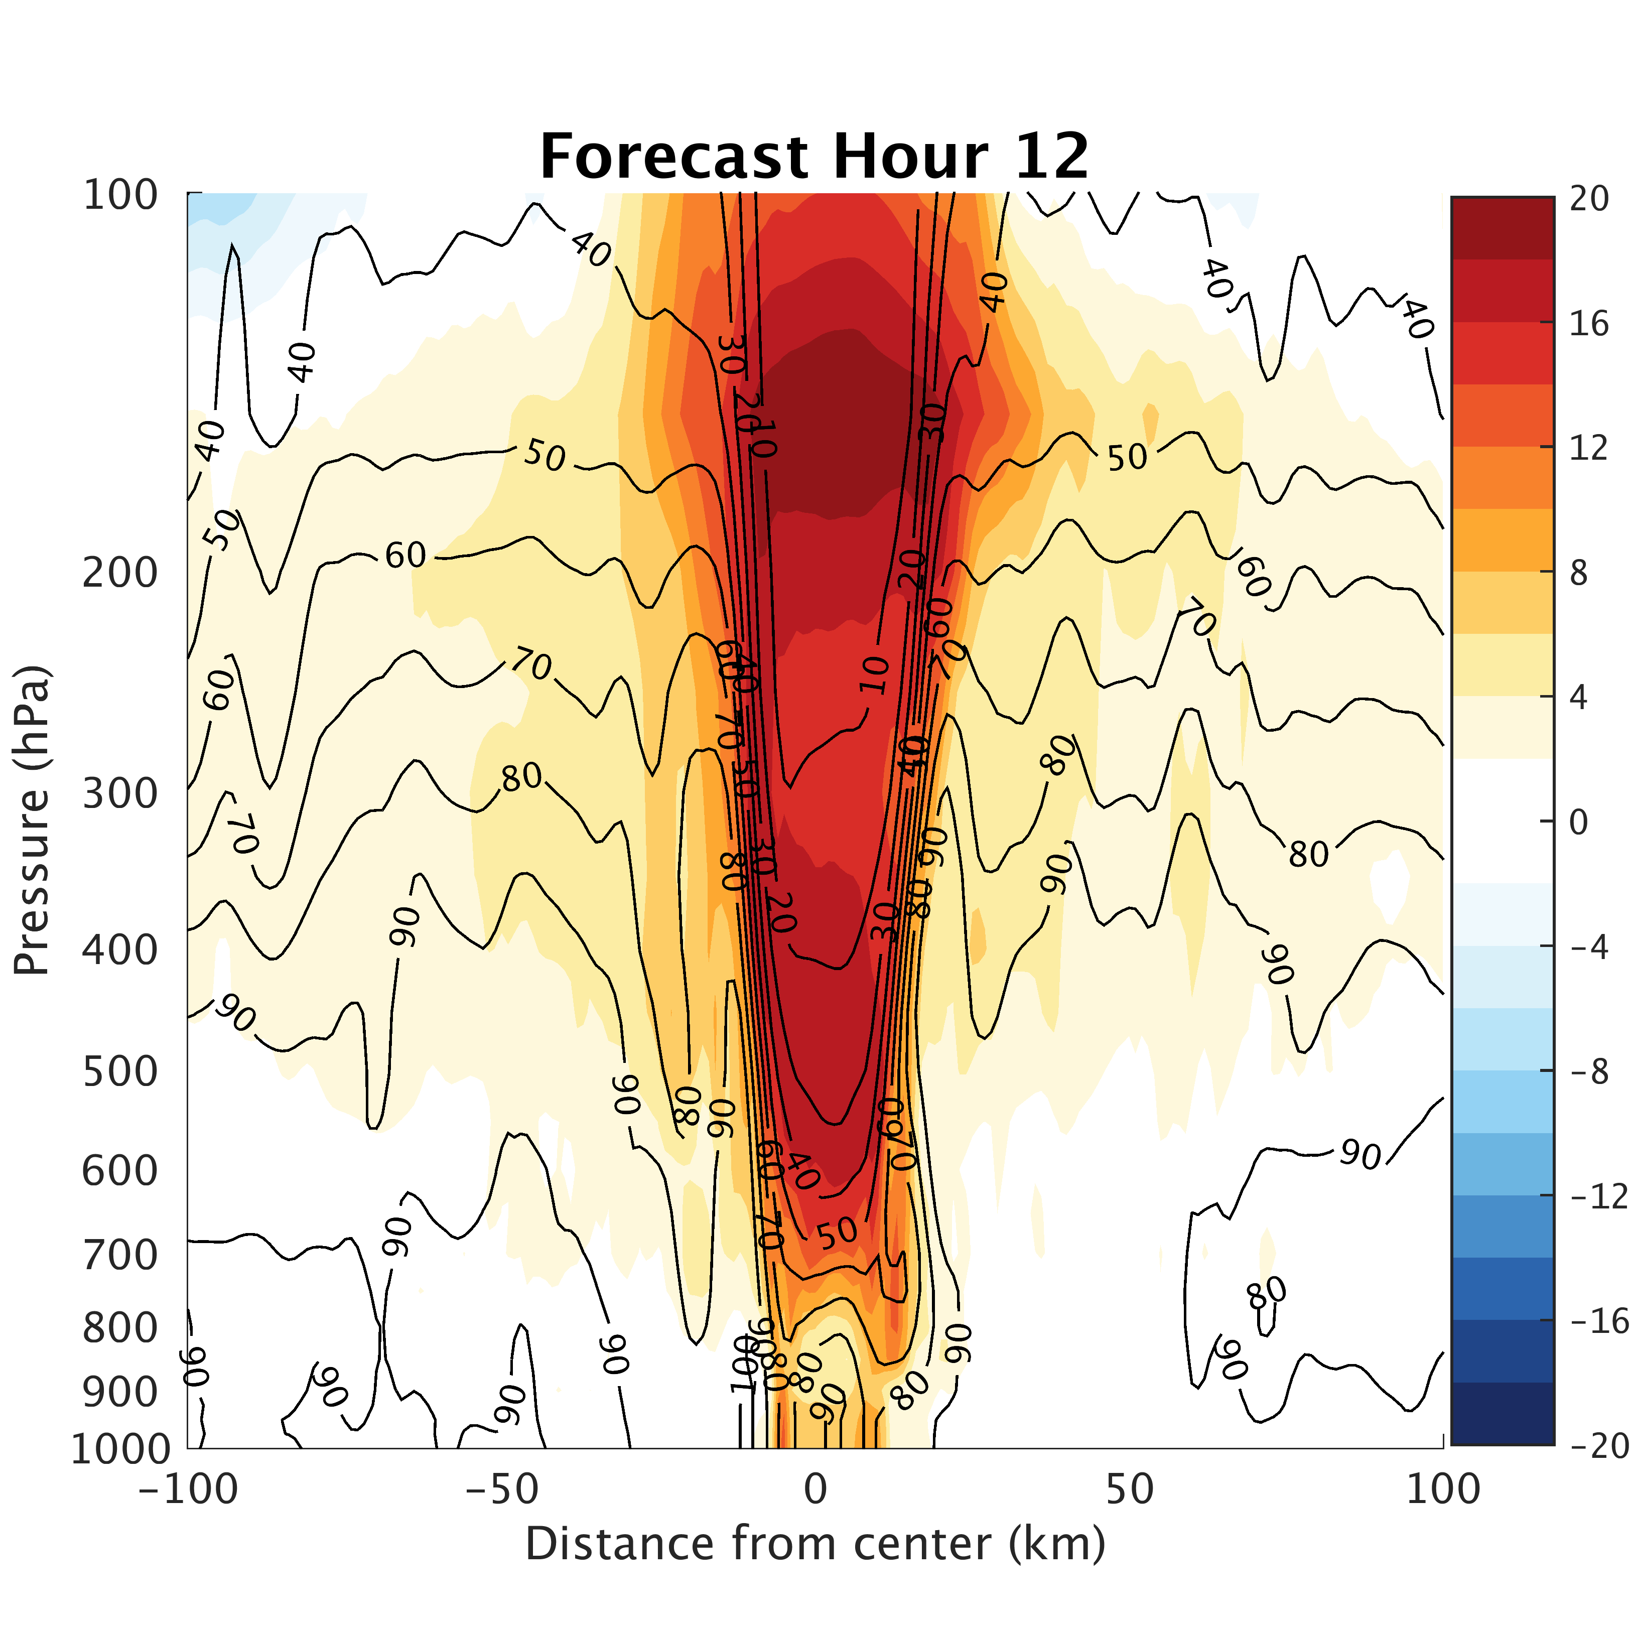
Differences from Resolution:
3-km
1-km
Notes:
Warm core stronger
Mid and upper-level warm core visible in both

Slide 15
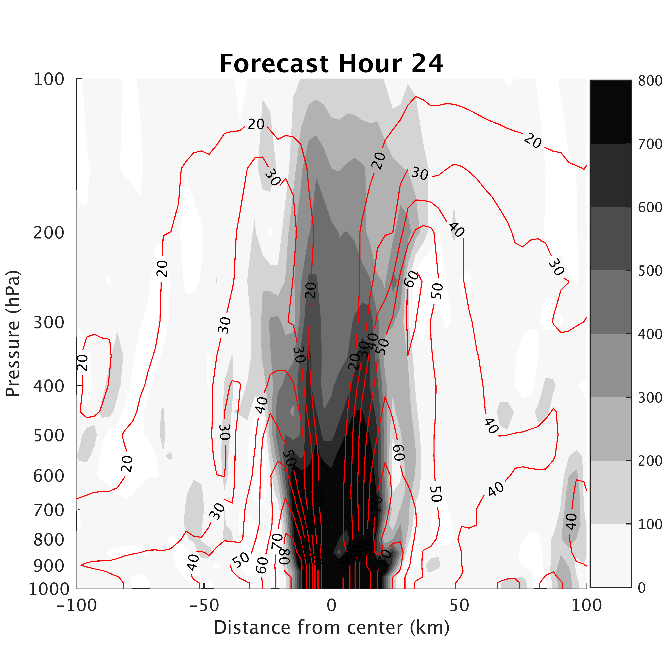
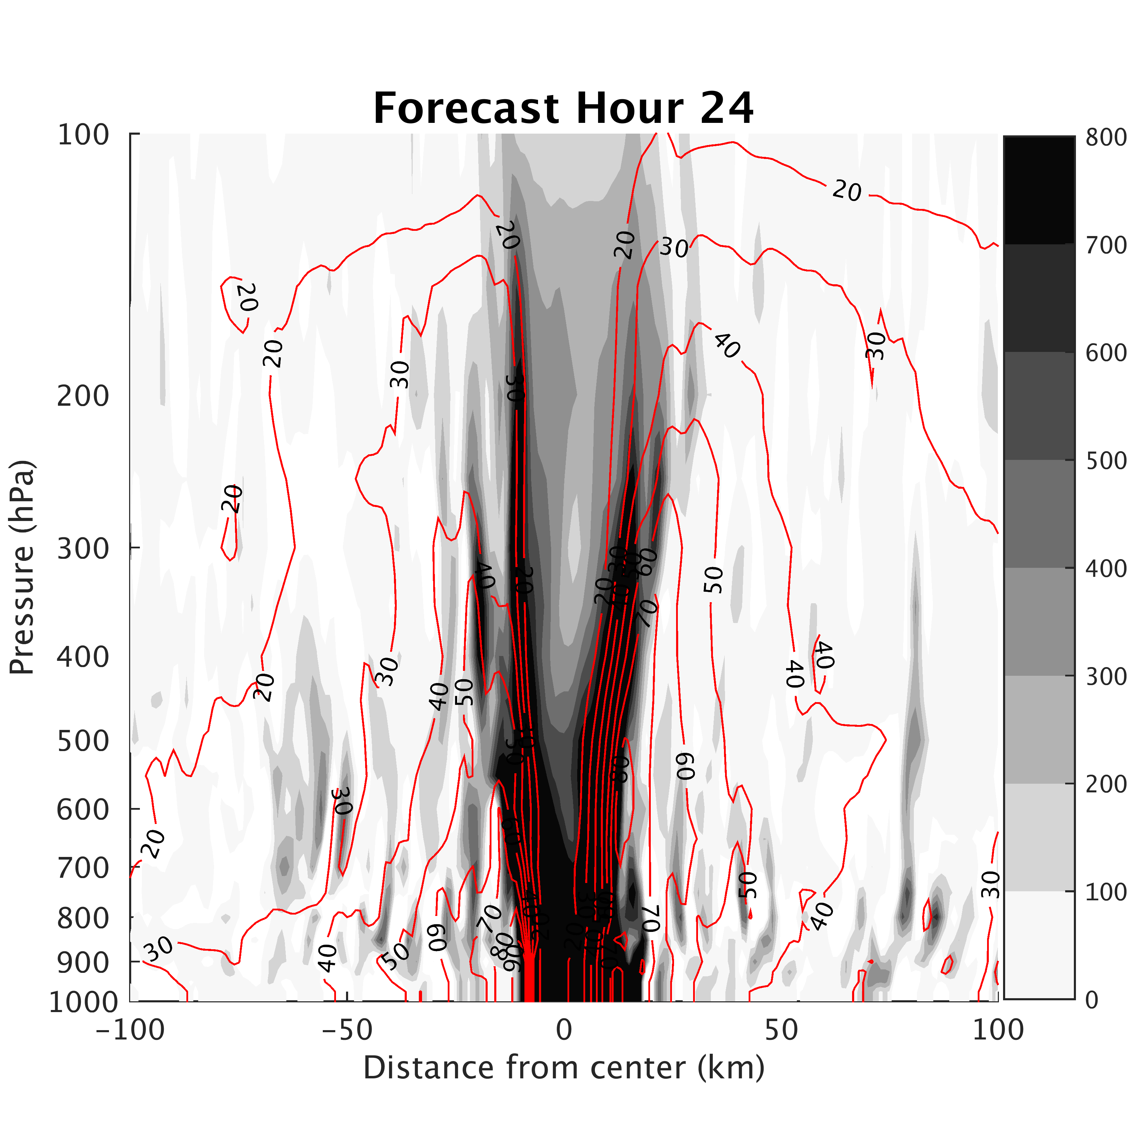
Differences from Resolution:
3-km
1-km
Notes:
Differences in rainbands visible as well!

Slide 16
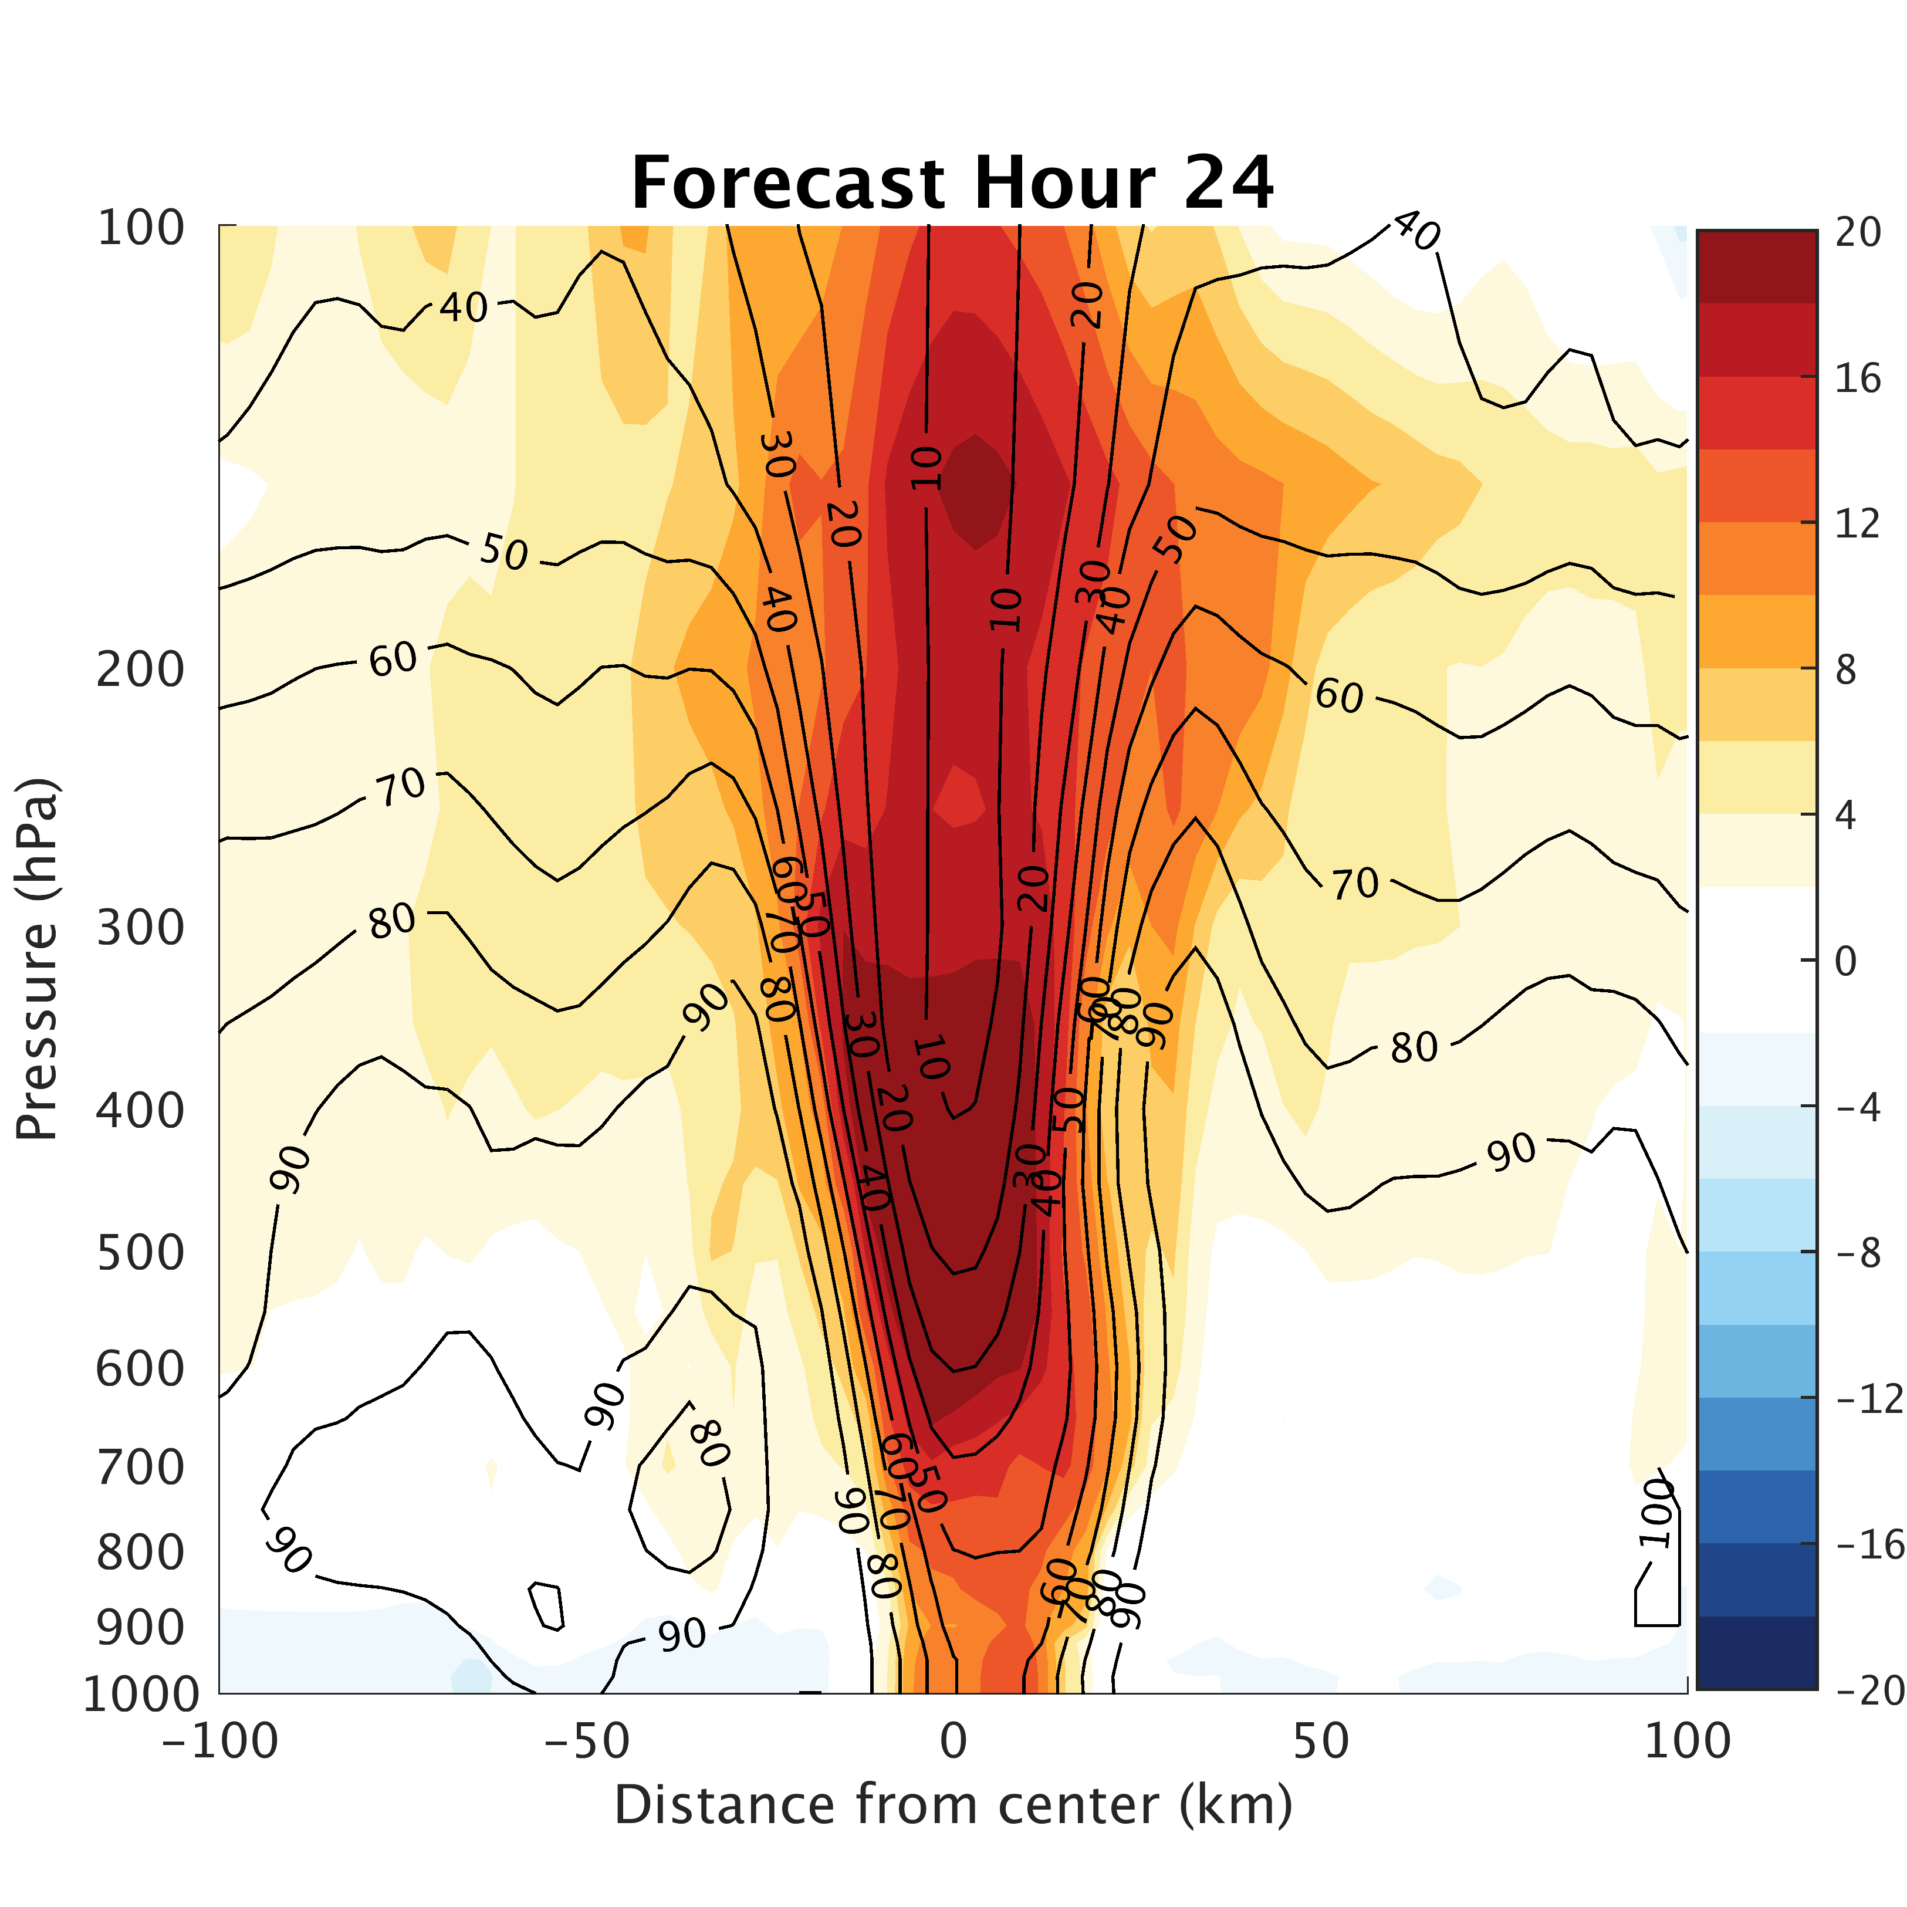
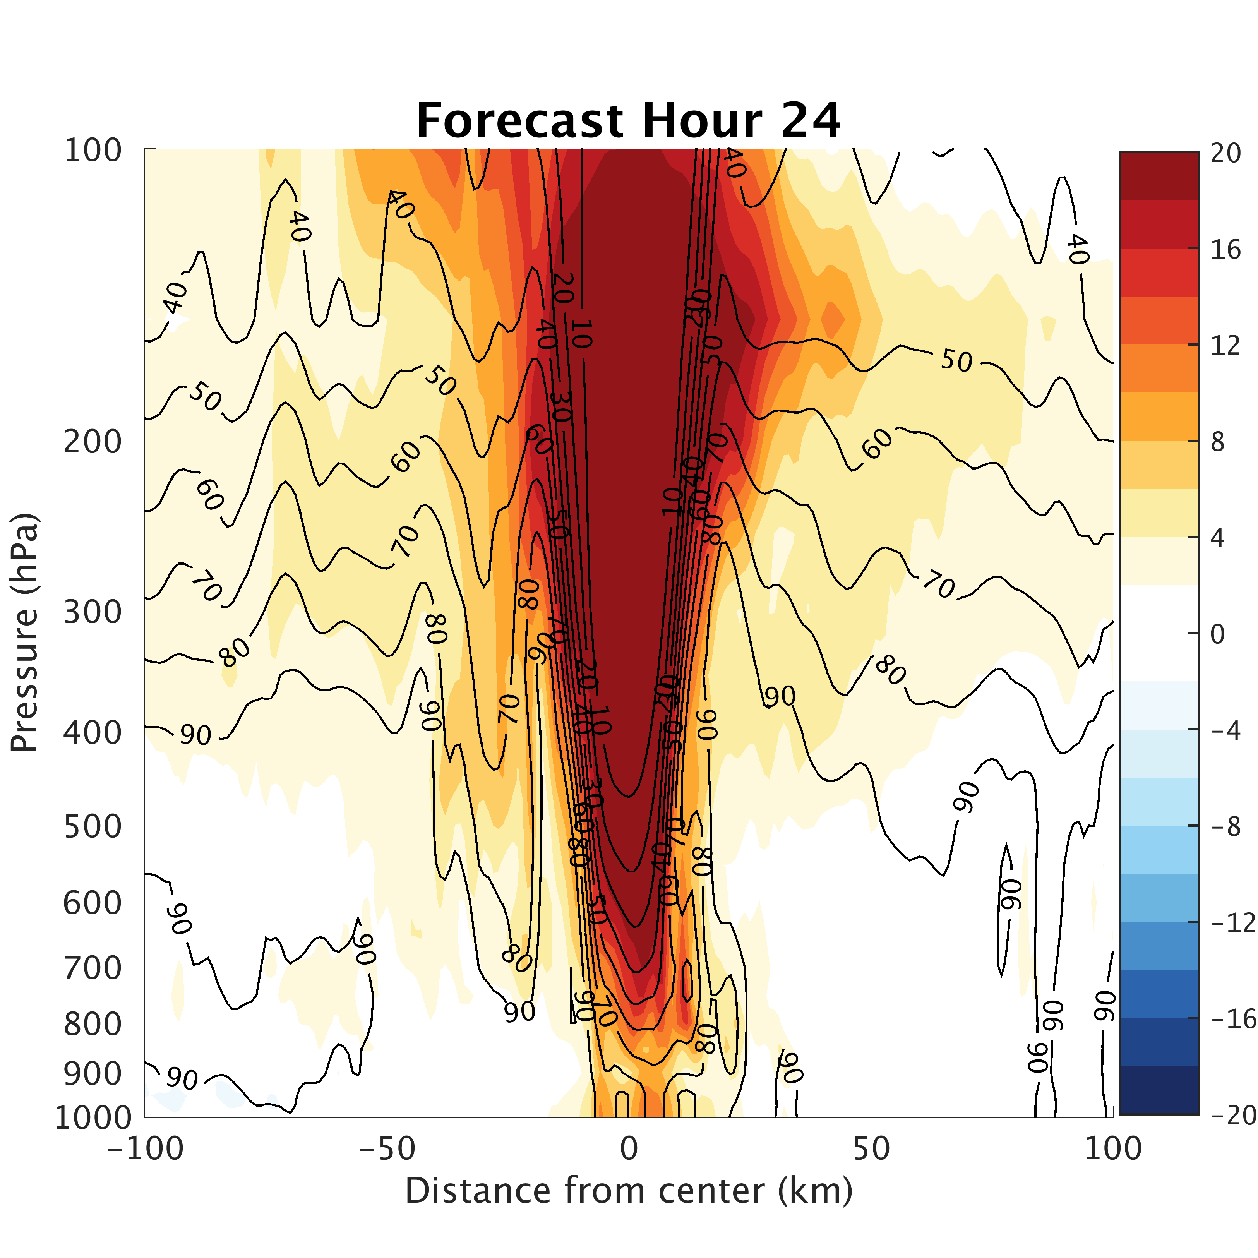
Differences from Resolution:
3-km
1-km
Notes:
Warm core in excess of 20 C!!!

Slide 17
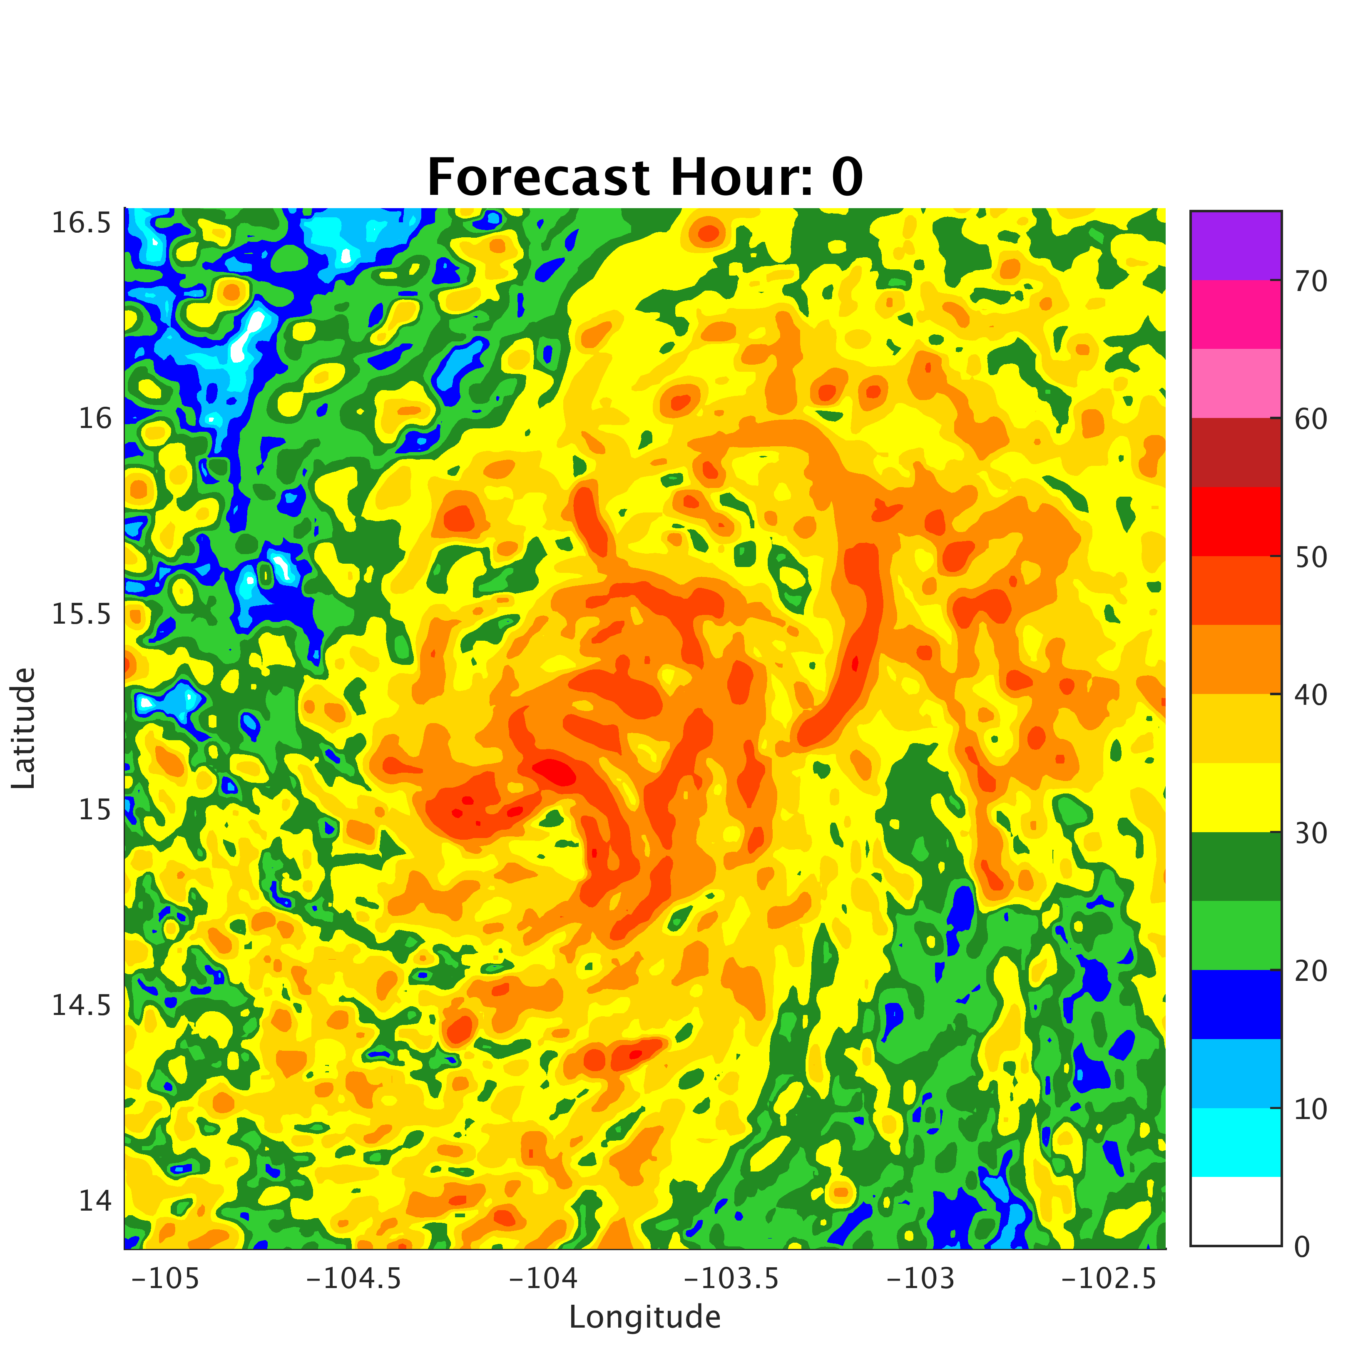
Summary and Future Work
1 km forecast using reduced C_{d} captures maximum intensity and intensification rate!
Reduced C_{d} -> lower heat and moisture fluxes
Stronger gradients and stronger warm-core in 1km simulation
Early forecasts still struggle!
Working on 1 km DA
Current challenge is position spread!
Also examining new SOs (4x increase)
Notes:
SOs at 1km for first flight are predominantly working to get storm in correct location not helping much with structure. May need additional obs (satellite to help!)

