Slide 1
Trends and variability of North American CO2 concentration revealed from ECMWF real-time analysis
Lily Zhang
State College Area High School
Contributors: Hans Chen, Thomas Lauvaux, Fuqing Zhang and Ken Davis
Notes:
Hans just talked about how CO2 concentration can be used to estimate CO2 fluxes. How does, however, CO2 concentration vary on a daily, or even seasonal basis? What do these trends tell us?

Slide 2
Overview of the talk
Model Reliability: data-model comparison
Spatial gradients of CO2 concentration
Diurnal and seasonal variabilities
Terrestrial impact
Data Used: ECMWF CO2 Analysis from Summer 2016 to Winter 2017
NASA ACT-American Airborne Measurements from Summer 2016
Notes:
The figure pictured here is a summary of ECMWF analysis data for the summer of 2016 over North America for 4 different times of day and for both summer and winter
Today, I will be talking about the
Spatial gradients observed
Diurnal and seasonal variabilities
Impact of terrestrial factors
And I will conclude with a discussion about model reliability using observational data

Slide 3
Model-Data Comparison
ECMWF Real-Time Analysis versus
ACT-American Airborne Measurements
Notes:
We’ve just looked at some trends the ECMWF analysis tells us. But how much can we trust the model?

Slide 4
ACT-America
Summer 2016 Flight campaign
July to August
Flights in Mid-Atlantic, Midwest, South
Flown between 100ºW and 70ºW
Model interpolation to flight position, altitude and time
Mean EC CO2 analysis during summer 2016 and flight tracks
Notes:
We compared the EC output to data obtained from ACT America Summer 2016 flight campain
Series of flights in three different regions: (as shown) between 100 and 70 W
We interpolated the model to the flight track

Slide 5
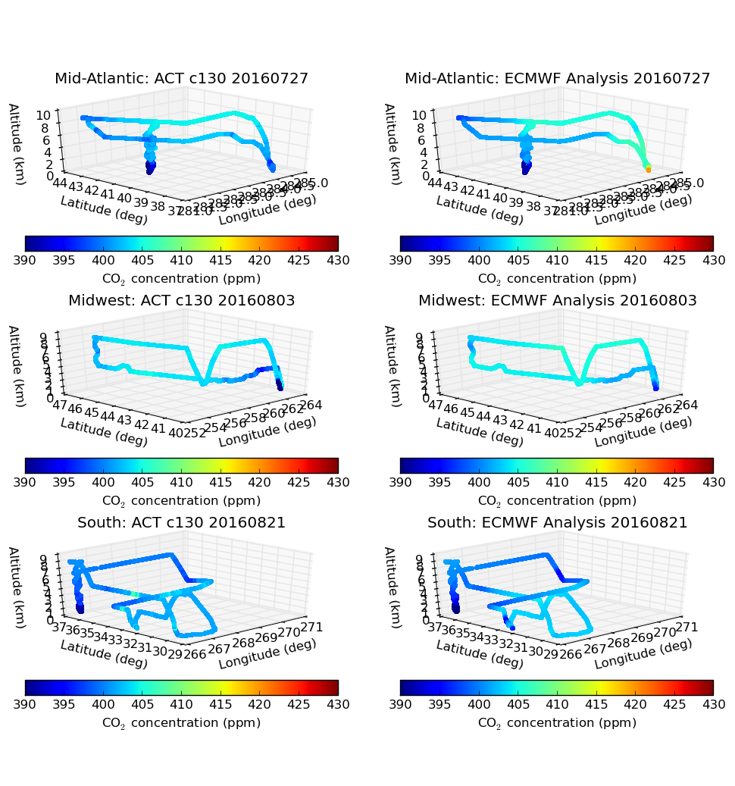
ACT-A observations (left) vs. ECMWF analysis (right)
Best model days for each region
Notes:
Are the best model days per region. As you can see, pretty good.

Slide 6
ACT-A observations (left) vs. ECMWF analysis (right)
Not so good a day: a boundary layer flight
Notes:
there are pretty bad days as well, like this.

Slide 7
ECMWF analysis versus ACT-A observations: RMSE and Mean Bias
ECMWF CO2 analysis has rather small RMSE versus ACT-A observations above the boundary layer with little to no mean bias in the summer, which suggests the ECMWF CO2 is reliable for the rest of the study.
Notes:
there are pretty bad days as well, like this.

Slide 8
Mean Spatial Gradients of CO2 Summer versus Winter

Slide 9
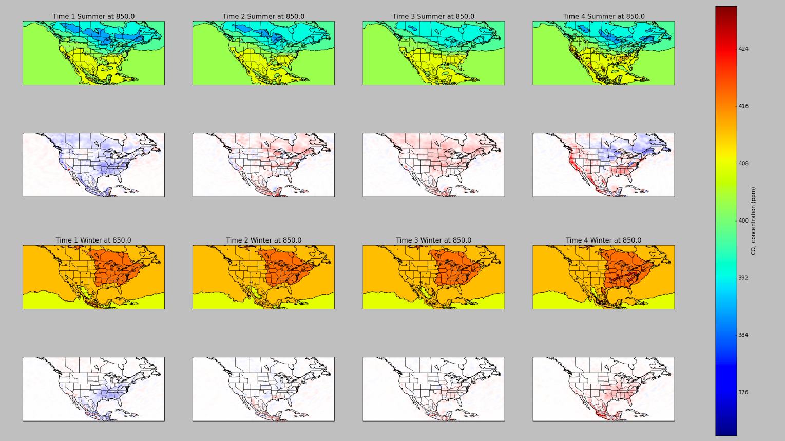
SUMMER
8 PM
2 AM
8 AM
2 PM
Diurnal Cycle
8PM – 2PM 2AM – 8PM 8AM – 2AM 2PM - 8 AM
WINTER
8 PM
2 AM
8 AM
2 PM
Diurnal Cycle
8PM – 2PM 2AM – 8PM 8AM – 2AM 2PM - 8 AM
Notes:
-Gradient
-Diurnal Cycle

Slide 10
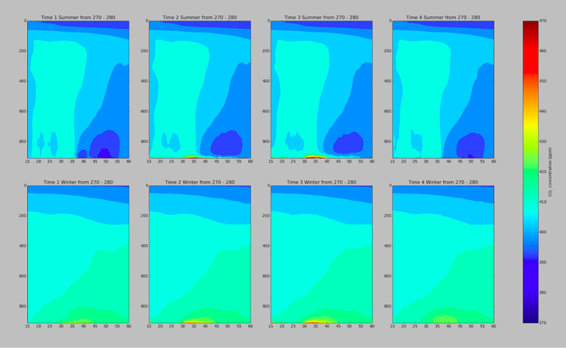
ECMWF CO2: Cross Section from 20 to 60N Averaged for 80-90W
SUMMER
8 PM
2 AM
8 AM
2 PM
WINTER
Notes:
Just to give you a quick look, the figure up on a screen is a vertical cross section of CO2 concentration over the longitudes 270-280 (Eastern United States). The horizontal axis represents latitude while the vertical axis represents pressure/height.

Slide 11
ECMWF CO2: Cross Section from 20 to 60N Averaged for 80-90W
North - South Gradient
Winter Reversal
SUMMER
Vertical Gradient
8 PM
2 AM
8 AM
2 PM
WINTER
CO₂ Concentration (ppm)
Notes:
-See evidence of a north to south gradient, with CO2 concentration decreasing with latitude during the summer but, interestingly enough, increasing with latitude during the winter
-Also a vertical gradient, with the upper layers of the atmosphere generally more stable and with CO2 concentration decreasing with height

Slide 12
Diurnal and Seasonal Variabilities

Slide 13
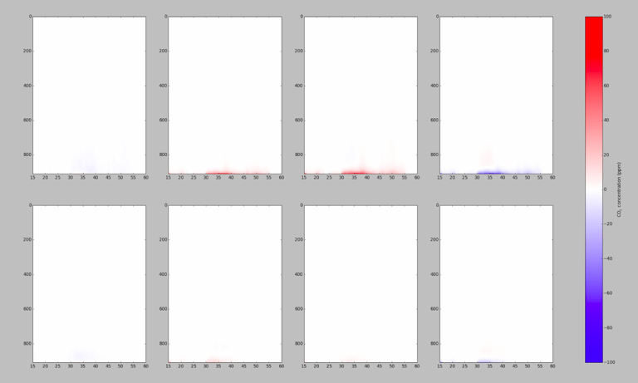
Diurnal Variabilities: mean changes of CO2 every 6 hours
Daytime intake
SUMMER
Nighttime output
2 PM - 8 PM
8 PM - 2 AM
2 AM - 8 AM
8 AM - 2 PM
WINTER
CO₂ Concentration (ppm)
Cross Section from 20 to 60N Averaged for 80-90W
Notes:
In addition, there are some noteworthy diurnal variabilities
This figure shows the net change between the four different times in the previous figure. Blue represents decrease in the CO2 concentration atmosphere while red represents an increase.
During the daytime hours there appears to be a net decrease while nighttime net increase

Slide 14
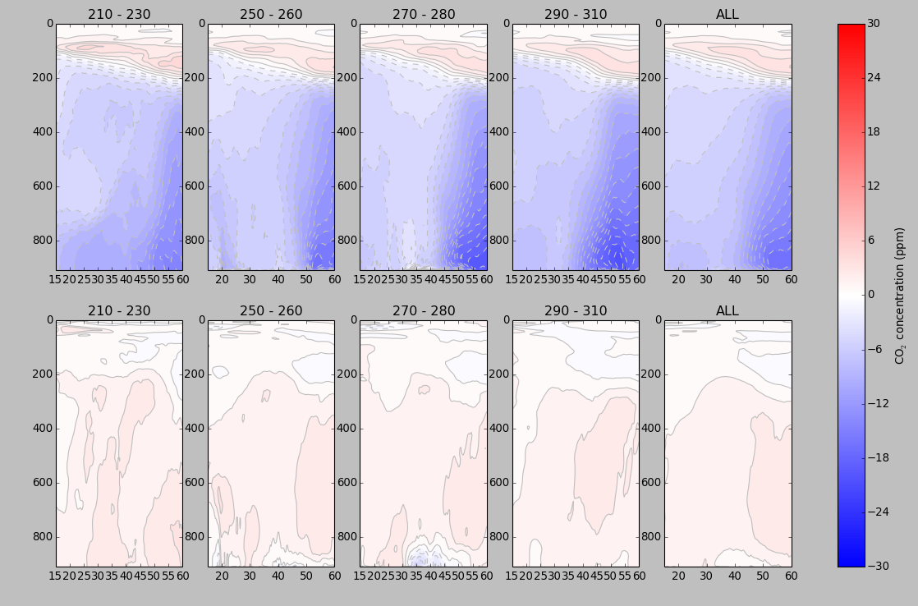
Seasonal Net CO2 Changes Averaged Over Different Longitude Ranges
Summer intake
Winter output
SUMMER
WINTER
130-150W 100-110W 80-90W 50-70W 50-150W
Pacific Rockies Plains Atlantic All NA
Notes:
This next figure shows the seasonal net changes for both winter and summer across various longitudes, with the rightmost panel depicting the average of all longitudes. Seasonally, there is a net intake of CO2 during the summer, especially in the northern regions, while winter there is a slight net output

Slide 15
Role of Plants in Explaining Trends and Variabilities
Notes:
We believe that terrestrial factors can offer some explanation in explaining these trends and variabilities

Slide 16
Photosynthesis
Respiration
Diurnal changes of CO2 every 6 hours
6CO₂ + 6H₂O ------> C₆H₁₂O₆ + 6O₂
SUMMER
CO₂ intake during the day
2 PM - 8 PM
8 PM - 2 AM
2 AM - 8 AM
8 AM - 2 PM
C₆H₁₂O₆ + 6O₂------> 6CO₂ + 6H₂O
WINTER
Cross Section from 20 to 60N Averaged for 80-90W
CO₂ output during the night
Notes:
Begin by discussing the two biological processes of photosynthesis and respiration. Photosynthesis is the process by which plants intake carbon dioxide and water, as you all know, results in a net intake of CO2 by the plant. In plants, photosynthesis happens during the day. Which explains the net intake during the two highlighted times.
In contrast, respiration (the same process that humans also go through) results in a net output of CO2 into the atmosphere. This is reflected during in nighttime figures.
As you can see, there appears to be less activity during the winter… which I will talk about in the next slide

Slide 17
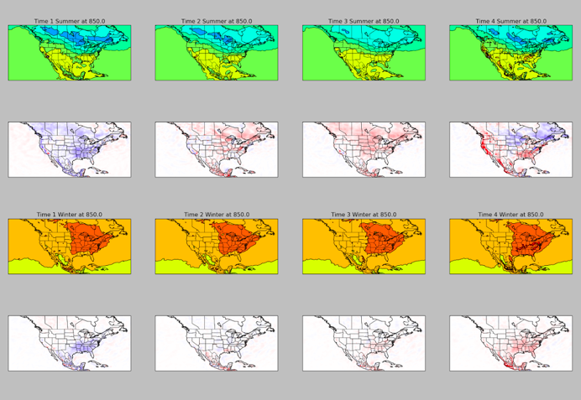
Forestation
Net CO2 Changes over Summer versus Winter
Reminder:
Net loss of CO2 in summer
Net gain of CO2 in winter
SUMMER
Heavily forested Northeastern United States
Relation to North-South gradient
WINTER
Relation to winter reversal
CO₂ Concentration (ppm)
130-150W 100-110W 80-90W 50-70W 50-150W
Pacific Rockies Plains Atlantic All NA
Notes:
Northern, especially north eastern, united states is heavily forested, and if you look at the map that is where lower CO2 concentration is found. Thus, the forrest acts a sink
Reason the winter is reversed is because you lose that sink when the leaves in the fall/winter, as you can see in the map there is a lot less activity during the winter

Slide 18
Conclusions
ECMWF analysis of CO2 concentration verified well with the ACT-American field campaign airborne observations.
There are large regional, seasonal and diurnal variabilities in the CO2 concentrations over North America.
The seasonal and diurnal changes in CO2 concentration can be mostly explained by the role of plants in biogenic carbon emission, in particular for the summer.
Notes:
Next step would be___
Causes such as terrestrial, real world implications
As well as further comparisons with ACT America observational data to investigate the model reliability

