Slide 1

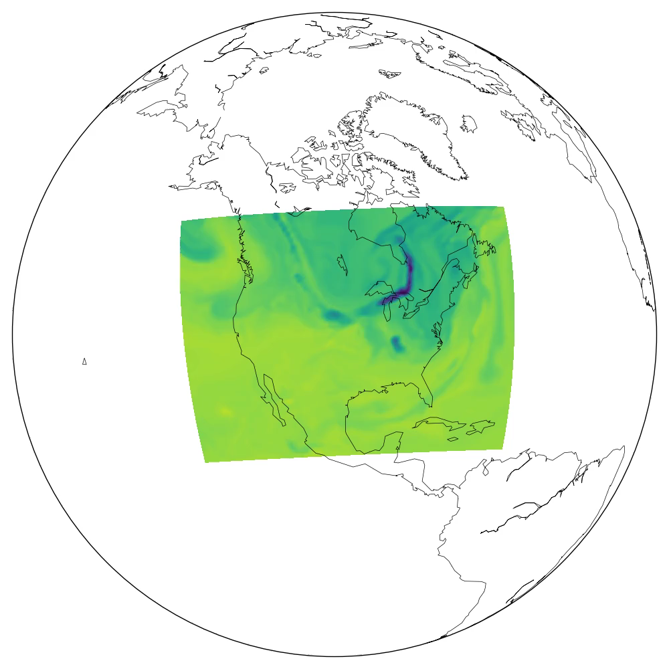



Progress toward estimating surface carbon dioxide fluxes at the regional scale using an augmented Ensemble Kalman Filter
Hans W. Chen, Fuqing Zhang, Thomas Lauvaux and Kenneth J. Davis
Department of Meteorology and Atmospheric Science
The Pennsylvania State University
Notes:
Talk about development of …
Work done with ...
Part of NASA-funded project: Atmospheric Carbon & Transport – America
Animation shows a model simulation of how ...

Slide 2
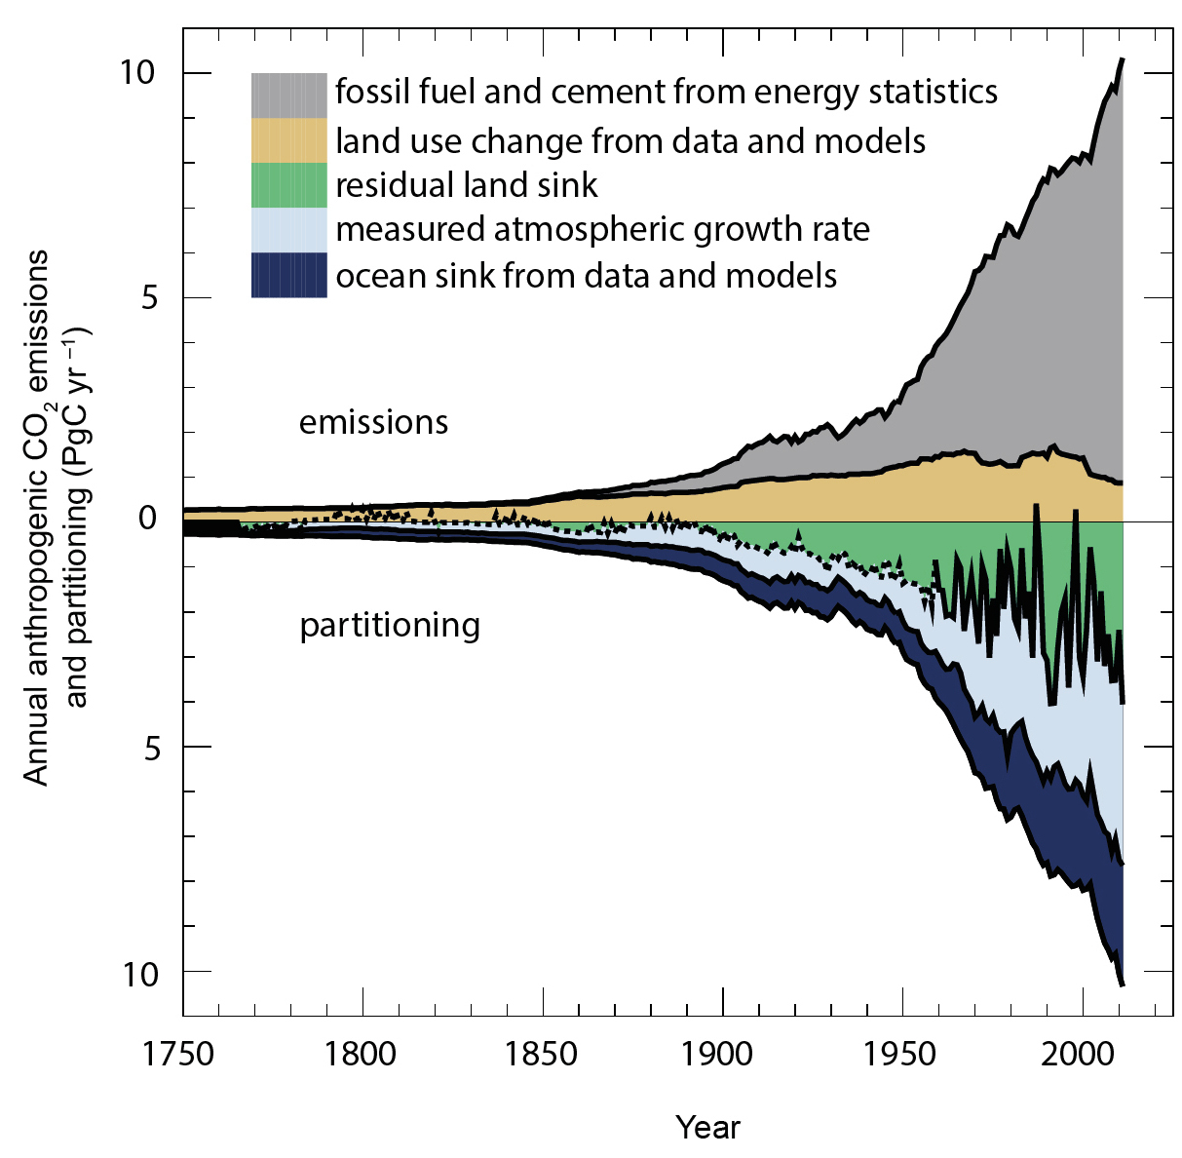
Surface CO₂ fluxes are important to know to determine the atmospheric CO₂ content
CO₂ emissions due to human activities
CO₂ in the atmosphere
CO₂ taken up by the ocean
Residual must have gone into the land
Will the land and ocean continue to act as sinks of CO₂?
[Stocker et al. 2013]
Notes:
Know that CO2 is an important GHG
Also know that humans have emitted CO2 -> increase in atmospheric CO2
Shown by chart from IPCC Technical Summary
Some taken up by ocean
Sure about these parts, not so sure about land
Need to know to make more accurate forecasts
Key question: how will these change in the future?

Slide 3
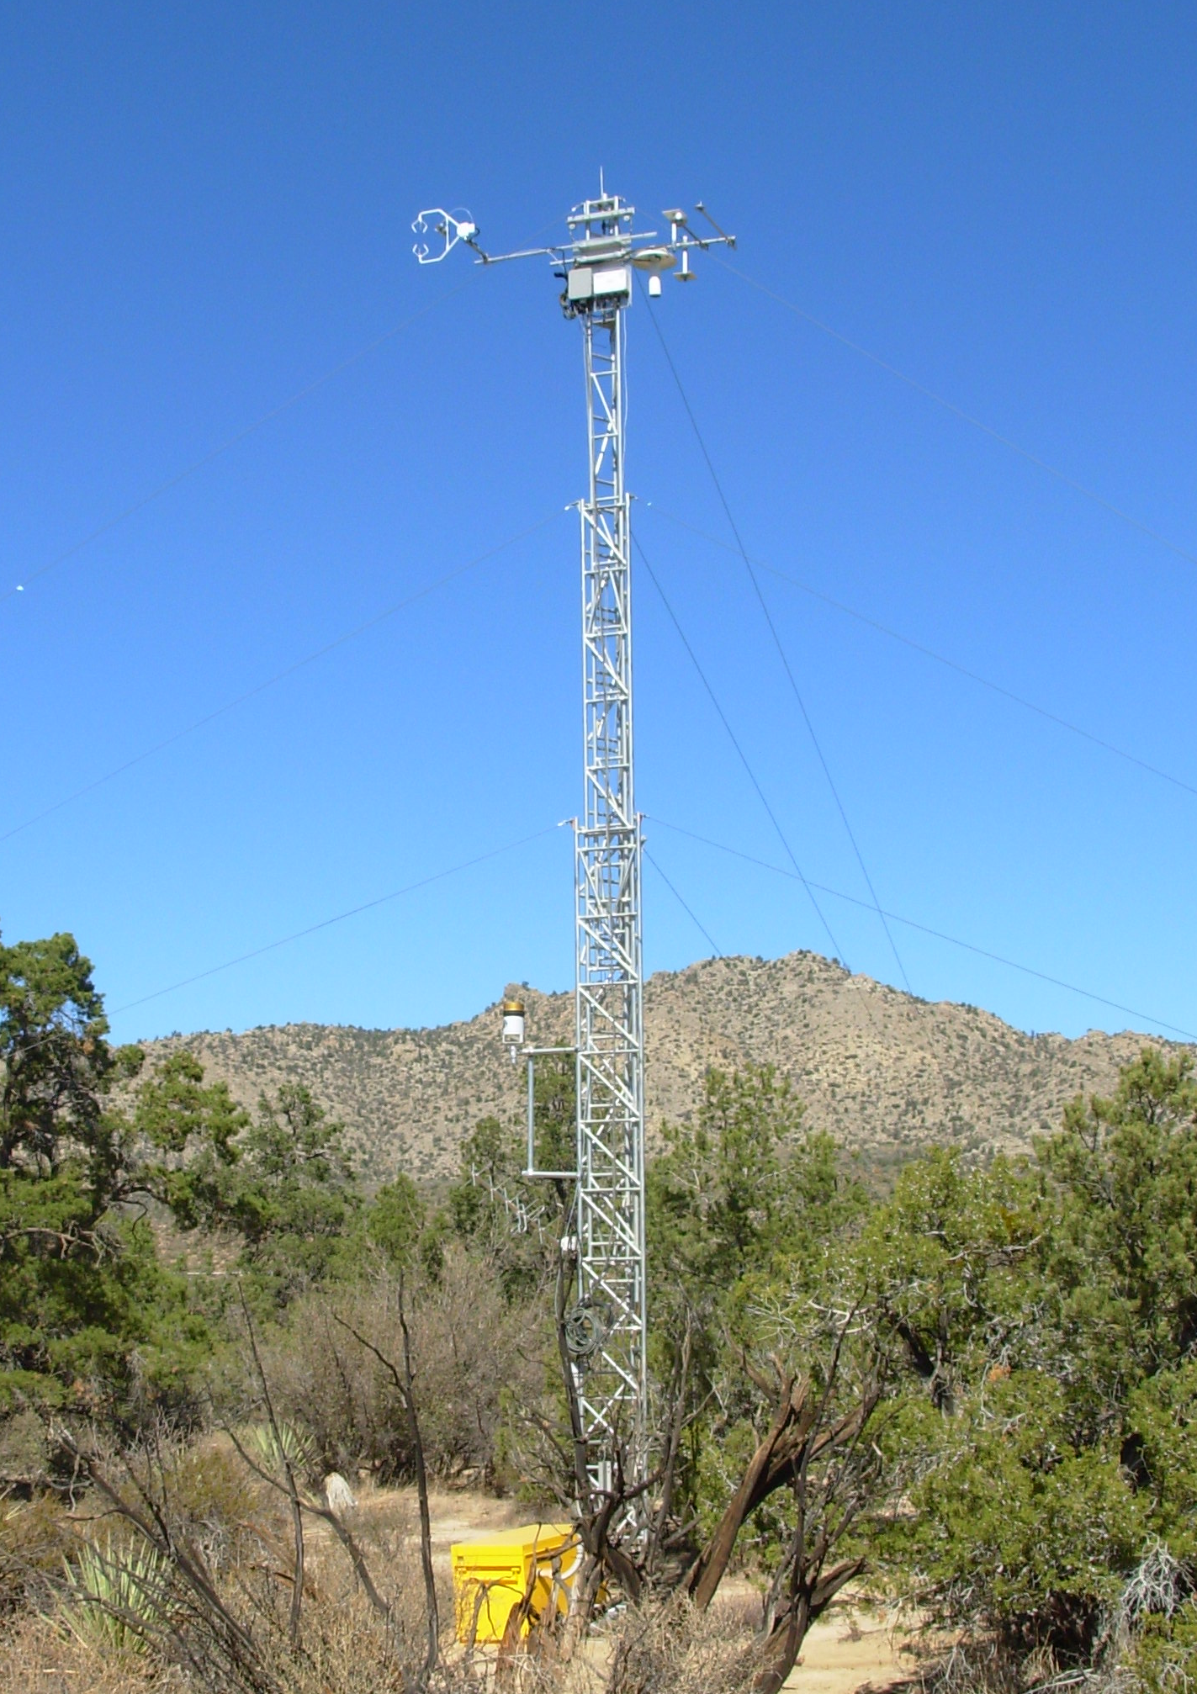
We have an idea about the CO₂ fluxes at the local and global scales, but what about in between?
Ocean
Land
Atmosphere
?
Human
emissions
Regional scale fluxes
Local scale observations
[AmeriFlux]
Global constraint on exchanges
Notes:
Understand something, usually start from obs
Problematic: obs small area
Other side of spectrum, global
CO2 in atmosphere generally well-mixed
How do ecosystems respond to e.g. climate disturbance – need ecosystem scale fluxes
Measure CO2 content, keep track of emissions, measure ocean fluxes -> derive land fluxes

Slide 4
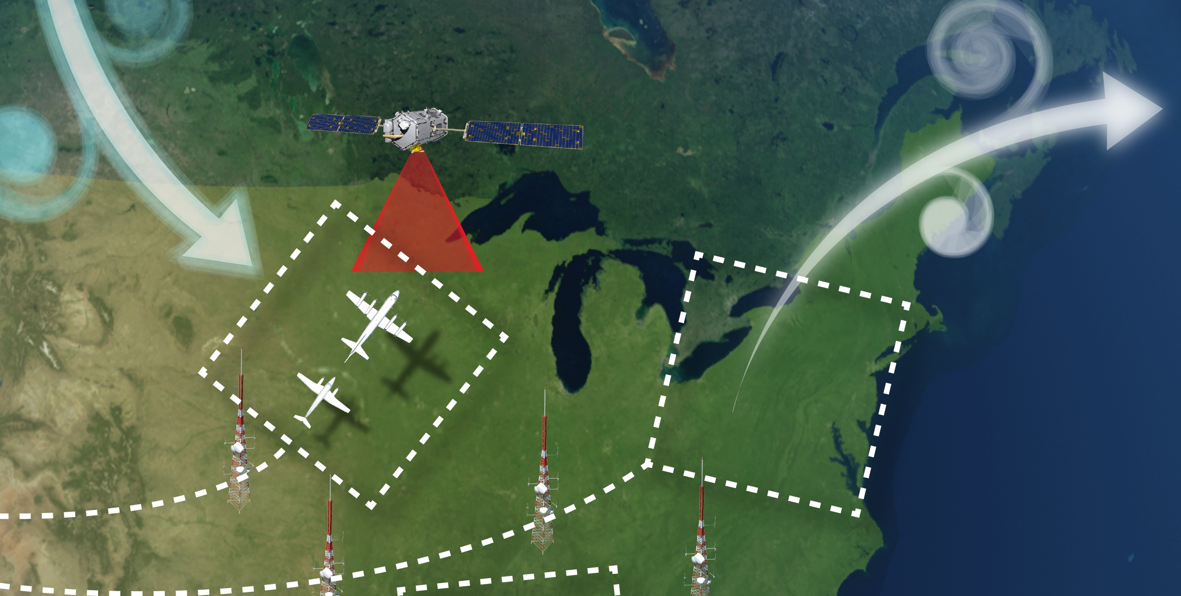
With more observations, there is hope to constrain CO₂ fluxes at the regional scale
[Tim Marvel, NASA Langley]
Notes:
There is hope; getting better picture of CO2 concentration in the atmosphere
Thanks to observations in the form of e.g. …
Know concentration well -> deduct fluxes
Herein also lies new challanges: transport
How to combine all this information and their uncertainties to estimate fluxes?

Slide 5
With more observations, there is hope to constrain CO₂ fluxes at the regional scale
Goals
Develop a regional ensemble-based data assimilation system and quantify the impact of atmospheric transport error on the estimated CO₂ fluxes and their uncertainties
[Tim Marvel, NASA Langley]
Notes:
Data assimilation!
Focus on the role of transport error

Slide 6
Parameter estimation in the Ensemble Kalman Filter framework
Wind
Truth
Notes:
Simple explanation of how the system works

Slide 7
Parameter estimation in the Ensemble Kalman Filter framework
Wind
Truth

Slide 8
Parameter estimation in the Ensemble Kalman Filter framework
Wind
Truth
Ensemble members

Slide 9
Parameter estimation in the Ensemble Kalman Filter framework
Wind
Truth
Ensemble members

Slide 10
Parameter estimation in the Ensemble Kalman Filter framework
Wind
Truth
Ensemble members
+
Observation

Slide 11
Parameter estimation in the Ensemble Kalman Filter framework
Wind
Truth
Ensemble members
+
Observation
Estimated

Slide 12
CO₂ fluxes are estimated by ecosystems in our system

Slide 13
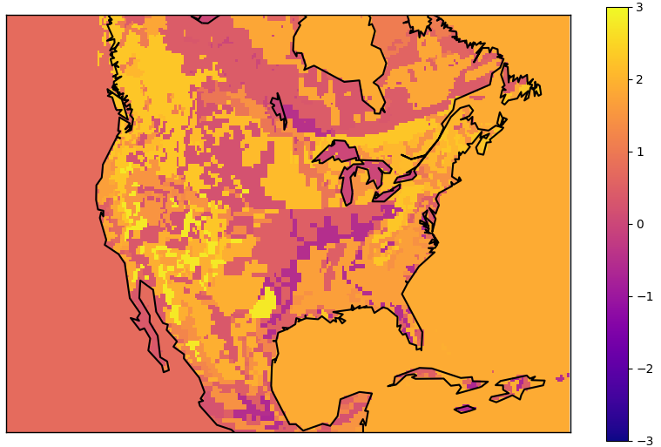
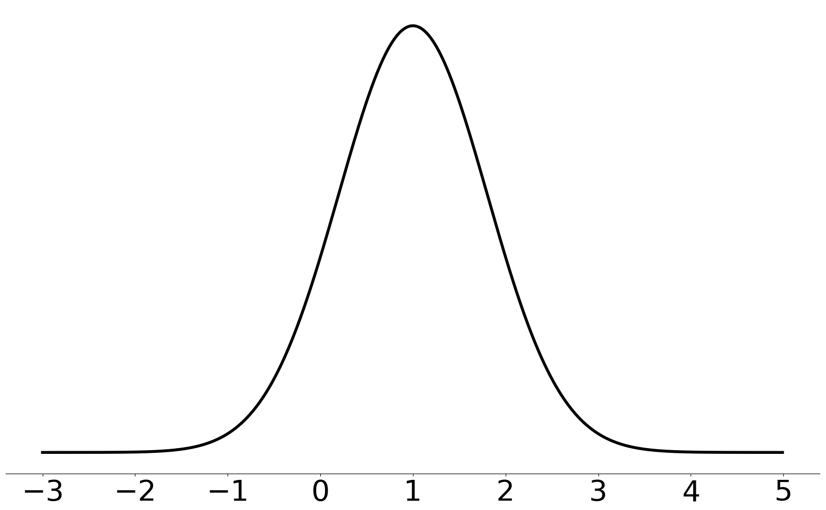
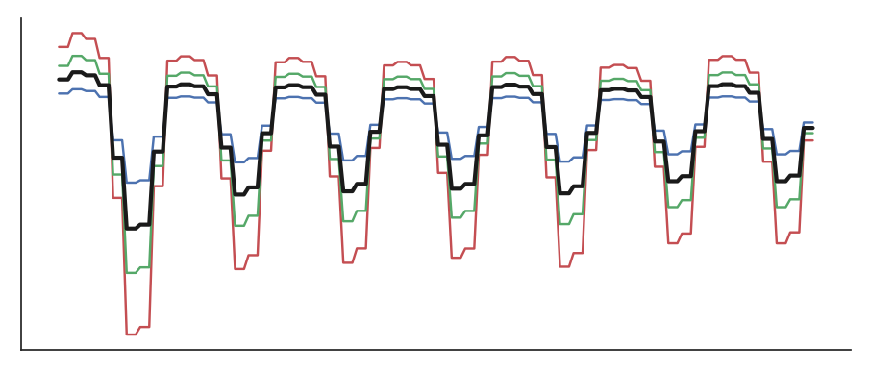


The prior fluxes were scaled by a scaling parameter λ for each ecosystem
$$Flux(x,y,t)=λ(x,y)⋅Flux_{prior}(x,y,t)$$
λ
$$λ(ecosystem)∼N(1, 0.8)$$
Flux
Transport model: WRF-Chem
Run at 27 km horizontal resolution
Time

Slide 14
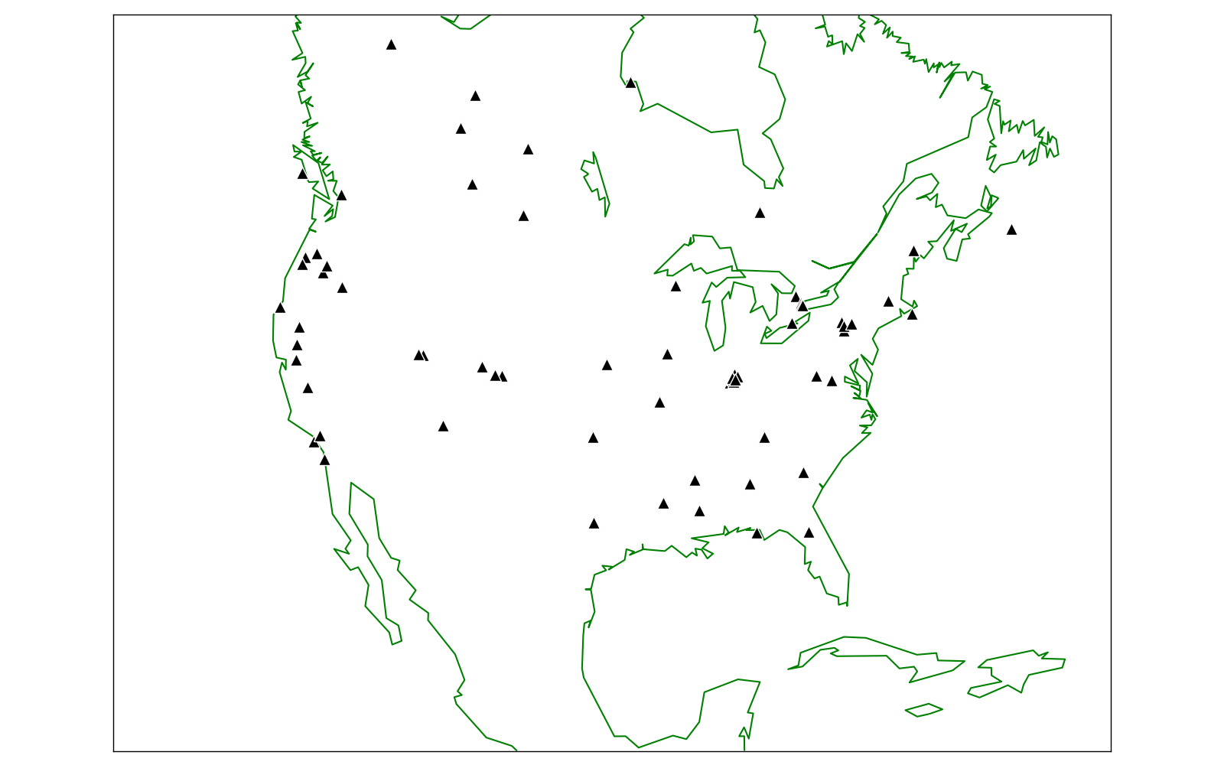
Simulated CO₂ concentration tower observations were assimilated

Slide 15
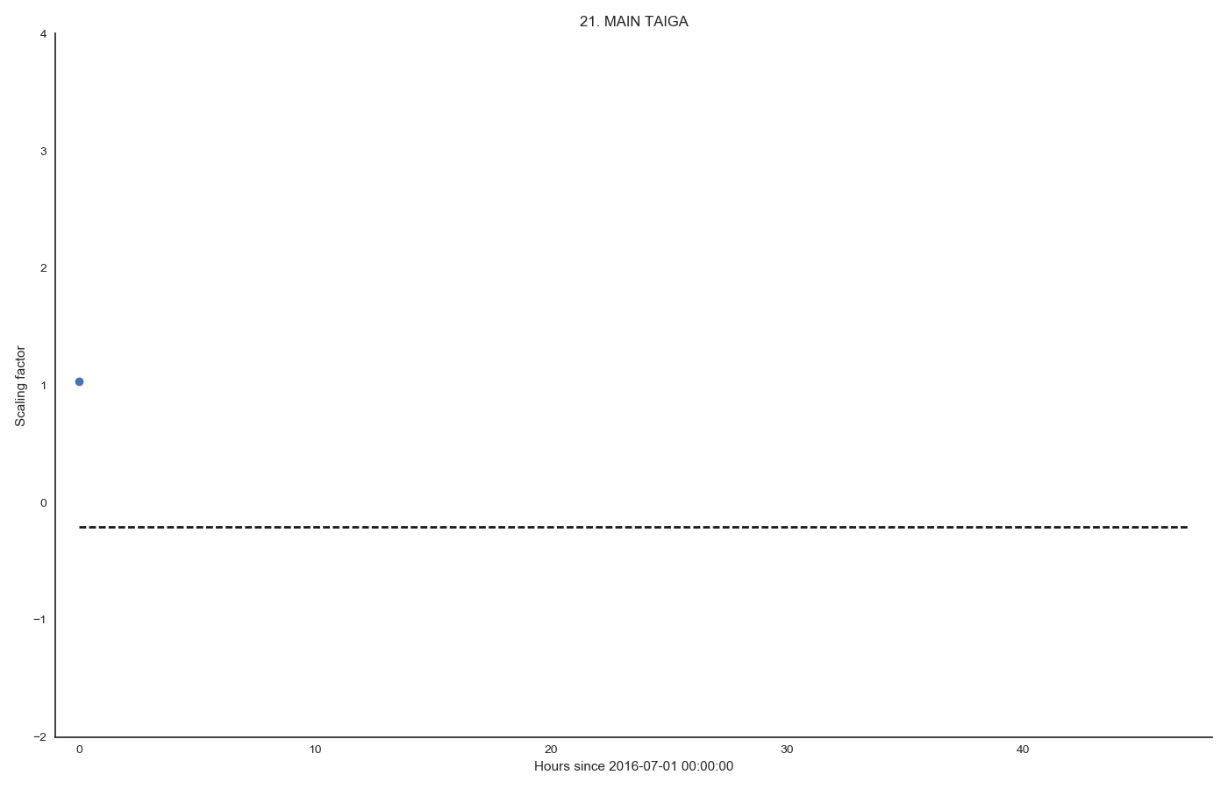
First guess
Truth

Slide 16
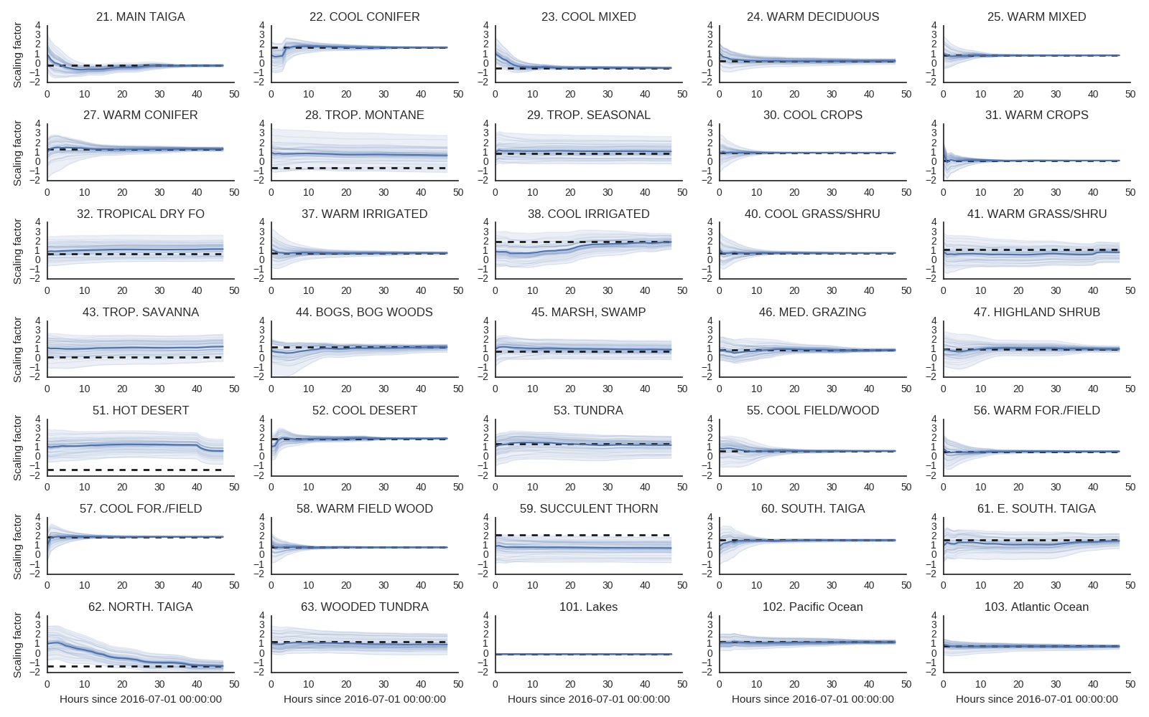

Slide 17
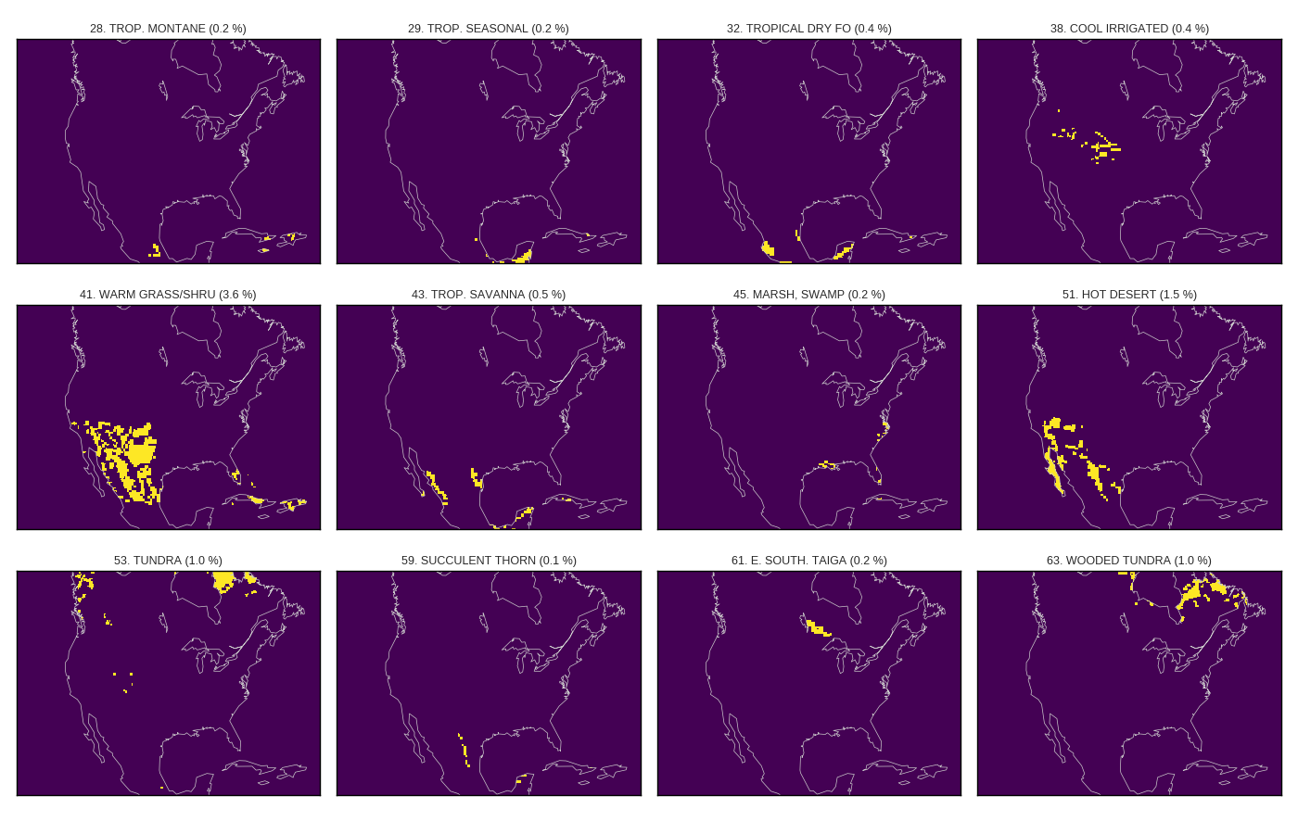
Ecosystems where the fluxes are relatively unconstrained

Slide 18
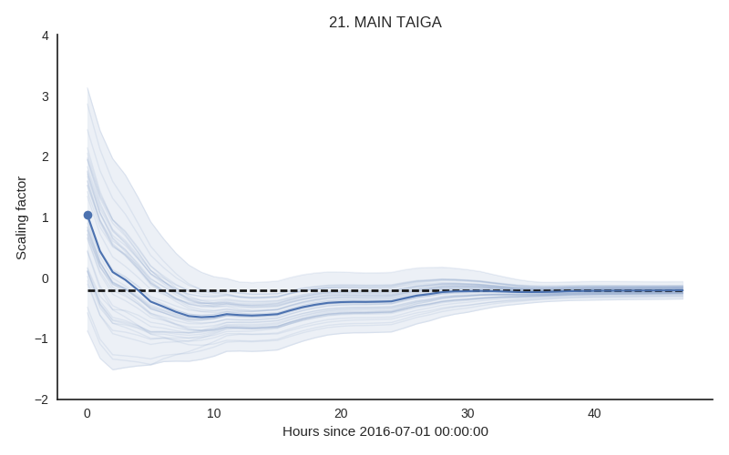
Summary
Our ensemble-based data assimilation system can assimilate CO₂ concentration to estimate CO₂ fluxes at the regional scale
Most ecosystem CO₂ fluxes are well constrained in our idealized experiment

Slide 19
Extra

Slide 20
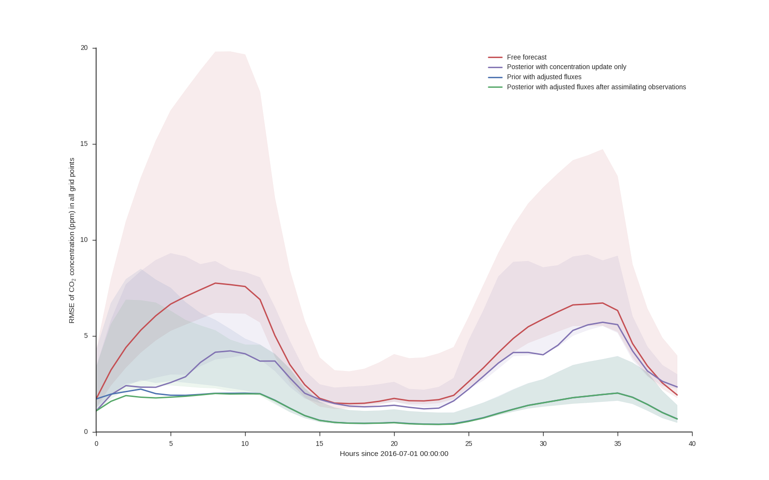

Slide 21
References
Stocker, T.F., D. Qin, G.-K. Plattner, L.V. Alexander, S.K. Allen, N.L. Bindoff, F.-M. Bréon, J.A. Church, U. Cubasch, S. Emori, P. Forster, P. Friedlingstein, N. Gillett, J.M. Gregory, D.L. Hartmann, E. Jansen, B. Kirtman, R. Knutti, K. Krishna Kumar, P. Lemke, J. Marotzke, V. Masson-Delmotte, G.A. Meehl, I.I. Mokhov, S. Piao, V. Ramaswamy, D. Randall, M. Rhein, M. Rojas, C. Sabine, D. Shindell, L.D. Talley, D.G. Vaughan and S.-P. Xie, 2013: Technical Summary. In: Climate Change 2013: The Physical Science Basis. Contribution of Working Group I to the Fifth Assessment Report of the Intergovernmental Panel on Climate Change [Stocker, T.F., D. Qin, G.-K. Plattner, M. Tignor, S.K. Allen, J. Boschung, A. Nauels, Y. Xia, V. Bex and P.M. Midgley (eds.)]. Cambridge University Press, Cambridge, United Kingdom and New York, NY, USA.

