Slide 1
Uncertainties in the Prediction of Super Typhoon Nepartak
Tonghua Su^{1,2} Fuqing Zhang²
August 17, 2017
1. Fujian Meteorological Observatory,
China Meteorological Administration
2. Department of Meteorology and Atmospheric Science,
Center for Advanced Data Assimilation and Predictability Techniques, Pennsylvania State University

Slide 2

Outline
Overview of Super Typhoon Nepartak
A big spread in the tracks before 00UTC 05 July 2016
Impact of zonal wind on the track spread
Summary
Notes:
2

Slide 3
Climatic Background: The strongest El Niño since 1997
Comparable to 1997-1998 El Niño
2015-16
1997-98
Strong
WPSH
especially
in June
and July

Slide 4
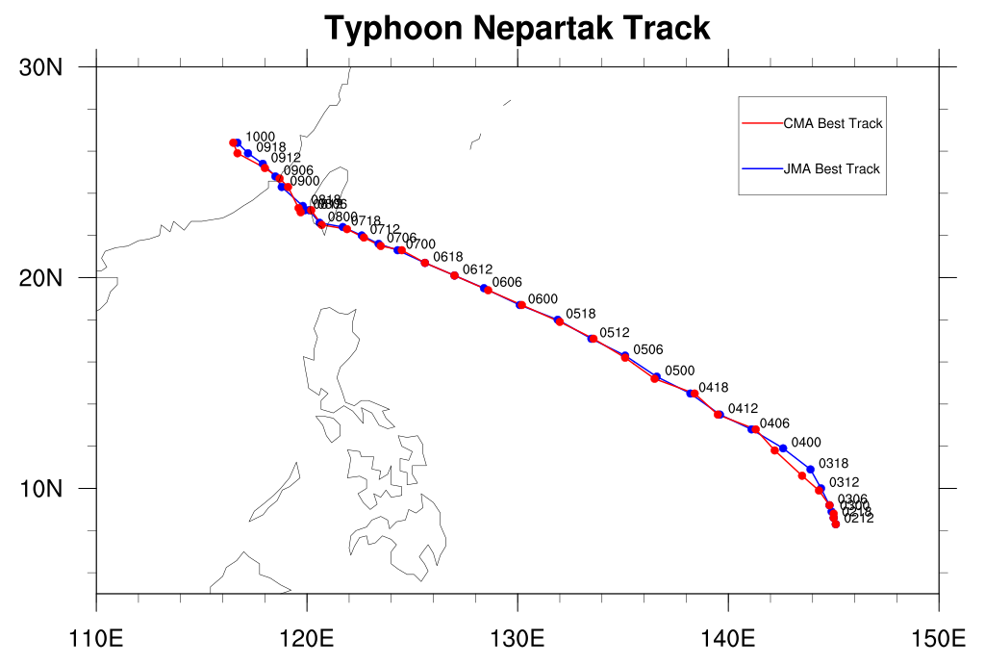
Nepartak Best Tracks from CMA and JMA
STS made landfall in middle costal Fujian
at 0906 UTC
83 deaths, 19 missing
$ 1.5B economic loss
Super TY made landfall in southern Taiwan
at 0722 UTC
3 deaths, 142 injuries

Slide 5
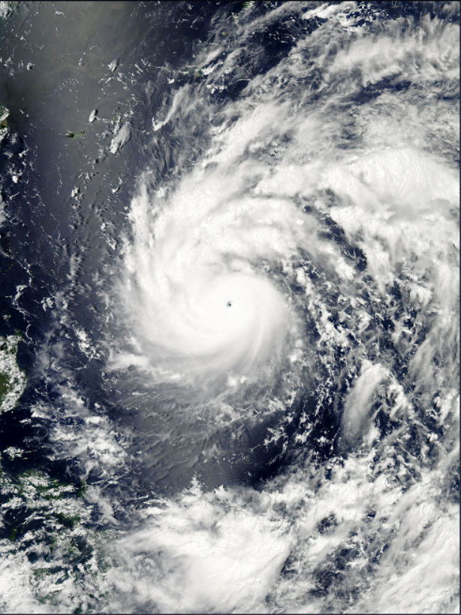
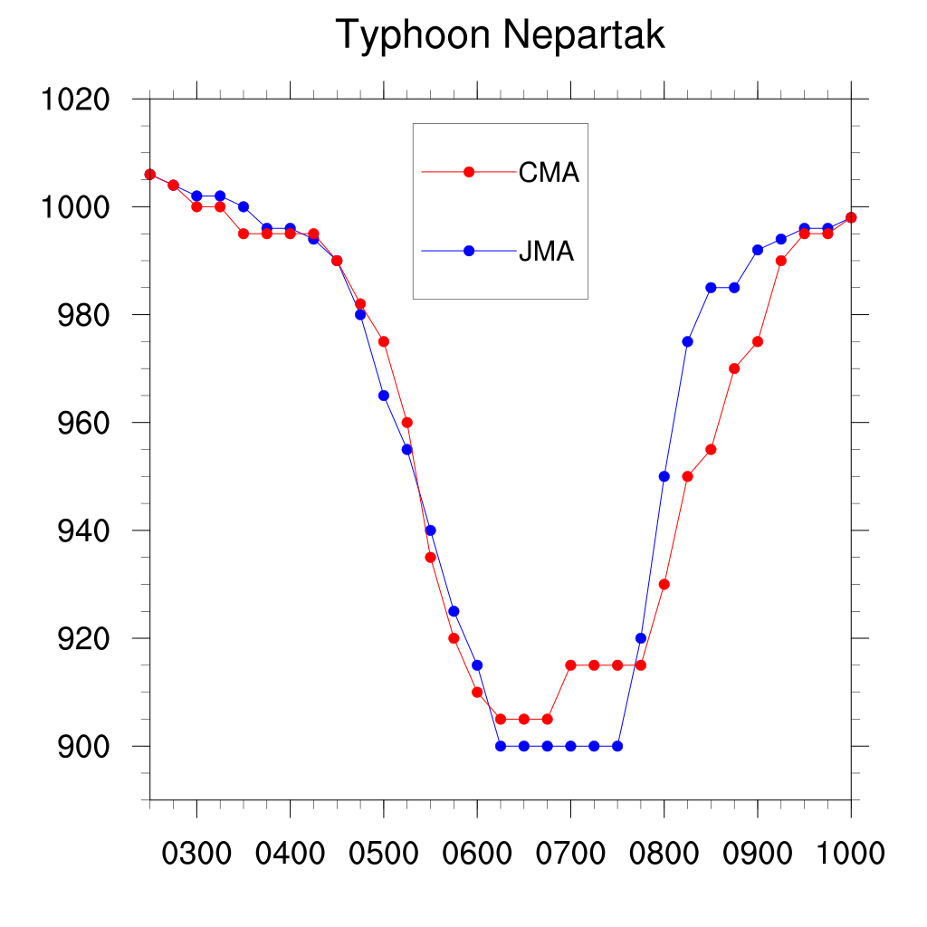
07060450 UTC
Nepartak Intensities from CMA and JMA
0300
0406
Lowest SLPmin:
CMA ≥ JMA
0606
0712

Slide 6
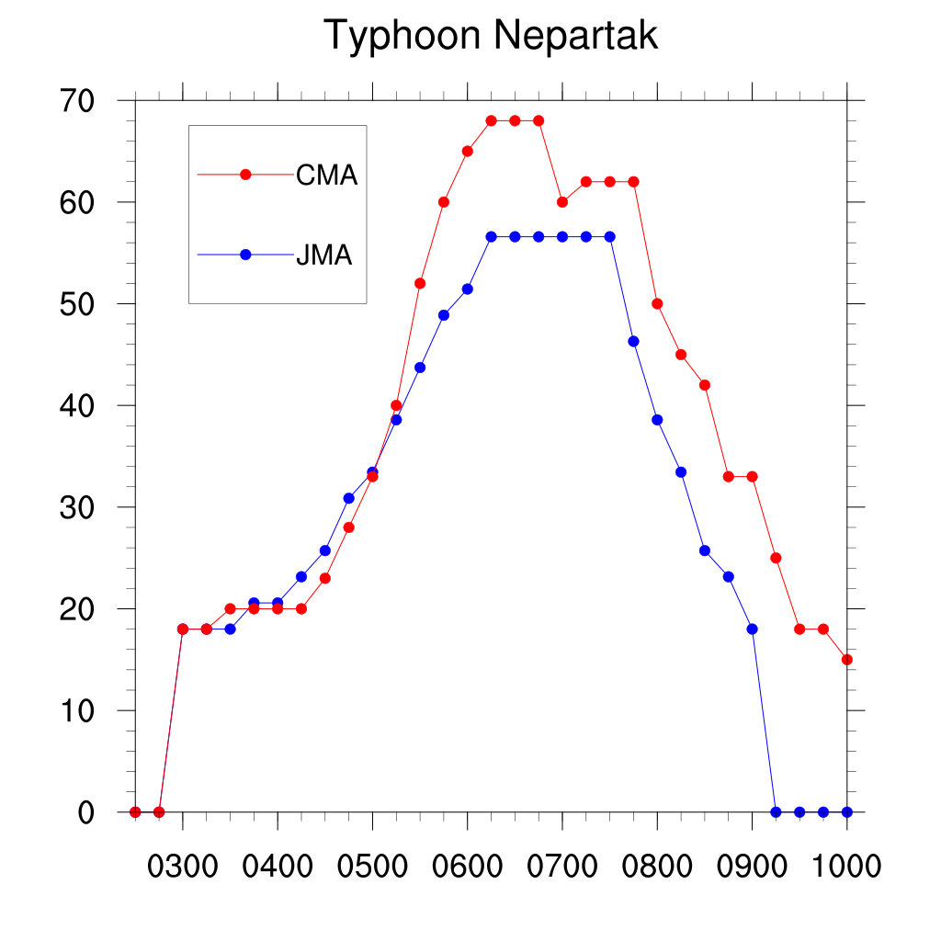
Maximum Wind of Nepartak from CMA and JMA
Strongest Vmax:
CMA ≥ JMA
0521
△Vmax=35 m/s = 68 kt
△SLPmin=70 hPa
(0421-0521, CMA)
0421

Slide 7
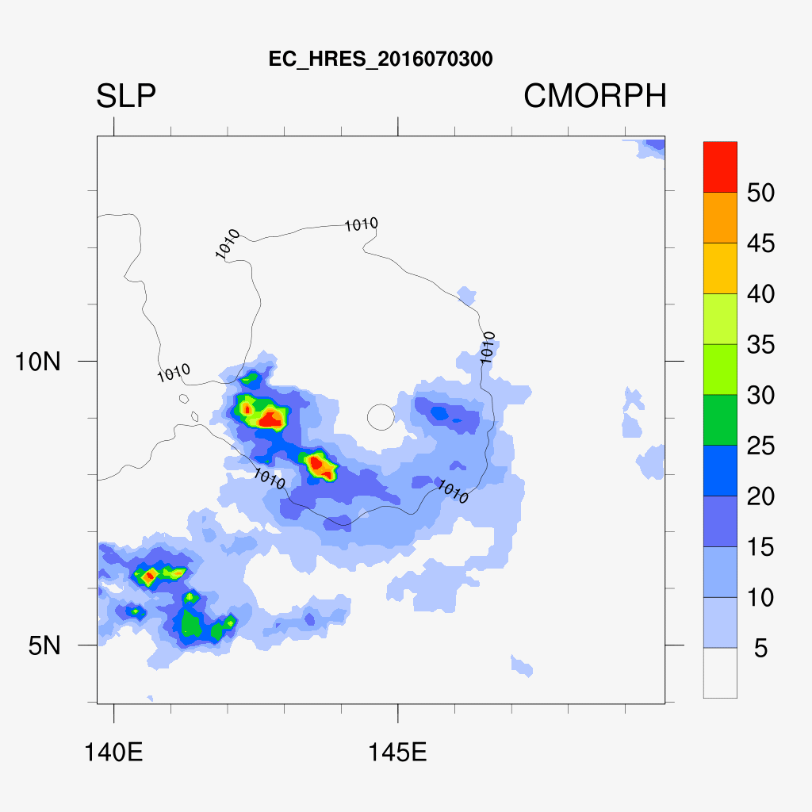

Slide 8
Outline
Overview of Super Typhoon Nepartak
A big spread in the tracks before 00UTC 05 July 2016
Impact of zonal wind on the track spread
Summary
Notes:
8

Slide 9
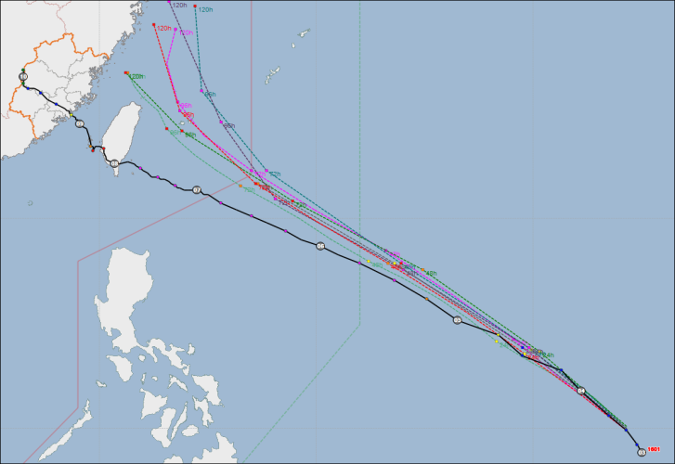
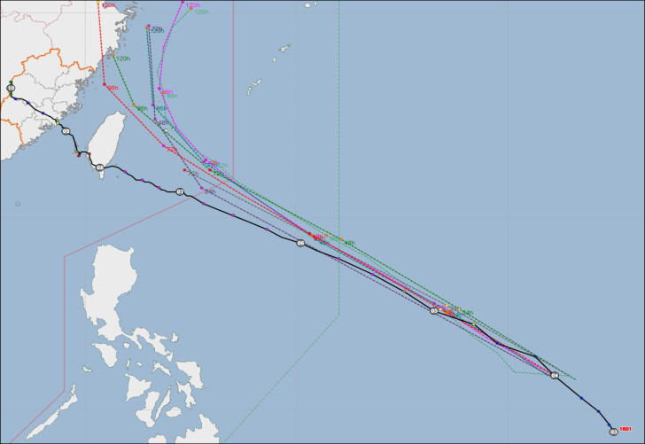
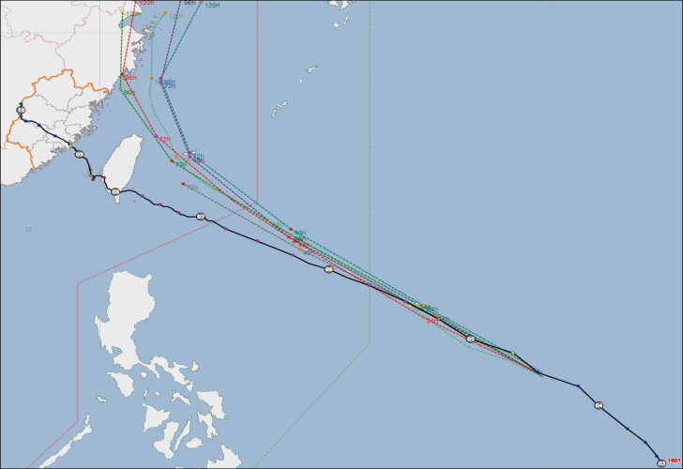
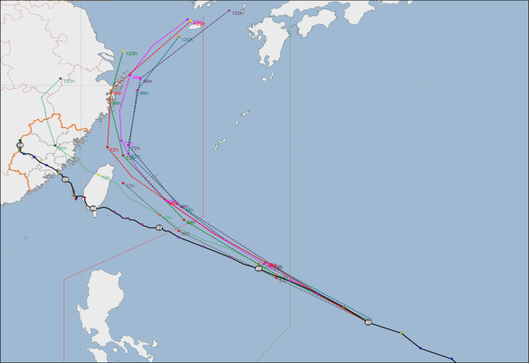
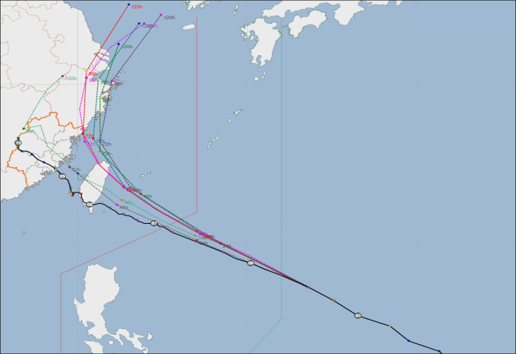
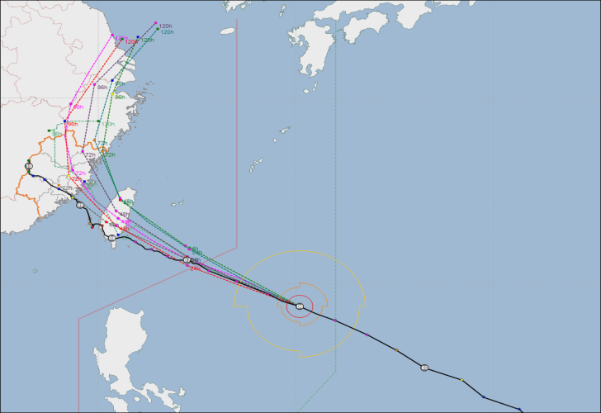
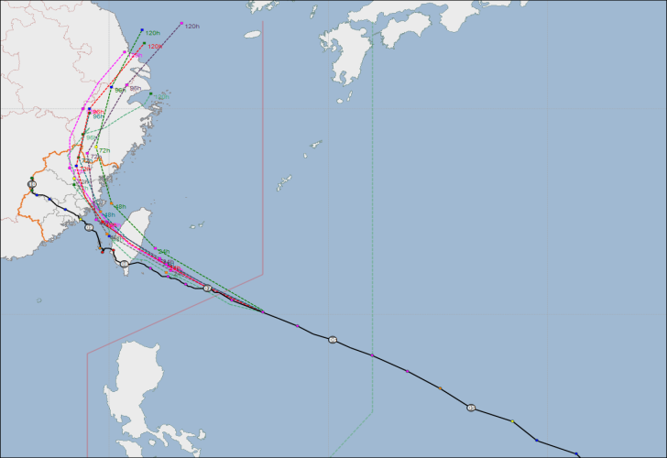
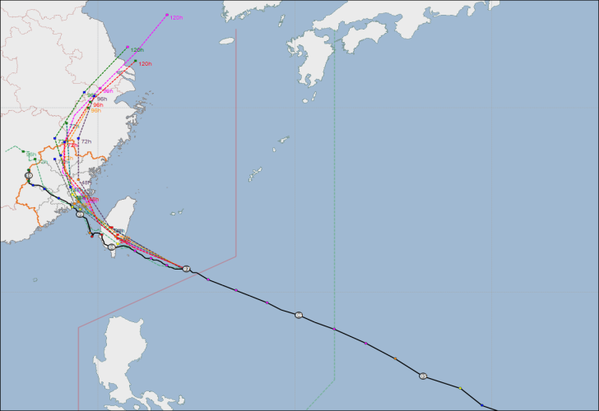
Official guidance tracks of Nepartak
0312
0400
0412
0500
0512
0600
0612
0700
CMA JMA CWB
JTWC KMA ECMF
FJOP OBS

Slide 10
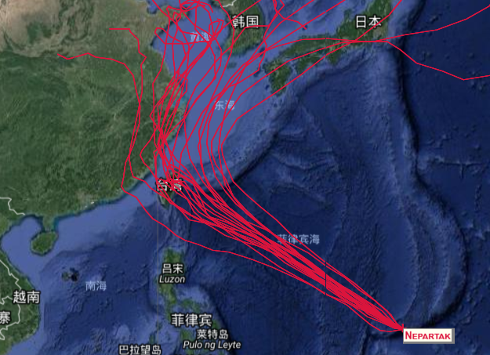
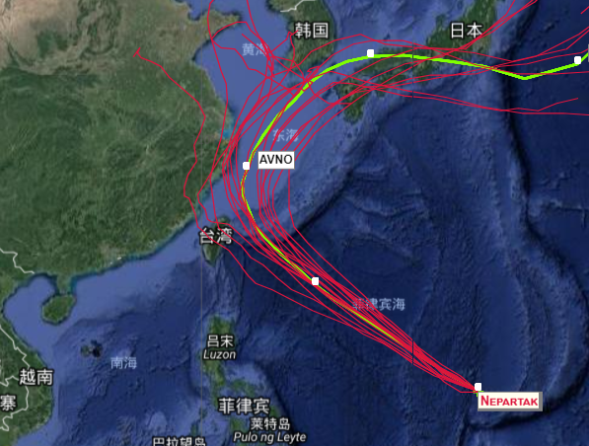
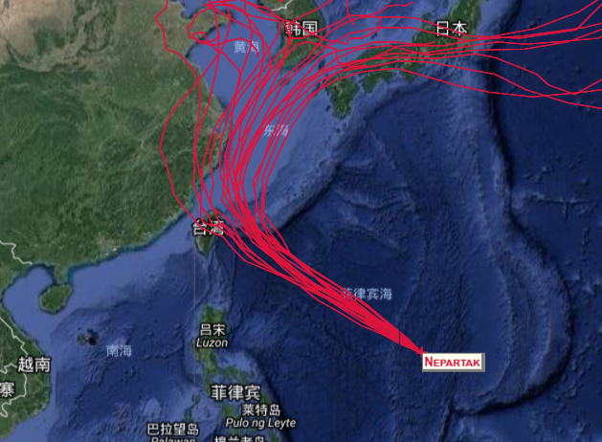
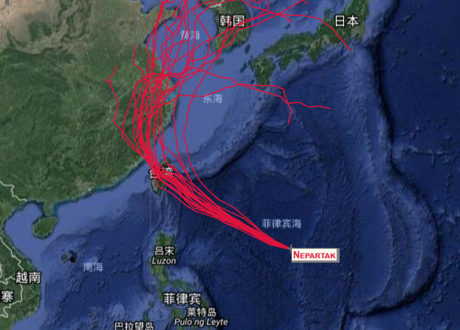
Ensemble Tracks: GEFS(21)
0400
0412
0500
0512

Slide 11
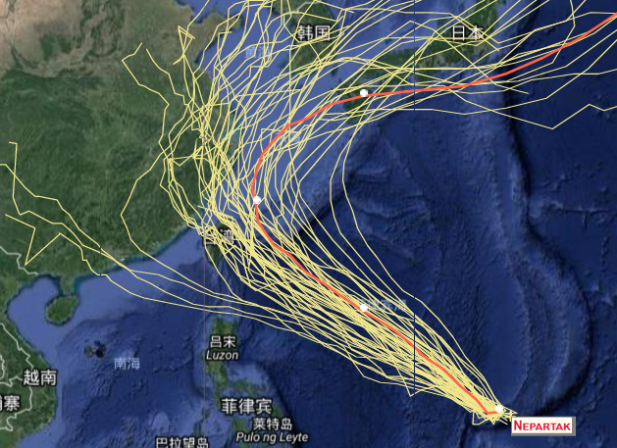
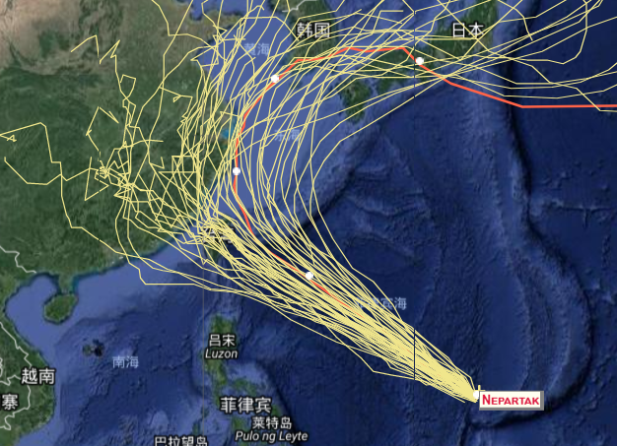
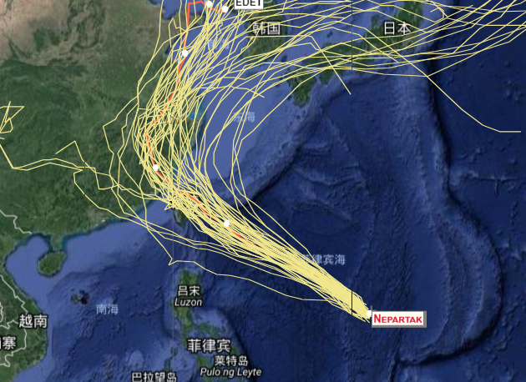
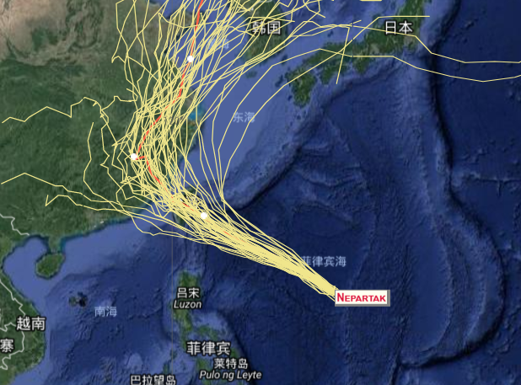
Ensemble Tracks: ECMWF(51)
0400
0412
0500
0512

Slide 12
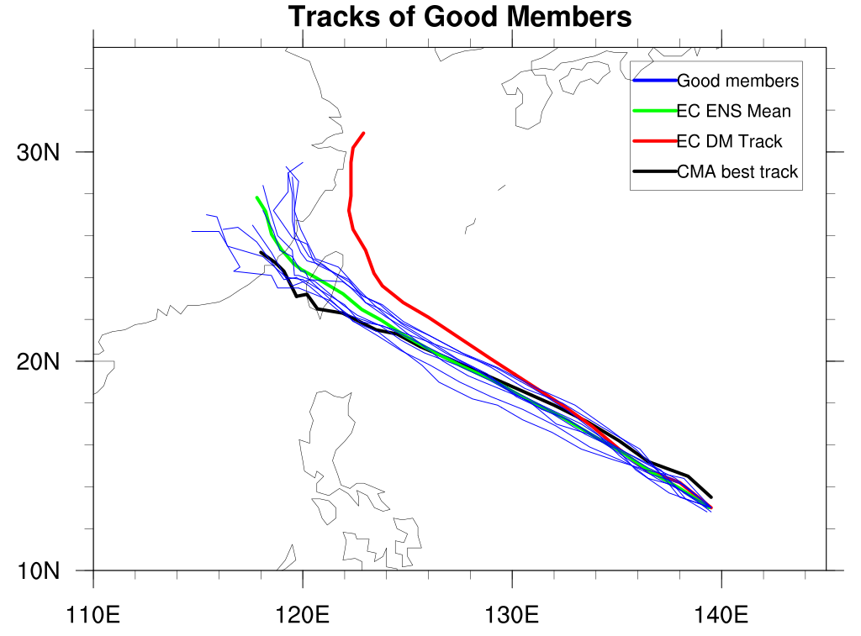
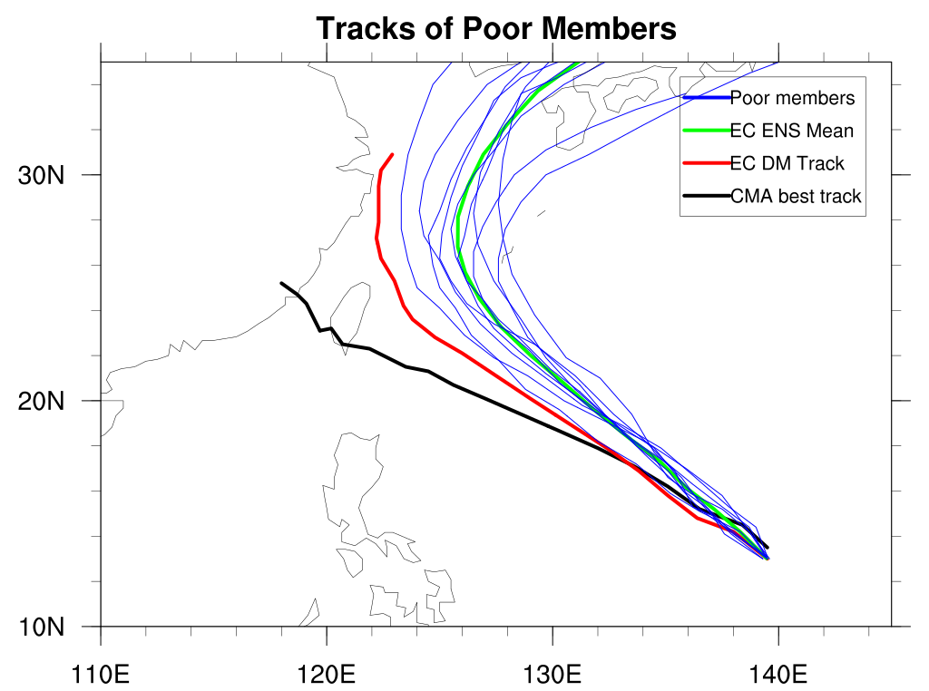
Tracks of good and poor members
0412
Along the west-northwest path, making landfall in Taiwan, and then Fujian?
Or out to Japan?

Slide 13
Outline
Overview of Super Typhoon Nepartak
A big spread in the tracks before 00UTC 05 July 2016
Impact of zonal wind on the track spread
Summary
Notes:
13

Slide 14
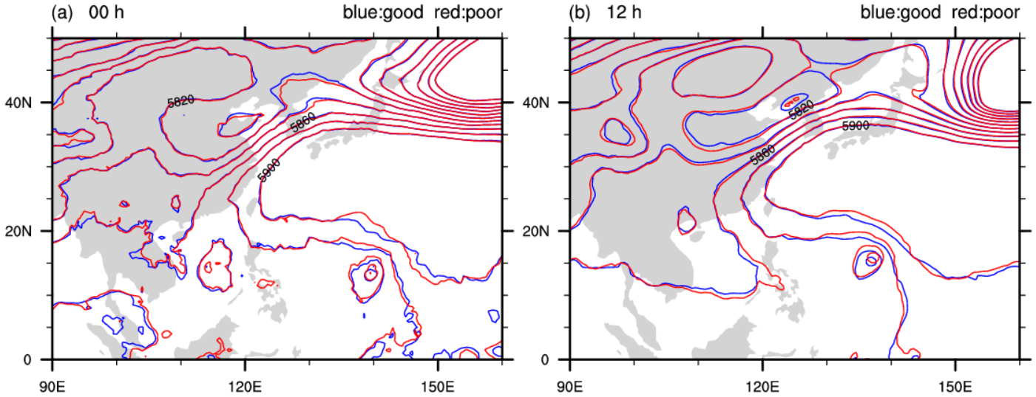
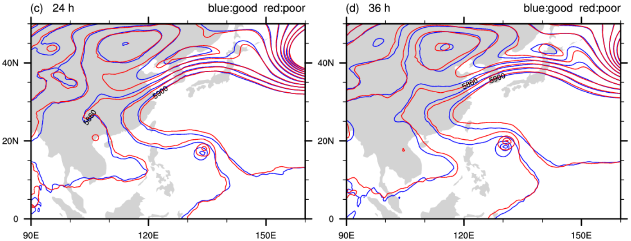
500 hPa

Slide 15
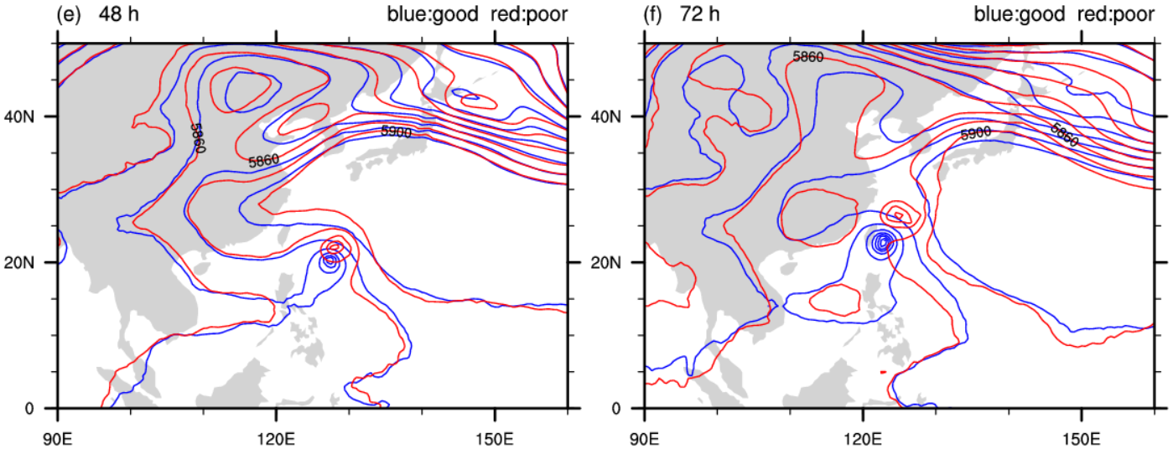
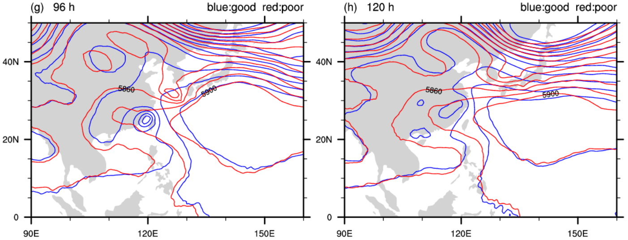
500 hPa

Slide 16
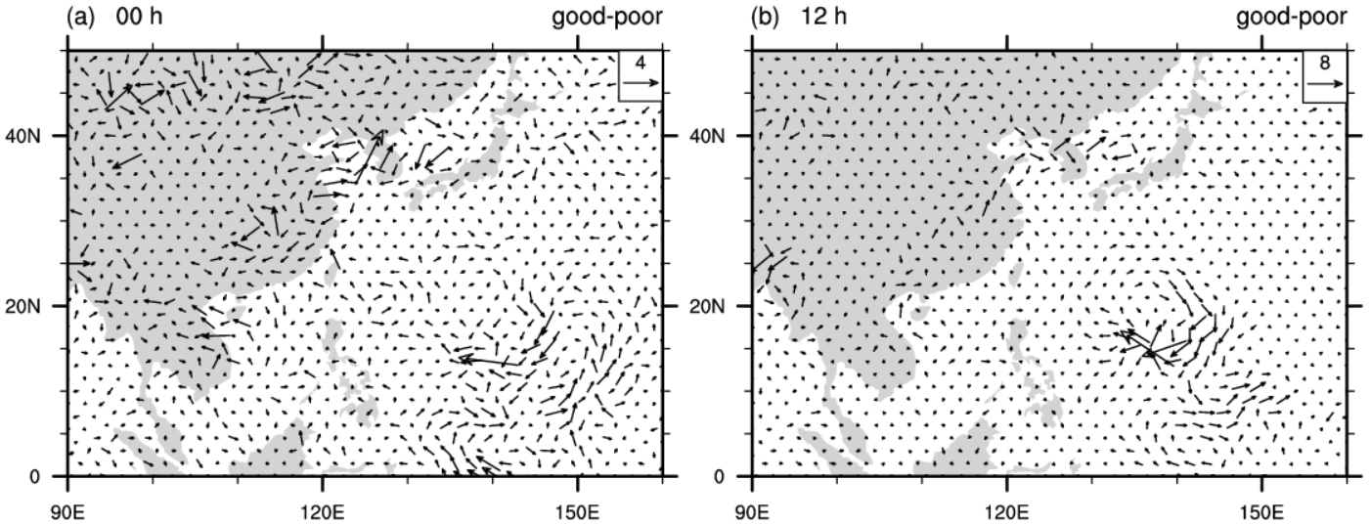
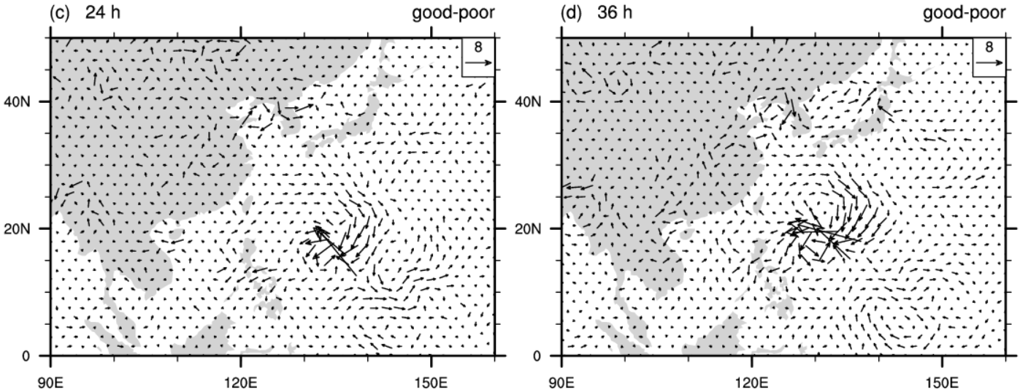
850 hPa

Slide 17
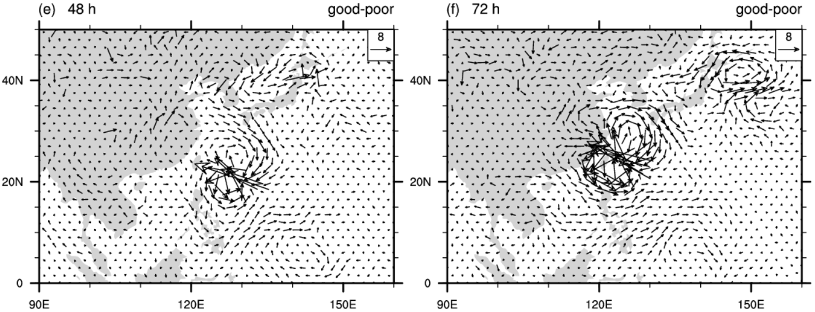
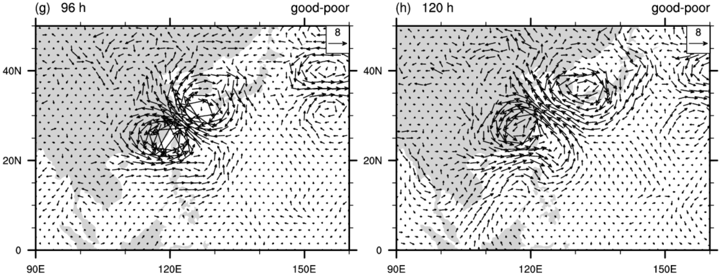
850 hPa

Slide 18
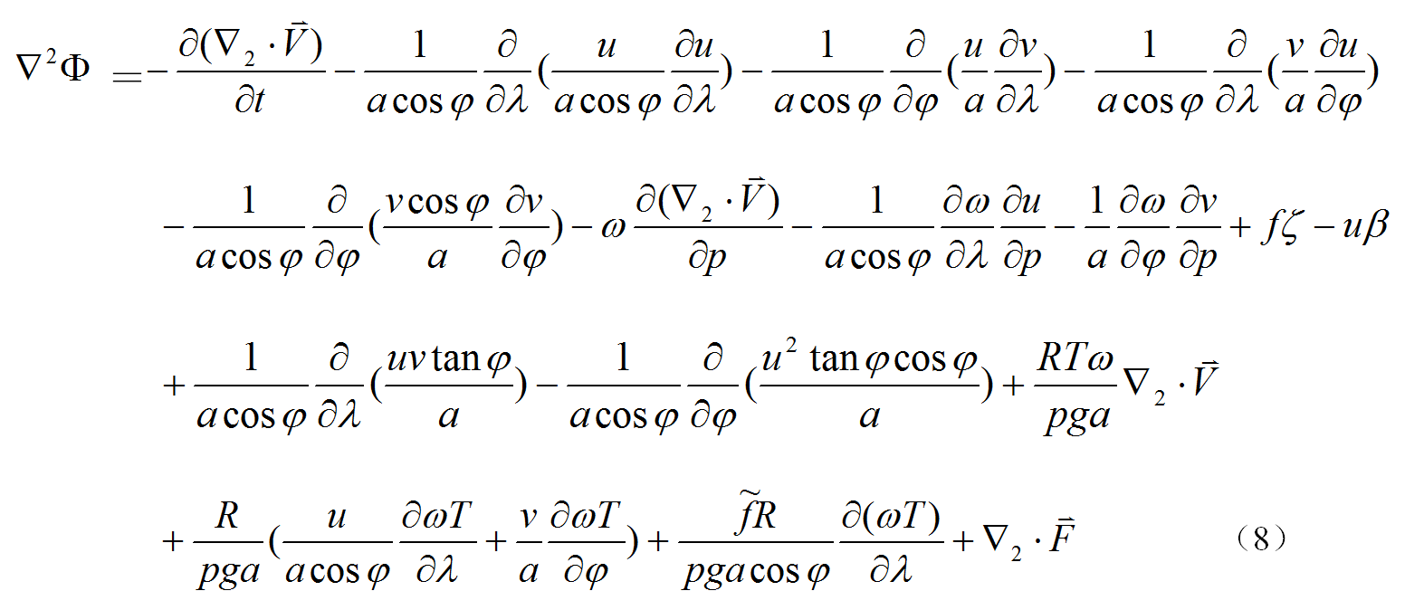
Linear geopotential diagnostic equation
The poisson equation of geopotential:
geostropic terms
（Yuan et al.，2008，QJRMS; Su et al., 2017）

Slide 19
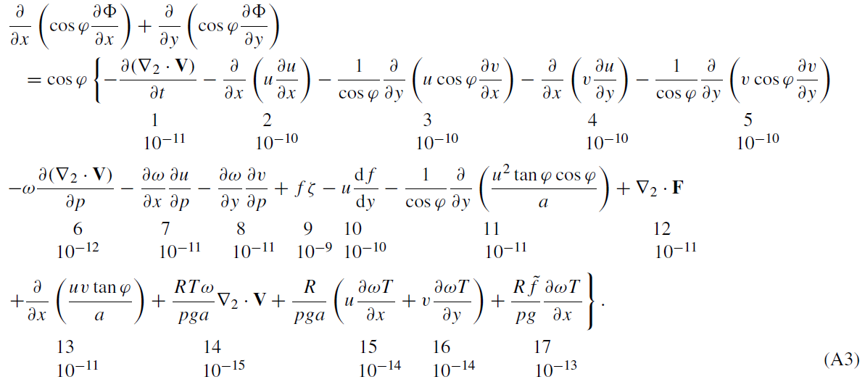
Linear geopotential diagnostic equation
（Yuan et al.，2008，QJRMS; Su et al., 2017）

Slide 20
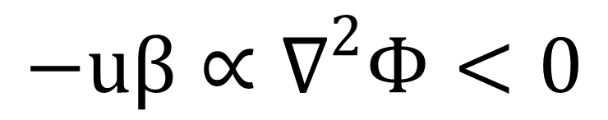
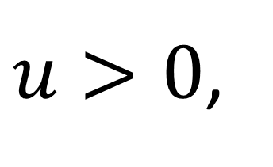
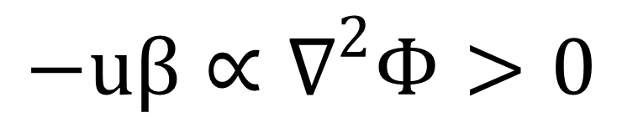
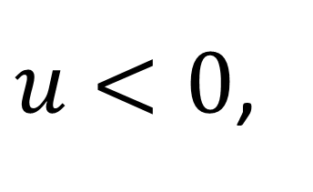
Impact of zonal wind on the track spread
Under the background of westerly wind:
$u>0$,
$$−uβ∝∇^{2}Φ<0$$
in favor of stronger WPSH
Under the background of easterly wind:
$u<0$,
$$−uβ∝∇^{2}Φ>0$$
in favor of weaker WPSH
WPSH: western Pacific subtropical high

Slide 21
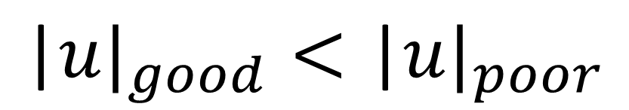
Impact of zonal wind on the track spread
Therefore, under the background of easterly wind:
$${\text{|}u|}_{good}<{\text{|}u|}_{poor}$$
It is more favorable for poor members to move northward, even northeastward through a positive feedback.

Slide 22
A simple conceptual diagram
Forecast time
β effect
Stronger
easterly wind
Lower GPH
Weaker WPSH
Positive
feedback
Initial time
Northward displacement
of TC

Slide 23
Summary
Even under the influence of the strong WPSH, big uncertainties in the prediction of the first typhoon in 2016 – Nepartak still exist at the early stage of its life span.
Through a comparison of good members and poor members of ECMWF ensemble forecast, it is found that a tiny difference in the southern part of WPSH will result in a huge spread in the ensemble tracks through a positive feedback between TC and WPSH

Slide 24

Thank you!
  Fujian Meteorological Observatory

Slide 25
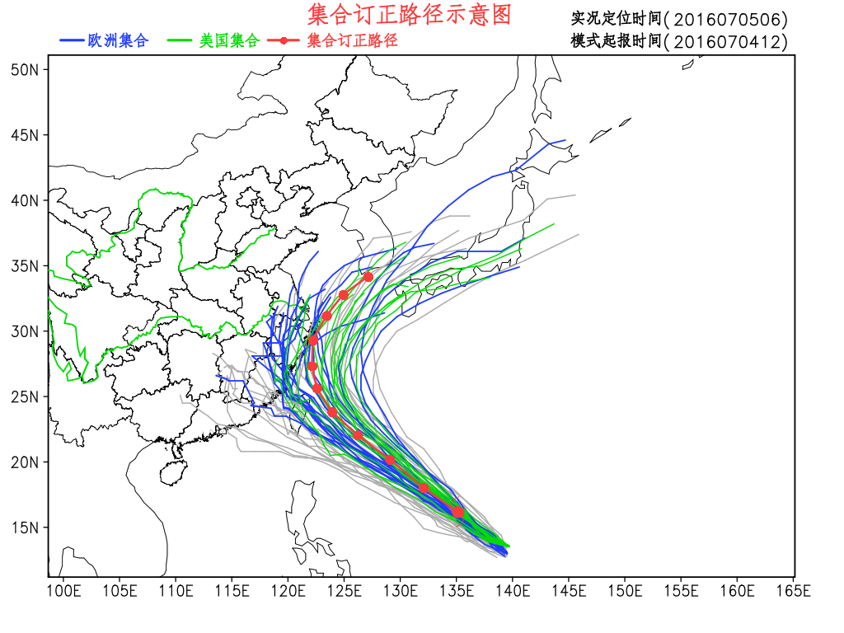
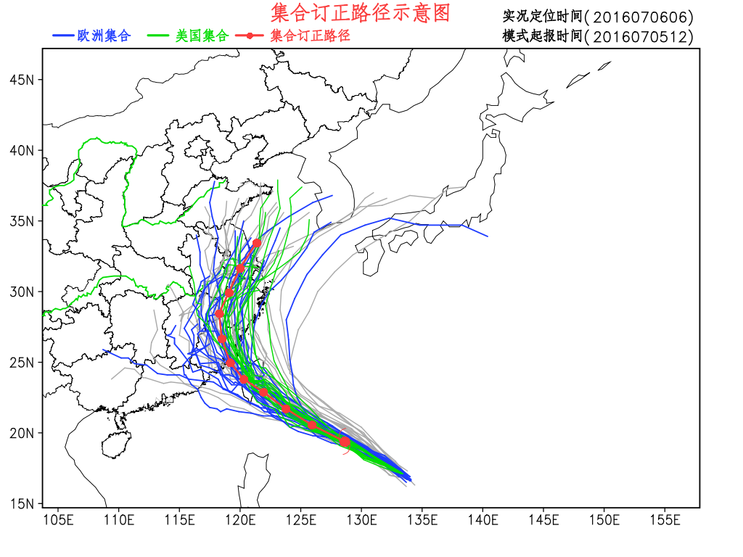
Ensemble Tracks
070412
070512

Slide 26
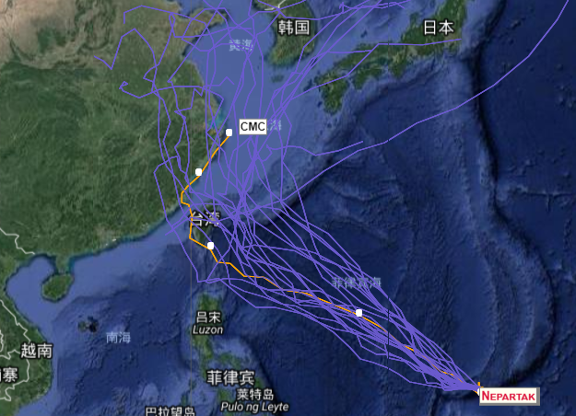
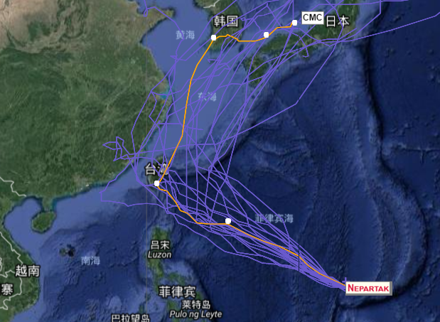
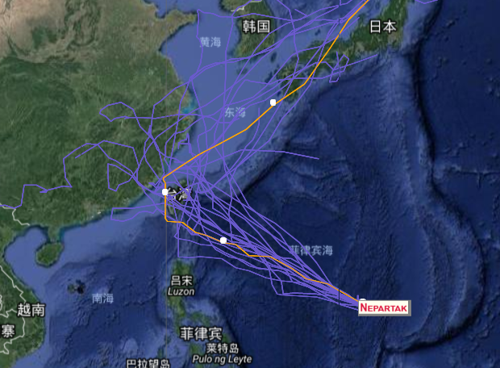
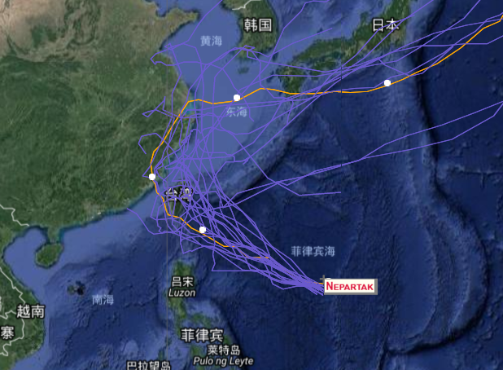
Ensemble Tracks: CMC(21)
0400
0412
0500
0512

Slide 27
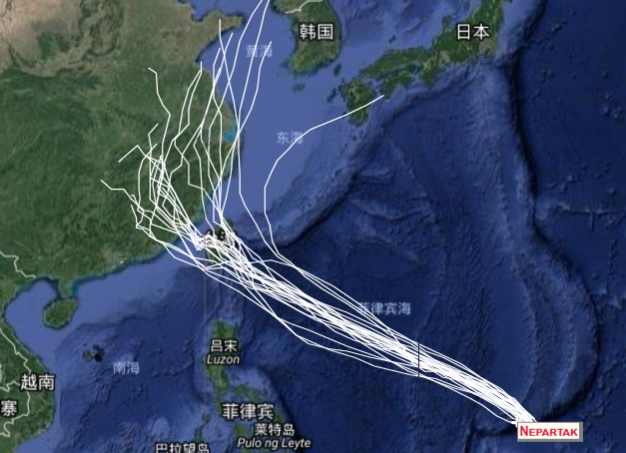
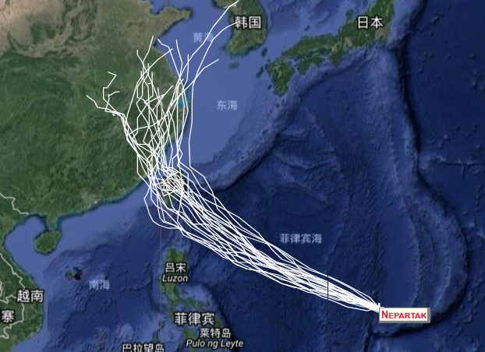
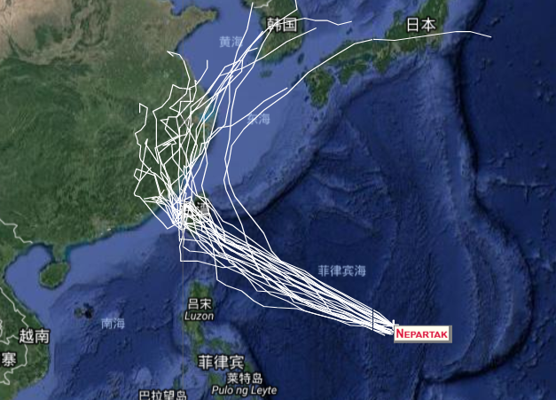
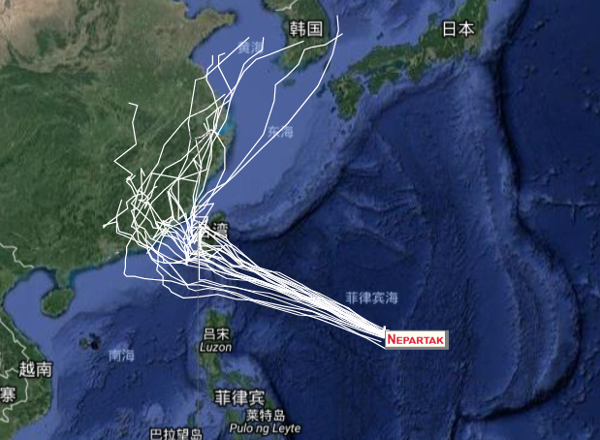
Ensemble Tracks: UKMO(24)
0400
0412
0500
0512

Slide 28
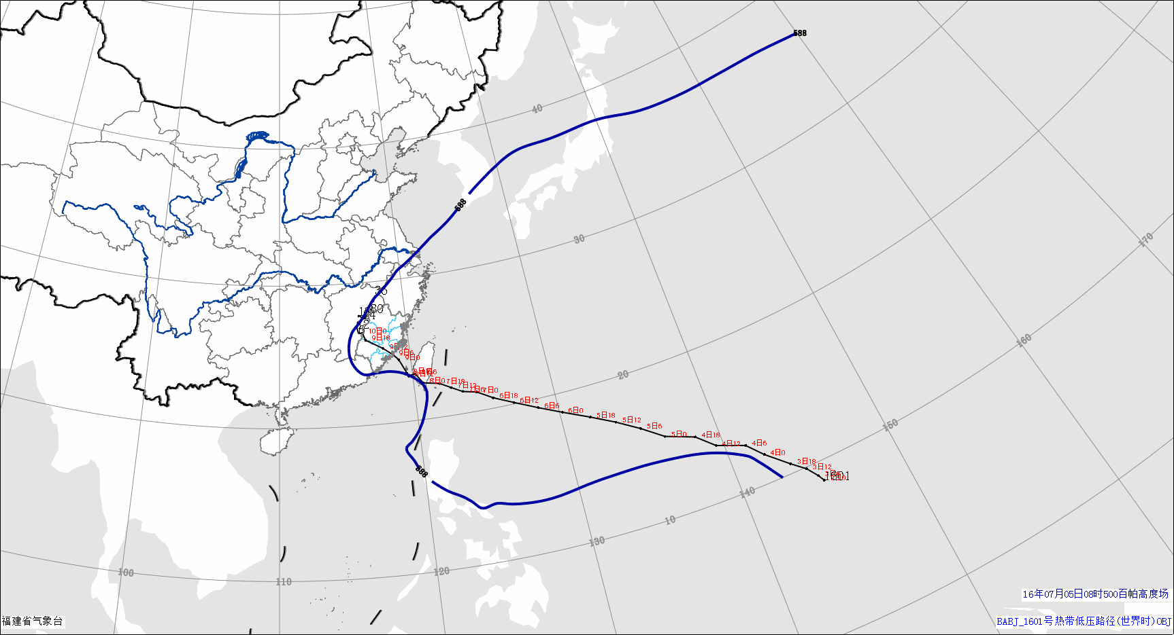
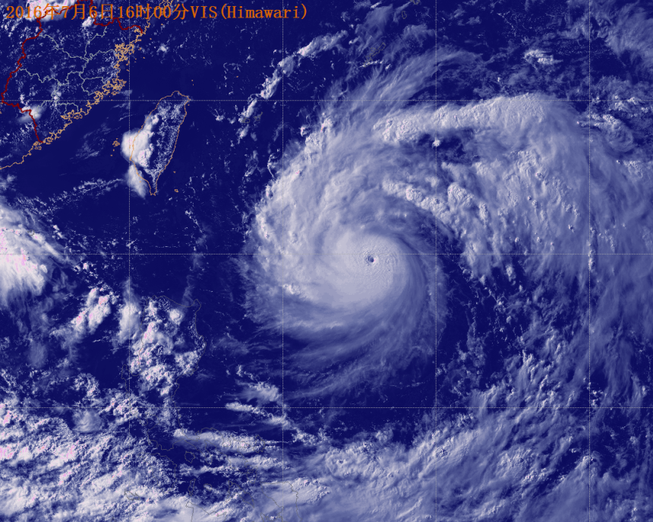

7日
6日
5日
WPSH intensified gradually
Notes:
在“莫拉克”形成初期，副高加强西伸，副高边缘西南气流是主要引导气流，“莫拉克”在其引导下向西北方向移动，移速较快。——“莫拉克”异常路径分析及预报（杨诗芳等）

Slide 29


700 hPa

Slide 30


700 hPa

Slide 31
Outline
Overview of Super Typhoon Nepartak
A big spread in the tracks before 00UTC 05 July 2016
Impact of zonal wind on the track spread
Summary
Notes:
31

