Slide 1
Sensitivity test of simulated Arctic roll cloud to planetary boundary layer schemes in the WRF model
Hui-Wen Lai, Fuqing Zhang, Eugene Clothiaux, and Hans Verlinde
Collaborators: Brian Gaudet, and David Stauffer
Group conference Aug 17 2017

Slide 2
Motivation
HSRL and KAZA observation
0800 UTC – 0900 UTC May 02 2013
Barrow
00
00
Time (min)
~2km

Slide 3
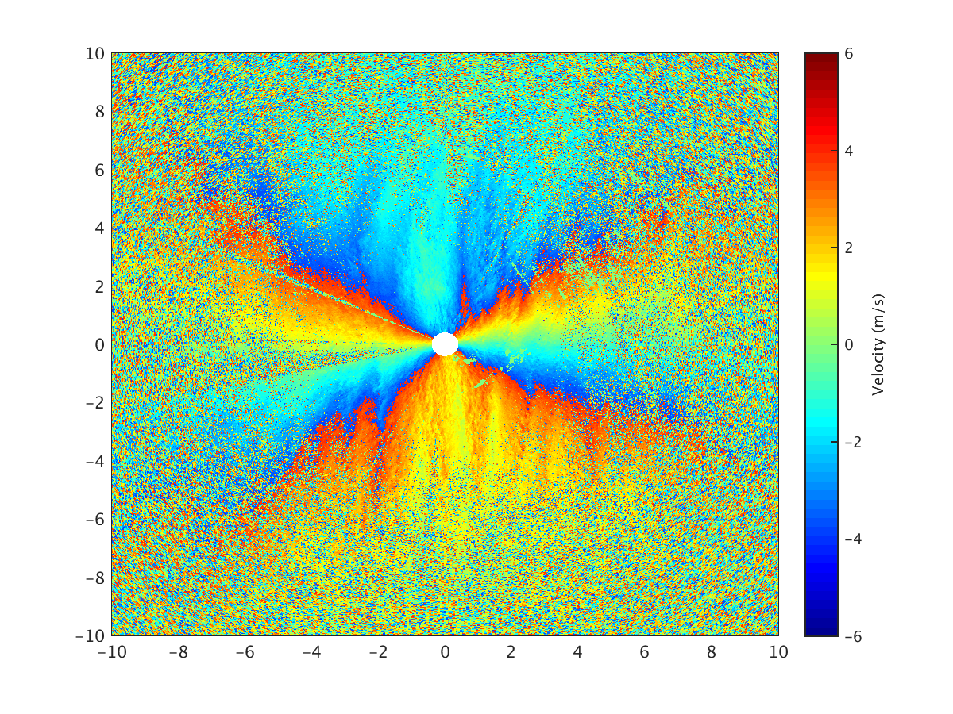
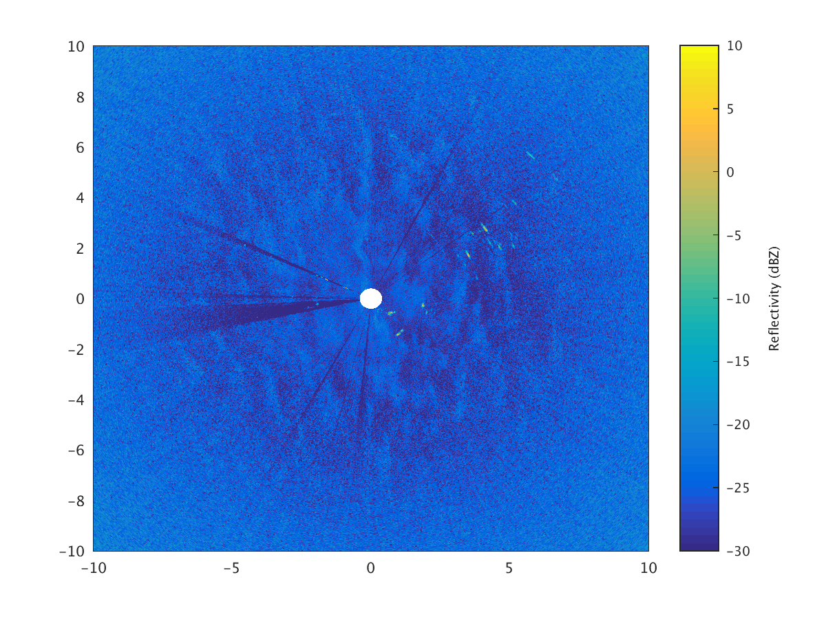
Motivation
WSACR observation
Mean doppler velocity
Barrow
02 May 2013
08:06:12 (UTC)
Reflectivity
Signal to noise ratio
SNR(dB)

Slide 4
Introduction
Atmospheric boundary layer rolls are frequently observed within convective boundary layers (CBLs), over a warmer surface.
Previous field campaigns (Mourad and Walter, 1996, and Verlinde et al., 2007) observed the boundary-layer roll clouds in various locations in the Arctic.
Numerical simulations of convective boundary layer rolls are summarized in reviews by Küttner (1971), Etling and Brown (1993), Atkinson and Zhang (1996), and Young et al.,(2002). However, the aspect ratio of the rolls can vary a lot and the reasons of that remain unclear.
(Verlinde et al., 2007)

Slide 5
Previous experiments:
We found the line-shaped convergence in the WRF simulation (1-km grid-spacing).
(g) 50-m
(Etling and Brown, 1993)
Objective
How do different PBL schemes in the WRF model simulate convection rolls in our case study?

Slide 6
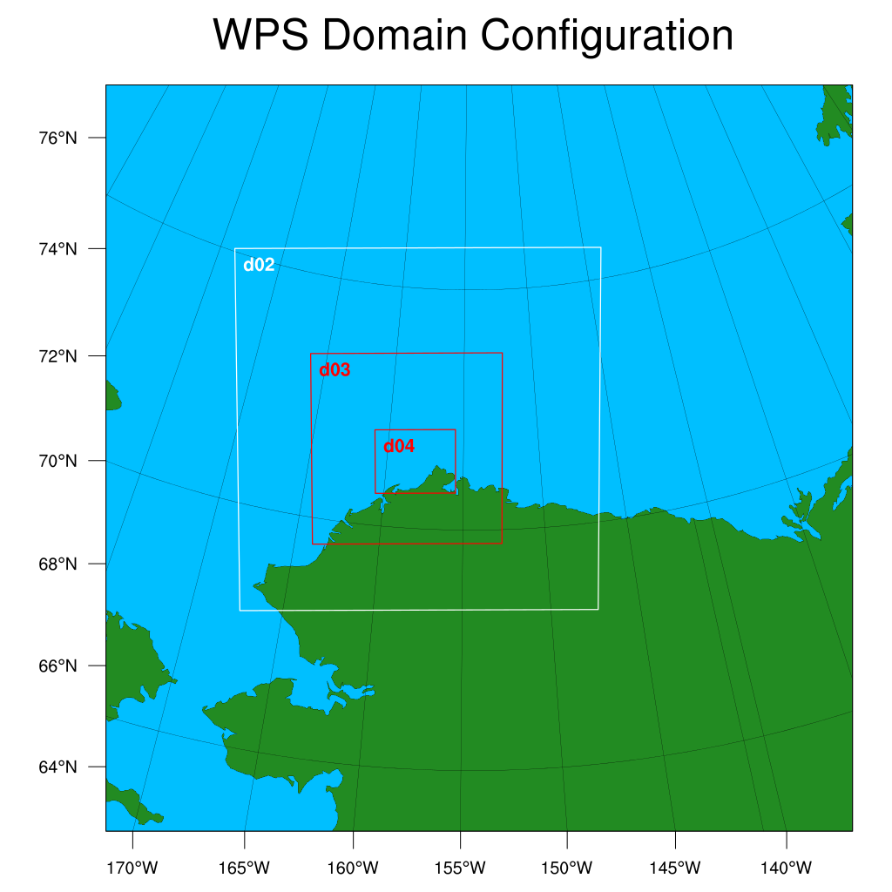
Sensitivity test to PBL schemes
d01
Time:
Simulations started
05/01
1800UTC
05/02
0000UTC
Physics Options in WRF
Surface layer scheme: | Depending on the PBL scheme
PBL Schemes: | YSU, MYJ, QNSE, and MYNN2
d01 : 65 × 65 × 130 (27km)
d02 : 94 × 94 × 130 (9km)
d03 : 148 × 148 ×130 (3km)
d04 : 187 × 148 ×130 (1km)
Vertical resolution below 2km is 33 m

Slide 7
MYJ
QNSE
MYNN2
YSU
Eddy exchange coefficients K(z)
Non-local
Local
Height
Stable
Stable
Near neutral
?
Unstable
Unstable
Stable
Virtual potential temperature
Stability
(Adapted from Stull, 1991)

Slide 8
Convergence lines in domain 3 and 4
Height@50m
0000 UTC May 2
YSU
MYJ
QNSE
MYNN
3-km
444 km
444 km
1-km
148 km
187 km
convergence
divergence

Slide 9
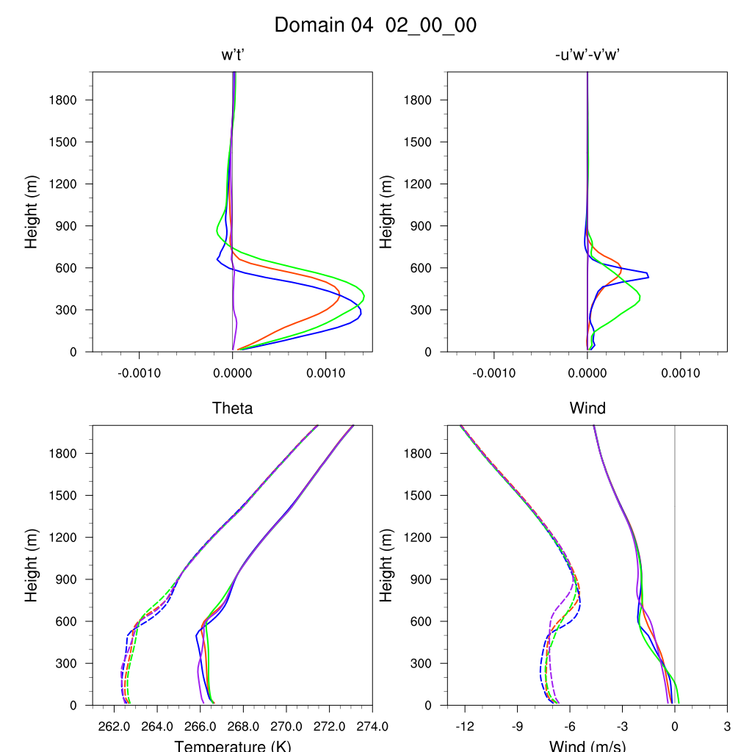
0000 UTC May 2
Buoyant production
Shear production
YSU
MYJ
QNSE
MYNN
Potential temperature
Wind profile
$$θ_{e}$$
U
$$θ_{v}$$
V

Slide 10
Changing K-value
MYNN2: K
MYNN2_30kh: 3.0*K
MYNN2_03kh: 0.3*K
0000 UTC May 2
MYNN2
MYNN2_30kh
MYNN2_03kh
1-km
Height
148 km
Height@50m
?
convergence
187 km
divergence
K(z)

Slide 11
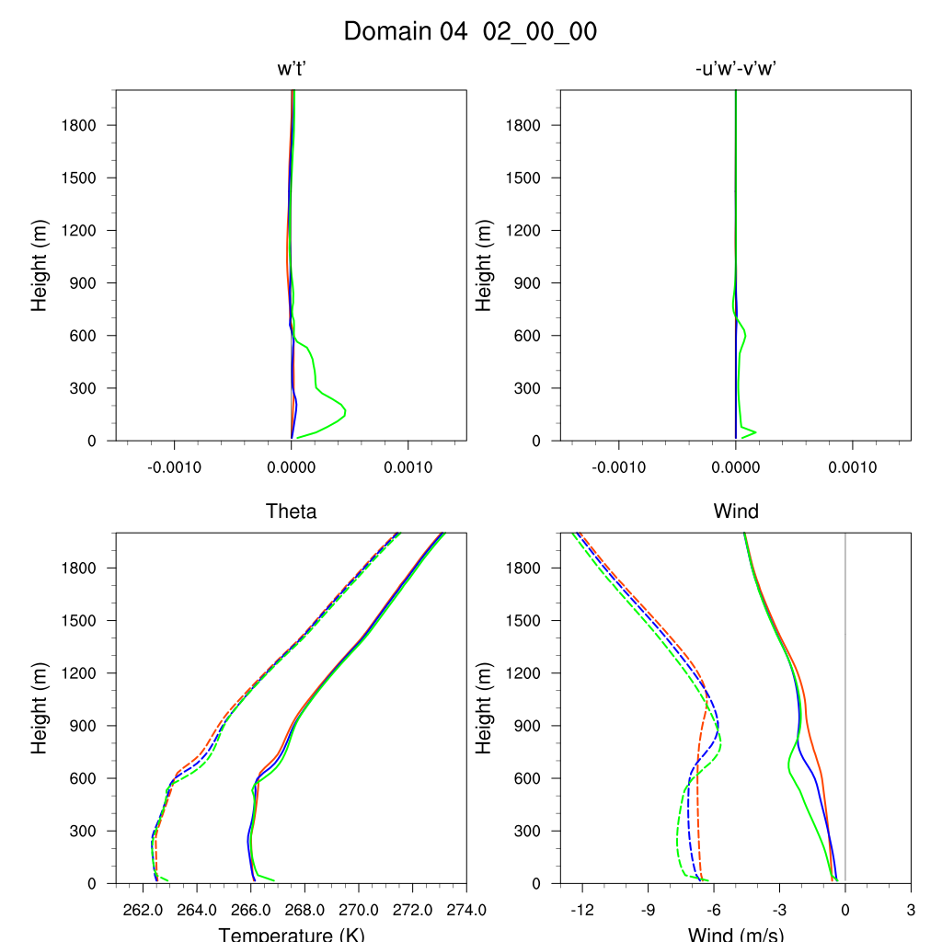
0000 UTC May 2
Buoyant production
Shear production
MYNN2_3.0kh
MYNN2_kh
MYNN2_0.3KH
Potential temperature
Wind profile
$$θ_{e}$$
U
$$θ_{v}$$
V

Slide 12
Summary
The formation of convection rolls are sensitive to PBL schemes due to different ways of vertical mixing.
The wavelength of the rolls decreases with TKE-based PBL schemes since the boundary layer is more turbulent. However, the roll can be destroyed when the layer is well mixed.

Slide 14
YSU: Yonsei University scheme
Nonlocal, first-order closure
With explicit entrainment layer and parabolic K-profile in unstable mixed layer
MYJ: Mellor-Yamada-Janjic scheme
Local, 1.5-order closure
QNSE: Quasi-Normal Scale Elimination PBL
Local, 1.5-order closure
MYNN2: Mellor-Yamada Nakanishi and Niino Level 2.5 PBL
Local, 1.5-order closure
With an equation for prognosis of turbulent kinetic energy
The differences between MYJ, QNSE, MYNN2 are dimensionless stability function and turbulent length scale which are for K-value.
Height
?
K(z)
(Cohen et al., 2015 and Hariprasad et al., 2014)
Notes:
Local scheme like MYJ uses local vertical gradients to predict turbulent kinetic energy and use it to get K as a function of height
Nonlocal schemes (YSU) estimate PBL height and use a prescribed profile shape to impose onto the PBL
In this case, the non-local scheme overestimated the buoyancy convection below 600m
Local scheme simulated a wind-driven turbulence below 600m

Slide 15
Convective boundary layer depth: $z_{i}$
Obukhov length: $L=−\frac{u_{∗}^{3}θ}{κgQ}$
$u_{∗}$: friction velocity
$θ$: mean temperature at the ground
$κ$: von Kármán constant
$g$: acceleration due to gravity
$Q$: surface heat flux
$−\frac{z_{i}}{L}$
(Salesky et al.,2017)

Slide 16
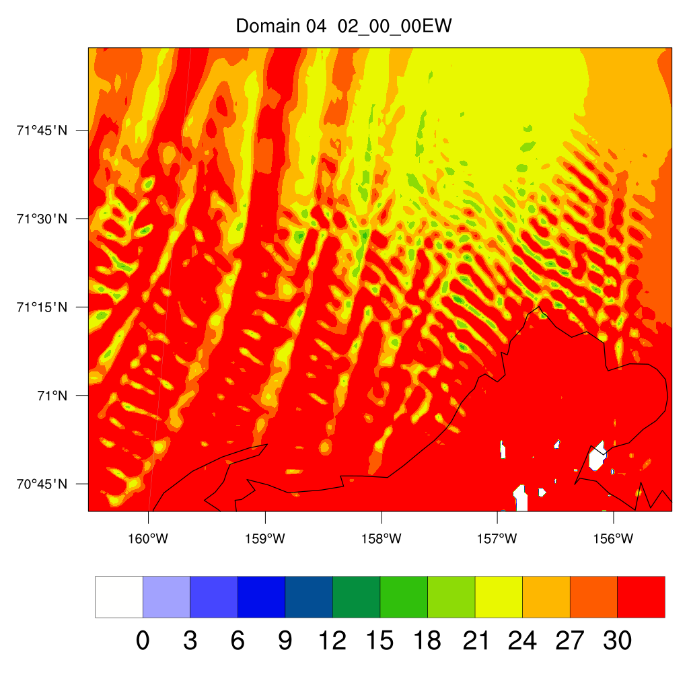
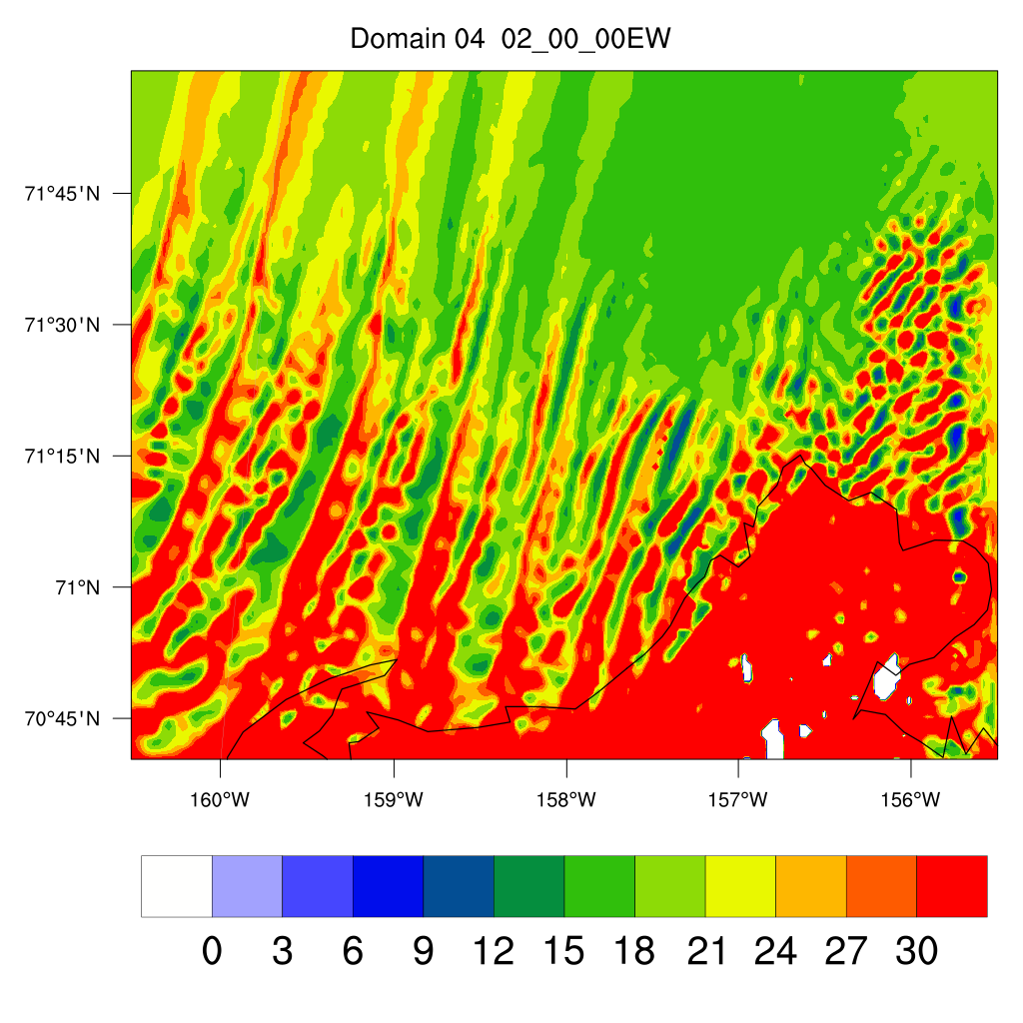
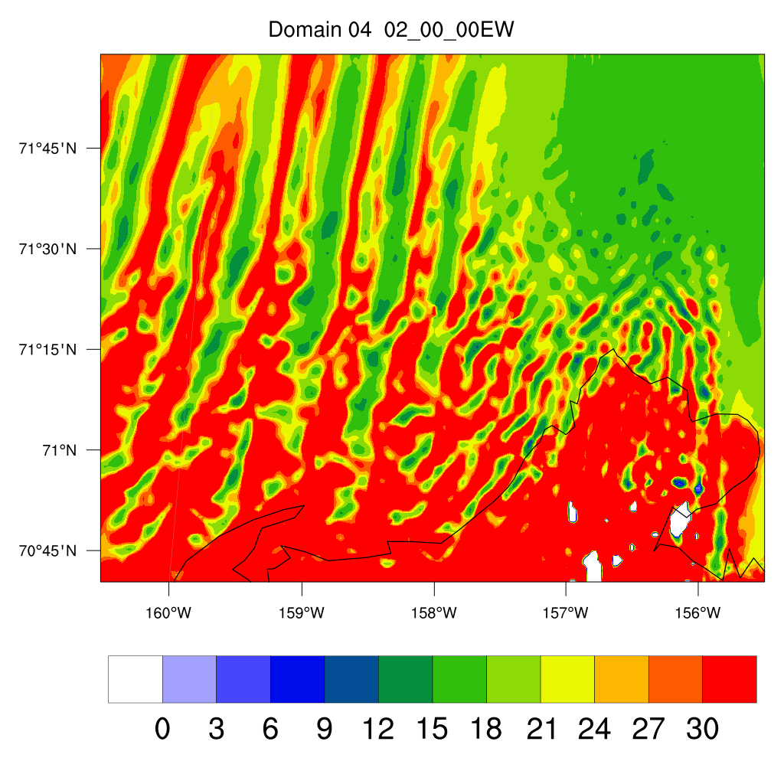
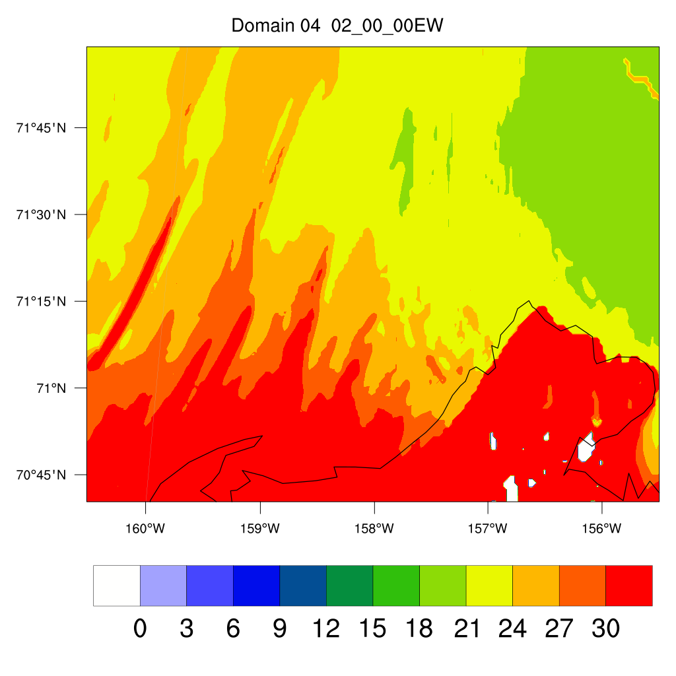
$−\frac{z_{i}}{L}$
$−\frac{z_{i}}{L}$ becomes small -> strong mean wind shear -> horizontal convective roll
$−\frac{z_{i}}{L}$ becomes large -> large surface heat fluxes -> polygonal cells
2-way
YSU
MYJ
QNSE
MYNN

Slide 17
W-wind and U-wind in domain 4
2-way
0000 UTC May 2
YSU
MYJ
QNSE
MYNN
Wavelength (km) | YSU | MYJ | QNSE | MYNN
1-km Δx Δy | 23.3 | 8.5 | 15.5 | 23.3
3-km Δx Δy | 18.5 | 24.6 | 18.5 | 37

Slide 18
Cloud water/ice in domain 4
0000 UTC May 2
2-way
YSU
MYJ
QNSE
MYNN

Slide 19
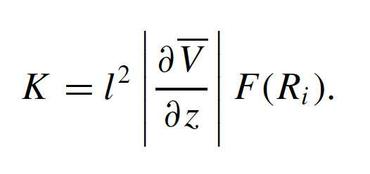
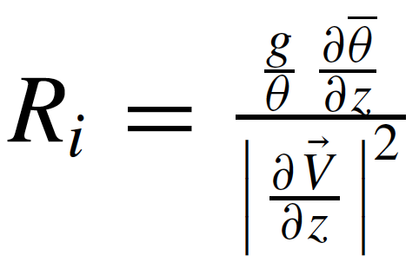
Local vs. Nonlocal
Local scheme uses local gradients to establish K-profile
Nonlocal scheme estimates PBL height and imposes K-profile shape function

Slide 20
Extra experiment
PBL scheme: MYJ
2-way
Height@50m
LW&SW: NASA Community Atmospheric Model (CAM)
LW: Rapid Radiative Transfer Model (RRTM)
SW: RRTMG
0000 UTC May 2
convergence
divergence

Slide 21
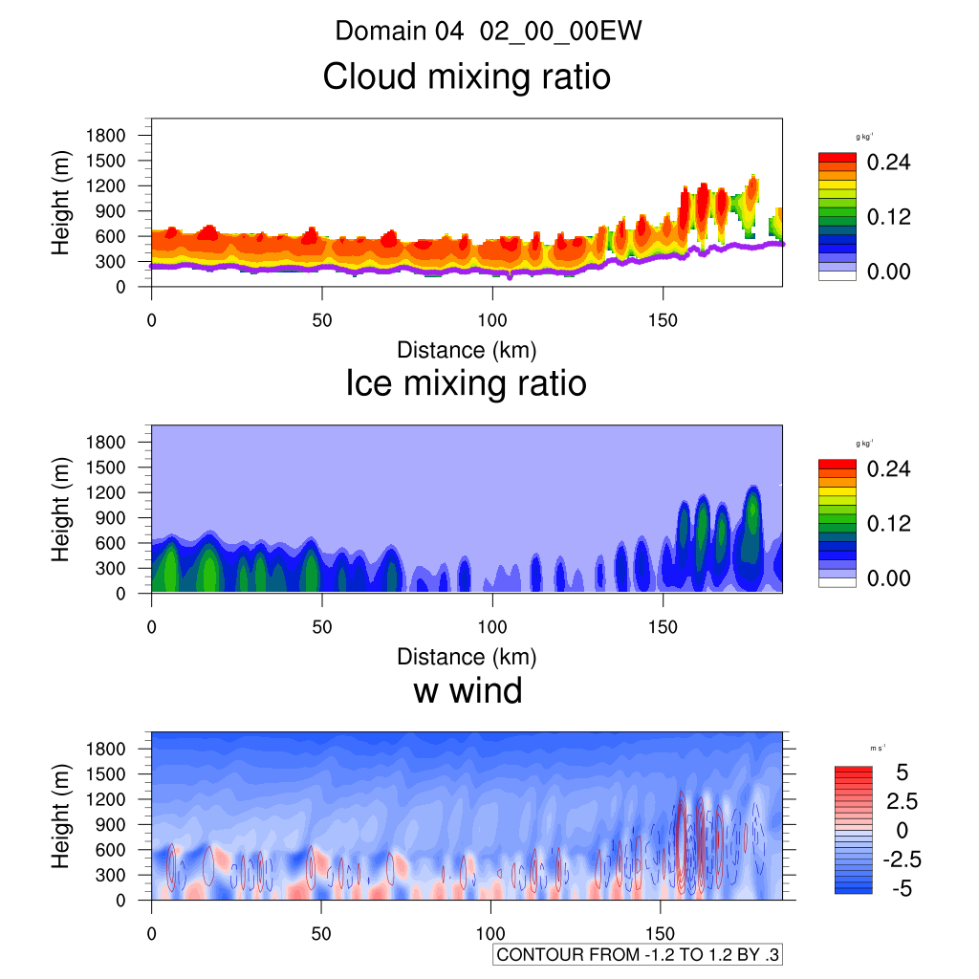
LW&SW: CAM
LW: RRTM
SW: RRTMG
0000 UTC May 2

Slide 22
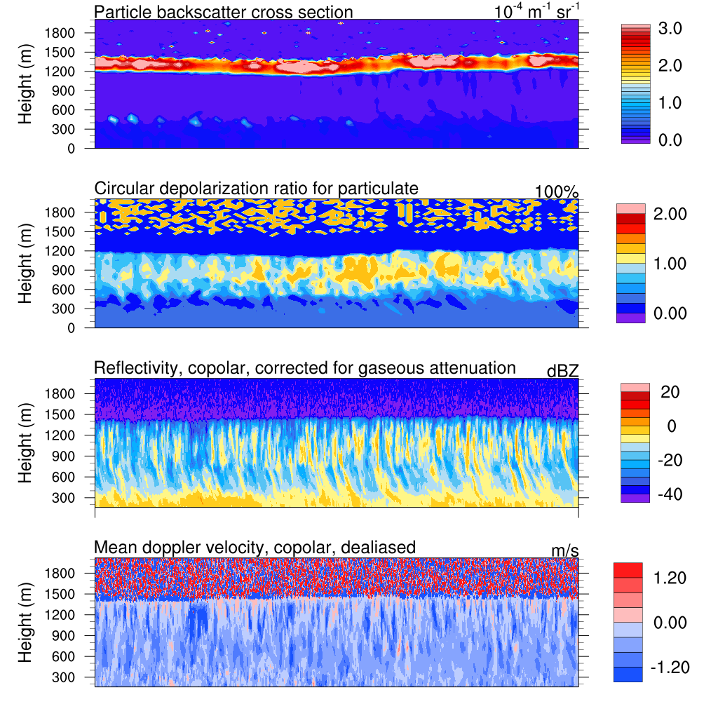
0100 UTC May 02
00
00

Slide 23
Vertical profiles in domain 4
0000 UTC May 2
2-way
YSU
MYJ
$$θ_{e}$$
$$θ_{e}$$
$$θ$$
$$T$$
$$θ$$
$$T$$
$$θ_{v}$$
$$Q_{v}$$
$$θ_{v}$$
$$Q_{v}$$
QNSE
MYNN
$$θ_{e}$$
$$θ_{e}$$
$$θ$$
$$T$$
$$θ$$
$$T$$
$$θ_{v}$$
$$Q_{v}$$
$$θ_{v}$$
$$Q_{v}$$

Slide 24
Question 1:
What are the differences of convection roll between different PBL schemes in the WRF model?
Wavelengths of roll in MYJ and QNSE are smaller than wavelengths of the roll in YSU and MYNN. Wind shear which is an important factor of the roll formation is stronger in MYJ and QNSE run than in YSU and MYNN.
Question 2:
What are the differences of convection roll between 1-way and 2-way WRF simulations?
Slightly affect the structures of the rolls.
Question 3:
What do the signals of refractivity from KASACR and WSACR represent?
Roll?

Slide 28
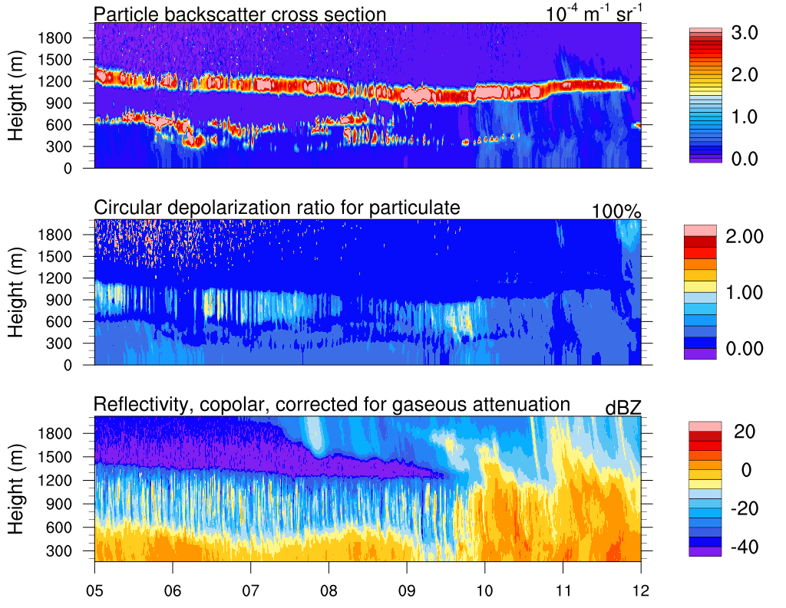
HSRL and KAZA observation
Time (UTC)

Slide 29
Domain | 1 (27 km) | 2 (9 km) | 3 (3 km) | 4 (1 km)
&physics
mp_physics | Morrison 2-moment (10)
ra_lw_physics | CAM3 (3)
ra_sw_physics | CAM3 (3)
radt | minute (1)
sf_sfclay_physics | Depending on the PBL scheme
sf_surface_physics | Noah Land surface (2)
bl_pbl_physics | YSU, MYJ, QNSE, MYNN
bldt | every time step (0)
cu_physics | Grell-3d (5) | Grell-3d (5) | 0 | 0
cudt | minute (0)
isfflx | drag and heat flux from physics (1)
ifsnow | no snow cover effect (0)
icloud | with cloud effect (1)
surface_input_source | surface input from WPS (1)
num_soil_layers | 4
sf_urban_physics | 0
fractional_seaice | 0
seaice_threshold | 0
mp_zero_out | 0
maxiens | GD only (1)
maxens | GD only (3)
maxens2 | GD only (3)
maxens3 | GD only (16)
ensdim | GD only (144)
&dynamics
w_damping | without vertical velocity damping (0)
diff_opt | 2nd order horizontal diffusion (1)
km_opt | 2D deformation (4)
diff_6th_opt | 6th order (2), but prohibit up-gradient diffusion
diff_6th_factor | 0.12
base_temp | base state temperature (290)
damp_opt | Rayleigh damping (3)
dampcoef | 0.2
zdamp | damping depth (5000 (m))
khdif | horizontal diffusion constant (0)
kvdif | vertical diffusion constant (0)
non_hydrostatic | TRUE
h-mom_adv_order | 5th (5)
v-mom_adv_order | 3rd (3)
moist_adv_opt | positive-definite (1)
scalar_adv_opt | positive-definite (1)
mix_full_fields | vertical diffusion (true)
sfs_opt | 0

Slide 30
YSU
Nonlocal, first-order closure
More accurately simulates deeper vertical mixing in buoyancy-driven PBL.
Overestimated PBL height
MYJ
Local, 1.5-order closure
Prognosis of TKE
Undermixes PBL
QNSE
Local, 1.5-order closure
Provide realistic depiction of potential temperature profiles, PBL height, and kinematic profiles based on observation and LES
Bias with too cool, too moist and shallow of a PBL
MYNN2
Local, 1.5-order closure
Expression of stability and mixing length are based on LES rather than on observations
Does not fully account for deeper vertical mixing associated with large eddies
(Cohen et al., 2015)
Notes:
Local scheme like MYJ uses local vertical gradients to predict turbulent kinetic energy and use it to get K as a function of height
Nonlocal schemes (YSU) estimate PBL height and use a prescribed profile shape to impose onto the PBL
In this case, the non-local scheme overestimated the buoyancy convection below 600m
Local scheme simulated a wind-driven turbulence below 600m

Slide 31
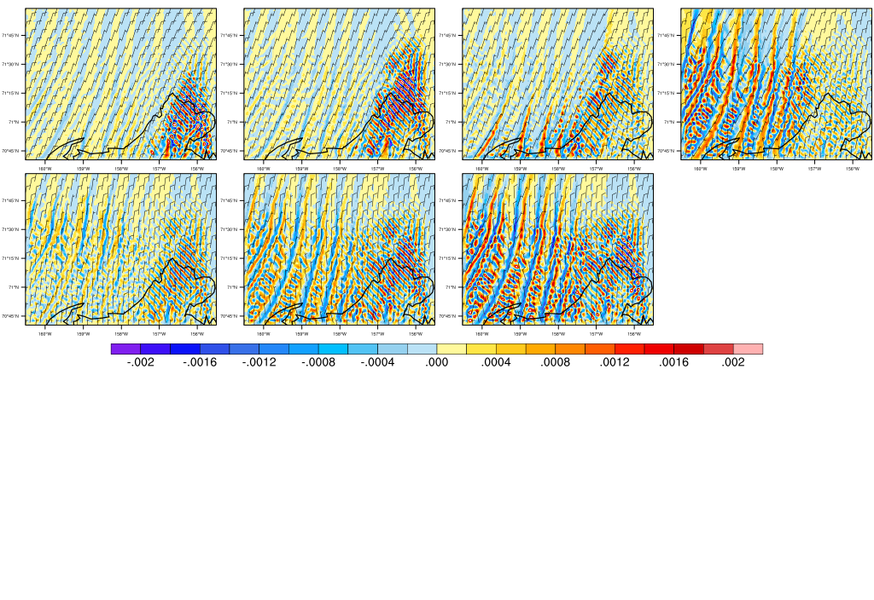
Convergence line in domain 4 in 4 domains-simulation
PBL scheme: YSU
0000 UTC May 2
(a) 1200-m
(b) 1000-m
(c) 800-m
(d) 600-m
(e) 400-m
(f) 200-m
(g) 50-m
148 km
convergence
divergence
187 km

Slide 32
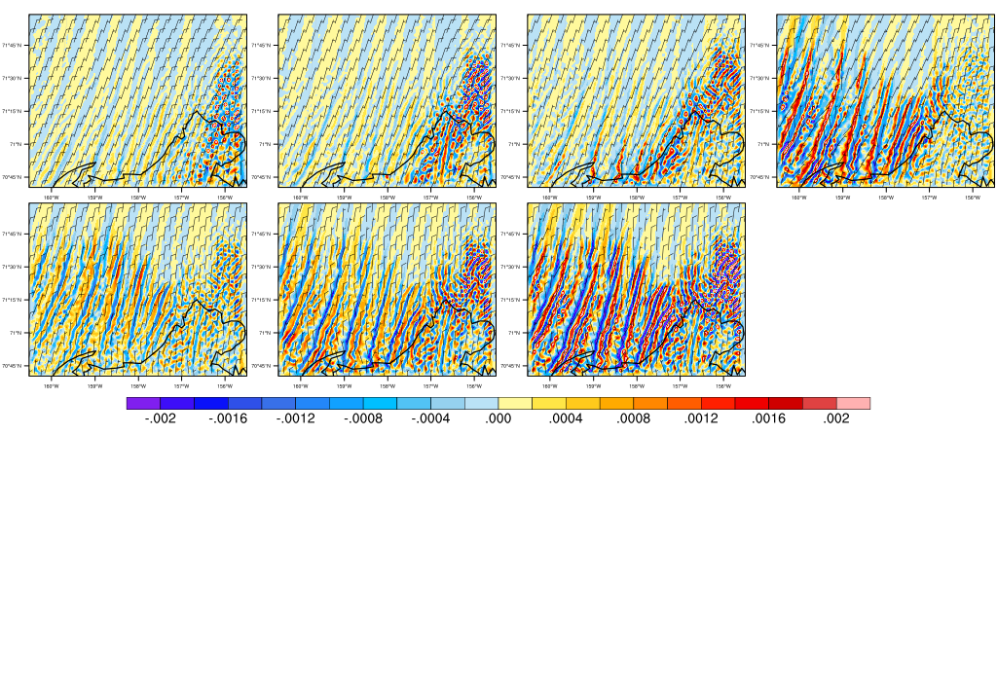
Convergence line in domain 4 in 4 domains-simulation
PBL scheme: MYJ
0000 UTC May 2
(a) 1200-m
(b) 1000-m
(c) 800-m
(d) 600-m
(e) 400-m
(f) 200-m
(g) 50-m
148 km
convergence
divergence
187 km

Slide 33
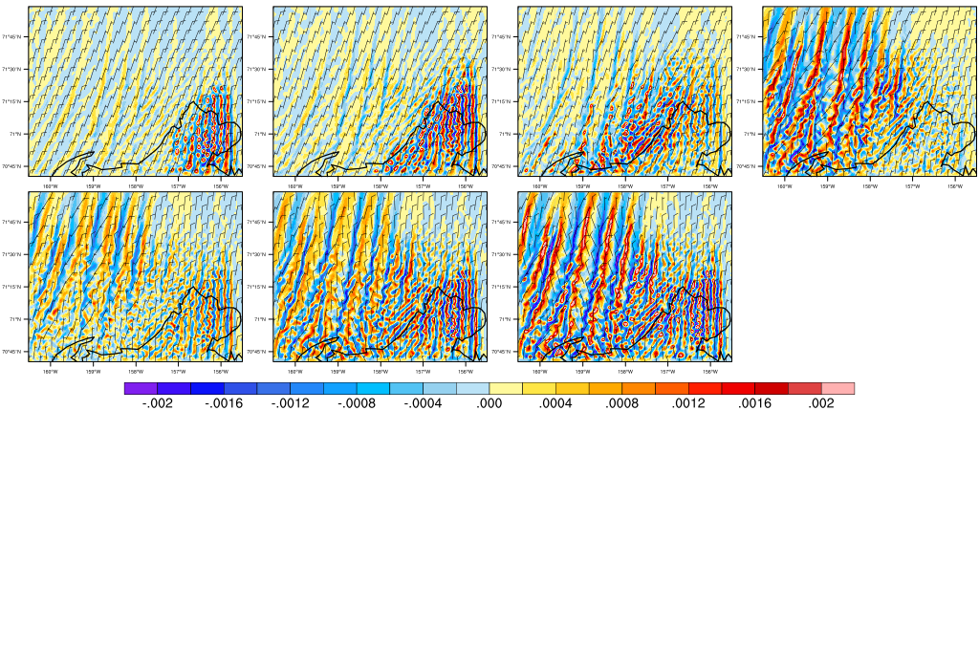
Convergence line in domain 4 in 4 domains-simulation
PBL scheme: QNSE
0000 UTC May 2
(a) 1200-m
(b) 1000-m
(c) 800-m
(d) 600-m
(e) 400-m
(f) 200-m
(g) 50-m
148 km
convergence
divergence
187 km

Slide 34
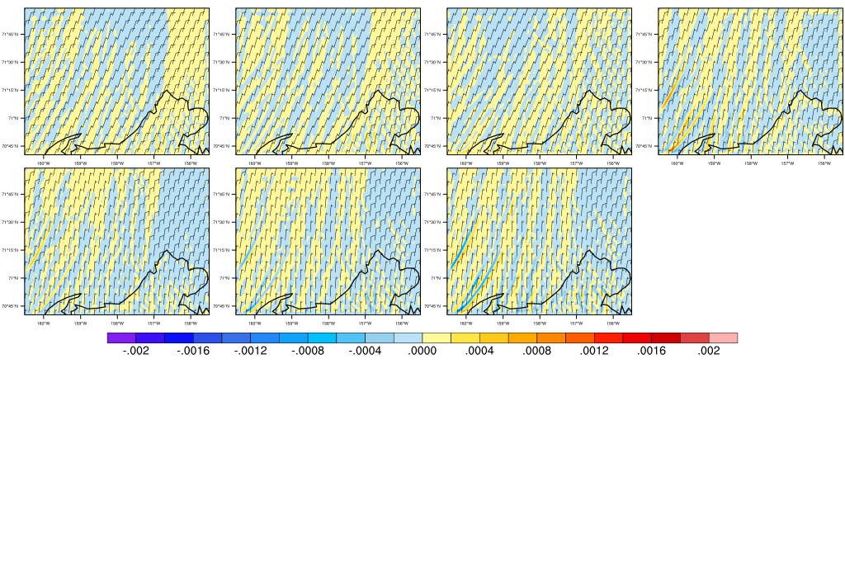
Convergence line in domain 4 in 4 domains-simulation
PBL scheme: MYNN2
0000 UTC May 2
(a) 1200-m
(b) 1000-m
(c) 800-m
(d) 600-m
(e) 400-m
(f) 200-m
(g) 50-m
148 km
convergence
divergence
187 km

Slide 35
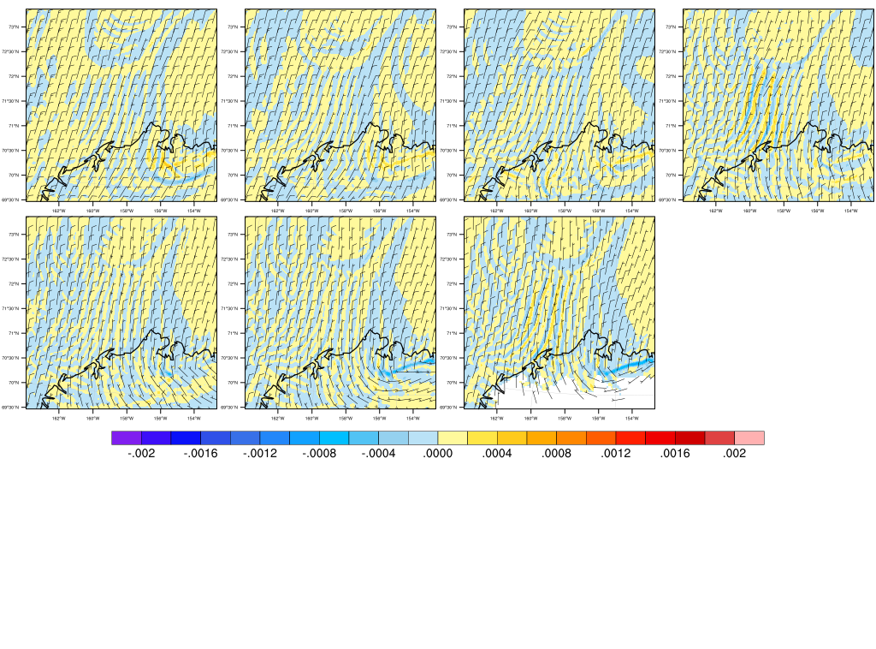
Convergence line in domain 3 in 4 domains-simulation
PBL scheme: YSU
0000 UTC May 2
(a) 1200-m
(b) 1000-m
(c) 800-m
(d) 600-m
(e) 400-m
(f) 200-m
(g) 50-m
444 km
convergence
divergence
444 km

Slide 36
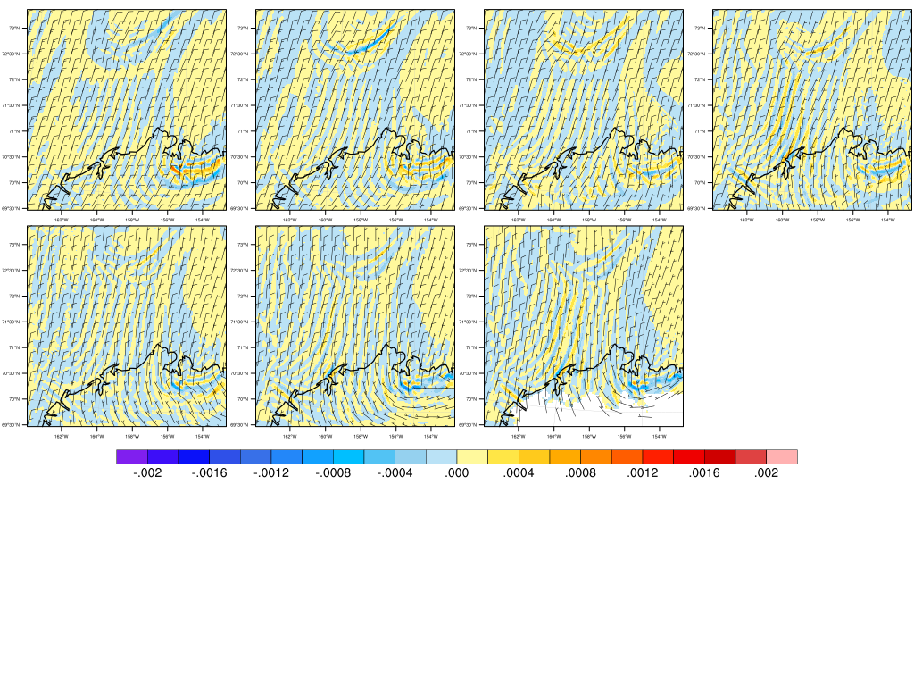
Convergence line in domain 3 in 4 domains-simulation
PBL scheme: MYJ
0000 UTC May 2
(a) 1200-m
(b) 1000-m
(c) 800-m
(d) 600-m
(e) 400-m
(f) 200-m
(g) 50-m
444 km
convergence
divergence
444 km

Slide 37
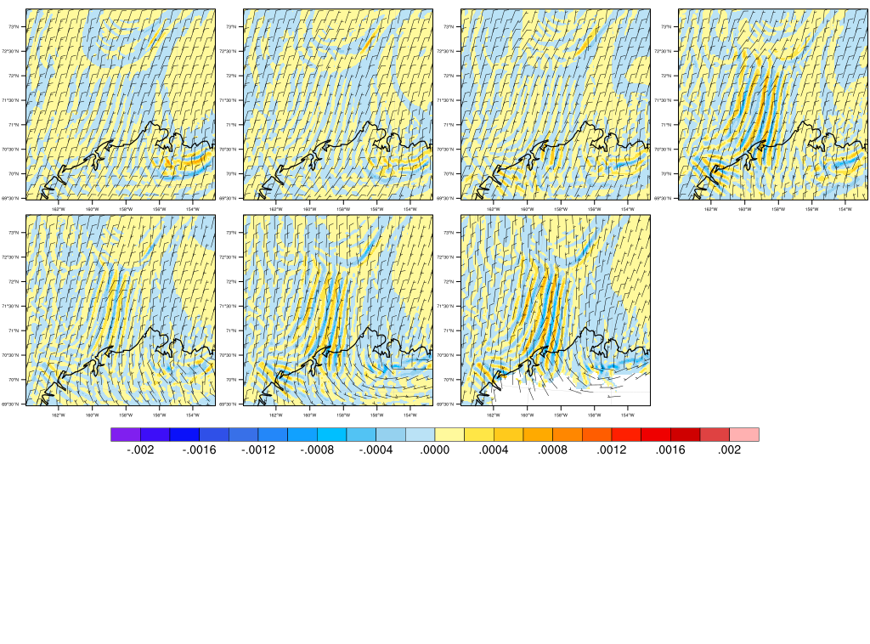
Convergence line in domain 3 in 4 domains-simulation
PBL scheme: QNSE
0000 UTC May 2
(a) 1200-m
(b) 1000-m
(c) 800-m
(d) 600-m
(e) 400-m
(f) 200-m
(g) 50-m
444 km
convergence
divergence
444 km

Slide 38
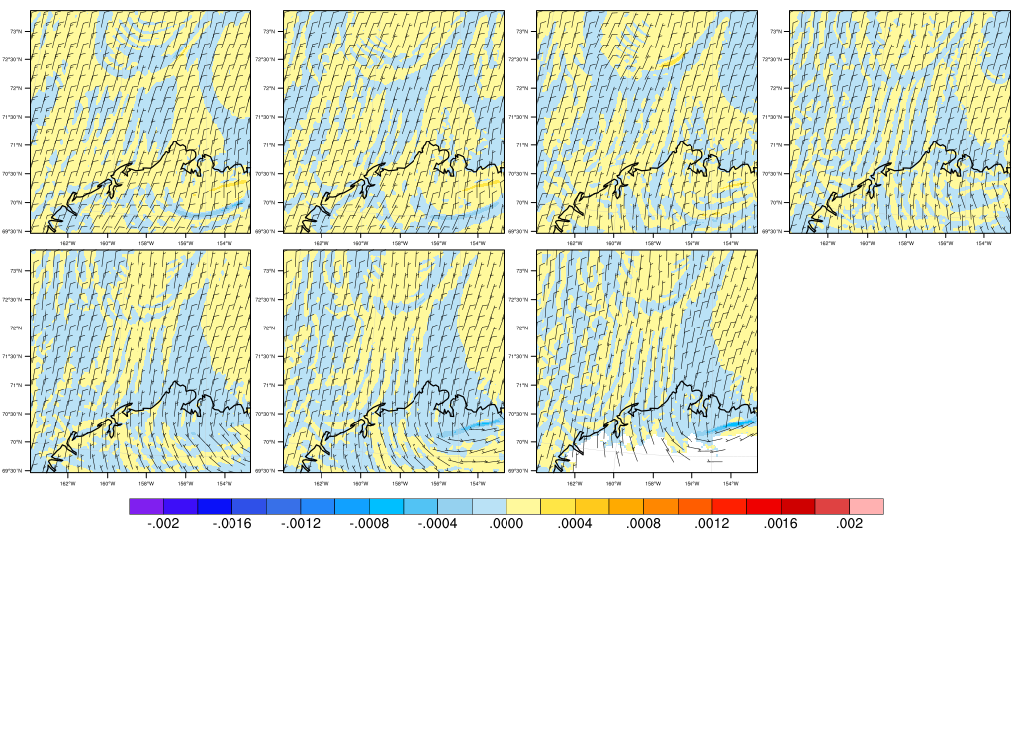
Convergence line in domain 3 in 4 domains-simulation
PBL scheme: MYNN2
0000 UTC May 2
(a) 1200-m
(b) 1000-m
(c) 800-m
(d) 600-m
(e) 400-m
(f) 200-m
(g) 50-m
444 km
convergence
divergence
444 km

Slide 39
Convergence line in domain 4 in 4 domains-simulation
PBL scheme: YSU
0000 UTC May 2
(a) 1200-m
(b) 1000-m
(c) 800-m
(d) 600-m
(e) 400-m
(f) 200-m
(g) 50-m
148 km
convergence
divergence
187 km

Slide 40
Convergence line in domain 4 in 4 domains-simulation
PBL scheme: MYJ
0000 UTC May 2
(a) 1200-m
(b) 1000-m
(c) 800-m
(d) 600-m
(e) 400-m
(f) 200-m
(g) 50-m
148 km
convergence
divergence
187 km

Slide 41
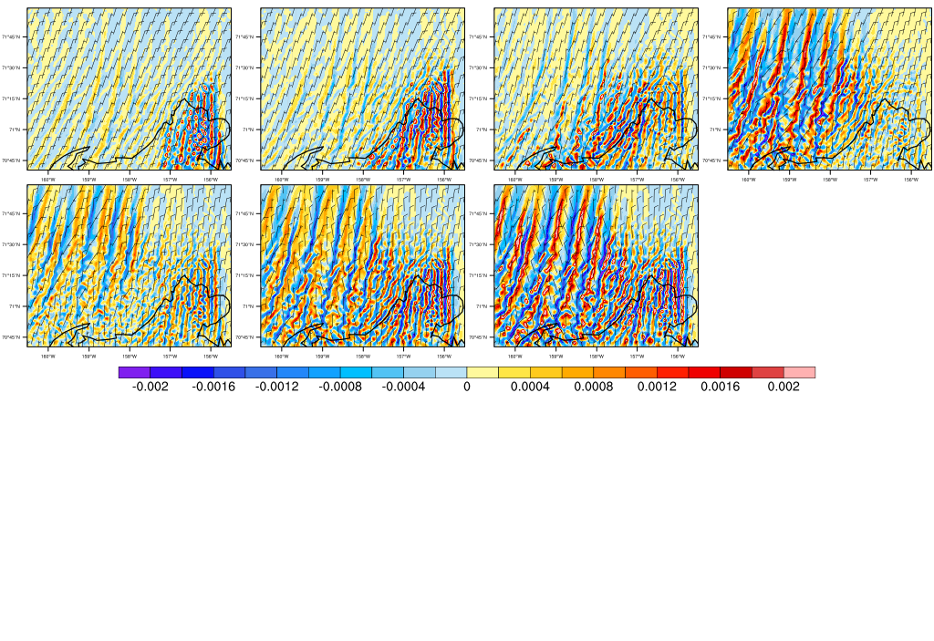
Convergence line in domain 4 in 4 domains-simulation
PBL scheme: QNSE
0000 UTC May 2
(a) 1200-m
(b) 1000-m
(c) 800-m
(d) 600-m
(e) 400-m
(f) 200-m
(g) 50-m
148 km
convergence
divergence
187 km

Slide 42
Convergence line in domain 4 in 4 domains-simulation
PBL scheme: MYNN2
0000 UTC May 2
(a) 1200-m
(b) 1000-m
(c) 800-m
(d) 600-m
(e) 400-m
(f) 200-m
(g) 50-m
148 km
convergence
divergence
187 km

Slide 43
Convergence line in domain 3 in 4 domains-simulation
PBL scheme: YSU
0000 UTC May 2
(a) 1200-m
(b) 1000-m
(c) 800-m
(d) 600-m
(e) 400-m
(f) 200-m
(g) 50-m
444 km
convergence
divergence
444 km

Slide 44
Convergence line in domain 3 in 4 domains-simulation
PBL scheme: MYJ
0000 UTC May 2
(a) 1200-m
(b) 1000-m
(c) 800-m
(d) 600-m
(e) 400-m
(f) 200-m
(g) 50-m
444 km
convergence
divergence
444 km

Slide 45
Convergence line in domain 3 in 4 domains-simulation
PBL scheme: QNSE
0000 UTC May 2
(a) 1200-m
(b) 1000-m
(c) 800-m
(d) 600-m
(e) 400-m
(f) 200-m
(g) 50-m
444 km
convergence
divergence
444 km

Slide 46
Convergence line in domain 3 in 4 domains-simulation
PBL scheme: MYNN2
0000 UTC May 2
(a) 1200-m
(b) 1000-m
(c) 800-m
(d) 600-m
(e) 400-m
(f) 200-m
(g) 50-m
444 km
convergence
divergence
444 km

