Slide 1
East Asia regional reanalysis with a focus on Tibet Plateau
-A joint project between University of Gothenburg (Sweden) and Penn State University (United States)
Tinghai Ou, Xingchao Chen, Fuqing Zhang, Deliang Chen
University of Gothenburg, Sweden
Penn State University, United States

Slide 2
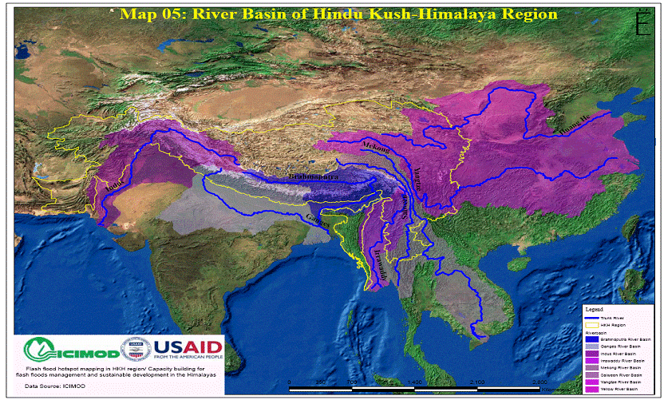
10 major rivers in Asia are originated from the Tibet Plateau
Water resource and security is a great concern in this region
210 million people living in the region
1.3 billion people (1/5 worlds’ population) living in the downstream river basins
More than 3 billion people benefit from the food and energy produced in these river basins that have their origin in the mountains
Tarim
Yellow
Amu Darya
Indus
The Third Pole
Brahmaputra
Yangtze
Ganges
Stores more snow and ice than anywhere else in the world outside the polar regions
Irrawady
Salween
Mekong
Notes:
The region stores more snow and ice than anywhere else in the world outside the polar regions, giving its name: ’The Third Pole‘. The Third Pole contains the world’s highest mountains, including all 14 peaks above 8,000 metres, is the source of 10 major rivers, and forms a formidable global ecological buffer.
The mountain resources provide a wide range of ecosystem services and the basis for the livelihoods to the 210 million people living in the region, as well as indirectly to the 1.3 billion people -- one fifth of the worlds’ population -- living in the downstream river basins. More than 3 billion people benefit from the food and energy produced in these river basins that have their origin in the mountains.

Slide 3
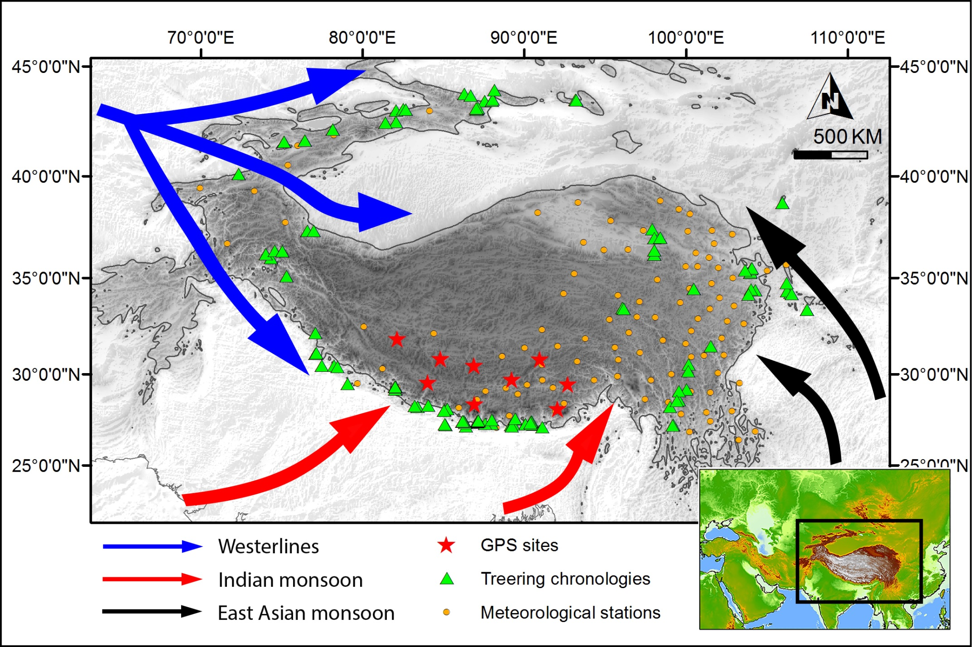

Slide 4
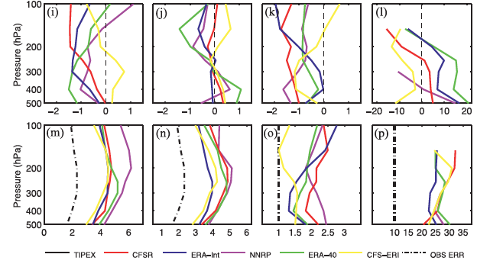
U(m/s) V (m/s) T(ºC) RH(%)
Bias RMSE
Bao, X., and F. Zhang, 2013: Evaluation of NCEP–CFSR, NCEP–NCAR, ERA-Interim, and ERA-40 reanalysis datasets against independent sounding observations over the Tibetan Plateau. J. Climate, 26, 206–214.

Slide 5
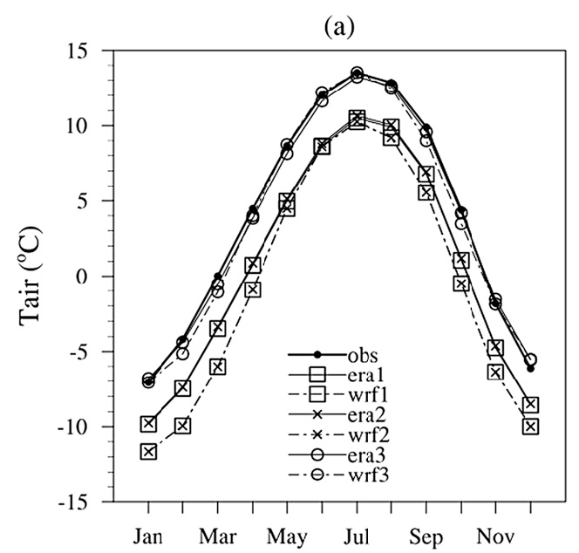
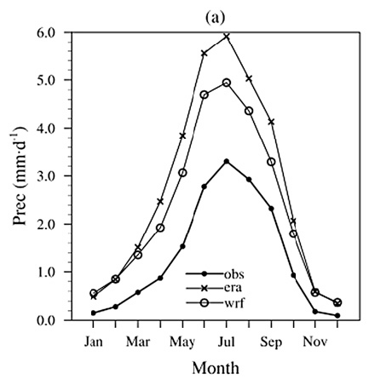
Added value by downscaling with WRF
(30 km resolution), means for 1979-2011

Slide 6
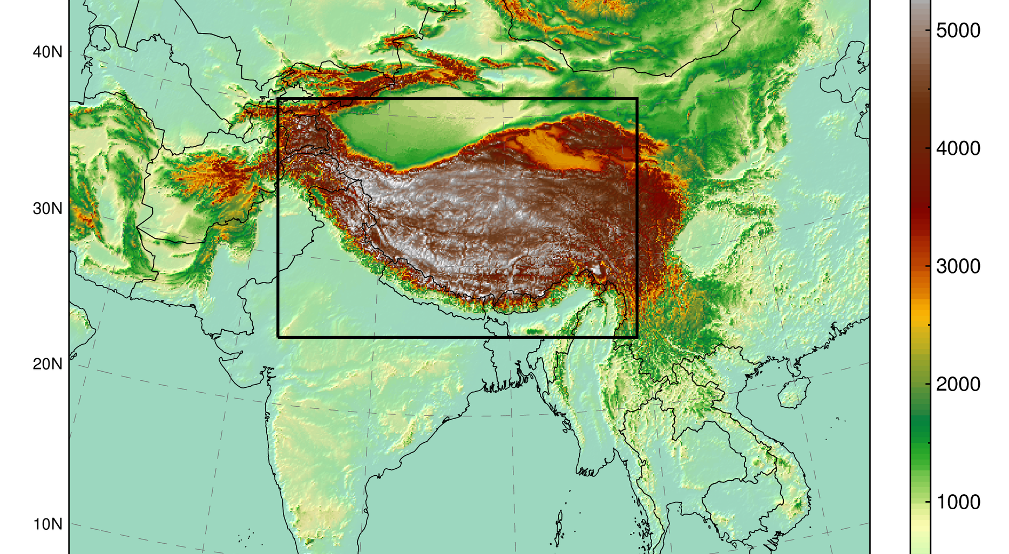
The High Asia Refined analysis (HAR)
Weather Research and Forecasting (WRF) model (V 3.3.1)
Forcing data: Final Analysis data from GFS + SST
Daily reinitialisation strategy (36 hrs simulations: 12 hrs spin-up discarded, remaining 24 hrs provide 1 day of the time series)
2001-2014, hourly, 30km & 10km
Limitation:
Not reanalysis
The data is not suitable for trend analyses (GFS data is not strictly homogeneous)
10km
30km

Slide 7
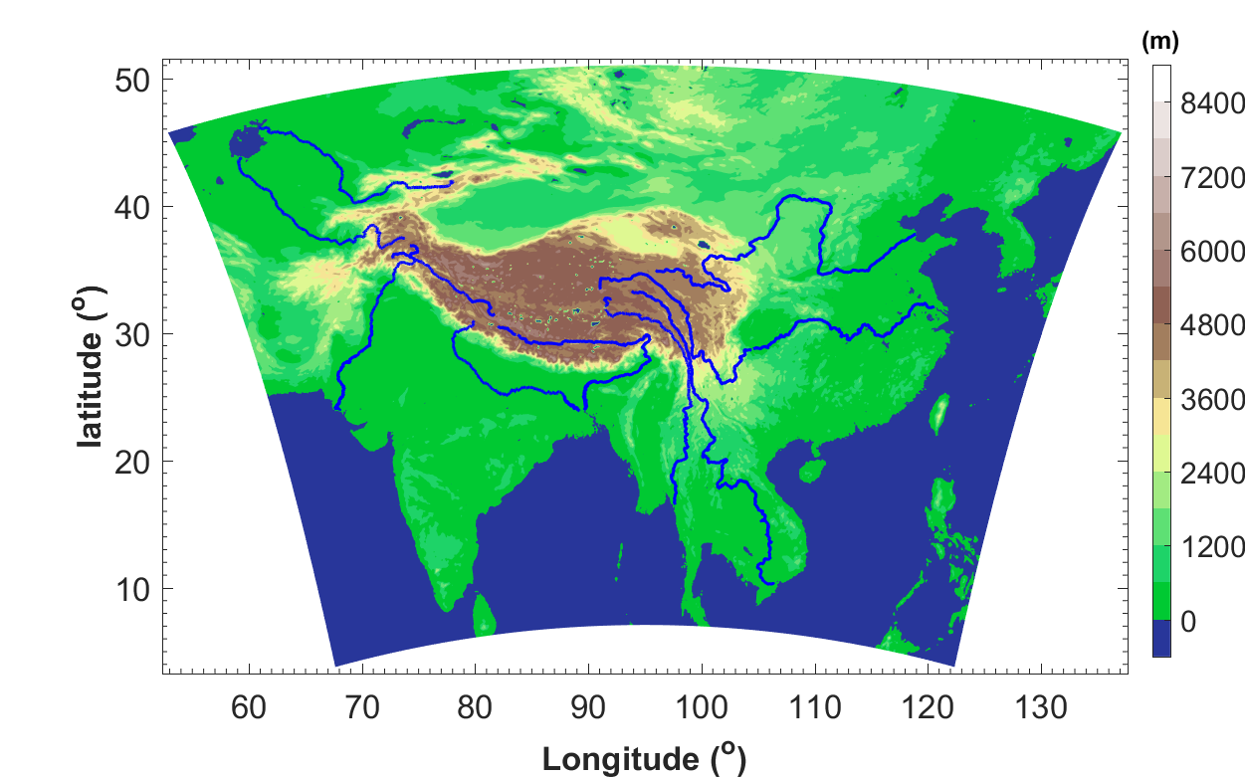
Aim
To generate a high-resolution regional reanalysis over East Asia with a focus on the Tibet Plateau

Slide 8
Project plan
Model: WRF 3.7.1
Initial and boundary: ERA5
  ERA5: Fifth generation of ECMWF atmospheric reanalyses of the global climate. Global 30km, with 137 hybrid sigma/pressure (model) levels in the vertical (up to 0.01 hPa), interpolated to 37 pressure, hourly (3 hourly reanalysis will be used)
Cover period: 1979 – present
Resolution: 9km (may adding a focus region with 3km)
Two steps
  Analysis nudging to ERA5 (Version 0)
  Reanalysis (Version 1)
    E3DVar/3DenVar (hybrid/coupling of EnKF & 3DVar) (Zhang et al. 2013)

Slide 9
Current stage
Eun-Gyeong Yang has already done some testing of EnKF
I am testing the analysis nudging to ERA5
  9km, 60 level up to 1hp
  Spectral nudging (3 hr)
    X ~1900km, Y ~2200km
    U/V, T, Φ, No Q
    Nudging coefficient
      0.0003
    No nudging in the PBL
    No nudging below level 5
    Limit nudging from above level 5

