Slide 1
Atmospheric Overturning of Indian Summer Monsoon: as seen through the Isentropic Analysis
Xingchao (XC) Chen¹, Olivier Pauluis² , Fuqing Zhang ¹
¹Department of Meteorology, The Pennsylvania State University, and Center for Advanced Data Assimilation and Predictability Techniques, University Park, Pennsylvania, USA
²Courant Institute of Mathematical Sciences. New York University, New York, USA

Slide 2
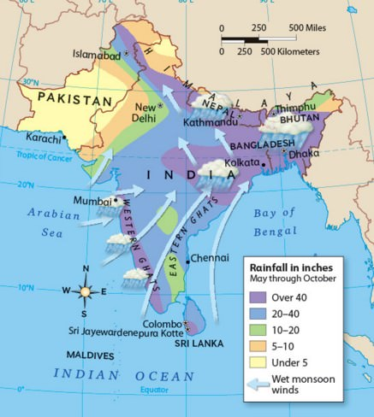
The Indian summer monsoon (ISM) is one of the most vigorous weather phenomena
It affecting the Indian subcontinent every year from June through September (JJAS).
It contributes about 80% of the total annual precipitation over the region and has substantial influences to the agricultural and industrial productions in India
The ISM exhibits strong low frequency variability in the form of “active” and “break” spells of monsoon rainfall, with two dominant modes on timescales of 30-60 days and 10-20 days.
The dynamics of ISM involves planetary-scale overturning and its interaction with mesoscale and convective-scale activities
Indian Summer Monsoon

Slide 3
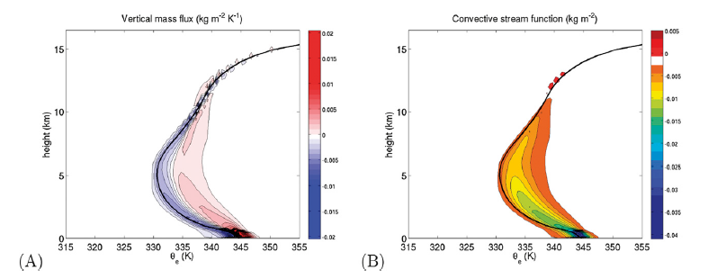
Isentropic Analysis
Mass flux on a given isentropic slice:
$$\left\langle \text{ρw}\right\rangle = \frac{1}{P{L_{x}L}_{y}}\int_{0}^{P}{\int_{0}^{L_{y}}{\int_{0}^{L_{x}}{ρw(x,y,z,t)δ\left[θ_{e0}−θ_{e}(x,y,z,t)\right]dxdydt}}}$$
$δ=1/$∆$θ_{e}$ when $θ_{e0}+$0.5 ∆$θ_{e}$ ≤ $θ_{e}$ ≤ $θ_{e0}+$0.5 ∆$θ_{e}$
Isentropic streamfuction: $ψ\left(z,θ_{e}\right)= \int_{−∞}^{θ_{e}}{\left\langle \text{ρw}\right\rangle }\left(z, {θ_{e}^{}}^{′}\right)d{θ_{e}^{}}^{′}$
Advantages:
Reduce the 4-D dataset into a 2-D coordinate
Identifying the atmospheric overturning associated with upward transport of warm moist air and downward transport of colder dryer air.
Systematically filtering gravity waves.
Vertical mass transport contributed by different scales of motions can thus be more easily identified.
$$\left(C_{pd}+C_{i}r_{T}\right)\ln{\frac{θ_{e}}{T_{f}}=\left[C_{pd}+r_{i}C_{i}+\left(r_{v}+r_{l}\right)C_{l}\right]\ln\left(\frac{T}{T_{f}}\right)−R_{d}\ln\left(\frac{P_{d}}{P_{0}}\right)+\left(r_{v}+r_{l}\right)\frac{L_{f}}{T_{f}}+r_{v}\frac{L_{v}}{T}−r_{v}R_{v}\ln{H}}$$
Pauluis and Mrowiec (2015)

Slide 4
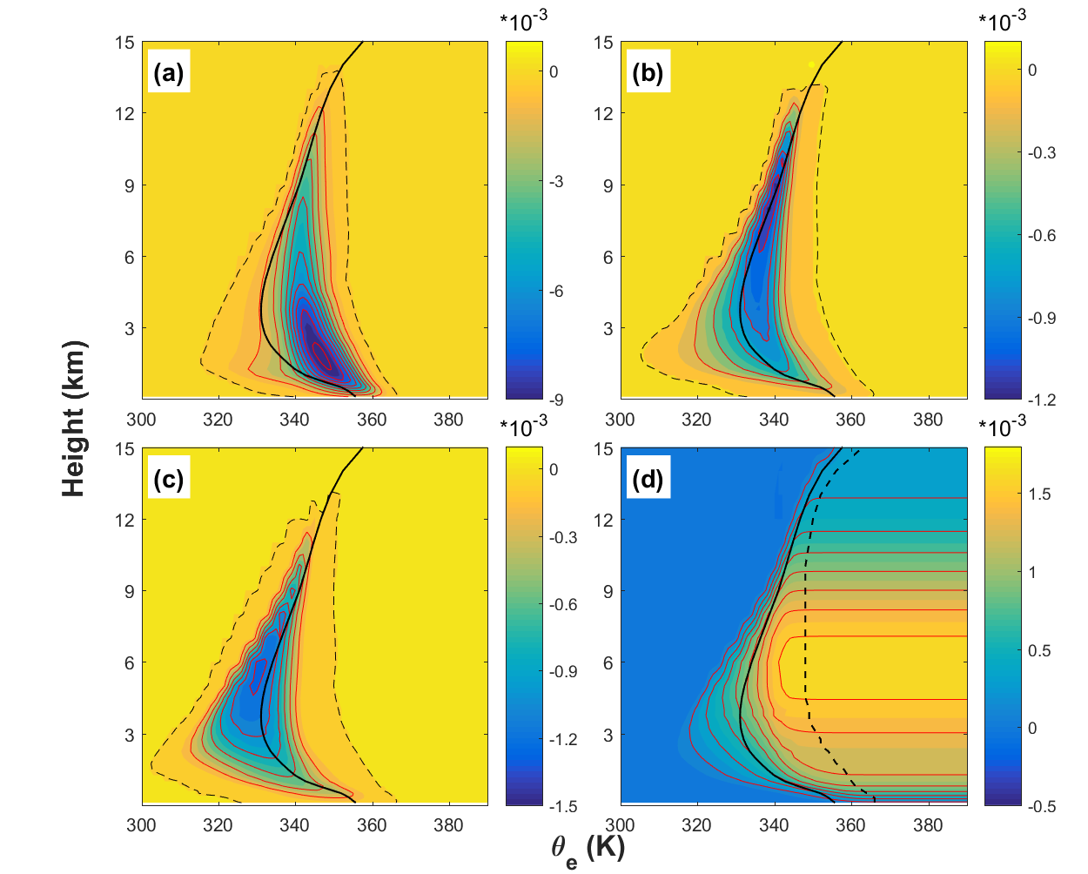
MJO Study

Slide 5
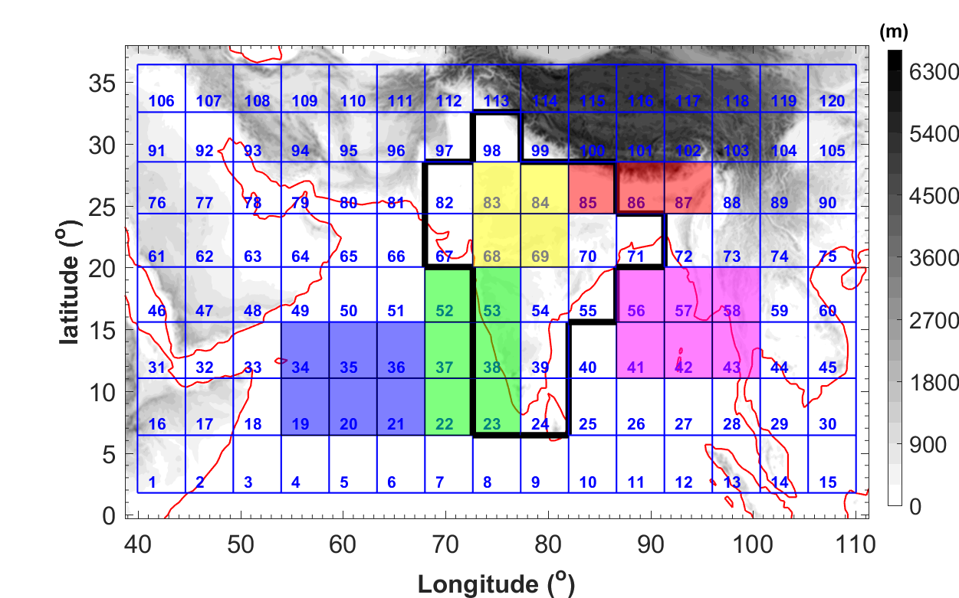
$\text{ρw}\text{mean}$: mean mass flux over each sub-region
$$\text{ρw}convective \left(x,y,z,t\right) =\text{ρw}−\text{ρw}\text{mean}$$
$$\text{ρw}\text{regional}\left(X,Y,z,t\right)=\text{ρw}\text{mean}−\text{ρw}\text{global}$$
$$\text{ρw}\text{global}\left(z,t\right)=\left(\frac{1}{nx∗ny}\right)\sum_{j=1}^{ny}{\sum_{i=1}^{nx}{\text{ρw}\text{mean}}}$$
Model domain used in the WRF simulations with topography (gray scales) and coastlines (red lines). Different subregions are shown by different color shadings (Blue: Arabian Sea; Green: Western Ghats; Yellow: North India; Red: Himalaya; Magenta: Bay of Bengal). The black polygon shows the Indian subcontinent.

Slide 6
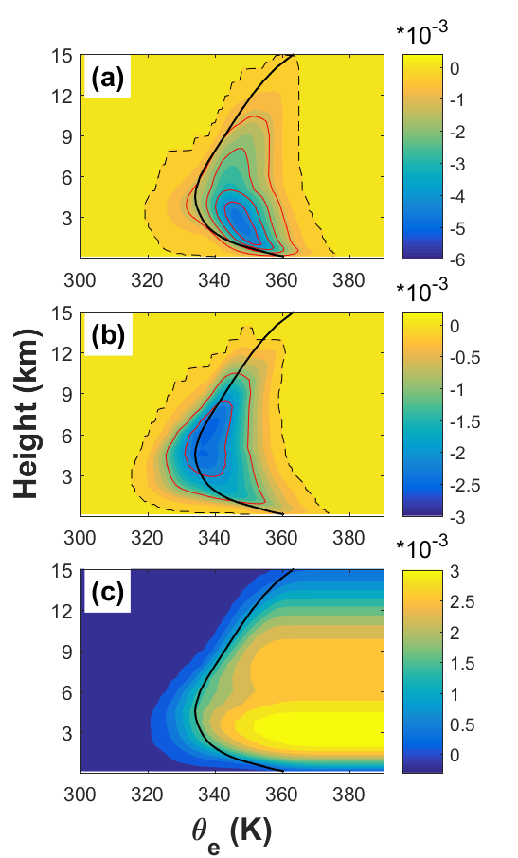
Convective-scale
Regional-scale
Basin-
wide
Isentropic streamfuctions associated with the (a) convective-scale, (b) large-scale and (c) basin-scale averaged over whole WRF domain during JJAS (color shading, kg m⁻² s⁻¹).

Slide 7
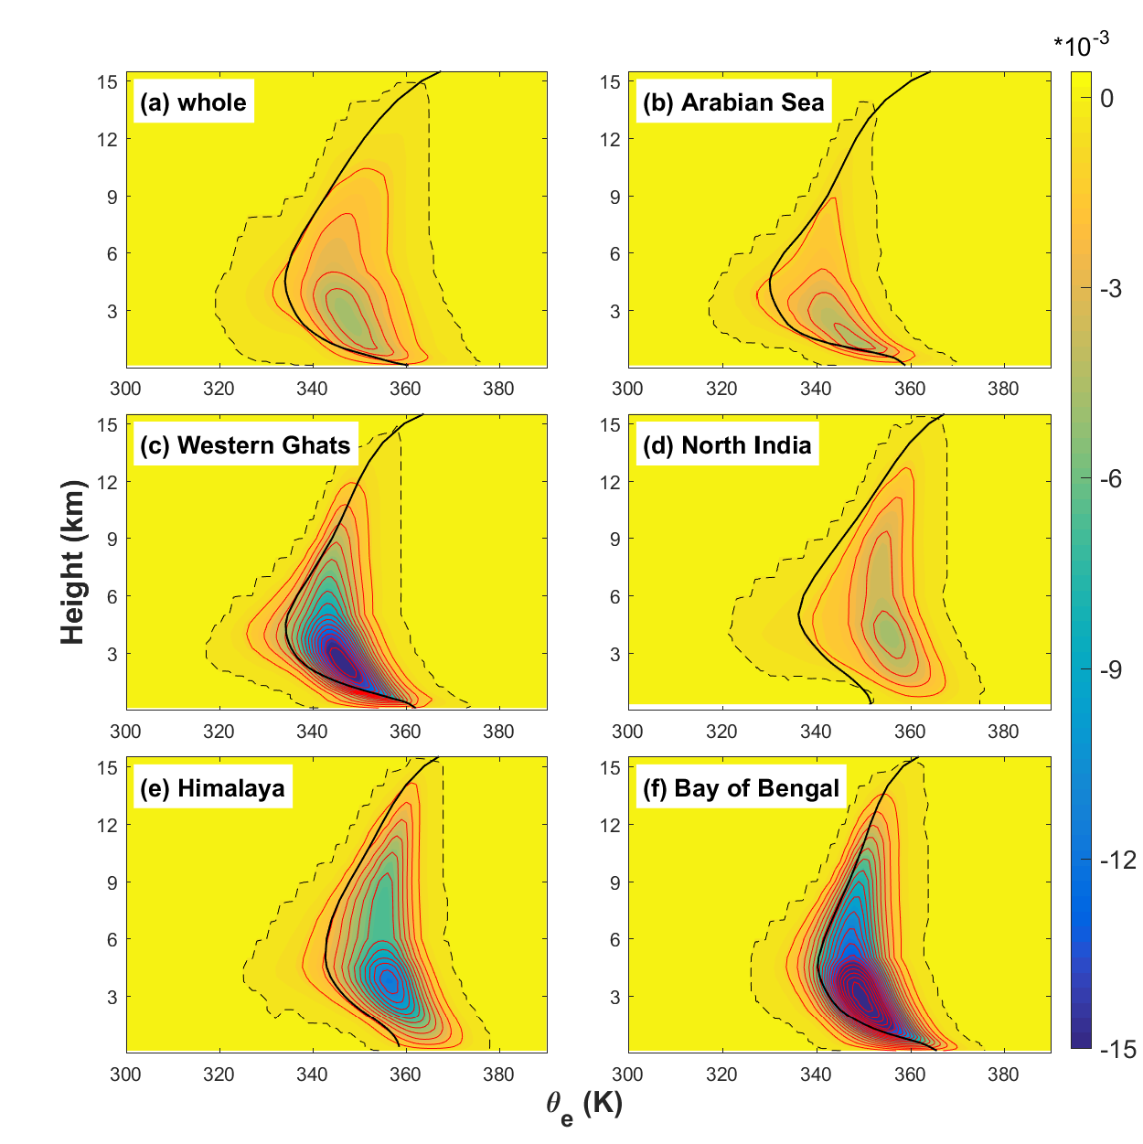
Isentropic streamfuctions associated with convective-scale (color shading, kg m⁻² s⁻¹) averaged over (a) whole WRF domain; (b) Arabian Sea; (c) Western Ghats; (d) North India; (e) Himalaya and (f) Bay of Bengal during JJAS.

Slide 8
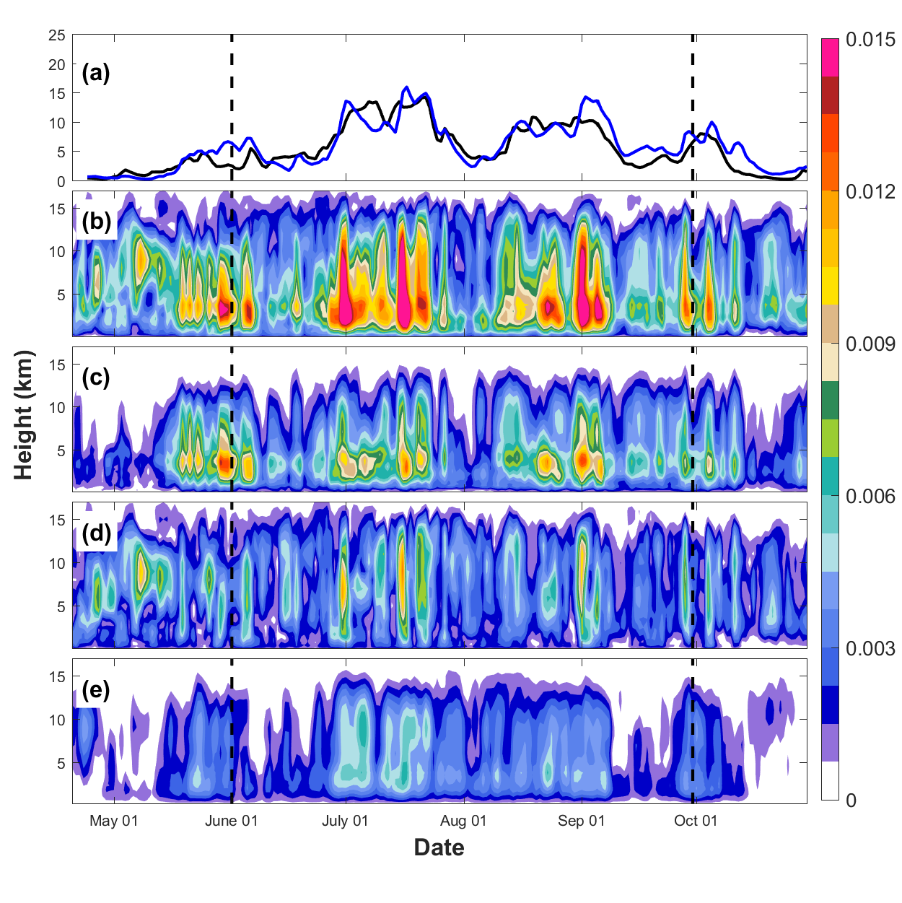
Isentropic upward mass transport: $M(z)=\max_{θ_{e}}\left[ψ\left(z,θ_{e}\right)\right]−\min_{θ_{e}}\left[ψ\left(z,θ_{e}\right)\right]$
rain
total
Convective
regional
Basin-wide

Slide 9
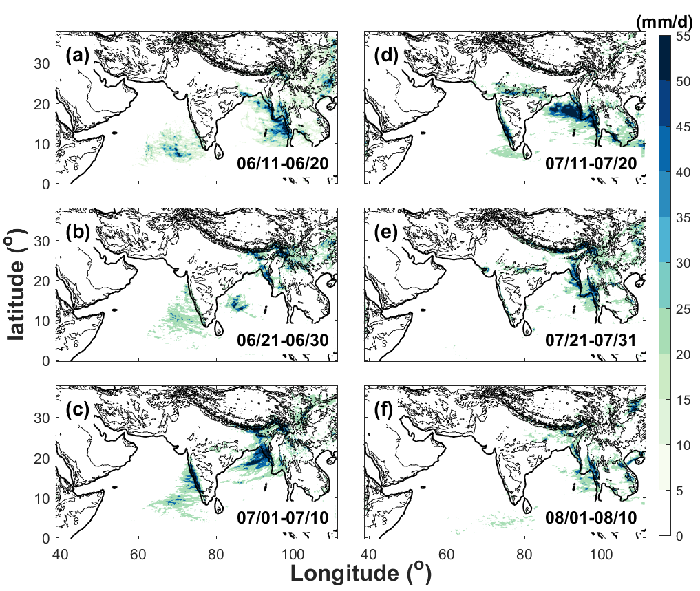
Intraseasonal variability:
Precipitation

Slide 10
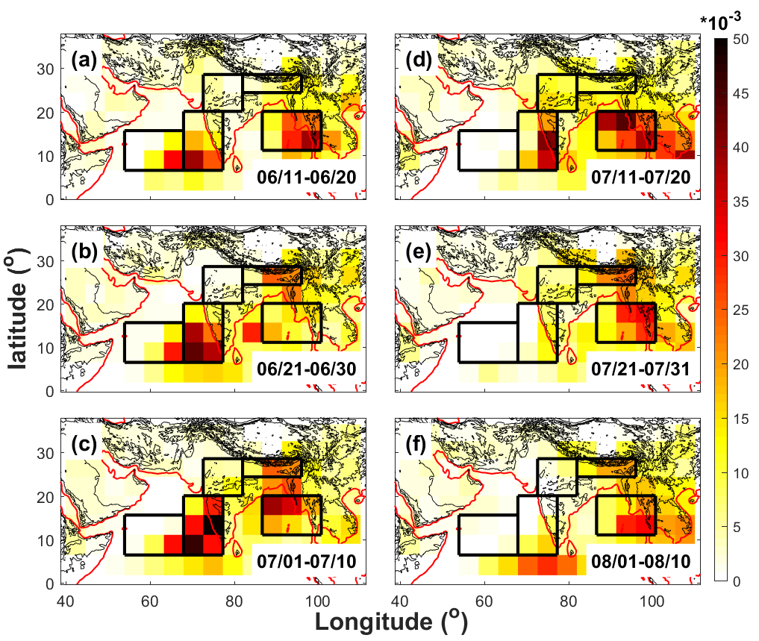
Intraseasonal variability:
Upward mass transportation ( 3 km)

Slide 11
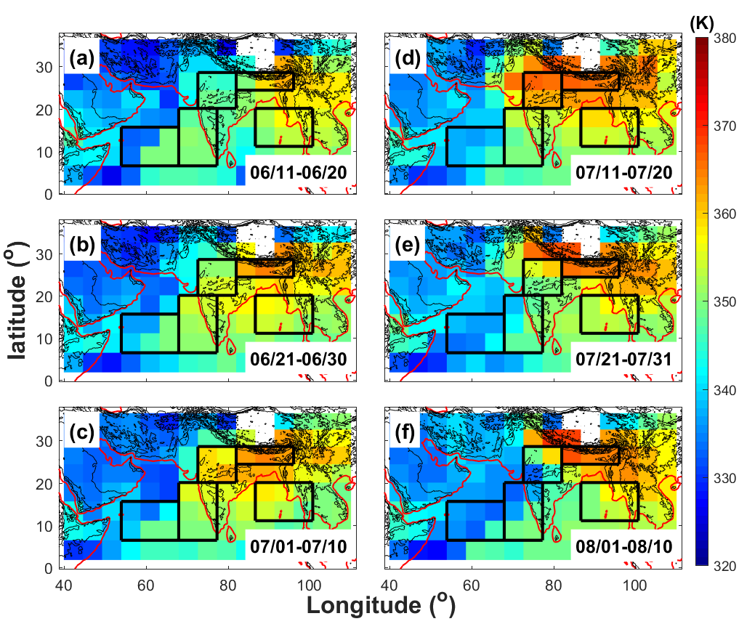
The isentropic-mean equivalent potential temperatures in convective updraft (3km):
$$M^{+}\left(z,t\right)=\int_{−∞}^{∞}{〈ρW_{C}〉H\left(〈ρW_{C}〉\right)dθ_{e} } θ_{e}^{+}\left(z,t\right)=\frac{1}{M^{+}}\int_{−∞}^{∞}{〈ρW_{C}θ_{e}〉H\left(〈ρW_{C}〉\right)}dθ_{e}^{′}$$

Slide 12
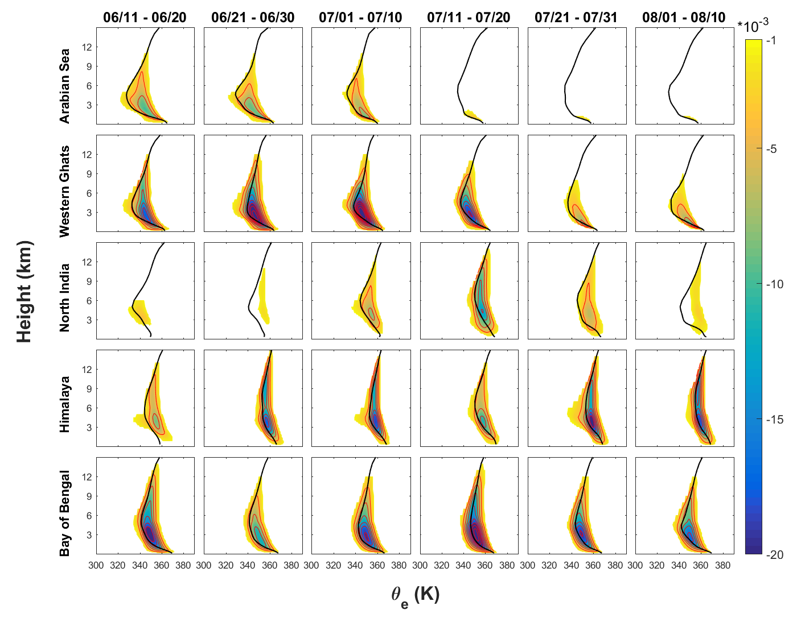
Intraseasonal variability:

Slide 13
Conclusion:
Compared to MJO, the convective-scale and regional-scale (or mesoscale and synoptic scale) atmospheric overturning is much stronger and deeper in Indian summer monsoon;
Different from MJO, the atmospheric overturning shows clear spatial variability with the convective-scale overturning is much deeper and shift to higher $θ_{e}^{}$ over the inland region, while the strength of convective-scale overturning is strongest over the coastal regions;
Over the Indian subcontinent, the regional-scale overturning dominates the upward mass transport from the middle to upper troposphere which allowing a deeper overturning;
Indian summer monsoon also shows strong intraseasonal variability in the atmospheric overturning.

Slide 14
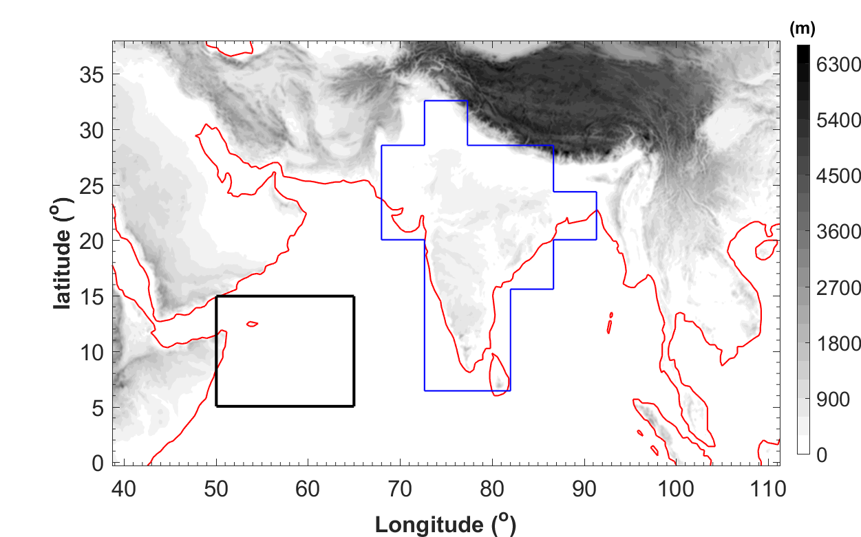
Regional simulation at gray zone resolution
Spatial spacing: 9 km
Integration: April 20th to October 30th
The black box shows the climatic zone used for the calculation of KELLF index The blue polygon shows the Indian subcontinent

Slide 15
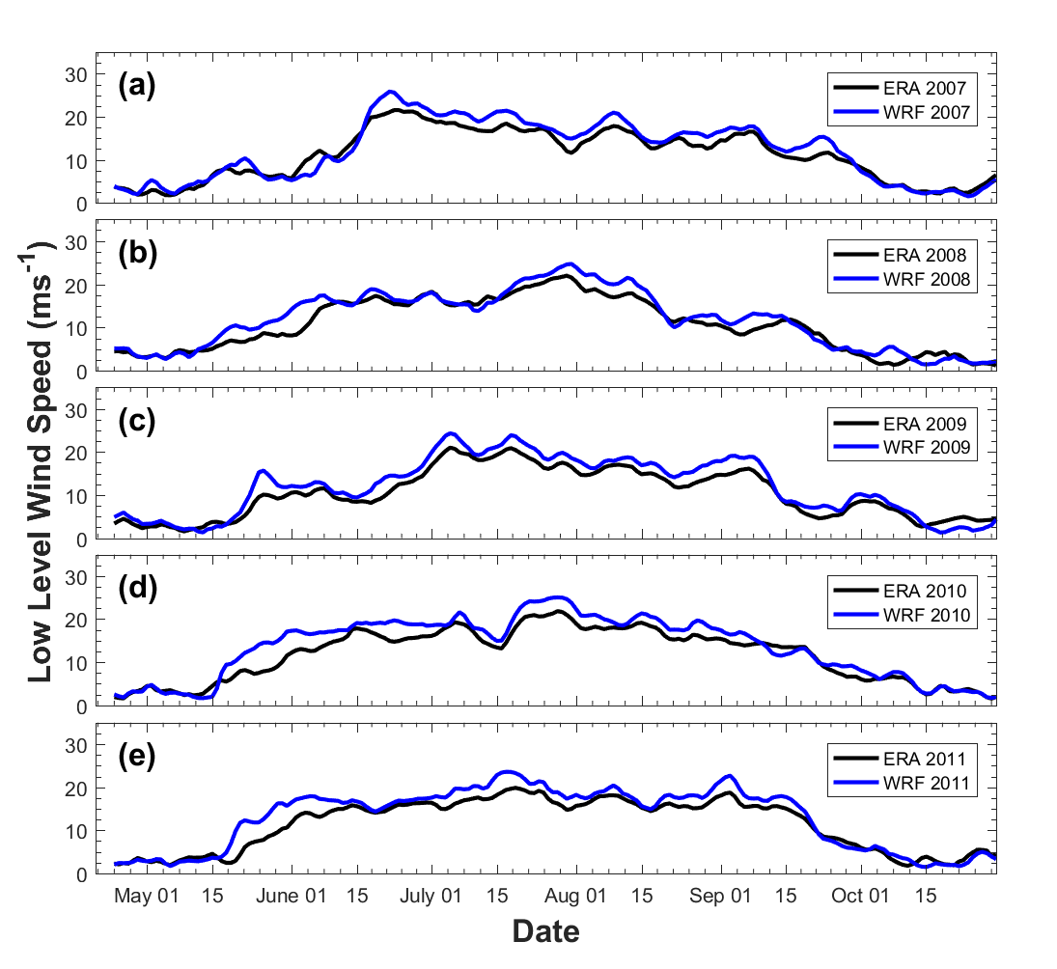
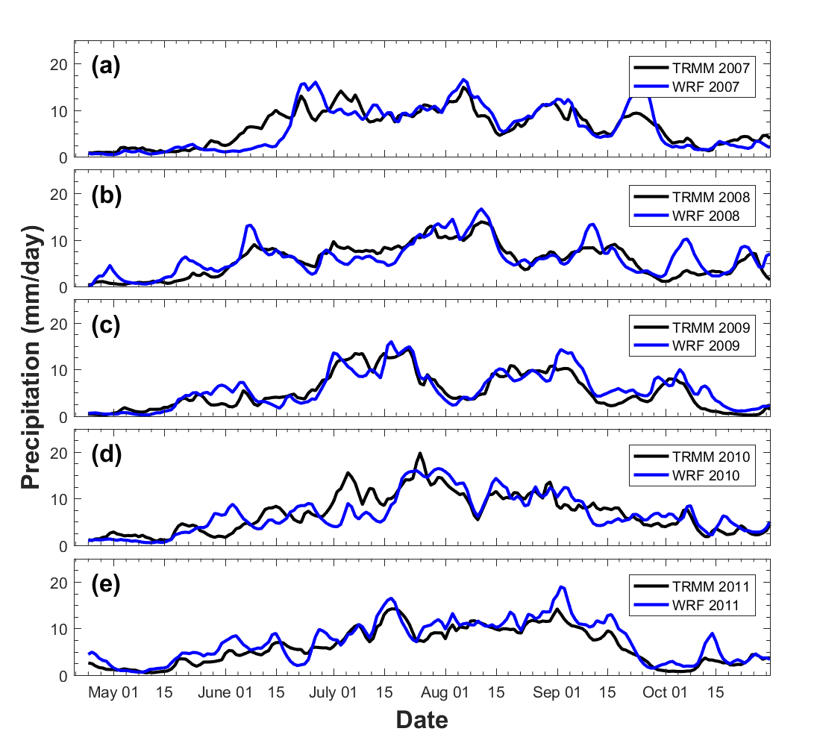
Regional simulation at gray zone resolution
Time evolution of Somali Jet
Time evolution of monsoon precipitation

Slide 16
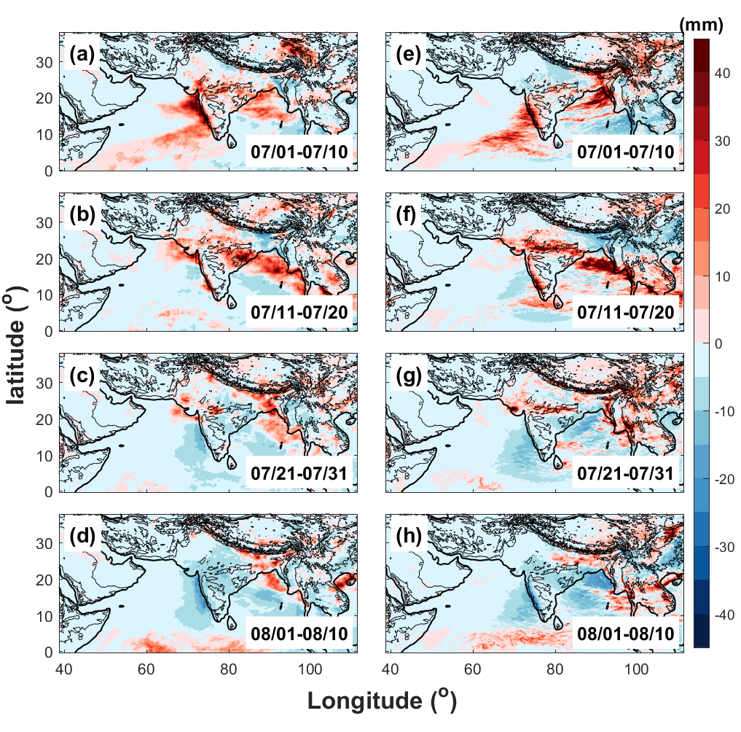
Regional simulation at gray zone resolution
Spatial distributions of 10-day averaged daily surface rainfall anomalies in (a, e) 1-10 July, (d, f) 11-20 July, (c, g) 21-31 July and (d, h) 01-10 August, 2009 derived from TRMM (left panels) and WRF-gray (right panels).

Slide 17
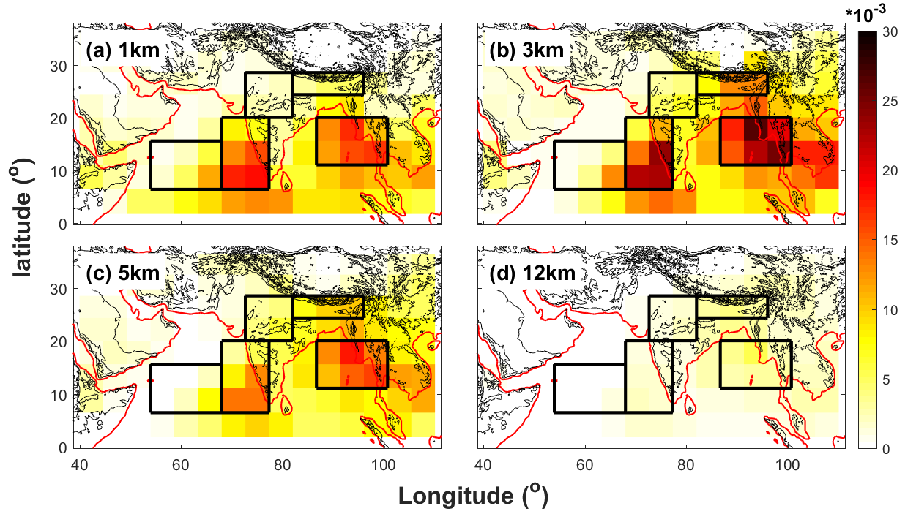
Isentropic upward mass transport:
$$M(z)=\max_{θ_{e}}\left[ψ\left(z,θ_{e}\right)\right]−\min_{θ_{e}}\left[ψ\left(z,θ_{e}\right)\right]$$

Slide 18
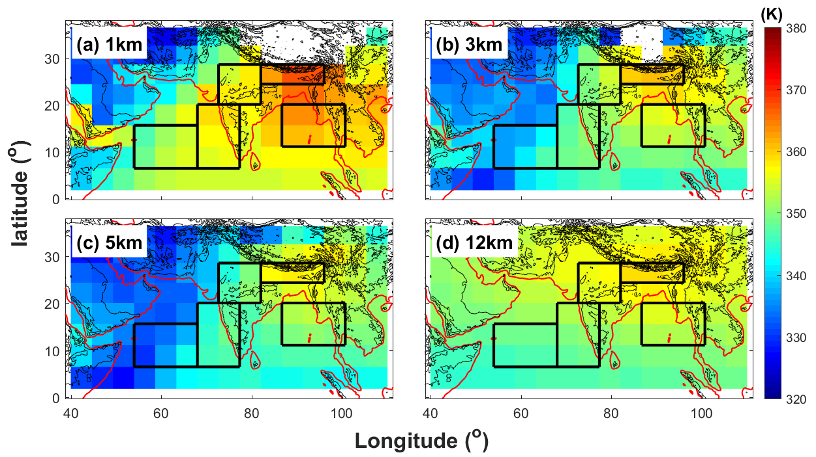
Two-stream approximation :
$$M^{+}\left(z,t\right)=\int_{−∞}^{∞}{〈ρW_{C}〉H\left(〈ρW_{C}〉\right)dθ_{e} } M^{−}\left(z,t\right)=\int_{−∞}^{∞}{〈ρW_{C}〉H\left(−〈ρW_{C}〉\right)dθ_{e} }$$
The isentropic-mean equivalent potential temperatures:
$$θ_{e}^{+}\left(z,t\right)=\frac{1}{M^{+}}\int_{−∞}^{∞}{〈ρW_{C}θ_{e}〉H\left(〈ρW_{C}〉\right)}dθ_{e}^{′} θ_{e}^{−}\left(z,t\right)=\frac{1}{M^{−}}\int_{−∞}^{∞}{〈ρW_{C}θ_{e}〉H\left(−〈ρW_{C}〉\right)}dθ_{e}^{′}$$
$$θ_{e}^{+}\left(z,t\right)$$

