Slide 1

Impacts of moisture updates on
Tropical cyclone initialization with assimilation of all-sky radiance from Himawari-8
Masashi Minamide and Fuqing Zhang
Himawari-8 image of Typhoon Soudelor (2015) from CIMSS Satellite blog
Notes:
Direct Assimilation of all-sky infrared radiance satellite observation for the analysis and forecast of tropical cyclones

Slide 2
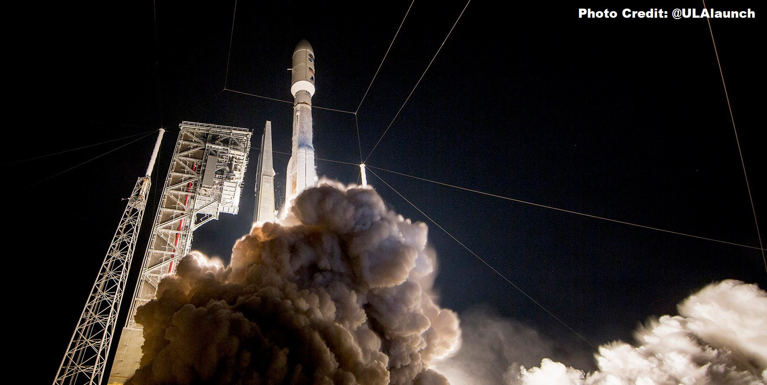
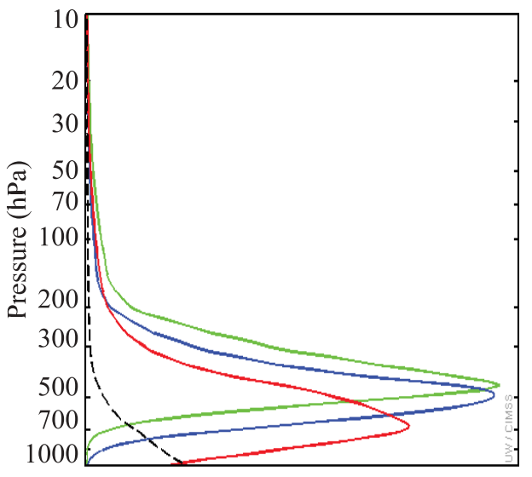
New Satellites! ~Himawari-8 & GOES-16~
Weighting functions
on WV channels
in CLEAR-sky
Water Vapor Channels
Band-8 | 6.19µm
Band-9 | 6.95µm
Band-10 | 7.34µm
Launch Dates:
Oct 2014 (Himawari-8, Japan)
Nov 2016 (GOES-16, USA)
Coverage: Hemispheric
Frequency: 10-15 minutes
Resolution: 2 km
(Otkin 2012)
Notes:
I would like to start my presentation with firstly introducing a good news.
GOES-R launched November 19.

Slide 3
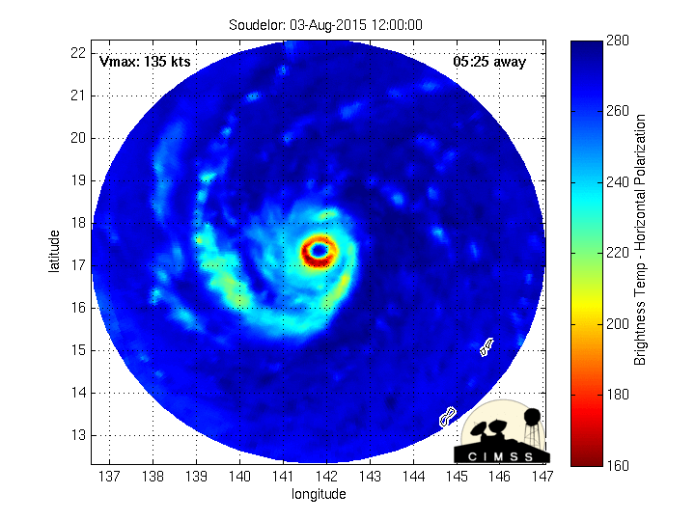
Super-typhoon Soudelor (2015)
RI
ERC
Genesis and developing stage
http://tparc.mri-jma.go.jp/cyclone/index.php
http://agora.ex.nii.ac.jp/digital-typhoon/summary/wnp/s/201513.html.en
Observed by Himawari-8
Strongest typhoon in 2015
Experienced rapid intensification (RI) & eyewall replacement cycle (ERC)
http://cimss.ssec.wisc.edu/goes/blog/archives/19064
Notes:
The case we are working on is super-typhoon soudelor (2015).
Soudelor is the strongest tropical cyclone in 2015 in west north pacific region. It formed in the central pacific ocean, surrounded by pretty favorable conditions for tropical cyclones.
After the genesis and developing stage from 30th Jul to 1st August, it experienced rapid intensification and reached at the strongest intensity as 900 mb of minimum SLP.
Afterward, it also experienced eyewall replacement cycle. Finally, it landed on both Taiwan and China, causing severe damage on both conuntries.
So, in many sense, Soudelor is quite interesting case.
Firstly, we will assimilate the satellite-observed brightness temperatures in genesis and developing stage to check how much we can improve the forecasts of RI processes and ERCs.

Slide 4
Experimental settings
DA cycle: Genesis stage, 12Z–18Z/31 JUL 2015, to predict RI
Model: WRF ver.3.6.1(Skamarock 2008), CRTM (Han et al. 2006)
PSU WRF-EnKF (Weng and Zhang, 2016)
Ensemble-based data assimilation system
  Ensemble size: 60
Regional convective-permitting model
  Resolution: 27, 9 & 3 km (D1-D3)
  Observation error modeling
  Adaptive Observation Error Inflation (AOEI)
Minamide and Zhang, 2016, MWR
BT+HPI
All-sky infrared BT (ch8: 6.19 μm)
minSLP (Hurricane Position and Intensity)
HPI
Every 1 hour
18Z/31
12Z/31 Jul
Notes:
This is the experimental settings. We set the data assimilation period from 12z 28th July to 00z 1st August. With models….
For the assimilation strategy, we prepared 2 types of observations. One is infrared brightness temperatures from Himawari-8 channel 8, and the other one is minimum SLP from ADT best-track data.
To save the computational resources, we only assimilated 1 of the 3 water vapor channels, and assimialted every 1-hour.

Slide 5
Experimental settings
DA cycle: Genesis stage, 12Z–18Z/31 JUL 2015, to predict RI
Model: WRF ver.3.6.1(Skamarock 2008), CRTM (Han et al. 2006)
PSU WRF-EnKF (Weng and Zhang, 2016)
Notes:
This is the model domain with moving nested domains of domain 2 & 3.

Slide 6
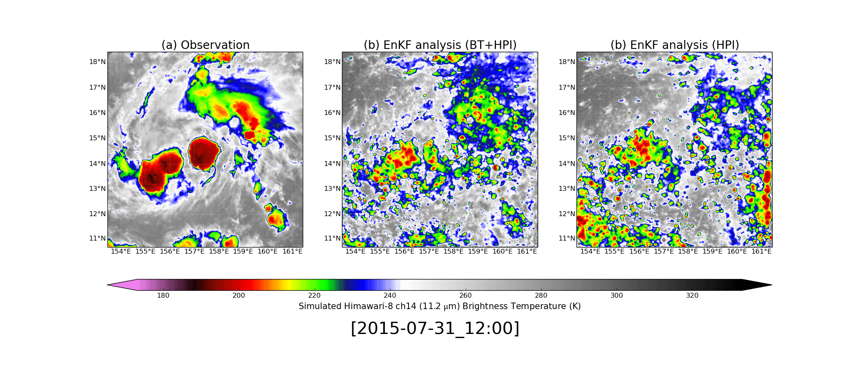
EnKF Performance Assimilating Himawari-8 BT
Himawari-8 Window Channel (ch14: 11.2 µm)
EnKF analysis (BT+HPI)
EnKF analysis (HPI)
Observation

Slide 7
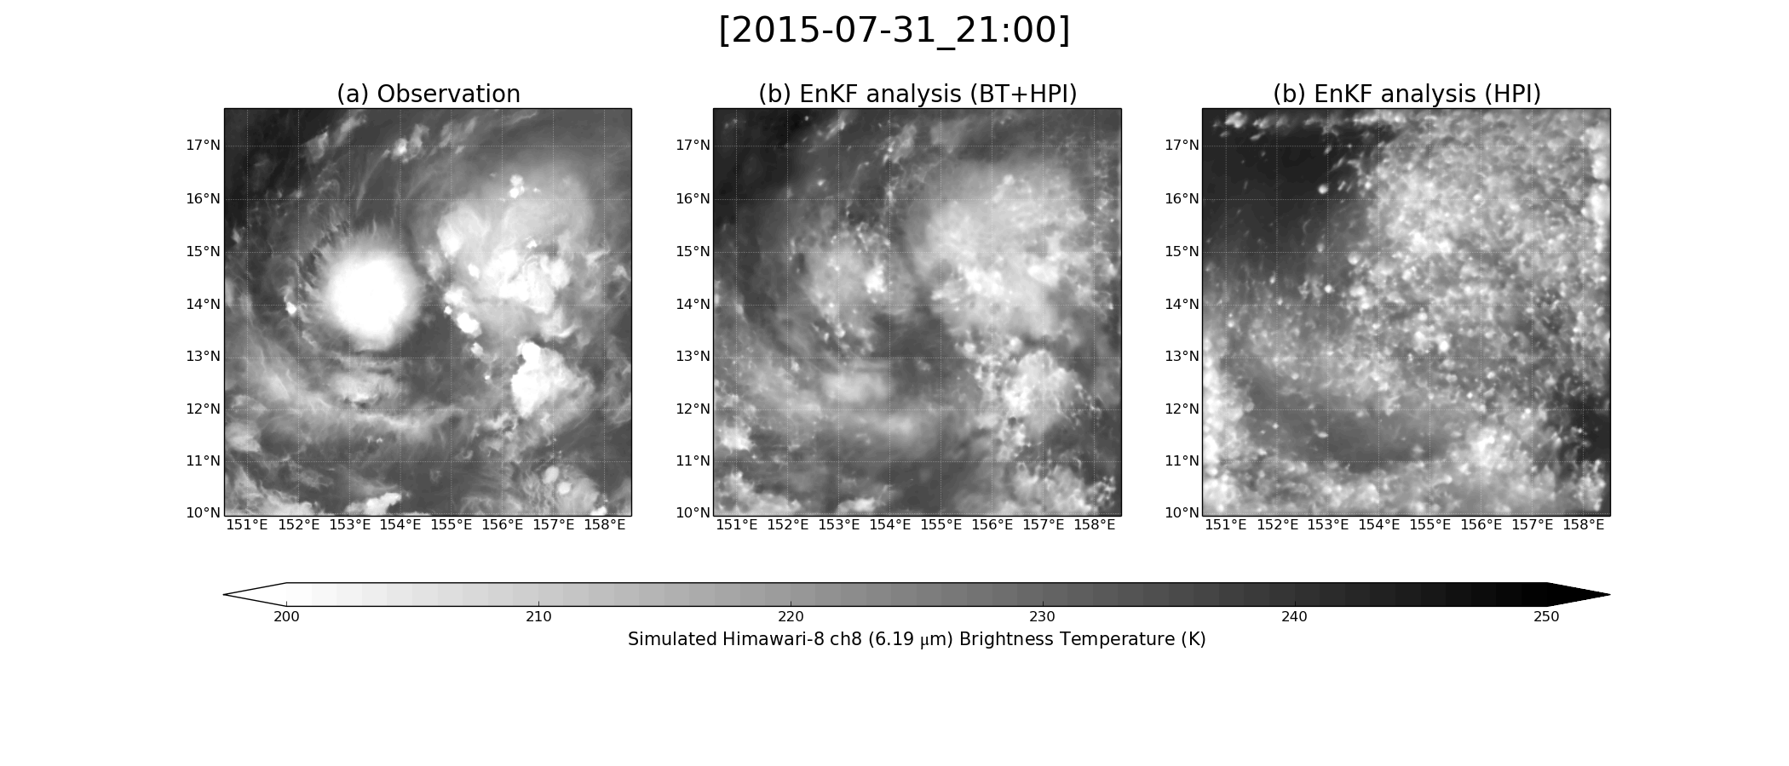
EnKF Performance Assimilating Himawari-8 BT
Himawari-8 Water Vapor Channel (ch8: 6.19 µm)
EnKF analysis (BT+HPI)
EnKF analysis (HPI)
Observation
Convections
Moist region
Dry region

Slide 8
EnKF Performance on TC intensity forecast
Minimum SLP
Max 10-m wind speed
Assimilation of BT greatly helped to capture RI.

Slide 9
Sensitivity experiments
minSLP (Hurricane Position & Intensity)
HPI
All-sky infrared BT (ch8: 6.19 μm)
BT+HPI (CNTL)
BT+HPI (QONLY)
BT+HPI (QOFF)
Every 1 hour
18Z/31
12Z/31 Jul
Notes:
This is the experimental settings. We set the data assimilation period from 12z 28th July to 00z 1st August. With models….
For the assimilation strategy, we prepared 2 types of observations. One is infrared brightness temperatures from Himawari-8 channel 8, and the other one is minimum SLP from ADT best-track data.
To save the computational resources, we only assimilated 1 of the 3 water vapor channels, and assimialted every 1-hour.

Slide 10
TC Inner-core structure comparison of QONLY
Relative humidity
Azimuthal wind
QONLY - CNTL
QONLY - HPI
Inner-core moisture cannot be obtained only by updating moisture.

Slide 11
TC intensity evolution of QONLY
Minimum SLP
Max 10-m wind speed
Moistened field improved RI forecasting.

Slide 12
TC Inner-core structure comparison of QOFF
Relative humidity
Azimuthal wind
QOFF - CNTL
QOFF - HPI
Strong but dry vortex is analyzed with QOFF.

Slide 13
TC intensity evolution of QOFF
Minimum SLP
Max 10-m wind speed
Assimilation of BT greatly helped to constrain vortex.

Slide 14
Summary
  Assimilation of water vapor channel all-sky brightness temperatures from Himawari-8 enables to capture RI of super-typhoon Soudelor (2015).
  Only updating moistures (QONLY) can still improve TC forecast. Assimilation of BTs can constrain moistures, which has a strong sensitivity on the intensification of TCs.
  Turning off the update of moistures (QOFF) indicates that assimilation of BTs can also contribute to reasonably well constraining vortex.
  Simultaneous update of moisture and other variables (CNTL) further improved both of those fields to simulate realistic RI.
Thank you very much for your attention. (minamide@psu.edu)

