Slide 1
Dynamics and predictability of Rapid Intensification of Super Typhoon Usagi (2013)
Simon Liu
Dandan Tao
Masashi Minamide
Advisor: Dr. Fuqing Zhang
Dr. Kun Zhao

Slide 2
Outline
Background and Motivation
Ensemble Forecast and correlation analysis
Role of Moisture: Switch Qvapor experiment
Conclusion

Slide 3
Outline
Background and Motivation
Ensemble Forecast and correlation analysis
Role of Moisture: Switch Qvapor experiment
Conclusion

Slide 4
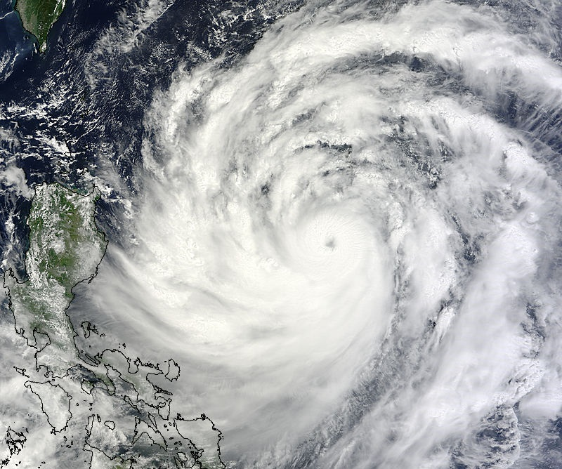
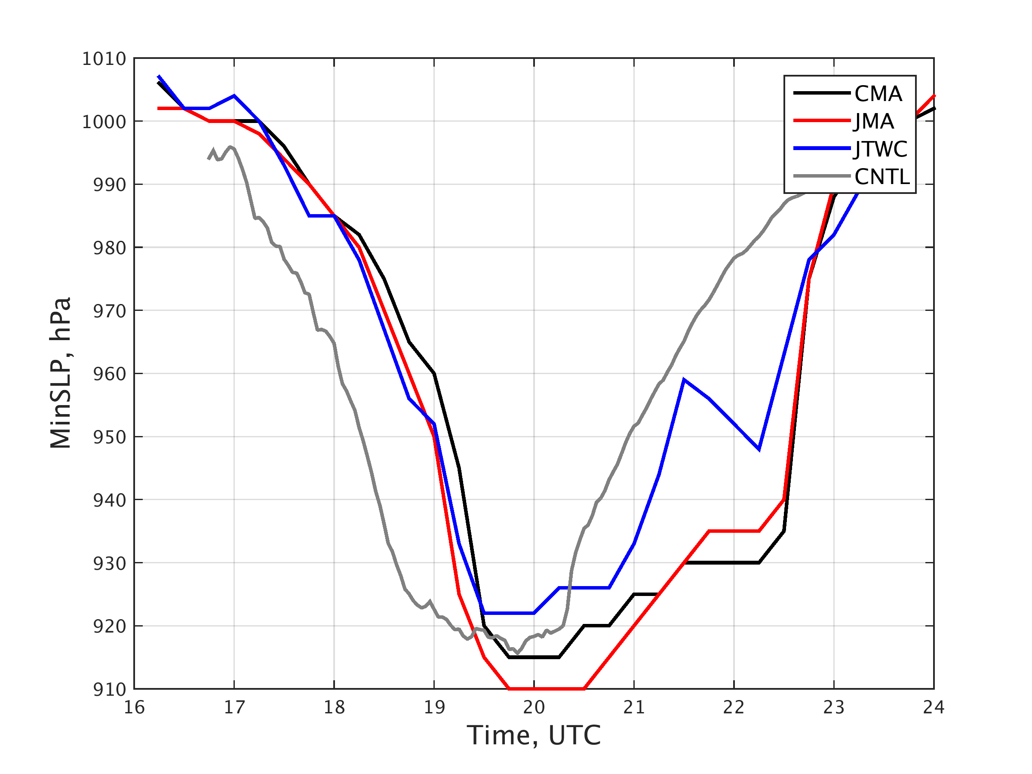
Super Typhoon Usagi (2013)
Usagi intensified by 65 knots (33 m/s) at 24 hours, double of standard of rapid intensification (30 knots).
Control Run predict much early RI with strong intensity

Slide 5
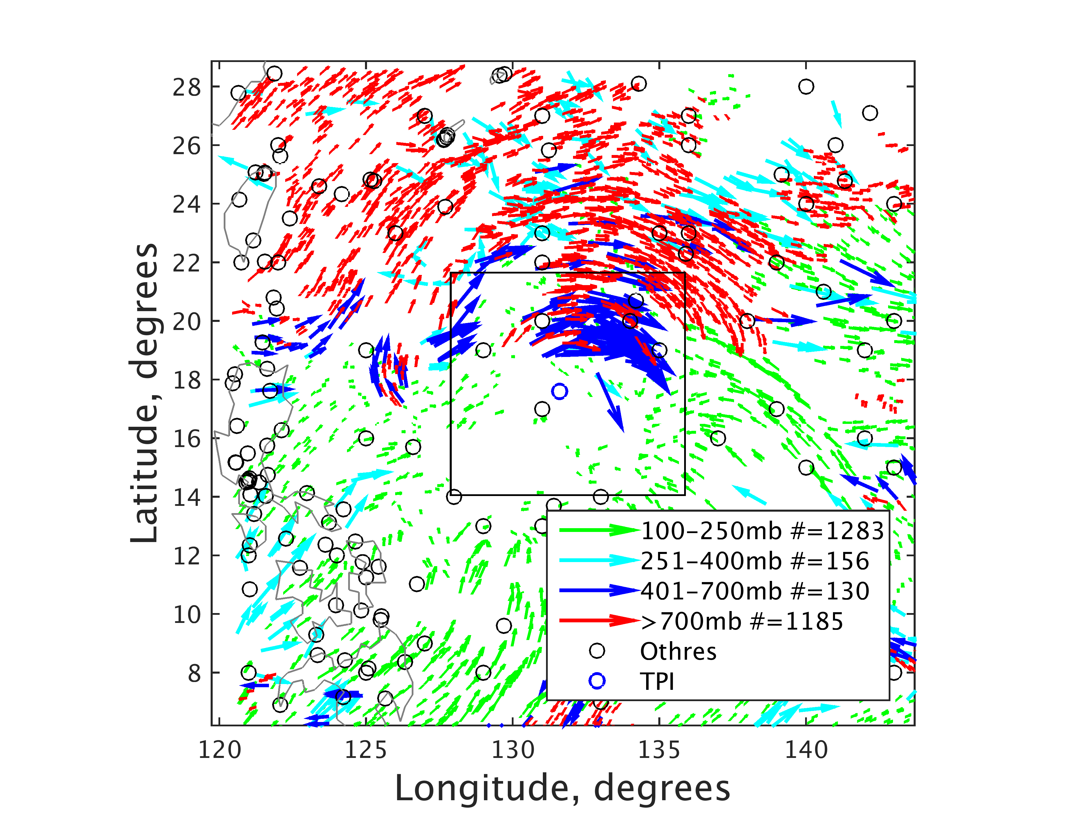
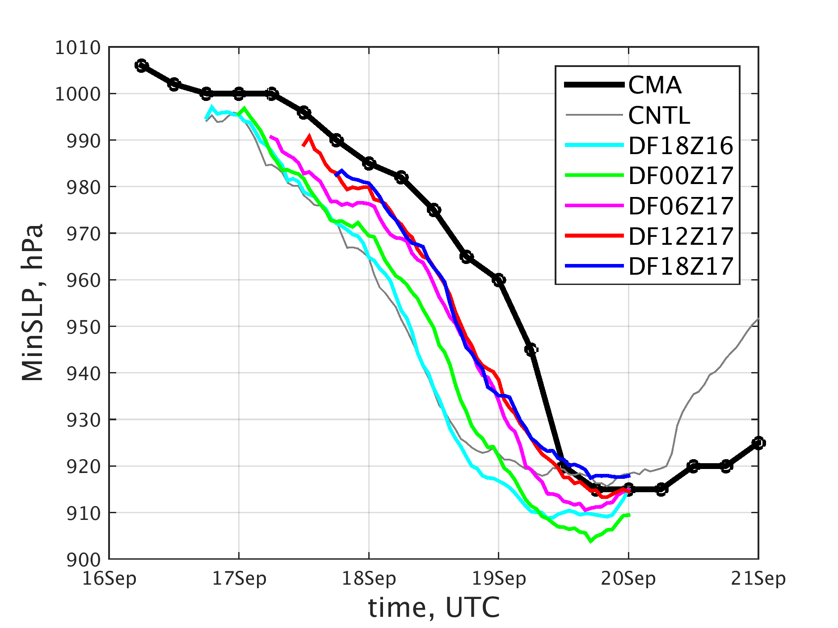
Data Assimilation using PSU-EnKF system
Questions:
How could DA Atmospheric Motion Vectors help improve RI forecast?
What factors impact the RI and intensity forecast of Usagi?

Slide 6
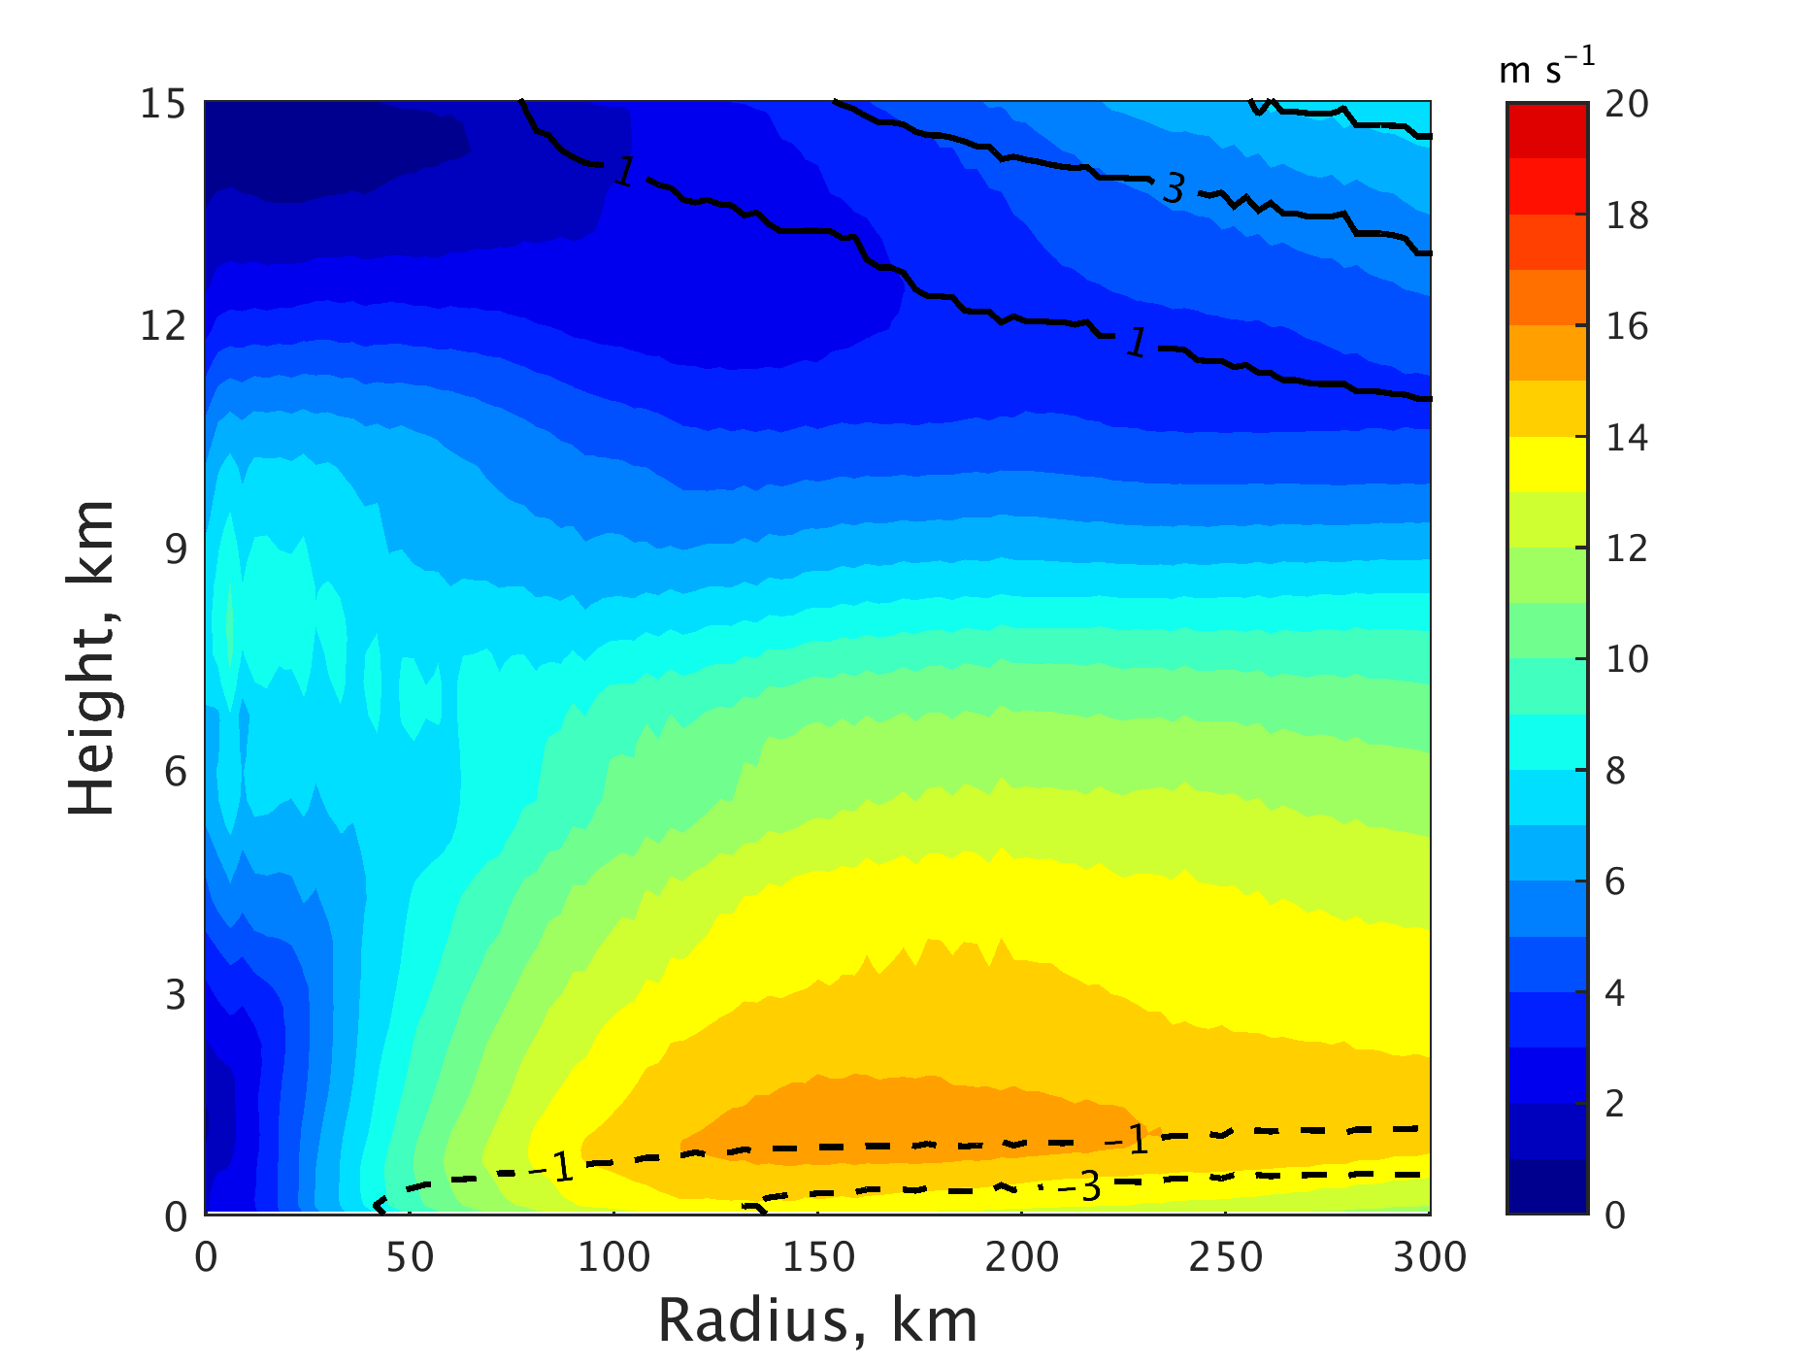
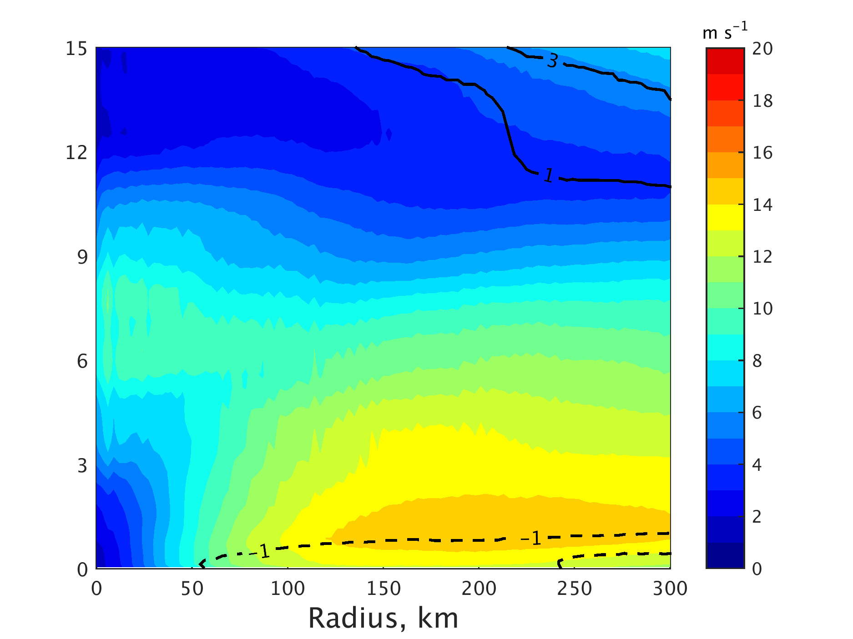
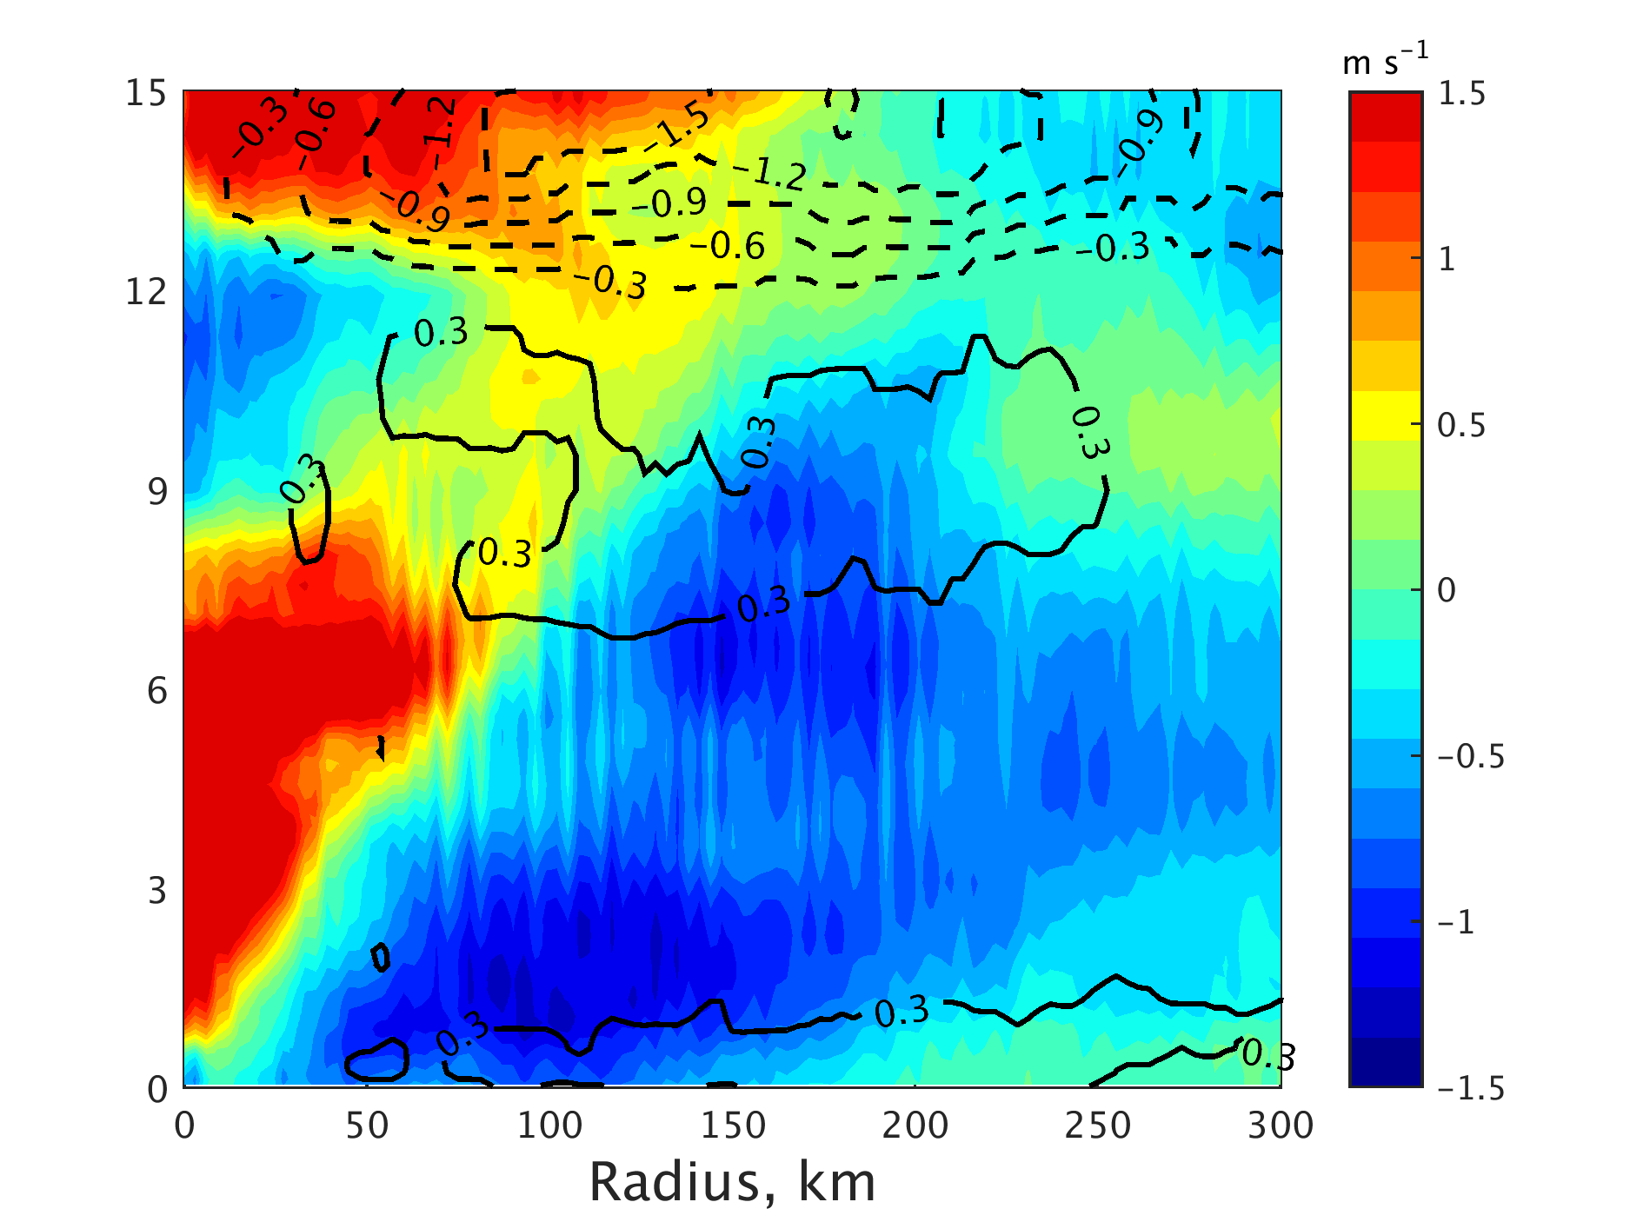
Analysis of DA experiment
Input
Analysis
Increment
During most of EnKF anlysis cycles, the primary and secondary circulation were reduced. e.g. tangential wind decreased by 1.5 m s⁻¹
Notes:
In order to demonstrate, we emply ensemble forecast

Slide 7
Outline
Background and Motivation
Ensemble Forecast and correlation analysis
Role of Moisture: Switch Qvapor experiment
Conclusion

Slide 8
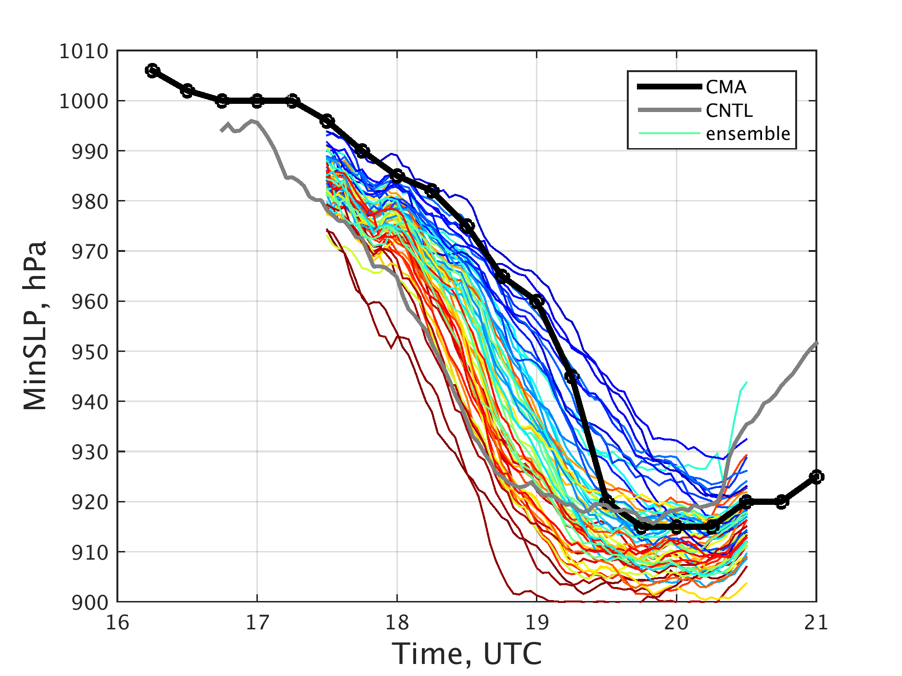
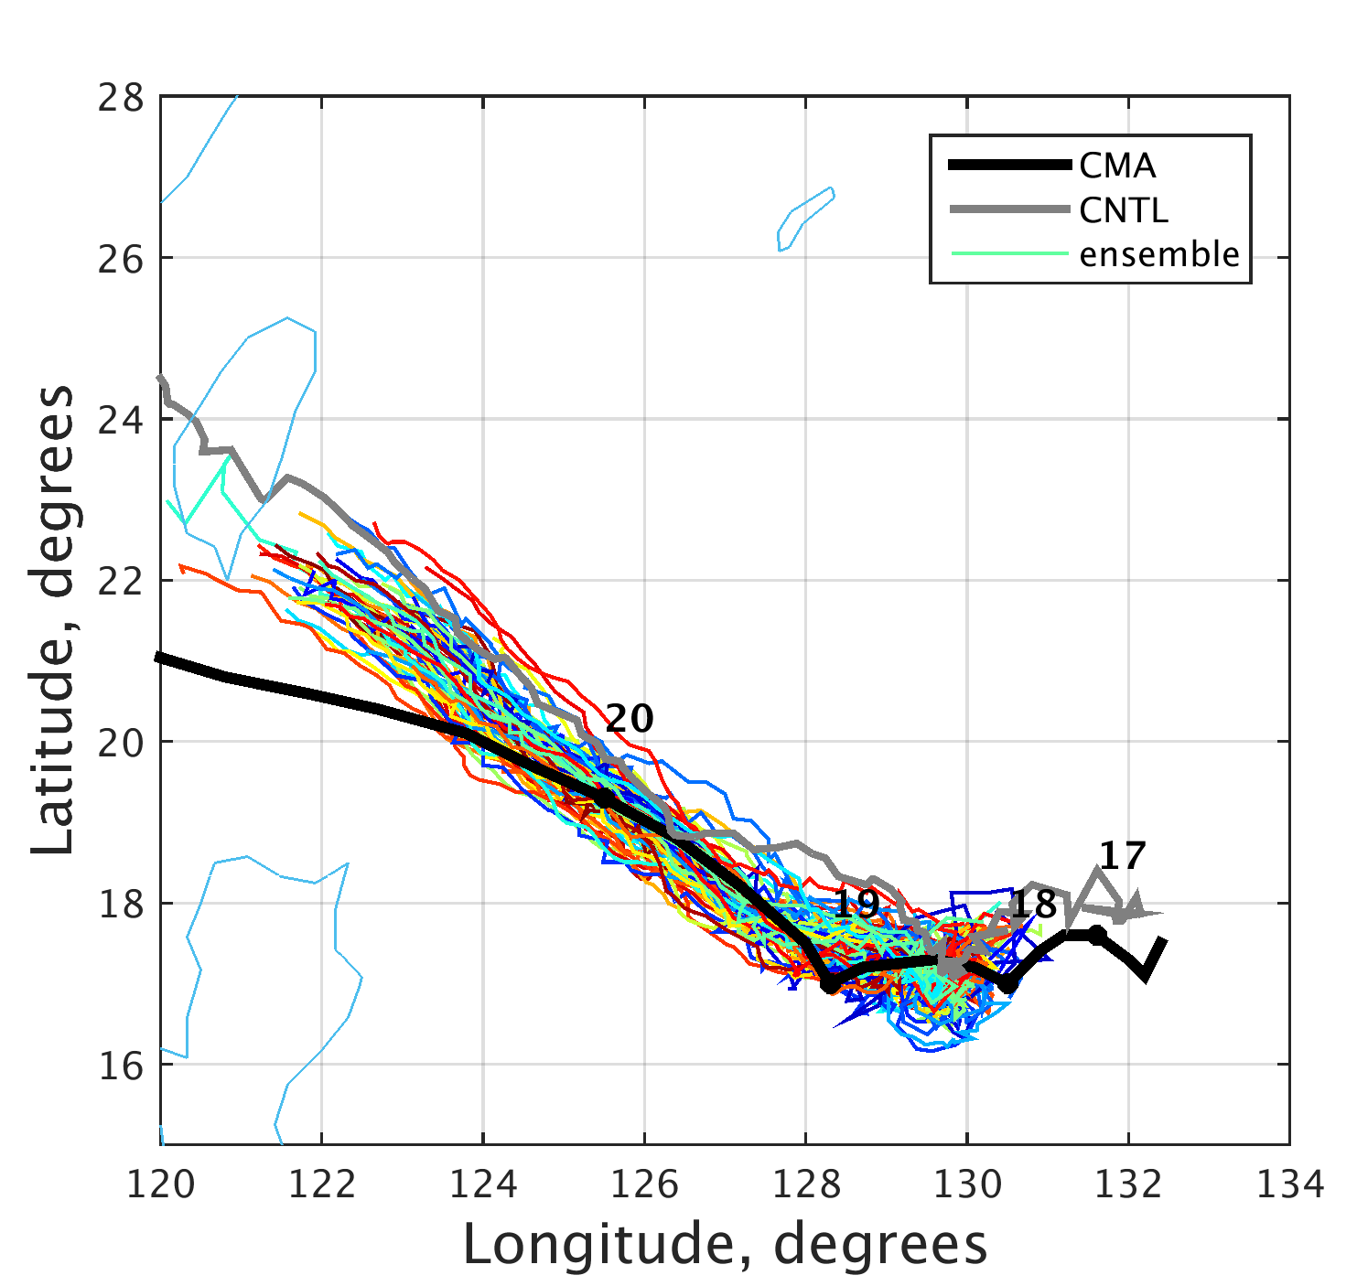
Ensemble Forecast
Features: significant RI onset timing variation and intensity diverge
Definition of RI timing: The time by subsequent 24 h intensity change (measured by min SLP) is maximized.
Notes:
Definition of RI timing: The time by subsequent 24 h intensity change (measured by min SLP) is maximized.

Slide 9
What factors cause the RI timing variation/ intensity divergence?
Environmental factors:
Deep layer shear?
Environment shear?
Dry air intrusion?
SST?
Internal factors:
Tilt (distance between low-level and middle-level vortex center)?
Initial vortex strength?
Inner core moistures?
$×$
$×$
$×$
$×$

Slide 10
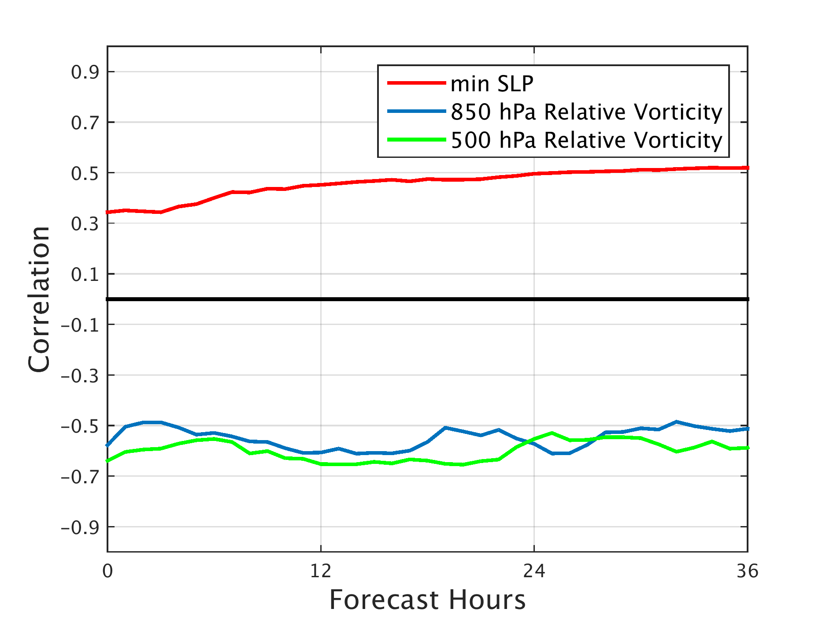
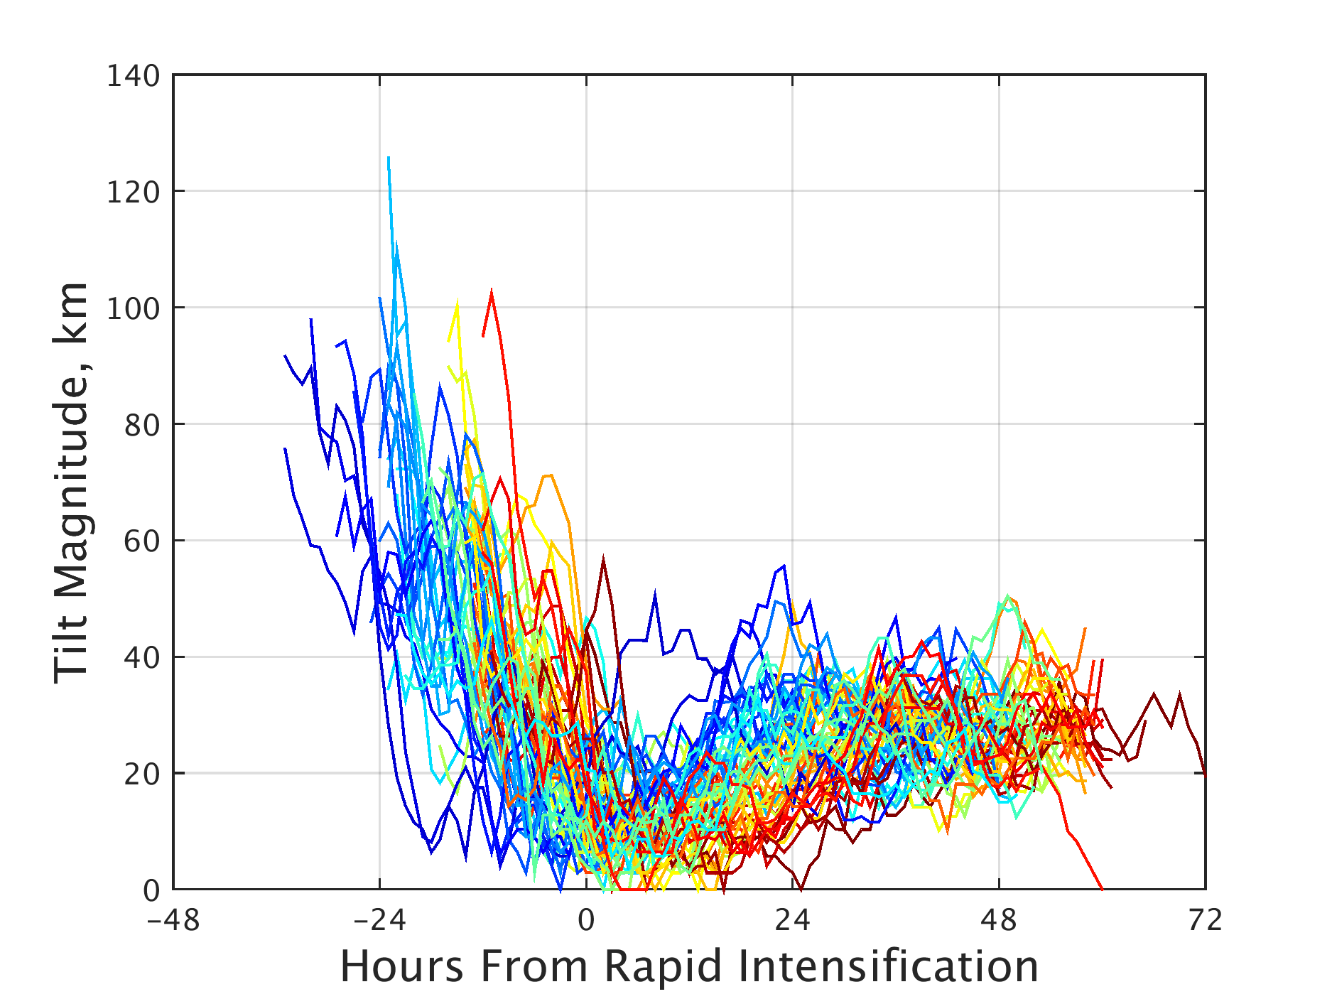
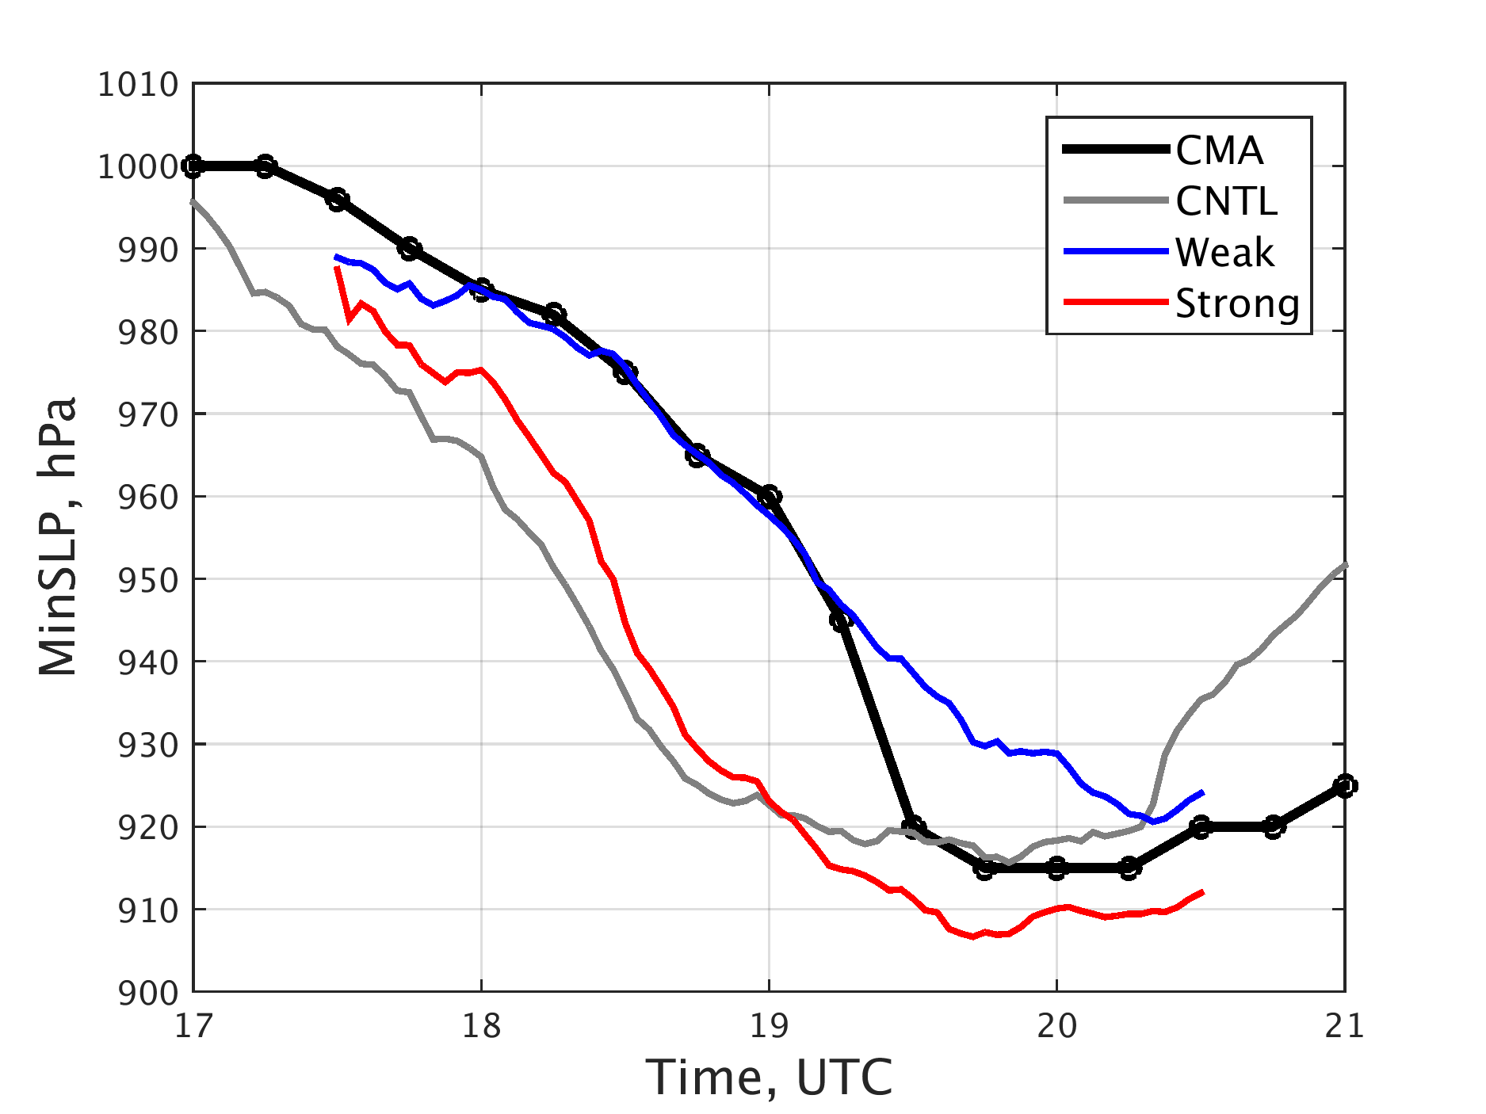
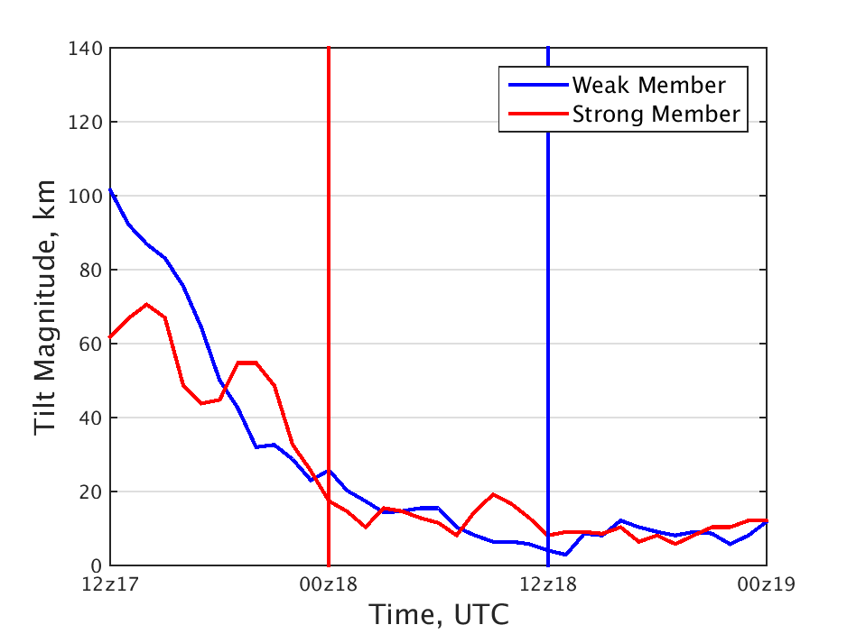
Correlation <vortex intensity, RI timing> and tilt
a
b
Correlation <Vortex Intensity, RI timing>=0.5-0.7
Explain the DA experiment
Tilt: distance between middle and low level vortex centers
Reduce of tilt
c
d

Slide 11
Partial Correlation <moisture, RI timing>
X: RI timing
Y: RH
Z1: current minSLP
Median Partial correlation <Moisture, RI timing>

Slide 12
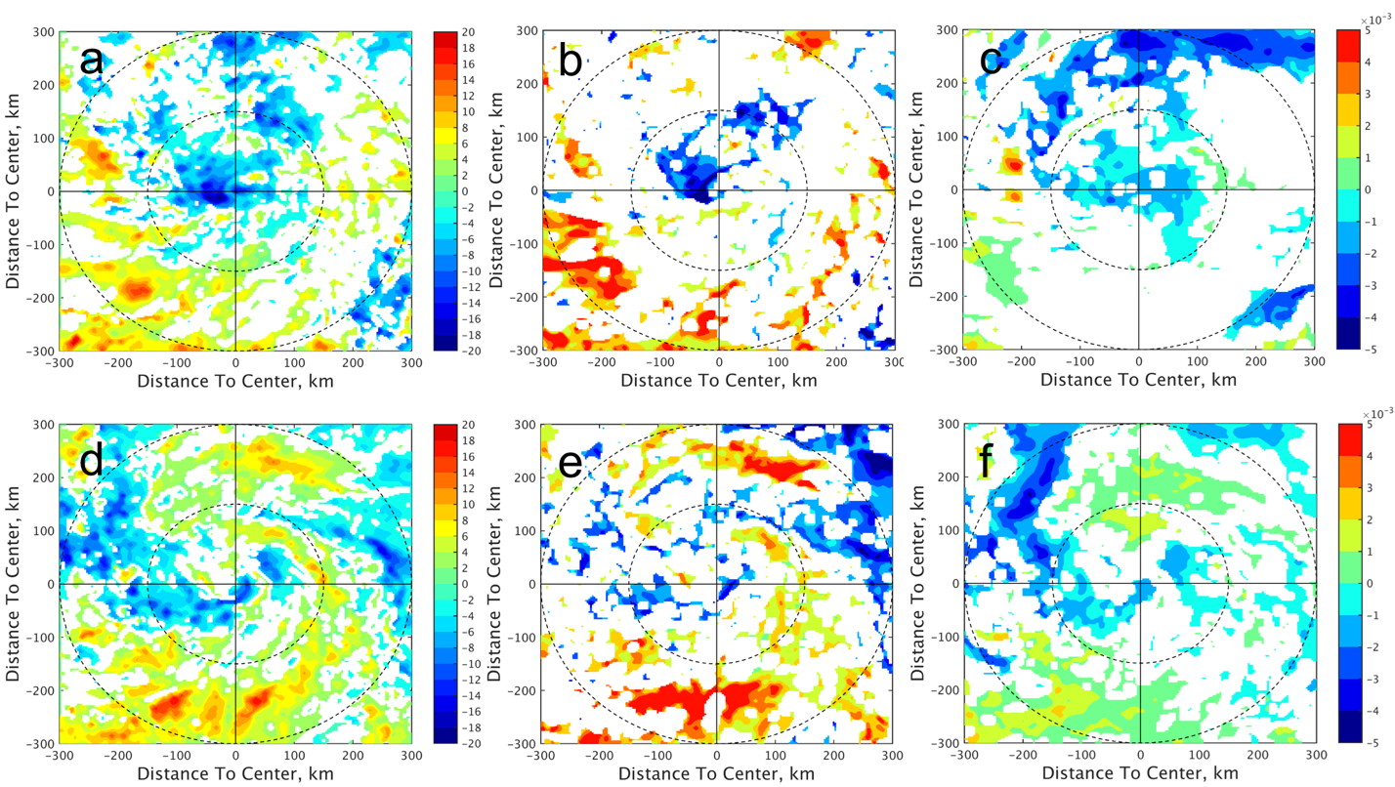
Moisture difference at 0 and 6 h
Water Vapor Path
850 hPa Moisture
500 hPa Moisture
Inner core moisture difference exist from 850 hPa to 500 hPa

Slide 13
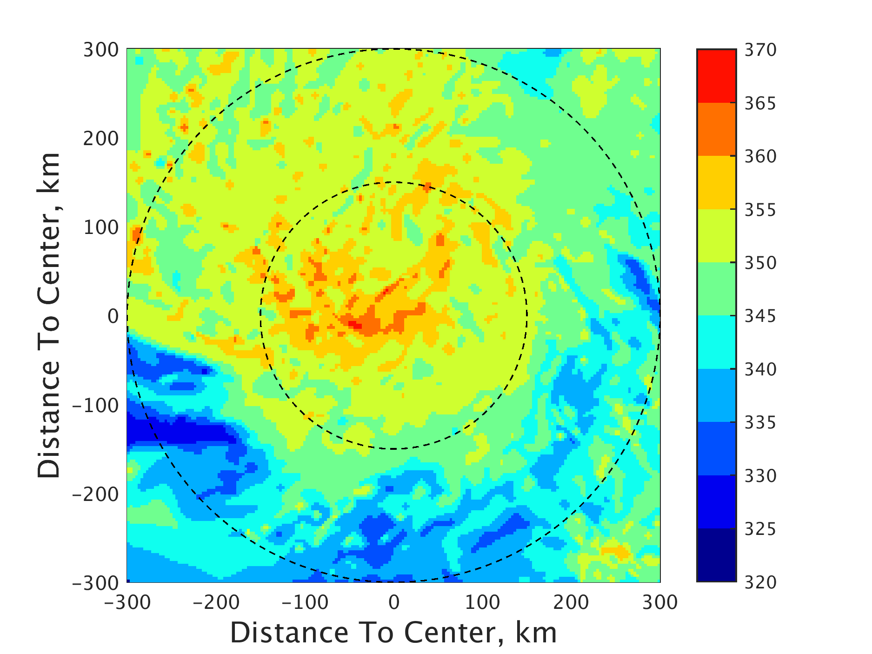
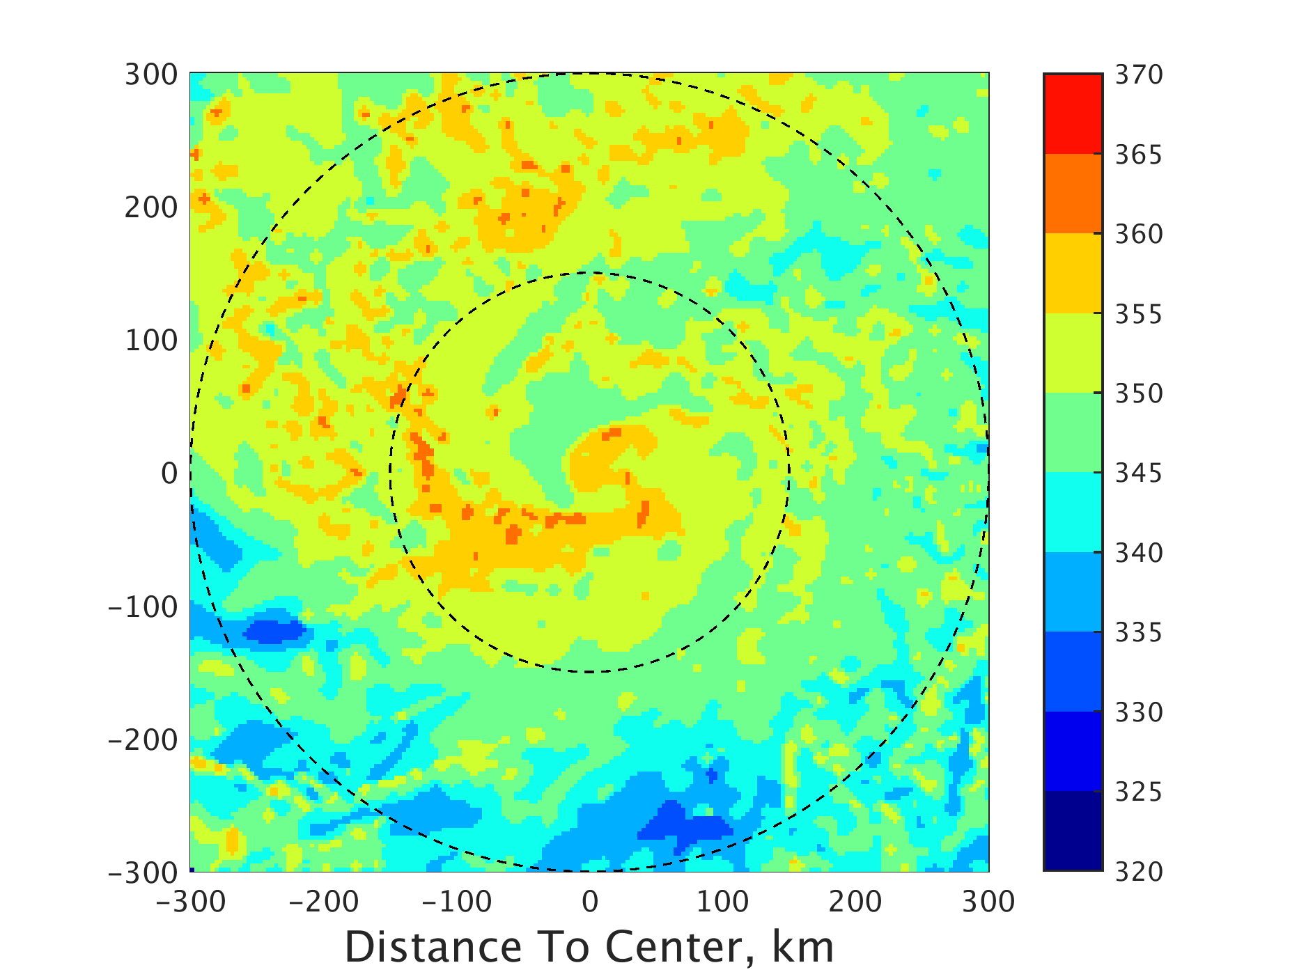
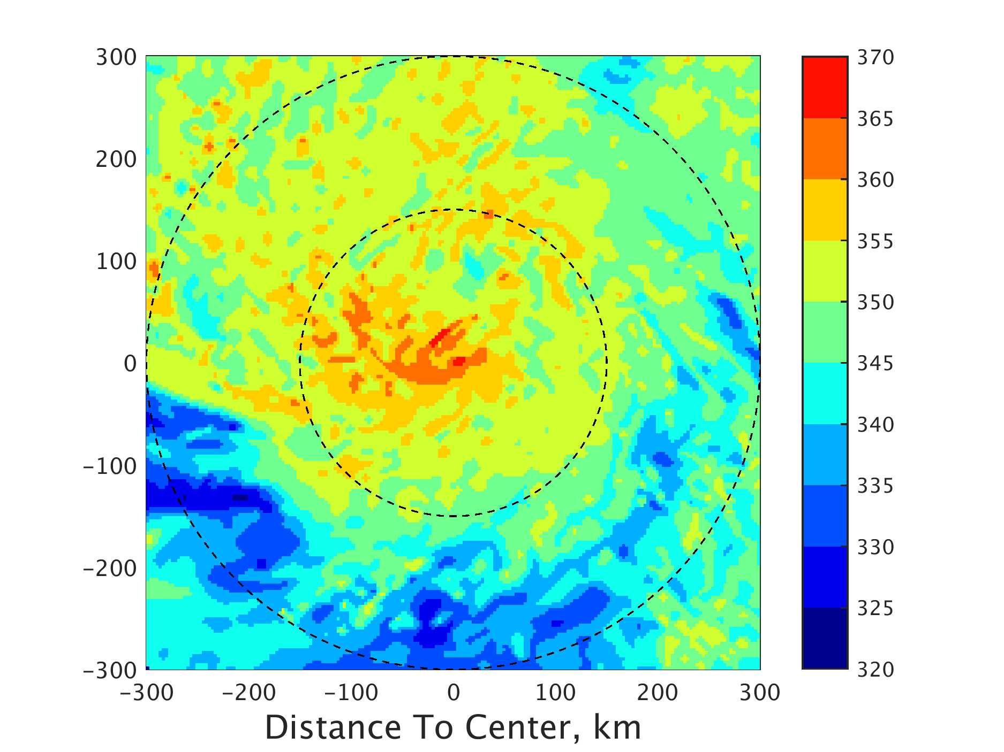
Atmospheric Instability-potential equivalent Temperature
Strong
Weak
EnvWeakQvaporStrong
a
b
c
Atmospheric Instability is modulated by moisture rather than temperature profile
Speculation: moisture-> convection -> RI process
Notes:
With speculation in mind

Slide 14
Outline
Background and Motivation
Ensemble Forecast and correlation analysis
Role of Moisture: Switch Qvapor experiment
Conclusion
Notes:
Correlation demonstrate possible connection, need to verify

Slide 15
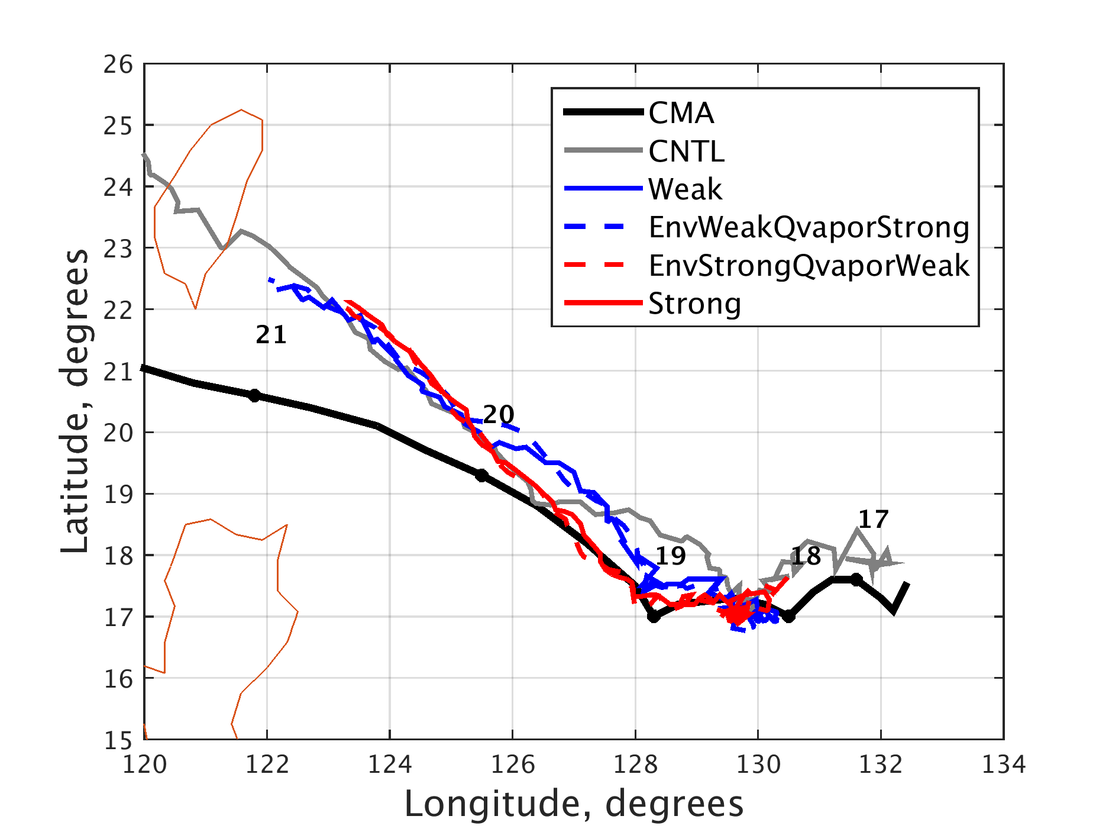
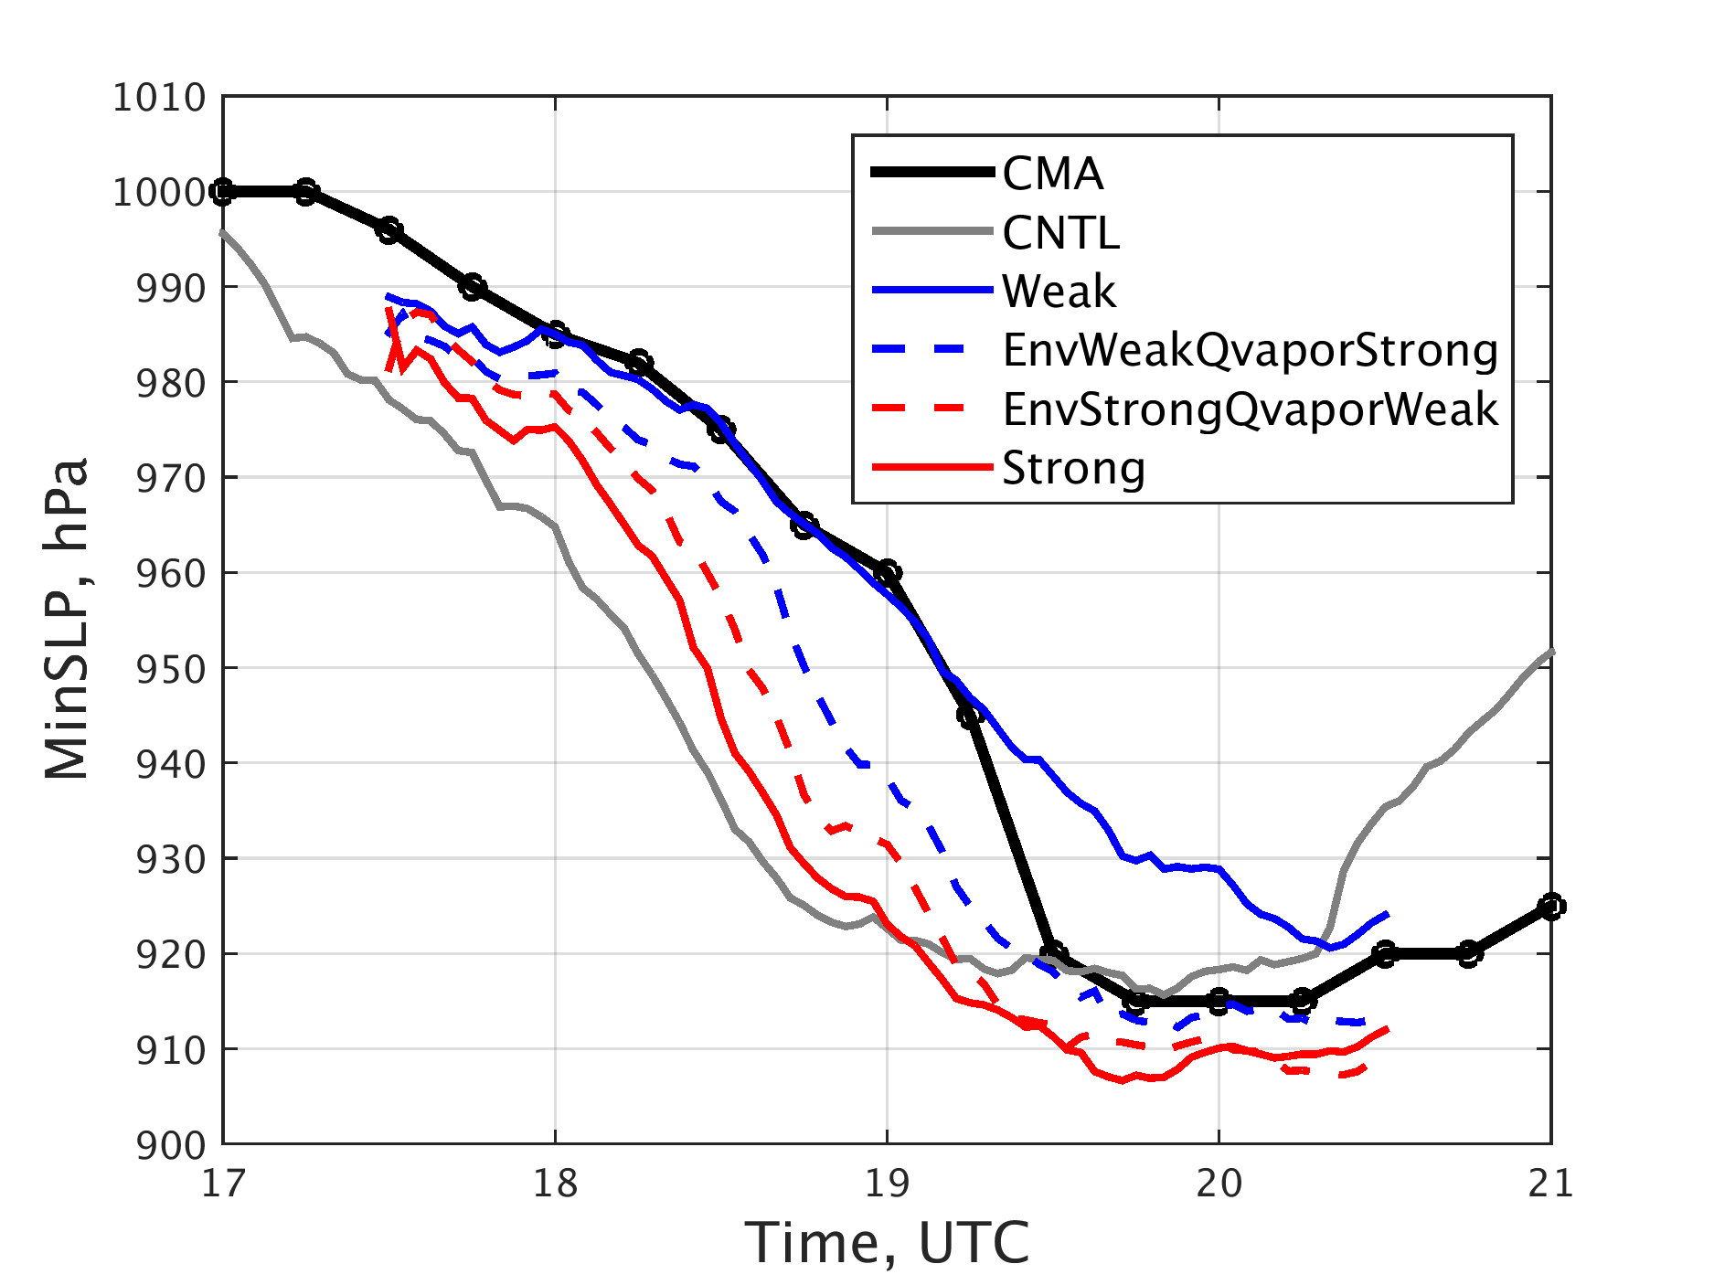
Switch Qvapor Experiment
a
b
Switch Qvapor experiment explain correlation <moisture and RI timing>

Slide 16
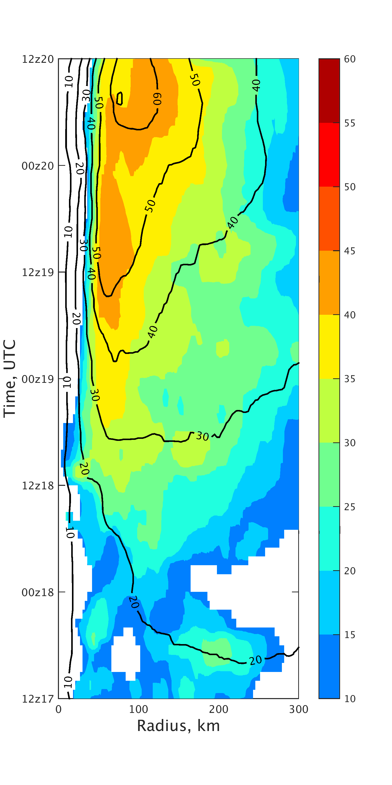
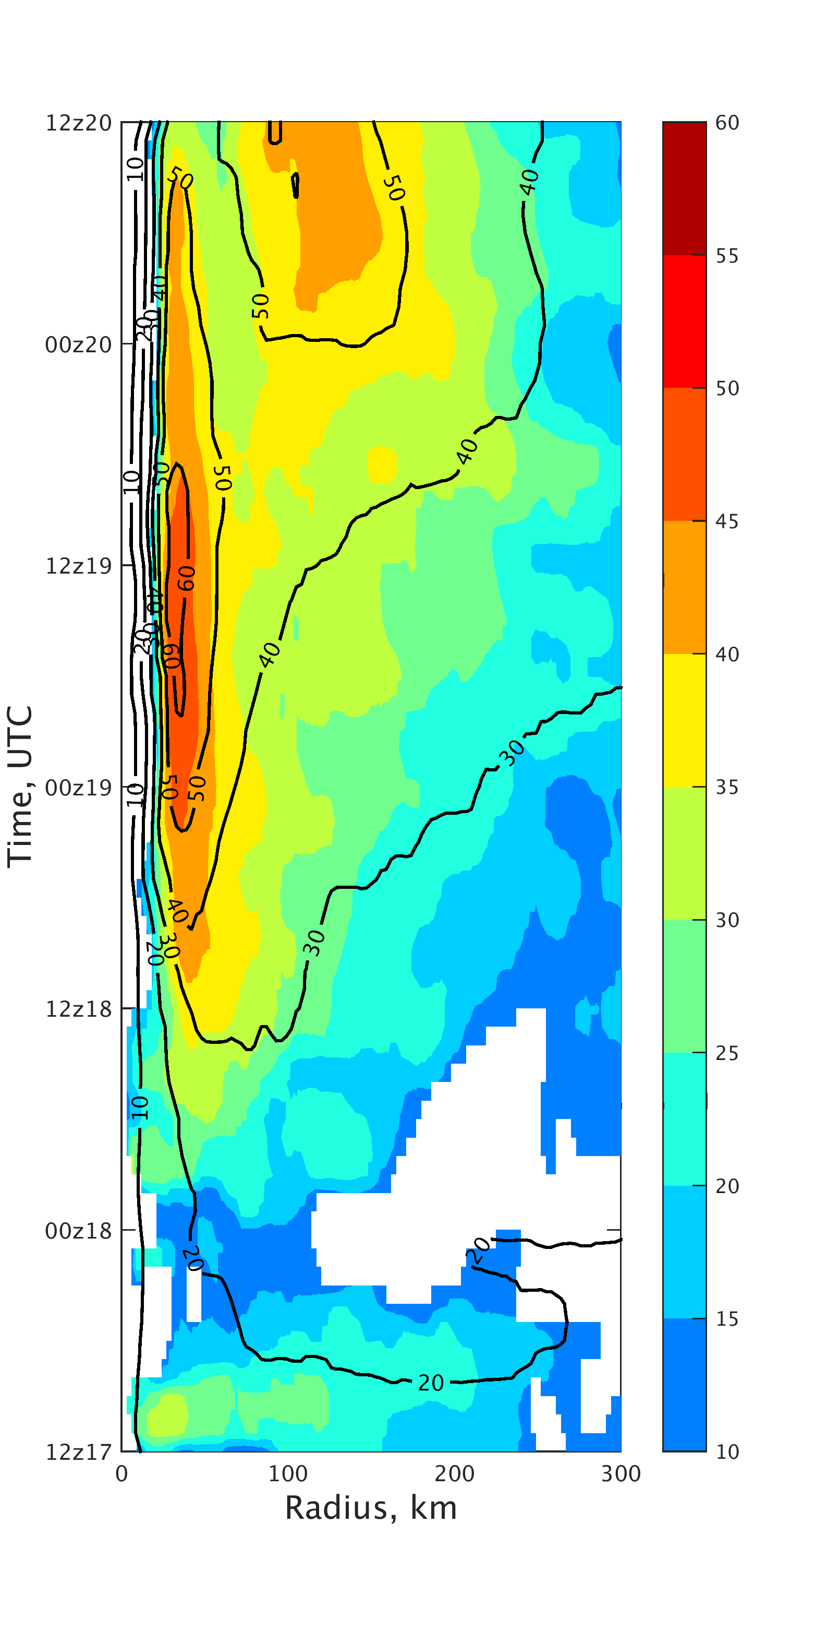
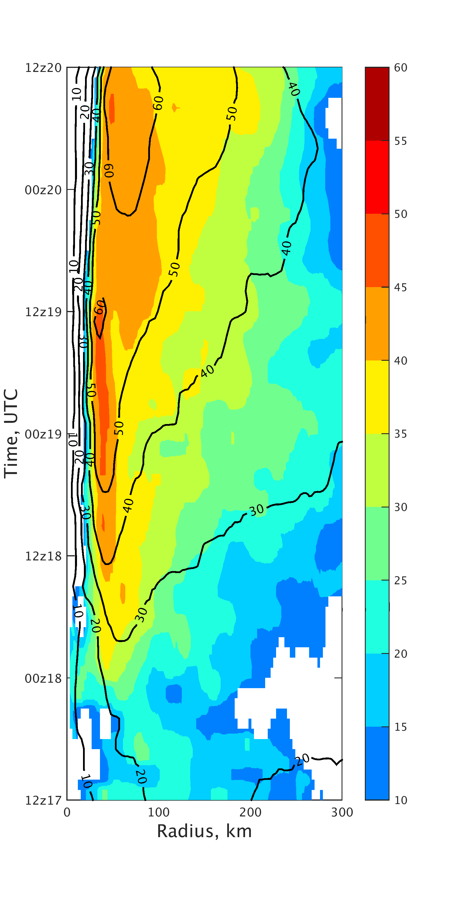
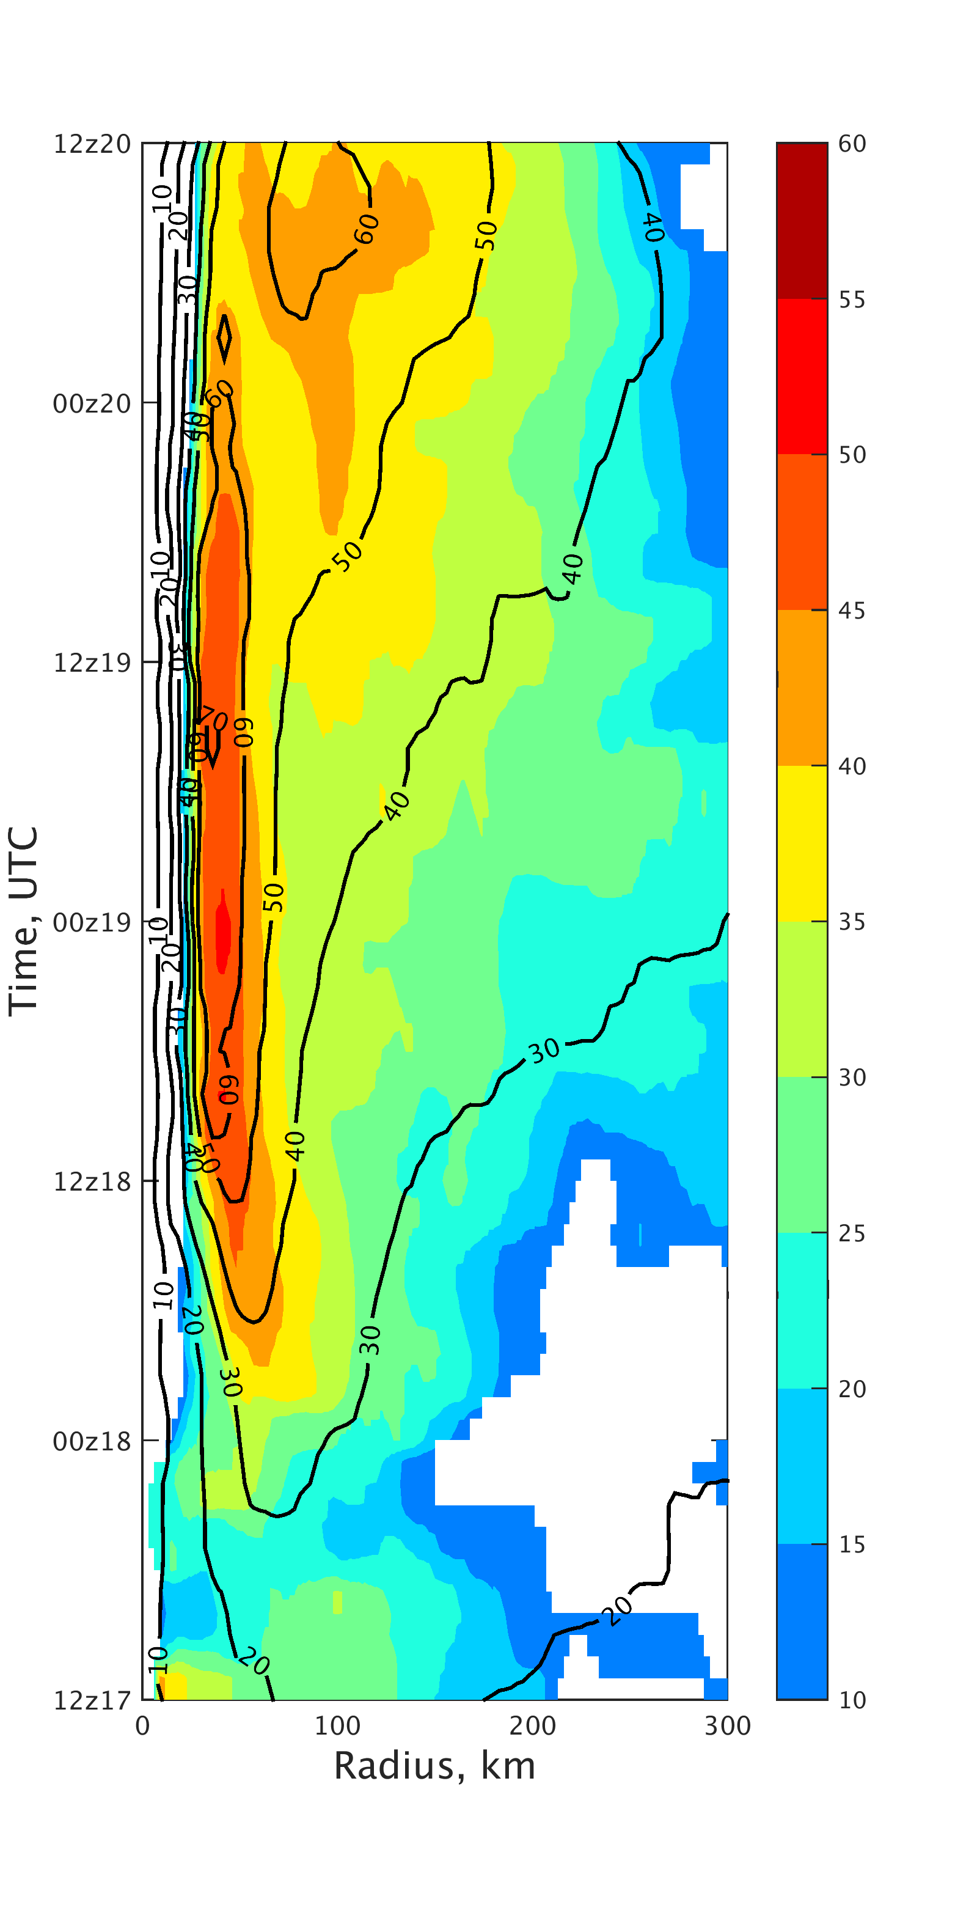
Tangential wind (1km) + composite reflectivity
(a) weak
(b) EnvWeakQvaporStrong
(c) EnvStrongQvaporWeak
(d) strong
Notes:
Precipitation, tangential wind evolve different

Slide 17
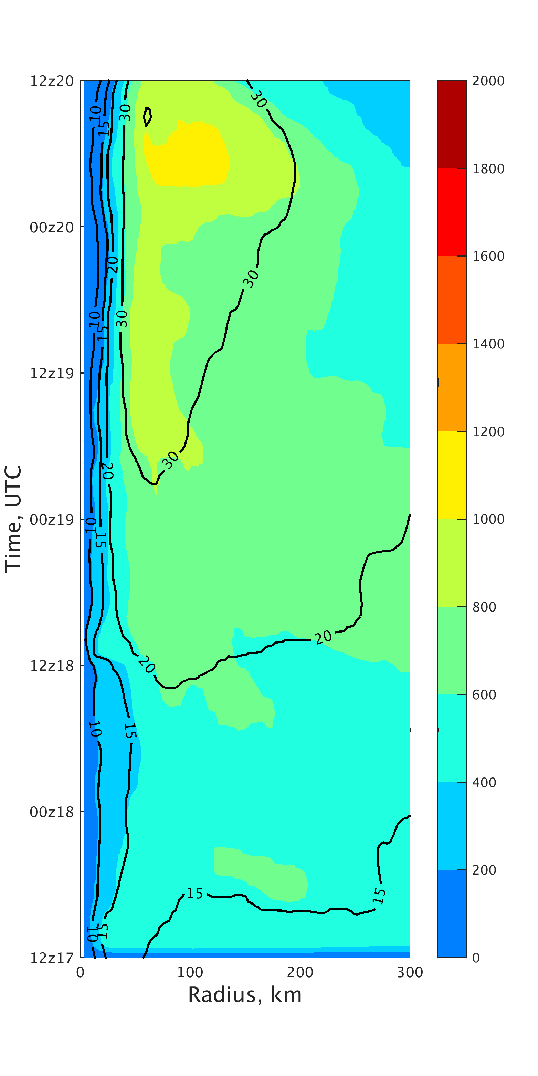
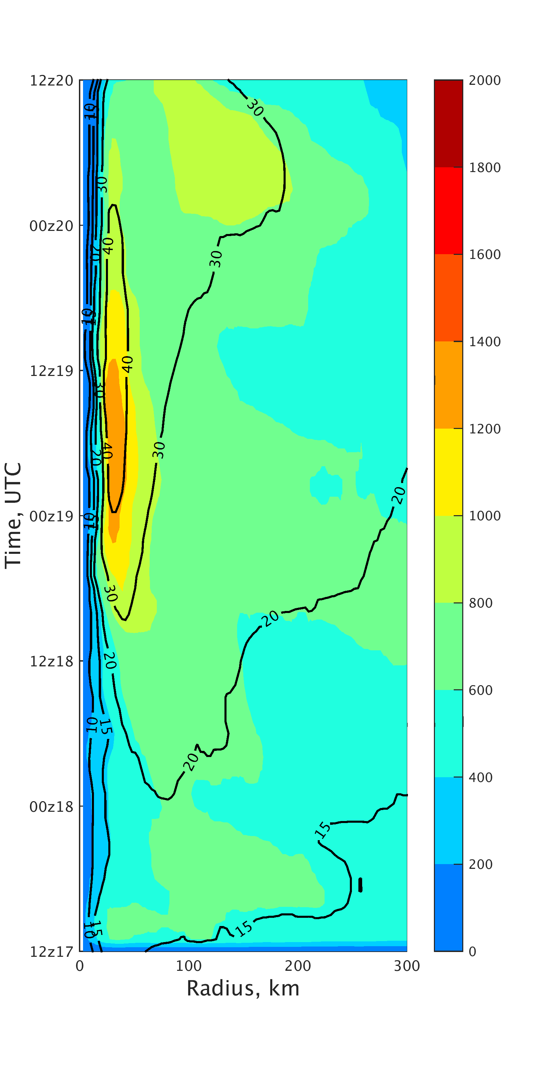
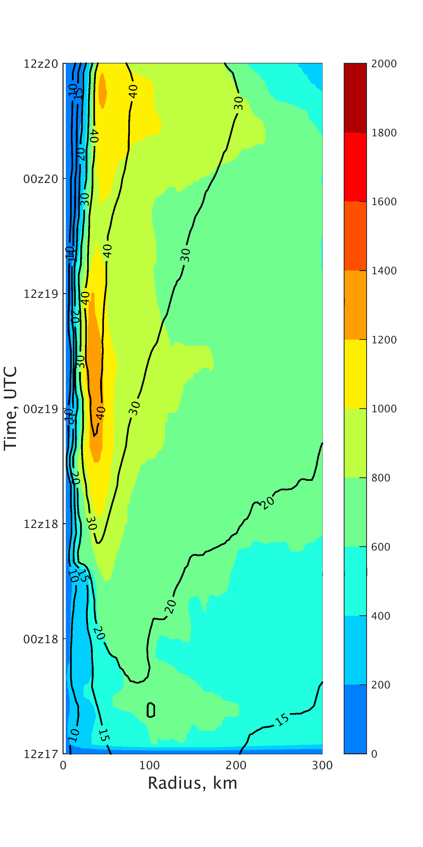
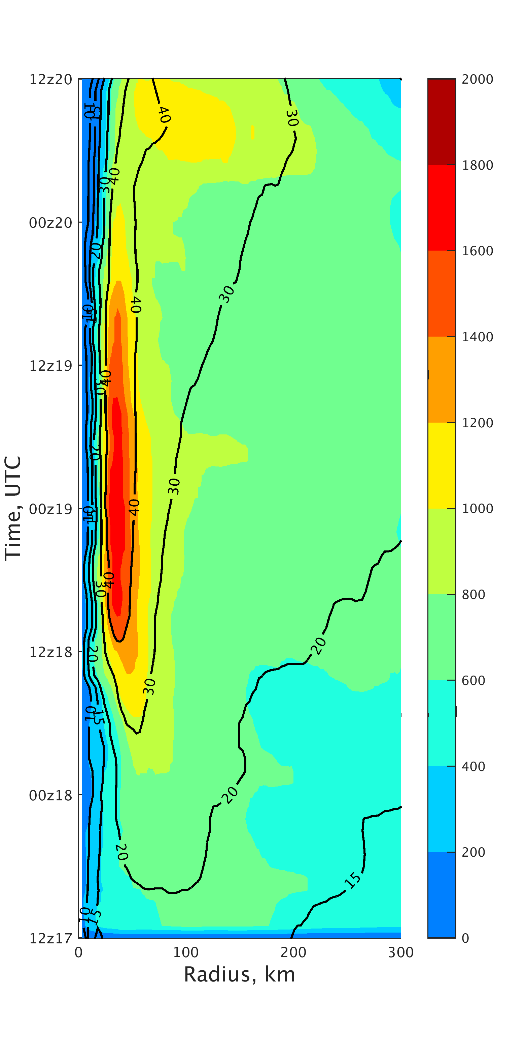
Surface Enthaly Flux + surface wind
Moisture->convection->surface wind -> surface enthalpy flux (wind induced surface heat exchange, WISHE)
Notes:
Enthalpy flux response to convection and surface wind, form a strong band

Slide 18
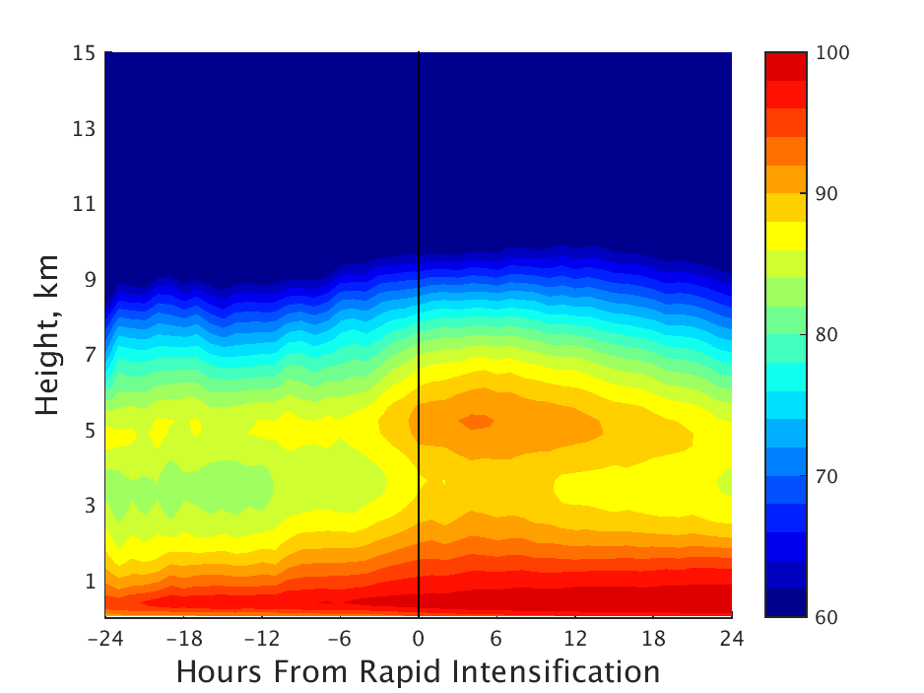
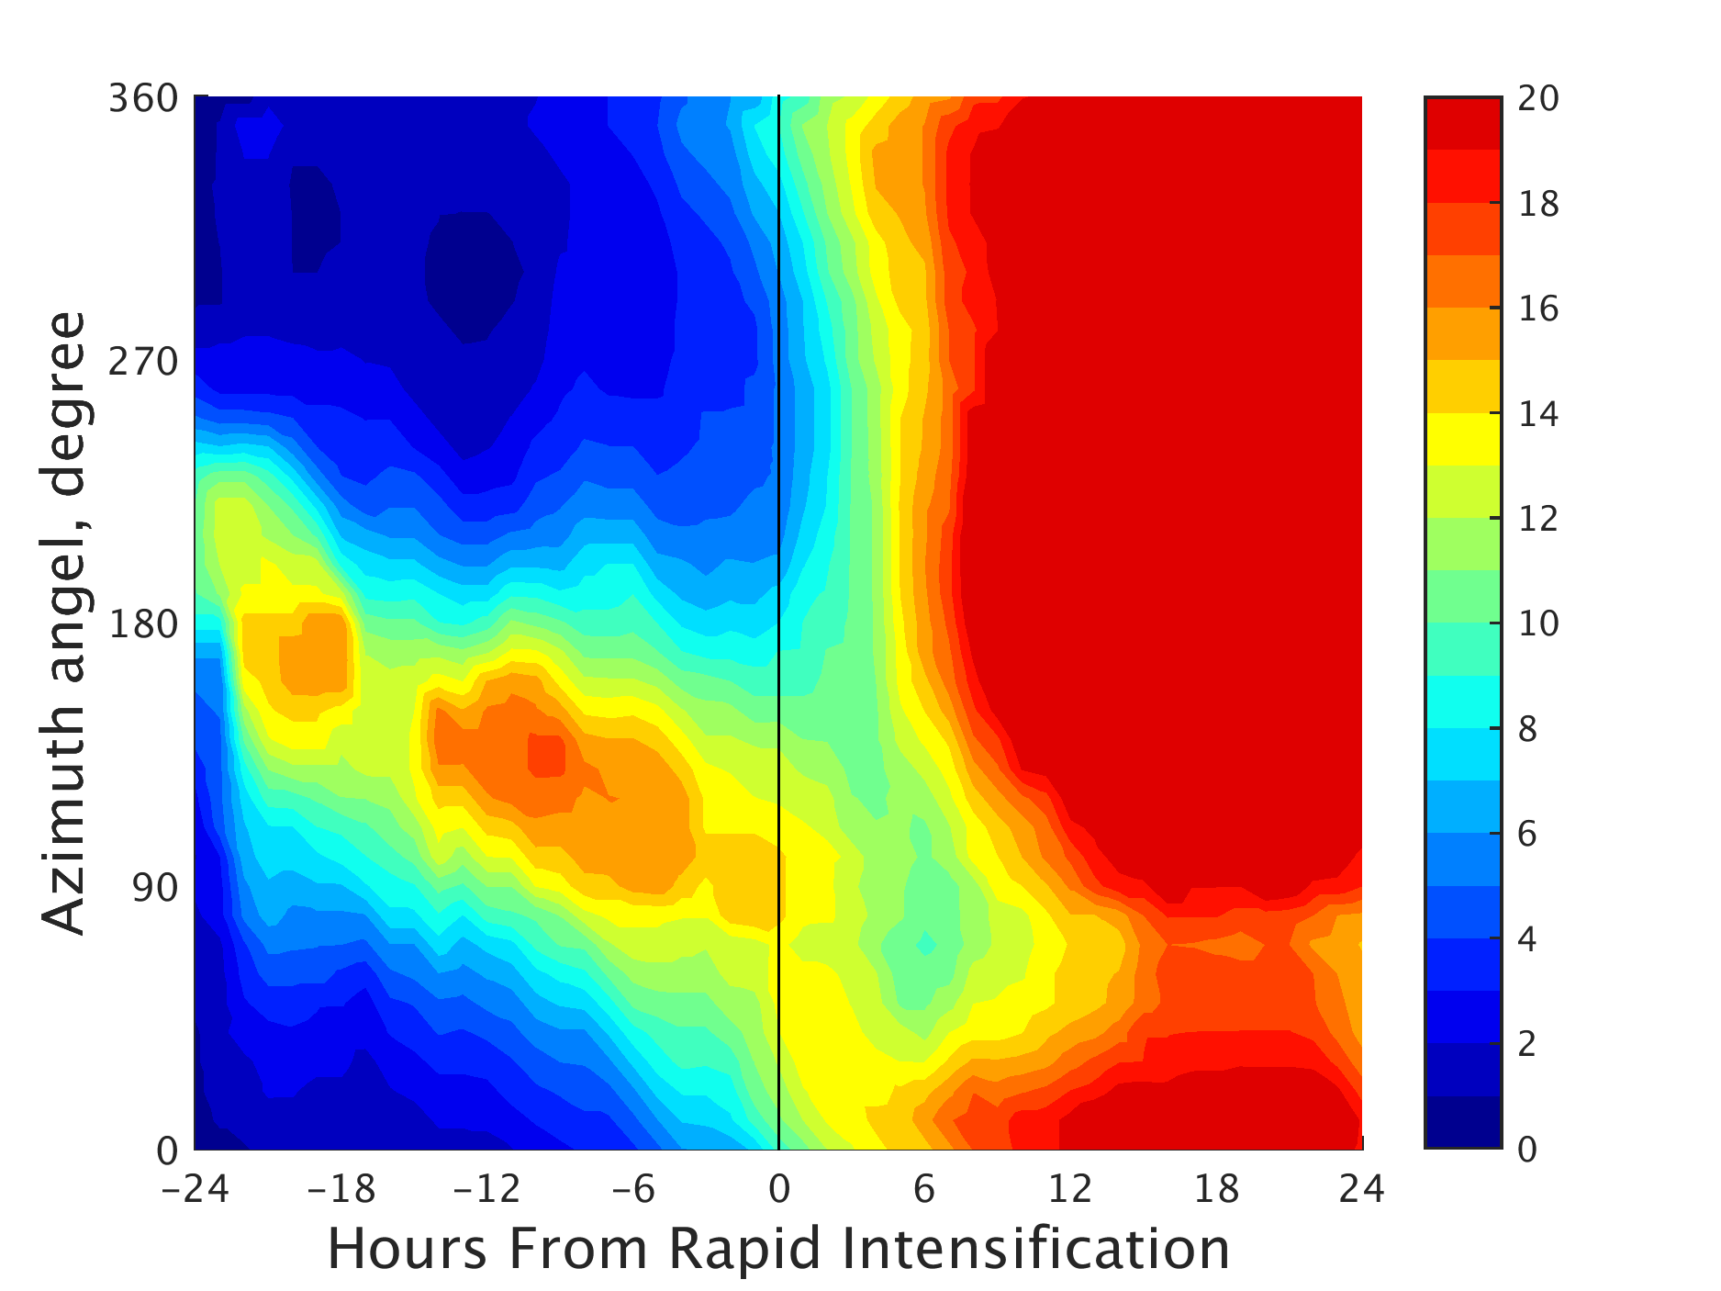
Precursor of RI
0$°$
360$°$
Eyewall Moisture
Eyewall Precipitation
270$°$
90$°$
a
b
180$°$
shear
Eyewall moisture jump at middle level at RI onset
precipitation propagate to up-shear and become axisymmetric at RI onset

Slide 19
Conclusion
Factors impact RI of Usagi: initial vortex intensity and inner core moisture
Correlation between initial vortex vorticity with RI timing is 0.5-0.7. Data Assimilation of AMVs data help RI process by weakening the initial vortex
Moisture->convection->surface wind -> surface enthalpy flux (wind induced surface heat exchange, WISHE)
RI onset features saturated eyewall moisture and axisymmetric precipitation

Slide 20
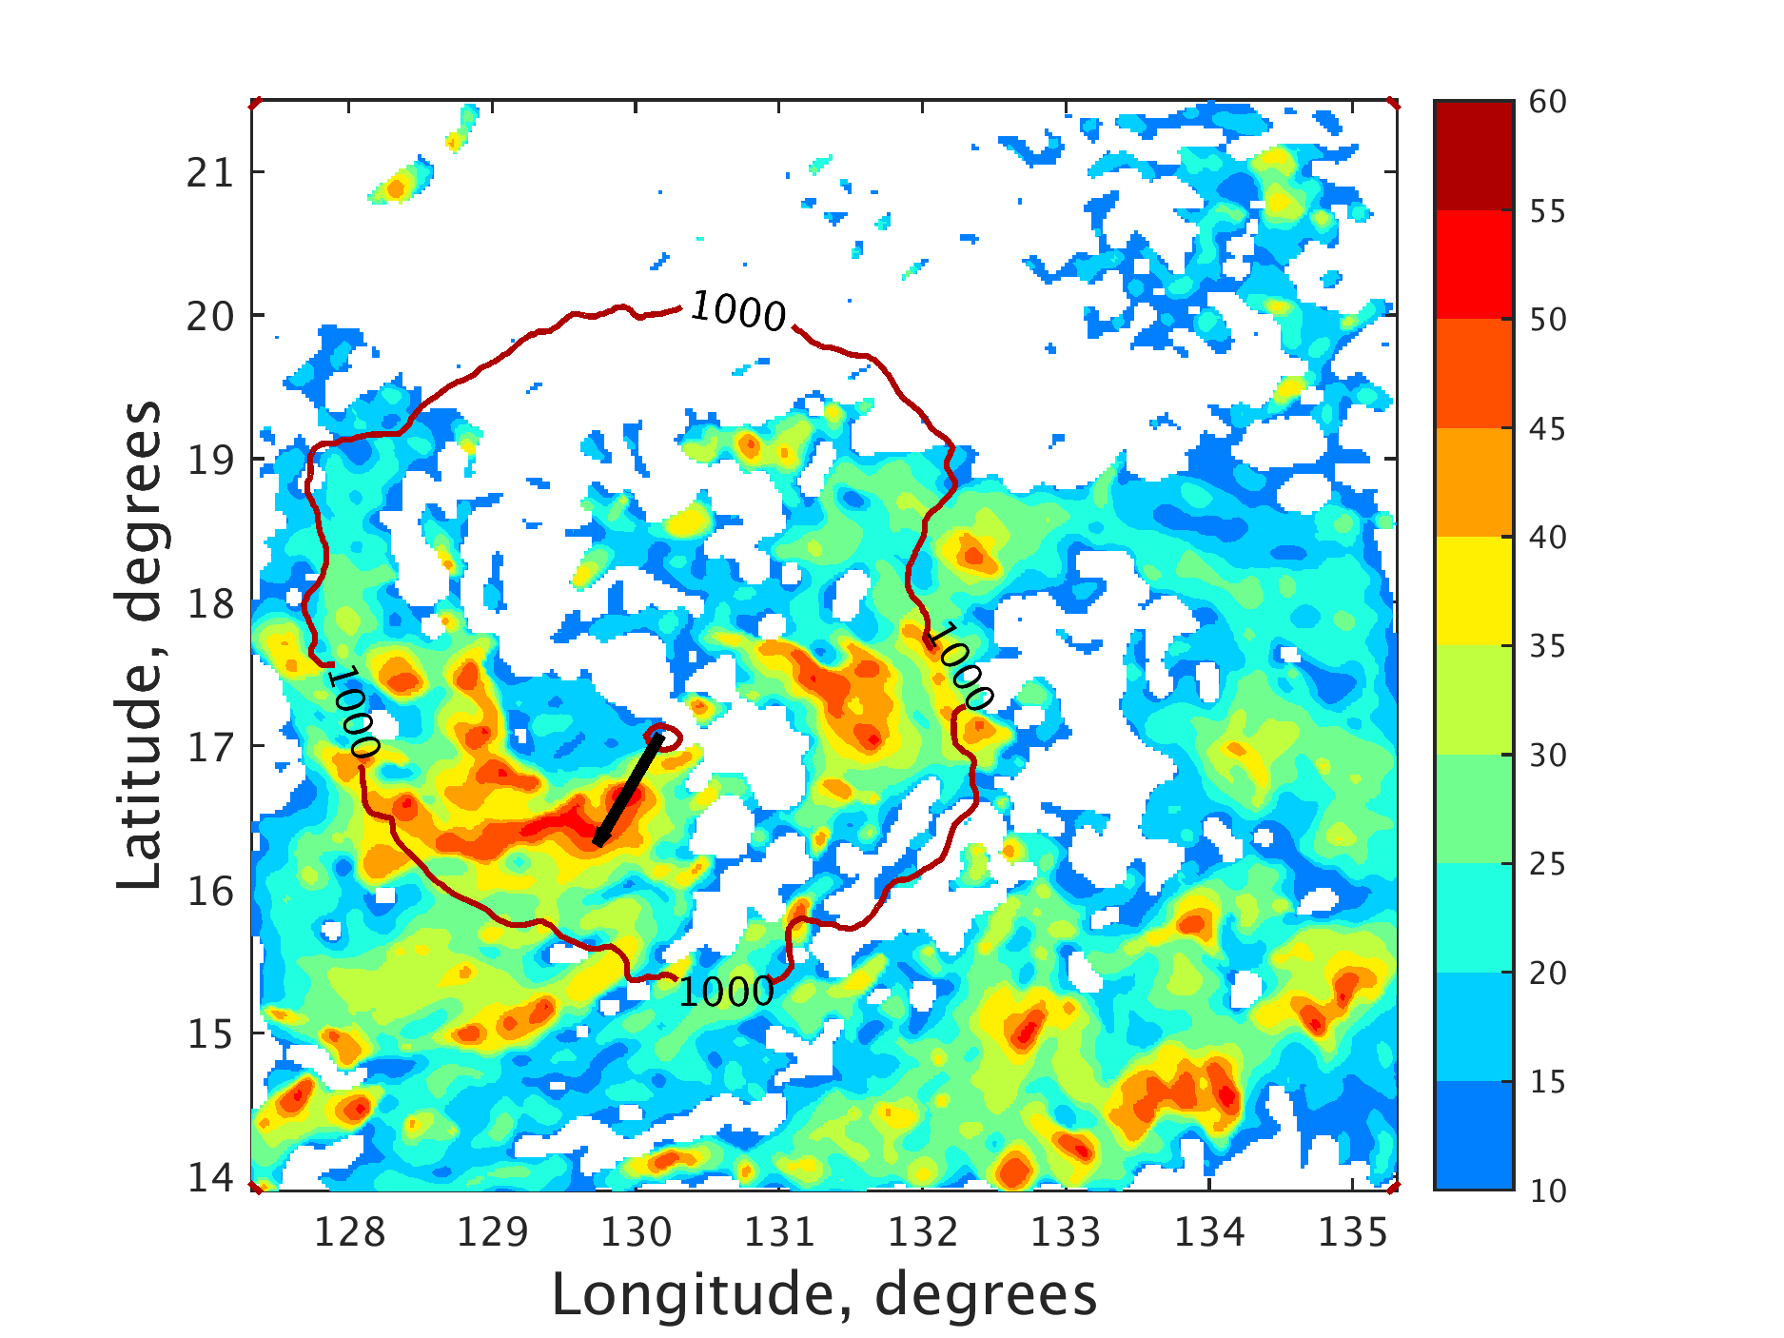
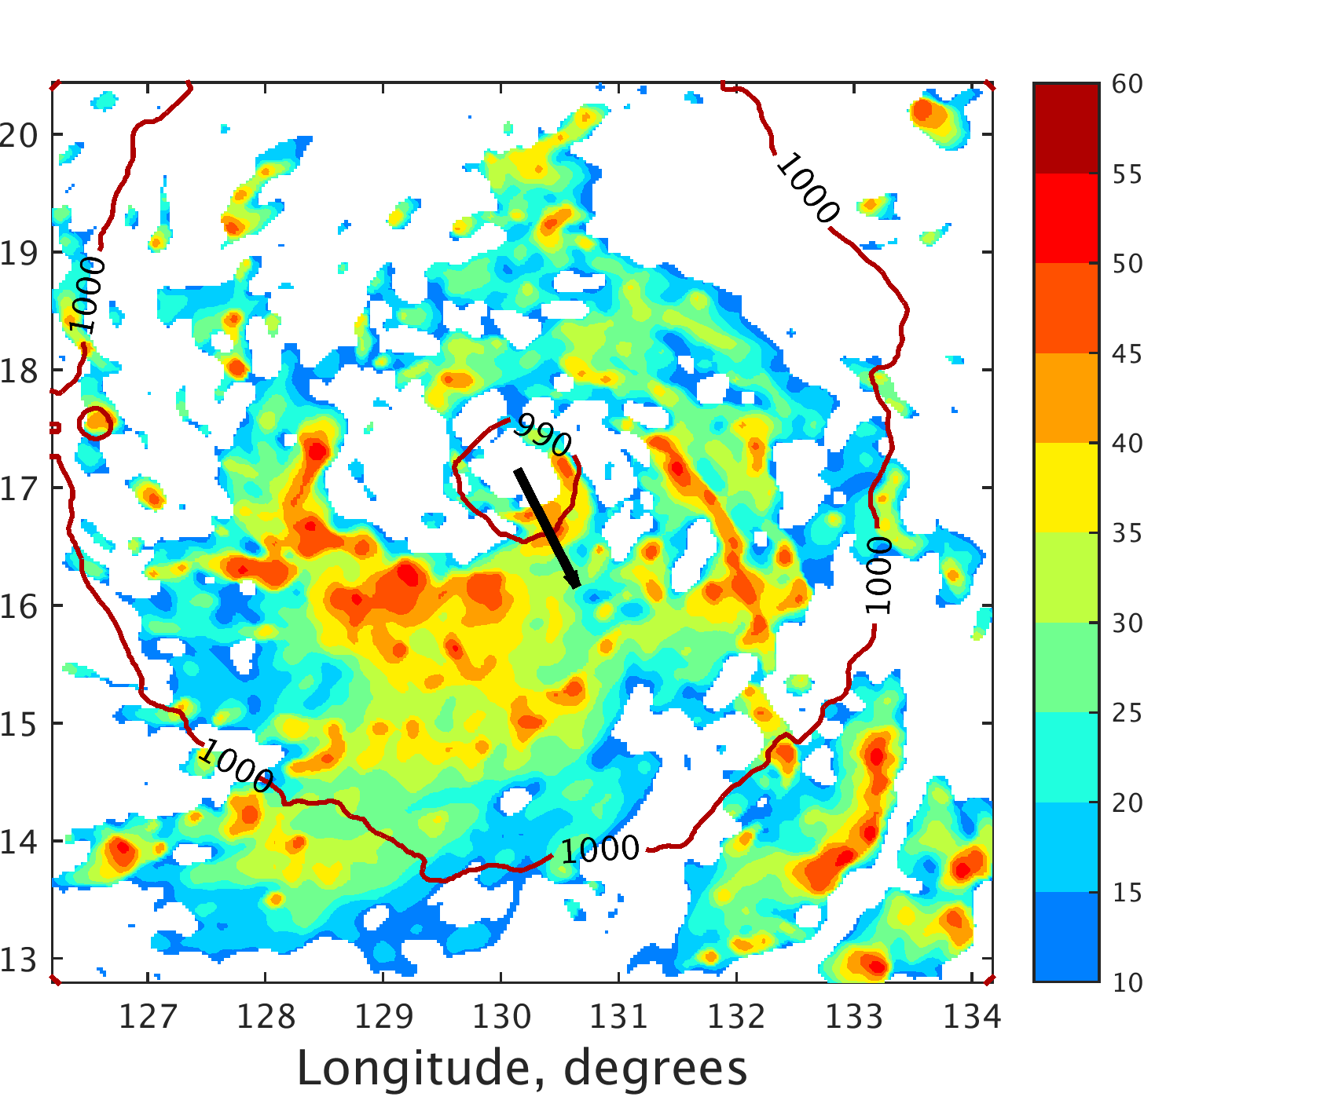
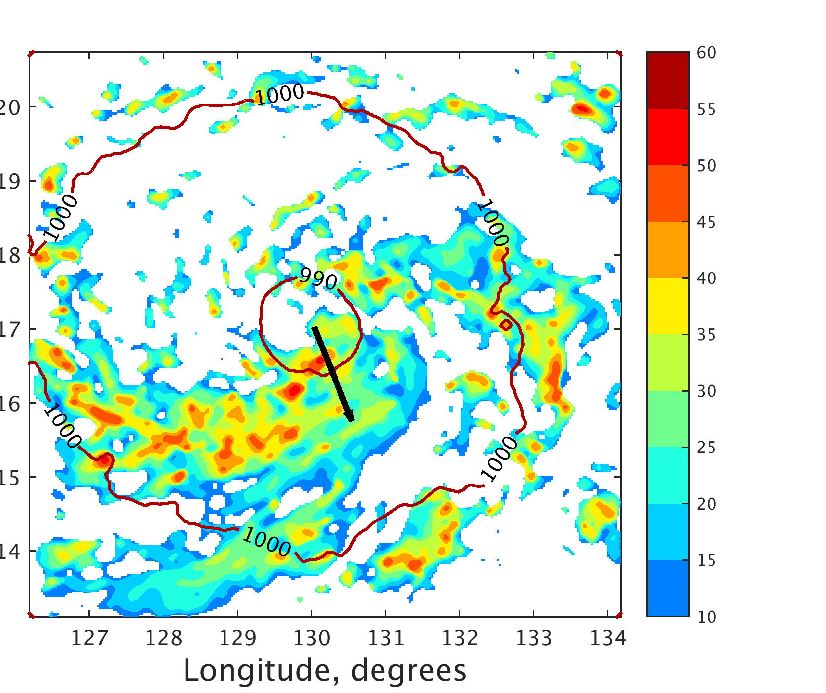
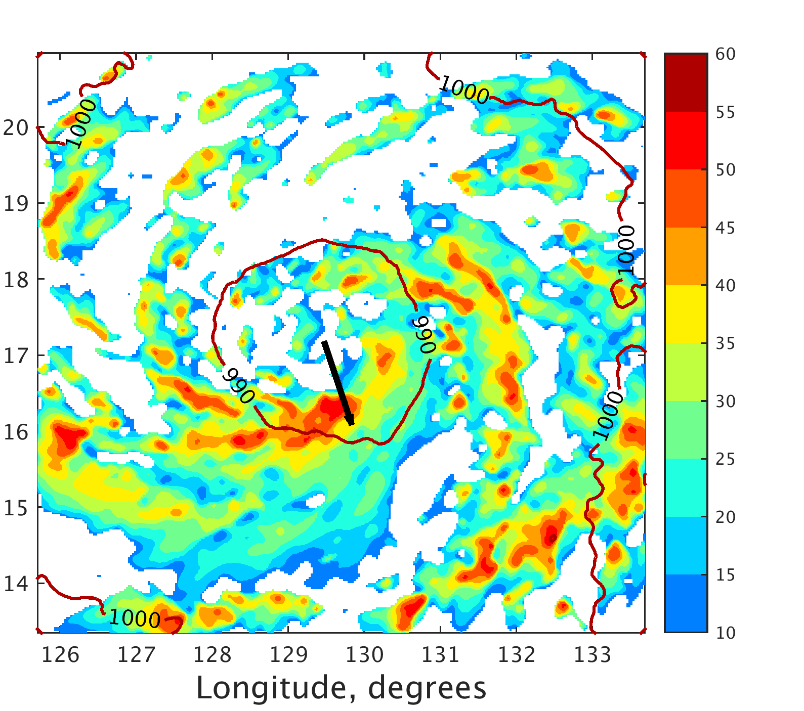
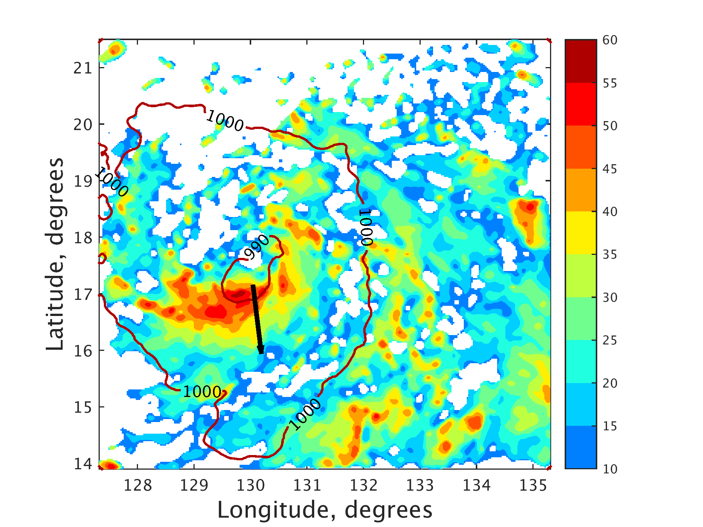
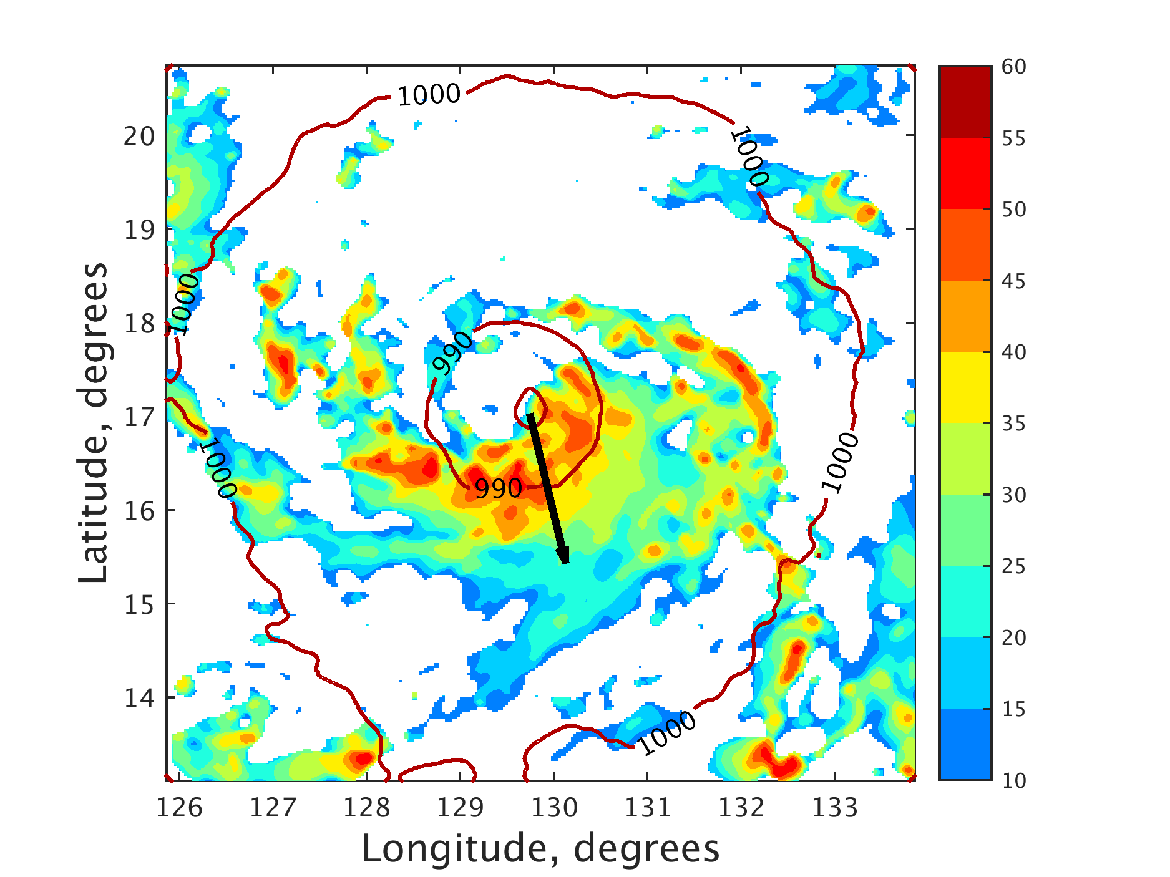
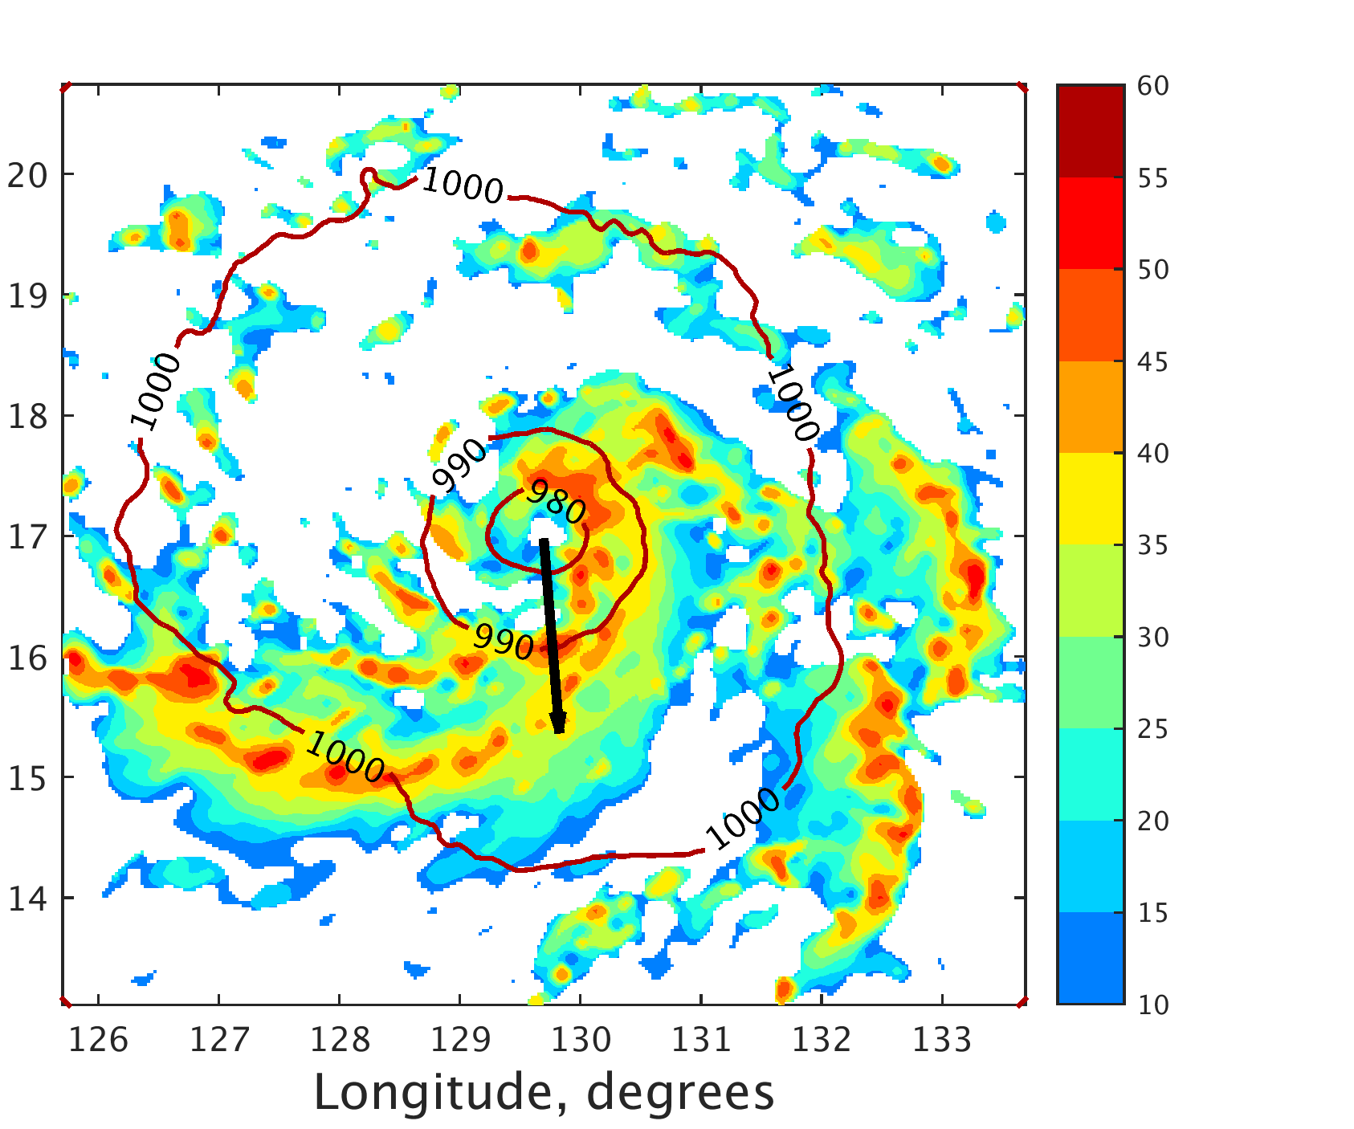
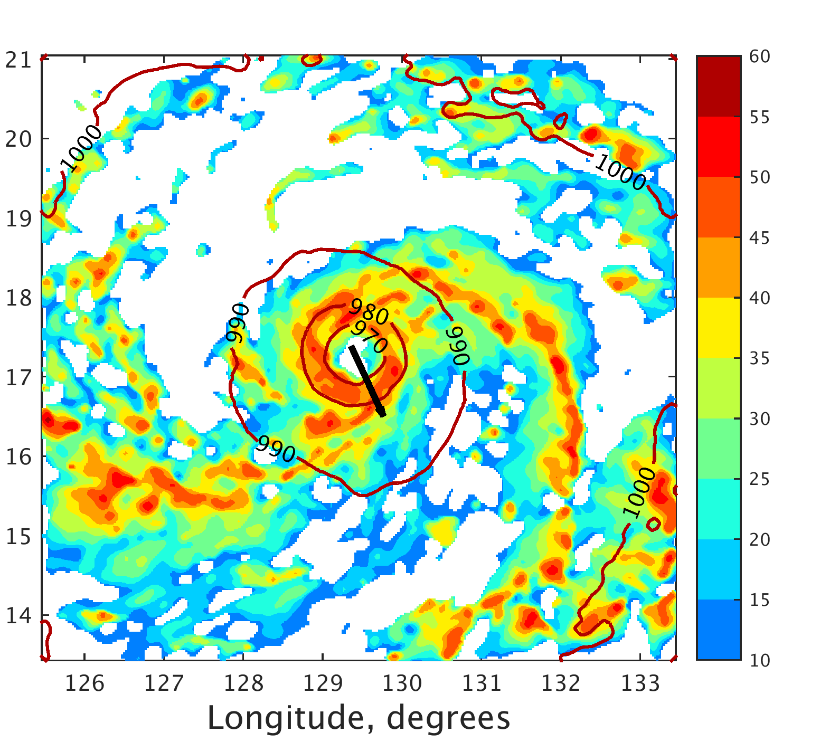
a
b
c
d
e
f
g
h

Slide 21
Equivalent Potential Temperature
Strong Member
Weak Member
Weak Member with strong member moisture

