Slide 1


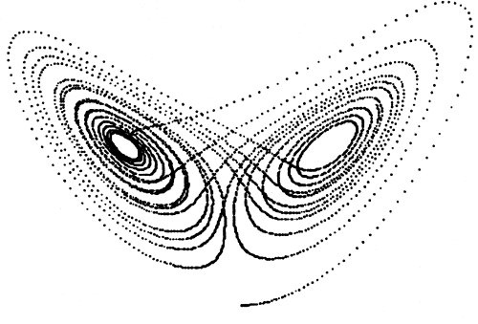
Atmospheric Predictability for Mid-Latitude Jet/front Systems
Y Qiang Sun, Fuqing Zhang
GroupMeeting 20170501
The Pennsylvania State University

Slide 2
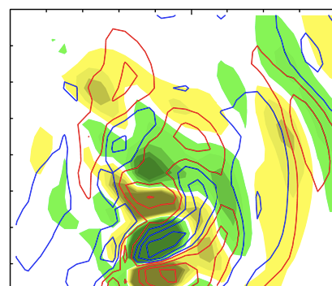
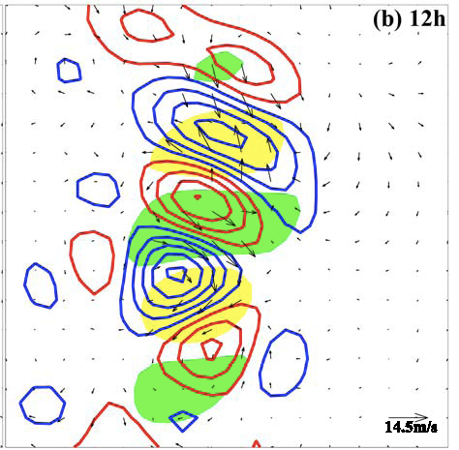
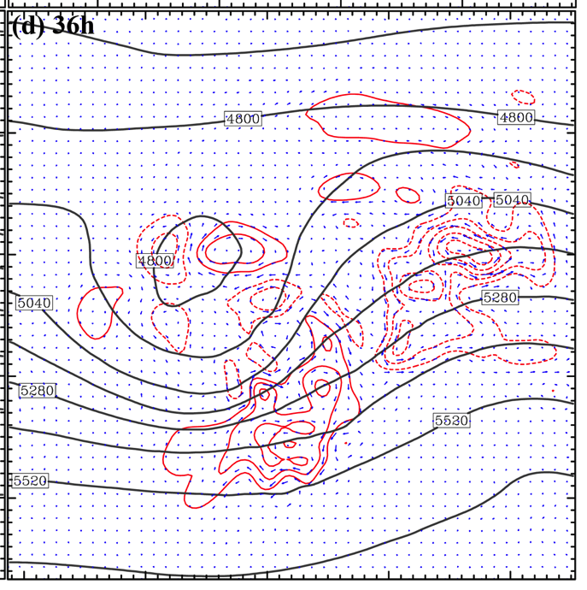
A Multistage Upscale Error Growth Model for Mesoscale Predictability
(Zhang et al. 2007, JAS)
_{Stage 1}
_{Stage 2}
_{Stage 3}
3h
_{2h}
_{300km}
_{1200km}
_{4200km}
_{T and w differences}
_{PV, Q and DIV differences}
_{Pressure and V differences}

Slide 3
Error Growth is NOT Sensitive to the Scale of the Initial Minute Perturbation
3h)
18h)
36h)
SMALL scale minute perturbation
LARGE scale minute perturbation
(Sun and Zhang 2016, JAS)

Slide 4
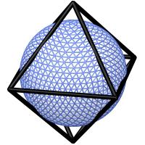
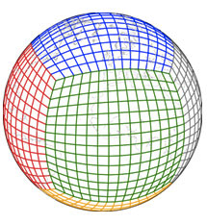
Global Mesoscale Convection Permitting Model
ECMWF:
Resolution: 9 km
10 Member Ensemble
20day simulation
Next Generation Global Prediction System FV3:
Resolution : 13km, 3km
Initial perturbation
EDA ensemble: Initial perturbations from each EDA analysis (operational uncertainty)
0.1EDA ensemble: initial perturbation reduced to 10% of EDA (centered on the CNTL)

Slide 5
Time evolution of the errors in 0.1EDA is consistent with Zhang 07 Conceptual model

Slide 6
Evolution of the perturbation kinetic energy spectrum over Mid-latitude
After ~3 days, errors in 0.1 EDA experiment catch up with the initial uncertainty of EDA experiment.
40ºN-60ºN

Slide 7
Ensemble spread of 500-hPa height averaged over 40ºN-60ºN
3-4 days predictability gap
Error growth in 0.1EDA experiment is similar with the EDA experiment once it achieves the initial uncertainty of the latter.

Slide 8
Evolution of the perturbation kinetic energy spectrum over Mid-latitude
Wavelength
1000km
0.1EDA

Slide 9
Evolution of Synoptic-scale Storm

Slide 10
12h accumulated precipitation at forecast day 10 for 0.1EDA

Slide 11
Dynamical processes associated with the error growth : short range
15m/s

Slide 12
Dynamical processes associated with the error growth : medium range
30m/s

Slide 13
Wave packets in the model (300mb V wind anomaly averaged over 40N-60N)
One member
Ensemble mean

Slide 14
Dynamical processes associated with the error growth : after 2 weeks

Slide 15
Conceptual Model for Multiscale Error Growth
Short range:
concept model proposed by Zhang 07, propagating with synoptic-scale phase speed. (~3 day predictability gap)
Baroclinic wave packets
2. Medium range:
Errors grow under baroclinic instability, propagating through baroclinic wave packets.
Time
3. Possible interaction with stationary Rossby waves, affecting sub-seasonal forecast.
Synoptic scale systems

