Slide 1



Modified CRTM: Exploring Different
Particle Scattering Properties
Research Group Meeting
01 May 2017
Scott Sieron
Advisors: Fuqing Zhang, Eugene Clothiaux
Major Collaborator: Lu Yinghui

Slide 2
Non-Spherical Particles

Slide 3
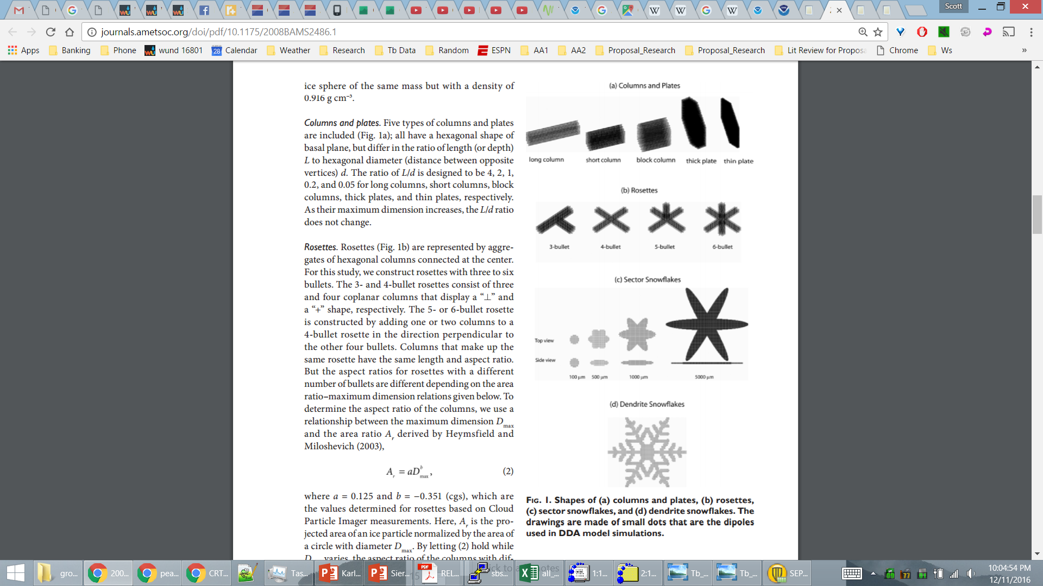
About Non-Spherical Particles
Database from Guosheng Liu (2008 MWR)
Optical properties simulated by Discrete Dipole Approximation (DDA; Draine and Flatau 1994)

Slide 4
About Non-Spherical Particles
Database from Guosheng Liu (2008 MWR)
Optical properties simulated by Discrete Dipole Approximation (DDA; Draine and Flatau 1994)

Slide 5
About Non-Spherical Particles
Database from Guosheng Liu (2008 MWR)
Optical properties simulated by Discrete Dipole Approximation (DDA; Draine and Flatau 1994)

Slide 6

About Non-Spherical Particles
These particles do not match size and mass of microphysics specifications
Lookup tables are consistent with particle mass distribution:
Concern: non-spherical particle database spans a smaller range of masses than the spherical particle database
$$M\left(D\right)=(\frac{π}{6} ρD^{3})N_{0}e^{−λD}$$

Slide 7
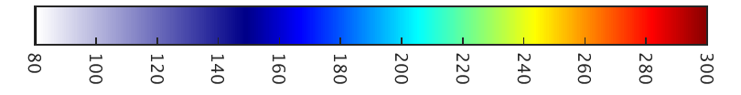
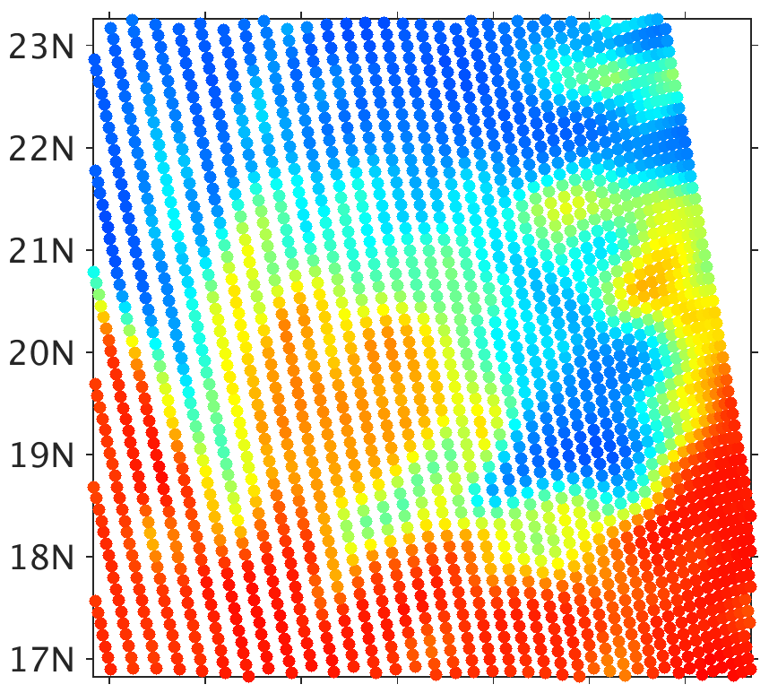
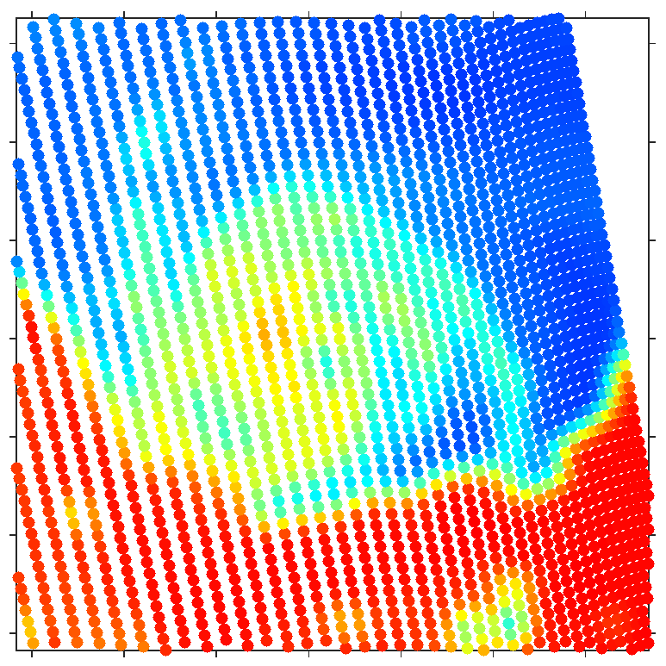
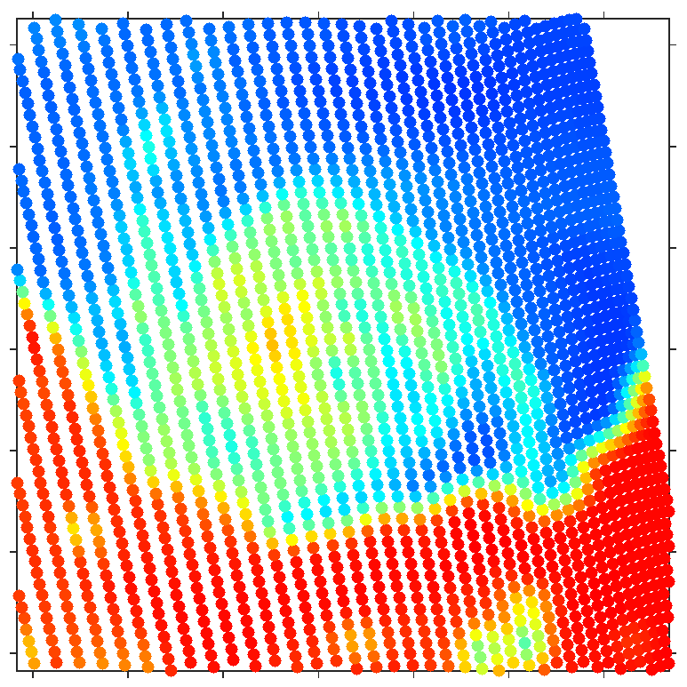

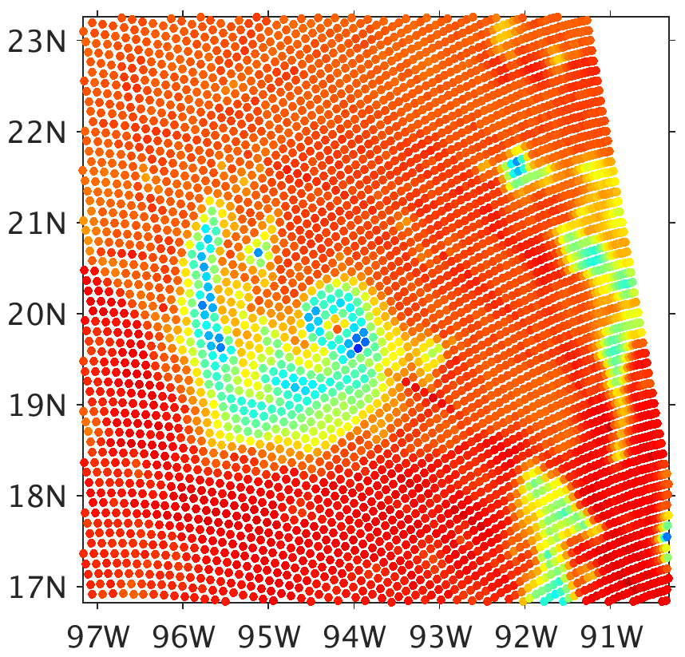
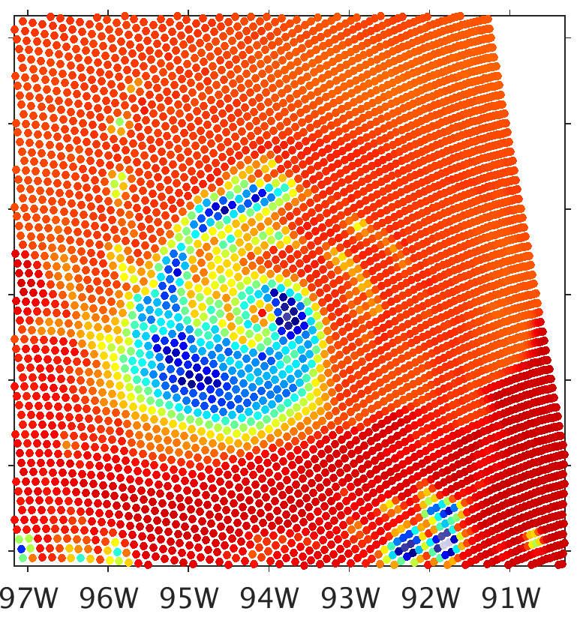
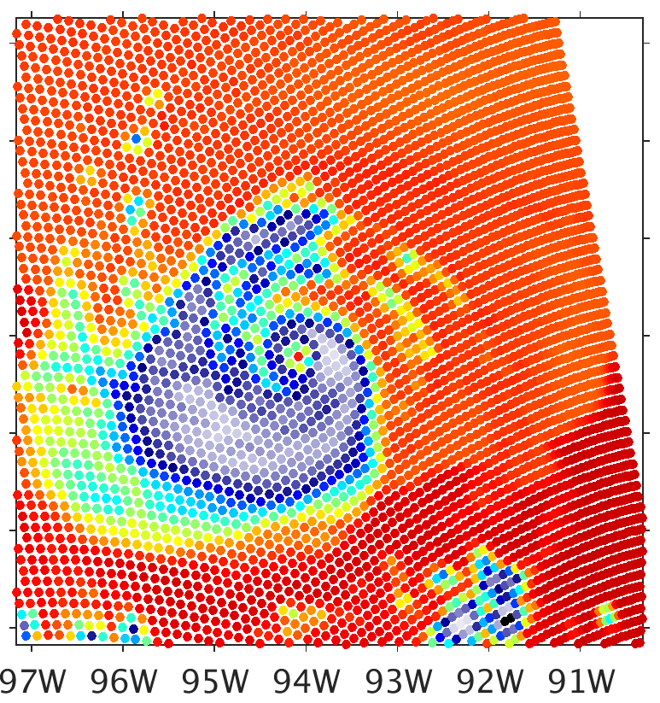
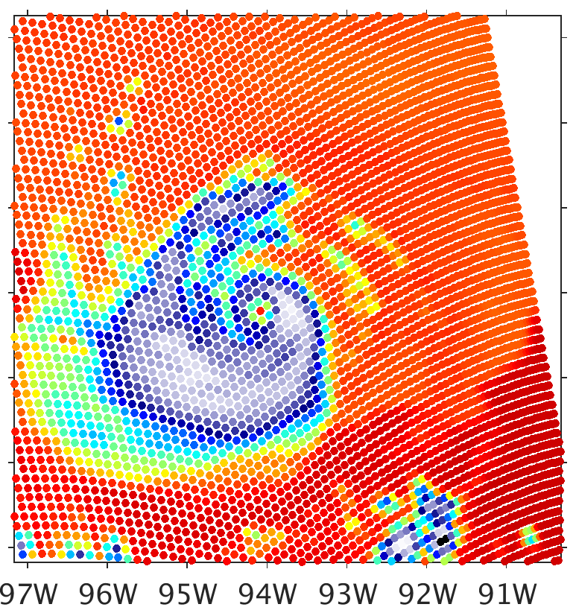
Brightness Temperature (K)
CRTM-DS WSM6
80
100
120
140
160
180
200
220
240
260
280
300
SSMIS Obs
Sphere
Long Column
Short Column
37.0 GHz
91.66 GHz
Notes:
Monodisperse graupel has colder brightness temperatures for sphere

Slide 8

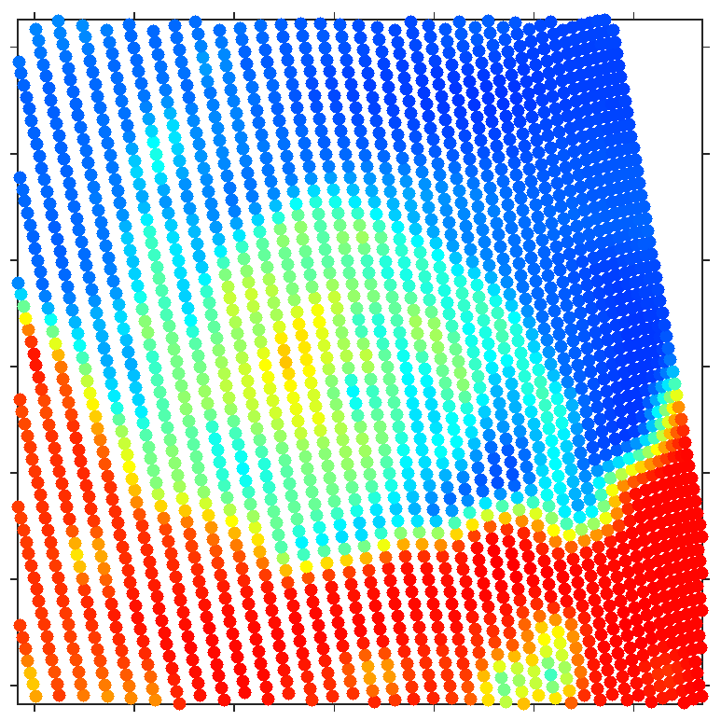
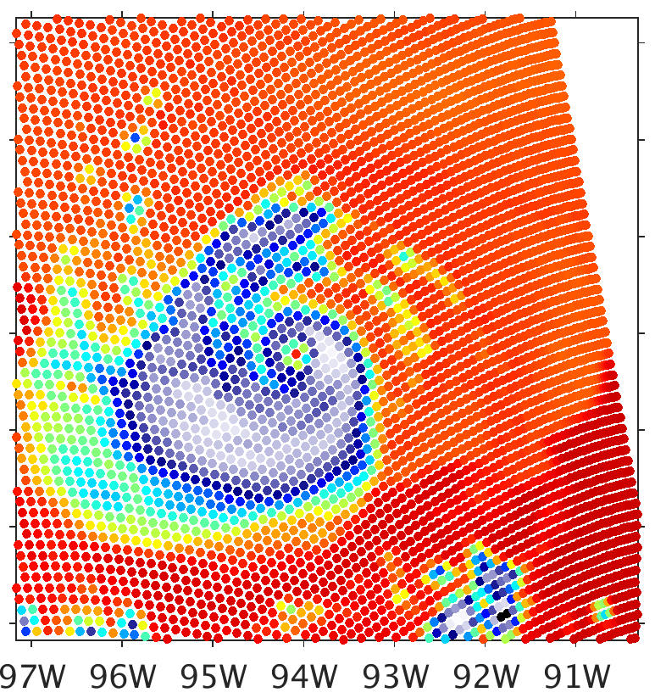

Brightness Temperature (K)
CRTM-DS WSM6
80
100
120
140
160
180
200
220
240
260
280
300
SSMIS Obs
Sphere
Block Column
Thick Plate
37.0 GHz
91.66 GHz
Notes:
Block column is the coldest of the types at 91.66 GHz

Slide 9
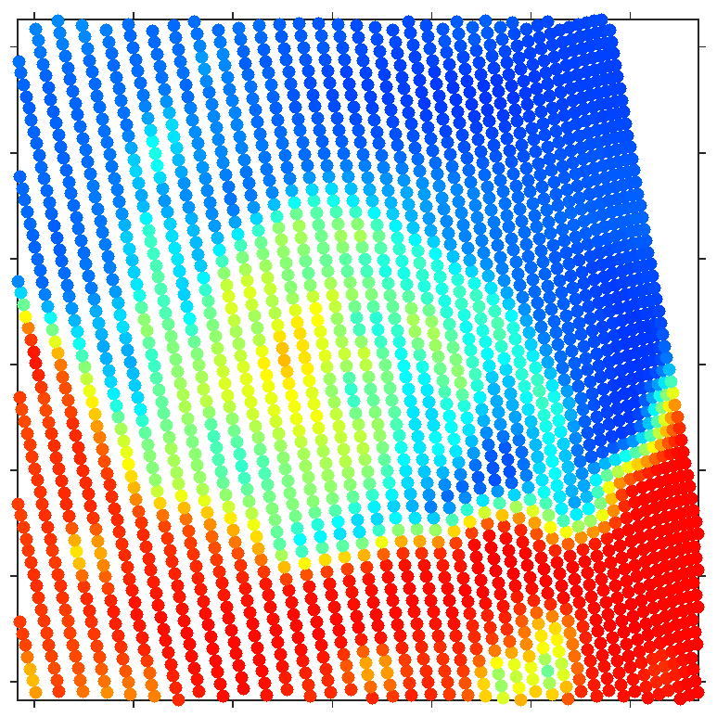
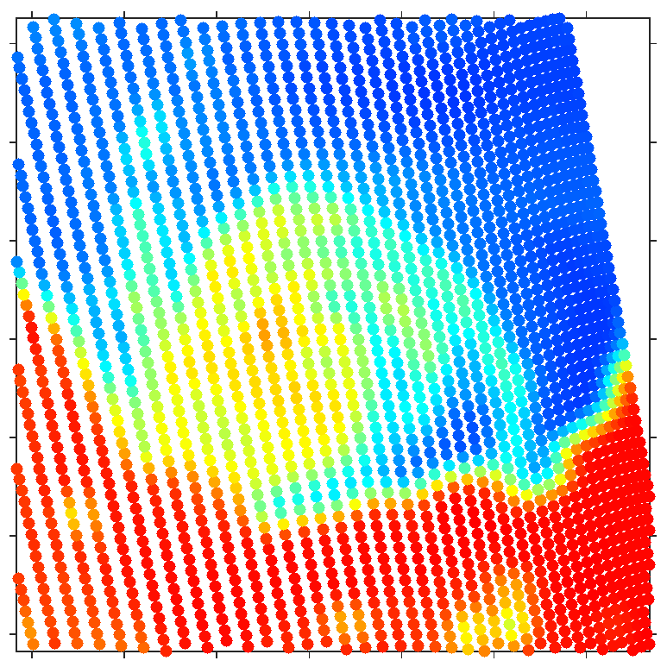
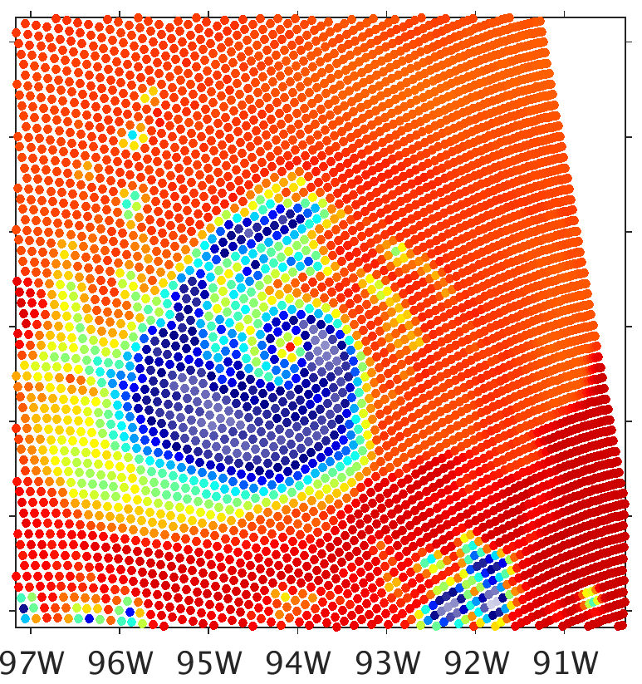
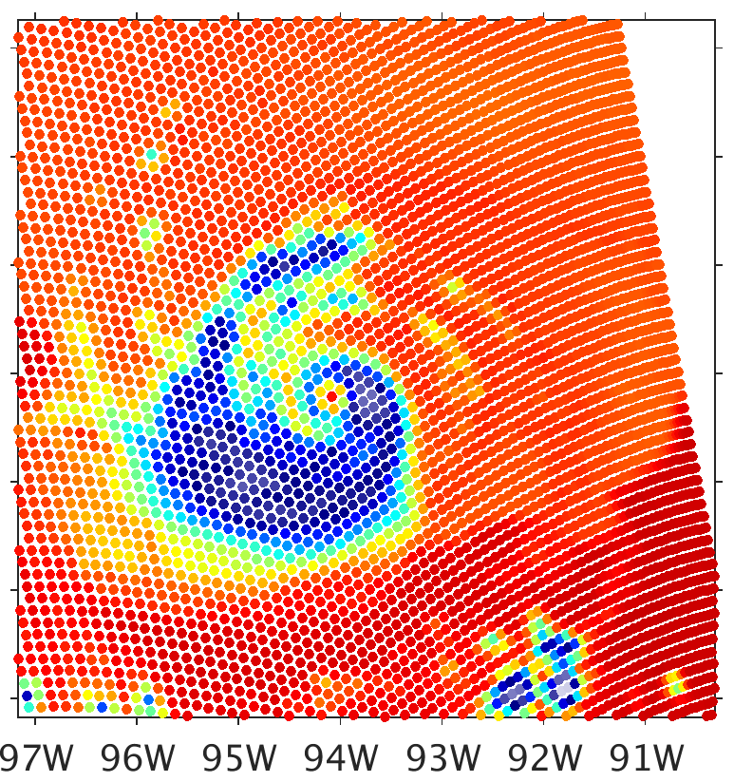
Brightness Temperature (K)
CRTM-DS WSM6
80
100
120
140
160
180
200
220
240
260
280
300
SSMIS Obs
Sphere
Thin Plate
3-Bullet Rosette
37.0 GHz
91.66 GHz
Notes:
Monodisperse graupel has colder brightness temperatures for sphere

Slide 10


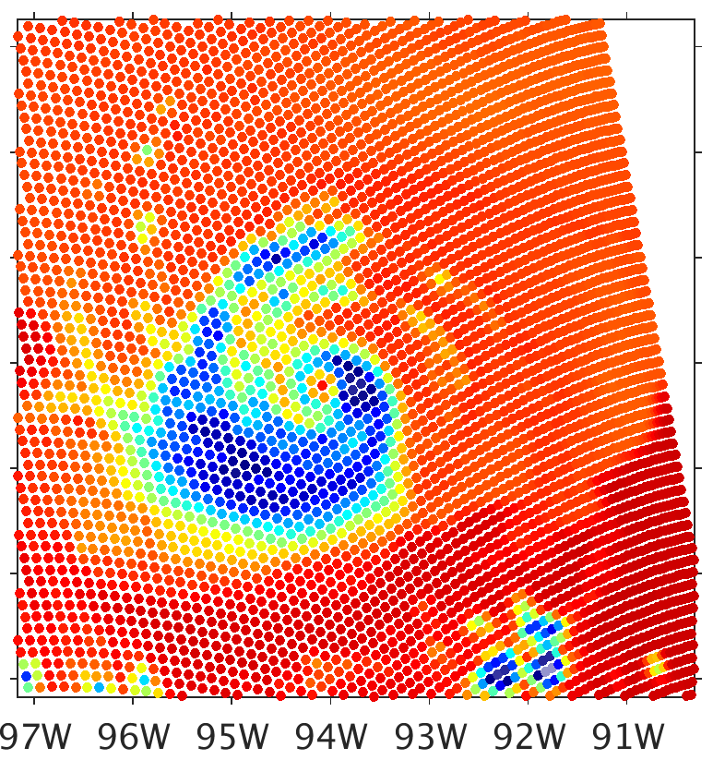

Brightness Temperature (K)
CRTM-DS WSM6
80
100
120
140
160
180
200
220
240
260
280
300
SSMIS Obs
Sphere
4-Bullet Rosette
5-Bullet Rosette
37.0 GHz
91.66 GHz
Notes:
Monodisperse graupel has colder brightness temperatures for sphere

Slide 11

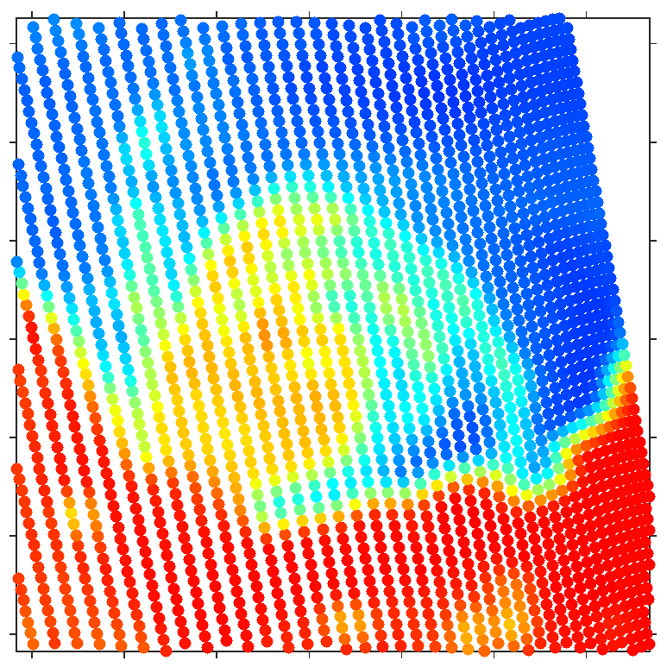

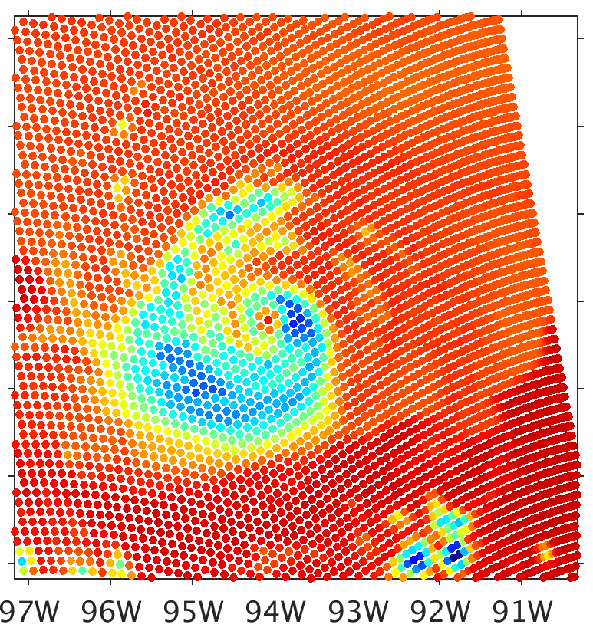
Brightness Temperature (K)
CRTM-DS WSM6
80
100
120
140
160
180
200
220
240
260
280
300
SSMIS Obs
Sphere
6-Bullet Rosette
Sector Snowflake
37.0 GHz
91.66 GHz
Notes:
Sector snowflake produces much warmer brightness temperatures
This is the species used by ECMWF for bias reduction in their radiative transfer model
Not a physically realistic replacement for graupel, but would seem far more realistic than spheres to represent snow snow

Slide 12
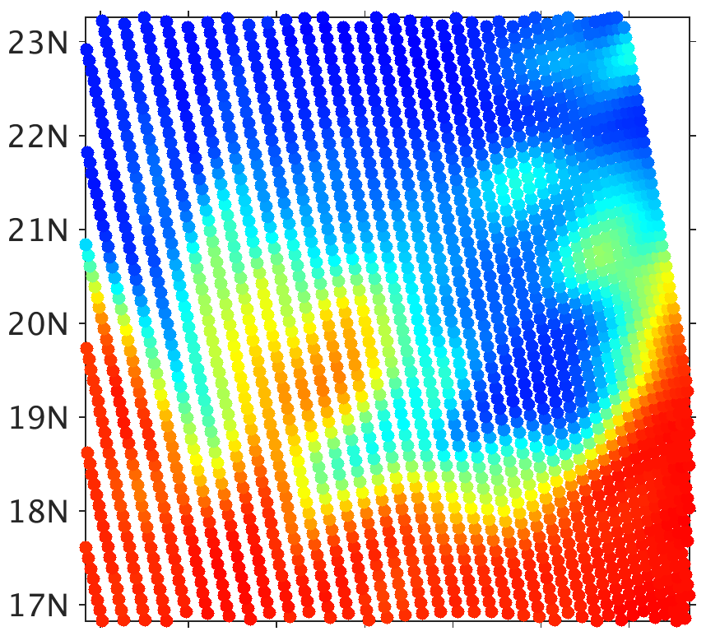
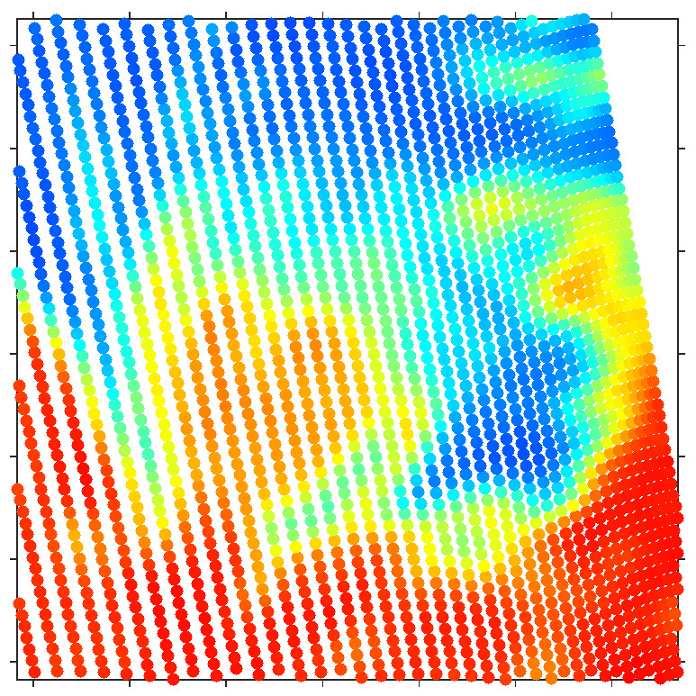
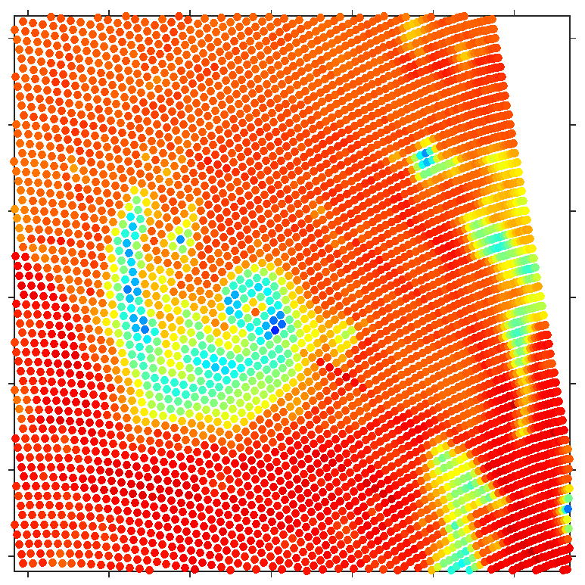
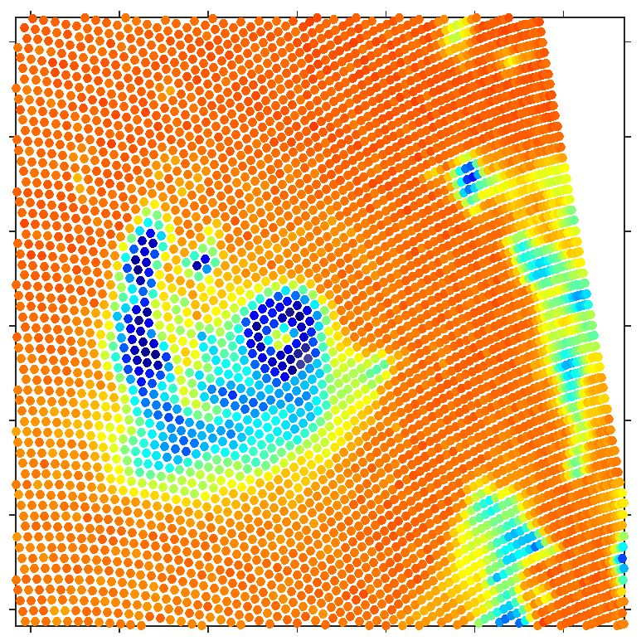
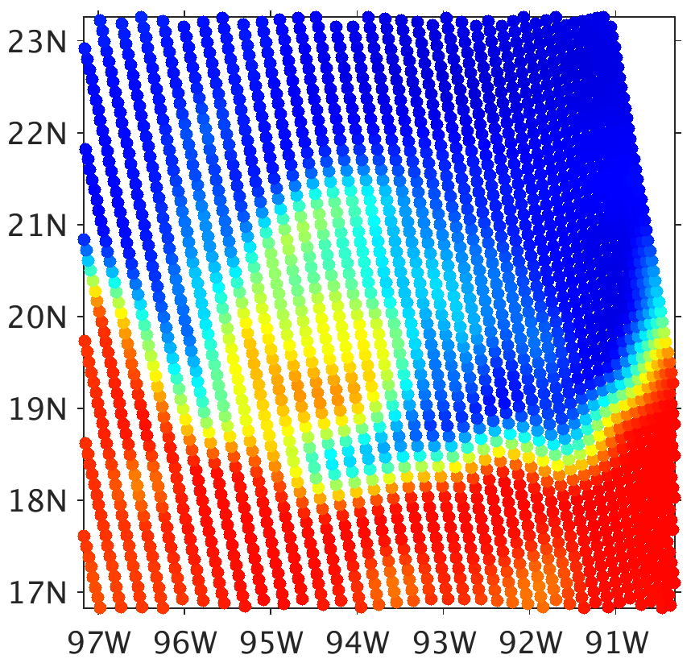
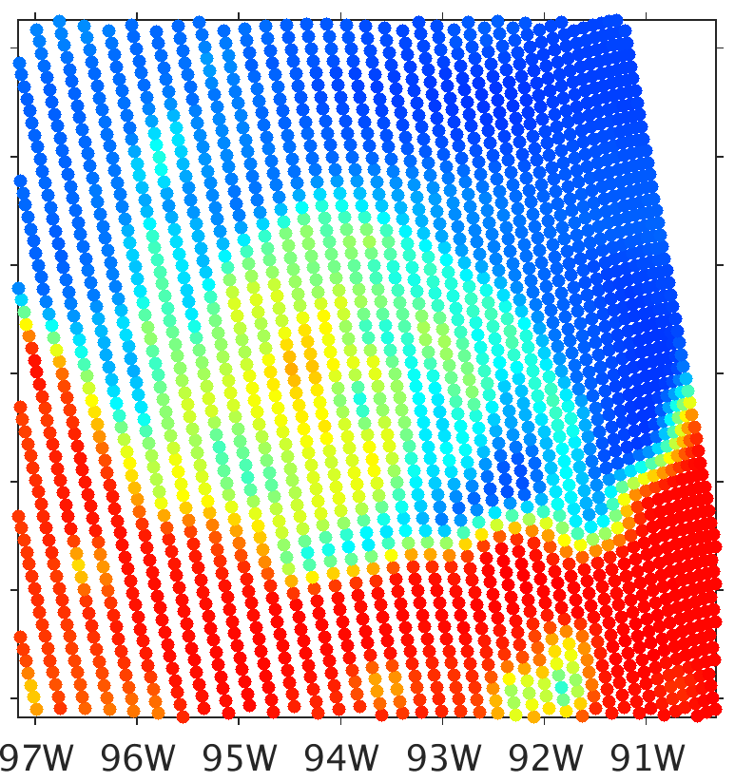
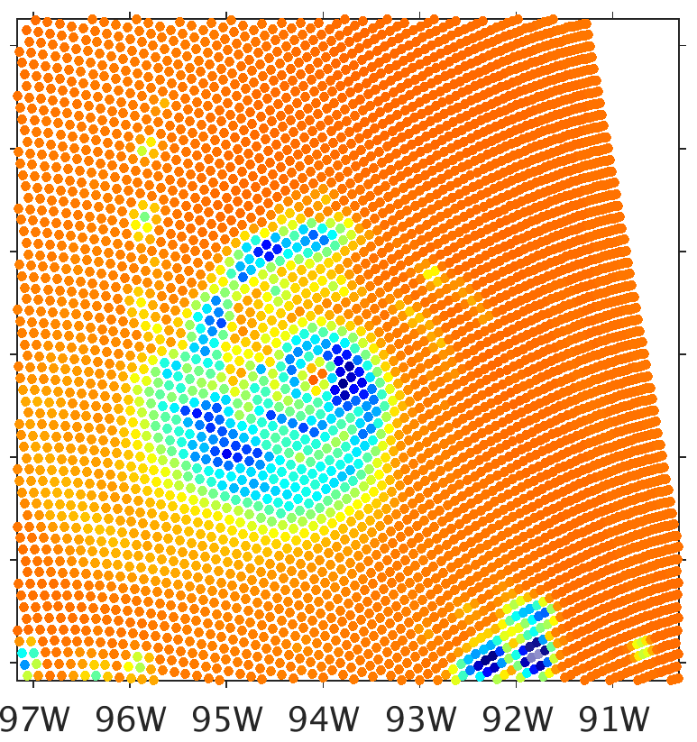
Brightness Temperature (K)
CRTM-DS Spheres
80
100
120
140
160
180
200
220
240
260
280
300
19.35 GHz
37.0 GHz
91.66 GHz
183.31±7 GHz
Obs
WSM6
Notes:
37 GHz and 91.6 GHz are too cold, while 183 GHz seems a little too warm
Compared to 183 GHz, 91.6 GHz is observed warmer, but simulated colder

Slide 13

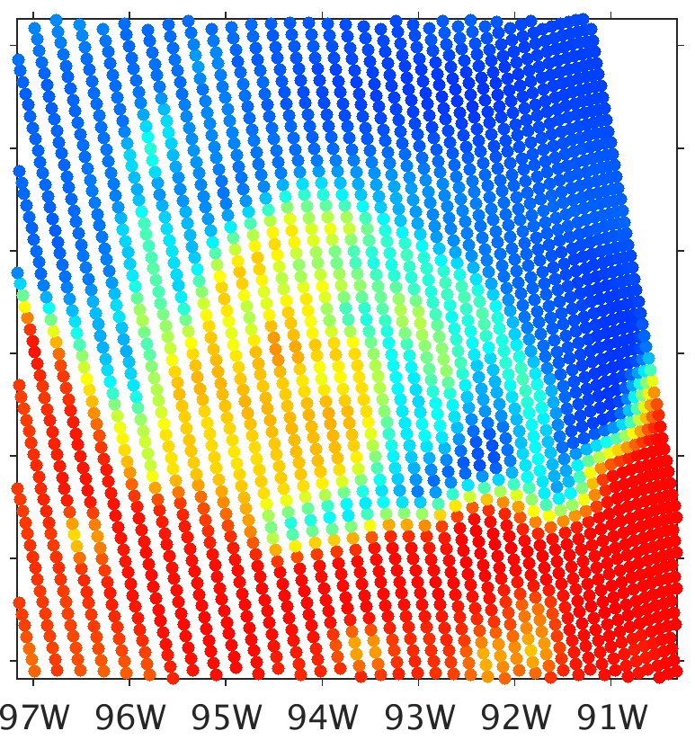
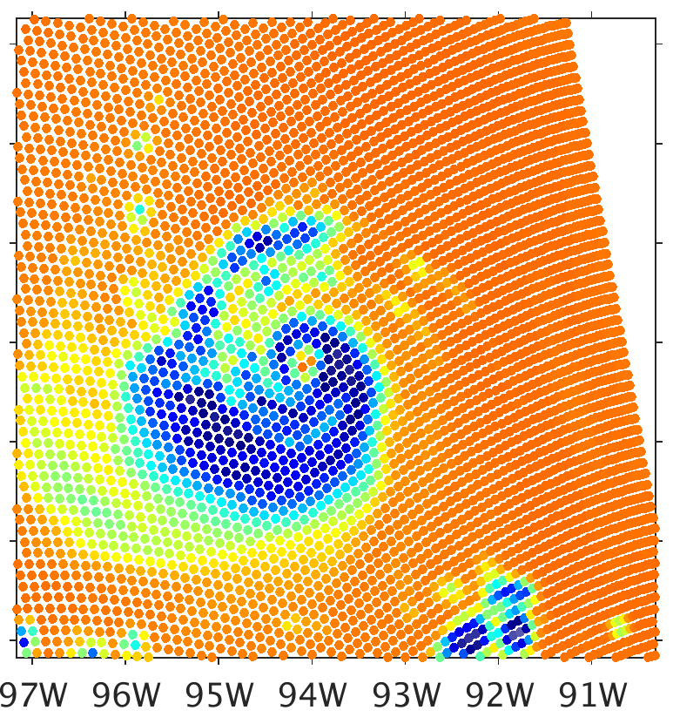
Brightness Temperature (K)
CRTM-DS Sector Snowflake
80
100
120
140
160
180
200
220
240
260
280
300
19.35 GHz
37.0 GHz
91.66 GHz
183.31±7 GHz
Obs
WSM6
Notes:
37 GHz and 91.6 GHz are warmer and are much less biased, while 183 GHz is colder
Now 183 GHz is colder than 91.6 GHz

Slide 14

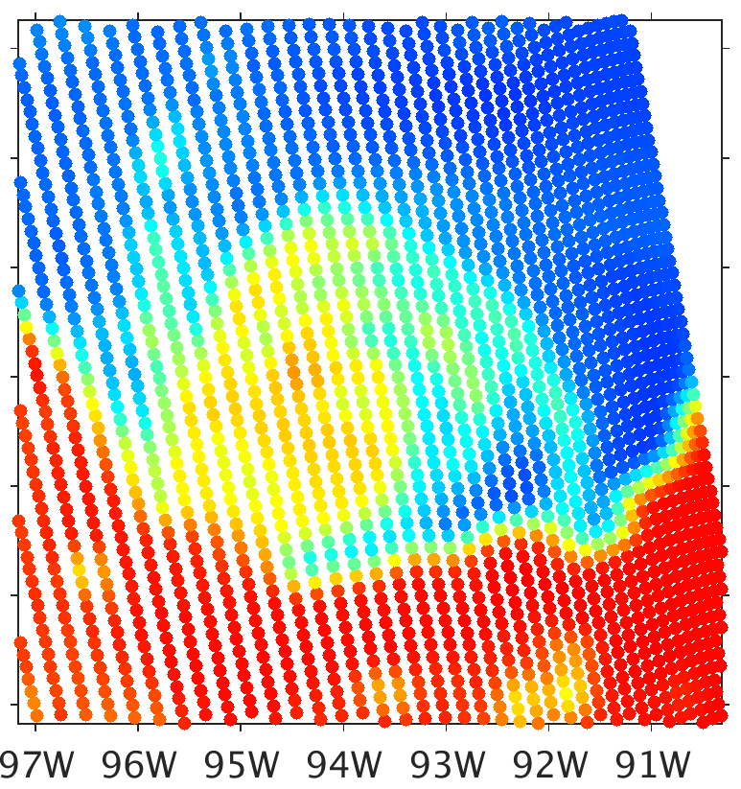
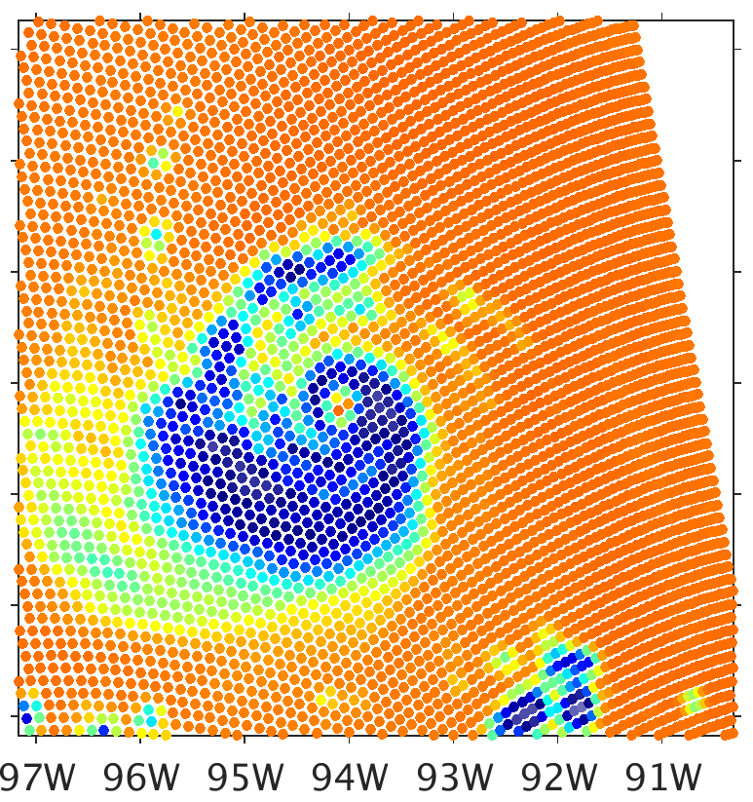
Brightness Temperature (K)
CRTM-DS 6-Bullet Rosette
80
100
120
140
160
180
200
220
240
260
280
300
19.35 GHz
37.0 GHz
91.66 GHz
183.31±7 GHz
Obs
WSM6
Notes:
Somewhat colder than sector snowflakes

Slide 15

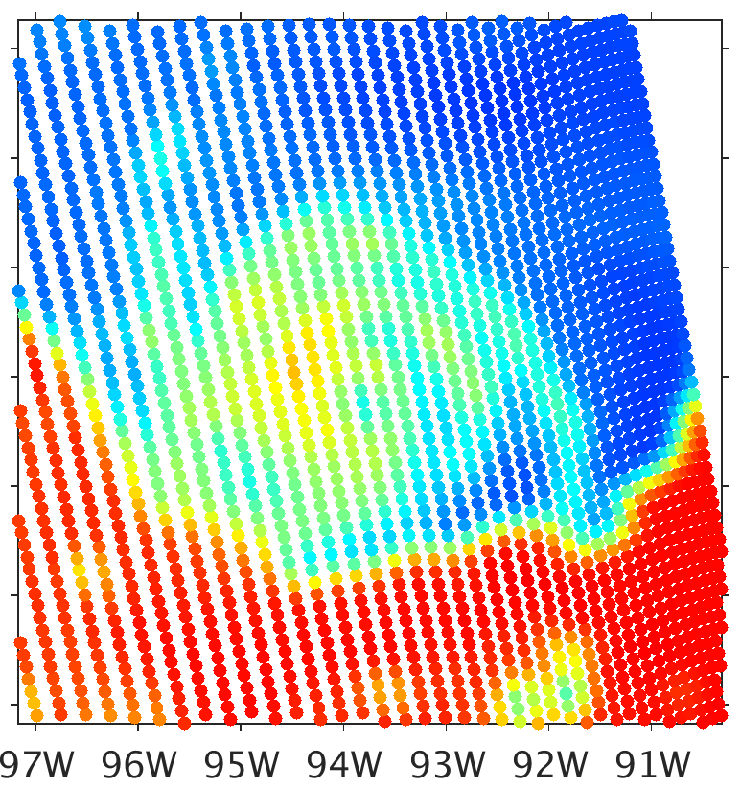
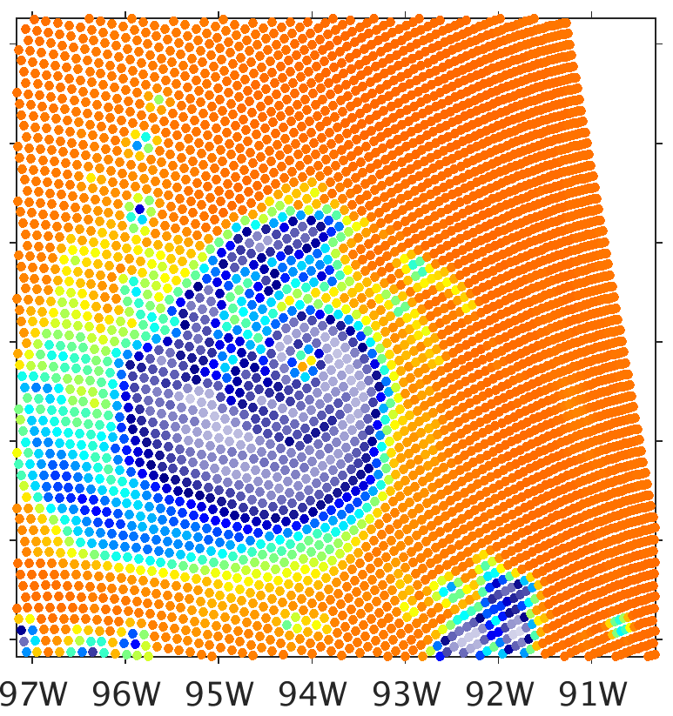
Brightness Temperature (K)
CRTM-DS Thin Column
80
100
120
140
160
180
200
220
240
260
280
300
19.35 GHz
37.0 GHz
91.66 GHz
183.31±7 GHz
Obs
WSM6
Notes:
Far too cold at all channels
183 GHz is now not colder than 91.6 GHz

Slide 16
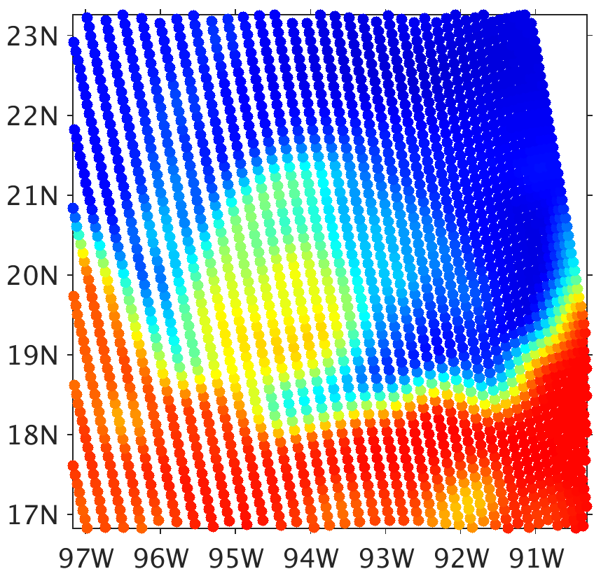
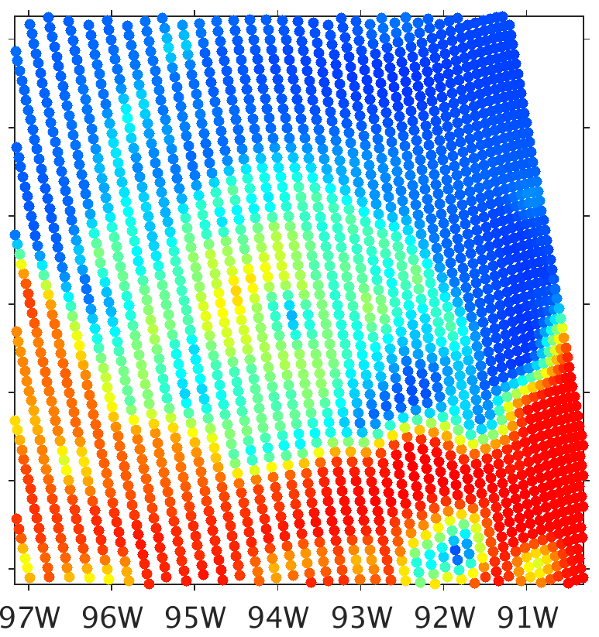
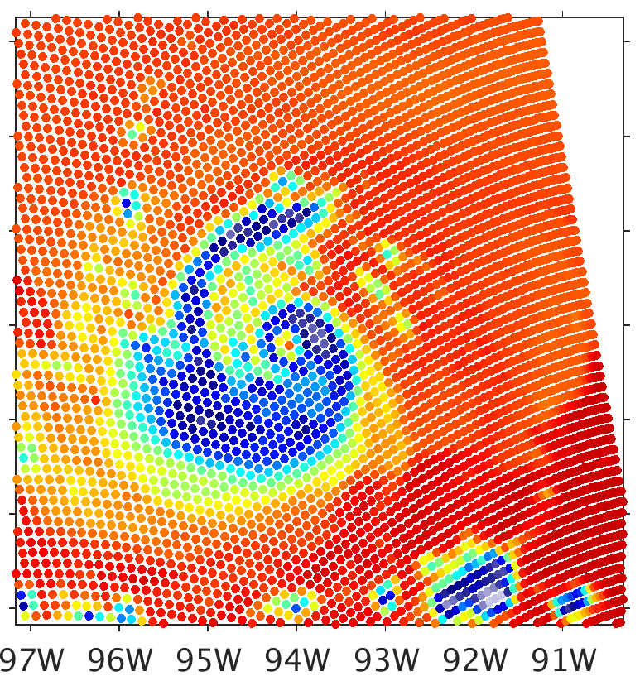
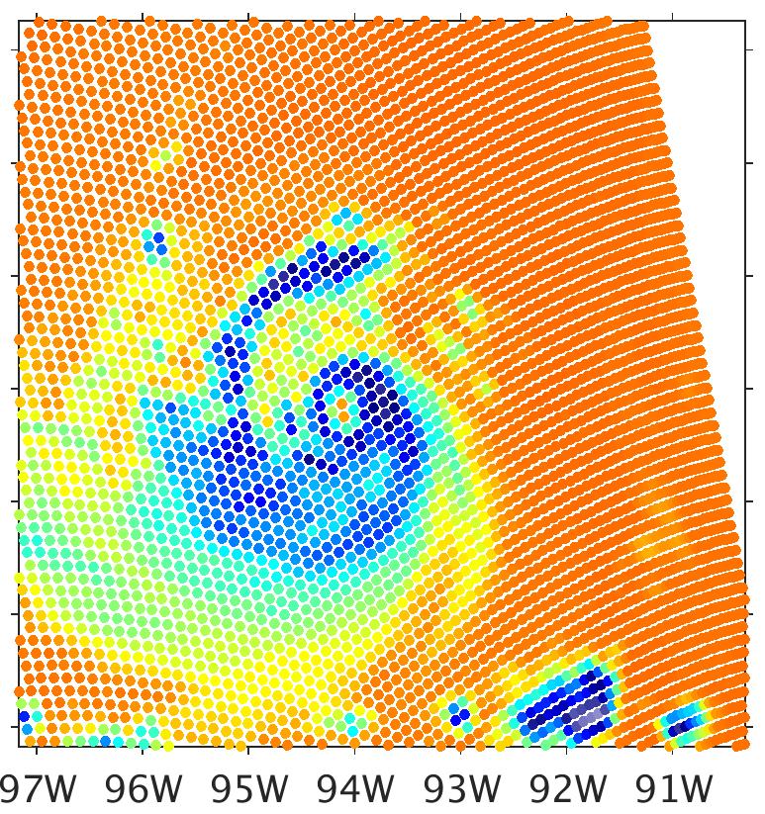
Brightness Temperature (K)
CRTM-DS Spheres
80
100
120
140
160
180
200
220
240
260
280
300
19.35 GHz
37.0 GHz
91.66 GHz
183.31±7 GHz
Obs
God-dard

Slide 17
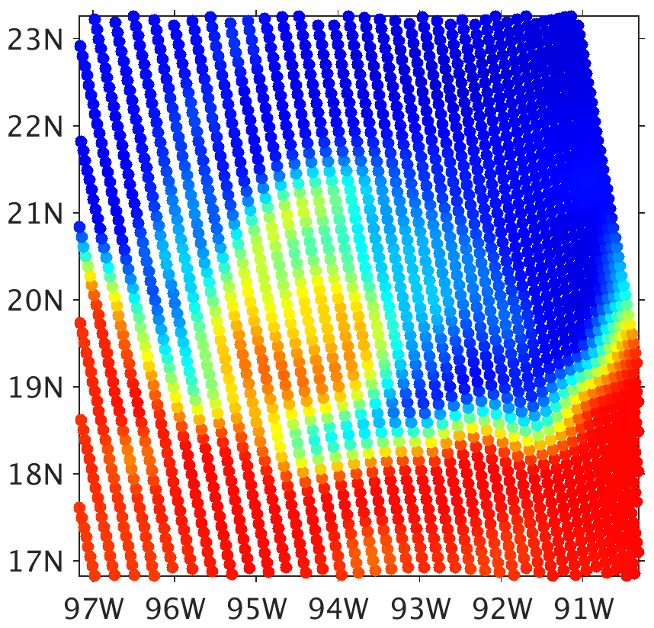
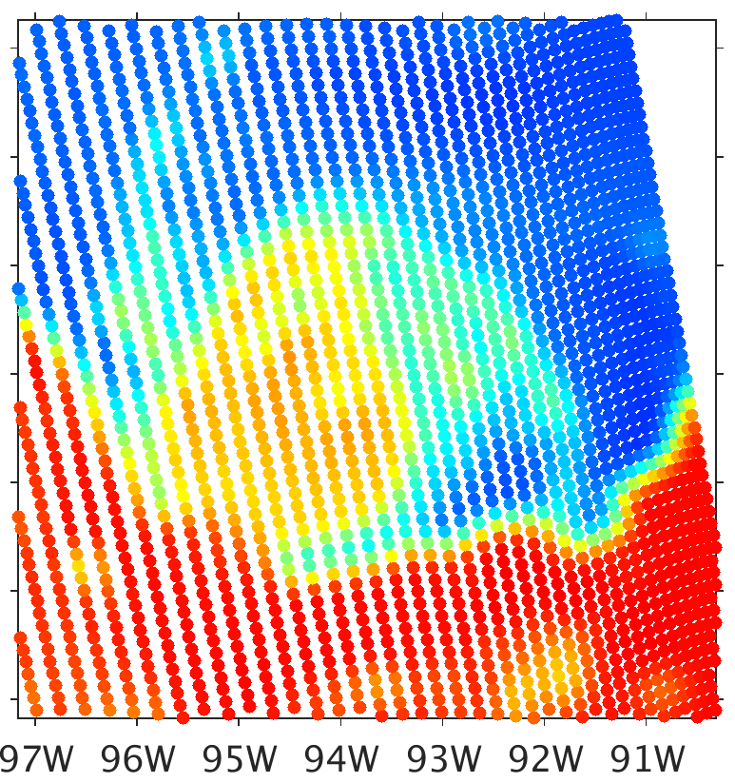
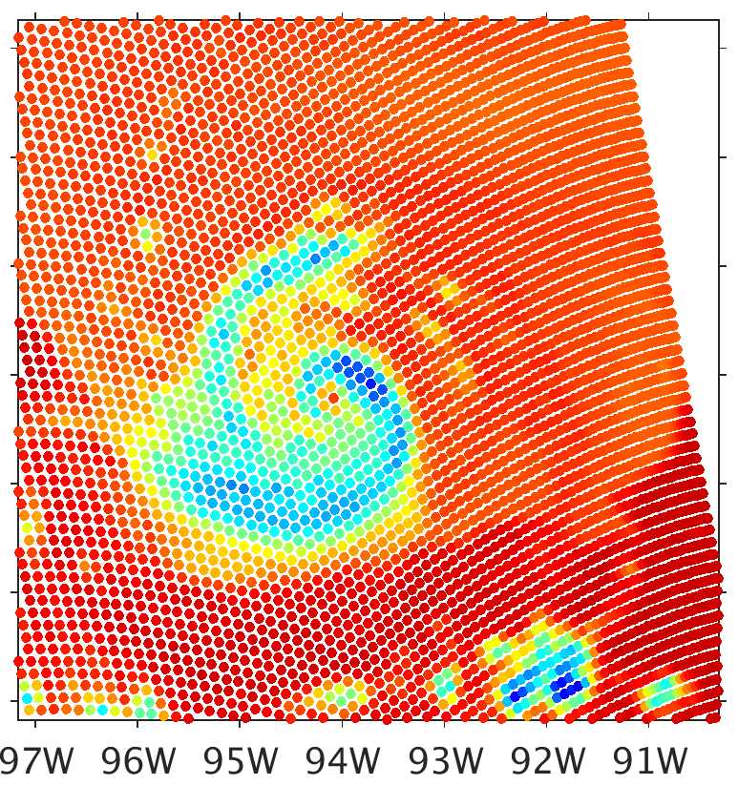
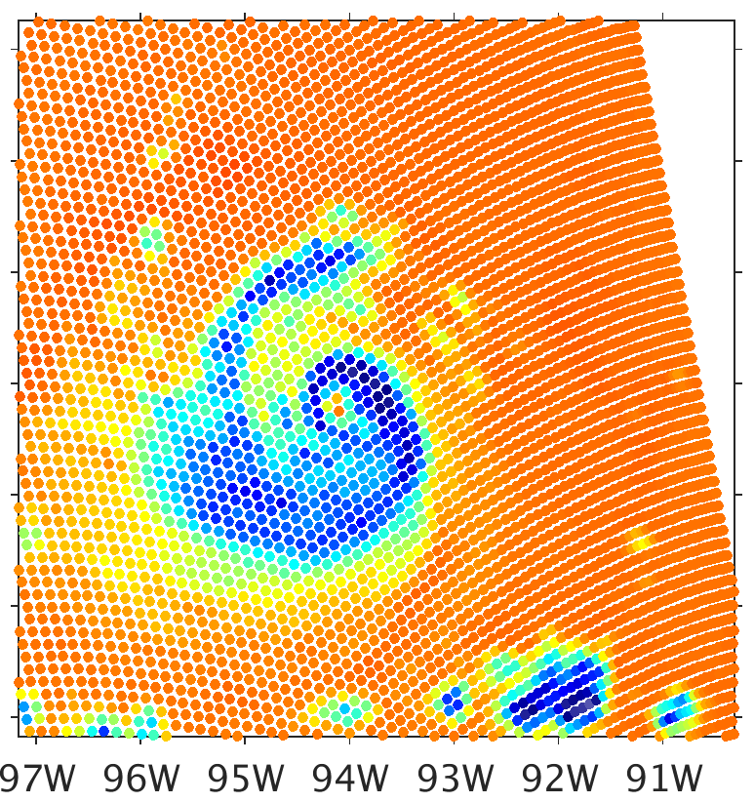
Brightness Temperature (K)
CRTM-DS Sector Snowflake
80
100
120
140
160
180
200
220
240
260
280
300
19.35 GHz
37.0 GHz
91.66 GHz
183.31±7 GHz
Obs
God-dard

Slide 18


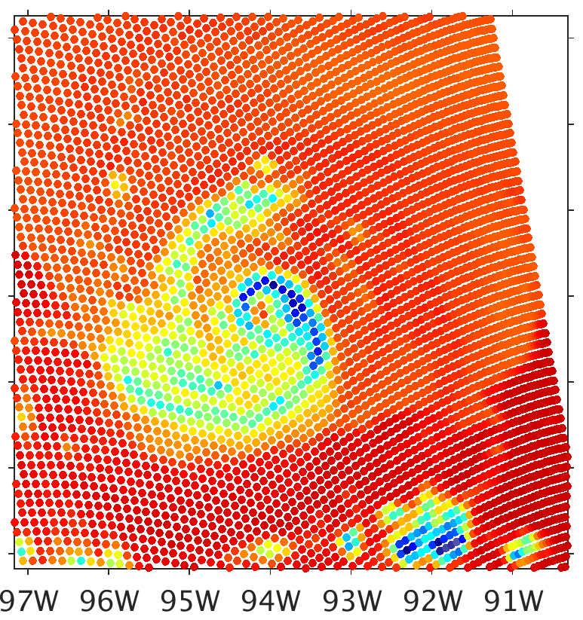
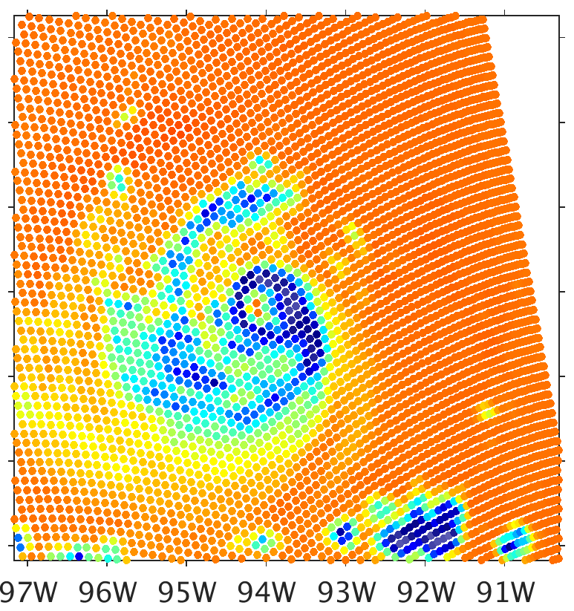
Brightness Temperature (K)
CRTM-DS 6-Bullet Rosette
80
100
120
140
160
180
200
220
240
260
280
300
19.35 GHz
37.0 GHz
91.66 GHz
183.31±7 GHz
Obs
God-dard
Notes:
There is an error with this lookup table. The same thing happened before. I had fixed it, and I’m not sure how it came back.

Slide 19
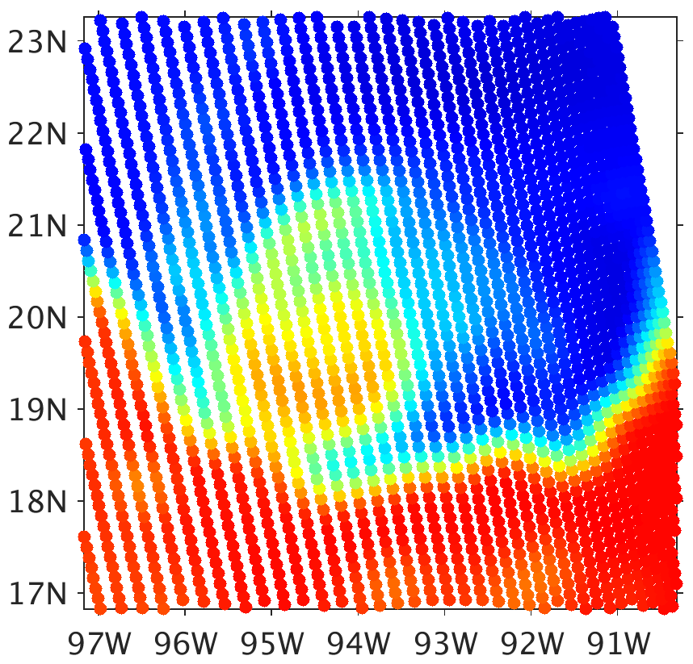
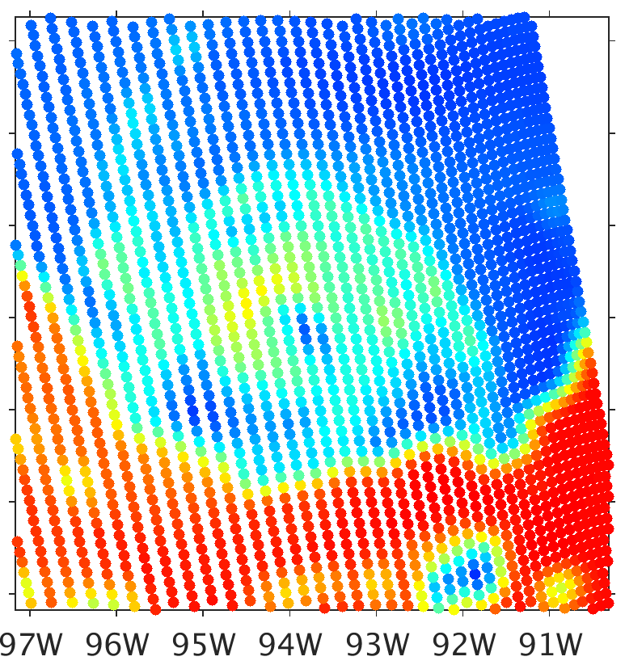
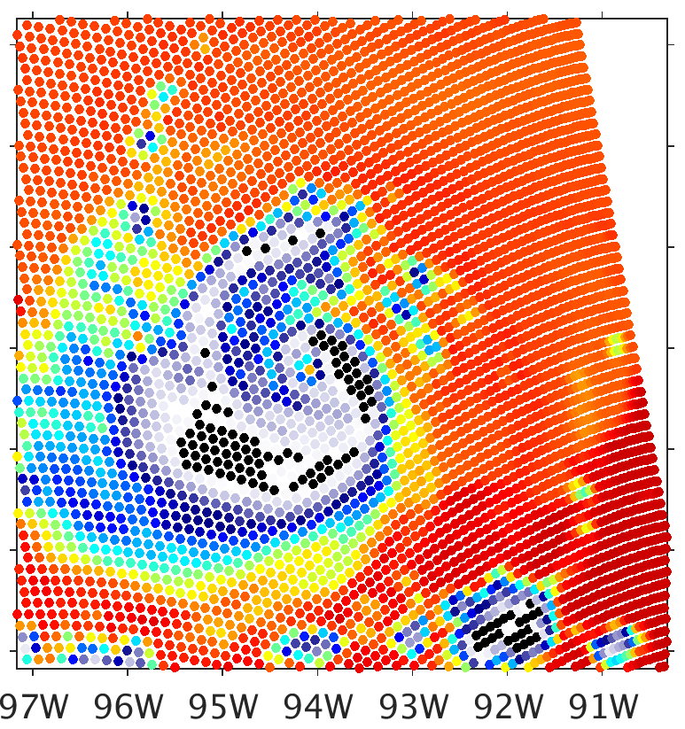
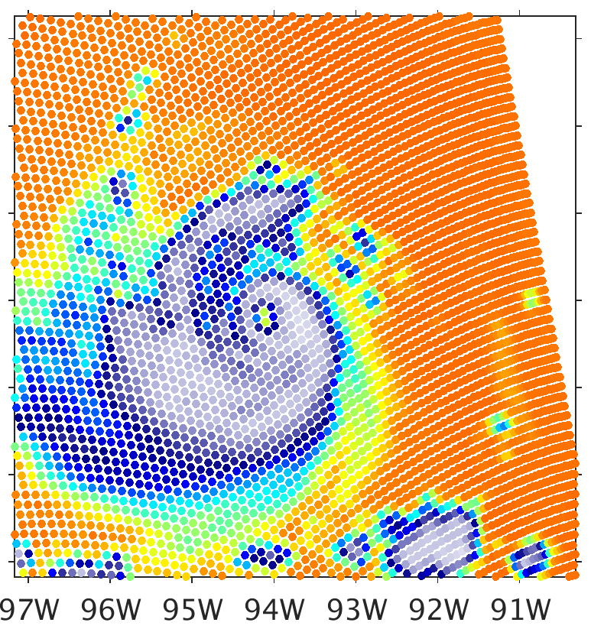
Brightness Temperature (K)
CRTM-DS Thin Column
80
100
120
140
160
180
200
220
240
260
280
300
19.35 GHz
37.0 GHz
91.66 GHz
183.31±7 GHz
Obs
God-dard
Notes:
Far too cold

Slide 20
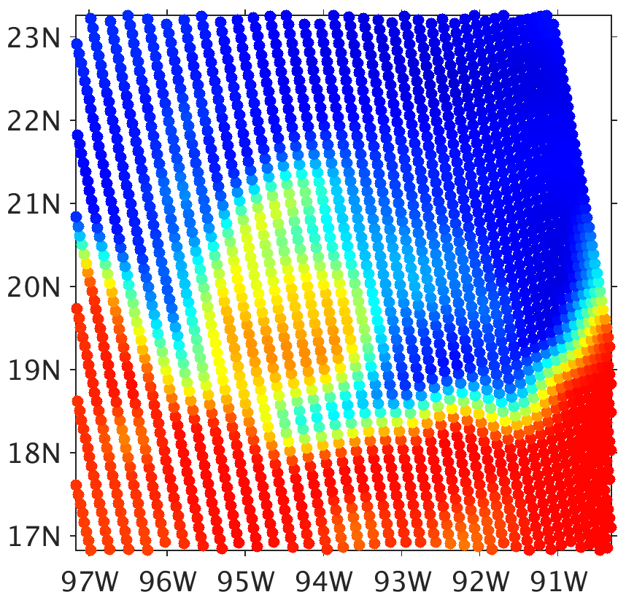
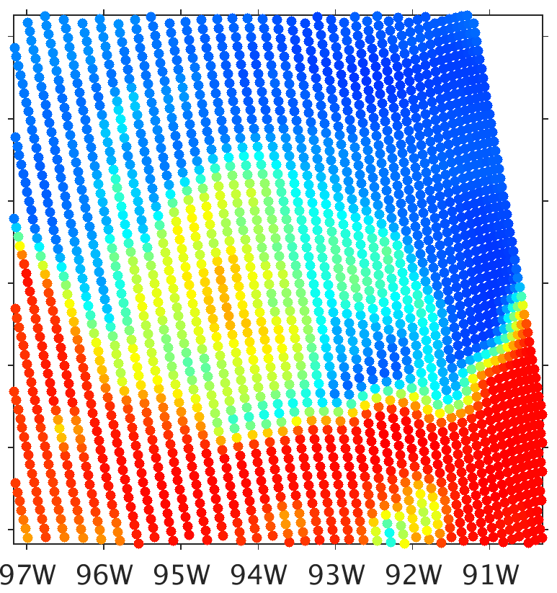
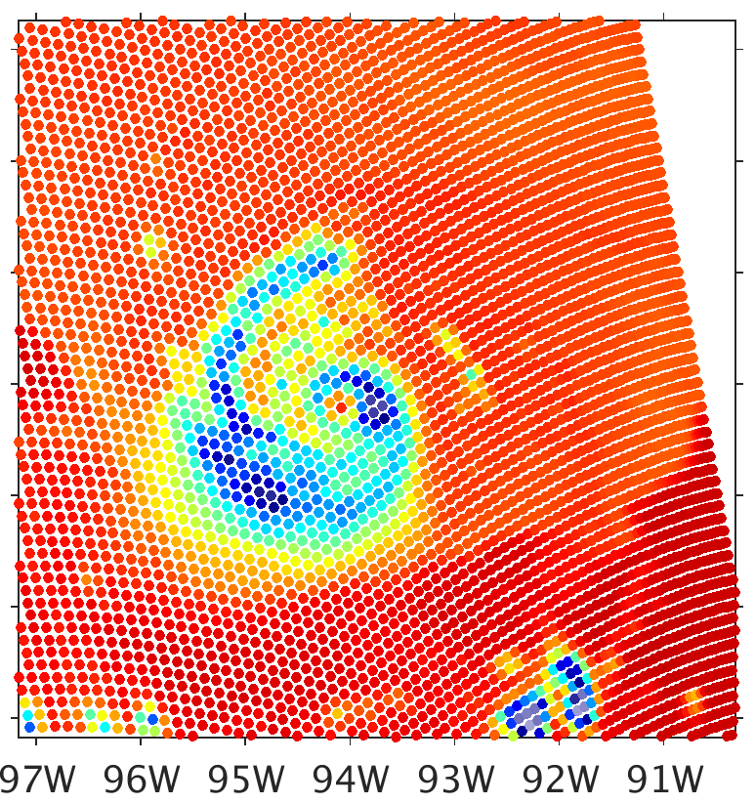
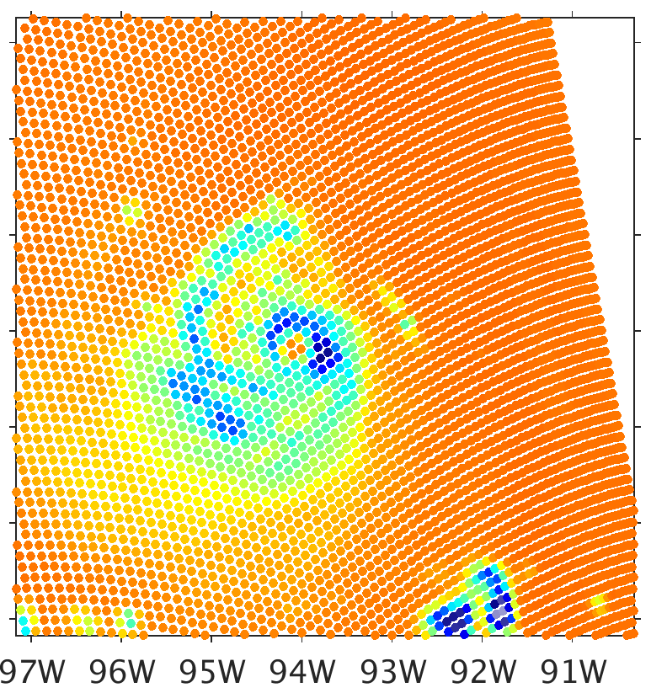
Brightness Temperature (K)
CRTM-DS Spheres
80
100
120
140
160
180
200
220
240
260
280
300
19.35 GHz
37.0 GHz
91.66 GHz
183.31±7 GHz
Obs
Mor-rison

Slide 21
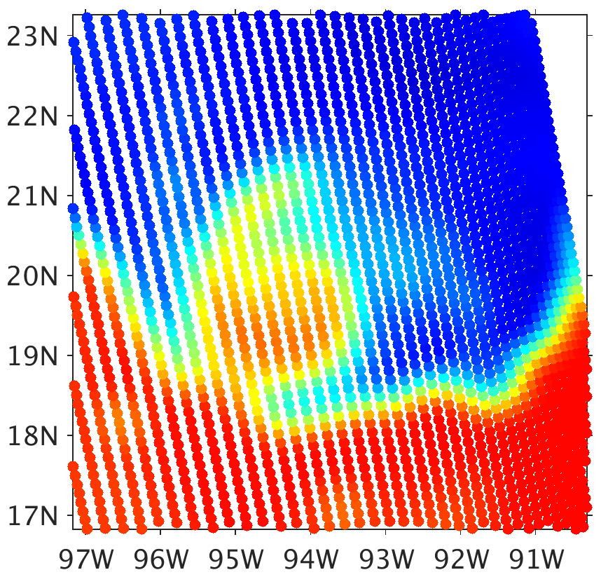



Brightness Temperature (K)
CRTM-DS Sector Snowflake
80
100
120
140
160
180
200
220
240
260
280
300
19.35 GHz
37.0 GHz
91.66 GHz
183.31±7 GHz
Obs
Mor-rison
Notes:
Unlike with the other schemes, 91.6 GHz is colder with sector snowflake than spheres

Slide 22




Brightness Temperature (K)
CRTM-DS 6-Bullet Rosette
80
100
120
140
160
180
200
220
240
260
280
300
19.35 GHz
37.0 GHz
91.66 GHz
183.31±7 GHz
Obs
Mor-rison

Slide 23
Brightness Temperature (K)
CRTM-DS Thin Column
80
100
120
140
160
180
200
220
240
260
280
300
19.35 GHz
37.0 GHz
91.66 GHz
183.31±7 GHz
Obs
Mor-rison

Slide 24
Spherical Particle Bulk Density
Lookup tables are consistent with particle mass distribution

Slide 25




Brightness Temperature (K)
CRTM-DS WSM6
80
100
120
140
160
180
200
220
240
260
280
300
SSMIS Obs
Consistent
200 Graupel
25 Snow
37.0 GHz
91.66 GHz
Notes:
Lower bulk density results in higher brightness temperatures at channels where ice scattering is impacting brightness temperatures

Slide 26




Brightness Temperature (K)
CRTM-DS WSM6
80
100
120
140
160
180
200
220
240
260
280
300
SSMIS Obs
Consistent
300 Graupel
50 Snow
37.0 GHz
91.66 GHz
Notes:
Slightly colder with slightly more dense ice

Slide 27




Brightness Temperature (K)
CRTM-DS WSM6
80
100
120
140
160
180
200
220
240
260
280
300
SSMIS Obs
Consistent
600 Graupel
200 Snow
37.0 GHz
91.66 GHz
Notes:
Slightly colder than benchmark with particles denser than reality

Slide 28


Brightness Temperature (K)
CRTM-DS WSM6
80
100
120
140
160
180
200
220
240
260
280
300
SSMIS Obs
Consistent
800 Graupel
400 Snow
37.0 GHz
91.66 GHz
Notes:
With very dense graupel, the trend reverses
The trend continues through the upper limit of reasonable representation of snow

Slide 29
About Particle Bulk Density
It is a component of the slope parameter, λ, of the particle size distribution
Can allow the particle size distribution to change in response to a different bulk density

Slide 30




Brightness Temperature (K)
CRTM-DS WSM6
80
100
120
140
160
180
200
220
240
260
280
300
SSMIS Obs
Consistent
400 New PMD
400 Same PMD
37.0 GHz
91.66 GHz
Notes:
No immediately noticeable differences
Will re-try with a greater change in bulk density, like 100 kg per cubic meter

