Slide 1

The predictability of Hurricane Joaquin (2015): An ensemble sensitivity perspective
Robert Nystrom and Fuqing Zhang
Notes:
Main event of the 2015 Atlantic season
Forecast challenges

Slide 2
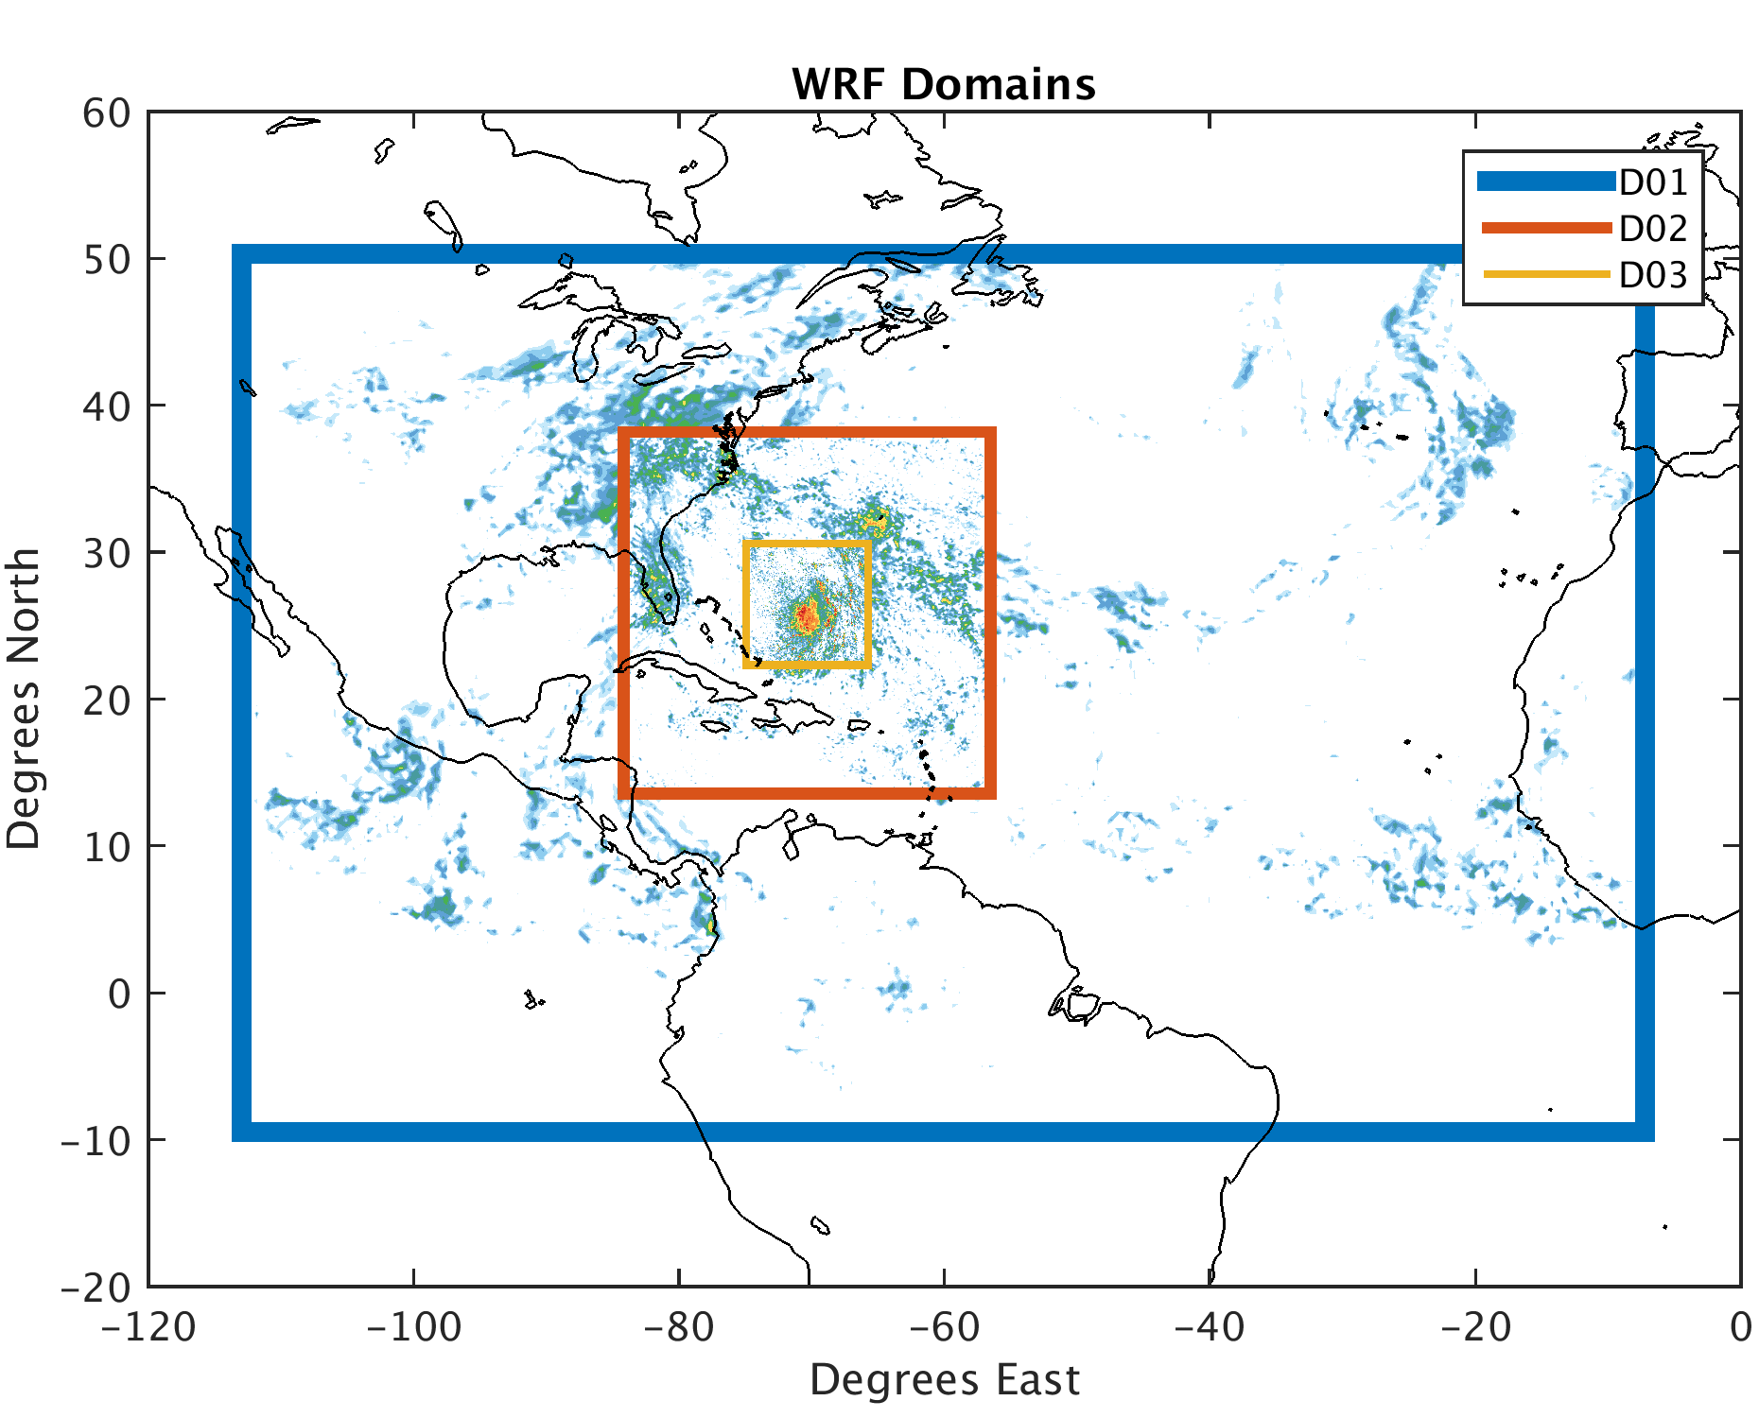
PSU WRF-EnKF Setup
Forecasts from 12z September 29th
60 member ensemble
3 hour continuous cycling EnKF
WRF v3.5.1
3 two-way nested domains
27/9/3 km grid spacing
Boundary conditions provided by GFS
Initial ensemble perturbations provided by background error covariance
WSM6 microphysics
YSU PBL
Dudhia Shortwave
Grell-Dévényi Cumulus (D01 Only)
Green and Zhang (2013) surface flux scheme
Notes:
Highlight specifications of PSU WRF-EnKF system
-Assimilate all conventional obs as well as aircraft radar (radial velocities)

Slide 3
a)
b)
c)
U.S. Landfall? Out to sea?
Notes:
Deterministic forecasts all correctly forecast Joaquin staying out to see
GFS fails to capture initial southwest motion
APSU captures some of the southwest motion but fails to capture full extent
ECMWF best captures southwest motion but has a slight westward bias
Ensemble forecasts demonstrate high uncertainty
– Majority of GFS and European ensemble members track toward US east coast
- PSU ensemble more evenly split

Slide 4
Major Hurricane? Tropical Storm?
Notes:
APSU deterministic captures intensification of Joaquin
Ensemble forecasts are all over the place!
Difference between weakest and strongest ensemble members ~80 kts
Where do these IC differences matter
Fcsts from same model, with same physics, BCs -> IC differences cause the forecast differences
Can analyze regions of IC important to forecast and regions where DA can help you (better/more observations)

Slide 5
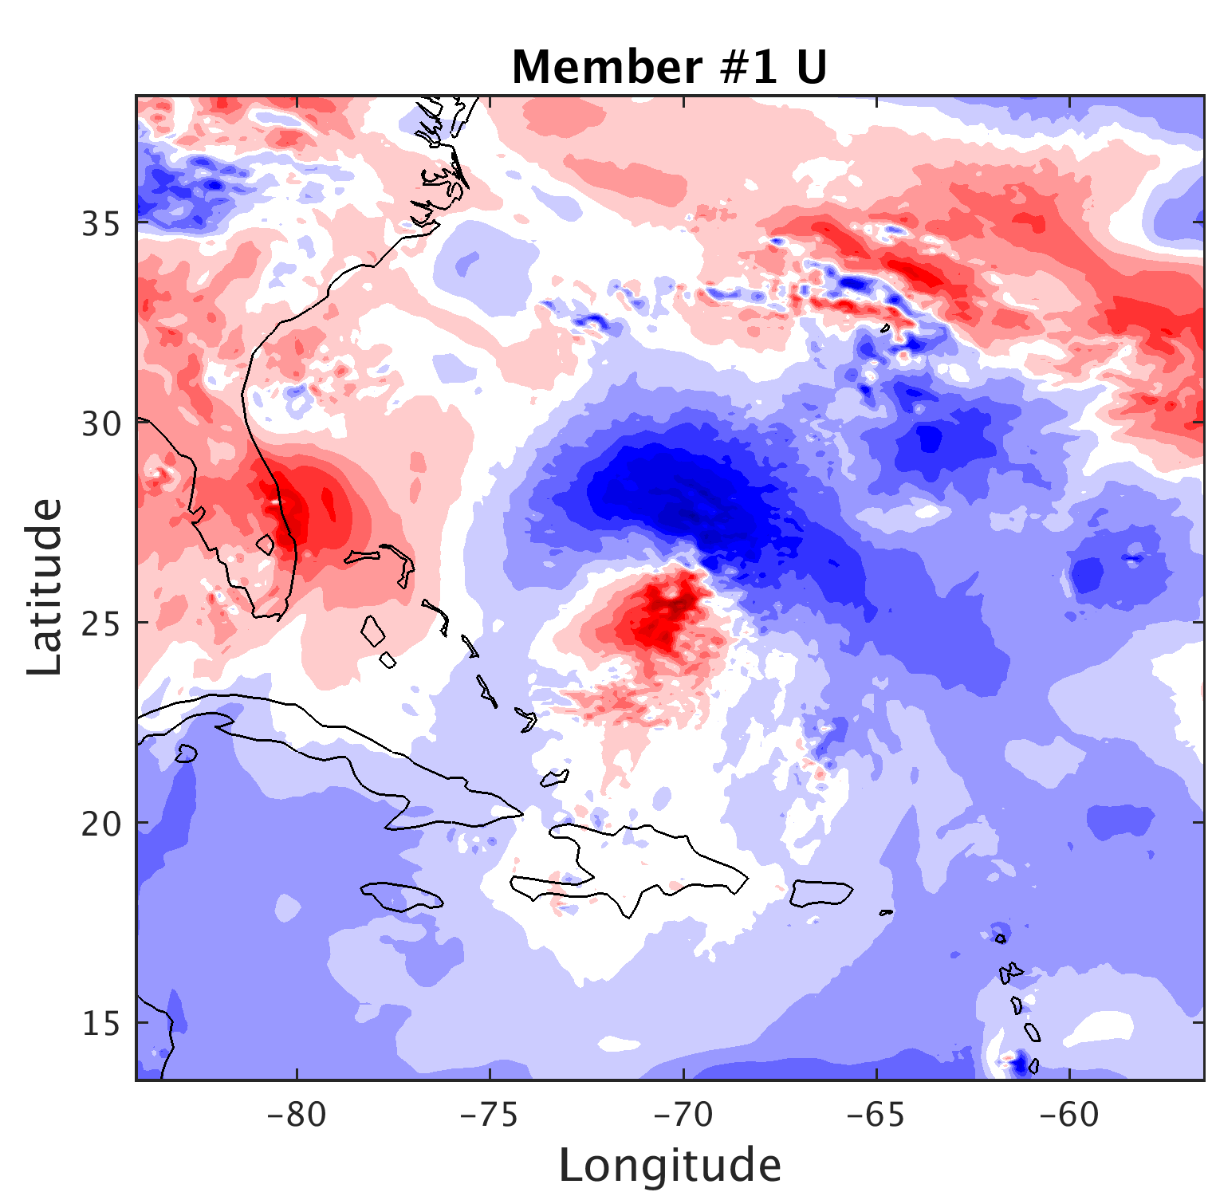
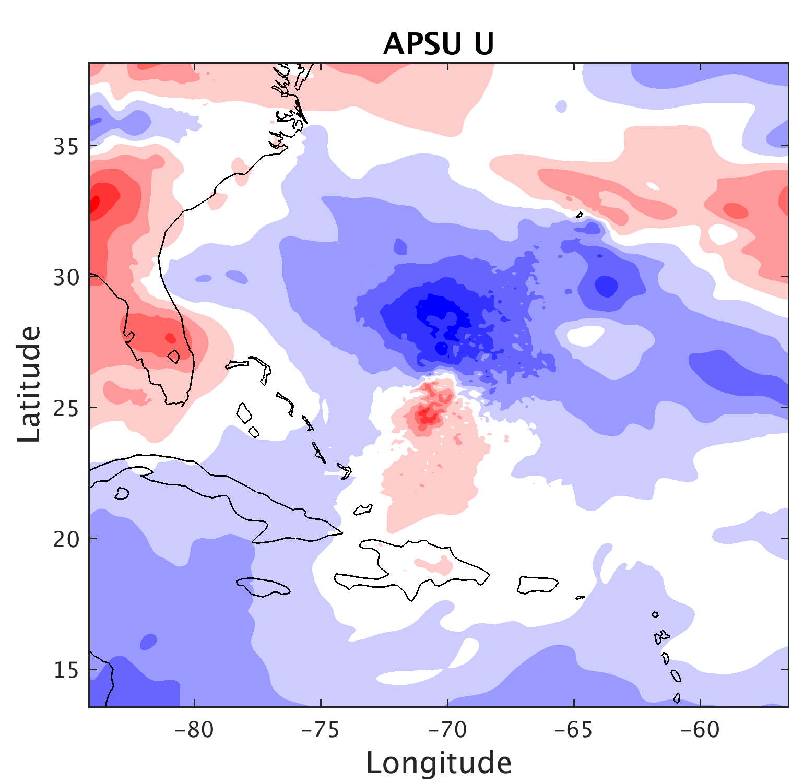
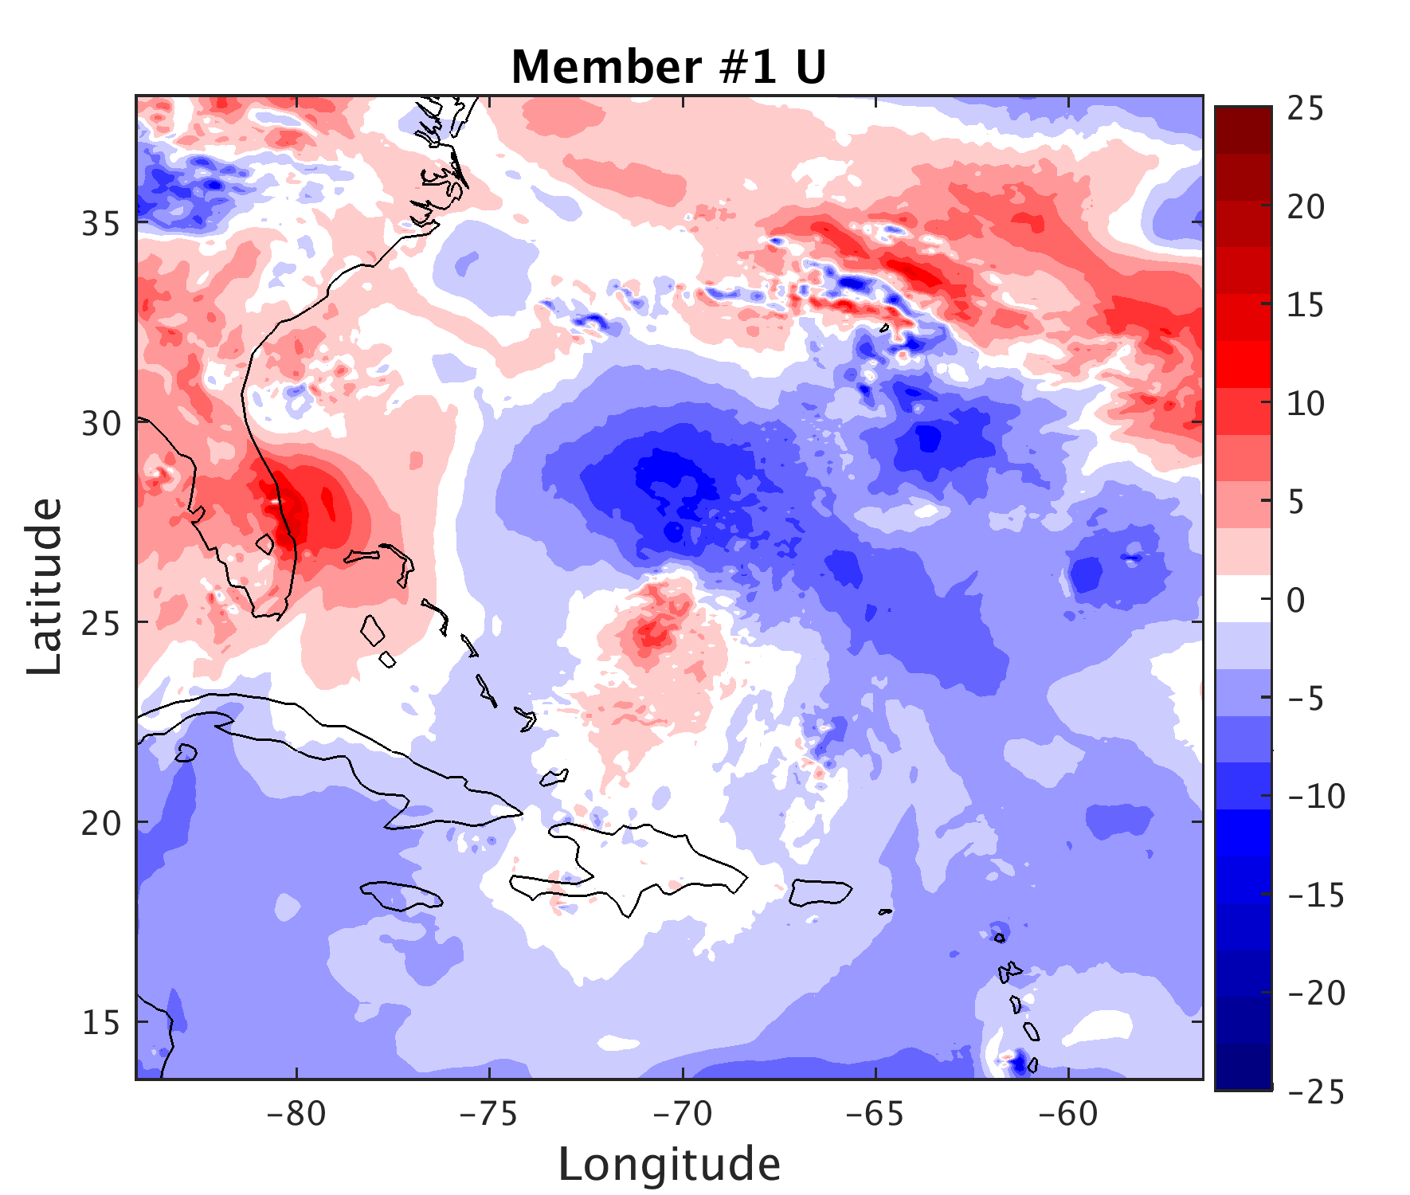
Relaxed to APSU vortex (RVOR)
+
=
$$\left\{\begin{aligned}a=\text{(}\text{Rmax}\text{−}\text{r}\text{)/(}\text{Rmax}\text{−}\text{Rmin}\text{) (}\text{if} \text{Rmin}≤\text{r}≤Rmax) \\ a=1.0 if r<Rmin \\ a=0 if r>Rmax \\ RVOR=UNRL∗(1−a)+APSU∗a \end{aligned}\right.$$
RVOR
Notes:
Rmin = 300 km
Rmax = 600 km
UNRL is the real-time ensemble

Slide 6
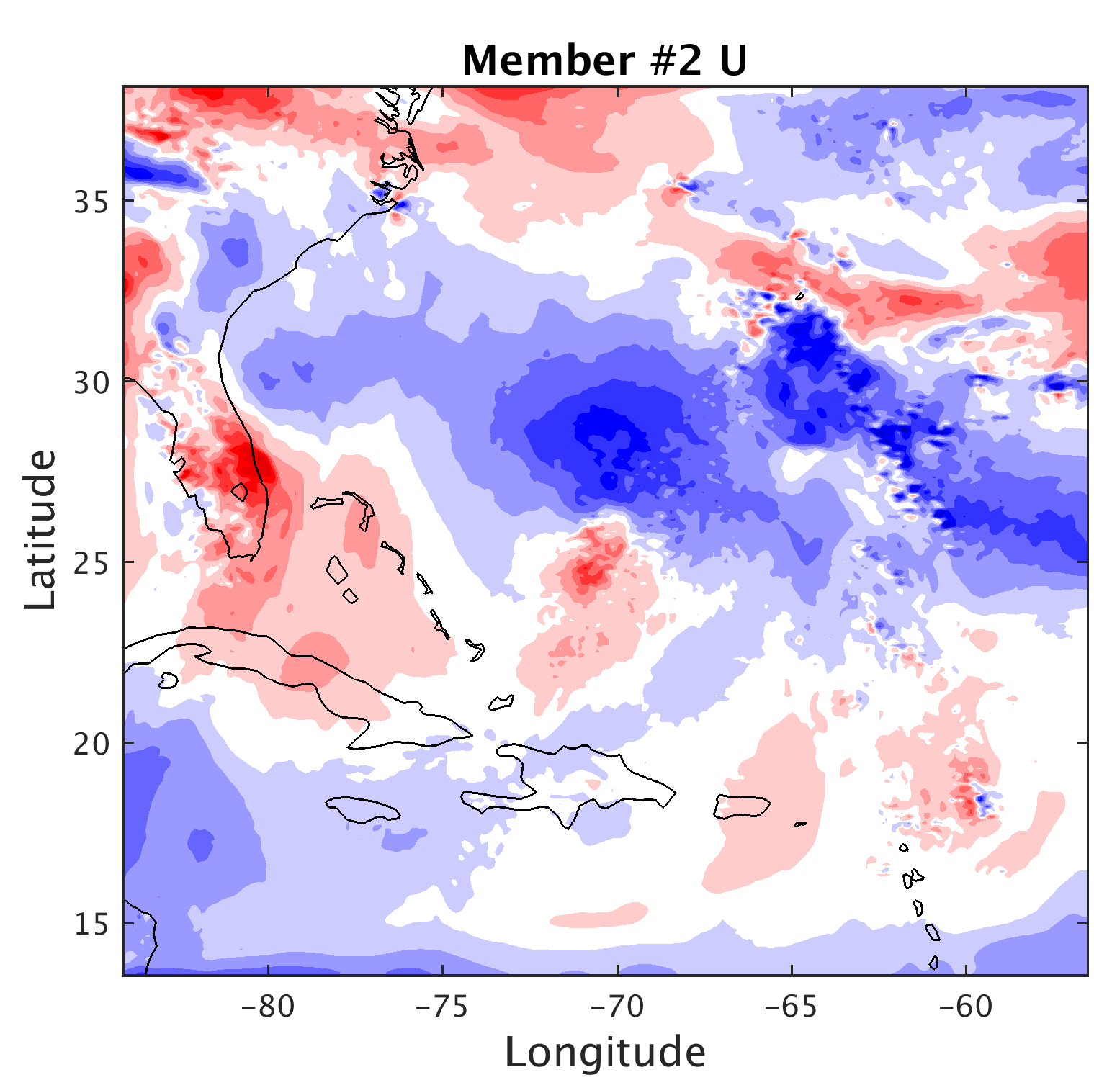
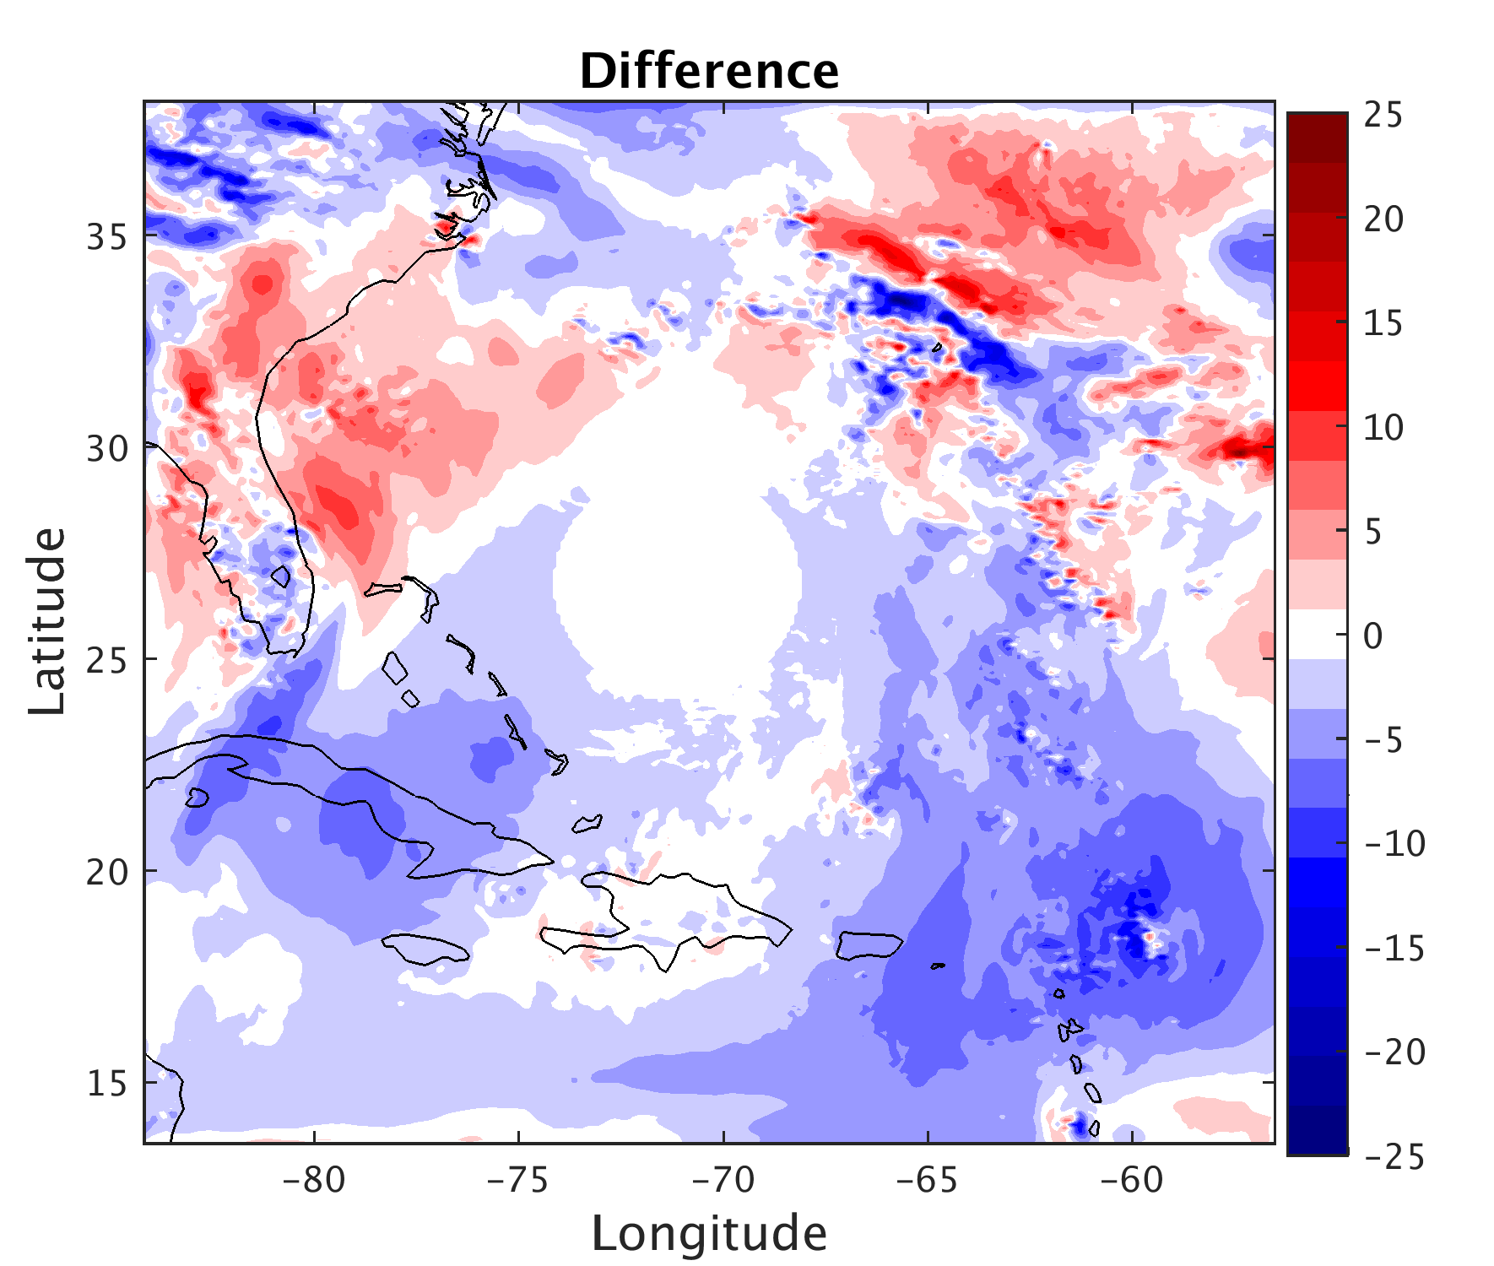
Initial Condition differences to the inner core
are removed!
RVOR
-
=
Notes:
Can now examine the effects of IC differences to only the environment on the forecast

Slide 7
a)
b)
c)
Large track spread remains
Intensity spread reduced for first 84 h
Delay in intensity spread growth
Notes:
Appreciable track spread remains (bifurcation in tracks still visible)
Intensity forecast spread reduced over 84 h
- Appears to take ~ 12 h for IC differences to the environment to begin to effect storm intensity

Slide 8
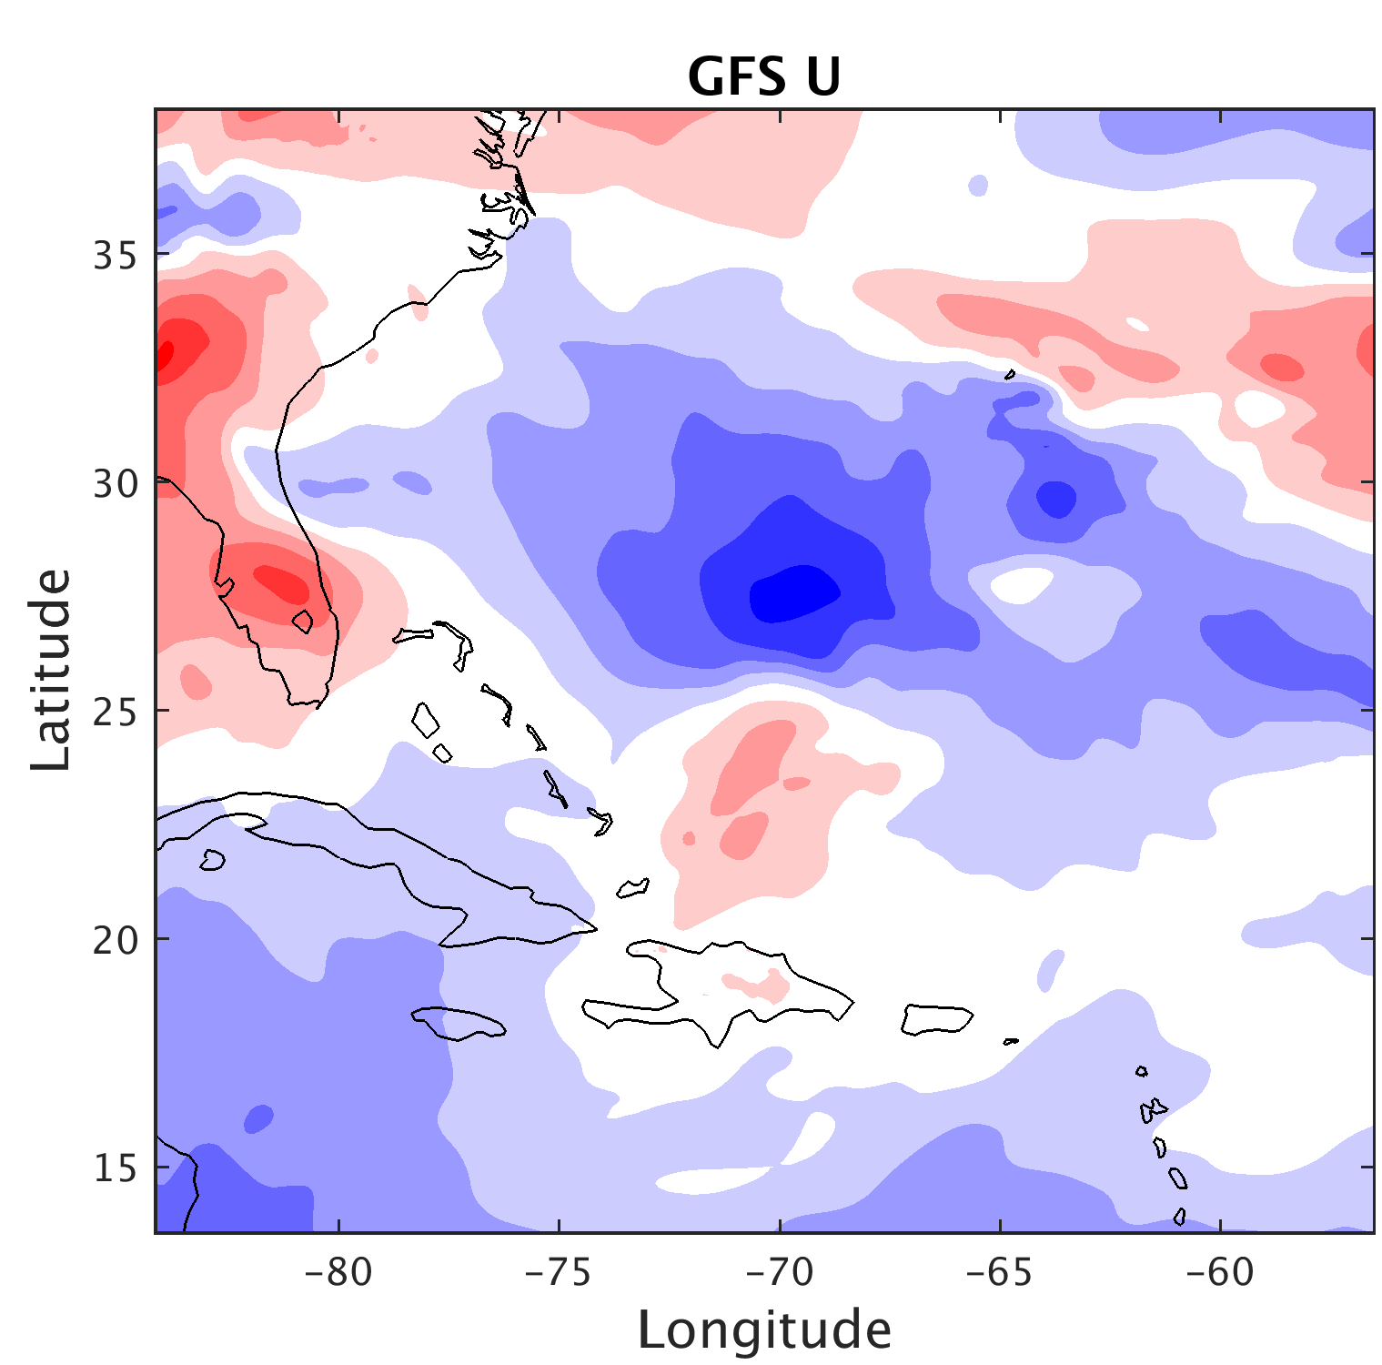
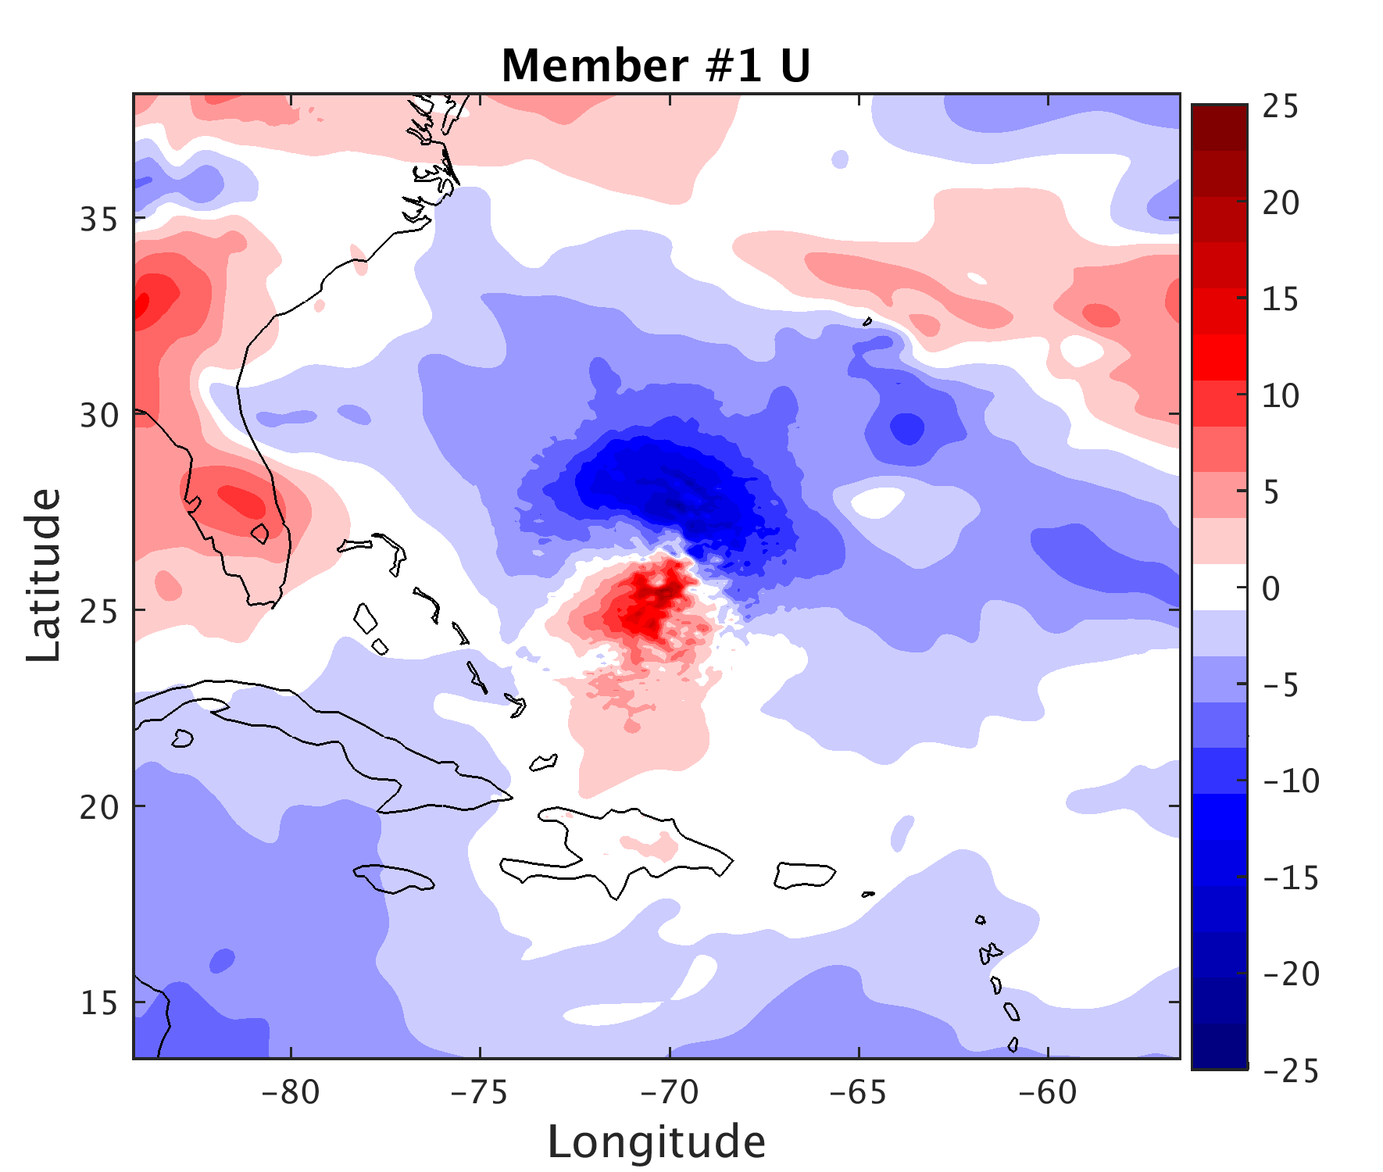
Relaxed to GFS environment (RENV)
+
=
$$\left\{\begin{aligned}a=\text{(}\text{Rmax}\text{−}\text{r}\text{)/(}\text{Rmax}\text{−}\text{Rmin}\text{) (}\text{if} \text{Rmin}≤\text{r}≤Rmax) \\ a=1.0 (if r<Rmin) \\ a=0 (if r>Rmax) \\ RENV=UNRL∗a+GFS∗(1−a) \end{aligned}\right.$$
RENV
Notes:
Rmin = 300 km
Rmax = 600 km
UNRL is the real-time ensemble

Slide 9
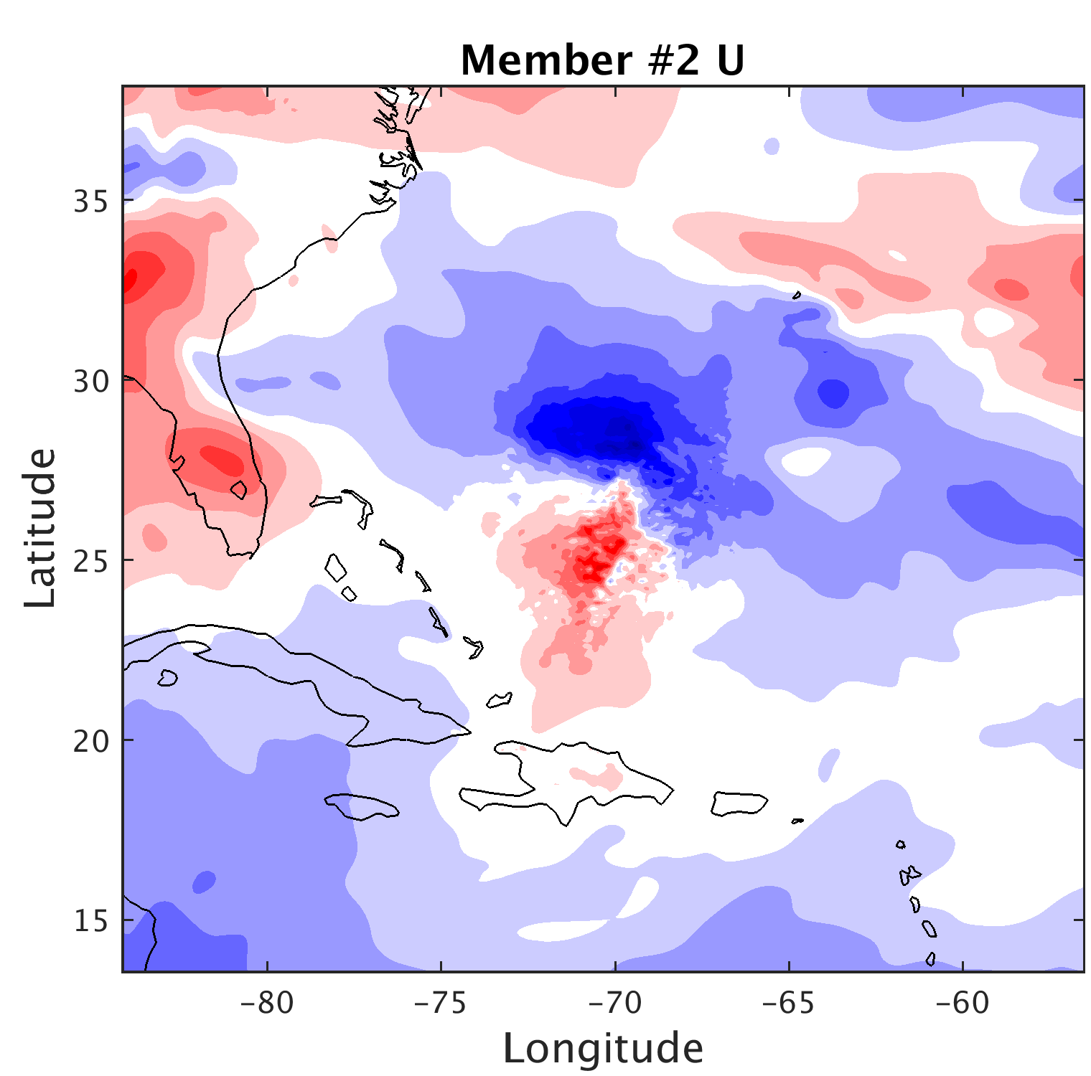
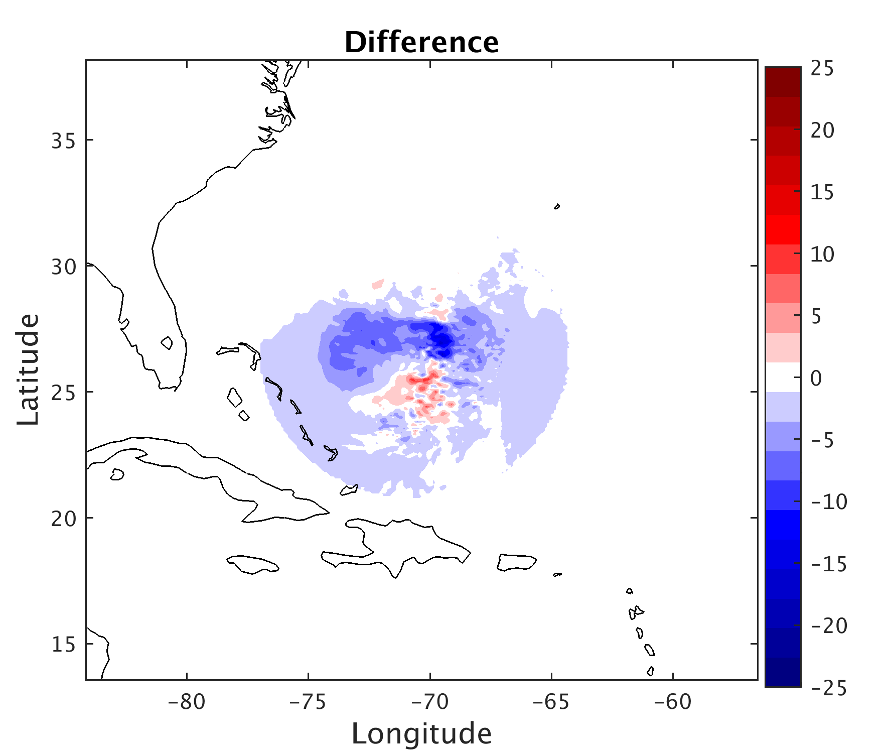
Initial Condition differences to the environment
are removed!
RENV
-
=
Notes:
Can now examine the effects of IC differences to only the storm vortex on the forecast

Slide 10
a)
b)
c)
Track spread greatly reduced
Large intensity spread remains
Notes:
Track spread is greatly reduced (track bifurcation no longer apparent)
Large intensity forecast spread from only IC differences to the storm vortex
- Everything from a major hurricane to non-intensifying tropical storm

Slide 11
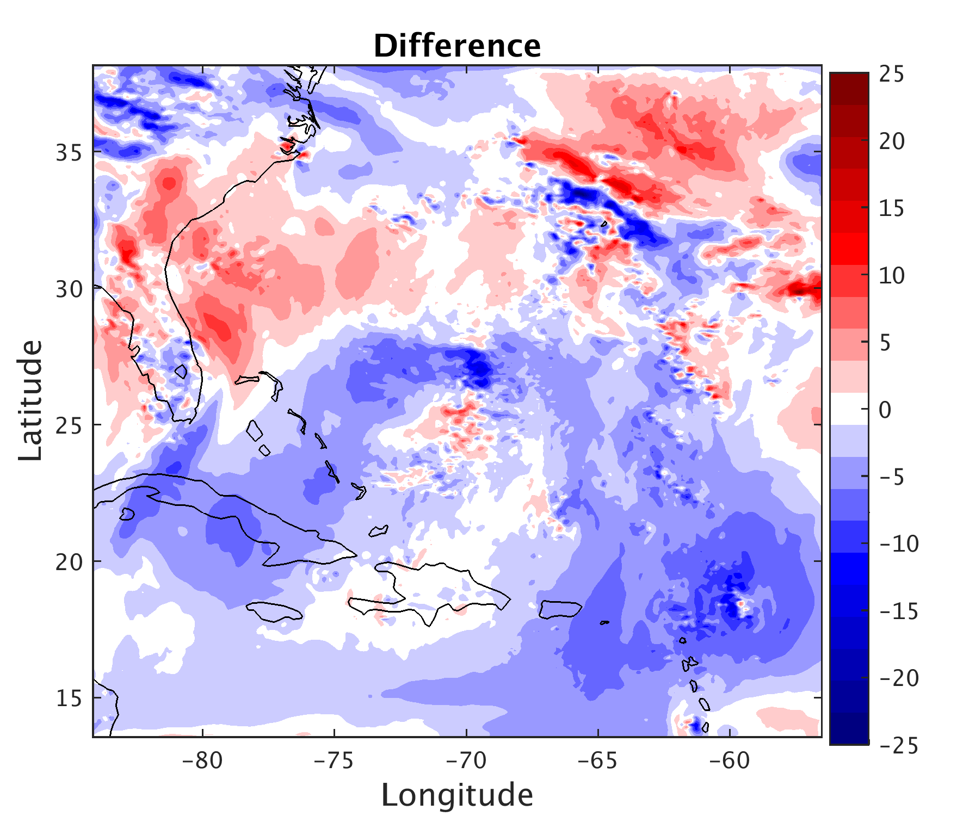
a)
b)
c)
RVOR only ensemble whose track spread approaches that of UNRL
RENV/RRNV track spread only slightly increases
RENV/RRNV can reproduce UNRL intensity spread
RVOR intensity spread still growing at 84 h
UNRL
RVOR
RENV
Notes:
Introduce RRNV ensemble( forecasts very similar to RENV and not shown)
Rate of track spread growth similar for UNRL and RVOR
UNRL/RENV/RRNV intensity spread saturated by ~48 h
RVOR intensity spread still growing at 84 h
Rate of intensity spread increase appears consistent across experiments

Slide 12
Initial intensity is very important!
From RRNV Ensemble:
Notes:
Stronger initial storm -> stronger final storm
Weaker initial storm -> weaker final storm
overestimated storms all intensify/only some under estimated storms intensify

Slide 13
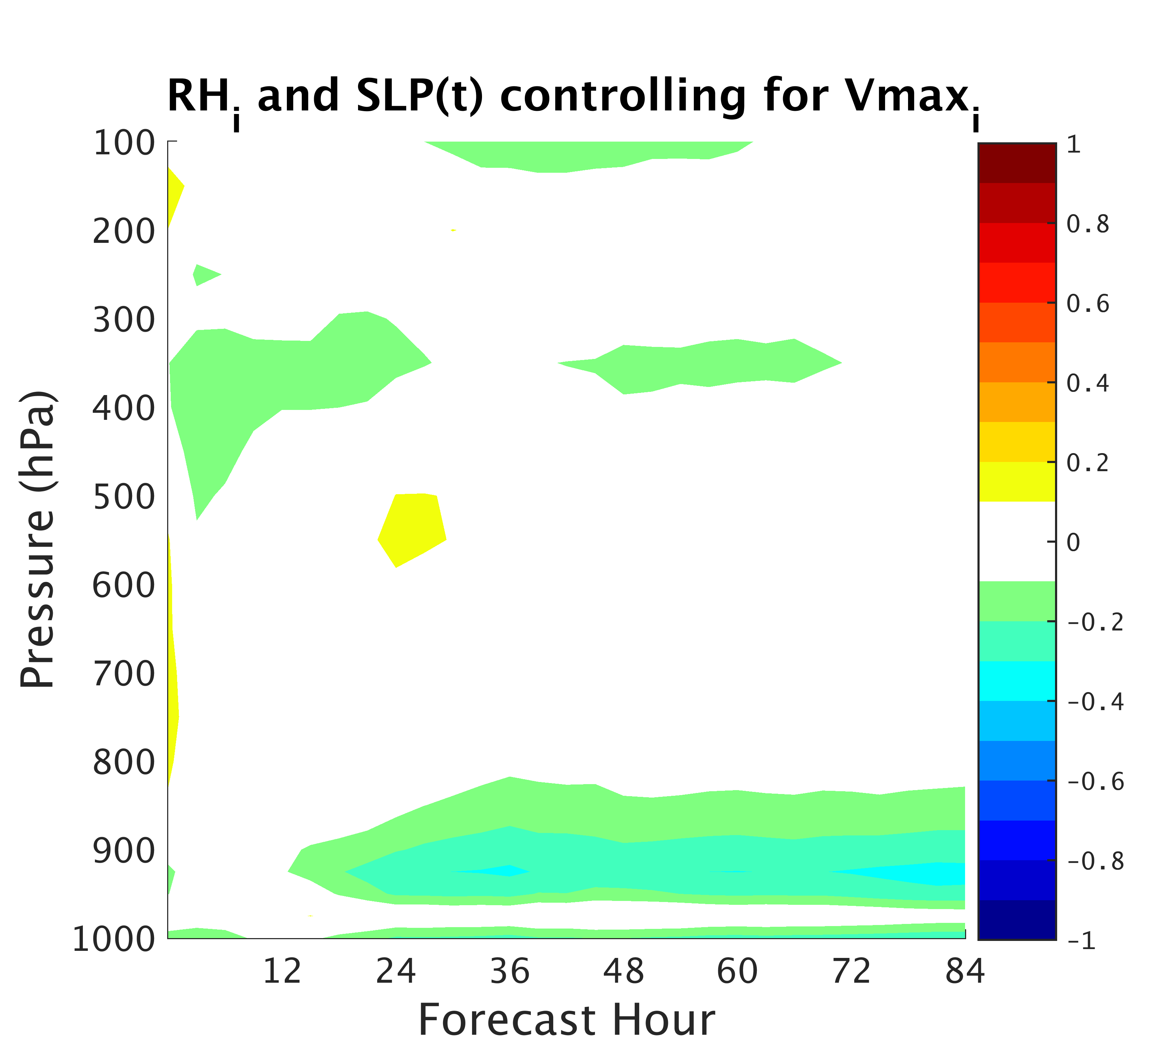
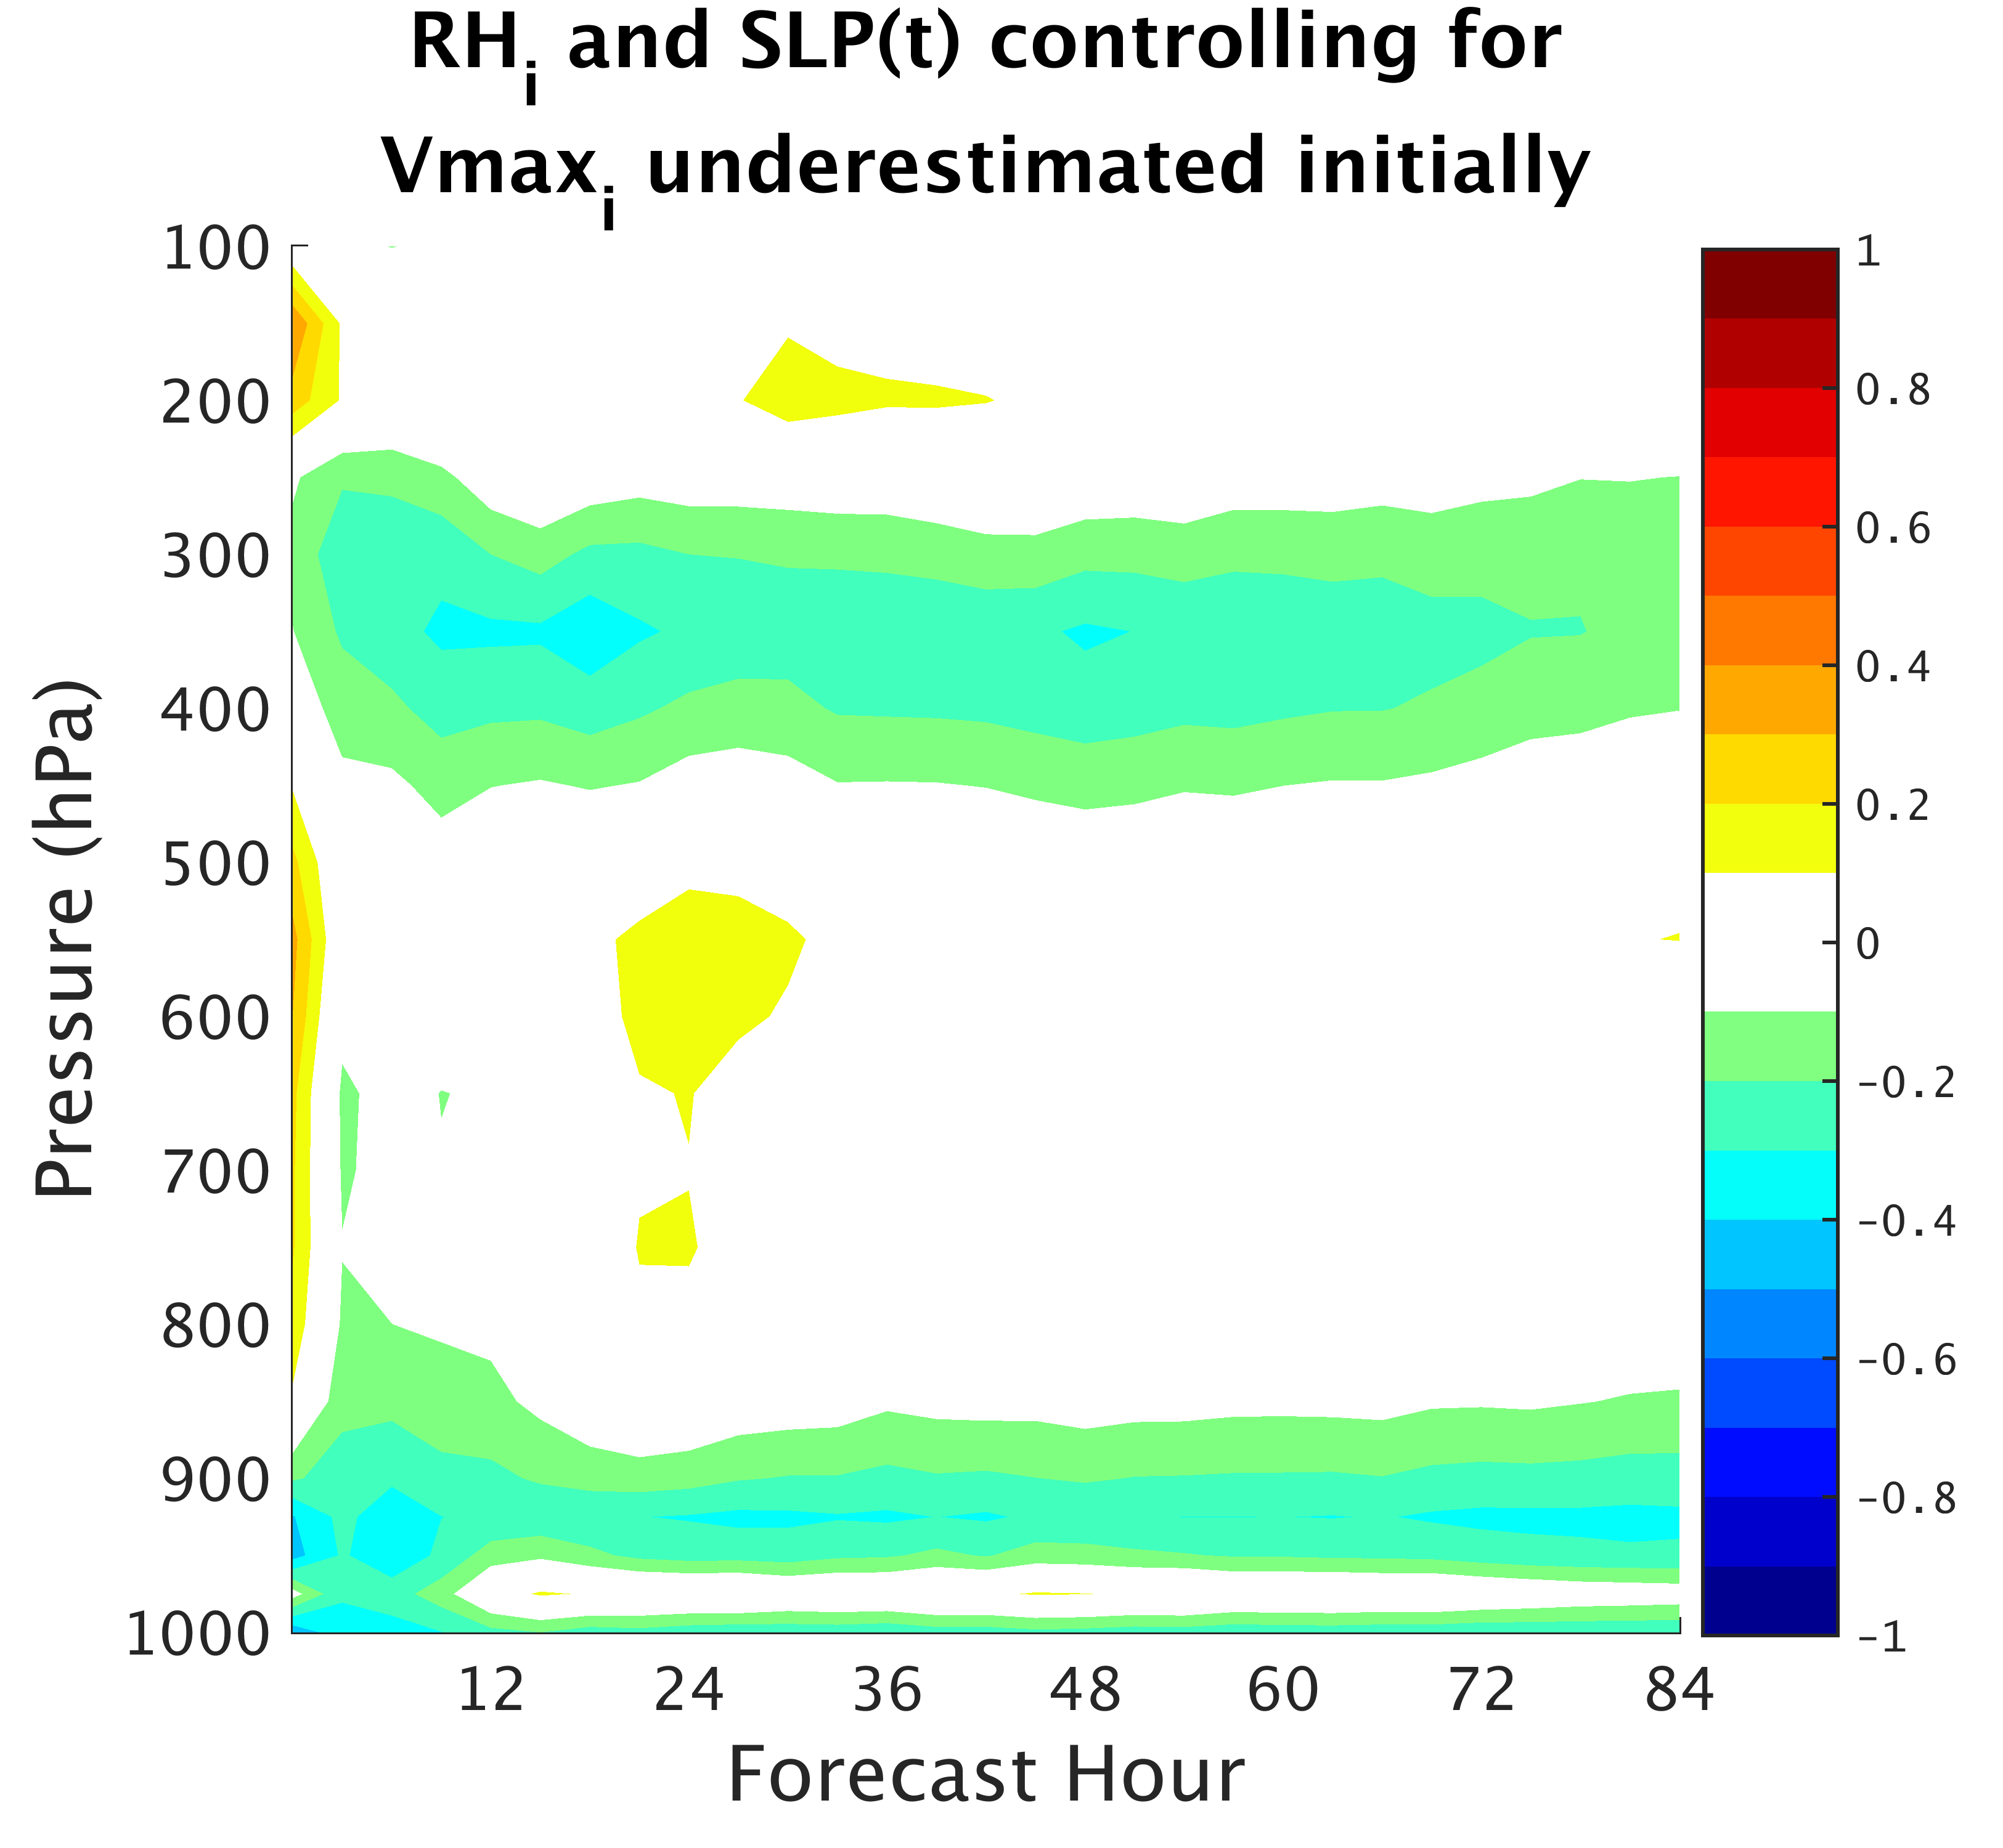
b)
c)
Notes:
Partial correlations of initial RH to SLP controlling for initial Vmax

Slide 14
Forecast track insensitive to intensity!
a)
b)
c)
What influences storm track?
Notes:
Composite groups of 15 members each created from real-time ensemble by analyzing track forecasts
-insensitive to intensity (both groups have major hurricanes and non-intensifying storms)
LMIC – left composite group members ICs composited together and relaxed to APSU vortex inside of 300 km
RMIC – Right composite group members ICs composited together and relaxed to APSU vortex inside of 300 km
Given same initial vortex the LMIC/RMIC intensity forecast nearly identical

Slide 15
Intensity specific steering flow through time
a)
b)
Notes:
Integrated steering flow first 96 hours
Markers represent every 12 h
can see bifurcation in steering flow
- LMIC negative zonal component
- RMIC positive zonal component
RMIC further south

Slide 16
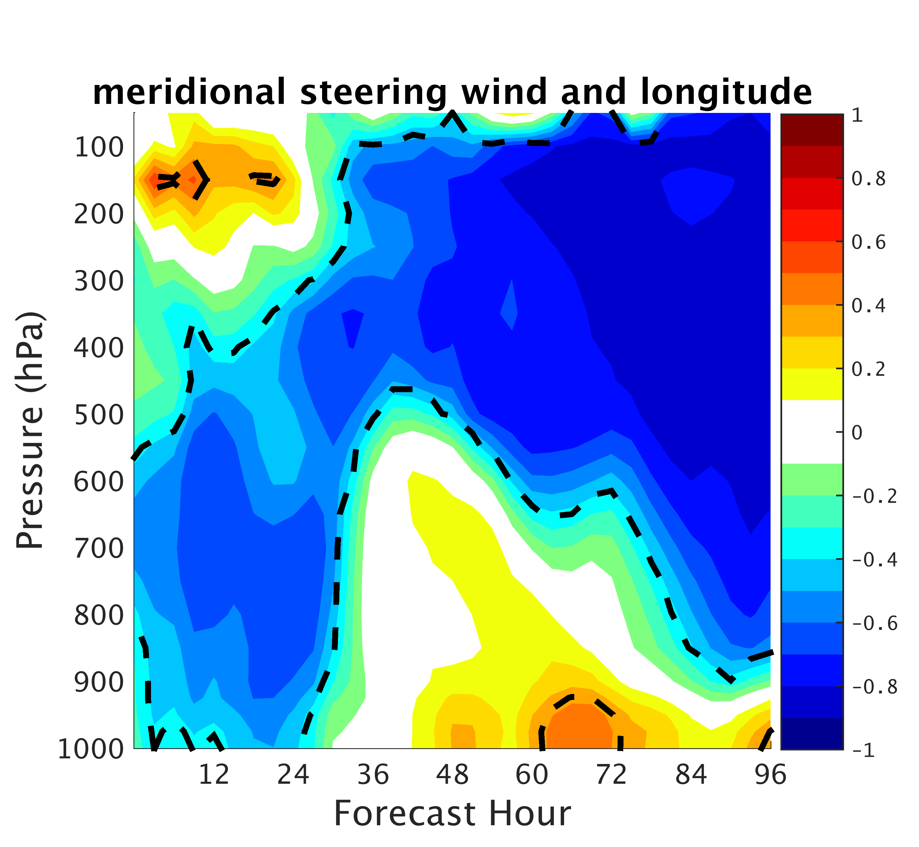
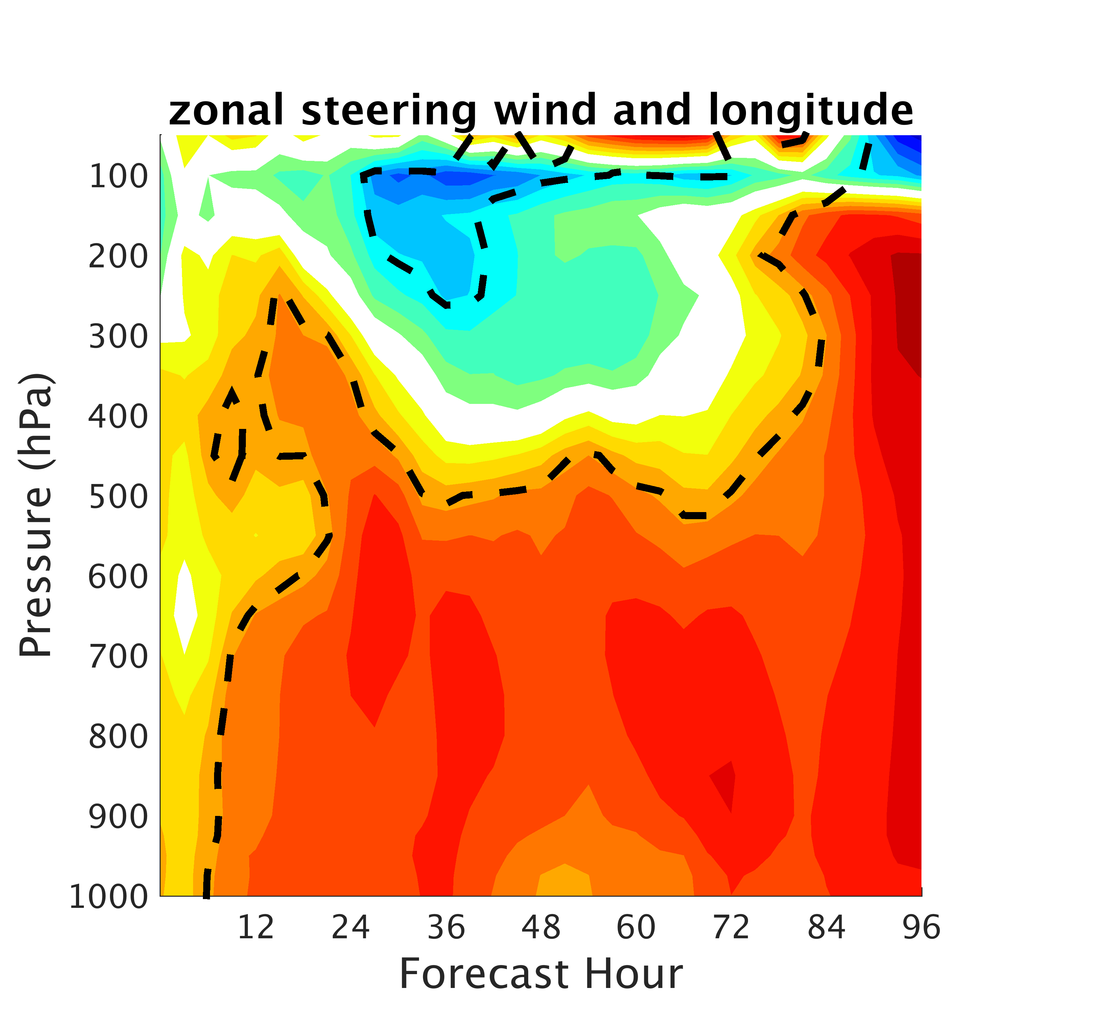
a)
b)
Pmin>1000 hPa | 999>Pmin>990 hPa | 989>Pmin>970 hPa | 969>Pmin>950 hPa | 949>Pmin>940 hPa | Pmin<940 hPa
700-850 hPa | 500-850 hPa | 400-850 hPa | 300-850 hPa | 250-850 hPa | 200-850 hPa
Notes:
Dashed line region where correlations are statistically significant at the 95% level
correlations originate in the low to mid troposphere
Where in relation to the storm do these come?

Slide 17
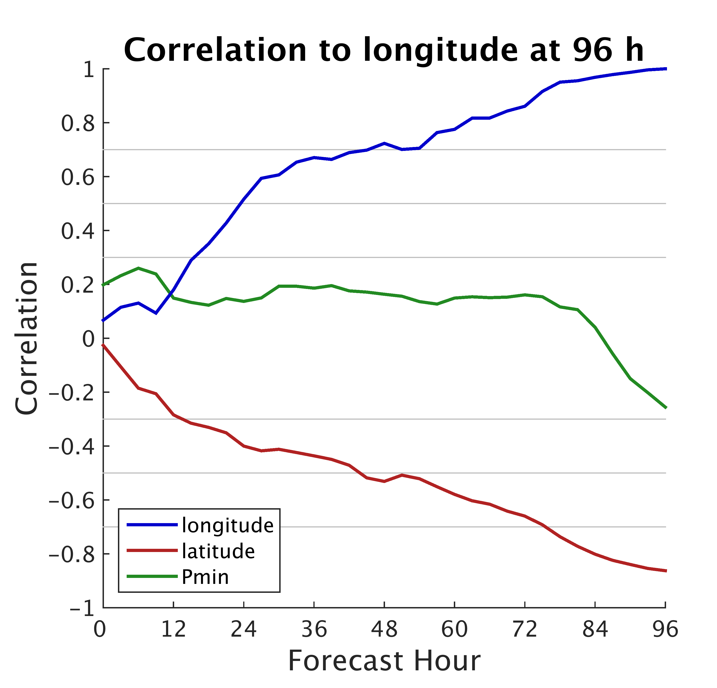
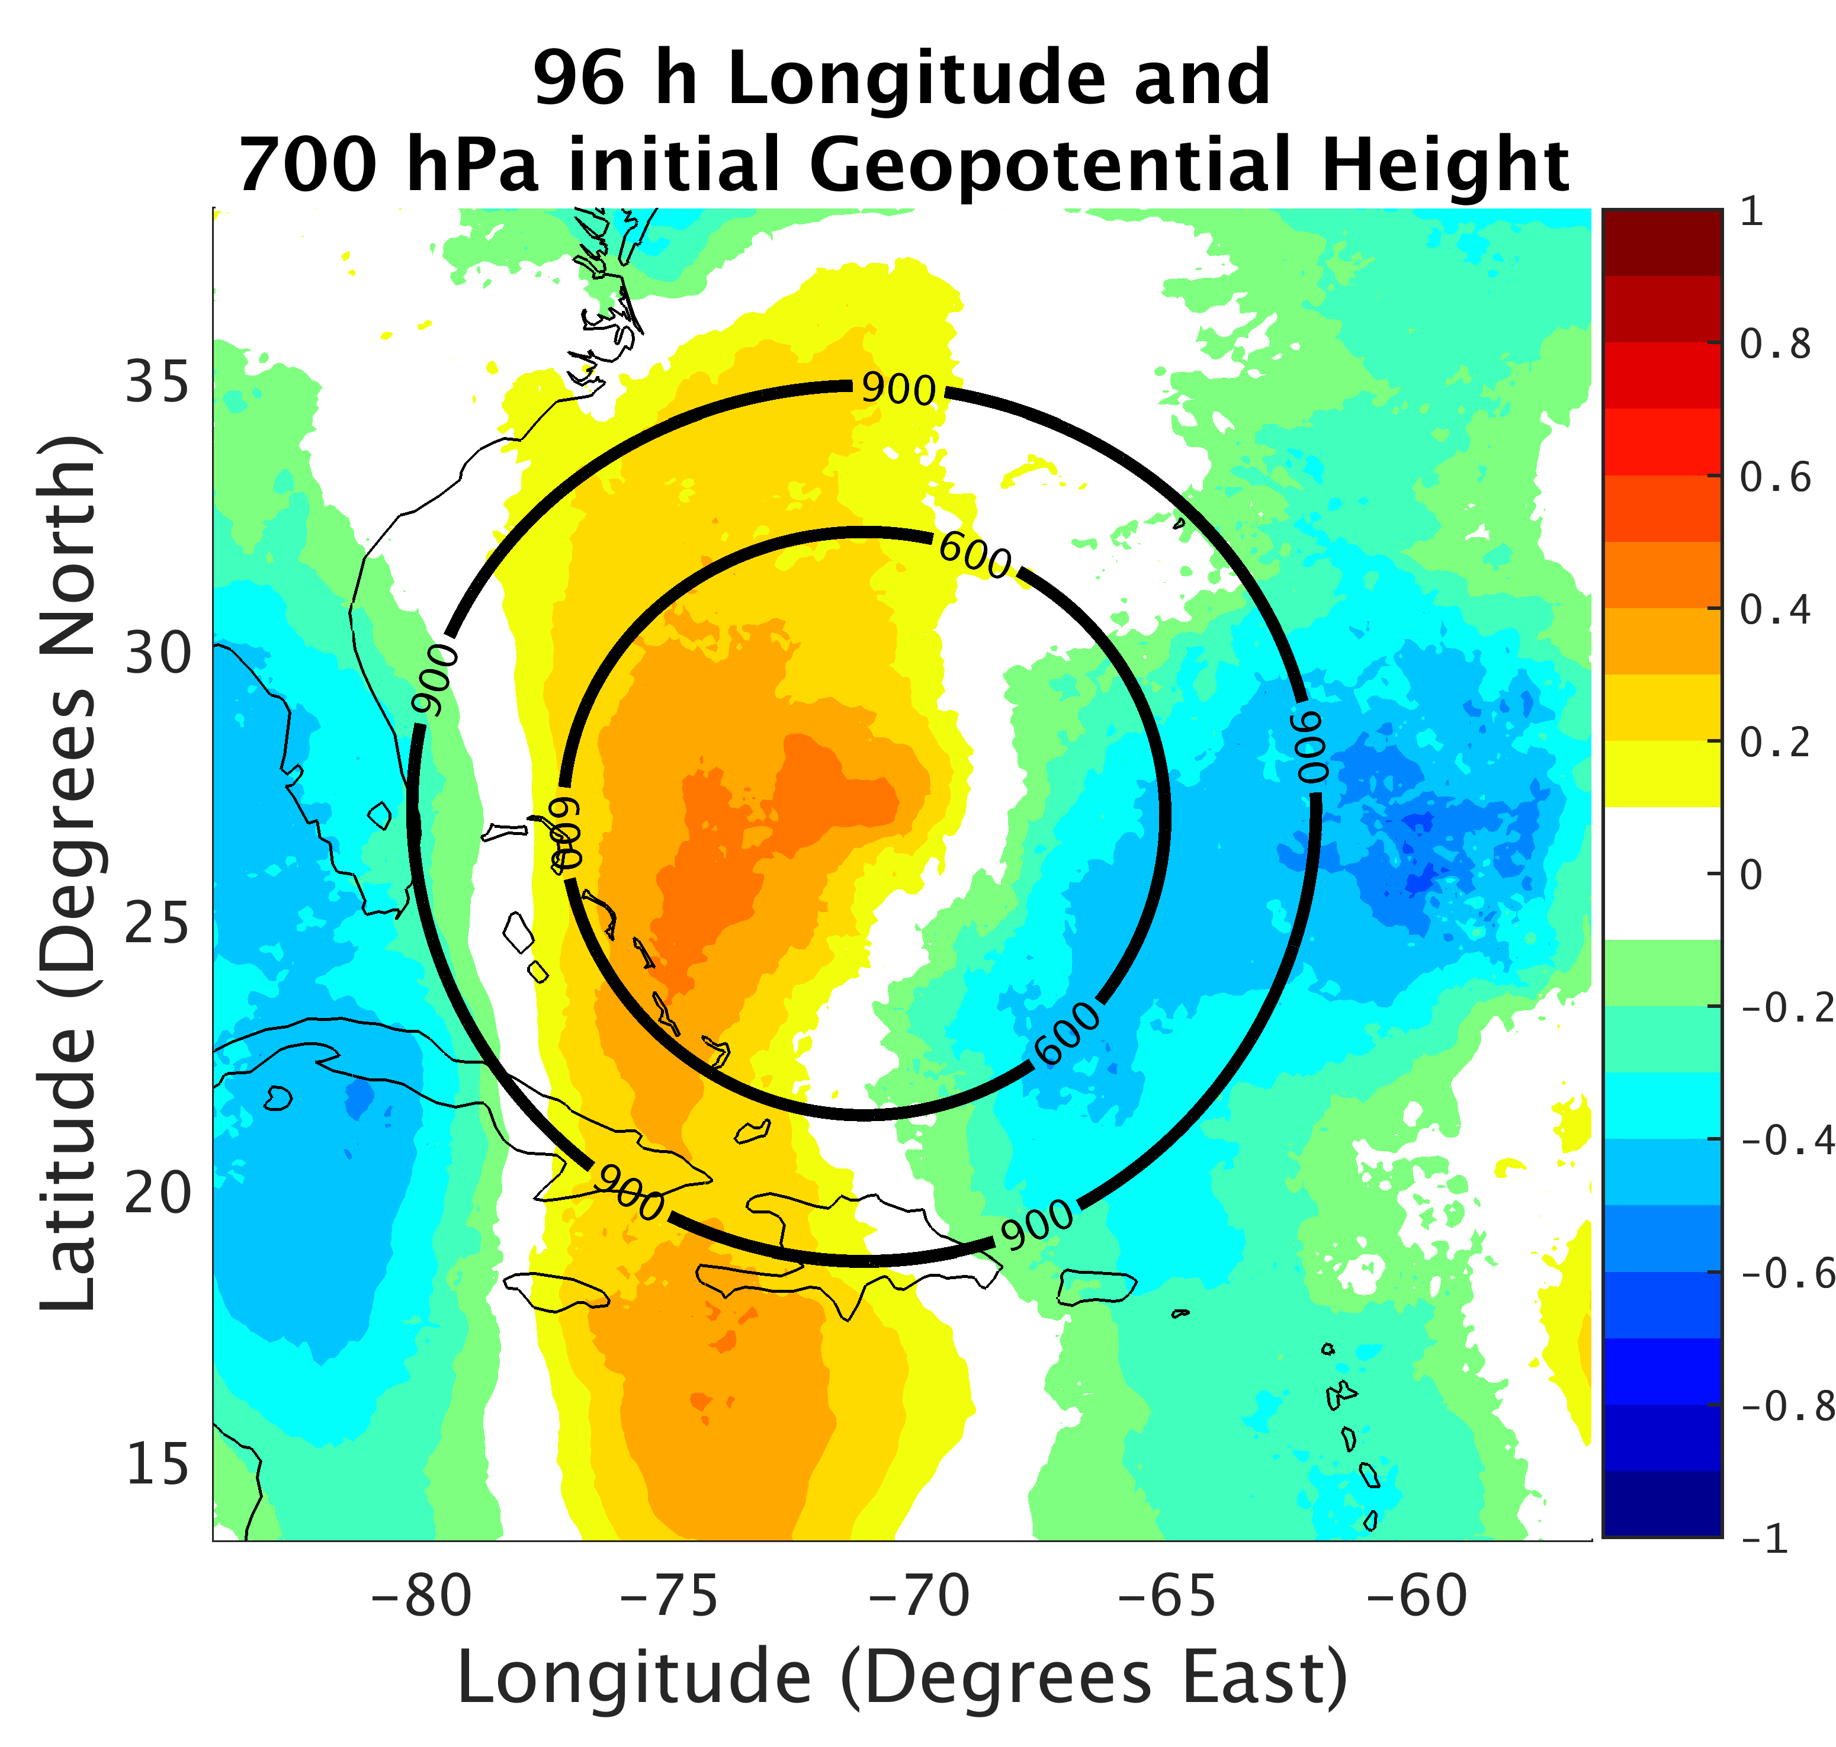
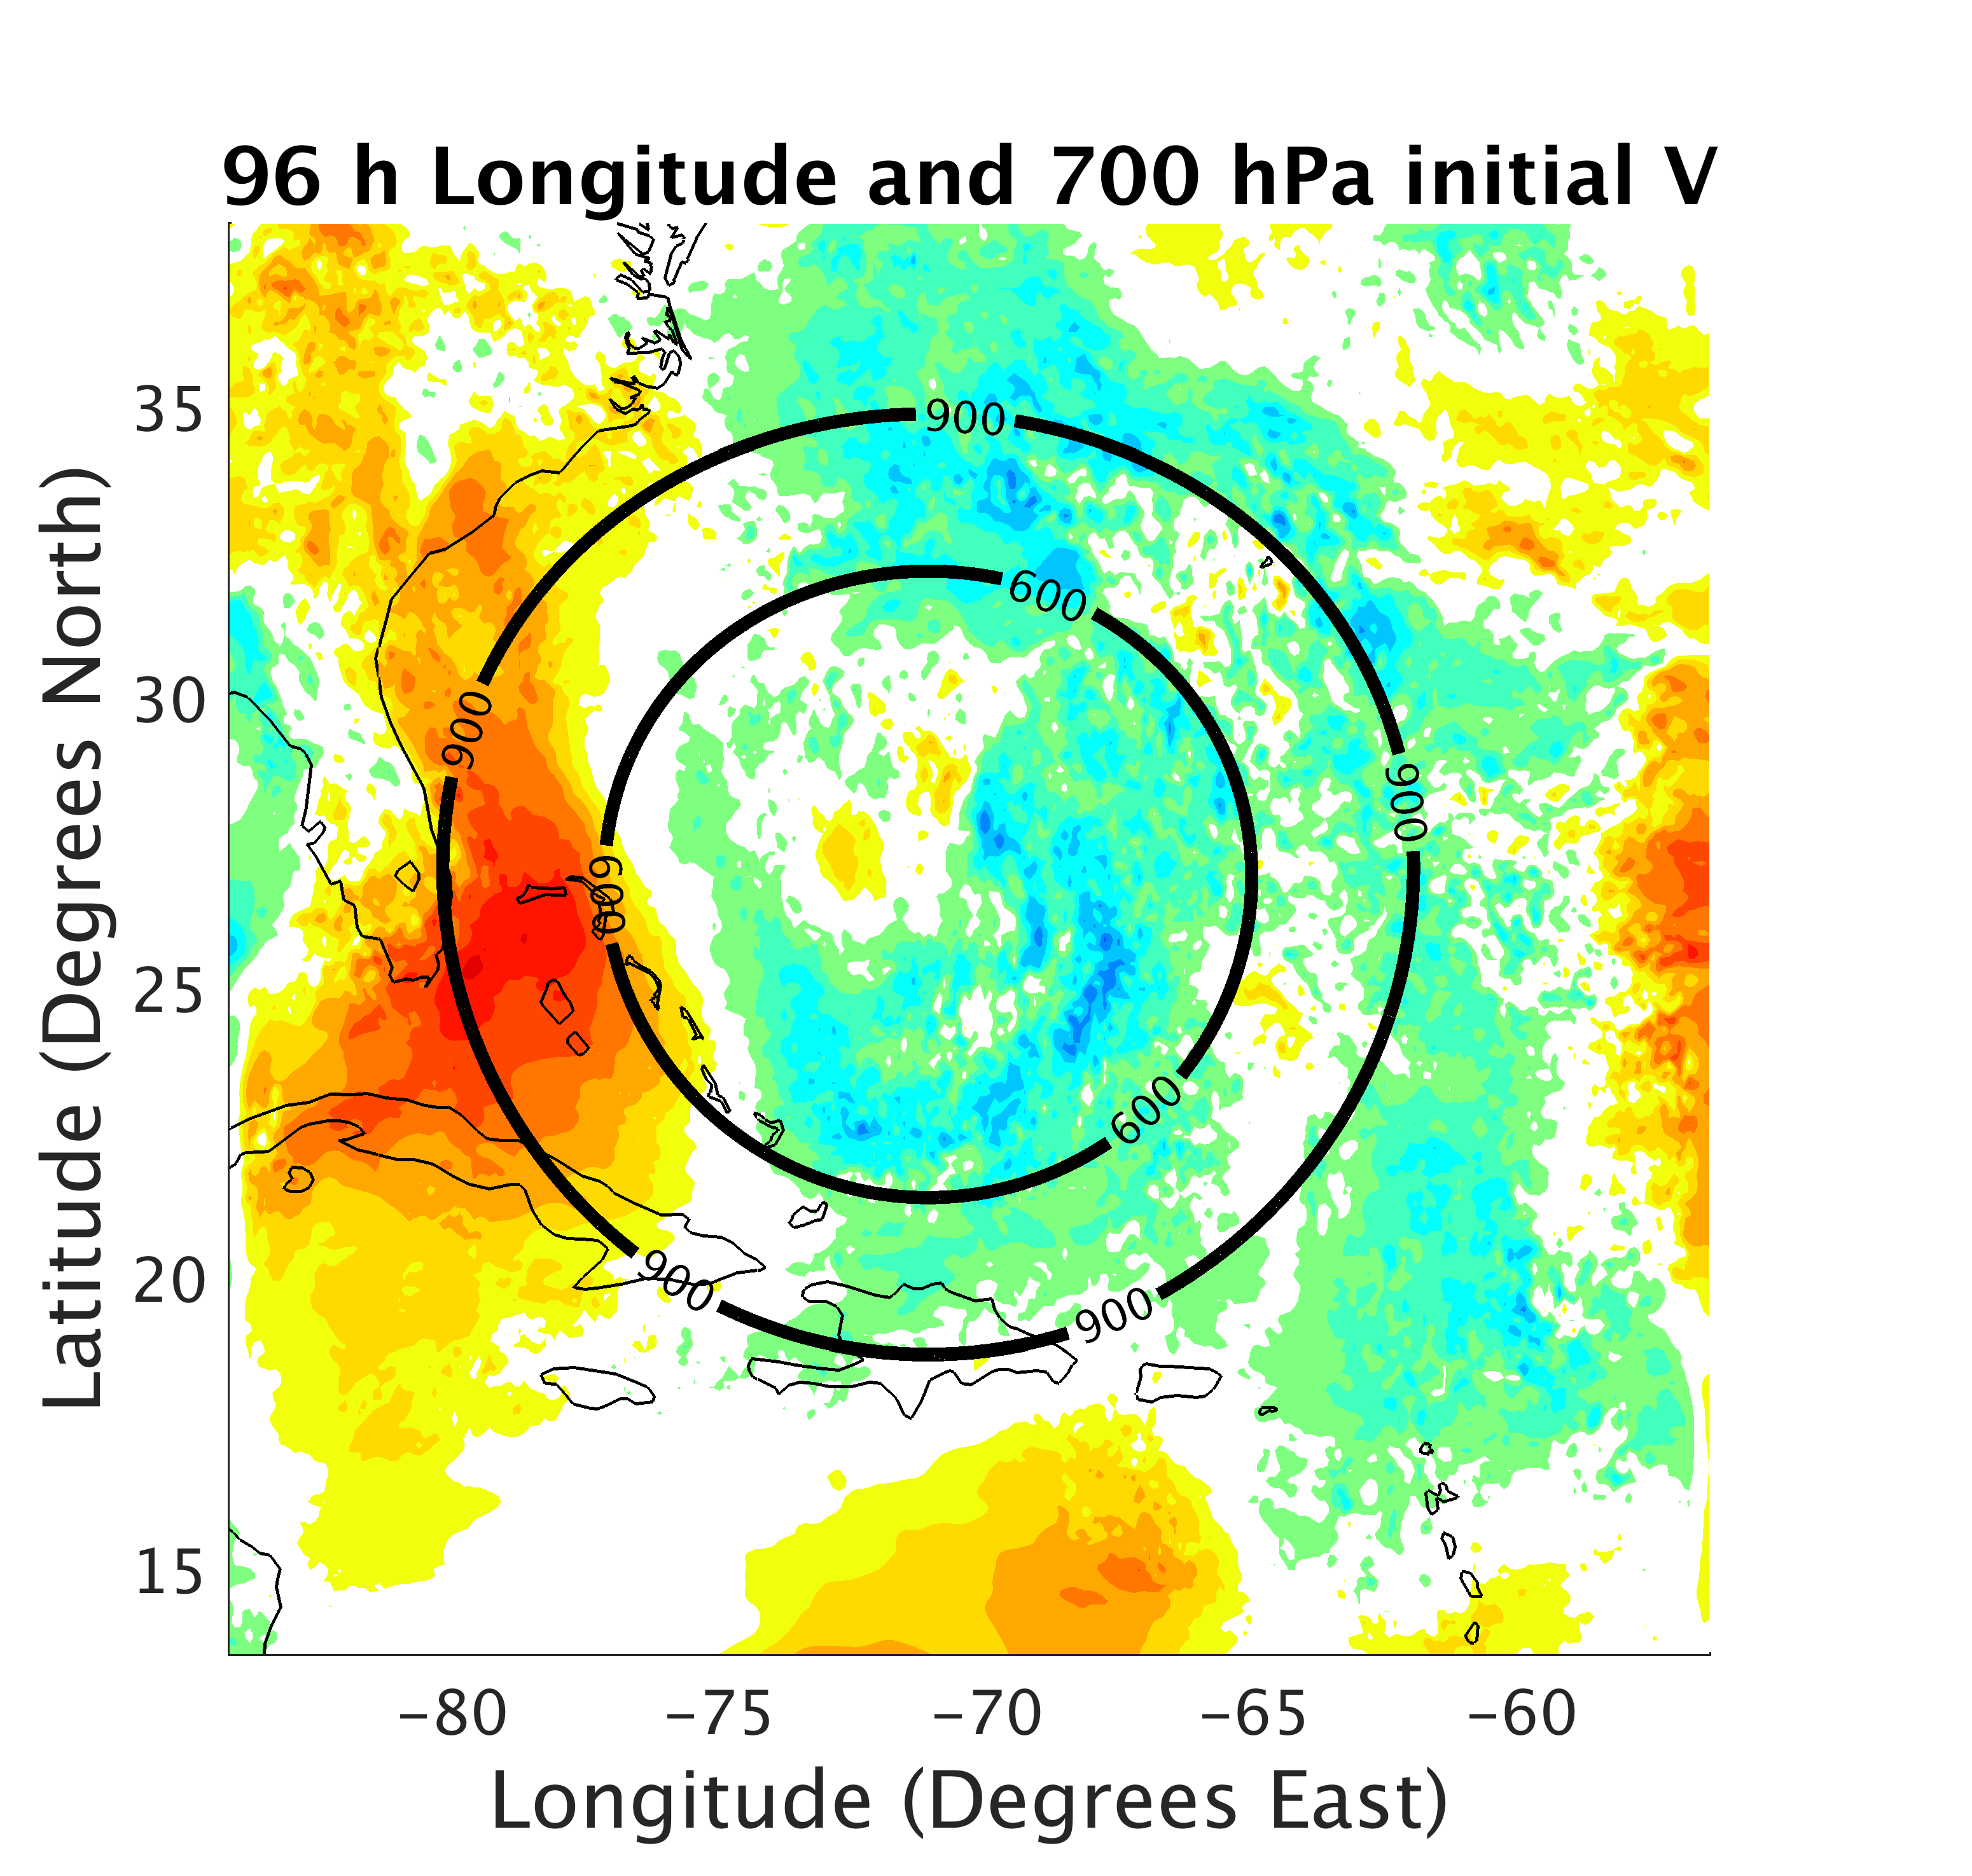
a)
b)
c)
Ridging to the East and North of initial location Important?
Notes:
No significant correlation between Pmin and 96 h longitude
Correlation between latitude and 96h longitude increases in magnitude from initial time
Correlation between longitude and 96 h longitude begins to increase near 12h
Spatial correlations suggest members that track further east have slightly strong ridging to the east and north of the initial position
Wind correlations dynamically consistent with geopotential height correlations

Slide 18
a)
b)
c)
d)
Notes:
The Radius at which the LMIC is relaxed to APSU ENV/VOR is varied (still 300 km relaxation radius)
Outside of 300/600/900/1200 ENV begins to be relaxed to APSU
Inside of 300/600/900/1200 IC are APSU
LMIC becomes more APSU like when IC differeces are removed between 600 and 900 km

Slide 19
a)
b)
c)
d)
Notes:
Members that go out to see steered further south initially

Slide 20
a)
b)
Notes:
North IC differences removed – very APSU like!
When any of the IC differenc3s are removed however large shift toward APSU

Slide 21
Summary
Ensemble forecasts of Joaquin had very large intensity and track spread
Intensity spread saturates most rapidly as a result of IC differences to the storm vortex (within 300 km)
  Initial intensity large determining factor in final intensity
  strong initial storm -> strong final storm
  weak initial storm -> weak final storm
  Secondary contribution from moisture for initially underestimated members
Track spread dominated by IC differences to the environment (beyond 300 km)
  Track bifurcation insensitive to storm intensity
  Mid to low-level steering wind differences appear to have resulted in track divergence
  IC differences between 600-900 km from initial storm location important!
Notes:
Method of relaxing vortex/environment can easily be expanded (by varying the radius) to diagnose regions of the environment resulting in the track bifurcation.

Slide 23
a)
b)
c)
d)
e)
f)
g)
h)
i)
j)
k)
l)

Slide 24
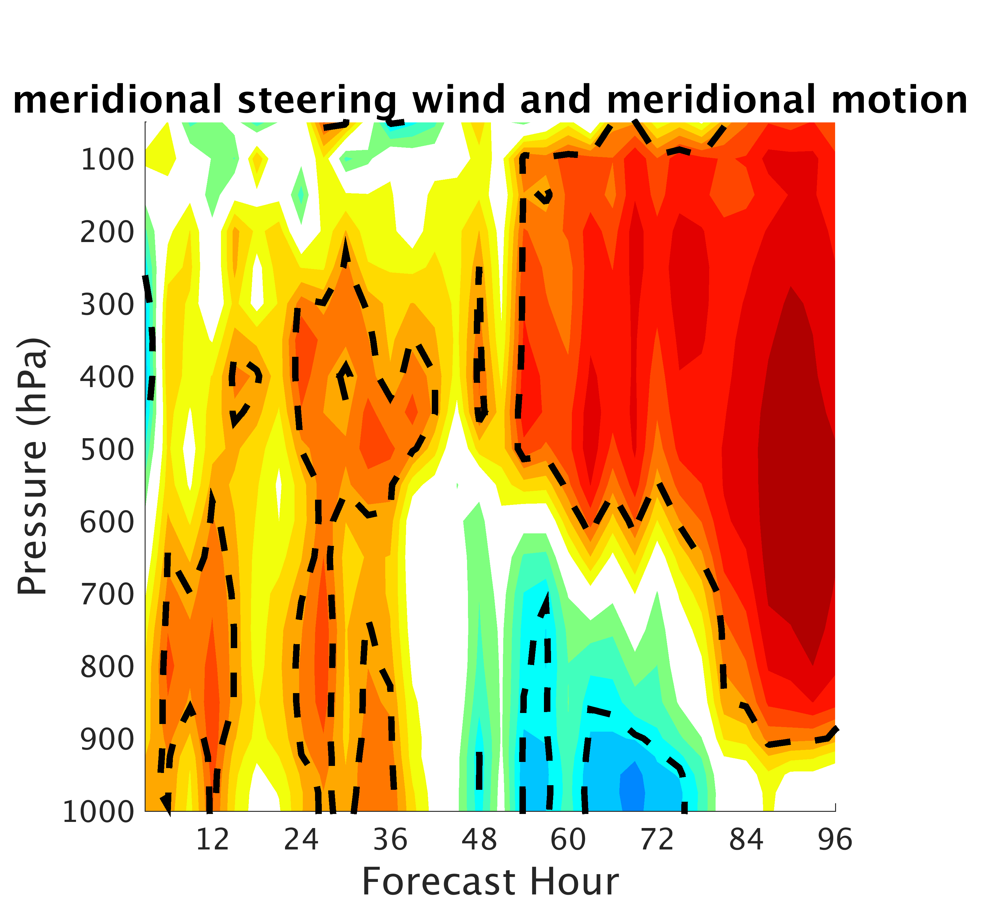
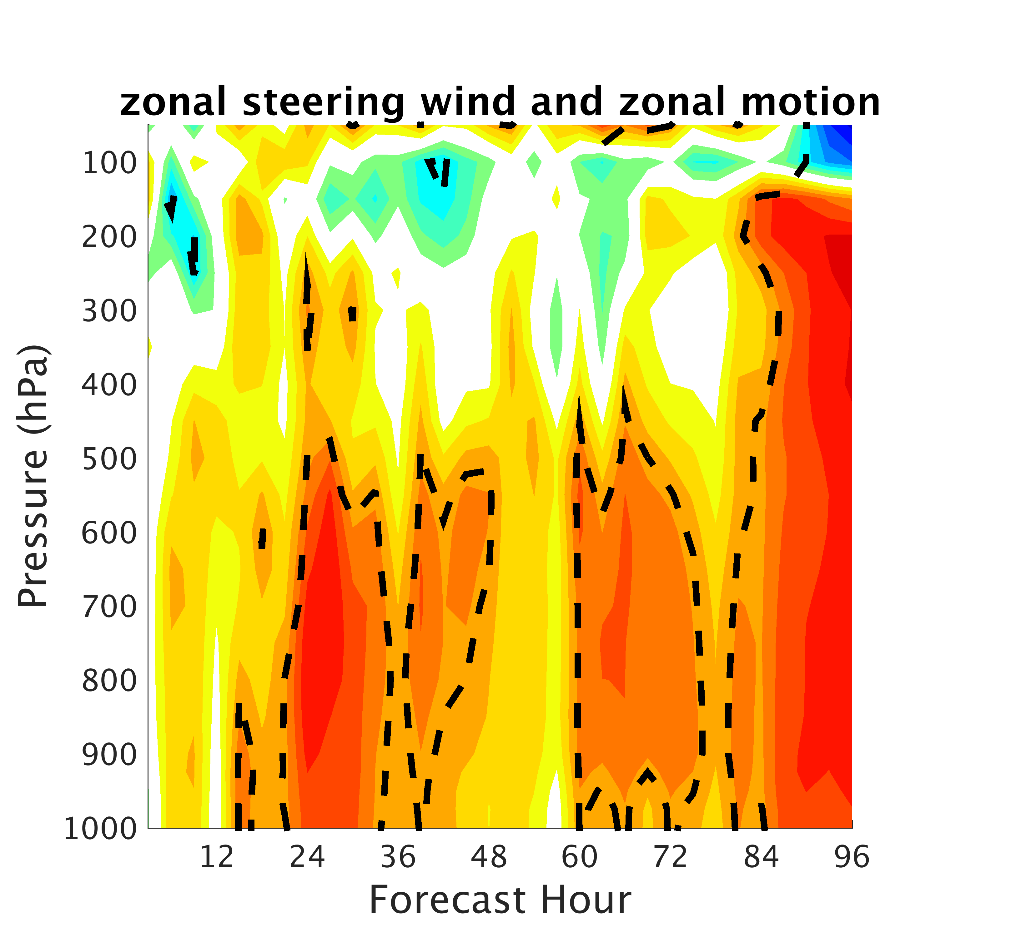

Slide 25
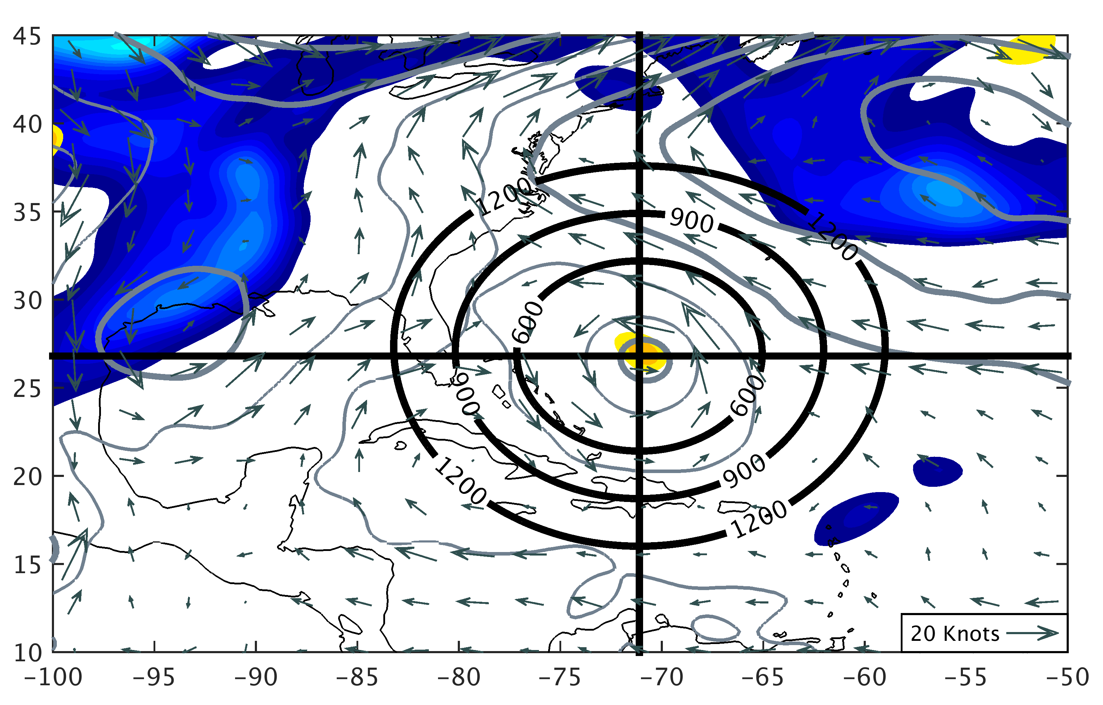
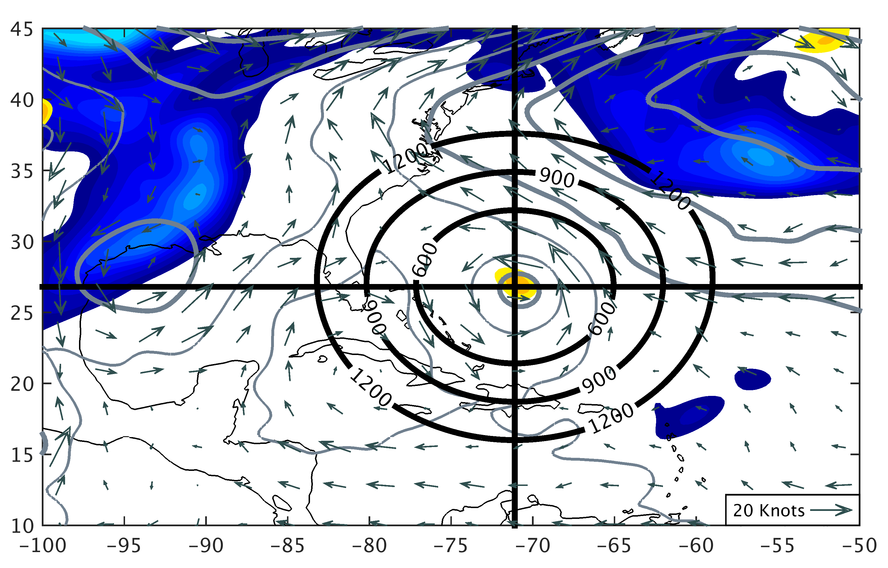
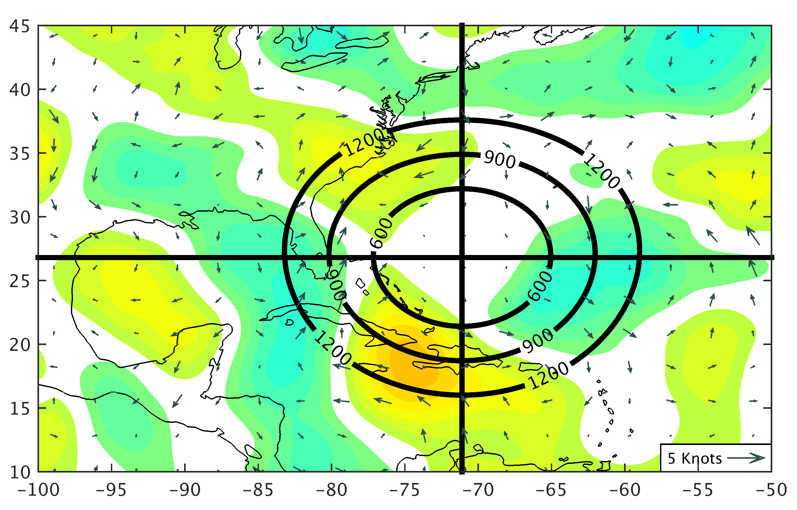
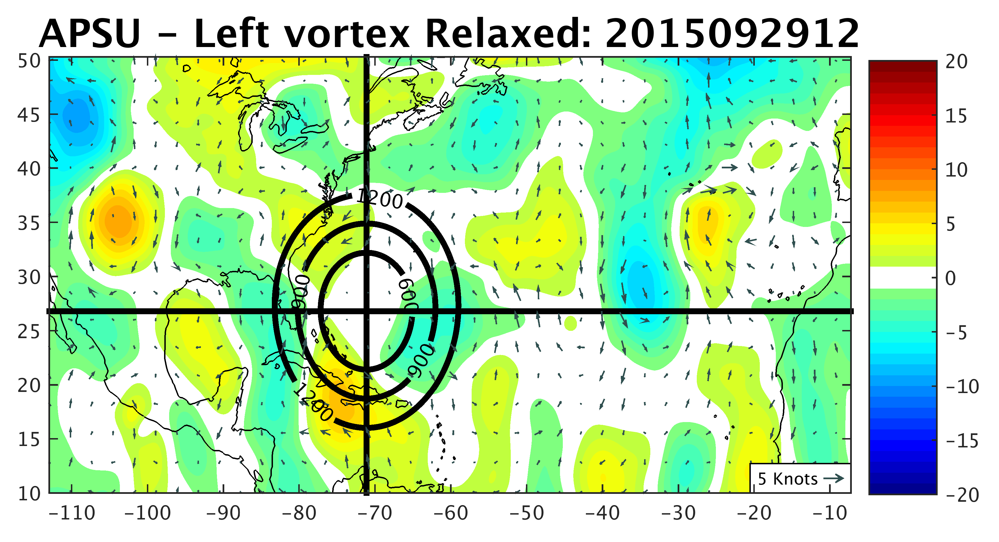
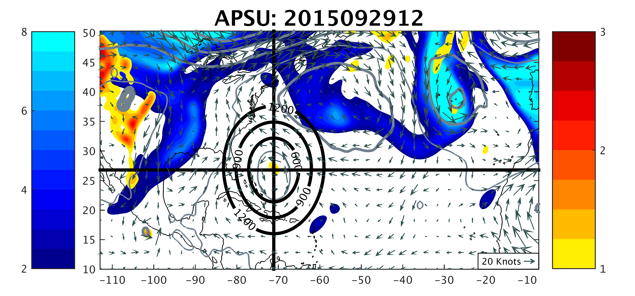
0 h
APSU
LMIC
APSU – LMIC
Forecast Hour 0
a)
b)
c)
1
2
3
2
4
6
8
-20
-10
0
10
20
850 hPa Potential Vorticity (PVU)
200 hPa Potential Vorticity (PVU)
700 hPa Geopotential Height Difference (m)

Slide 26
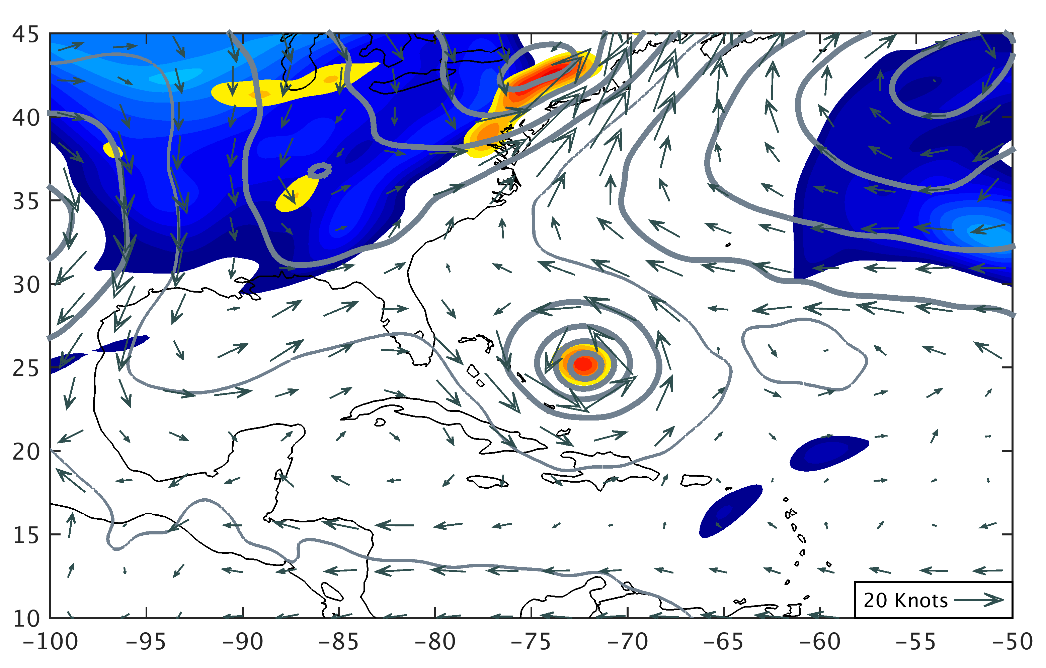

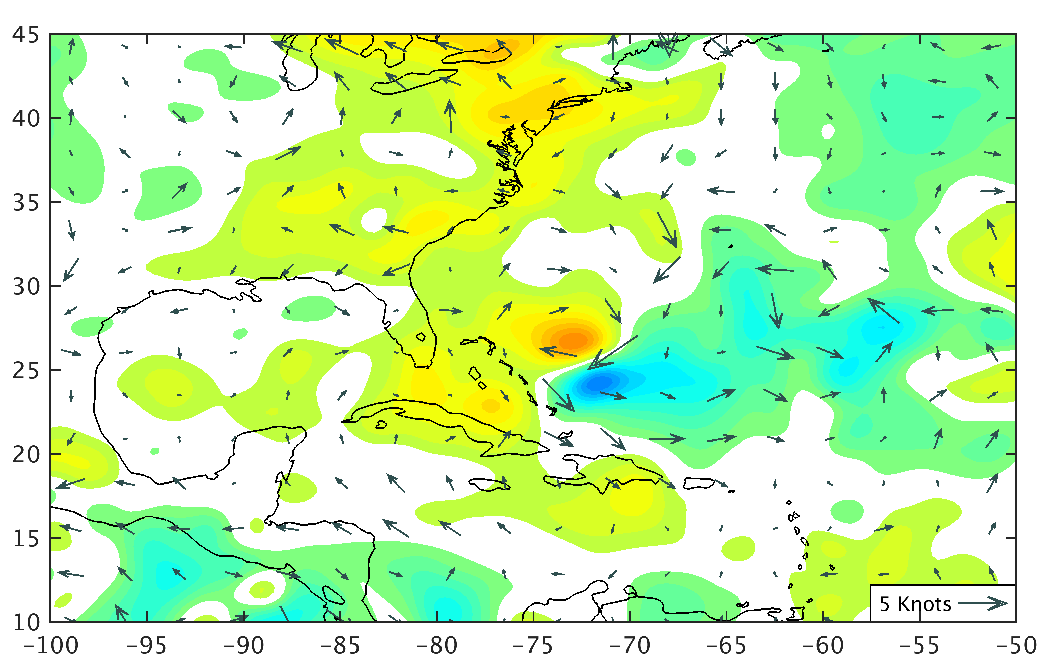
24 h
APSU
LMIC
APSU – LMIC
Forecast Hour 24
d)
e)
f)
1
2
3
2
4
6
8
-20
-10
0
10
20
850 hPa Potential Vorticity (PVU)
200 hPa Potential Vorticity (PVU)
700 hPa Geopotential Height Difference (m)

Slide 27
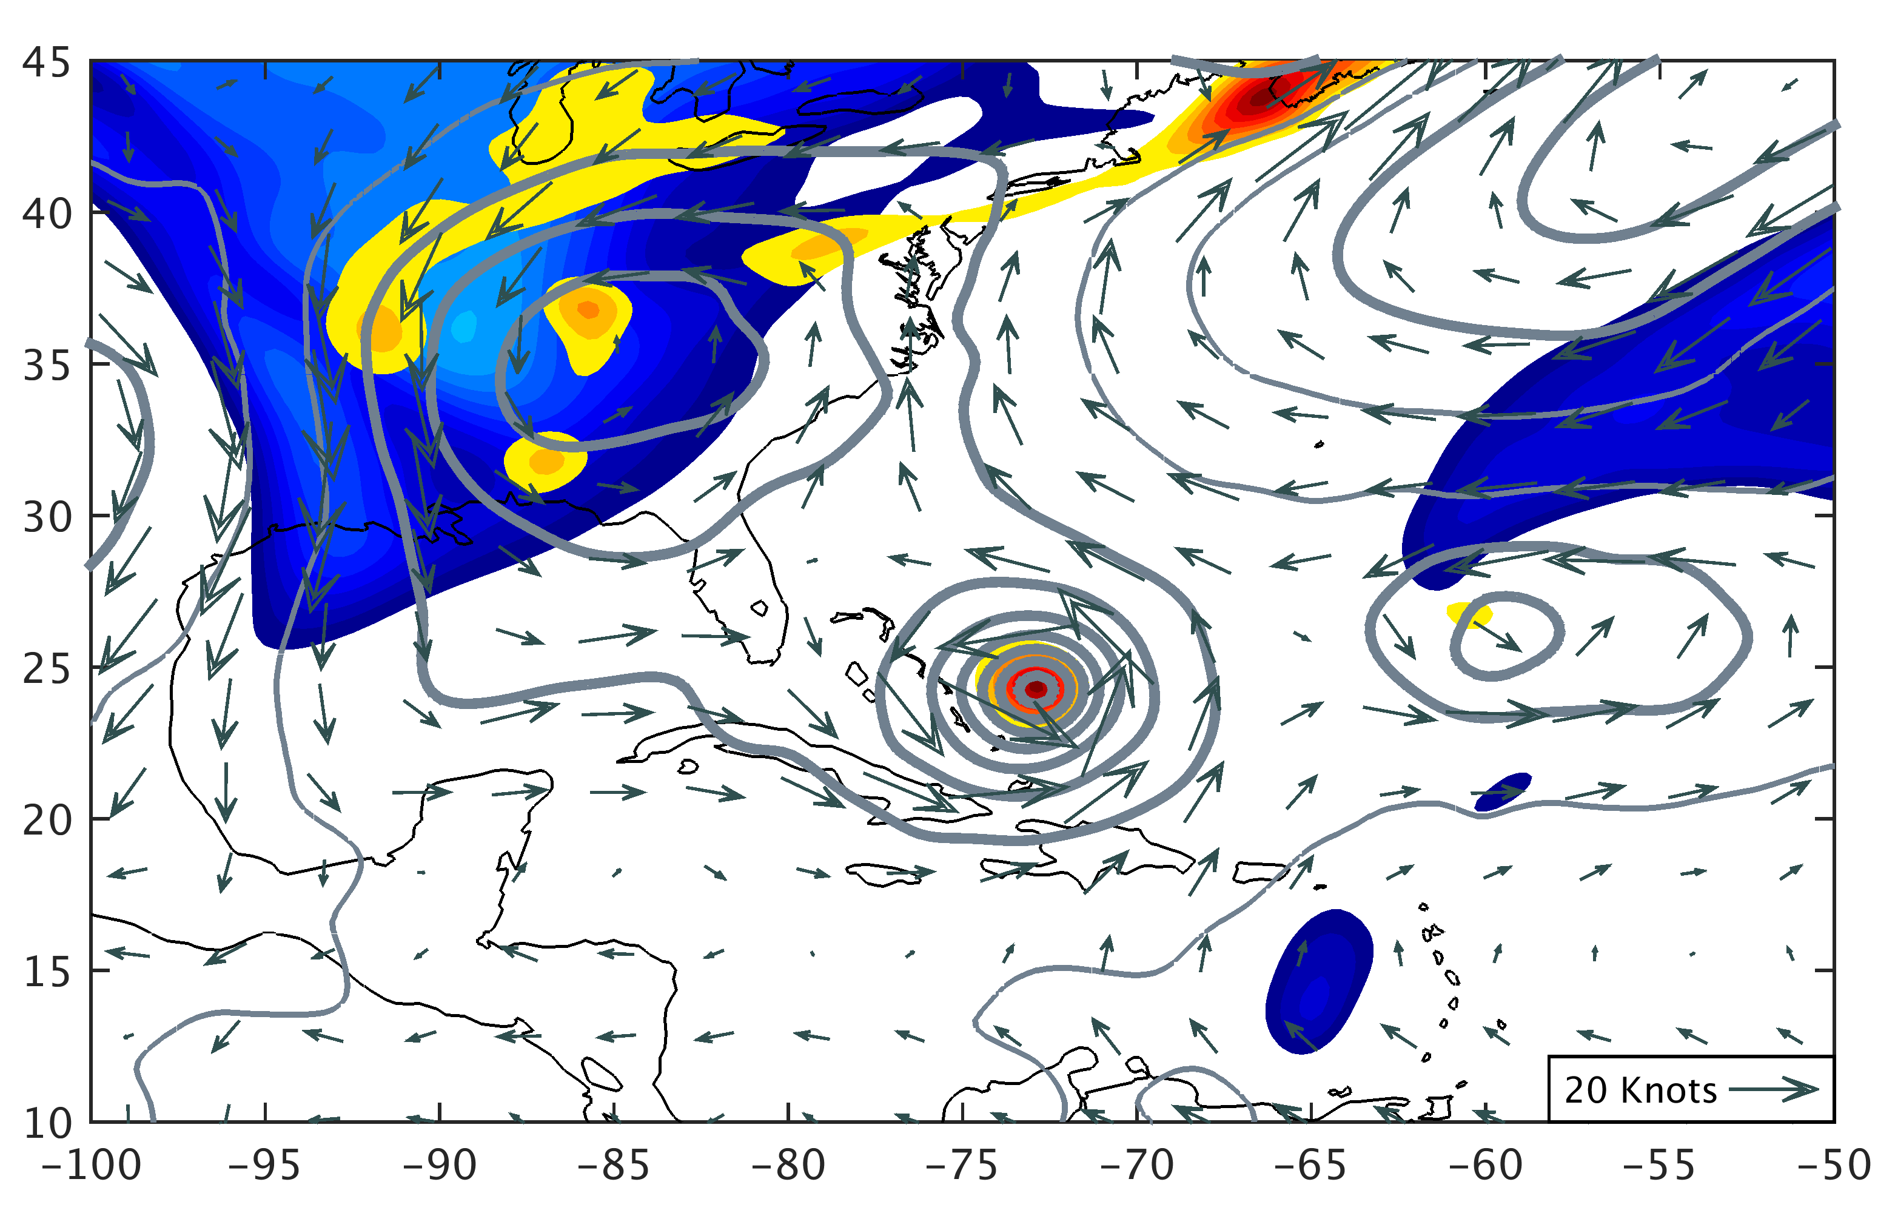
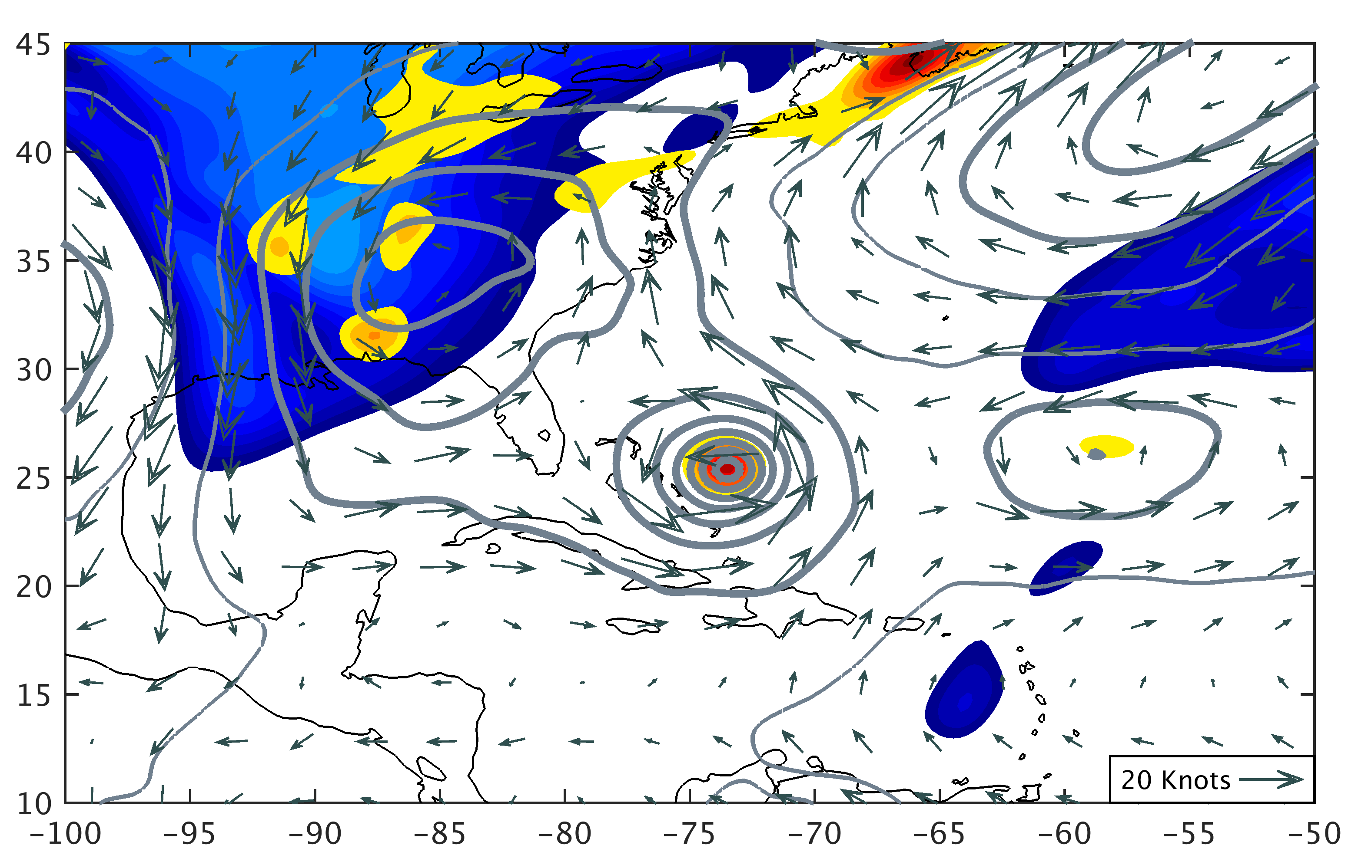
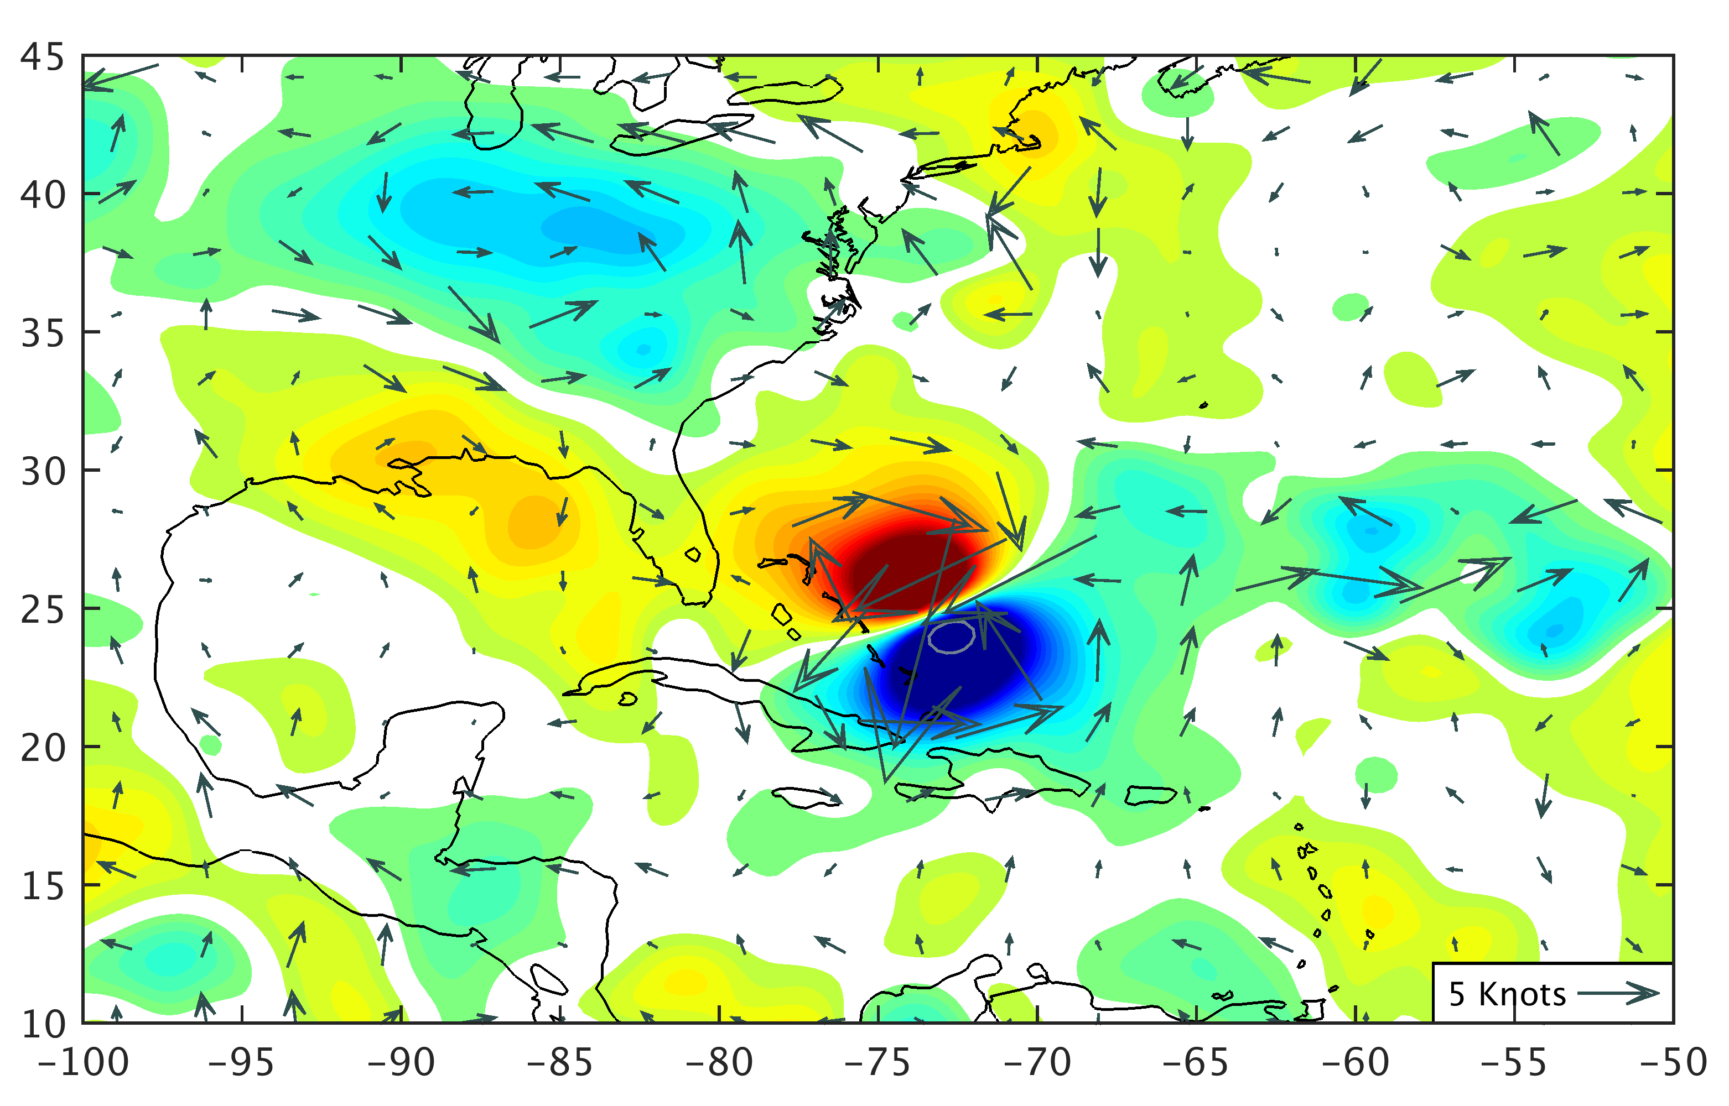
48 h
APSU
LMIC
APSU – LMIC
Forecast Hour 48
g)
h)
i)
1
2
3
2
4
6
8
-20
-10
0
10
20
850 hPa Potential Vorticity (PVU)
200 hPa Potential Vorticity (PVU)
700 hPa Geopotential Height Difference (m)

Slide 28
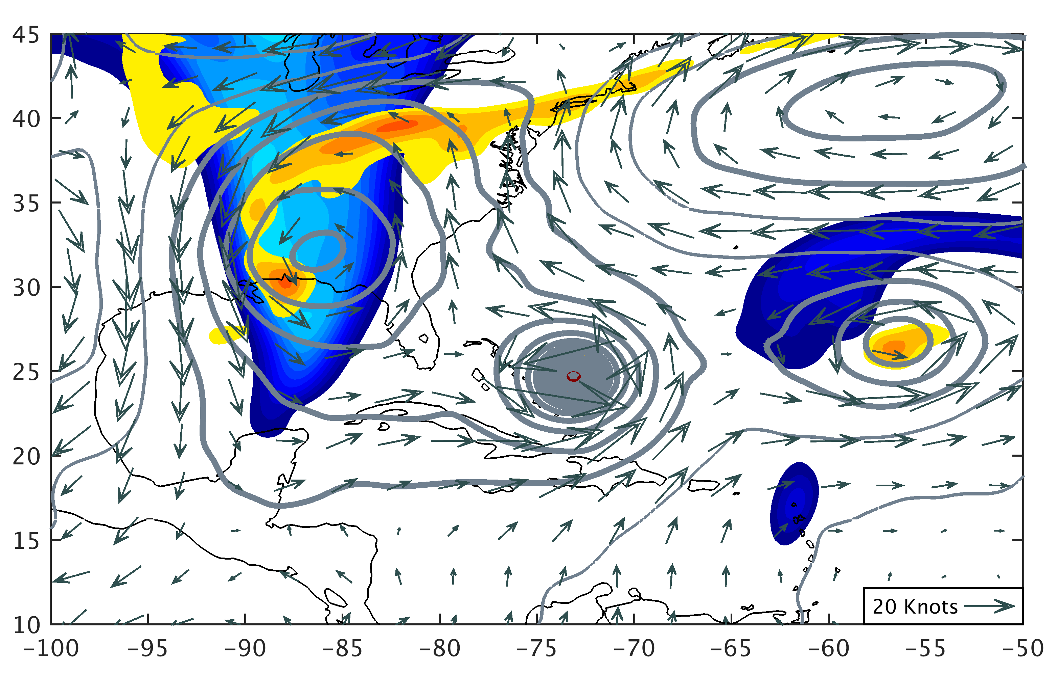
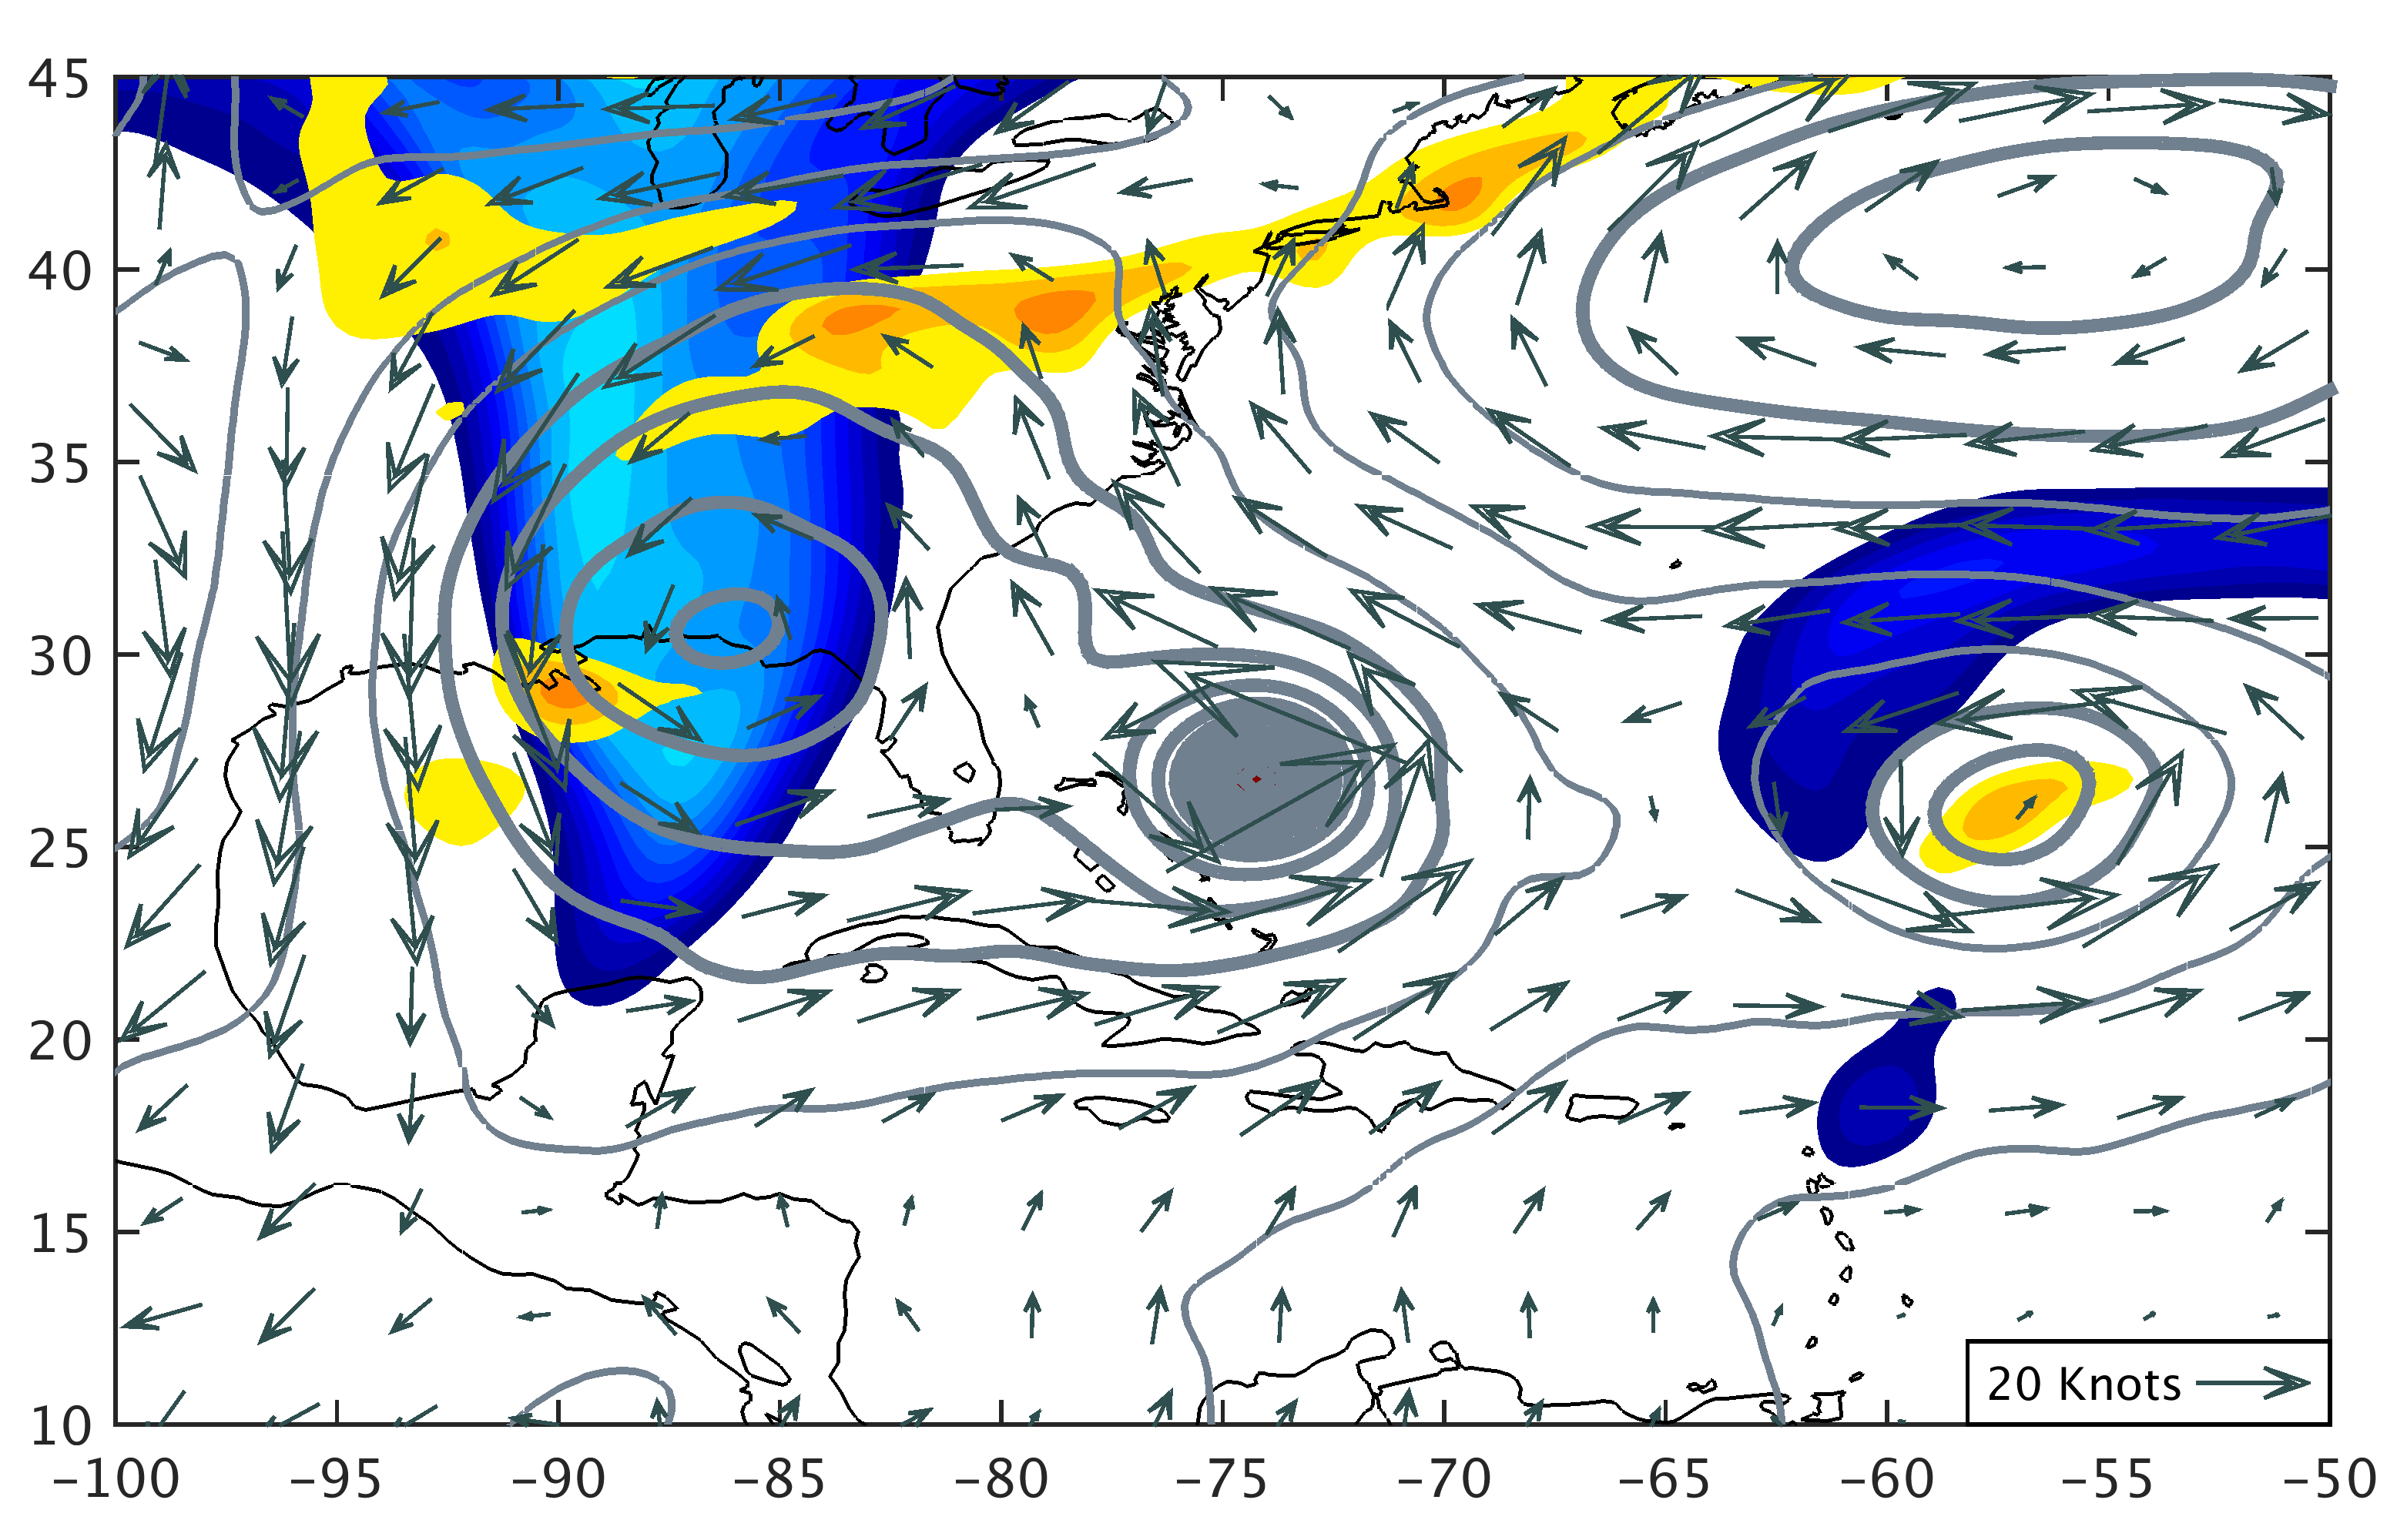
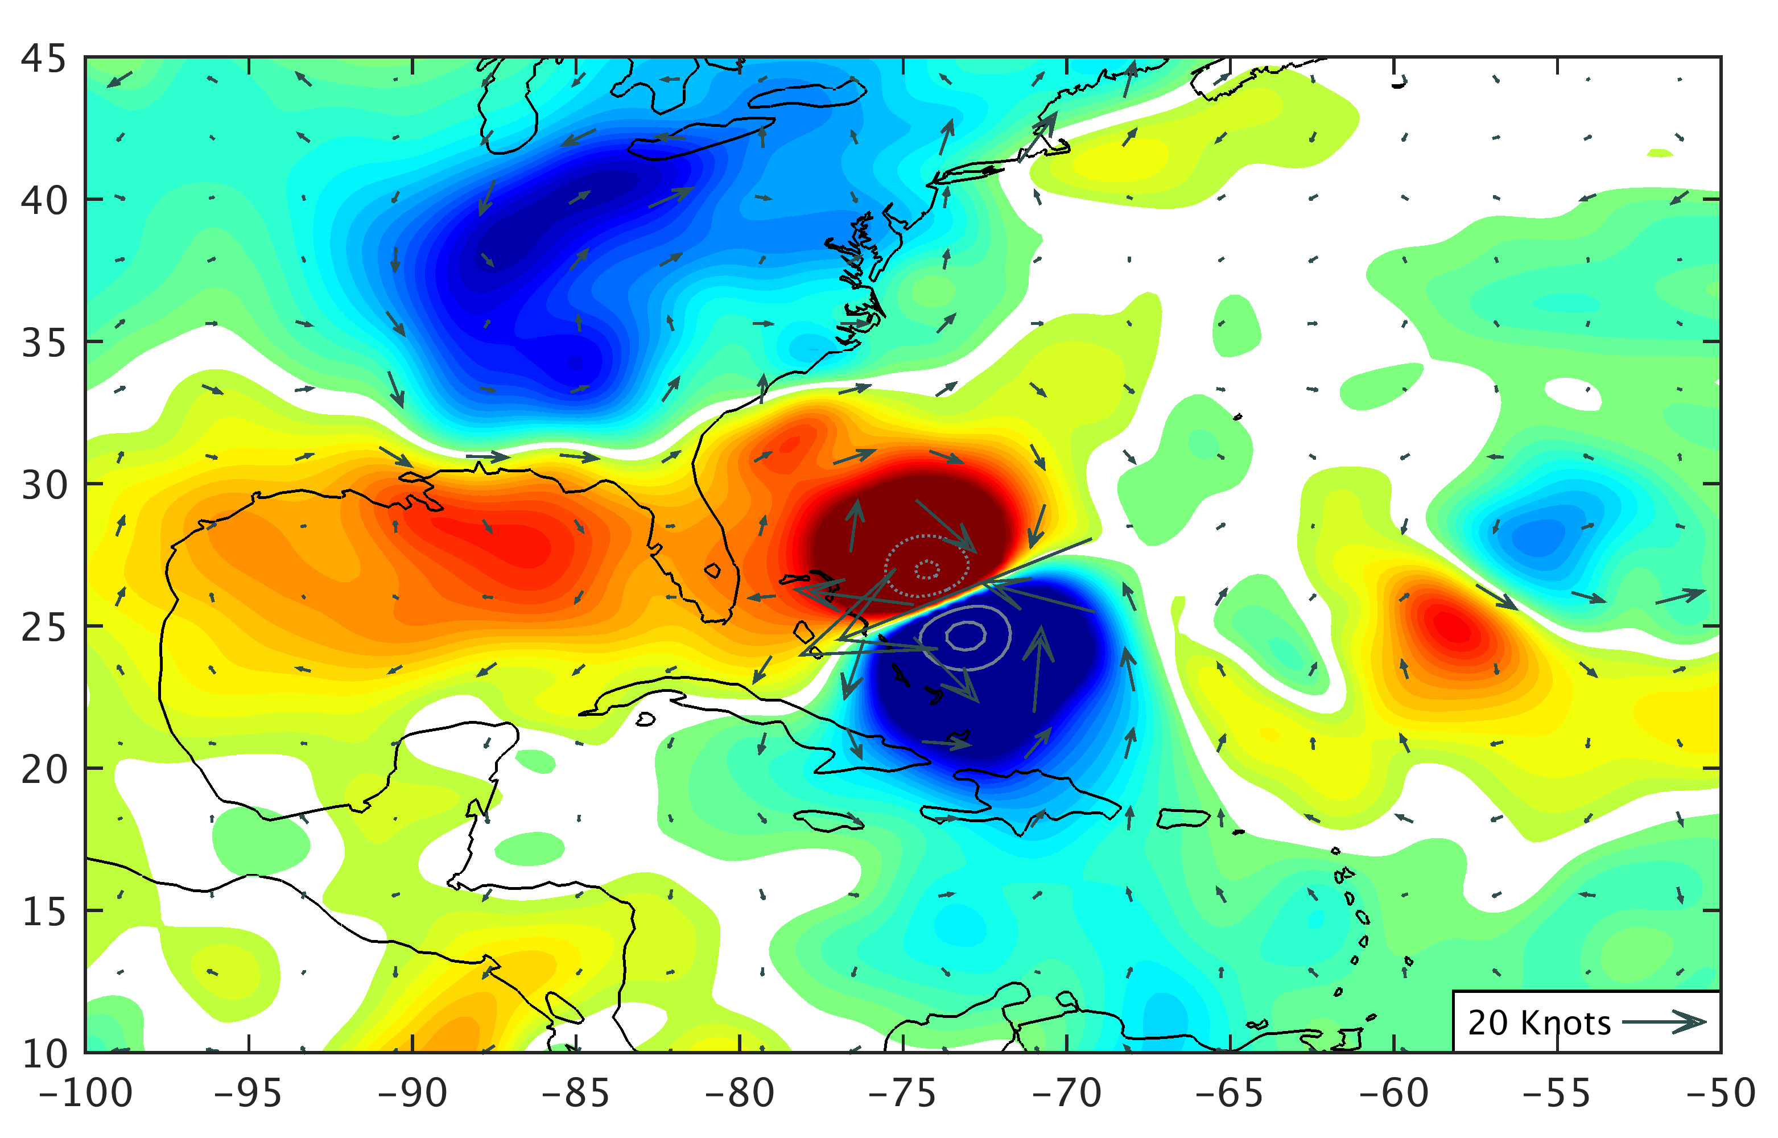
72 h
APSU
LMIC
APSU – LMIC
Forecast Hour 72
j)
k)
l)
1
2
3
2
4
6
8
-20
-10
0
10
20
850 hPa Potential Vorticity (PVU)
200 hPa Potential Vorticity (PVU)
700 hPa Geopotential Height Difference (m)

