Slide 1
Dynamic and thermodynamic processes in a multi-layered Arctic mixed-phase boundary layer cloud: A case study
Hui-Wen Lai
Advisors: Fuqing Zhang and Eugene Clothiaux
Group meeting 05/01/17

Slide 2
Introduction
Arctic clouds play a significant role in Earth’s radiative budget. The solar and longwave radiative fluxes in the Arctic are strongly impacted by Arctic Mixed-Phase Stratocumulus (AMPS) clouds (Curry et al., 1996).
Previous research have examined the sensitivity of mixed-phase clouds to environment temperature, large scale advection, and ice nuclei number concentration in large eddy simulations (Harrington et al., 1999; Jiang et al., 2000; Solomon et al., 2015)

Slide 3
Introduction
The multi-layer AMPS cloud has been frequently observed in the previous field campaigns. Luo et al. (2008) simulated a multi-layer AMPS and found that the surface fluxes and large-scale advection control the formation of the lower cloud layer.
Objective
This study focuses on the dynamic and thermodynamic processes of how multi-layer AMPS clouds form in the simulation based on a base study.

Slide 4
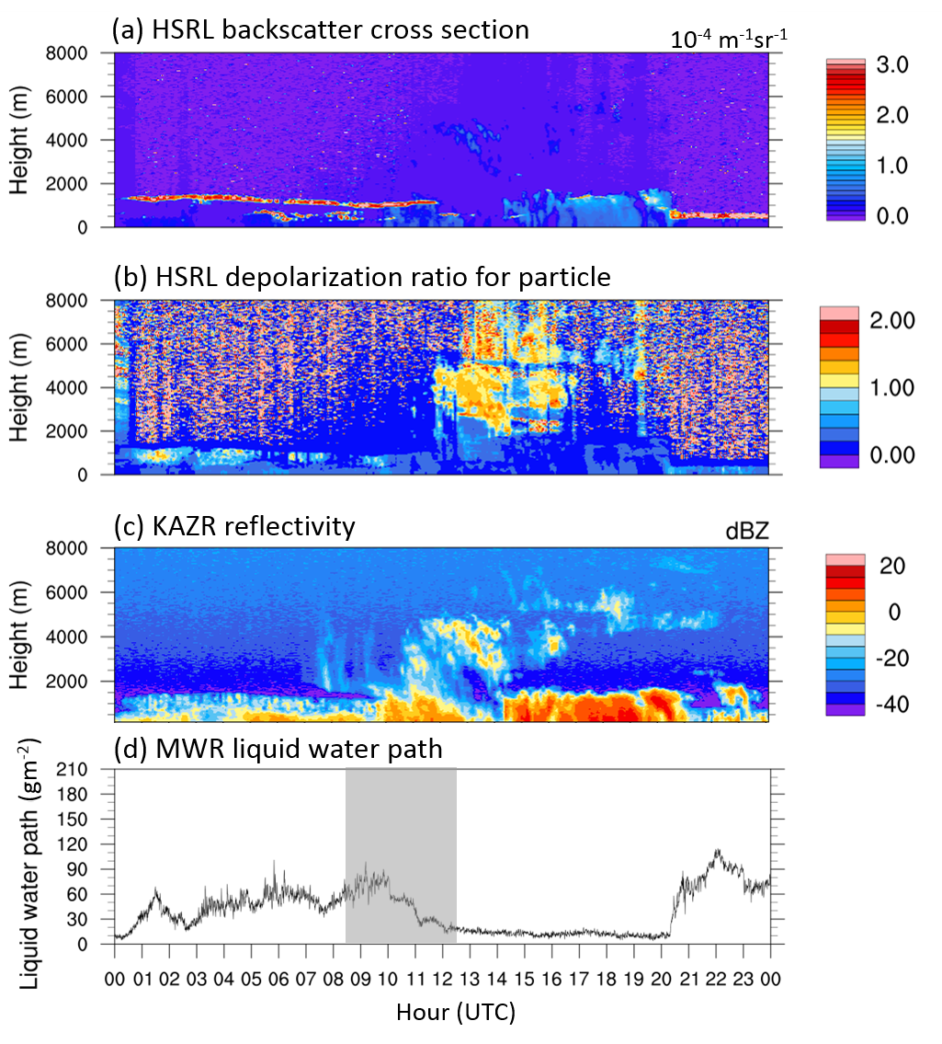
Multi-layer Mixed-phase cloud in the HSRL and KAZR observation
May 2 2013
Barrow, Alaska
warm advection
L
H
L
H
(NCEP/DOE AMIP-II Reanalysis (Reanalysis-2) GrADS image)

Slide 5
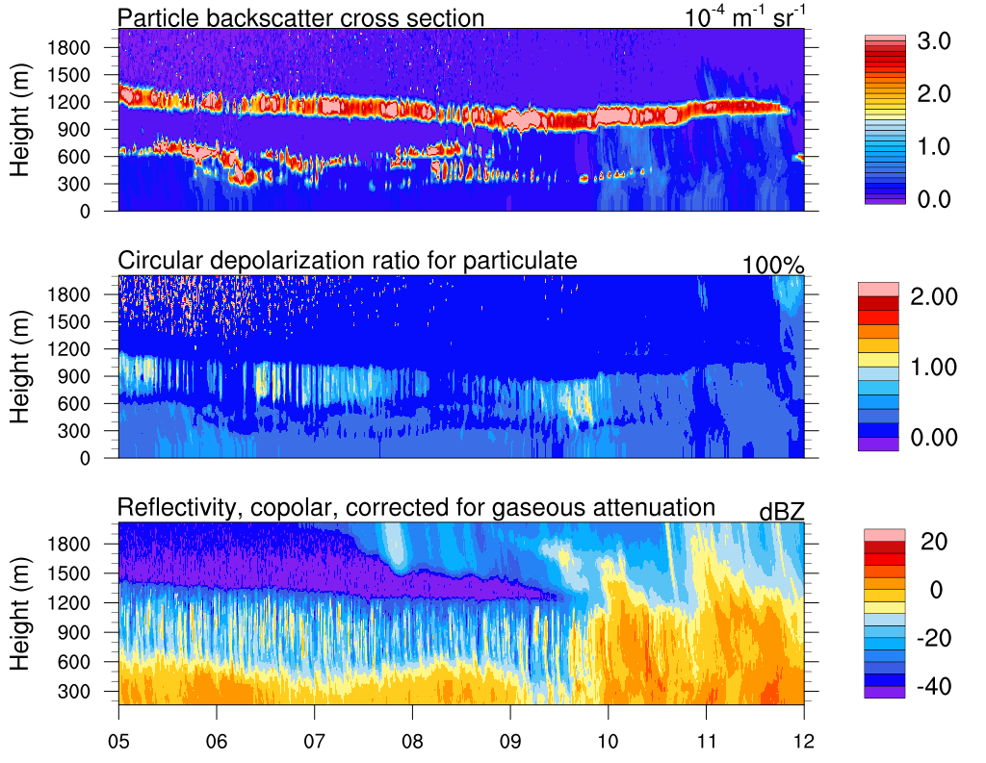
HSRL and KAZA observation
Time (UTC)

Slide 6
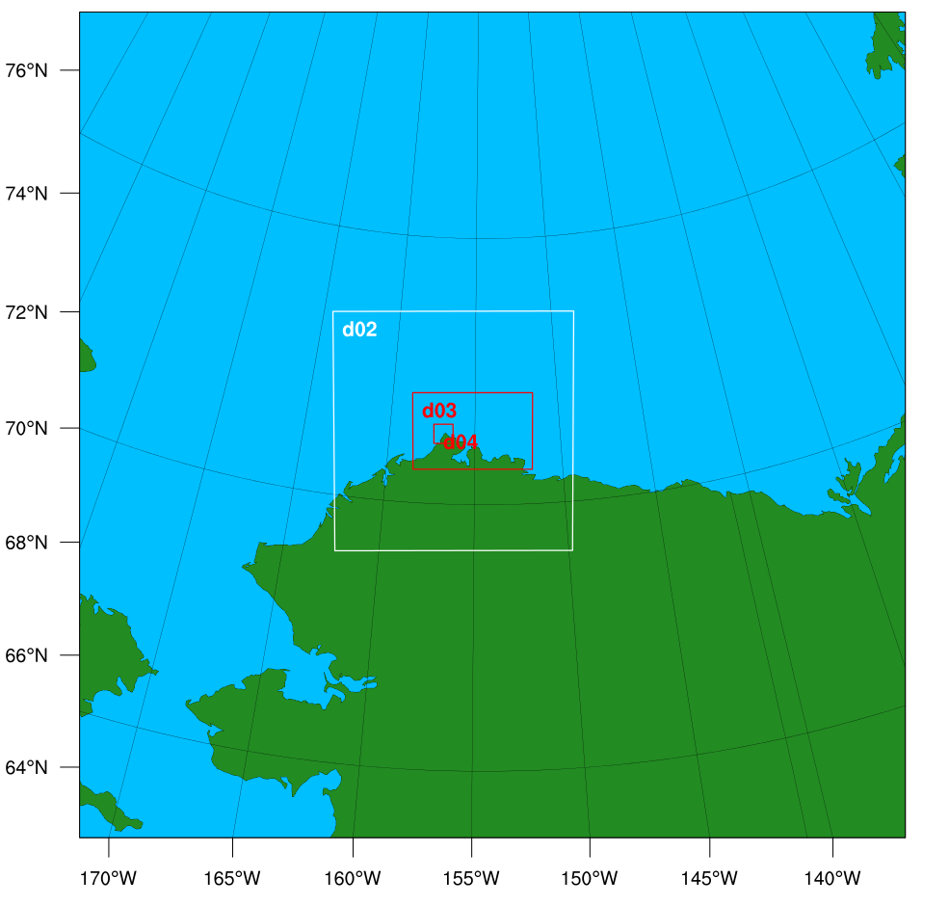
Model Setting
Time:
d01
d01, d02 and
d03 started
d04 started
05/01
1800UTC
05/02
0000UTC
05/03
0000UTC
Physics Options in WRF
Cumulus Parameterization: | Grell-Freitas scheme (d01, d02)
PBL Schemes: | Yonsei University scheme (d01, d02)
Cloud microphysics scheme: | Morrison 2-moment scheme
d01 : 70 ×70 × 130 (25km)
d02 : 101 ×101 ×130 (5km)
d03 : 251 ×161 ×130 (1km)
d04 : 201 ×201 ×130 (0.2km)
Vertical resolution below 2km is 33 m

Slide 7
The simulated multi-layer clouds (cloud water mixing ratio) at different heights
0330 UTC May 2
1200-m
1000-m
800-m
600-m

Slide 8
The calculated convergence at different heights in the simulation
2200 UTC May 1
1200-m
1000-m
800-m
600-m
02
400-m
200-m
50-m
15
01
05
05
01
15
02
What drives the convergence lines in the simulation (1-km grid-spacing)?

Slide 9
Virtual potential temperature at different height
2200 UTC May 1
1200-m
1000-m
800-m
600-m
K
400-m
200-m
50-m
Cold air at higher level was advected into a warm region.
Shaded: U-wind (ms⁻¹)
Contour: W-wind (ms⁻¹)
Convective instability
m s⁻¹

Slide 10
How does mean wind organize the direction of roll?
Without inflection point in the wind profile
Markowski, P., and Richardson, Y. (2010)
Notes:
Rayleigh number: a ratio of the destabilizing effect of buoyancy to the stabilizing effect of viscosity
Inviscid stability
Rayleigh
Fjortoft

Slide 11
How does mean wind organize the direction of roll?
The vortexes along a horizontal line tend to organize themselves to move upwards simultaneously along lines that are parallel to wind direction. Thus, no differential vorticities can develop between them along the wind direction and the convection is uninhibited by restoring forces (Kuettner, 1971).

Slide 12
Vertical profile of simulated vorticity and wind.
2200 UTC May 1
1200-m
1000-m
800-m
600-m
02
400-m
200-m
50-m
15
01
05
05
01
15
02
Vertical cross section of domain average vorticity along y-axis
Left boundary of the purple box
Right boundary of the purple box
2000 UTC May 1
V
V
U
U
South
North
$$\frac{∂w}{∂y}−\frac{∂v}{∂z}$$

Slide 13
Summary
2200 UTC May 1
Etling and Brown (1993)
Shaded: U-wind (ms⁻¹)
Contour: W-wind (ms⁻¹)

Slide 15
Summary
In this case, the temperature difference at the lower level induced the convective instability within the boundary layer.
Vertical wind shear reorganized the buoyancy-driven turbulence and form the convection roll.
The convection can be one of the reasons that form the multi-layer AMPS cloud.

Slide 16
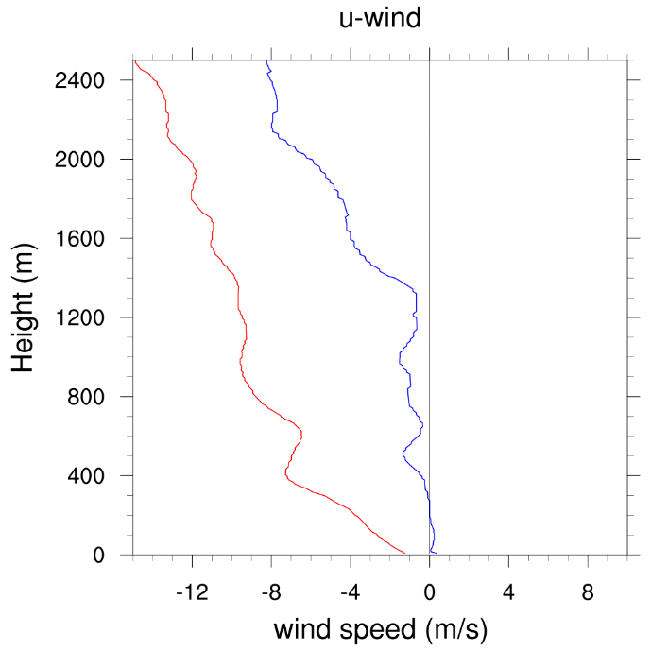
HSRL and KAZA observation
NSA sounding
0530 UTC May 2 2013
V
U
Time (UTC)

Slide 17
Equivalent potential temperature
Vertical cross section of equivalent potential temperature along the line in the previous slide.
Potential temperature
Water vapor mixing ratio

Slide 18
Shaded: V-wind (ms⁻¹)
Contour: W-wind (ms⁻¹)
U&W wind
V&W wind
Shaded: U-wind (ms⁻¹)
Contour: W-wind (ms⁻¹)
20 Z
21 Z
22 Z
0
25
50 km
0
25
50 km

