Slide 1
Development and Evaluation of
a Regional Reanalysis over East Asia
Eun-Gyeong Yang
Atmospheric Predictability and Data Assimilation Laboratory
Dept. of Atmospheric Science, Yonsei Univ., Republic of Korea
Spring 2017 Group Meeting
05/01/2017

Slide 2
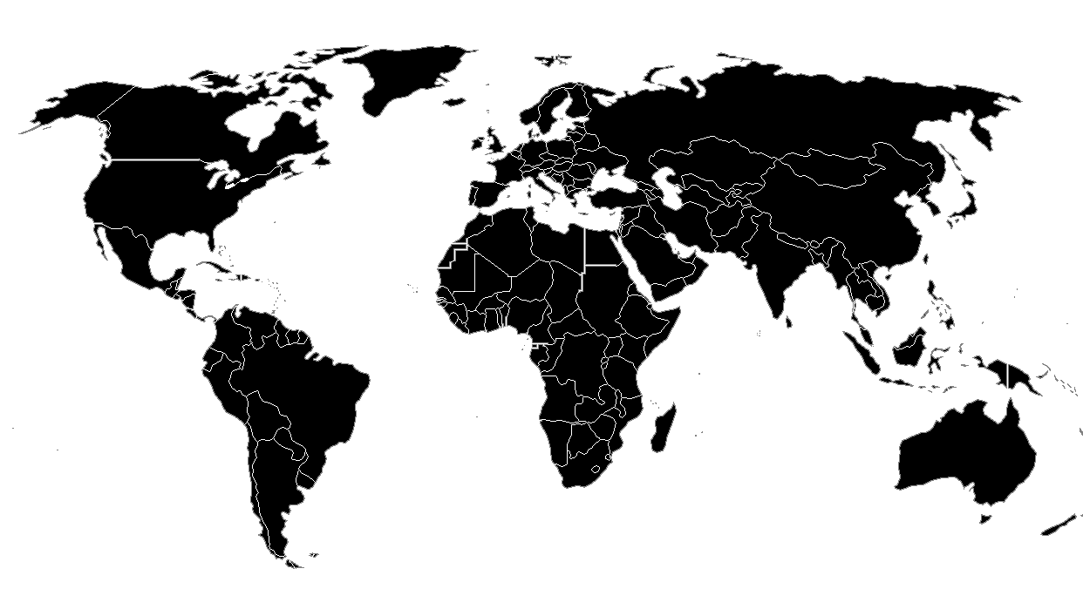
Introduction
A reanalysis is a high-quality climate data set.
produced by assimilating long-time series of observations with a consistent and state-of-the-art NWP model and data assimilation system
the best estimate of the state of the atmosphere
widespread applications in many research areas
Most reanalyses have been produced for the global area.
ECMWF: ERA-15, ERA-40, ERA-Interim, ERA-20CM
NCEP: NCEP/NCAR (R1), NCEP/DOE (R2), NCEP CFSR
JMA: JRA-25, JRA-55
NASA MERRA, NOAA-CIRES (20CRv1 and v2)
Due to the coarse resolution of global reanalyses, many meteorological organizations started or plan to produce regional reanalyses with higher resolution.
North America (NARR), Europe (EURO4M), Arctic (ASR)
Europe (UERRA) and South Asia in preparation

Slide 3
Introduction
In East Asia, a high-resolution regional reanalysis is required to precisely analyze the regional climate. However, no regional reanalysis has been produced for East Asia.
Accordingly, the East Asia Regional Reanalysis (EARR) was developed for the two-year period of 2013-2014 (Yang and Kim 2017).
to prepare for a future, long-term execution of the EARR project
For practical applications of reanalysis, validation is essential.
A reanalysis is an estimate of the atmospheric state.
Thus, the characteristics and uncertainties of EARR for the period 2013-2014 are compared against ERA-Interim and observation data.
Part 1
Because the EARR domain does not cover all Tibet region, in order to analyze Tibetan Plateau in greater detail, a regional reanalysis including Tibet region is required.
Therefore, to find out the appropriate reanalysis system before developing it, investigation is needed.
Part 2

Slide 4
East Asia Regional Reanalysis (EARR)
Evaluation of reanalysis
01
03
05
Regional
Reanalysis including
Tibetan
Plateau
Introduction
Part 1
Part 2
Development
Evaluation
02
04
Test of EnKF for compare with EARR
East Asia Regional Reanalysis (EARR)
Model Configuration
Observations for EARR
Development with EnKF
Evaluation

Slide 5
Part 1
East Asia Reanalysis system
Model configuration
Observations for EARR
Evaluation of reanalysis

Slide 6
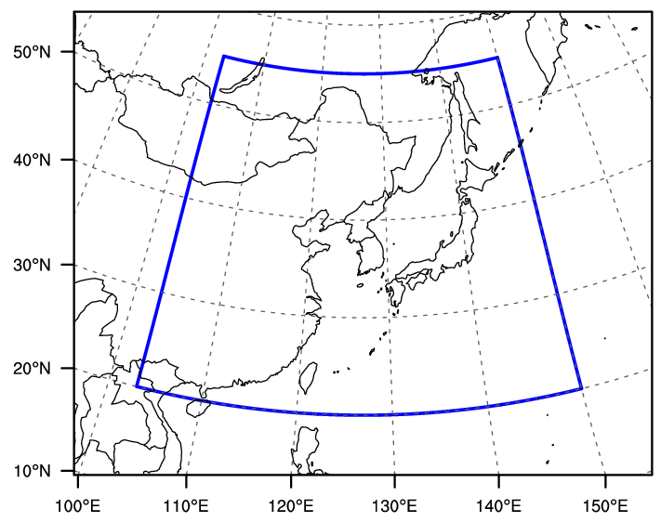
Model configuration
Part 1. East Asia Regional Reanalysis
Table 1. Model configuration
EARR domain
Horizontal Resolution | 12 km (0.11° $×$ 0.11°, 540 $×$ 432 grid points)
Vertical Levels | 70 vertical levels (top ~ 80 km)
Model | Unified Model (Davies et al. 2005) at the KMA (v8.2, the KMA operational forecasting system in June 2015)
Lateral boundary condition | Analysis and forecast fields from Global model (25 km) of the UM at the KMA
Data assimilation | 4DVAR (Courtier et al. 1994, Rawlins et al. 2007)
Spatial discretization | Finite Difference method
Time integration/advection | Semi-implicit time integration and semi-Lagrangian advection scheme
Planetary boundary layer | First-order non-local boundary-layer scheme based on Lock et al. (2000)
Radiation | Edwards-Slingo general 2-stream scheme (Edward and Slingo 1996)
Cumulus convection | Mass flux convection with CAPE closure (Gregory and Rowntree 1990)
Surface | Joint UK Land Environment Simulator (JULES, Best et al. 2011) 4-layer soil model using van Genuchten (1980) soil hydrology
Microphysics | Mixed-phase precipitation scheme (Wilson and Ballard 1999)
Verification domain
20°N–55°N 103°E–150°E
Global UM
15UTC
18UTC
21UTC
00UTC
03UTC
06UTC
Boundary condition
Assimilation window
Assimilation window
Assimilation window
EARR
Increment
Increment
Increment
15UTC
18UTC
21UTC
00UTC
03UTC
06UTC
09
Reanaylsis
Reanaylsis
Reanaylsis

Slide 7
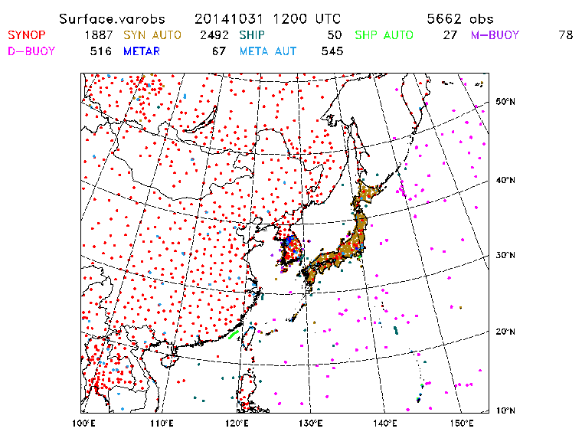
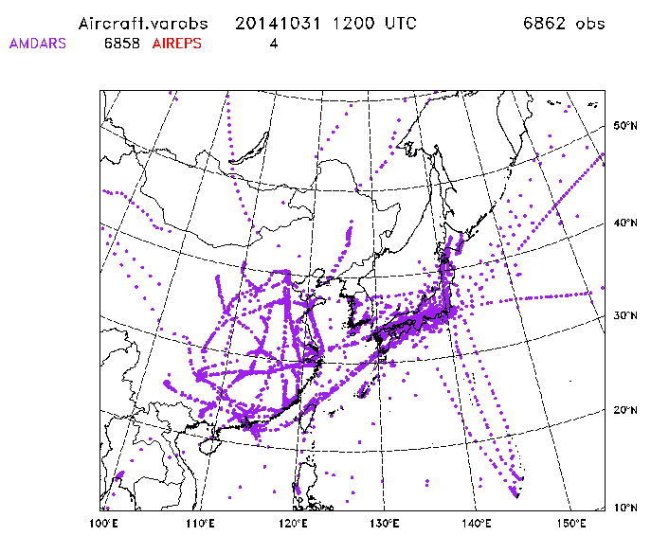
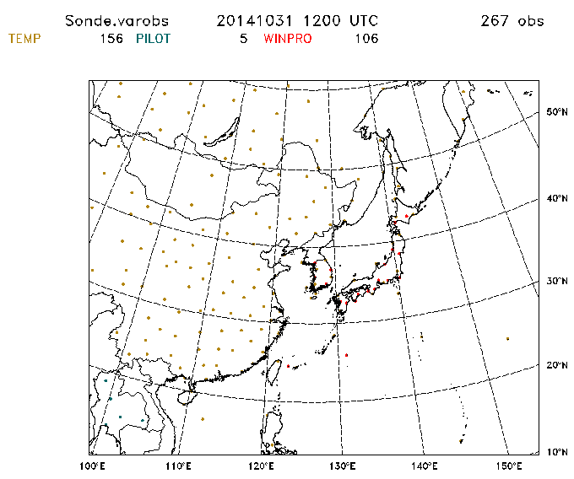
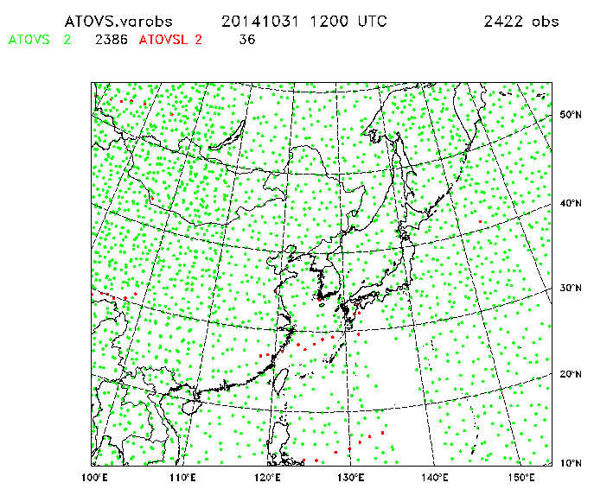
Observations
Part 1. East Asia Regional Reanalysis
Observation |  |  | Description | Variable | Source
SURFACE |  | SYNOP | Land surface synoptic weather observations | Sfc pressure, wind, temp., humidity | Global Telecommunication System (GTS), KMA, JMA
 |  | METAR | Surface weather observations and reports | Sfc pressure, wind, temp., humidity | GTS, Meteorological Assimilation Data Ingest System (MADIS)
 |  | Ship | Sea surface weather observations by ship | Sfc pressure, wind, temp., humidity | GTS
 |  | Buoy | Sea surface weather observations by buoy | Sfc pressure, wind, temp. | GTS
 |  | BOGUS | Bogus observations generated by national meteorological centres | Sfc pressure, wind | KMA National Typhoon Center (NTC)
Aircraft |  |  | Aircraft-based observations reported by the Aircraft Meteorological Data Relay (AMDAR) and Aircraft reports (AIREPs) | Flight-level wind, temp. | GTS, MADIS
Upper air | TEMP |  | Upper-air observations from radiosonde | Upper-air wind, temp., humidity | GTS, KMA
 | PILOT |  | Upper-air wind profile from pilot balloon or radiosonde | Upper-air wind | GTS
 | Wind profiler |  | Upper-air wind profile from wind profiler | Upper-air wind | GTS, KMA, JMA, Deutscher Wetterdienst (DWD)
ATOVS |  |  | Advanced Microwave Sounding Unit (AMSU) and High-resolution Infrared Radiation Sounder(HIRS) | Radiance | UKMO, Regional ATOVS Retransmission Services (RARS)
IASI |  |  | Infrared Atmospheric Sounding Interferometer | Radiance | UKMO
AIRS |  |  | Atmospheric Infrared Sounder | Radiance | NOAA National Environmental Satellite, Data, and Information Service (NESDIS)
ASCAT |  |  | Advanced Scatterometer | Wind | Royal Netherlands Meteorological Institute (KNMI)
AMV |  |  | Atmospheric Motion Vector | Wind | GTS, NOAA NESDIS
GPSRO |  |  | Global Positioning System Radio Occultation | Bending angle | GTS, NOAA NESDIS, EUMETCast
Table 2. The type and source of observations assimilated for EARR

Slide 8
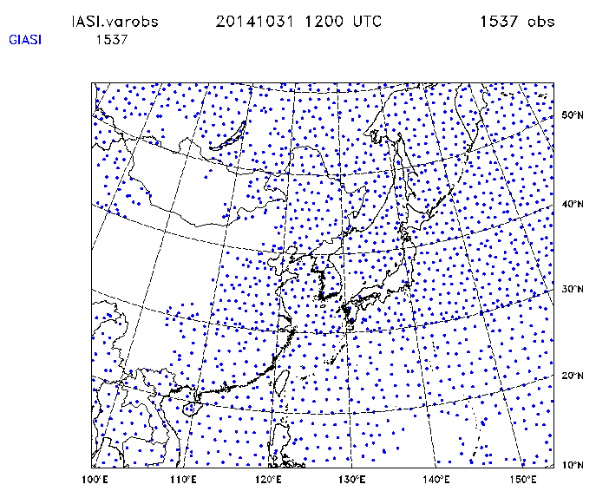
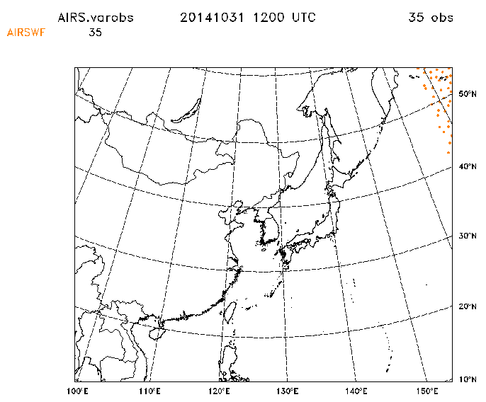
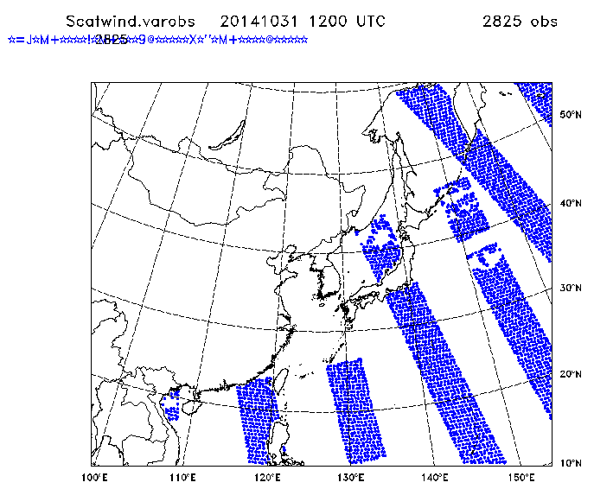
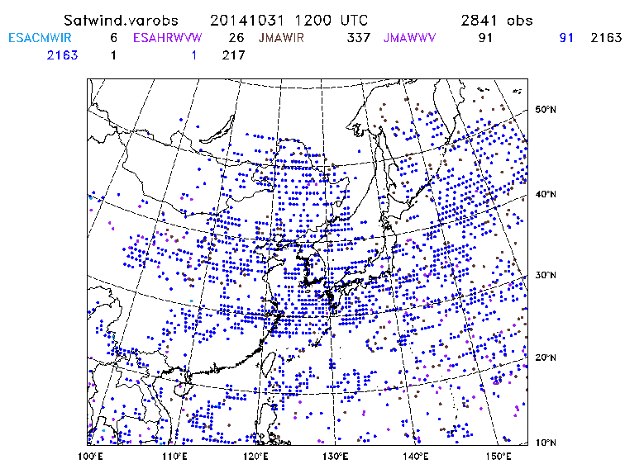
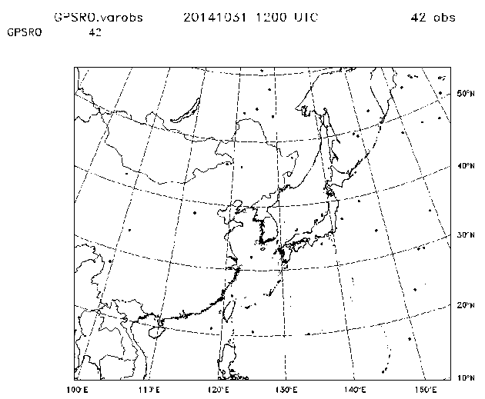
Observations
Part 1. East Asia Regional Reanalysis
Observation |  |  | Description | Variable | Source
SURFACE |  | SYNOP | Land surface synoptic weather observations | Sfc pressure, wind, temp., humidity | Global Telecommunication System (GTS), KMA, JMA
 |  | METAR | Surface weather observations and reports | Sfc pressure, wind, temp., humidity | GTS, Meteorological Assimilation Data Ingest System (MADIS)
 |  | Ship | Sea surface weather observations by ship | Sfc pressure, wind, temp., humidity | GTS
 |  | Buoy | Sea surface weather observations by buoy | Sfc pressure, wind, temp. | GTS
 |  | BOGUS | Bogus observations generated by national meteorological centres | Sfc pressure, wind | KMA National Typhoon Center (NTC)
Aircraft |  |  | Aircraft-based observations reported by the Aircraft Meteorological Data Relay (AMDAR) and Aircraft reports (AIREPs) | Flight-level wind, temp. | GTS, MADIS
Upper air | TEMP |  | Upper-air observations from radiosonde | Upper-air wind, temp., humidity | GTS, KMA
 | PILOT |  | Upper-air wind profile from pilot balloon or radiosonde | Upper-air wind | GTS
 | Wind profiler |  | Upper-air wind profile from wind profiler | Upper-air wind | GTS, KMA, JMA, Deutscher Wetterdienst (DWD)
ATOVS |  |  | Advanced Microwave Sounding Unit (AMSU) and High-resolution Infrared Radiation Sounder(HIRS) | Radiance | UKMO, Regional ATOVS Retransmission Services (RARS)
IASI |  |  | Infrared Atmospheric Sounding Interferometer | Radiance | UKMO
AIRS |  |  | Atmospheric Infrared Sounder | Radiance | NOAA National Environmental Satellite, Data, and Information Service (NESDIS)
ASCAT |  |  | Advanced Scatterometer | Wind | Royal Netherlands Meteorological Institute (KNMI)
AMV |  |  | Atmospheric Motion Vector | Wind | GTS, NOAA NESDIS
GPSRO |  |  | Global Positioning System Radio Occultation | Bending angle | GTS, NOAA NESDIS, EUMETCast
Table 2. The type and source of observations assimilated for EARR

Slide 9
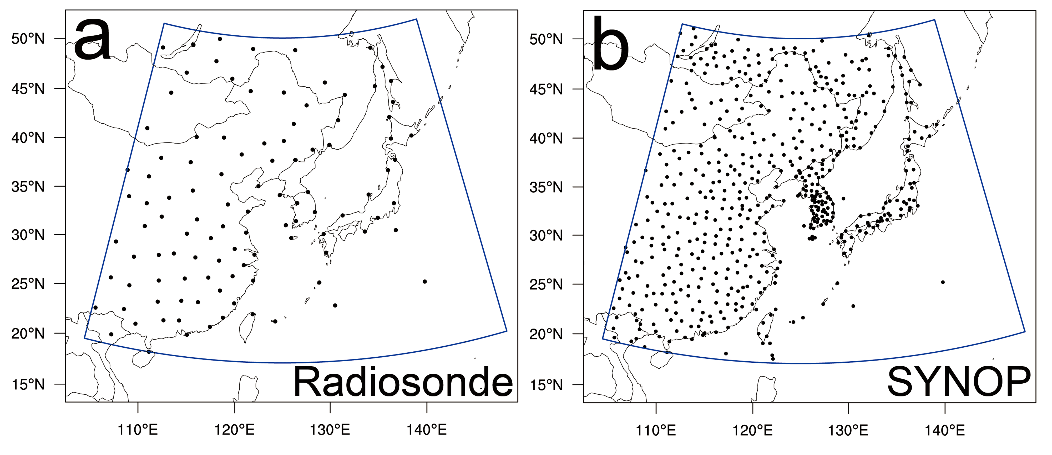
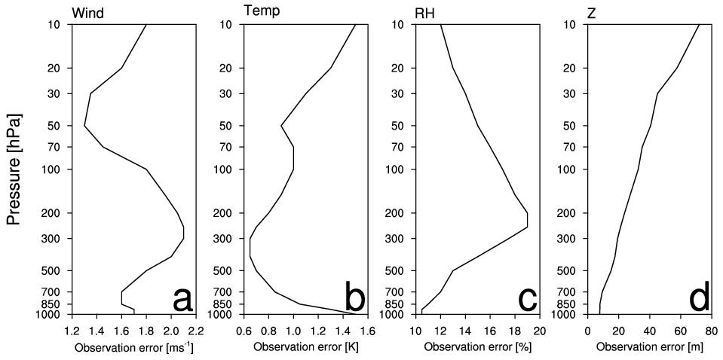
Evaluation
Part 1. East Asia Regional Reanalysis
Locations of obs
Locations of obs
108 obs
550 obs
Observation error
Observation error
Wind
Temp
RH
Z
Variable | 10m Wind | 2m Temp | 2m RH | MSLP
Obs error | 2 [m/s] | 1.1 [K] | 6.2 [%] | 1 [hPa]
The near-surface variables
For the verification of each variable, approximately 108 radiosonde and 550 SYNOP observations are used at each time (00 and 12 UTC).
The upper-air variables

Slide 10
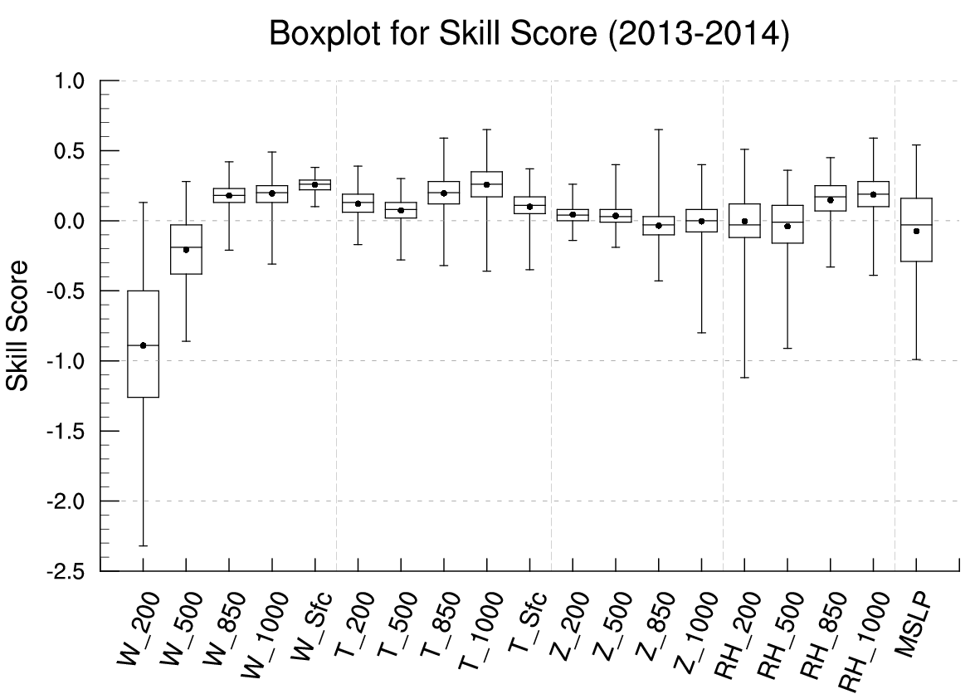
Evaluation – Skill Score
Part 1. East Asia Regional Reanalysis
The skill score reveals how much the performance of the system is improved from that of a reference (previous system).
In this study, ERA-Interim reanalysis → a reference
Skill Score > 0 → EARR performance improved compared to ERA-I. Skill Score < 0 → degraded
better than ERA-I (SS>0)
Averaged skill scores at 00 and 12 UTC for the period 2013-2014.
Except for MSLP, the geopotential height at 850 and 1000 hPa, and the upper-air wind and relative humidity, the EARR performance for most variables, such as wind, temperature, relative humidity, and geopotential height, is improved compared to ERA-I.
degraded than ERA-I (SS<0)
(Yang and Kim 2017)

Slide 11
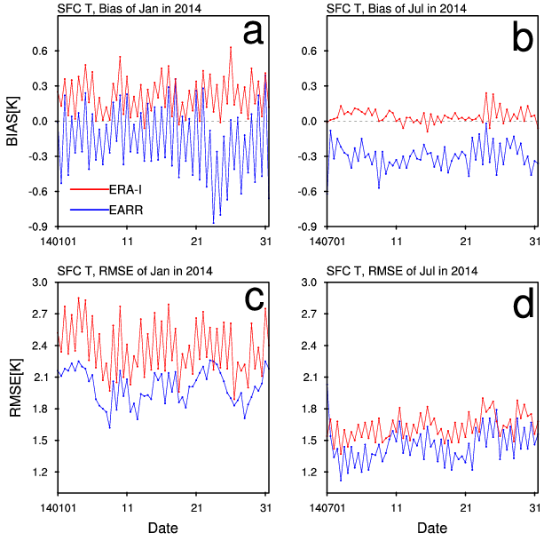
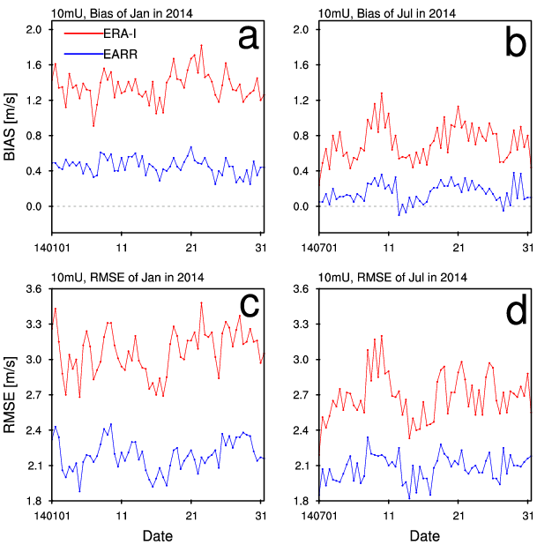
Evaluation – RMSE
Part 1. East Asia Regional Reanalysis
2 m T
Jan
Jul
10 m U
Jan
Jul
(Yang and Kim 2017)

Slide 12
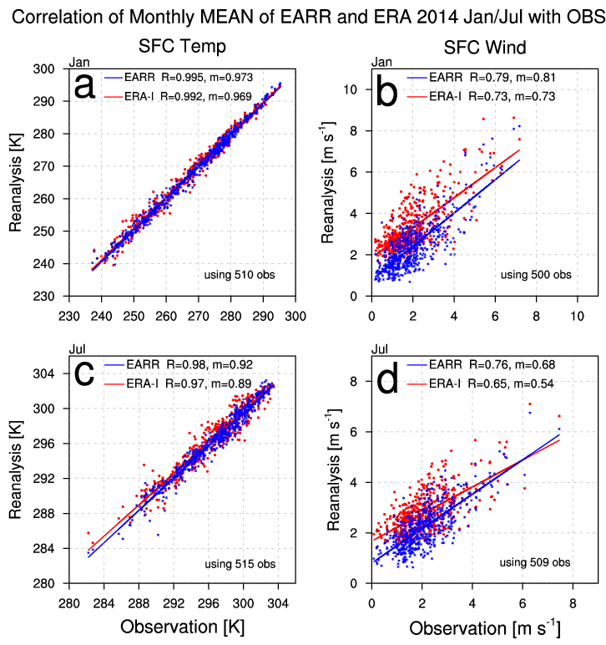
Evaluation – Corr. Coeff.
of Monthly Mean (Jan/Jul in 2014)
Part 1. East Asia Regional Reanalysis
R = correlation coefficient m = slope of regression line, regression coefficient
The monthly means were calculated and linear regression analysis was conducted.
by interpolating reanalysis variables to the locations of the surface synoptic observations via bilinear interpolation
by averaging the reanalyses and observations at 00 and 12 UTC in Jan and Jul 2014
EARR → larger R, m closer to 1 than ERA-I
In terms of the correlation coefficients for the near-surface U and T, EARR can provide a much improved representation of the near-surface variables, which are more consistent with the observations compared to ERA-I.
significant difference at the 1% level.
Jan
Jul
(Yang and Kim 2017)

Slide 13
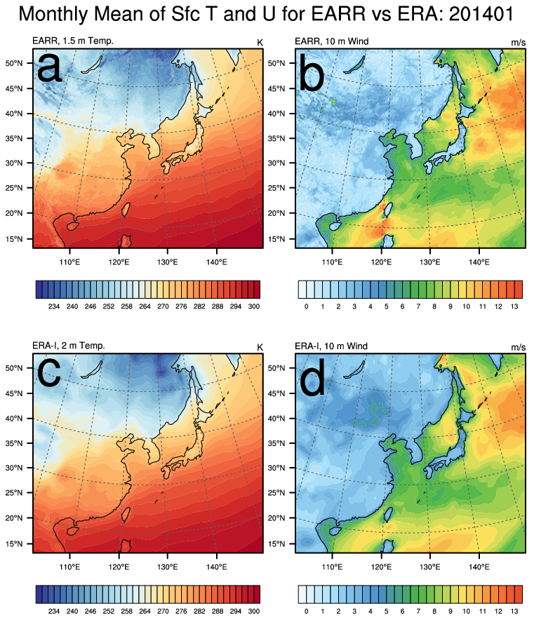
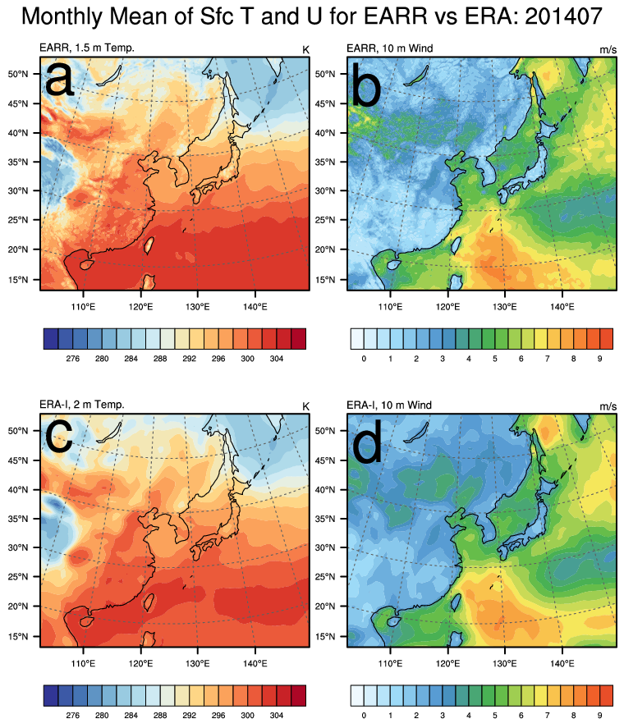
Evaluation – Comparison of
Monthly Mean
Part 1. East Asia Regional Reanalysis
Jan 2014
Jul 2014
SFC T
SFC U
SFC T
SFC U
EARR
ERA-I
(Yang and Kim 2017)
Notes:
Overall, the spatial distributions of the monthly mean near-surface U and T from EARR for Jan and Jul 2014 are similar to those from ERA-I. However, EARR is good at reproducing the fine-scale features of the near-surface variables in greater detail than ERA-I.

Slide 14
Conclusion
Part 1. East Asia Regional Reanalysis
In this study, the East Asia Regional Reanalysis (EARR) was developed for the period 2013-2014 and characteristics of the EARR were examined compared to ERA-Interim (ERA-I) reanalysis.
Compared to the ERA-I, in terms of skill scores, the EARR performance for wind, temperature, and geopotential height improved except for MSLP, the lower-air geopotential height, and the upper-air wind and the upper-air relative humidity.
Based on the results of various evaluation tools, it is found that EARR simulates near-surface variables better than ERA-I.
Therefore, although special care needs to be taken when using the upper-air wind and relative humidity from EARR, the near-surface variables of the EARR developed are found to be more accurate than those of ERA-I.
More analysis will be conducted after EARR is produced for a longer period.

Slide 15
Part 2
A regional reanalysis for Tibetan Plateau
Test for EnKF to compare with EARR
Development
Evaluation
Future plan

Slide 16
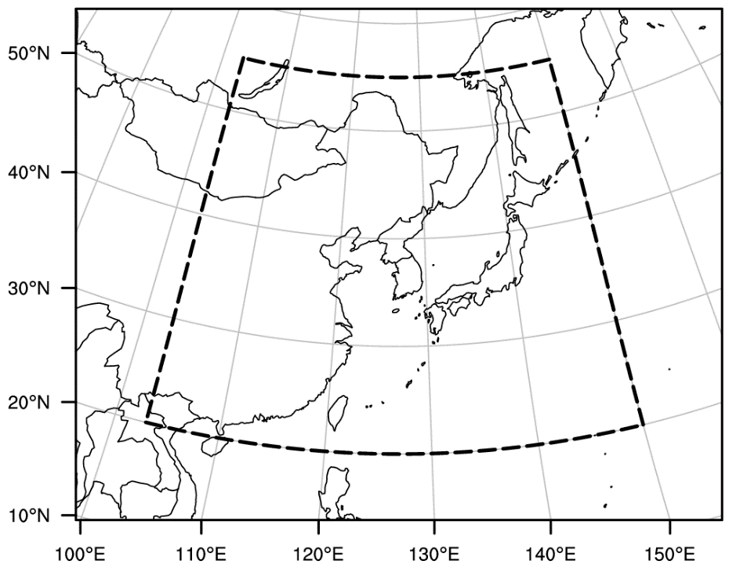
Test for EnKF to compare EARR*
Part 2. A Regional Reanalysis for Tibetan Plateau
 | ERA-I | EARR | EnKF
Grid spacing | 80 km | 12 km | 12 km
Assimilation Window | 12 h | 6 h | 6 h
Assimilation | 4D-Var | 4D-Var | EnKF
Model | IFS (Cy31r2) | The Unified Model in KMA | WRF (v3.7.1)
Reanalyses
ERA-Interim (ERA-I)
EARR (Yang and Kim 2017)
EnKF (GFS for IC and BC, Conventional obs)
EnKF
20 Ensemble members
40 Ensemble members
40 Ensemble members with multi-physics
Verification Domain
EARR Domain
*Yang, E.-G., and H. M. Kim, 2017: Evaluation of a regional reanalysis and ERA-Interim over East Asia using in situ observations during 2013-2014, J. Appl. Meteor. Climatol., doi: 10.1175/JAMC-D-16-0227.1, in press.

Slide 17
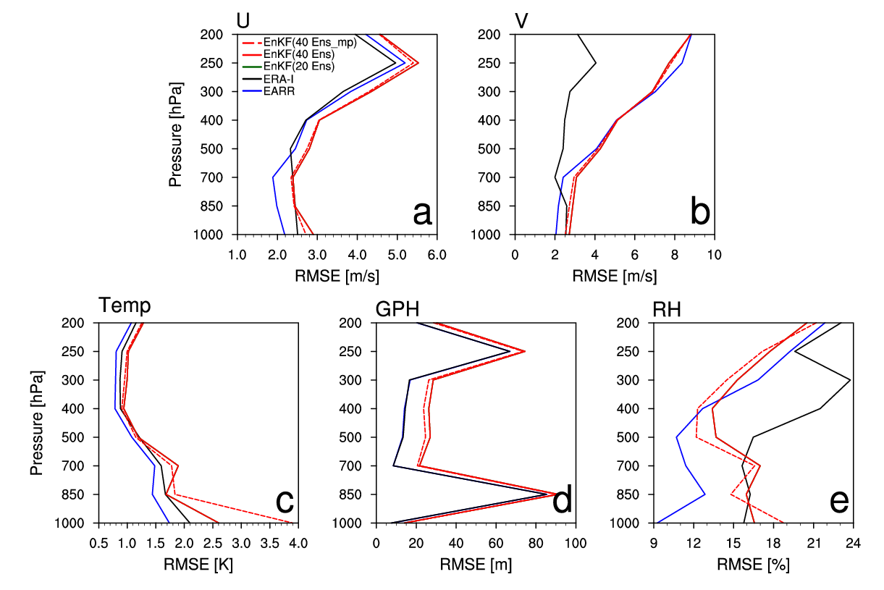
Test for EnKF to compare EARR
Part 2. A Regional Reanalysis for Tibetan Plateau
RMSE
<Method>
Verification Period: 2013/Jan/02 00Z – 2013/Jan/05 12Z (every 12 h)
Verification Measures: RMSE against Radiosonde observations
<Results>
Generally, RMSEs of EnKF are similar or a bit larger, compared to EARR and ERA-I.
Even though we didn’t tune every option, yet, the results seem reasonable.

Slide 18
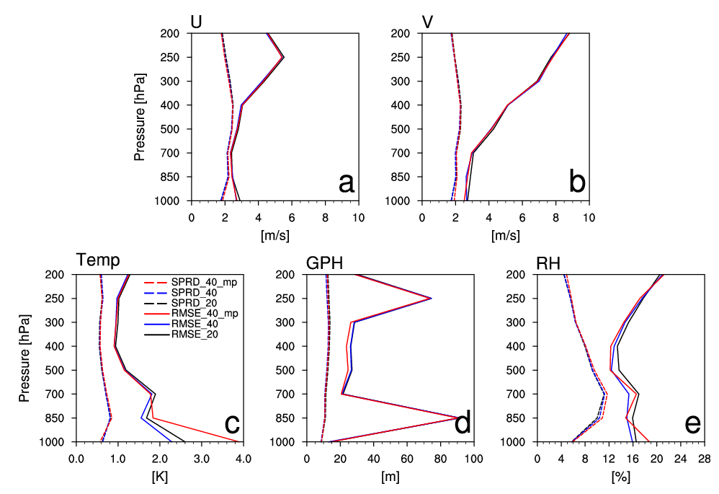
Test for EnKF to compare EARR
Part 2. A Regional Reanalysis for Tibetan Plateau
Analysis RMSE with Spread
<Method>
Verification target: Analysis field
Verification Period: 2013/Jan/02 00Z – 2013/Jan/05 12Z (every 12 h)
Verification Measures: RMSE and Spread

Slide 19
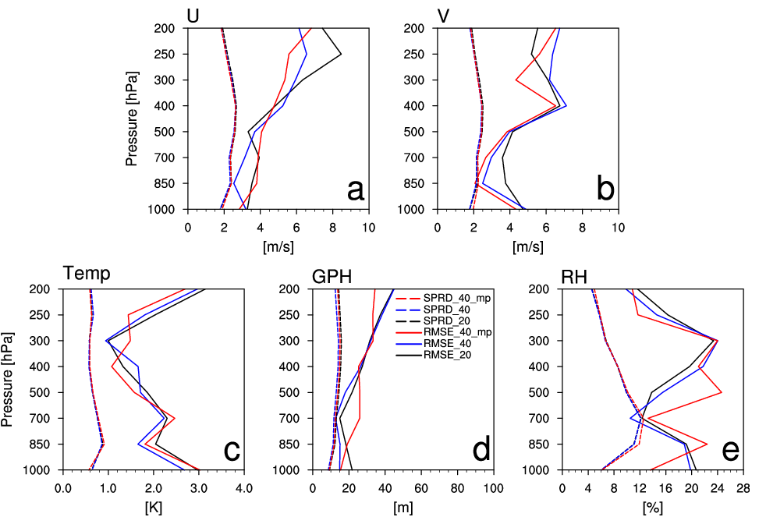
Test for EnKF to compare EARR
Part 2. A Regional Reanalysis for Tibetan Plateau
6h forecast RMSE with Spread
<Method>
Verification target: 6h forecast field
Verification Period: 2013/Jan/02 00Z – 2013/Jan/05 12Z (every 12 h)
Verification Measures: RMSE and Spread

Slide 20
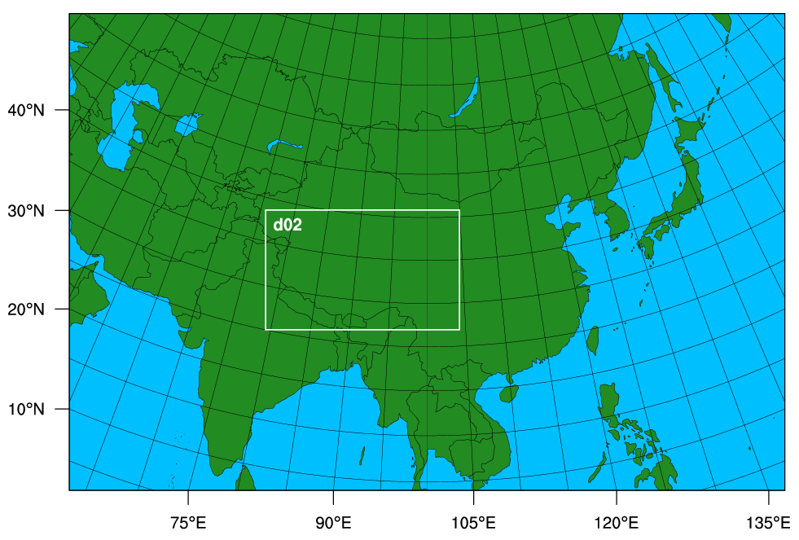
Development
Part 2. A Regional Reanalysis for Tibetan Plateau
Domain for a regional reanalysis including Tibet region
Grid spacing: 30 km
Grids: 300 x 200 grid points
ERA-Interim as I.C. and B.C.
Conventional obs.
Tibetan Plateau

Slide 21
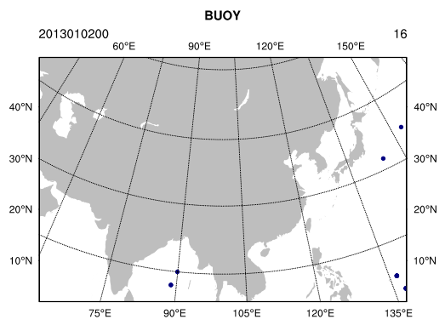
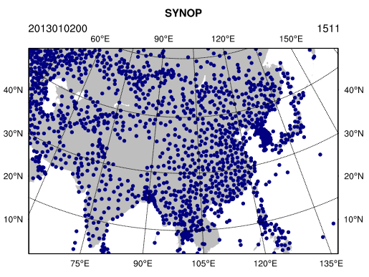
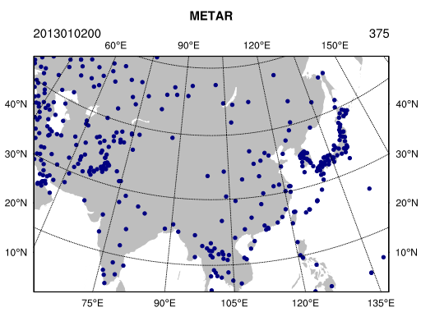
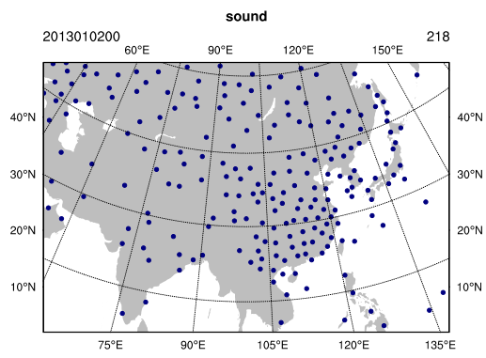
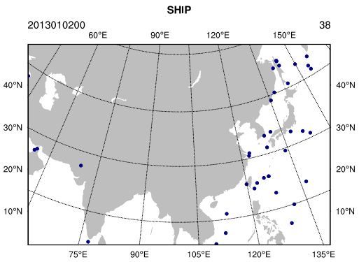
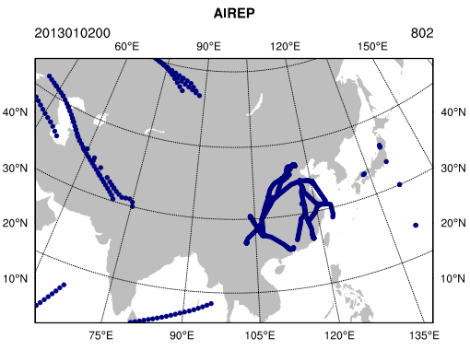
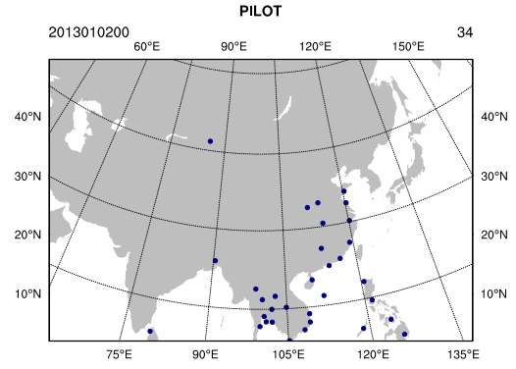
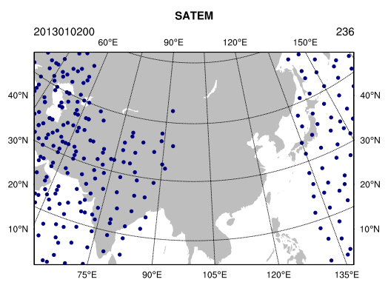
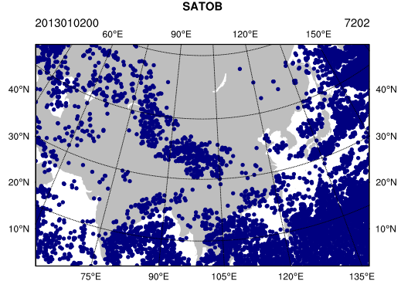
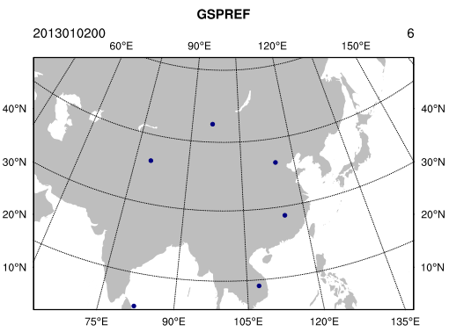
Development - observations
Part 2. A Regional Reanalysis for Tibetan Plateau

Slide 22
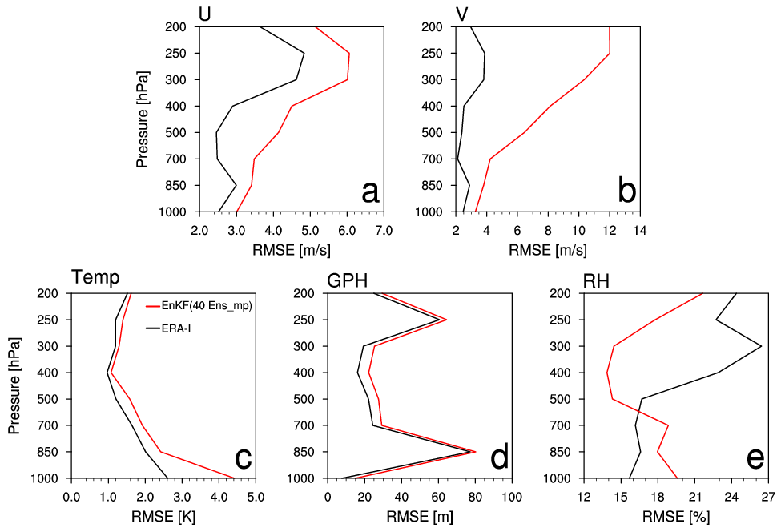
Evaluation
Part 2. A Regional Reanalysis for Tibetan Plateau
RMSE
<Method>
Verification Period: 2013/Jan/02 00Z – 2013/Jan/05 12Z (every 12 h)
Verification Measures: RMSE against Radiosonde observations

Slide 23
Future plan
Part 2. A Regional Reanalysis for Tibetan Plateau
To find the most appropriate and cost-efficient assimilation method, hybrid data assimilation method will be also investigated.
hybrid with EnKF and 6h forecast of ERA-Interim or
E3dvar
For the period of one month, using the two assimilation methods (EnKF and hybrid) for assimilating observations, a regional reanalysis including Tibetan Plateau will be produced and investigated.
A regional reanalysis will be produced for a long period of time, after the reanalysis system is developed.

