Slide 1
What determines the optimal localization radius
in ensemble filtering
for multi-scale quasi-geostrophic dynamics?
Yue (Michael) Ying, Fuqing Zhang, PennState/ADAPT
Jeffery Anderson, NCAR/DAReS
Group meeting, May 1 2017

Slide 2
In pursuit of an optimal localization:
"True" correlation
(N=2000)
sample-estimated
correlation (N=20)
localized
analysis increment
adaptive algorithms:
Zhen and Zhang 2014
Perianez et al. 2014
Kirchgessner et al. 2014
Flowerdew 2015
localization radius depends on:
ensemble size
observing network properties (density, frequency, accuracy)
underlying covariance structure, flow-dependency (Anderson 2007)
What is their relative importance for multi-scale dynamics?

Slide 3
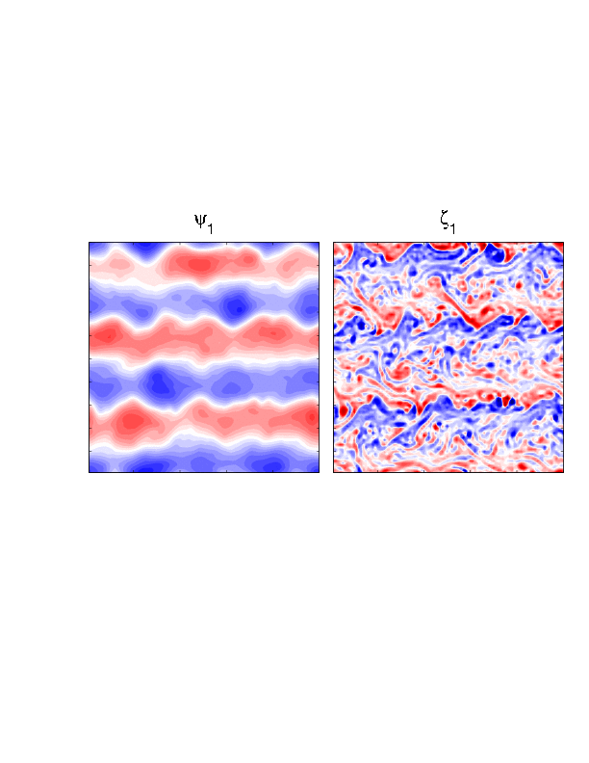
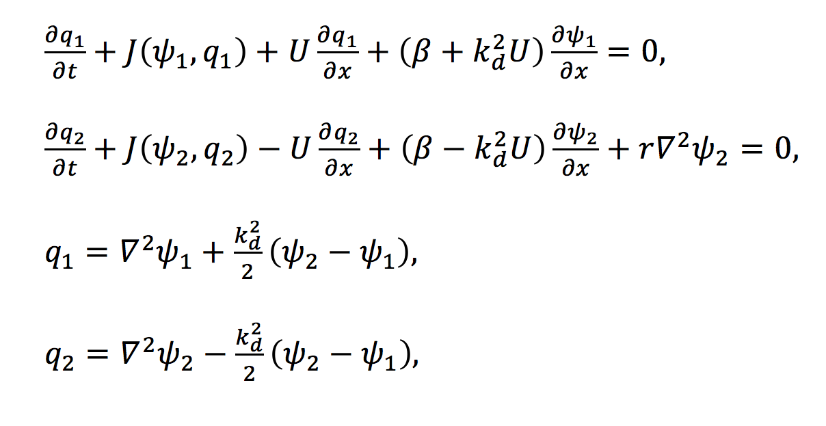
Two-layer Quasi-Geostrophic Model
KE spectrum
-3
$$k_{β}$$
$$k_{d}$$
governing equations:
colored lines: error evolution
gray: reference energy
capture the essence of large-scale atmospheric dynamics
simple enough for sensitivity experiments

Slide 4
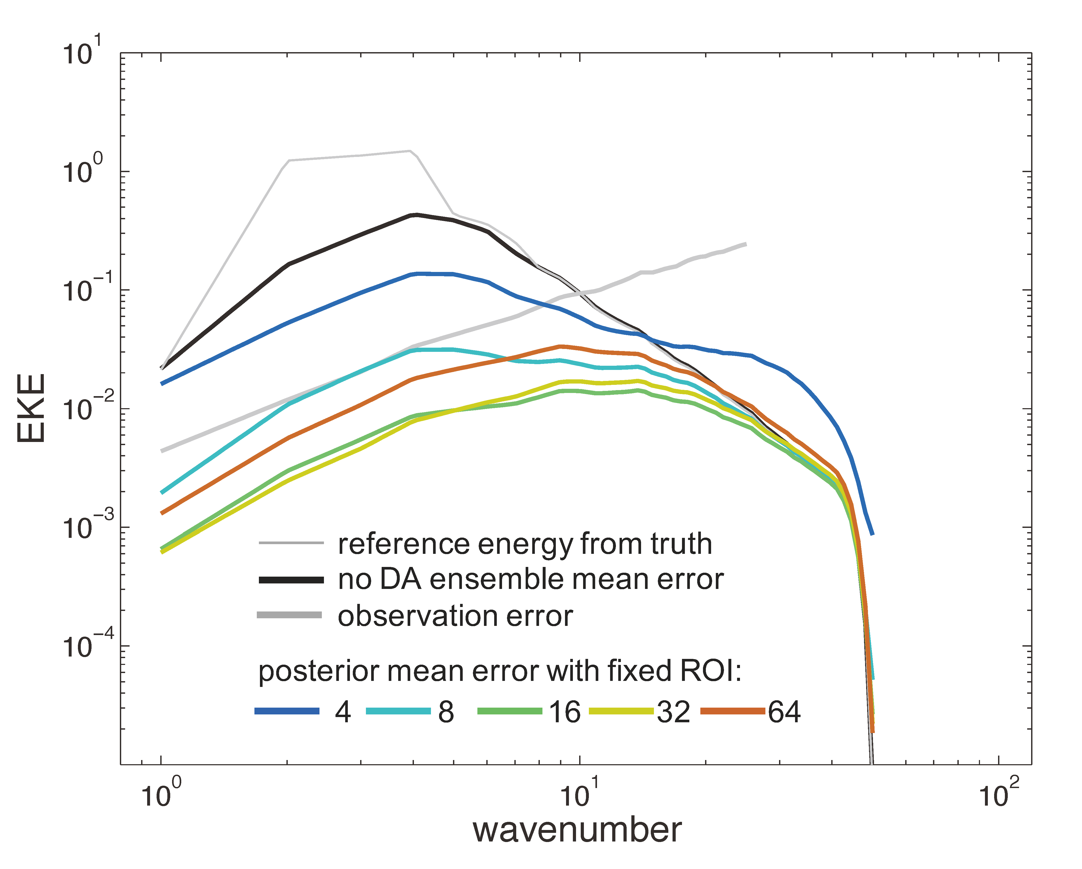
Finding best radius of influence (ROI) by trial-and-error
KE spectrum
CNTL experiment
ensemble size N = 40
observing network
$Δ$x = 2 dx
model grid resolution
L = n dx, n = 100
observation: u,v
state variable: $ψ$
best ROI is 16
larger ROI is suboptimal for all scales
smallest ROI introduce noise in the unobserved scales

Slide 5
Mean absolute correlation (MAC) as a function of distance
$|corr(ψ,u)|$ averaged over space and time
No DA correlation scale remains large
Asymptotic value of MAC is determined by ensemble size N.
For the best ROI = 16, at distance = 16 the MAC is close enough to the asymptotic value.
distance

Slide 6
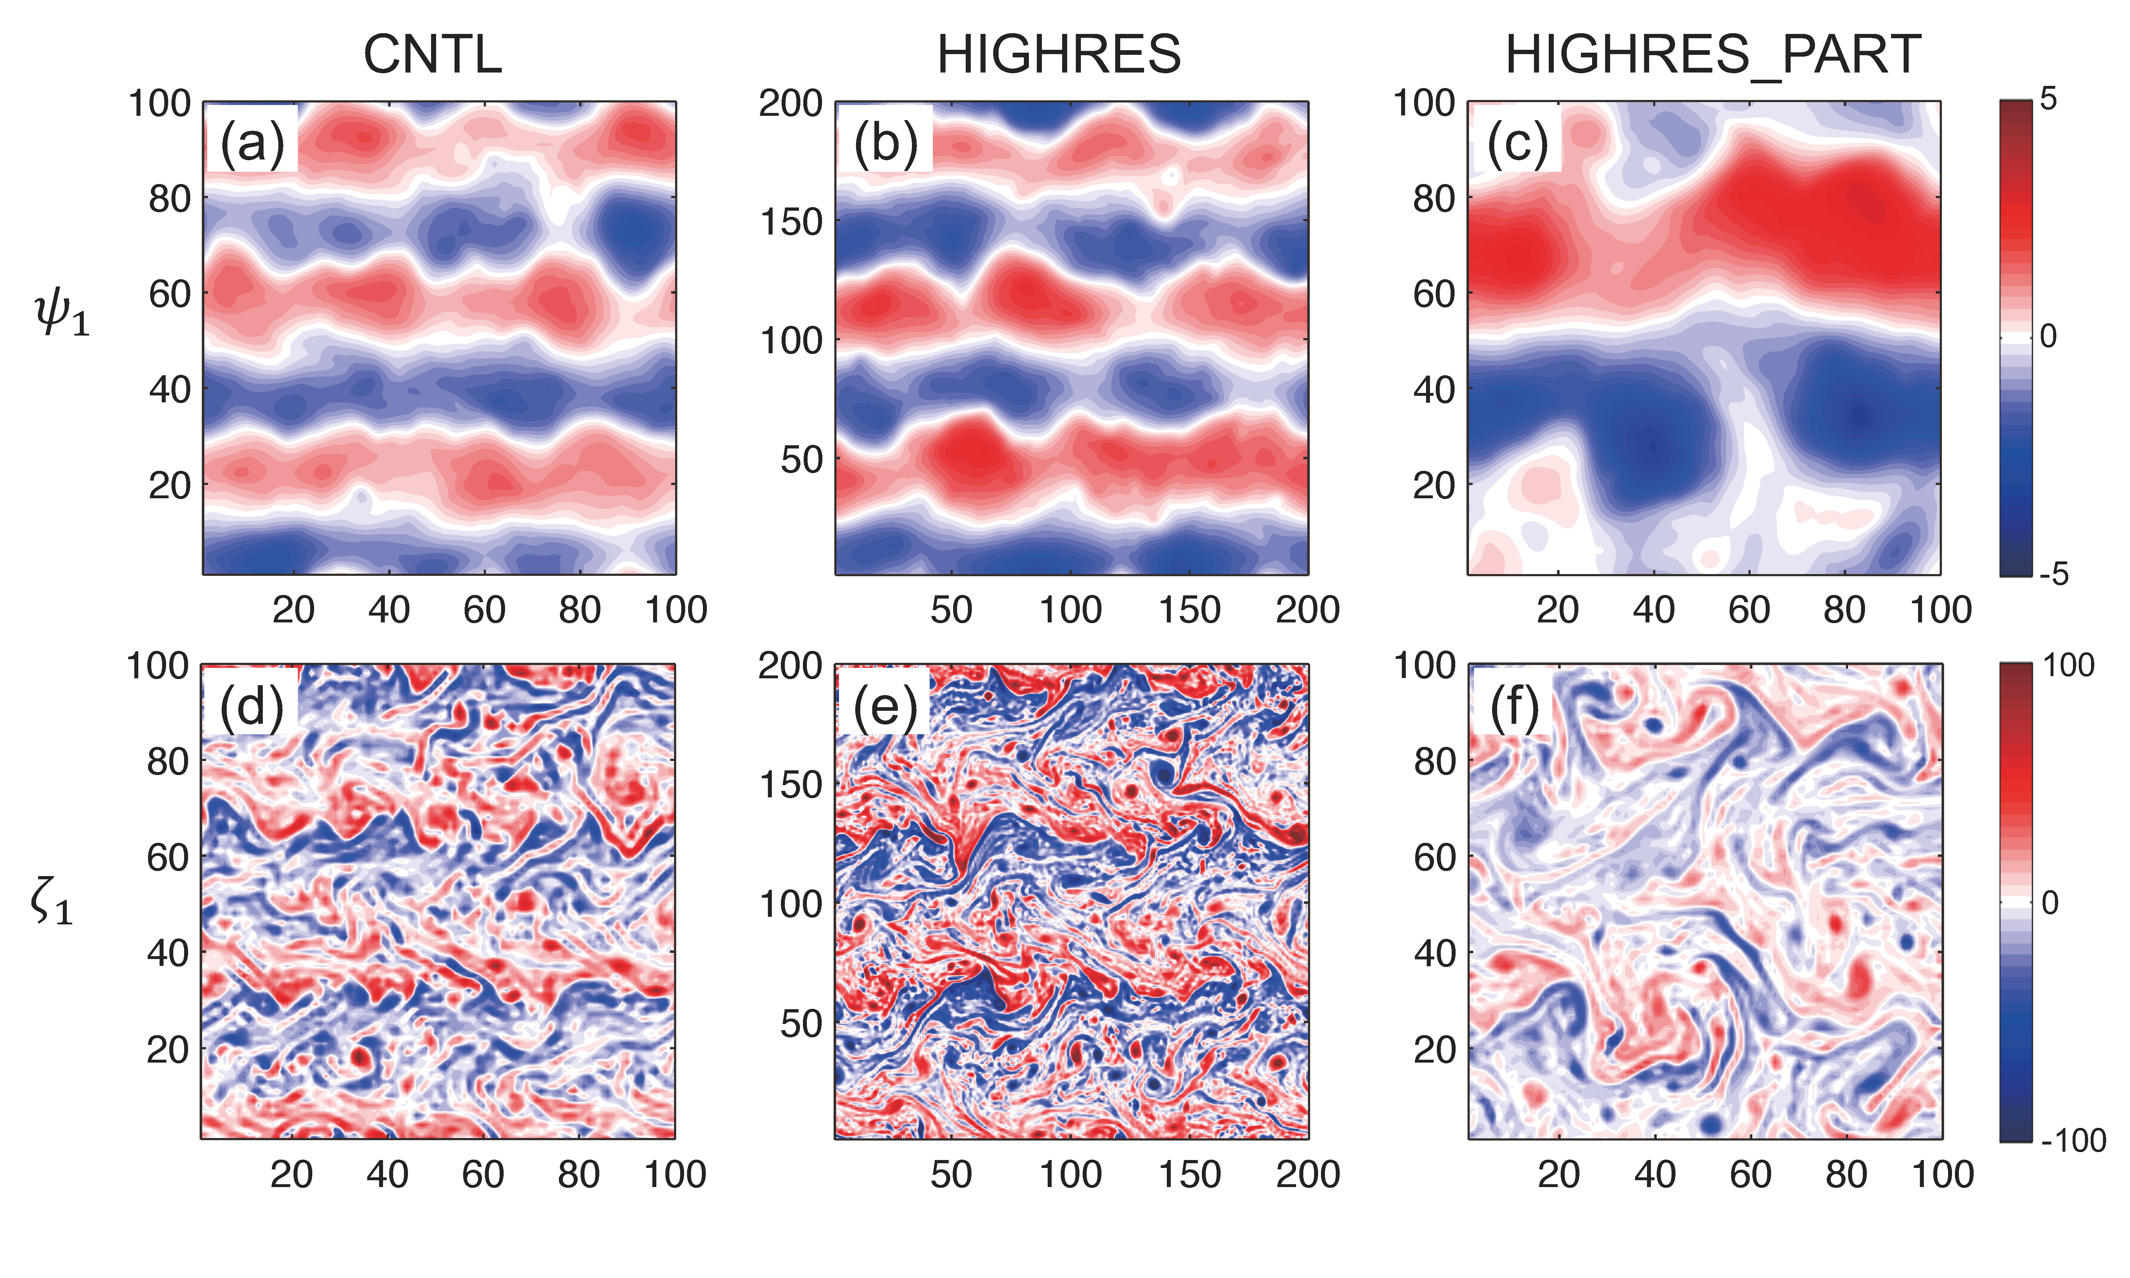
Sensitivity to model resolution
same domain size L
grid spacing dx/2
domain size L/2
grid spacing dx/2

Slide 7
Sensitivity to model resolution
reference KE spectrum
total error KE
ROI
MAC
Increasing model resolution does not change the characteristic correlation scales, therefore the best ROI remains 16.
(ROI is defined as # of dx)

Slide 8
Sensitivity to characteristic correlation scales
reference KE spectrum
MAC
Changing characteristic correlation scale by shifting spectral peak,
more energy in small scale => shorter correlation scale.
The best ROI shifts to larger value if correlation scale is larger.
This effect is more evident for smaller ensemble
total error KE
(N = 40)
total error KE
(N = 10)

Slide 9
Sensitivity to ensemble size
CNTL ($Δ$x = 2 dx)
sparse network ($Δ$x = 4 dx)
ROI
Ensemble size determines the amount of sampling error
shorter ROI should be used for smaller ensemble size (Anderson 2007 and many others)
For denser observing network (left), the small ensemble size seems to have more tolerance to sampling error.

Slide 10
Sensitivity to observing network
CNTL (N = 40)
small ensemble (N = 10)
Contradicting results:
Denser network requires shorter ROIs (Fuqing's experience, Dong et al. 2011, Kirchgessner et al. 2014, Perianez et al. 2014)
Denser network has broader optimal localization function (Anderson 2007)
Similar effect of increasing observation density (OBS_DENSE), time frequency (OBS_FREQ), or reducing observation error (OBS_ERR_HALF).

Slide 11
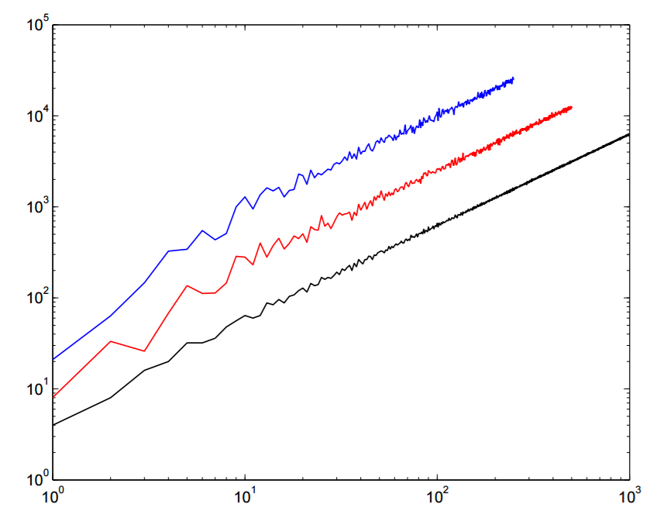
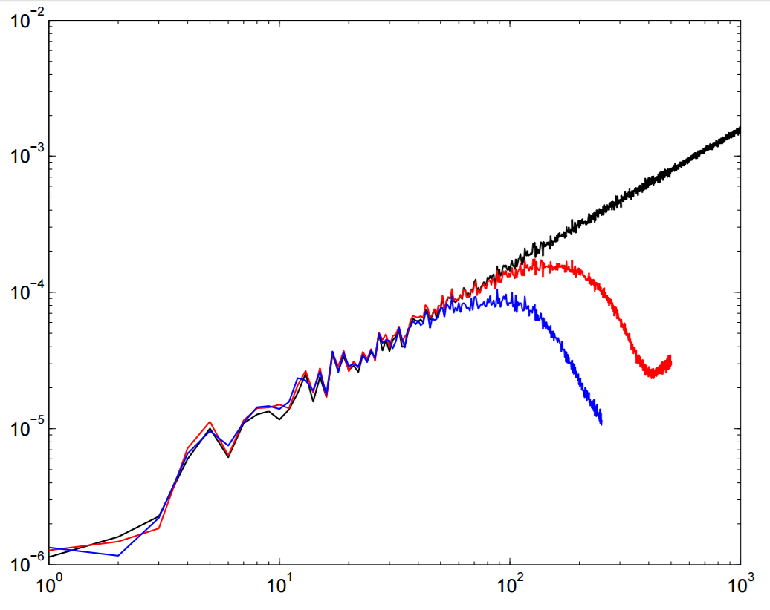
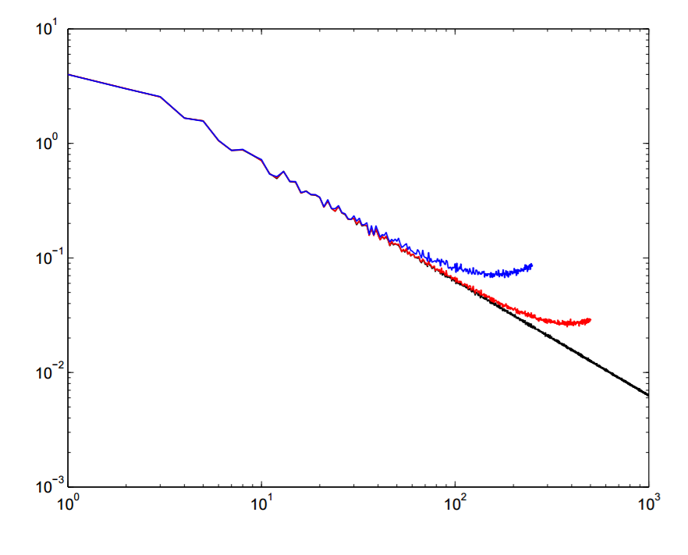
observation error spectrum: white vs. red noise
white noise (k¹)
white noise
superobs (smoothing)
$Δ$x = 1 dx
$Δ$x = 2 dx
$Δ$x = 4 dx
red noise (k⁻¹)
white noise: sparser network will have larger spectral error if the observation error at each data point is the same.
Superobs preserve error spectrum and reduces number of observations
red noise: larger scale contains more error energy (correlated error; due to variable transform, e.g. $ψ$ to u,v)

Slide 12
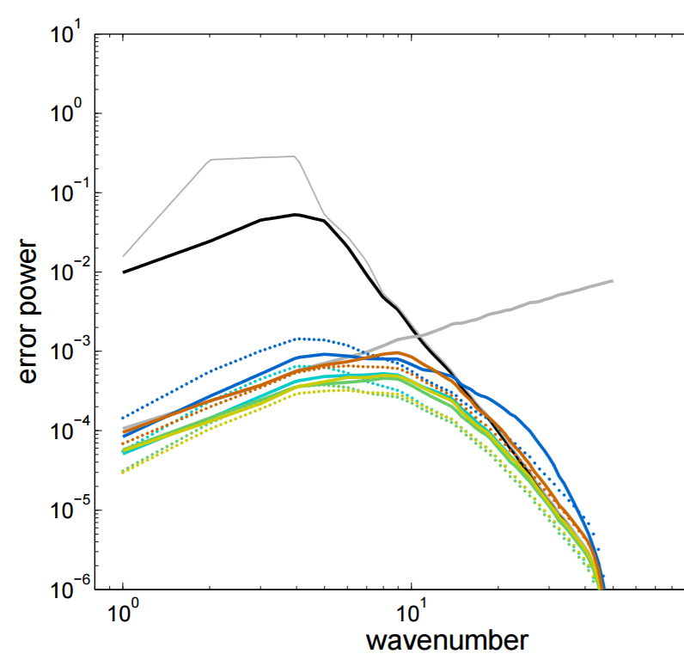
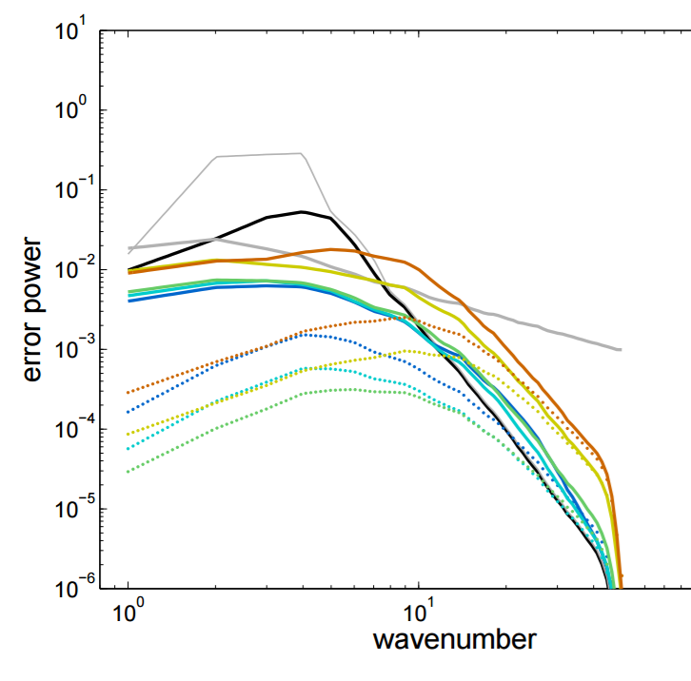
assimilating with white/red observation error
obs error is white noise
obs error is red noise
reference no DA obs error
analysis error with ROI =
4 8 16 32 64
(dotted line: prior spread)
With red noise observation error, the large-scale error remains large,
but the spread is reduced too much. (filter thinks it is still a white noise!)
a spectral adaptive inflation scheme?

Slide 13
Concluding remarks
A comprehensive sensitivity experiment is conducted in QG model to investigate how best localization radius changes with:
- ensemble size
(small N requires shorter ROI, especially for sparse network)
- observing network
(sparser network requires shorter ROI if N is small; but can use longer ROI if N is large enough?)
- characteristic correlation scale (determined by dynamics)
(an important factor, especially for small N)
When observation error is not white noise, the filter assumption is violated, scale-dependent inflation is needed (under development).

