Slide 1
Ensemble Forecast and predictability of Rapid Intensification of Super Typhoon Usagi (2013)
Simon Liu
Masashi Minamide
Dandan Tao
Advisor: Dr. Fuqing Zhang
Dr. Kun Zhao

Slide 2
Outline
Background and Motivation
Assimilate Atmospheric Motion Vector experiments
Ensemble Forecast
Role of Moisture in forecast: Switch moisture experiment
Conclusion

Slide 3
Outline
Background and Motivation
Assimilate Atmospheric Motion Vector experiments
Role of Moisture during DA: DA without updating hydrometers
Ensemble Forecast
Conclusion

Slide 4
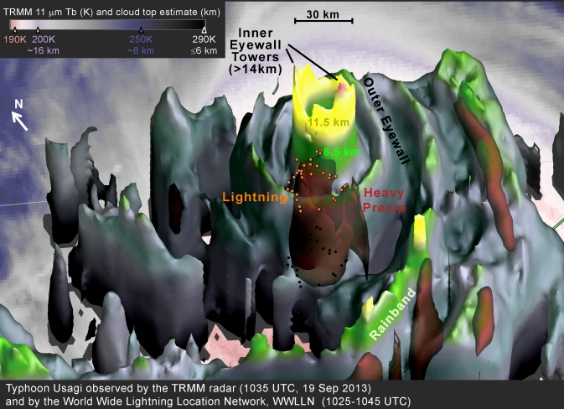
Super Rapid Intensification- NASA
Super Typhoon Usagi (2013) is one of the most powerful typhoon at 2013 at West Pacific Basin
Usagi intensified by 65 knots (33 m/s) at 24 hours, double of standard of rapid intensification (30 knots).

Slide 5
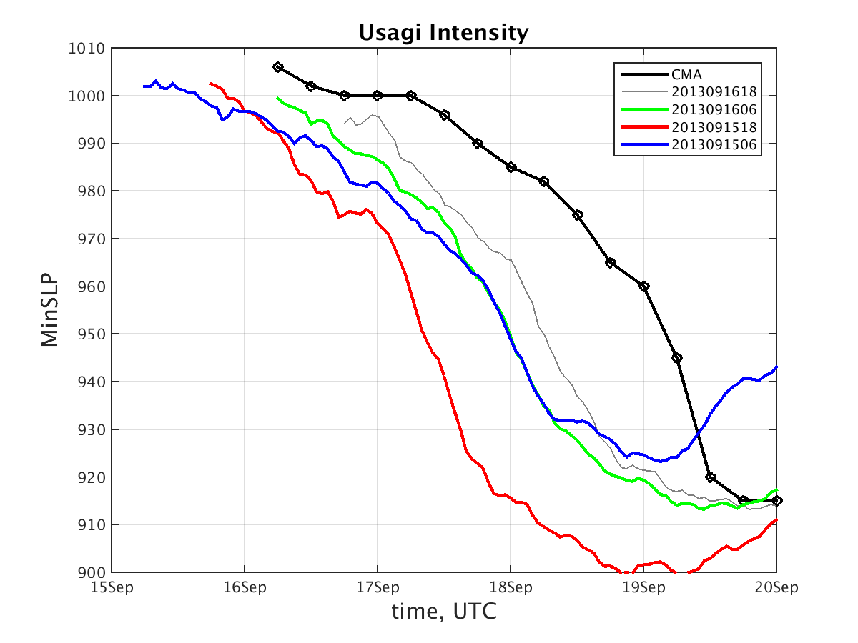
24 hours
Super rapid intensification storm can be predicted 1 days ahead!
RI timing is wrong!
Questions:
Can data assimilate help improve intensity forecast?
What factors cause forecast intensity divergence?

Slide 6
Outline
Background and Motivation
Assimilate Atmospheric Motion Vector experiments
Role of Moisture during DA: DA without updating hydrometers
Ensemble Forecast
Conclusion

Slide 7
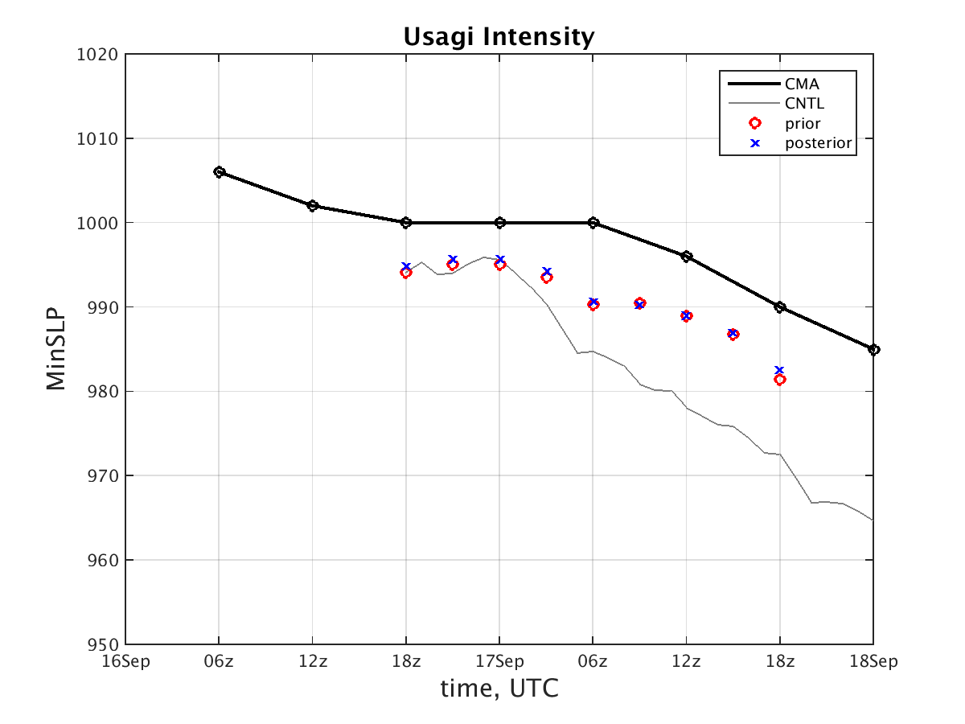
initial
DA every 3 hours
DA configuration
DA: HPI (Best Track SLP)+GTS data every 3 hours
D01: 379*244, 27 km
D02: 298*298, 9 km
D03: 298*298, 9 km
WSM6 physics
YSU PBL
Modified Tiedtke cumulus scheme
Flux from ocean=1

Slide 8
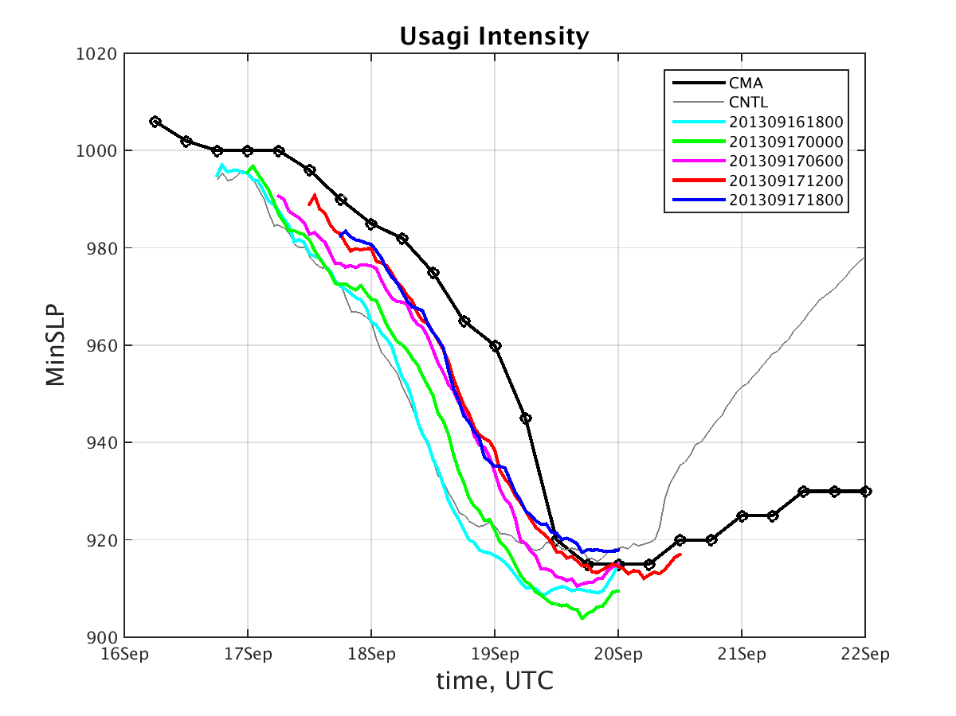
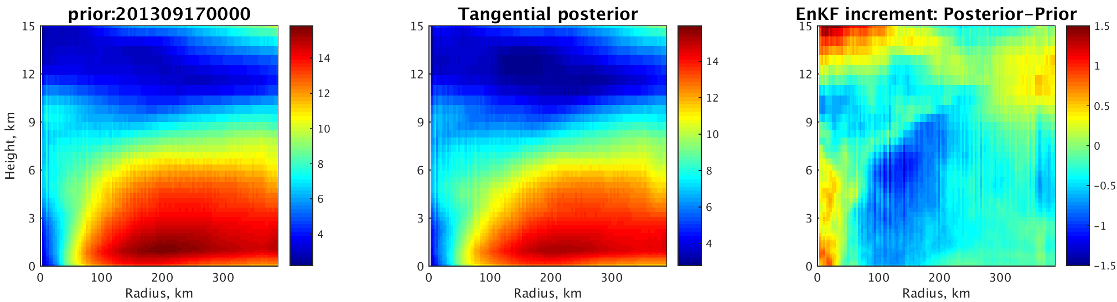
Intensity Forecast
Intensity forecast improve significantly after more DA cycles
Forecast tracks are getting better
Vortex strength (represent by tangential wind) is weaken by 1 m/s during most of EnKF cycles
Prior
Posterior
Increment

Slide 9
Outline
Background and Motivation
Assimilate Atmospheric Motion Vector experiments
Ensemble Forecast
Role of Moisture in forecast: Switch moisture experiment
Conclusion

Slide 10
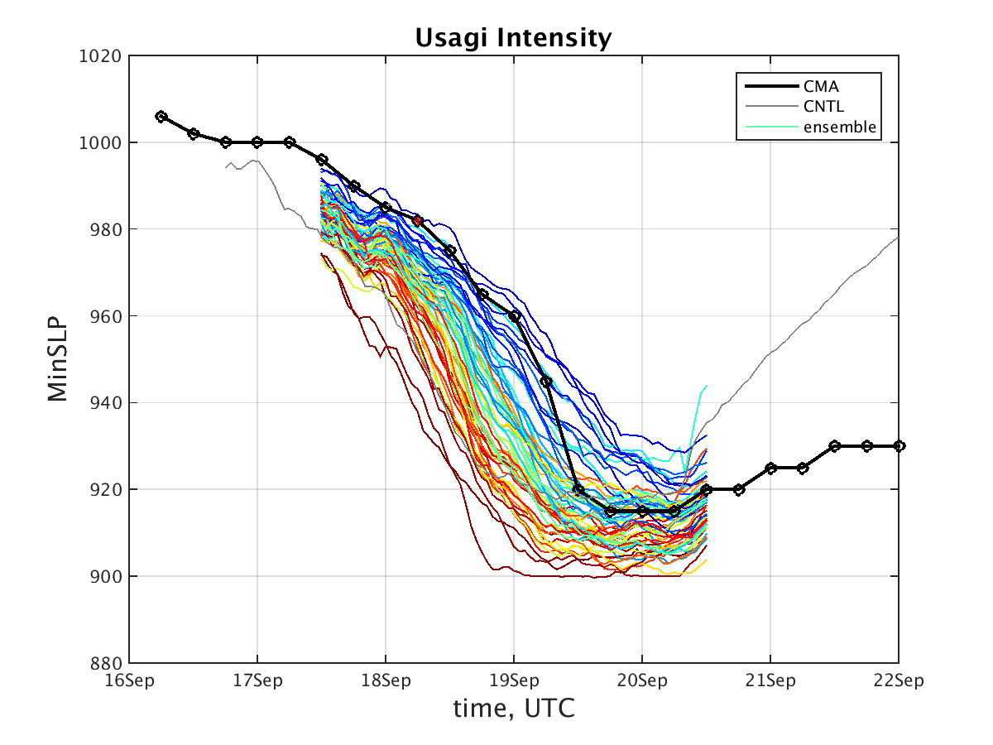
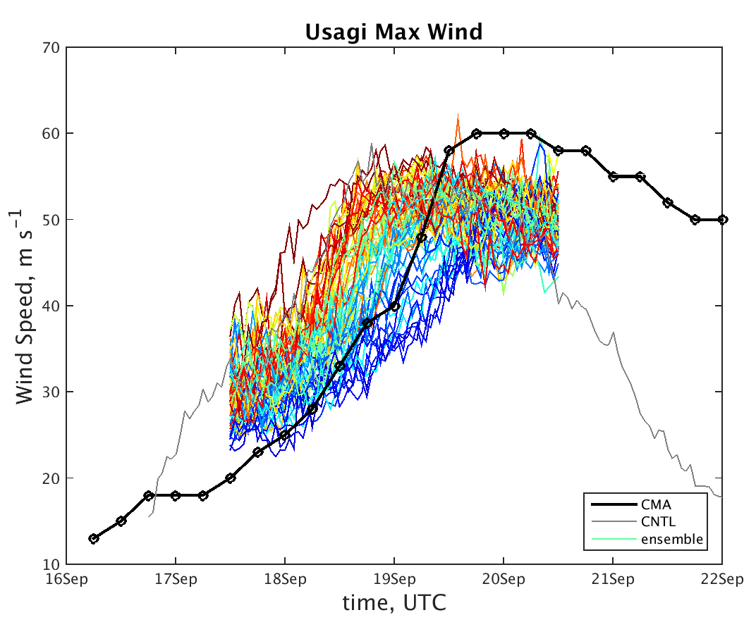
Ensemble Forecast
Questions: What factors cause the RI timing variation/ intensity divergence?
Notes:
Color based on RI onset time (the earlier, the warmer)

Slide 11


What factors cause the RI timing variation/ intensity divergence?
Environmental factors:
Deep layer shear?
Environment shear?
Dry air intrusion?
SST?
Internal factors:
Tilt between low-level and middle-level vortex center?
Initial vortex strength?
Inner core moistures?
$×$
$×$
$×$
$×$
$×$

Slide 12
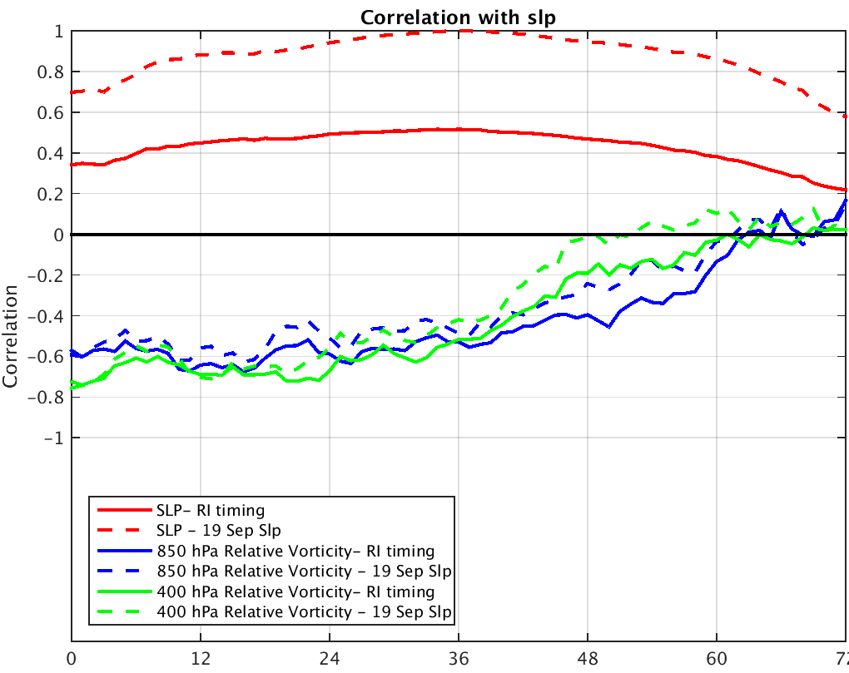
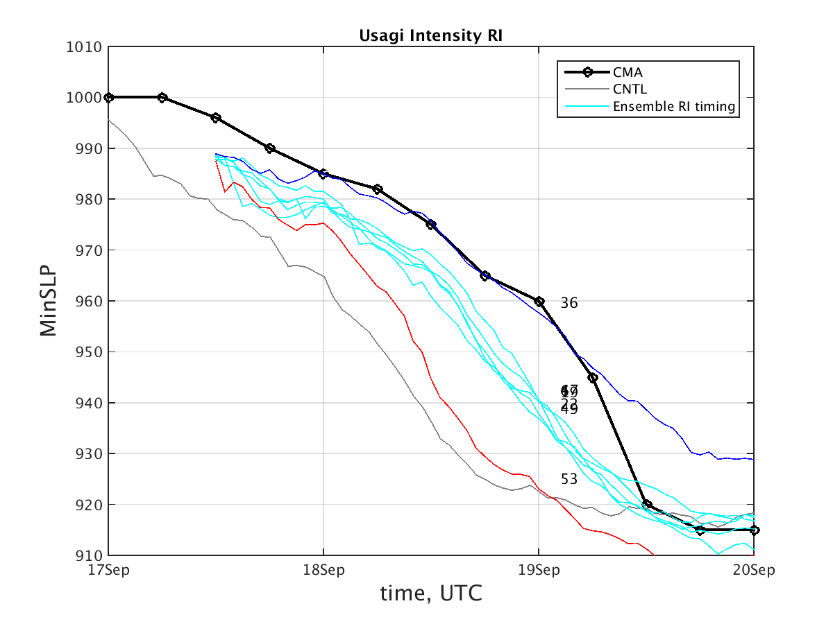
Weak Member
All members intensify before 36 h
Strong Member
Correlated <vortex vorticity, RI timing>= 0.7, explaining 50% variation
However, for similar initial vortex strength, intensity could have huge variation as well.
Questions: What other factors caused these members to diverge in intensity?

Slide 13
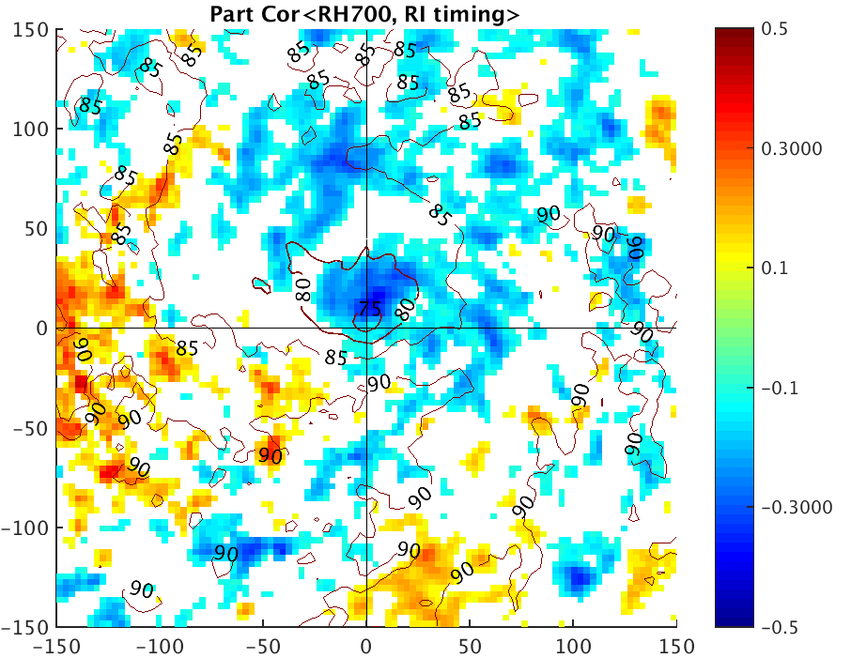
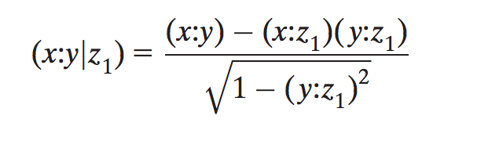
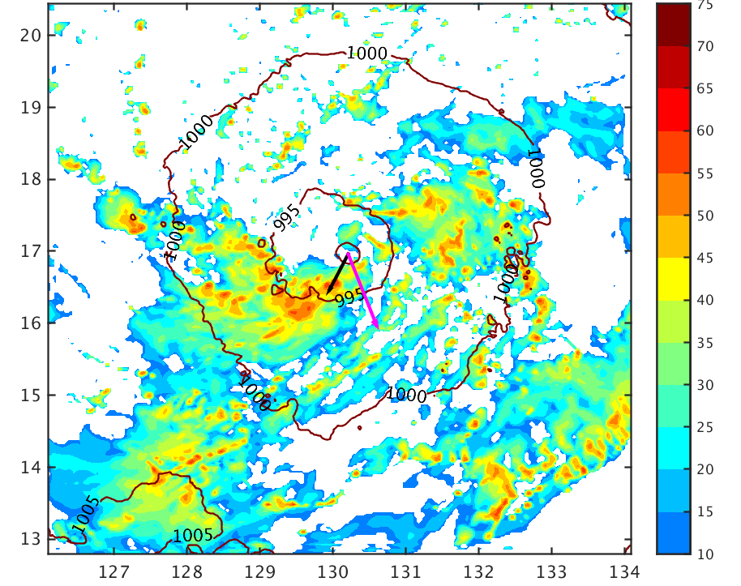
Partial Correlation
X: RI timing
Y: RH
Z1: current minSLP
shear
Median Partial correlation between RH and RI timing, consider current intensity as constant

Slide 14
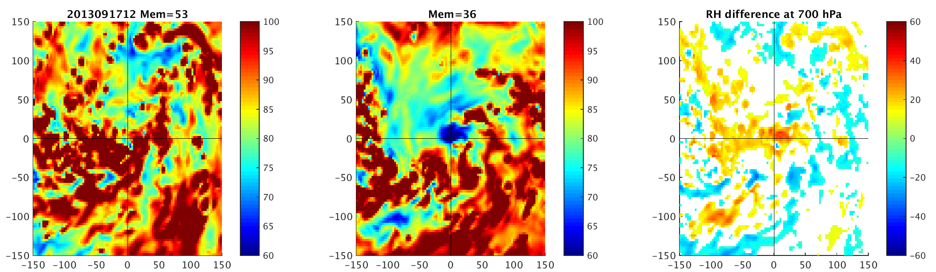
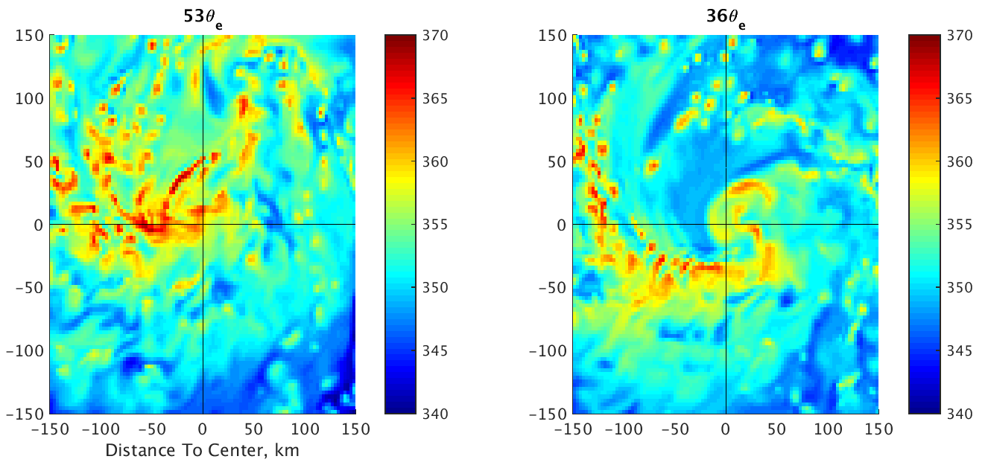
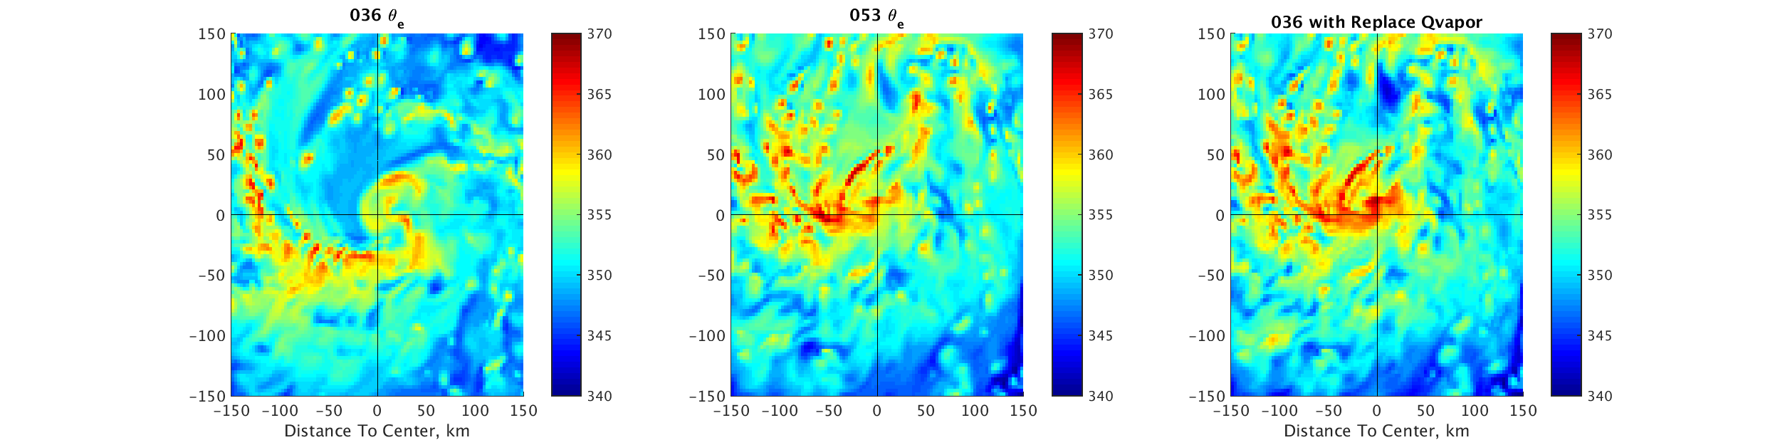
Strong Member
Weak Member
Difference
Moisture
Weak Member with strong member moisture
Strong Member
Weak Member
Equivalent Potential Temperature

Slide 15
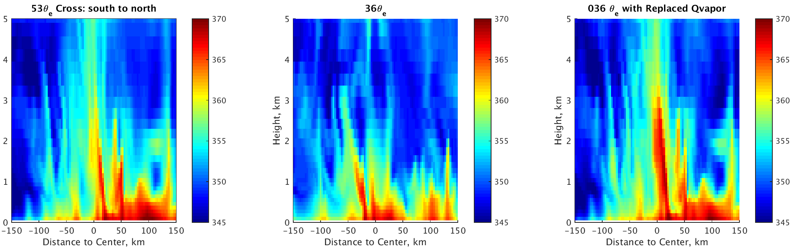
Equivalent Potential Temperature
Cross Section from south to north
Atmospheric instability come from moisture difference
Strong Member
Weak Member
Weak Member with strong member moisture

Slide 16
Outline
Background and Motivation
Assimilate Atmospheric Motion Vector experiments
Ensemble Forecast
Role of Moisture in forecast: Switch moisture experiment
Conclusion

Slide 17
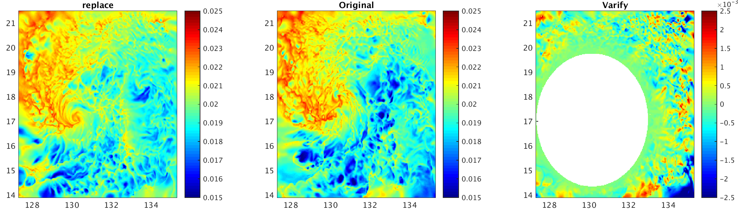
Additional Experiment 2- Switch Moisture
Hypnosis: Initial inner core moisture field could impact the RI process
Keep inner core (300 km), replace environment (>600 km), relaxing linearly in between. Replace all Qvapor fields in D01,D02,D03
Strong Member
Weak Member
Weak Member with strong member moisture

Slide 18
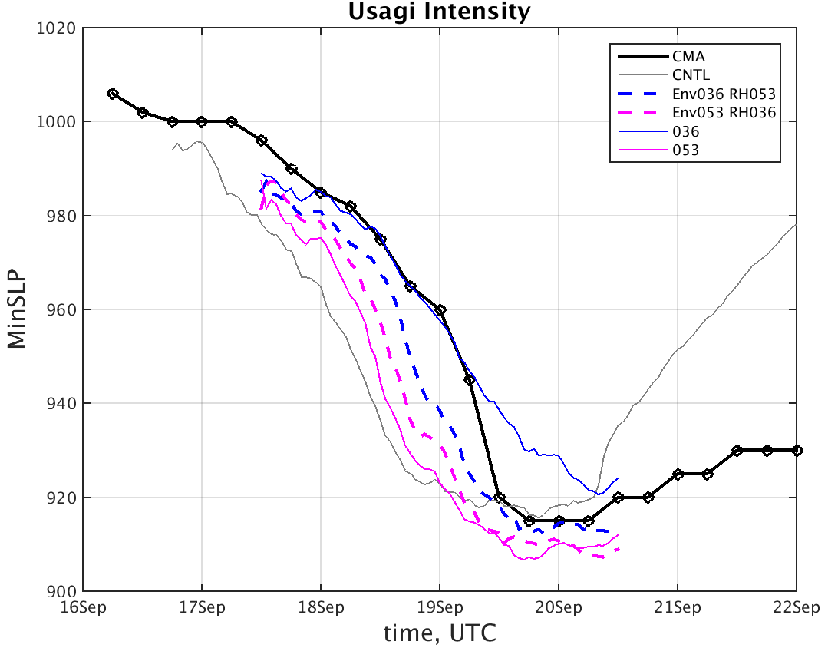
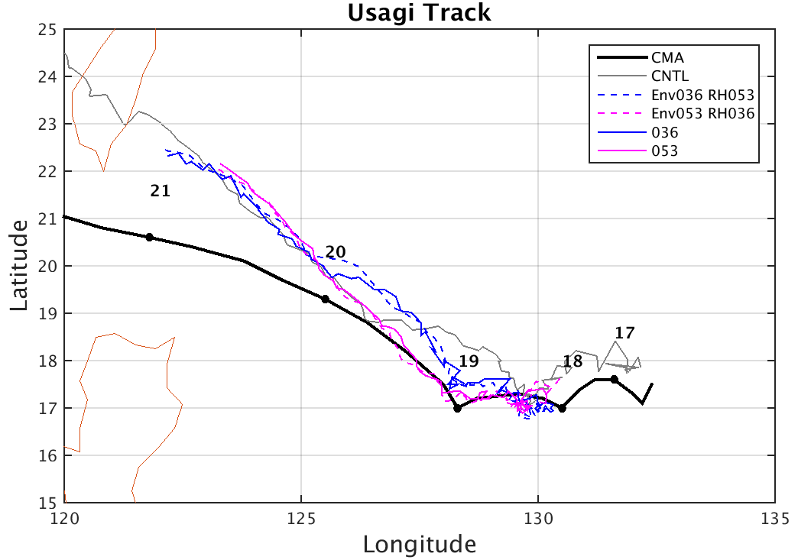
Replace RH do impact storm intensity to expected direction
Hypnosis confirmed !

Slide 19
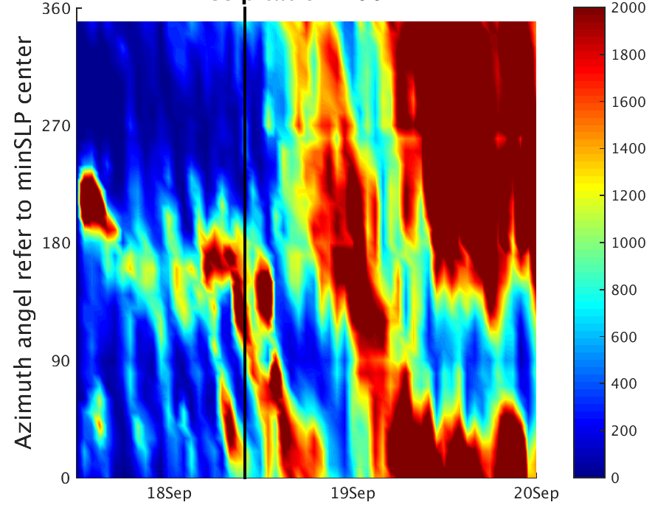
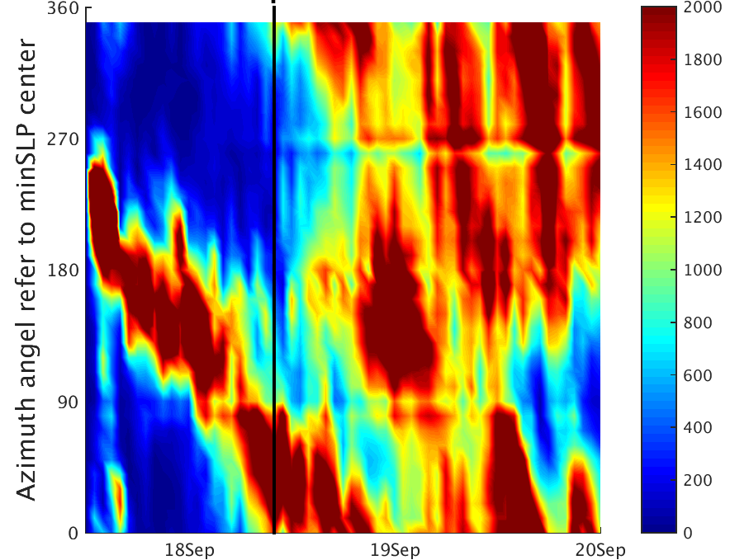





Precipitation
360$°$
0$°$
270$°$
90$°$
Weak Member
180$°$
shear
Weak Member with strong member moisture

Slide 20
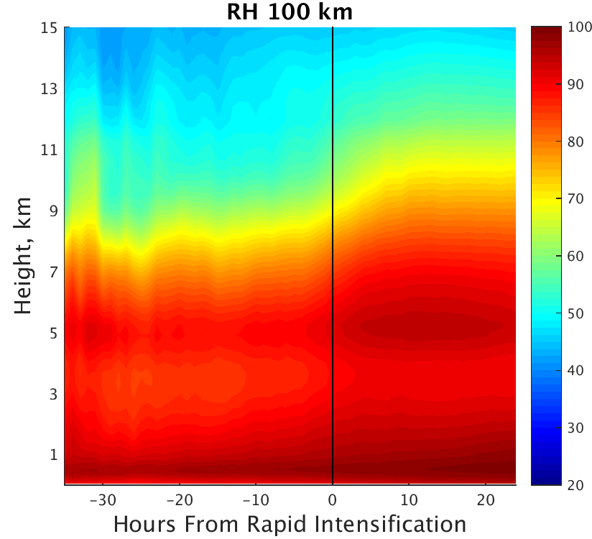
RH change regarding to RI time
Ensemble
Mean RH
Idea 100 km, no flow
Surface centered
RH is perfected moisten up to 7 km at RI onset

Slide 21
Conclusion
Forecasts of super rapid intensification of TC Usagi surprisingly over-strong predict of RI process. Data Assimilation of GTS data help weaken the initial vortex, then significantly improve the storm intensity / RI timing forecast.
Ensemble Forecast from EnKF members predicted huge RI timing variation (35 hours) with large storm intensify spread (60 hPa).
Correlation between initial vortex vorticity with RI timing/minSLP at 19 Sep is 0.7. Initial vortex strength explain 50 % intensity variation.
Besides initial vortex strength, sensitivity experiments demonstrate inner core moisture have significant impact on RI timing as well.
Moisture control instability of air. Strong member has large moisture/instability around vortex center, especially at north part. Moisture help initial convection and storm more easily become axisymmetric, facilitating RI process
Inner core is perfectly moisten from surface to 7 km at RI onset, consistent with idea study by Dandan.

Slide 22
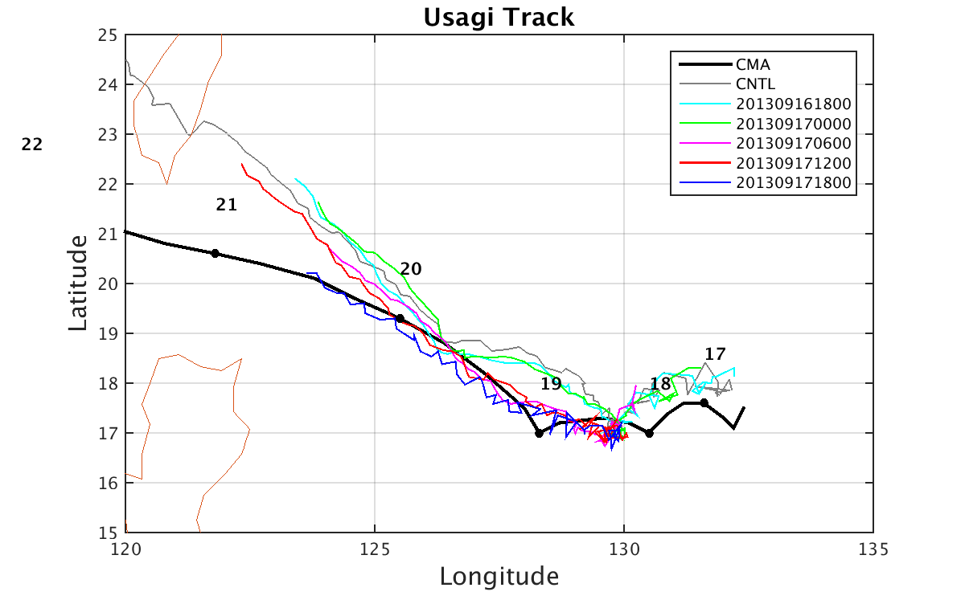
Intensity Forecast
Intensity forecast error decrease after more DA cycles
Forecast tracks are getting better
Maybe because we introduce GFS information every 6 hours

Slide 23
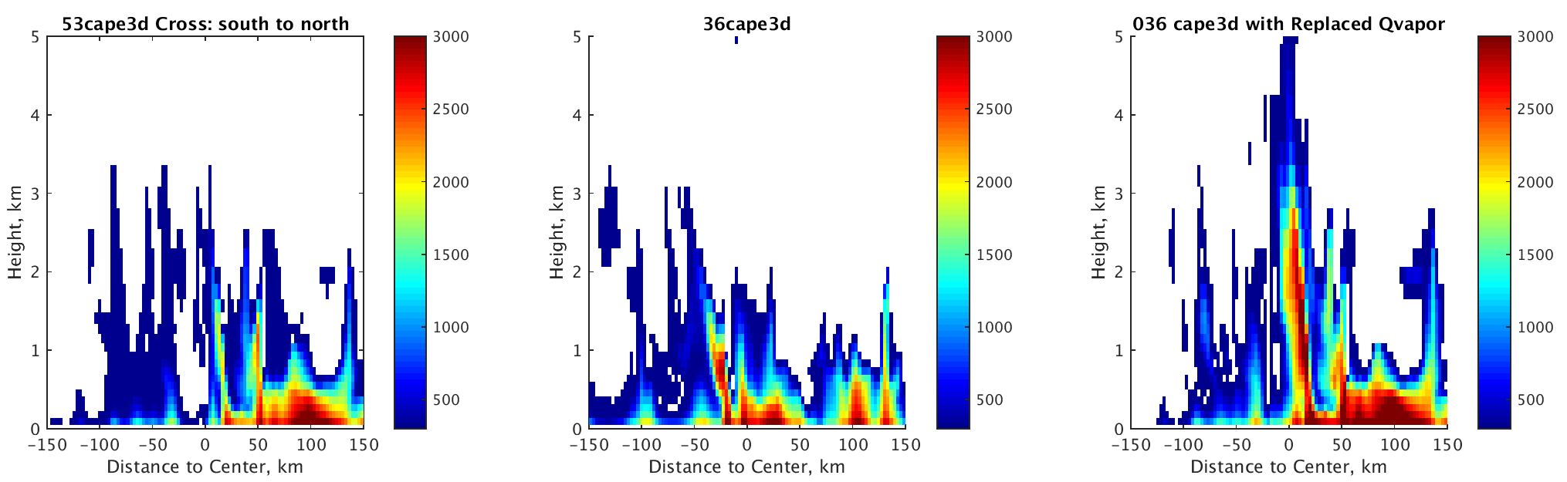
Equivalent Potential Temperature
Strong Member
Weak Member
Weak Member with strong member moisture

Slide 24
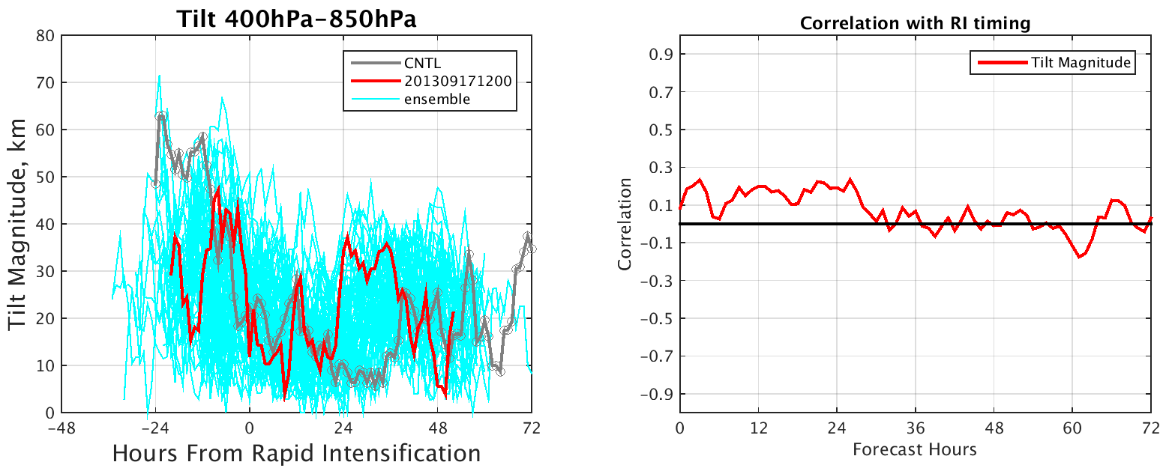
Tilt of all members reduce to less than 40 km at RI onset. The correlation, around 0.2 before 36h, is significant but smaller than Munsell et al. 2016 paper

Slide 25
