Slide 1
A symmetric parametric tropical cyclone precipitation (R-CLIPER) model in WP
Construction of TC precipitation radial profiles
Derived from TRMM in WP
Yanting Ye
08-19-2016

Slide 2
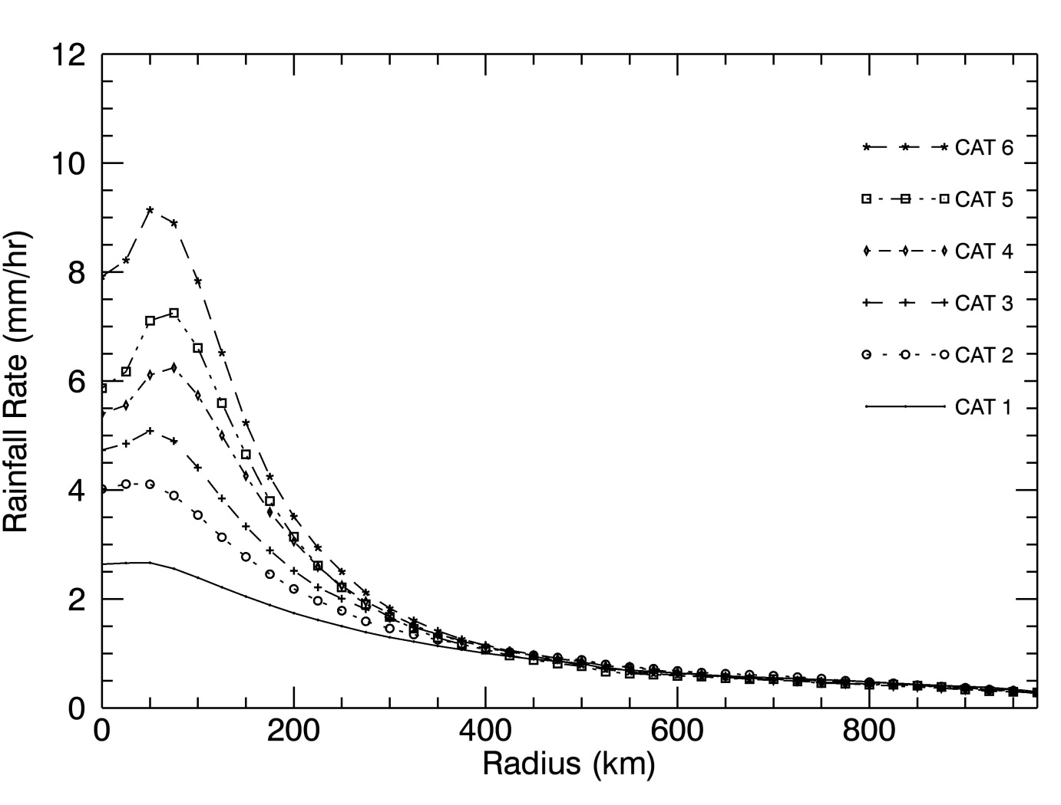
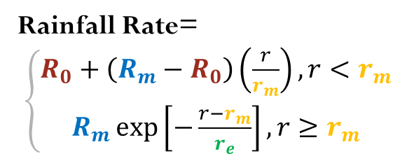
R-CLIPER
Tropical cyclone Rainfall Climatology and Persistence model
R0
= a1 + b1*MWS
= a2 + b2*MWS
= a3 + b3*MWS
= a4 + b4*MWS
Rm
rm
re
Rainfall Rate=
$\left\{\begin{aligned}R_{0}+\left(R_{m}−R_{0}\right)\left(\frac{r}{r_{m}}\right),r<r_{m} \\ R_{m}\exp\left[−\frac{r−r_{m}}{r_{e}}\right],r≥r_{m}\end{aligned}\right.$
Reference: Frank D. Marks, Jr. 2003. Development of a Tropical Cyclone Rainfall Climatology and Persistence Model

Slide 3

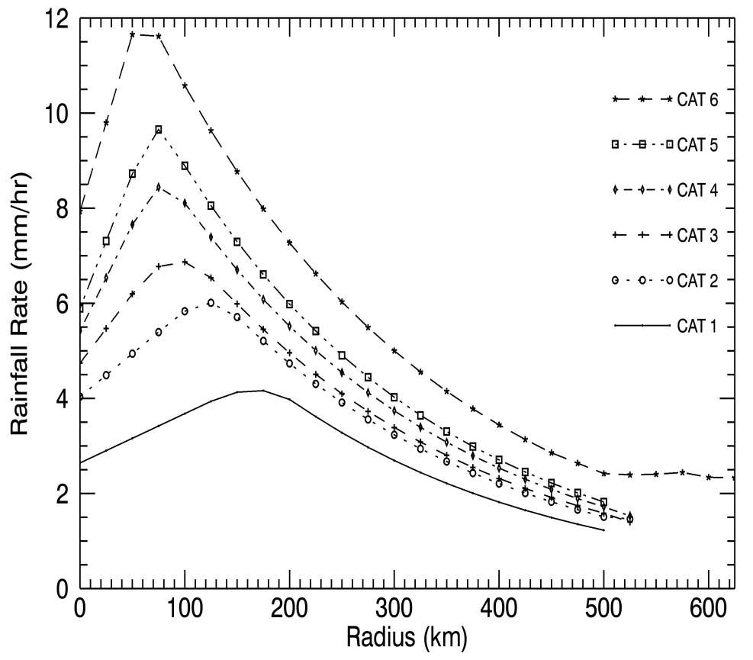
R-CLIPER
Tropical cyclone Rainfall Climatology and Persistence model
TRMM
Constructed
R0
R0 = a1 + b1*MWS

Slide 4
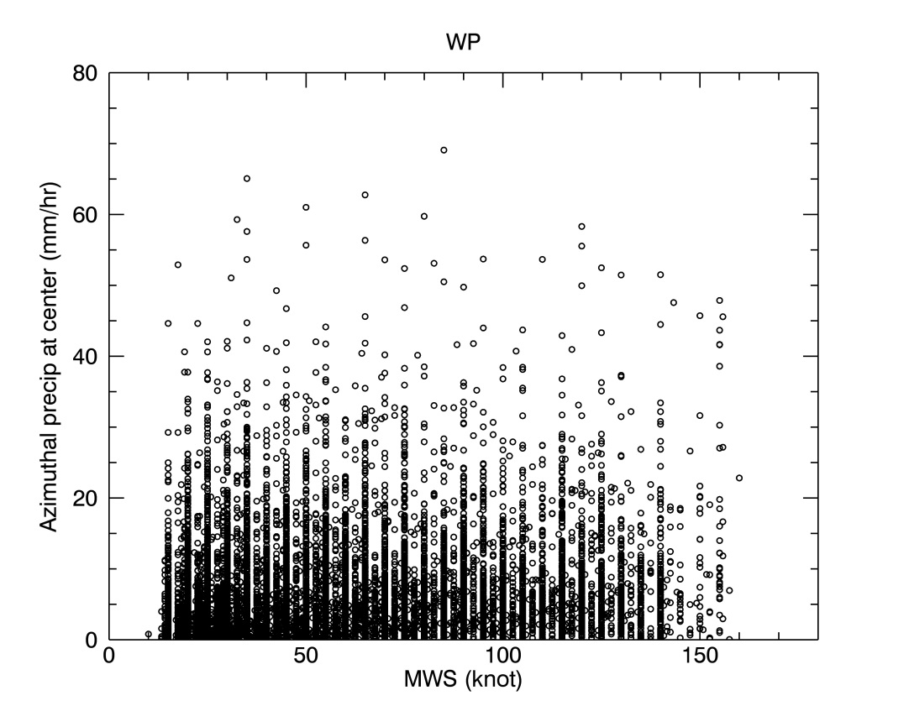
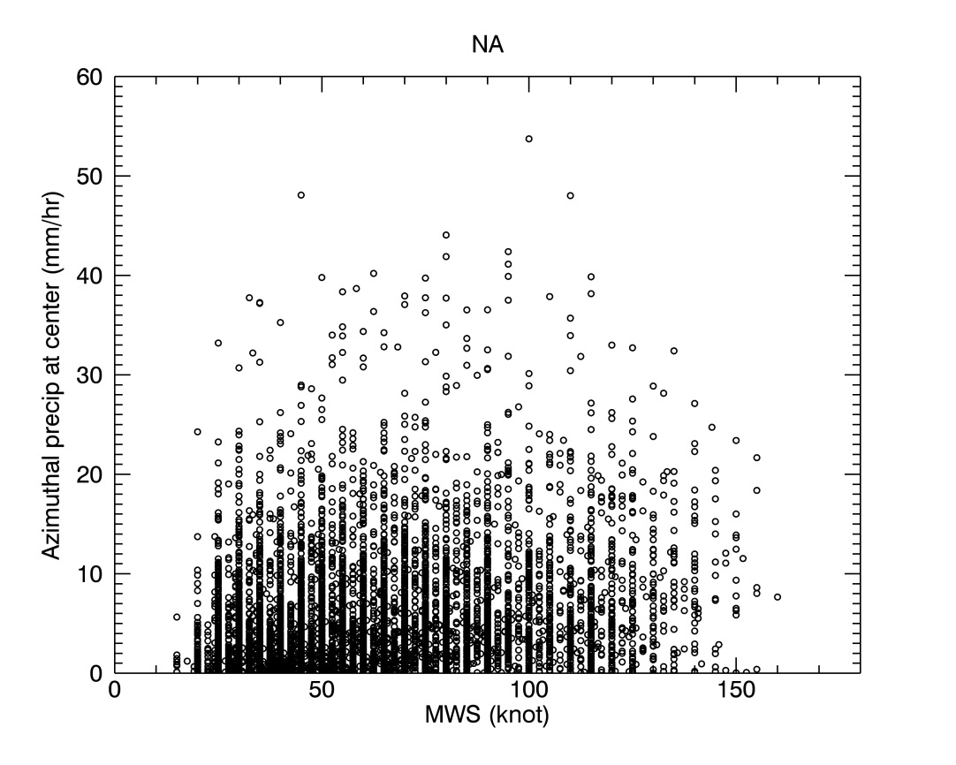
R-CLIPER
Tropical cyclone Rainfall Climatology and Persistence model
R0 = a1 + b1*MWS

Slide 5
R-CLIPER
Tropical cyclone Rainfall Climatology and Persistence model
TRMM
Constructed
Rm
Rm = a2 + b2*MWS

Slide 6
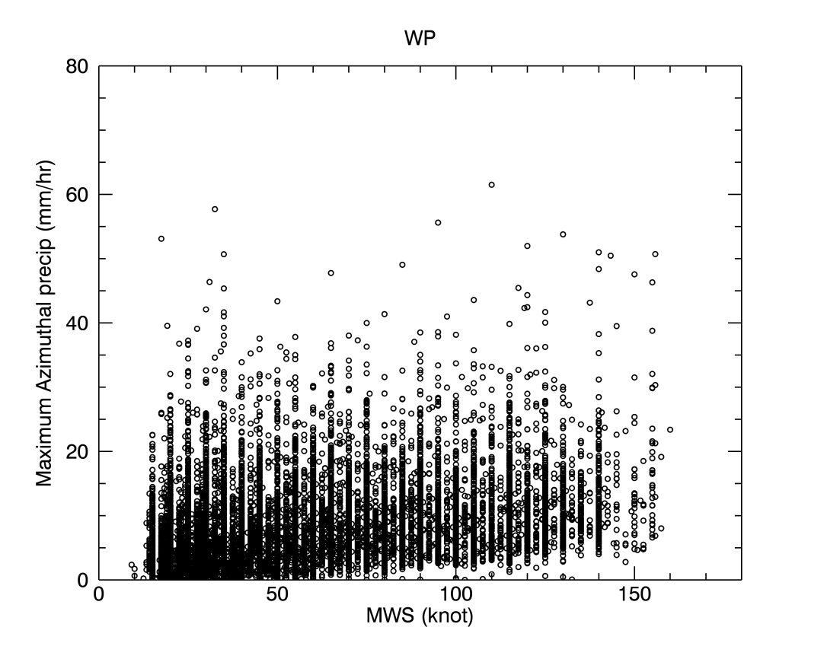
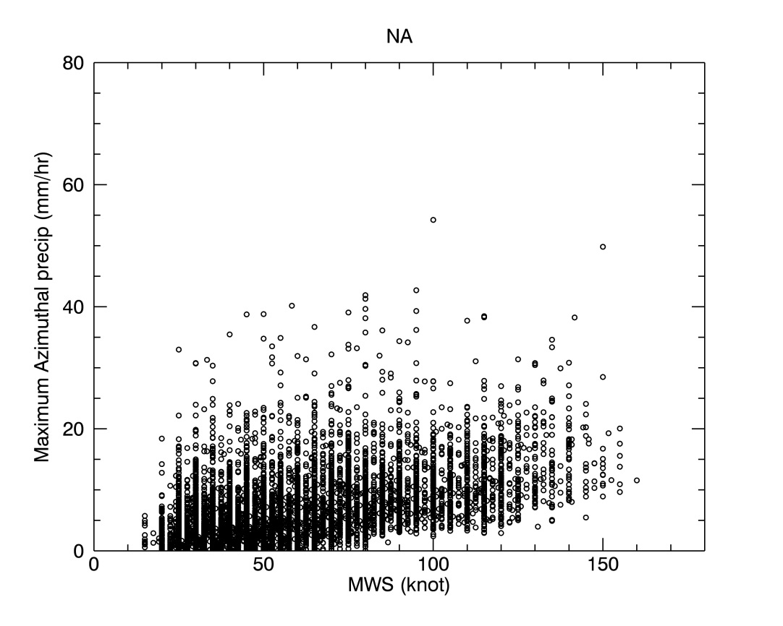
R-CLIPER
Tropical cyclone Rainfall Climatology and Persistence model
Rm = a2 + b2*MWS

Slide 7
R-CLIPER
Tropical cyclone Rainfall Climatology and Persistence model
TRMM
Constructed
rm
rm = a3 + b3*MWS

Slide 8
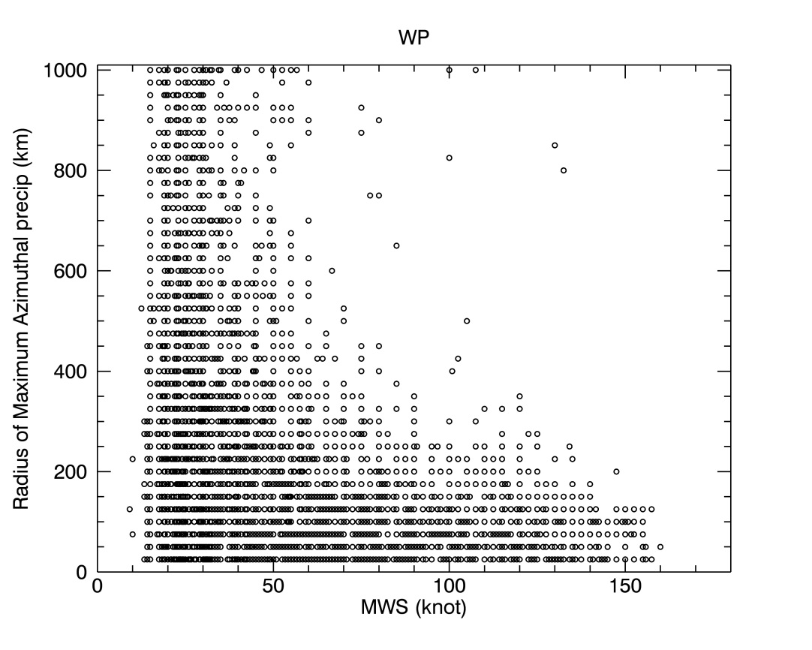
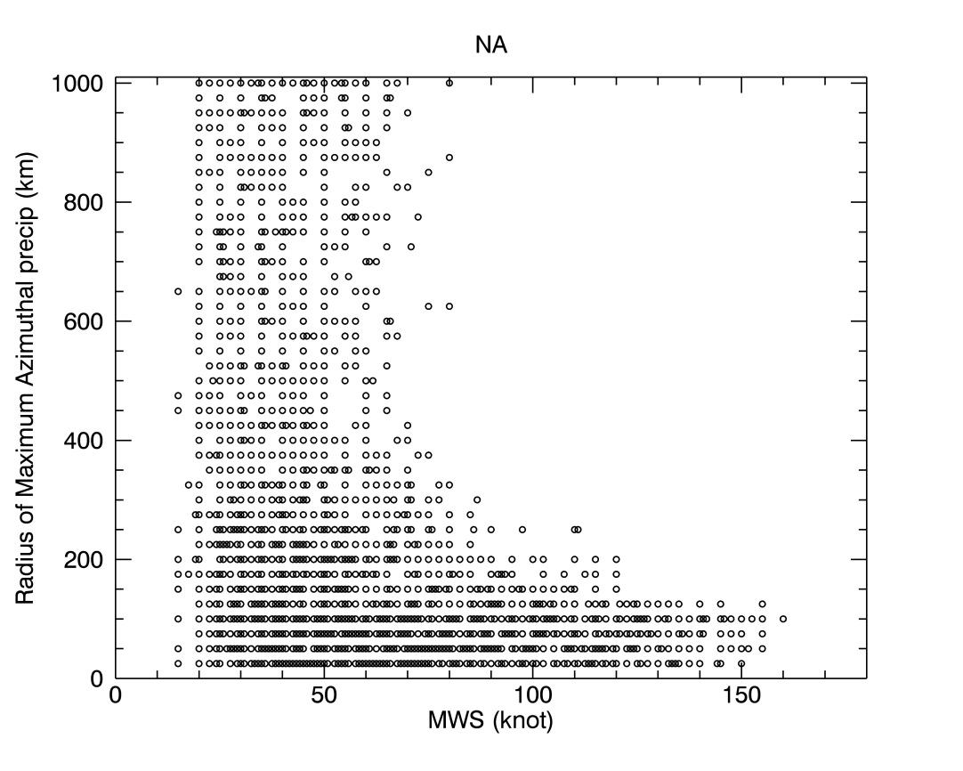
R-CLIPER
Tropical cyclone Rainfall Climatology and Persistence model
rm = a3 + b3*MWS

Slide 9

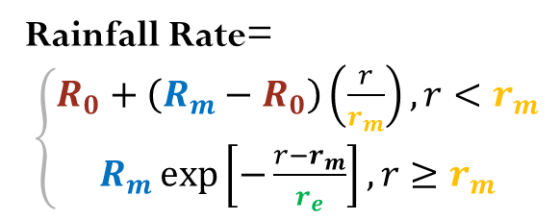
R-CLIPER
Tropical cyclone Rainfall Climatology and Persistence model
TRMM
Constructed
Rm
R0
Rainfall Rate=
$\left\{\begin{aligned}R_{0}+\left(R_{m}−R_{0}\right)\left(\frac{r}{r_{m}}\right),r<r_{m} \\ R_{m}\exp\left[−\frac{r−r_{m}}{r_{e}}\right],r≥r_{m}\end{aligned}\right.$

Slide 10

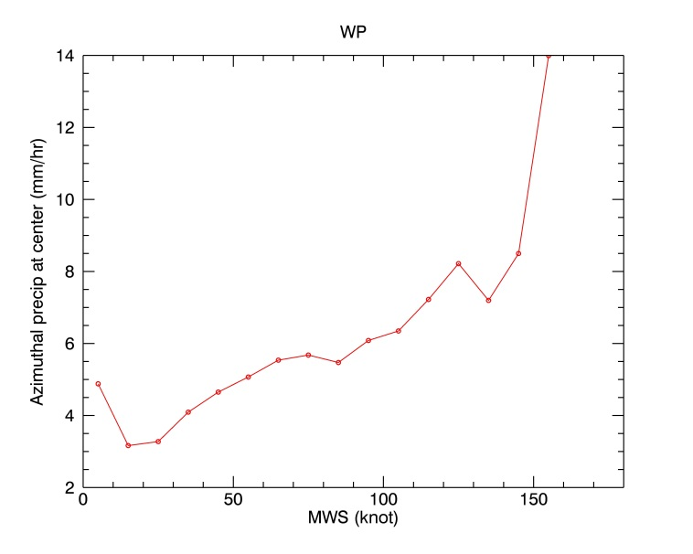

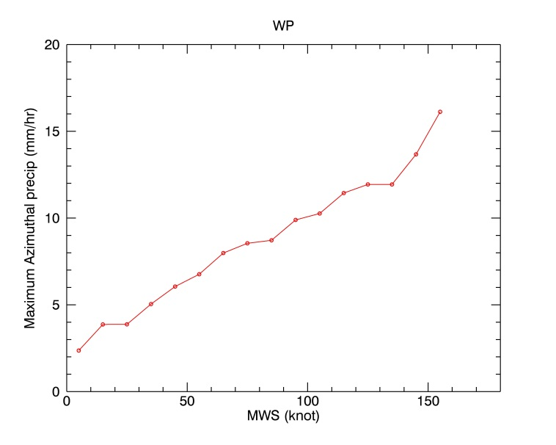
R-CLIPER
Tropical cyclone Rainfall Climatology and Persistence model
Make an average of R0 and Rm in each 10-knot bin
R0
Rm

Slide 11


R-CLIPER
Tropical cyclone Rainfall Climatology and Persistence model
Make an probablistic estimation of Rm in each bin
5%
10%
20%
25%
30%

