Slide 1

Assimilation of all-sky brightness temperatures from Himawari-8 for the genesis and developing stage of tropical cyclones
Masashi Minamide, Fuqing Zhang and Eugene Clothiaux
Himawari-8 image of Typhoon Soudelor (2015) from CIMSS Satellite blog
Notes:
Direct Assimilation of all-sky infrared radiance satellite observation for the analysis and forecast of tropical cyclones

Slide 2
New Geostationary Satellite, Himawari-8 AHI!
http://www.mlit.go.jp/koku/15_hf_000105.html
Dates:
Launched Oct 2014
In Operation from JUL 2015
Coverage: Hemispheric
Frequency: 10 minutes
Resolution: 2 km
Notes:
Here, I wrap up of the satellite we are using.
We have started to use the real-observation data from new generation satellite, Himawari-8.
This Himawari-8 was launched on October of 2014, and began to be in operation from July 2015 last year. It has a hemispheric coverage as shown in the figure., mostly focusing on west Pacific region.
It has really high temporal and spatial frequency as 10 minutes and 2 km, and of course, have multiple water vapor channels.

Slide 3
Super-typhoon Soudelor (2015)
Strongest typhoon in 2015
Experienced rapid intensification (RI) & eyewall replacement cycle (ERC)
http://tparc.mri-jma.go.jp/cyclone/index.php
RI
Genesis and developing stage
ERC
http://agora.ex.nii.ac.jp/digital-typhoon/summary/wnp/s/201513.html.en
Notes:
The case we are working on is super-typhoon soudelor (2015).
Soudelor is the strongest tropical cyclone in 2015 in west north pacific region. It formed in the central pacific ocean, surrounded by pretty favorable conditions for tropical cyclones.
After the genesis and developing stage from 30th Jul to 1st August, it experienced rapid intensification and reached at the strongest intensity as 900 mb of minimum SLP.
Afterward, it also experienced eyewall replacement cycle. Finally, it landed on both Taiwan and China, causing severe damage on both conuntries.
So, in many sense, Soudelor is quite interesting case.
Firstly, we will assimilate the satellite-observed brightness temperatures in genesis and developing stage to check how much we can improve the forecasts of RI processes and ERCs.

Slide 4
Experimental settings
DA cycle: Genesis stage, 12Z/28 JUL – 00Z/01 AUG 2015
Model: WRF ver.3.6.1(Skamarock 2008), CRTM (Han et al. 2006)
PSU WRF-EnKF (Weng and Zhang, 2016)
Ensemble-based data assimilation system
  Ensemble size: 60
Regional convective-permitting model
  Resolution: 27, 9 & 3 km (D1-D3)
  Observation error modeling
  Adaptive Observation Error Inflation (AOEI)
Infrared BT (ch8; 6.19 μm)
minSLP from best-track data
BT+HPI
Every 1 hour
00Z/01 AUG
12Z/28 Jul
Notes:
This is the experimental settings. We set the data assimilation period from 12z 28th July to 00z 1st August. With models….
For the assimilation strategy, we prepared 2 types of observations. One is infrared brightness temperatures from Himawari-8 channel 8, and the other one is minimum SLP from ADT best-track data.
To save the computational resources, we only assimilated 1 of the 3 water vapor channels, and assimialted every 1-hour.

Slide 5
Experimental settings
DA cycle: Genesis stage, 12Z/28 JUL – 00Z/01 AUG 2015
Model: WRF ver.3.6.1(Skamarock 2008), CRTM (Han et al. 2006)
PSU WRF-EnKF (Weng and Zhang, 2016)
Notes:
This is the model domain with moving nested domains of domain 2 & 3.

Slide 6
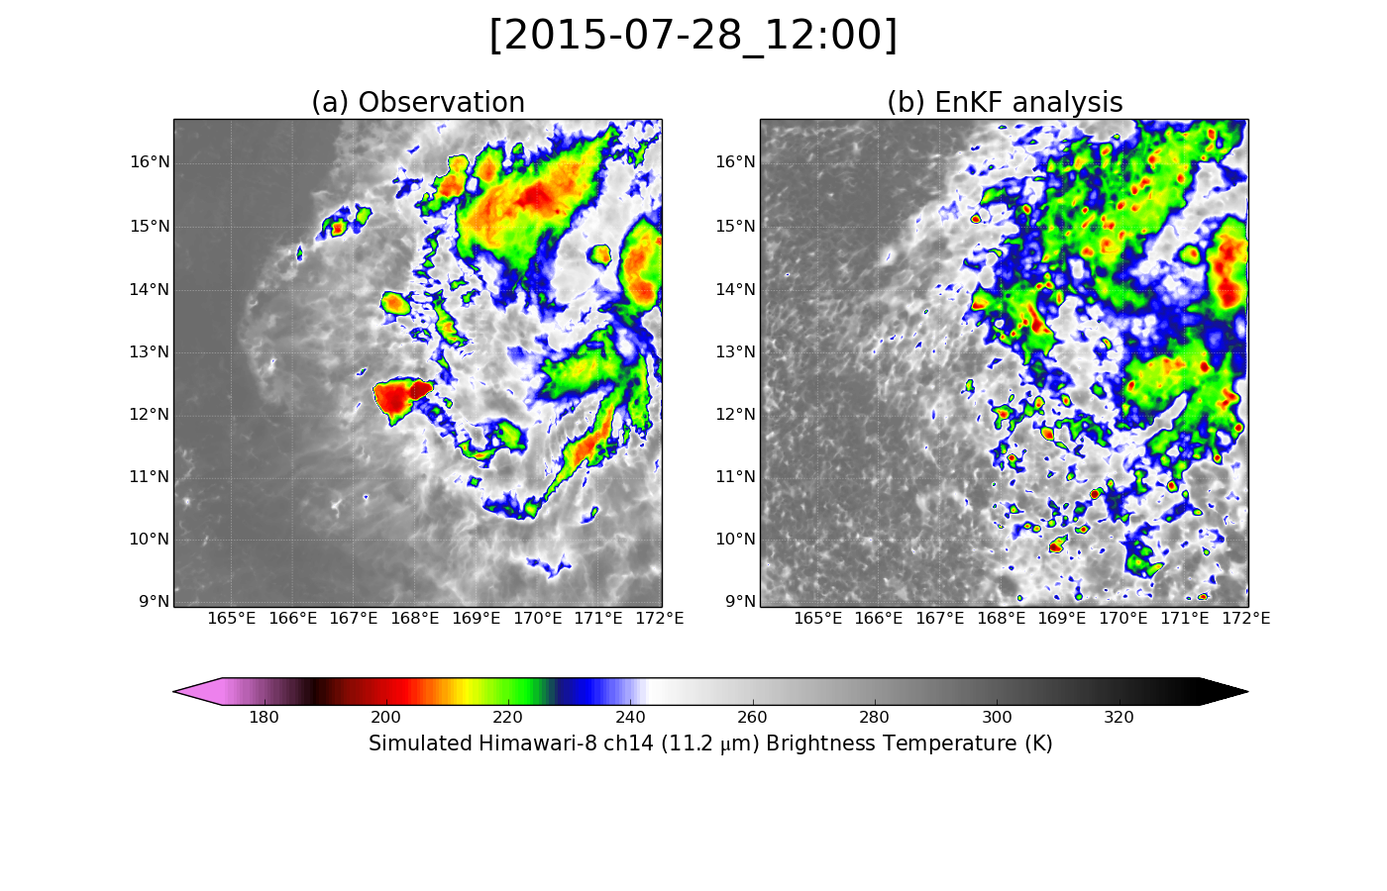
EnKF Performances on Brightness Temperature
Himawari-8 AHI Brightness Temperature (ch14, 11.2µm)
Observation
EnKF Analysis

Slide 7

EnKF Performances on Brightness Temperature
Himawari-8 AHI Brightness Temperature (ch14, 11.2µm)
Observation
EnKF Analysis
Notes:
Assimilation of brightness temperature generally well captured the clear and cloudy sky distributions.

Slide 8
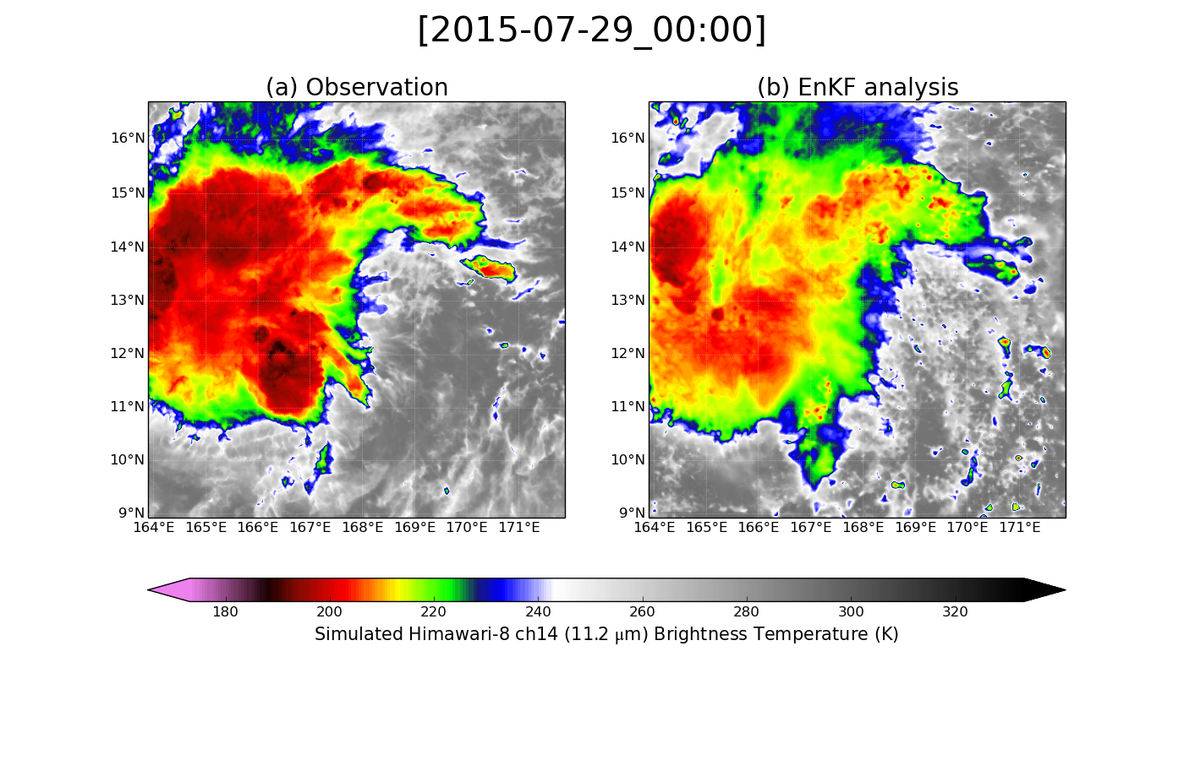
EnKF Performances on Brightness Temperature
Himawari-8 AHI Brightness Temperature (ch14, 11.2µm)
Observation
EnKF Analysis
  Hard to capture individual convective bursts
Notes:
But if you have a careful look at them, there some difficulties. Especially, strongly convective regions such as convective bursts cannot be captured well by our assimilation of brightness temperature.

Slide 9
Bias as a function of cloud-top temperature
Strong convections
Cloudy
Clear
Effects of smoothing; bias depends on cloud (top).
Hard to analyze clouds with strong convections.
Notes:
The difficulty in capturing convective bursts can be clearly seen by checking the bias as a function of cloud top temperature.
This figure shows the bias of 1-day assimilation cycle. Horizontal axis shows the brightness temperature of window channel 14. You may just simply think left side with lower brightness temperature means cloudy sky, and right side with high brightness temperature means clear sky.
Vertical axis shows the bias with each cloud top temperature.
Red line shows prior and blue line shows posterior to EnKF analysis.
Firstly, with red line, we can see the smoothing effect, because this compared ensemble mean with observation. Ensemble mean tend to have middle brightness temperature, and tend to have negative bias in clear sky and positive bias in cloudy sky.
Interesting point is, if you check the blue line, most of the negative bias in clear sky is solved through assimilation. However, especially strong convective region with lower than 220K, even EnKF analysis had a difficulty in capturing those structure.
This highlights the difficulty in capturing strong convective bursts.

Slide 10
EnKF Analysis on Tropical Cyclone Intensity
Minimum SLP (hPa)
Maximum 10m wind (m/s)
Assimilation of BT made the TC genesis much earlier.
Notes:
In addition to that, here I show the EnKf performance on TC intensities.
All the EnKF analysis showed much stronger intensity than the best-track data, and even compared to noDA.

Slide 11
Forecasts on Tropical Cyclone Intensity
Minimum SLP (hPa)
Maximum 10m wind (m/s)
Assimilation of BT made RI much earlier.
Notes:
The impacts can be even more clearly seen with forecast. This is the similar TC intensity figure as previous, but showing deterministic forecasts from the different timing of EnKF analysis instead of EnKF cycle.
All the forecasts experienced much earlier rapid intensification than the best-track data, indicating that EnKF analysis made too favorable conditions for TCs.

Slide 12
DA impacts on TC intensities
Absolute Vorticity at 850hPa (s⁻¹)
Relative humidity at 600hPa (%)
Potential intensity (m s⁻¹)
Vertical wind shear (m s⁻¹)
Assimilation of BT might have introduced high CAPE.
Notes:
In order to show the reason why our EnKF experiments had stronger intensity, those plots show the temporal evolution of indices related to the favorable conditions for TCs.
Red line shows EnKF cycle, and gray-dashed line is noDA. We can clearly see that red line shows higher potential intensity than noDA, which may indicate assimilation of BT might have spuriously introduced high CAPE.

Slide 13
Concluding Remarks
  Real-observation data from new geostationary satellite Himawari-8 was assimilated in the genesis and developing stage of tropical cyclones.
  Current strategy can generally capture clear- and cloudy-sky regions, but it has a difficulty in capturing strong convections, especially convective bursts.
  Assimilation of channel 8 of Himawari-8 made the development of typhoon Soudelor (2015) too early, maybe spuriously introducing favorable conditions for TCs.
  Future investigation will be more frequent assimilation cycle, usage of other channels, change in ROIs and so on.

Slide 14
Biases of different channels
Notes:
RMSE increases likely because the storm is intensifying at this time.

Slide 15
RMSEs and Biases in OSSE
Notes:
RMSE increases likely because the storm is intensifying at this time.

Slide 16
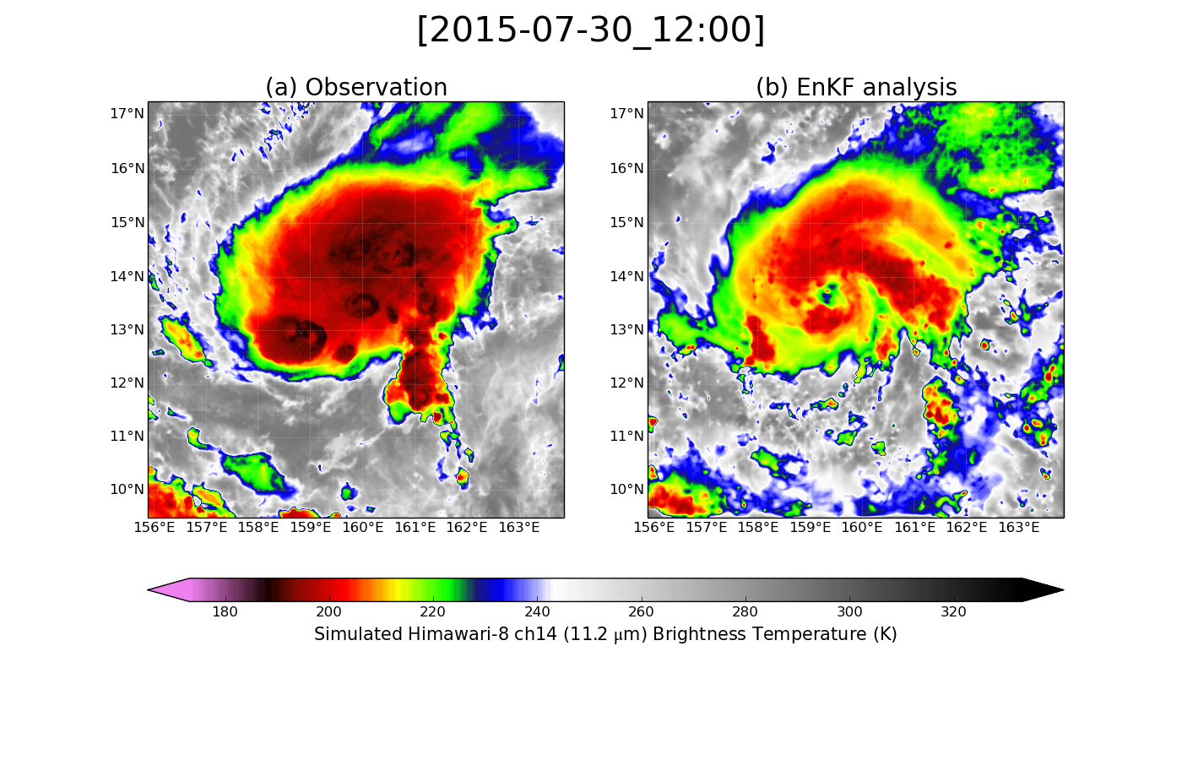
EnKF Performances on Brightness Temperature
Himawari-8 AHI Brightness Temperature (ch14, 11.2µm)
Observation
EnKF Analysis
  EnKF analysis formed eyewall much earlier.

