Slide 1
Impact of Microphysics Schemes in WRF on Passive Microwave Brightness Temperatures
Research Group Meeting
19 August 2016
Scott Sieron
Advisors: Fuqing Zhang, Eugene Clothiaux
Major Collaborator: Lu Yinghui

Slide 2
Radiative Transfer Basics
Input:
Vertical profile of
Temperature
Pressure (also vertical discretization variable)
Water vapor
Cloud water, pristine cloud ice, rain, snow, graupel, hail
Water content (kg m⁻³), effective radius (μm)
Surface temperature and wind
Surface wind → geometry of water surface → water surface emissivity
Sensor and viewing angle
Output: Brightness Temperature
obtain from weather model output
Notes:
All of the inputs impact the absorption, emission or scattering of radiation
Everything atmospheric and surface is readily obtainable from the output file of the Weather Research and Forecast (WRF) or similar mesoscale model… everything but the effective radius of every instance of cloud and precipitation.

Slide 3
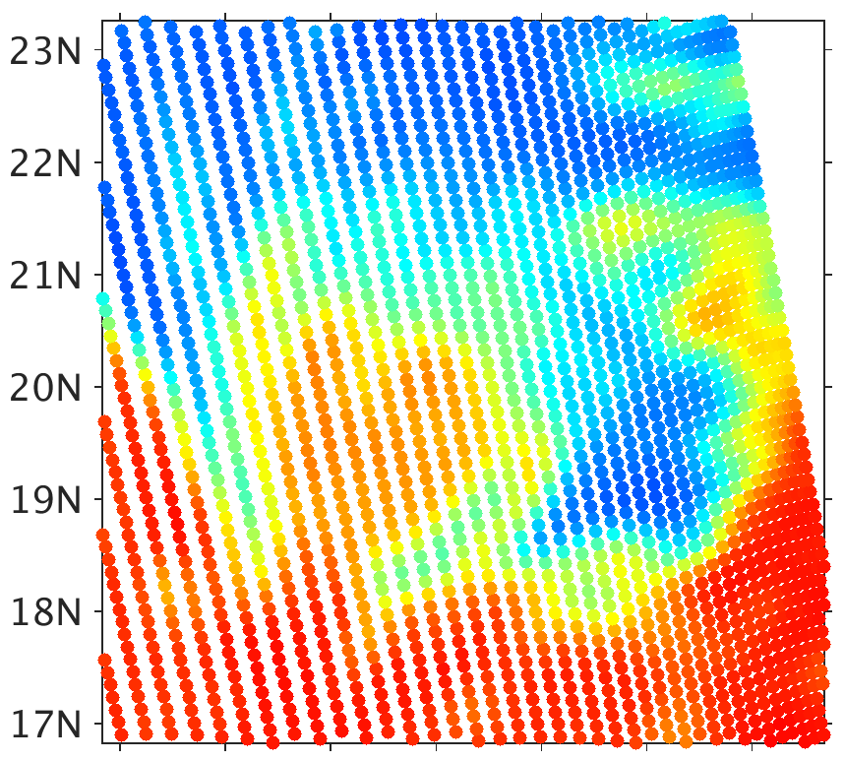
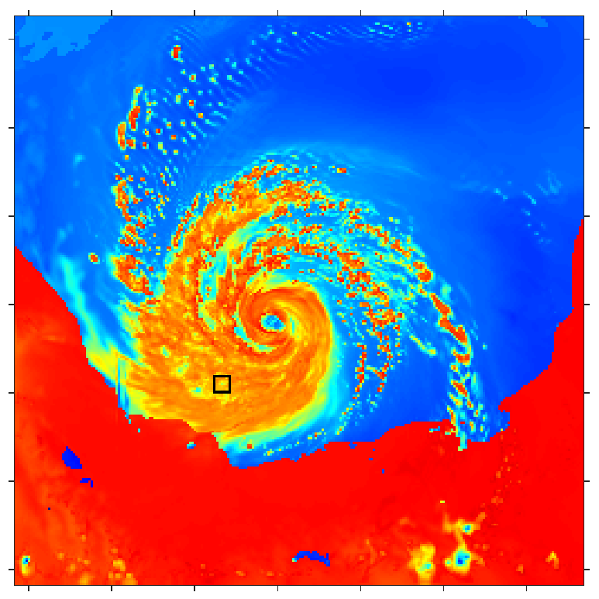
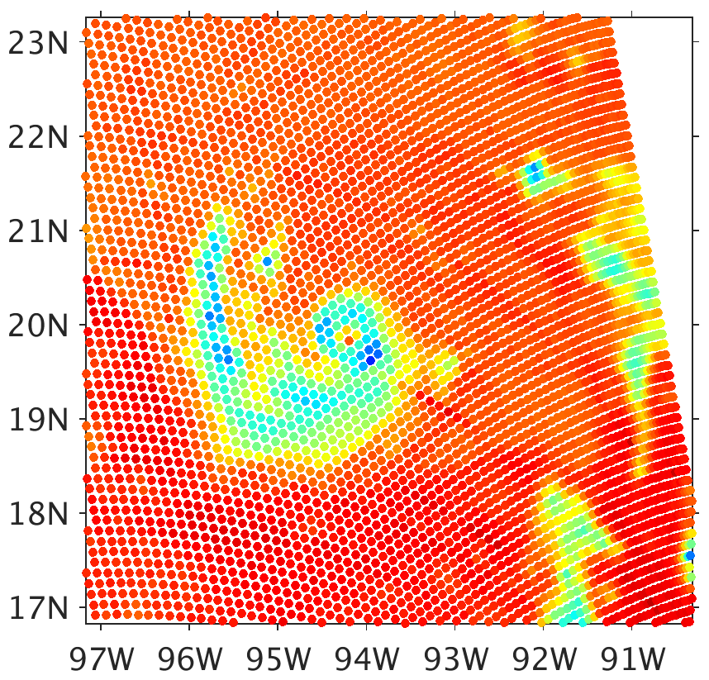
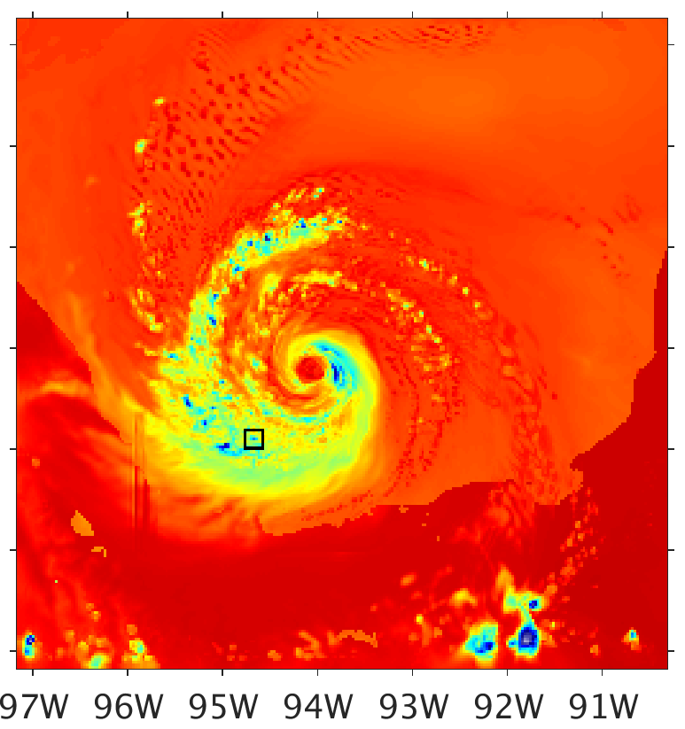
CRTM Effective Radius
SSMIS Obs
CRTM HT74 R_{eff}
37.0 GHz
The community defines effective radius as
$$r_{eff}=\frac{\int_{r2}^{r1}{r^{3}N\left(r\right)dr}}{\int_{r2}^{r1}{r^{2}N\left(r\right)dr}}$$
This is “mean radius for scattering” for scattering by a particle $∝r^{2}$ (Hansen and Travis 1974)
For generalized gamma PSD, $r_{eff}=(μ+3)λ^{−1}$
91.66 GHz
Brightness Temperature (K)
80
100
120
140
160
180
200
220
240
260
280
300
Notes:
New thinking about how CRTM defines effective radius (but no different values used), and motivation for work
These results also match pretty well. 37 GHz is seemingly appropriately colder, while 91.66 GHz is warmer.
Effective radius of monodisperse clouds is the particle size
Note the small black boxes overlaid on the brightness temperature fields. At the location in the center of this box…

Slide 4
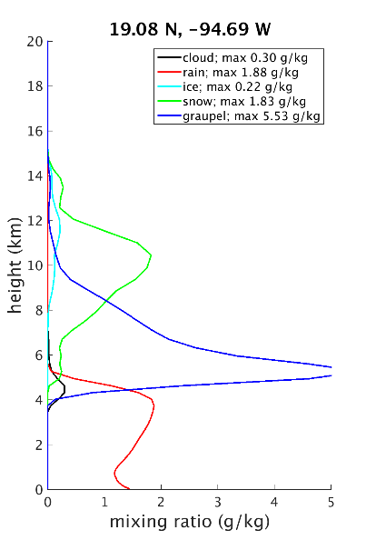
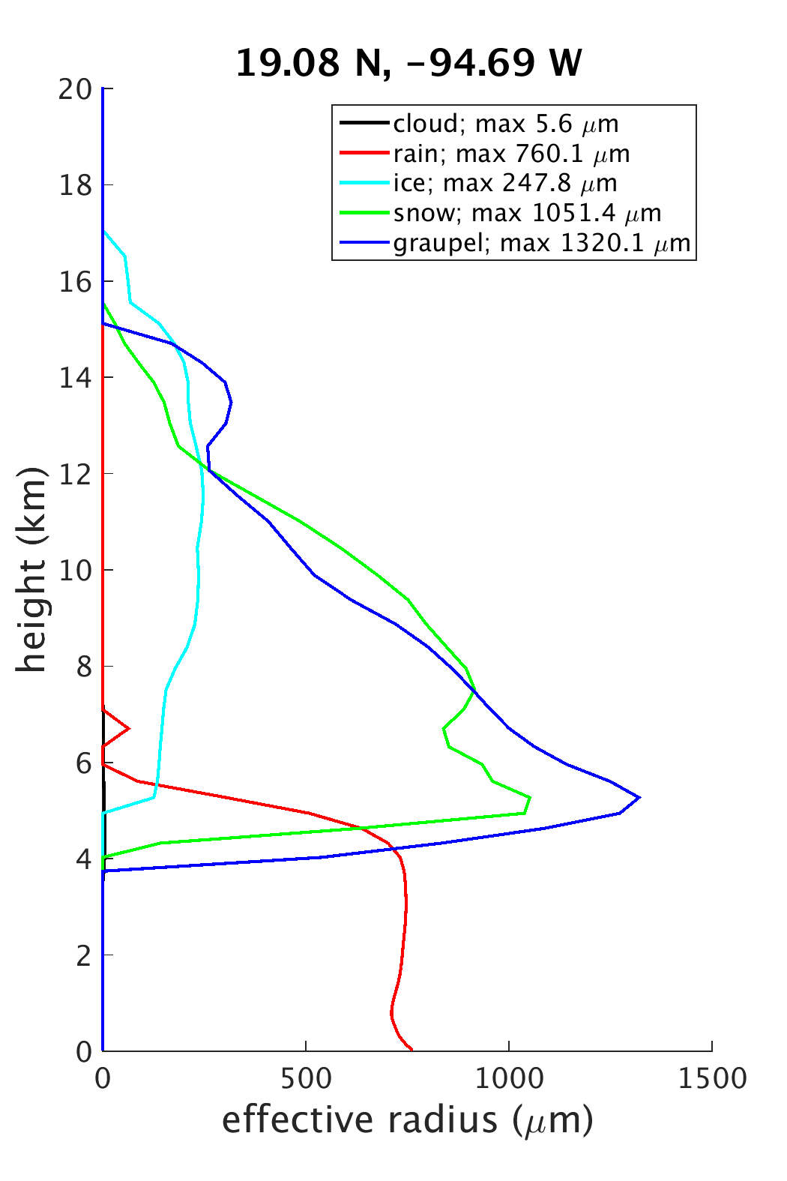
CRTM Effective Radius (cont.)
The community defines effective radius as
$$r_{eff}=\frac{\int_{r2}^{r1}{r^{3}N\left(r\right)dr}}{\int_{r2}^{r1}{r^{2}N\left(r\right)dr}}$$
This is “mean radius for scattering” for scattering by a particle $∝r^{2}$ (Hansen and Travis 1974)
For generalized gamma PSD, $r_{eff}=(μ+3)λ^{−1}$
Notes:
- Most effective radii values exceed the assumed constant values. There is greater scattering per mass at these higher effective radius values. It is interesting that at 91.66 GHz the brightness temperatures for this experiment is higher than in the fixed effective radius experiment.

Slide 5
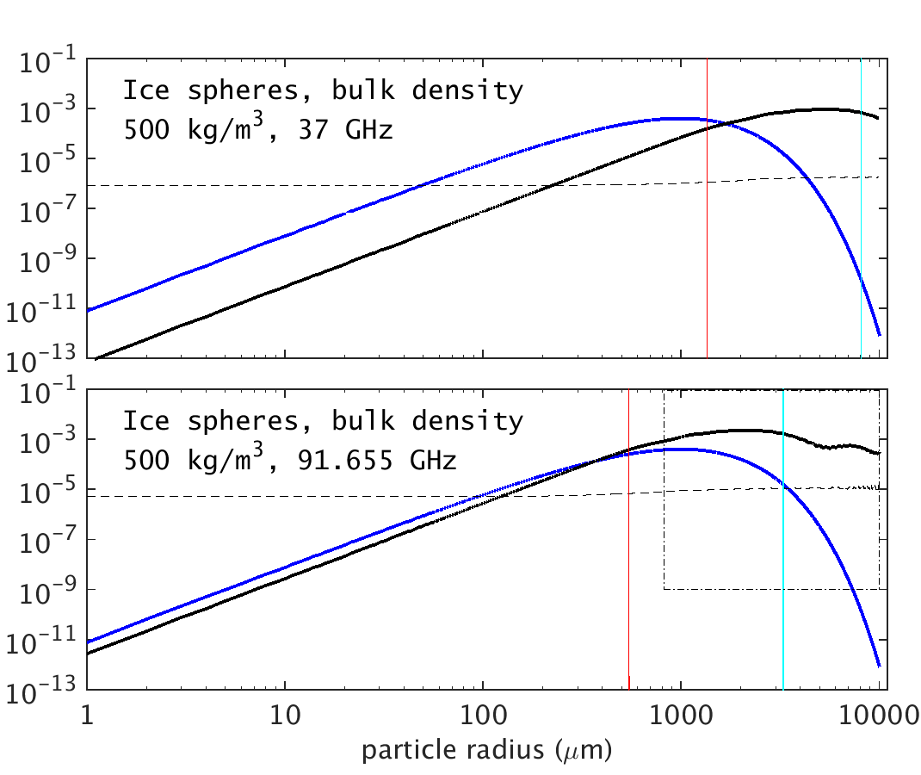
CRTM Effective Radius (cont.)
For precipitation in microwave, scattering by a particle is NOT $∝r^{2}$
Scattering $∝r^{6}$ for particles much smaller than wavelength
No simple relationship between particle size and scattering cross-section
Effective radius fails
WSM6 graupel at 1.24 g m⁻³
Black: scattering coeff. (m² kg⁻¹) Dashed: absorption coeff. (m² kg⁻¹)
Blue: sample particle mass distribution (kg m⁻³ µm⁻¹) of graupel-like ice spheres
Light blue: wavelength
Red: one-sixth wavelength
Notes:
Scattering proportionality to particle cross-section is valid for particles much larger than the wavelength.
The community with S- and C-band radar (those are wavelengths of about 10 and 5 cm), they appropriate use sixth-moment of distribution to relate particle size distributions to reflectivity
Lots of variety of particle size distributions between the four scheme shown earlier

Slide 6
Modifying the CRTM for All-sky Microwave
Method 1, “Distribution-Specific:” cloud scattering property lookup tables constructed at very high resolution consistent with MP schemes
New method 2, “Generalized Bin:” particle scattering property lookup tables, MP scheme information managed within CRTM
Model the properties of single particles (soft spheres, as specified by MP scheme)
Maxwell-Garnett mixing formula for ice dielectric constants
Liquid dielectric constants from Tuner et al. (2016)
Notes:
Though both the MP schemes and CRTM remain sources for error/bias to observation

Slide 7
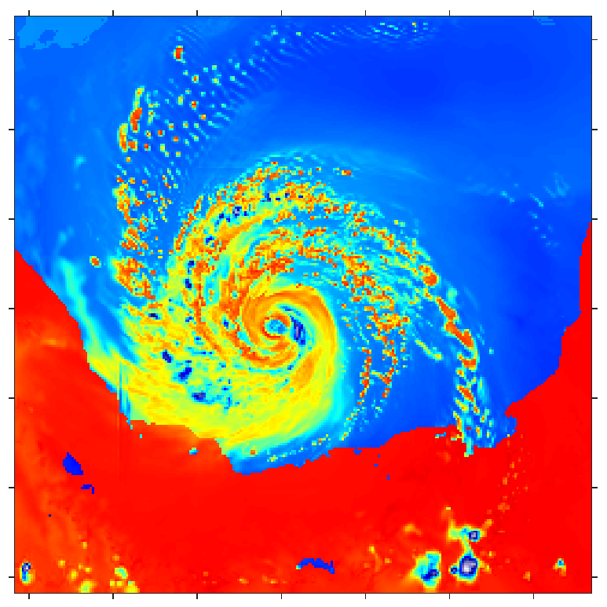
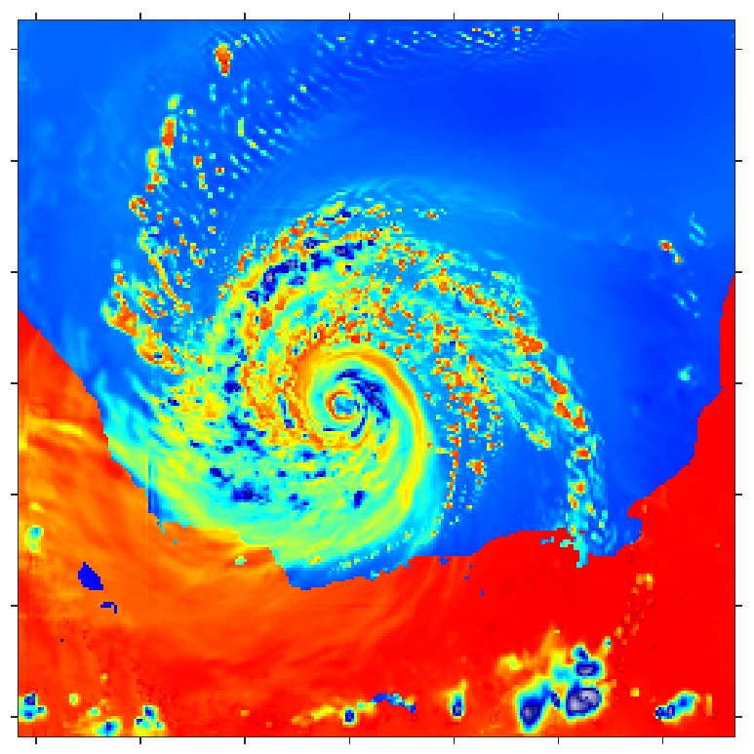
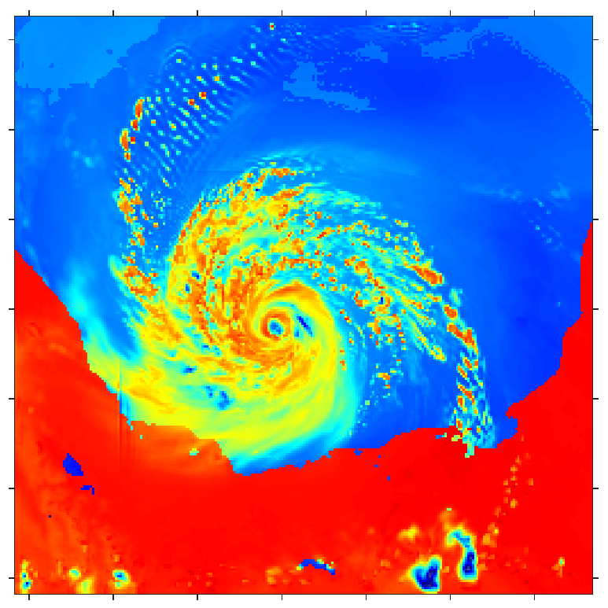
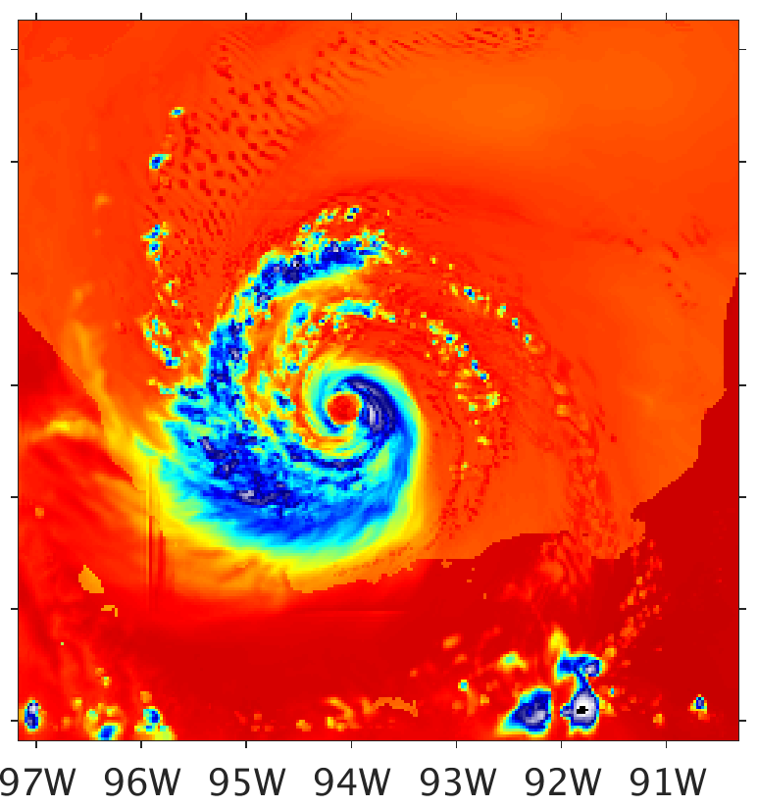
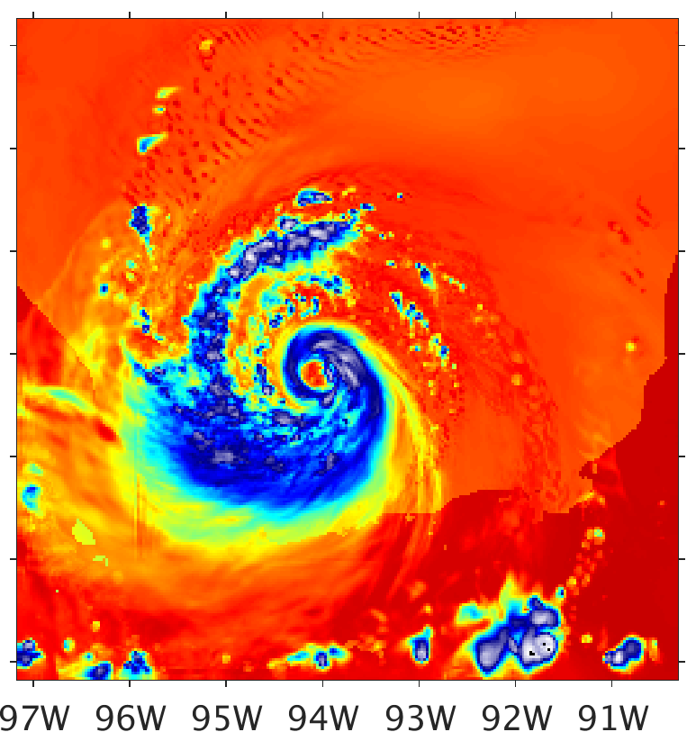
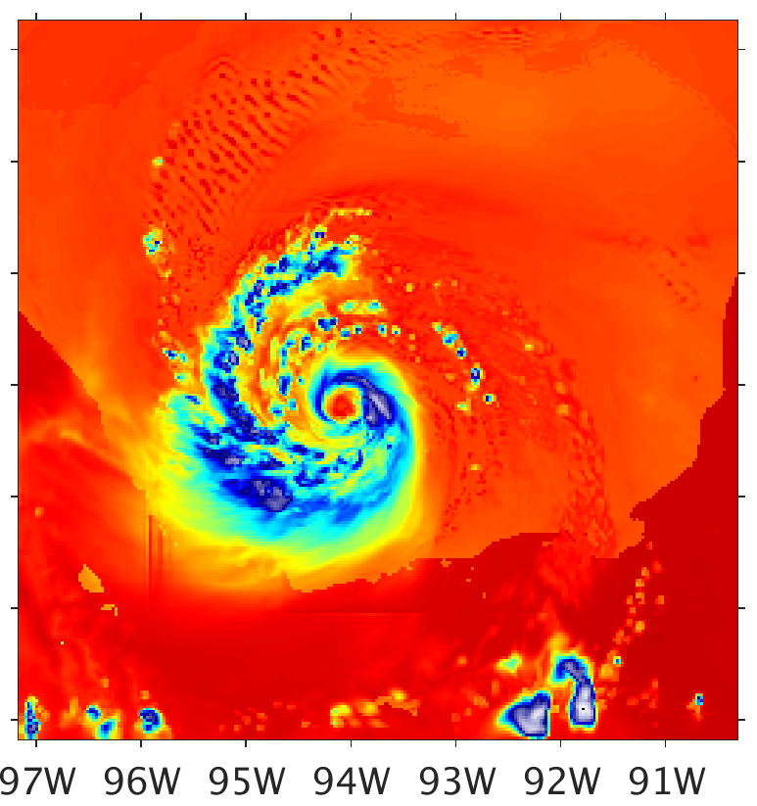
Brightness Temperature (K)
CRTM-DS
80
100
120
140
160
180
200
220
240
260
280
300
SSMIS Obs
WSM6
Goddard
Morrison
37.0 GHz
91.66 GHz
Notes:
All of the 91.66 GHz brightness temperatures look cooler than before. A change was made to the scattering properties of ice particles. Lily will go into detail with that.
The Morrison 91.66 GHz brightness temperatures look much cooler than before, when it was substantially warmer than anything else. An error in the snow was solved.
Great variety in the simulated brightness temperatures between the different microphysics schemes
Substantially lower brightness temperatures than observations

Slide 8
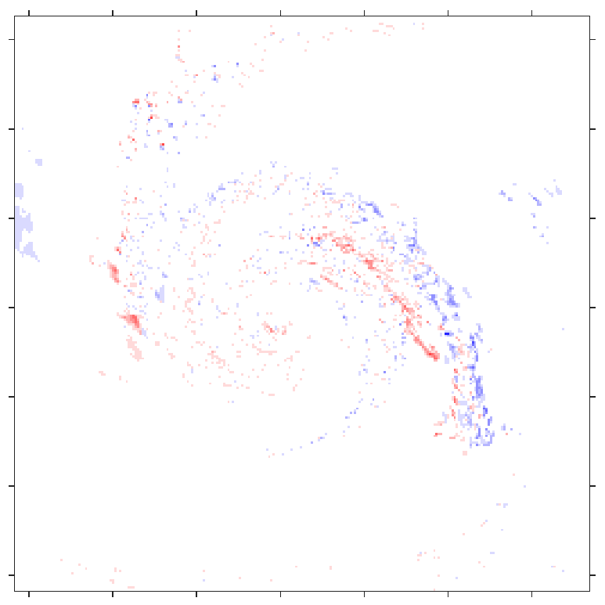
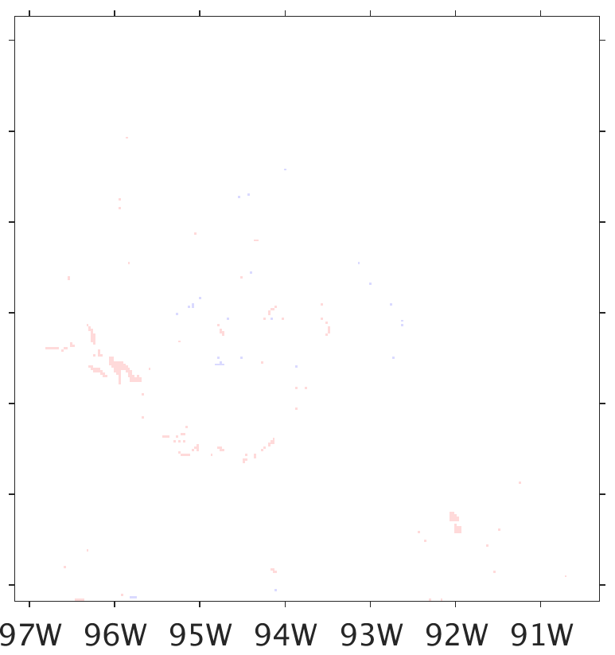
Brightness Temperature (K)
WSM6
80
100
120
140
160
180
200
220
240
260
280
300
SSMIS Obs
CRTM-DS
CRTM-BG 32
Difference
37.0 GHz
2
1
91.66 GHz
0
-1
-2
Notes:
Testing the Bin-Generalized modified CRTM
32 Bins matches well to CRTM-DS in this case

Slide 9
Results and Discussion
Modified CRTM: too low of brightness temperatures, too much scattering
Similar results to radar and passive microwave observations vs. simulated studies using the Goddard-SDSU [Zupanski et al. 2011; Zhang et al. 2013; Han et al. 2013; Chambon et al. 2014]
Conclusion: too much or too big of snow and/or graupel in upper troposphere by microphysics schemes
Results of CRTM-BG limit to results of CRTM-DS for increasing bin count
32 bins offers good balance between speed and accuracy

Slide 10
Results and Discussion (continued)
Differences in simulated brightness temperatures between microphysics schemes:
Different integrated cloud masses
Significantly different particle size distributions

Slide 11
Future Directions
Refining and adding modifications, working within the CRTM repository
Optimize Bin Discretized computations, reduce redundant LUT queries
Non-spherical particle optical properties
Tangent linear, adjoint, K-matrix
Antenna pattern convolution and slant path constructions (features in satellite simulators)
Automatic stream number estimation
Uses for this tool:
Ensemble parameter estimation
Observing System Experiments (testing data assimilation)
Simulated or real observations

Slide 12
References
Chambon, P., S. Q. Zhang, A. Y. Hou, M. Zupanski, and S. Cheung, 2014: Assessing the impact of pre-GPM microwave precipitation observations in the Goddard WRF ensemble data assimilation system. Quart. Jour. Roy. Meteor. Soc., 140, 1219–1235.
Han, M., S. A. Braun, T. Matsui, and C. R. Williams, 2013: Evaluation of cloud microphysics schemes in simulations of a winter storm using radar and radiometer measurements. J. Geophys. Res. Atmos., 118, 1401–1419.
Liu, Q., and F. Weng, 2006: Advanced doubling-adding method for radiative transfer in planetary atmospheres. J. Atmos. Sci., 63, 3459‒3465.
Skamarock, W. C., J. B. Klemp, J. Dudhia, D. O. Gill, D. M. Barker, M. G. Duda, X.-Y. Huang, W. Wang, and J. G. Powers, 2008: A description of the Advanced Research WRF version 3. NCAR Technical Note 475, http://www.mmm.ucar.edu/wrf/users/docs/arw_v3.pdf.
Weng, Y., and F. Zhang, 2012: Assimilating Airborne Doppler Radar Observations with an Ensemble Kalman Filter for Convection-permitting Hurricane Initialization and Prediction: Katrina (2005). Mon. Wea. Rev., 140, 841-859.
Wong, V., and K. A. Emanuel, 2007: Use of cloud radars and radiometers for tropical cyclone intensity estimation, Geophys. Res. Lett., 34, L12811, doi:10.1029/2007GL029960.
Zhang, S. Q., M. Zupanski, A. Y. Hou, X. Lin, and S. H. Cheung, 2013: Assimilation of Precipitation-Affected Radiances in a Cloud-Resolving WRF Ensemble Data Assimilation System. Mon. Wea. Rev.,141, 754–772.
Zhang, F., Y. Weng, J. A. Sippel, Z. Meng, and C. H. Bishop, 2009: Cloud-resolving Hurricane Initialization and Prediction through Assimilation of Doppler Radar Observations with an Ensemble Kalman Filter. Mon. Wea. Rev., 137, 2105-2125.
Zupanski, D., S. Q. Zhang, M. Zupanski, A. Y. Hou, and S. H. Cheung, 2011: A Prototype WRF-Based Ensemble Data Assimilation System for Dynamically Downscaling Satellite Precipitation Observations. J. Hydrometeor., 12, 118–134.

Slide 13
Extra Slides

Slide 14
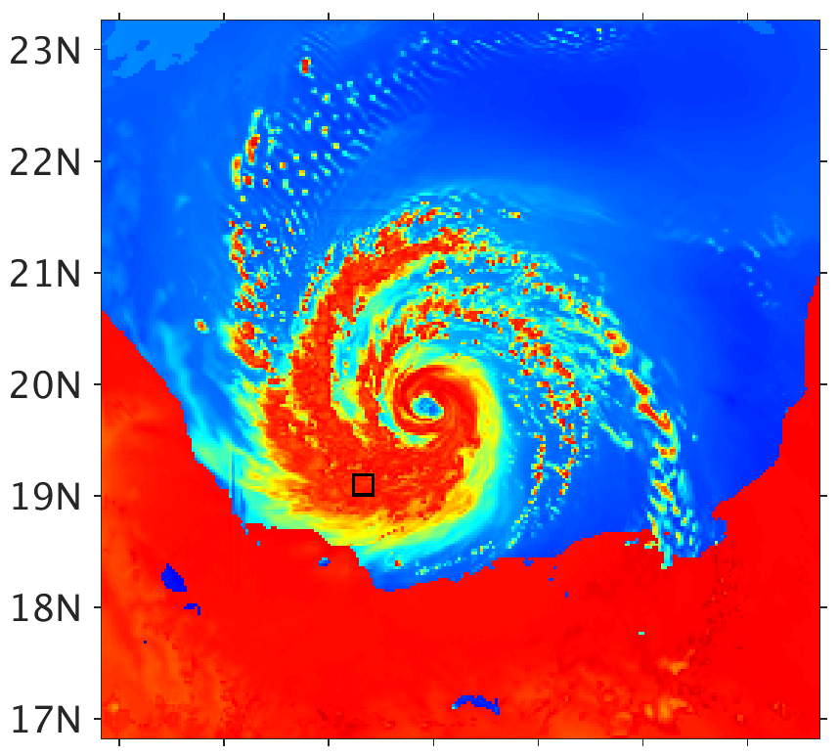
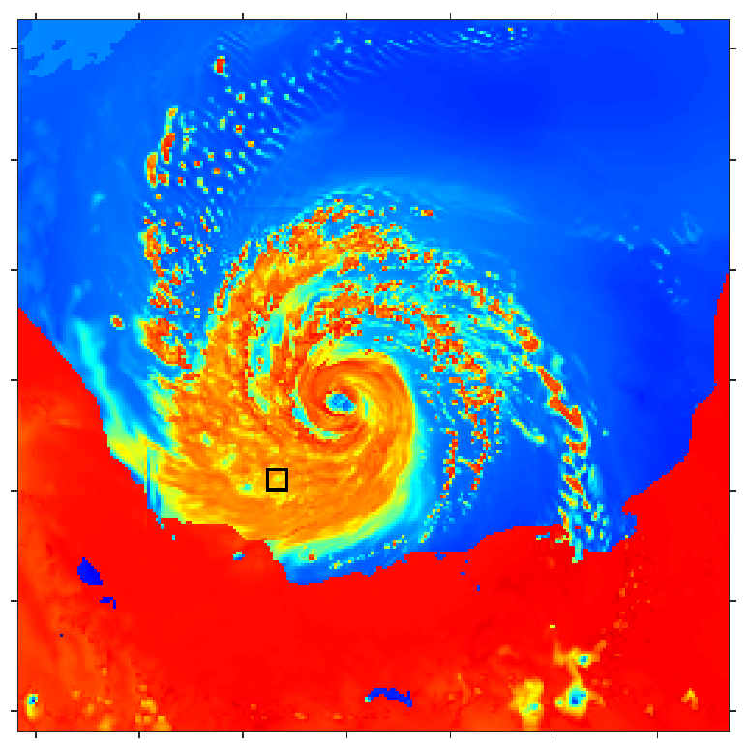
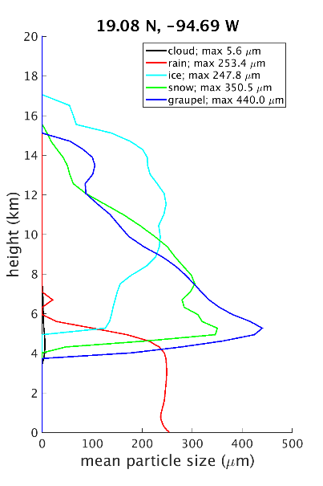
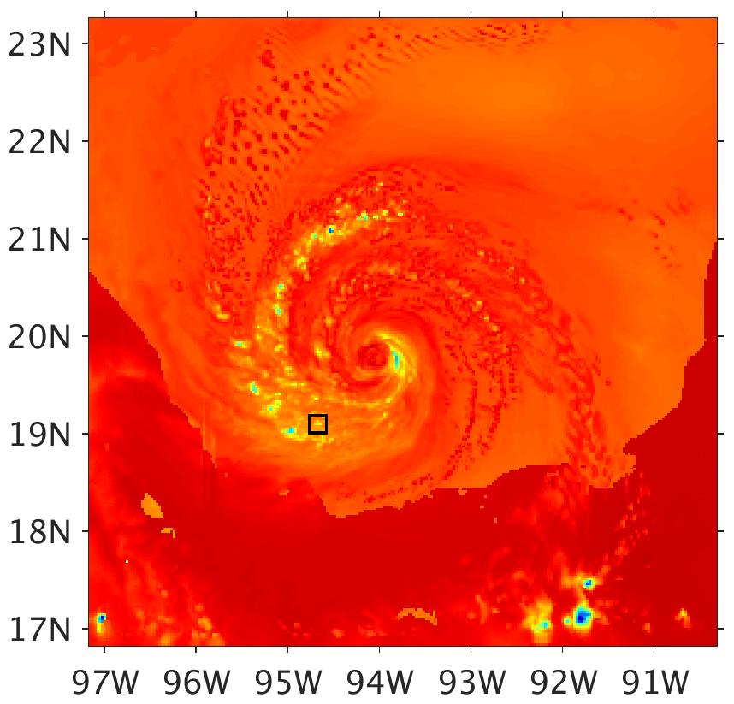
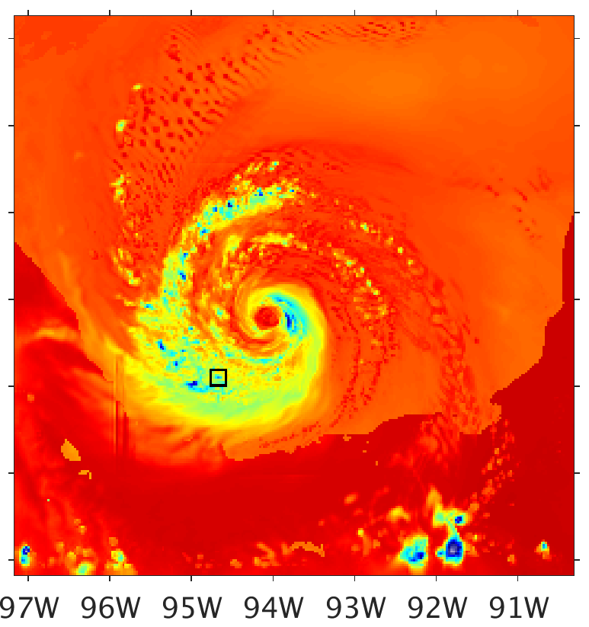
a1) Mean as ER 36.5H
b1) 6th moment as ER 36.5H
c)
d)
a2) Mean as ER 89.0H
b2) 6th moment as ER 89.0H
c) WSM6 89.0H
Brightness Temperature (K)
90
120
150
180
210
240
270
300

Slide 15
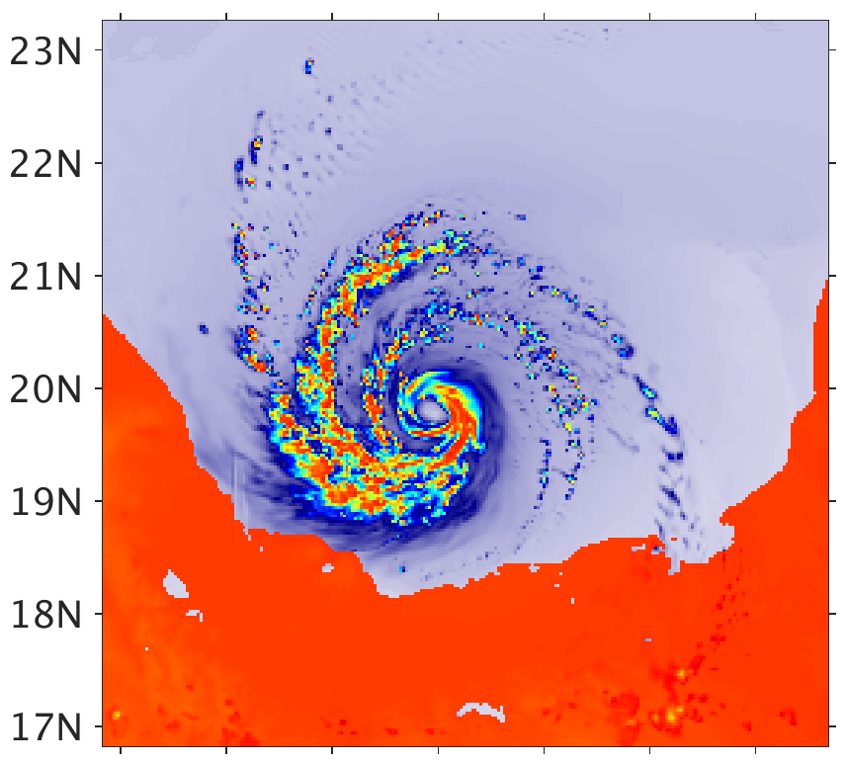
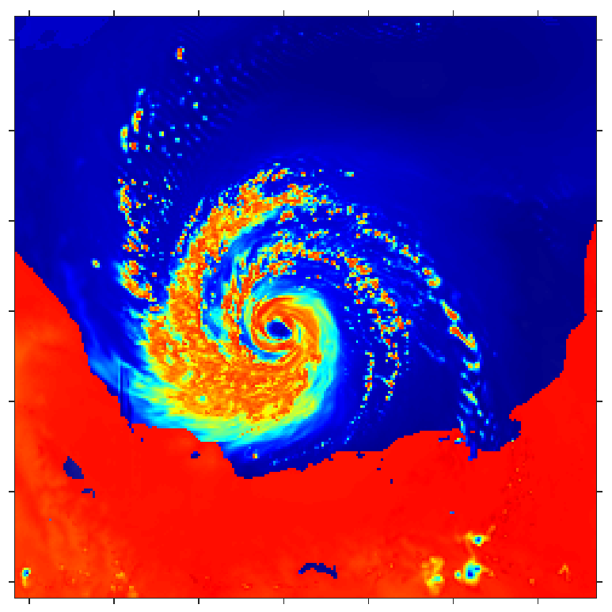
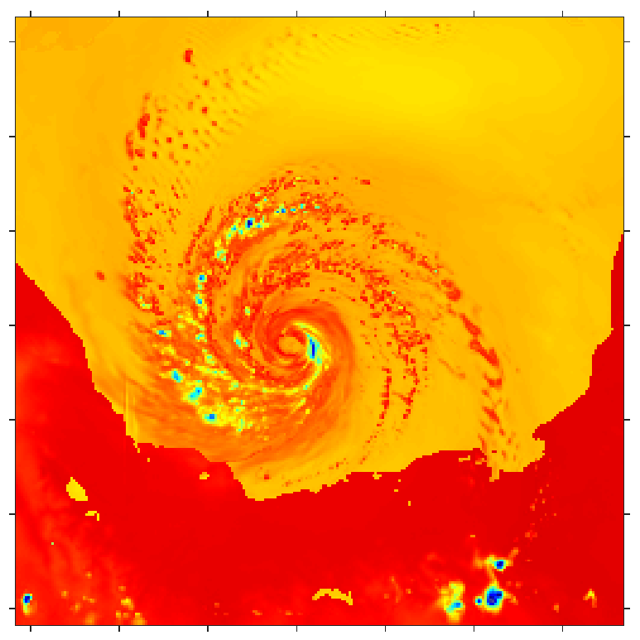
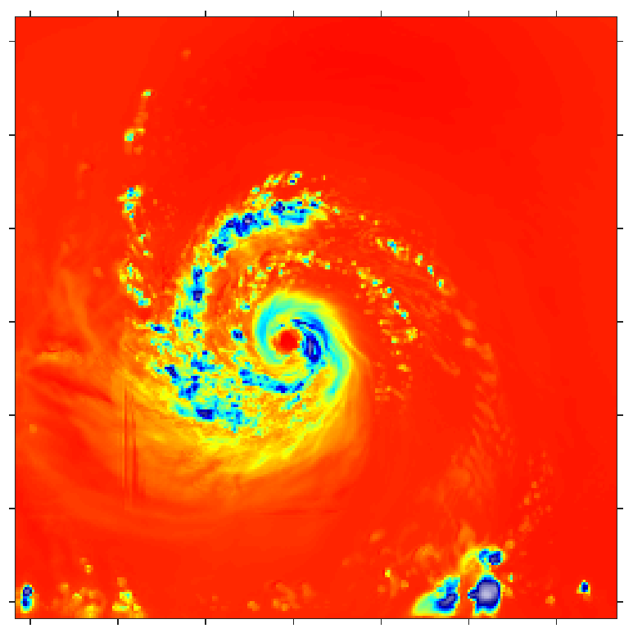
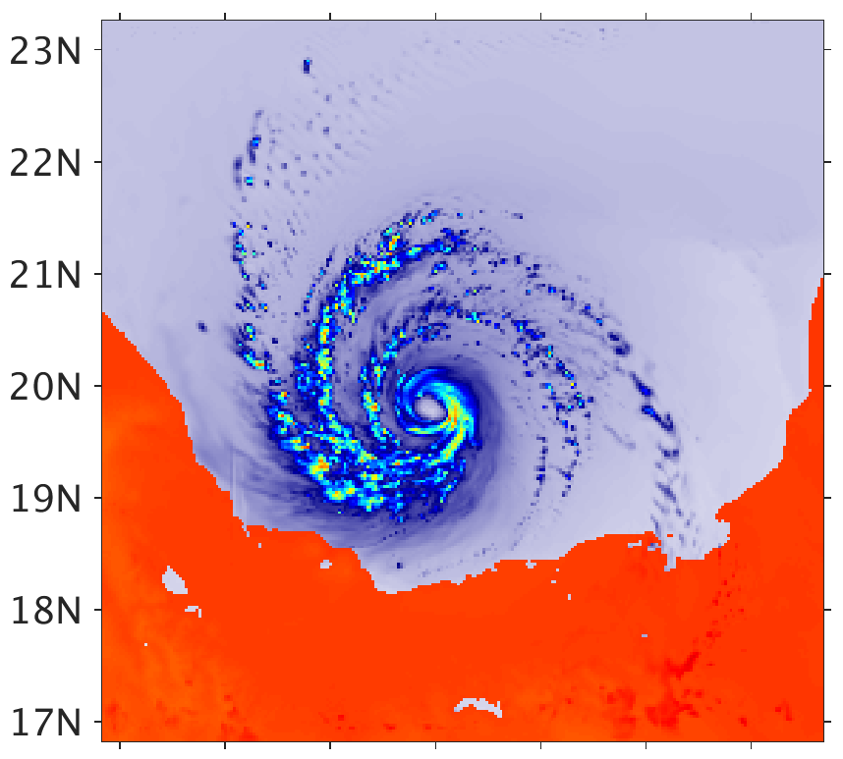
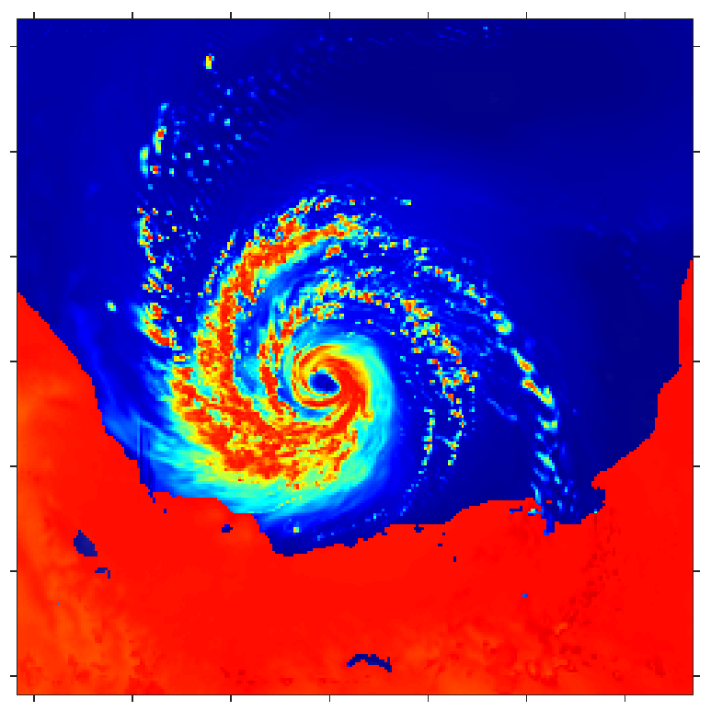
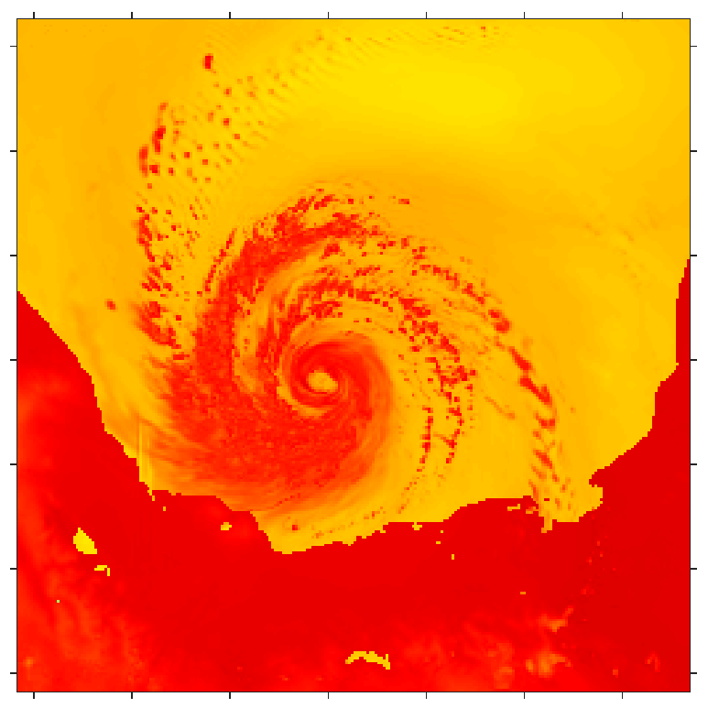
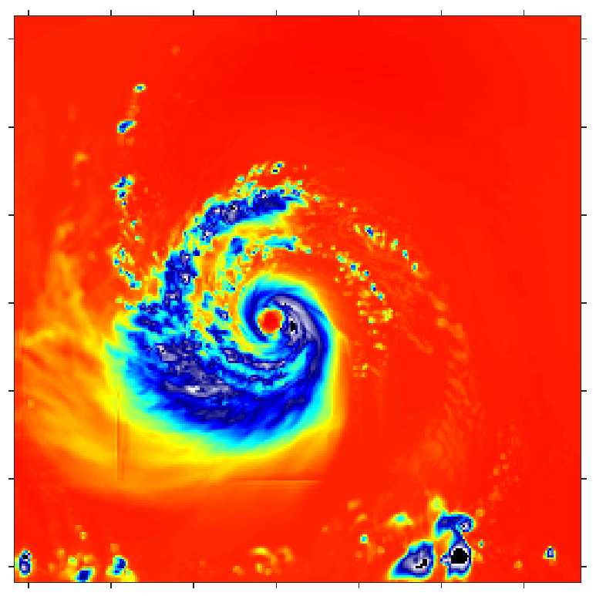
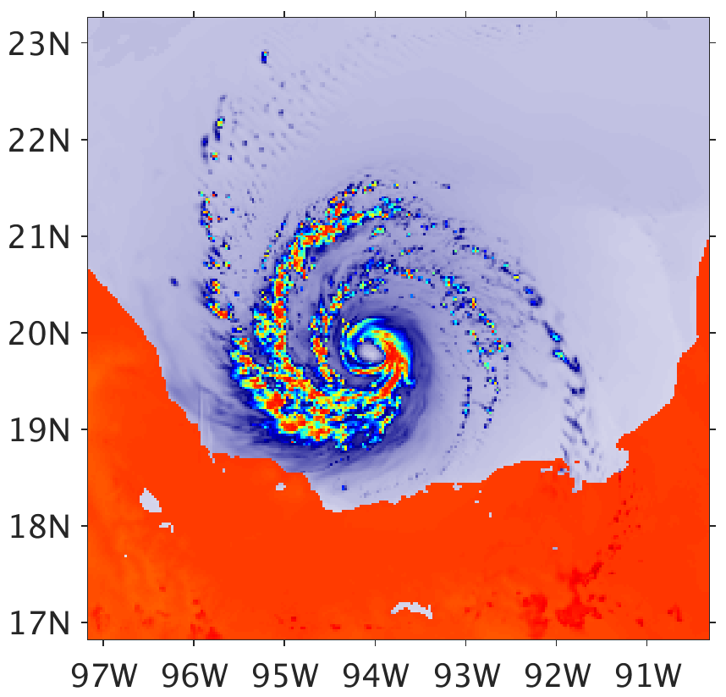
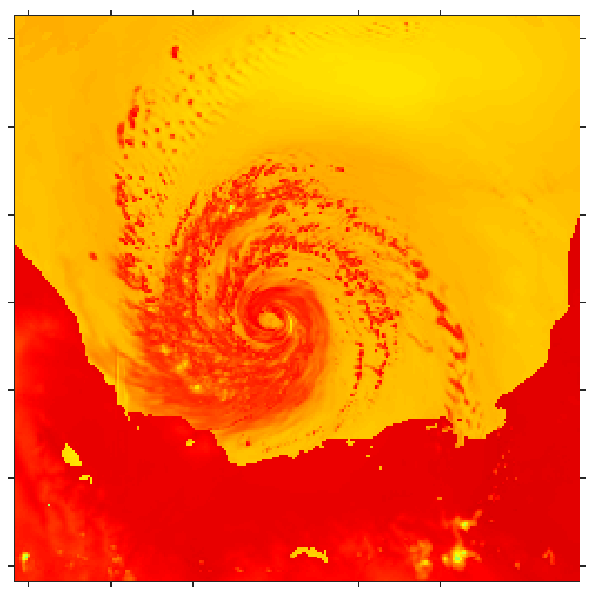
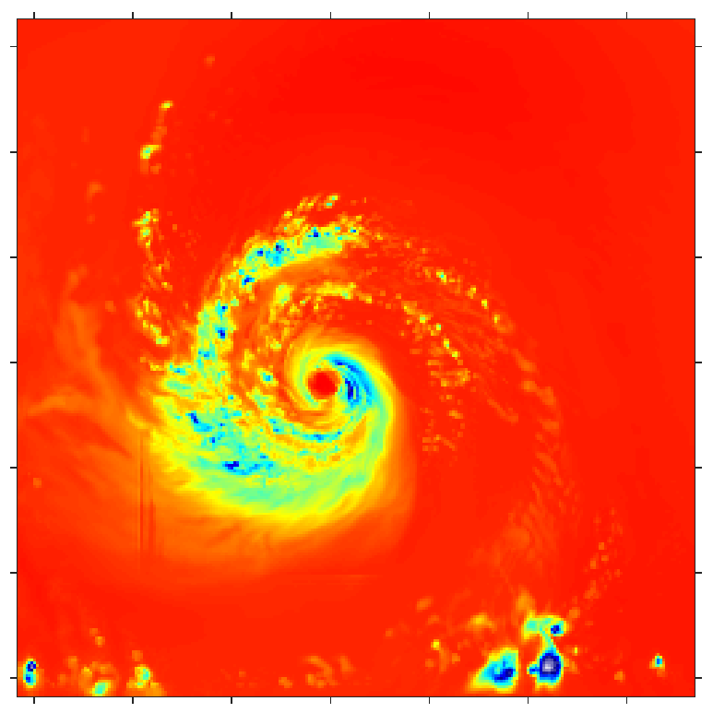
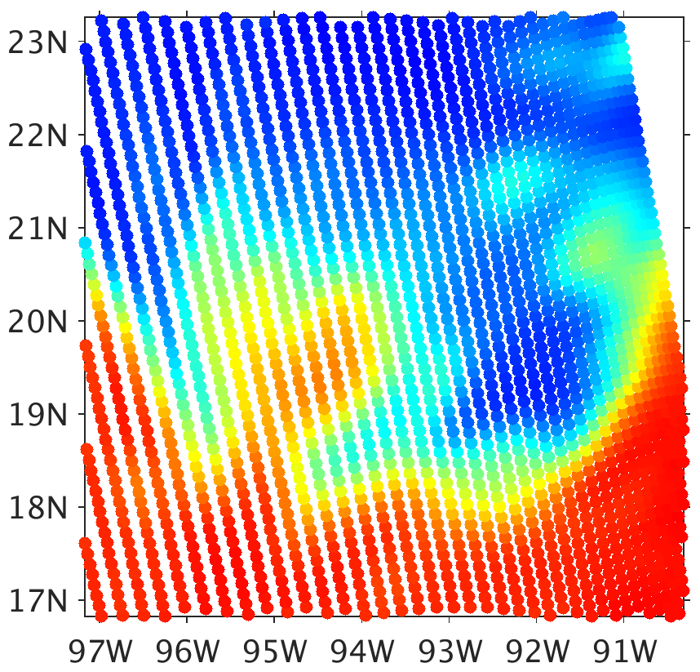
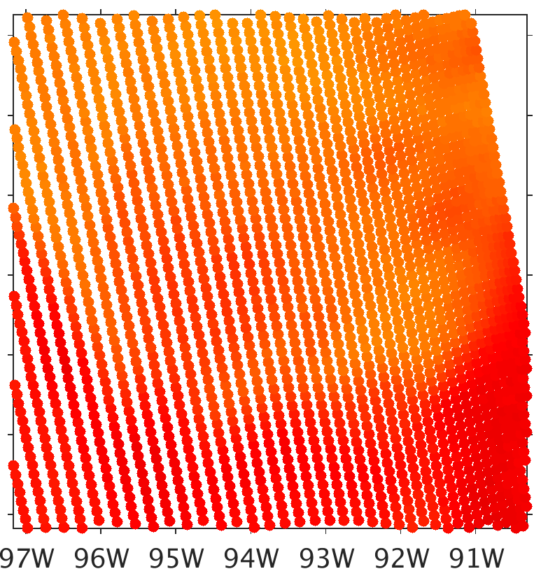
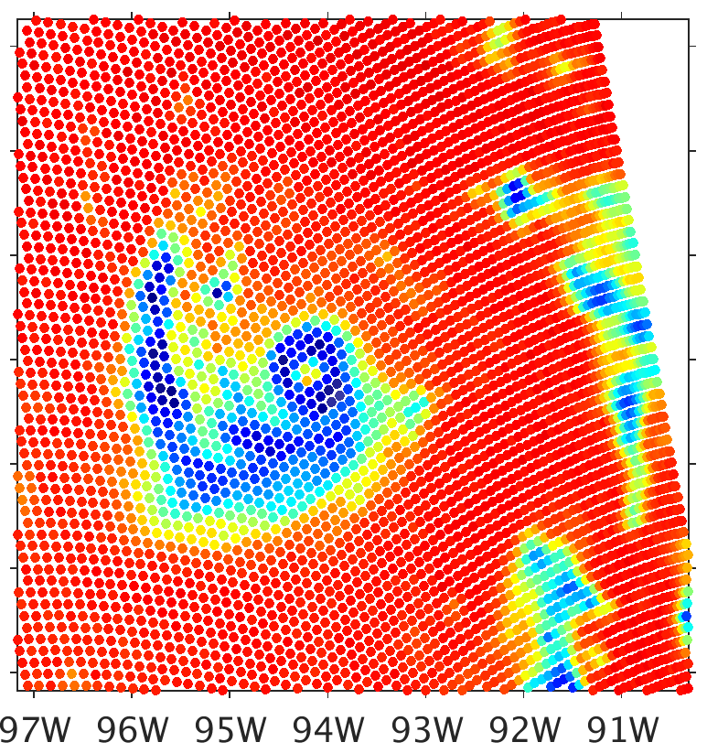
a1) Consistent Clouds 10.65H
b1) Consistent Clouds 18.7H
c1) Consistent Clouds 23.8V
d1) Consistent Clouds 165.5H
a2) Fixed Radius 10.65H
b2) Fixed Radius 18.7H
c2) Fixed Radius 23.8V
d2) Fixed Radius 165.5H
Brightness Temperature (K)
a3) 6th-Moment Radius 10.65H
b3) 6th-Moment Radius 18.7H
c3) 6th-Moment Radius 23.8V
d3) 6th-Moment Radius 165.5H
90
120
150
180
210
240
270
300
b4) SSMIS 19.35H
c4) SSMIS 22.23V
d4) SSMIS 150H

