Slide 1
Progress Towards an Alternative to the HWRF Vortex initialization Method
Robert Nystrom¹, Fuqing Zhang¹, and Jason Sippel²
¹ Penn State University
² NCEP

Slide 2
Why The need to replace HWRF Vortex Initialization?
Created from 2D axi-symmetric vortex
Wind field is simply smoothed until RMW or max wind speed is matched
Storm size and intensity corrected
Known vortex “spin-down” issue
HWRF Model Documentation 2015

Slide 3
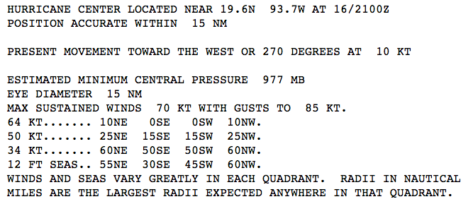
What are Quadrant Wind Radii Estimates?
Represent the largest distance from the center of the storm anywhere in a specific quadrant that a wind speed (34, 50, or 64 knots) can be found or if it can be found.
NW
NE
SW
SE

Slide 4
TC Vitals Quadrant Wind Radii Estimates
Estimated radii of the 34/50/64 knot winds are contained in TCVitals for each quadrant of the storm when available.
Contains information on the possible asymmetric wind structure of the storm
Large errors!
Estimated radii of the RMW is also given but no information on where it is located
34 kt wind radii
50 kt wind radii
64 kt wind radii

Slide 5
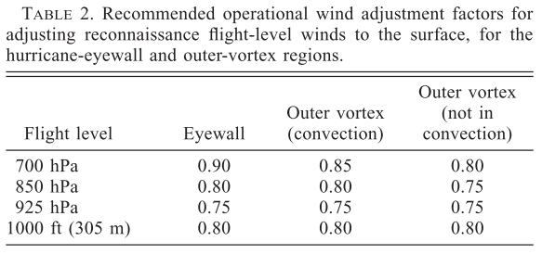
Creation of Synthetic Wind Observations
3 hourly synthetic wind observations created by linearly interpolating between 6 hourly TCvitals data
Also interpolated to cardinal direction (maximum of 8 observations per wind speed)
Winds speeds estimated above the PBL so that they can be assumed approximately tangential
1500 and 3000 m
ROI calculated as a function of radius
Increases with increasing radius
Franklin et al. 2003

Slide 6
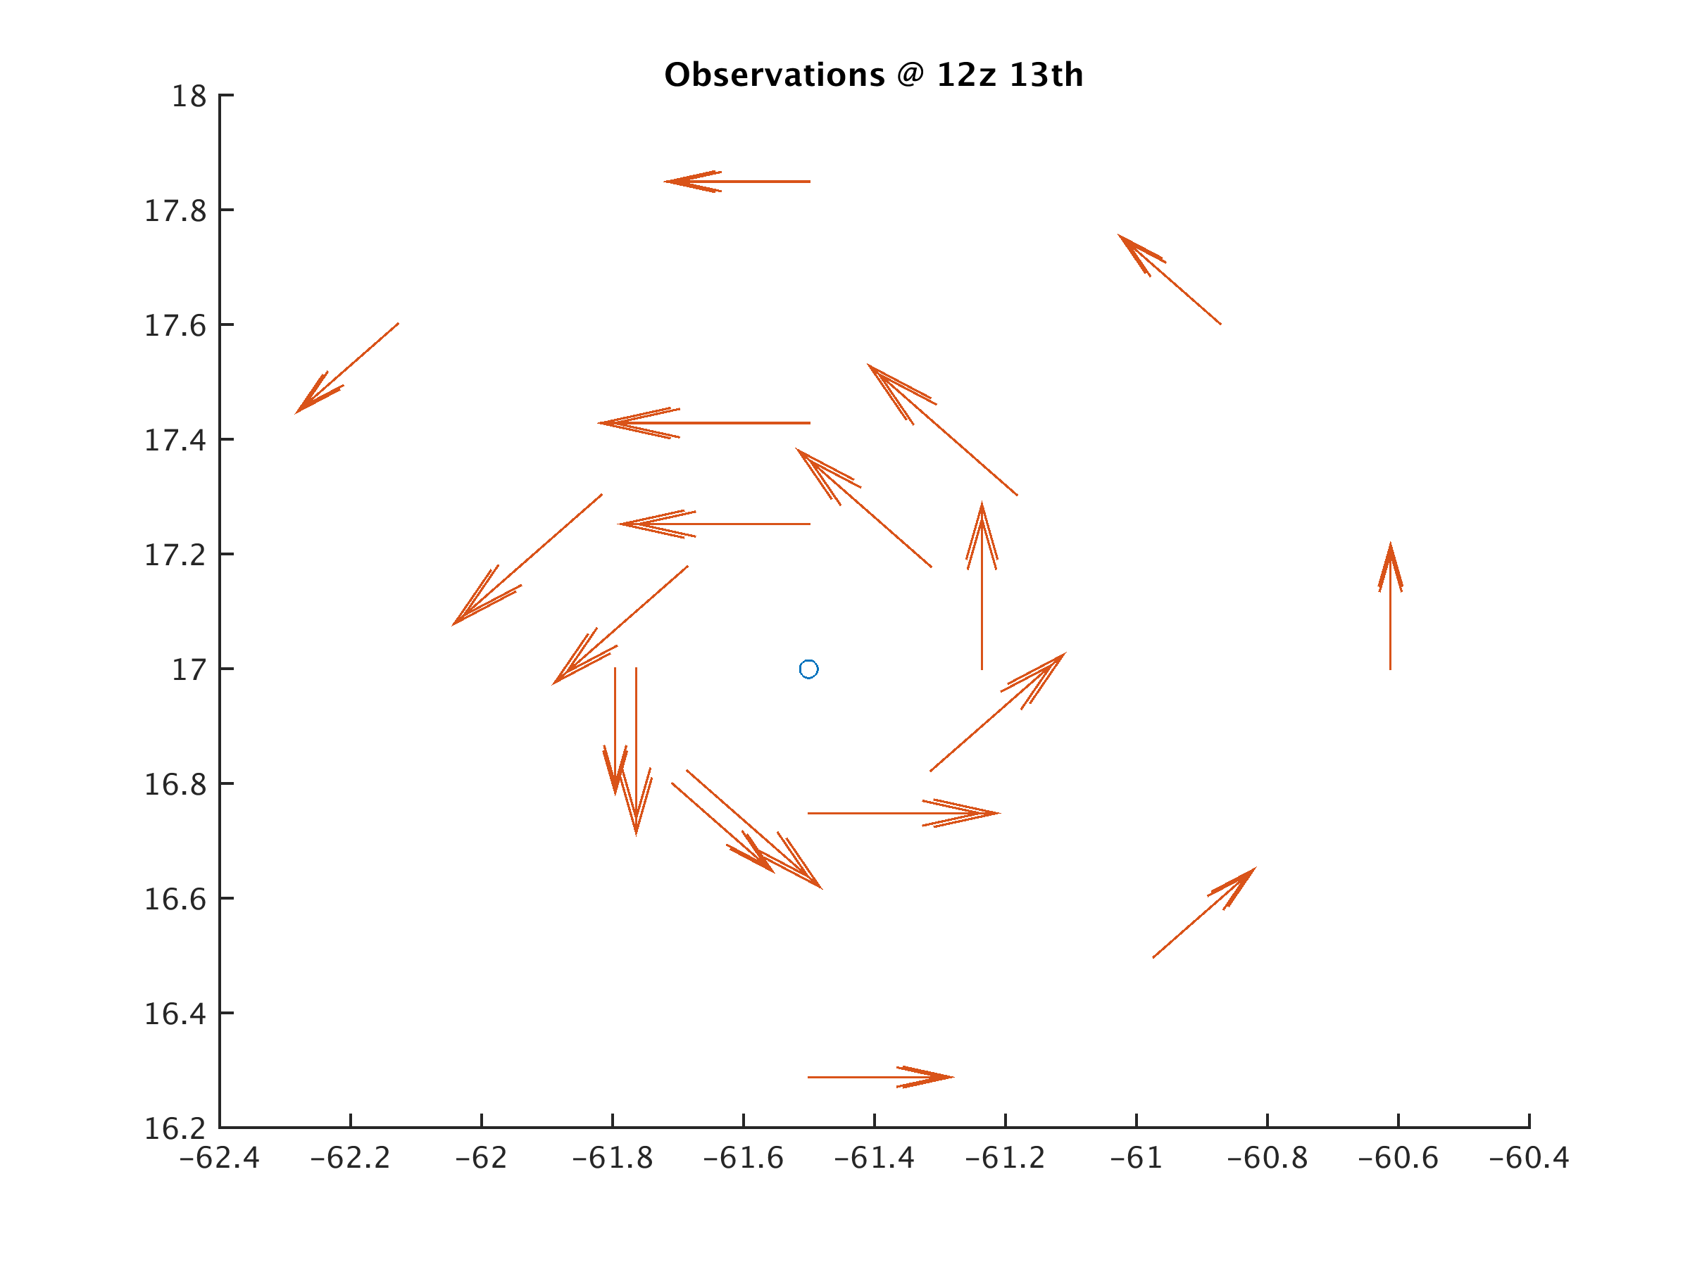
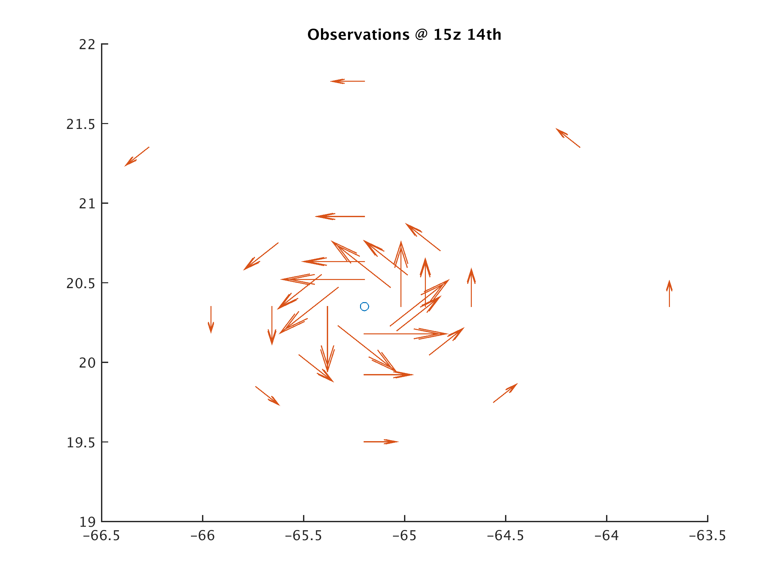
Observations

Slide 7
Gonzalo (2014)
From 12z 13th
Alpha=0.4
Initial intensity of 50 kts according to TCV

Slide 8
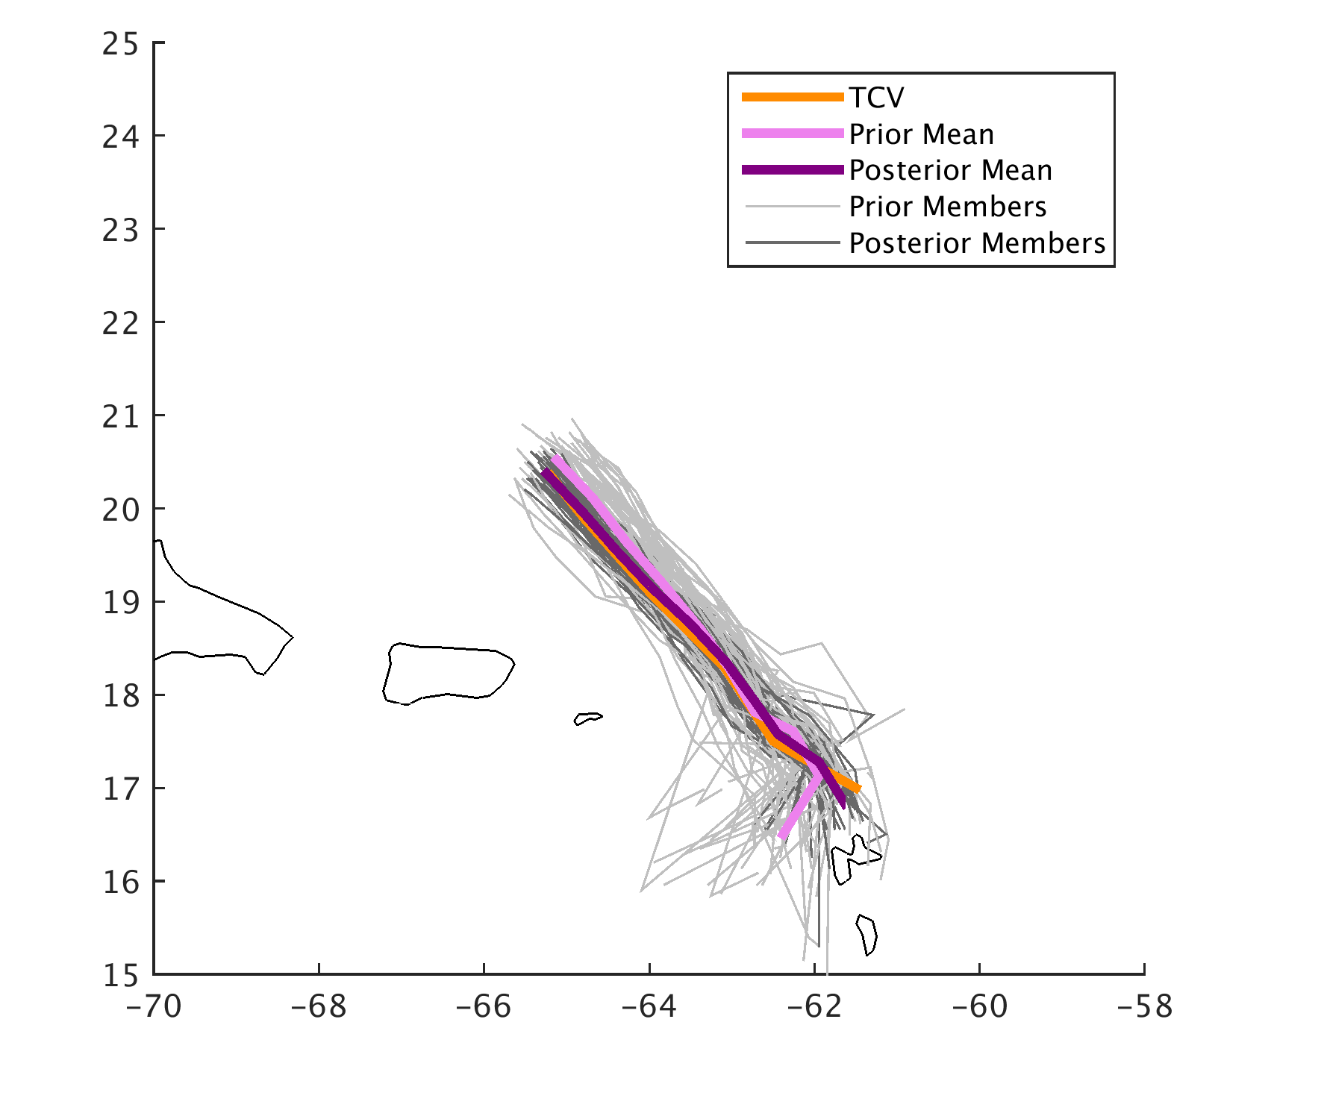
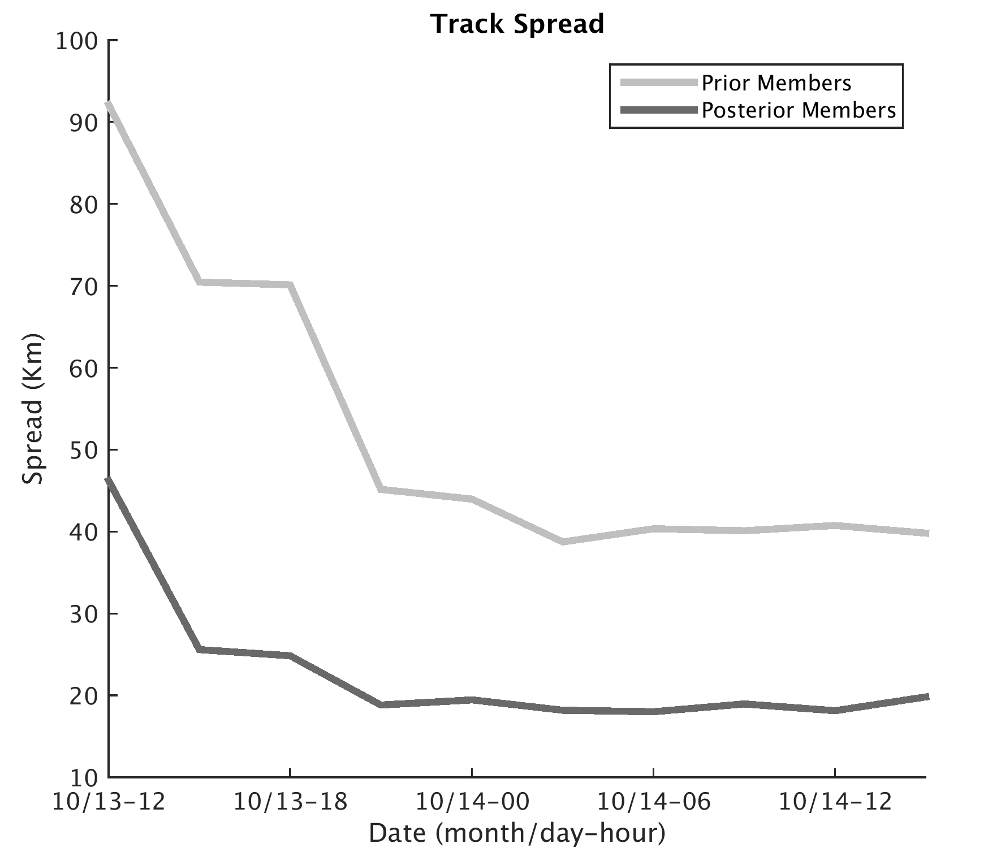

Slide 9
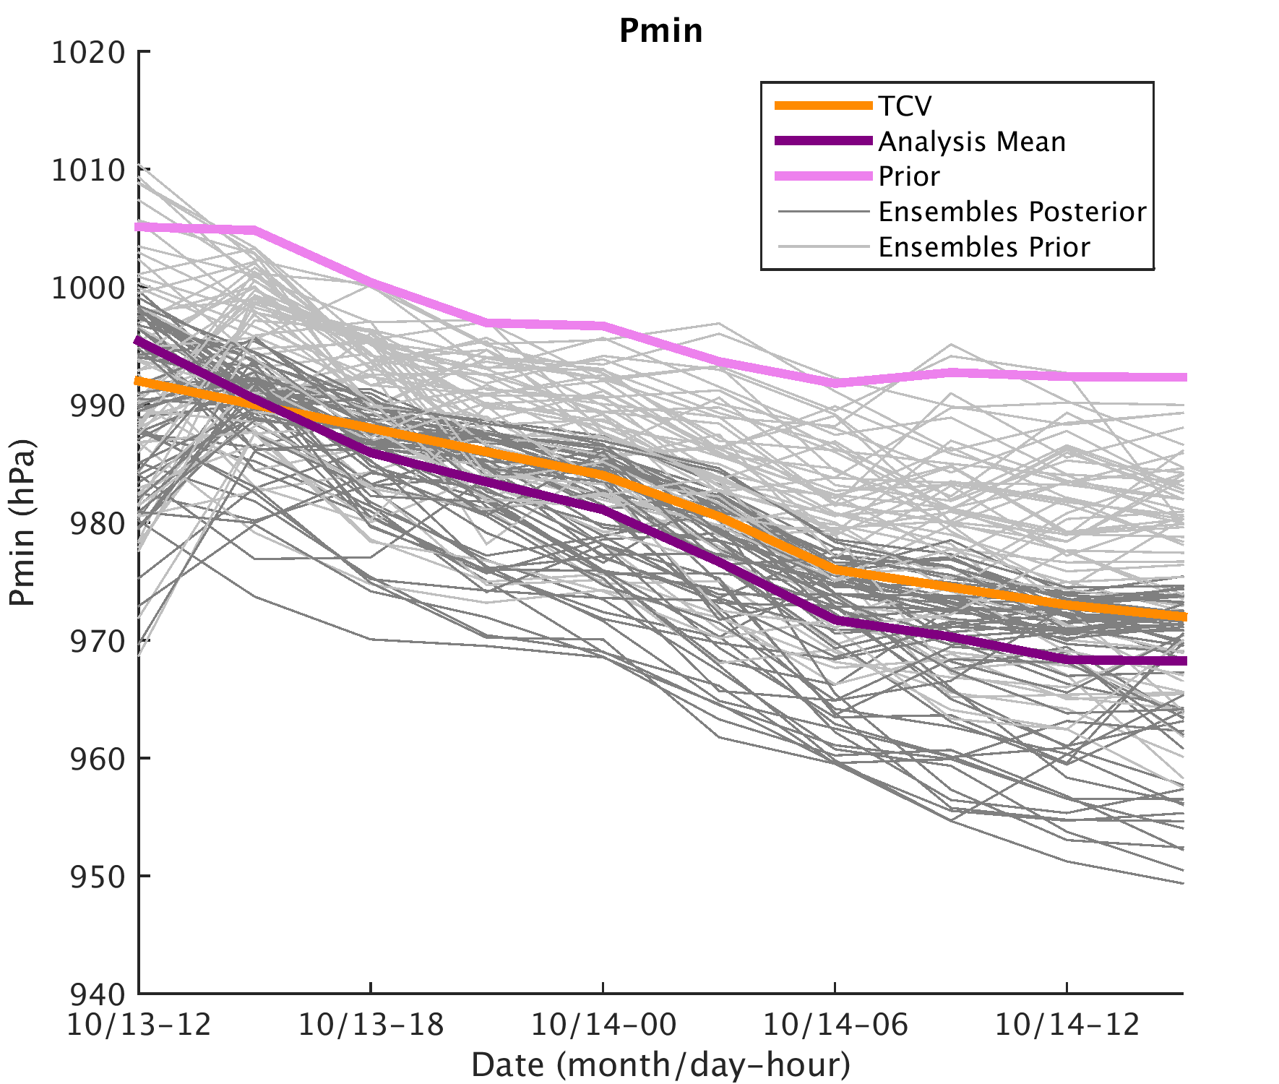
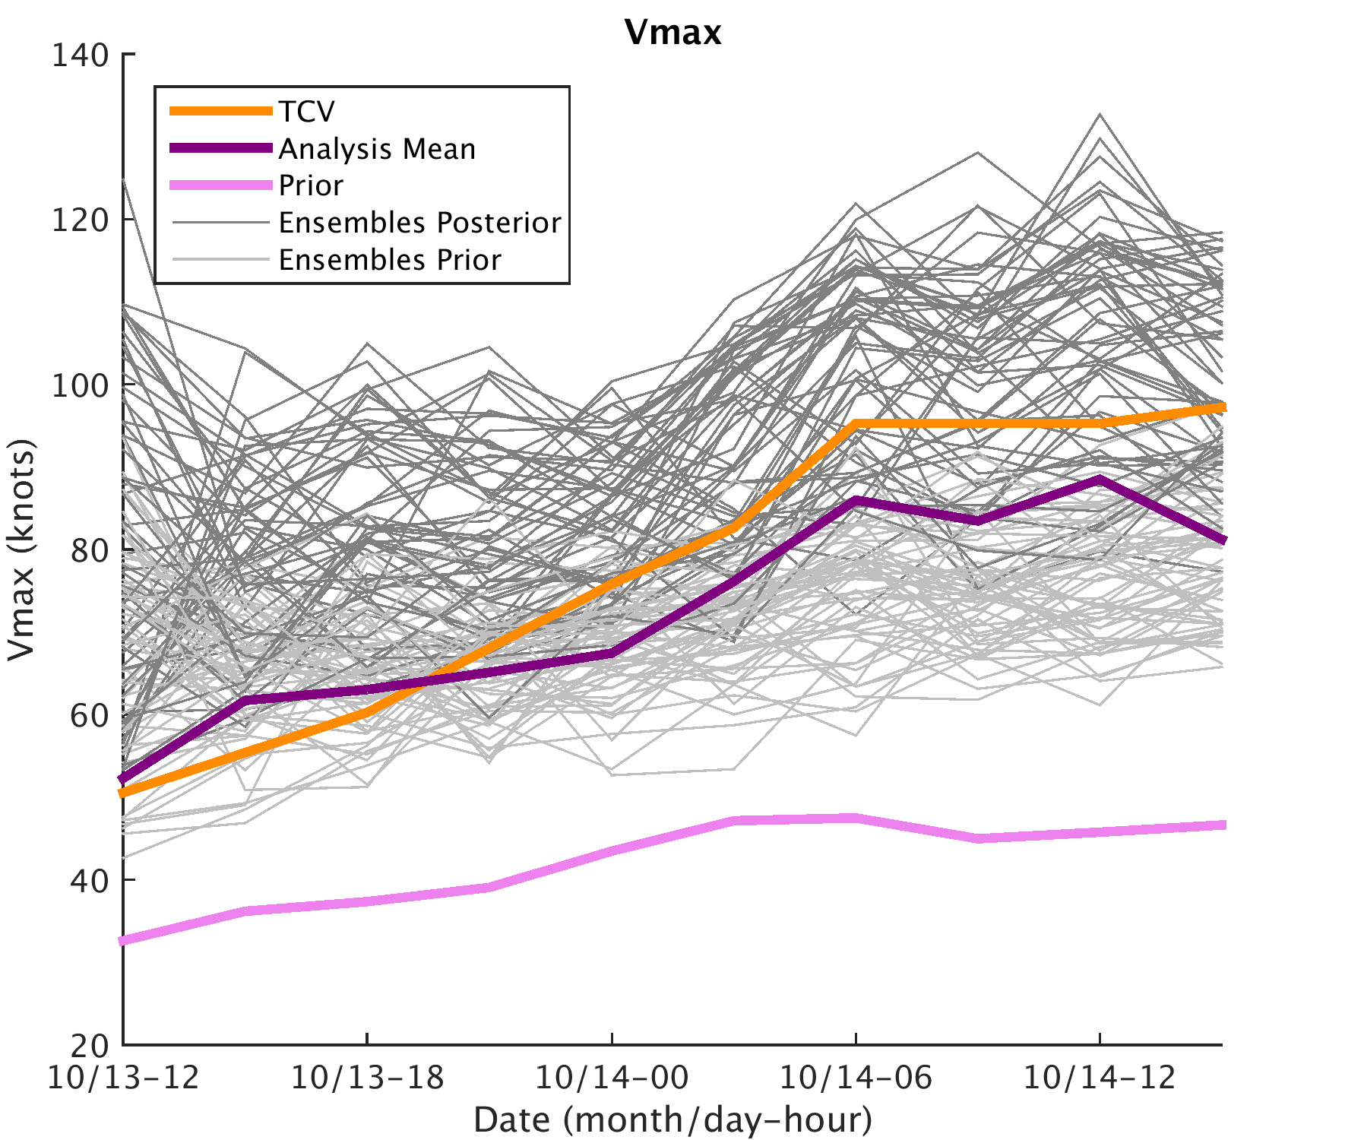

Slide 10
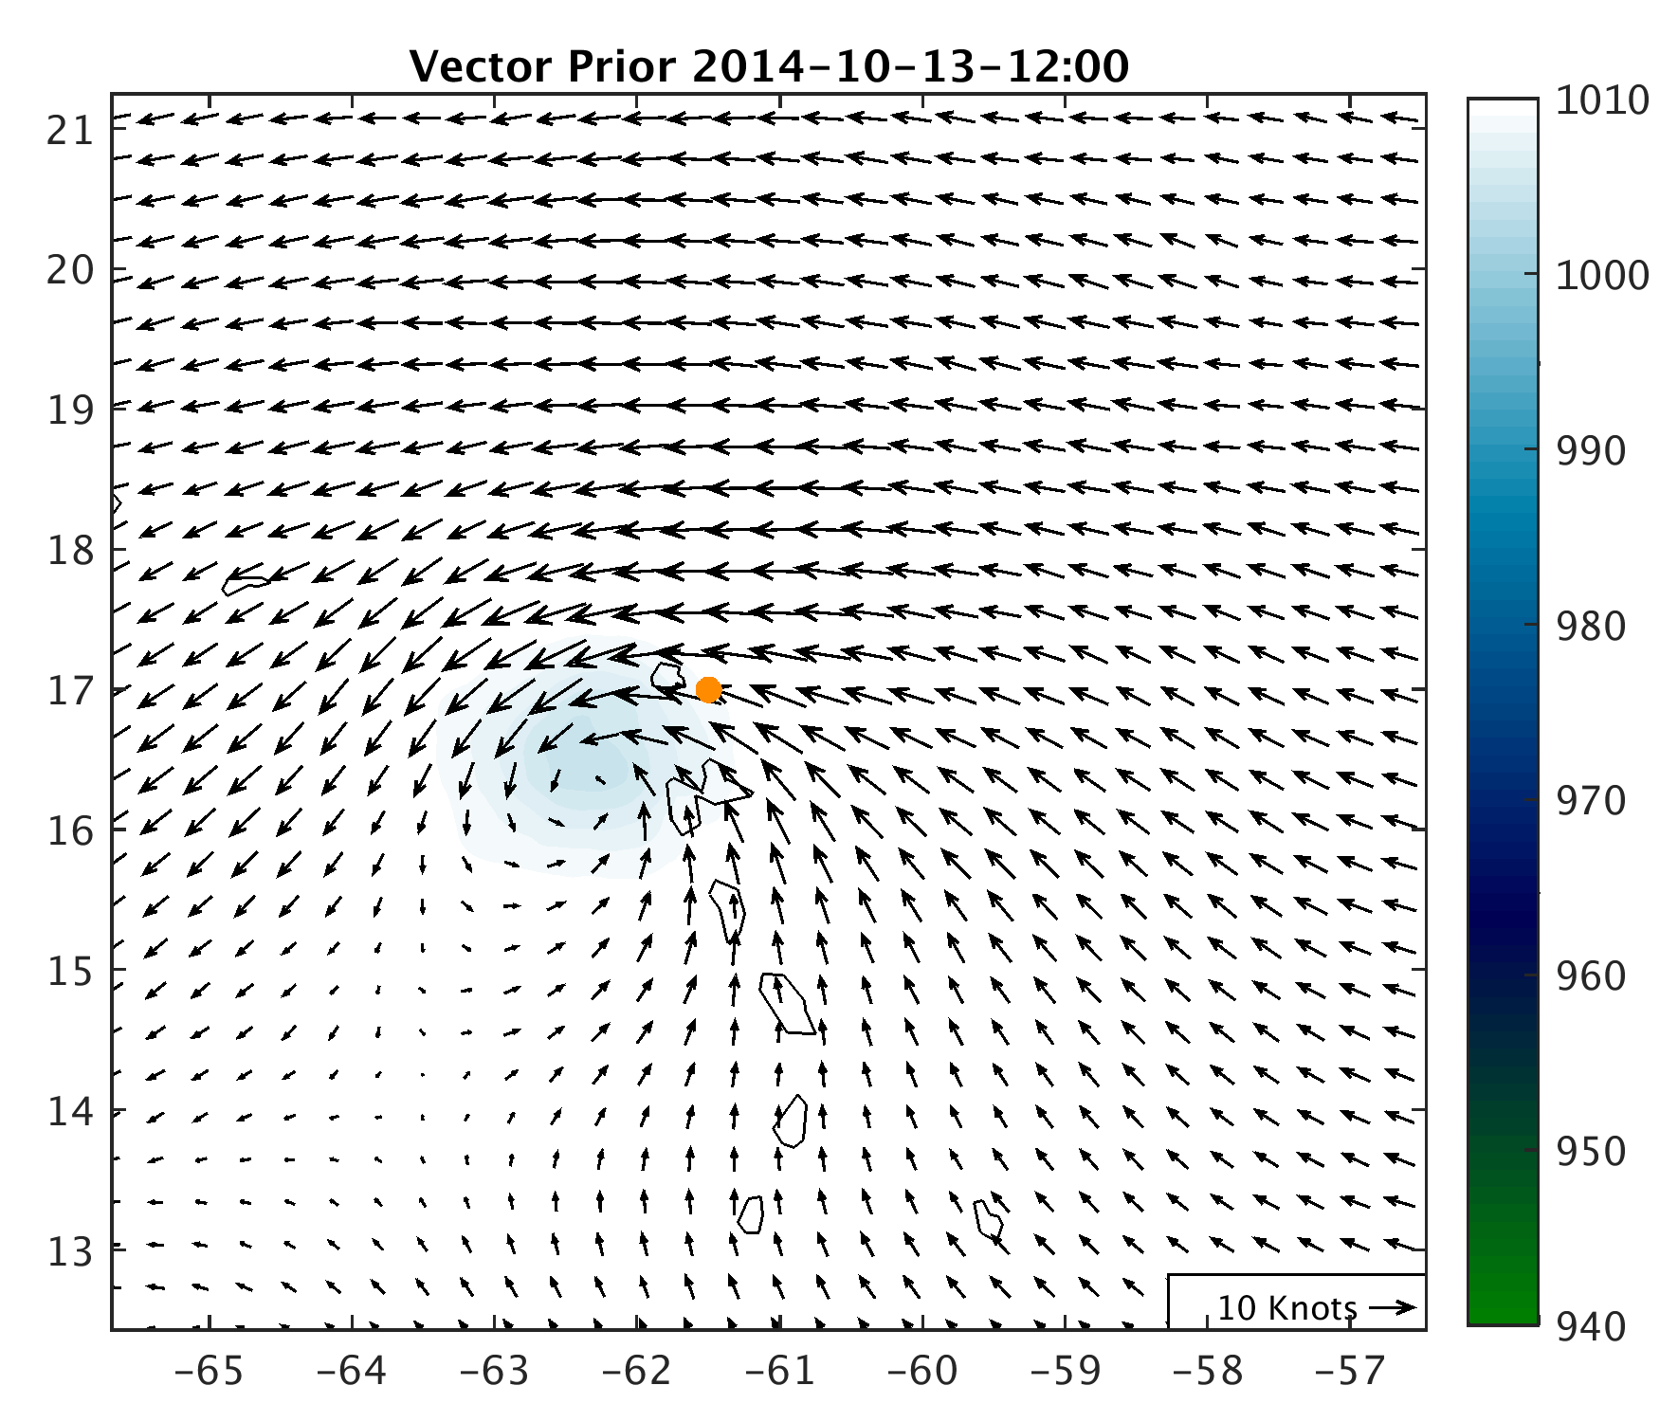
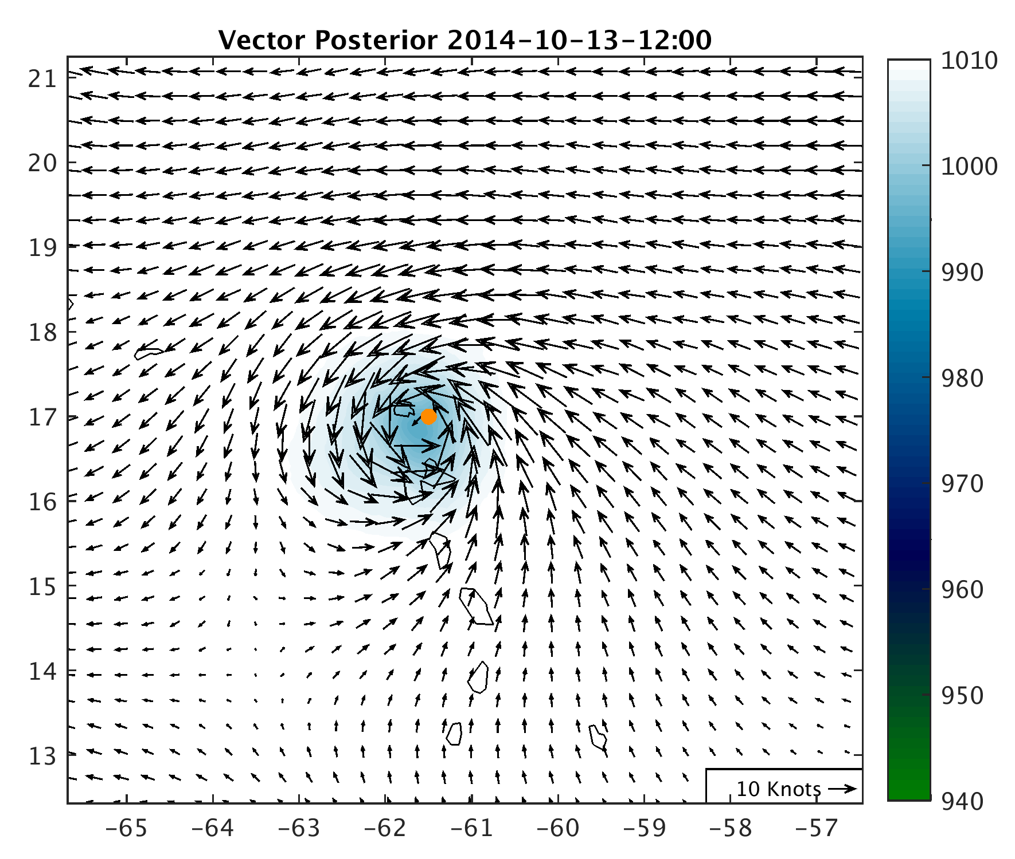
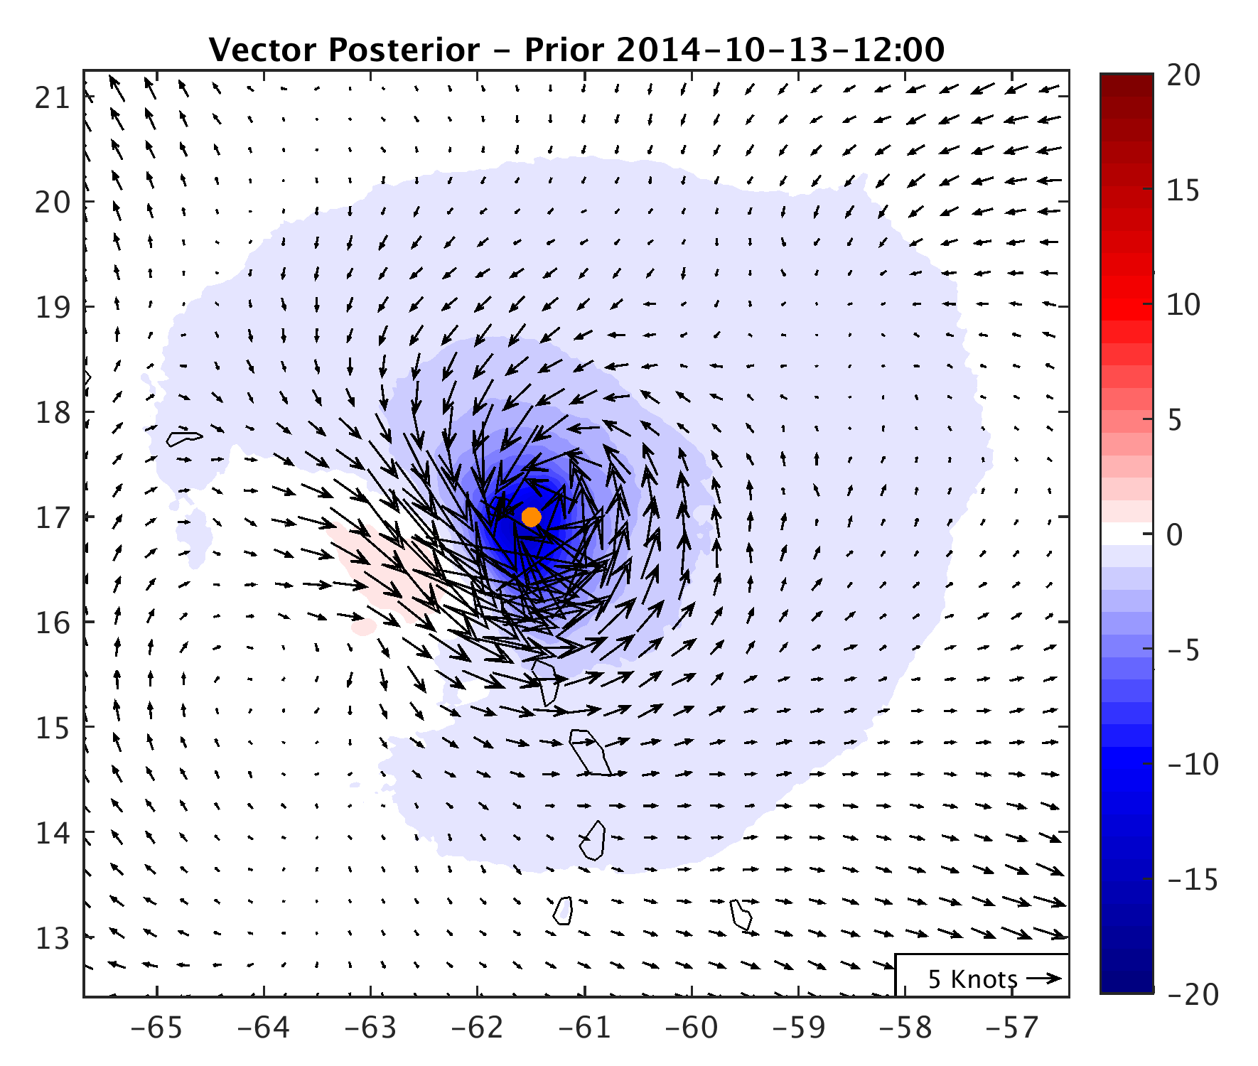
Orange dot represents TCV center

Slide 11
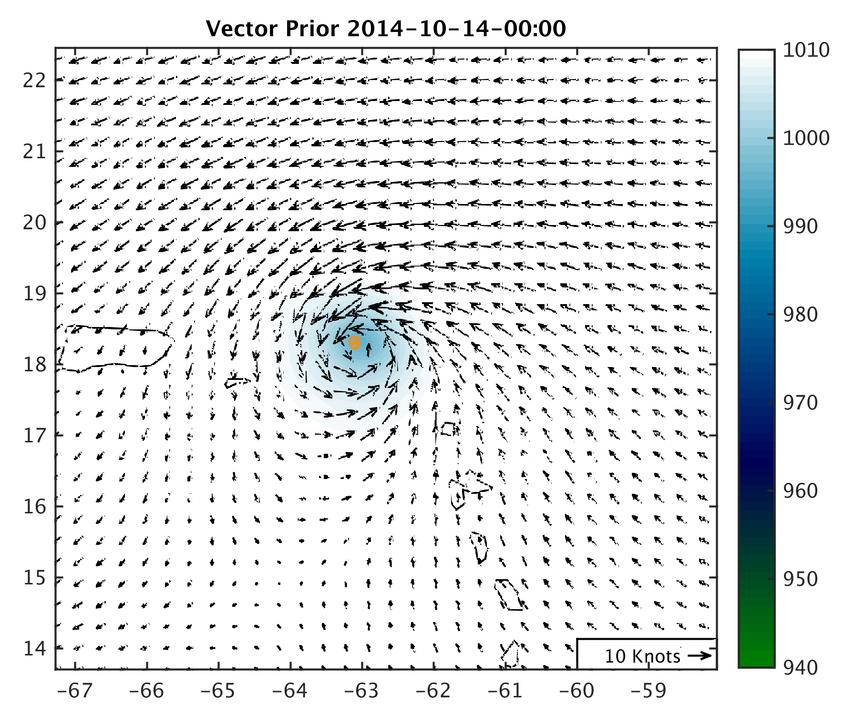
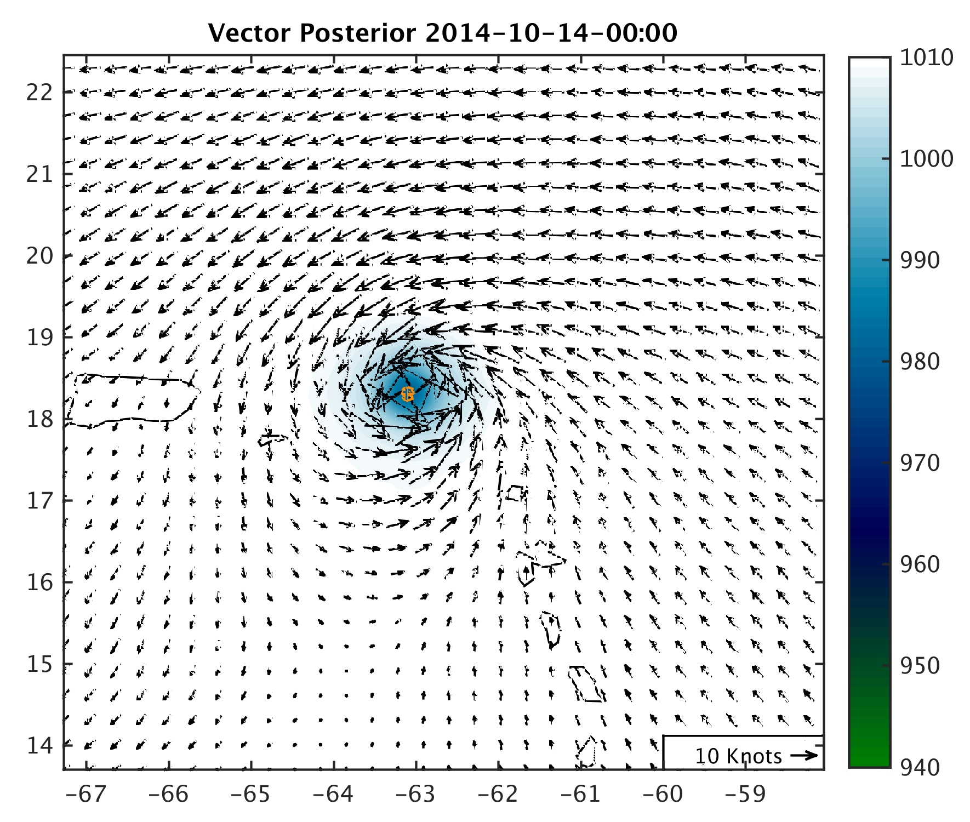
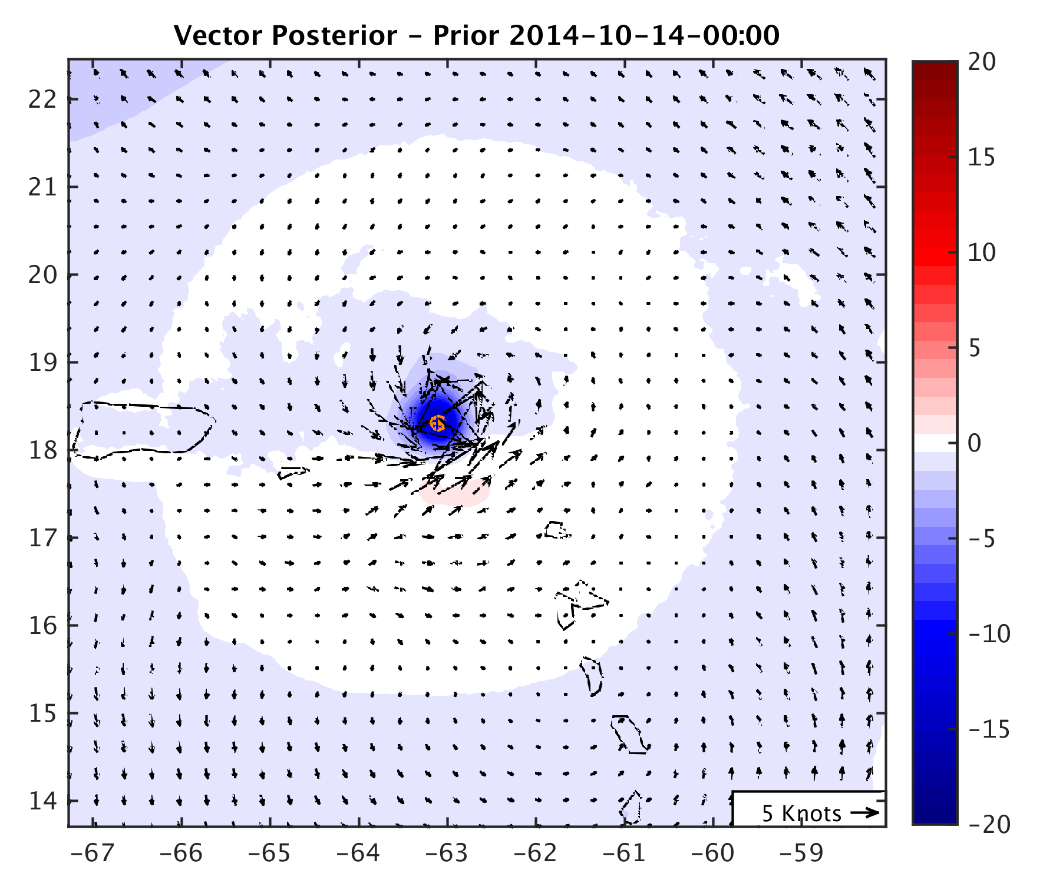
Orange dot represents TCV center

Slide 12
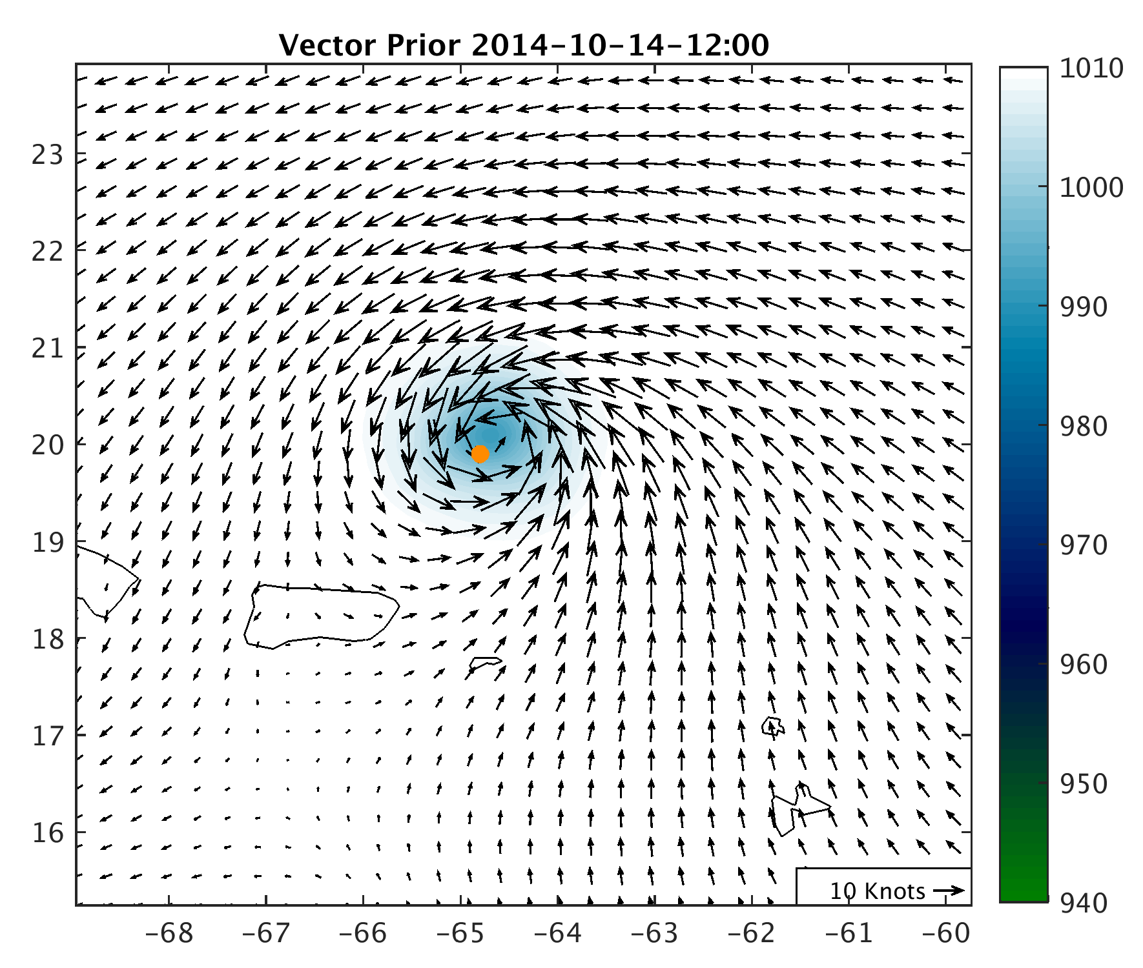
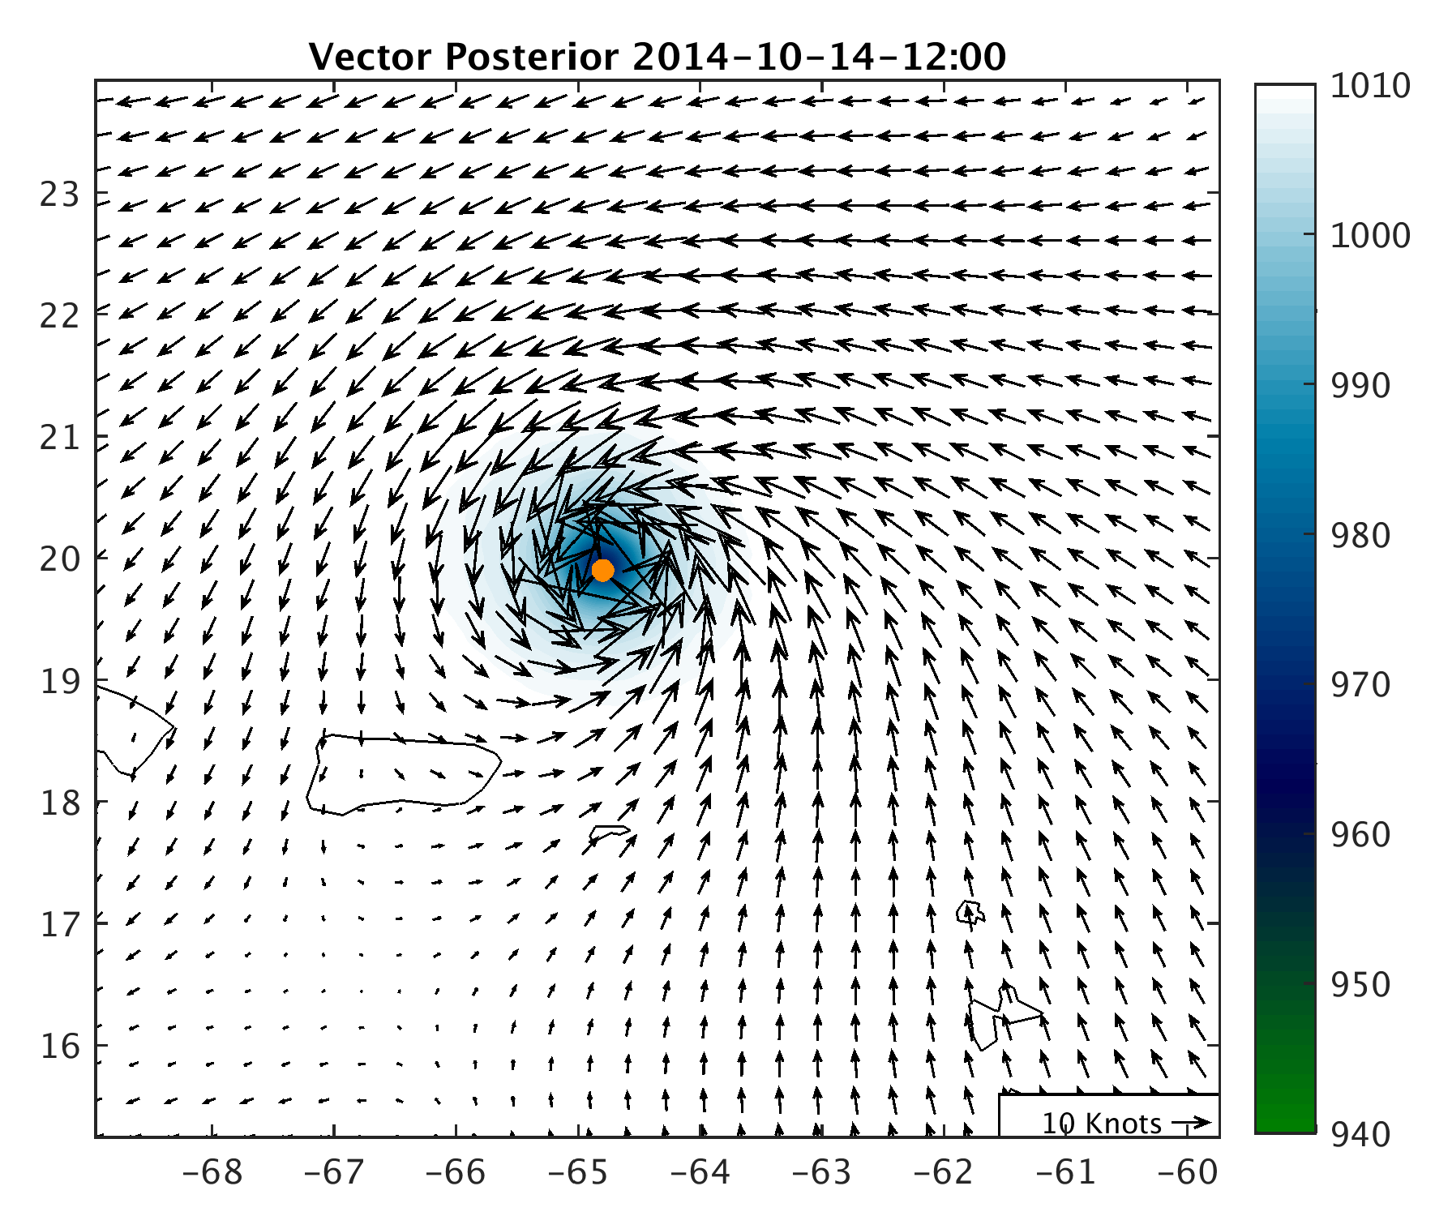
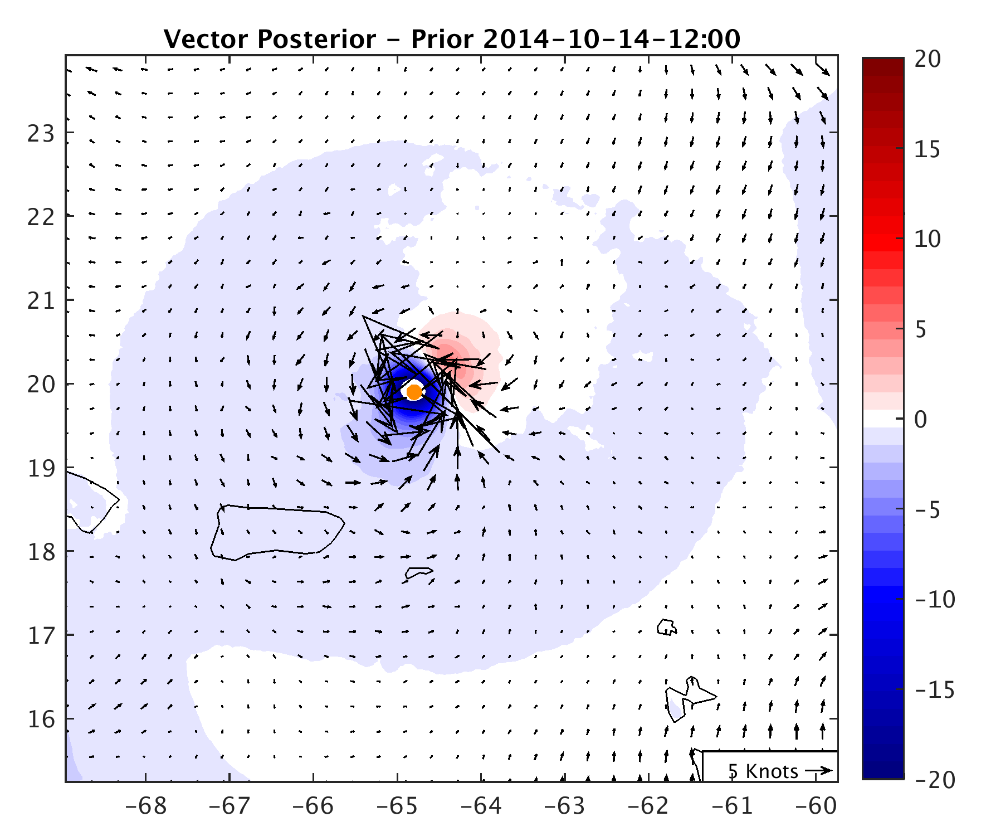
Orange dot represents TCV center

Slide 13
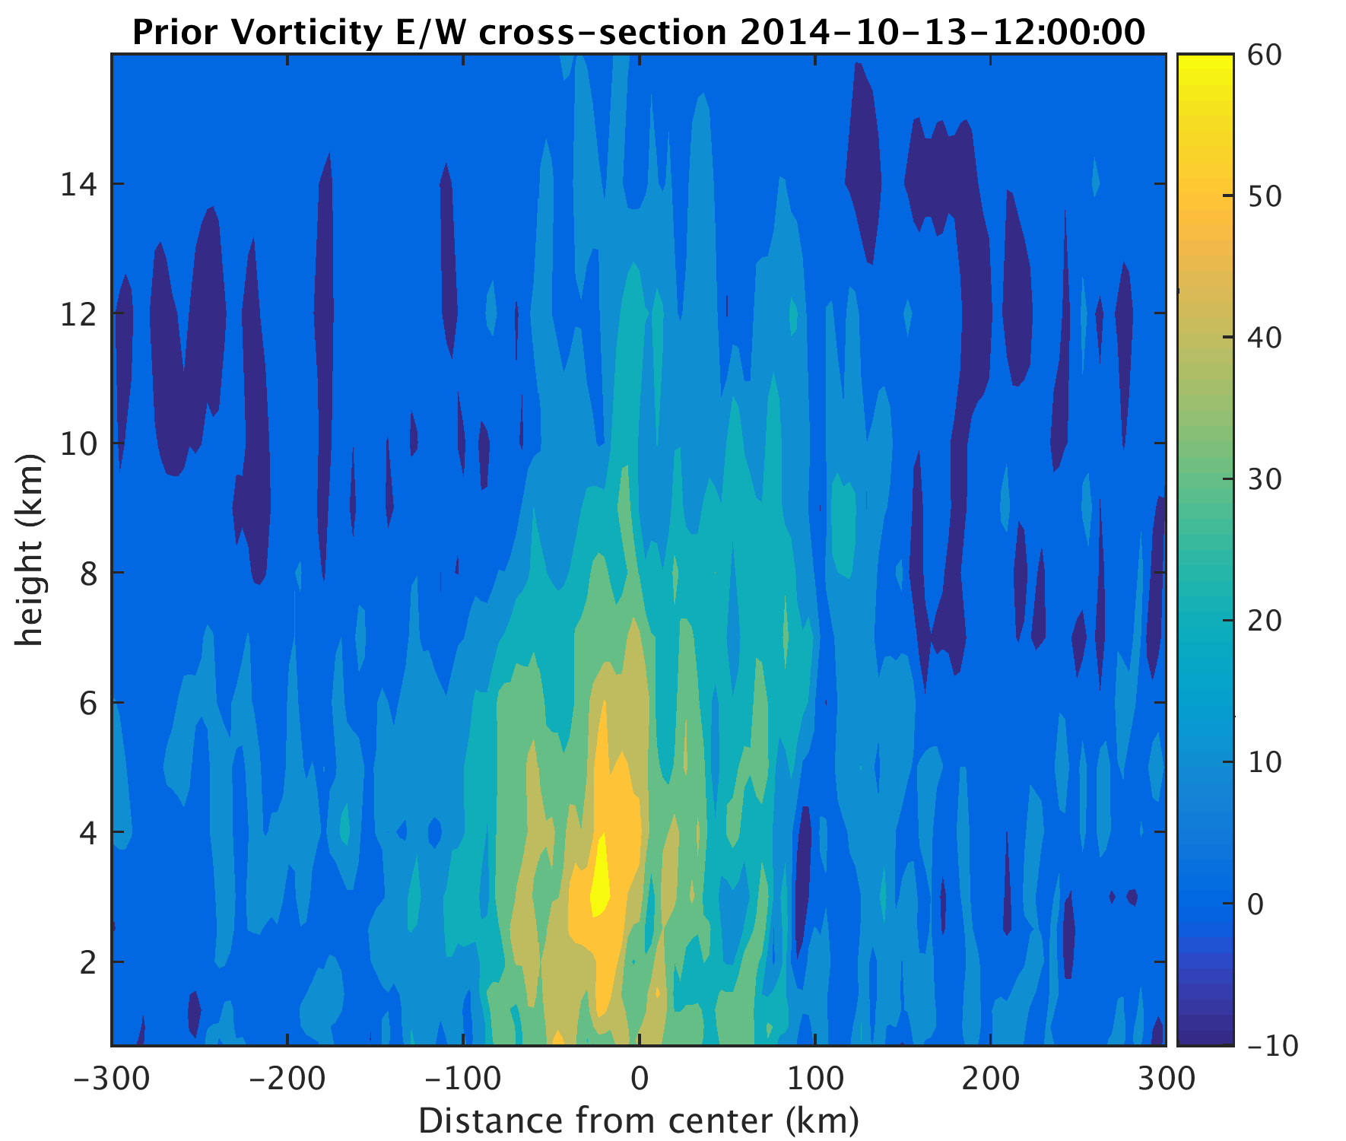
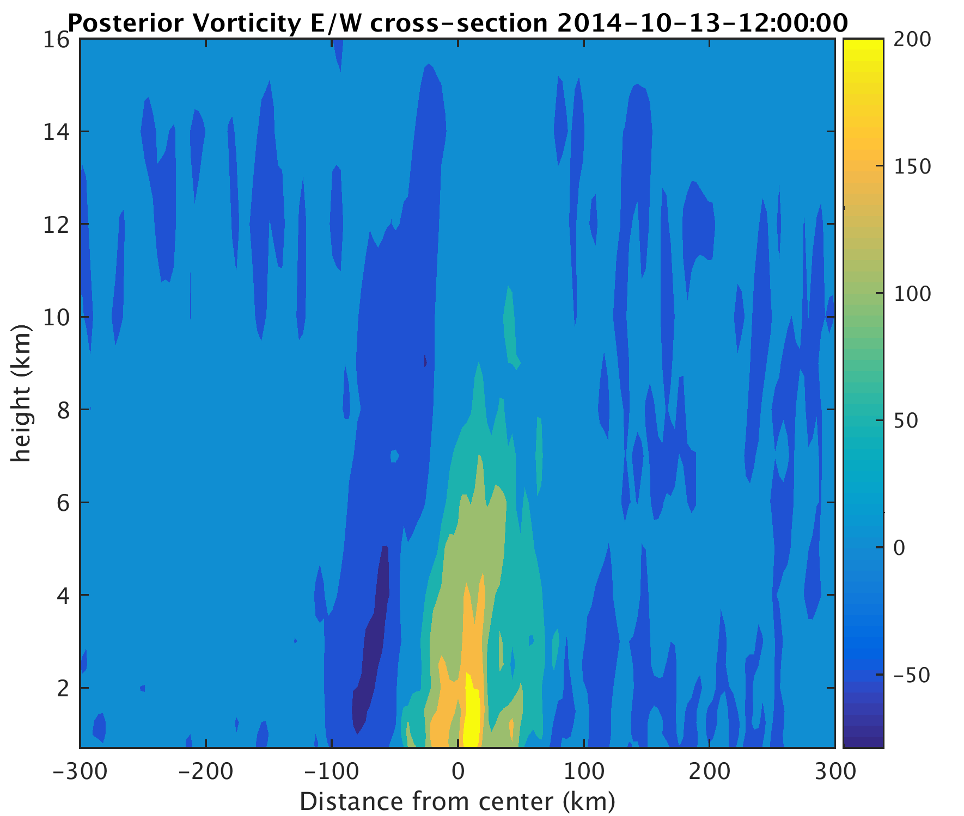
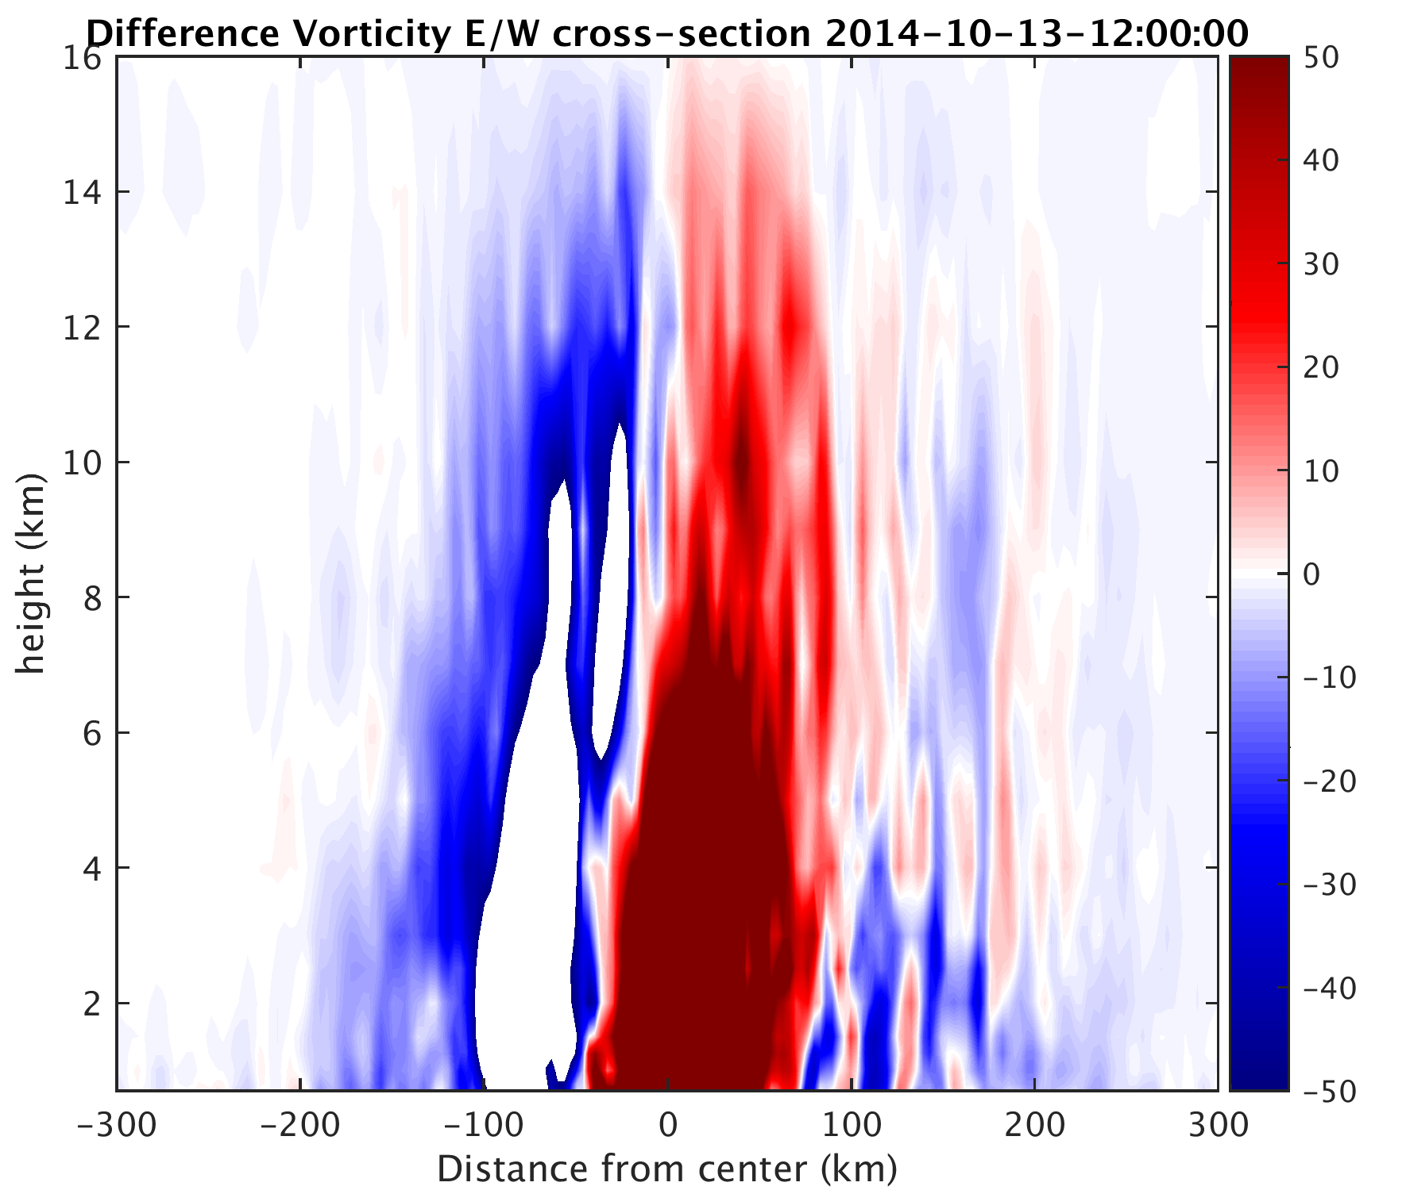
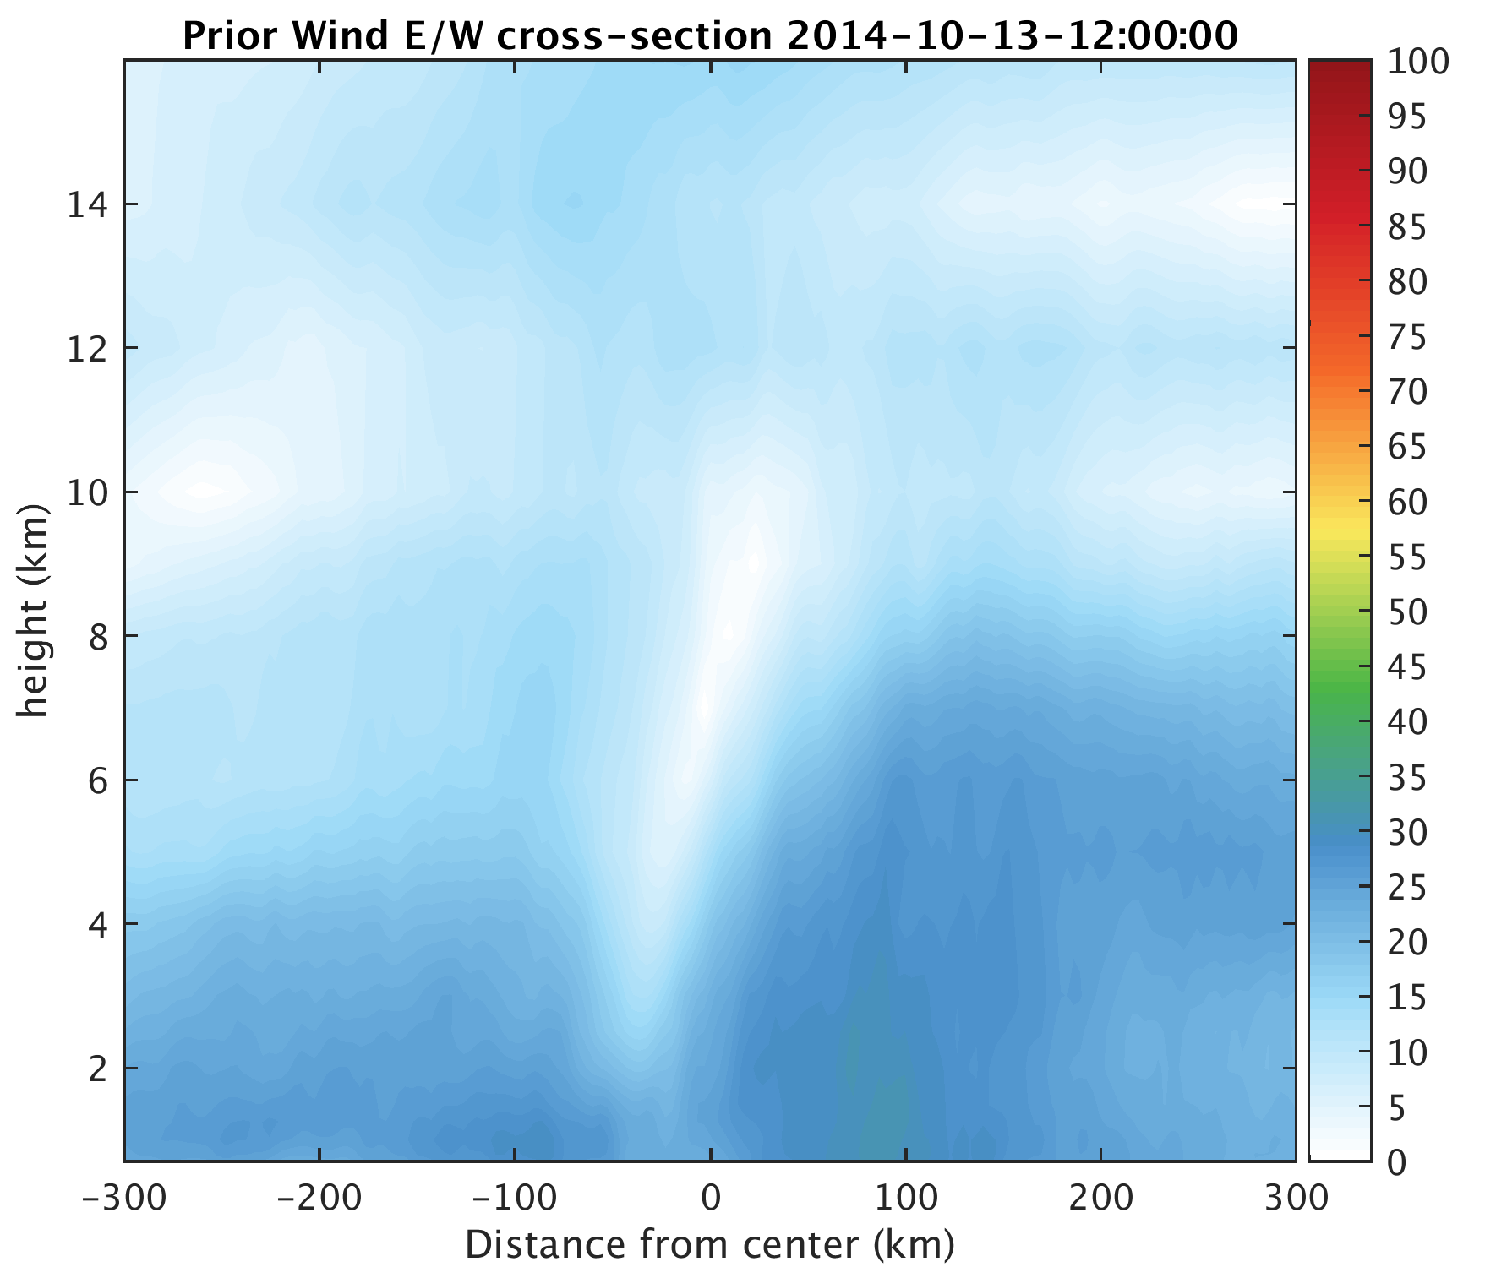
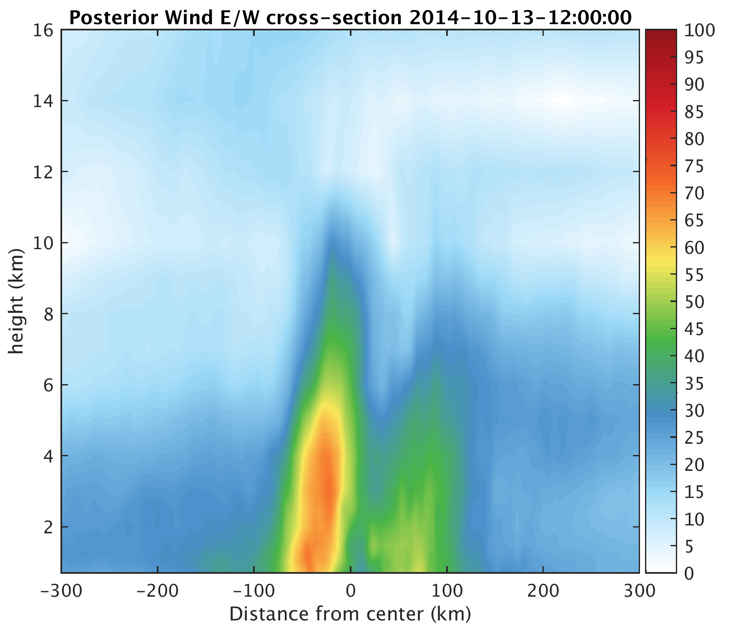
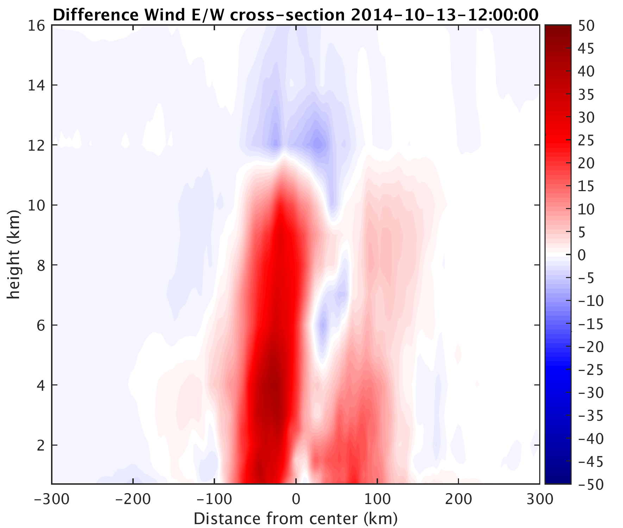

Slide 14
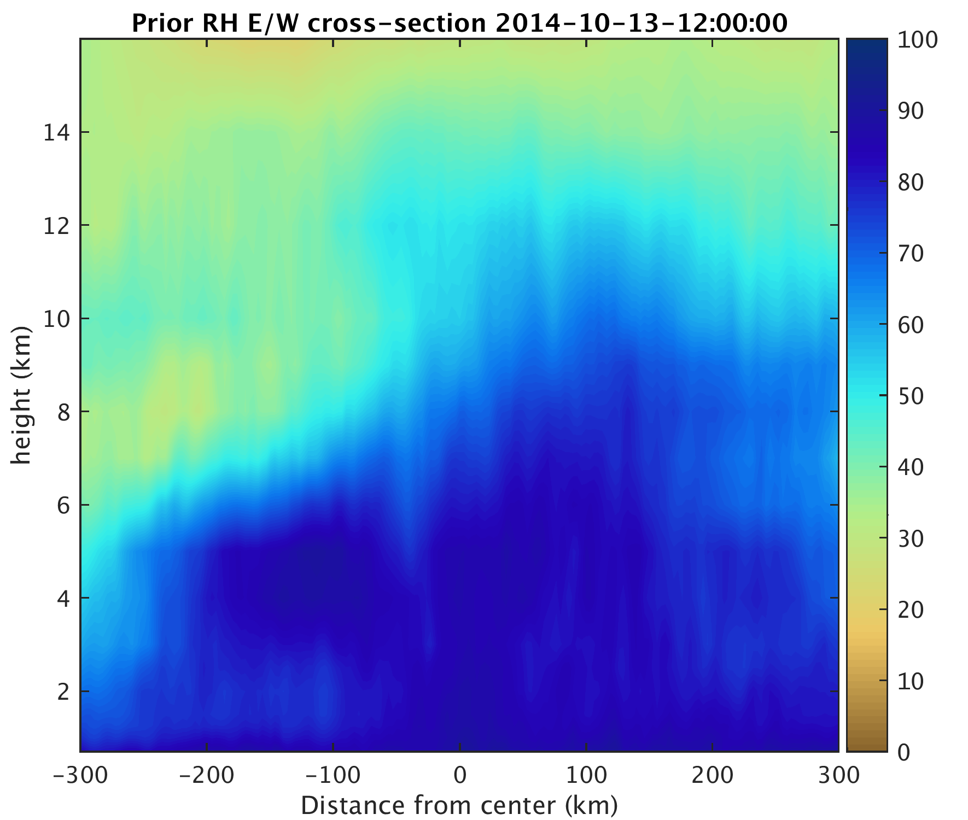
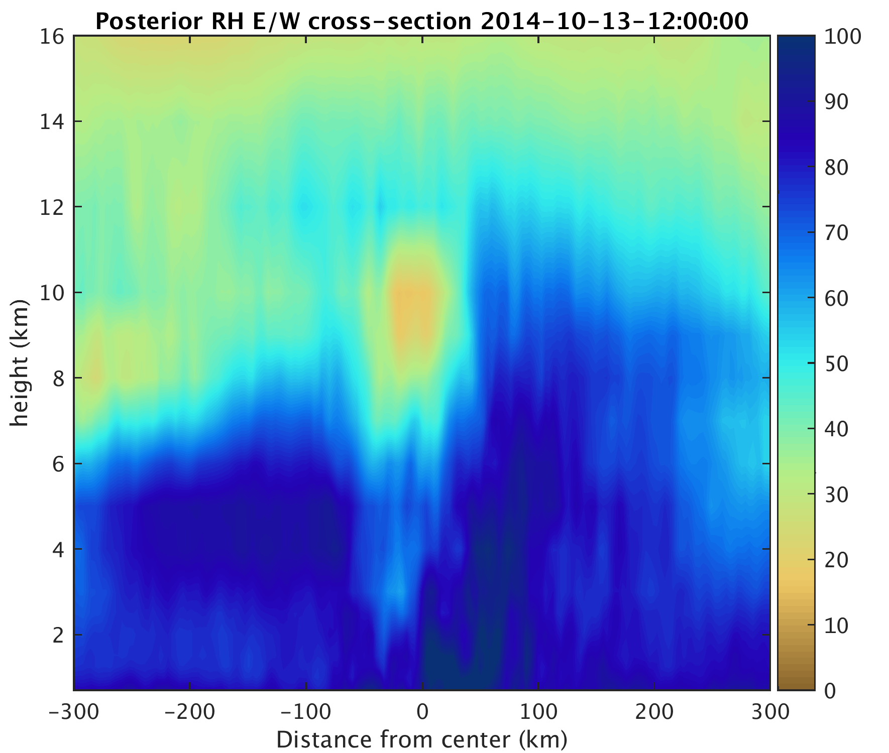
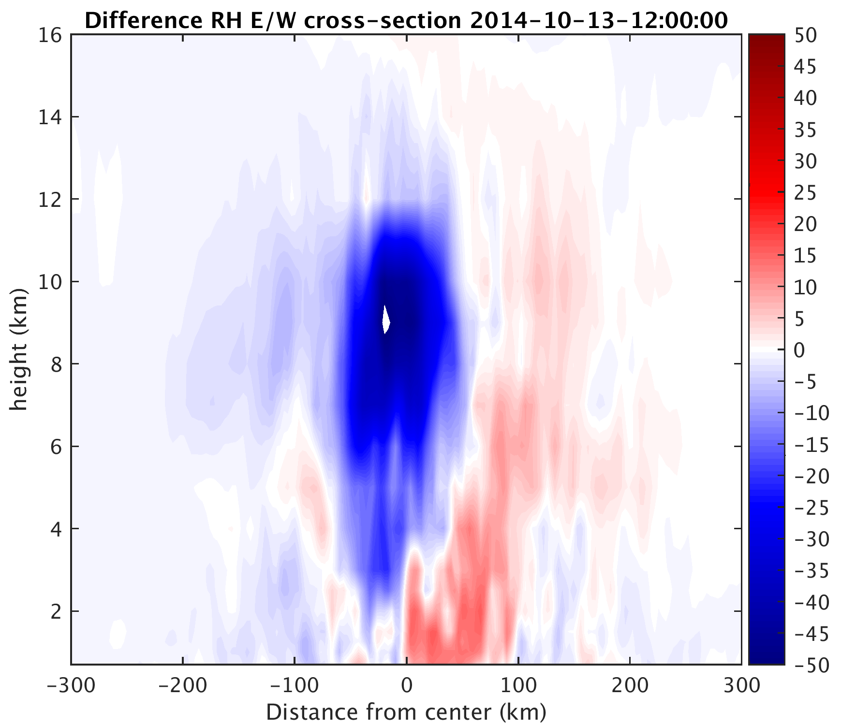
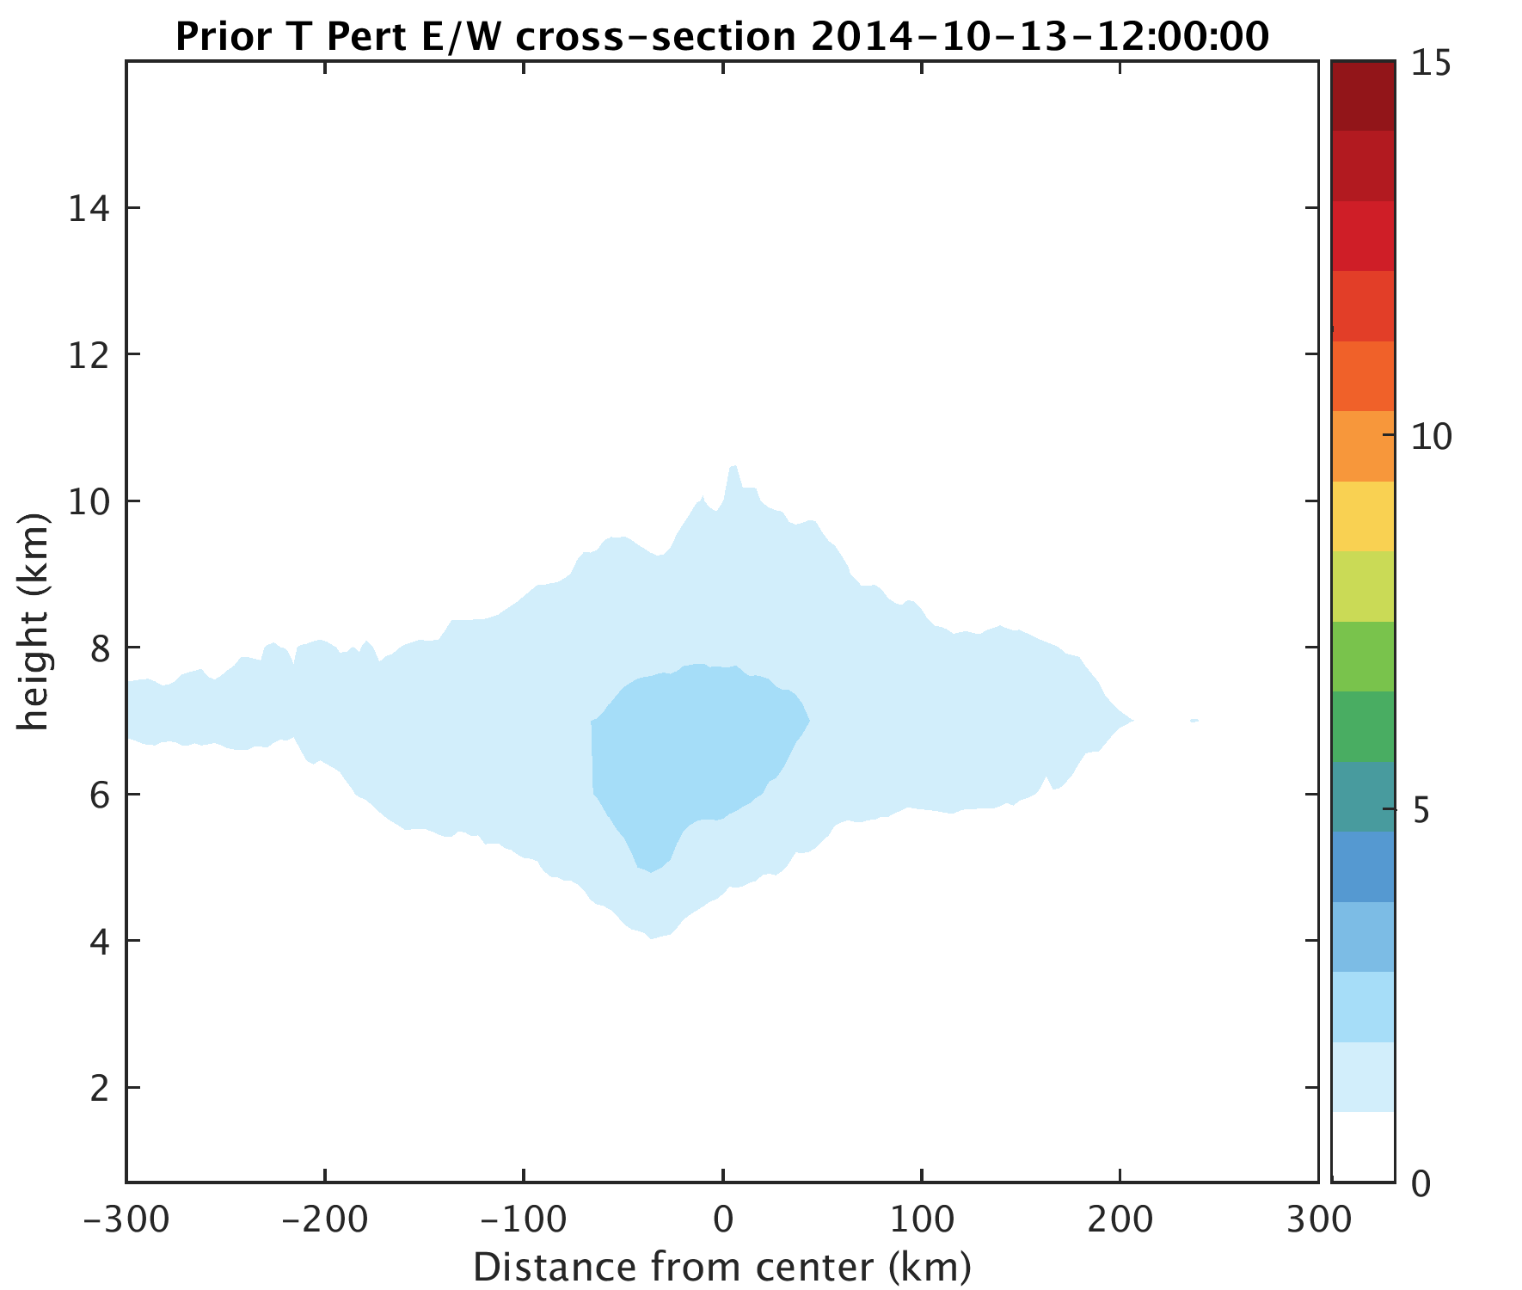
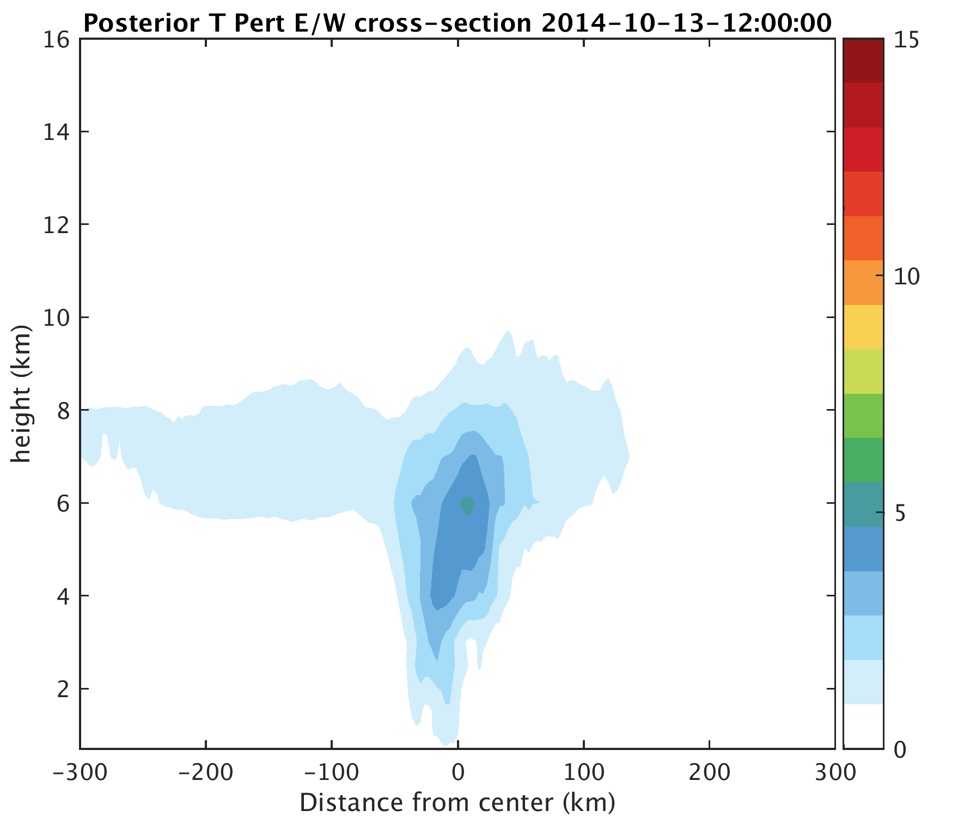
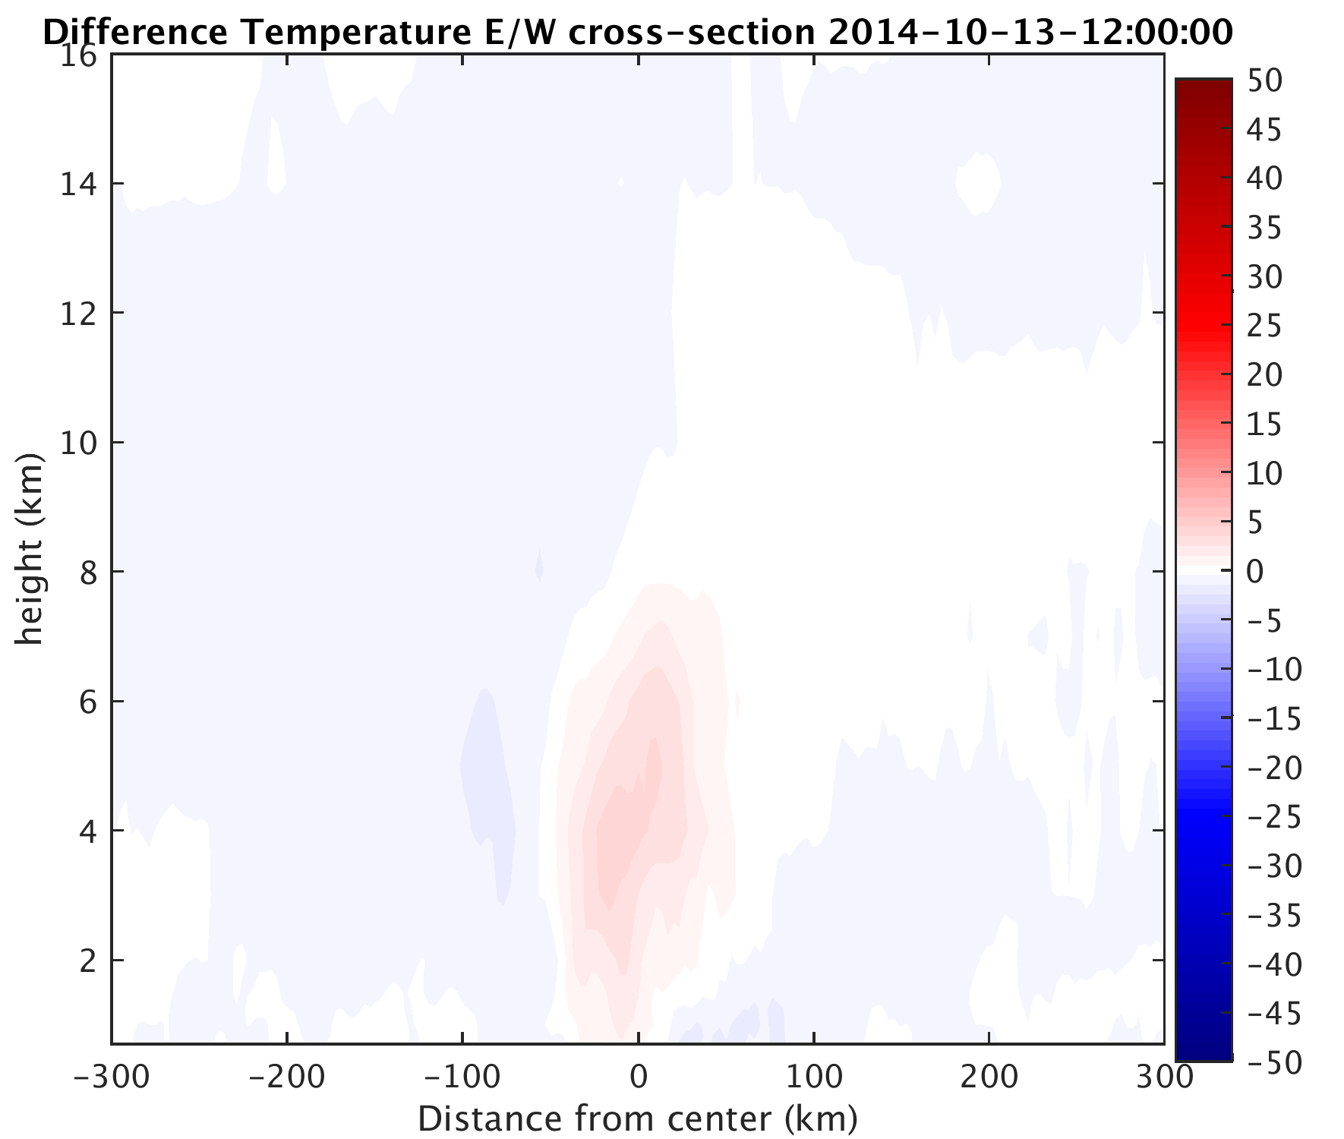

Slide 15
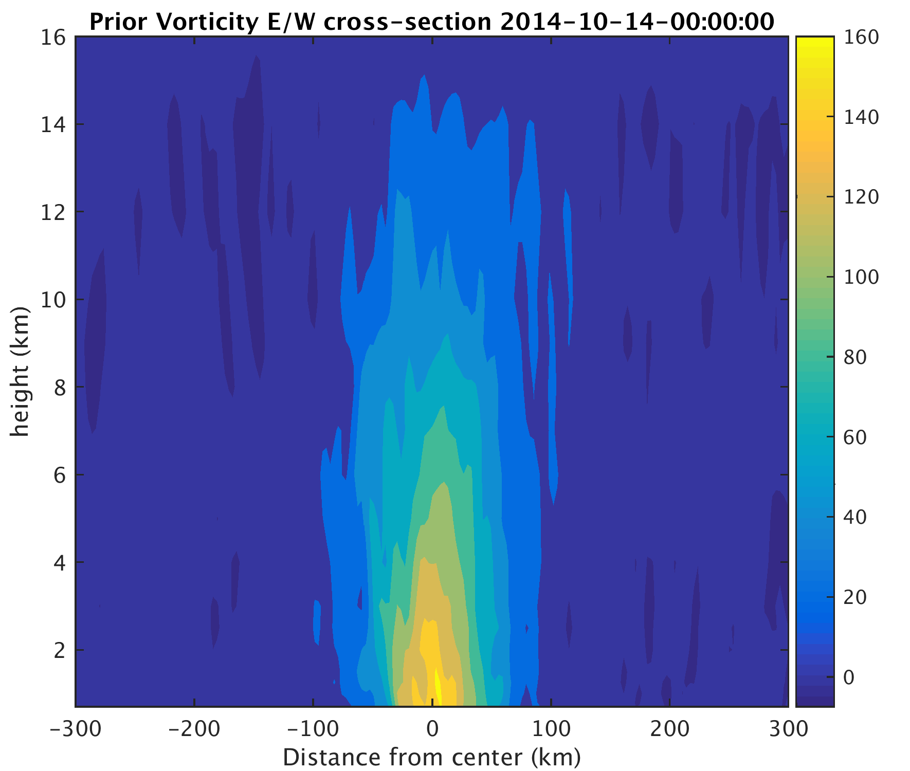
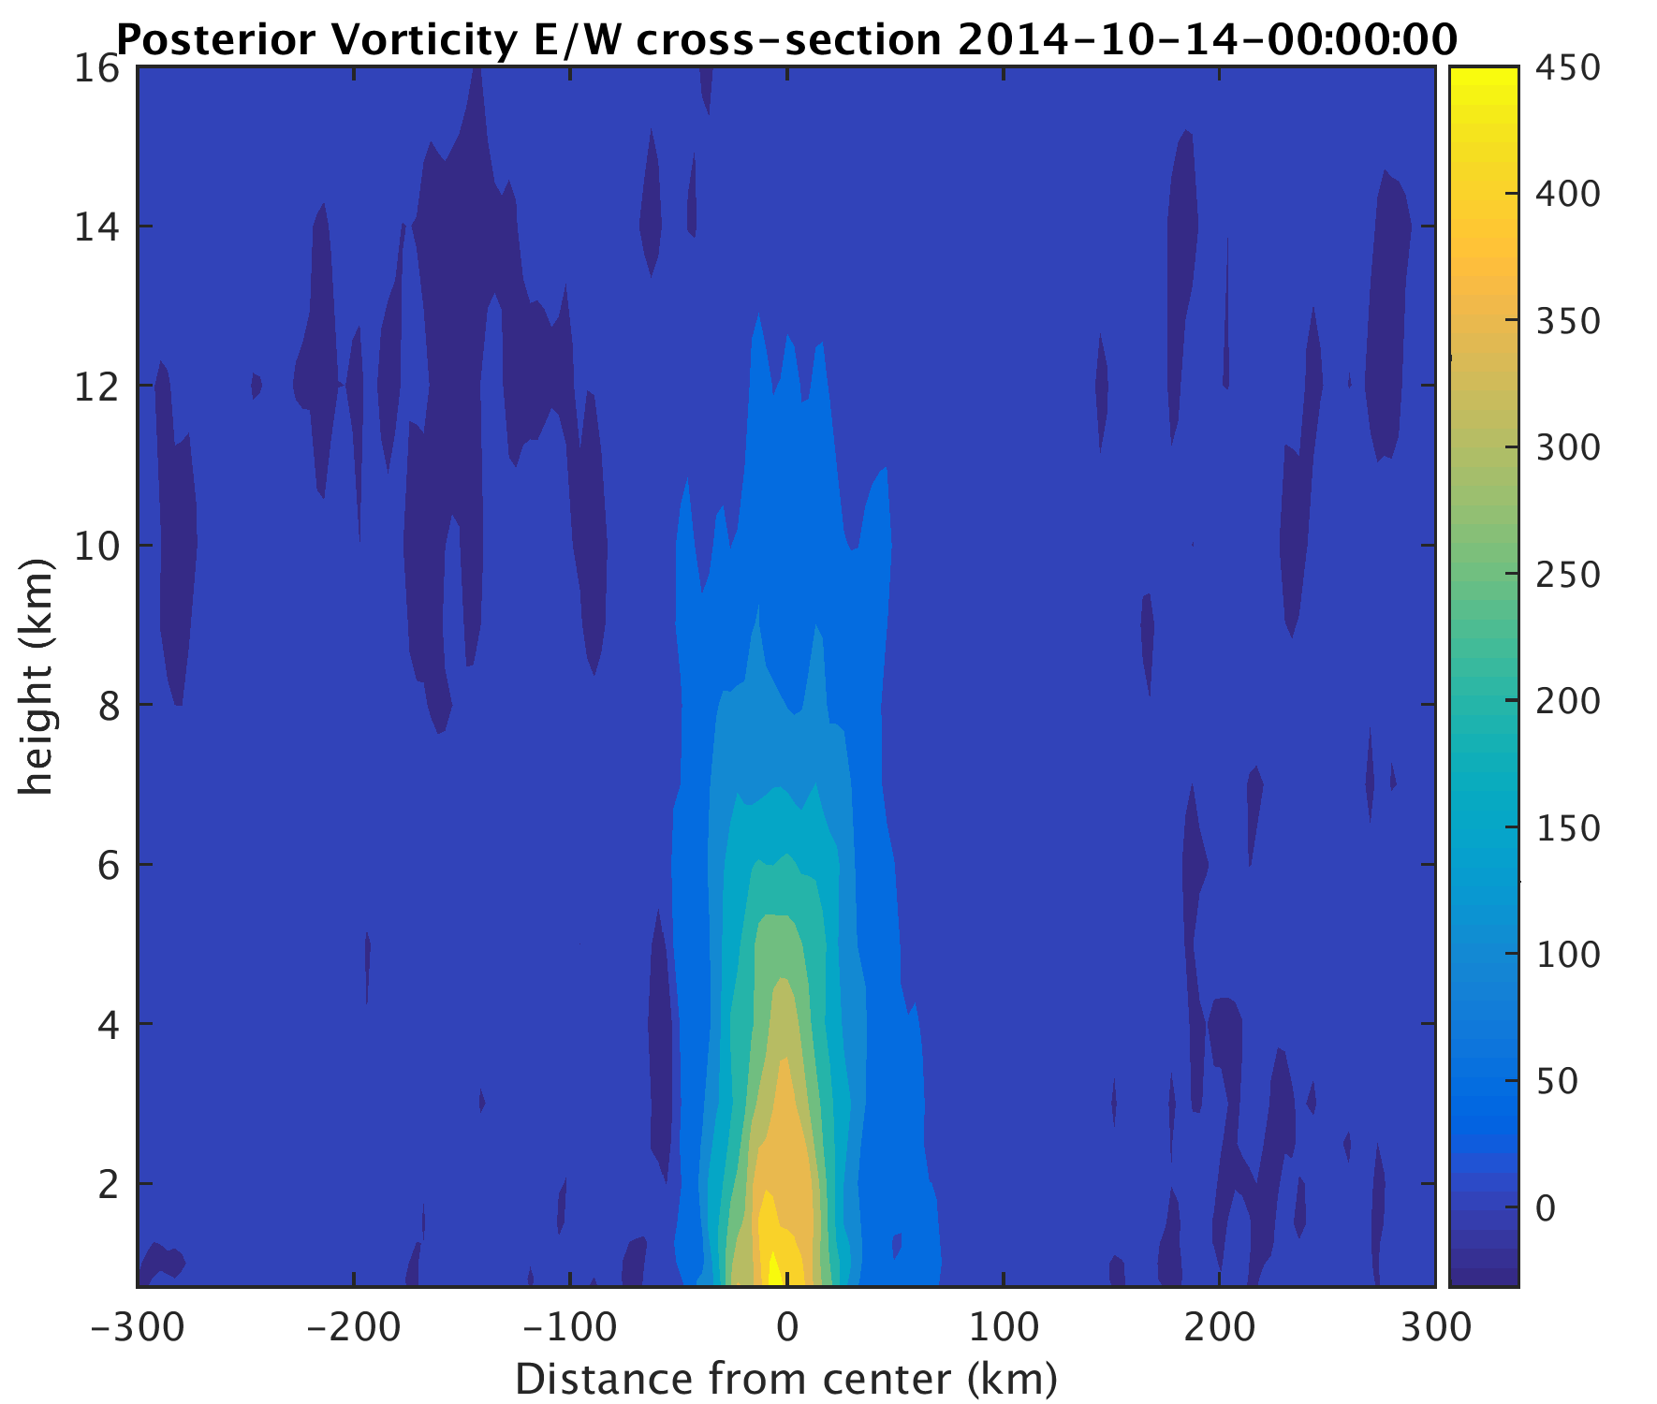
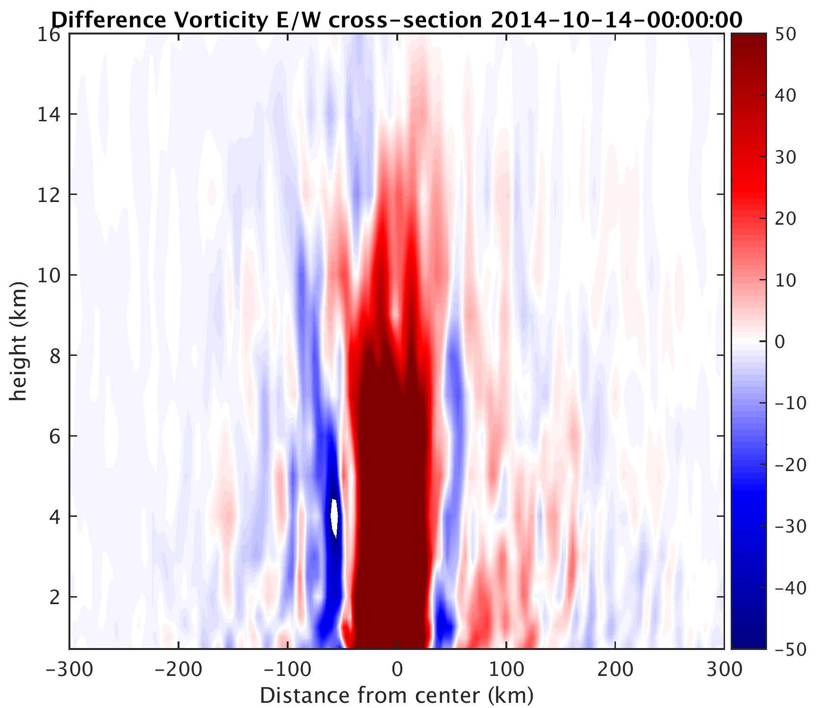
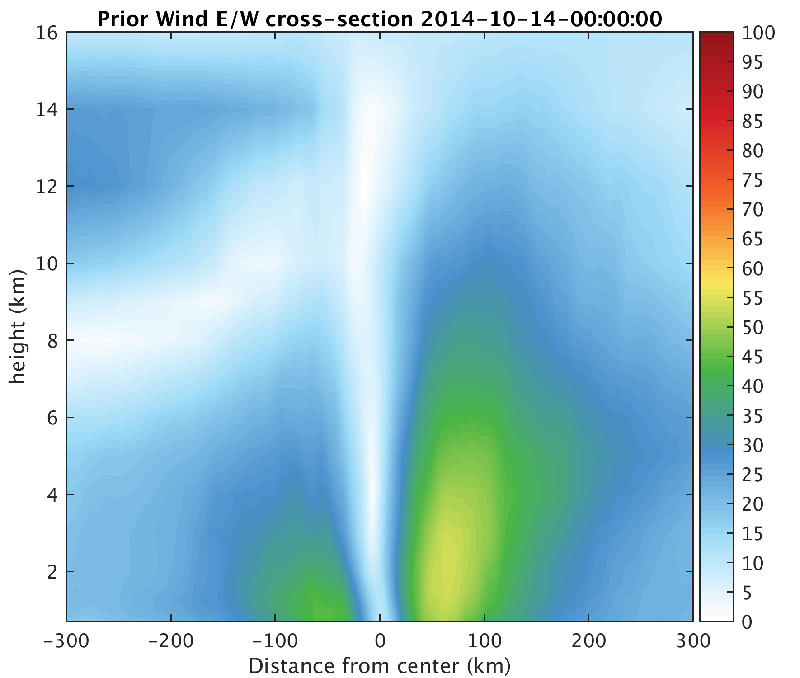
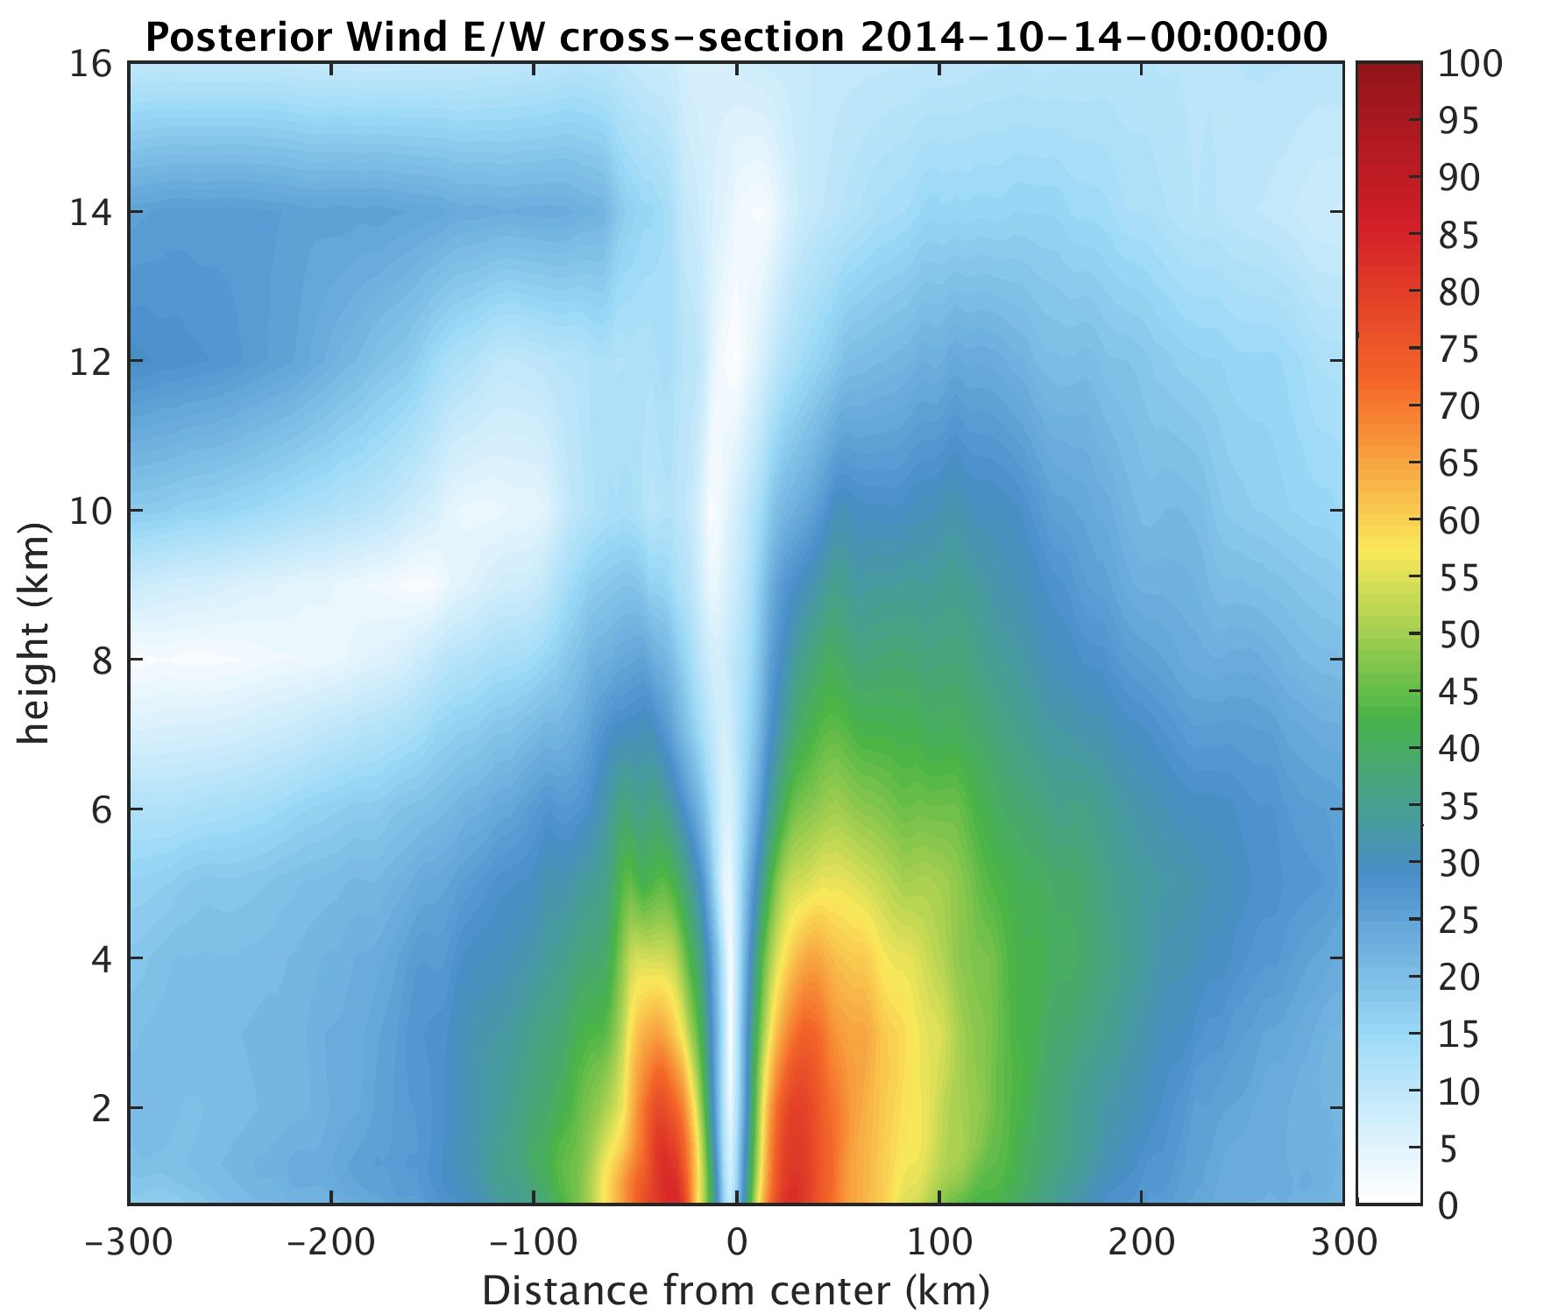
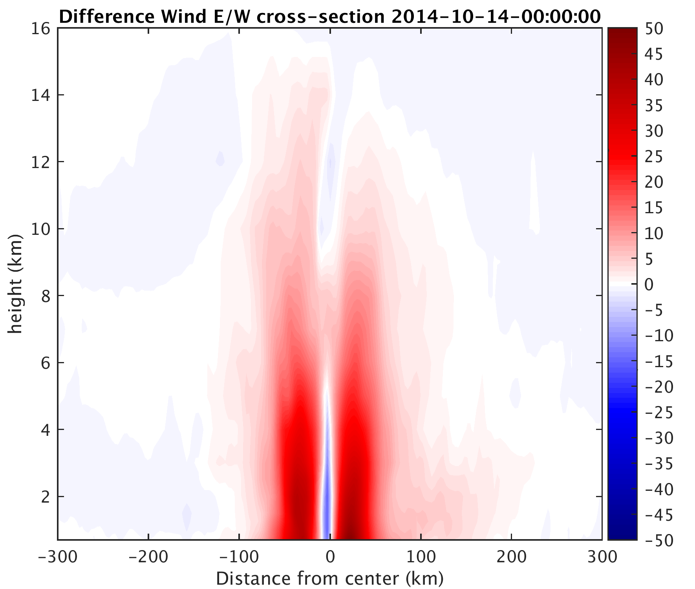

Slide 16
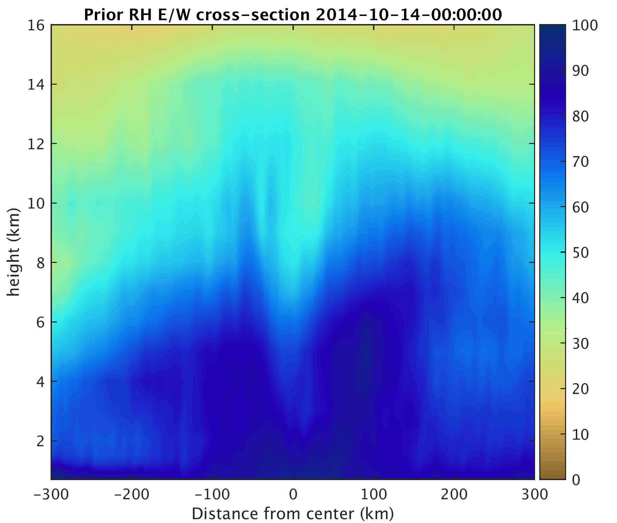
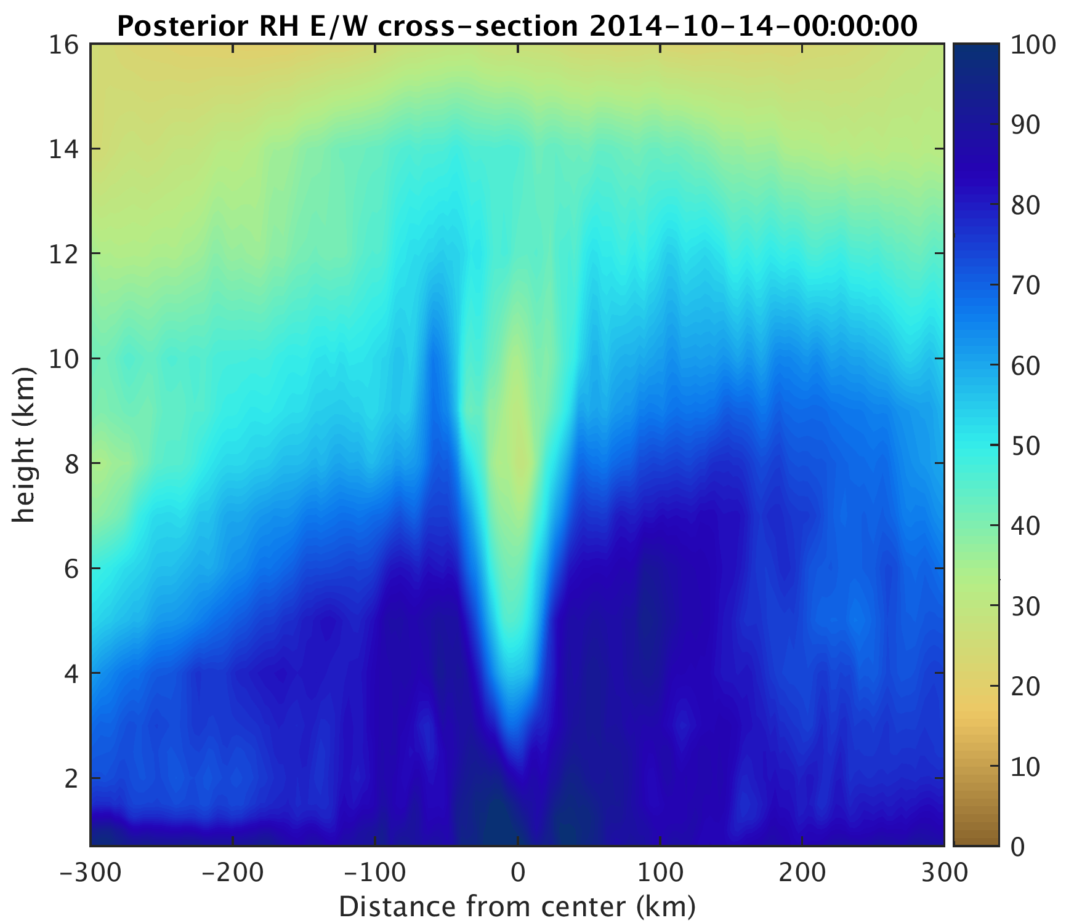
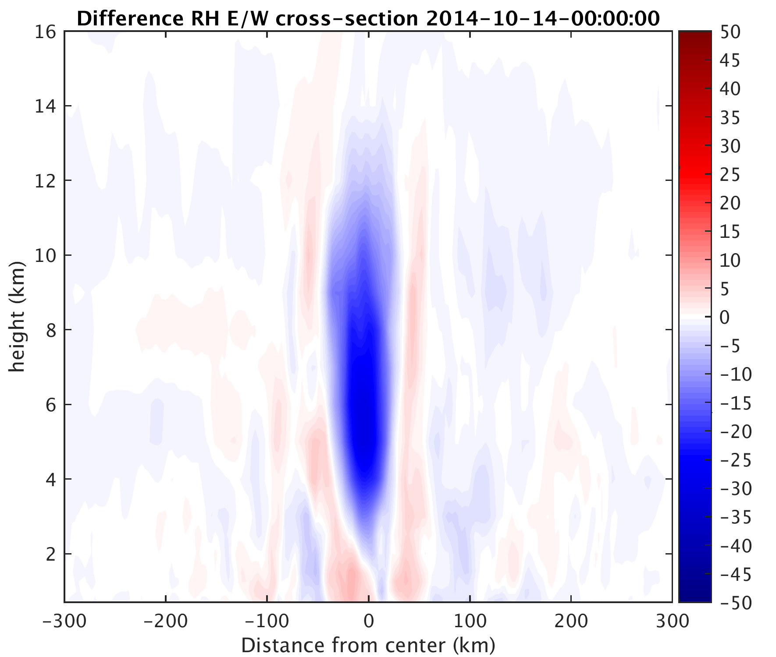
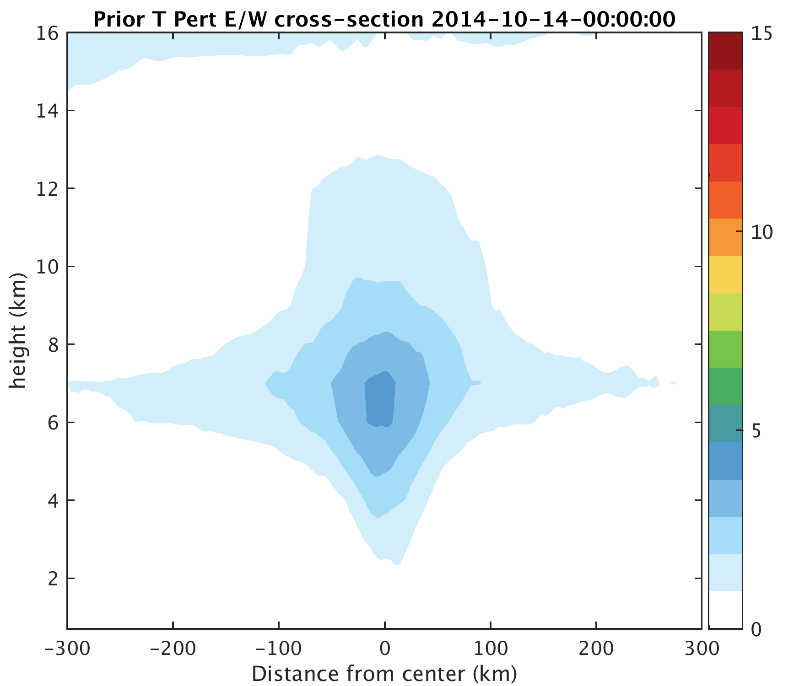
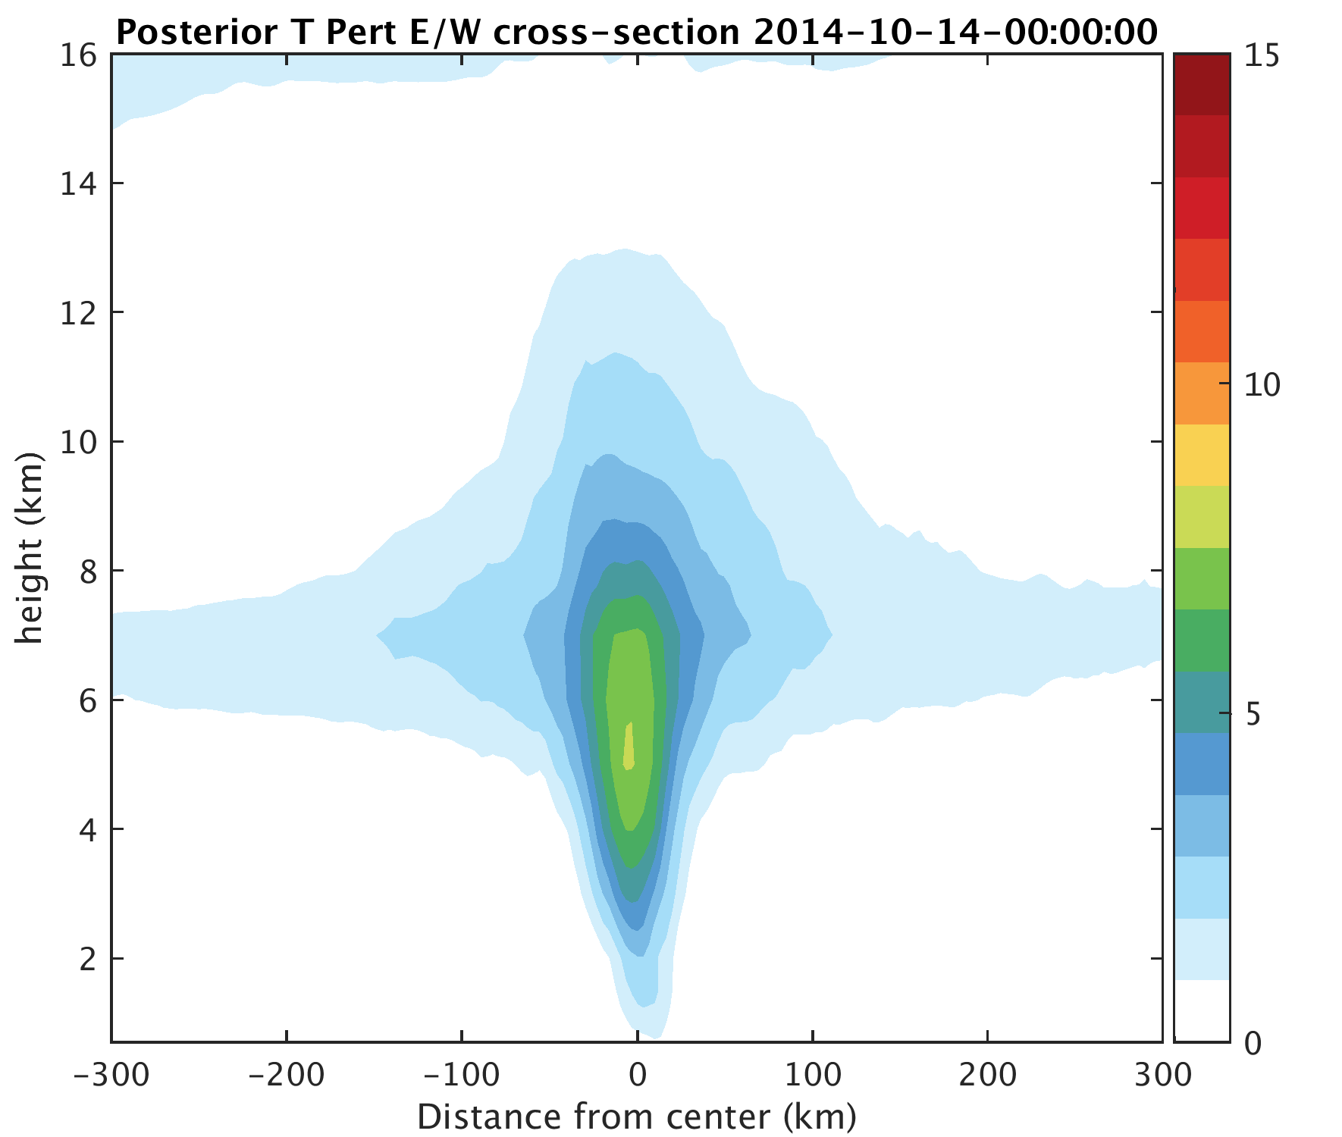
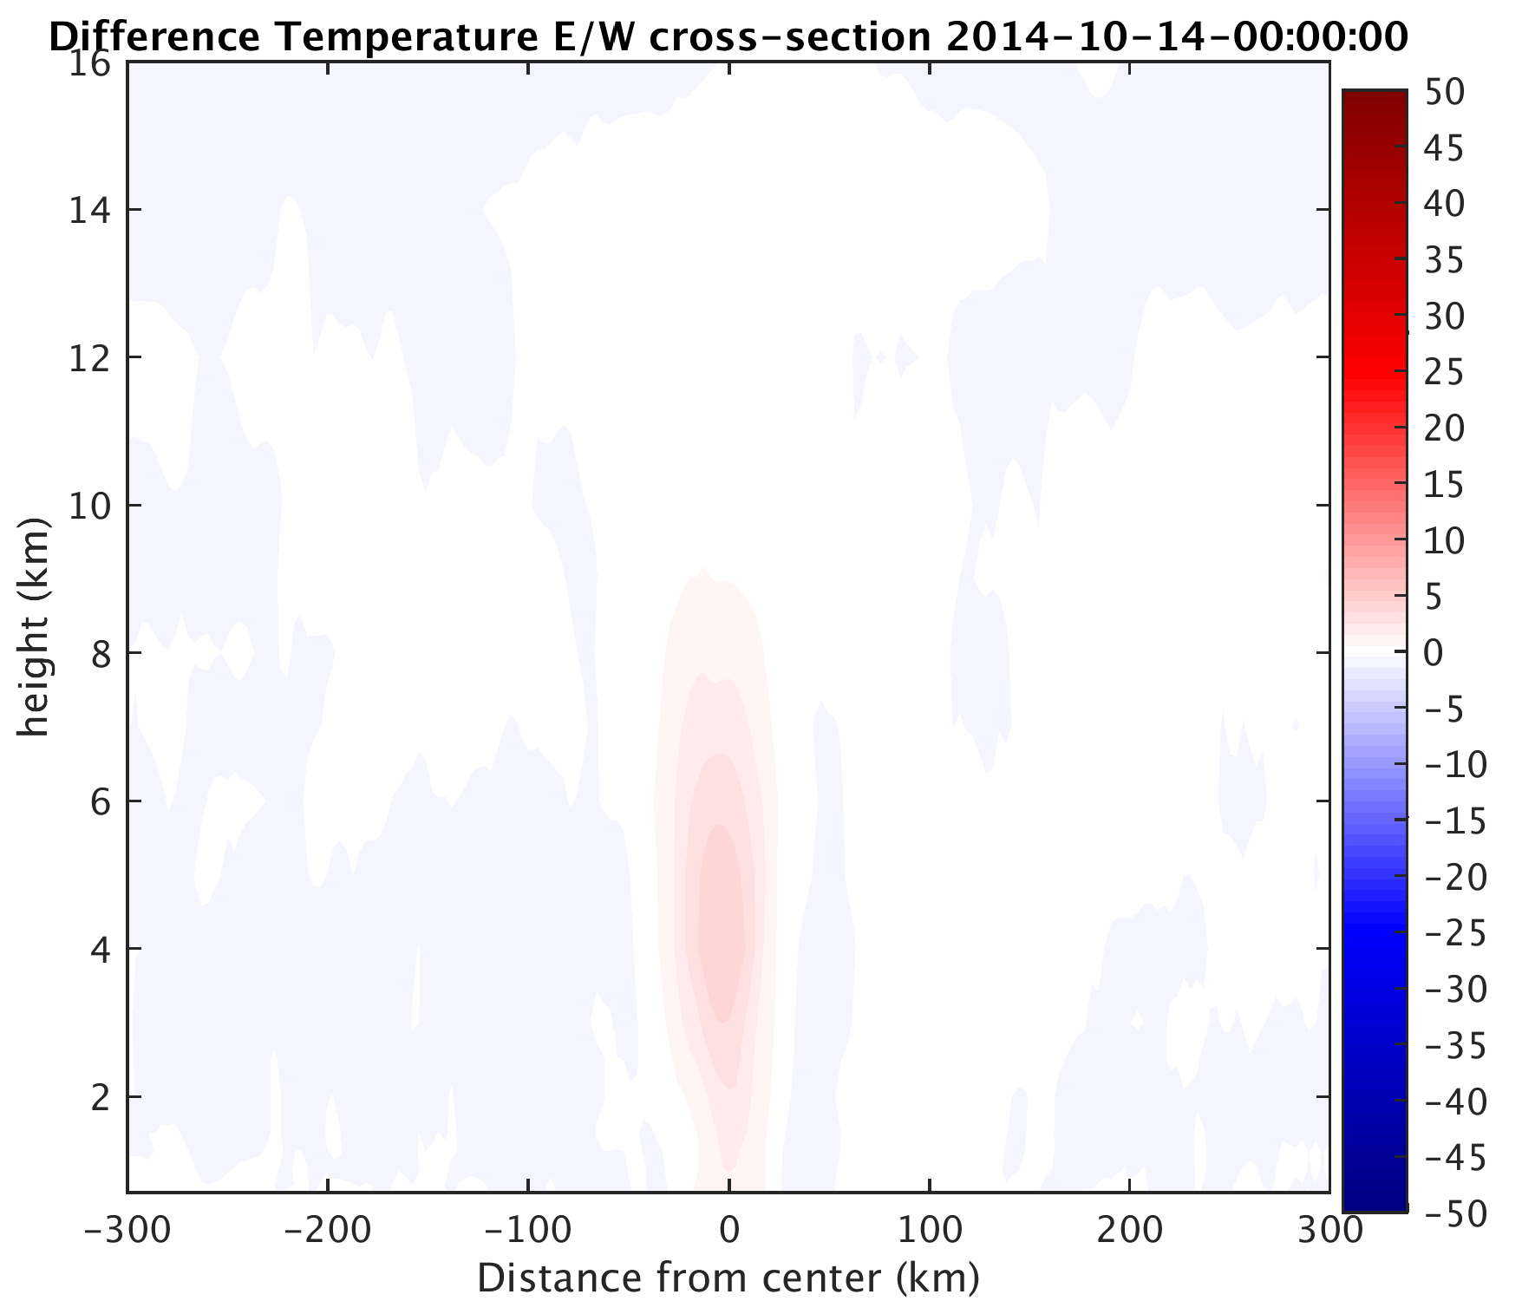

Slide 17
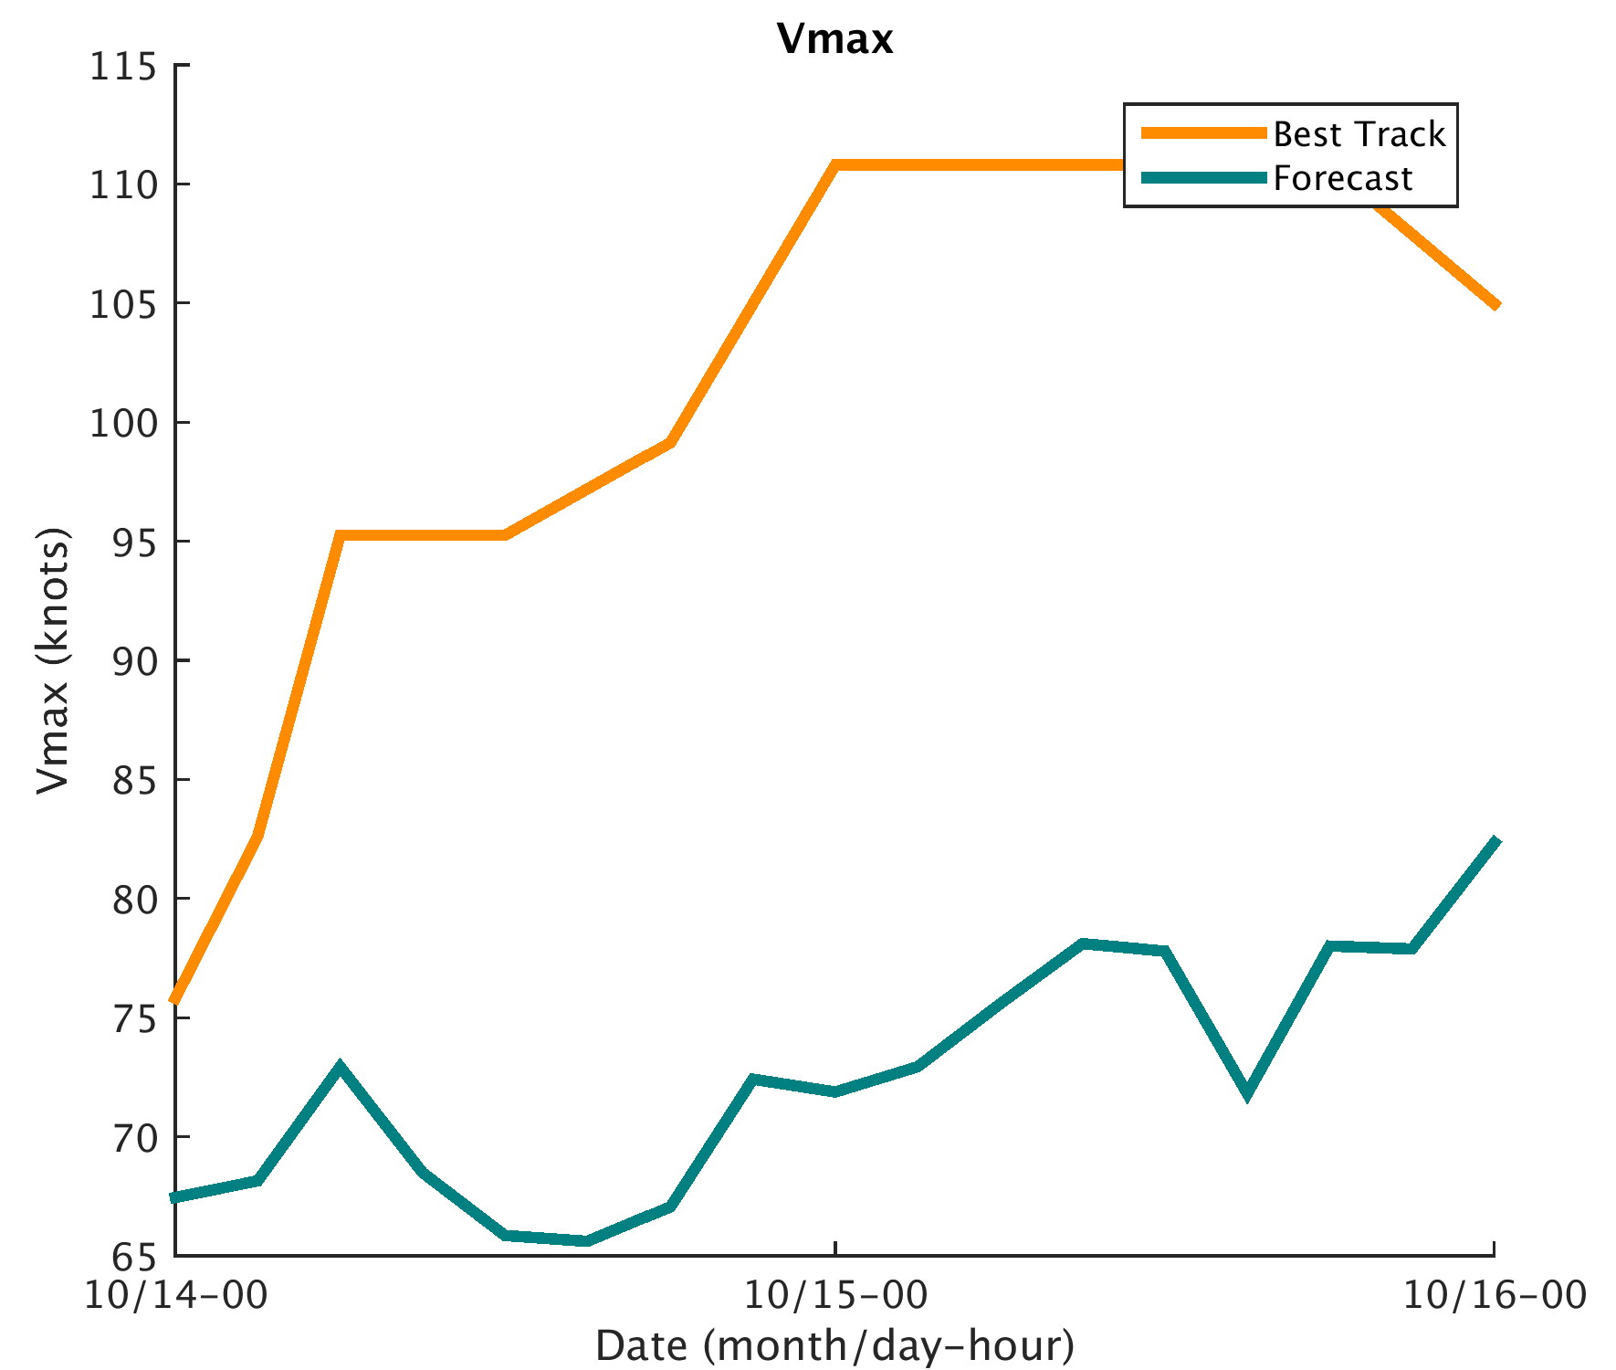
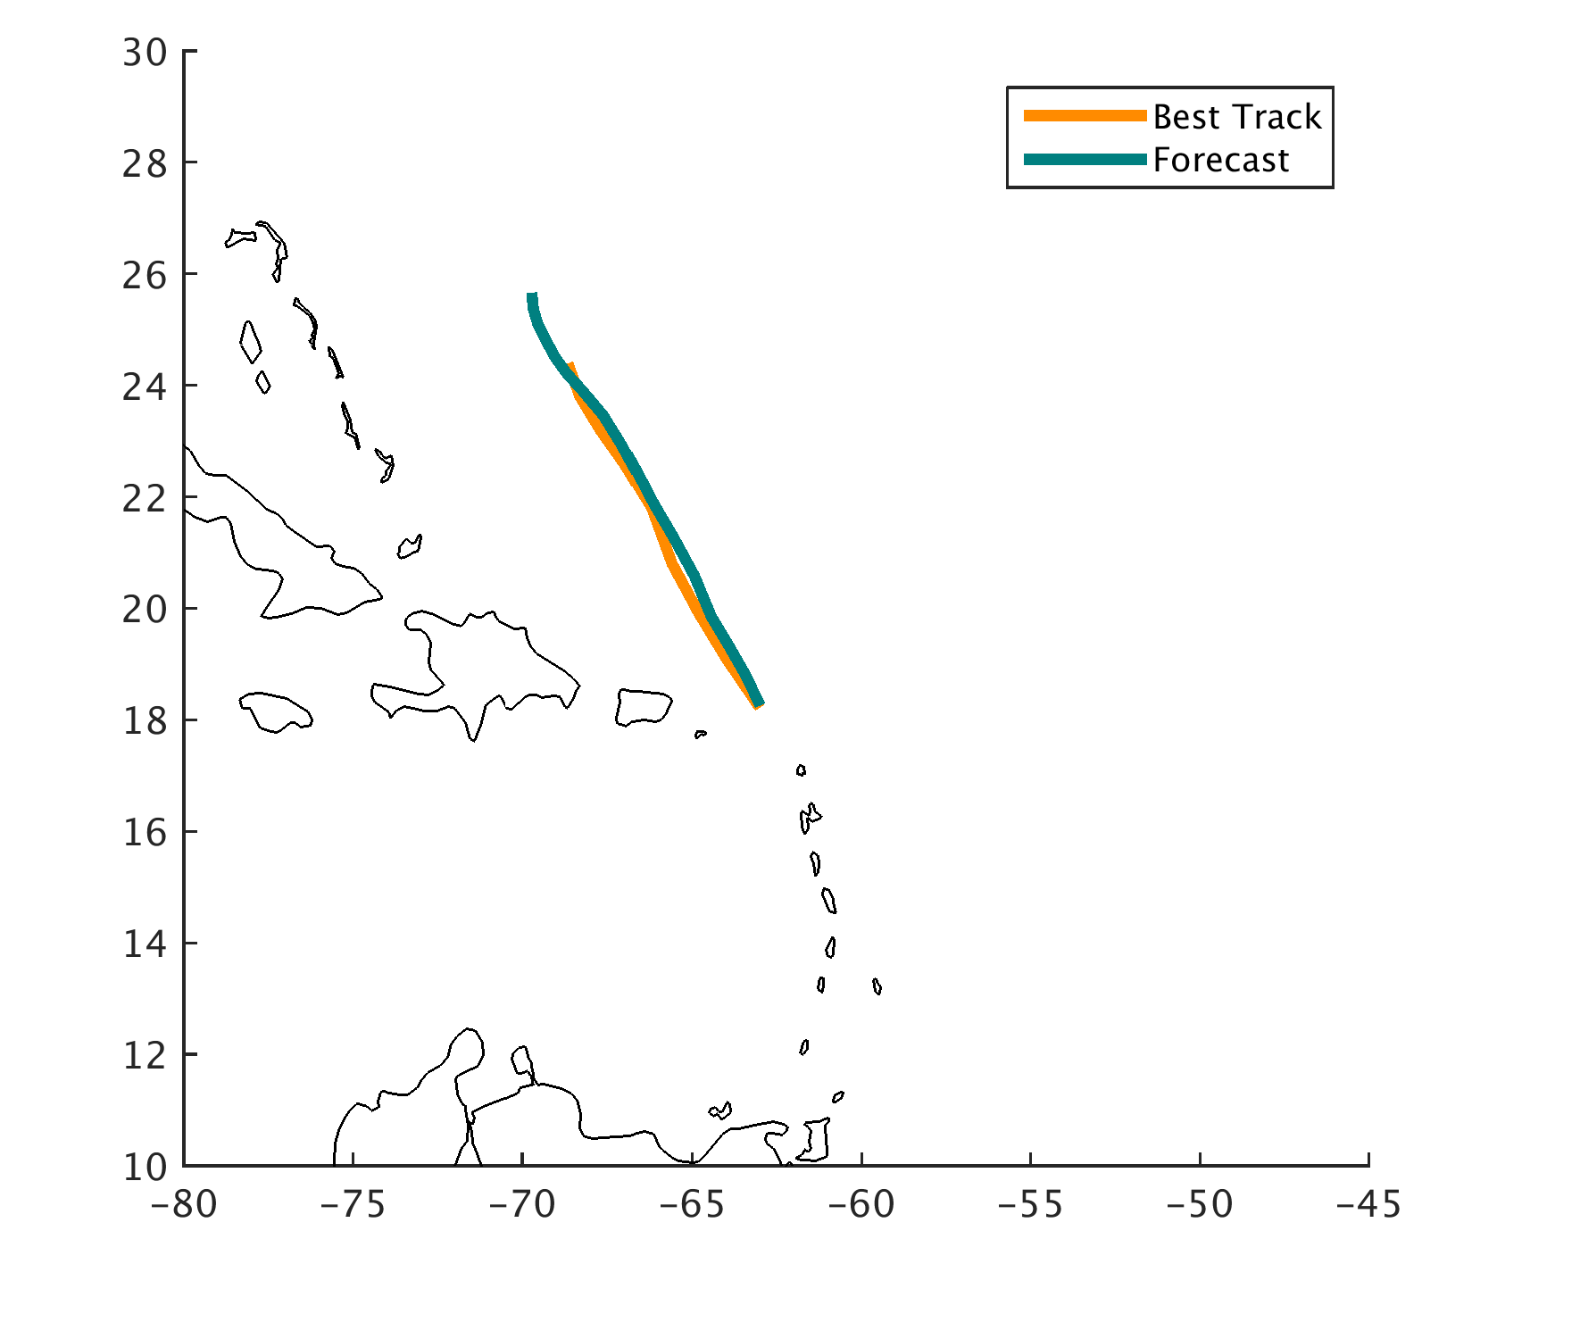
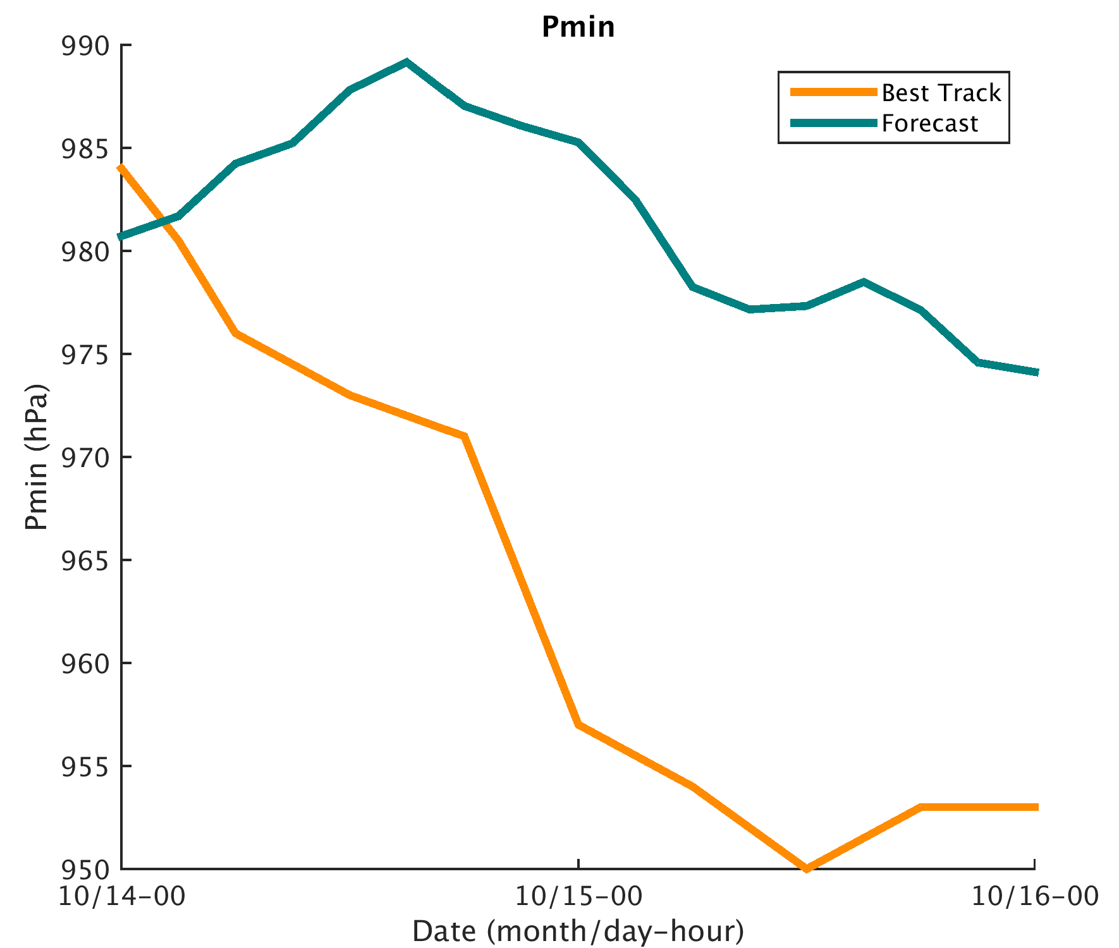
Forecast launched from Analysis mean at 0z on the 14th

Slide 18
Vmax Bias Correction
$$\overline{u_{new}}=\overline{u_{b}}+α∗Δ\overline{u}$$
$$\overline{v_{new}}=\overline{v_{b}}+α∗Δ\overline{v}$$
$$\vec{\overline{V_{obs}}}=\sqrt{{\overline{u_{new}}}^{2}+{\overline{v_{new}}}^{2}}$$
Update u, v, and T within PBL and within 300 km of Observation center
$α$=1 above PBL and outside of 300 km

Slide 19
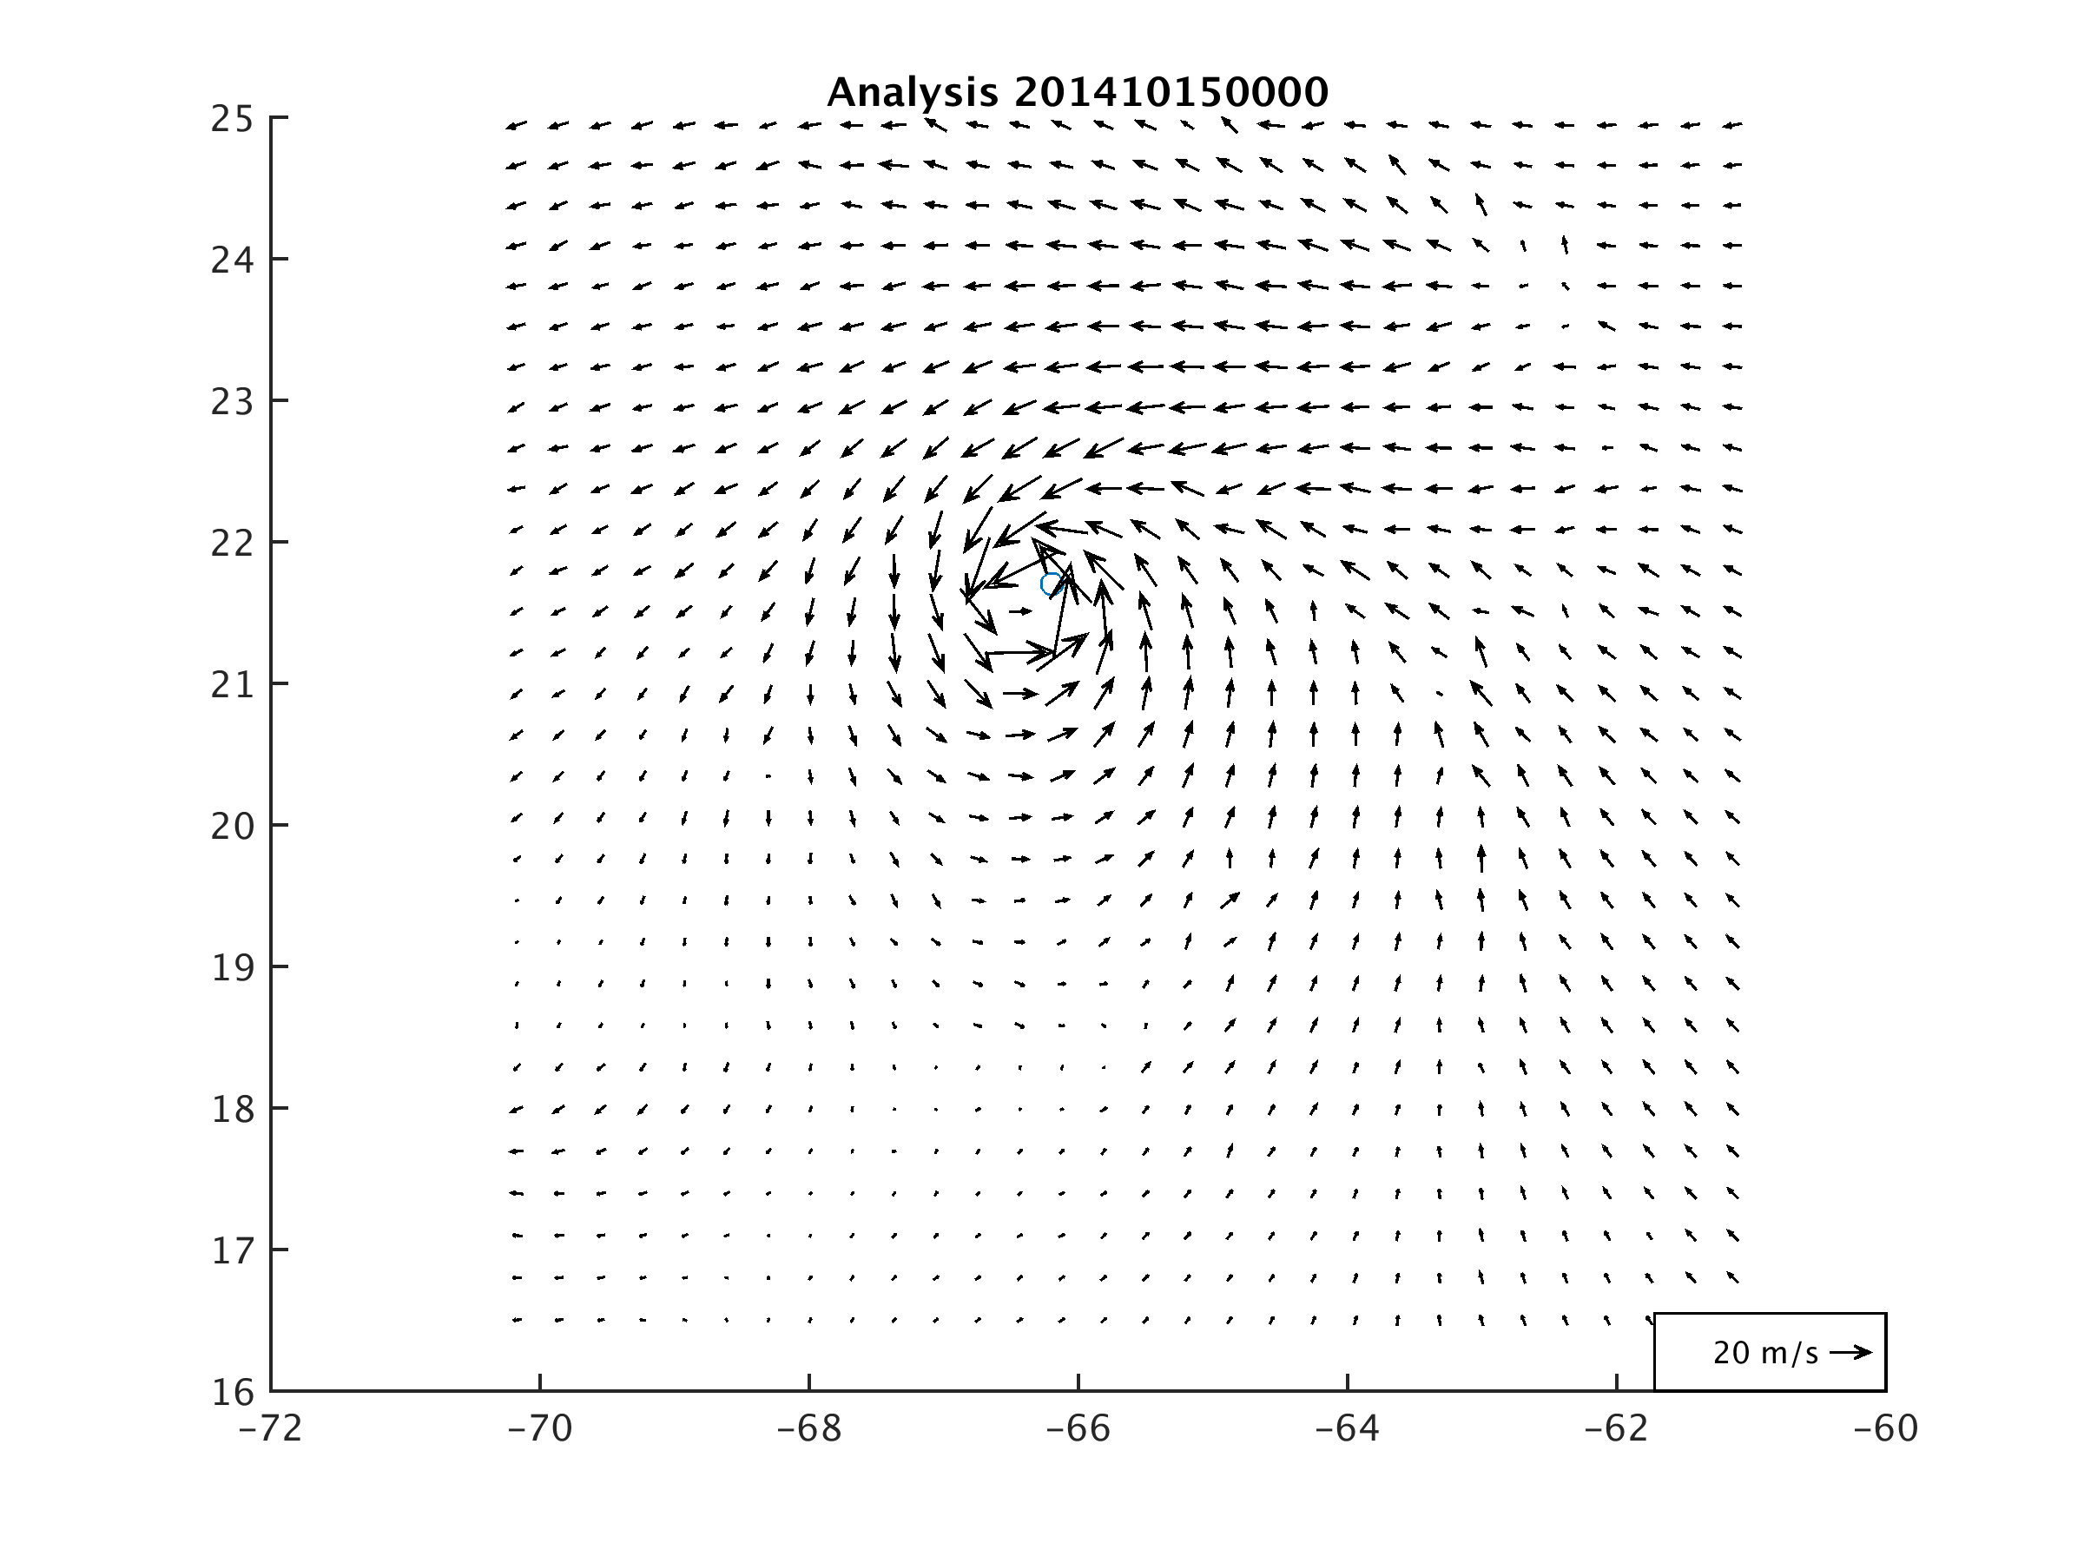
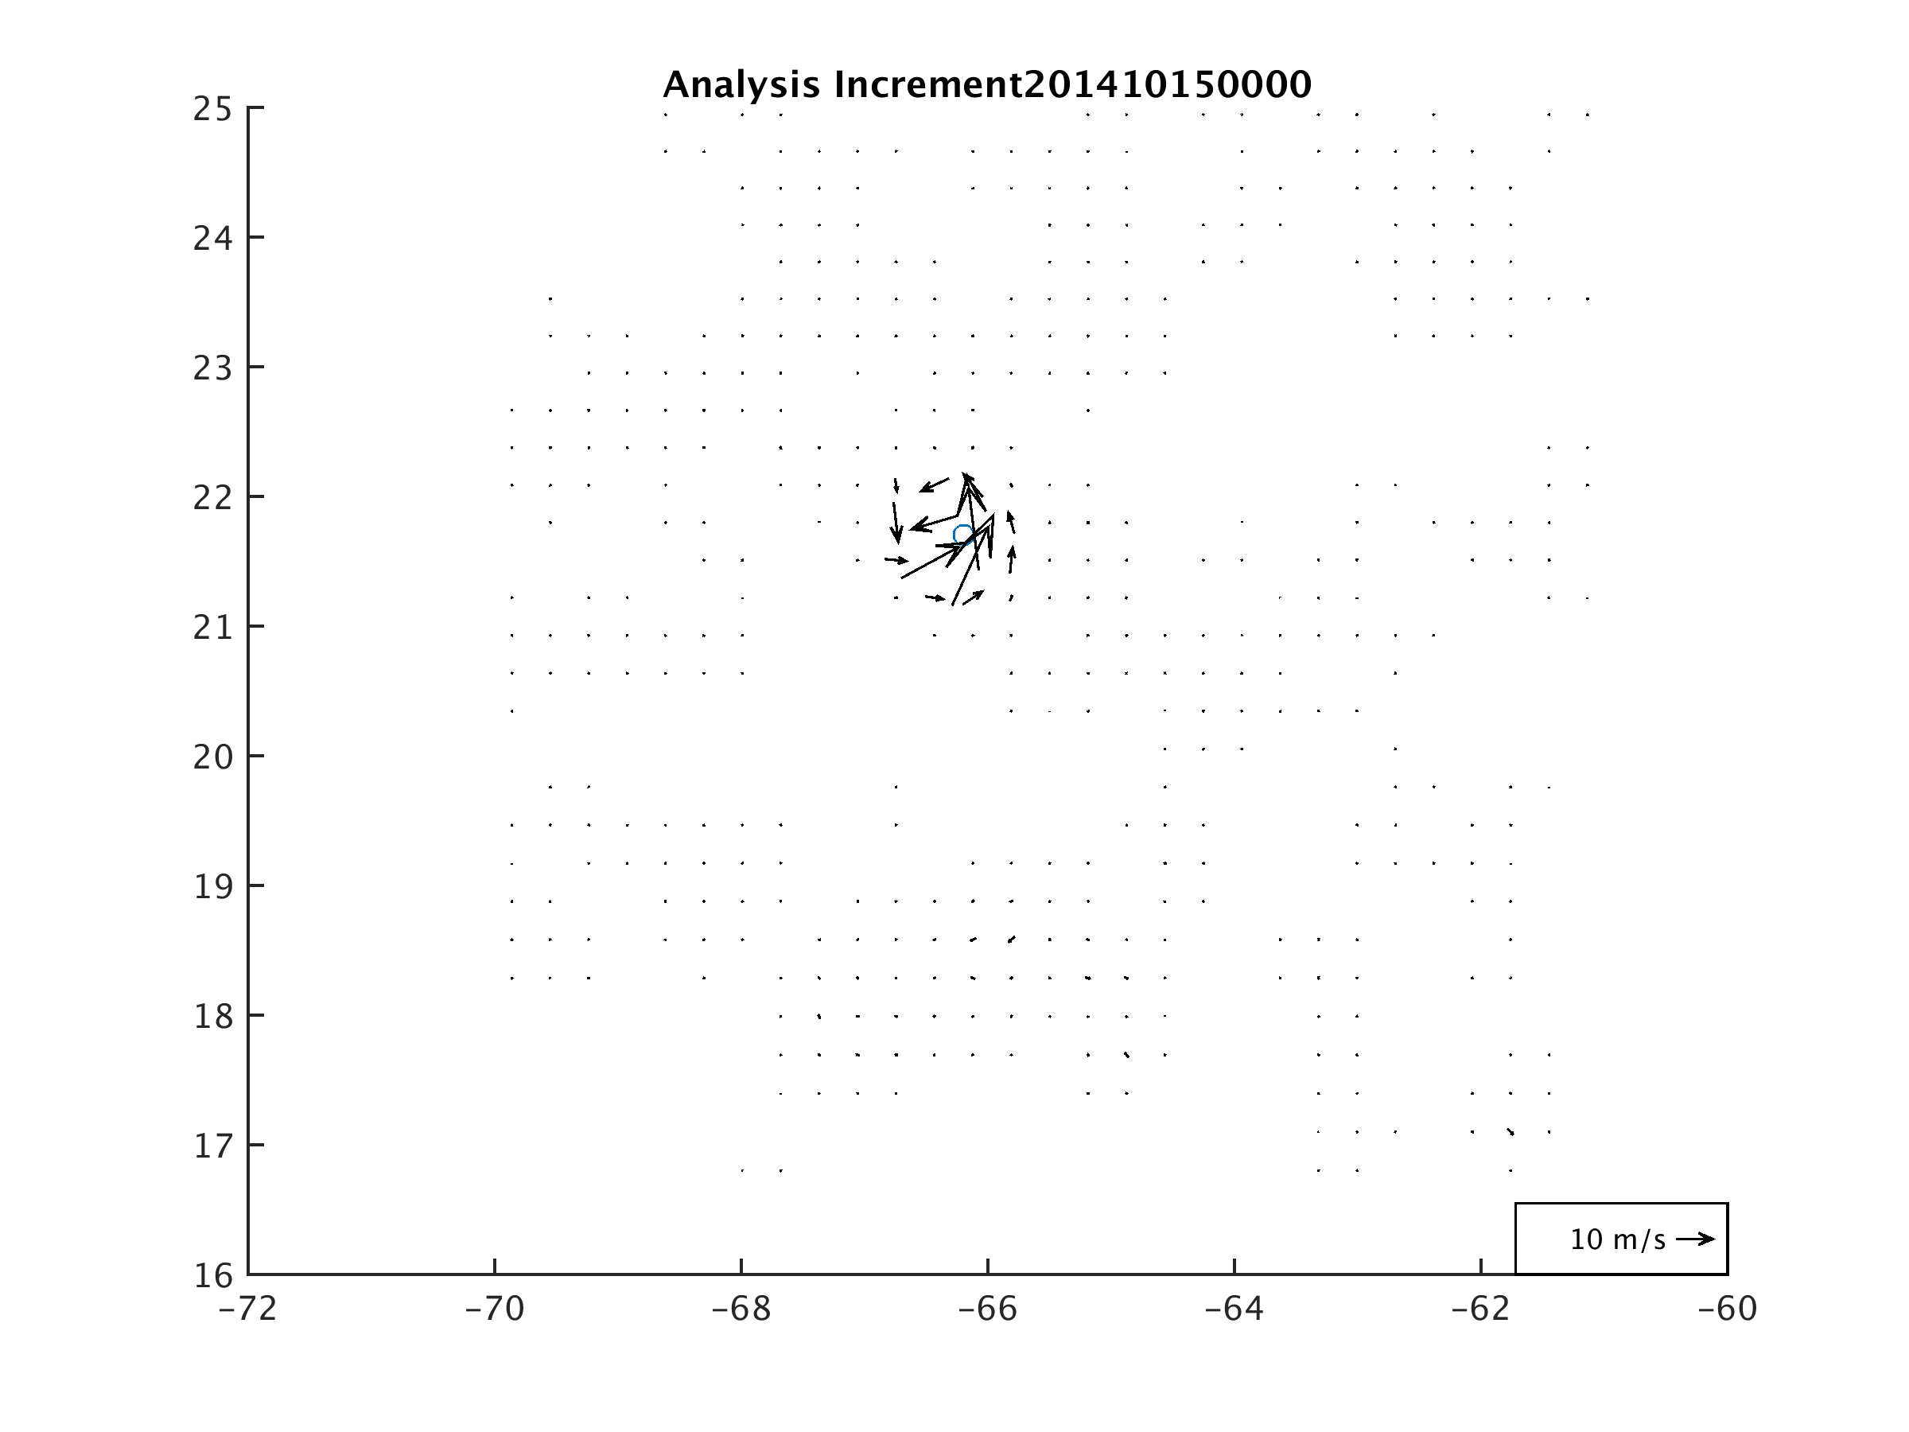
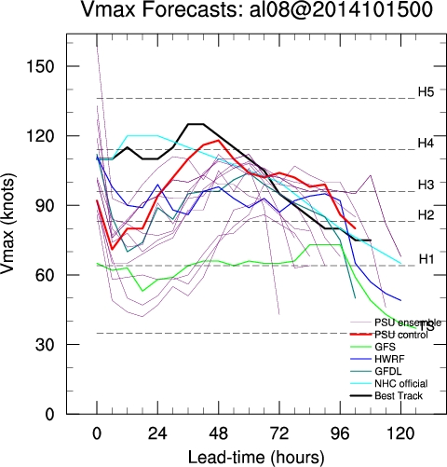
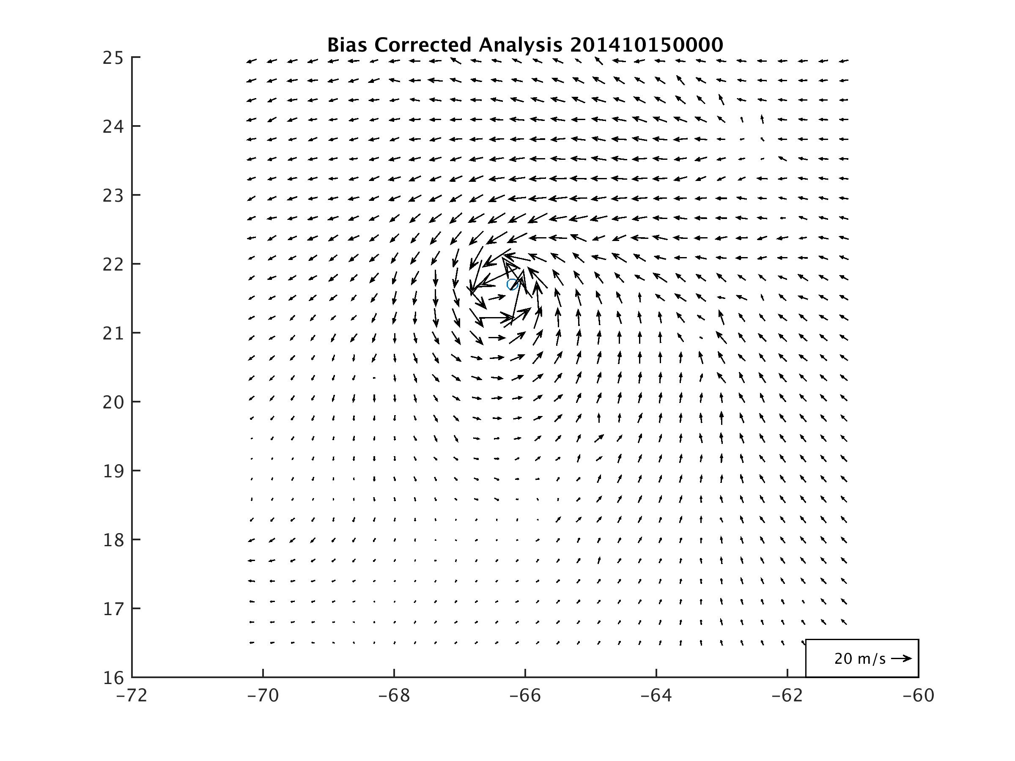
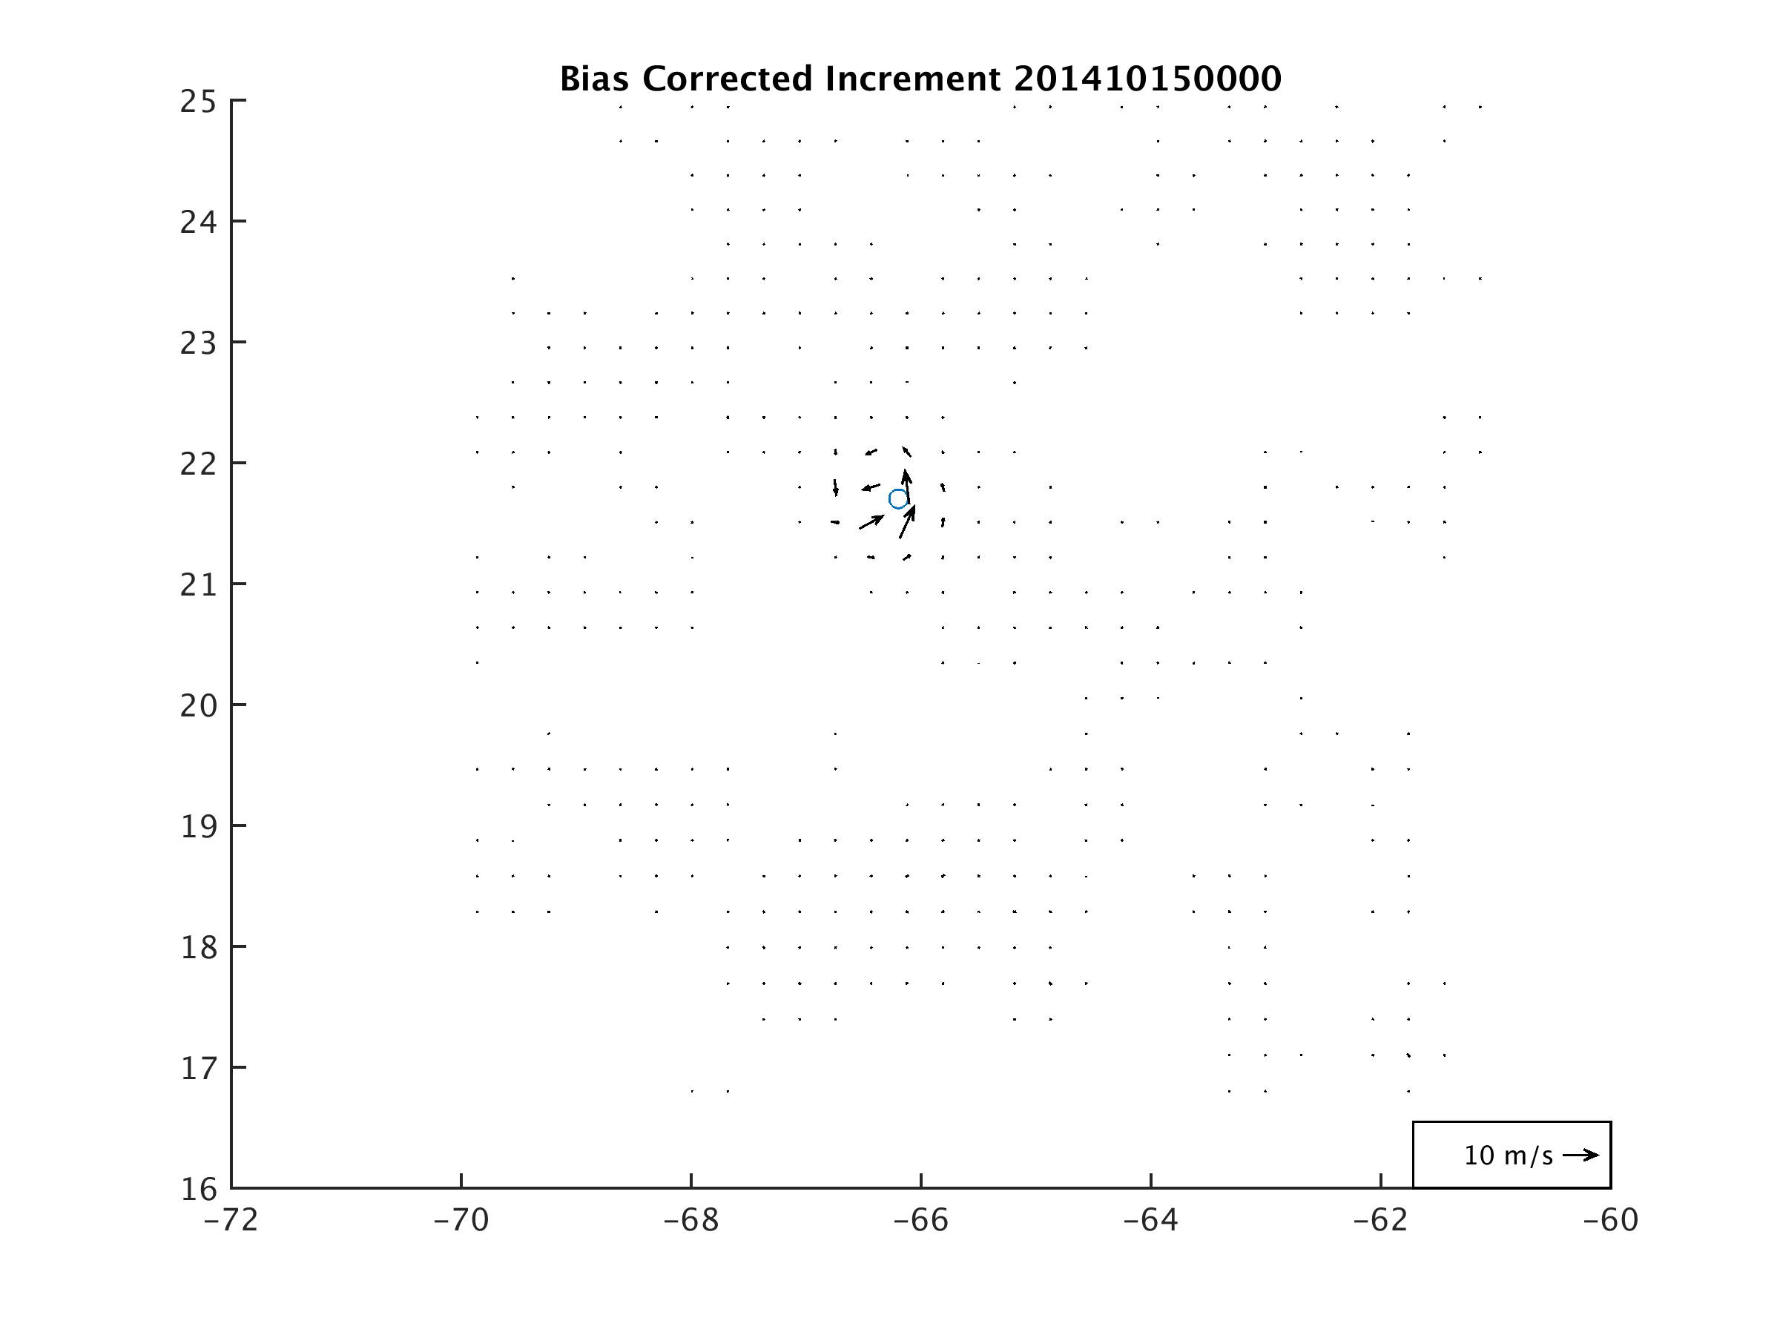
Initial intensity bad

Slide 20
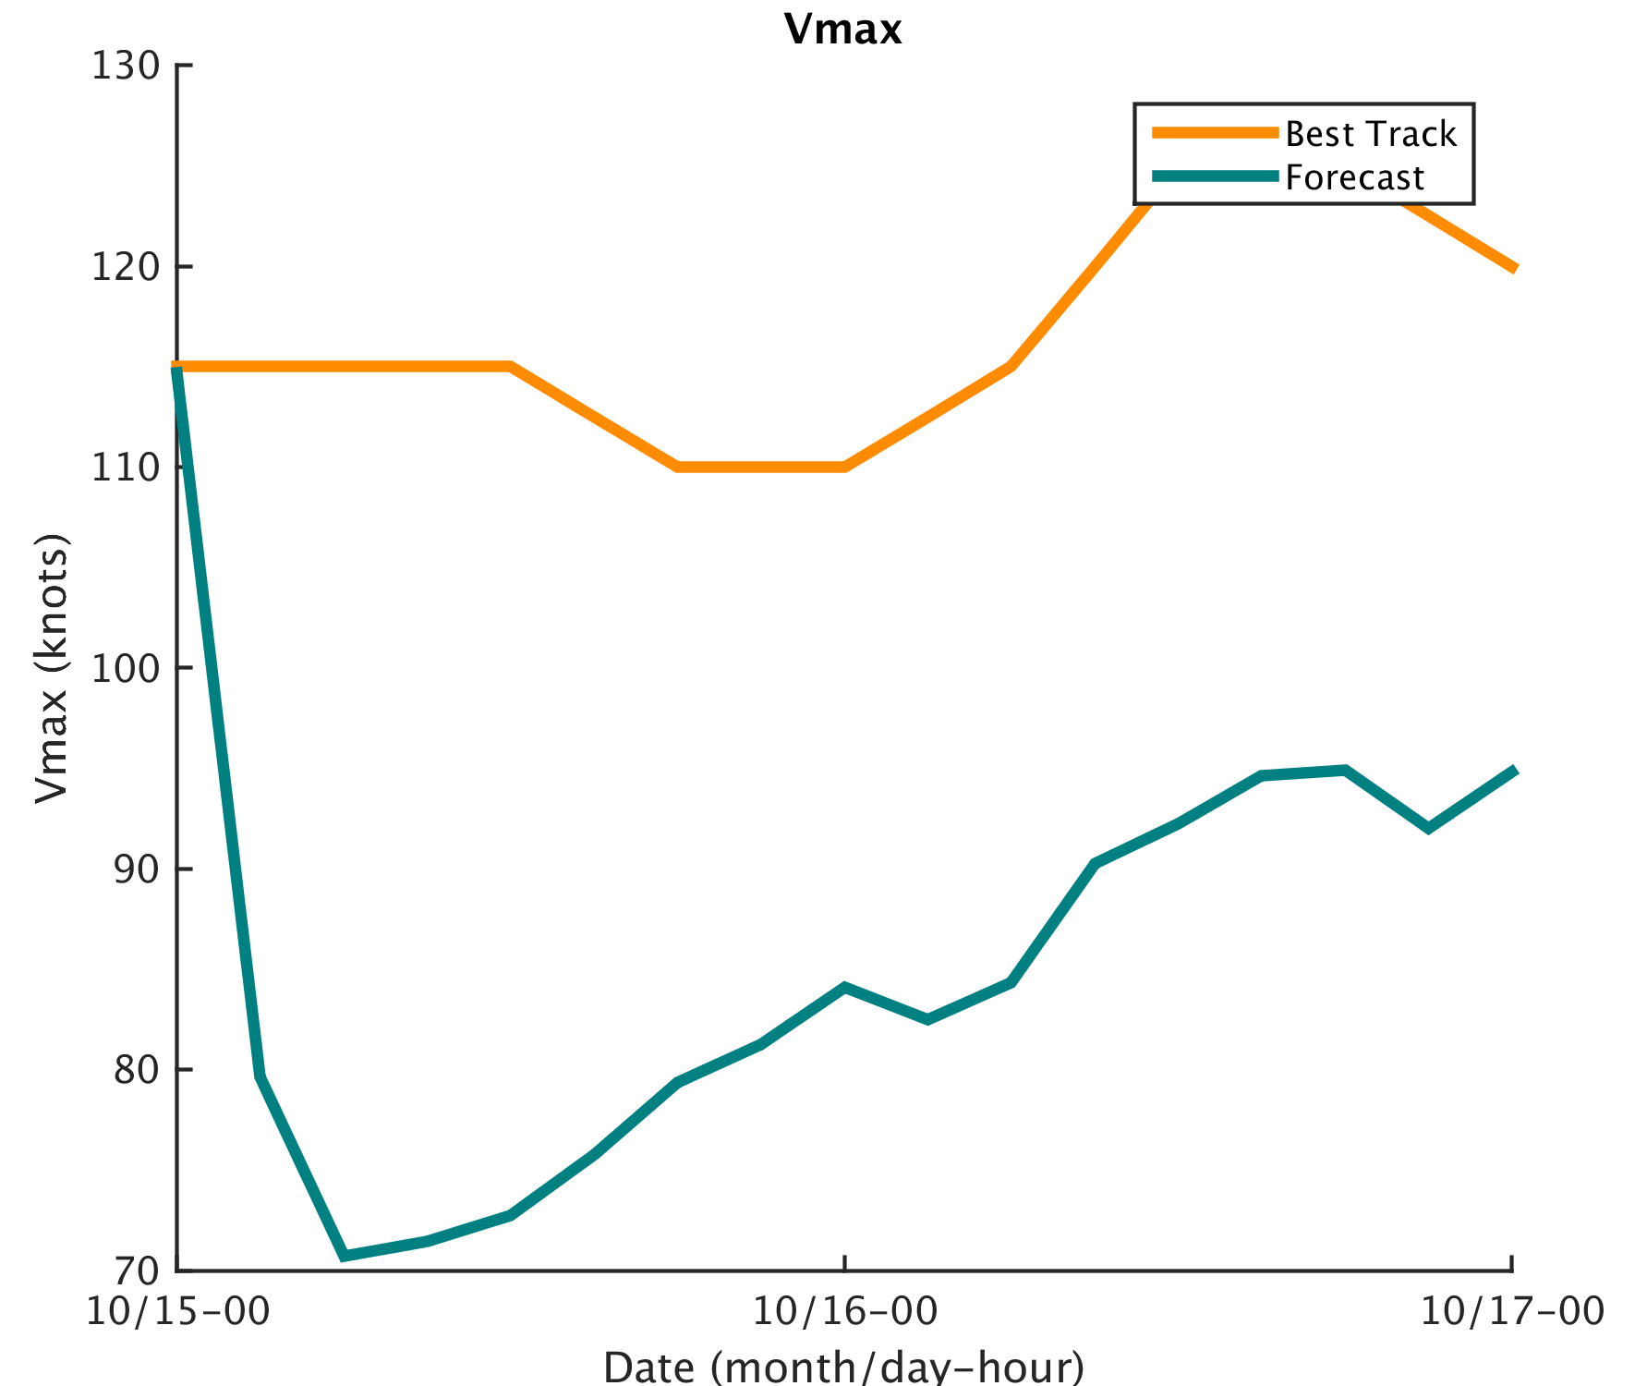
Forecast launched from Vmax Bias Corrected Analysis mean at 0z on the 15th

