Slide 1
Impact of Non-Spheric Particle Shapes on Cloud Radiative/Optical Properties
Lily Zhang

Slide 2
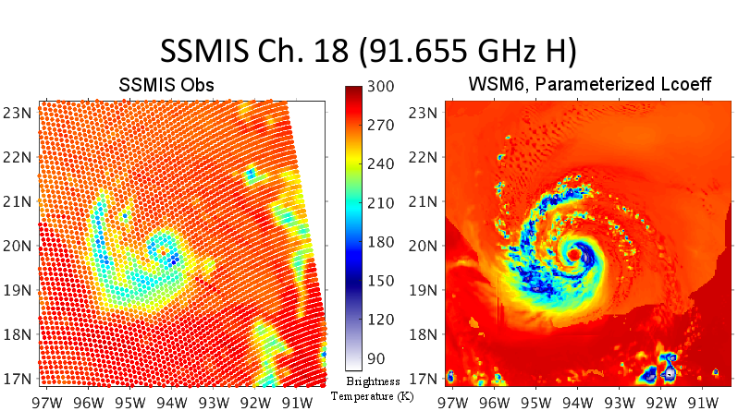
CRTM-DS WSM6, Parameterized Phase Function
Notes:
First, we’ll start off with this image, which shows the results of running the CRTM using a parameterized phase function. However, you will notice that the predicted brightness temperatures, on the right, were lower than the observed. This of course, begs the question, why?

Slide 3
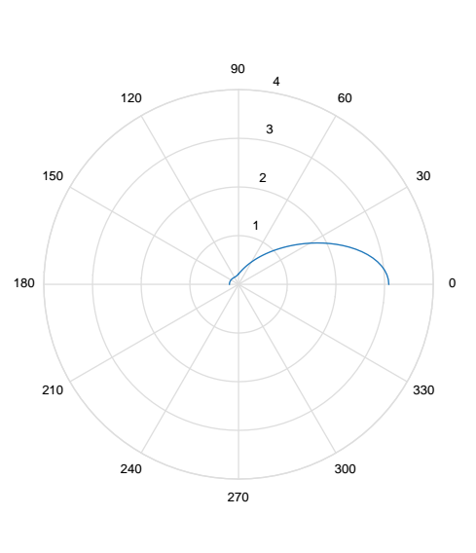
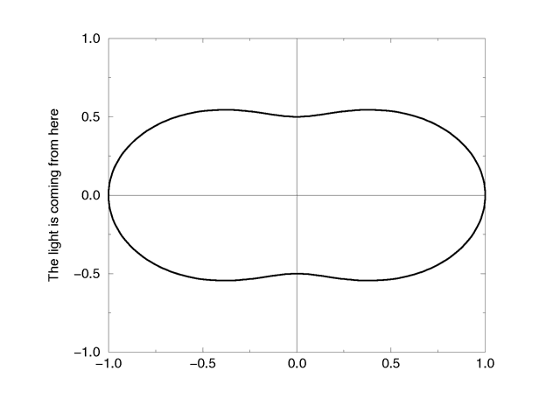
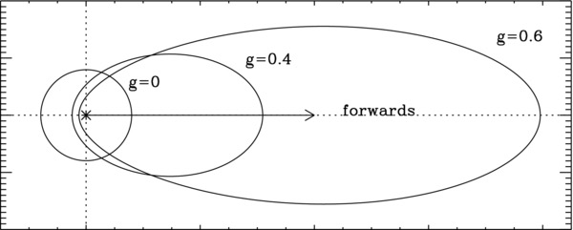
Scattering Phase Functions
Rayleigh
Henyey Greenstein
Combined Phase Function
Notes:
Well, first, we need to talk about what exactly the parametrized phase function is. The parameterized phase function is actually a combination of the Rayleigh and Henley Greenstein models. Much like the Henyey Greenstein, the combined phase function has more forward scattering at higher asymmetry parameters while it resembles the Rayleigh at smaller asymmetry parameters

Slide 4
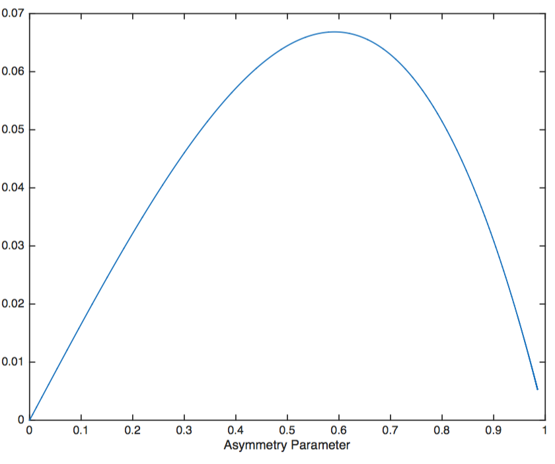

Combined Henyey–Greenstein and Rayleigh Phase Function
g-G
Modified asymmetry parameter - G
Notes:
The graph here shows the difference between the parameterized asymmetry parameter and the given asymmetry parameter.
However, because the parameterized phase function was giving colder brightness temperatures, we had to try something else.

Slide 5
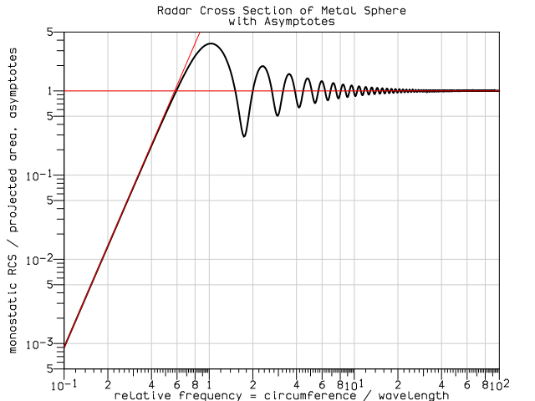
Mie Theory
CRTM treats the ice particles as spheres
Mie theory describes scattering of a homogenous sphere
Notes:
CRTM treats the ice particles as homogenous spheres
Mie theory describes scattering of a homogenous sphere
So then, we thought, why not input the exact mis theory phase function into the CRTM.

Slide 6
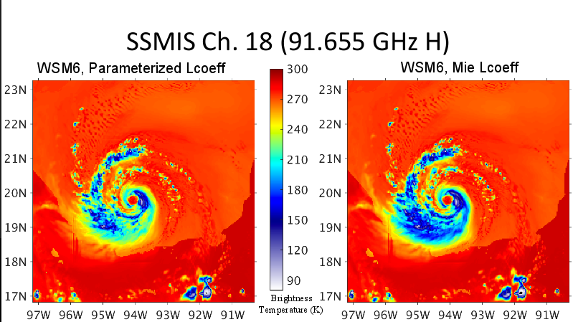
CRTM-DS WSM6, Parameterized Phase Function
CRTM-DS WSM6, Mie Theory Phase Function
Notes:
Well that didn’t work so well
Mie turned out to be even colder

Slide 7
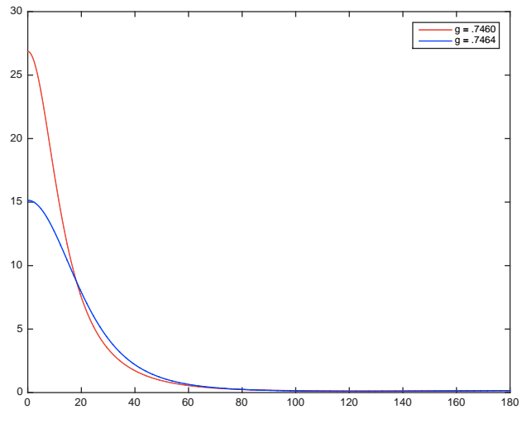
Phase Function
Notes:
In an attempt to understand the difference in predicted brightness temperatures, we plotted the two phase functions, integrated over the wsm6 psd for a graupel cloud, and compared the two.
-Observation #1: By definition, the parameterized phase (red) function asymmetry parameter value is lower than the Mie theory phase function (blue). A lower asymmetry parameter means a lower percentage of scattering is forward.
-#2: However, as you can see here, for scattering at angles 0 to 15 degrees, the parameterized phase function is greater than the Mie phase function

Slide 8
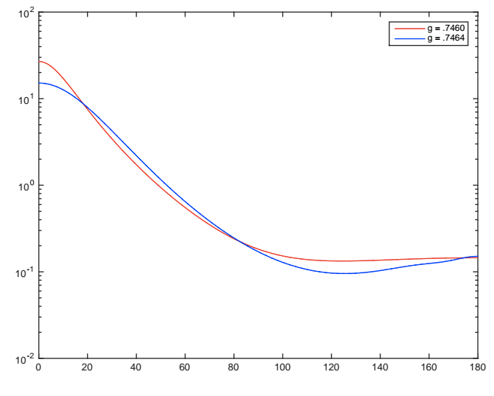
Phase Function
Notes:
Here is the graph again, plotted on a semi log scale. As you can see here
-the higher asymmetry parameter value for Mie theory is because of the higher phase function values between 15 and 75 degrees
-means more radiation is scattered to the side, scattered back down, or is eventually absorbed. This leads to lower brightness temperatures when observing from above the graupel.
however, this got us thinking, maybe asymmetry parameters are not enough.

Slide 9
Moving Forward

Slide 10
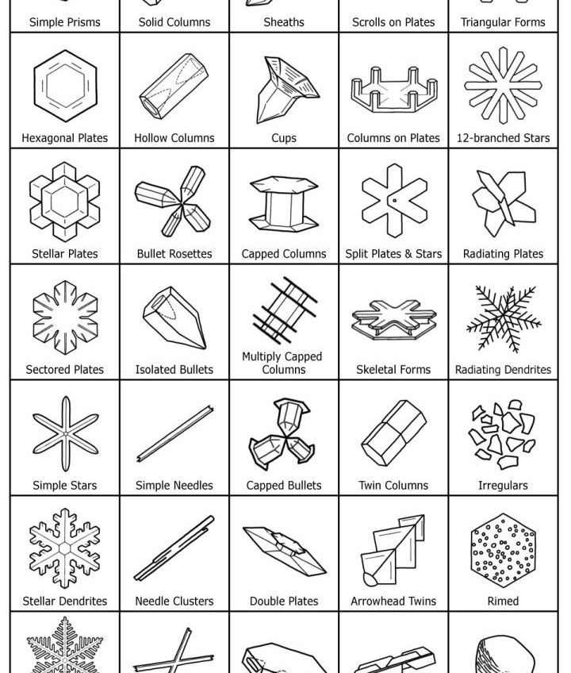
Non-Spheric Particles
Ice does not form in spheroid shapes
Guosheng Liu database
Notes:
What if, however, the problem lies elsewhere.
As we all know, snowflakes and ice are not perfect spheres. Guosheng liu and his colleagues, recognizing this fact, ran a series of simulations and compiled a database of single-scattering properties for 13 different particle types (using DDA).

Slide 11
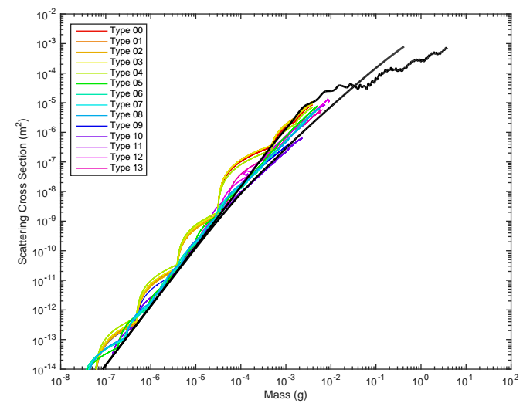
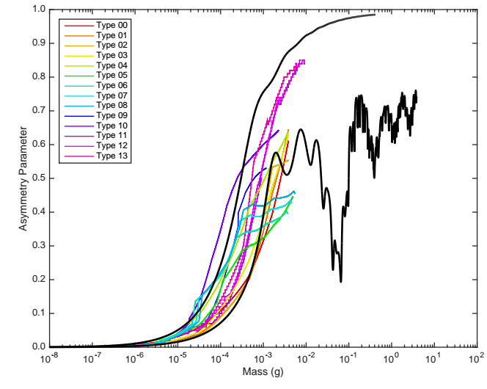
Differences are not immediately obvious
More detailed cross section data for different particles needed
Notes:
The colorful lines you see represent guosheng’s, while the black lines plotted on top are the mis theory results. To properly ___, more detailed cross section data will be needed and that’s the direction we hope to go.

