Slide 1
Intrinsic Limit of Atmospheric Predictability for Mid-Latitude Jet/front Systems
Y Qiang Sun, Fuqing Zhang
Collaborator: Linus Magnusson et al.
Groupmeeting 08/18

Slide 2
ENSEMBLE FORECASTING

Slide 3
PRACTICAL vs. INTRINSIC PREDICTABILITY
(Lorenz 1995; Melhauser & Zhang 2012 JAS)
Practical predictability: the ability and uncertainty to predict given practical initial condition uncertainties and/or model errors, both of which remain significantly big in the present-day forecast systems.
Intrinsic predictability: the limit to predict given nearly perfect initial conditions and nearly perfect forecast systems, in other words when the initial condition and model errors become infinitesimally small.
GOOD REGIME
PRACTICAL PREDICTABILITY
POOR REGIME
OBSERVED
TRUTH
INTRINSIC PREDICTABILITY
ENSEMBLE MEMBERS
ENSEMBLE
MEAN
“the butterfly effect” (Lorenz 1969)
Notes:
Environmental differences are derived from the current ability of data assimilation systems to provide a reasonable representation of the atmosphere.
Top diagram displays a schematic of reducing the initial conditions similar to the experiment between EFIG and EFIP.
Smaller circles represent decreasing the initial spread of the ensemble by decreasing analysis error or observation error (similar to reducing EFIG to EFIA, etc…)
Highlights importance of knowing the correct flow regime in relation to the truth.
Better initial conditions will not always lead to better forecasts and event predictability.
MAIN POINT:
Decreasing ensemble initial condition won’t necessarily increase predictability. Depends on the flow regime and where the truth lies. If it lies in the good regime, decreasing the initial conditions will increase the predictability. If it is close to the middle, it will not help as much since it will still embody both regimes.

Slide 4
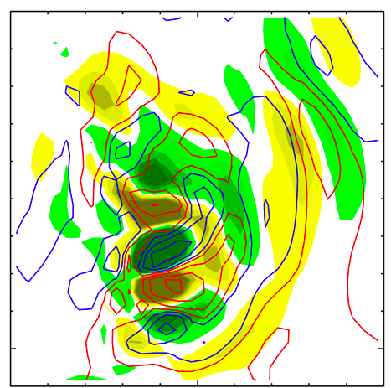
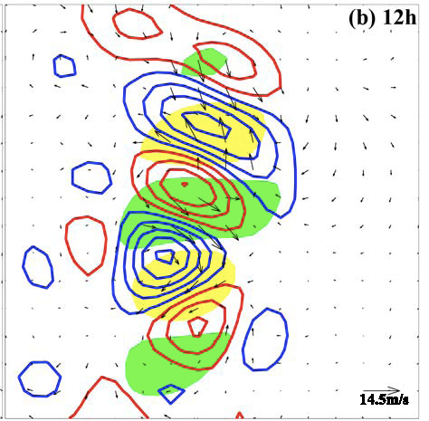
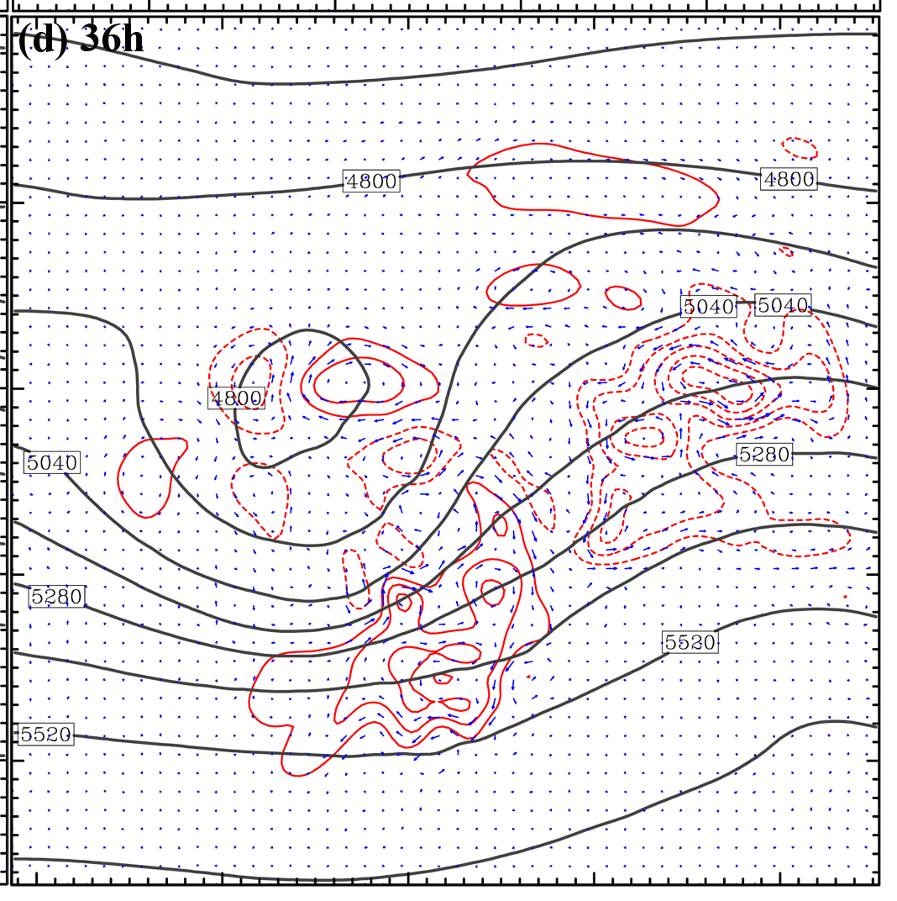
A Multistage Upscale Error Growth Model for Mesoscale Predictability
(Zhang et al. 2007, JAS)
Stage I, convective growth: Errors grow mostly from small-scale convective instability and saturate at convective scales on O(1 h). The amplitude of saturation may be a function of CAPE and its areal coverage determined by large-scale flows.
Stage II, transient growth: Saturated errors transform from convective-scale unbalanced to larger-scale balanced motions through balance adjustment and GWs at the time scale O(2π/f).
Stage III, baroclinic growth: Balanced components of saturated error project onto the larger-scale flow and grow with background dynamics and instability at the time scale of O(1day).
_{Stage 1}
_{Stage 2}
_{Stage 3}
3h
_{2h}
_{300km}
_{1200km}
_{4200km}
_{T and w differences}
_{PV, Q and DIV differences}
_{Pressure and V differences}

Slide 5
Baroclinic wave simulations: Dry vs. Moist
Sun and Zhang (2016 JAS)
Simulated dry baroclinic Jets have a -3 slope, while moist experiments show a transition at mesoscale.

Slide 6
Research question:
Where is the intrinsic limitation of our operational forecast for mid-latitude jet/front system?
Data:
ECMWF 9km Analysis
ECMWF HRES 9km global ensemble simulations
ECMWF 16km global ensemble simulations

Slide 7
power
wavenumber

Slide 8
500 hpa geopotential height error (practical vs. intrinsic; day2 vs. day10)
AN: analysis
FC: 9km HRES forecast
CF: 16km ctrl forecast

Slide 10
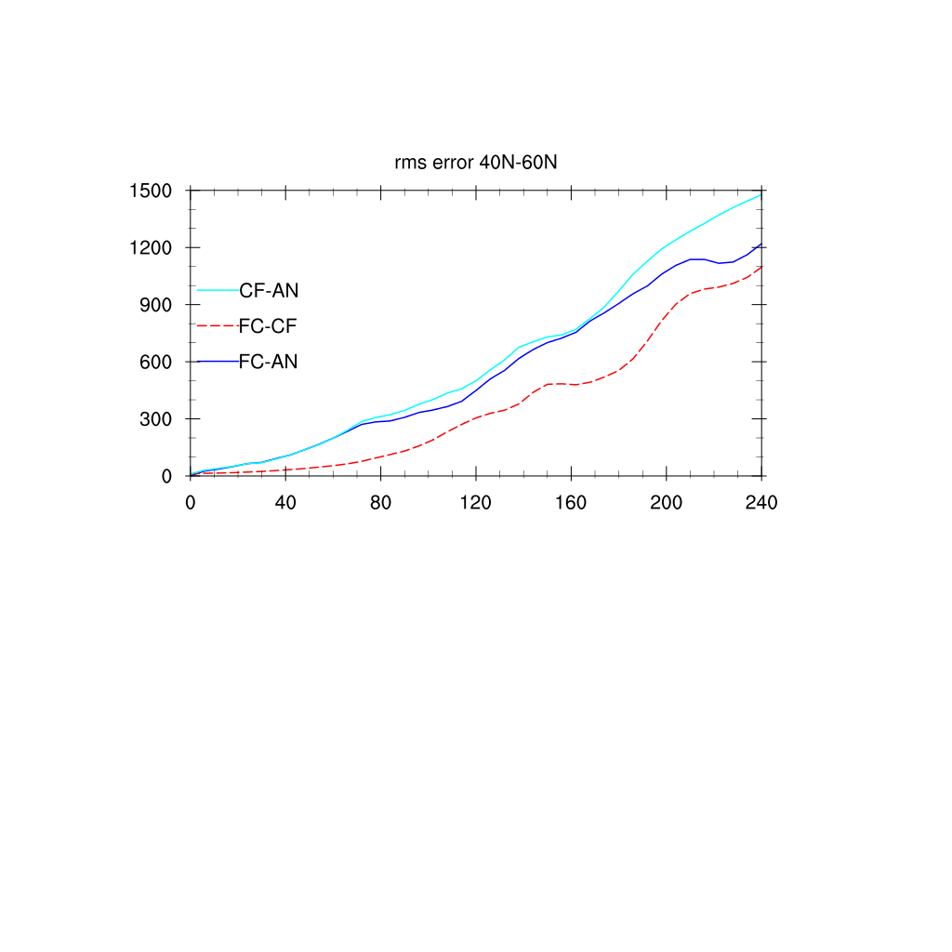
PRACTICAL vs. INTRINSIC PREDICTABILITY
Root Mean Square Error evolution for mid-latitude (Averaged over 40$°$N~60$°$N)
RMSE
Time (hour)

Slide 11
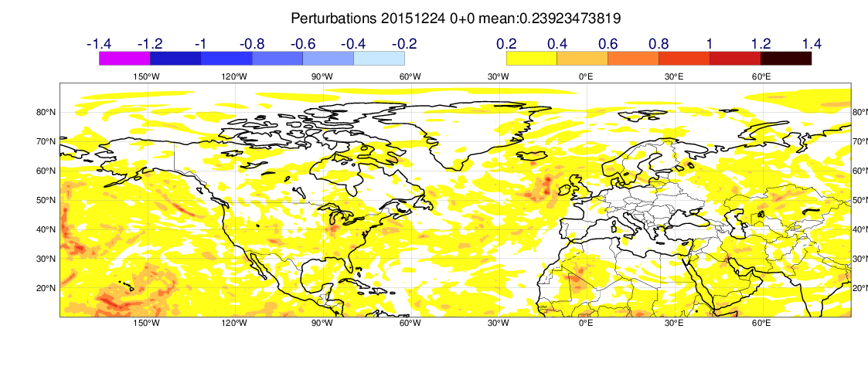
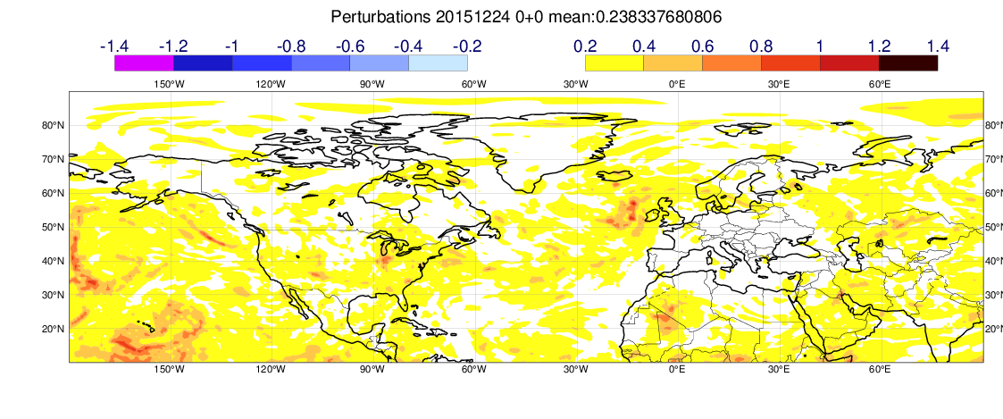
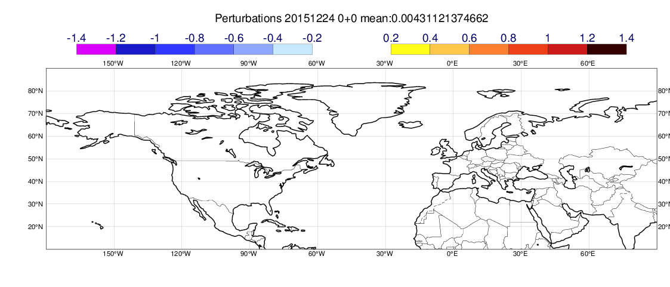
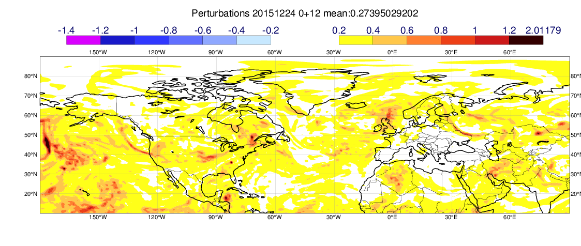
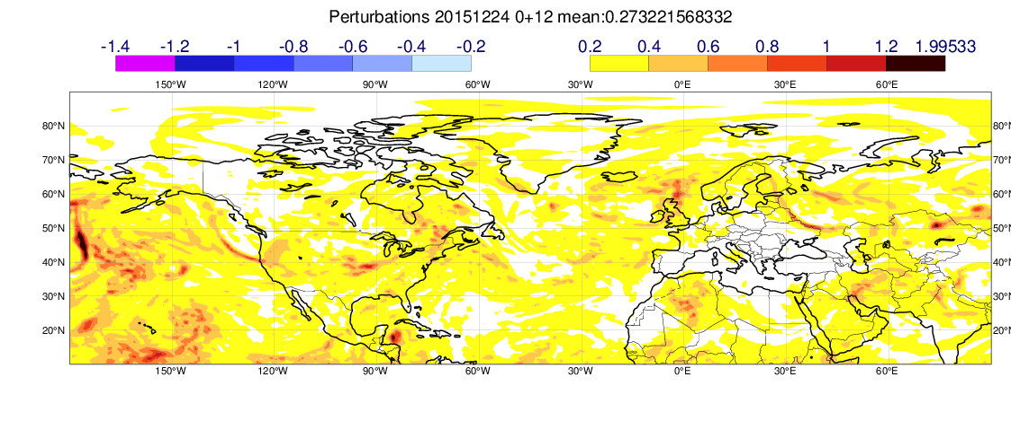
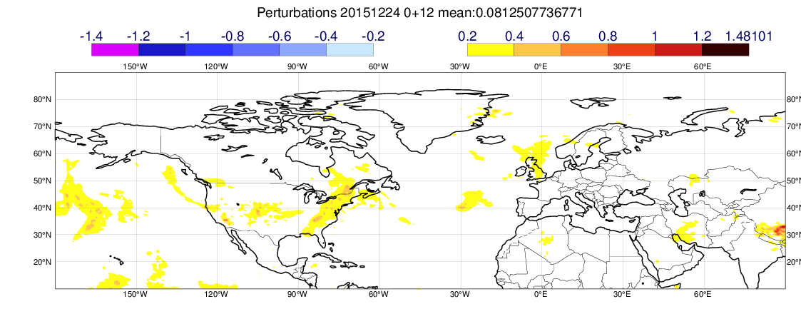
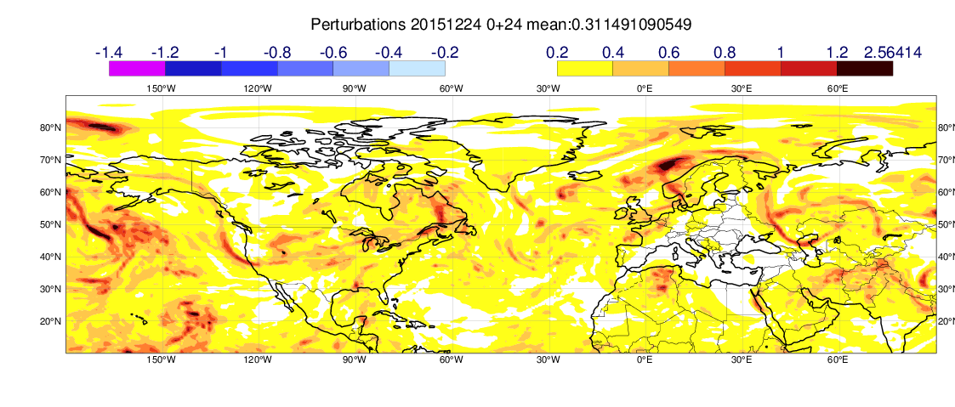

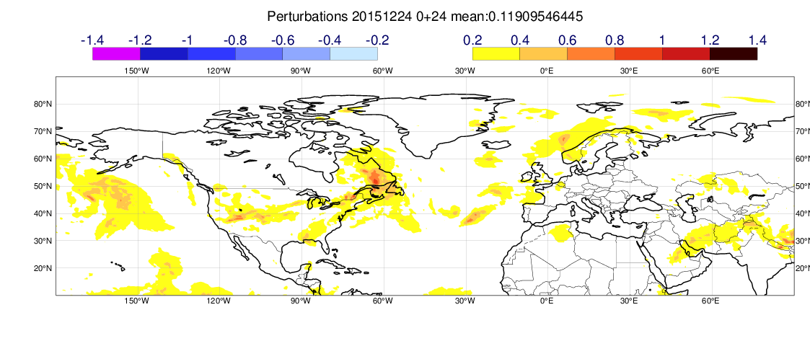
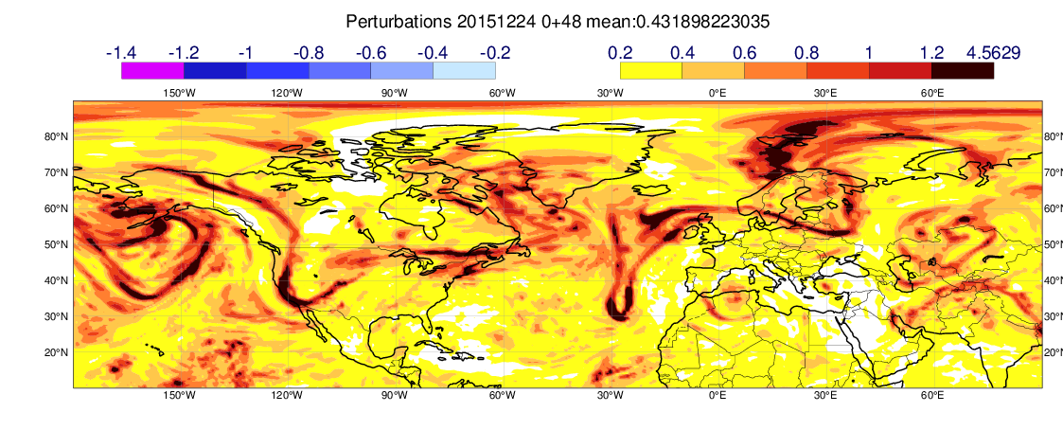
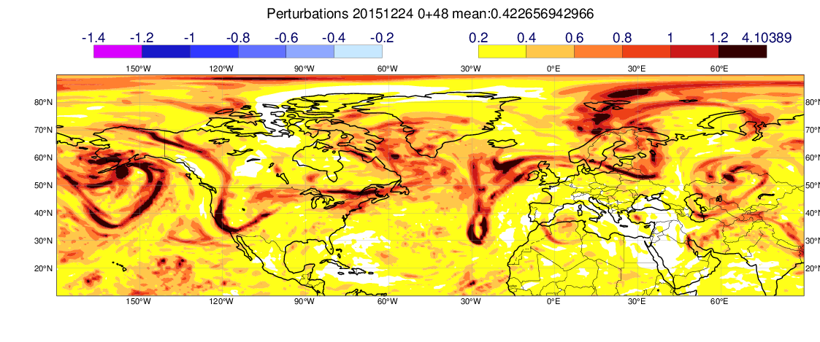
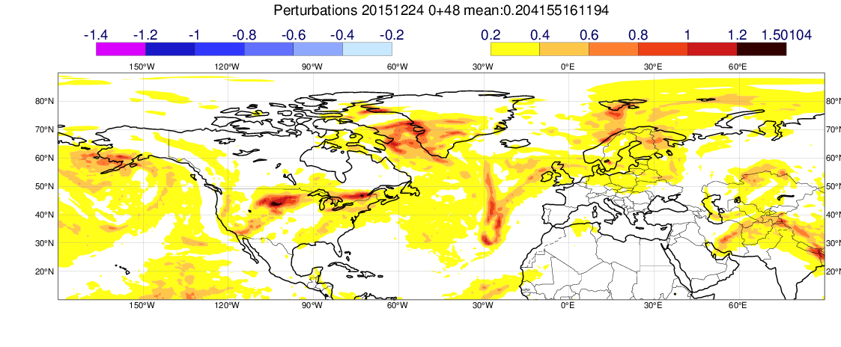
Temperature model level 97 (near 500hPa)
Courtesy of Linus @ECMWF
TCo639 mean(abs(PF-CF))
TCo1279 mean(abs(PF-CF))
Mean(abs(TCo1279(n)-TCo639(n)))
Step 0
Step 12
Step 24
Step 48

Slide 12


Limit of predictability Mid-latitude vs. Tropics
error kinetic Energy spectrum
40$°$N~60$°$N
$10°S$~10$°$N

Slide 13

$$Perturbation≠Error$$
day 30
day 0

Slide 14
Concluding marks and Future Plans
RMSE
Intrinsic predictability:
2 more days is the best we can do!
Practical predictability:
10-15 days for any signal with wavelength < 10000km
Gravity wave ?
Possible connection between Tropics and Extratropics?
Multi-models?

