Slide 1
WRF Simulation of Arctic Mixed-Phased Stratiform Cloud
Hui-Wen Lai
19 Aug. 2016
Advisor: Fuqing Zhang, Eugene Clothiaux

Slide 2
Motivation
In the Arctic, radiative energy lost to space greatly exceeds the energy received from the sun. This phenomenon plays an important role in Earth’s atmospheric general circulation. Arctic Mixed phase stratiform (AMPS) clouds in the lower troposphere of the Arctic have a large impact on down-welling solar and longwave radiative fluxes. Thus, a change in AMPS clouds can have a major influence on the local and potentially global climate system.
Mixed phase clouds are composed of a mixture of supercooled liquid water and ice crystals in a single or multiple stratiform layers. There are many factors that influence ice crystal growth conditions in mixed phase clouds, for example temperature, saturation ratio, and updraft speed.

Slide 3
Motivation
In AMPS clouds, multiple cloud layers interact with each other in a shallow layer. For coarse resolution models, we have to use parameterization to simulate turbulence on scales smaller than the grid spacing. With fine resolution simulations, we can resolve the turbulence directly. The fine resolution simulation may be useful to resolve the large eddies inside these clouds.

Slide 4
Objective
What are the physical processes behind the formation of multi-layer mixed-phase clouds?
How does WRF simulation do in the AMPS clouds?

Slide 5
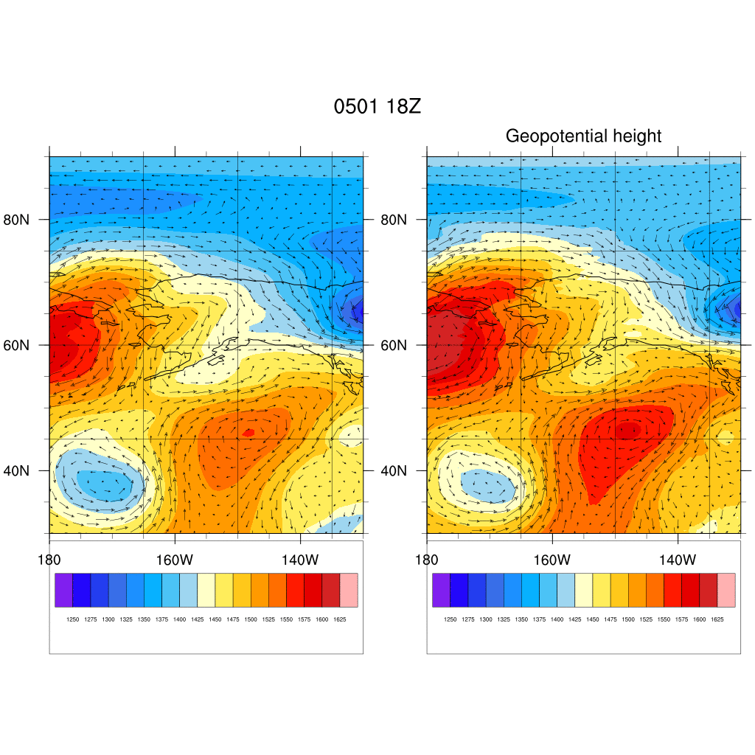
Case
Time: 18Z 1 May – 18Z 2 May 2013
Geopotential Height
ECMWF
FNL
90N
90N
60N
60N
30N
30N
180E
160W
140W
130W
180E
160W
140W
130W

Slide 6
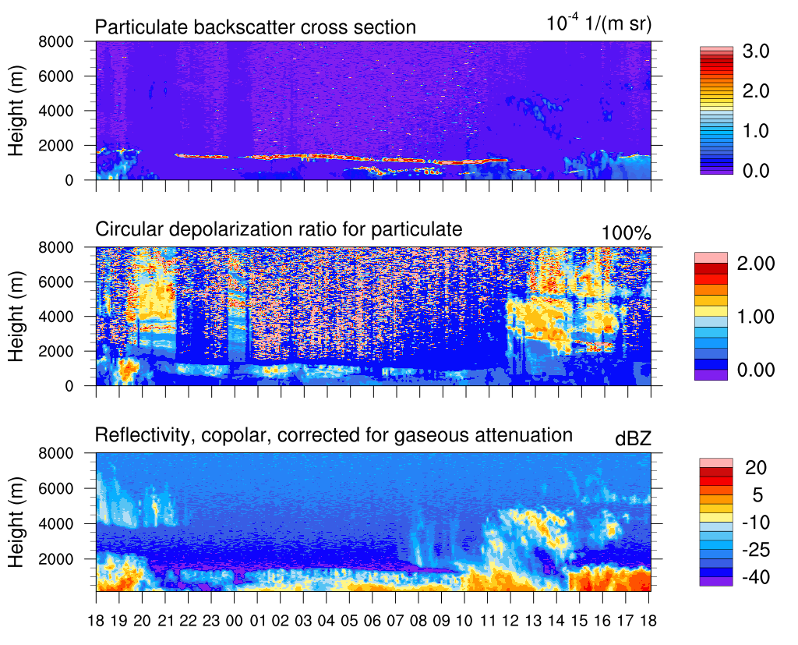
HSRL and KAZR observation
(Z)

Slide 7
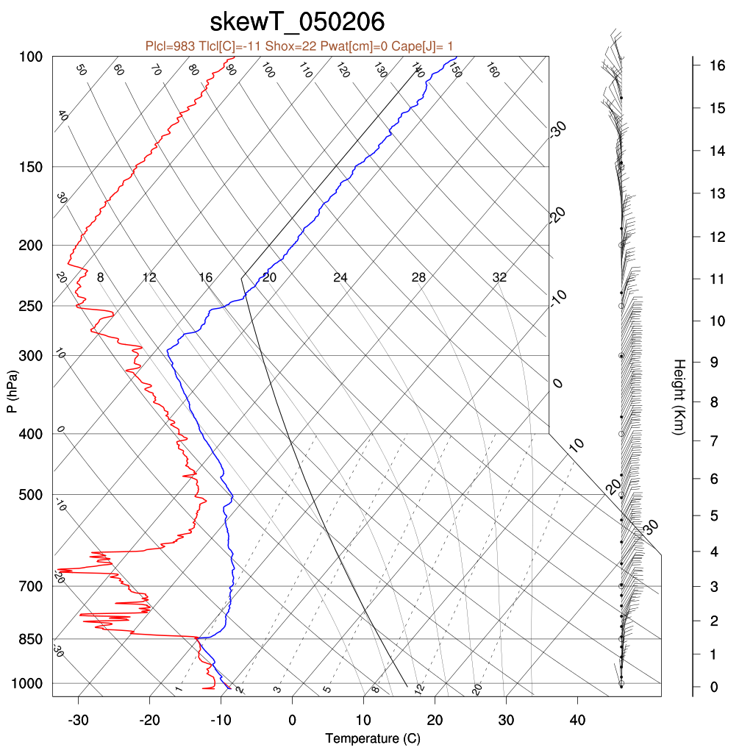
HSRL and KAZR observation
(Z)

Slide 8
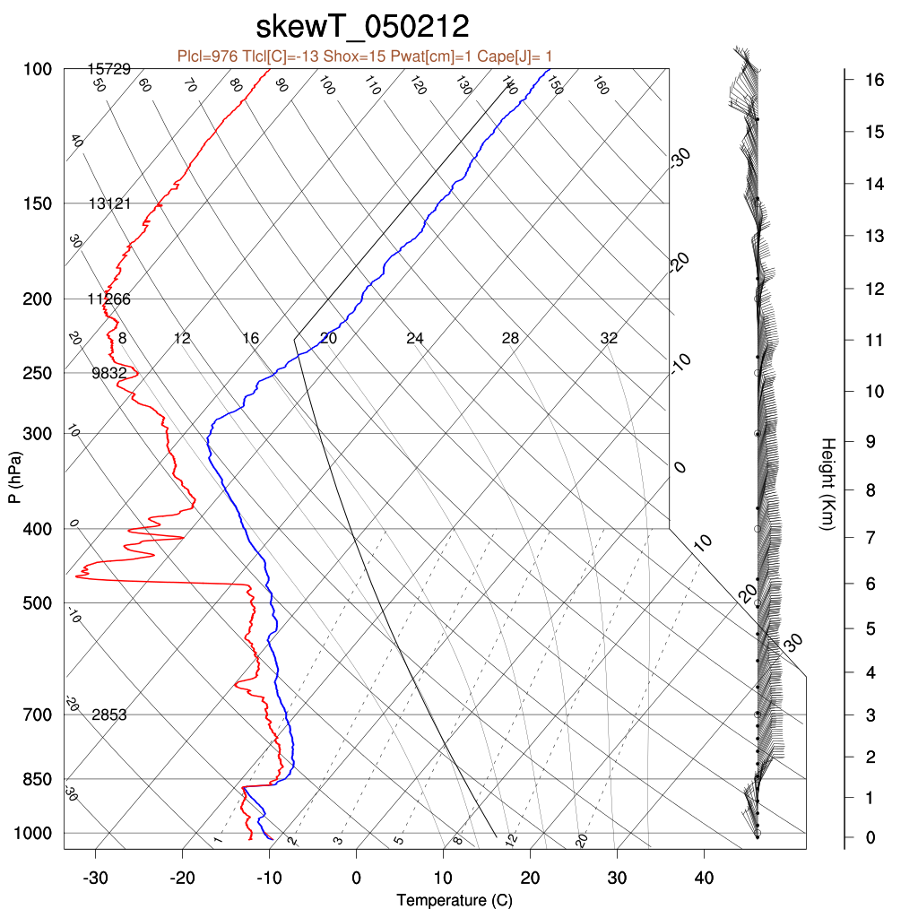
HSRL and KAZR observation
(Z)

Slide 9
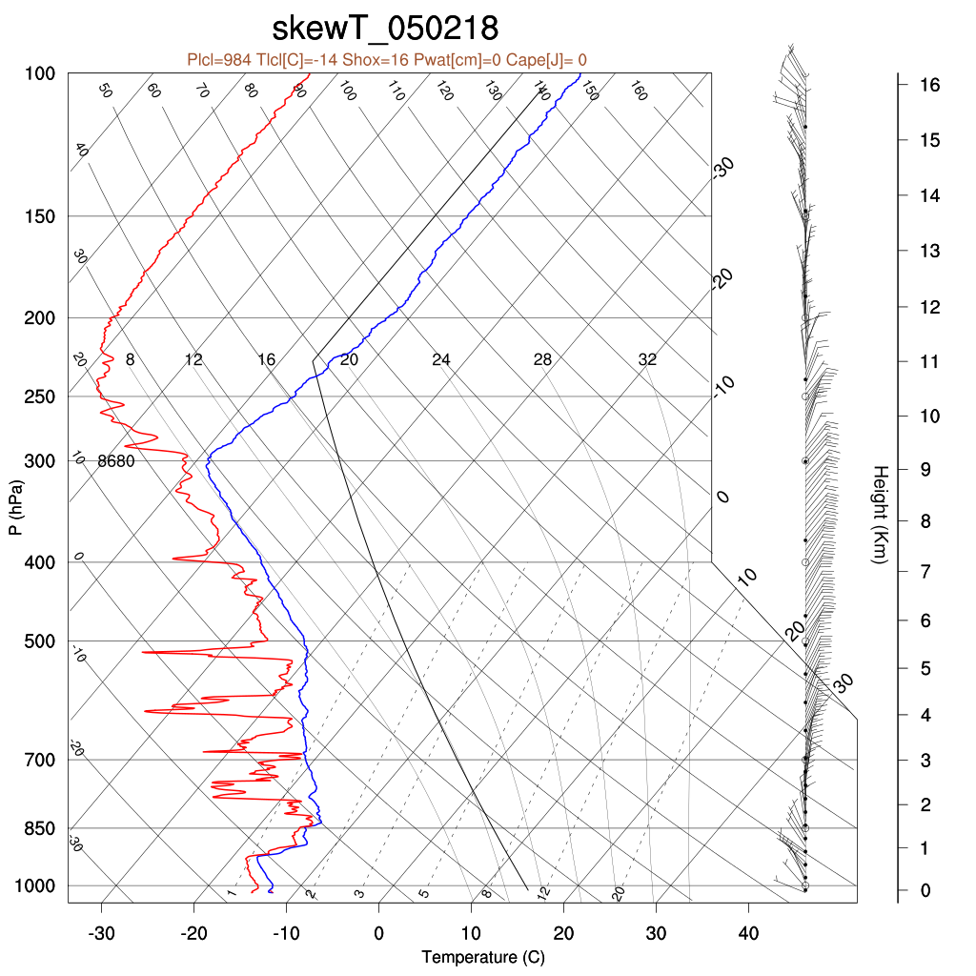
HSRL and KAZR observation
(Z)

Slide 10
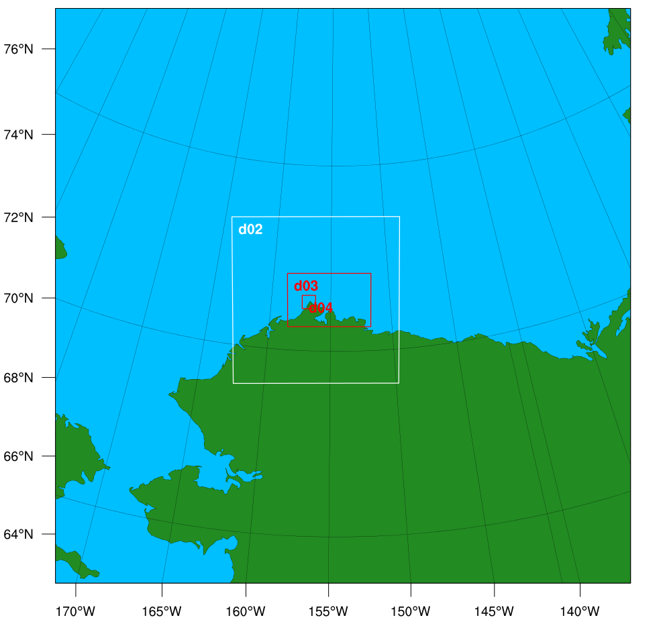
Model Setting
d01
 | Parameterized | Large Eddies Simulation (LES)
Max domain | 3 | 4
Planetary Boundary layer | YSU (ALL) | YSU (D01, D02)
Cumulus Parameterization | Grell-3D (D01, D02) | Grell-3D (D01, D02)
Microphysics Scheme | Morrison 2-moment scheme (ALL) | Morrison 2-moment scheme (ALL)
LES domain |  | D03, D04*
d01 : 70 ×70 × 130 (25km)
d02 : 101 ×101 ×130 (5km)
d03 : 251 ×161 ×130 (1km)
d04 : 201 ×201 ×130 (0.2km)
Vertical resolution below 2km is 40 m
* D04 starts 6 hours later

Slide 11
Model Setting
d01
Exp. 1 – Different initial time
12Z 01 - 18Z 02
18Z 01 - 18Z 02
00Z 02 - 18Z 02
06Z 02 - 18Z 02
Exp. 2 – Different initial and boundary condition
FNL from 18Z 01
ECMWF from 18Z 01
FNL+ECMWF from 18Z 01
Exp. 3 – Large Eddies Simulation
Parameterized from 00Z 02
LES from 00Z 02
d01 : 70 ×70 × 130 (25km)
d02 : 101 ×101 ×130 (5km)
d03 : 251 ×161 ×130 (1km)
d04 : 201 ×201 ×130 (0.2km)
Vertical resolution below 2km is 40 m

Slide 12
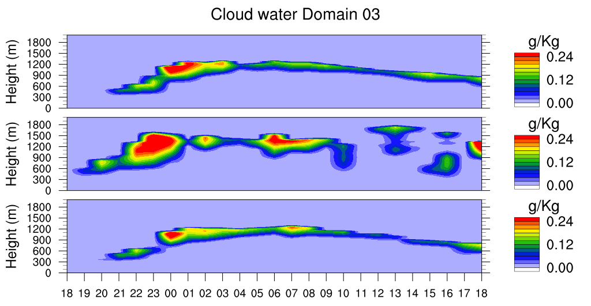
Simulation
Different initial condition Variable: Cloud water
FNL 18Z
ECMWF 18Z
FNL+ECMWF 18Z
(Z)

Slide 13
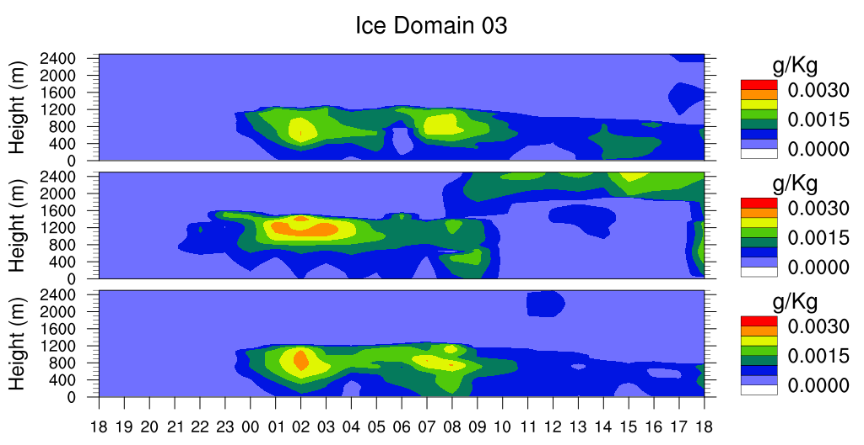
Simulation
Different initial condition
Variable: Cloud ice
FNL 18Z
ECMWF 18Z
FNL+ECMWF 18Z
(Z)

Slide 14
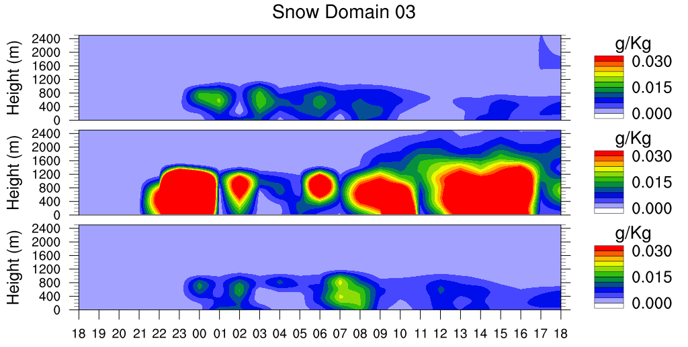
Simulation
Different initial condition Variable: Snow
FNL 18Z
ECMWF 18Z
FNL+ECMWF 18Z
(Z)

Slide 15
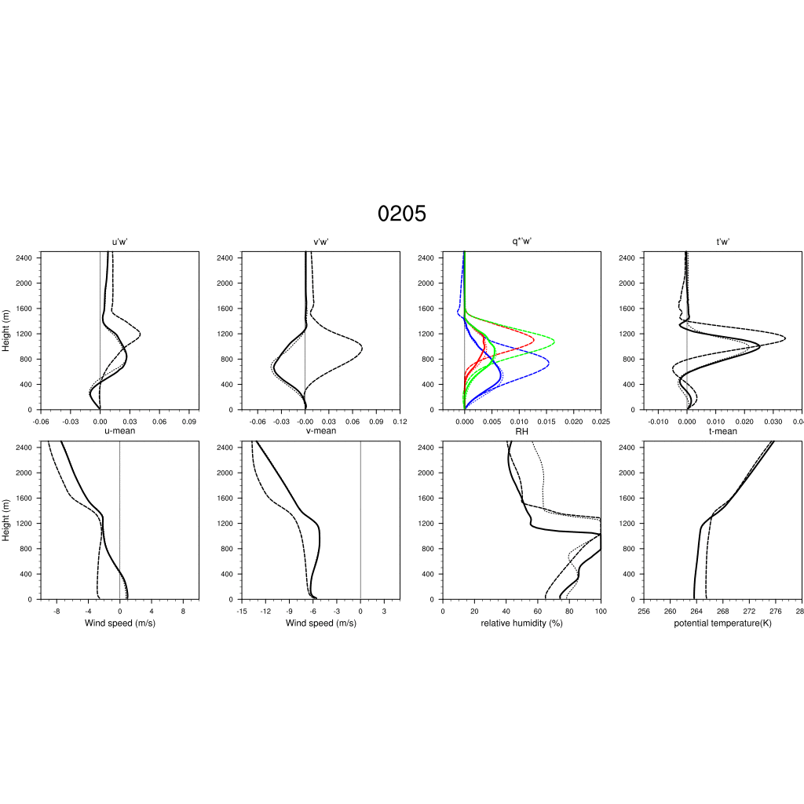
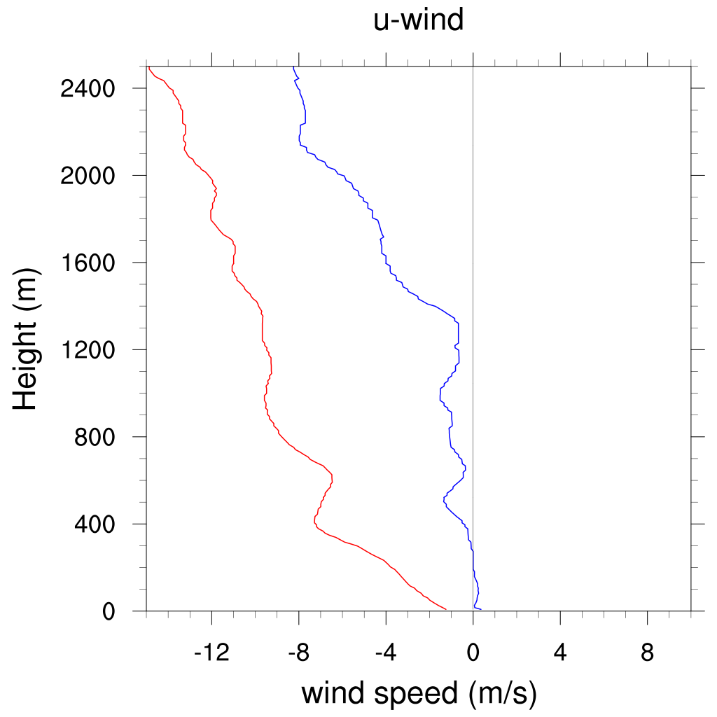
Simulation
FNL
ECMWF
FNL+ECMWF
water vapor
cloud water
hydrometeor
Different initial condition - Momentum flux in domain 3
05Z-10Z: Multiple cloud layers
Sounding 06Z
U-wind
V-wind

Slide 16
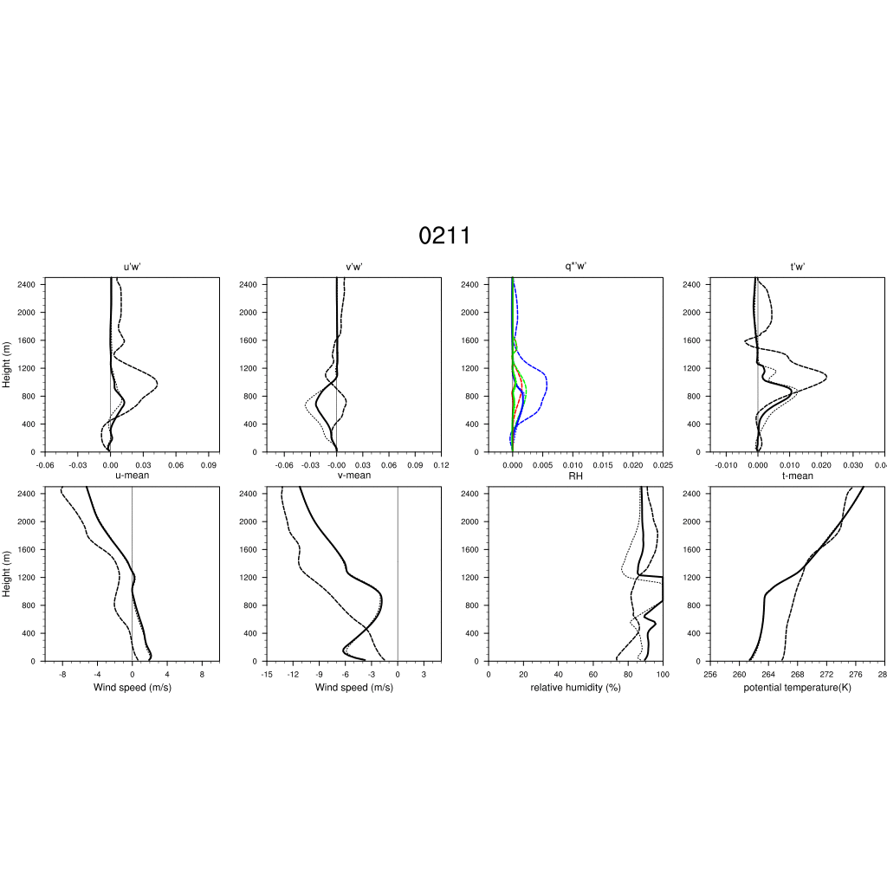
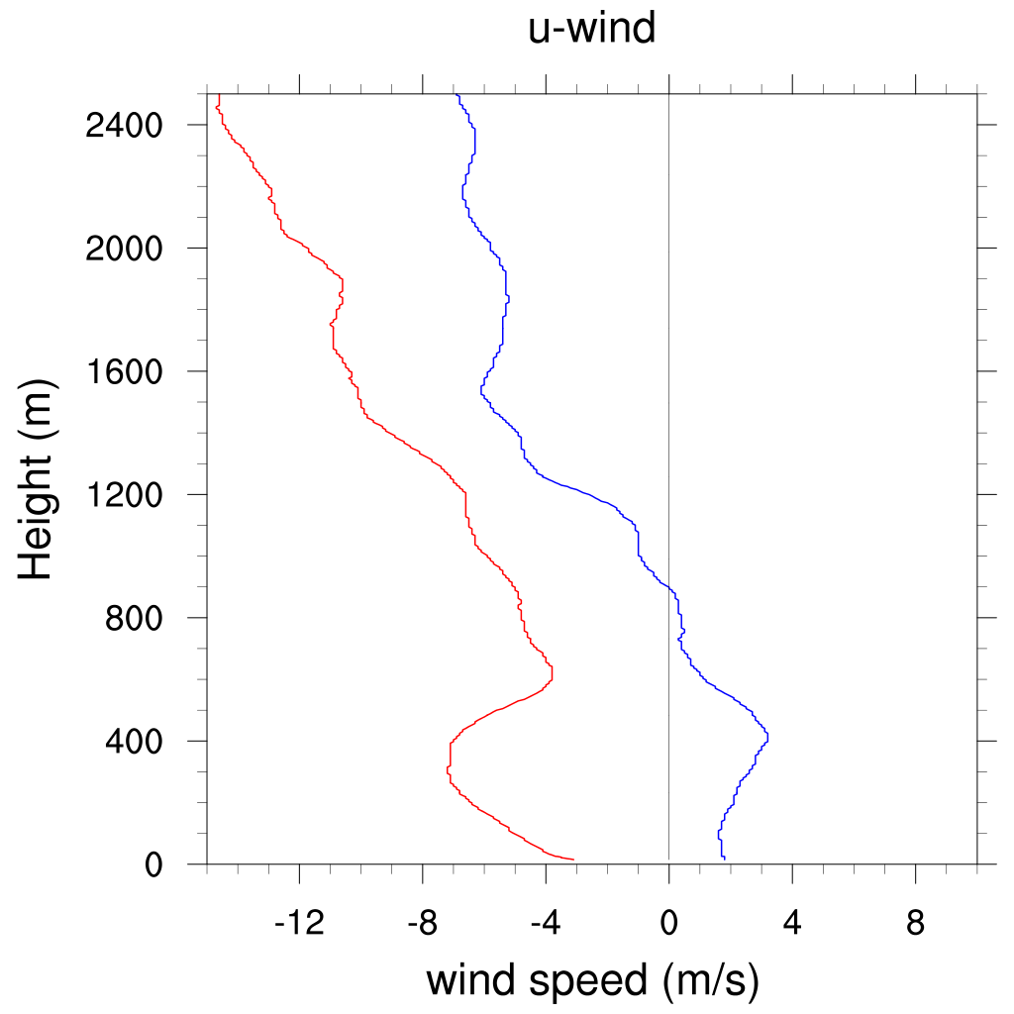
Simulation
FNL
ECMWF
FNL+ECMWF
water vapor
cloud water
hydrometeor
Different initial condition - Momentum flux in domain 3
11Z-14Z: Frontal system
Sounding 12Z
U-wind
V-wind

Slide 17
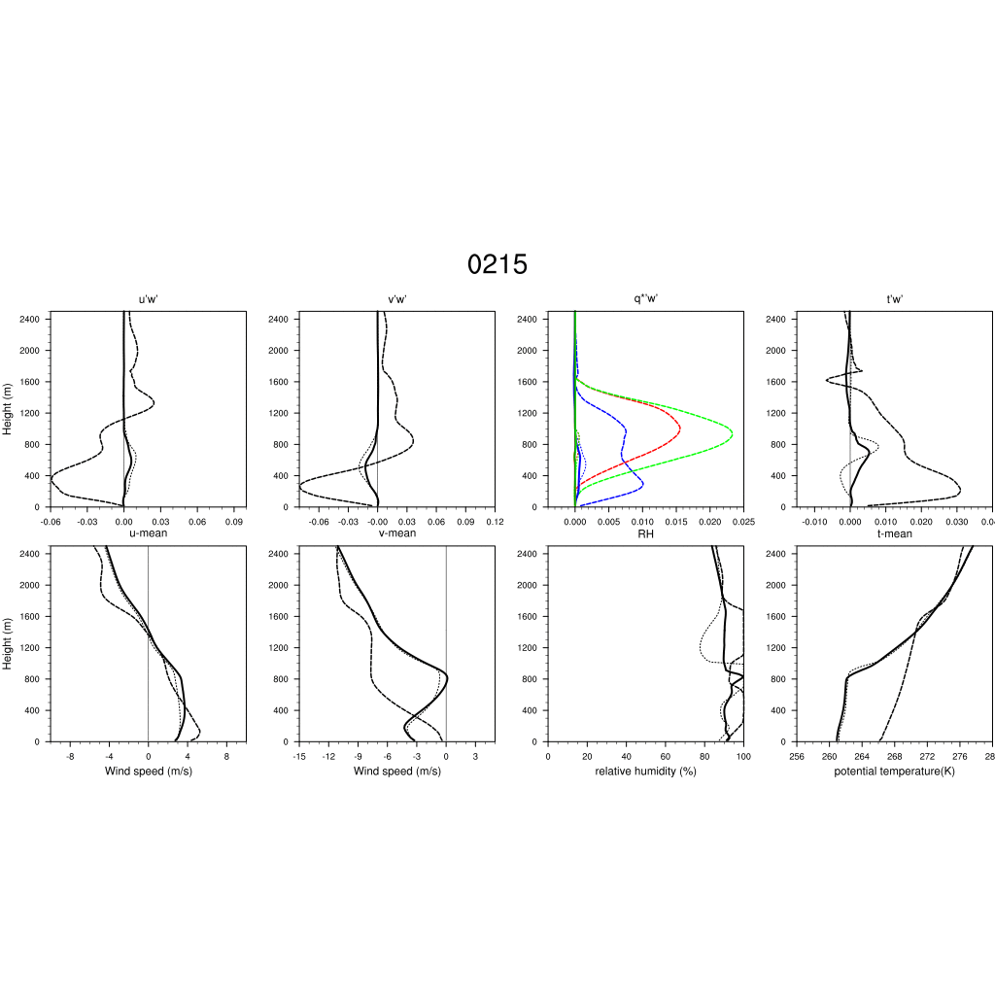
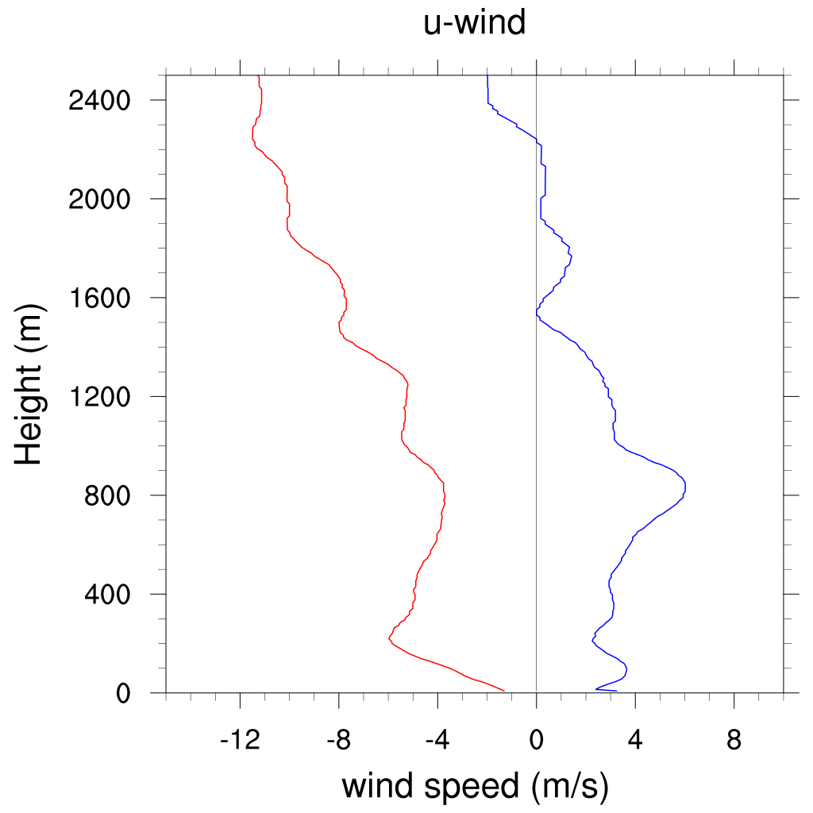
Simulation
FNL
ECMWF
FNL+ECMWF
water vapor
cloud water
hydrometeor
Different initial condition - Momentum flux in domain 3
15Z-18Z: Precipitation
Sounding 18Z
U-wind
V-wind

Slide 18
Simulation
Parameterized and LES
Variable: Cloud water
00Z 02 May
06 02 May
LES d04

Slide 19
Simulation
Parameterized and LES
Variable: Cloud ice
00Z 02 May
06 02 May
LES d04

Slide 20
Simulation
Parameterized and LES
Variable: Snow
00Z 02 May
06 02 May
LES d04

Slide 21
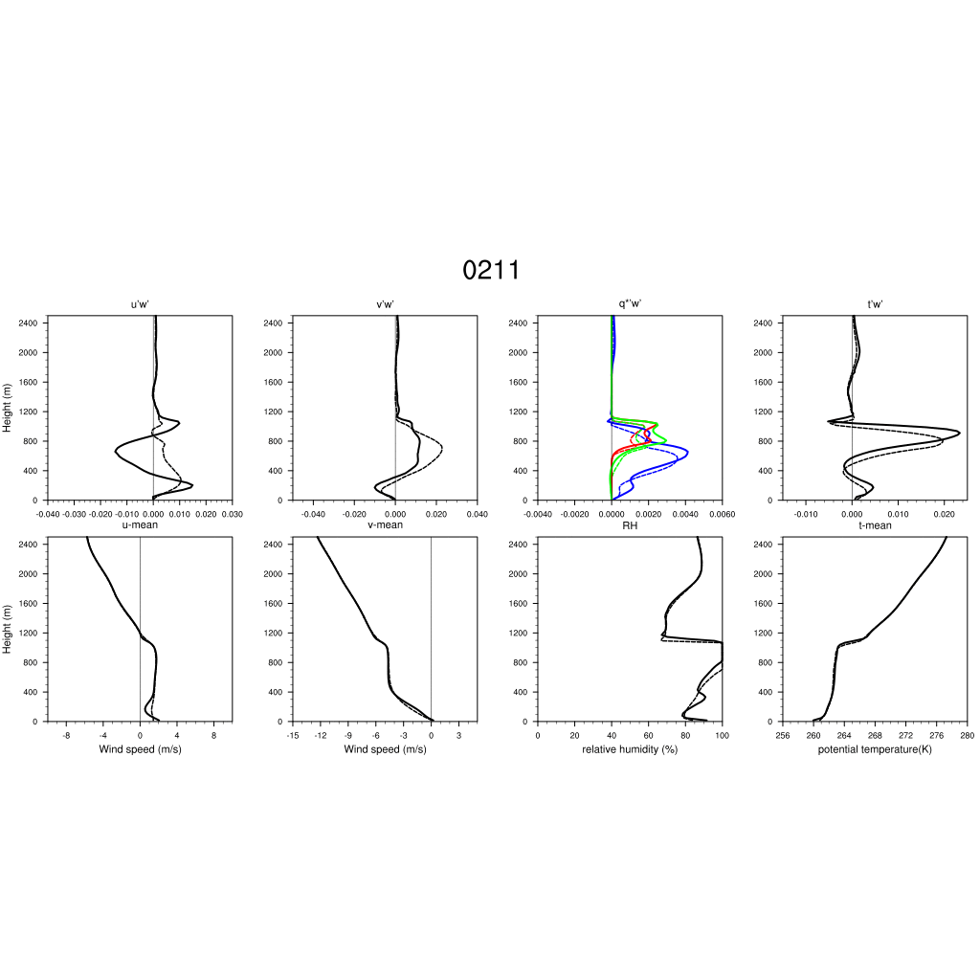
Simulation
Parameterized and LES - Momentum flux in domain 4
11Z-14Z: Frontal system
param.
LES
water vapor
cloud water
hydrometeor
Sounding 12Z
U-wind
V-wind

Slide 22
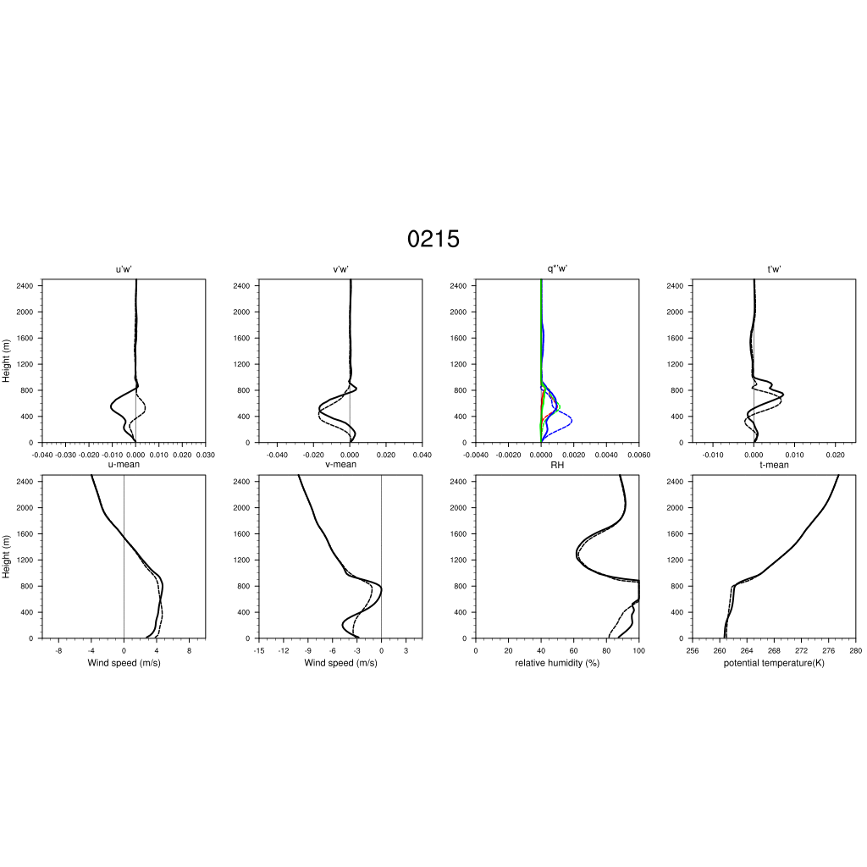
Simulation
Parameterized and LES - Momentum flux in domain 4
15Z-18Z: Precipitation
param.
LES
water vapor
cloud water
hydrometeor
Sounding 18Z
U-wind
V-wind

Slide 23
Conclusions
In the initial condition experiments, the FNL run provides a better synoptic wind field that matches the observed advection better, but didn't drive the formation of clouds and snow well because of insufficient water vapor. ECMWF provides more water vapor that forms a thicker cloud layer and got more ice and snow. However, ECMWF provides a poorer environmental wind field near the surface and has a weaker frontal system. The combination of FNL and ECMWF provides a better dynamical and physical structure of AMPS clouds.
With the fine resolution, LES resolves more turbulences directly. In this case, the difference of momentum flux between parameterized simulation and LES is related to the turbulence produced by wind shear. Since water vapor is transferred by turbulence, the LES may help to improve the simulation of the shallow AMPS clouds.

Slide 25
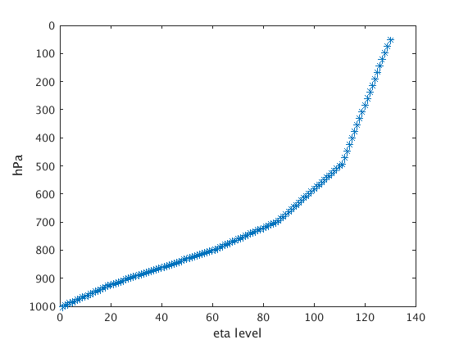
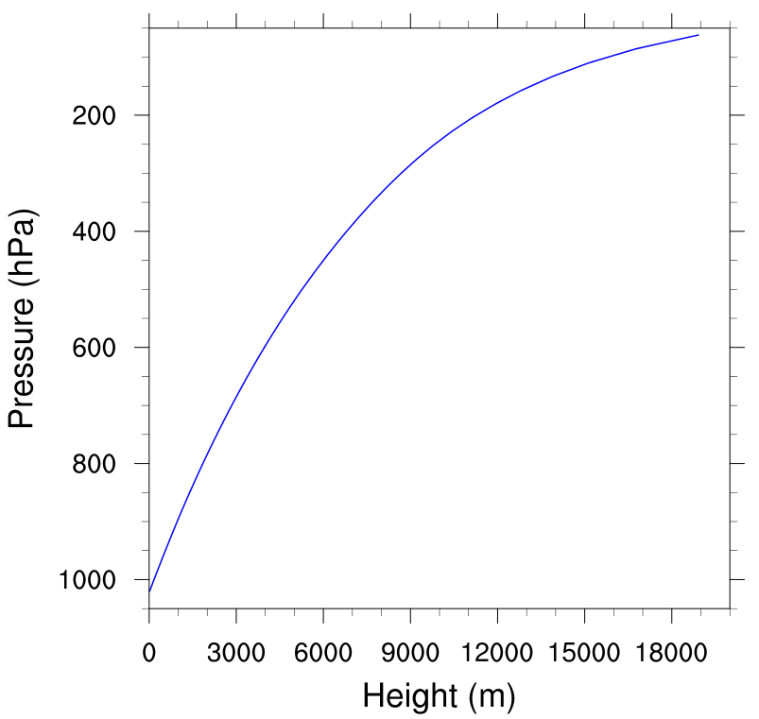
Model setting (vertical layer)
Layer distribution
Pressure and height
20
25
25
40
20

Slide 26
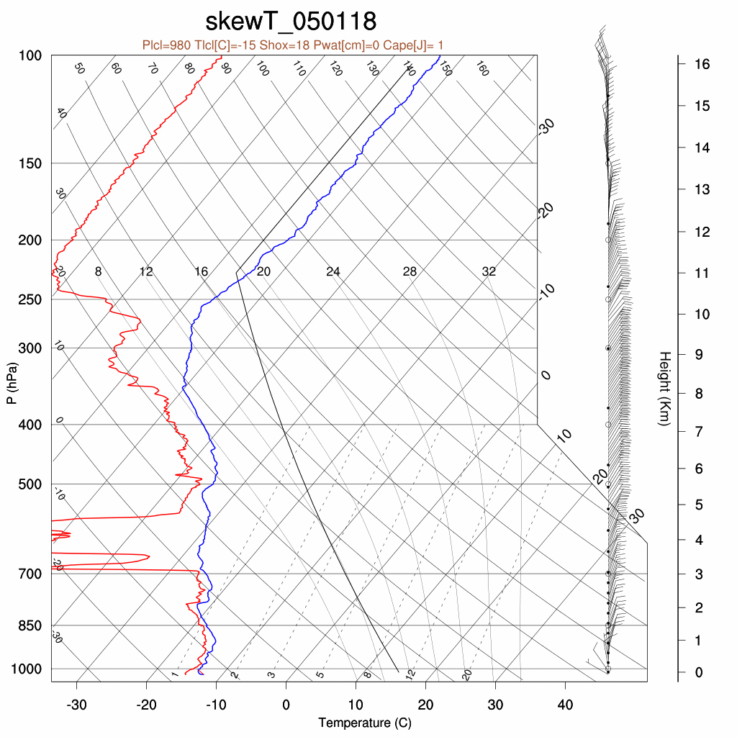
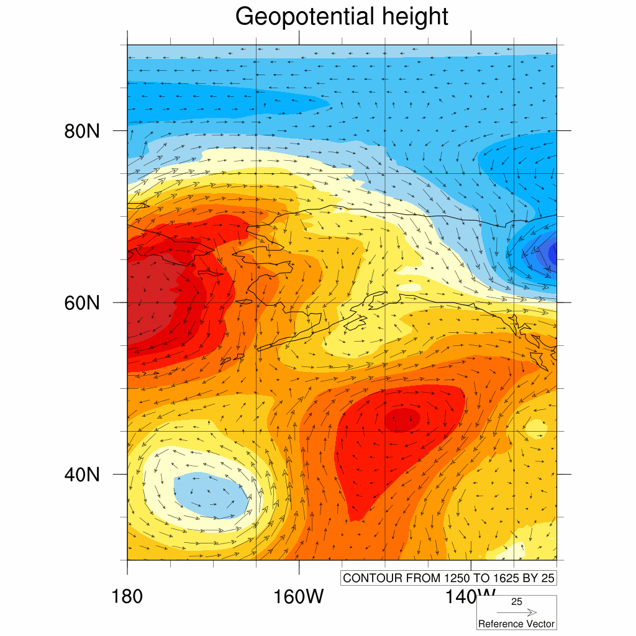
Case
Time:
18Z 1 May -18Z UTC 2 May 2013
FNL Geopotential Height
90N
30N
180W
130W

Slide 27
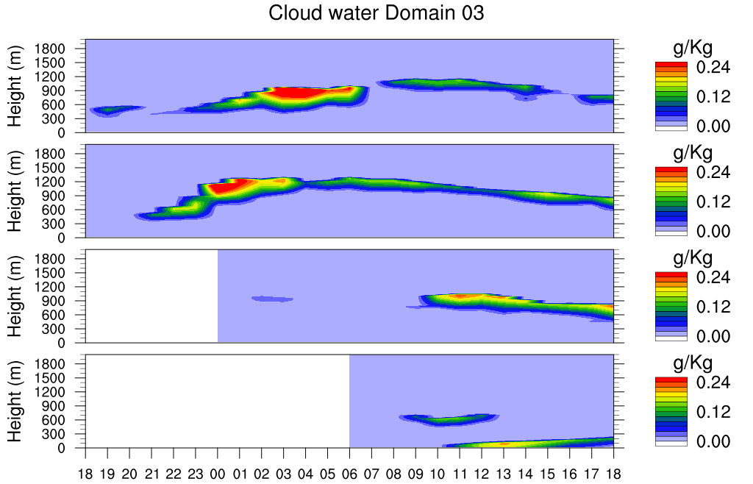
Simulation
Different initial time Variable: Cloud water
12Z 01 May
18Z 01 May
00Z 02 May
06 02 May
(Z)

Slide 28
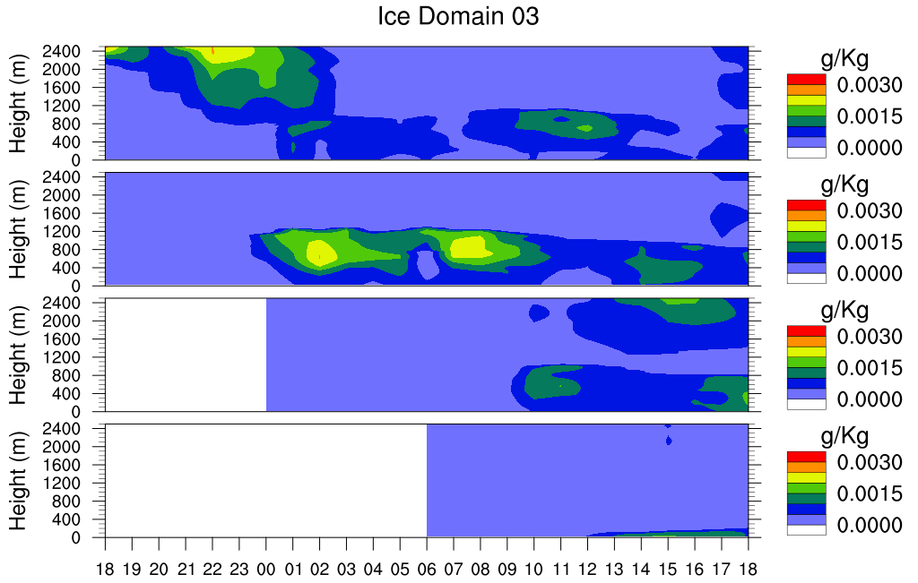
Simulation
Different initial time Variable: Cloud ice
12Z 01 May
18Z 01 May
00Z 02 May
06 02 May
(Z)
(Z)

Slide 29
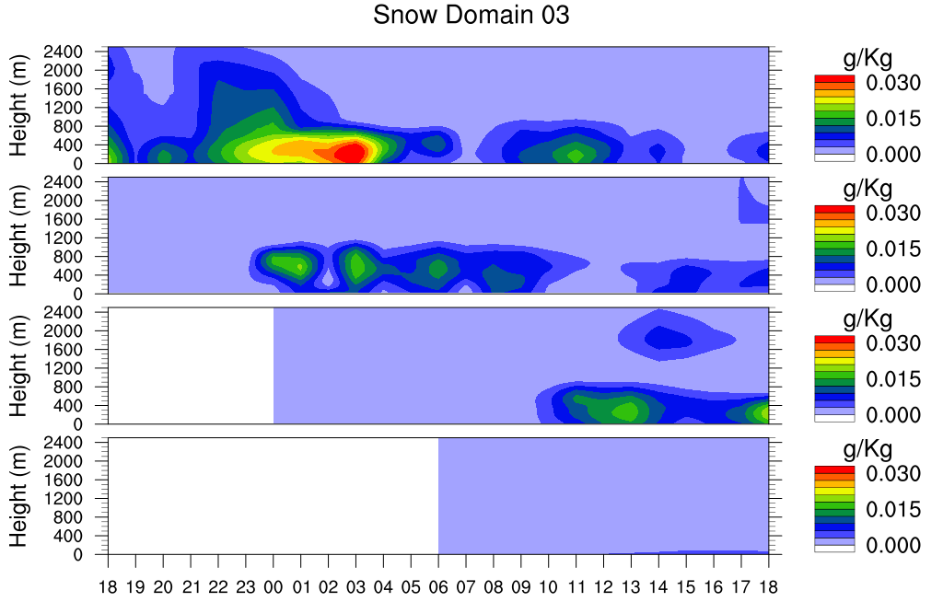
Simulation
Different initial time Variable: Snow
12Z 01 May
18Z 01 May
00Z 02 May
06 02 May

Slide 30
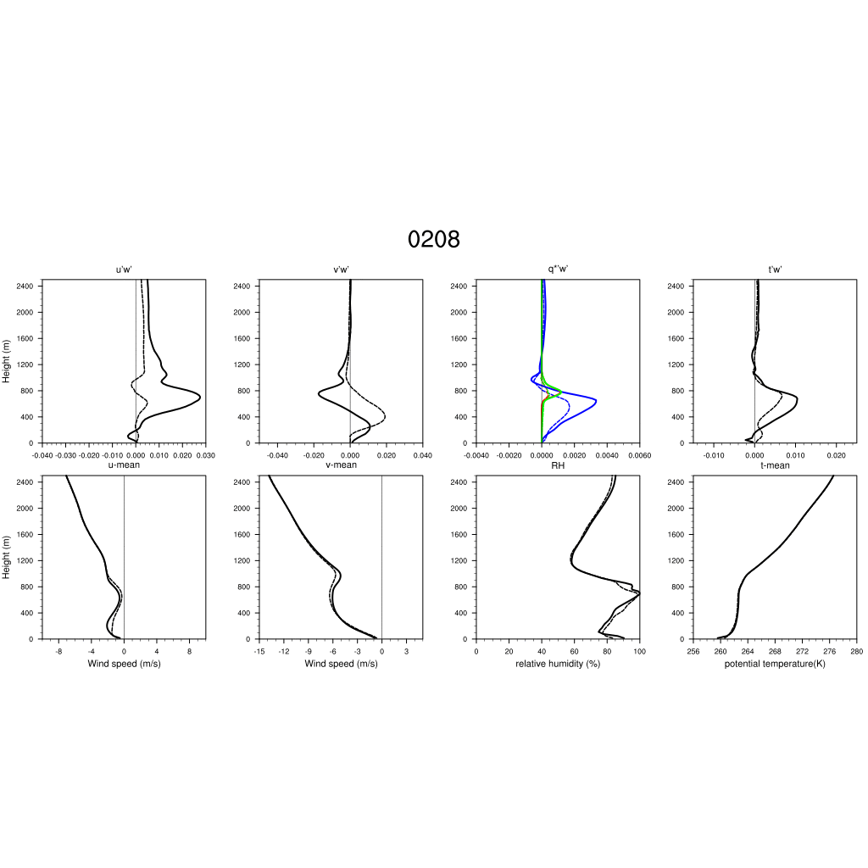
Simulation
Parameterized and LES - Momentum flux in domain 4
05Z-10Z: Multiple cloud layers
00Z02d03 (param.)
06Z02d04 (LES)
water vapor
cloud water
hydrometeor
Sounding 06Z
U-wind
V-wind

Slide 32
Simulation
18Z 01 May W-E vertical profile of wind field at Barrow
km
FNL 18Z
ECMWF 18Z
FNL+ECMWF 18Z
XSAPR Radar radial velocity
km
3
2
RHI_180037
1
-40
0 km
40
0 km
-40
0 km
40
-40
40
-40 km
0
40 km
m/s
-9
9
m/s

Slide 33
Simulation
16Z 02 May W-E vertical profile of wind field at Barrow
km
FNL 18Z
ECMWF 18Z
FNL+ECMWF 18Z
XSAPR Radar radial velocity
km
3
2
RHI_155445
1
-40
0 km
40
0 km
-40
0 km
40
-40
40
-40 km
0
40 km
m/s
0
m/s

