Slide 1


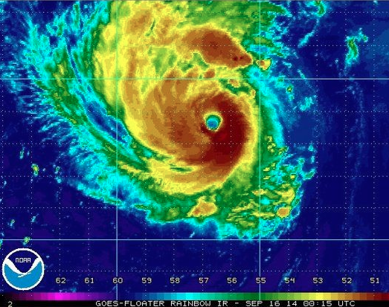
The thermodynamic structure of Hurricane Edouard (2014): An ensemble perspective
Erin Munsell
Summer 2016 Group Meeting
August 19th, 2016

Slide 2
Ensemble Tracks classified by performance
SST’s contoured (constant amongst members)
Munsell et al. 2016, In review
Maximum 10-m Wind Speed (kts) classified by performance
Best Track – Black
GOOD – Blue
GOOD_EARLY – Green
GOOD_LATE – Magenta
POOR – Red

Slide 3
HS3 Edouard Dropsonde Positions (to determine inner-core sondes)
Flight #1
Flight #2
Flight #3
Flight #4

Slide 4
HS3 Edouard Dropsonde Perturbation Temperatures (°C)
Flight #1
Flight #2
Flight #3
Flight #4

Slide 5
HS3 Edouard Flight #3 Dropsonde Perturbation Temperatures (°C) – Colored by distance from center
Mean Distance from Center (km)

Slide 6
Modeled vs. (Raw Data) Observations (Flight 3)
GOOD
Dropsondes
Temperature Perturbations (°C)
S-HIS
AMSU
From RAMMB/CIRA

Slide 7
Tracks, Minimum SLP (hPa), and Maximum 10-m Wind Speeds (kts) for GOOD_EARLY, GOOD, GOOD_LATE, POOR, and APSU
(extended to 12 UTC 17 September 2014)

Slide 8
Edouard WRF-EnKF Perturbation Temperatures (°C) – 09/17/14 at 00 UTC
GOOD_EARLY
GOOD
Temperature Perturbations (°C)
GOOD_LATE
POOR

Slide 9
Edouard WRF-EnKF Perturbation Temperatures (°C) – Time/Height
GOOD_EARLY
GOOD
Temperature Perturbations (°C)
GOOD_LATE
POOR

Slide 10
Edouard Warm Core Structure at 18Z Sept 16 2014 – GOOD

Slide 11
Edouard Warm Core (within 25-km radius) Evolution – GOOD

Slide 12
Correlation between height and strength of maximum temperature perturbation (within 25-km from Edouard’s center) and RI time and current intensity (minimum SLP)

Slide 13
Correlation between temperature perturbation (averaged within 25-km of Edouard’s center) and RI time (of three developing composite groups)
Correlation between temperature perturbation (averaged within 25-km of Edouard’s center) and current intensity (minimum SLP of three developing composite groups)

Slide 14
Scatterplot of Height of Maximum Temperature Perturbation (km; within 25-km from Edouard’s surface center) for the 40 members of the composite groups over time
Scatterplot of Strength of Maximum Temperature Perturbation (km; within 25-km from Edouard’s surface center) for the 40 members of the composite groups over time

Slide 15
Summary and Conclusions
Utilize wealth of HS3 observations and PSU WRF-EnKF ensemble forecast of Hurricane Edouard (2014) to examine the evolution and variability of Edouard’s warm core structure, particularly throughout its RI period
Four HS3 flights into Edouard – Flight 3 temperature perturbations suggest two possible perturbation structures
  1) a mid-tropospheric maxima between 4–6 km and a slightly weaker but distinct upper-tropospheric maxima between 10–12 km (as in many of the Earl sondes in Stern and Zhang (2016)) – likely in the eye, closest to the center
  2) a single maxima (slightly weaker than either of the maxima in 1) between 8–10 km – farther from center, perhaps eyewall
Temperature perturbation structure of GOOD composite at 00Z 17 Sept 2014 (during HS3 Flight #3) compares mostly favorably to observations
Area-averaged temperature perturbations begin developing in the lower to mid-troposphere (between 2–6 km) and build upwards – development is mostly confined to AFTER RI time
Correlation analyses support these conclusions, however, once all developing composites begin RI, there is little relationship between height of maximum temperature perturbation and RI time/current MSLP

