Slide 1
Joint Effects of Ocean Cooling and Reduced Wind Drag on Hurricane Forecasting
Yingjian Chen, Fuqing Zhang and Xiping Yu
2016.08.19

Slide 2
Introduction
Wind stress is an important driving force for meteorological and oceanographical processes.
It can be calculated by
The tendency of wind stress coefficient in hurricane condition remains controversial for decades.
The recent field data showed that the wind stress coefficient levels off and even decreases when the wind speed exceeds 30-40 m/s
To investigate the sensitivity of hurricane intensity forecast to different tendency of wind stress coefficient in extreme wind condition.
Notes:
Figure 1 shows that the drag formulas proposed by different authors vary to a large extent in high wind condition.

Slide 3
Ex. coefficient for wind drag:
C-Y (Chen and Yu, 2016)
WRF Opt 2
PSU (Green and Zhang, 2013)
Ex. coefficient for sensible heat:
(Brutsaert, 1975)
Notes:
Three drag formulas are chosen. These three options use the same heat flux scheme. The ratio of Ck to Cd is plotted in figure 2. Opt_CYJ is larger than 0.75 when wind speed is beyond 64 m/s, which is consistent with the conclusion of Emanuel (1995) that the ratio in real hurricanes lies above 0.75.

Slide 4
Introduction
Hurricane wind field has significant impacts on ocean physics:
(1) Sensible and latent heat are lost to the atmosphere
(2) cyclonic motion of hurricane intensifies the oceanic cyclonic circulation,
(3) strong winds enhances the turbulent entrainment.
As a result, SST decreases during the hurricane period.
Negative feedback may occur between the SST response and hurricane intensity
To investigate the joint effect of ocean cooling and reduced wind drag on hurricane forecast.
Notes:
In general, most of the operational systems use the time-independent sea surface temperature field to forecast the hurricane intensity and doesn’t consider the ocean cooling effect.
As is known, hurricane wind field has significant impacts on ocean physics
colder water in the deeper layer in the ocean will rise to the surface and the sea surface temperature is lowered. (Next ppt)
Negative feedback from ocean response will occur. Lower SST may reduce the heat flux from ocean to air and impede the hurricane intensificaition.
So the hurricane motion is a strongly coupled process
So in summary my research is to investigate Joint Effects of Ocean Cooling and Reduced Wind Drag on Hurricane Forecast

Slide 5
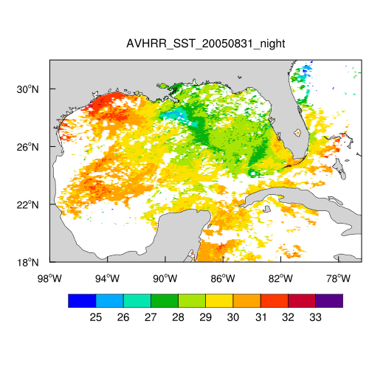
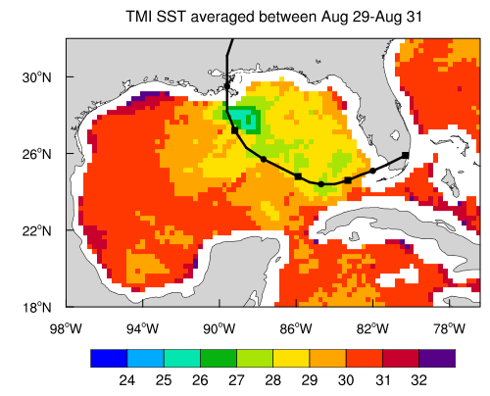
Satellite-observed SST
Notes:
Plotted in the figures is the satellite observed SST during the hurricane Katrina. We can clearly see the temperature cooling region in the black circle. The SST cooling is up to 6-7 degree Celsius during Katrina.

Slide 6
Coupled model
WRF
Momentum
Latent heat
SST
Sensible heat
Short wave
Long wave
ROMS
Notes:
The wind stress derived from the three drag formulas discussed above is calculated in WRF and transferred to ROMS to drive the ocean dynamics.

Slide 7
Case Study: Katrina
Case ID | Name | Coupled | Drag Formula | SST Field
1 | PSU_Cpl | × | PSU (Green and Zhang, 2013) | GFS
2 | Opt 2_Cpl | × | WRF Opt 2 | GFS
3 | CY_Cpl | × | C-Y (Chen and Yu, 2016) | GFS
4 | PSU_Cpl | √ | PSU (Green and Zhang, 2013) | Global HYCOM
5 | Opt 2_Cpl | √ | WRF Opt 2 | Global HYCOM
6 | CY_Cpl | √ | C-Y (Chen and Yu, 2016) | Global HYCOM
Notes:
The hurricane case I study is Katrina because it has extremely large intensity and is applicable for the sensitivity analysis of wind stress coefficient in high wind condition. I set six cases. The first three are run only in WRF and not coupled with the ocean model. They use three different drag formulas and the static SST fields are from GFS product. The later three cases are coupled with the ocean model.

Slide 8
Model Configuration
WRF
3 nesting domains:
D01 (304*274, 27 km)
D02 (403*382, 9 km)
D03 (403*403, 3 km)-vortex following
Vertical levels = 43
Initial condition: interpolated from the EnKF ensemble mean output created by Green and Zhang (2013)
Boundary condition: GFS
Notes:
I used three nesting domains in WRF. The horizontal grid resolution is 27, 9, 3 km respectively. Vertical direction uses 43 levels.
The initial condition was interpolated from the EnKF ensemble mean output created by Green and Zhang (2013)
Lateral boundary condition use GFS

Slide 9
Model Configuration
ROMS
1 domain (540*346, 1/25°)
Total vertical levels = 36, with at least 15 levels in the upper 50-m
Bathymetry: GEBCO
Forcing field: WRF output
Initial condition: global HYCOM
Boundary condition: global HYCOM
Notes:
15 levels in the upper 50 m to better resolve the ocean mixed layer.

Slide 10
00:00 UTC, 26 Aug, 2005
Initial conditions:
Sea Surface Temp.
Sea Surface Height (SSH):
50-m depth Temp.
Notes:
The case is initialized at 00Z Aug 26, 2005. Figure 2a plots the sea surface temperature. We can see that SST is over 30 C throughout the gulf of mexico. Plotted in figure 1 is the sea surface height and Plotted in figure 2b is the temperature at 50-m depth. These two figures all show warm core eddies in red circles and cold eddies in purple circles. This mesoscale oceanic features can not be resolved in the original GFS SST fields.

Slide 11
Notes:
The dash lines are the uncoupled case and the solid lines are the coupled case. The simulated tracks in all cases are close to but slower than the best track. And the coupled ones move a little left to the uncoupled ones and are all closer to the best track. The track is insensitive to the drag formulas because the track position is mainly determined by large-scale steering flows.

Slide 12
Hurricane Intensity
Non Coupled
Coupled
Notes:
For the non-coupled cases, the minimum SLP is similar to some extent. This may be due to the same parameterization scheme of heat flux they used. But the case with the reduced wind drag in hurricane condition yields much larger wind speed than the other two cases and the best track.
After coupled with the ocean model, the minimum SLP and the maximum wind speed are both significantly lower than the non-coupled ones because of the ocean cooling. While the two cases with larger wind stress underestimated the intensity of Katrina, the result from the case with the reduced wind drag is consistent with best track. It can also reproduce the intensification and peak value at this time.
So we can conclude in this Katrina case that considering the ocean cooling effect and decreasing tendency of the wind stress coefficient in high wind condition, the hurricane intensity can be well reproduced.

Slide 13
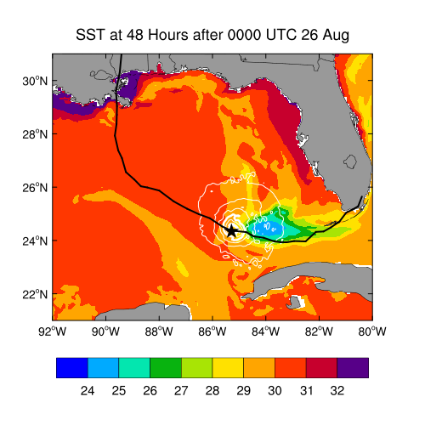
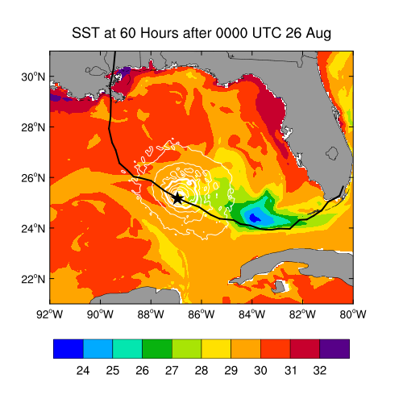
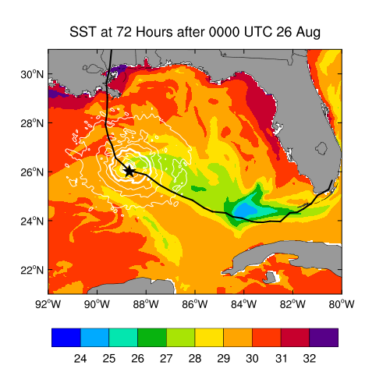
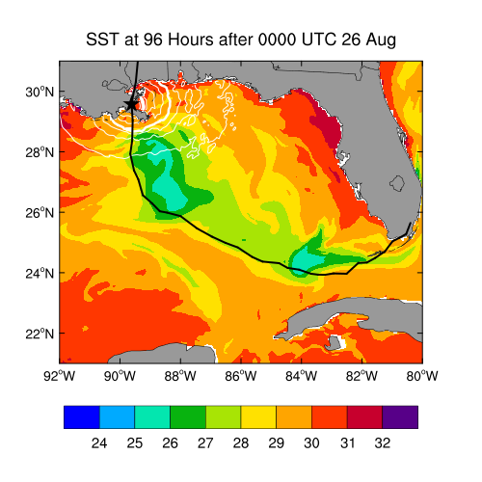
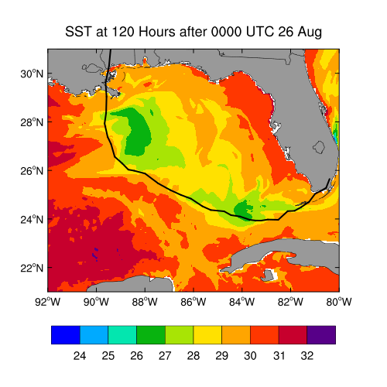
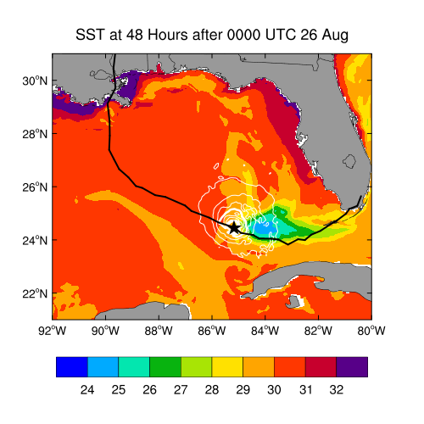
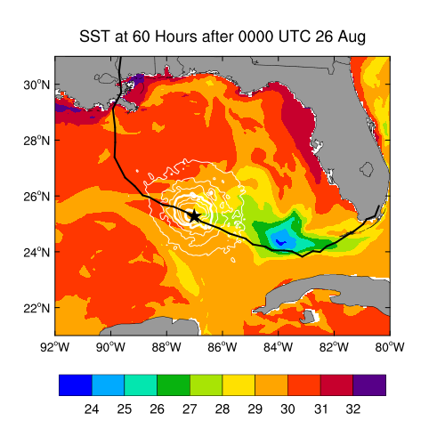
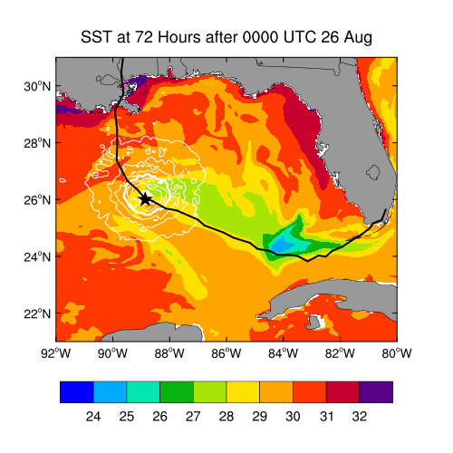
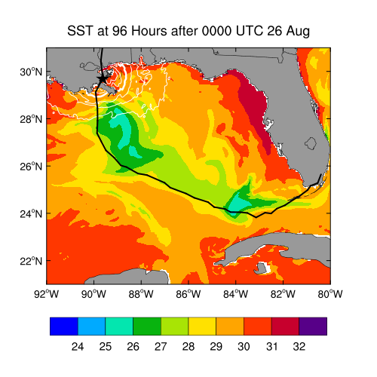
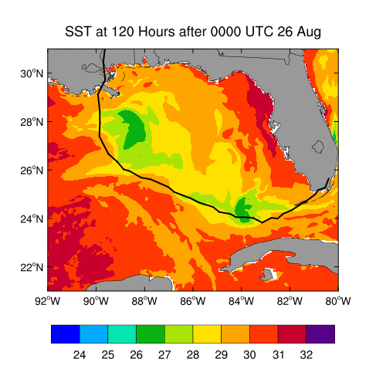
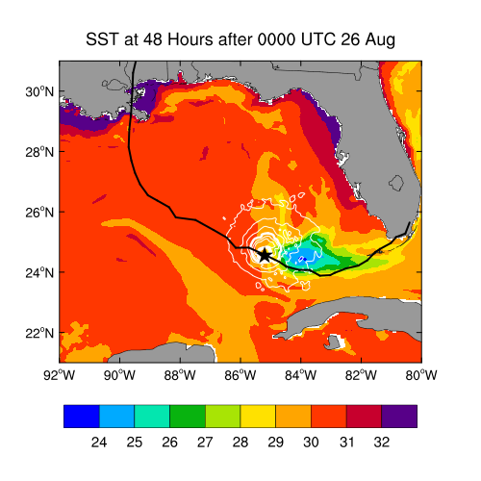
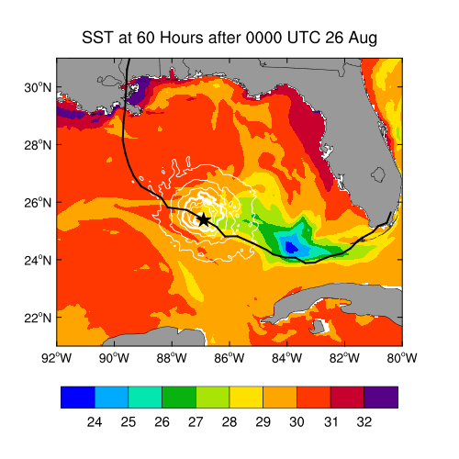
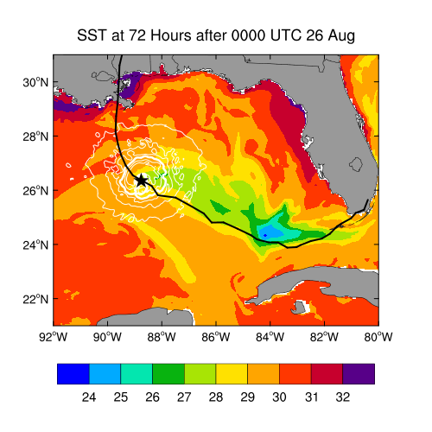
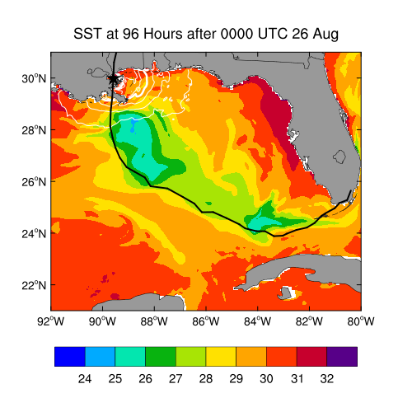
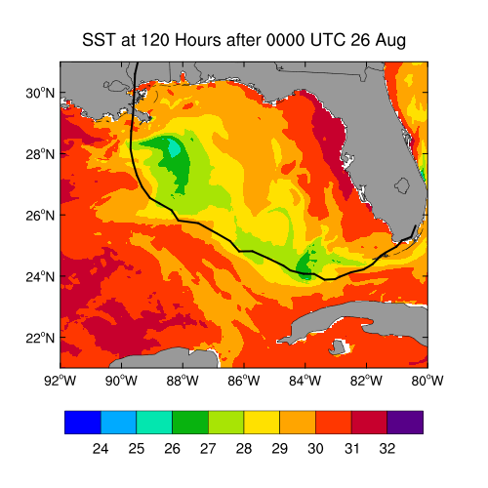
SST computed by different drag formulas
CY_Cpl
Opt 2_Cpl
PSU_Cpl
Notes:
This figures are the SST evolution computed by three cases.
Let’s see the first row. When the hurricane passed by, we can easily see the ocean cooling. And the maximum cooling accur in this two regions. Which is consistent with the cold core eddy in the initial condition. During these two regions, the hurricane passed over the Loop Current, the temperature decreased not much, so in this area the hurricane intensified.
When compared three cases, we can see the SST fields are similar. Although PSU drag formula yields the wind stress coefficient increasing with the wind speed, the simulated wind speed is smaller than the other two cases, so these two variables compensate with each other. We can see the white lines in the figures. It is the contour of the wind stress. The distribution and the magnitudes are much alike. As a result the SST fields driven by the wind forcing are similar.

Slide 14
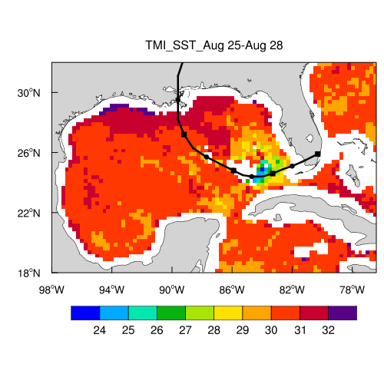
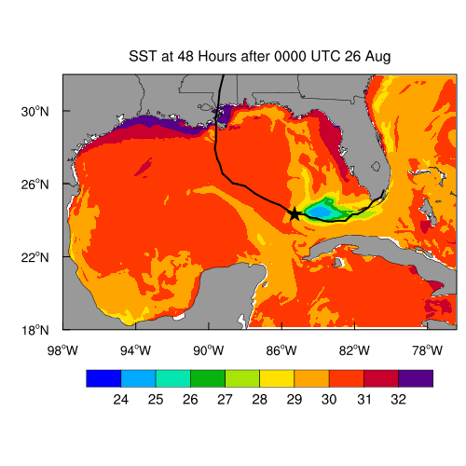

Slide 15
CY_Cpl
Opt 2_Cpl
PSU_Cpl
Coupled
Non Coupled
Notes:
The major differences of the 10-m wind speed among three options lie in the tangential wind instead of the radial wind velocity.
The thick black lines represent 950 millibar, it expands throughout the first 90 hours after the initial time in the coupled cases. But the minimum sea level pressure all peaks at around 72 hours. At this time the hurricane pass over the Loop Current.
Without the coupling, the whole pressure field expand throughout the 90 hours.

Slide 16
CY_Cpl
Opt 2_Cpl
PSU_Cpl
Coupled
Non Coupled
Notes:
The major differences of the 10-m wind speed among three options lie in the tangential wind instead of the radial wind velocity. We can see the

Slide 17
CY_NoCpl
CY_Cpl
Opt 2_NoCpl
Opt 2_Cpl
Sensible heat flux
Latent heat flux

Slide 18
Azimuthally averaged 10-m wind fields
48 hours
72 hours

Slide 19
Case Study: Katrina
Case ID | Name | Coupled | Drag Formula | Wind Field
7 | PSU_ROMS | × | PSU (Green and Zhang, 2013) | CY_Cpl WRF output
8 | Opt 2_ROMS | × | WRF Opt 2
9 | CY_ROMS | × | C-Y (Chen and Yu, 2016)

Slide 20
48 Hours
surface
20-m depth
50-m depth
CY_ROMS
PSU_ROMS

Slide 21
48 Hours
surface
20-m depth
50-m depth
CY_ROMS
PSU_ROMS

Slide 22
48 Hours after 00:00 UTC, 26 AUG, 2005
CY_ROMS
PSU_ROMS

Slide 23
84 Hours after 00:00 UTC, 26 AUG, 2005
CY_ROMS
PSU_ROMS

Slide 24
Conclusions
The reduced wind stress coefficient in hurricane conditions largely increases the hurricane intensity
With the ocean cooling effect, the hurricane intensity decreases
Considering the joint effects of reduced wind drag and ocean cooling, the intensity of Katrina can be well reproduced.
Future Plan
Test the applicability of the joint effects on hurricane Edouard.

