Slide 1
Ozone Sensitivity to Nitric Oxide Emissions in WRF-Chem
ADAPT meeting- Summer 2016
Andrew Thomas
Advisers: Amy Huff and Fuqing Zhang

Slide 2
No_{x} Sensitivity tests
O₃ is a secondary pollutant, from which NO₂ is one precursor chemical.
NO_{x} emissions contain many uncertainties and are updated once every few years.
NEI-2011 Emissions
NEI-2011 Emissions with 20% less anthropogenic NO_{x}
NEI-2011 Emissions with 20% more anthropogenic NO_{x}
NEI-2005 Emissions
Notes:
earlier

Slide 3
O₃ and human health
Ozone is considered by the EPA as one of the 6 “criteria pollutants.”
Ozone is inhaled and it oxidizes the mucus membrane lining of the lung
Inhaled ozone oxidizes the lining of the lungs, causing a “reactive cascade” which leads to cardiovascular problems.
Air Quality Index Levels of Health Concern | Maximum 8 Hour Average Ozone Level | Meaning
Good | 0-55 ppb | Air quality is considered satisfactory, and air pollution poses little or no risk.
Moderate | 55-71 ppb | Air quality is acceptable; however, for some pollutants there may be a moderate health concern for a very small number of people who are unusually sensitive to air pollution.
Unhealthy for Sensitive Groups | 71-86 ppb | Members of sensitive groups may experience health effects. The general public is not likely to be affected.
Unhealthy | 86-106 ppb | Everyone may begin to experience health effects; members of sensitive groups may experience more serious health effects.
Very Unhealthy | 106-201 ppb | Health warnings of emergency conditions. The entire population is more likely to be affected.
Hazardous | >201 ppb | Health alert: everyone may experience more serious health effects.

Slide 4
Background: O₃ and NO_{x}
$O+O2+M→O3+M$
$NO2+hν\left(λ<424 nm\right)→O+NO$
Ozone formed from oxygen atom and oxygen molecule.
Oxygen molecule formed from the photolization (reaction with UV radiation) of NO₂
NO₂ formed via NO and CH₃O₂
Notes:
Fewer eqns

Slide 5
The model: WRF-Chem
Offline Air Quality Models (like CMAQ)
Online Air Quality Models (like WRF-Chem)
Computes chemistry after meteorology
Computationally inexpensive
Used operationally and for regulatory purposes
Often interpolates between chemistry grid and meteorology grid.
Computes chemistry concurrently with meteorology
Computationally more expensive
Used experimentally
Has the potential to allow chemistry to affect meteorology.

Slide 6
‘Control’ Model Setup
Chemistry
RACM
Photolysis
Madronich
Biogenic Emissions
MEGAN
Anthropogenic Emissions
NEI-2011
Chemical Boundary Conditions
MOZART
Cumulus Physics
Grell-Devenyi
Radiation
Dudhia (SW) and RRTM (LW)
Microphysics
WSM6
Boundary Layer
YSU
Boundary and Initial Conditions
GFS, cycled every 24 hours
Model spun up for two days prior to analysis

Slide 7
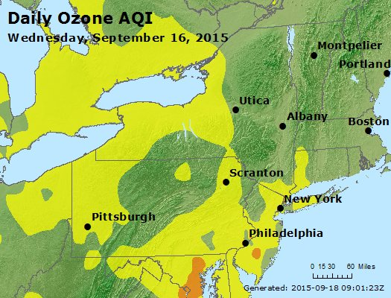
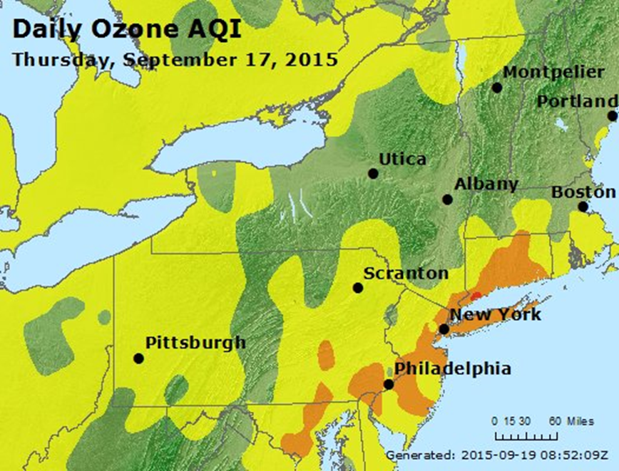
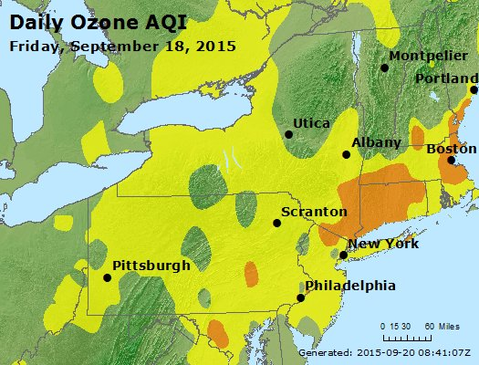
Description of event:
Model spun up from 9/13/15 12:00 UTC – 9/15/15 12:00 UTC
Model ran from 9/15/15 12:00 UTC – 9/21/15 12:00 UTC
Peak event occurred 9/16/15 – 9/18/15 UTC
One of the few periods with multiday high ozone event

Slide 8
Verification of ‘Control’ Model over event

Slide 9
Verification of ‘Control’ Model over event

Slide 10
Verification of ‘Control’ Model over event

Slide 11
No_{x} Sensitivities of nEI-11: NO_{x}

Slide 12
No_{x} Sensitivities of nEI-11: O₃

Slide 13
No_{x} Sensitivity: Reduction comparison
Average Hourly O₃ from 9/17/15 12 UTC to 9/18/15 12 UTC
Notes:
Fix colorbars
Remove suptitle

Slide 14
No_{x} Sensitivity: Increase comparison
Average Hourly O₃ from 9/17/15 12 UTC to 9/18/15 12 UTC

Slide 15
NEI 2011 and NEI 2005

Slide 16
NEI 2005 – NEI 2011 Comparison
Average Hourly O₃ from 9/17/15 12 UTC to 9/18/15 12 UTC

Slide 17
Conclusions
This is still an early result
There may be more at work with the other pollutants. The change in ozone from changing only the NO_{x} is smaller than expected.
Ozone during the day seems to be more sensitive to NO_{x} emissions than ozone in the evening.
Despite being a secondary pollutant, WRF-Chem produces better O₃ forecasts than NO_{x} forecasts
There may be a bias here- NO_{x} monitors are usually sparser than O₃ monitors and found in urban areas.

Slide 18
O₃
NO_{x}
Notes:
Separate plots
Limit to 17th

Slide 19
Background: O₃ and Simplified Nonlinear relationship to NO_{x}
From Meteo 419, year 2014, lecture 15

Slide 20
Background: Human Health and Ozone
Notes:
No fig
Bring in communication and modelling bqckg

Slide 21
‘Control’ Model Setup
Setting | Name
Chemistry | Regional Atmospheric Chemical Mechanism (RACM) with Kinetic Preprocessor (KPP)
Photolysis | Madronich
Biogenic Emissions | Model of Emission of Gases and Aerosols from Nature (MEGAN)
Anthropogenic Emissions | National Emissions Inventory 2011 (NEI-2011)
Chemical Boundary Conditions | Model of Ozone and Related Tracers (MOZART)
Resolution | 12 km with 159 gridpoints, 44 vertical levels
Boundary Layer | Yonsei State University (YSU)
Cumulus | Grell-Devenyi
Microphysics | WRF Single Moment 6 class (WSM6)
Meteorological initial and Boundary Conditions | Global Forecasting System (GFS) refreshed every 24 hours. Two day spin-up (not shown).
Radiation | Dudhia (shortwave) and RRTM (longwave)
Notes:
Bullets

Slide 22
Description of Test event: Sept. 15th 2015: Beginning
Notes:
Less meteo

Slide 23
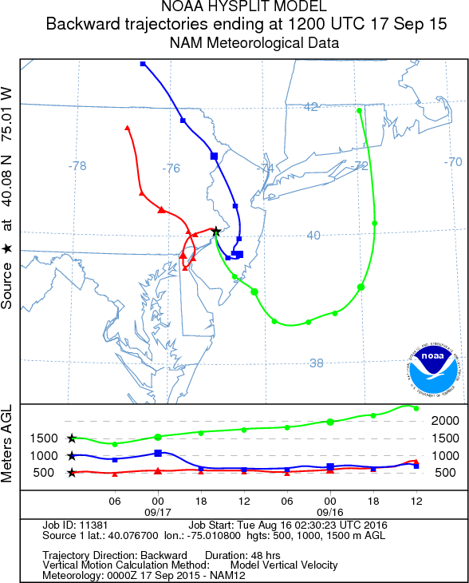
Description of Test event: Sept. 17th 2015: Peak
Lee Trough

Slide 24
Description of Test event: Sept. 21st, 2015: End

