Slide 1
Progress toward investigating triple eyewall formation of tropical cyclone Usagi (2013) using data assimilation
Simon Liu and Fuqing Zhang

Slide 2
Outline
Background
Control run
Inject GBVTD axisymmetric wind
Conclusion and future work

Slide 3
Outline
Background
Control run
Inject GBVTD axisymmetric wind
Conclusion and future work

Slide 4
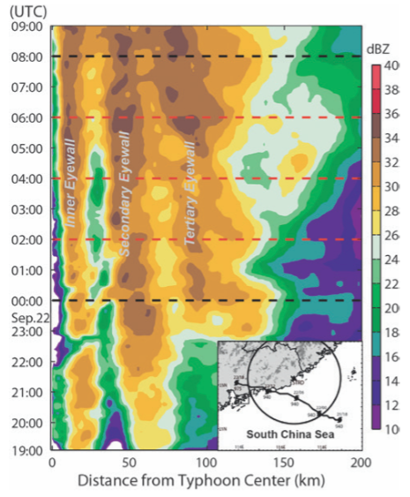
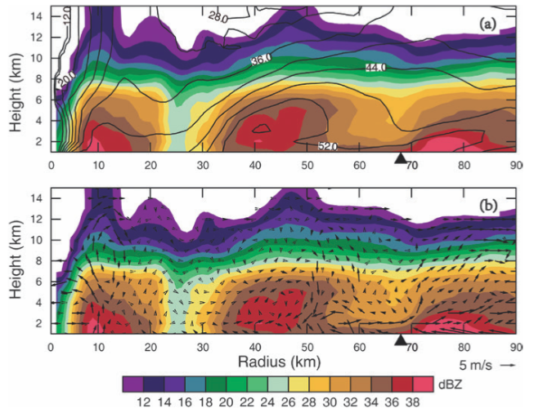
Observation: triple eyewalls!
Questions:
1. What the role of tertiary eyewall?
2. Why inner eyewall did not dissipate after secondary eyewall formation?
Zhao et al. 2016
Notes:
Both secondary and tertiary eyewall contract with time
Both moats dominate with downdraft

Slide 5
Triple eyewall
Secondary eyewall

Slide 6
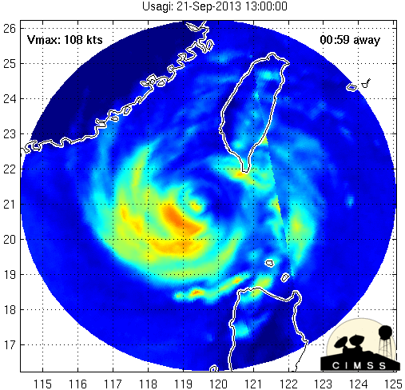
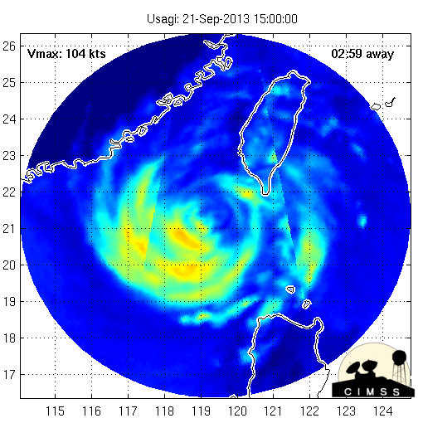
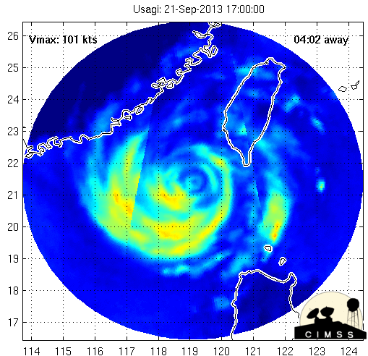
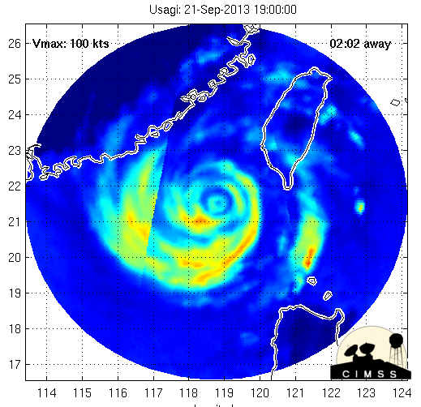
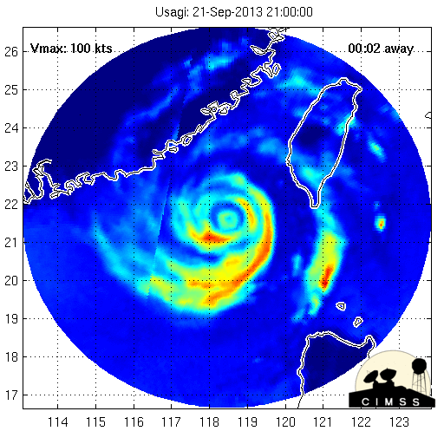
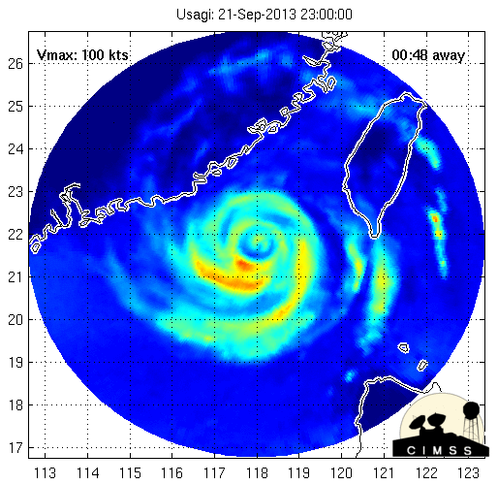
1300z
1500z
1700z
Morphed Integrated Microwave Imagery from CIMSS
1900z
2100z
2300z
Notes:
Triple eyewall form at weak stage of TC

Slide 7
Outline
Background
Control run
Inject GBVTD axisymmetric wind
Conclusion and future work

Slide 8
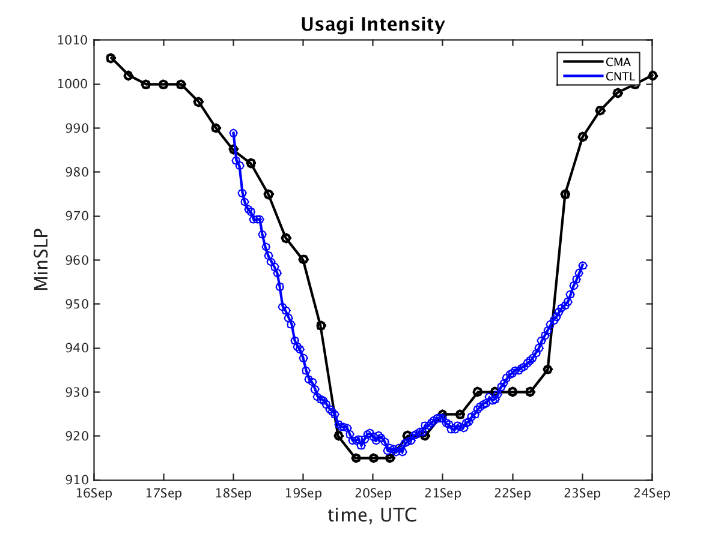
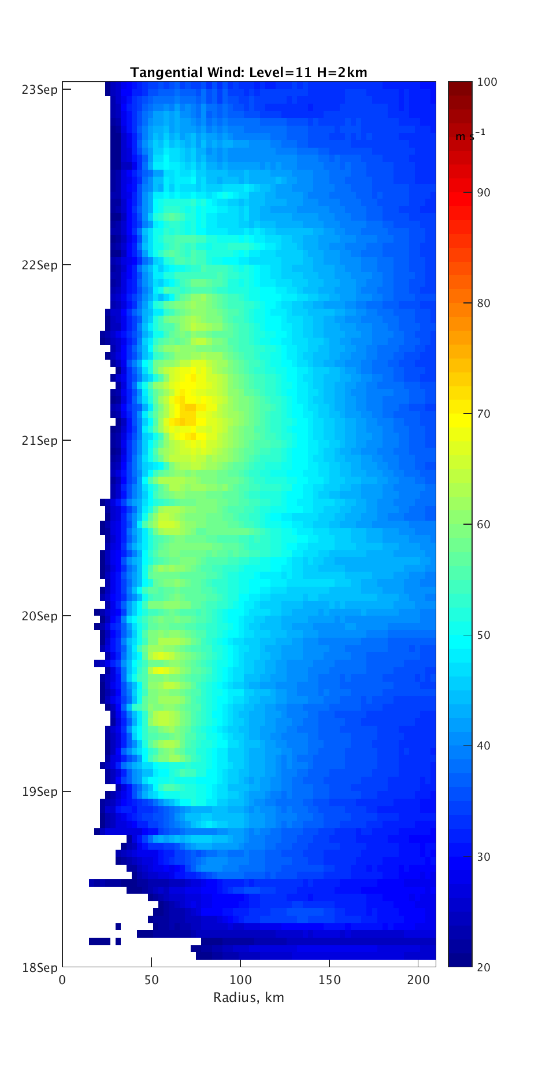
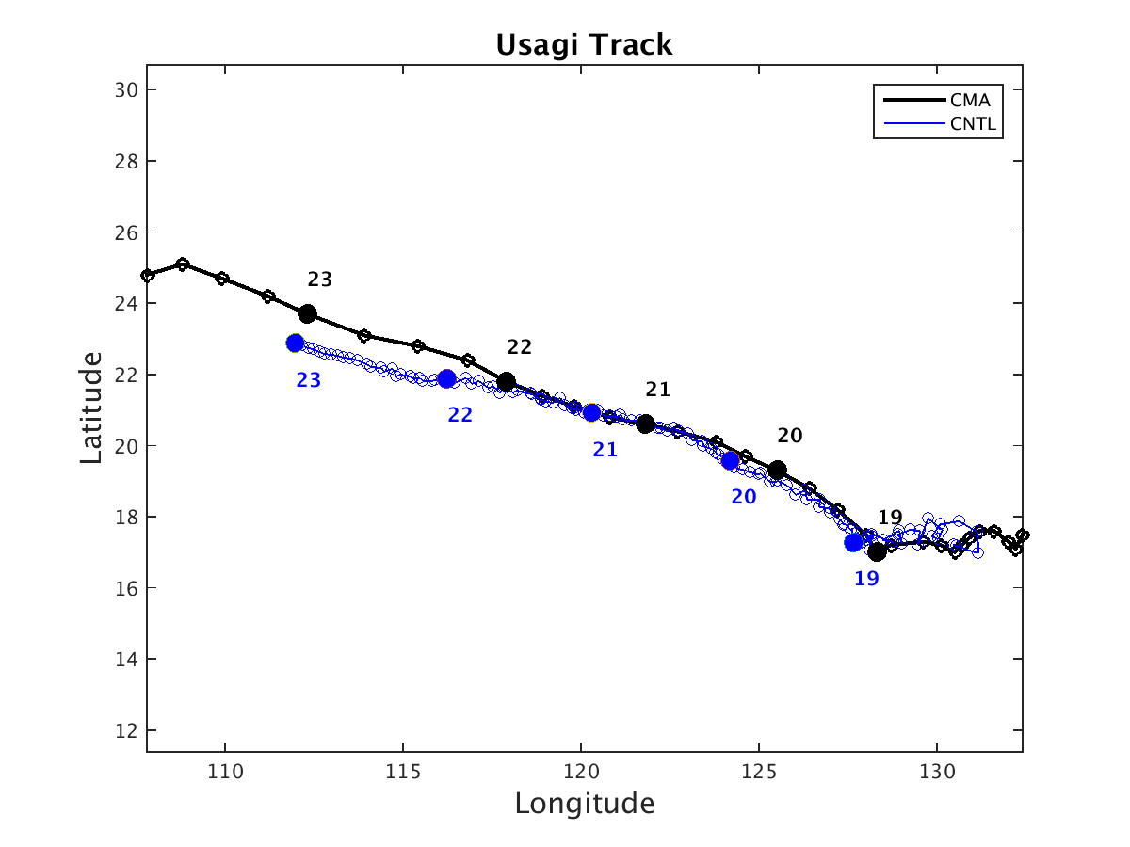
Control Run
Use GFS as initial condition
Good track and Intensity
No secondary eyewall formation
Notes:
Choose 21Setp 16:00 as time to inject since it is close to best track

Slide 9
More initial run
We try:
Use ECMWF 0.14 degree data
Increase resolution to 1 km
Change model start time (+6/-6 hrs)
…

Slide 10
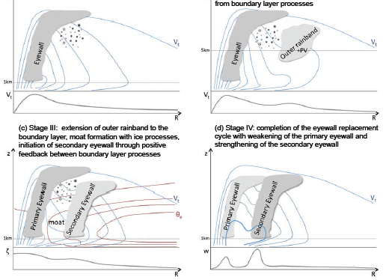
Downward building of outer convection
Zhang and Tao et al. 2016, JAMES
Notes:
Downward building

Slide 11
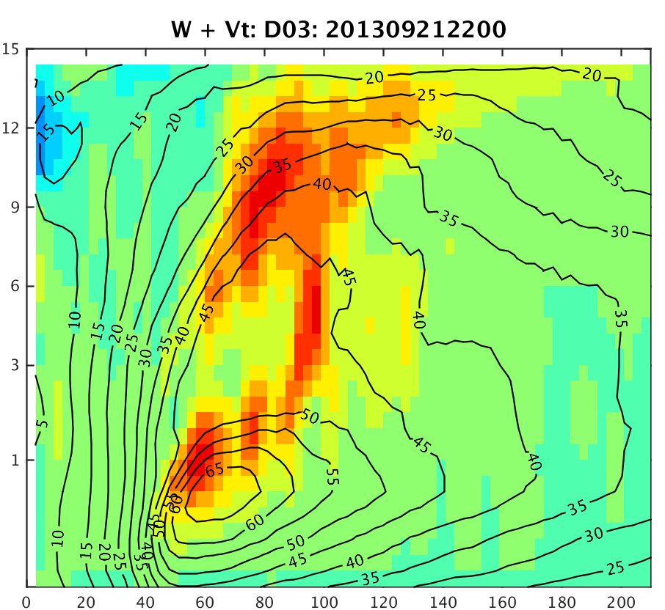
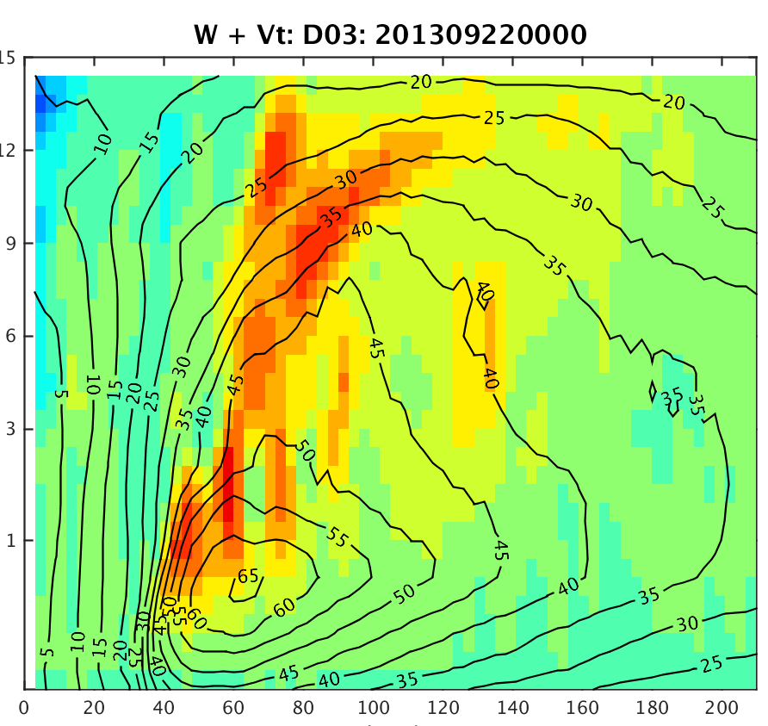
There is sign of downward convection propagation, but no secondary eyewall

Slide 12
Outline
Background
Control run
Inject GBVTD axisymmetric wind
Conclusion and future work

Slide 13
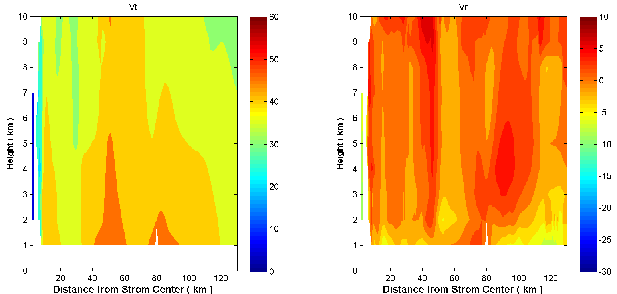
Axisymmetric wind
model
GBVTD: Ground-Based Velocity Track Display
GBVTD
GBVTD can retrieval 3 tangential wind maximum
GBVTD cannot retrieval low level strong inflow

Slide 14
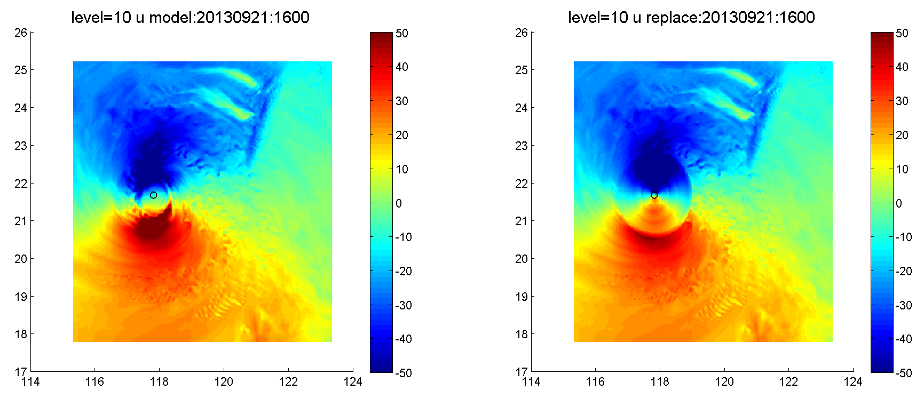
Interpolate tangential and radial wind into 3D u and v
Inject into model from 1-10 km

Slide 15
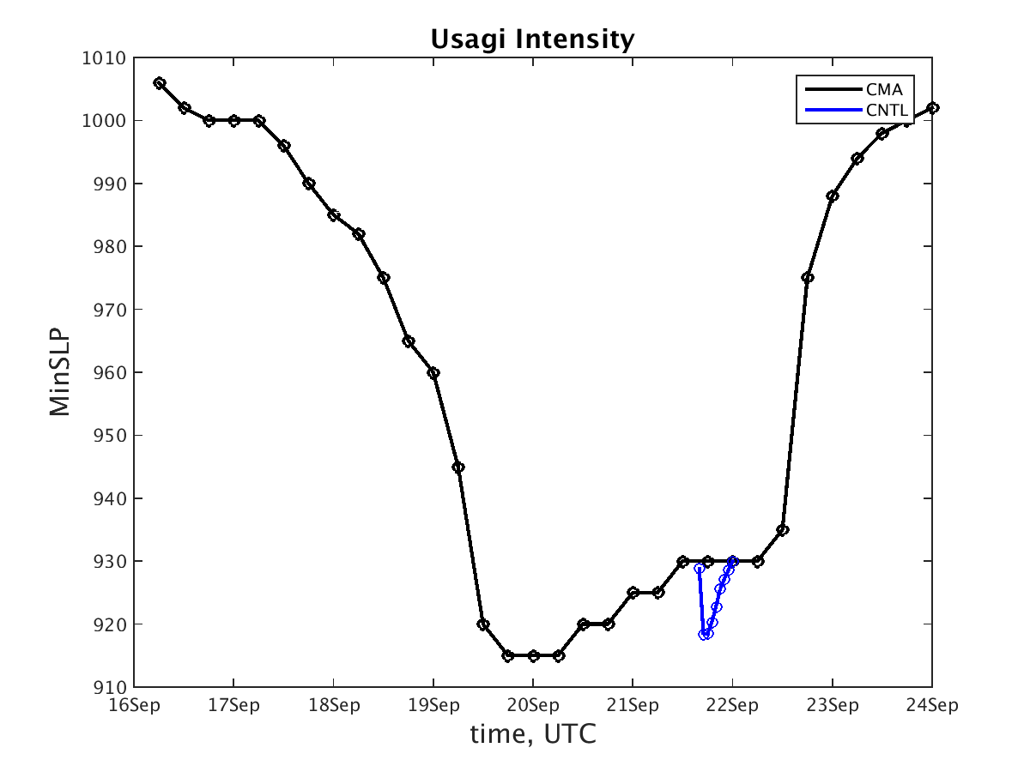
Simulation results
Note: the wind we inject is not gradient wind field. So wind field is NOT balanced with pressure field

Slide 16
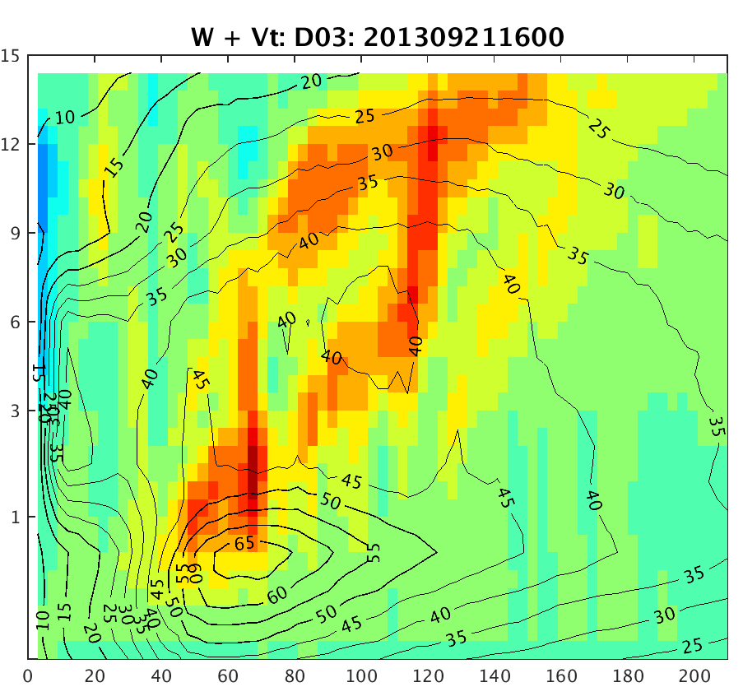
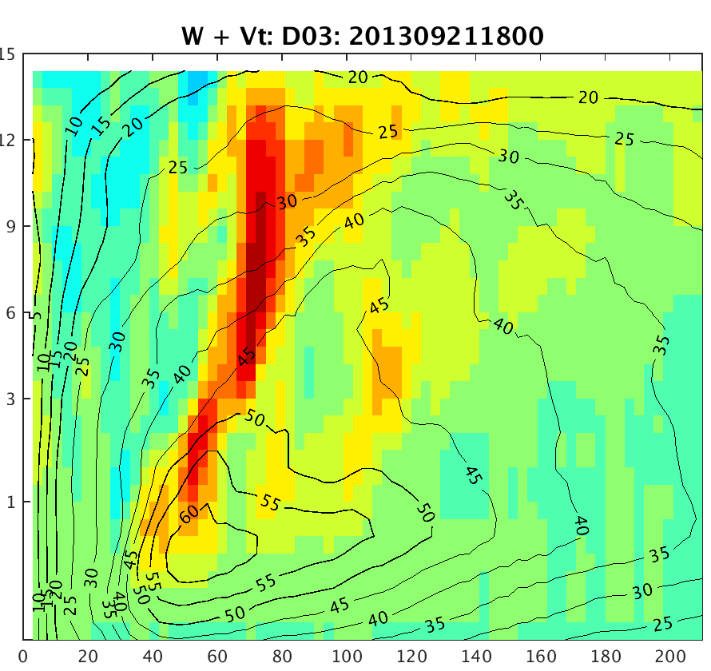
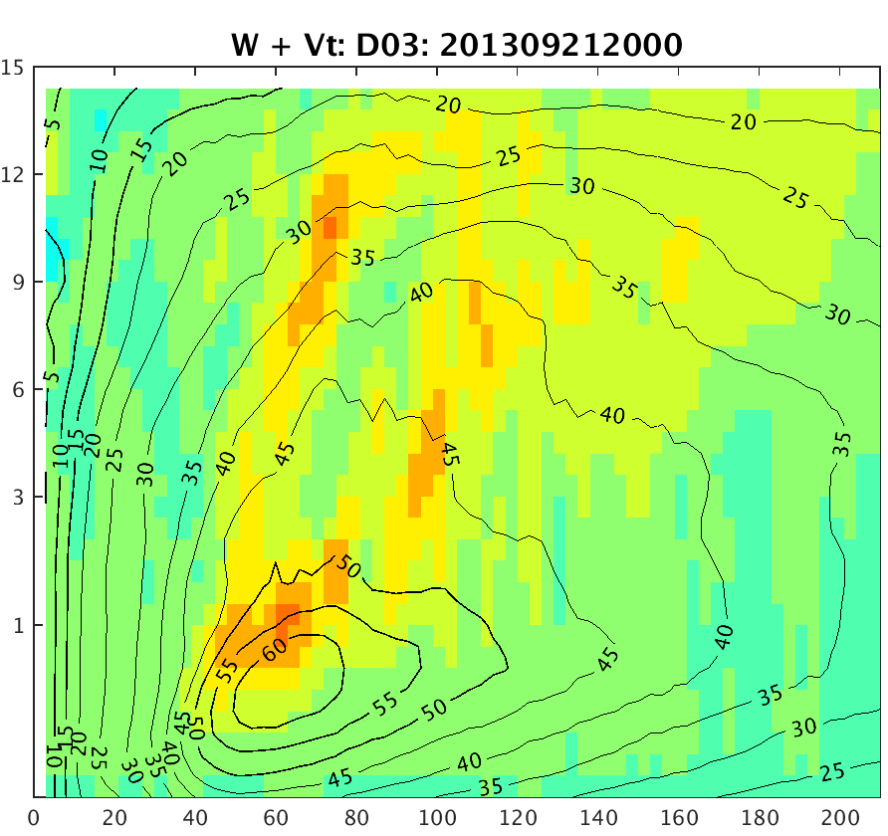
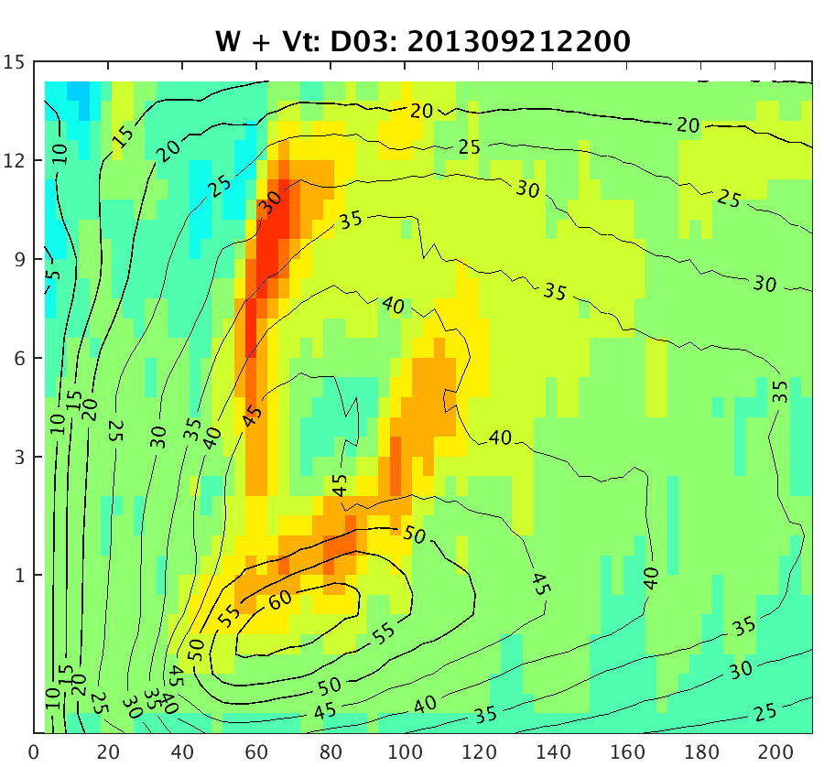
Tangential wind information disappear soon
There is sign of outer convection, but no secondary tangential wind maximum

Slide 17
Conclusion
GBVTD retrieval reasonable tangential wind (Vt) and radial wind (Vr) between 1-10 km, but cannot resolve low level strong inflow
The multiple tangential maximums disappear quickly after injection
Future plan:
assimilate GOES IR data

Slide 18
Thanks!

