Slide 1
A brief introduction of a parametric tropical cyclone precipitation model
Yanting Ye
2016-05-10

Slide 2
Background
Used for risk analysis of TC disasters
  Risk management, rate determination,…
Not focuse on a certain case, a large amount of samples needed

Slide 3
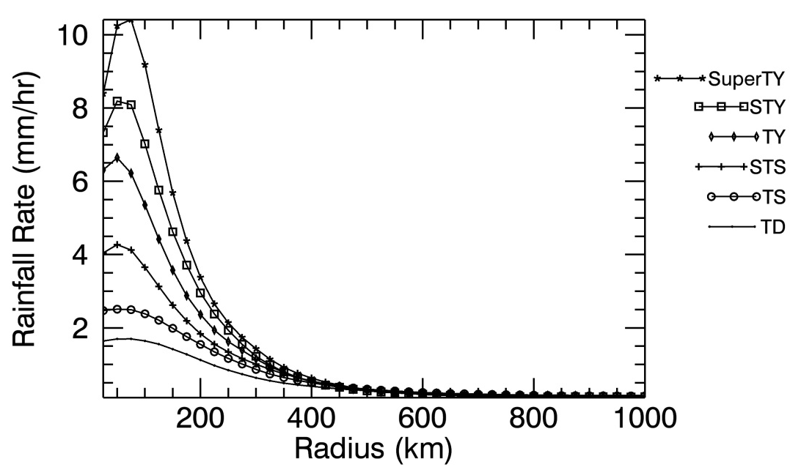
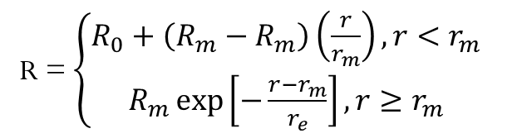
R-CLIPER model
Tropical cyclone Rainfall Climatology and Persistence model
Step1,: symmetric instantaneous rainfall field
Rainfall rate R:
R = $\left\{\begin{aligned}R_{0}+\left(R_{m}−R_{m}\right)\left(\frac{r}{r_{m}}\right),r<r_{m} \\ R_{m}\exp\left[−\frac{r−r_{m}}{r_{e}}\right],r≥r_{m}\end{aligned}\right.$
subscript = m
subscript = 0

Slide 4
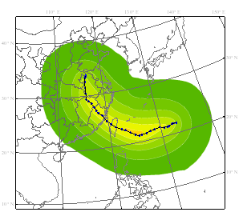
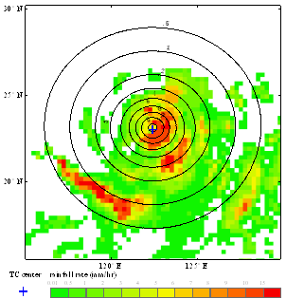
Future work
Step2: asymmetric factors (overland/oversea)
VWS, motion, slope,topography…
Step3: accumulated rainfall field

