Slide 1

An Adaptive Observation Error Inflation Method for Assimilating
All-sky Satellite Brightness Temperatures
Masashi MINAMIDE
Himawari-8 image of Typhoon Soudelor (2015) from CIMSS Satellite blog
Notes:
Direct Assimilation of all-sky infrared radiance satellite observation for the analysis and forecast of tropical cyclones

Slide 2
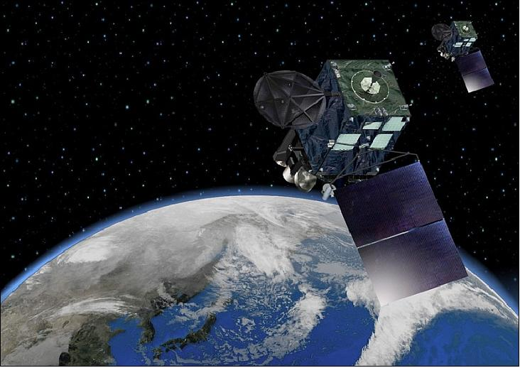
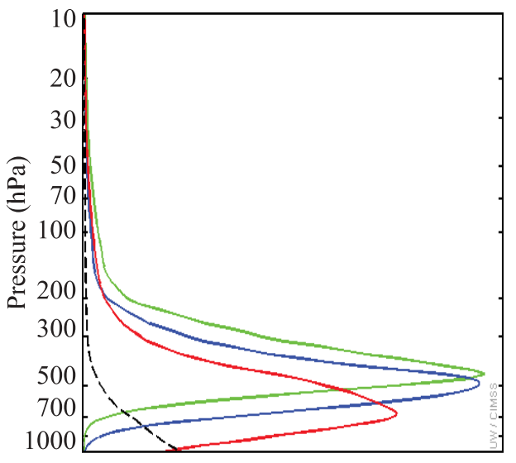
New Satellites! Himawari-8 AHI & GOES-R ABI
Weighting functions
on WV channels
Water Vapor Channels
Band-8 | 6.19µm
Band-9 | 6.95µm
Band-10 | 7.34µm
Pressure (hPa)
Launch Dates:
Oct 2014 (Himawari-8, Japan)
Oct 2016 (GOES-R, USA)
Coverage: Hemispheric
Frequency: 10-15 minutes
Resolution: 2 km
(Otkin 2012)
Notes:
New satellite was launched on October 2014 in last year, which is called Himawari-8 Advanced Himawari Imager by Japan Meteorological Agency.
Another satellite with almost the same ability is planned to be launched on March 2016 from US, which is called GOES-R ABI.
They both have wide coverage, quite high temporal & spatial resolution.
Characteristics is that they have 3 WV channels. Generally, 2D > difficult to gain vertical information
New satellites are expected to provide vertical information.

Slide 3
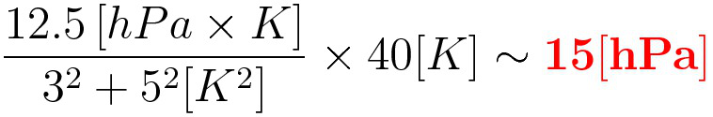
Adaptive Observation Error Inflation (AOEI)
Problem: erroneous analysis increments
If Model (clear / cloudy) ≠ Observation (cloudy / clear)
In updating SLP,
AOEI: inflating observation error variance
With AOEI,
AOEI
    suppresses erroneous analysis increments,
    relieves the issues of representativeness & sampling,
& contributes to maintaining balance.
Notes:
If typical value is assigned,
Representative error and sampling error can cause large increments that can introduce imbalance in model.
AOEI can suppress those erroneous increments due to representative error and sampling error.
And thus, it can contributes to maintaining balance
Obs err
\sigma _{o-AOEI} ^{2} = max\left\{ \sigma _{o} ^{2} , [y_{o} - h(x_{b}) ] ^{2}-\sigma _{h (x_{b})} ^{2} \right\}
Original:
x_{a} - x_{b} = \frac{cov\left[x_{b},h (x_{b}) \right] }{ \sigma _{o} ^{2} + \sigma _{h (x_{b})} ^{2} } \times [y_{o} - h(x_{b}) ]
\frac{12.5 \left[hPa \times K \right] }{ 3^{2} + 5^{2} [K^{2}]} \times 40[K] \sim {\bf \textcolor{red}{15 [hPa]}}
AOEI:
x_{a} - x_{b} =
\frac{cov\left[x_{b},h (x_{b}) \right] }{ max\left\{ \sigma _{o} ^{2} + \sigma _{h (x_{b})} ^{2} , [y_{o} - h(x_{b}) ] ^{2} \right\} } \times [y_{o} - h(x_{b}) ]
\frac{12.5 \left[hPa \times K \right] }{ 40^{2} [K^{2}]} \times 40[K] \sim {\bf \textcolor{red}{0.3 [hPa]}}

Slide 4
Adaptive Observation Error Inflation (AOEI)
GOES-13 Observation
Background Error / Spread
Not inflated
inflated
Not inflated
inflated
(K)
Color: observed brightness temperature
Contour: Background error
Color: ensemble spread
Notes:
If typical value is assigned,
Representative error and sampling error can cause large increments that can introduce imbalance in model.
AOEI can suppress those erroneous increments due to representative error and sampling error.
And thus, it can contributes to maintaining balance
Obs err
\sigma _{o-AOEI} ^{2} = max\left\{ \sigma _{o} ^{2} , [y_{o} - h(x_{b}) ] ^{2}-\sigma _{h (x_{b})} ^{2} \right\}
Original:
x_{a} - x_{b} = \frac{cov\left[x_{b},h (x_{b}) \right] }{ \sigma _{o} ^{2} + \sigma _{h (x_{b})} ^{2} } \times [y_{o} - h(x_{b}) ]
\frac{12.5 \left[hPa \times K \right] }{ 3^{2} + 5^{2} [K^{2}]} \times 40[K] \sim {\bf \textcolor{red}{15 [hPa]}}
AOEI:
x_{a} - x_{b} =
\frac{cov\left[x_{b},h (x_{b}) \right] }{ max\left\{ \sigma _{o} ^{2} + \sigma _{h (x_{b})} ^{2} , [y_{o} - h(x_{b}) ] ^{2} \right\} } \times [y_{o} - h(x_{b}) ]
\frac{12.5 \left[hPa \times K \right] }{ 40^{2} [K^{2}]} \times 40[K] \sim {\bf \textcolor{red}{0.3 [hPa]}}

Slide 5
Observing System Simulation Experiments (OSSE)
Truth run: Hurricane Karl (2010), 21Z/16 – 00Z/18 Sept 2010
Model: WRF ver.3.6.1(Skamarock 2008), CRTM (Han et al. 2006)
PSU WRF-EnKF (Weng and Zhang, 2016)
21Z/16, Sep.
True simulation
00Z/18, Sep.
Synthetic observations
Every 1 hour
minSLP
minSLP
HPI
Every 10 min
Infrared BT (ch8,9&10)
BT+HPI (AOEI)
BT+HPI (noAOEI)
22:00
22:10
…
23:00
…
Notes:
Firstly we assimilated only minimum SLP, called HPI
Then we added brightness temperatures for second experiment.
Third experiment further added AMVs.

Slide 6
Observing System Simulation Experiments (OSSE)
Truth run: Hurricane Karl (2010), 21Z/16 – 00Z/18 Sept 2010
Model: WRF ver.3.6.1(Skamarock 2008), CRTM (Han et al. 2006)
PSU WRF-EnKF (Weng and Zhang, 2016)
Resolution: 27, 9 & 3 km (D1-D3)
D1
D2
D3
Notes:
Red line represents our experiment time.

Slide 7
Root Mean Square Error (RMSE) with/without AOEI
Horizontal Wind
Temperature
RMSE of Horizontal Wind (m/s)
RMSE of Temperature (K)
AOEI shows smaller RMSE than without AOEI.
Suppression of erroneous analysis increments is important in all-sky satellite DA.
Notes:
RMSE increases likely because the storm is intensifying at this time.

Slide 8
EnKF Performances on Hurricane Karl (2010)
Verifying Truth
HPI
Perfect-model OSSE
BT+HPI (AOEI)
BT+HPI (noAOEI)
AOEI helped to capture more dynamically consistent vortex structure.
Notes:
Because brightness temperatures are most sensitive to microphysics, we used different microphysic scheme to represent model error as imperfect-model OSSE.

Slide 9
EnKF Performances on Hurricane Karl (2010)
Observation
HPI
Real-data GOES-13 assimilation experiments
BT+HPI (AOEI)
BT+HPI (noAOEI)
AOEI helped to capture more dynamically consistent vortex structure.
(K)
Notes:
Because brightness temperatures are most sensitive to microphysics, we used different microphysic scheme to represent model error as imperfect-model OSSE.

Slide 10
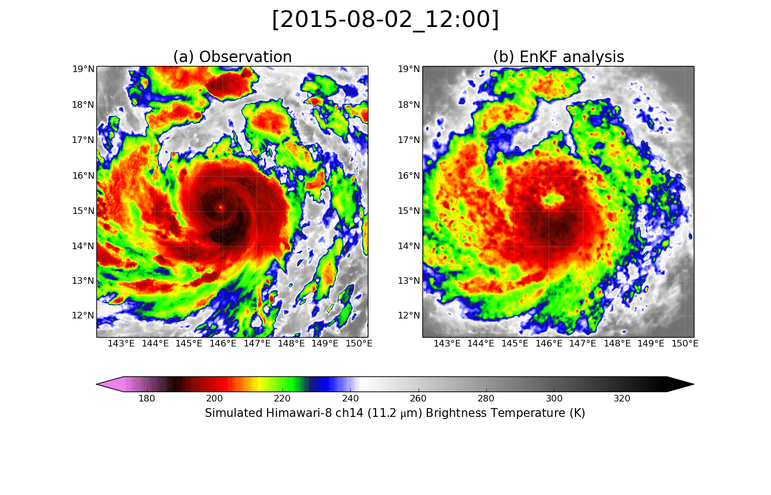
EnKF Performances on Typhoon Soudelor (2015)
Himawari-8 AHI Brightness Temperature (ch14, 11.2µm)
Observation
BT+HPI (AOEI)
BT assimilation well captured asymmetric structure of TC.
Impacts on forecasts will be further investigated.
Notes:
Preliminary result of assimilating Himawari-8 is also encouraging.
Cloud patterns reasonably well match.
We are still working on both assimilation strategy and forecasting.

Slide 11
Concluding Remarks
  Nonlinearity of infrared brightness temperatures along with sampling issue induces erroneous analysis increments.
  Adaptive Observation Error Inflation (AOEI) method is proposed. AOEI can control the erroneous analysis increments in assimilating all-sky brightness temperatures.
  Benefits of assimilating all-sky brightness temperatures with AOEI were shown through perfect-model OSSE and the experiments assimilating real-data from GOES-13 and Himawari-8.
  Assimilation of all-sky brightness temperatures well captured the asymmetric detailed structure of tropical cyclones.

Slide 12
EnKF Performance on Tropical Cyclone Intensity
Maximum 10m wind (m/s)
Minimum SLP (hPa)
Notes:
The impact is not limited to radiance field. > temporal change of TC intensity.
Though it’s not perfect, I t can capture the general intensity change.

Slide 13
Background Error of Satellite Radiance
GOES-13 Observation
EnKF Background
(K)
Notes:
If typical value is assigned,
Representative error and sampling error can cause large increments that can introduce imbalance in model.
AOEI can suppress those erroneous increments due to representative error and sampling error.
And thus, it can contributes to maintaining balance
Obs err
\sigma _{o-AOEI} ^{2} = max\left\{ \sigma _{o} ^{2} , [y_{o} - h(x_{b}) ] ^{2}-\sigma _{h (x_{b})} ^{2} \right\}
Original:
x_{a} - x_{b} = \frac{cov\left[x_{b},h (x_{b}) \right] }{ \sigma _{o} ^{2} + \sigma _{h (x_{b})} ^{2} } \times [y_{o} - h(x_{b}) ]
\frac{12.5 \left[hPa \times K \right] }{ 3^{2} + 5^{2} [K^{2}]} \times 40[K] \sim {\bf \textcolor{red}{15 [hPa]}}
AOEI:
x_{a} - x_{b} =
\frac{cov\left[x_{b},h (x_{b}) \right] }{ max\left\{ \sigma _{o} ^{2} + \sigma _{h (x_{b})} ^{2} , [y_{o} - h(x_{b}) ] ^{2} \right\} } \times [y_{o} - h(x_{b}) ]
\frac{12.5 \left[hPa \times K \right] }{ 40^{2} [K^{2}]} \times 40[K] \sim {\bf \textcolor{red}{0.3 [hPa]}}

Slide 14
Adaptive Observation Error Inflation (AOEI)
Original EnKF Eq.
Analysis increment
×
=
Kalman Gain (weight)
Innovation
If Model (clear or cloudy) $≠$ Observation (clear or cloudy)
Suppose x is SLP,
of analysis increment may occur.
Notes:
Problem in using infrared radiance data is their non-linearity to cloud.
Vertical information in the previous slide can only be provided in the clear-sky.
In cloudy sky, all 3 water vapor channels have the same information, because they are all sensitive to top of the cloud with the existence of cloud. Their correlation is almost over 0.99.
In cloudy, 1 cannel. In clear, we can fully derive the ability of multiple WV channels. > In-between

Slide 15
Adaptive Observation Error Inflation (AOEI)
Adaptive Observation Error Inflation EnKF Eq.
Analysis increment
×
=
Kalman Gain (weight)
Innovation
If Model (clear or cloudy) $≠$ Observation (clear or cloudy)
Suppose x is SLP,
is the suppressed analysis increment.
Notes:
Problem in using infrared radiance data is their non-linearity to cloud.
Vertical information in the previous slide can only be provided in the clear-sky.
In cloudy sky, all 3 water vapor channels have the same information, because they are all sensitive to top of the cloud with the existence of cloud. Their correlation is almost over 0.99.
In cloudy, 1 cannel. In clear, we can fully derive the ability of multiple WV channels. > In-between

Slide 16
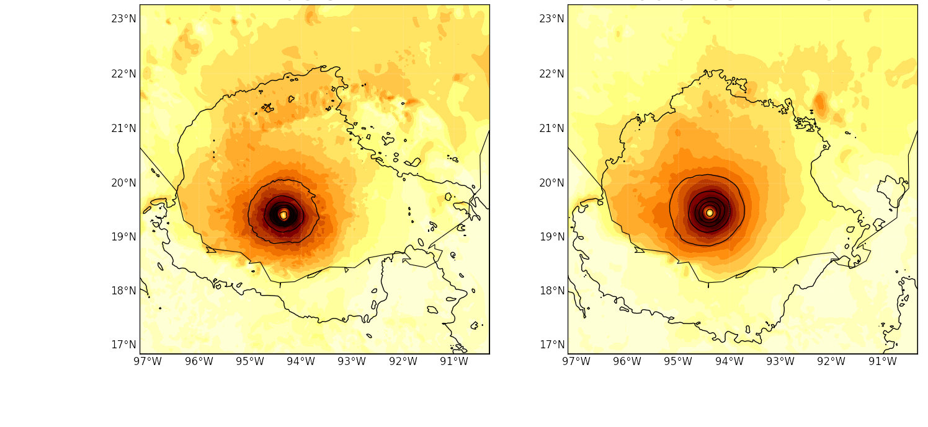
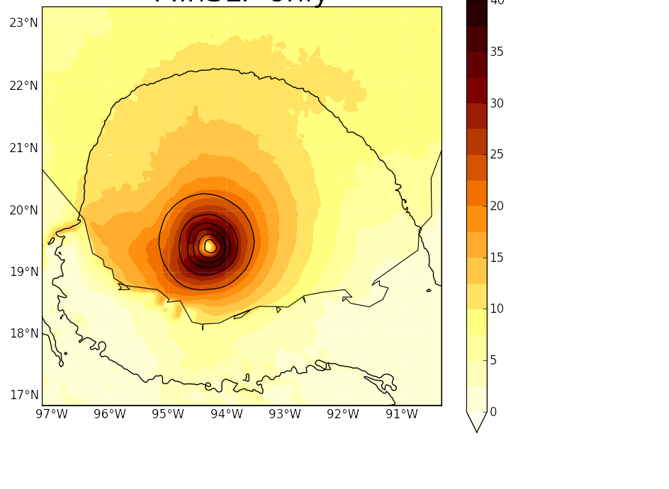
EnKF Performance on 10-m wind speeds
Truth versus EnKF-analyzed Infrared
10-m wind speed (m s⁻¹)
EnKF analysis
with radiance
& minimum SLP
EnKF analysis
with minimum SLP only
Verifying truth
Secondary horizontal wind maximum
maximum wind within the eyewall
m/s
Colors: 10-m wind speeds
Contours: SLP
Notes:
Furthermore, I would like to show some fields which are not directly connected with radiance.
Our assimilation captured the maximum wind associated with eyewall region quite well.
Even the secondary horizontal wind maximum with principle rainbands is also somehow captured.

