Slide 1
Assimilating all-sky infrared radiances with ARW-EnKF system: test
Yonghui Weng
2016/05/10

Slide 2
Review the real-time/operational forecasts for hurricane Joaquin (2015)

Slide 3
Adding GOES-13 Infrared radiances into the PSU real-time system

Slide 4
Difficulties in Assimilating Cloudy Radiance
Clouds can be spatially complex
Clouds can be radiatively complex
Clouds can introduce non-linearities
Clouds need to be consistent with temperature and humidity fields
Andrew Collard, 2012

Slide 5
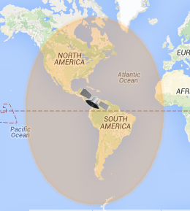
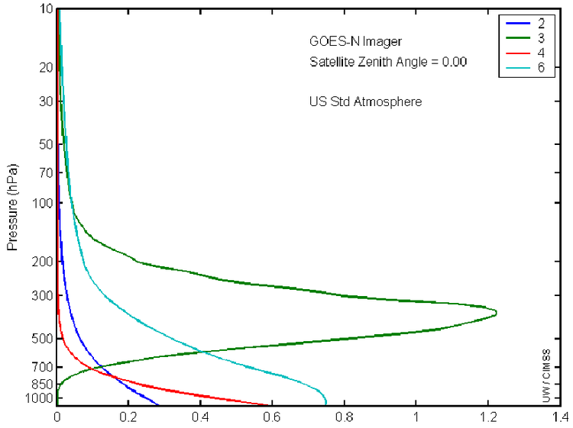
OBS: GOES-13 Imager – imgr_g13
GOES-13: Geostationary orbit; altitude 35786km; 75° W;
IMAGER:
  5 channels covering VIS, MWIR and TIR
    0.65µm (0.55-0.75);
    3.90µm (3.80-4.00); 6.55µm (5.80-7.30); 10.70µm (10.2-11.2); 13.25µm (13.0-13.7)
  4.0 km for IR channels; 1.0 km for the VIS channel;
  Full disk every 30 min.
Only assimilates Channel 3 to reduce the impact of clouds.
GOES-13 Imager Waiting Functions

Slide 6
System: APSU system with Satellite Radiance
GVAR Imager Data:
  Raw Netcdf from CLASS/NOAA;
  Create SOs for selected sensors and channels for specified model area (d02);
  Thinned to 8km x 8km;
  Randomly sorted before EnKF;
  Obs error is set to 5.0K
XB
  Xb is calculated outside of EnKF, it is calculated before EnKF for each domain, each member, each sensor and each channel;
  Calculate cloud top height from the 1st member;
EnKF
  2D interpolation: Interpolate XB to SO’s position;
  Horizontal roi=15km;
  Signed cloud top height to vertical ROI height;
  SOs will be assimilated for all 3 domains with 1/9:2/9:6/9 SCL technique;
  AOE – Adaptive Observation Error;
WRF
  Version 3.5.1 with BZ isftcflux option 99;
  Model top = 10mb.

Slide 7
EnKF increments
GOES-13 Imager Ch3
Analysis without BT
Analysis with BT
Prior—before EnKF
Increments without BT
Increments with BT

Slide 8
ROI – cutting off
BT vertical ROI function is centered to the model level of cloud top.
RUC post method:
  From top to bottom, if qcloud+qice > 0.0000001, then set this level as cloud top.

Slide 9
Observation Bias
OmF
OmA

Slide 10

Observation Error
ECMWF & NCEP: assign different observation errors for clear-air and cloudy radiances, and combine them based on the cloud coverage.
Zhang et al., 2016: adaptive observation error (AOE)

Slide 11
Fixed Observation Error (FOE)

Slide 12
Satellite DA vs. Realtime for Joaquin：DFs

Slide 13
Satellite DA for Gonzalo (2014)

Slide 14
Satellite DA for Edouard (2014)

Slide 15
Remark and Plan
Exciting
  Case study shows positive impact on TC track/intensity prediction;
  EnKF reduces the observation bias;
Discussing
    The impact of AOE;
  Frustration
    The assimilation of radiance makes the storm stronger;
  Next
    Continue sensitive experiments of observation error, data thinning and ROI, GFS-relaxation distance, et al.;
    Diagnosis for moisture and temperature increments, structure.

Slide 16
I3D2 vs EnKF: hurricane analysis for perturbations

Slide 17
I3D2 vs EnKF: hurricane analysis for perturbations

