Slide 1
On the Role of Surface Fluxes and WISHE in Tropical Cyclone Intensification
Fuqing Zhang (Penn State) & Kerry Emanuel (MIT)
Sponsored by ONR, NSF and the MIT Houghton Lecturer Fund

Slide 2
What is WISHE?
AMS Glossary: “A hypothesis for the amplification of certain atmospheric circulations, including tropical cyclones, polar lows, and the Madden– Julian oscillation.
The [WISHE] mechanism involves a positive feedback between the circulation and heat fluxes from the sea surface, with stronger circulation giving rise to larger surface fluxes of heat, which are then quickly redistributed aloft by convection, in turn strengthening the circulation. In this theory, emphasis is placed on the surface fluxes as the principal rate-limiting process; convection serves only to redistribute heat. This can be contrasted with conditional instability of the second kind (CISK), in which circulations amplify through their interaction with the convection itself.”
(Emanuel 1986; Rotunno and Emanuel 1987; Emanuel 1989, 1991)

Slide 3
Motivating Questions
Is the wind dependence of the surface heat fluxes (WISHE) essential or incidental?
Is the positive feedback between the circulation (surface wind) and surface heat flux important for TC intensification?
Would the TC development rate change if turning off the feedback by artificially capping the surface heat flux at a small wind?
What would happen to the real-world major hurricanes (e.g., Katrina 2005, Edourad 2014) if without the WISHE feedback?
Note: Emanuel (1989) showed that a mesoscale column of nearly saturated air must be attained before growth by WISHE can occur; the WISHE instability begins with a finite-amplitude initial vortex.

Slide 4
TC development with capped surface flux predicted by
a simple analytical model versus a 2D axisymmetric model
(Zhang & Emanuel 2016 JAS)
Analytical model solution by replacing Ck with
Numerical solutions (red) with the simple 2D model in Emanuel (2012)

Slide 5
TC development with capped surface flux
3-D 2-km WRF simulations with idealized initial vortex
Vinitial=15m/s, SST=27C, no vertical wind shear, f=fc
HFX = rho*cp*Ch*|V|*(deltaT)
LH = rho*Lv*Cq*|V|*(deltaQ)

Slide 6
TC development with capped surface flux
3-D 2-km WRF simulations with idealized initial vortex
Vinitial=15m/s, SST=27C, no vertical wind shear, f=fc
Experiment | Ck (x 10⁻³) | Vcap (m/s)
1 (control) | 1 | None
2 | 0.5 | 5
3 | 0.5 | 10
4 | 0.5 | 20
5 | 1 | 5
6 | 1 | 10
7 | 1 | 20
8 | 1.5 | 5
9 | 1.5 | 10
10 | 1.5 | 20
11 | 2 | 5
12 | 2 | 10
13 | 2 | 20

Slide 7
TC development with capped surface flux
WRF 3-km simulations of Hurricane Katrina 2005
“Control” is the same as Green and Zhang (2014) initialized with WRF-EnKF assimilation of P3 TDR data

Slide 8
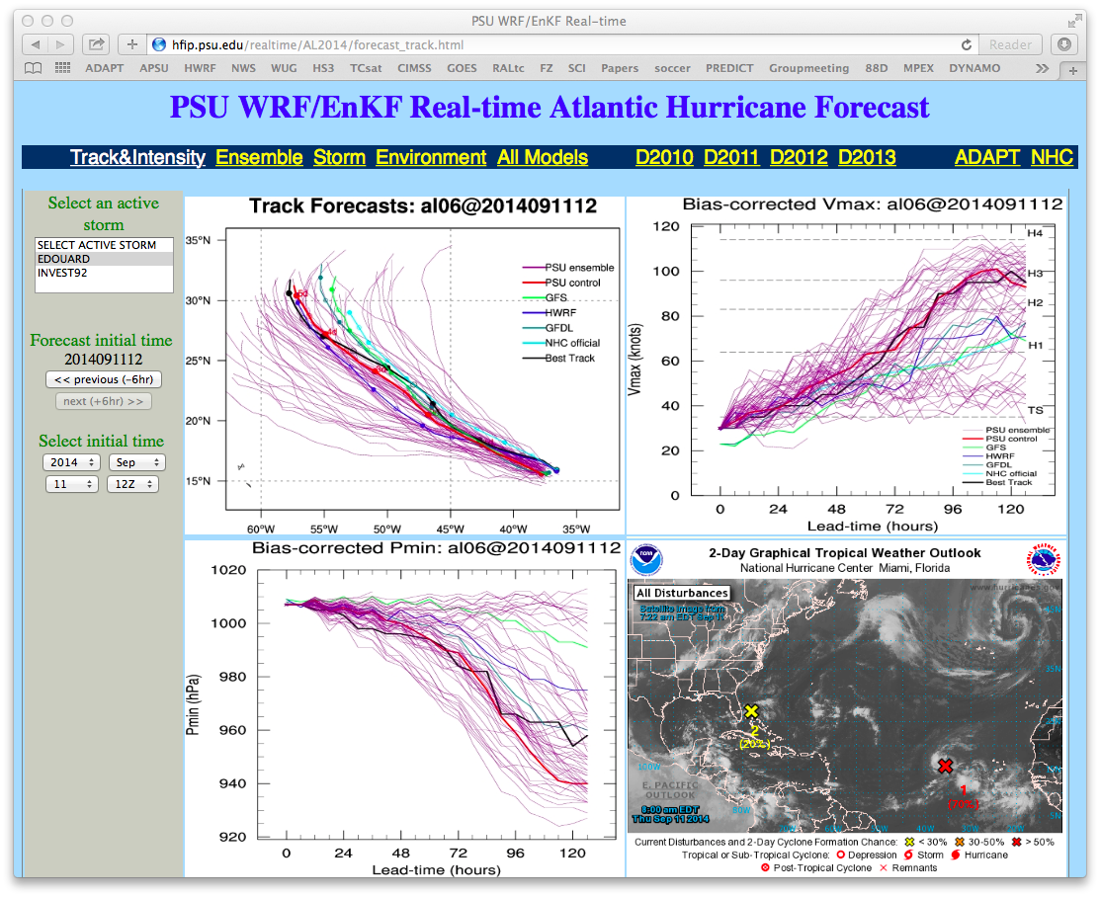

Slide 9
TC development with capped surface flux
WRF 3-km simulations of Hurricane Edourad 2014
“Control” is initialized with the PSU WRF-EnKF real-time cycling analysis (APSU) as in Weng and Zhang (2016) but with constant heat flux coefficient Ck=0.001

Slide 10
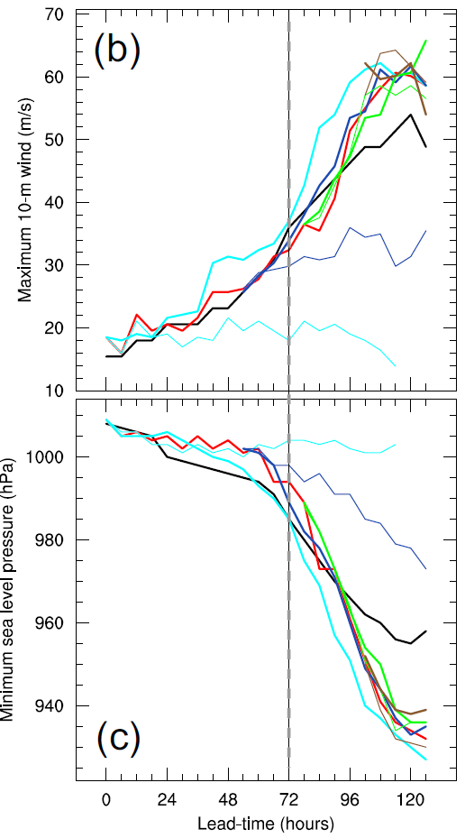
Impacts of the Diurnal Radiation Cycle
CONTROL: normal diurnal
DayOnly: solar insolation fixed at noon
NightOnly: no solar insolation
DayOnly 48h
NightOnly 0h
DayOnly 0h
Notes:
The control experiment has a normal diurnal radiation cycle including longwave and shortwave radiation forcing. Four sets of sensitivity experiments are conducted to test the effect of diurnal radiation cycle on different stages of storm formation and mature. A DayOnly and a NightOnly experiment are included in each set of sensitivity experiments. DayOnly means solar insolation set at local noon, NightOnly means no solar insolation. The four sets start at 0, 48, 72, 96 model integration hours, respectively. The results of the 4 sets of experiments are different.

Slide 11
Edouard: PSU WRF-EnKF realtime ensemble performance
Impacts of shear and initial vortex
Munsell, Zhang, Sippel and Braun, in review of JAS

Slide 12
Concluding Remarks
Is WISHE the positive feedback between the circulation and surface heat flux important for TC intensification? Yes!
Is the wind dependence of the surface heat flux (WISHE) is essential for TC intensification? Semantically speaking no but yes for real-world hurricanes; there will be no major hurricanes of Katrina (2005) or Edouard (2014) without WISHE.
Can the WISHE hypothesis be extended to explain the TC intensification in experiments that artificially cap the surface heat flux at a small wind? Yes.
Is the wind dependence of the surface heat flux incidental? No.
Does the TC development rate depend on WISHE? Yes.
Do 3-D asymmetries, atmospheric stability and moist convection not explicit in WISHE play a role in the TC development? Yes.

Slide 13
TC Intensification with capped surface flux predicted by
a simple analytical model modified from Emanuel (2012)
(Emanuel 2012, JAS)
The analytical solution by replacing Ck with
(Zhang & Emanuel 2016, JAS)

Slide 14
Schematics of Hurricane Carnot Cycle (Emanuel 1991)

Slide 15
What is WISHE?
Emanuel (1986 JAS): Observations and numerical simulations of tropical cyclones show that evaporation from the sea surface is essential to the development of reasonably intense storms. On the other hand, the CISK hypothesis, in the form originally advanced by Charney and Eliassen, holds that initial development results from the organized release of preexisting conditional instability. In this series of papers, we explore the relative importance of ambient conditional instability and air-sea latent and sensible heat transfer in both the development and maintenance of tropical cyclones using highly idealized models. In particular, we advance the hypothesis that the intensification and maintenance of tropical cyclones depend exclusively on self-induced heat transfer from the ocean. In this sense, these storms may be regarded as resulting from a finite amplitude air-sea interaction instability rather than from a linear instability involving ambient potential buoyancy. In the present paper, we attempt to show that reasonably intense cyclones may be maintained in a steady state without conditional instability of ambient air. In Part II [Rotunno and Emanuel 1987] we will demonstrate that weak but finite-amplitude axisymmetric disturbances may intensify in a conditionally neutral environment.

Slide 16
What is WISHE?
Rotunno and Emanuel (1987 JAS): “… The reversible thermodynamics implied by this [WISHE] assumption allows the mature storm to be thought of as a simple Carnot engine, acquiring heat at the high-temperature ocean surface and losing heat near the low-temperature tropopause. … The hypothesis …, is that the truly important thermodynamic interaction, even in the developing stage, is between vortex and ocean (as distinct from vortex and convection sustained by preexisting conditional instability as in the CISK theory) with cumulus convection rapidly redistributing heat acquired at the oceanic source upward and outward to the upper tropospheric sink. On this view, it is not the organization of convection that is needed per se, but the organization of surface heat flux. ….... The numerical experiments show that as a result of a finite-amplitude air-sea interaction instability a hurricane-like vortex may indeed amplify in an atmosphere which is neutral to cumulus convection and attain an intensity and structure which are in excellent agreement with the theoretical predictions of Part I. We examine in detail the model's heat budget which confirms the crucial importance of boundary-layer processes in controlling the structure and evolution of the vortex.”

Slide 17
“My real motivation”

