Slide 1



The CRTM to Microphysics-Consistent Cloud Optical Properties: Analyses and Applications
Research Group Meeting
10 May 2016
Scott Sieron
Advisors: Fuqing Zhang, Eugene Clothiaux
Major Collaborator: Lu Yinghui

Slide 2
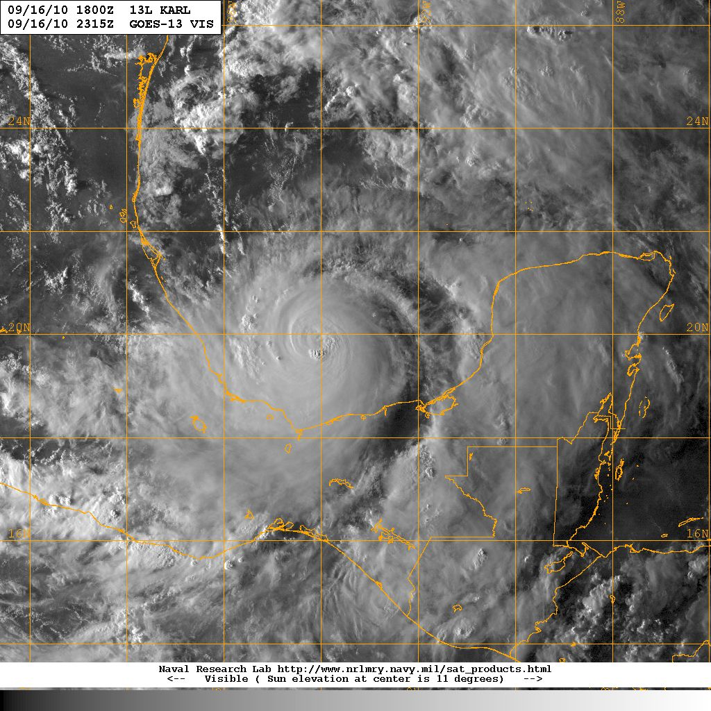
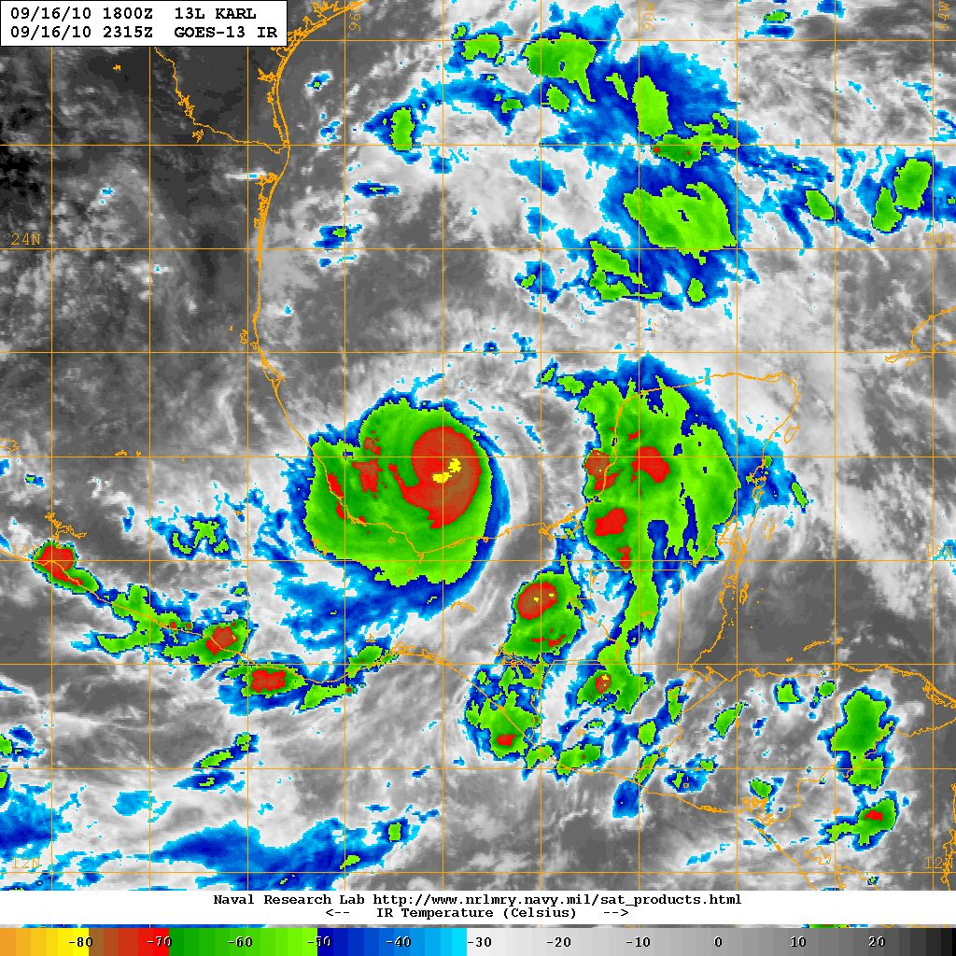
Visible (near sunset)
Infrared
190
210
230
250
270
290
COLD
Brightness Temperature (K)
WARM
Hurricane Karl 09/16/10 2315Z
(GOES-13 VIS, image courtesy NRL)
Hurricane Karl 09/16/10 2315Z
(GOES-13 IR, image courtesy NRL)
Notes:
I’m sure that many of us are familiar with these sorts of representations of tropical cyclones, namely the visible and infrared as viewed from satellites. These images certainly demonstrate the existence of the storm, and provide some qualitative sense of storm intensity, but there is little direct evidence or signal from what is present below cloud top.
The visible image is produced by scattered sunlight, while the signal at this IR frequency is produced mostly by the emission from the highest altitude solids and liquids and is indicative of their temperature.

Slide 3
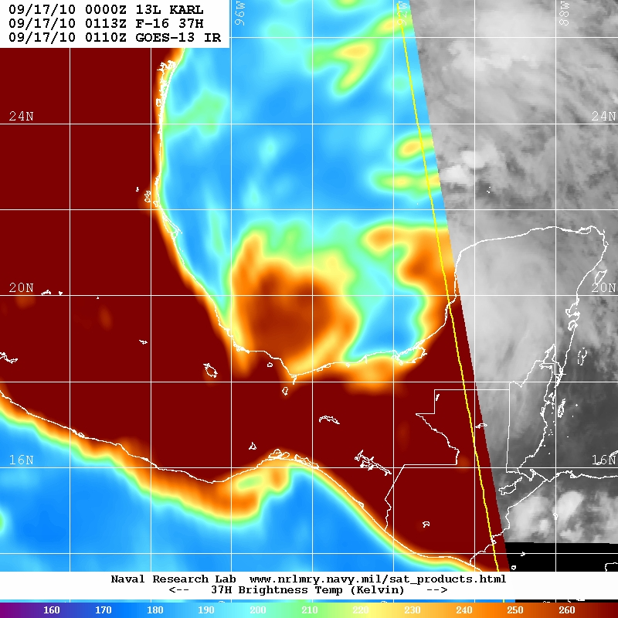
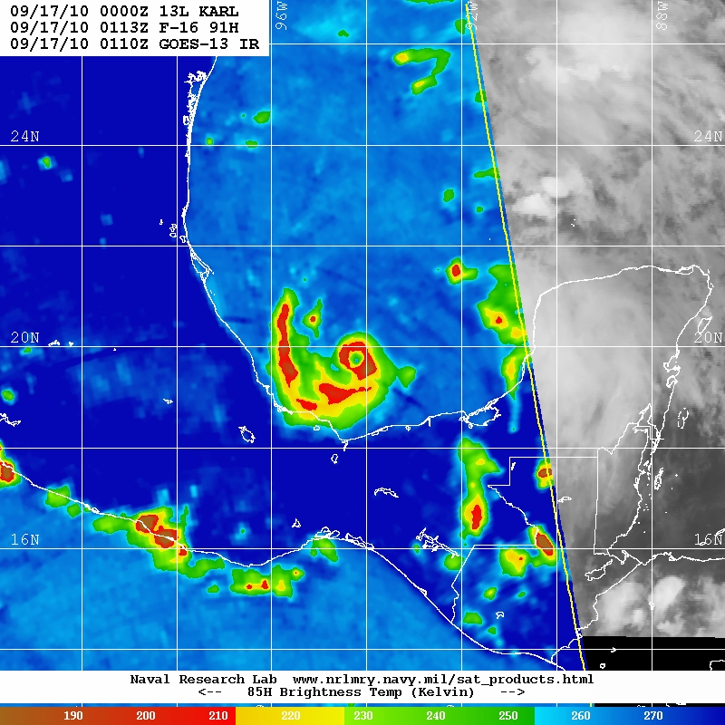
Low-mid microwave freq. (37 GHz)
High-mid microwave freq. (91.7 GHz)
160
180
200
220
240
260
190
210
230
250
270
COLD
Brightness Temperature (K)
WARM
COLD
Brightness Temperature (K)
WARM
Hurricane Karl 09/17/10 0113Z
(SSMI/S image courtesy NRL)
Hurricane Karl 09/17/10 0113Z
(SSMI/S image courtesy NRL)
Notes:
In contrast, shown here are perhaps less familiar representations of tropical cyclones, these are satellite images of brightness temperature in the microwave spectrum. This is of the same hurricane at nearly the same time as the previous two images. In these passive microwave observations, there is much more direct evidence of what exists below cloud top, which can be very useful information.
In both images, the hurricane looks substantially different than, for example the area of cloudiness to the north. The right image is even more substantially different, having greater contrast within the area of the hurricane, and an evident eye-like structure; in fact, it is the eye.
Clear-air 37 GHz over ocean has low brightness temperature because surface has low emissivity, it’s emitting far less radiation at this frequency than would a “perfect” black body emitter. The land has high emissivity, it has high brightness temperature.
Warm anomalies in 37 GHz brightness temperature over ocean is liquid cloud and rain. Liquid drops have fairly high emissivity and net adds to the radiance. It also absorbs some of what the surface emits, but clearly it emits more than it absorbs.
There is substantial dynamic range within observable liquid hydrometeor content: the warmer it is, the more liquid hydrometeors there are. Observe that the heavy rain of the tropical cyclone (and convection south of Mexico) is substantially warmer than cloudy areas elsewhere.
Clear-air 91 GHz are warm both over water and land, and low brightness temperature anomalies are present over both. This is the precipitation-size ice particles (snow, graupel and hail) scattering

Slide 4
Low-mid microwave freq. (37 GHz)
High-mid microwave freq. (91.7 GHz)
Clear air
Cloud
Rain
Heavy Rain,
Precip Ice
160
180
200
220
240
260
190
210
230
250
270
COLD
Brightness Temperature (K)
WARM
COLD
Brightness Temperature (K)
WARM
Hurricane Karl 09/17/10 0113Z
(SSMI/S image courtesy NRL)
Hurricane Karl 09/17/10 0113Z
(SSMI/S image courtesy NRL)
Notes:
Using observations at substantially different frequencies can be especially powerful.
At lower frequencies such as 37 GHz, over locations of water surface, higher brightness temperatures correspond to more cloud liquid and rain present, but it is largely ambiguous as to the presence of ice particles. A higher frequency observation, such as 91.7 GHz, is sensitive to this.
At higher frequencies such as 91.7 GHz, warmer temperatures (shown in blue) correspond to lack of ice particles, but it is ambiguous as to the presence of some low-altitude liquid cloud. The lower-frequency observation is sensitive to this.
Clear-air 37 GHz over ocean has low brightness temperature because surface has low emissivity, it’s emitting far less radiation at this frequency than would a “perfect” black body emitter. The land has high emissivity, it has high brightness temperature.
Warm anomalies in 37 GHz brightness temperature over ocean is liquid cloud and rain. Liquid drops have fairly high emissivity and net adds to the radiance. It also absorbs some of what the surface emits, but clearly it emits more than it absorbs.
There is substantial dynamic range within observable liquid hydrometeor content: the warmer it is, the more liquid hydrometeors there are. Observe that the heavy rain of the tropical cyclone (and convection south of Mexico) is substantially warmer than cloudy areas elsewhere.
Clear-air 91 GHz are warm both over water and land, and low brightness temperature anomalies are present over both. This is the precipitation-size ice particles (snow, graupel and hail) scattering

Slide 5
Microwave Radiative Transfer and
Frozen Hydrometeors
Hydrometeor size is critical. For ice:
  Up to [particle radius] ≈ ~1/6 wavelength: scattering increases by ~[particle mass]²
    Rayleigh scattering of a homogenous sphere
  Beyond [particle radius] ≈ ~1/6 wavelength: mass scattering coefficient grows more slowly, oscillates, then declines
    Mie scattering of a homogenous sphere
Largest precipitation particles exceed Rayleigh scattering size regime
Mass extinction (thick solid), scattering (dashed) and absorption (thin solid) coefficients (m² g⁻¹) of solid ice spheres as a function of radius for three imaging channels. Wavelength and 1/6-wavelength demarked.

Slide 6
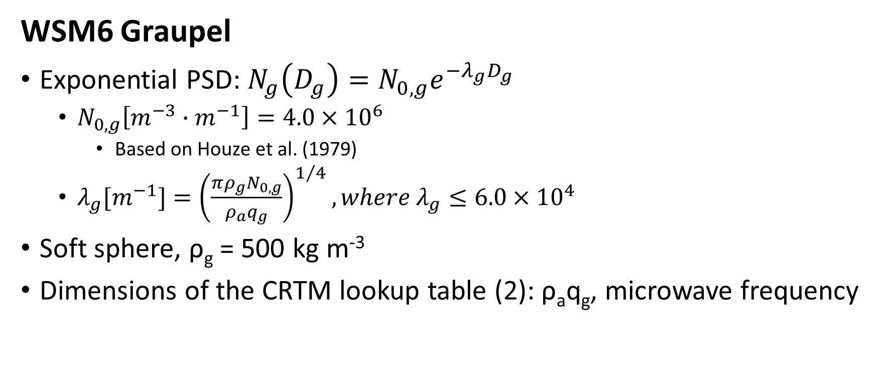

Microphysics Scheme Details, Example
WSM6 Graupel PSD for $λg$ = 3000 m⁻¹
WSM6 Graupel
Exponential PSD: $N_{g}\left(D_{g}\right)=N_{0,g}e^{−λ_{g}D_{g}}$
  $N_{0,g}\left[m^{−3}∙m^{−1}\right]=4.0×{10}^{6}$
    Based on Houze et al. (1979)
  $λ_{g}[m^{−1}]={\left(\frac{πρ_{g}N_{0,g}}{ρ_{a}q_{g}}\right)}^{1/4}, where λ_{g}≤6.0×{10}^{4}$
Soft sphere, ρ_{g} = 500 kg m⁻³
Dimensions of the CRTM lookup table (2): ρ_{a}q_{g}, microwave frequency

Slide 7
Research Questions
The Community Radiative Transfer Model (CRTM) uses effective radius to represent particle sizes
  No translation for microphysics (MP) scheme output is provided
Can the CRTM be modified to ensure accurate represent the radiance impacts of hydrometeors produced by regional-scale NWP microphysics (MP) schemes?
  The CRTM is important: used for operational data assimilation of radiance measurements in clear- and cloud-sky conditions
How do the results of the modified CRTM compare to observations?

Slide 8
Modifying the CRTM for All-sky Microwave
Method 1, “Distribution-Specific:” cloud scattering property lookup tables constructed at very high resolution consistent with MP schemes
New method 2, “Generalized Bin:” particle scattering property lookup tables, MP scheme information managed within CRTM
Model the properties of single particles (soft spheres, as specified by MP scheme)
  Maxwell-Garnett mixing formula for ice dielectric constants
  Liquid dielectric constants from Tuner et al. (2015)
Notes:
Though both the MP schemes and CRTM remain sources for error/bias to observation

Slide 9
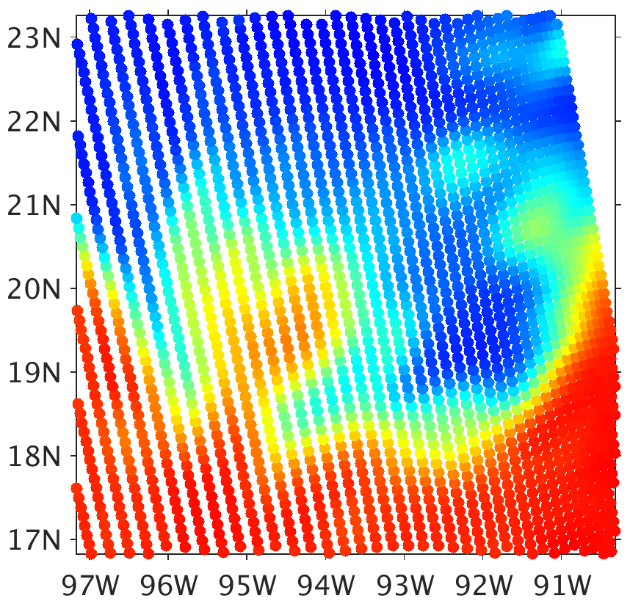
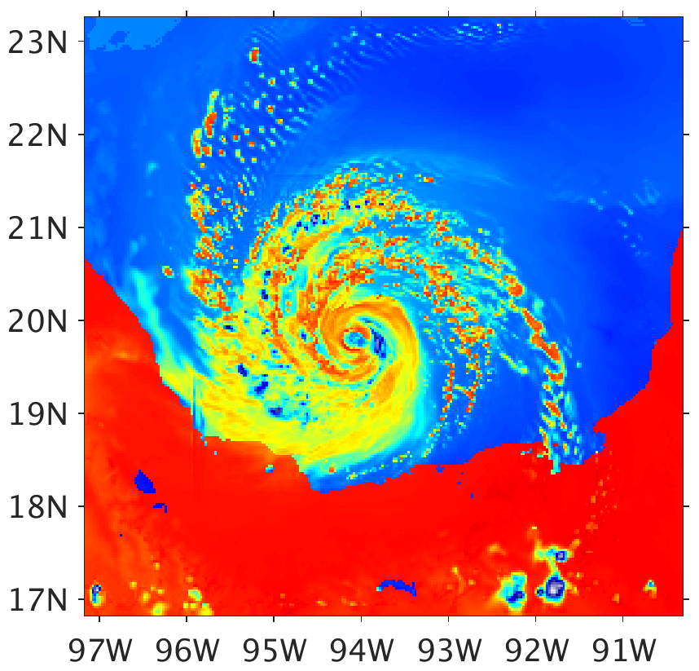

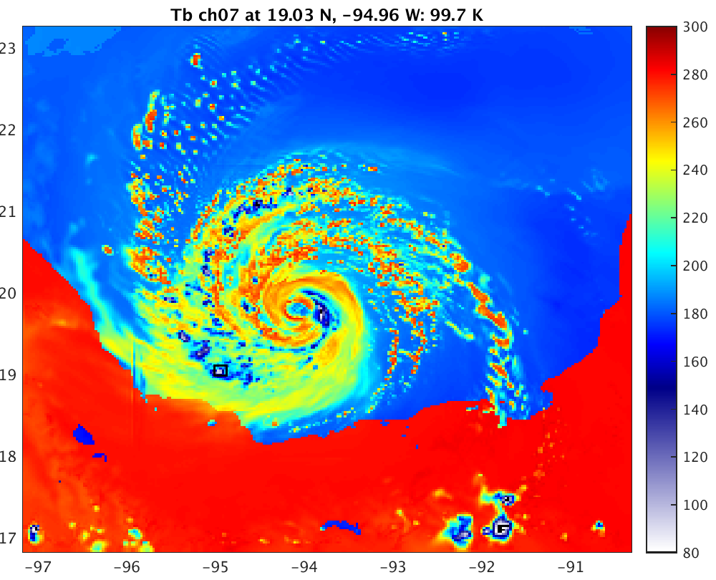
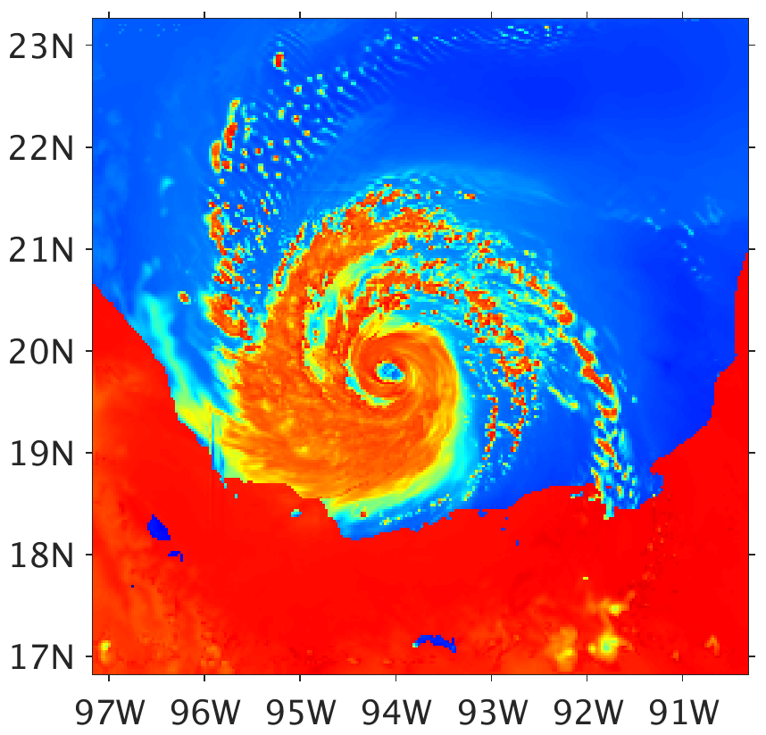
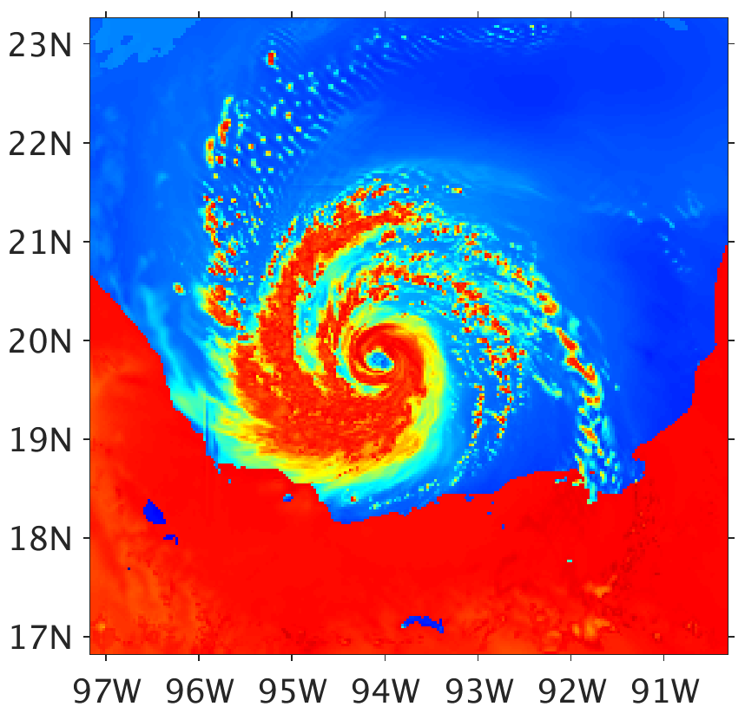
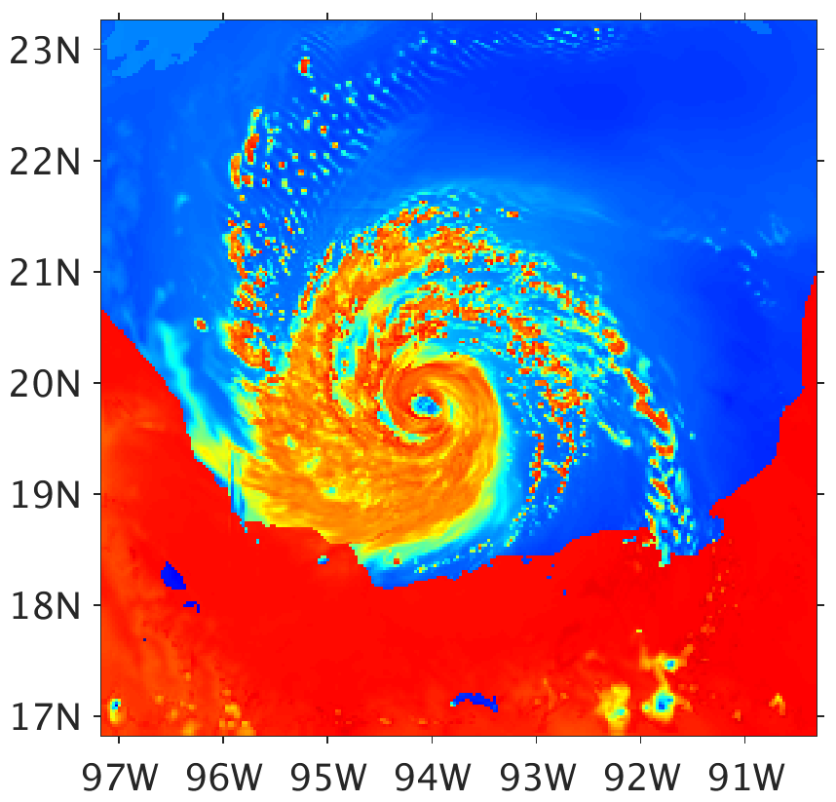
SSMI/S Ch. 4 (37.0 H)
CRTM, Distribution-Specific
(GMI Ch. 7, 36.5 H)
CRTM, Generalized Bin (64)
(GMI Ch. 7, 36.5 H)
WSM6
WSM6
WSM6
300
260
220
CRTM, Fixed Effective Radii
CRTM, Inverse of PSD Slope Parameter as Effective Radius
CRTM, 6th Moment Based Effective Radius
180
WSM6
WSM6
WSM6
140
100
Brightness Temperature (K)
Notes:
Bug fixes and other changes since last group meeting, so new results
Values of fixed effective radii for CRTM as released
Cloud: 20 μm Rain: 400 μm Ice: 40 μm Snow: 400 μm Graupel: 400 μm

Slide 10
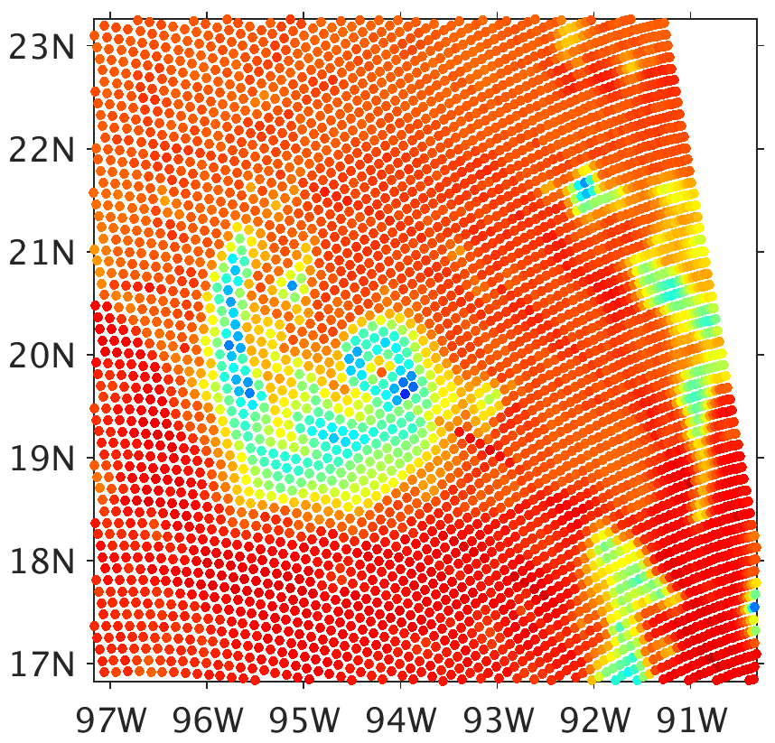
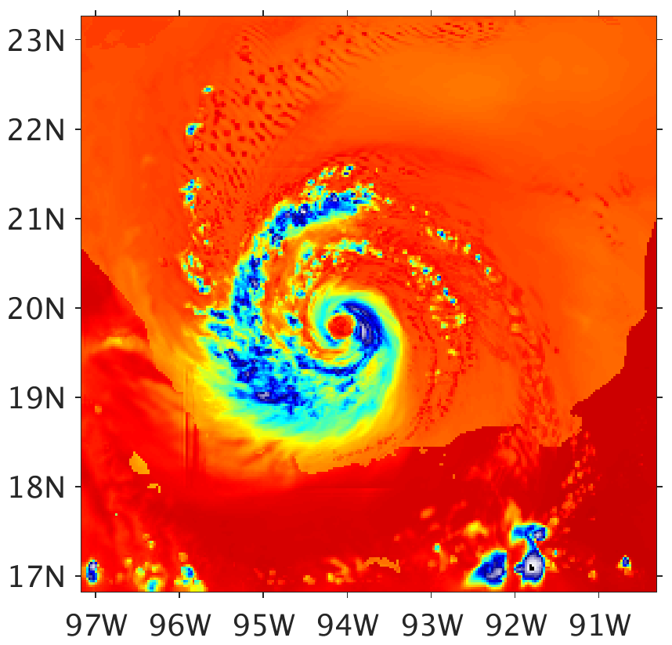

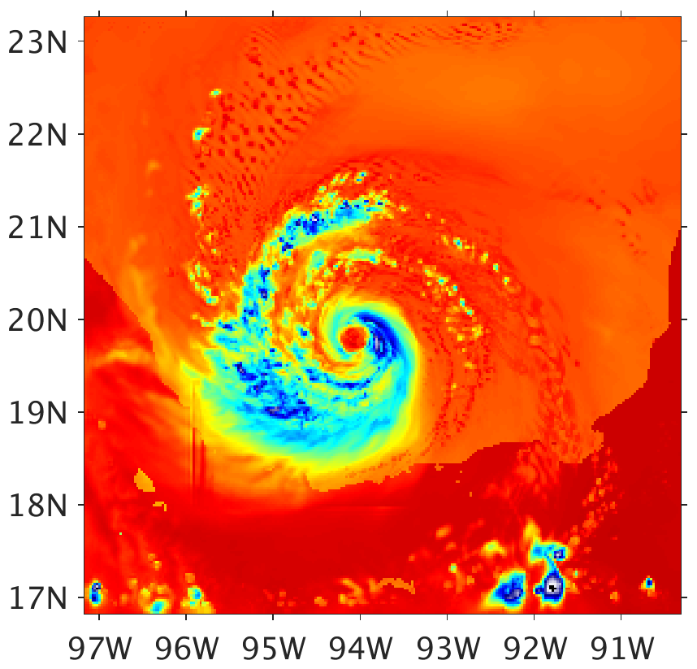
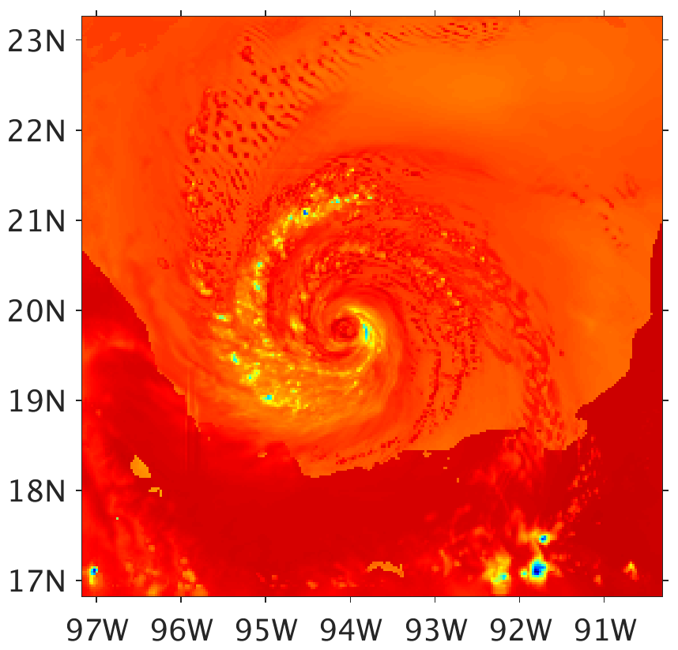
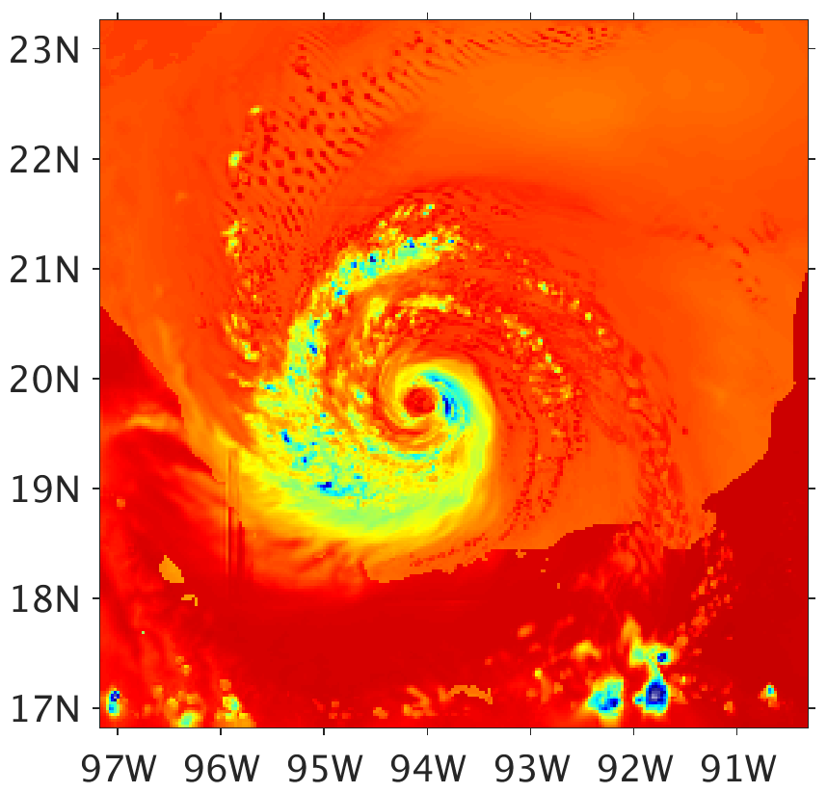
SSMI/S Ch. 4 (37.0 H)
CRTM, Distribution-Specific
(GMI Ch. 7, 36.5 H)
CRTM, Generalized Bin (64)
(GMI Ch. 7, 36.5 H)
WSM6
WSM6
WSM6
300
260
220
CRTM, Fixed Effective Radii
CRTM, Inverse of PSD Slope Parameter as Effective Radius
CRTM, 6th Moment Based Effective Radius
180
WSM6
WSM6
WSM6
140
100
Brightness Temperature (K)
Notes:
Effective Radii for CRTM As Released
Cloud: 15 μm Rain: 500 μm Ice: 50 μm Snow: 1000 μm Graupel: 1000 μm

Slide 11
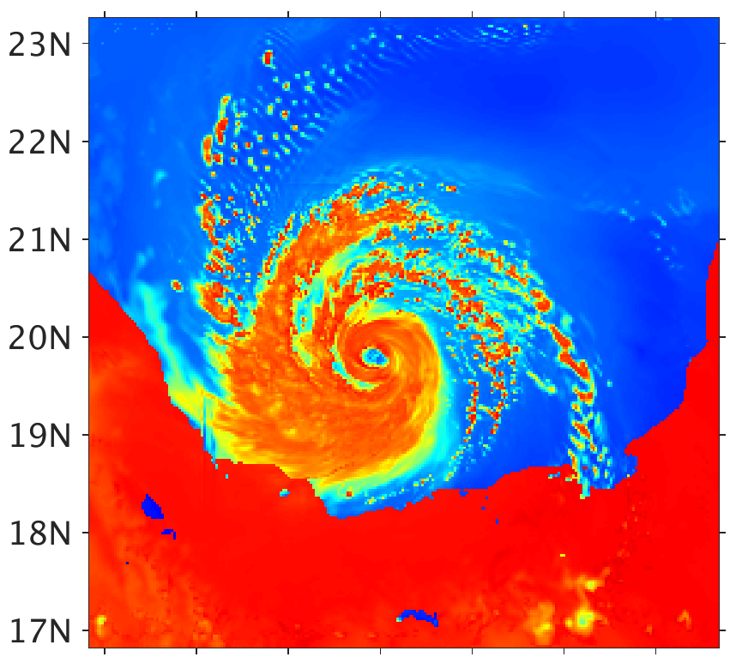
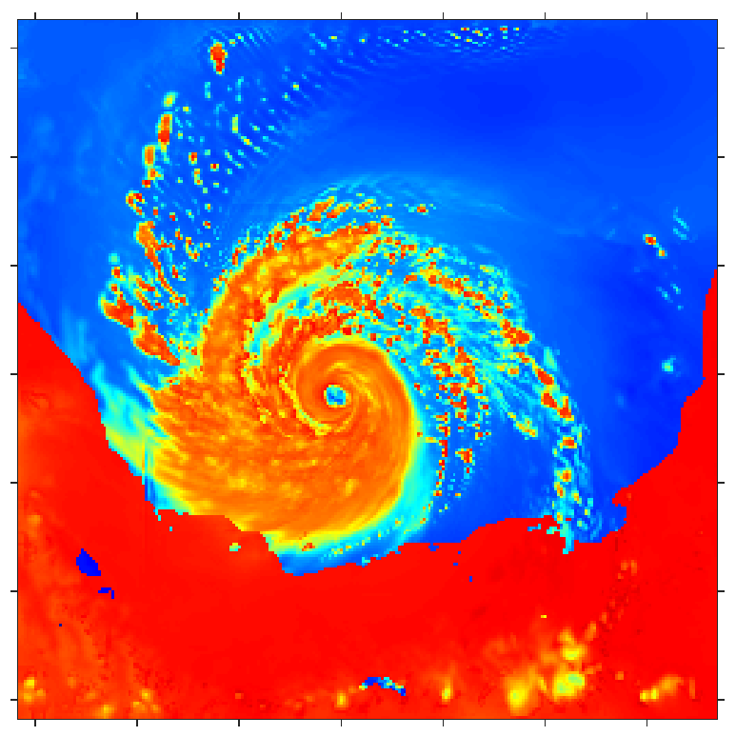
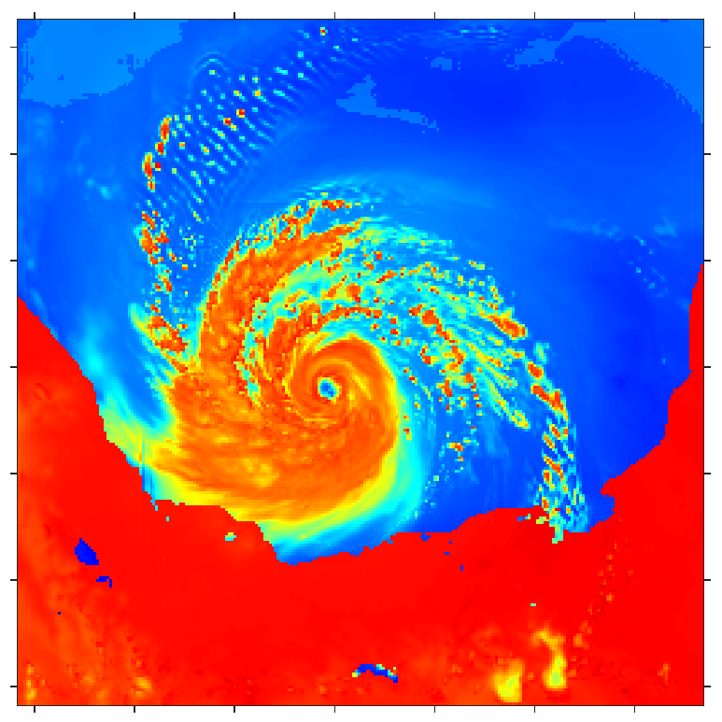
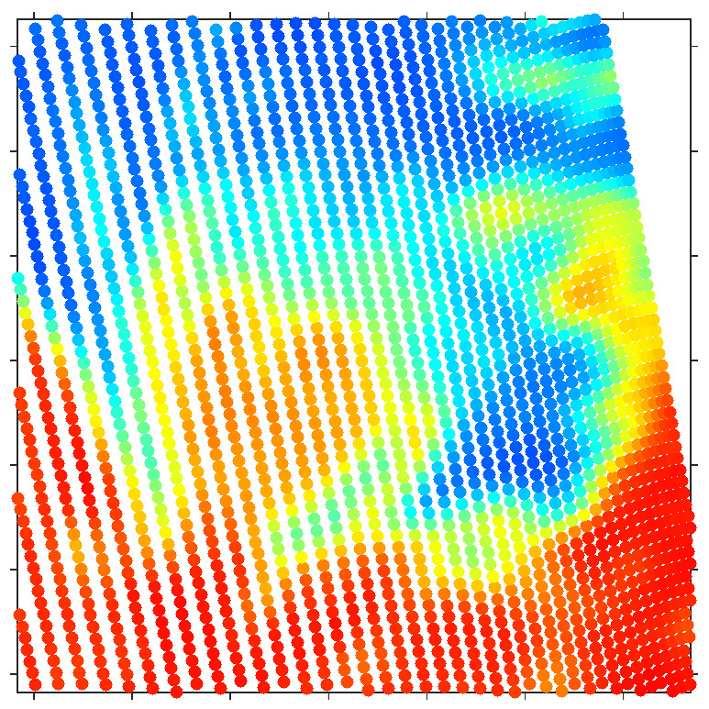
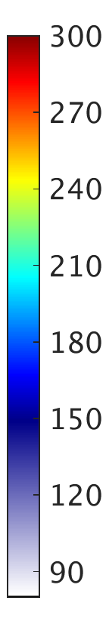
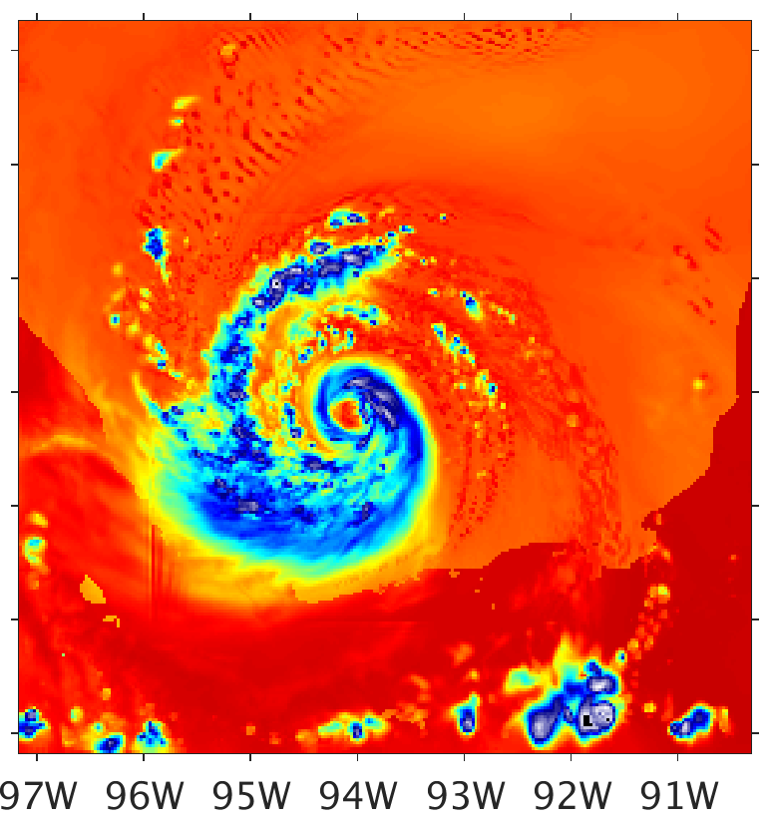
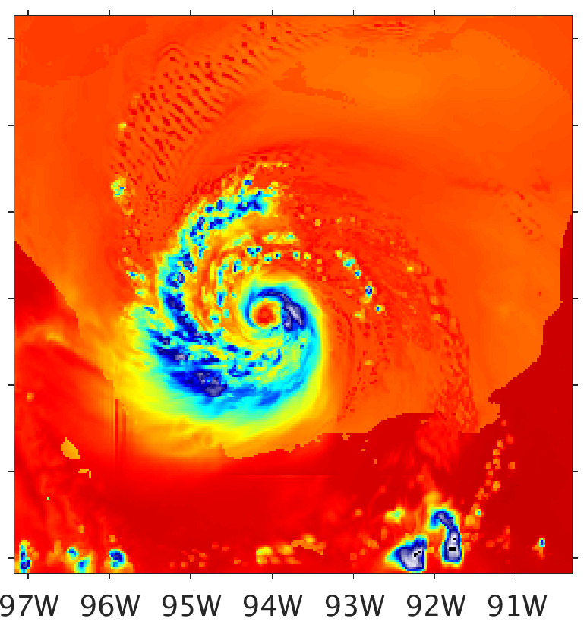
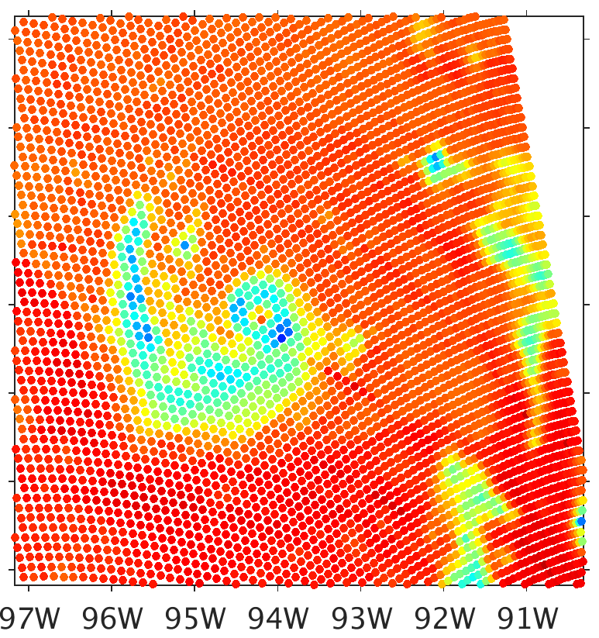
CRTM As-Released with Fixed Effective Radii
a1) WSM6 36.5H
a2) Goddard 36.5H
a3) Morrison 36.5H
a4) SSMIS 37.0H
b1) WSM6 89.0H
b2) Goddard 89.0H
b3) Morrison 89.0H
b4) SSMIS 91.66H
Brightness Temperature (K)

Slide 12
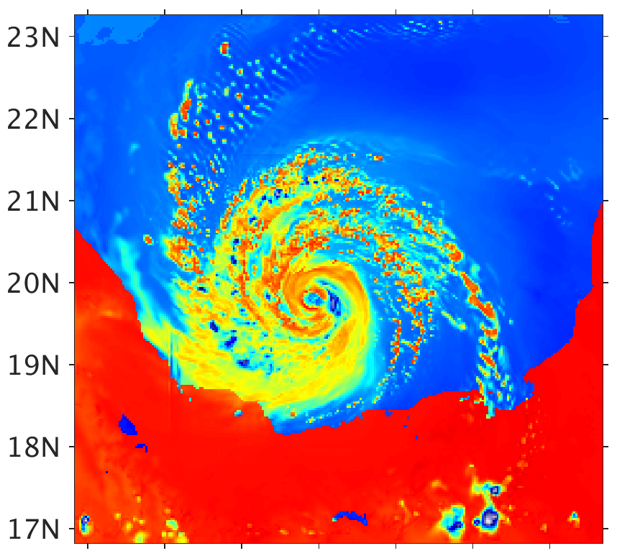
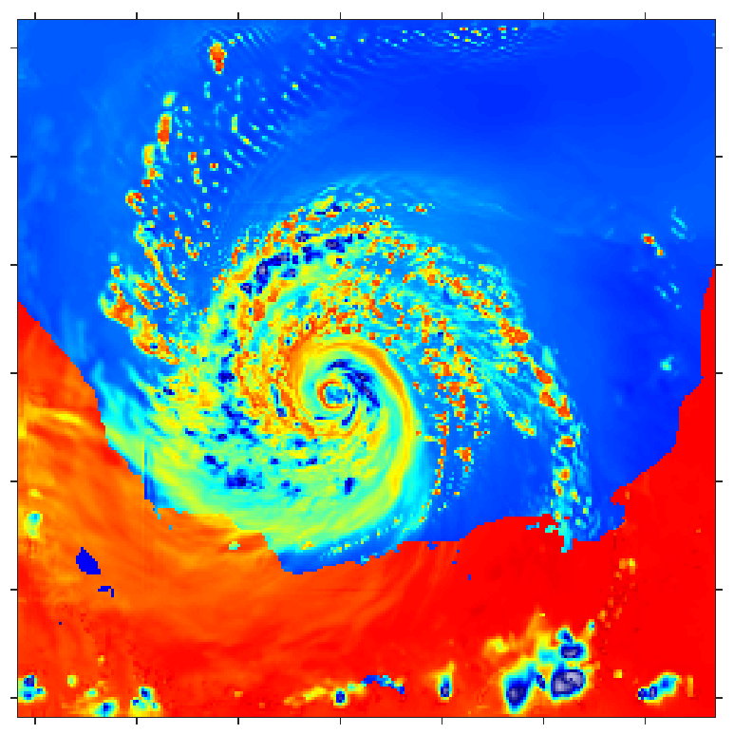
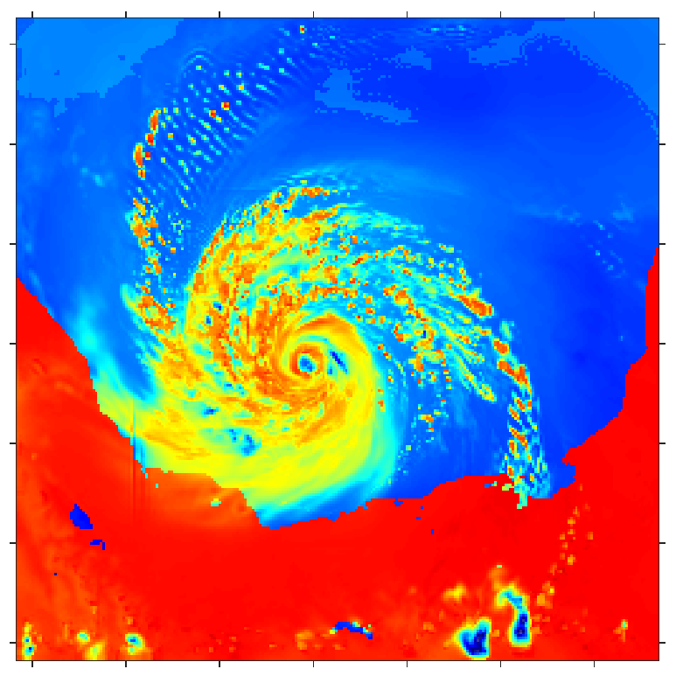
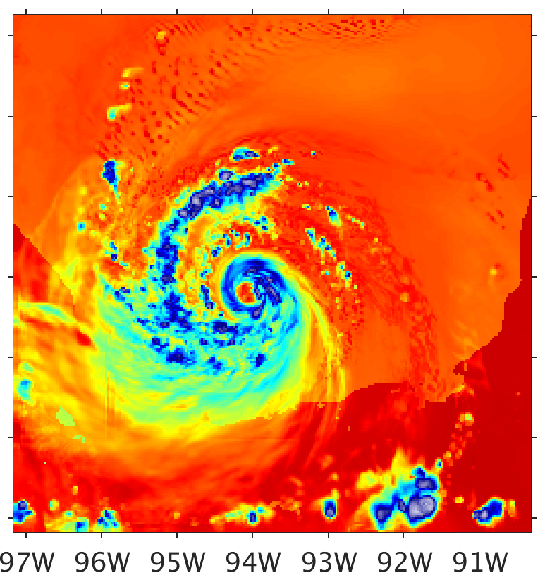
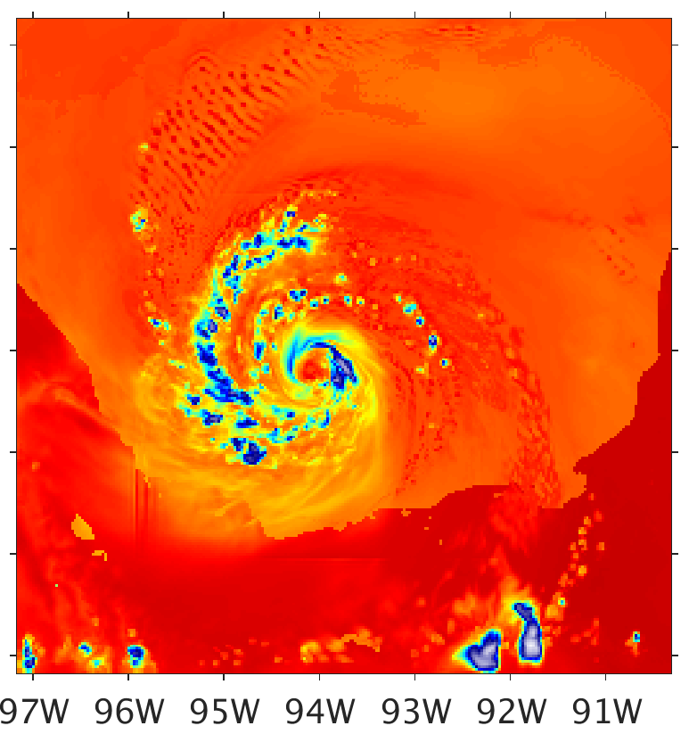
CRTM Distribution-Specific
a1) WSM6 36.5H
a2) Goddard 36.5H
a3) Morrison 36.5H
a4) SSMIS 37.0H
b1) WSM6 89.0H
b2) Goddard 89.0H
b3) Morrison 89.0H
b4) SSMIS 91.66H
Brightness Temperature (K)

Slide 13
Results and Discussion
CRTM with Microphysics-Consistent Radiative Properties (CRTM-MRP): too low of brightness temperatures, too much scattering
  Similar results to radar and passive microwave observations vs. simulated studies using the Goddard-SDSU [Zupanski et al. 2011; Zhang et al. 2013; Han et al. 2013; Chambon et al. 2014]
  Conclusion: too much or too big of snow and/or graupel in upper troposphere by microphysics schemes
Results of Bin Discretized limit to results of Distribution-Specific for increasing bin count
  64 bins offers good balance between speed and accuracy

Slide 14
Results and Discussion (continued)
Between the microphysics schemes,
  Similar integrated cloud masses
  Significantly different particle size distributions
CRTM as-released, either fixed or 6th-moment effective radii, produce the most realistic brightness temperatures
  Compensating for CRTM and MP scheme errors
  The 6th-moment of the PSD is a good guess at being the link between the effective radius and the PSDs used to construct LUT as-released

Slide 15
Future Directions
Refining and adding modifications, working within the CRTM repository
  Optimize Bin Discretized computations, reduce redundant LUT queries
  Non-spherical particle optical properties
  Tangent linear, adjoint, K-matrix
  Antenna pattern convolution and slant path constructions (features in satellite simulators)
  Automatic stream number estimation
Uses for this tool:
  Ensemble parameter estimation
  Observing System Experiments (testing data assimilation)
    Simulated or real observations

Slide 16
References
Chambon, P., S. Q. Zhang, A. Y. Hou, M. Zupanski, and S. Cheung, 2014: Assessing the impact of pre-GPM microwave precipitation observations in the Goddard WRF ensemble data assimilation system. Quart. Jour. Roy. Meteor. Soc., 140, 1219–1235.
Han, M., S. A. Braun, T. Matsui, and C. R. Williams, 2013: Evaluation of cloud microphysics schemes in simulations of a winter storm using radar and radiometer measurements. J. Geophys. Res. Atmos., 118, 1401–1419.
Liu, Q., and F. Weng, 2006: Advanced doubling-adding method for radiative transfer in planetary atmospheres. J. Atmos. Sci., 63, 3459‒3465.
Skamarock, W. C., J. B. Klemp, J. Dudhia, D. O. Gill, D. M. Barker, M. G. Duda, X.-Y. Huang, W. Wang, and J. G. Powers, 2008: A description of the Advanced Research WRF version 3. NCAR Technical Note 475, http://www.mmm.ucar.edu/wrf/users/docs/arw_v3.pdf.
Weng, Y., and F. Zhang, 2012: Assimilating Airborne Doppler Radar Observations with an Ensemble Kalman Filter for Convection-permitting Hurricane Initialization and Prediction: Katrina (2005). Mon. Wea. Rev., 140, 841-859.
Wong, V., and K. A. Emanuel, 2007: Use of cloud radars and radiometers for tropical cyclone intensity estimation, Geophys. Res. Lett., 34, L12811, doi:10.1029/2007GL029960.
Zhang, S. Q., M. Zupanski, A. Y. Hou, X. Lin, and S. H. Cheung, 2013: Assimilation of Precipitation-Affected Radiances in a Cloud-Resolving WRF Ensemble Data Assimilation System. Mon. Wea. Rev.,141, 754–772.
Zhang, F., Y. Weng, J. A. Sippel, Z. Meng, and C. H. Bishop, 2009: Cloud-resolving Hurricane Initialization and Prediction through Assimilation of Doppler Radar Observations with an Ensemble Kalman Filter. Mon. Wea. Rev., 137, 2105-2125.
Zupanski, D., S. Q. Zhang, M. Zupanski, A. Y. Hou, and S. H. Cheung, 2011: A Prototype WRF-Based Ensemble Data Assimilation System for Dynamically Downscaling Satellite Precipitation Observations. J. Hydrometeor., 12, 118–134.

Slide 17
Extra Slides

Slide 18
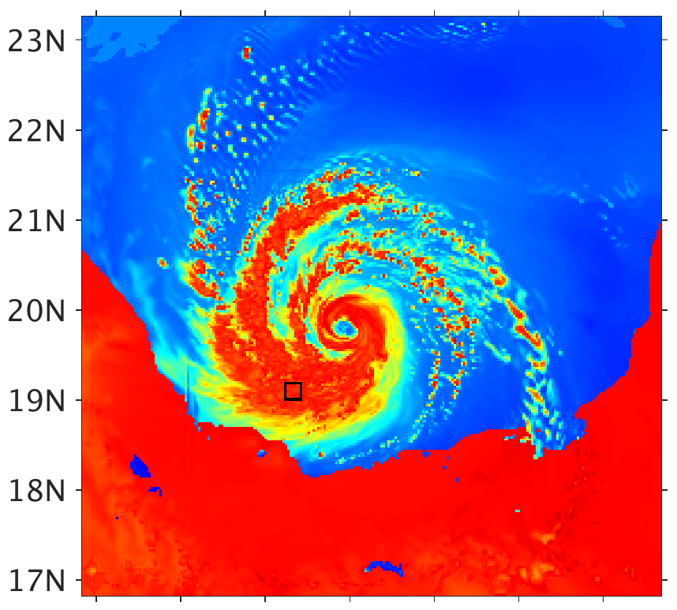
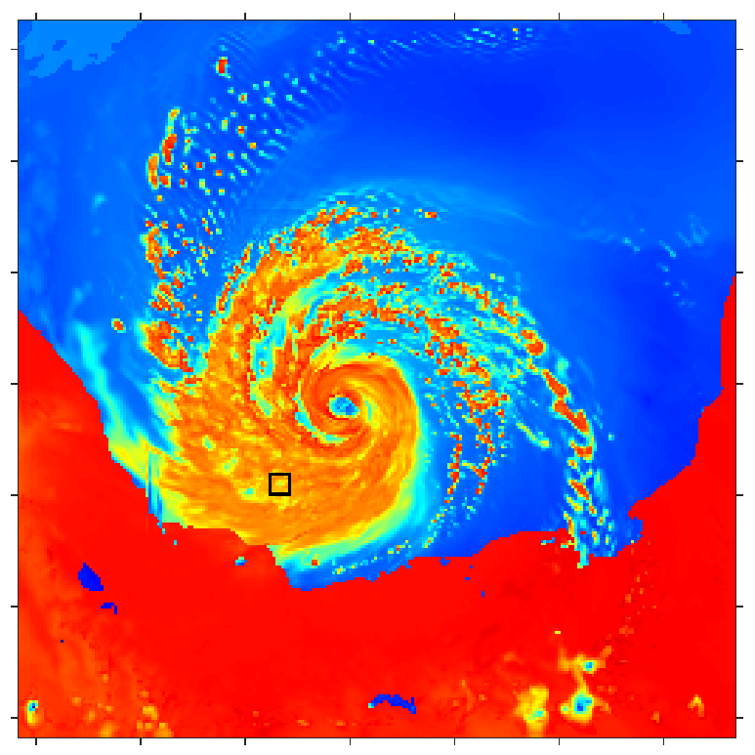
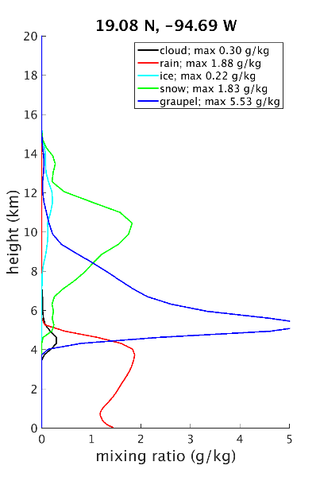
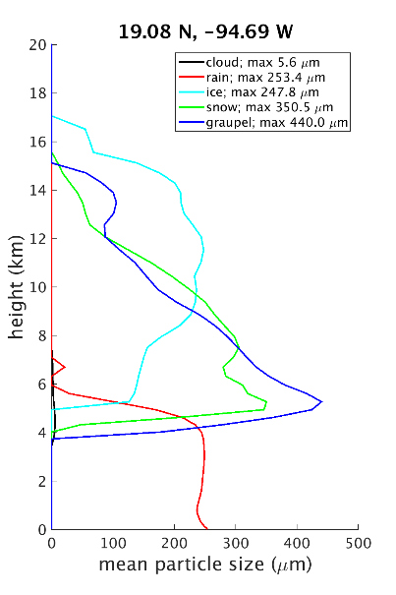

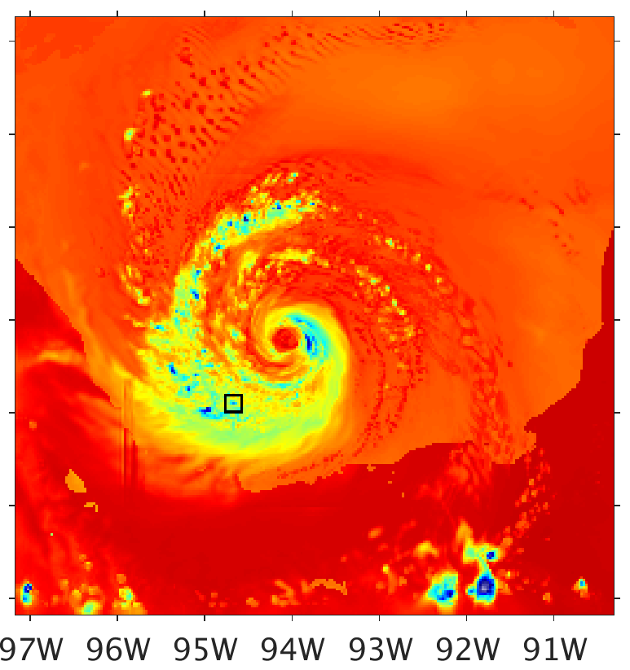
a1) Mean as ER 36.5H
b1) 6th moment as ER 36.5H
c)
d)
a2) Mean as ER 89.0H
b2) 6th moment as ER 89.0H
c) WSM6 89.0H
Brightness Temperature (K)
90
120
150
180
210
240
270
300

Slide 19
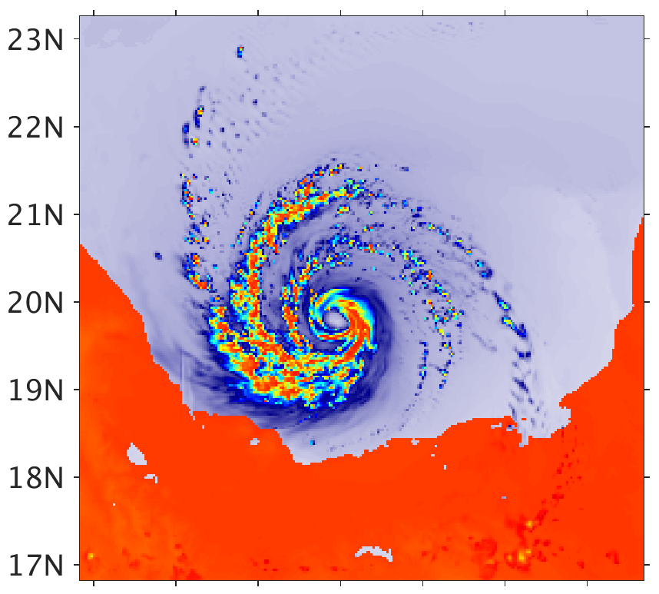
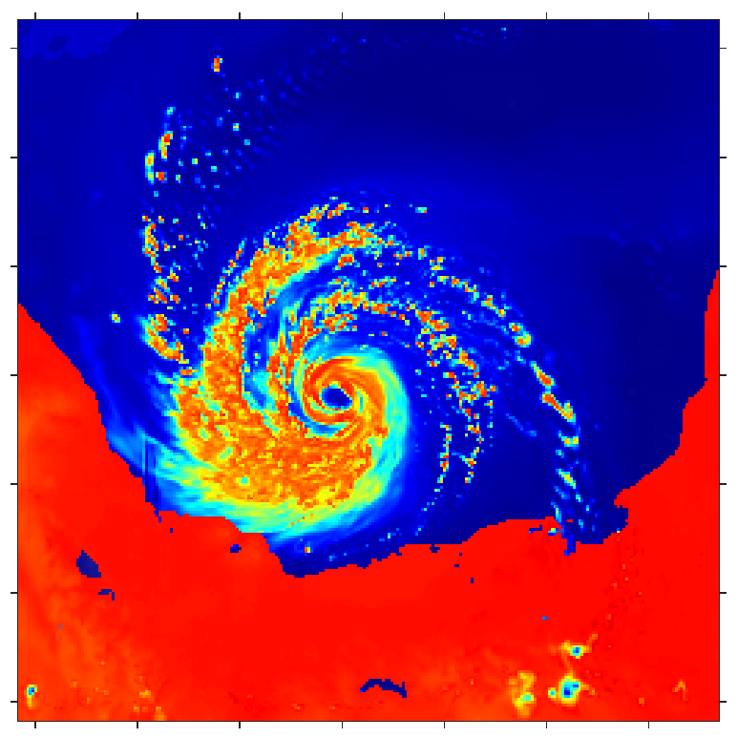
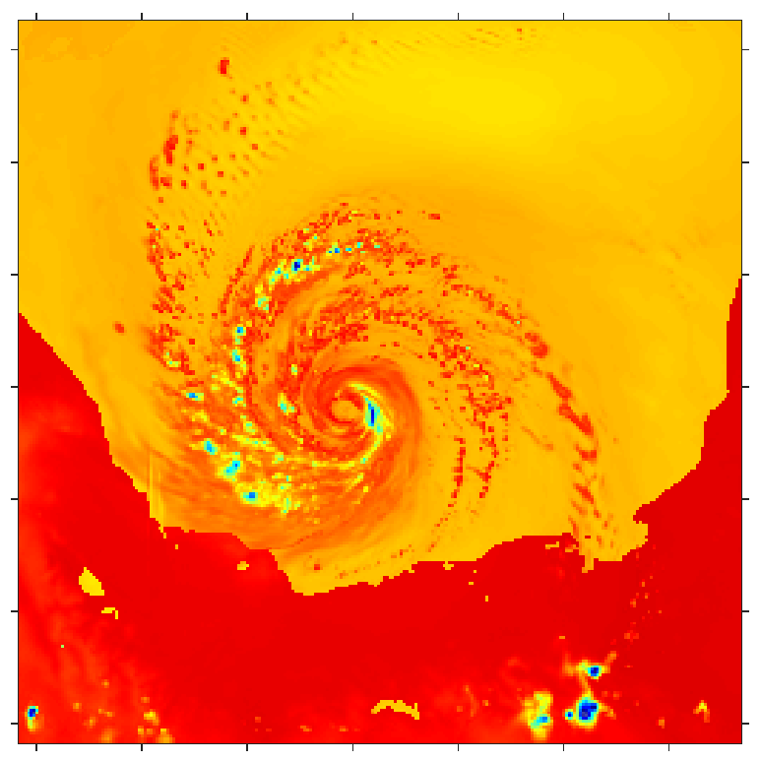
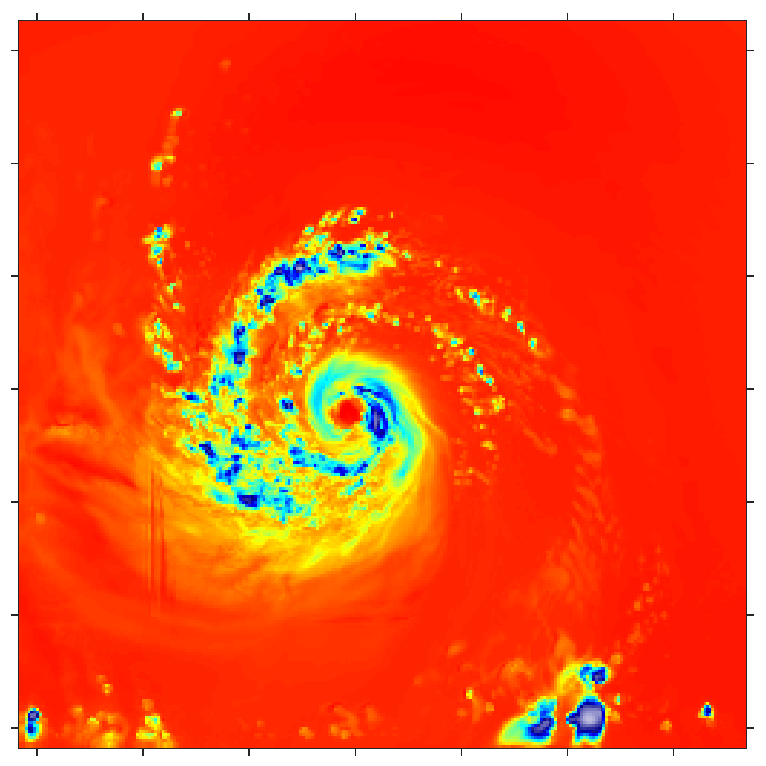
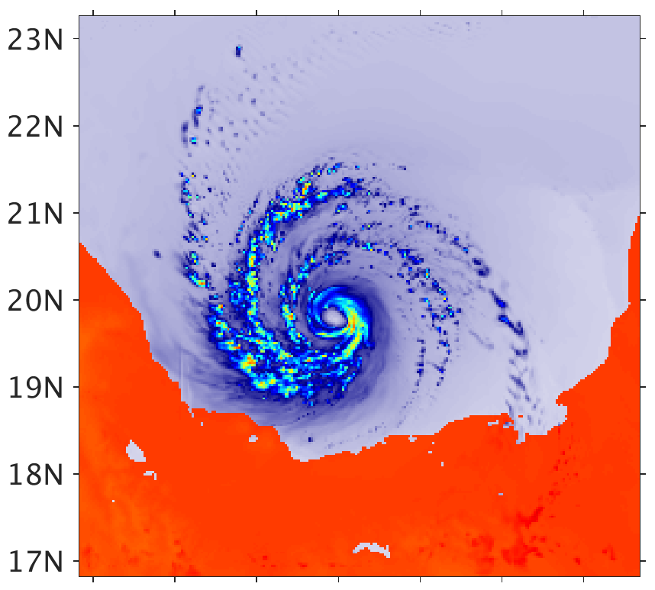
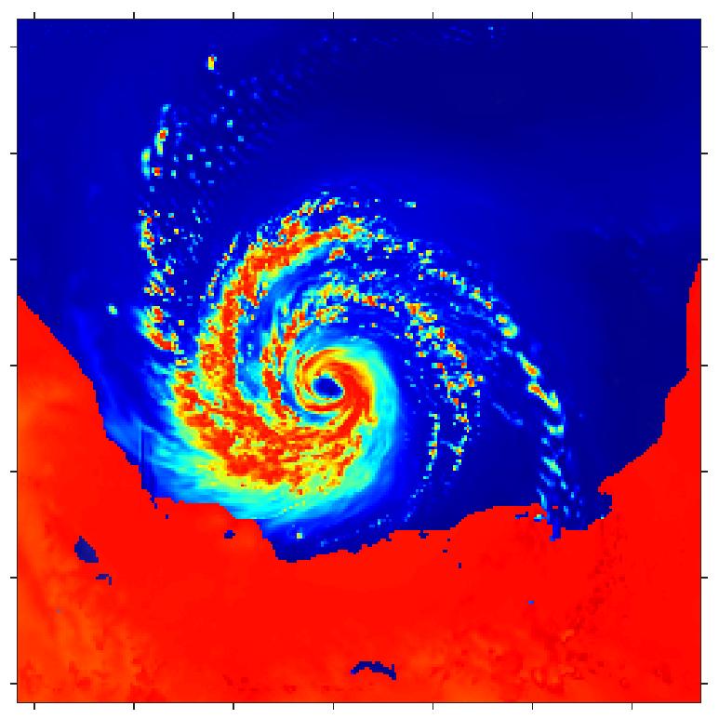
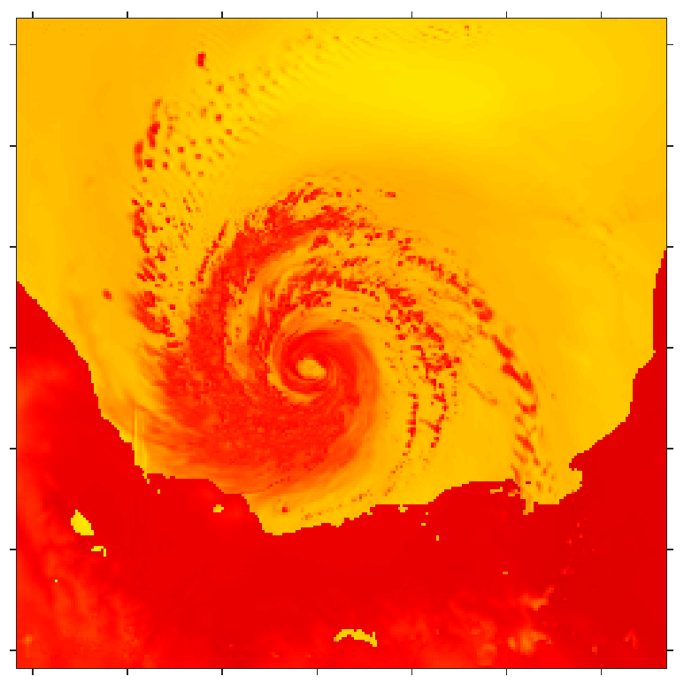
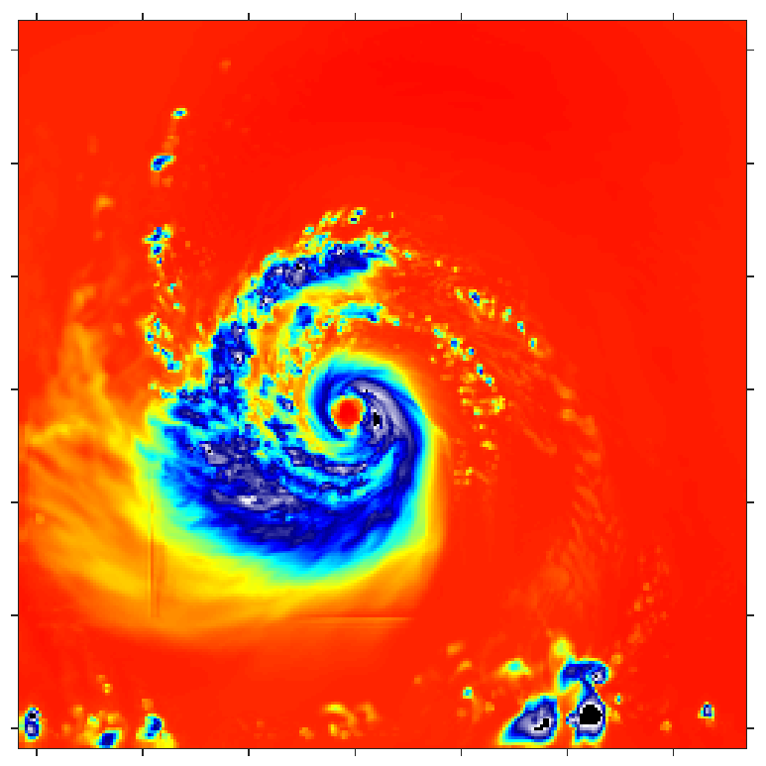
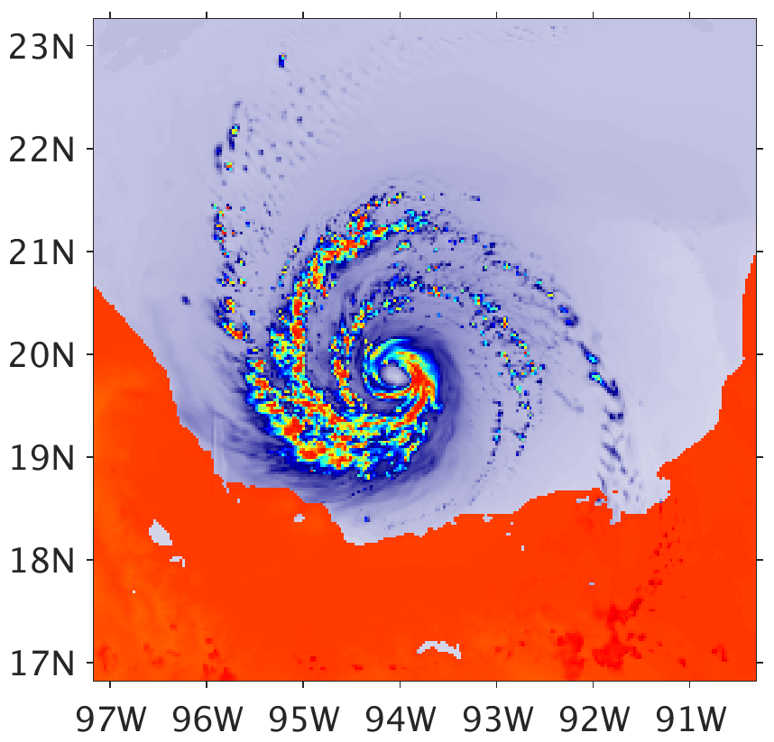

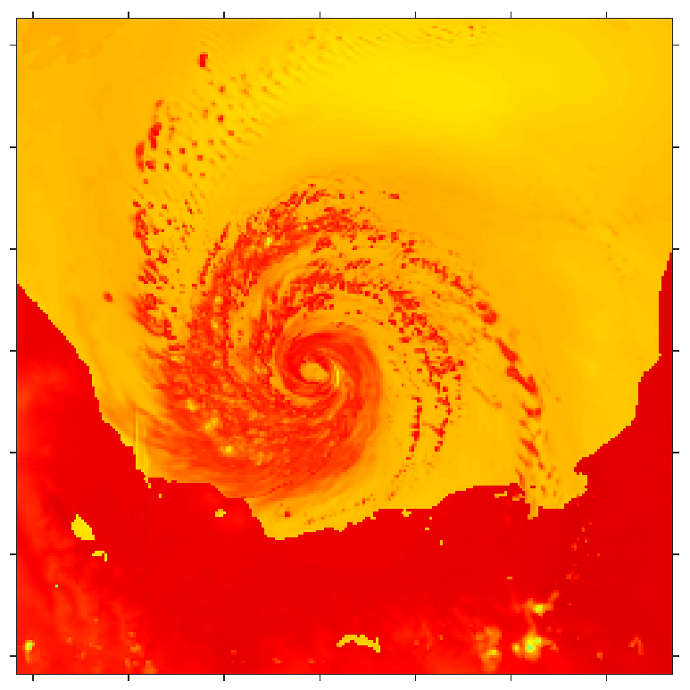
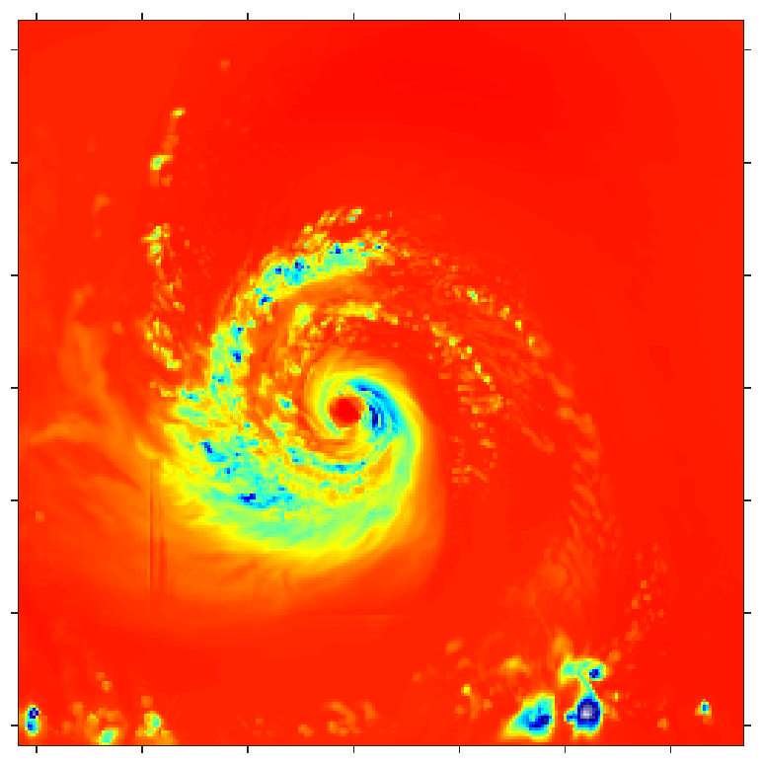
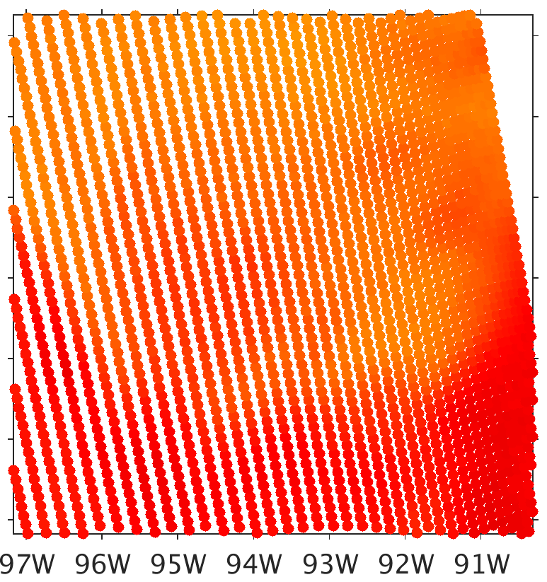
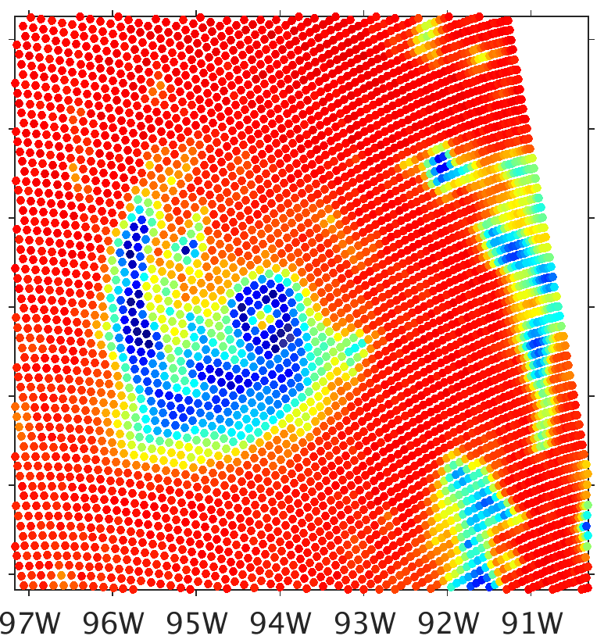
a1) Consistent Clouds 10.65H
b1) Consistent Clouds 18.7H
c1) Consistent Clouds 23.8V
d1) Consistent Clouds 165.5H
a2) Fixed Radius 10.65H
b2) Fixed Radius 18.7H
c2) Fixed Radius 23.8V
d2) Fixed Radius 165.5H
Brightness Temperature (K)
a3) 6th-Moment Radius 10.65H
b3) 6th-Moment Radius 18.7H
c3) 6th-Moment Radius 23.8V
d3) 6th-Moment Radius 165.5H
90
120
150
180
210
240
270
300
b4) SSMIS 19.35H
c4) SSMIS 22.23V
d4) SSMIS 150H

Slide 20
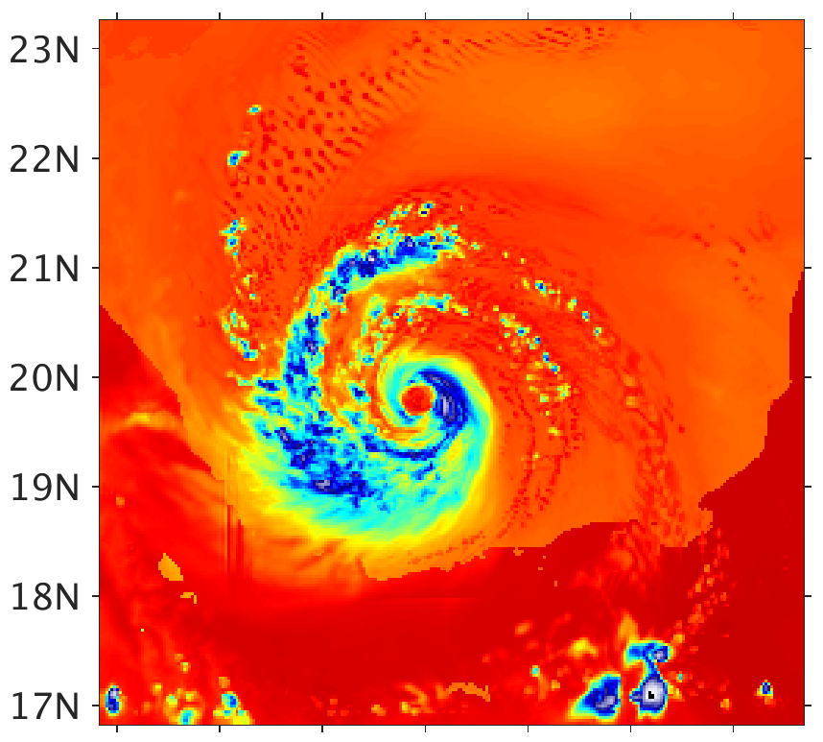
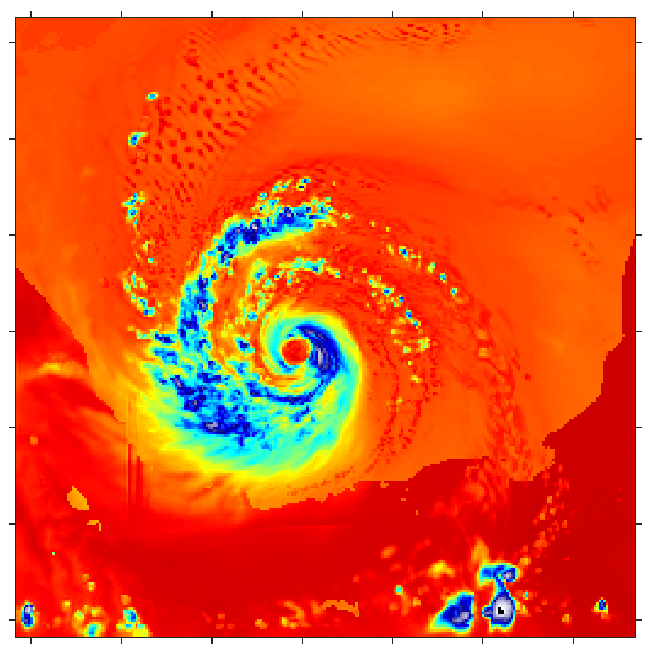


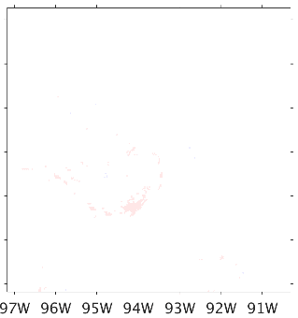


a) Consistent Clouds 89.0H
b1) Generalized Bin–128 89.0H
c1) Generalized Bin–64 89.0H
d1) Generalized Bin–32 89.0H
300
270
240
210
180
150
120
90
Brightness Temperature (K)
e) SSMIS 91.66H
b2) Difference using 128 Bins
c2) Difference using 64 Bins
d2) Difference using 32 Bins
3
2
1
0
-1
-2
-3

Slide 21


Figure 1: Mass scattering (solid) and absorption (dashed) coefficients (m² kg⁻¹) and sample particle mass distribution (dot-dashed; kg m⁻³ µm⁻¹) of (left) spherical rain drops and (right) graupel-like ice spheres as a function of radius for two imaging frequencies. Particle mass distribution for liquid spheres is WSM6 rain at 4.96 g m⁻³, ice spheres is WSM6 graupel at 1.24 g m⁻³. Wavelength (blue) and one-sixth the wavelength (red) shown for reference. Area in box (dotted line) for ice spheres at 89 GHz shown in greater detail in Figure 2.

Slide 22

Figure 2: Zoom of the area in box (dotted line) for ice spheres at 89 GHz in Figure 6. Solid green and dotted red lines indicate the particle radii corresponding to bin edges and centers, respectively, when using a total of 64 bins. The grey shading beneath the particle mass distribution (dot-dashed; kg m⁻³ µm⁻¹) and between two adjacent bin edges represents calculating the mass of the corresponding bin. The red stars along the bin center and at each the mass scattering (solid) and absorption (dashed) coefficient (m² kg⁻¹) plots represents determining the values of these quantities applicable for the bin.

Slide 23





WSM6
10.65-H
18.7-H
23.8-V
36.5-H
89.0-H
165.5-H

