Slide 1
Improving the Vortex Initialization of Hurricane Karl (2010) Through the Assimilation of Tropical Cyclone Vitals Quadrant Wind Radii Estimates
Robert Nystrom, Fuqing Zhang, and Jason Sippel

Slide 2
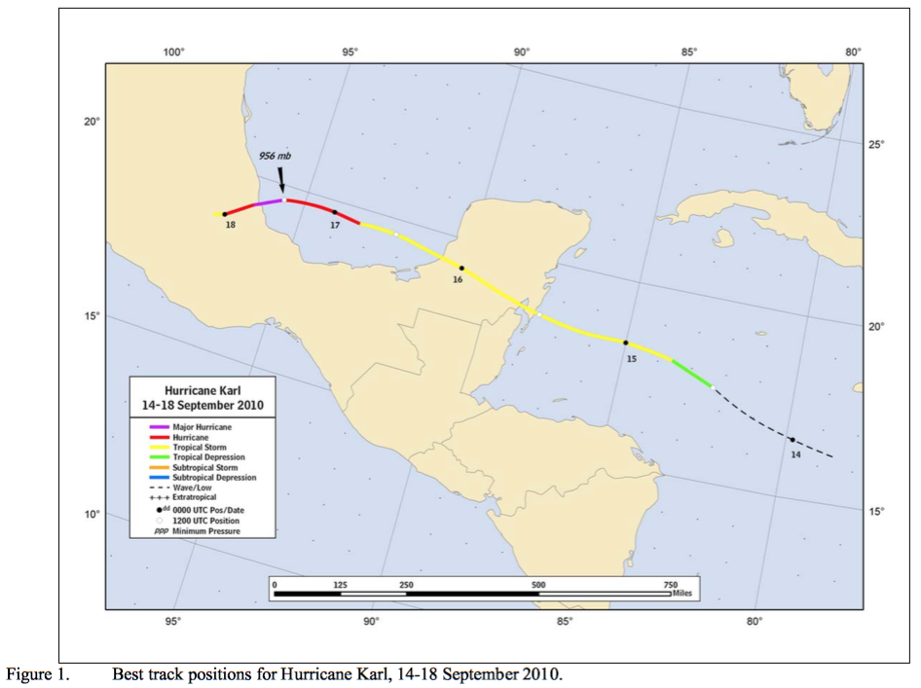
Hurricane Karl (2010)
Initially formed as a tropical depression 12z September 14th, 2010
Became a tropical storm 18z on the 14th
Made landfall on the Yucatan Peninsula shortly after 12z on the 15th
Emerged in the bay of Campeche and rapidly intensified into a category 3 hurricane before making landfall in Veracruz ~17z on the 17th
From Tropical Cyclone Report Hurricane Karl

Slide 3
TC Vitals Quadrant Wind Radii Estimates
Estimated radii of the RMW and the 34/50/64 knot winds are contained in TCVitals for each quadrant of the storm when available.
Contains information on the possible asymmetric wind structure of the storm
Large errors!
34 kt wind radii
50 kt wind radii
64 kt wind radii

Slide 4
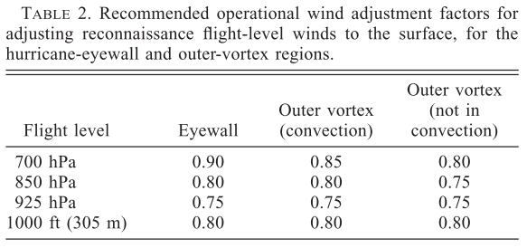
Creation of Synthetic Wind Observations
Hourly synthetic wind observations created by linearly interpolating between 6 hourly TCvitals data
Also interpolated to cardinal direction (maximum of 8 observations per wind speed)
Winds speeds estimated above the PBL so that they can be assumed approximately tangential
1500 and 3000 m
ROI calculated as a function of radius
Increases with increasing radius
Franklin et al. 2003

Slide 5
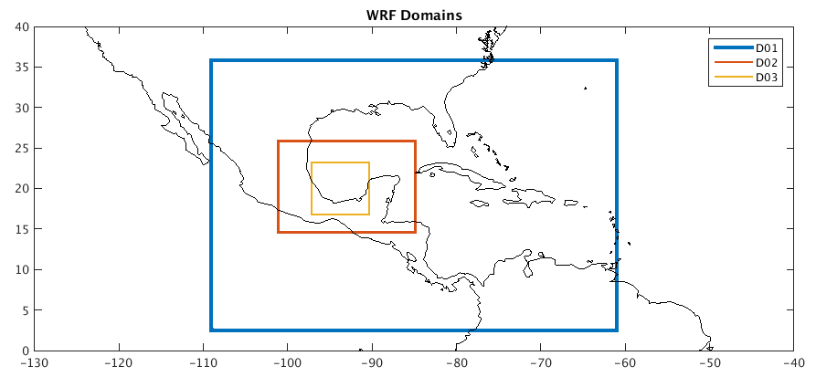
Experimental Set-up
3 two-way nested domains of 27, 9, and 3 km respectively
60 member ensemble
Forecast initialized 12z on the 16th
7 hour spin-up time from 12z to 19z
Airborne radar data assimilated at 19, 20 and 21z
HPI or HPI and TCwinds then assimilated hourly beginning at 22z 16th until 12z 17th
Alpha = 0.8

Slide 6
NoDA Simulation:
19z 16th
Airborne
20z 16th
Airborne
21z 16th
Airborne
12z 17th
12z 16th
HPI Simulation:
19z 16th
Airborne
20z 16th
Airborne
21z 16th
Airborne
22z 16th
HPI
23z 16th
HPI
12z 17th
HPI
12z 16th
HPI + TCwinds Simulation:
22z 16th
HPI + TCwinds
23z 16th
HPI + TCwinds
12z 17th
HPI + TCwinds
19z 16th
Airborne
20z 16th
Airborne
21z 16th
Airborne
12z 16th

Slide 7
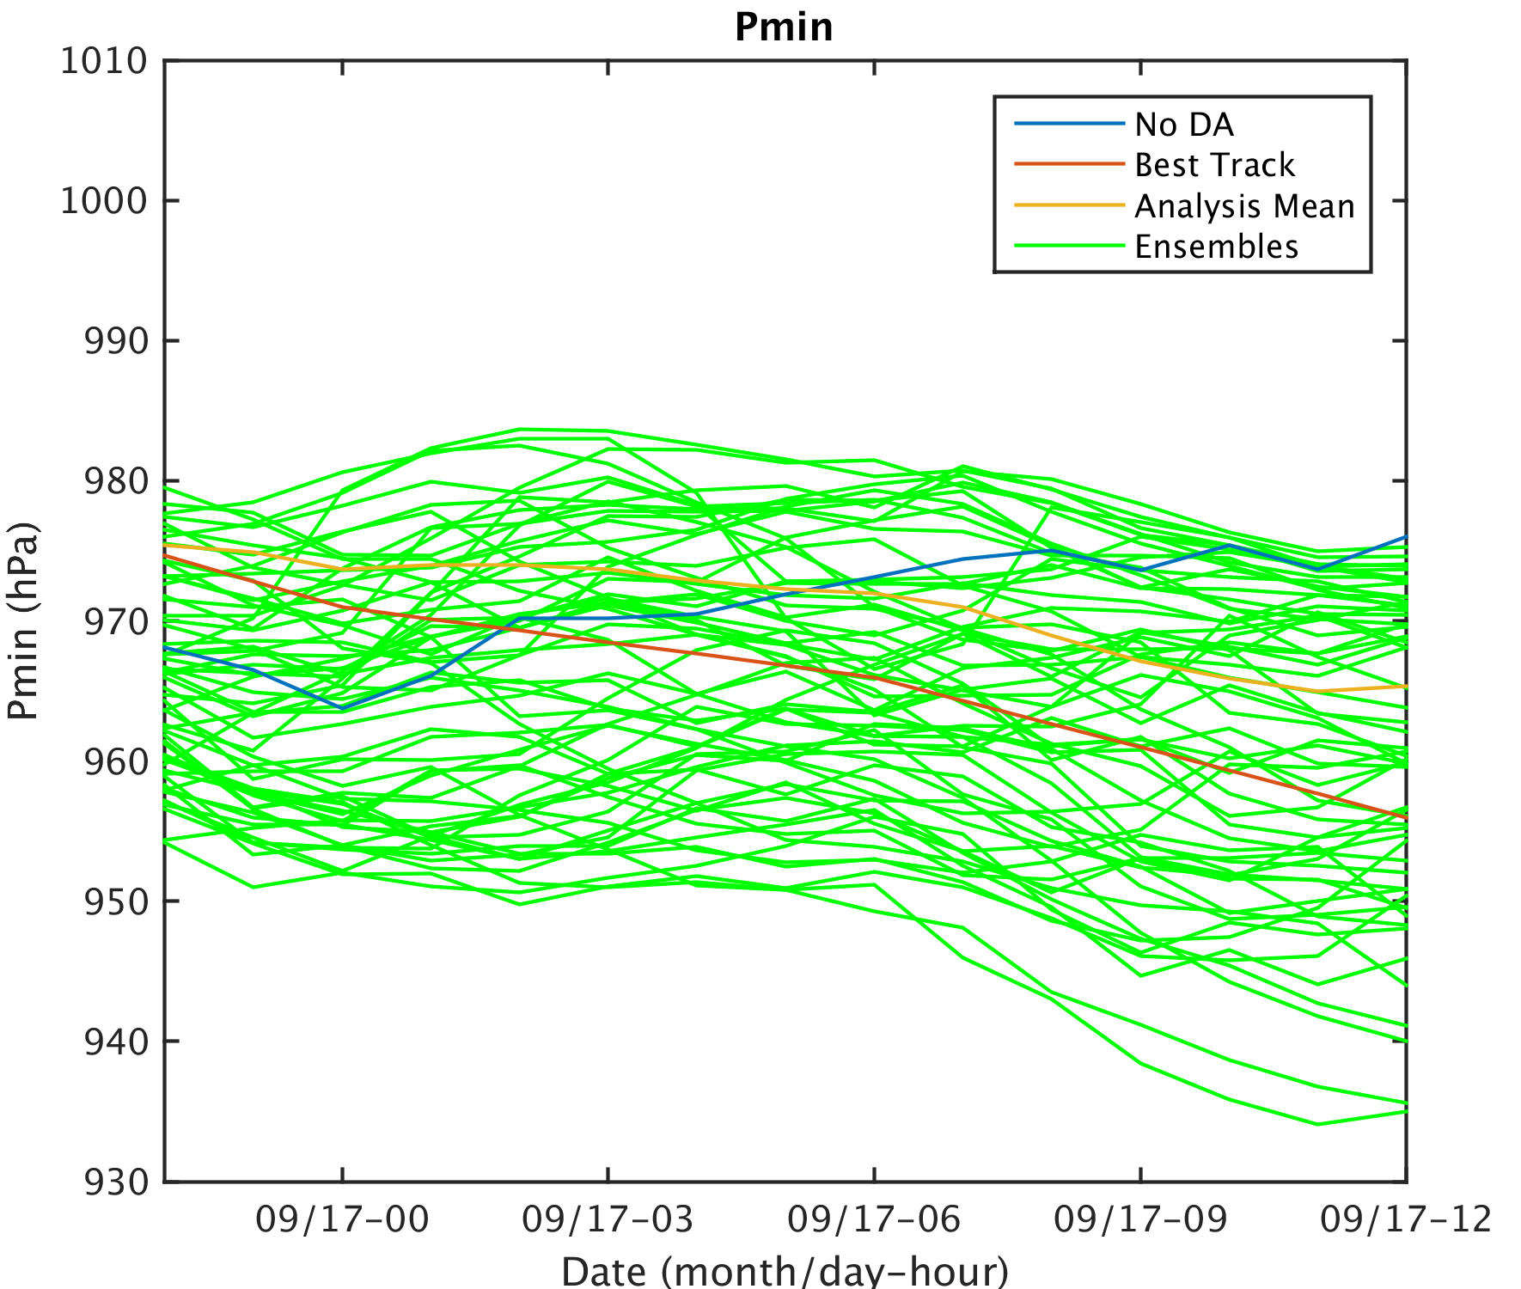
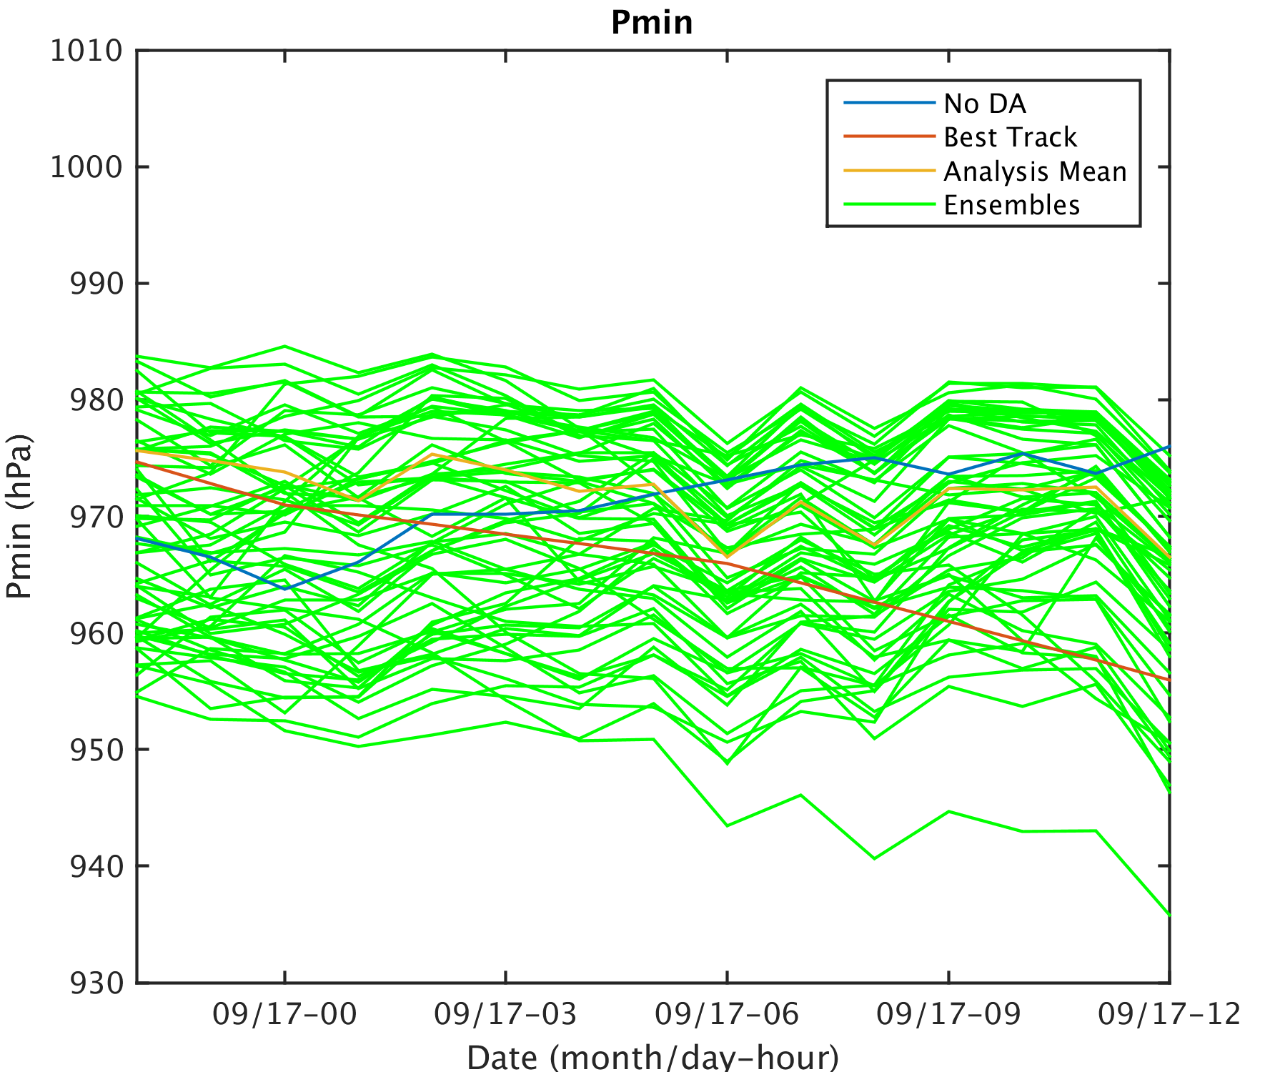
HPI
HPI+TCwinds

Slide 8
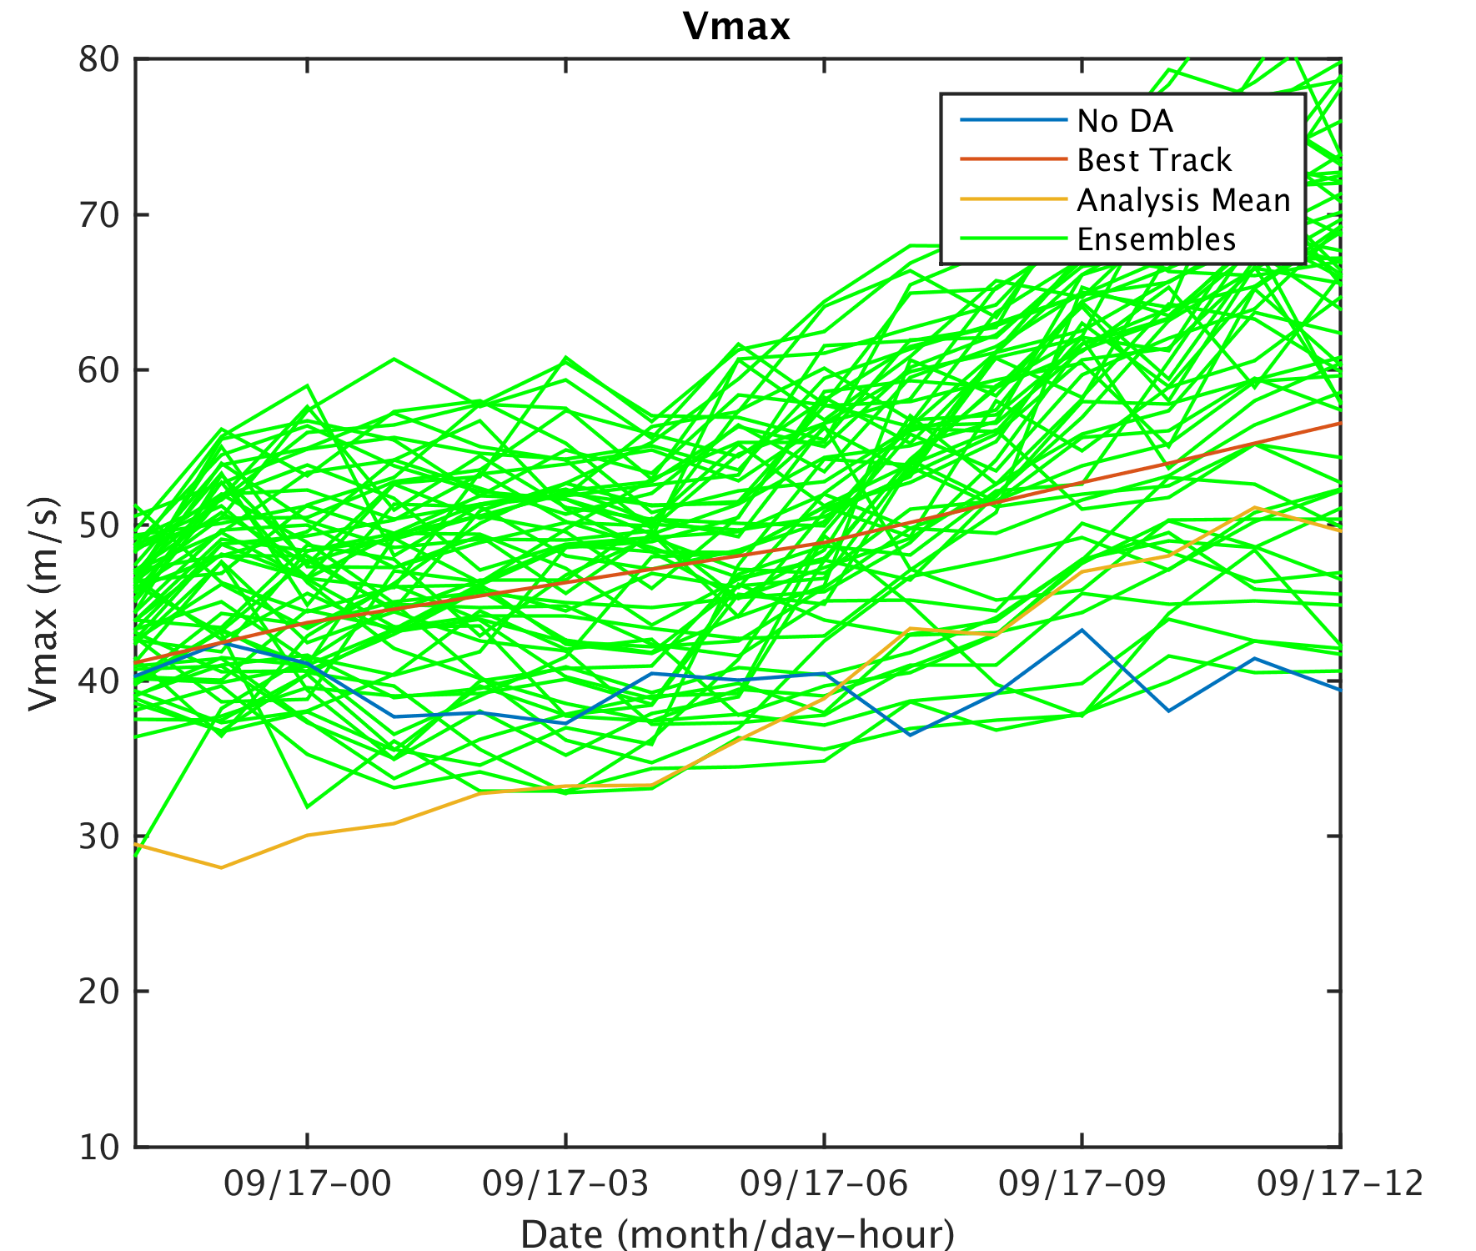
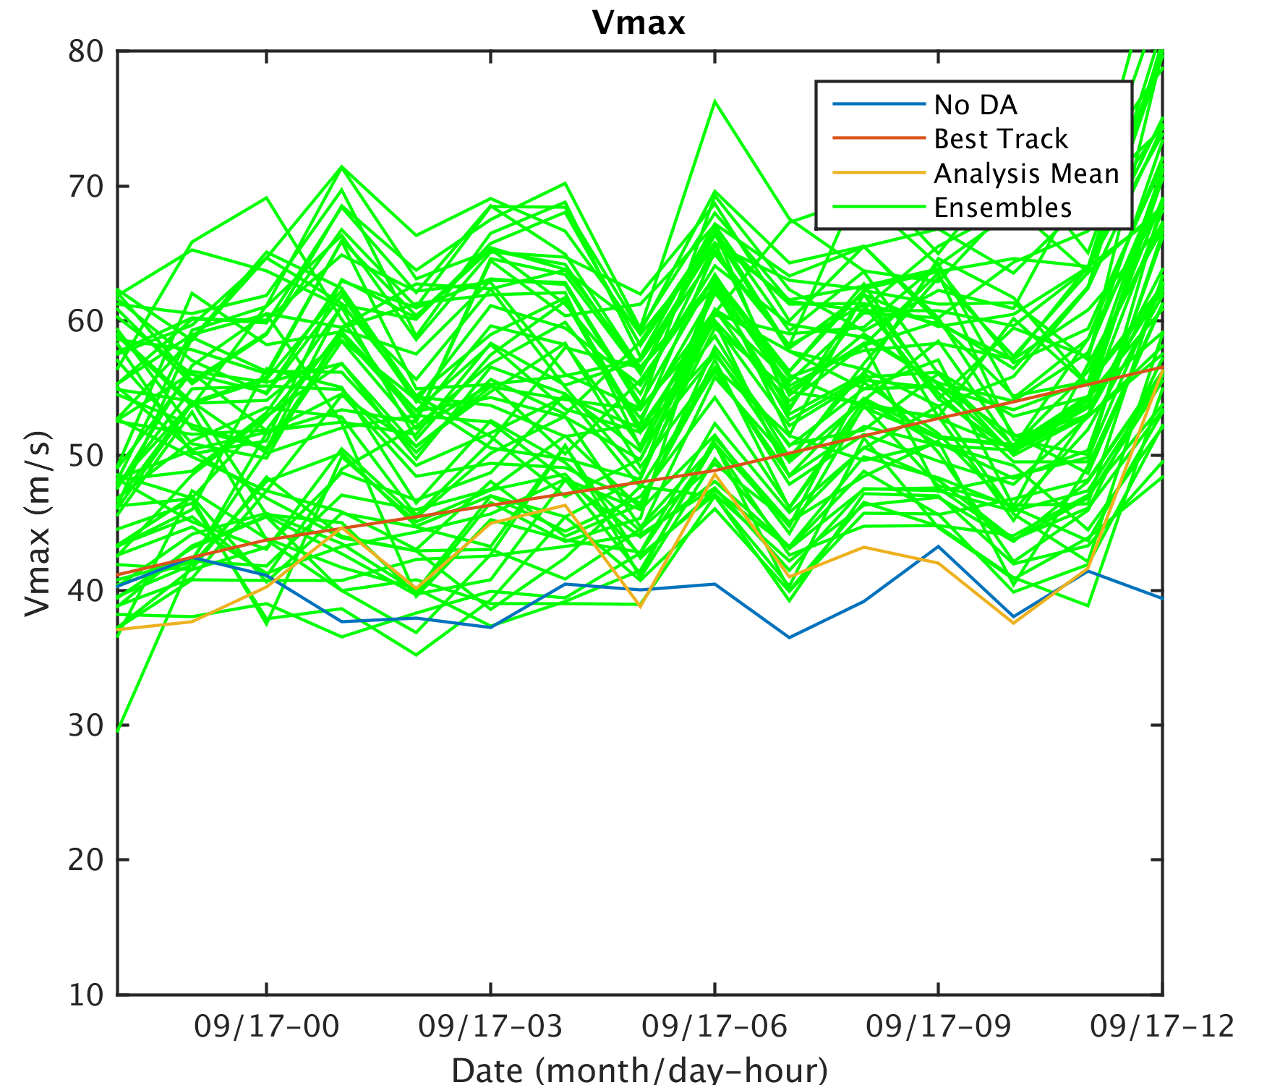
HPI
HPI+TCwinds

Slide 9
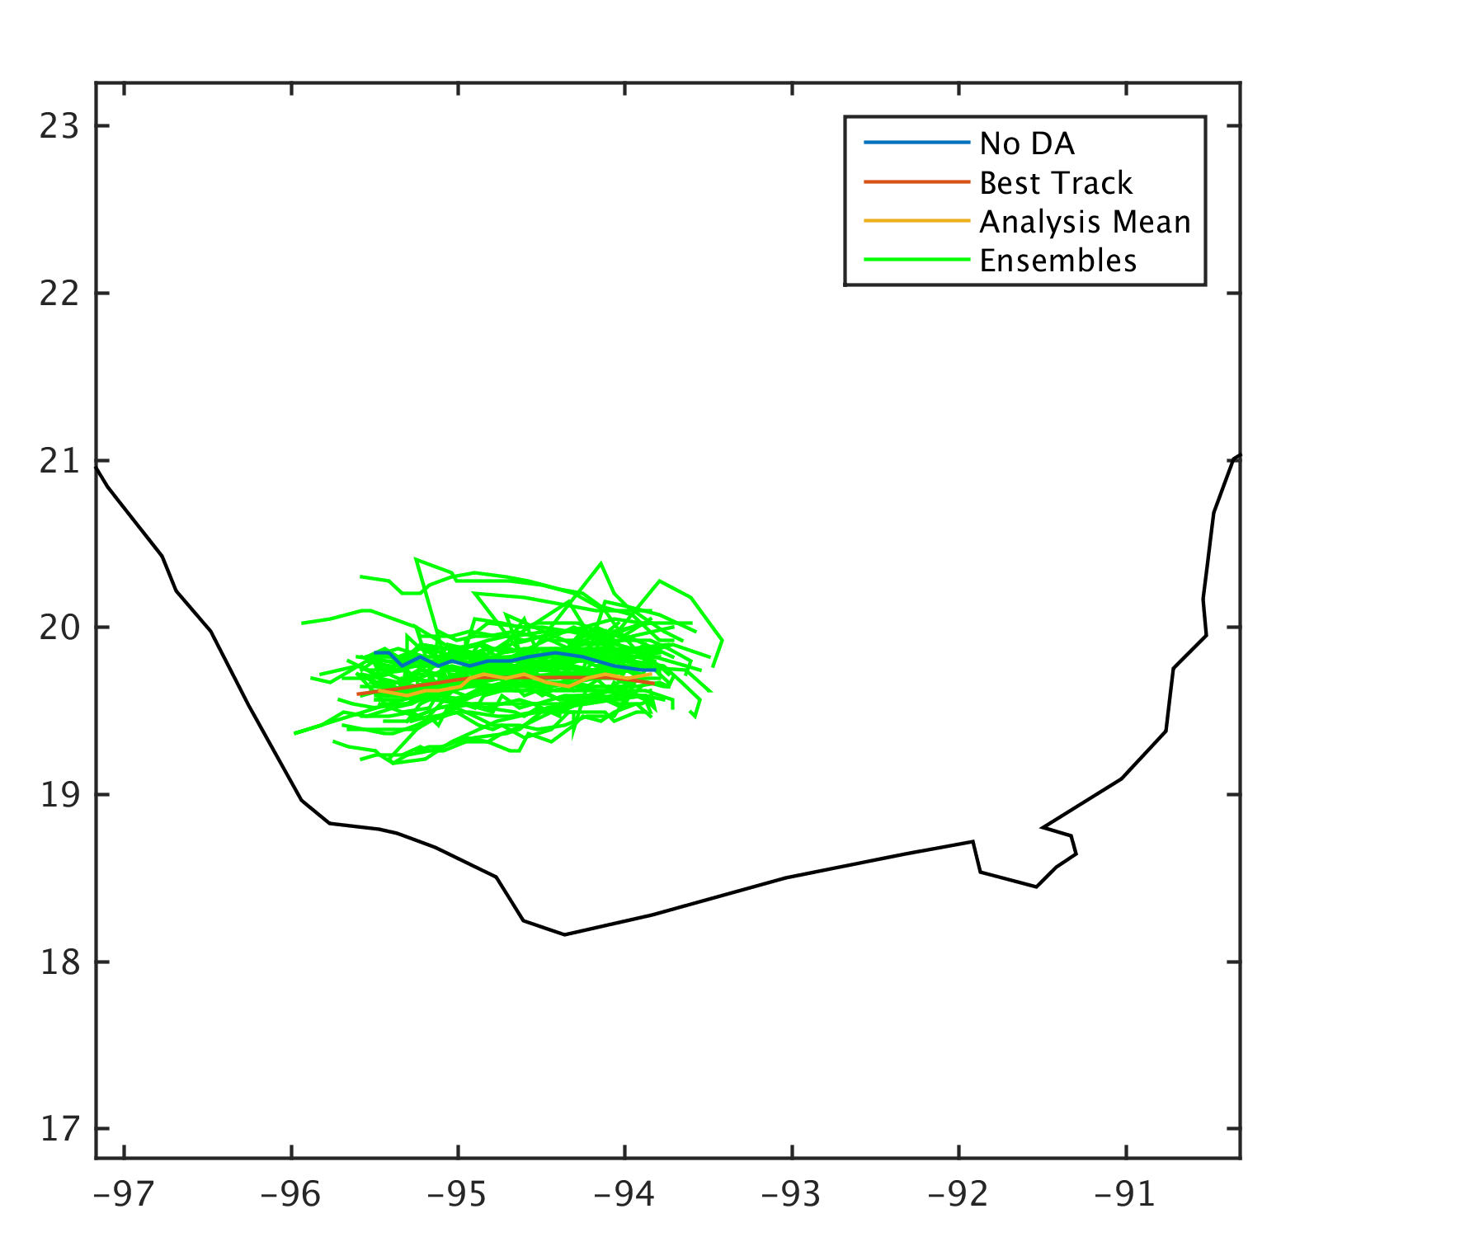
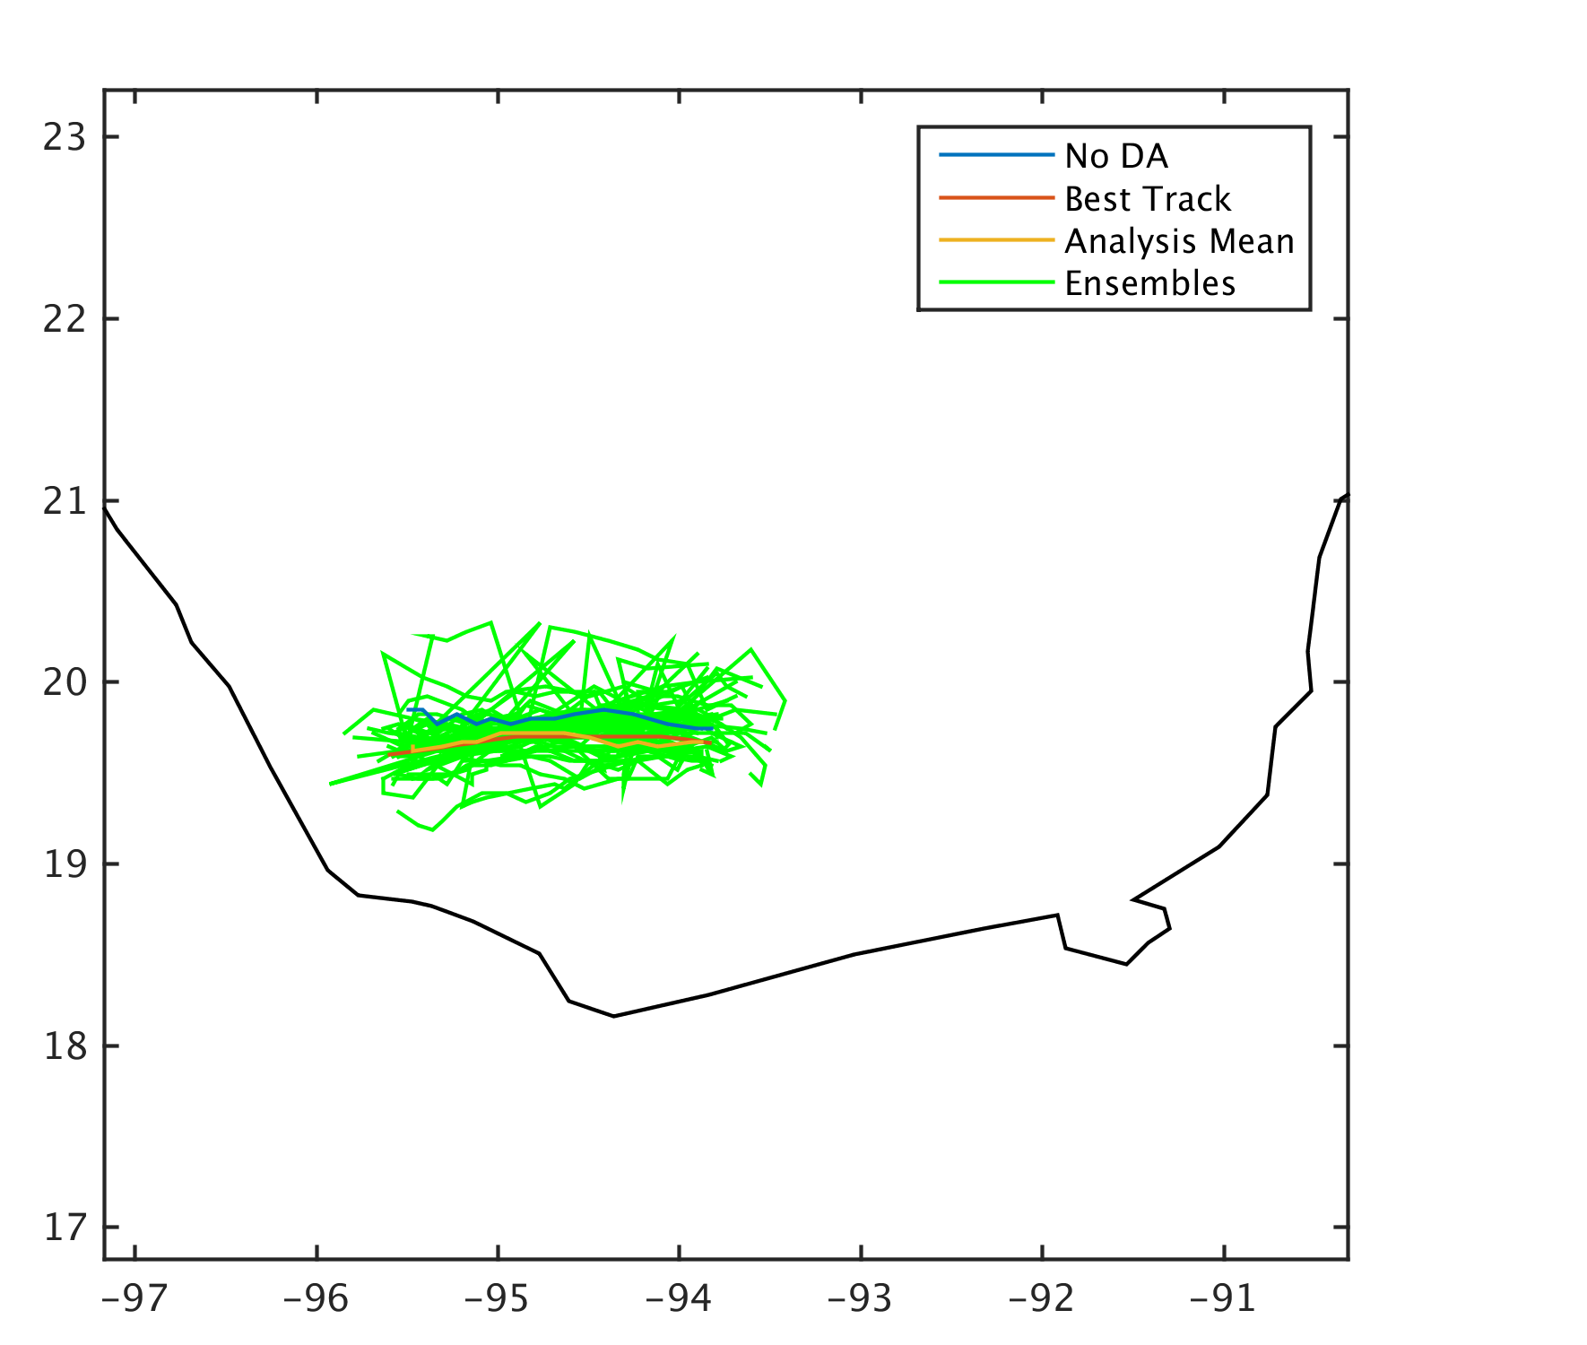
HPI
HPI+TCwinds
Notes:
Add tracks comparison here

Slide 10
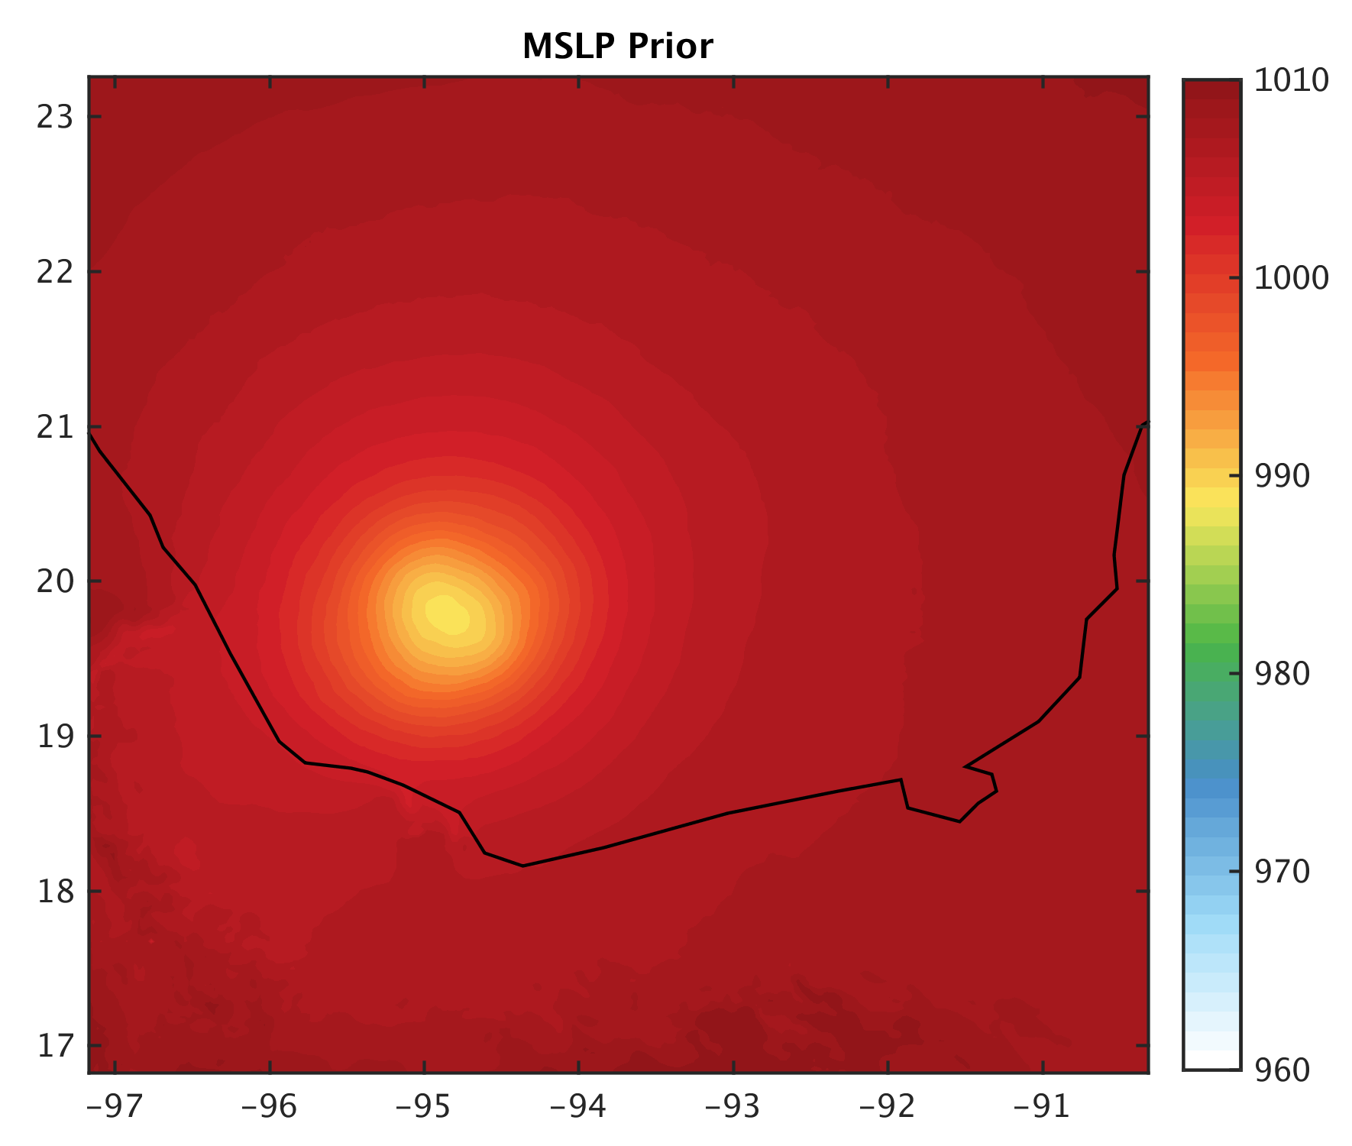
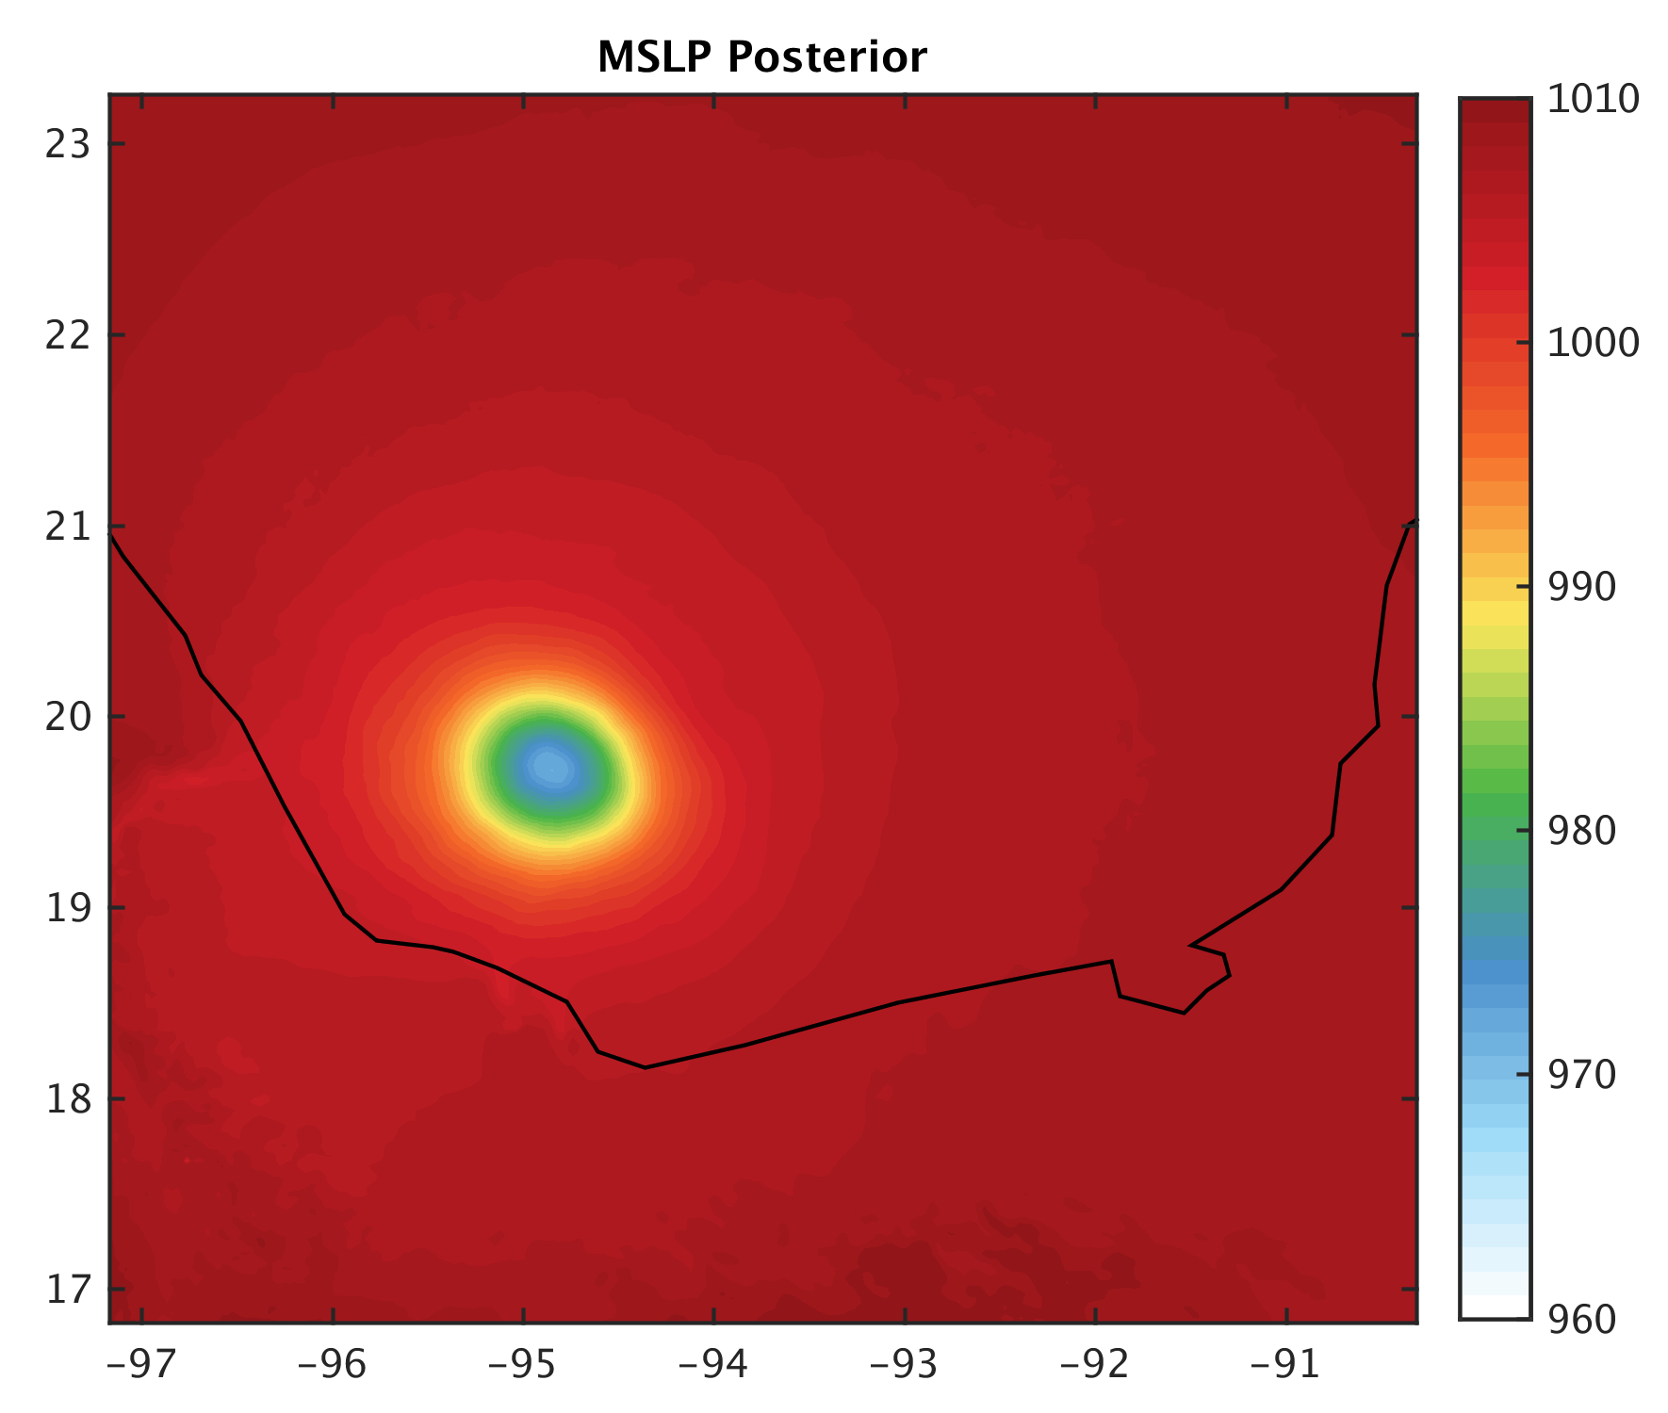
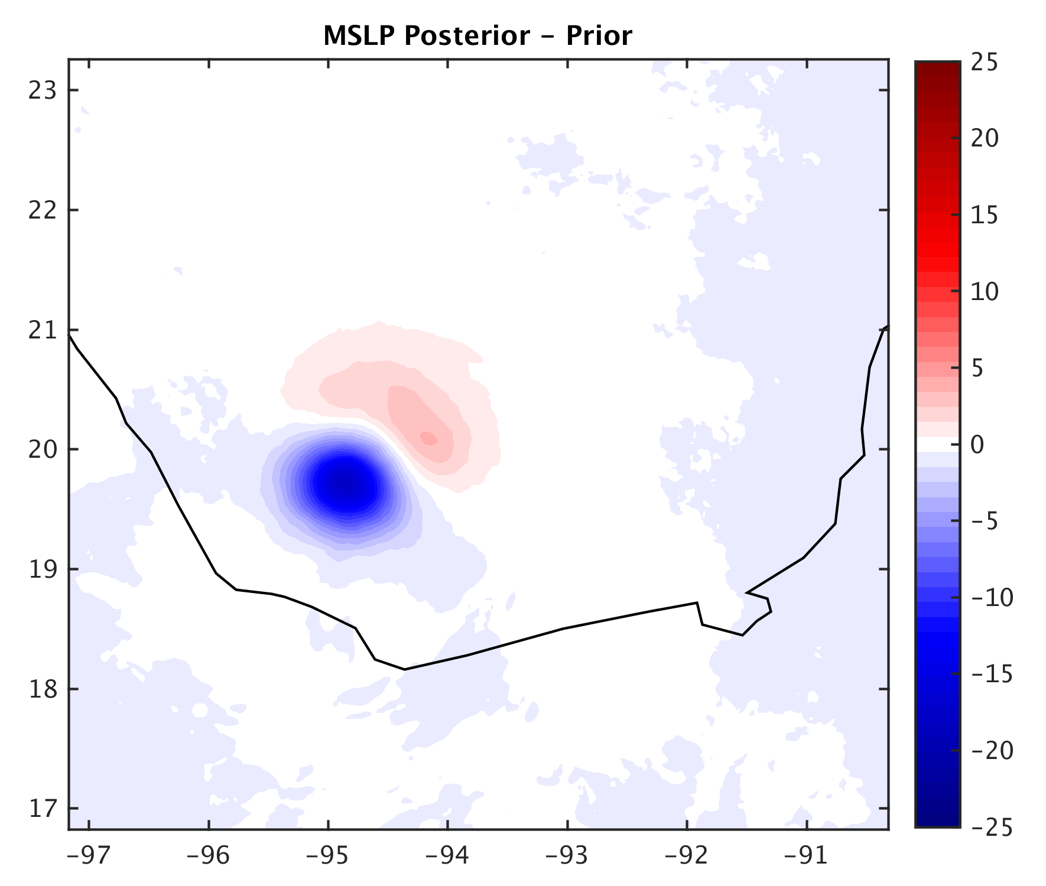
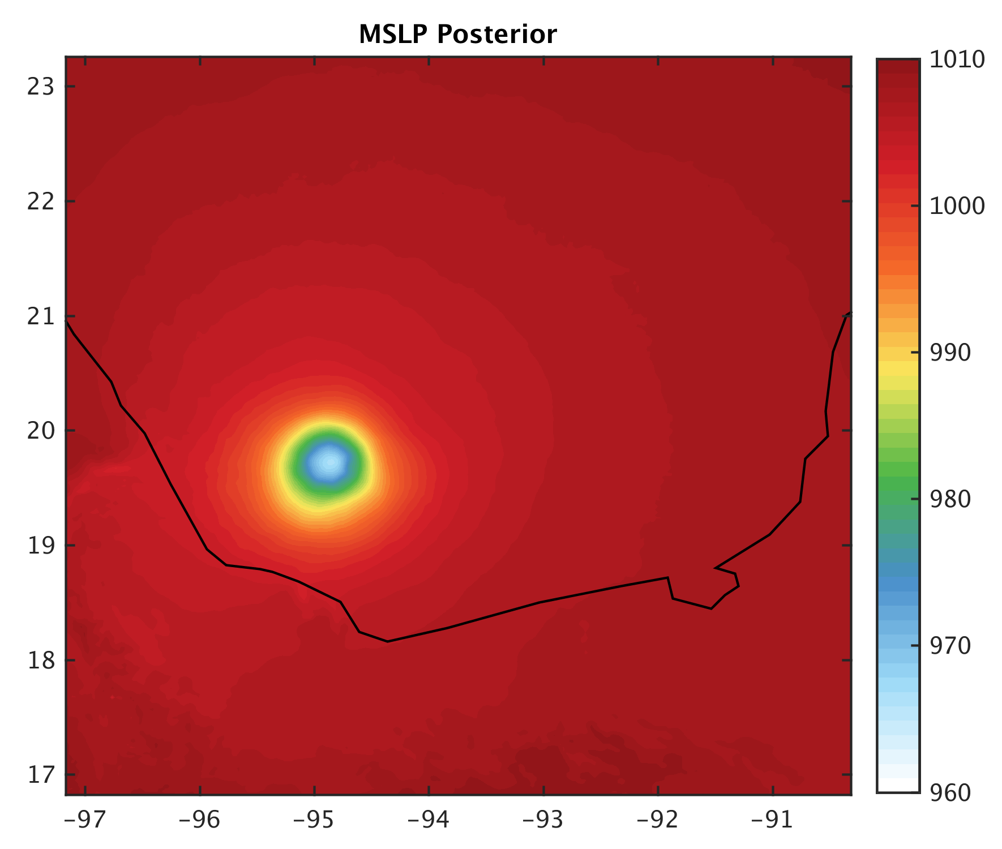
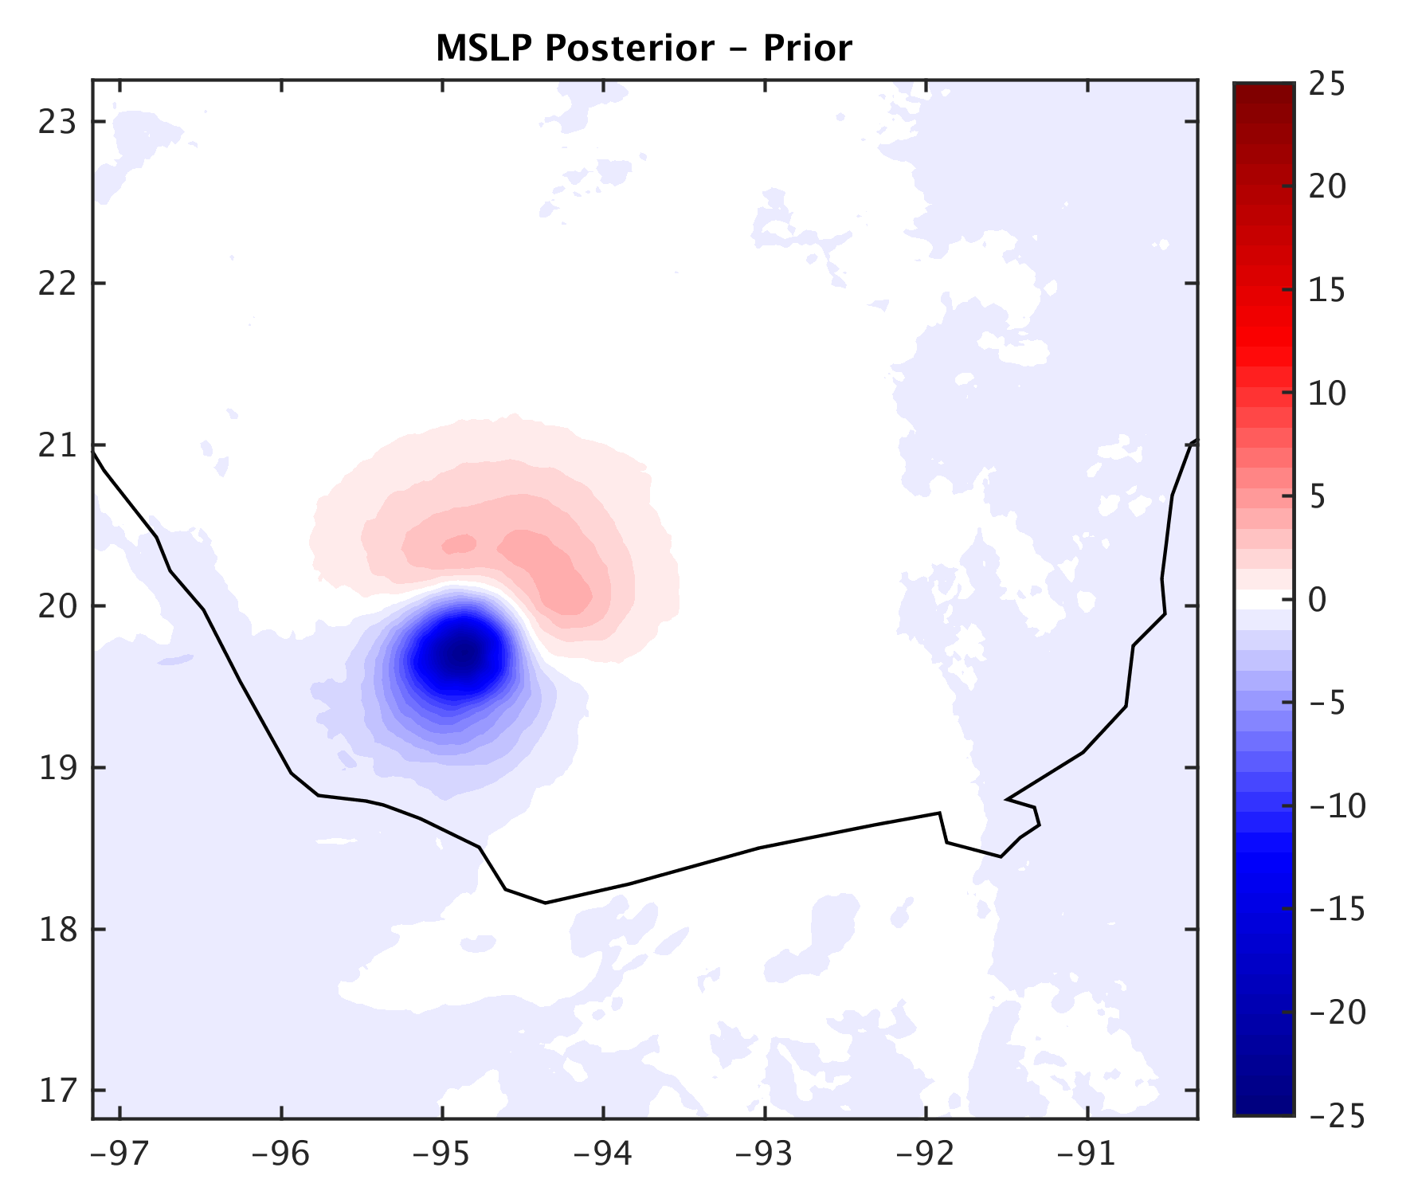
6z 17th
HPI
HPI+TCwinds
Notes:
Lower pressure for HPI+TCwinds

Slide 11
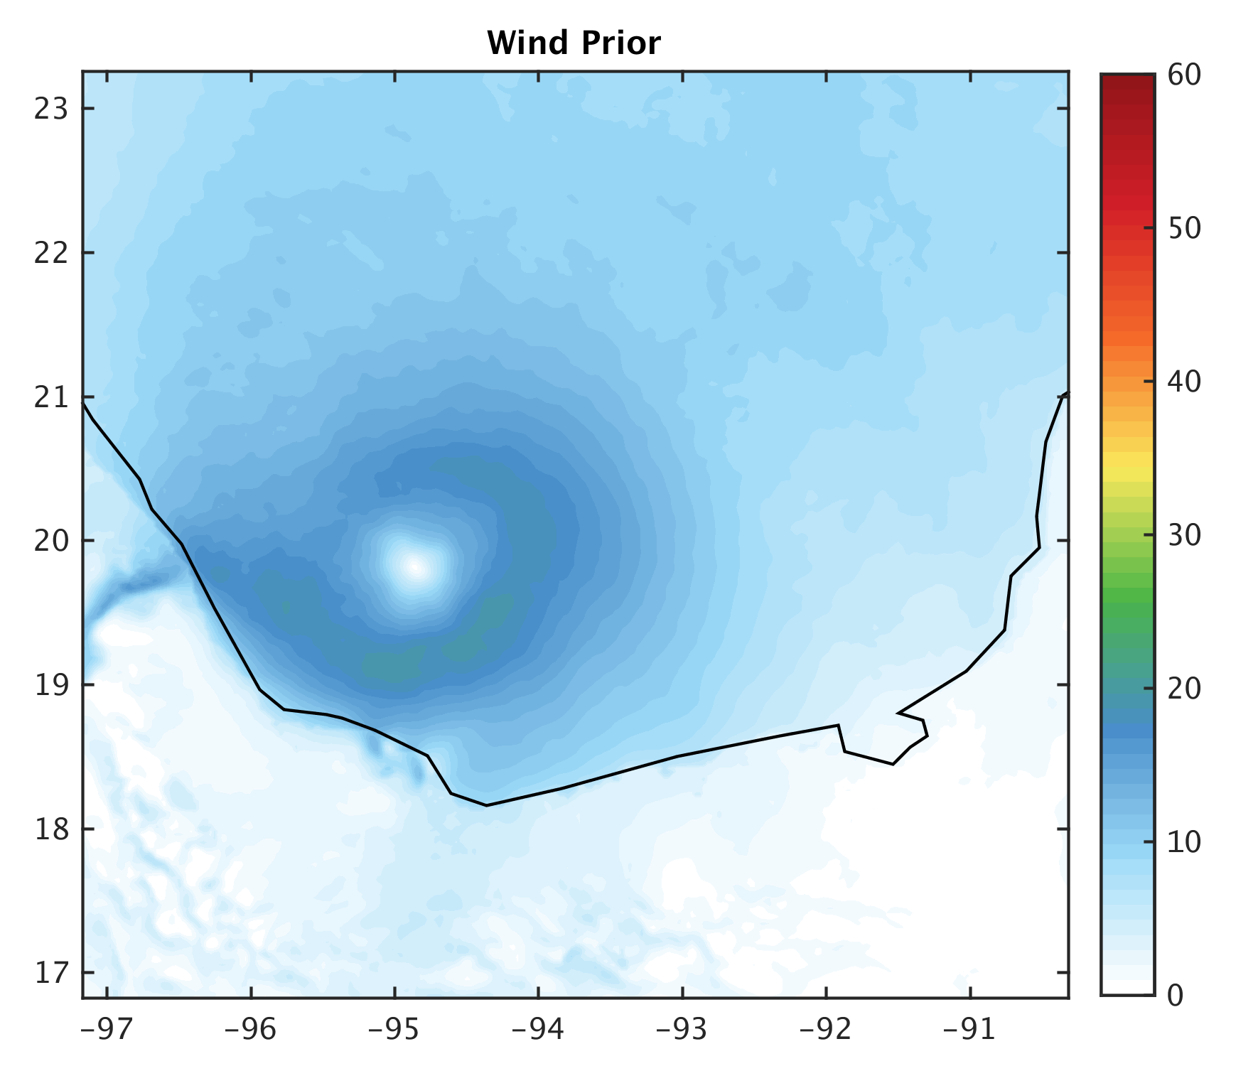
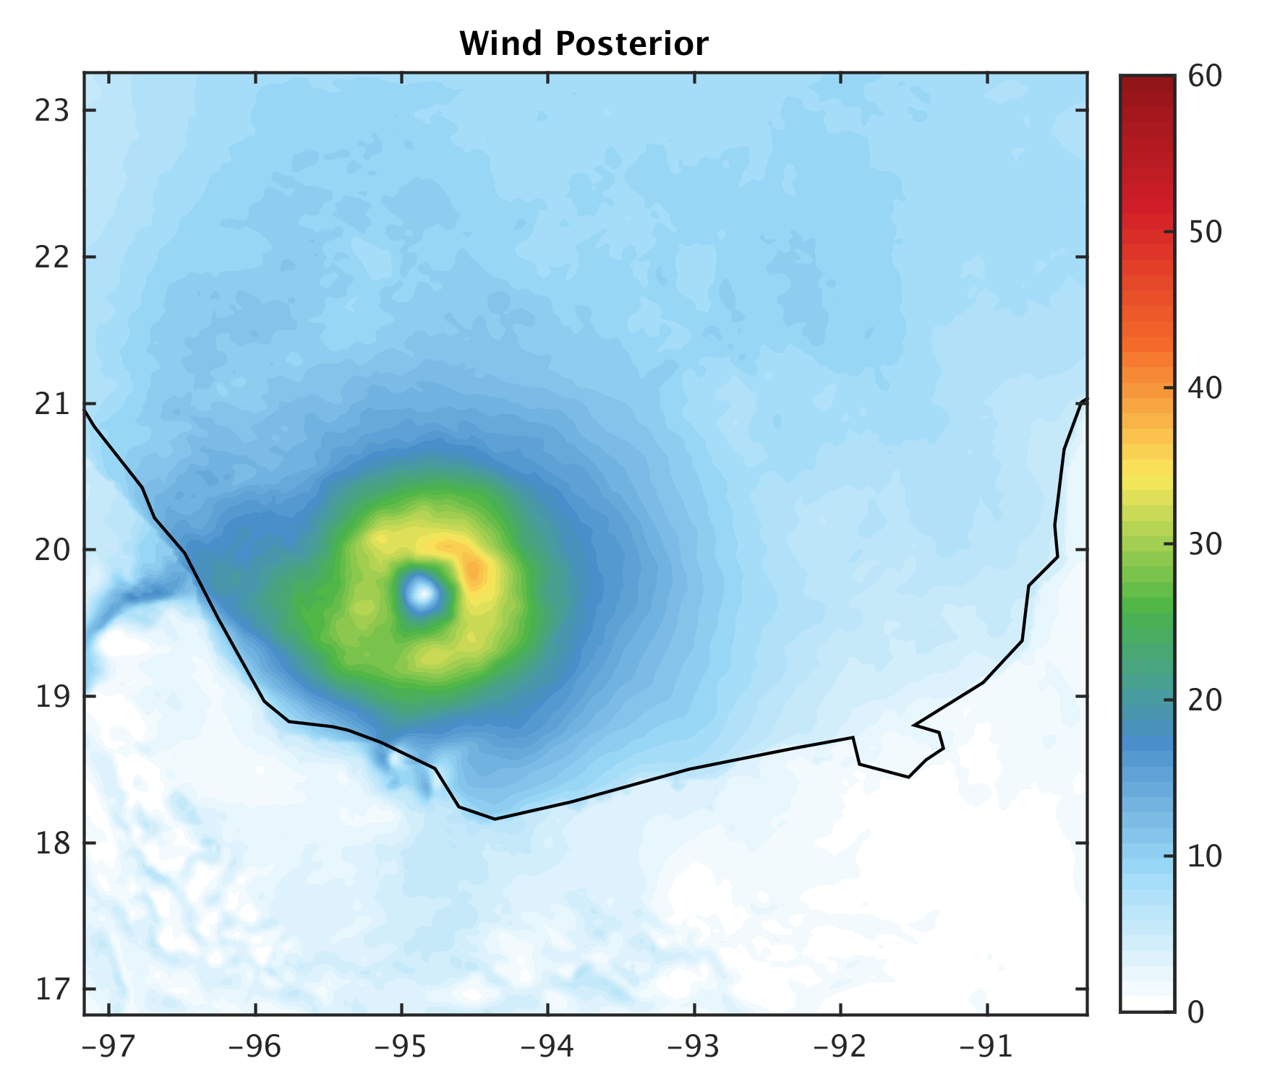
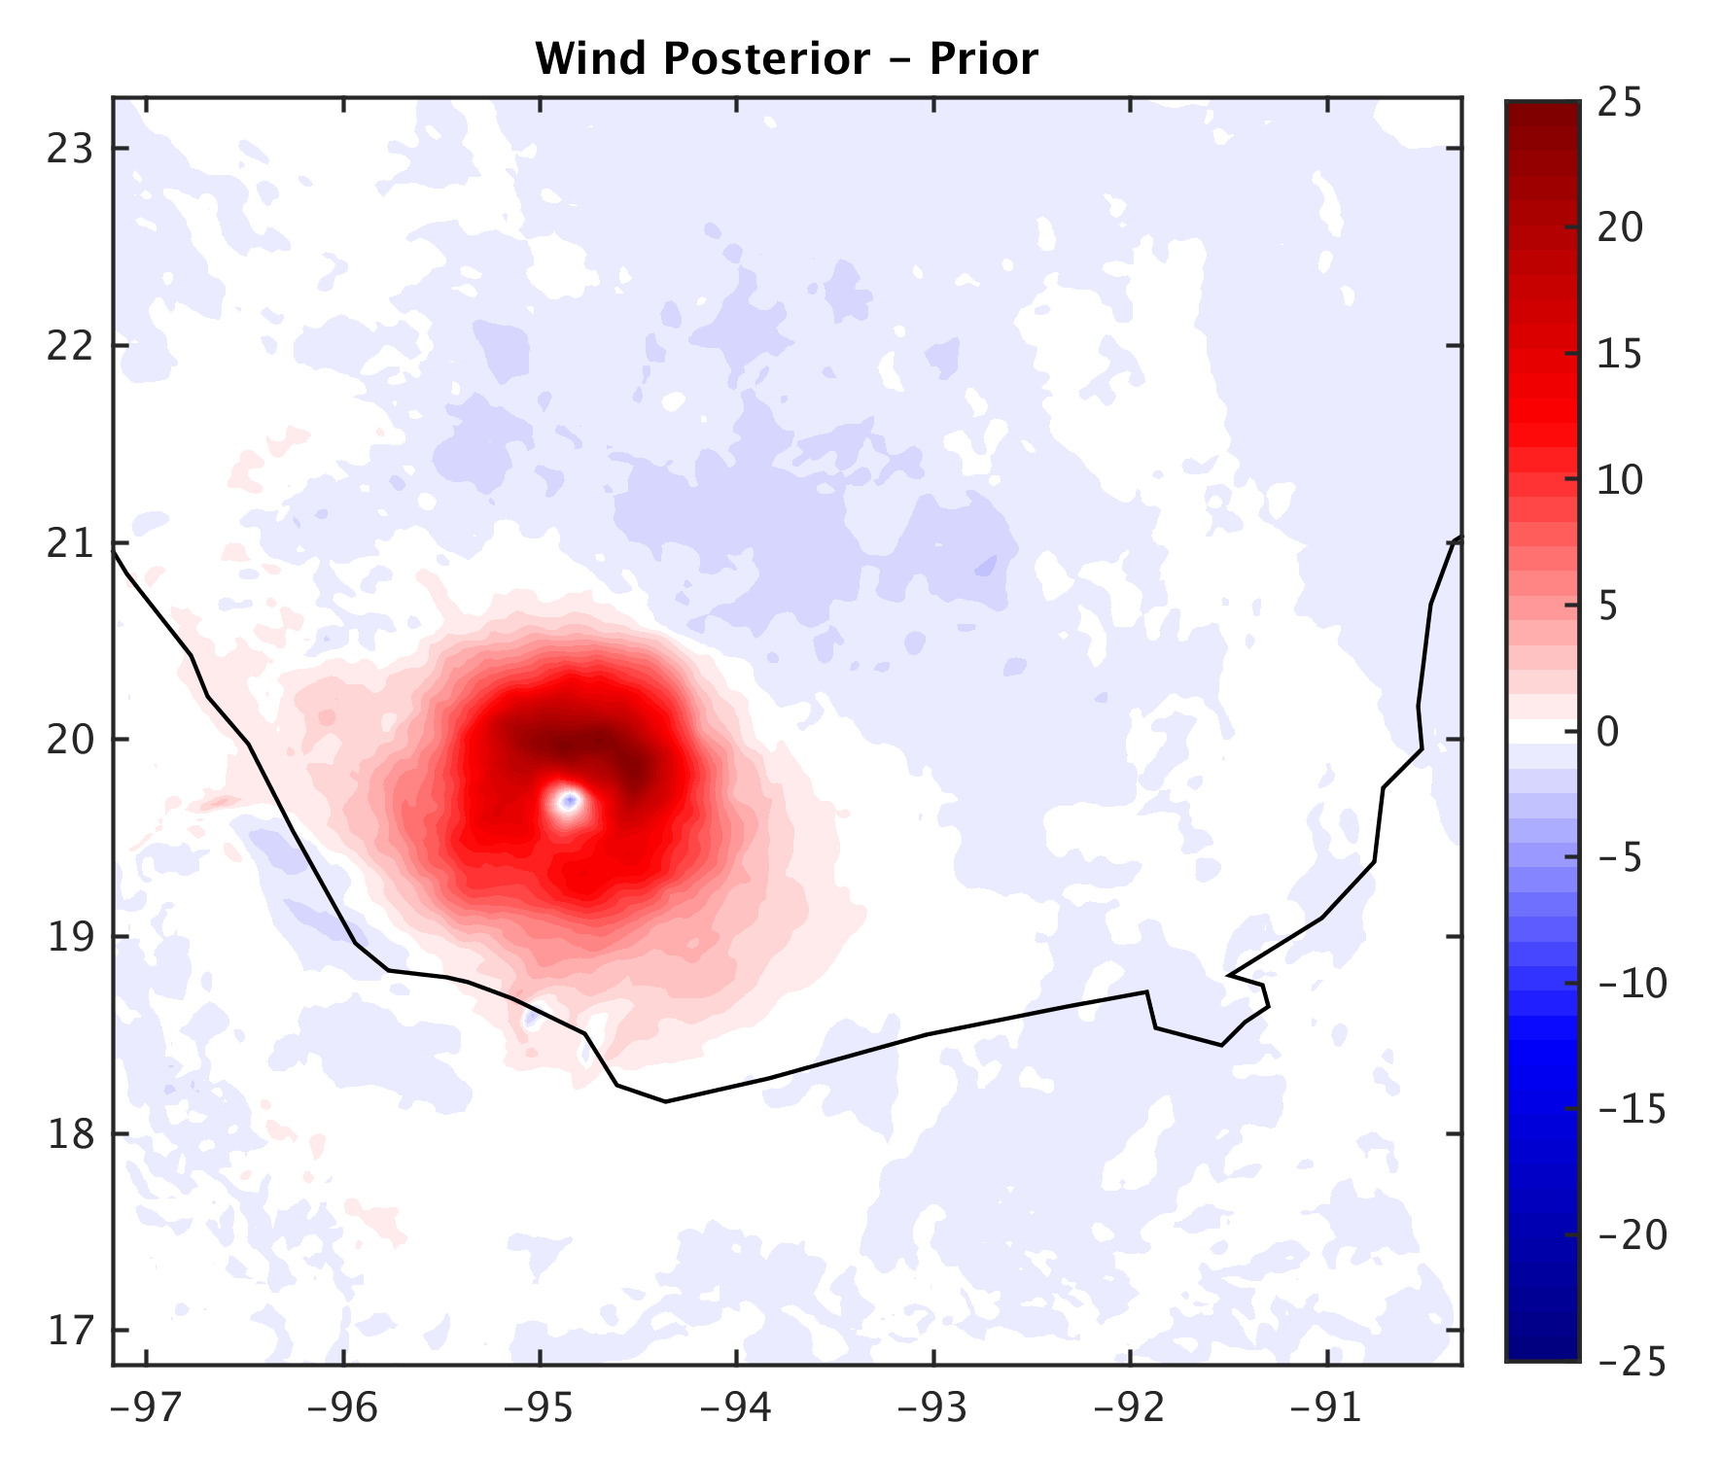
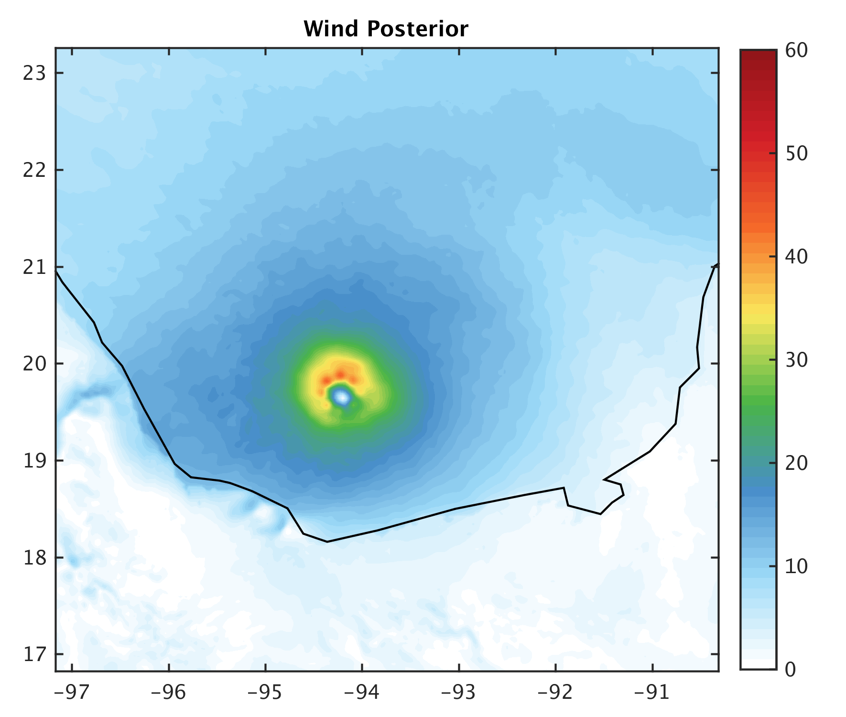
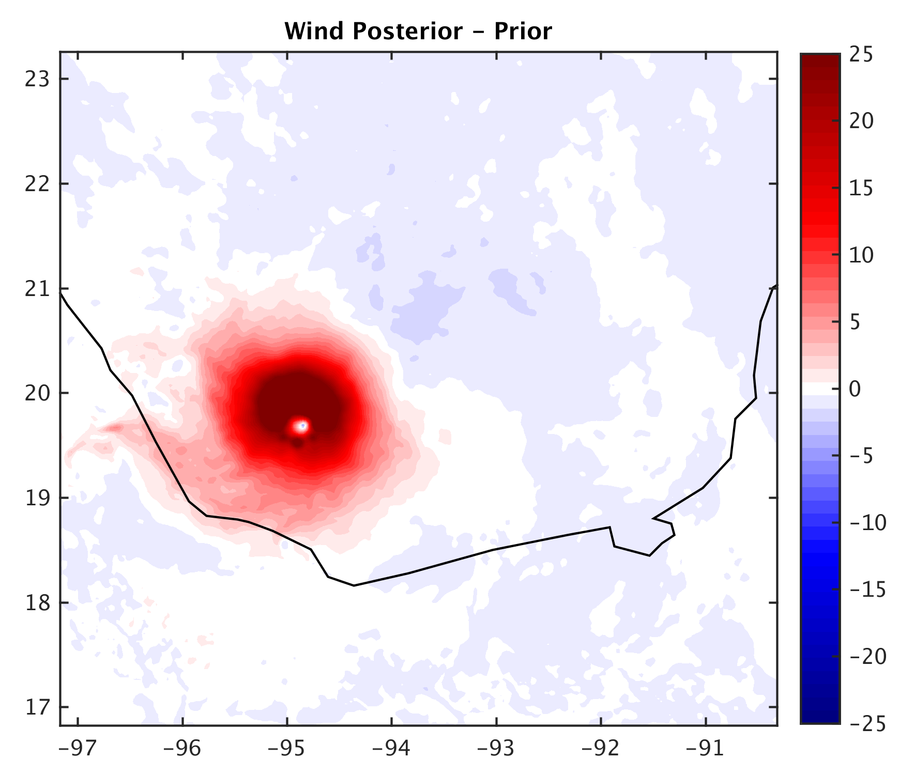
6z 17th
HPI
HPI+TCwinds
Notes:
- Stronger storm (larger Vmax) and more constrained (less spread) in HPI+Tcwinds, therefore mean will appear stronger

Slide 12
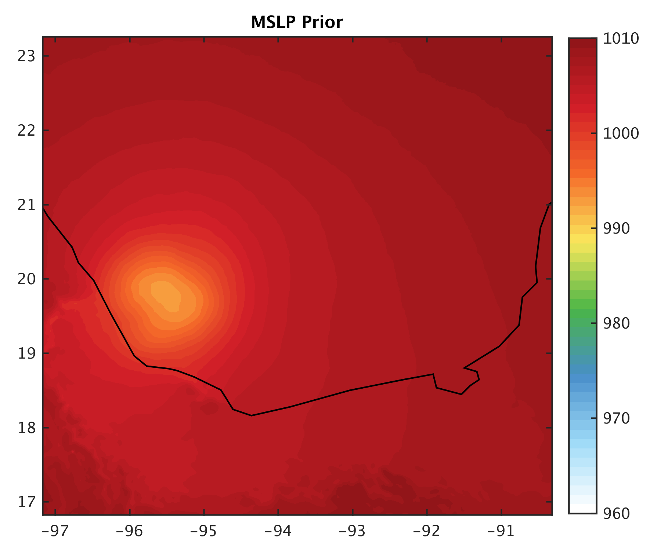
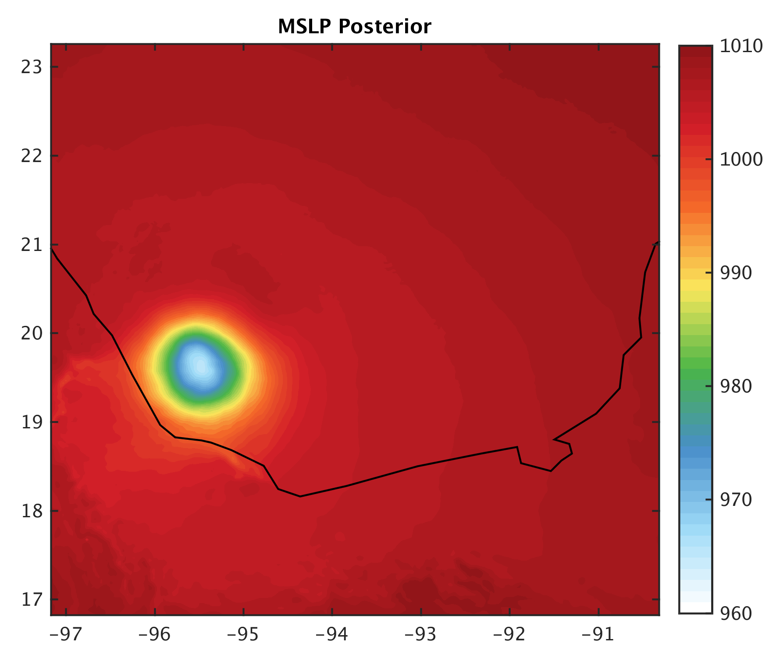
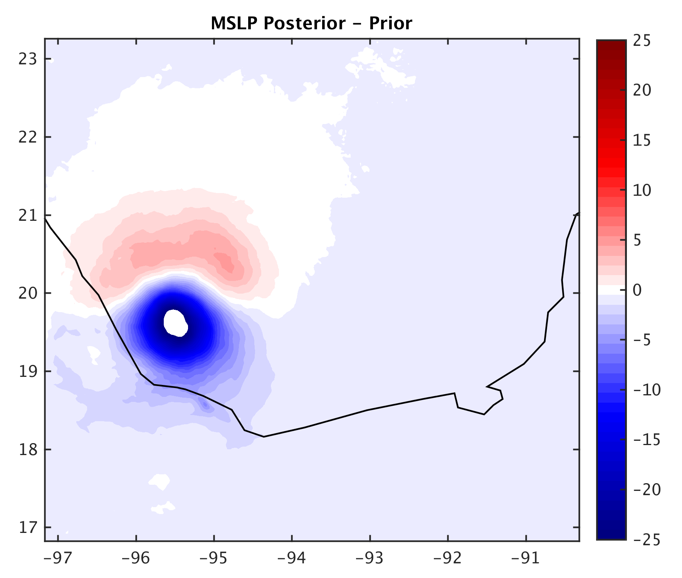
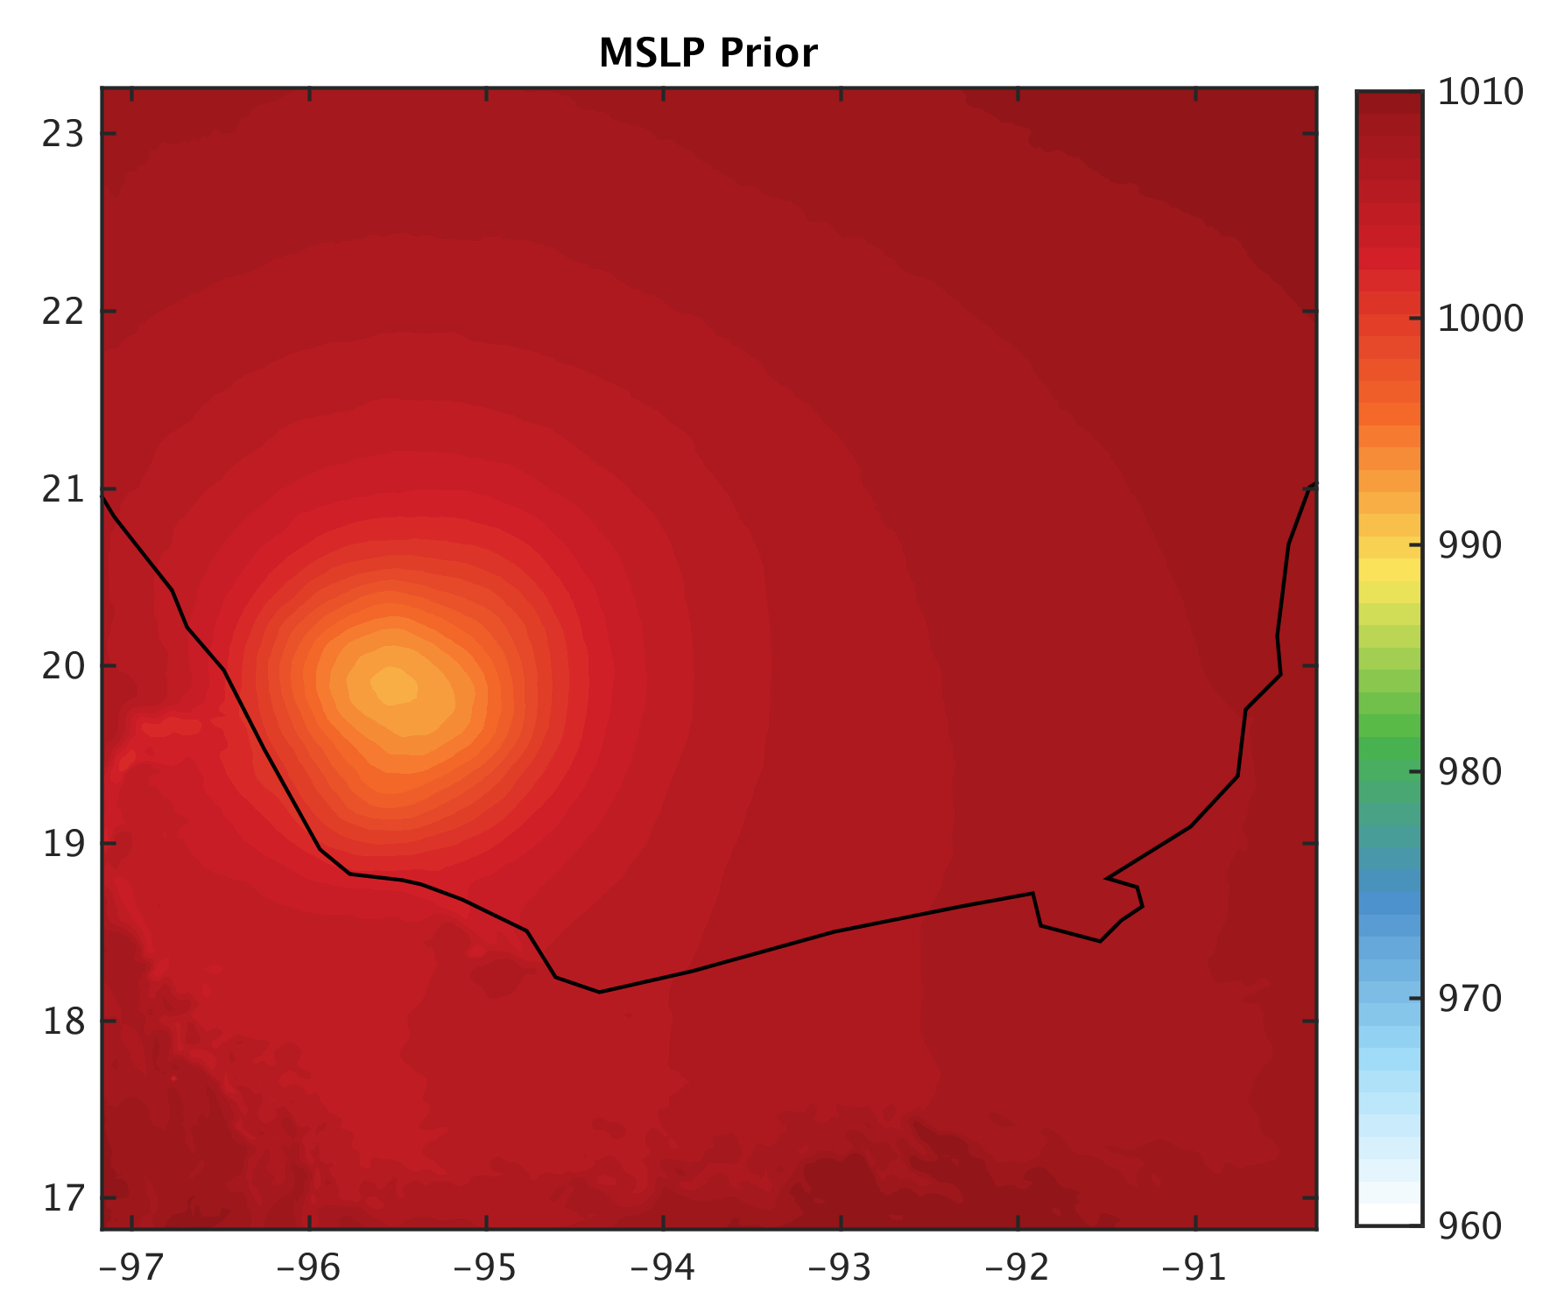
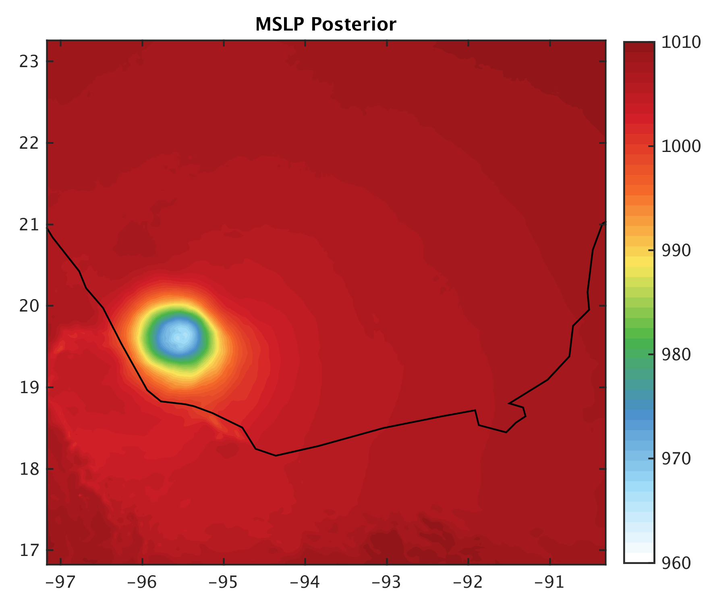
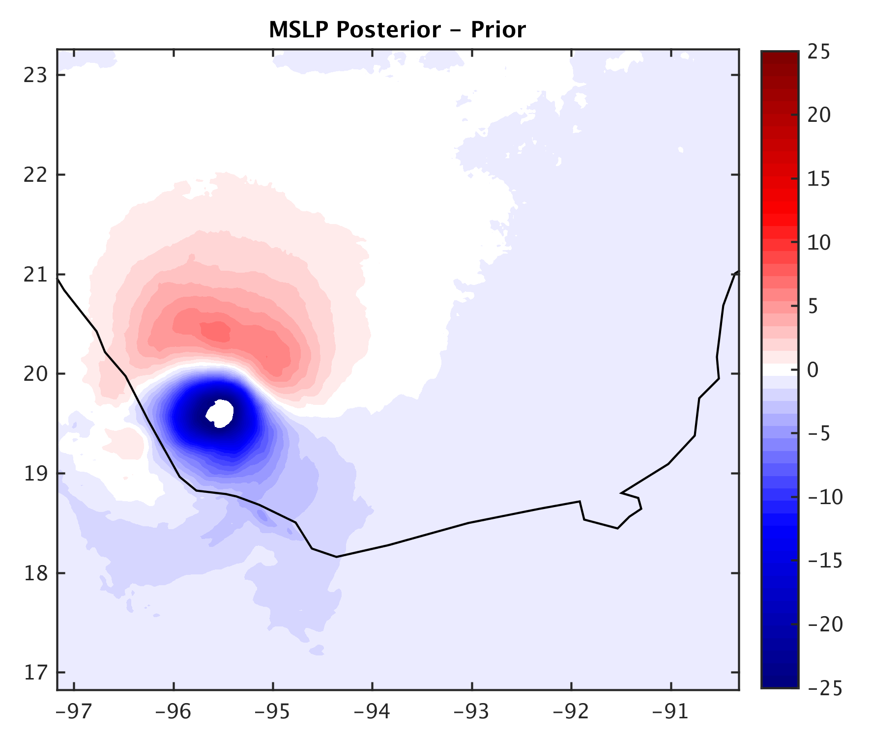
12z 17th
HPI
HPI+TCwinds
Notes:
Lower pressure for HPI+TCwinds

Slide 13
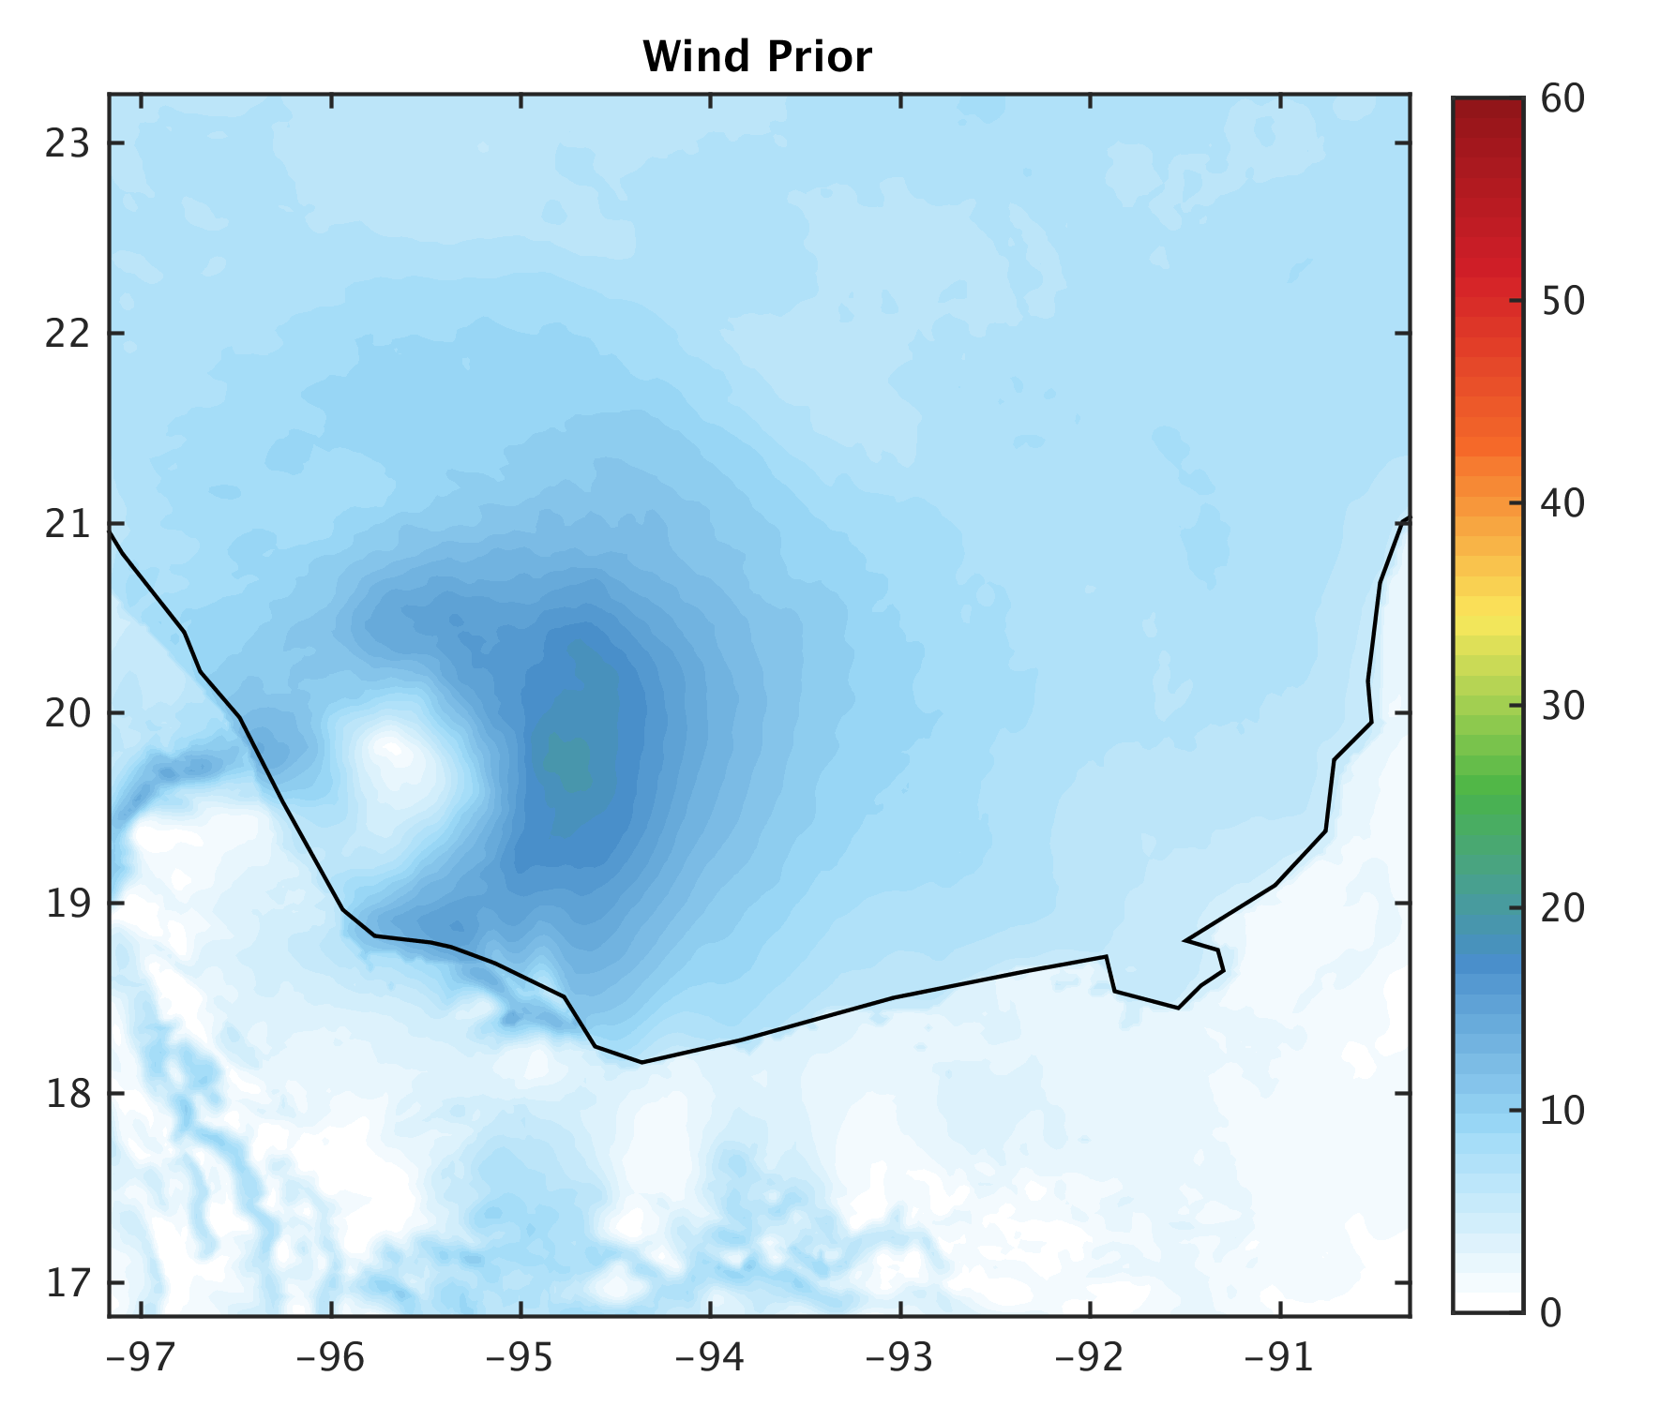
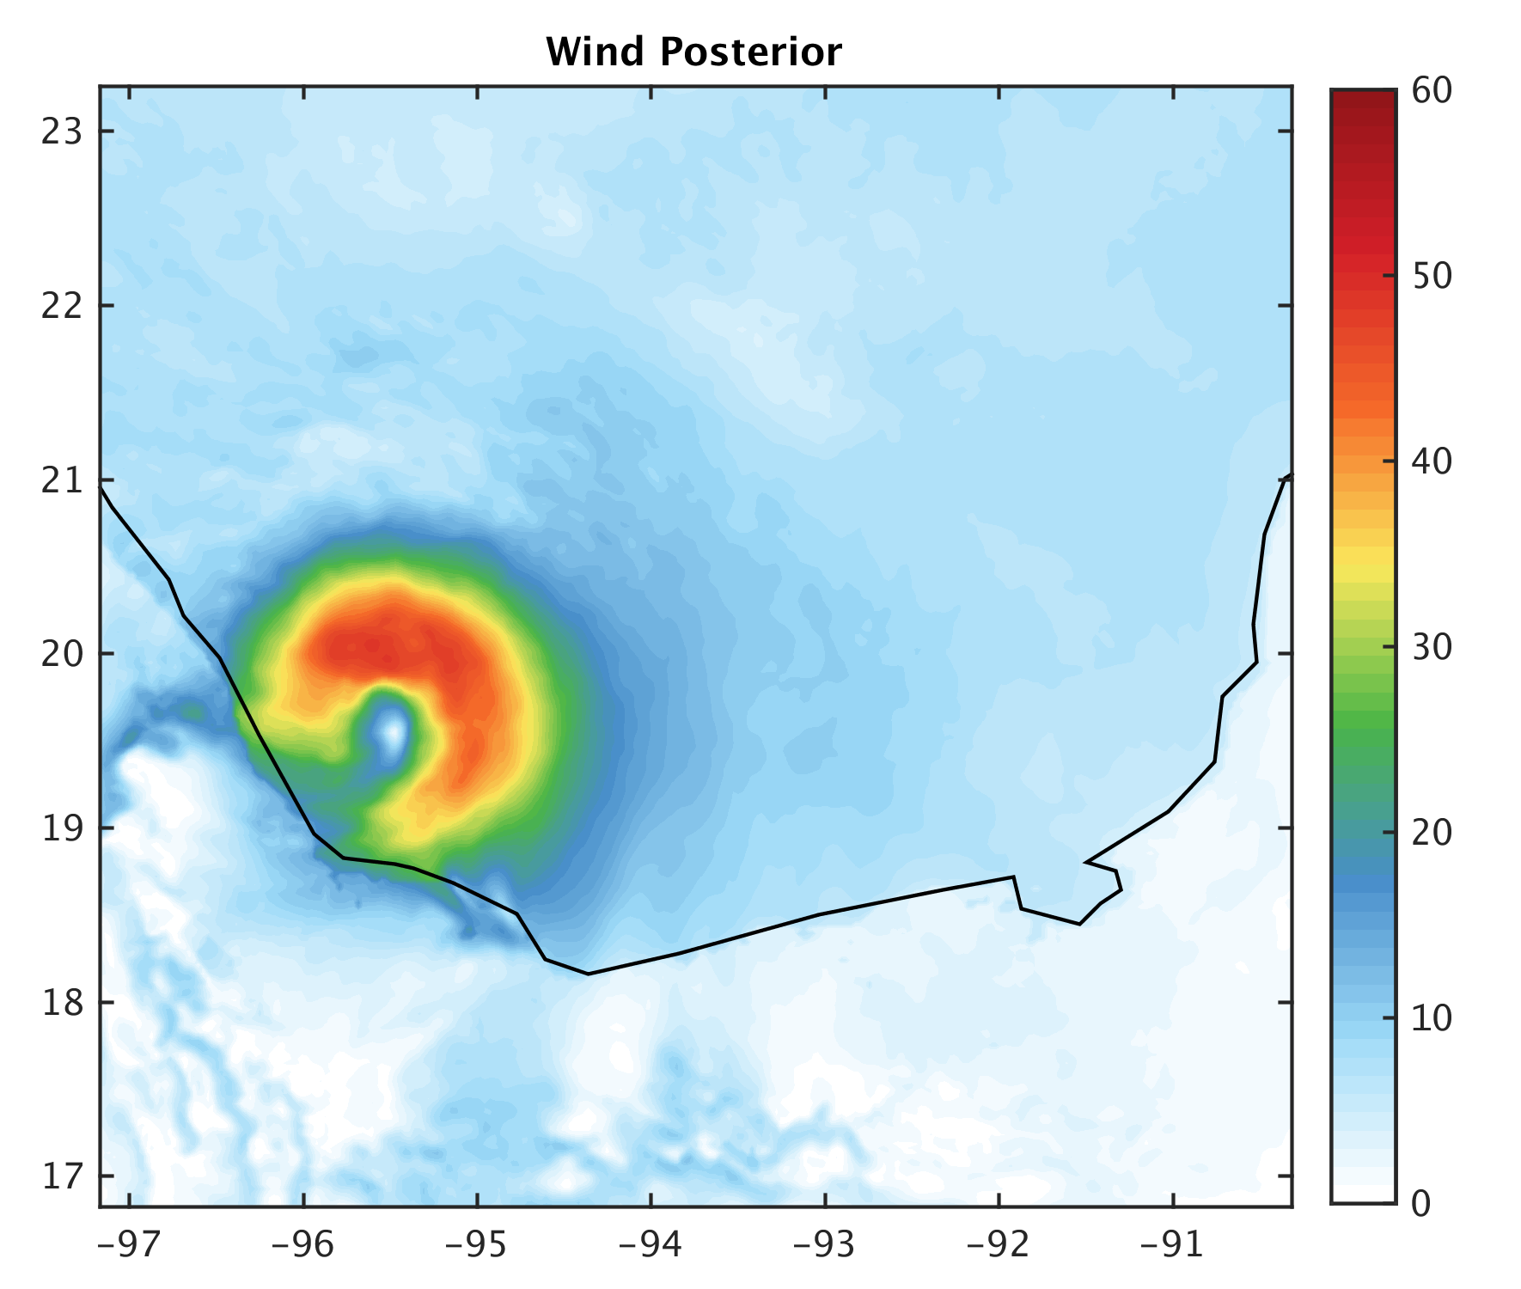
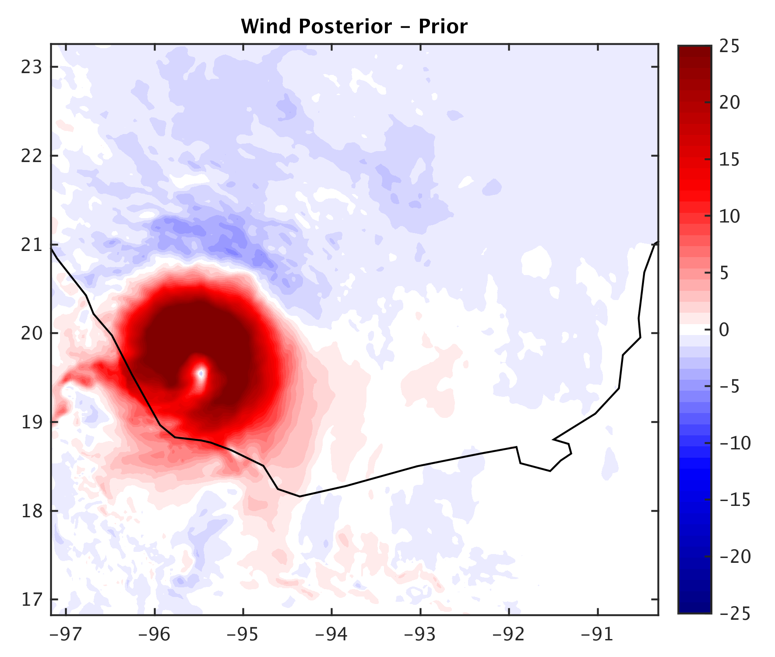
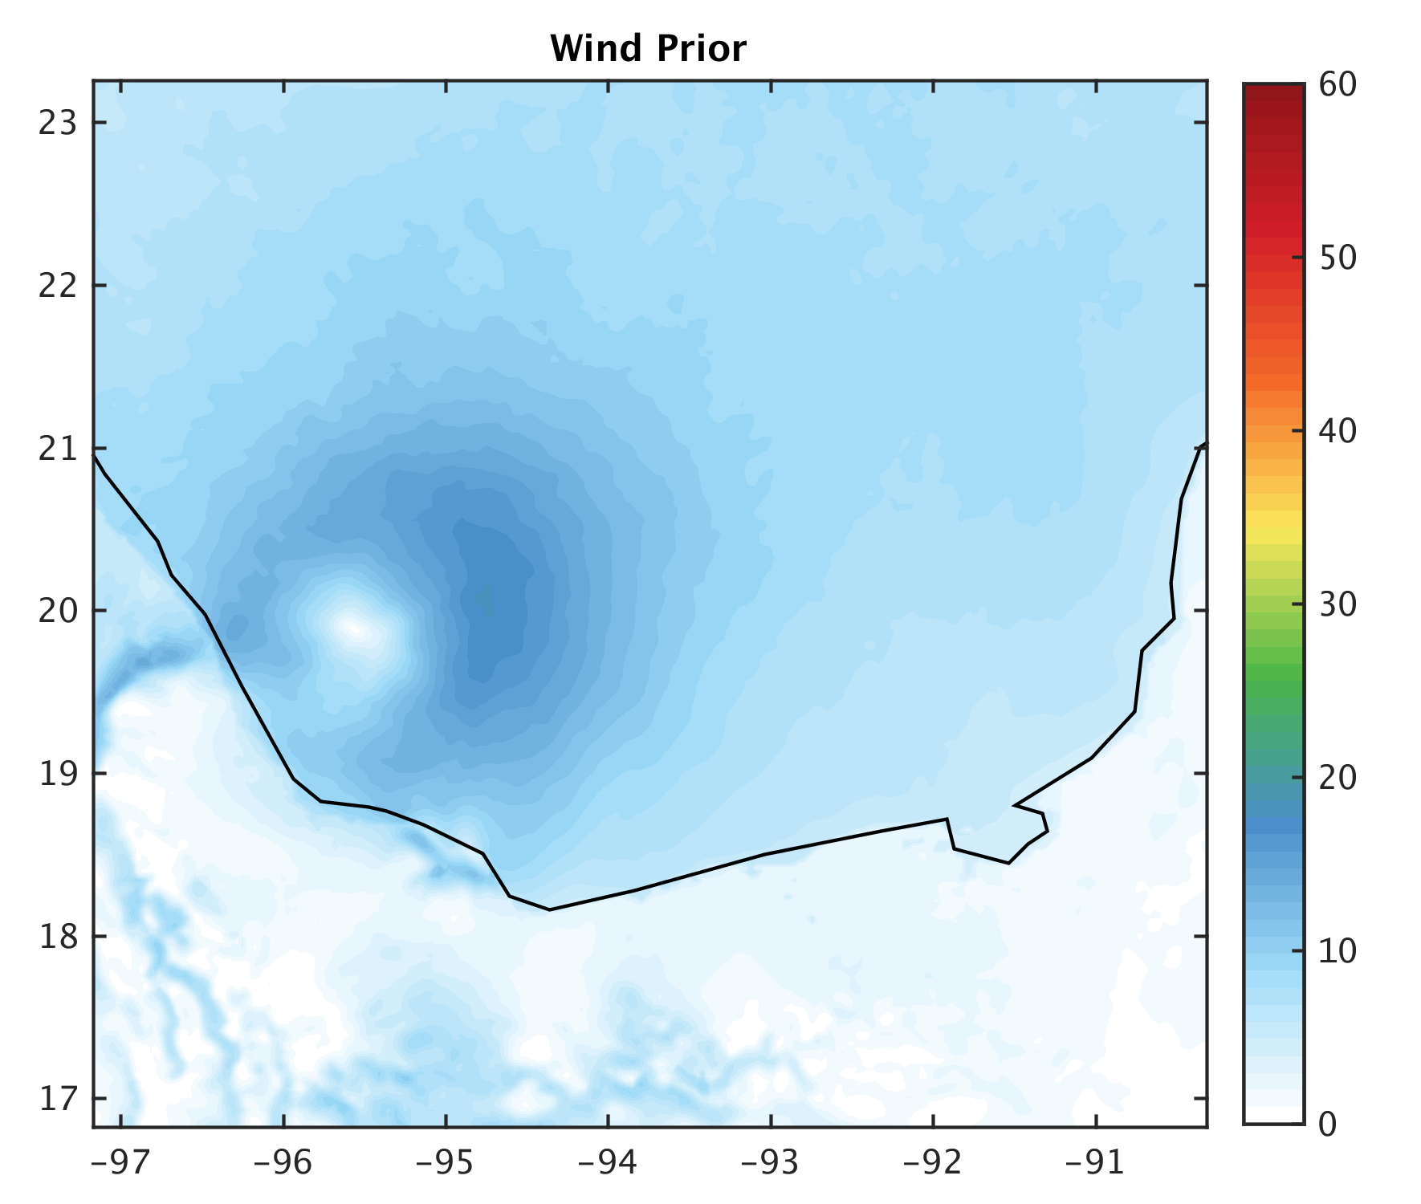
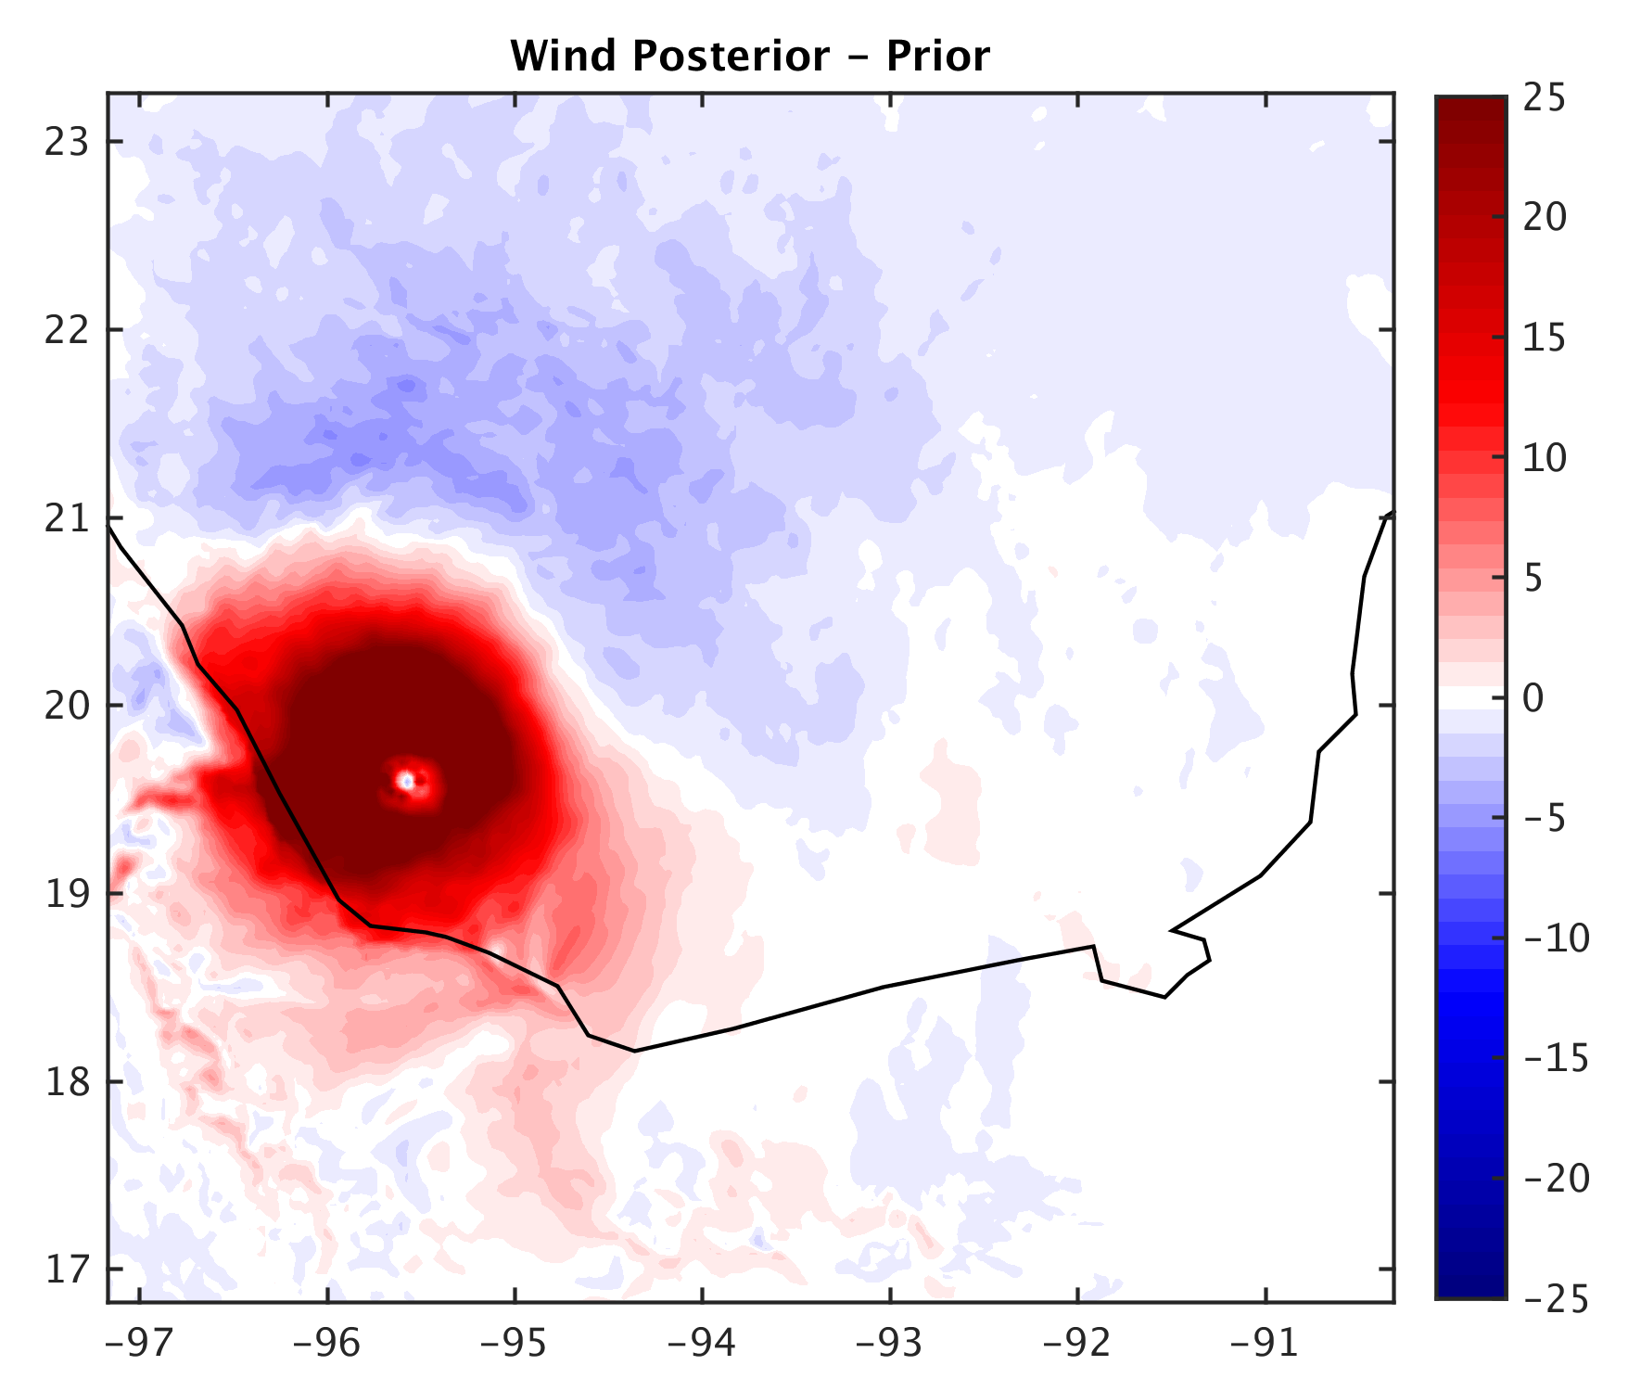
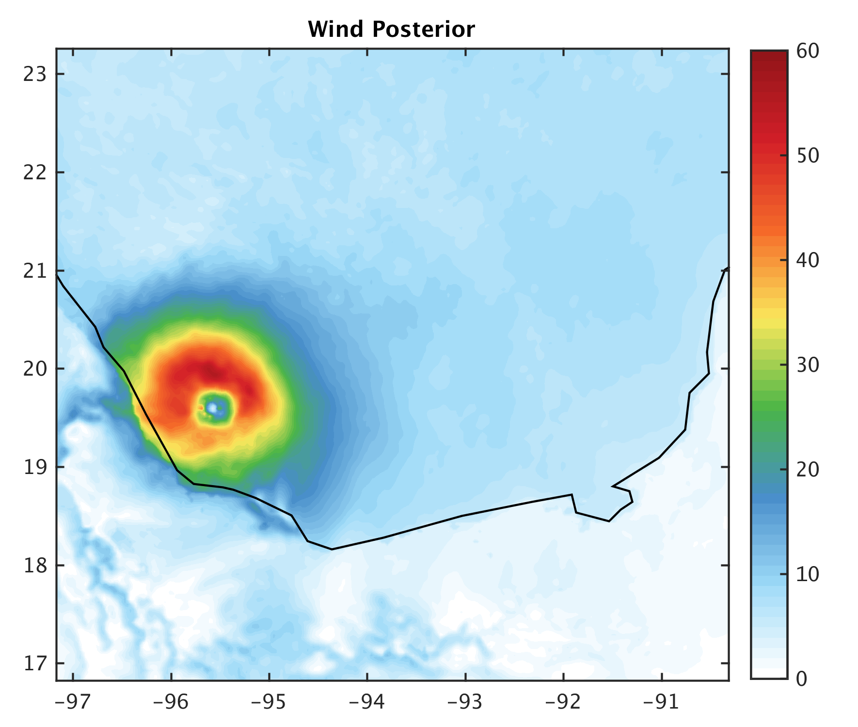
12z 17th
HPI
HPI+TCwinds

Slide 14
Conclusions and Next Steps
Some benefit to assimilating quadrant wind radii estimates
Investigate 3 hourly assimilation of quadrant wind radii estimates.
Examine impacts on forecasts and impacts of TCwinds with other observations included
Examine better localisation methods and future reduced observation error of TC quadrant wind radii estimates

