Slide 1
Impact of initial moisture on hail production (real case simulation and sensitivity experiments using WRF)
Mingxin Li , Fuqing Zhang and Jerry Y. Harrington

Slide 2
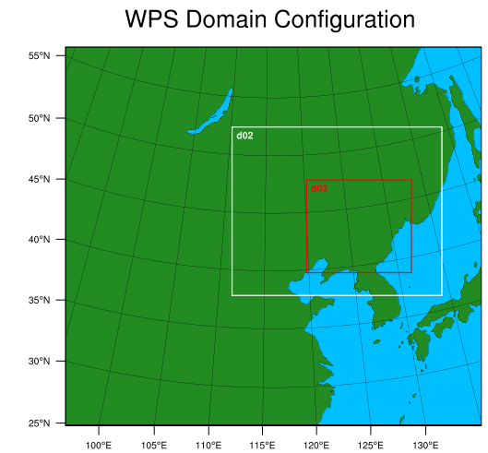
Sensitivity experiments
CTR 3total domains and 2 way nested dx=dy=9km 3km 1km
Microphysics: Milbrandt 2-mom (graupel hail)
2005-6-10 12:00:00---2005-6-11 18:00:00（UTC）
Output every 20 minutes
Reduce initial qvapor by 10%
Increase initial qvapor by 5%
Increase initial qvapor by 10%

Slide 3
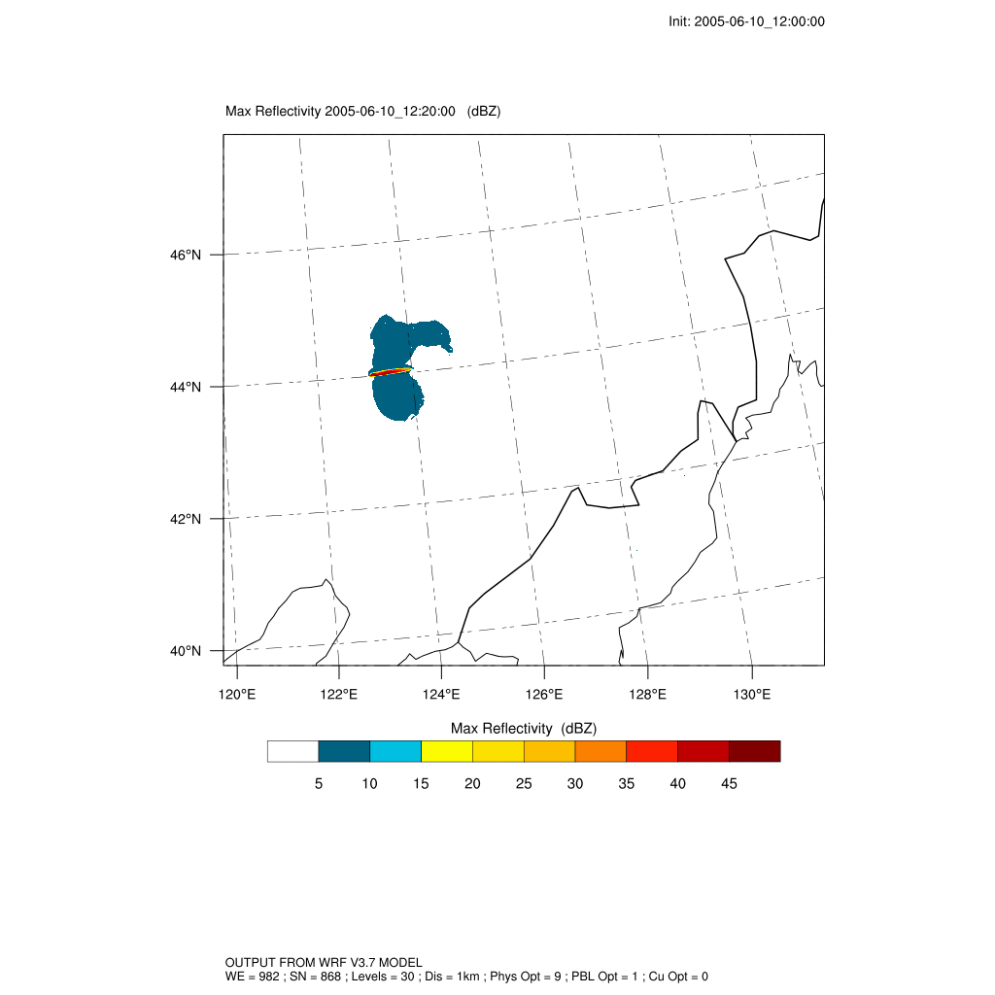
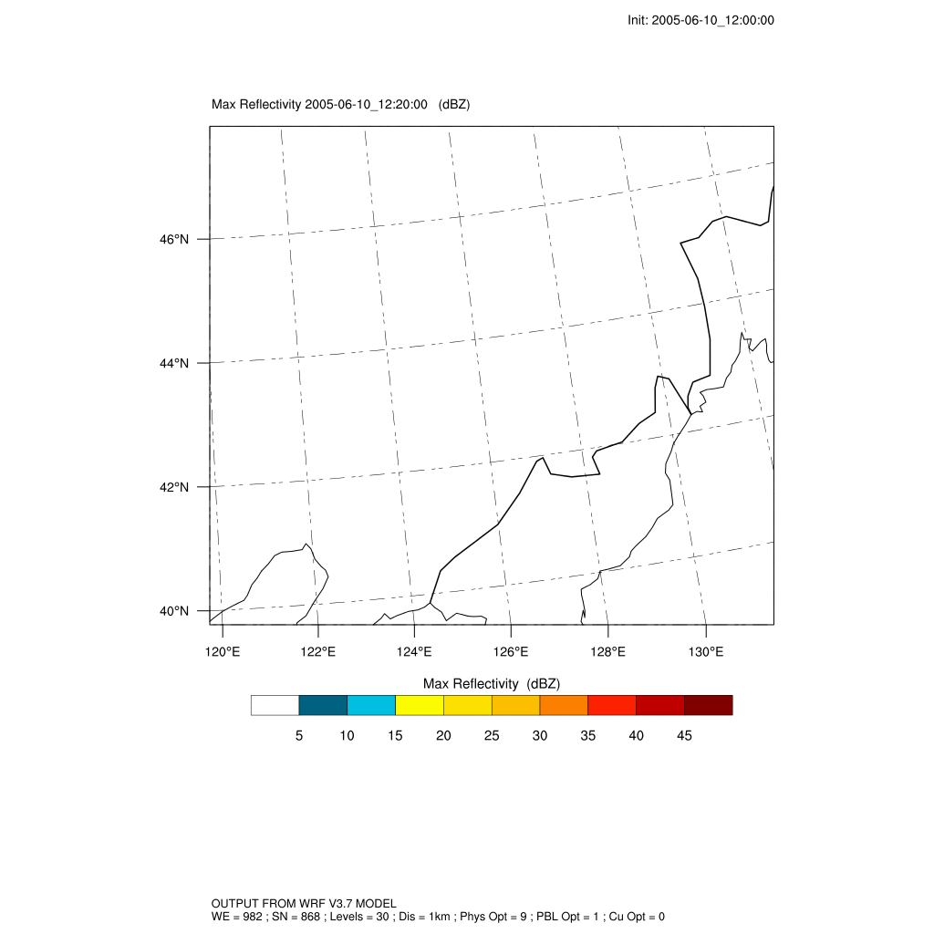
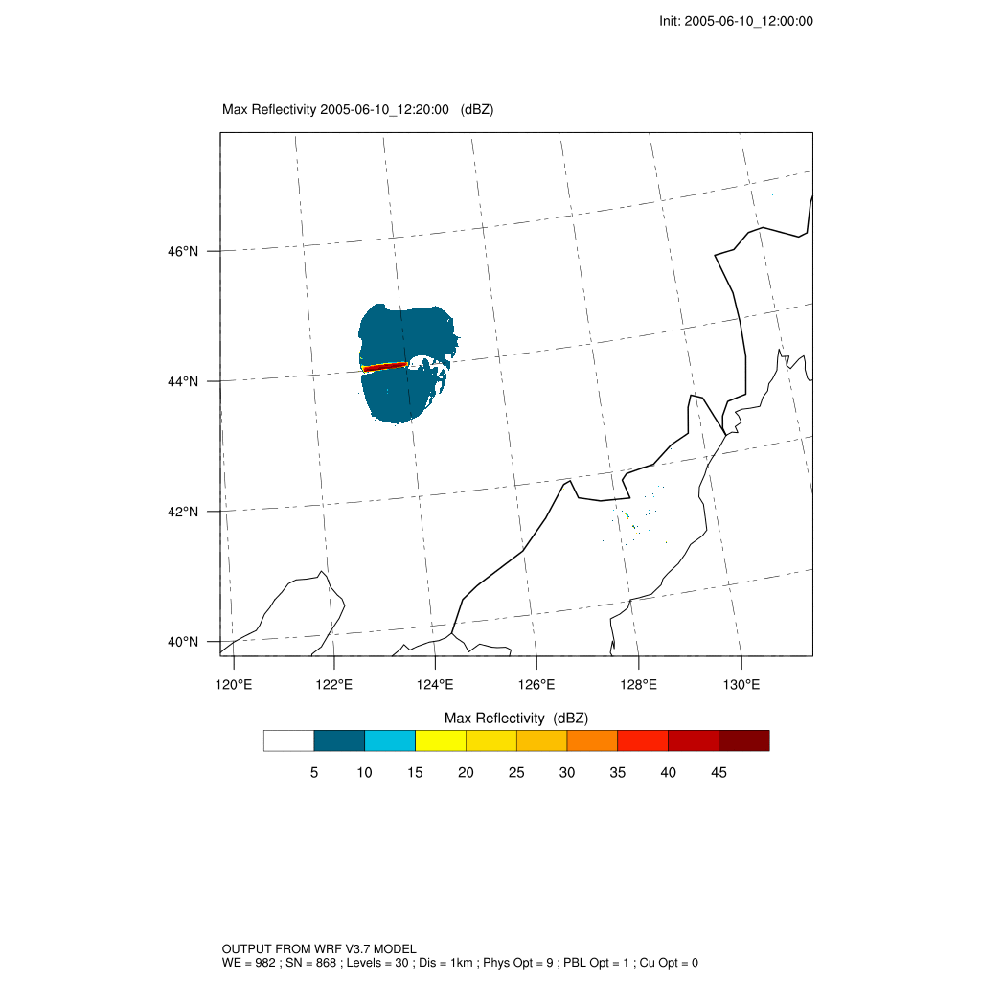
Storm evolution
(Maximum reflectivity)
2 processes
ctr -10
+5 +10

Slide 4
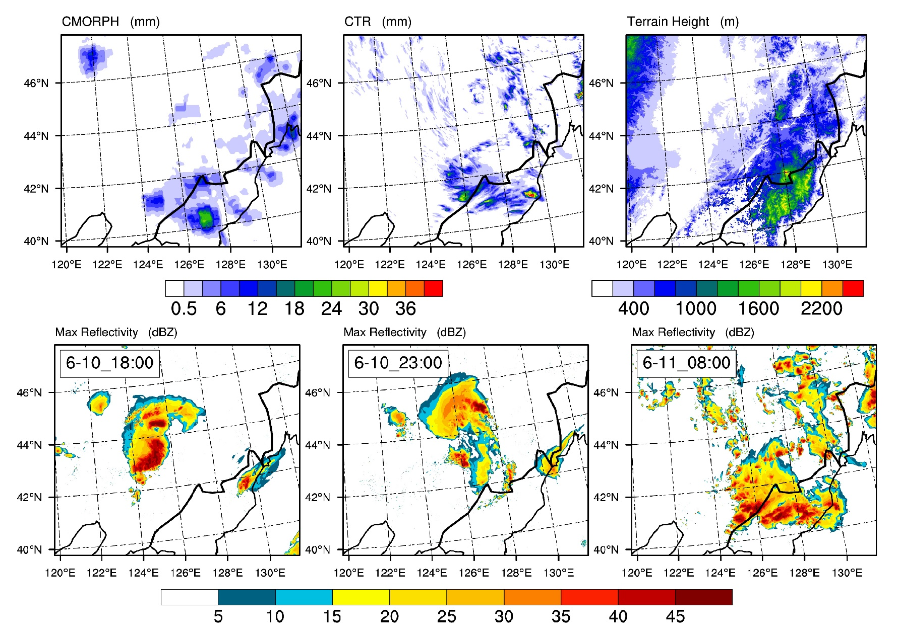

Slide 5
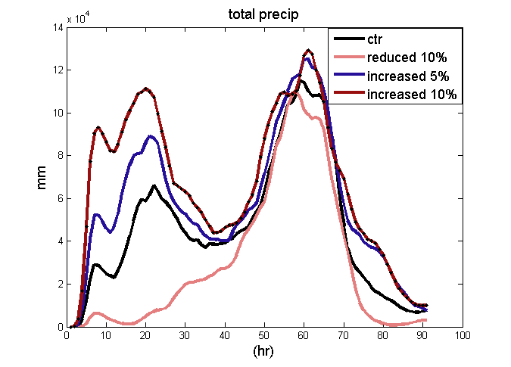
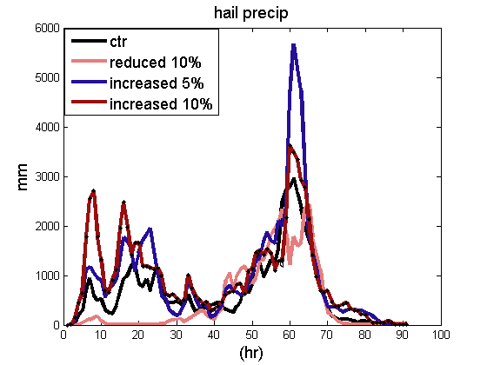
Precipitation every 20 minutes
Total precipitation increase with qvapor
Responds of hail precipitation to increased qvapor is nonlinaer

Slide 6
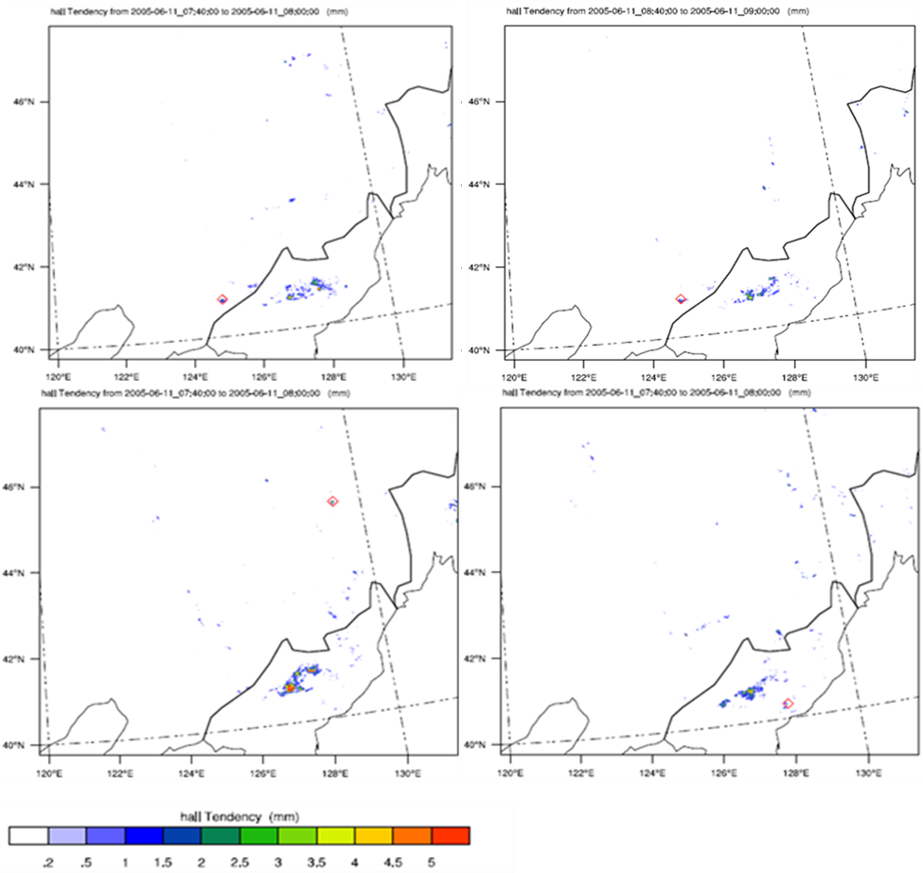
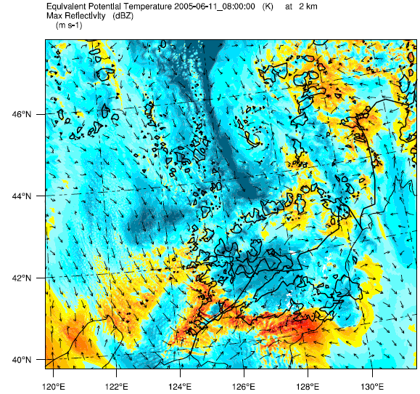
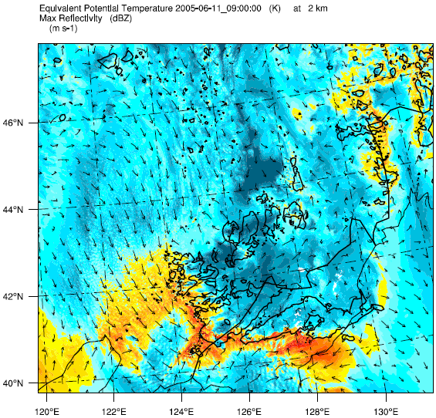
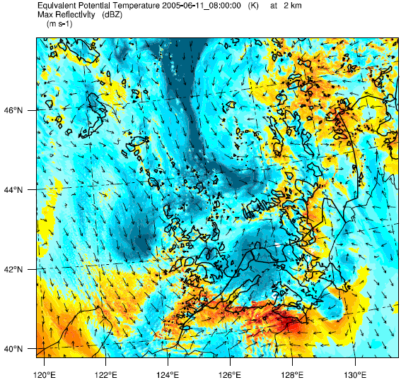
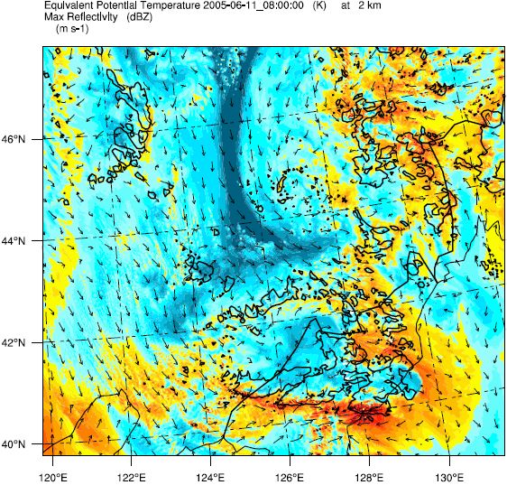
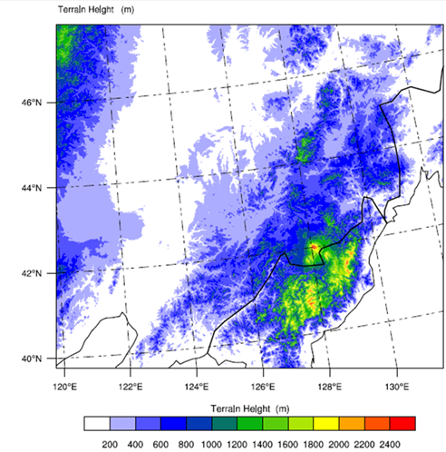
Max hail precip occur on high topography for all simulations
ctr -10
+5 +10

Slide 7
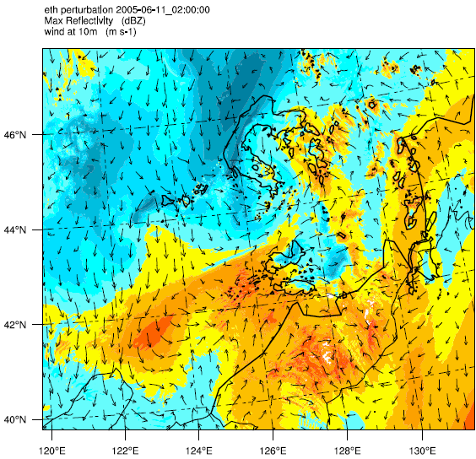
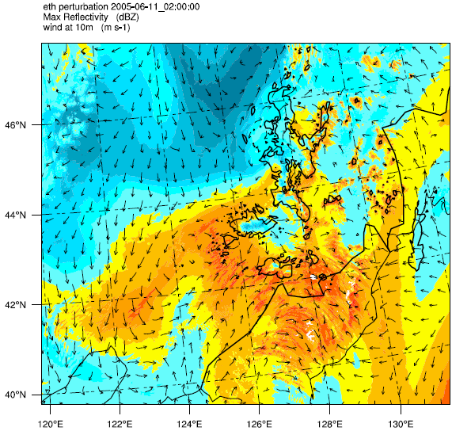
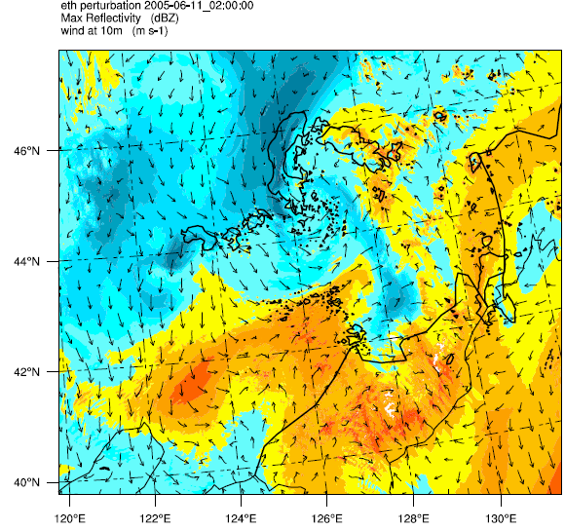
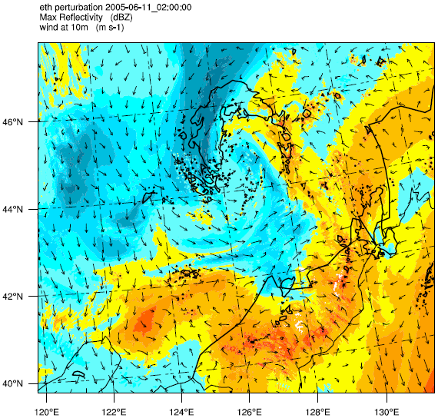
06-11_02:00 (the second process initiated)
ctr -10
+5 +10

Slide 8
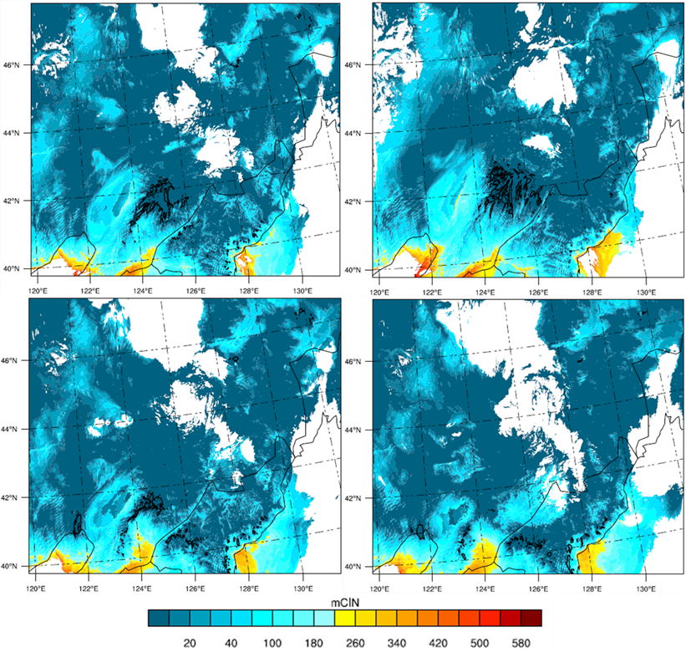
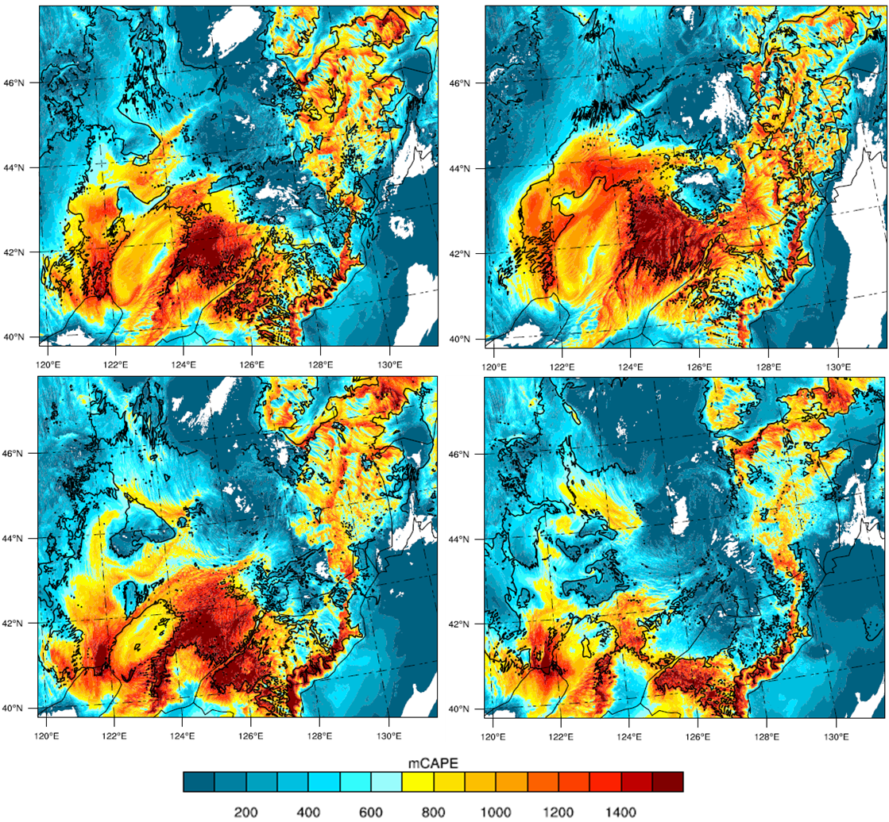
A widespread persistent cold pool generated by the first process affect the structure intensity and development of the second process.
mCIN
CAPE
Lfc>3km
black contour: cape>=1600

Slide 9
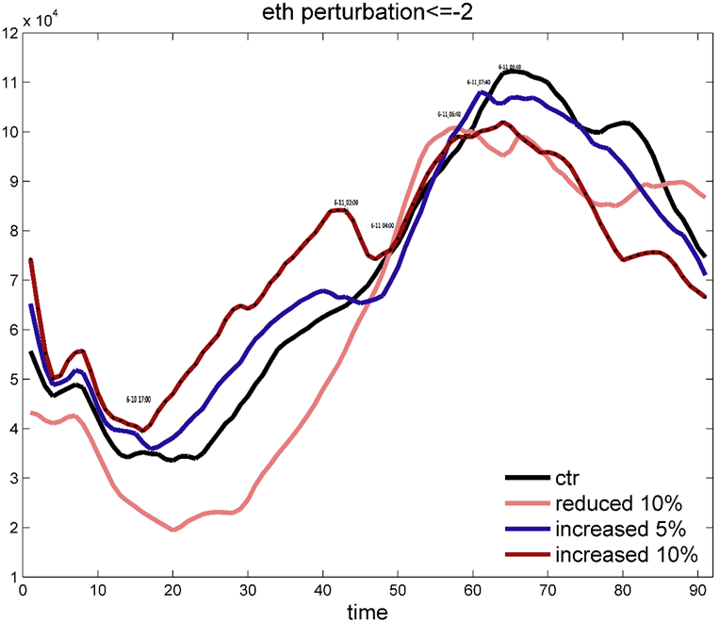
Cold pool area

Slide 10
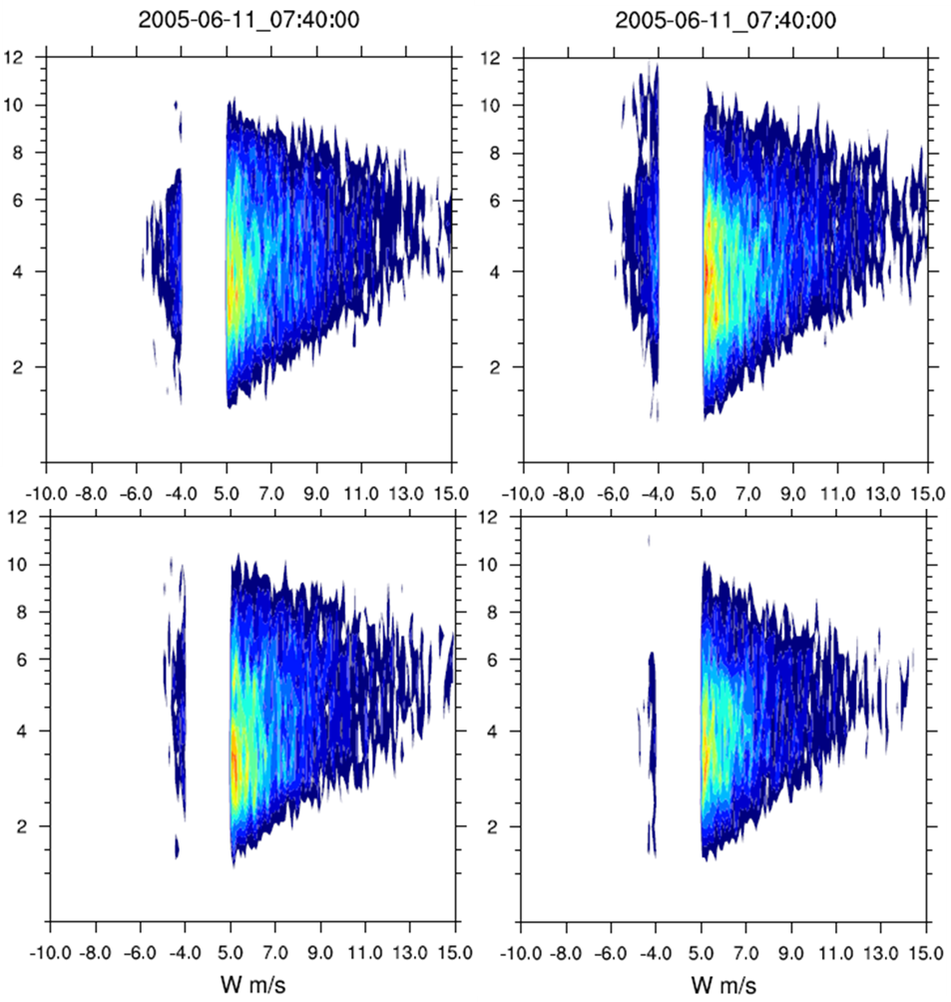
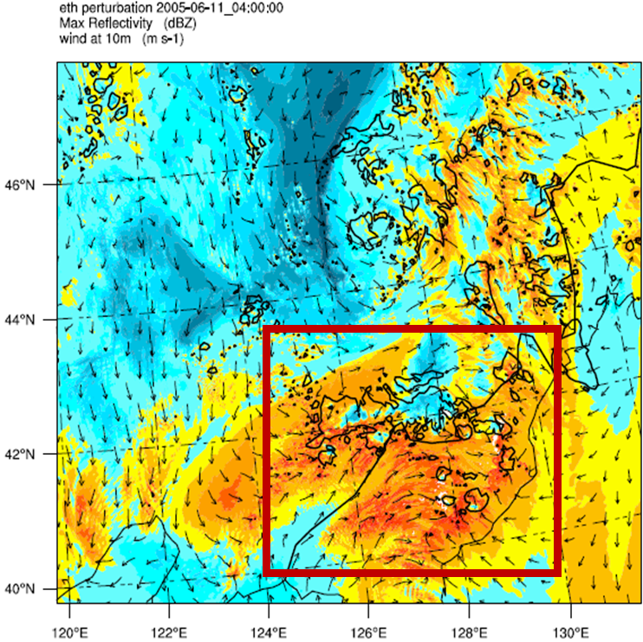
ctr -10
+5 +10
-10 exp has the strongest updraft and downdraft during the second process

Slide 11
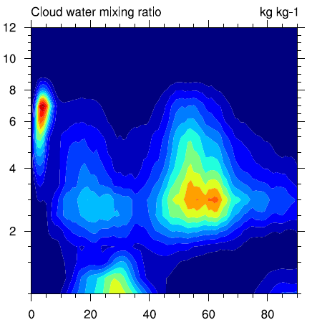
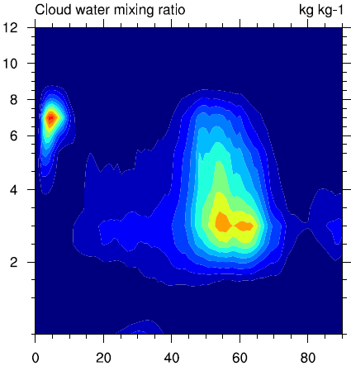
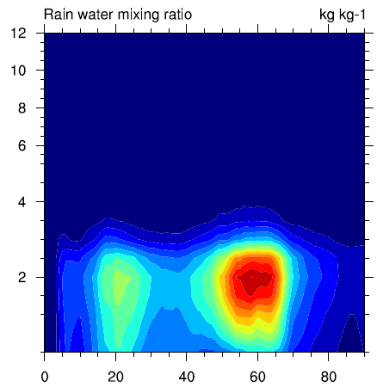
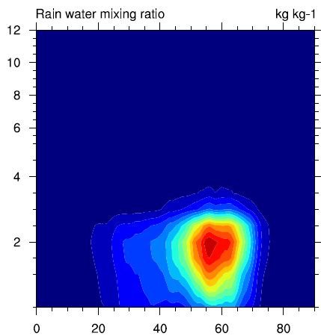
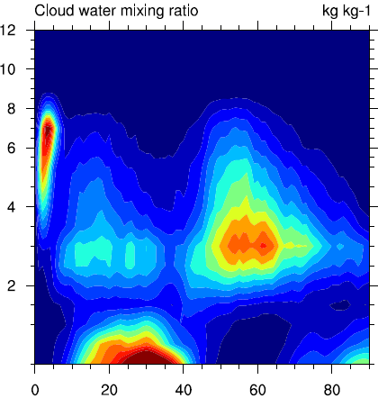
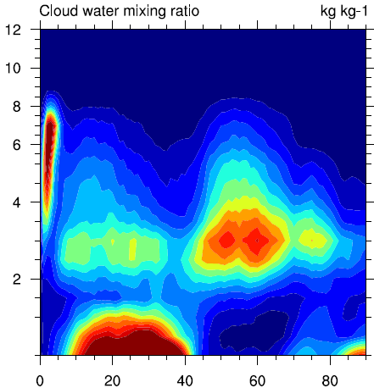
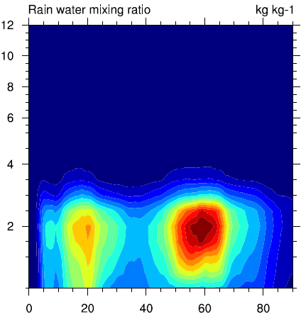
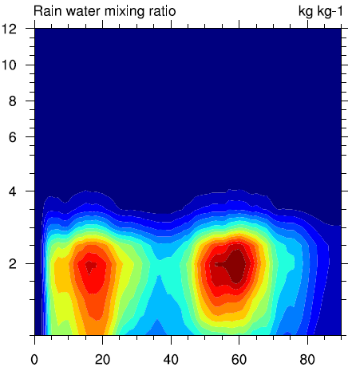
Mixing ratio vary with altitude and simulation time
Cloud water and rain water increase with increased initial qvapor
ctr -10
+5 +10

Slide 12
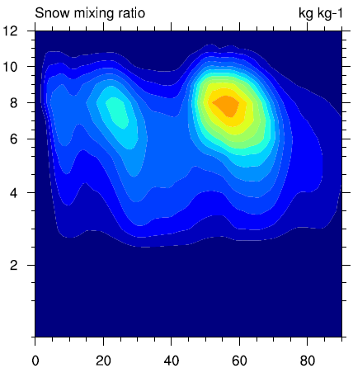
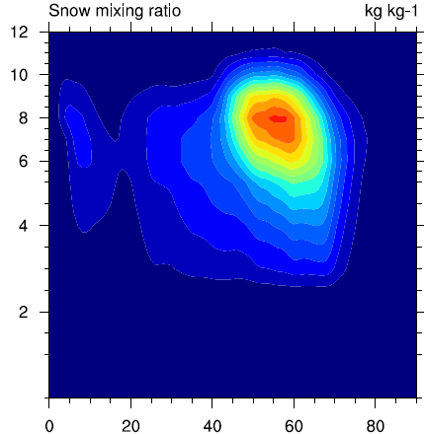
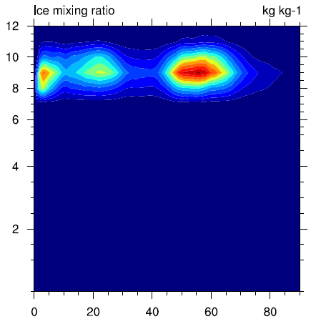
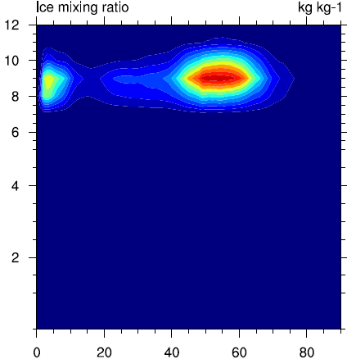
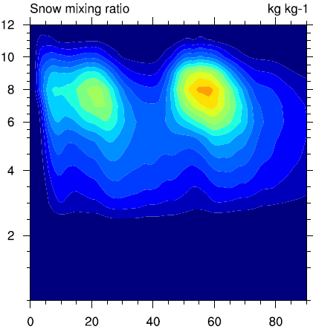
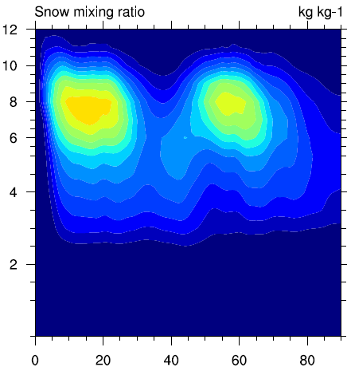
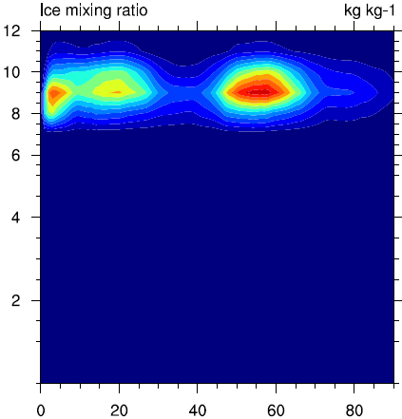
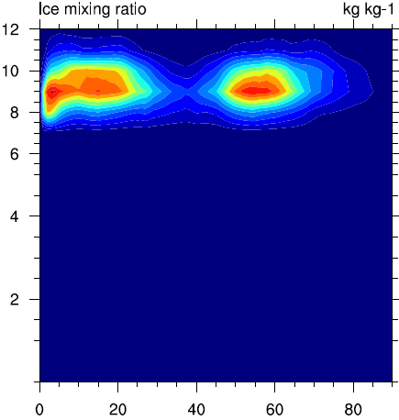
Mixing ratio vary with altitude and simulation time
Opposite results for cloud ice and snow
ctr -10
+5 +10

Slide 13
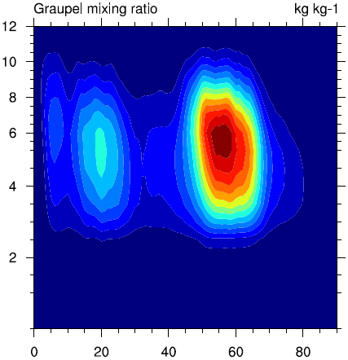
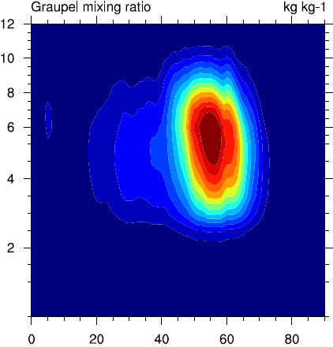
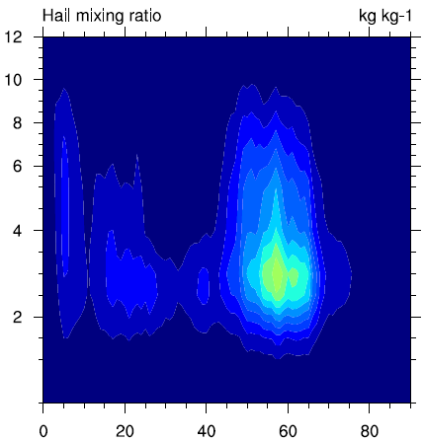
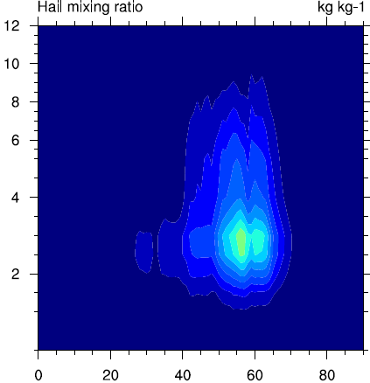
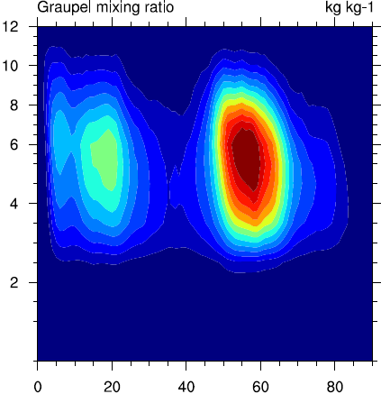
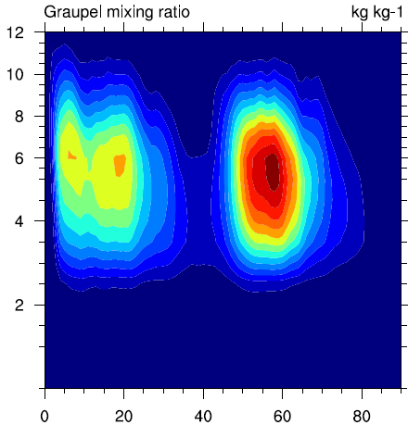
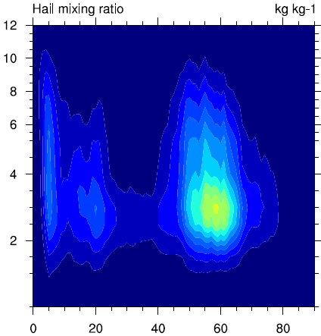
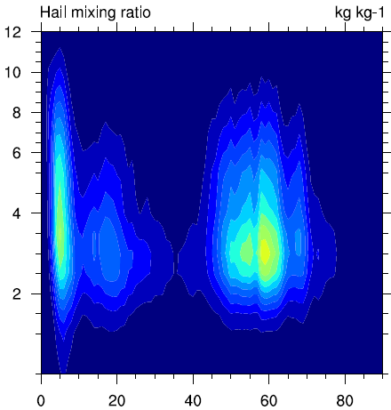
Mixing ratio vary with altitude and simulation time
ctr -10
+5 +10

Slide 14
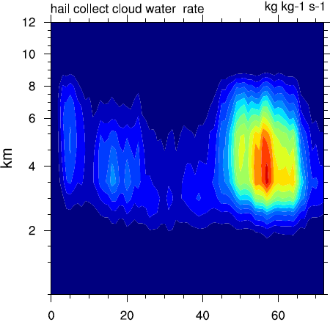
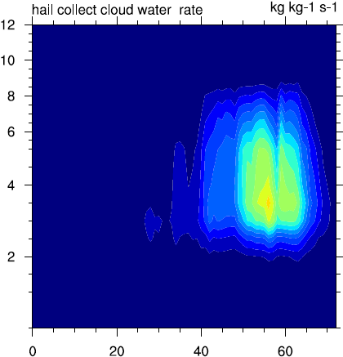
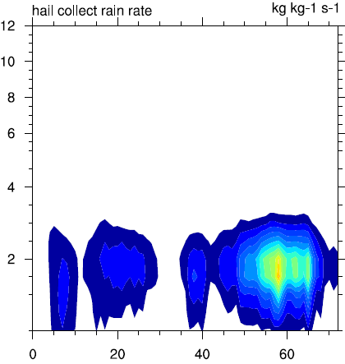
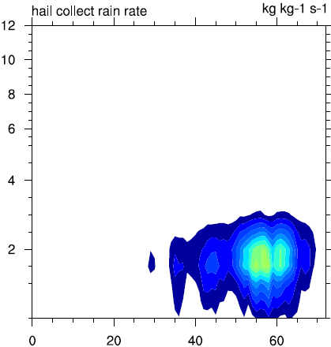
Ctr -10%
+5% +10%
Rate of hail collect cloud water (g kg-1s-1)
Rate of hail collect rain water (g kg-1s-1)

Slide 15
Color: w shade: hail mixing ratio black contour: θe
Crosssection when maximum hail precip occur
ctr -10
+5 +10
-10 has separate cells with narrow area
of hail rich cloud.
+10 has more hail mass at lower level and does not reach high levels as others.

Slide 16
ctr -10
+5 +10
Shade: cloud water number concentration
Color: rate of hail collecting cloud water (g /kg*s)
Dash line: temperature in °C
-10 has the smallest collecting rate

Slide 17
ctr -10
+5 +10
Shade: rain water number concentration
Color: rate of hail collecting rain water (g /kg*s)
Dash line: temperature in °C

Slide 18
Large vertical motion enhance ice process
Lacking of liquid water content limit hail growth

Slide 19
summary
Topogrophy
Dynamic: cold pool effect weak vertical motion at later stage
(+) (-)
more precip at beginning 1. less snow and ice aloft (+)
(less compete on qvapor)
2. reduce graupel as rimed ice (-)
attain larger size but less hail source
hail precip
more cloud water and rain water
(+)
Thermal-dynamic: supercooled water (+) riming process (+) qhail
hail size(fall velocity)
Hail
precipitation
Hail mass mixing ratio
+5 experiment has a considerable large upward motion with enough amount of super-cooled liquid water, which organize the storm well and sustain hail to grow. When coming across high terrain, it produce the most hail precipitation.

Slide 20
Ctr -10%
+5% +10%
Rate of graup convert to hail (g kg-1s-1)
graupel mixing ratio vary with time and altitude

Slide 21
Previous work
850hPa
GPH
weak dynamic forcing
weak v wind
difference of hail days and non-hail day difference of the period before and after 1990.
v-wind composite

Slide 22
Domain total
Large vertical motion enhance ice process
Lacking of liquid water content limit hail growth

Slide 23
/wave/s5/www/html/Groupmeeting/20160510/
/wave/s5/www/html/Groupmeeting/20160510/

