Slide 1
Contributions of moist convection and internal gravity waves to building the atmospheric “-5/3” kinetic energy spectra
Y. Qiang Sun
Richard Rotunno
Fuqing Zhang
End of Semester Groupmeeting
2016-05-10

Slide 2
Observed Power Spectra of Wind and Potential Temperature From Aircraft
Synoptic scale
mesoscale
Nastrom and Gage (1985)

Slide 3
Baroclinic wave simulations: Dry .vs. Moist
Sun and Zhang (2016)
Simulated dry baroclinic Jets have a -3 slope, while moist experiments show a transition at mesoscale.

Slide 4

Difference Total Energy (DTE) Growth: Dry .vs. Moist
Error growth behavior is possibly linked to the spectral slope.
Implication of spectral slopes on intrinsic predictability consistent with the recent study of Rotunno and Snyder (2008 JAS).

Slide 5
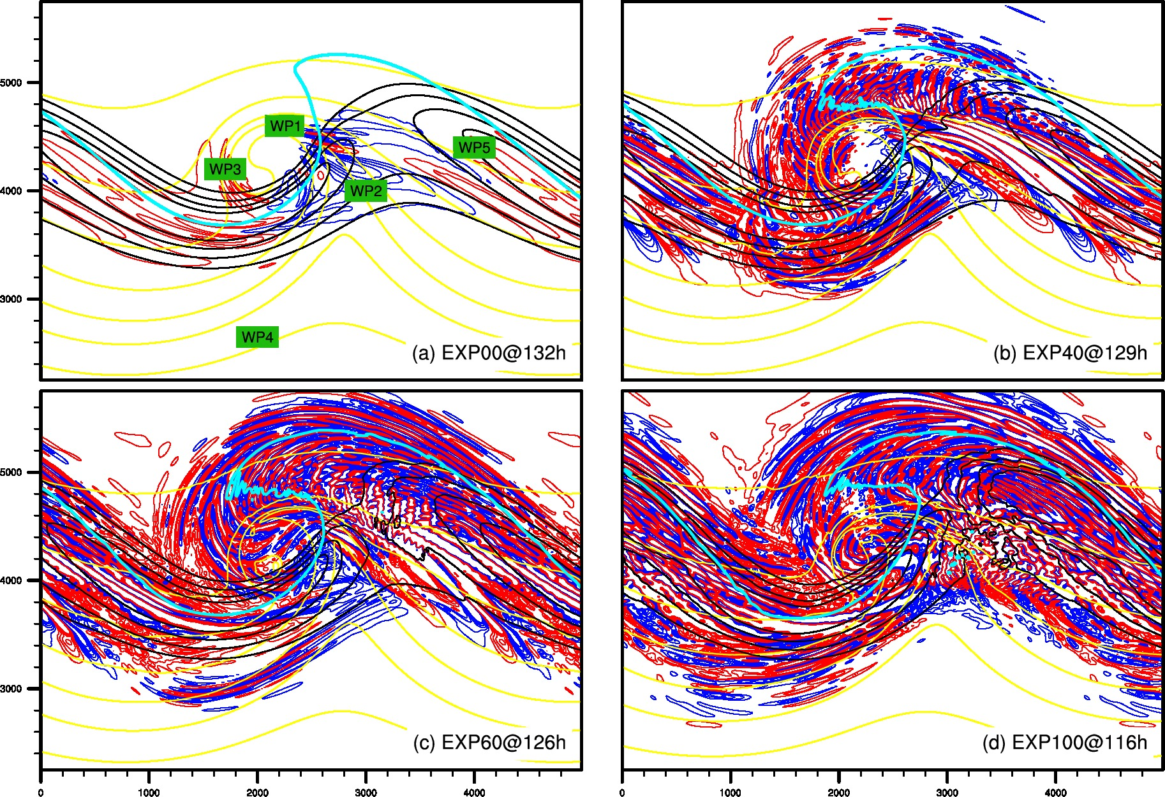
Gravity waves in baroclinic wave simulations: Dry .vs. Moist
(Wei and Zhang 2014 JAS; 2015 JAMES)
Convection and gravity waves key to flatten the meso/small-scale spectral slope.
Adjustment and gravity waves likely play a key role in the error propagation across scales, as hypothesized in Zhang et al. (2007 JAS).

Slide 6
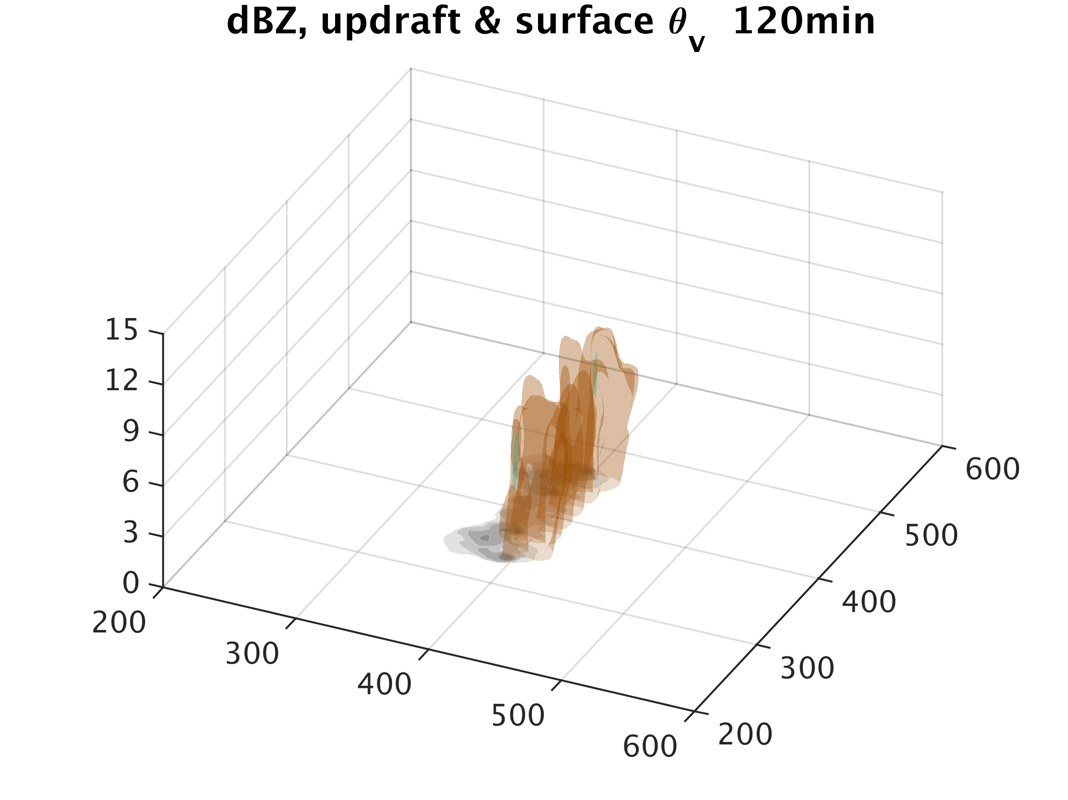
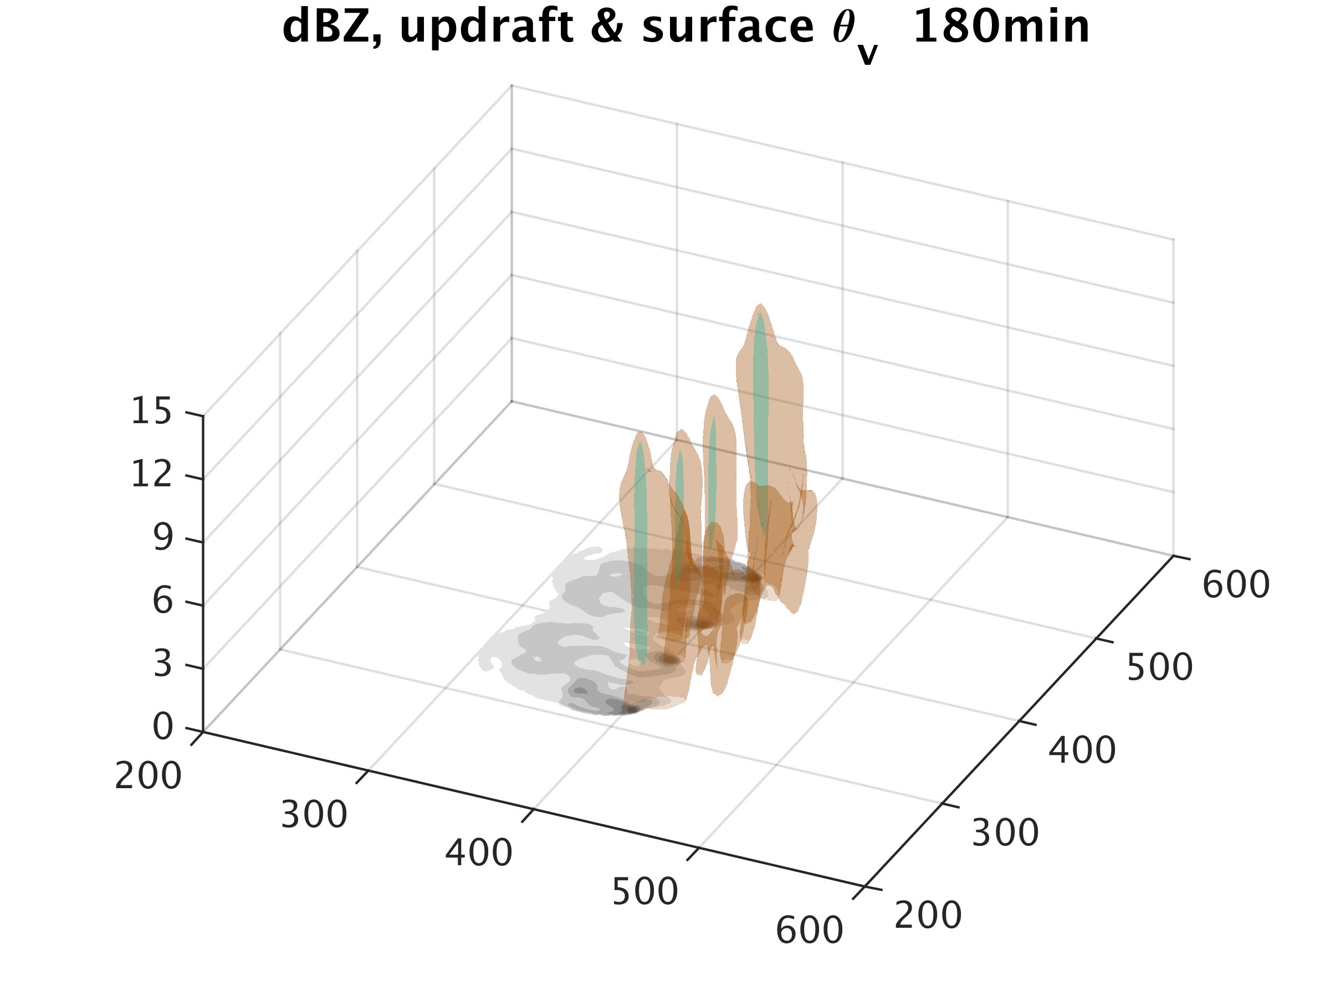
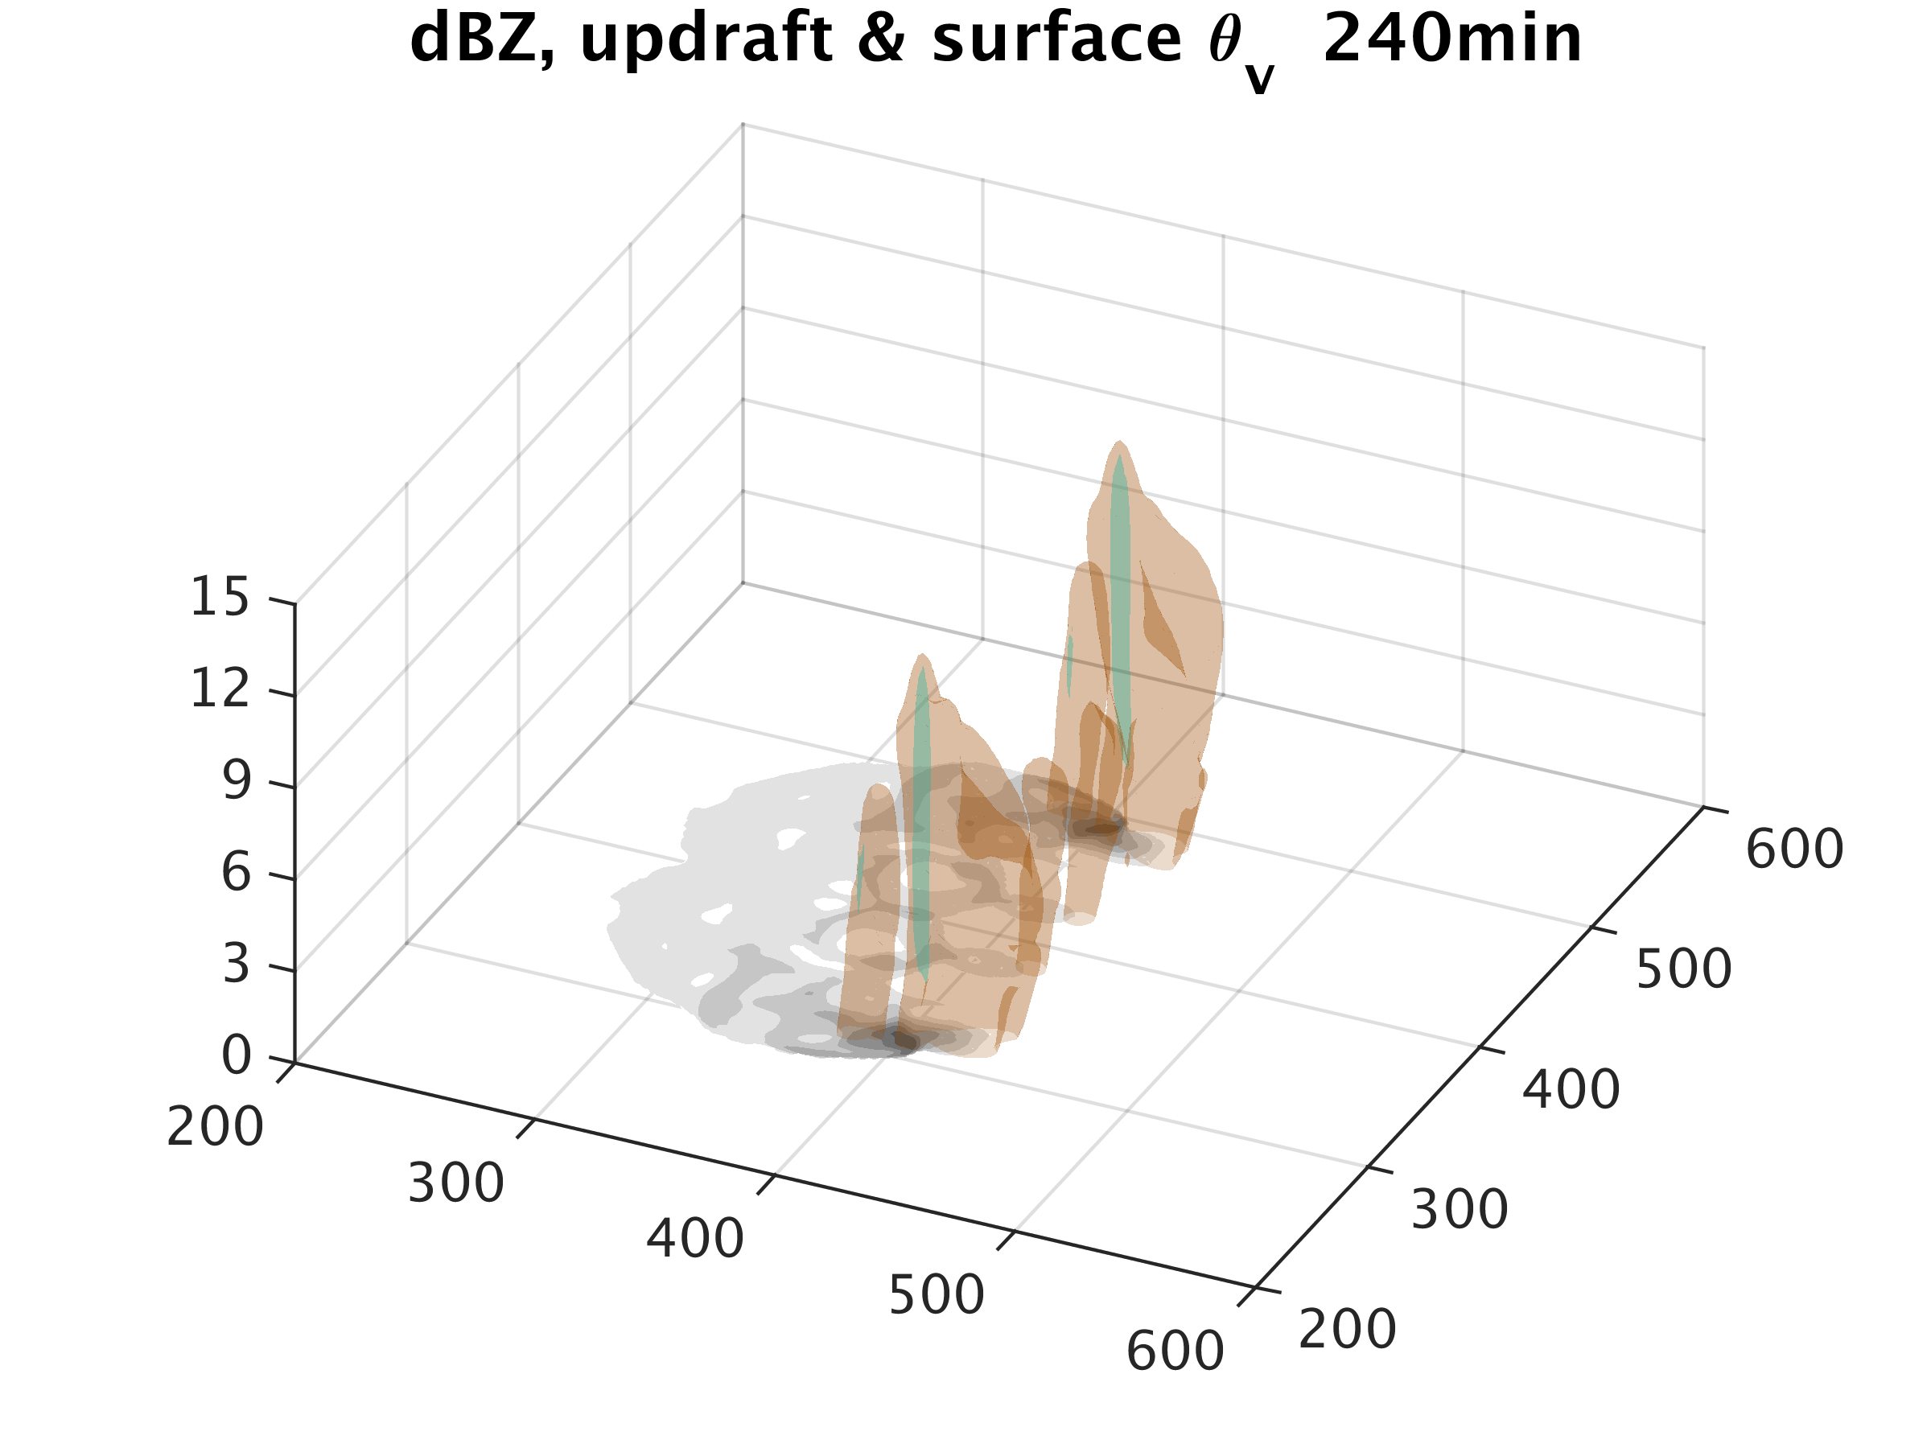
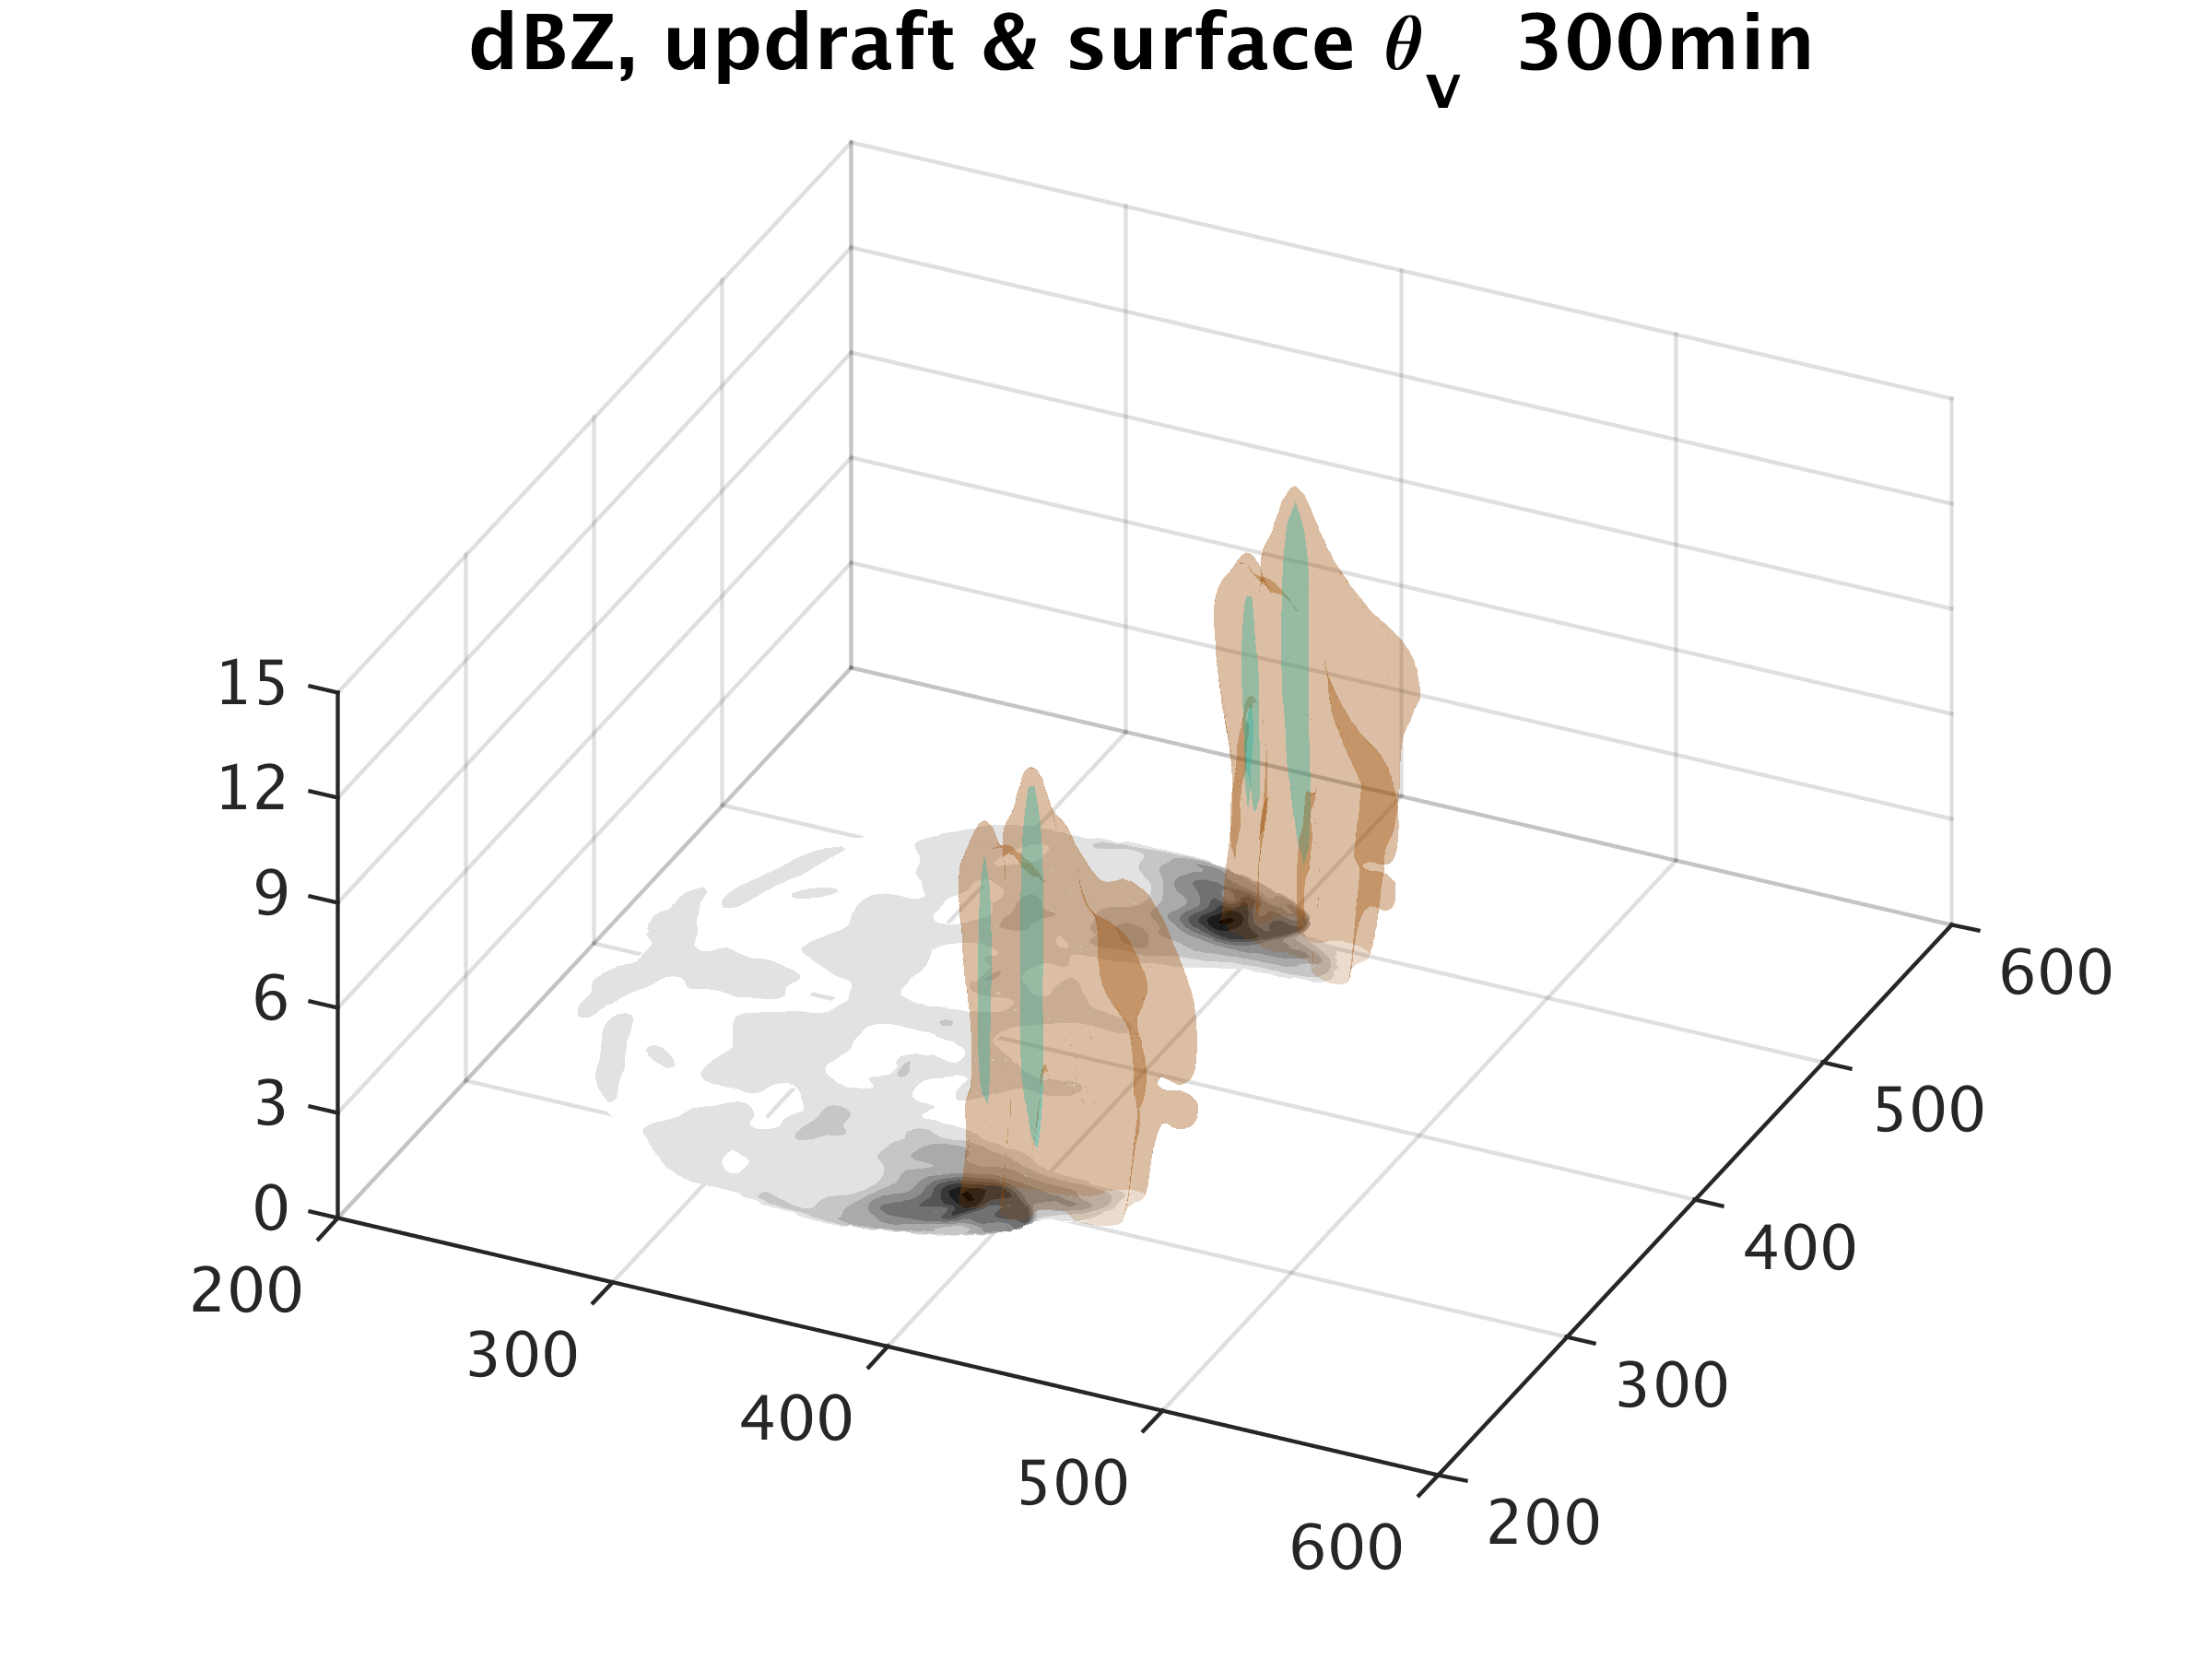
Time evolution of our simulated squall line
2h
3h
4h
5h

Slide 7
Moist convection and gravity waves generated by convection
South-north (km)
Heat fluxes

Slide 8
Kinetic Energy Spectra in our Simulation
wavelength (km)
wavelength (km)
400 200 100 50 25 16
400 200 100 50 25 16
E(k)
10 100
10 100
wavenumber
wavenumber

Slide 9
Spectra Budget Analysis for Kinetic Energy
T(k): Energy transfer between different scales
B(k): Energy conversion from potential energy, buoyancy production
T(k)
B(k)
Flux(k): Communication between different height levels, induced by convection and vertical propagating gravity waves
Flux(k)

Slide 10
Spectra Budget Analysis at different levels
Lower
Troposphere
Upper
Troposphere
Lower
Stratosphere

Slide 11
Kinetic Energy Spectra in Experiment with Coriolis effect
wavelength (km)
400 200 100 50 25 16
10 100
wavenumber

Slide 12
Spectra Budget Analysis at different levels (Coriolis experiment)

Slide 13
Conclusion
Convective systems, triggered in a horizontally homogeneous environment, are able to generate a background mesoscale kinetic energy spectrum with a -5/3 slope.
Three physical processes actively contribute to the formation of the kinetic energy spectrum.
The classical cascade picture can not be applied to our simulation.
Strong communications exist between different height levels, due to vertical energy fluxes induced by convection and the gravity waves.
T(k)
B(k)
Flux(k)

