Slide 1


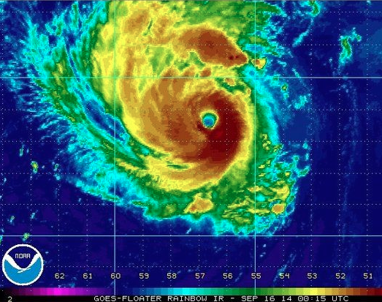
Ensemble forecasts of the rapid intensification of Hurricane Edouard (2014): Predictability, dynamics, and thermodynamic structure
Erin Munsell
Spring 2016 Group Meeting
May 10th, 2016

Slide 2
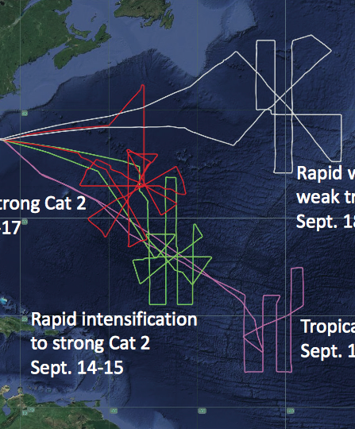
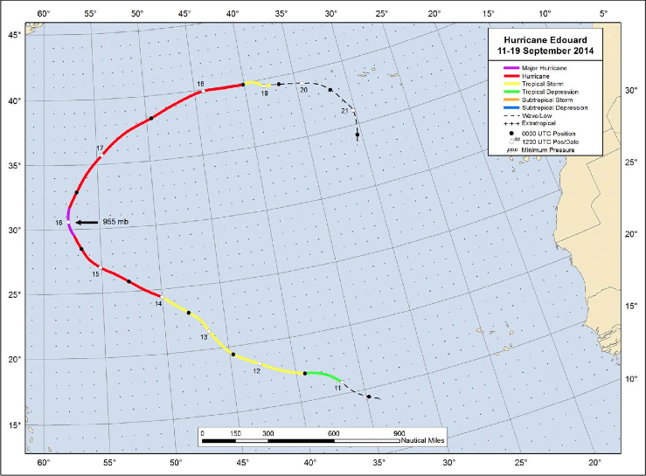
Edouard Best Track & HS3 Flight Information
Four HS3 flights into Edouard covering all stages of its lifetime
PSU WRF-EnKF initialized at 12Z on Sept 11th – TD 6 designation
Simulation ends on 18Z on Sept 16th – just after peak intensity (major hurricane, 1st of HS3!)

Slide 3
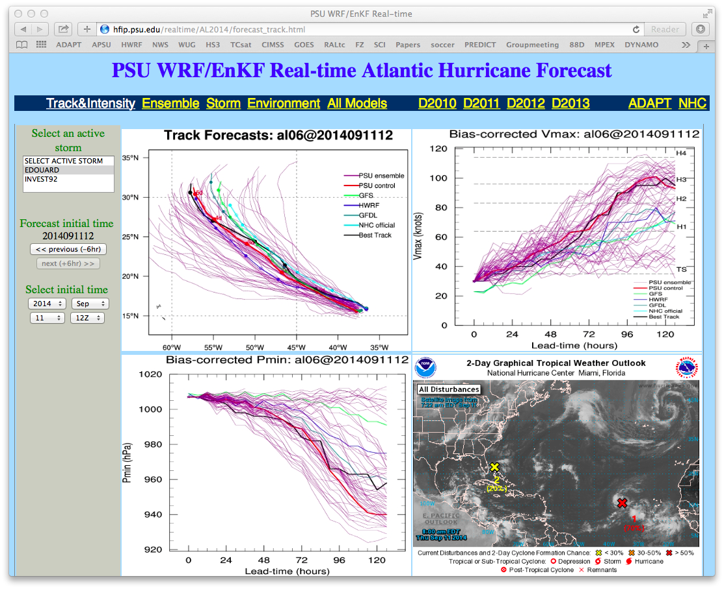
Excellent case for studying the predictability associated with RI

Slide 4
Ensemble Tracks classified by performance
SST’s contoured (constant amongst members)
Munsell et al. 2016, In review
Maximum 10-m Wind Speed (kts) classified by performance
Best Track – Black
GOOD – Blue
GOOD_EARLY – Green
GOOD_LATE – Magenta
POOR – Red

Slide 5
Deep-layer shear (850-hPa – 200-hPa) averaged over a 200-km to 500-km radius for the ensemble members of the composite groups

Slide 6
Idealized Experiments: Sensitivity to Increasing Magnitudes of Wind Shear
SH7.5-SST29 (GOOD_EARLY)
SH10-SST29 (GOOD or GOOD_LATE)
SH12.5-SST29 (POOR)
Zhang and Tao (2013), Tao and Zhang (2014)

Slide 7
Mean deep-layer (850-hPa – 200-hPa) vertical wind shear of composite groups – time in relation to beginning of RI

Slide 8
Mean tilt magnitude (difference between 850-hPa and 500-hPa weighted PV centers in km) of composite groups of Edouard
Mean tilt magnitude (difference between 850-hPa and 500-hPa weighted PV centers in km) of composite groups in time in relation to beginning of RI

Slide 9
T_{RI} – 48 h T_{RI} – 36 h T_{RI} – 24 h
GOOD_LATE GOOD GOOD_EARLY

Slide 10
T_{RI} – 12 h T_{RI} T_{RI} + 12 h
GOOD_LATE GOOD GOOD_EARLY

Slide 11
Edouard Temperature Structure – Modeled vs. Observations (Flight 3)
GOOD
Dropsondes
Temperature Perturbations (°C)
S-HIS
AMSU
From RAMMB/CIRA

Slide 12
Edouard WRF-EnKF Perturbation Temperatures (°C) – 09/16/14 at 18 UTC
GOOD_EARLY
GOOD
Temperature Perturbations (°C)
GOOD_LATE
POOR

Slide 13
Edouard WRF-EnKF Perturbation Temperatures (°C) – Time/Height
GOOD_EARLY
GOOD
Temperature Perturbations (°C)
GOOD_LATE
POOR

Slide 14
Summary and Conclusions
12 UTC 11 Sept ensemble initialization of Hurricane Edouard provides an excellent framework to assess the dynamics, predictability, and thermodynamic structure of RI
Shear magnitude is strongest throughout the simulation for POOR; decreases in magnitude for GOOD_LATE, GOOD and GOOD_EARLY
Shear decreases in all groups approximately 12 h prior to RI onset
Tilt magnitude decreases approximately 24–48 h prior to RI
Timing of RI onset is related to the impact of wind shear on vortex tilt, location of convection, and the subsequent precession and alignment
Modeled (GOOD) inner-core temperature structure compares favorably to HS3 dropsondes and S-HIS data from Edouard Flight 3; Warm core height approximately 6 – 9 km
Warm core in composite groups strengthens after RI begins; Evolution is consistent across developing composites

Slide 16
700-hPa storm-centered composite relative humidity of GOOD at 09 UTC 12 September 2014 (21 h)
Dropsondes (markers) from Flight 1
950-hPa storm-centered composite winds of GOOD at 09 UTC 12 September 2014 (21 h)
Dropsondes (markers) from Flight 1

Slide 17
Dropsonde positions with height: Flight 3
Dropsonde temperature perturbation profiles (within 50-km of surface center): Flight 3

