Slide 1
Mid-Atlantic Air Quality Model: Initial Results from WRF-Chem
Presenter: Andrew Thomas
Co-Advisers: Fuqing Zhang and Amy Huff

Slide 2
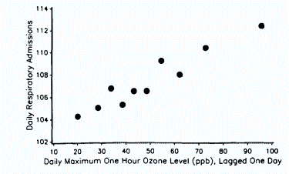
Pollutant of interest: Ozone
Ground level ozone affects children and the elderly the most (Yang et al. 2003)
Respiratory disorders are worsened by high ozone events (see figure)
Short term ozone exposure can result in heart attacks in otherwise healthy middle aged adults (Ruidavets, et al. 2005)
Image source: Burnett et al., 1994; U.S. EPA, 1996

Slide 3
Ozone production
O₃
O
NO+O₃
NO₂
NO+CH₃O₂
NO+HO₂
NO
Ozone formed from a molecular oxygen, diatomic oxygen, and a third body.
Oxygen molecule formed a number of ways
Most prevalent is through the photolysis of NO₂
NO₂ is formed through
Destruction of ozone,
Oxidation through HO₂
NO and alkanes (or general VOCs)

Slide 4
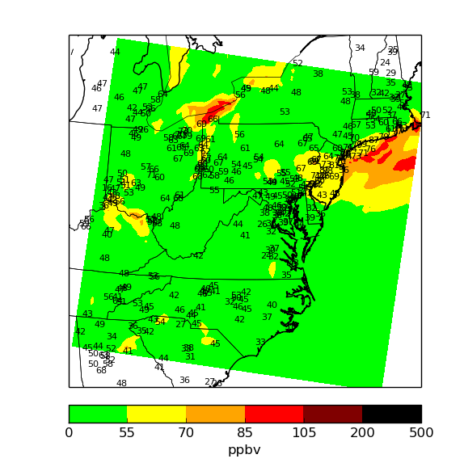
Initial results: Daily Maximum of running 8 hour average
7/29/2015
Combining anthropogenic emissions, biogenic emissions, and using inexpensive (RADM2) chemistry.
Localized domain.
Spin-up of 7 days
Questions:
How much spin-up time is needed?
Effect of improvements of other parameterizations.

Slide 5
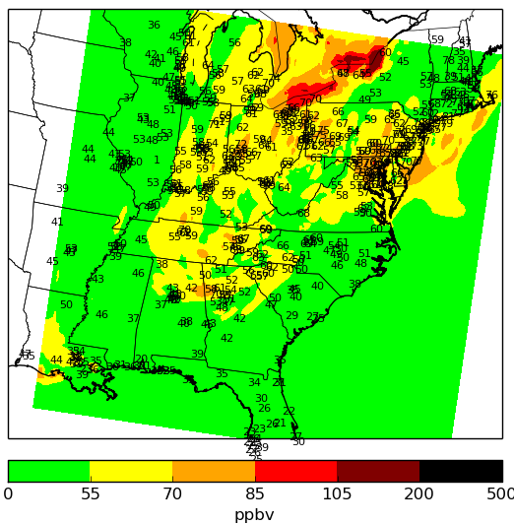
First Change: Domain Selection
9/17/15
A smaller domain is computationally efficient
However, a smaller domain does not model the emissions from the Midwest

Slide 6
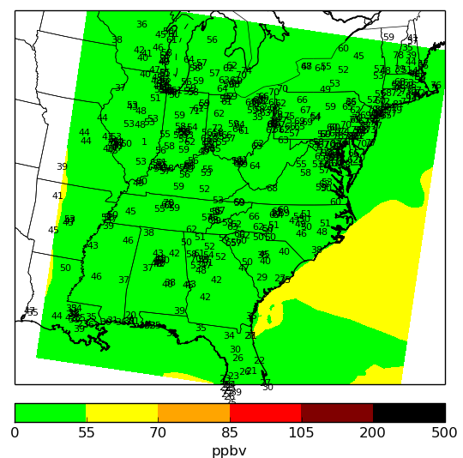
“Enhancement,” but not really
9/17/15
Changed the chemical mechanism from relatively inexpensive (RADM2) to detailed and expensive (RACM).
Changed microphysics to 2nd moment Thompson.
MOZART chemical boundary conditions
Ozone mixing ratios were about ½ what they should’ve been.
Attempted replication of bad result.

Slide 7
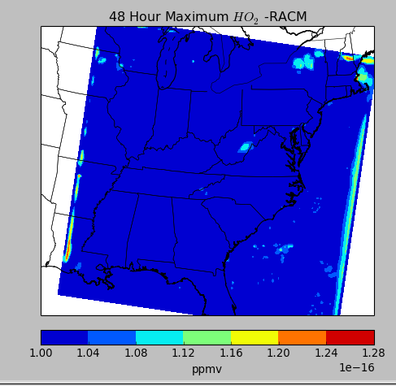
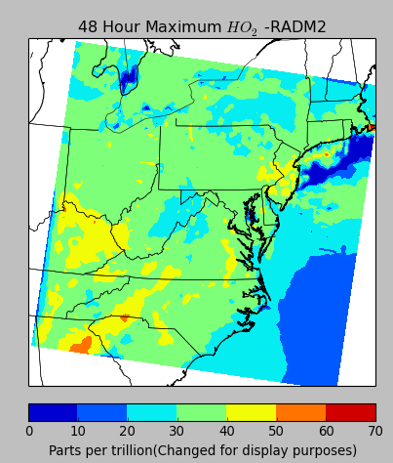
Problem Identification: Chemical Mechanism
Restored model to previous format, larger domain.
Change one setting at a time.
Identified RACM chemistry as the culprit.
For reference, machine epsilon for floating point is 2.22044604925e-16

Slide 8
Near Future Improvements/Current Endeavors
Using a different version of RACM
The one used here was “Highly experimental” according to the code developer.
Extension to fine particulate matter
MOZART chemical boundary conditions

Slide 9
References
Yang, Q., Chen, Y., Shi, Y., Burnett, R. T., McGrail, K. M. and Krewski, D. (2003). Association between ozone and respiratory admissions among children and the elderly in Vancouver, Canada, Inhalation Toxicology: International Forum for Respiratory Research 15: 1297-1308. doi:10.1080/08958370390241768
Ruidavets et al. (2005.) Ozone Air Pollution Is Associated With Acute Myocardial Infarction, Circulation February 8th 2005.

