Slide 1
A WRF FDDA Realtime System and Its Recent Applications
ADAPT Spring 2016 Group Meeting/Symposium
Aijun Deng
10 May 2016

Slide 2
OUTLINE
Introduction to FDDA
A WRF Realtime Multiscale FDDA WRF System with Built-in Model Verification
FDDA Applications
  Dynamic Analysis
  Realtime Forecast

Slide 4
Two types of FDDA
  Analysis Nudging or Grid Nudging: towards gridded analyses
    3-D analyses
    Surface analyses
  Observation Nudging or OBS Nudging: towards individual observations

Slide 5
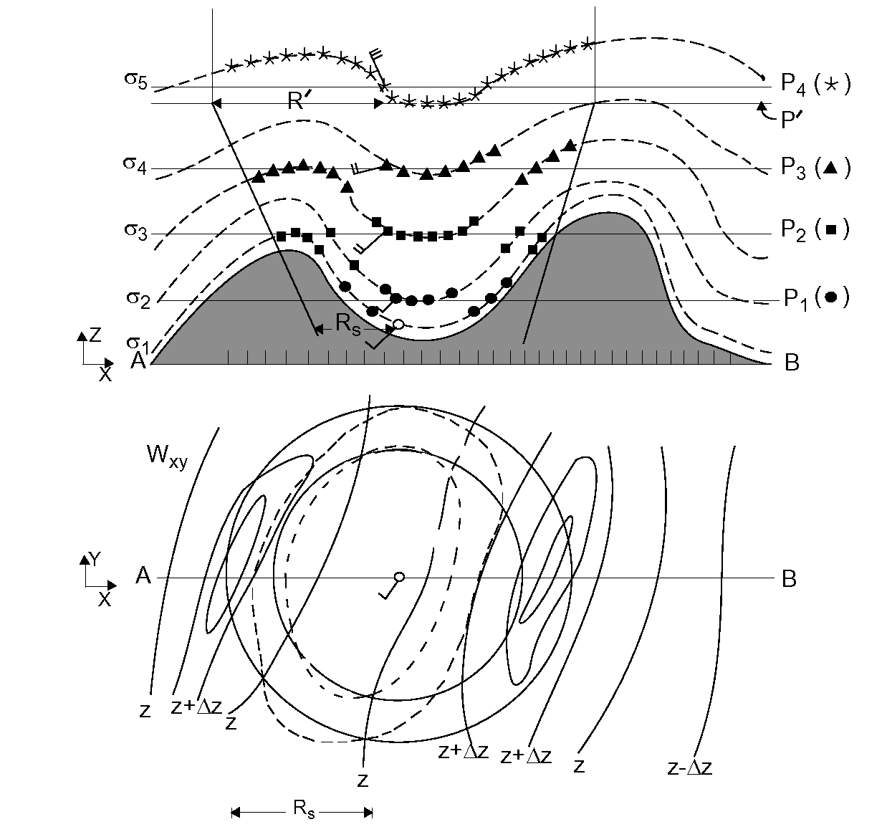
Observation Nudging Weighting Functions
w_{σ}
w_{xy}
w_{t}

Slide 6
Vertical Weighting Examples in WRF Obs nudging
Rogers et al. 2013
Default for regime 4
Default for regimes 1 and 2
Column # | 1 | 2 | 3 | 4 | 5 | 6 | 7 | 8 | Column #
Ramp Layer | 0 | -5000 | 50 | 0 | 50 | 50 | -5000 | -5000 | obs_nudgezrampr*
Full Layer | -5000 | 0 | -5000 | 50 | 0 | 50 | 50 | -4950 | obs_nudgezfullr*
z_{i}+50 |  |  |  |  |  |  |  |  | z_{i}+50
z_{i} |  |  |  |  |  |  |  |  | z_{i}
z_{i}-50 |  |  |  |  |  |  |  |  | z_{i}-50
100 |  |  |  |  |  |  |  |  | 100
50 |  |  |  |  |  |  |  |  | 50
0 |  |  |  |  |  |  |  |  | 0
Weighting | 0 1 | 0 1 | 0 1 | 0 1 | 0 1 | 0 1 | 0 1 | 0 1 | Weighting
Original WRF default (all regimes)
MM5 default (but lowest 3 layers and only wind; all regimes)
Notes:
RTFDDA default is column 2

Slide 7
OBSGRID Functionality
Takes input first-guess gridded pressure-level data and observations to provide
  A new gridded upper-air pressure-level analysis
  A 2D surface gridded analysis for use in surface analysis nudging
  Deng et al. 2009 (WRF Workshop Preprint)

Slide 8
Methods
Cressman or Multiquadric analysis options
Quality control by gross error checking, background checking, buddy checking, and vertical consistent checking, etc.
Time interpolation of first guess to optionally provide higher frequency surface analyses

Slide 9
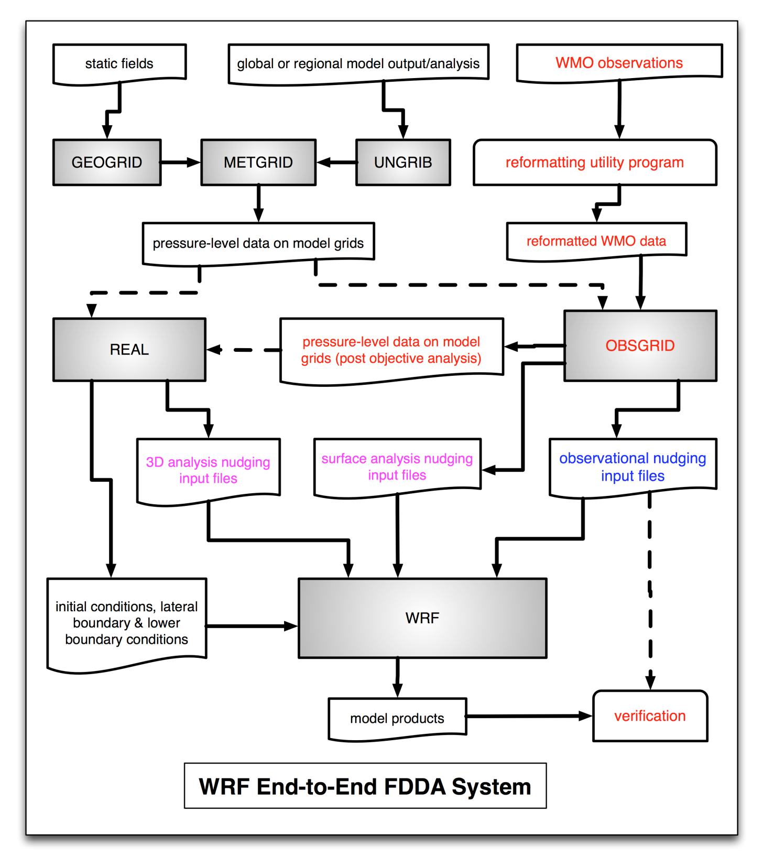

Slide 10
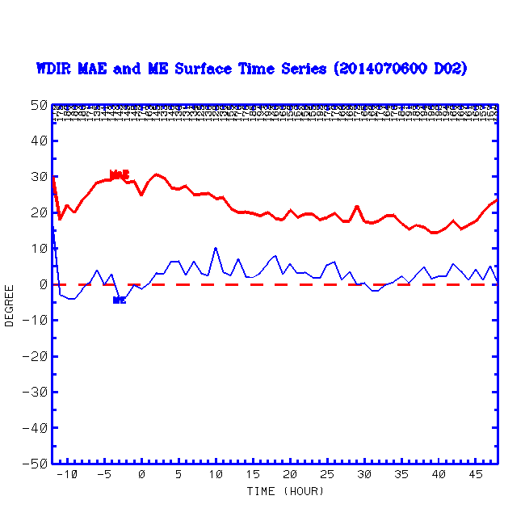
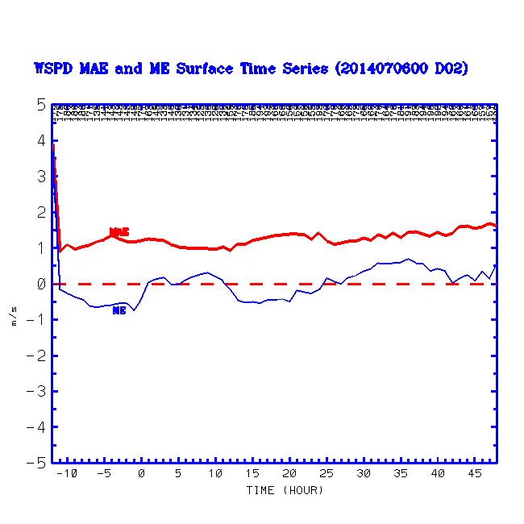
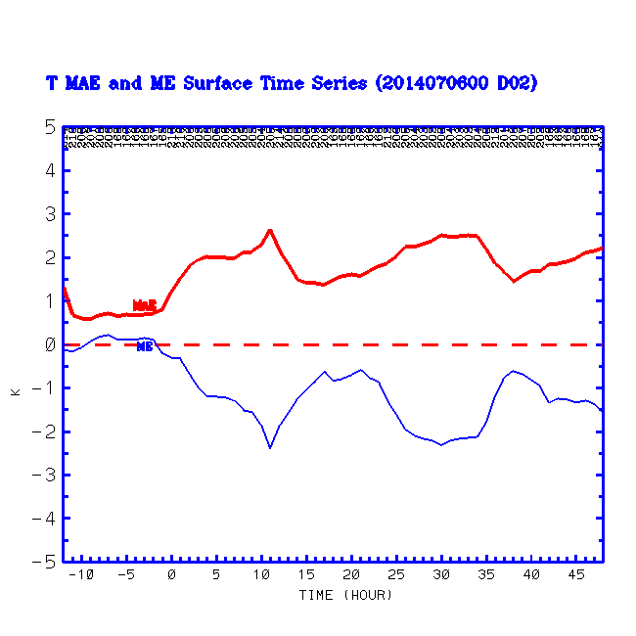
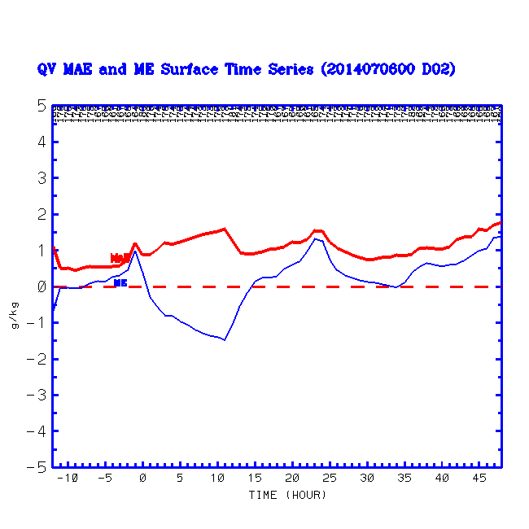
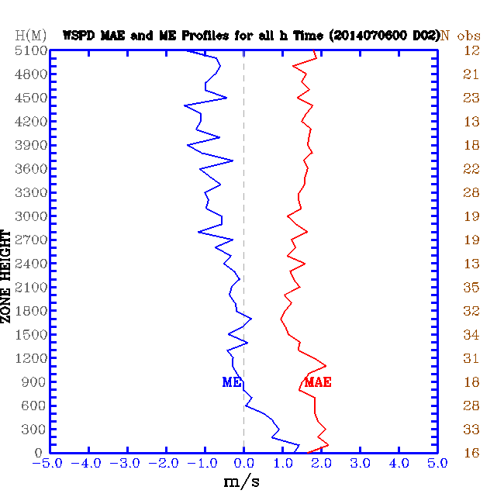
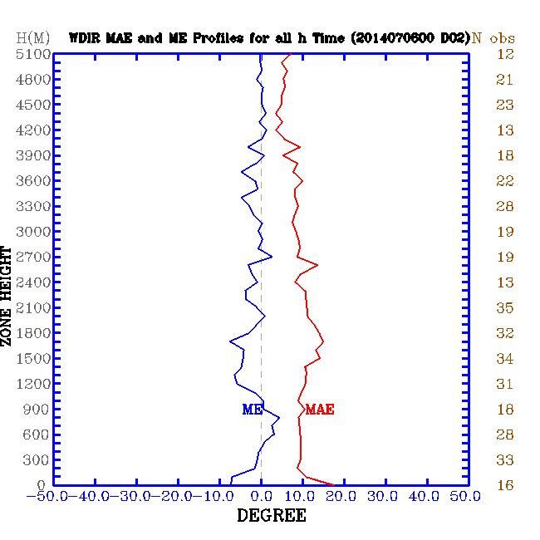
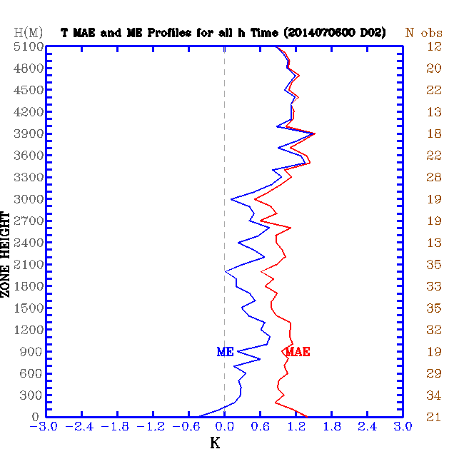
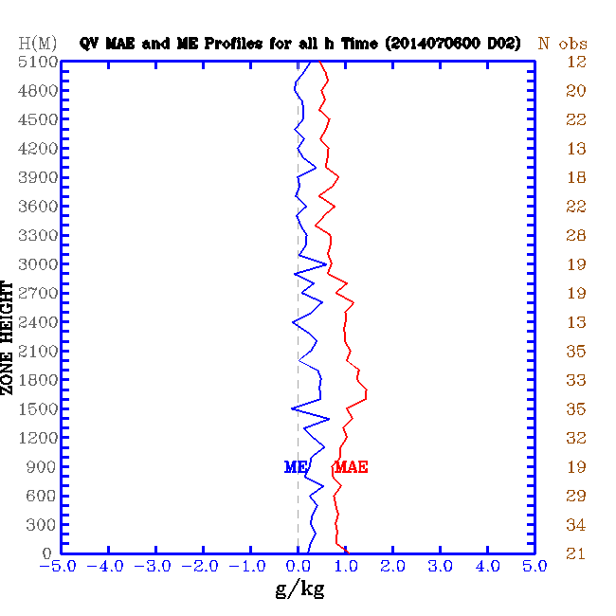
Model Error (Mean Absolute Error) Produced On-the-Fly
Speed
Direction
Temperature
Mixing Ratio

Slide 11
Multiscale WRF FDDA System
-6h
-3h
0h
3h
….
30h
36h
….
48h
Analysis Nudging
9km
3km
1km
OBS Nudging

Slide 12
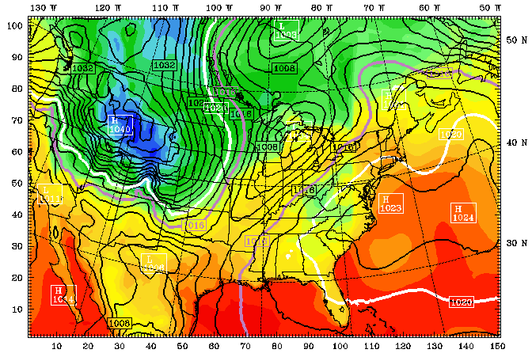
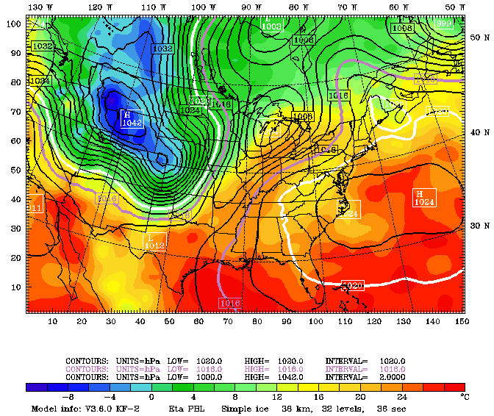
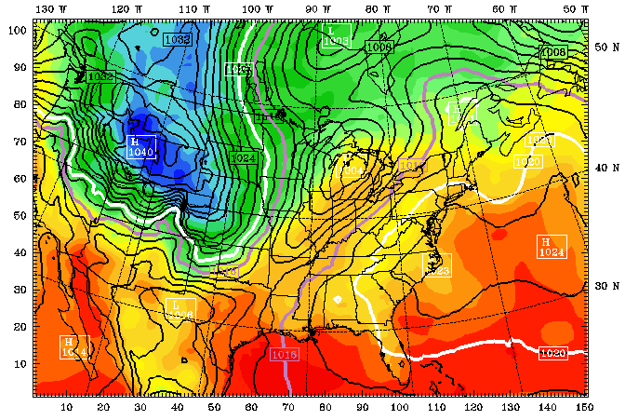
Surface Temperature and Sea Level Pressure
12 UTC, 20 September 1983 (+48h)
No Surface FDDA
Surface Analysis
Surface FDDA

Slide 13
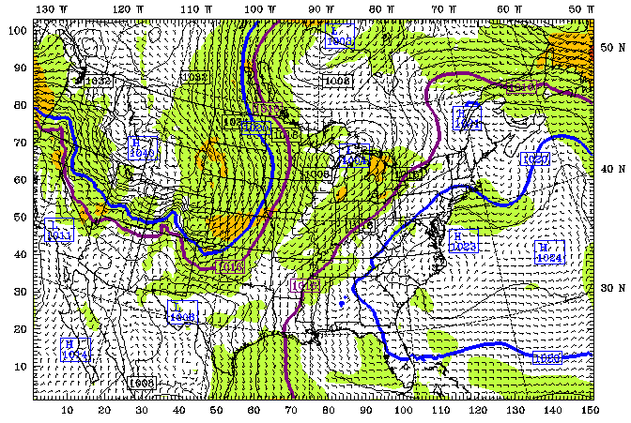
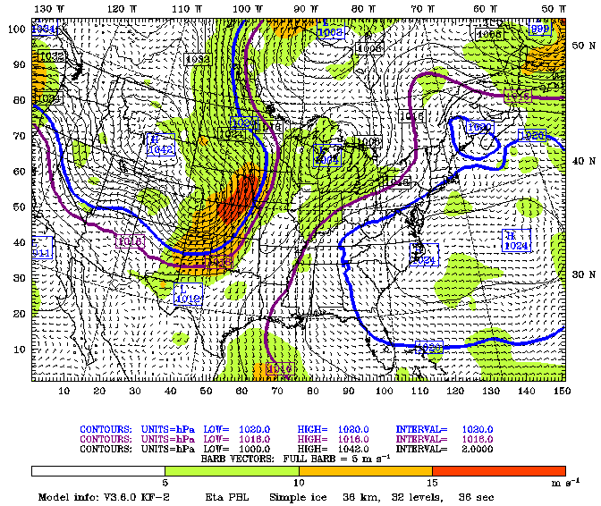
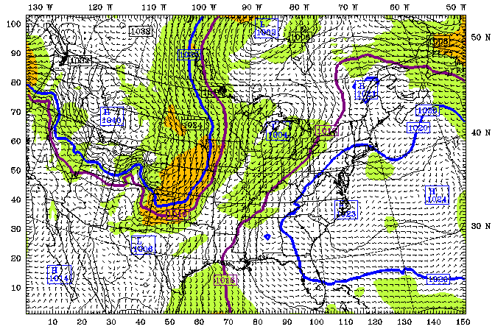
Surface Wind and Sea Level Pressure
12 UTC, 20 September 1983 (+48h)
No Surface FDDA
Surface Analysis
Surface FDDA

Slide 14
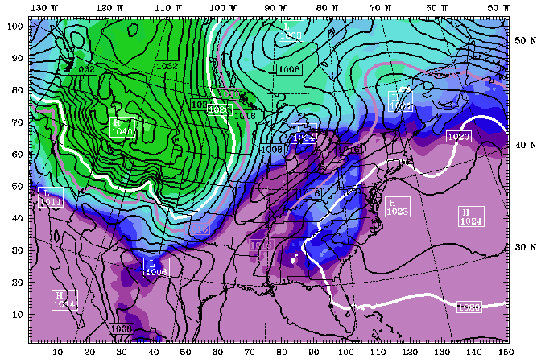
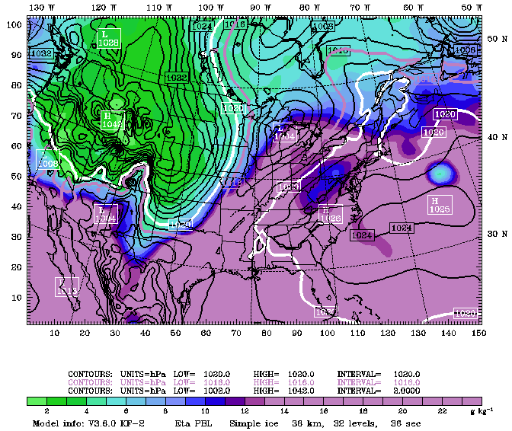
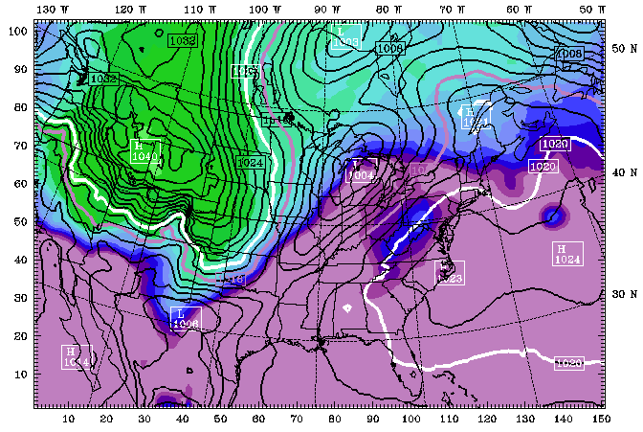
Surface Water Vapor and Sea Level Pressure
12 UTC, 20 September 1983 (+48h)
No Surface FDDA
Surface Analysis
Surface FDDA

Slide 15
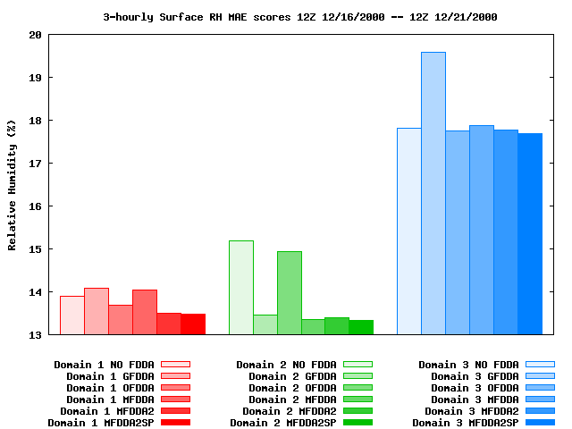
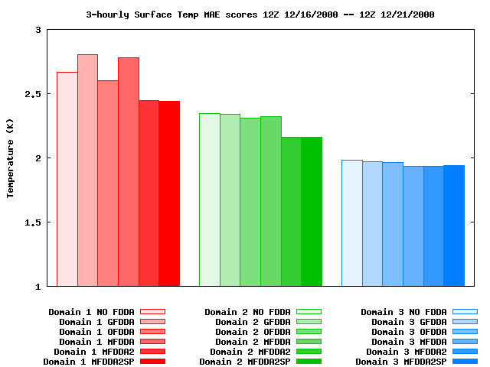
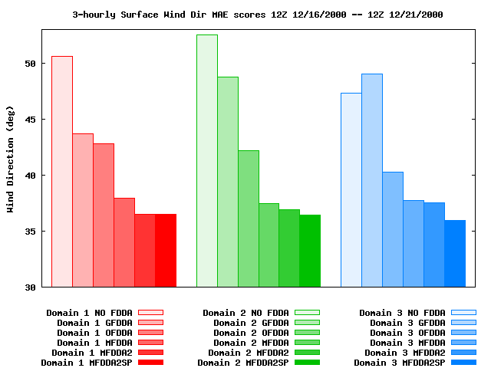
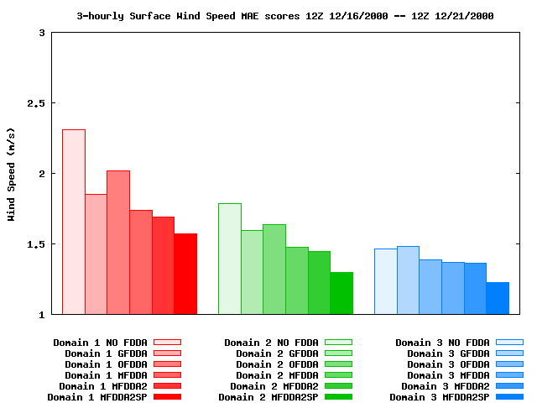
Dynamic Analysis
Rogers et al. 2013, JAMC
Winter Case Results – FDDA Exps - Surface
RH
T
T
RH
Wind Dir
DIR
Wind Speed
Speed

Slide 16
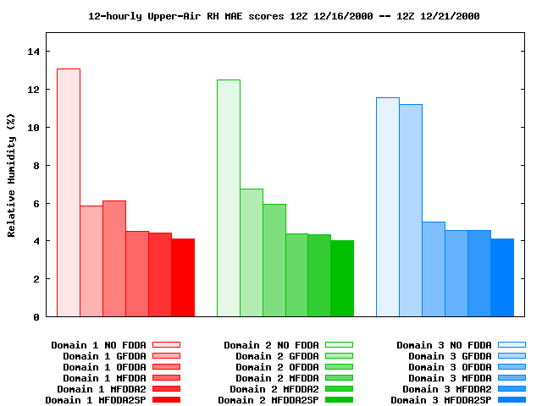
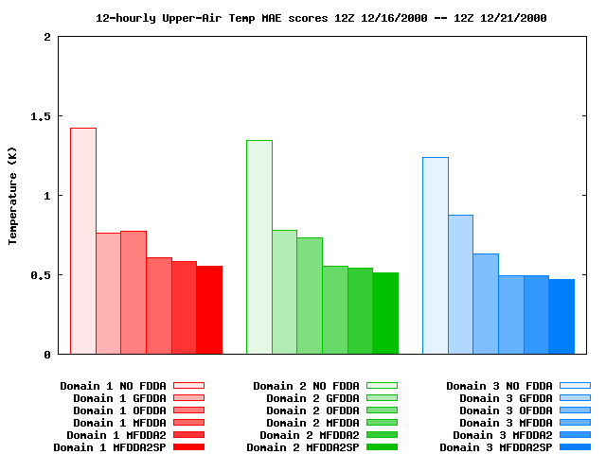
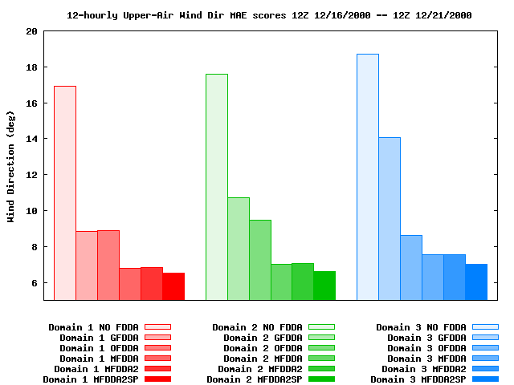
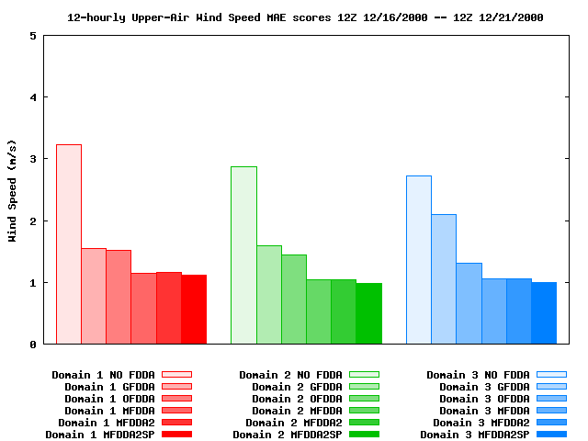
Dynamic Analysis
Rogers et al. 2013, JAMC
Winter Case Results – FDDA Expt – Upper Air
RH
T
T
RH
Wind Dir
DIR
Wind Speed
Speed

Slide 17
Dynamic Analysis
Winter Case Results – SV – 4-km Domain
No FDDA
MFDDA2SP
Daytime: 0000UTC 17 Dec 2000
Rogers et al. 2013, JAMC

Slide 18
Dynamic Analysis
Winter Case Results – SV – 4-km Domain
No FDDA
MFDDA2SP
Nighttime: 1200UTC 17 Dec 2000
Rogers et al. 2013, JAMC

Slide 19
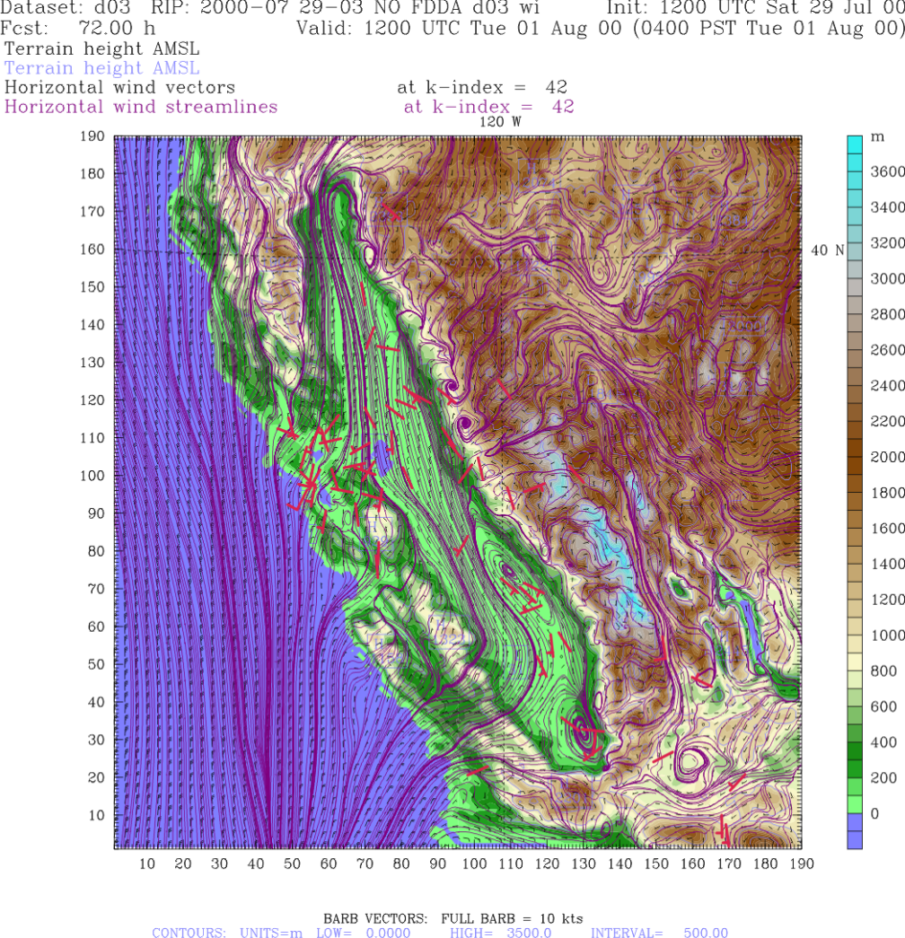
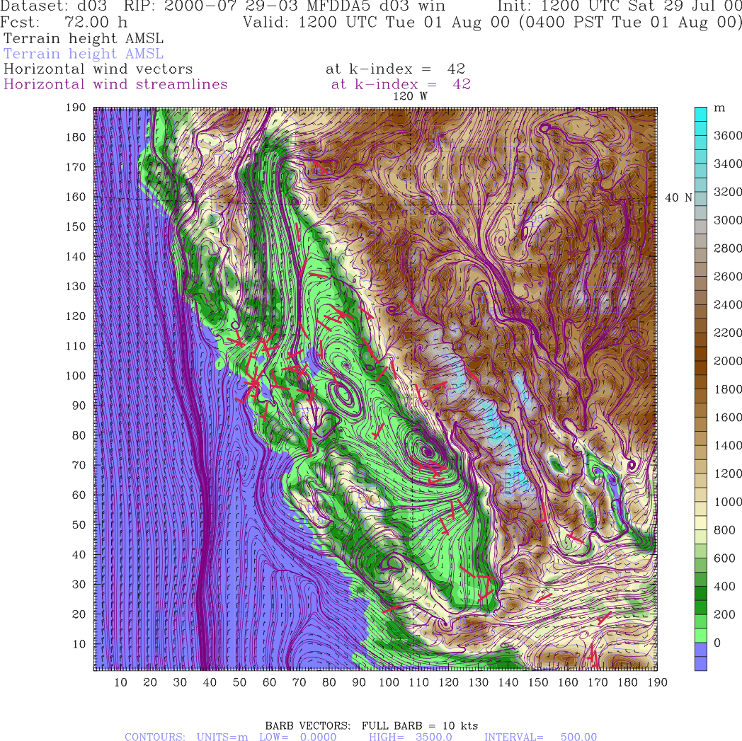
Dynamic Analysis
Summer Case Results – SV – 4-km Domain
No FDDA
MFDDA5
Rogers et al. 2013, JAMC
Nighttime: 1200UTC 01 Aug 2000

Slide 20
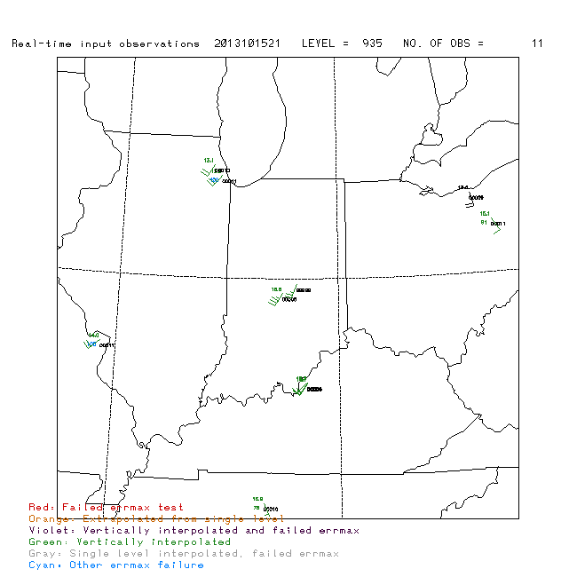
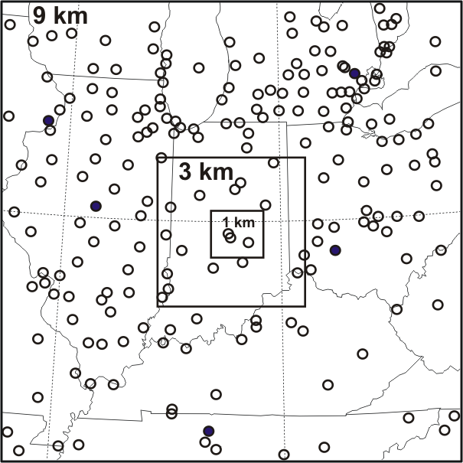
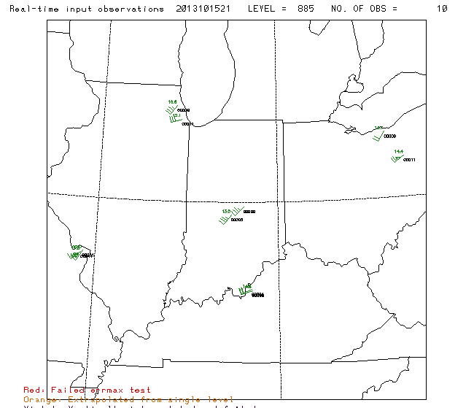
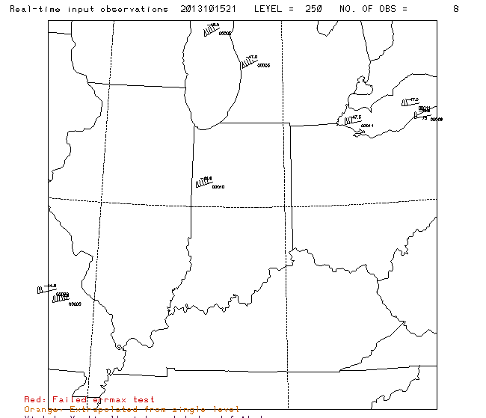
Dynamic Analysis
INFLUX Meteorological Observations Assimilated
Deng et al. 2016
WMO
ACARS & Lidar at 935 hPa
ACARS & Lidar at 885 hPa
ACARS at 250 hPa

Slide 21
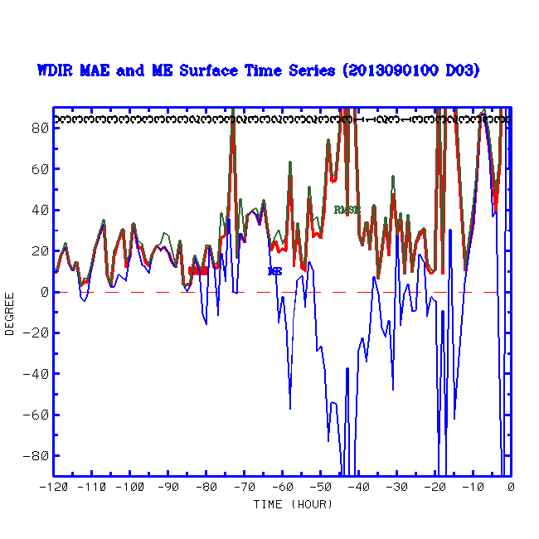
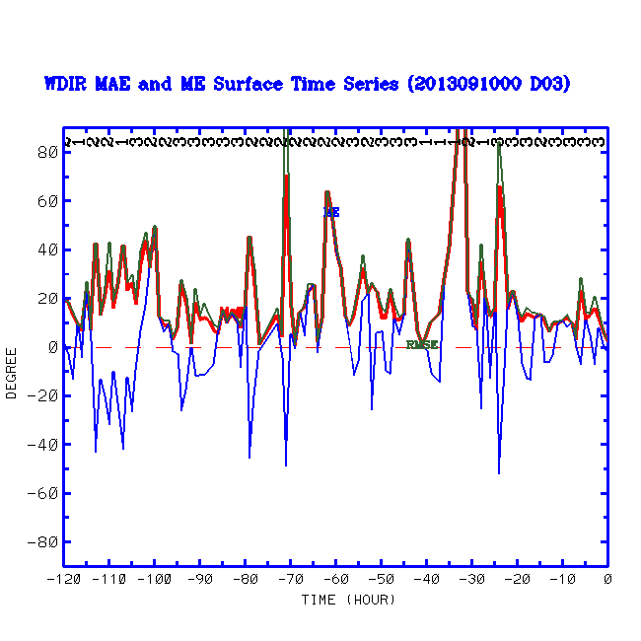
Dynamic Analysis
Deng et al. 2016
No-FFDA vs. FDDA Simulations
INFLUX Wind Direction
5 days ending at 00 UTC 2013
No-FDDA FDDA with WMO OBS

Slide 22
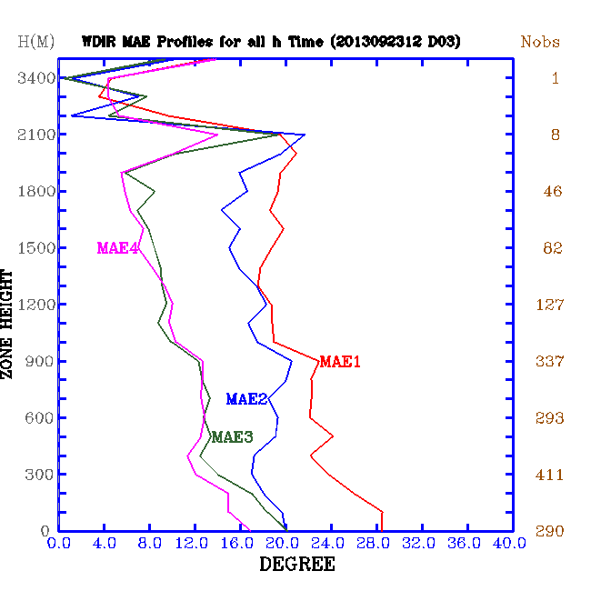
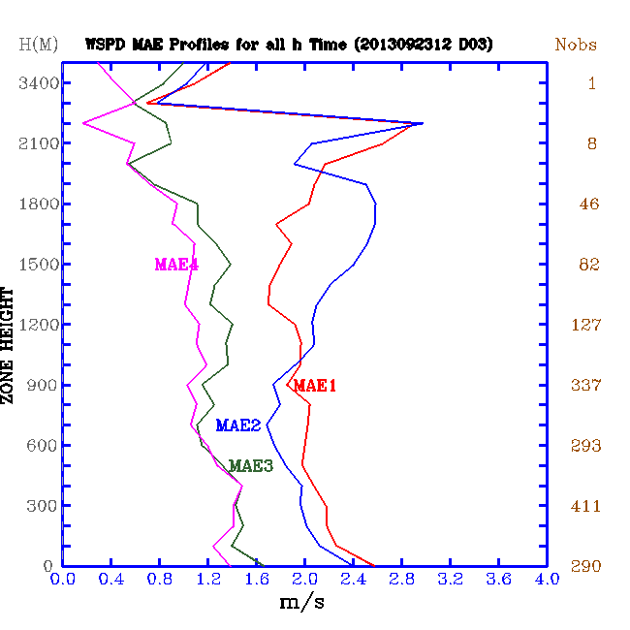
Dynamic Analysis
Deng et al. 2016
INFLUX WRF 1-km Grid Wind Direction Error, MAE
INFLUX WRF 1-km Grid Wind Speed Error, MAE
1: NOFDDA
2: FDDA_WMO
3: FDDA_WMO_Lidar
4: FDDA_WMO_Lidar_ACARS
1: NOFDDA
2: FDDA_WMO
3: FDDA_WMO_Lidar
4: FDDA_WMO_Lidar_ACARS

Slide 23
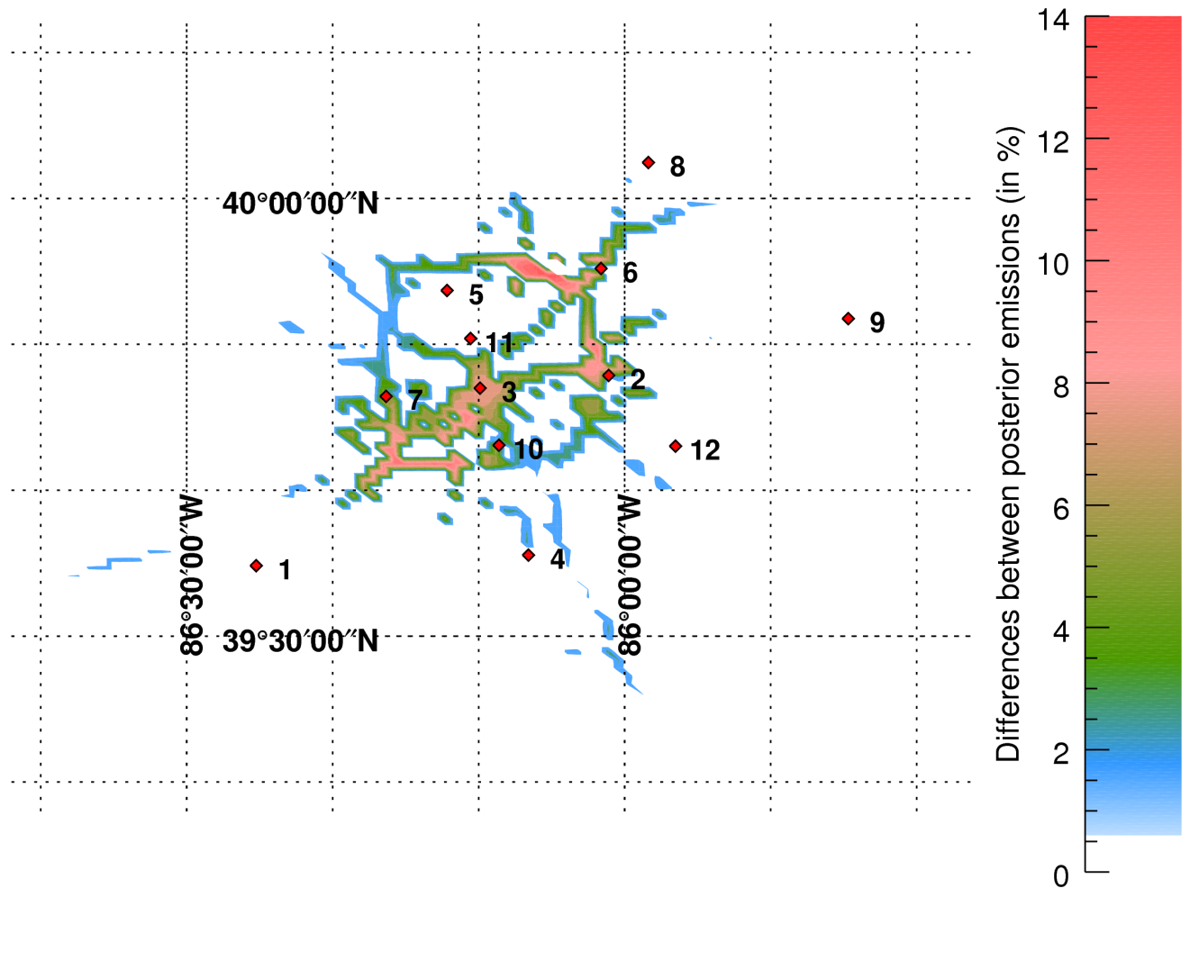
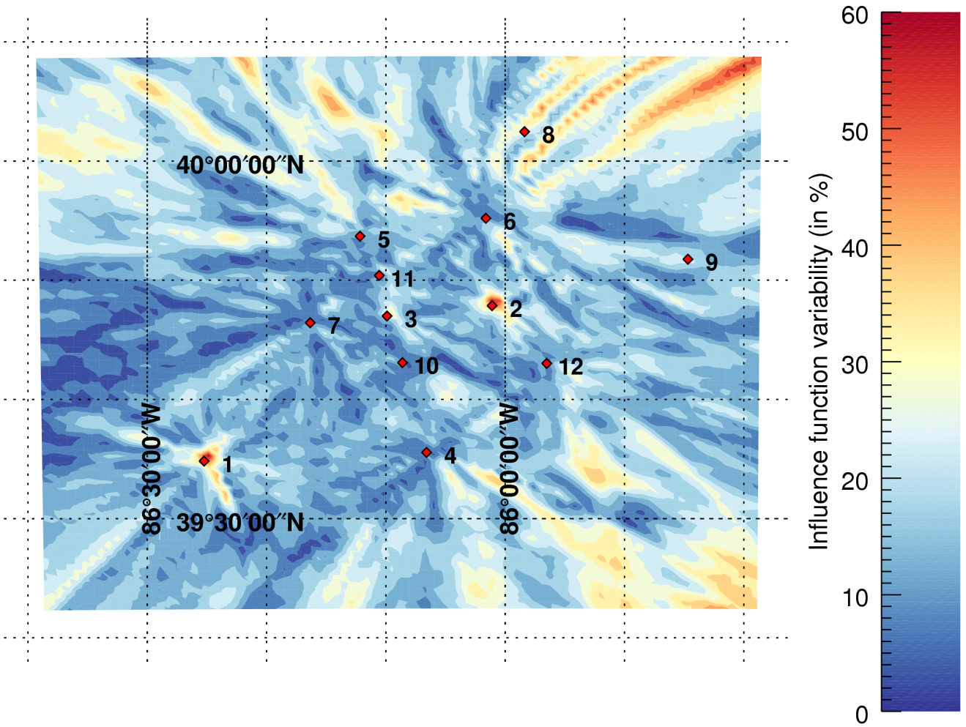
Dynamic Analysis
Deng et al. 2016

Slide 25
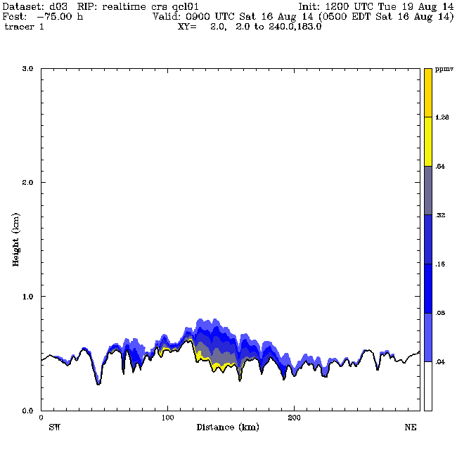
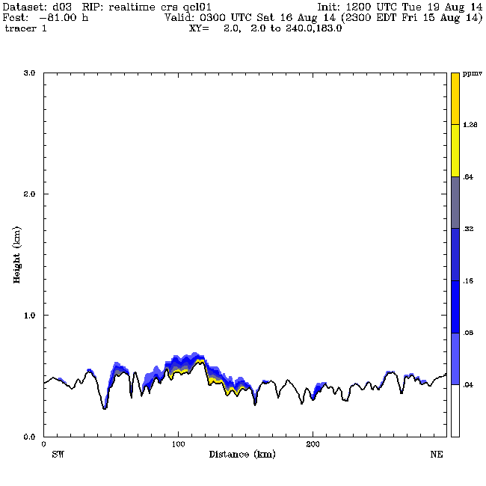
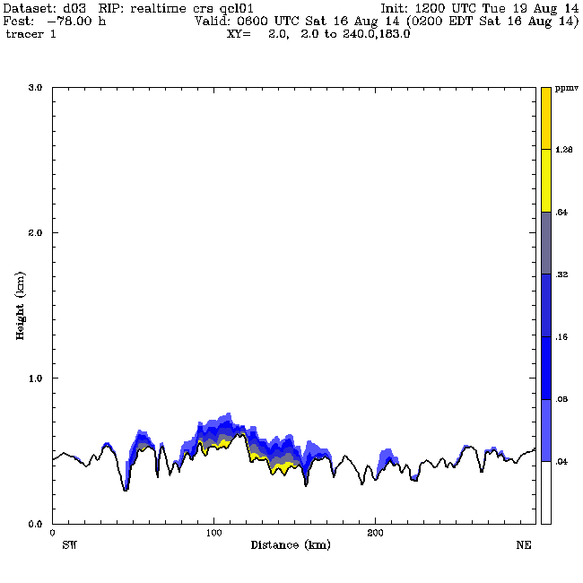
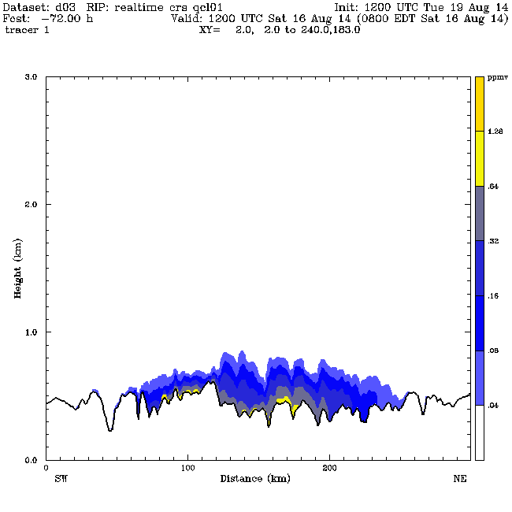
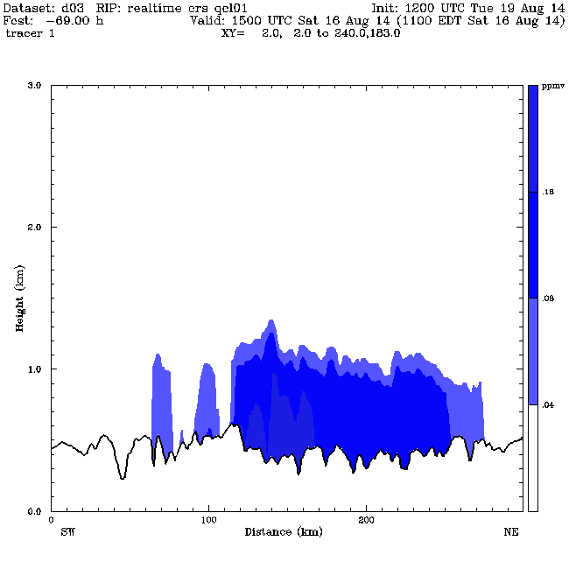
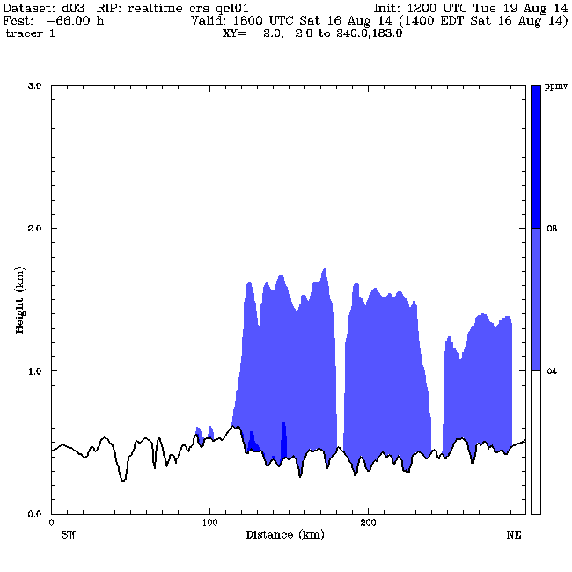
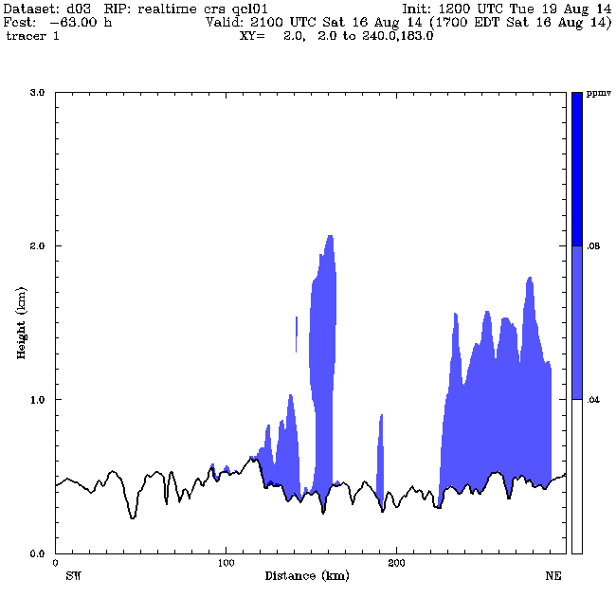
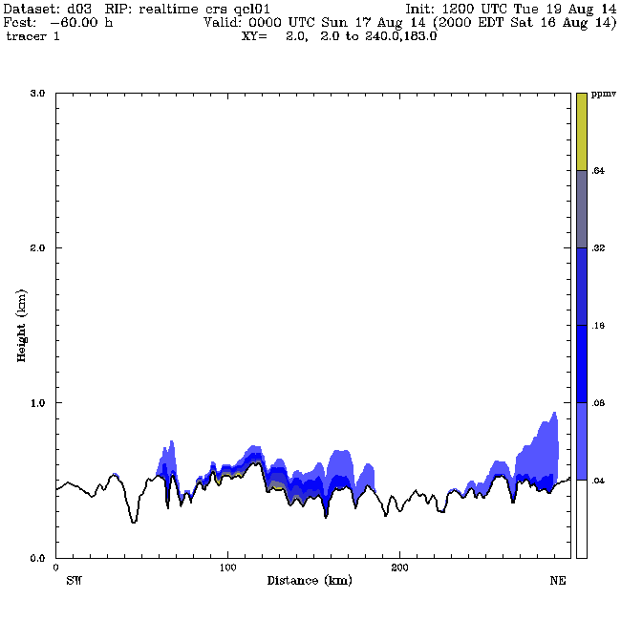
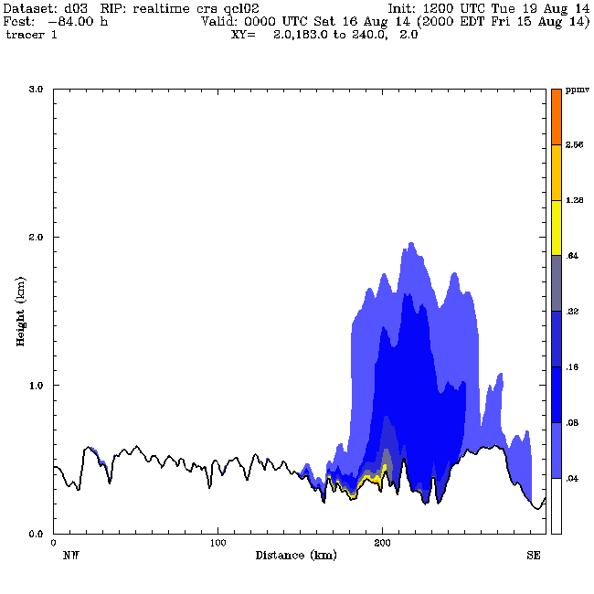
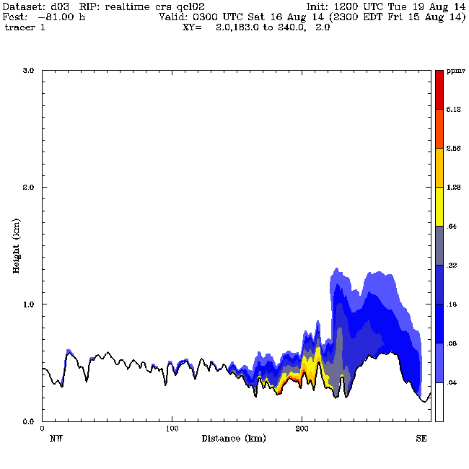
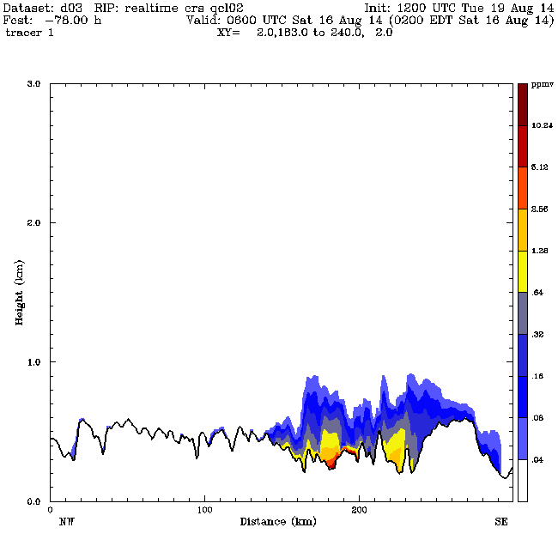


































Realtime Forecast
SW-NE
NW-SE
WRF CH4 at 8 m AGL
W-E
S-N

Slide 26



Realtime Forecast
Barkley et al. 2016

Slide 27

Realtime Forecast
Daytime Realtime Large Eddy Simulation (LES) System
(Deng et al. 2012, WRF Workshop)
WRF Grids: dx=9/3/1/0.333/0.111 km
NXxNYxNZ=202x202x50/202x202x50/202x202x50/202x202x50/202x202x50
Z(1)=8 m,
Model Physics (V3.4.1):
MYJ PBL on the first 3 grids and 3-D TKE on grid 4 and 5
RRTM/Dudhia LW/SW
Thompson microphysics
Grell-3D CPS on the 9-km grid, No SCP
RUC LSM
FDDA for dynamic initialization (DI)

Slide 28


Realtime Forecast
111-m LES Grid
Landuse
Terrain

Slide 29



Realtime Forecast
Penn State WRF NWP System Used for In-Flight Planning
for Minimal Fuel Consumption
The 2011 Green Flight Challenge Champion
(http://cafefoundation.org/v2/gfc_main.php)
(Langelaan et al. 2013, Journal of Aircraft)
WRF 1-km Resolution Forecast

Slide 30



Realtime Forecast
Deng et al. 2012
12 UTC
15 UTC
18 UTC
October 29, 2011

Slide 31




Realtime Forecast
Deng et al. 2012
15 UTC
16 UTC
17 UTC
18 UTC

Slide 32

Observed Precipitation Type Reported on Oct. 29, 2011 at LaGuardia (LGA), John F. Kennedy (JFK), and Newark (EWR) Airports
Realtime Forecast
Deng et al. 2012
NGAFS Forecast
Red lines above the time lines indicate rain. Blue lines indicate snow.

Slide 33

Six ACARS Composite Temperature Soundings (C) from Aircraft Ascents and Descents in the NYC Area Between 1200 – 1800 UTC, Oct. 29, 2011
Realtime Forecast
Deng et al. 2012

Slide 34




Realtime Forecast
4-h Precipitation Type Forecasts on the 1-km grid
Deng et al. 2012
16 UTC
No FDDA
16 UTC
ACARS

Slide 35



Realtime Forecast
1-km NGAFS-Predicted Surface Temperature with Observations
16 UTC
NO FDDA
16 UTC
RUC Analysis
16 UTC
ACARS
Deng et al. 2012

Slide 36

Realtime Forecast
NGAFS 4-h Forecast of the Low-level Temperature Structure
Deng et al. 2012

Slide 37

Realtime Forecast
Observed and NGAFS Wind Direction Forecasts
Deng et al. 2012

