Slide 1
Triple concentric eyewalls formation in Typhoon Usagi (2013): observation and simulation
Simon(Su) Liu, Fuqing Zhang

Slide 2
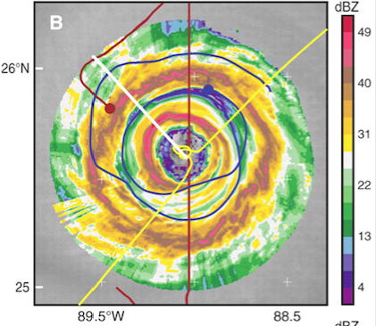
Concentric Eyewall Replacement Cycle (ERC)
Procedure:
1. Outer rainbands may strengthen and organized into a convective ring surrounding the inner eyewall
2 Outer eyewall contract and ‘chock’ inner eyewall
3. Outer eyewall replace inner one
Houze et al. 2007
Primary Eyewall
Secondary Eyewall
Why important?
ERC connect with TC intensity change

Slide 3
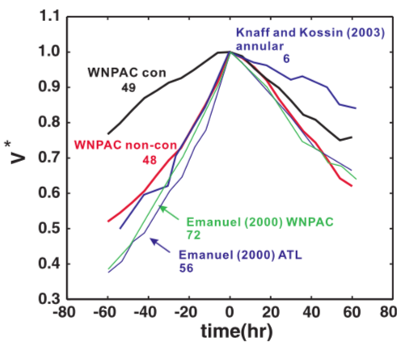
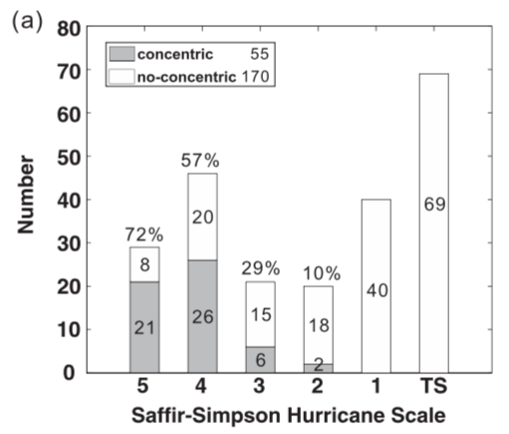
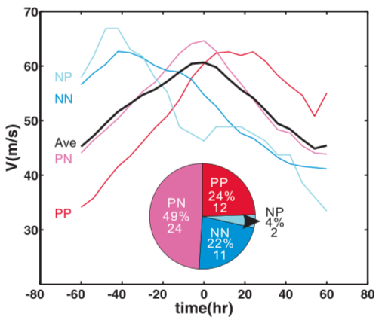
Backgroud: Statistic of Concentric Eyewalls (CE)
Most of Intense TC has CE structure
Half the CE happen in TC intensity peak
Compare to No-CE TC, CE has higher intensity for longer duration
Kuo et al. 2009
Notes:
Half of concentric eyewall has ERC process, Yang et al. 2013

Slide 4
Concentric Eyewall formation theory-Still under research
Potential Vorticity generation
Vortex Rossby wave
Formation of unbalanced supergradient wind
2D vortex interactions
…
Here comes more interesting phenomena
-Triple eyewall

Slide 5
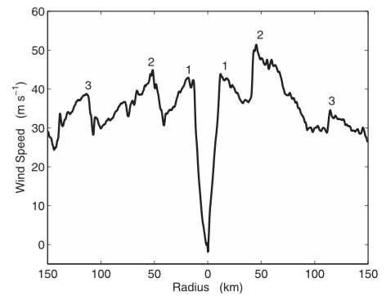
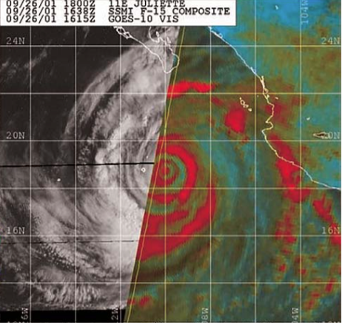
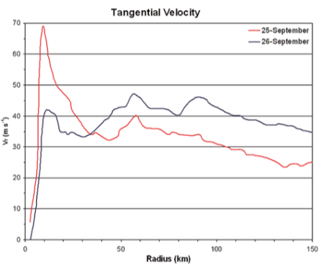
Triple Eyewall Observation-aircraft measure
Hurricane Frances 2004
Hurricane Juliette 2001
Sitkowski et al. 2011
McNoldy et al. 2004
No evolution or detail structure

Slide 6
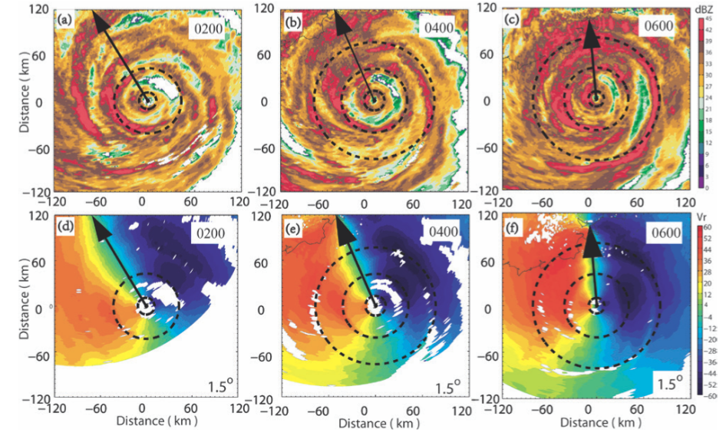
Doppler Observation of Usagi 2013
Zhao et al. 2016

Slide 7
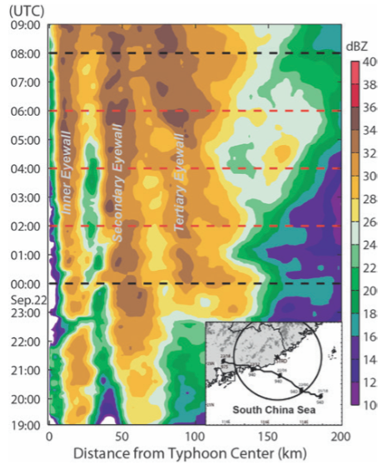
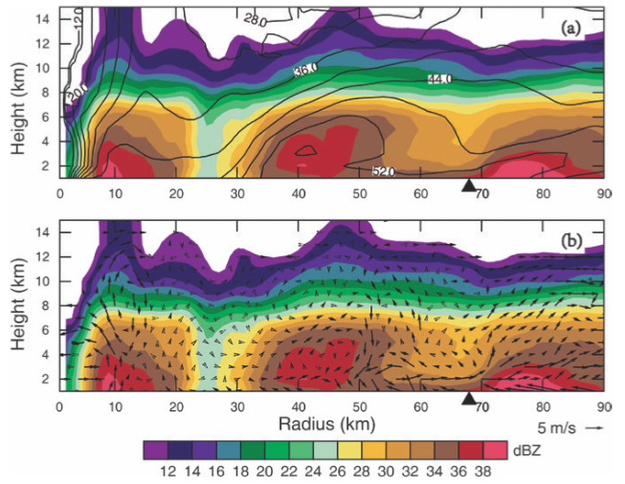
Structure of Eyewalls
Both secondary and tertiary eyewall contract with time
Both moats dominate with downdraft
Questions:
1. What the role of tertiary eyewall?
2. Why inner eyewall did not dissipate after secondary eyewall formation?
Zhao et al. 2016

Slide 8
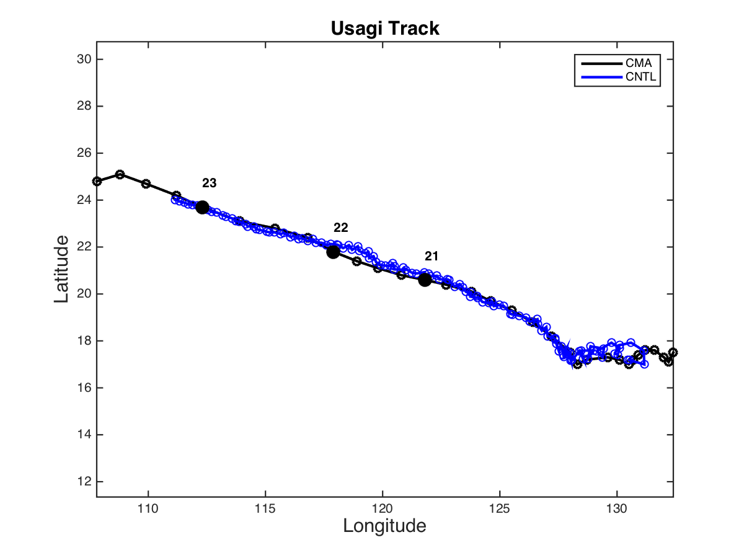
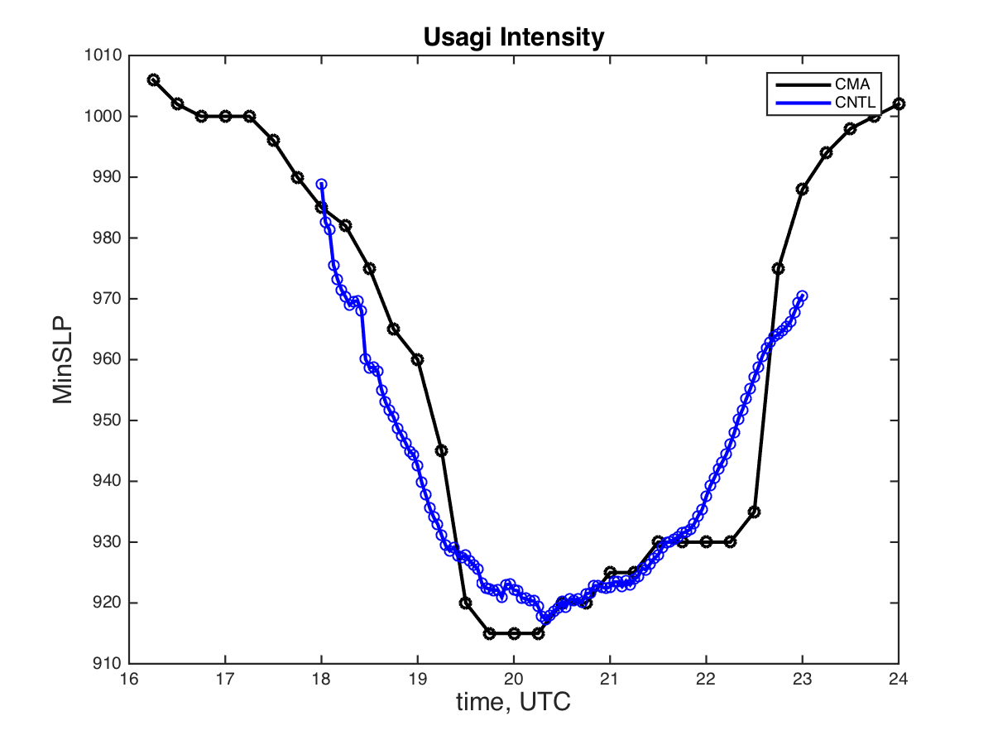
Initial Run
3 domains
27km/9km/3km
Domain 2 and 3 present moving
No Data Assimilation
Future Plan:
Get best initial run (track)
Assimilation doppler velocity to see if triple eyewall could be simulate
…

Slide 9
Thanks!
Questions?

