Slide 1
Compound Severity of Tropical Cyclones in Mainland China
Yanting Ye
2015-12-11

Slide 2
Background
The existing TC/Hurricane scale criteria are based on the wind speed;
  Beaufort scale, Saffir-Simpson hurricane wind scale
Wind is not the only hazard;
  Katrina(2005) – storm surge
  Billis(2006) – Precipitation
  Fetow (2013) – inland flooding
  …
Incomprehensive understanding of hazards →insufficient disaster preparedness;
  Wind → weather warning → other hazards ignored

Slide 3
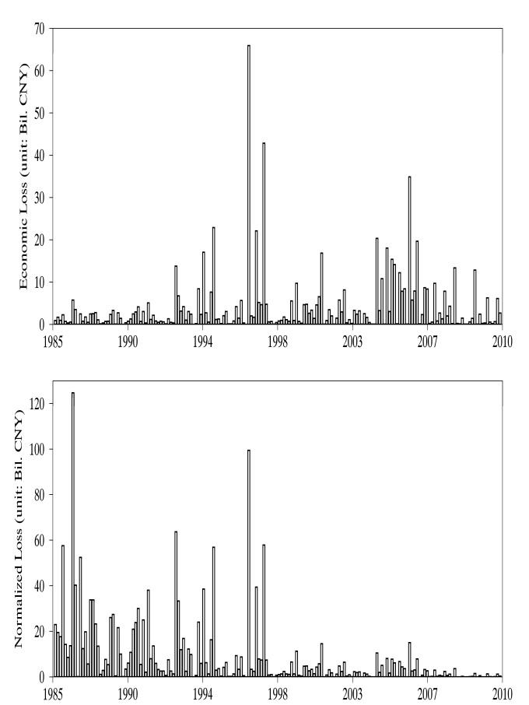
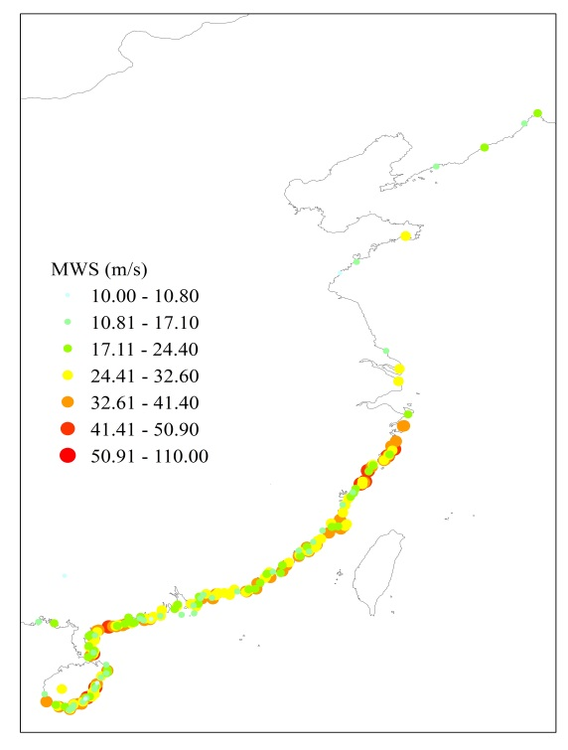
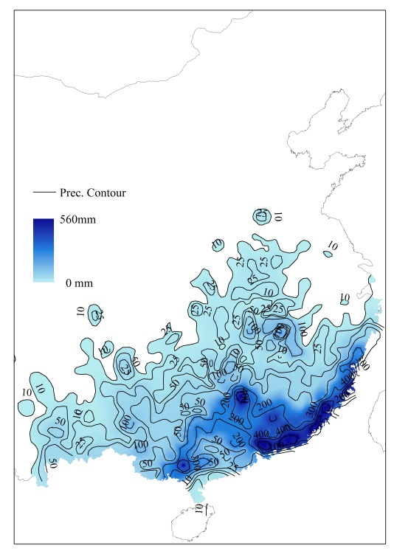
Data
Two hazards
  Wind speed at landed point
  Total precipitation
Normalized direct economic Loss

Slide 4
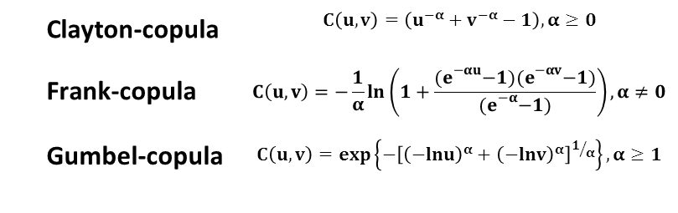
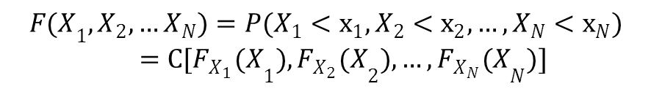
Method
Index
  Return period exceeding probability
Probability analysis
  Marginal distribution
  Copula function: a function to joint two-dimension or more marginal CDFs
$${F(X}_{1},X_{2},…X_{N})=P(X_{1}<x_{1},X_{2}<x_{2},…,X_{N}<x_{N})=C[{F_{X_{1}}(X}_{1}),{F_{X_{2}}(X}_{2}),…,{F_{X_{N}}(X}_{N})]$$
Clayton-copula | $$C\left(u,v\right)=\left(u^{−α}+v^{−α}−1\right),α≥0$$
Frank-copula | $$C\left(u,v\right)=−\frac{1}{α}ln\left(1+\frac{{(e}^{−αu}−1){(e}^{−αv}−1)}{{(e}^{−α}−1)}\right),α≠0$$
Gumbel-copula | $$C\left(u,v\right)=\exp\left\{−{\left[{\left(−lnu\right)}^{α}+{\left(−lnv\right)}^{α}\right]}^{1/α}\right\},α≥1$$

Slide 5
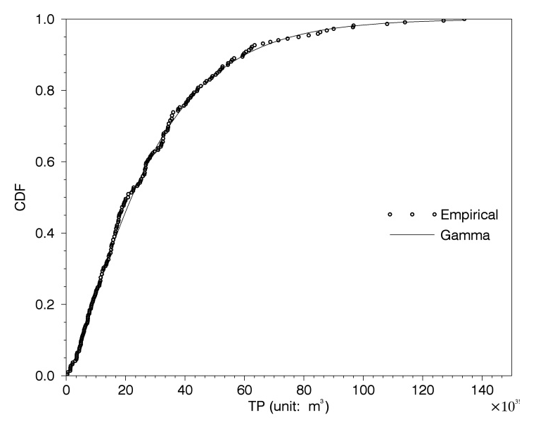
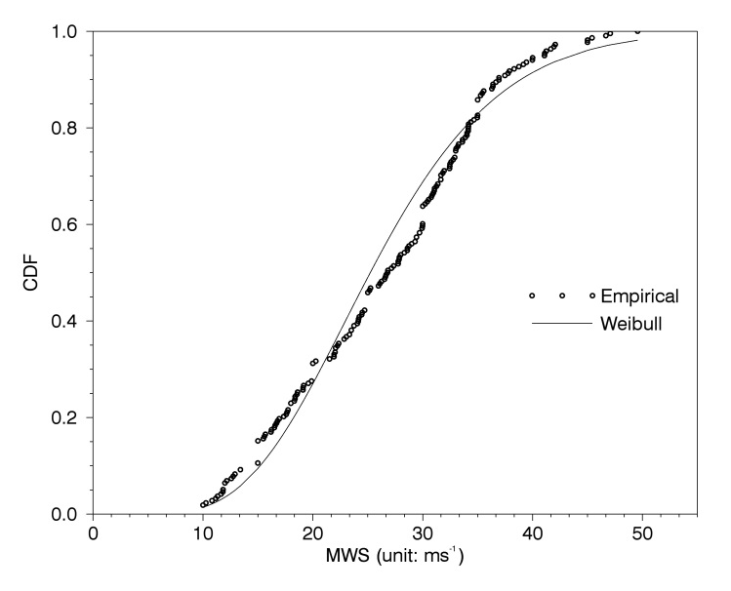
Result
Fitted probability

Slide 6
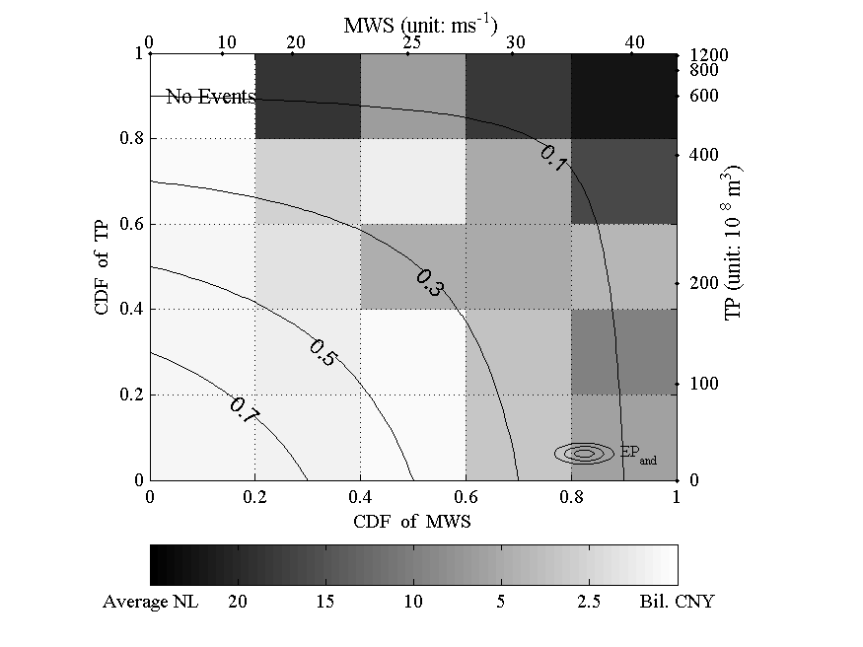
Result
Compound severity

Slide 7
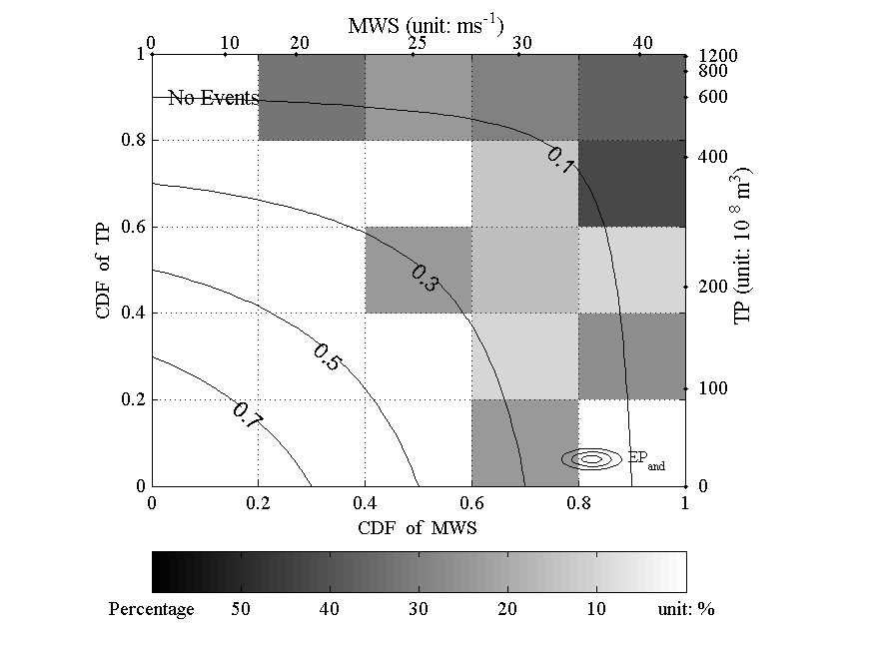
Result
Compound severity
Percentage of TCs with NL > 20 billion CNY

Slide 8
Future work
More hazards to be added, storm surge, duration…
A index to present the compound severity to be build.

