Slide 1
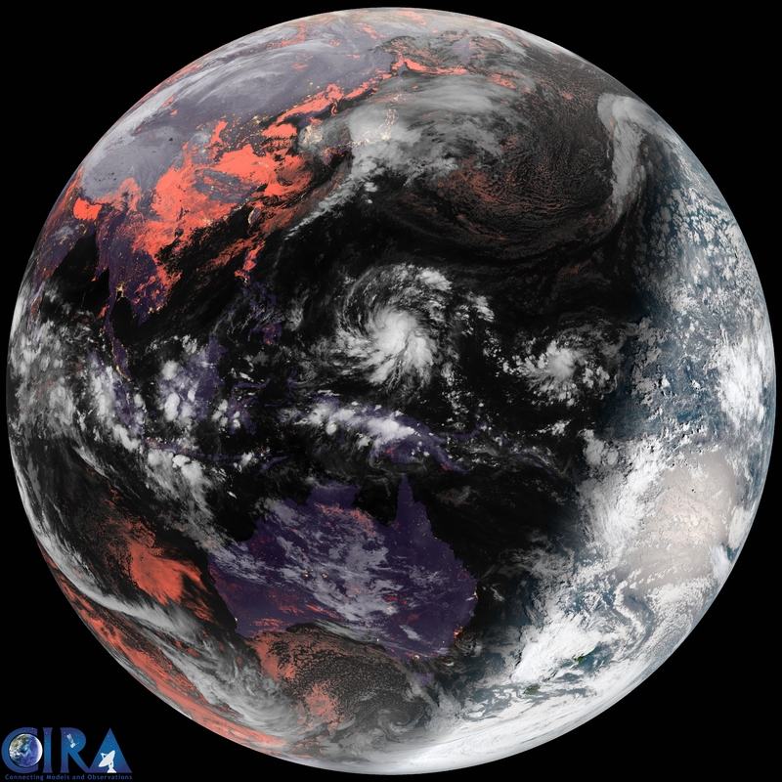
Assimilation of All-sky Infrared Brightness Temperatures and
Atmospheric
Motion Vectors in
Tropical Cyclone Analysis
Himawari-8 image
from CIRA website
Group meeting 2015.8.18
Masashi MINAMIDE, Fuqing ZHANG,
Eugene CLOTHIAUX
Notes:
Direct Assimilation of all-sky infrared radiance satellite observation for the analysis and forecast of tropical cyclones

Slide 2
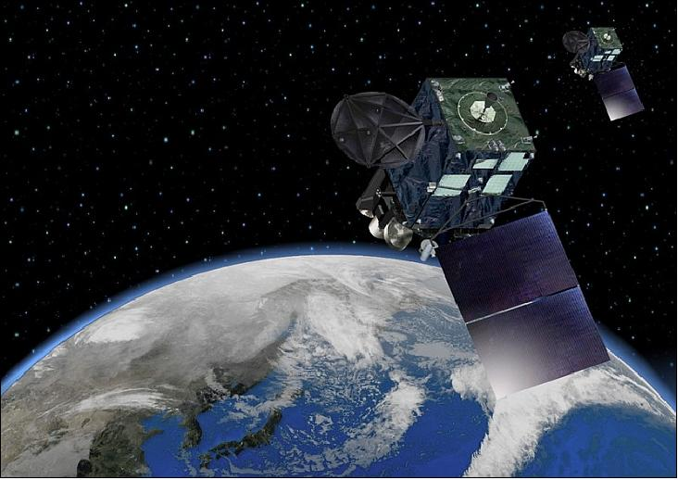
New Satellites! ~Himawari-8 AHI & GOES-R ABI~
Launch Dates:
Oct 2014 (Himawari-8, Japan)
Mar 2016 (GOES-R, USA)
Coverage: Hemispheric
Frequency: 10-15 minutes
Resolution: 2 km
Error sources in assimilation:
Instrument error
Observation operator (CRTM)
Representative error
And so on!
Retrieved variables
Assignment of appropriate observation error
Notes:
New satellite was launched on October 2014 in last year, which is called Himawari-8 Advanced Himawari Imager by Japan Meteorological Agency.
Another satellite with almost the same ability is planned to be launched on March 2016 from US, which is called GOES-R ABI.
They both have wide coverage, quite high temporal & spatial resolution.
Characteristics is that they have 3 WV channels. Generally, 2D > difficult to gain vertical information
New satellites are expected to provide vertical information.

Slide 3
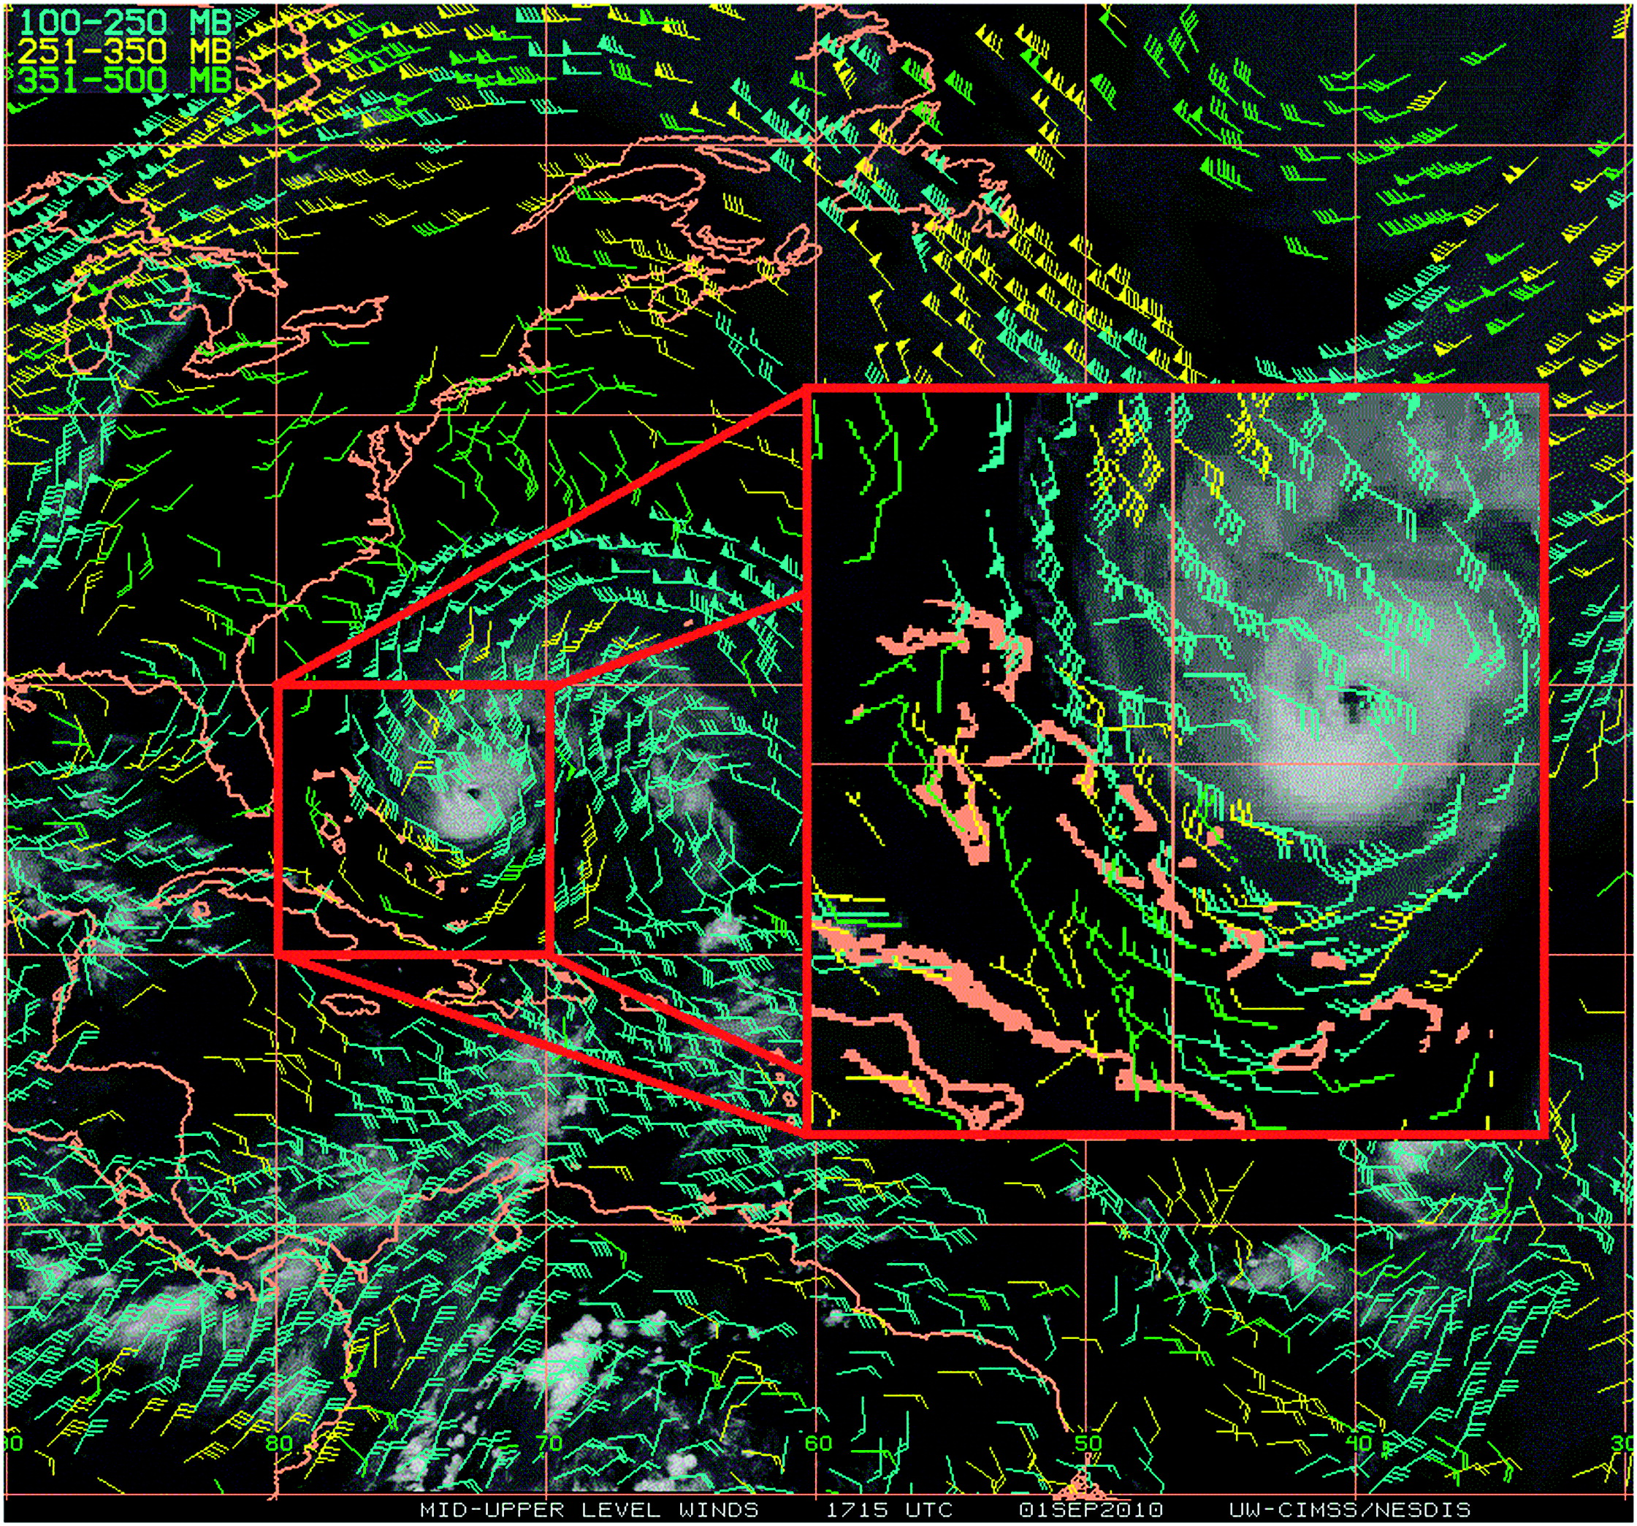
Satellite-Retrieved Atmospheric Motion Vectors (AMV)
Good:
Nonlinear!
Accurate & dense by High Frequency & High Resolution
Error sources:
Only cloud edge
Height limited (cirrus or cumulous)
Height assignment
Cloud assumption (track-able, real wind)
Fig. Sears and Velden (2012)
Notes:
New satellite was launched on October 2014 in last year, which is called Himawari-8 Advanced Himawari Imager by Japan Meteorological Agency.
Another satellite with almost the same ability is planned to be launched on March 2016 from US, which is called GOES-R ABI.
They both have wide coverage, quite high temporal & spatial resolution.
Characteristics is that they have 3 WV channels. Generally, 2D > difficult to gain vertical information
New satellites are expected to provide vertical information.

Slide 4
Tb Data Assimilation: WRF-EnKF via CRTM
t
WRF
EnKF-CRTM
Observation: y
t+dt
Calculate brightness temperature (Tb): h(x^{b})
Community Radiative Transfer Model (CRTM; Han et al. 2006)
WRF version 3.6.1 (Skamarock et al. 2008)
PSU WRF-EnKF: Zhang et al. (2009); Weng and Zhang (2012)
Ensemble size: 60
Relaxation to prior: alpha=0.5 (Zhang et al. 2004)
Notes:
For direct assimilation of radiance, I coupled CRTM to PSU WRF-EnKF framework.
It can calculate the simulated radiance from WRF output, and directly compare them with the satellite observation.
In this framework, I used…

Slide 5
Flow-dependent Observation Error Inflation
Original EnKF Equation
Kalman Gain=weight
Innovation
Suppose x is SLP, if model is clear-sky & obs. is cloudy-sky,
of reduction may occur.
Updated EnKF Equation
Observation Error Inflation
Notes:
Problem in using infrared radiance data is their non-linearity to cloud.
Vertical information in the previous slide can only be provided in the clear-sky.
In cloudy sky, all 3 water vapor channels have the same information, because they are all sensitive to top of the cloud with the existence of cloud. Their correlation is almost over 0.99.
In cloudy, 1 cannel. In clear, we can fully derive the ability of multiple WV channels. > In-between

Slide 6
Successive Covariance Localization (Zhang et al. 2004)
RMSE of Brightness Temperature (K)
4-grid: ROI=30km
for small scale
6-grid: ROI=300km
for large scale
20 | 30 | 40 | 50 | 100 | 200 | 300
Radius of influence (km)
Notes:
Problem in using infrared radiance data is their non-linearity to cloud.
Vertical information in the previous slide can only be provided in the clear-sky.
In cloudy sky, all 3 water vapor channels have the same information, because they are all sensitive to top of the cloud with the existence of cloud. Their correlation is almost over 0.99.
In cloudy, 1 cannel. In clear, we can fully derive the ability of multiple WV channels. > In-between

Slide 7
Observing System Simulation Experiments (OSSE)
Truth run: Hurricane Karl, 21Z 16 – 00Z 18 SEP 2010
Resolution: 27, 9 & 3 km (D1-D3), EnKF only for D3
12Z/16
19Z
20Z
21Z/16
True simulation
00Z/18
Airborne
Synthetic observations
Every 1 hour
minSLP
minSLP
HPI
Every 10 min
Infrared Tb (ch8,9&10)
BT+HPI
Every 1 hour
AMVs
AMVs
AMV+BT+HPI
22:00
22:10
…
23:00
…
Notes:
Since those new satellites are not yet in operation now, we conducted OSSE with hurricane Karl case.
Firstly, we assimilated airborne doppler radar observation to have a good Karl simulation. Then, we assumed this as truth and conducted OSSE.
There are 2 experiments. One is to assimilate both synthetic infrared radiance observation and synthetic minimum SLP, and the other is to assimilate only synthetic minimum SLP.
Thus, comparing those 2 simulations, we can see the impact of radiance.
Radiance is assimilated every 10 minutes, which I assumed as Himawari-8.
Minimum SLP is assimilated every 1 hour, which I assumed as interpolated best track data.

Slide 8
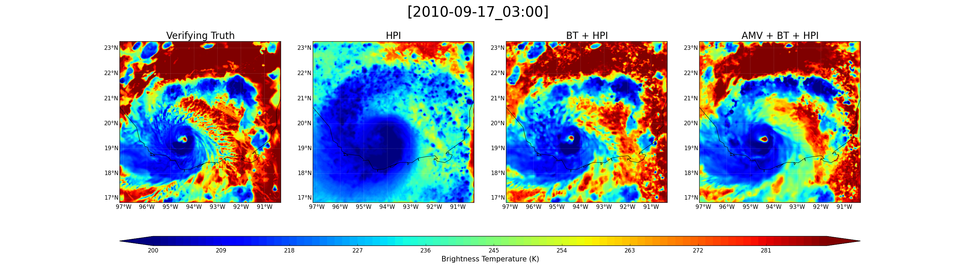
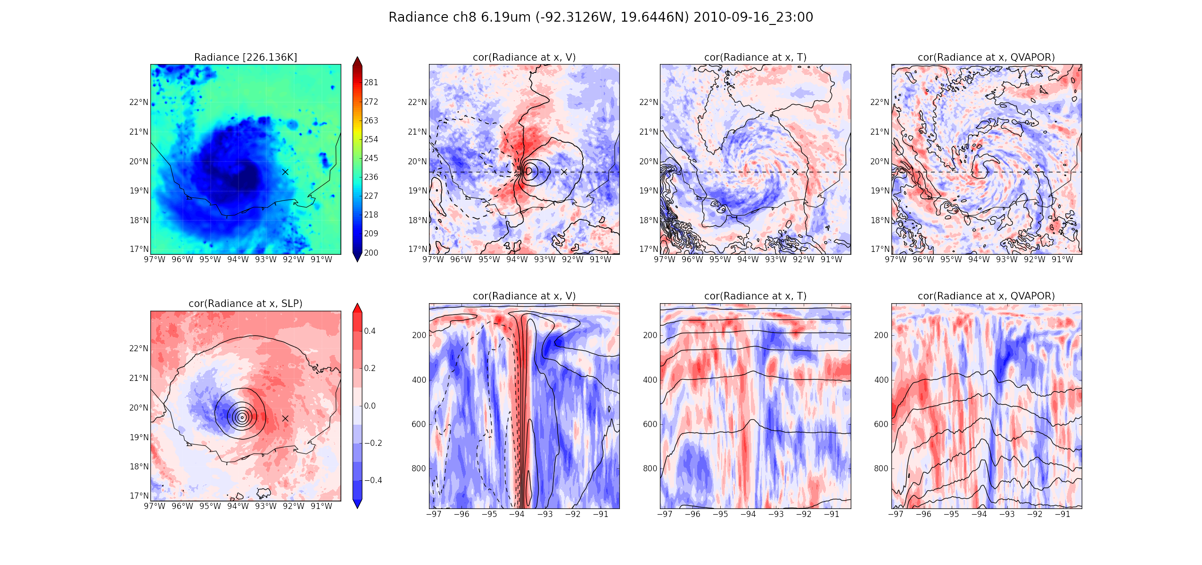
EnKF Performance Assimilating Simulated Radiance
Truth versus EnKF-analyzed Infrared
Brightness Temperature of GOES-R ABI Ch14 (11.2 µm)
Verifying truth
HPI
BT +HPI
AMV +BT +HPI
Notes:
Captures most of the cloud field.
Minimum SLP assimilation cannot capture

Slide 9
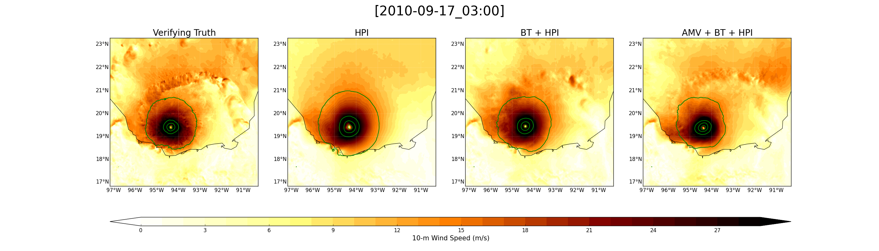
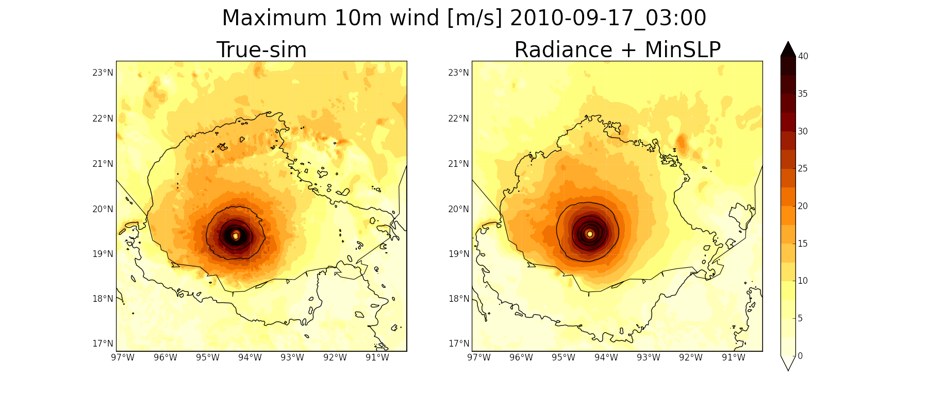
EnKF Performance Assimilating Simulated Radiance
Truth versus EnKF-analyzed
10-m wind speed (m/s)
Verifying truth
HPI
Secondary horizontal wind maximum
BT +HPI
AMV +BT +HPI
Notes:
Captures most of the cloud field.
Minimum SLP assimilation cannot capture

Slide 10
EnKF Performance on Tropical Cyclone Intensity
Minimum SLP (hPa)
Maximum 10m wind (m/s)
The longer the assimilation, the better the analysis.
Analysis is capable of capturing the intensity changes.
Notes:
The impact is not limited to radiance field. > temporal change of TC intensity.
Though it’s not perfect, I t can capture the general intensity change.

Slide 11
EnKF Performance on Horizontal wind
RMSE of Wind Speed (m/s)
Notes:
Though they are little bit smoothed in entire domain, the detailed structure of eyewall, and rainbands structure are captured.

Slide 12
EnKF Performance on Vapor
RMSE of Mixing Ratio (g/kg)
Notes:
Though they are little bit smoothed in entire domain, the detailed structure of eyewall, and rainbands structure are captured.

Slide 13
Concluding Remarks
  New methodology to assign a flow-dependent adaptive observation error has been proposed.
  Satellite-measured infrared brightness temperatures and satellite-retrieved atmospheric motion vectors have complimentary impacts through assimilation on tropical cyclones.
  Imperfect model OSSE, assimilation of real-data observations is underway.

Slide 14
RMSE of Clear sky
RMSE of Cloudy sky
Notes:
As in slide 16 but in clear sky

Slide 15
RMSE of Clear sky
RMSE of Cloudy sky
Notes:
As in slide 16 but in clear sky

Slide 16
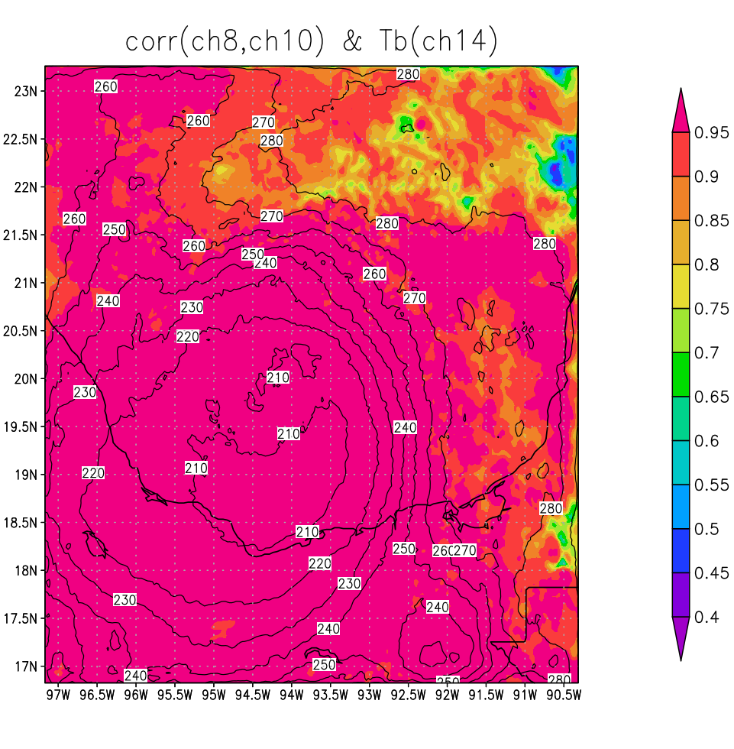
0. Supplementary slides
Channel Selection
Clear-sky
Band-8 (6.19µm) | upper troposphere
Band-9 (6.95µm) | middle troposphere
Band-10 (7.34µm) | lower troposphere
Band-14 (11.2µm) | surface
(shaded)Correlation between band-8 & 10 on each grid, calculated with 60 ensemble members
(contour) band-14 radiance field of ensemble mean

Slide 17
Channel Selection based on Correlation Analysis
285K
292K
Axis: Ch14, could top temperature
Cloudy
In-between
(almost clear)
Clear
Ch8, 6.19 um
Ch9, 6.95 um
Ch10, 7.34 um
1 channel for cloudy-sky
2 channels for in-between region
All 3 water vapor channels for clear-sky
Notes:
Problem in using infrared radiance data is their non-linearity to cloud.
Vertical information in the previous slide can only be provided in the clear-sky.
In cloudy sky, all 3 water vapor channels have the same information, because they are all sensitive to top of the cloud with the existence of cloud. Their correlation is almost over 0.99.
In cloudy, 1 cannel. In clear, we can fully derive the ability of multiple WV channels. > In-between

Slide 18
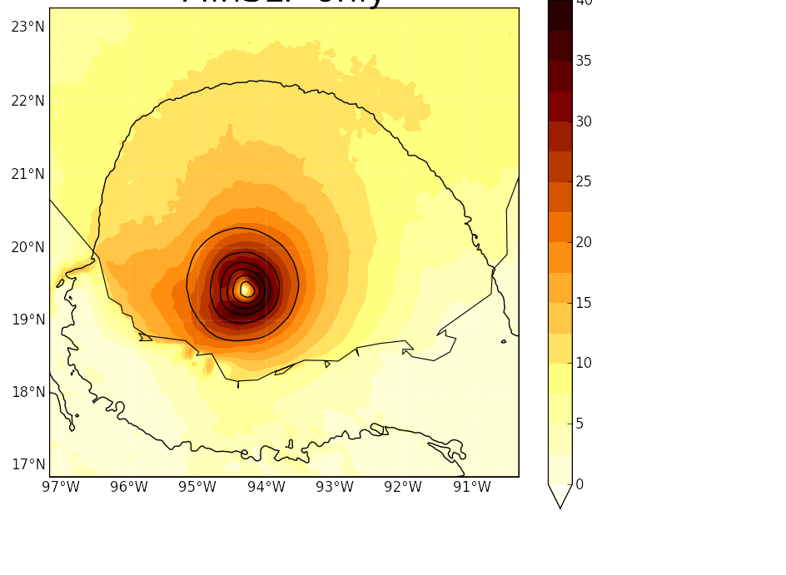
EnKF Performance on 10-m wind speeds
0. Supplementary slides
EnKF analysis
with radiance
& minimum SLP
EnKF analysis
with minimum SLP only
Verifying truth
Secondary horizontal wind maximum
maximum wind within the eyewall
m/s
Colors: 10-m wind speeds
Contours: SLP
Notes:
Furthermore, I would like to show some fields which are not directly connected with radiance.
Our assimilation captured the maximum wind associated with eyewall region quite well.
Even the secondary horizontal wind maximum with principle rainbands is also somehow captured.

Slide 19
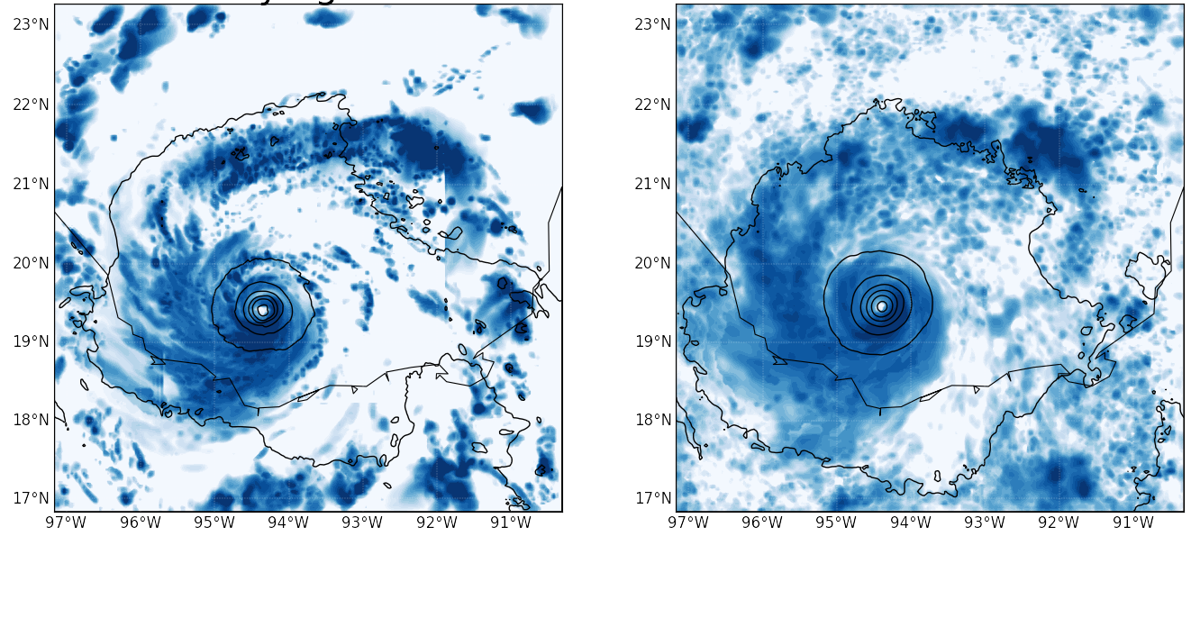
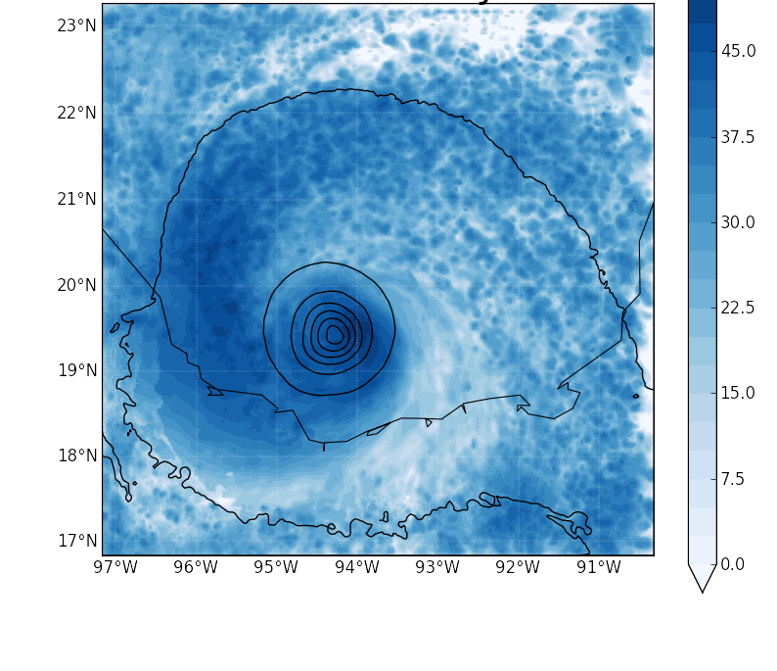
EnKF Performance on Radar Reflectivity
0. Supplementary slides
Rainband structure
EnKF analysis
with radiance
& minimum SLP
EnKF analysis
with minimum SLP only
Verifying truth
Strong Precipitation in south of eyewall
dbz
Colors: simulated reflectivity
Contours: SLP
Notes:
Though they are little bit smoothed in entire domain, the detailed structure of eyewall, and rainbands structure are captured.

Slide 20
Simulated Radiance and Correlations to SLP
Colors: ensemble correlation of SLP to brightness temp. at ‘X’
Contours: ensemble mean SLP
Simulated GOES-R ABI
Ch8 (6.19 µm)
brightness temperature
Notes:
Before going to the assimilation result, I firstly would like to show the potential impact of radiance to model state variables by the correlation analysis.
Left figure is the simulated infrared radiance of channel 8, which is one of the WV channels, using CRTM.
Right is the ensemble correlation of SLP to the radiance at the point of x.
Infrared radiance is sensitive to T, vapor and hydrometeors, thus it is not dynamically connected to SLP.
But there is a strong correlation between them, indicating that the radiance at this x point has an ability to move the hurricane center zonally.

Slide 21
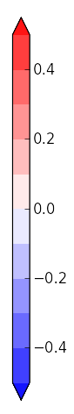
Correlations of Radiance to Model State Variables
V
Temperature
Vapor
Colors: ensemble correlation to brightness temp. (6.19 µm) at ‘x’ ,
Contours: ensemble mean at 930 hPa (top) & 19.6 N (below)
Notes:
Those are the same figures as SLP, but different variables. Below figures are the vertical cross section at dashed line.
Consistent with SLP, V field also shows the impact of radiance to move the hurricane position zonally.
Especially from T and Vapor field, we can clearly see that this radiance is strongly sensitive to some vertical layer, indicating the ability to provide vertical information.

