Slide 1
Implementation of covariance inflation methods on a two-layer quasi-geostrophic model
Yicun (Ethan) Zhen
Department of Mathematics
The Pennsylvania State University

Slide 2
Overview
Introduction of the QG model
Review of several covariance inflation methods
Experimental Setup
Numerical results and analysis
Summary and short-term future plan

Slide 3
Brief intro of QG model
2D periodic domain with 128×128×2 grid points;
2 vertical layers;
Prognostic variables: potential vorticity(q);
Diagnostic variables: (u,v) and stream function(ψ).
Top layer :
Bottom layer :
Atmosphere case and ocean case

Slide 4
Brief intro of QG model

Slide 5
Review of several covariance inflation Methods
Obs
Relx
ACI
Obs
Forecast
Analysis
model
Forecast
Relx: covariance relaxation
CI_af: covariance inflation
after data assimilation
CI_bf: covariance inflation
before data assimilation
ACI: adaptive covariance inflation methods
(Berry-Sauer’s and modified Belanger’s method).
CI_bf
CI_af

Slide 6
Review of several covariance inflation Methods
Relx
ACI
Obs
Obs
Forecast
Analysis
model
Forecast
CI_af
CI_bf
Relx :
CI_af :
CI_bf, ACI :
is adaptive for ACI but fixed for others.

Slide 7
Experimental Setup
Serial EnSrF with ensemble size = 20;
Observation network: stream function value at 6×6×2 uniformly spaced grid points;
rº=0.001 for the atmosphere case and 0.25E for the ocean case, where E is the mean squared value of the stream function;
Gaspari-Cohn localization with radius = 30 grid points;

Slide 8
Numerical Results and Analysis
The RMSE without using covariance inflation and the α estimates by Berry-Sauer’s method
Observation: Berry-Sauer’s method indeed can detect the increase and decrease of RMSE (at least in this experiment).

Slide 9
Numerical Results
Relx
ACI
Obs
Obs
Forecast
Analysis
model
Forecast
CI_af
CI_bf
α(atm) | 0.01 | 0.03 | 0.05 | 0.07 | 0.09 | ACI(B-S)
CI_af | 0.0492 | 0.0496 | 0.0579 | NaN | NaN
CI_bf | 0.0493 | 0.0496 | 0.054 | 0.0615 | NaN | 0.0541
α(ocn) | 0.001 | 0.003 | 0.005 | 0.007 | 0.009 | ACI(B-S)
CI_af | 1.11 | 0.989 | 1.144 | 1.195 | 1.277
CI_bf | 1.18 | 1.08 | 1.184 | 1.275 | NaN | 1.4926
Relx | 0.1 | 0.4 | 0.6 | 0.7 | 0.8 | 0.9
atm | 0.0546 | 0.0498 | 0.0565 | 0.0675 | 0.0854 | 0.119
ocn | 2.25 | 1.628 | 1.302 | 1.13 | 1.158 | 1.401

Slide 10
Numerical Results and Analysis
Observation: Berry-Sauer’s method improved RMSE but the result is not optimal.
 | CI_af | CI_bf | Relx | ACI(B-S)
atm | 0.0492 | 0.0493 | 0.0498 | 0.0541
ocn | 0.989 | 1.08 | 1.13 | 1.4926

Slide 11
Numerical Results and Analysis
The ratio of the mean eigenvalue of the covariance matrix after inflation to that before inflation.
Observation:
In most of the time B-S’s method was not triggered

Slide 12
Numerical Results and Analysis
For modified Belanger’s method, we also observed that the inflation was not triggered in most of the time.
We think a major reason is the following:
Berry-Sauer’s method:
modified Belanger’s method:
Statistics from the last time step
Linear F_{k}
Compare with statistics at the current time step
Statistics from all past time steps
Compare with statistics at the current time step
Linear F₁ , F₂ ,…, F_{k}

Slide 13
Numerical Results and Analysis
Innovation process:
Berry-Sauer’s method:
Will refer to this diagonal version of Berry-Sauer’s method by B-S1

Slide 14
Numerical Results and Analysis
Observation: B-S1 improved upon B-S
 | CI_af | CI_bf | Relx | ACI(B-S) | ACI(B-S1)
atm | 0.0492 | 0.0493 | 0.0498 | 0.0541 | 0.0534
ocn | 0.989 | 1.08 | 1.13 | 1.4926 | 1.0794

Slide 15
Summary and short-term future plan
With the ansatz , many covariance estimation methods can be implemented on high dimensional problems. We will test some other ansatz in the future.
The diagonal version of Berry-Sauer’s method seems work fine. We will test this method in more scenarios.
Will work on the code to increase its efficiency.

Slide 16
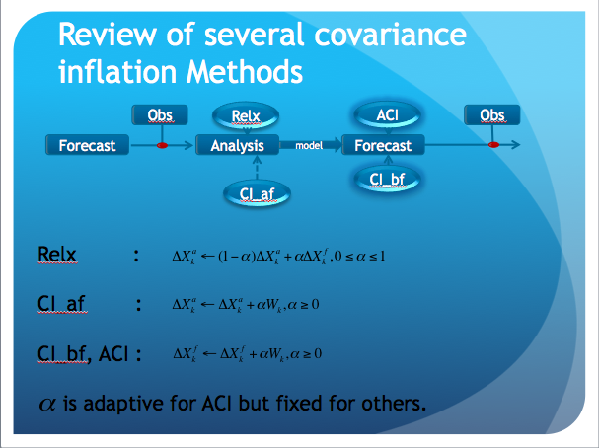
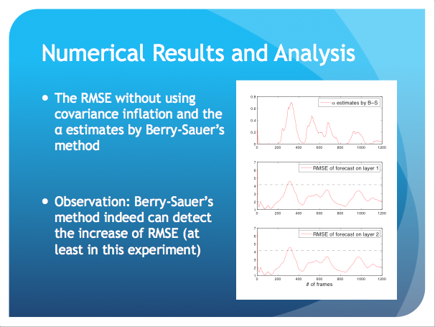
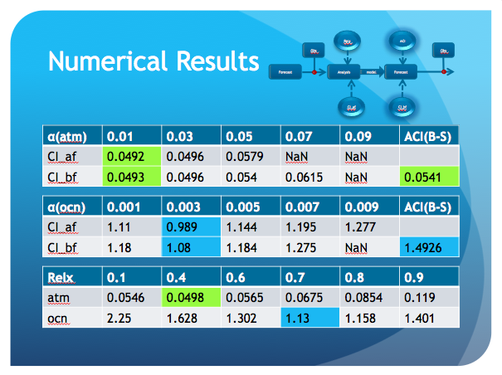
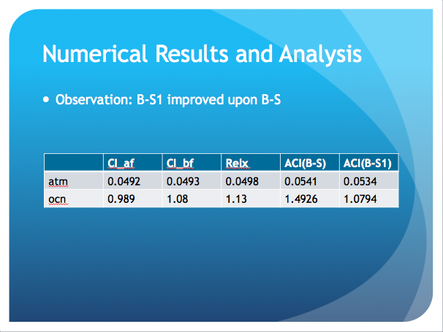
Thanks!

