Slide 1
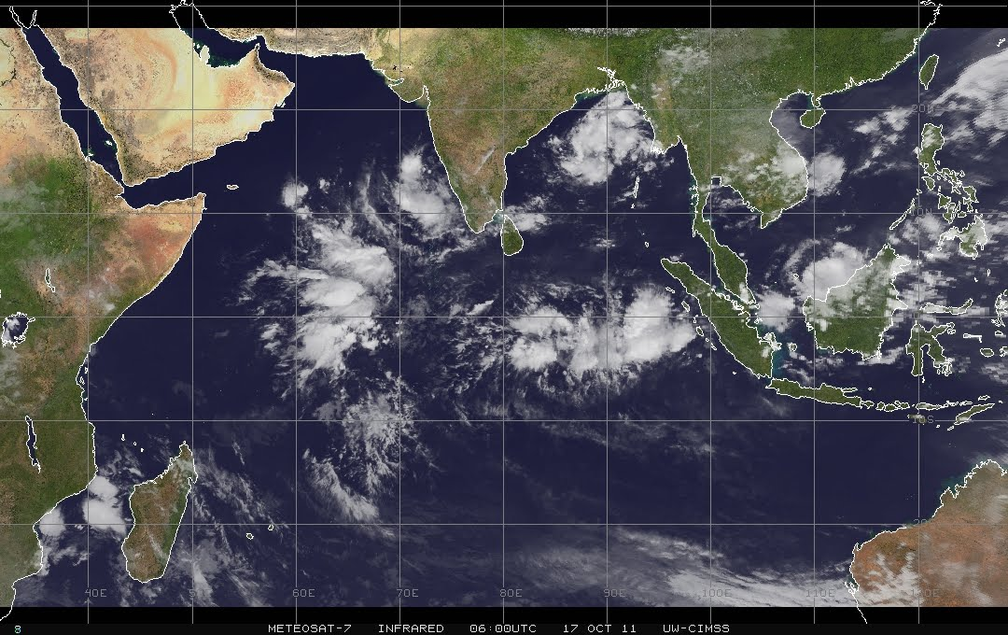
Role of Circumnavigating Signal in the Initiation and Propagation of the October Dynamo MJO event in a Cloud-permitting Model
Sourav Taraphdar

Slide 2
Science Question:
What are the relative role of Circumnavigating signal and local dynamics in the MJO Initiation and Propagation?
Model & Experimental Design:
Oct 2011 MJO event during CINDY/DYNAMO field campaign
WRF (3.4.1) model at 9km horizontal resolution with 45 vertical levels [48ºE – 120ºE & 20ºS – 20ºN]
ERA-Interim as initial and boundary conditions
Simulation starts from 1Oct 2011 (46 days simulation), with spectral nudging of horizontal winds for first 3 days
Experiments | MJO filter bands of periods and wavenumbers | Descriptions
CNTL | ------ | Control simulation
NoMJOinIC | 20 – 96 days and 0 – 9 | MJO filter applied on the initial condition only
NoMJOinBC | 20 – 96 days and 0 – 9 | MJO filter applied on the boundary condition only
NoMJOinICBC | 20 – 96 days and 0 – 9 | MJO filter applied in both the initial and boundary conditions
NoMJOinBC1 | 20 – 96 days and 0 – 9 | Same as NoMJOinBC but MJO filter applied on 16 Oct onwards instead of 1st Oct
NoMJOinBC2 | 20 – 96 days and 0 – 9 | Same as NoMJOinBC but MJO filter applied on 26 Oct onwards

Slide 3
Realistically representation of MJO initiation around 16th Oct at ~60E and its slow eastward propagation
The organized convection at NoMJOinBC & NoMJOinICBC experiments could be due to synoptic variability's
(a) ERA + TRMM
(a) TRMM
(b) CNTL
(c) NoMJOinIC
(b) CNTL
(c) NoMJOinIC
(d) NoMJOinBC
(e) NoMJOinICBC
(d) NoMJOinBC
(e) NoMJOinICBC

Slide 4
(i) Dry Phase
(ii) Initiation Phase
(iii) Propagation Phase
Zonal anomaly of Vertical motion (cm/s; red shading ascent; blue shading descent) and Precipitation (line) averaged over 0º – 5ºN in three different phases, (i) Dry Phase (6 – 12 Oct), (ii) Initiation Phase (15 – 17 Oct) and (iii) Propagation Phase (21 – 31 Oct)
(a) CNTL
(b) NoMJOinIC
(c) NoMJOinBC
(d) NoMJOinICBC
Weak activity during the dry phase of convection followed by stronger updraft between 55º – 70º E longitude and associated positive rainfall anomaly over the same region during Initiation phase, suggests that convection starts to build up over the region of initiation

Slide 5
(a) ERA + TRMM
Spatial distribution of daily precipitation (shaded; mm/day) and horrizontal winds at 850 hPa (vector) during the MJO propagation phase (21st – 31st Oct 2011)
(b) CNTL
(c) NoMJOinIC
An organized structure of precipitation in TRMM3B42 along with CNTL and NoMJOinIC experiment suggests realistic MJO propagation but the NoMJOinBC and NoMJOinICBC experiments does not able to capture the same
(d) NoMJOinBC
(e) NoMJOinICBC

Slide 6
Same as earlier but snap shots at three different time: (i) 23rd Oct 2011 (left panels), (ii)26th Oct 2011 (middle) and (iii) 30th Oct 2011 (right panels)
(a) CNTL
(b) NoMJOinIC
NoMJOinBC and NoMJOinICBC experiments starts deviating from CNTL after 23rd Oct 2011
(c) NoMJOinBC
(d) NoMJOinICBC

Slide 7
(a) CNTL
Zonal – vertical composite (21st Oct – 31st Oct 2011) structure of intense convection averaged over 5ºS – 5ºN
Striking feature in terms of MJO vertical structure is tilting of vertical motion and zonal wind associated with dominant first baroclinic mode in zonal wind
CNTL and NoMJOinIC experiment successfully demonstrates the onset of lower level convergence to the east of the convection center due to Kelvin wave responses along with warmer lower to middle troposphere and warm SST anomaly (figures not shown) that favors the development of boundary-layer moisture convergence to the east of the convection center
(b) NoMJOinIC
(c) NoMJOinBC

Slide 8
Role of Boundary condition on MJO
NoMJOinBC1
NoMJOinBC2
Boundary condition plays an important role to initiate the MJO during the dry phase at the west Indian ocean

Slide 9
(a) TRMM
(a) TRMM
3-hourly rainfall data shows the eastward propagation of MJO, and its associated westward propagating small scale waves
(b) CNTL
(c) NoMJOinIC
(b) CNTL
(c) NoMJOinIC
TRMM3B42, CNTL and NoMJOinIC experiment shows presence of both the eastward propagating Kelvin waves and also westward propagating n=1 Inertia-gravity waves
(d) NoMJOinBC
(e) NoMJOinICBC
(d) NoMJOinBC
(e) NoMJOinICBC

Slide 10
Summary & Future Scope
Control simulation realistically captures the initiation of MJO around 16th Oct at ~60E and shows the slow eastward propagation of MJO event
MJO initiation and propagation is captured realistically by NOMJOinIC simulations compared to NoMJOinBC and NoMJOinICBC, suggests the importance of Circumnavigating signal in MJO initiation and propagation
NoMJOinIC experiment successfully simulates the onset of lower level convergence to the east of the convection center due to Kelvin wave responses along with warmer lower to middle troposphere and warm SST anomaly that favors the development of boundary-layer moisture convergence to the east of the convection center. This boundary-layer convergence favors the development of convective heating to the east of the previous convection center; as a result MJO convection moves eastward
More detail reasoning of failure of MJO on NoMJOinBC and NoMJOinICBC experiments based on the dynamics and variability of westward-propagating equatorial diurnal and 2-day waves.

