Slide 1



All-Sky Fast Radiative Transfer Modeling in the Microwave: Advancing the CRTM to Microphysics-Consistent Cloud Optical Properties
Research Group Meeting
11 December 2015
Scott Sieron
Advisor: Fuqing Zhang
Major Collaborators: Eugene Clothiaux, Lu Yinghui

Slide 2
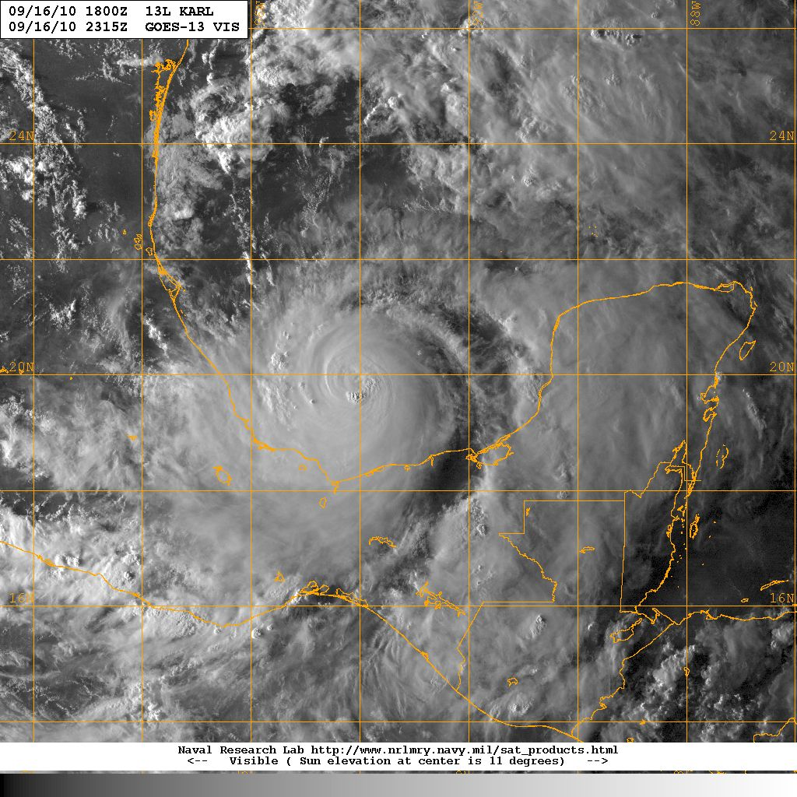
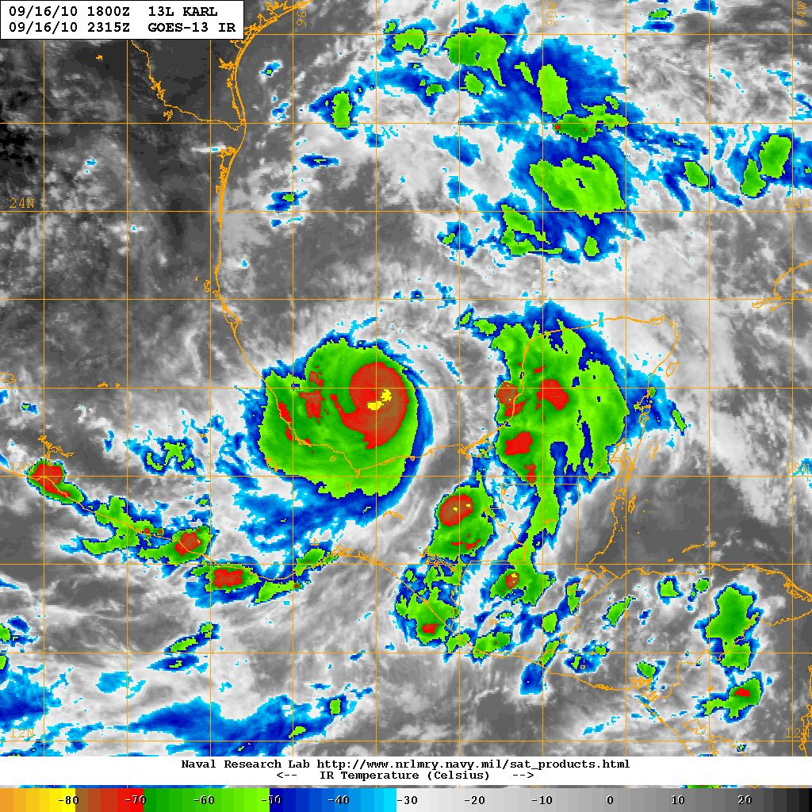
Visible (near sunset)
Infrared
190
210
230
250
270
290
COLD
Brightness Temperature (K)
WARM
Hurricane Karl 09/16/10 2315Z
(GOES-13 VIS, image courtesy NRL)
Hurricane Karl 09/16/10 2315Z
(GOES-13 IR, image courtesy NRL)
Notes:
I’m sure that many of us are familiar with these sorts of representations of tropical cyclones, namely the visible and infrared as viewed from satellites. These images certainly demonstrate the existence of the storm, and provide some qualitative sense of storm intensity, but there is little direct evidence or signal from what is present below cloud top.
The visible image is produced by scattered sunlight, while the signal at this IR frequency is produced mostly by the emission from the highest altitude solids and liquids and is indicative of their temperature.

Slide 3
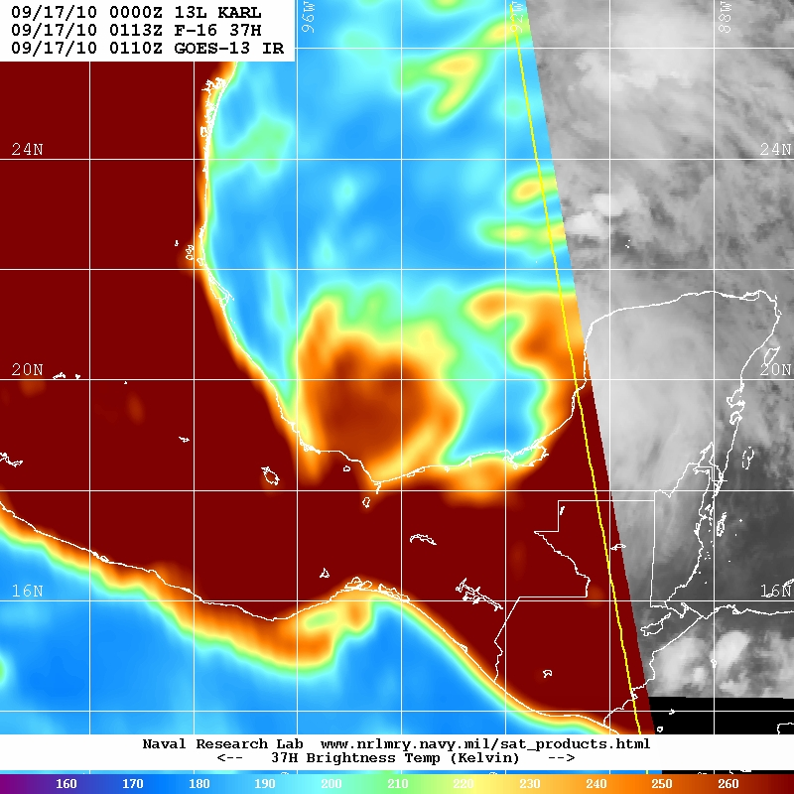
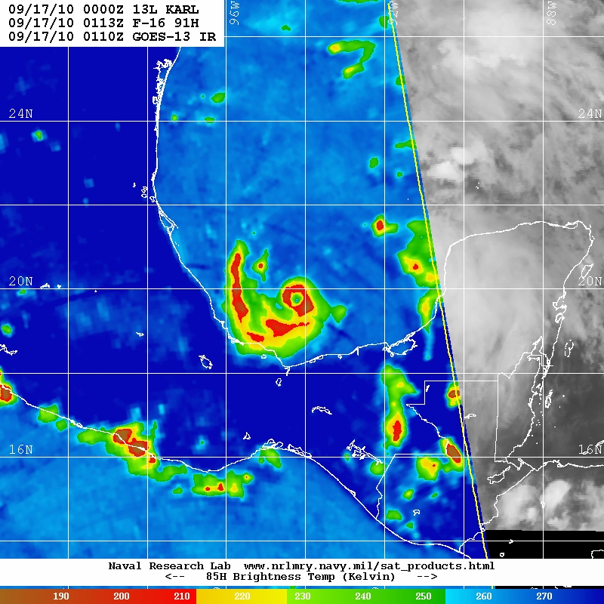
Low-mid microwave freq. (37 GHz)
High-mid microwave freq. (91.7 GHz)
160
180
200
220
240
260
190
210
230
250
270
COLD
Brightness Temperature (K)
WARM
COLD
Brightness Temperature (K)
WARM
Hurricane Karl 09/17/10 0113Z
(SSMI/S image courtesy NRL)
Hurricane Karl 09/17/10 0113Z
(SSMI/S image courtesy NRL)
Notes:
In contrast, shown here are perhaps less familiar representations of tropical cyclones, these are satellite images of brightness temperature in the microwave spectrum. This is of the same hurricane at nearly the same time as the previous two images. In these passive microwave observations, there is much more direct evidence of what exists below cloud top, which can be very useful information.
In both images, the hurricane looks substantially different than, for example the area of cloudiness to the north. The right image is even more substantially different, having greater contrast within the area of the hurricane, and an evident eye-like structure; in fact, it is the eye.
Clear-air 37 GHz over ocean has low brightness temperature because surface has low emissivity, it’s emitting far less radiation at this frequency than would a “perfect” black body emitter. The land has high emissivity, it has high brightness temperature.
Warm anomalies in 37 GHz brightness temperature over ocean is liquid cloud and rain. Liquid drops have fairly high emissivity and net adds to the radiance. It also absorbs some of what the surface emits, but clearly it emits more than it absorbs.
There is substantial dynamic range within observable liquid hydrometeor content: the warmer it is, the more liquid hydrometeors there are. Observe that the heavy rain of the tropical cyclone (and convection south of Mexico) is substantially warmer than cloudy areas elsewhere.
Clear-air 91 GHz are warm both over water and land, and low brightness temperature anomalies are present over both. This is the precipitation-size ice particles (snow, graupel and hail) scattering

Slide 4



Background:
Passive Microwave
Observations
Planck function radiance (surface temperature)
Actual radiance
ATMOSPHERE
At higher frequencies
(> ~50 GHz),
  Surface has high emissivity (high brightness temperatures in clear air)
  Primary hydrometeor impact: reduction of radiance due to scattering by precipitation ice (snow, graupel, hail)
OCEAN
Notes:
- Lower brightness temperature corresponds to more and larger precipitation ice

Slide 5
Background:
Passive Microwave
Observations
Planck function radiance (surface temperature)
Actual radiance
ATMOSPHERE
At lower frequencies
(< ~50 GHz) over water,
  Surface has low emissivity (low brightness temperatures in clear air) in H-polarization
  Primary hydrometeor impact: net addition of radiance due to absorption/emission by cloud and rain
OCEAN
Notes:
- Higher brightness temperature corresponds to more mass of liquid hydrometeors

Slide 6

Background:
Passive Microwave
Observations
Planck function radiance (surface temperature)
Actual radiance
ATMOSPHERE
At lower frequencies
(< ~50 GHz) over water,
  Surface has low emissivity (low brightness temperatures in clear air) in H-polarization
  Primary hydrometeor impact: net addition of radiance due to absorption/emission by cloud and rain
  (Great numbers of large ice particles will produce meaningful scattering)
OCEAN

Slide 7
Low-mid microwave freq. (37 GHz)
High-mid microwave freq. (91.7 GHz)
Clear air
Cloud
Rain
Heavy Rain,
Precip Ice
160
180
200
220
240
260
190
210
230
250
270
COLD
Brightness Temperature (K)
WARM
COLD
Brightness Temperature (K)
WARM
Hurricane Karl 09/17/10 0113Z
(SSMI/S image courtesy NRL)
Hurricane Karl 09/17/10 0113Z
(SSMI/S image courtesy NRL)
Notes:
Using observations at substantially different frequencies can be especially powerful.
At lower frequencies such as 37 GHz, over locations of water surface, higher brightness temperatures correspond to more cloud liquid and rain present, but it is largely ambiguous as to the presence of ice particles. A higher frequency observation, such as 91.7 GHz, is sensitive to this.
At higher frequencies such as 91.7 GHz, warmer temperatures (shown in blue) correspond to lack of ice particles, but it is ambiguous as to the presence of some low-altitude liquid cloud. The lower-frequency observation is sensitive to this.
Clear-air 37 GHz over ocean has low brightness temperature because surface has low emissivity, it’s emitting far less radiation at this frequency than would a “perfect” black body emitter. The land has high emissivity, it has high brightness temperature.
Warm anomalies in 37 GHz brightness temperature over ocean is liquid cloud and rain. Liquid drops have fairly high emissivity and net adds to the radiance. It also absorbs some of what the surface emits, but clearly it emits more than it absorbs.
There is substantial dynamic range within observable liquid hydrometeor content: the warmer it is, the more liquid hydrometeors there are. Observe that the heavy rain of the tropical cyclone (and convection south of Mexico) is substantially warmer than cloudy areas elsewhere.
Clear-air 91 GHz are warm both over water and land, and low brightness temperature anomalies are present over both. This is the precipitation-size ice particles (snow, graupel and hail) scattering

Slide 8
Microwave Radiative Transfer and
Frozen Hydrometeors
Hydrometeor size is critical:
  Up to [particle radius] ≈ ~1/6 wavelength: scattering increases by ~[particle mass]²
    Rayleigh scattering of a homogenous sphere
  Beyond [particle radius] ≈ ~1/6 wavelength: mass scattering coefficient grows more slowly, oscillates, then declines
    Mie scattering of a homogenous sphere
Largest precipitation particles exceed Rayleigh scattering size regime
Mass extinction (thick solid), scattering (dashed) and absorption (thin solid) coefficients (m² g⁻¹) of solid ice spheres as a function of radius for three imaging channels. Wavelength and 1/6-wavelength demarked.

Slide 9
Community Radiative Transfer Model (CRTM)
A radiative transfer forward model simulates the radiance that would be measured by a specified sensor under specified atmospheric and surface conditions
The CRTM represents hydrometeor particle sizes with an effective radius parameter
  The calculation of an effective radius from a particle size distribution is non-trivial when the sizes of some particles exceed the Rayleigh scattering regime
  The CRTM effective radius parameter is representative of some unknown, specific particle size distribution which may or may not match that of the intended CRTM input

Slide 10
Research Questions
Can the CRTM be modified to accurately represent the radiance impacts of hydrometeors produced by regional-scale NWP microphysics (MP) schemes?
  The CRTM is important: used for operational data assimilation of radiance measurements in clear- and cloud-sky conditions
If yes, then how do the results of the modified CRTM compare to observations?

Slide 11
Modifying the CRTM for All-sky Microwave
Create new cloud optical property lookup tables
  Model the properties of single particles (soft spheres, as specified by MP scheme)
    Maxwell-Garnett mixing formula for ice dielectric constants
    Liquid dielectric constants from Tuner et al. (in prep)
    Product of the Henyey-Greenstein and Rayleigh scattering phase functions, and Legendre coefficients thereof, as specified by Liu and Weng (2006)
  Calculate per-mass optical properties of clouds constructed with particles with size distribution as specified by MP scheme
Lookup table dimensions match MP scheme output variables
MP scheme will be directly interfaced with CRTM
Notes:
Though both the MP schemes and CRTM remain sources for error/bias to observation

Slide 12
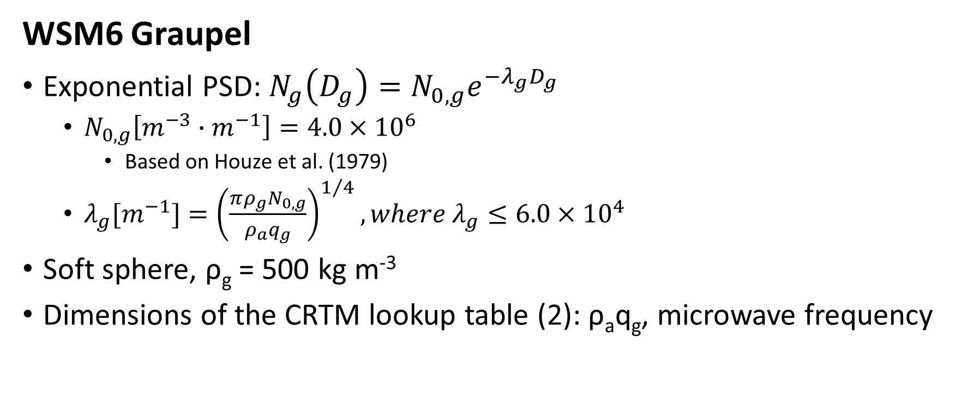

Microphysics Scheme Details, Example
WSM6 Graupel PSD for $λg$ = 3000 m⁻¹
WSM6 Graupel
Exponential PSD: $N_{g}\left(D_{g}\right)=N_{0,g}e^{−λ_{g}D_{g}}$
  $N_{0,g}\left[m^{−3}∙m^{−1}\right]=4.0×{10}^{6}$
    Based on Houze et al. (1979)
  $λ_{g}[m^{−1}]={\left(\frac{πρ_{g}N_{0,g}}{ρ_{a}q_{g}}\right)}^{1/4}, where λ_{g}≤6.0×{10}^{4}$
Soft sphere, ρ_{g} = 500 kg m⁻³
Dimensions of the CRTM lookup table (2): ρ_{a}q_{g}, microwave frequency

Slide 13
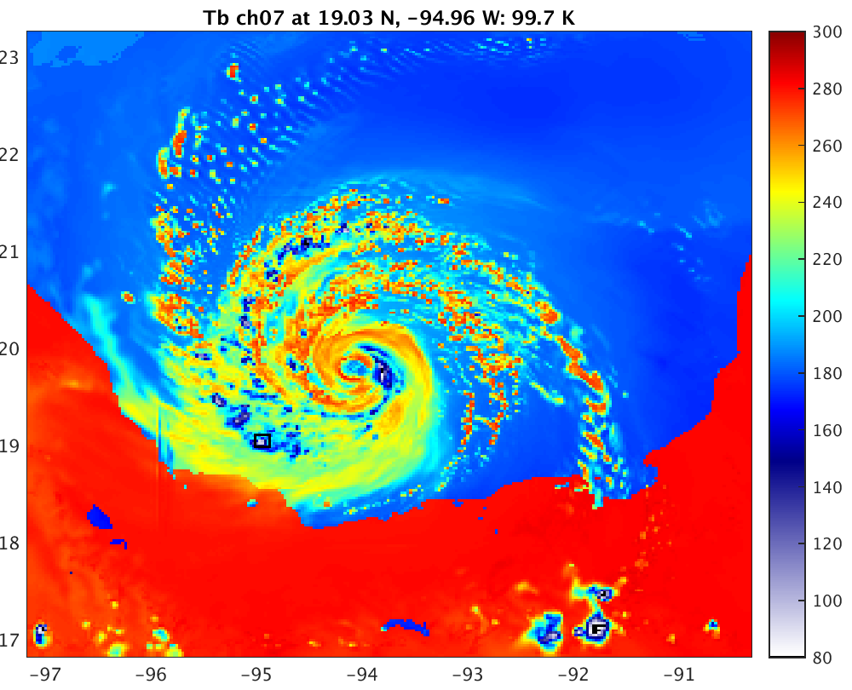
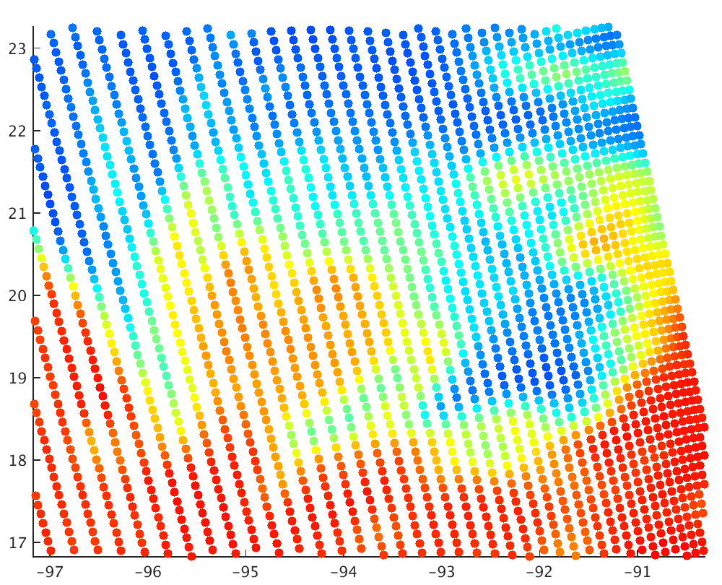
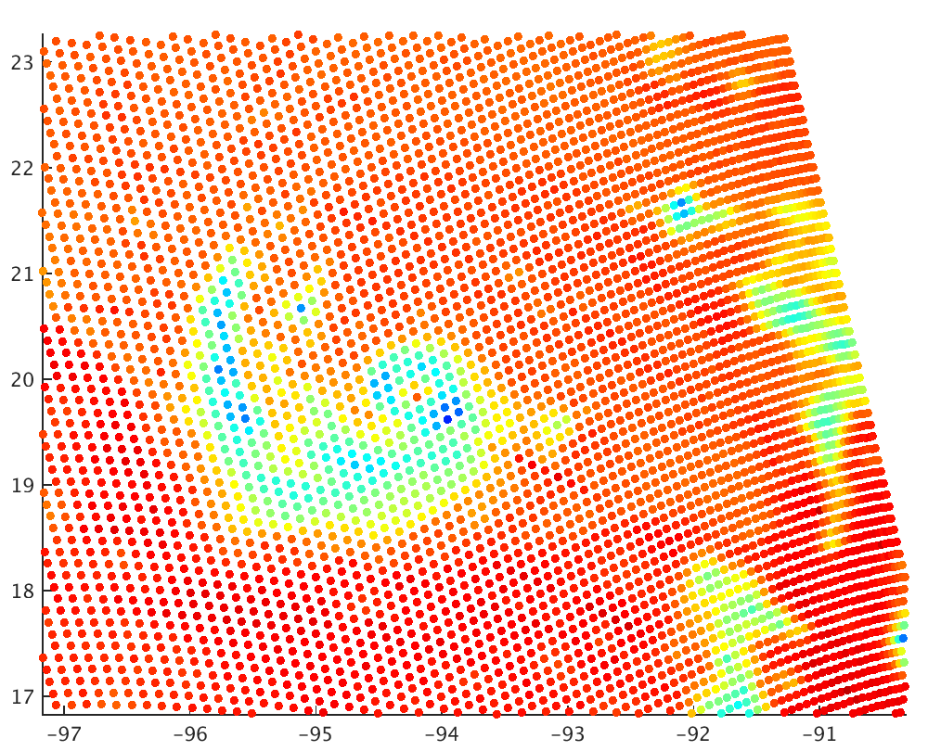
Observations (SSMI/S)
Brightness Temperature (K)
Obs 37 GHz
300
Obs 91.7 GHz
23N
23N
260
22N
22N
220
21N
21N
20N
180
20N
19N
19N
140
18N
18N
100
17N
17N
97W
96W
95W
94W
93W
92W
91W
97W
96W
95W
94W
93W
92W
91W

Slide 14
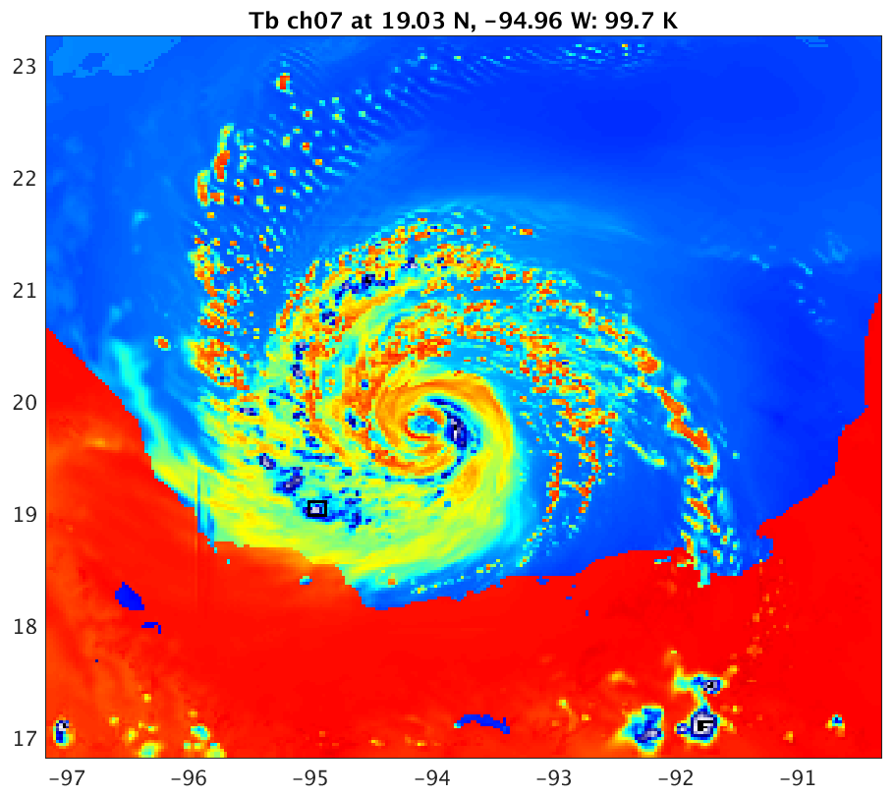
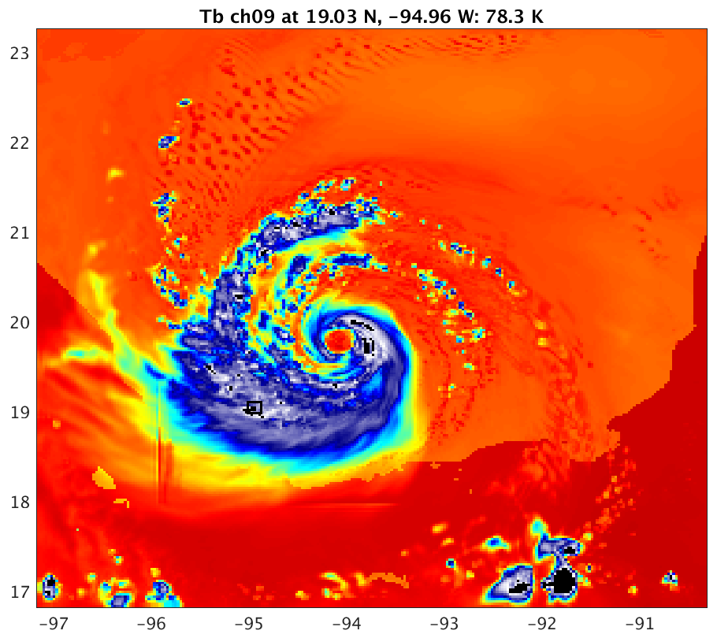
Obs. 37 GHz
Obs. 91.7 GHz
WSM6 Microphysics,
New Lookup Table
Brightness Temperature (K)
CRTM 36.5 GHz
300
CRTM 89 GHz
23N
23N
260
22N
22N
21N
220
21N
20N
180
20N
19N
19N
140
18N
18N
100
17N
17N
97W
96W
95W
94W
93W
92W
91W
97W
96W
95W
94W
93W
92W
91W
Notes:
- This and the other CRTM results to follow are from the output of a 3-hour simulation using the WRF-ARW model at a 3 km grid. All of the simulations are of identical setup, initial and boundary conditions, differing only in the microphysics scheme.

Slide 15
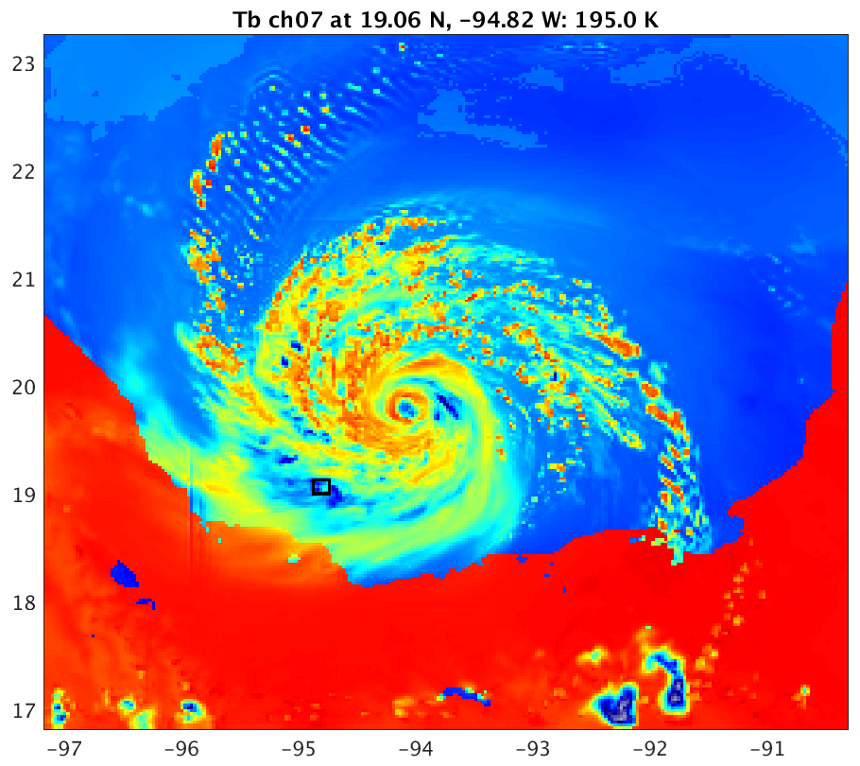
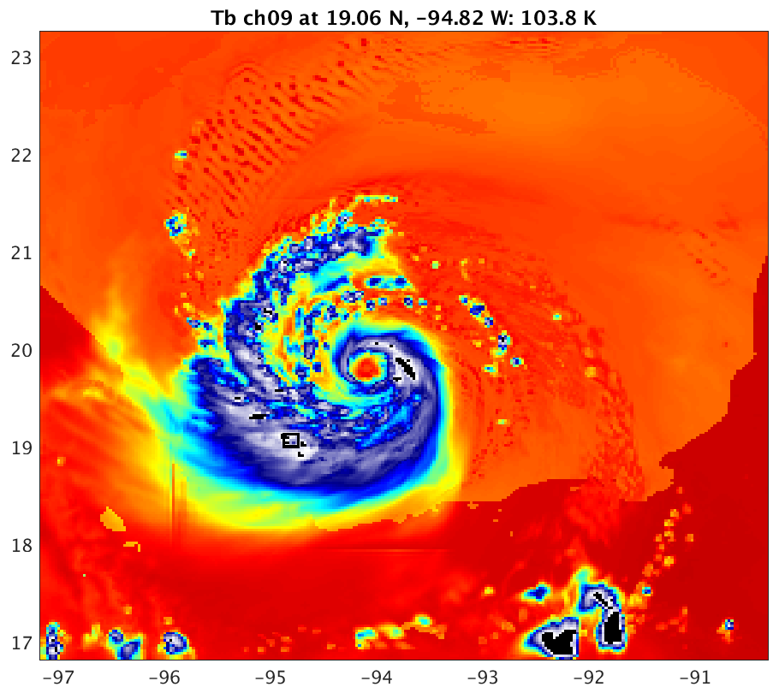
Obs. 37 GHz
Obs. 91.7 GHz
Morrison Microphysics,
New Lookup Table
Brightness Temperature (K)
CRTM 36.5 GHz
300
CRTM 89 GHz
23N
23N
260
22N
22N
21N
220
21N
20N
180
20N
19N
19N
140
18N
18N
100
17N
17N
97W
96W
95W
94W
93W
92W
91W
97W
96W
95W
94W
93W
92W
91W
Notes:
- This and the other CRTM results are from the output of a 3-hour simulation using the WRF-ARW model at a 3 km grid. All of the simulations are of identical setup, initial and boundary conditions, differing only in the microphysics scheme.

Slide 16
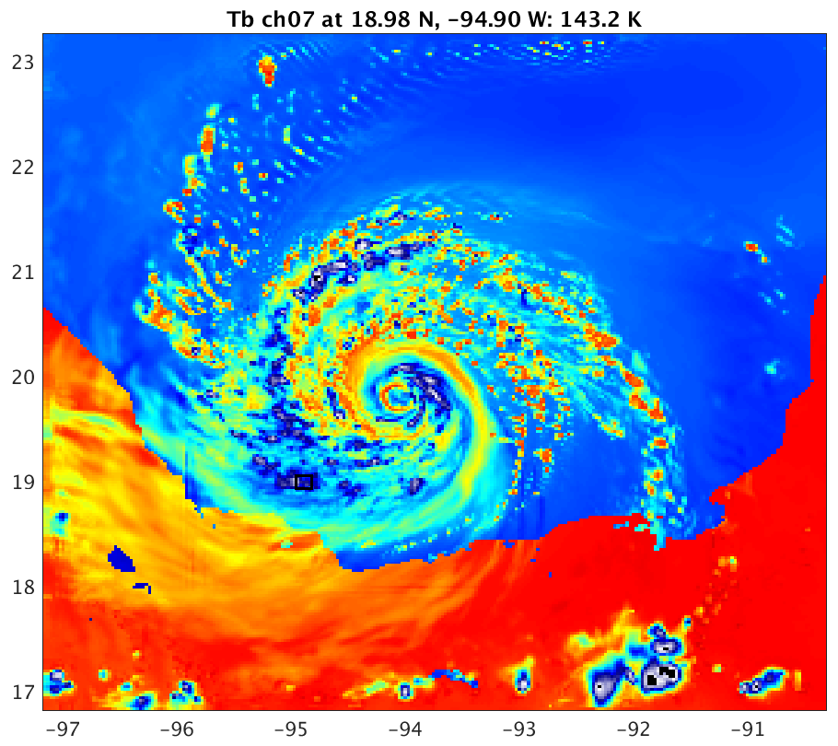
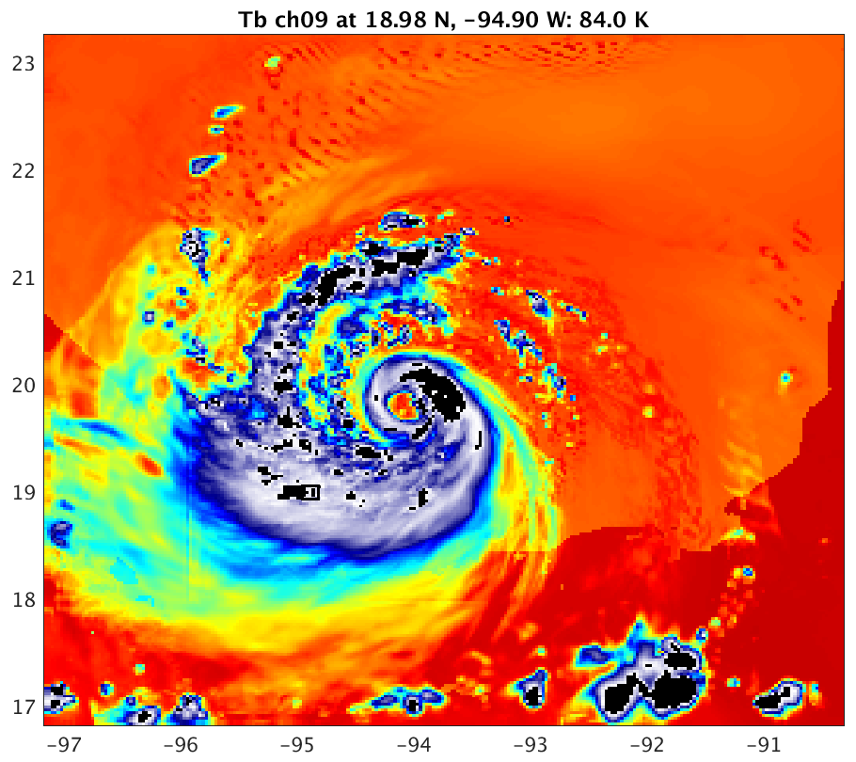
Obs. 37 GHz
Obs. 91.7 GHz
Goddard Microphysics,
New Lookup Table
Brightness Temperature (K)
CRTM 36.5 GHz
300
CRTM 89 GHz
23N
23N
260
22N
22N
21N
220
21N
20N
180
20N
19N
19N
140
18N
18N
100
17N
17N
97W
96W
95W
94W
93W
92W
91W
97W
96W
95W
94W
93W
92W
91W
Notes:
- This and the other CRTM results are from the output of a 3-hour simulation using the WRF-ARW model at a 3 km grid. All of the simulations are of identical setup, initial and boundary conditions, differing only in the microphysics scheme.

Slide 17
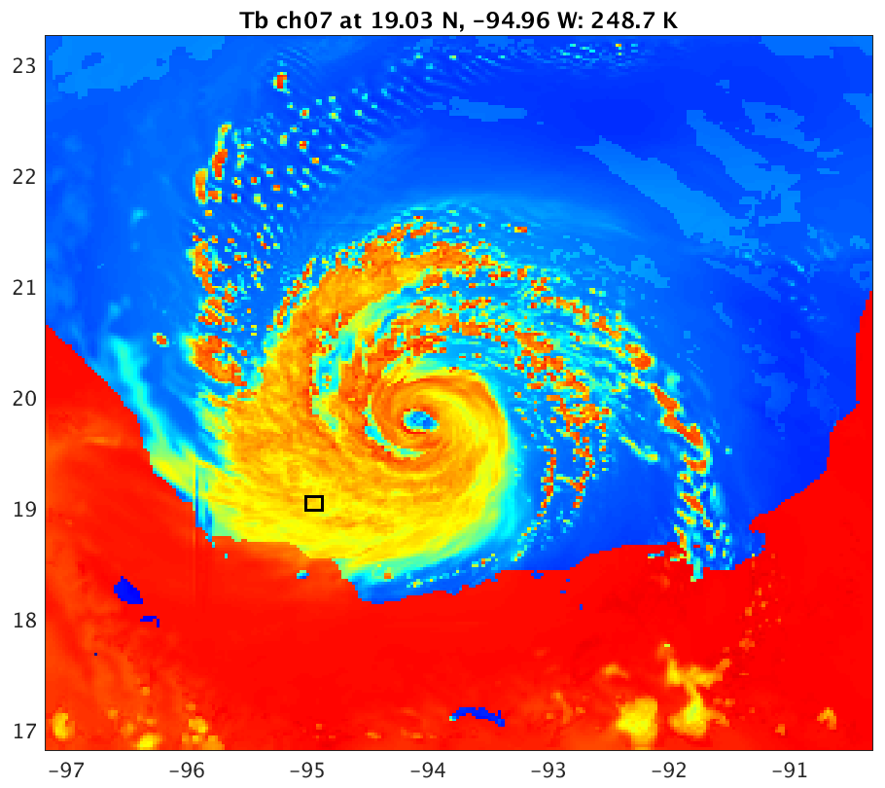
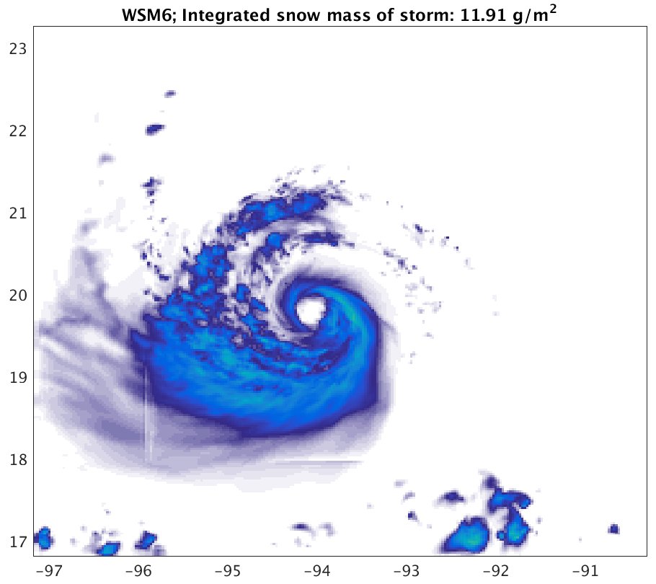
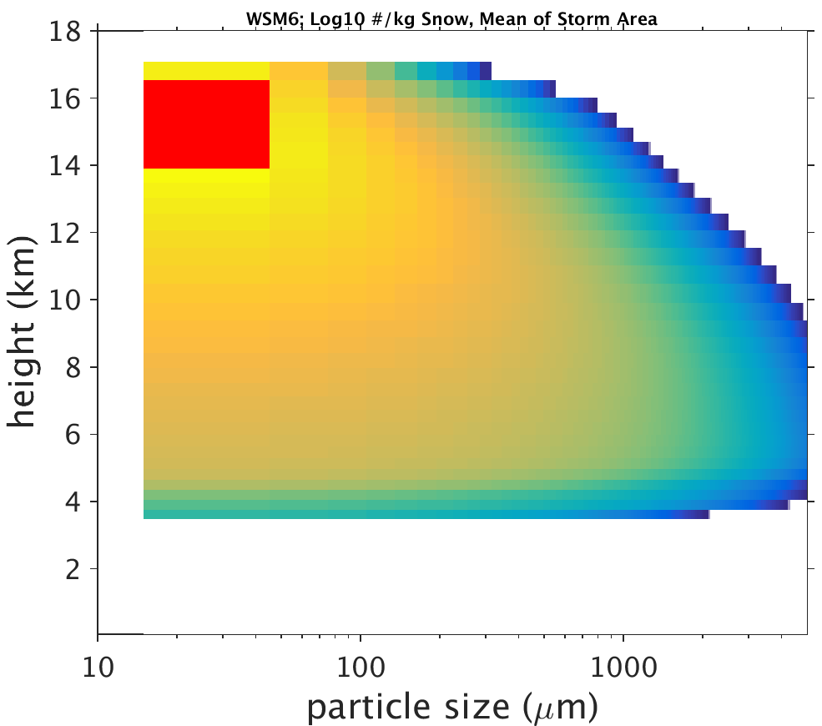
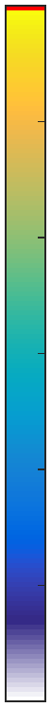
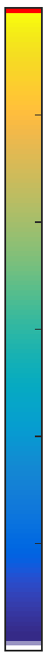
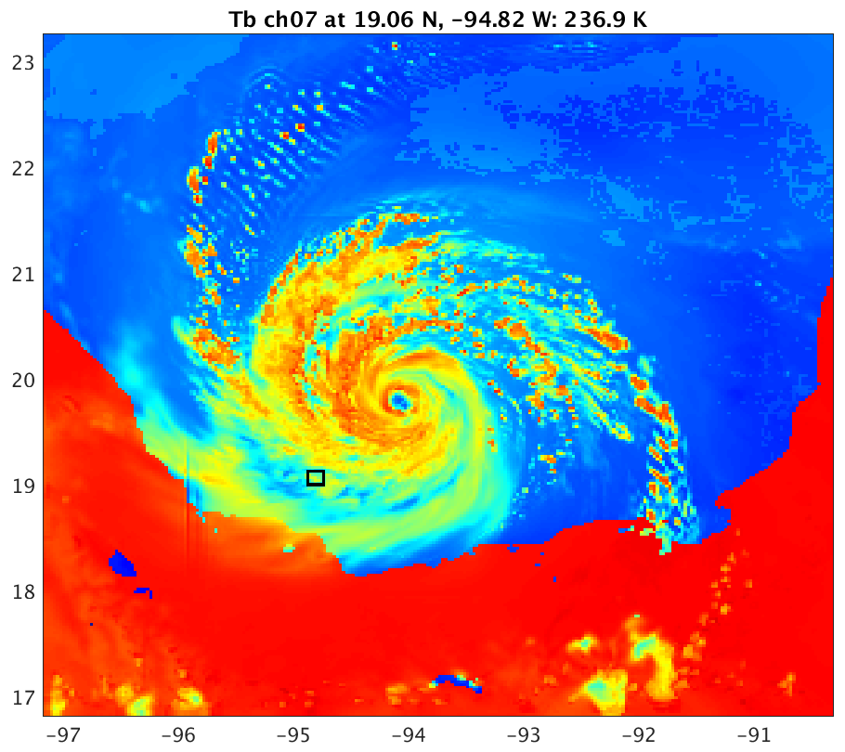
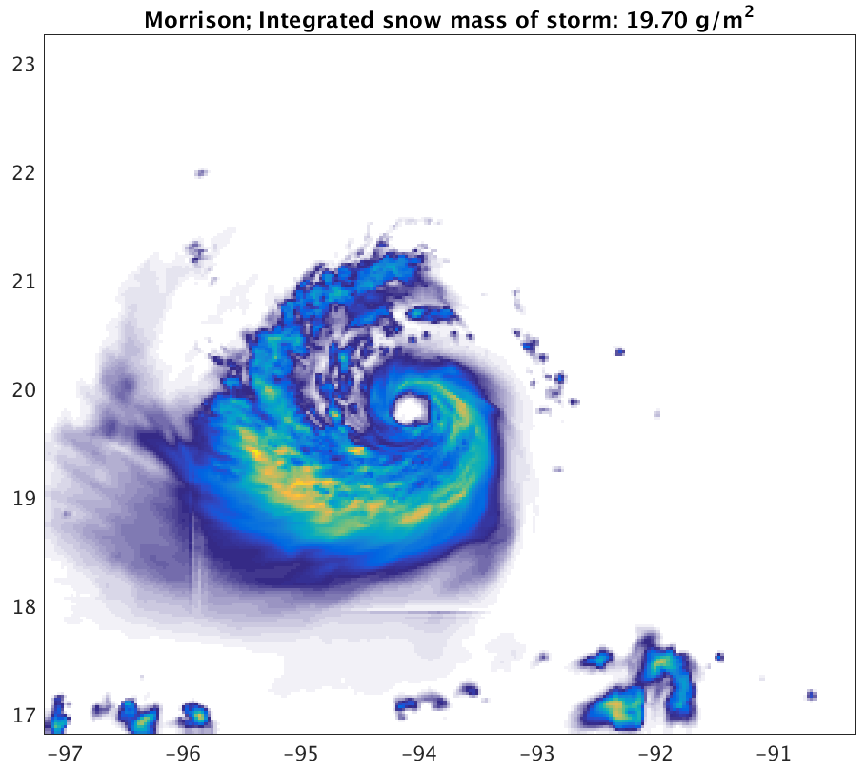
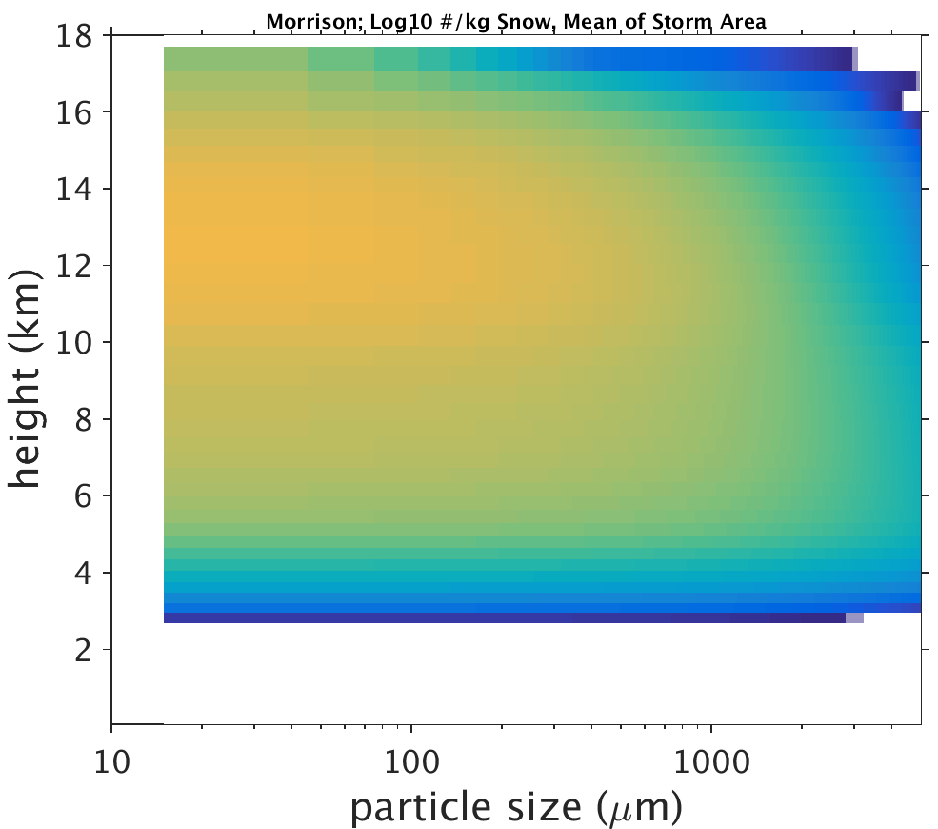
Snow
Snow particle concentration (Log₁₀ #/kg), height vs. particle size in the storm area
CRTM T_{B} (K) 36.5-H GHz, Only Cloud Liquid, Rain and Snow
Snow water path (g m⁻²)
WSM6
300
Storm area average: 11.9 g m⁻²
120
6
260
100
4
80
2
220
60
0
180
Morrison
Storm area average: 19.7 g m⁻²
40
2
140
20
-4
100
0
-6

Slide 18
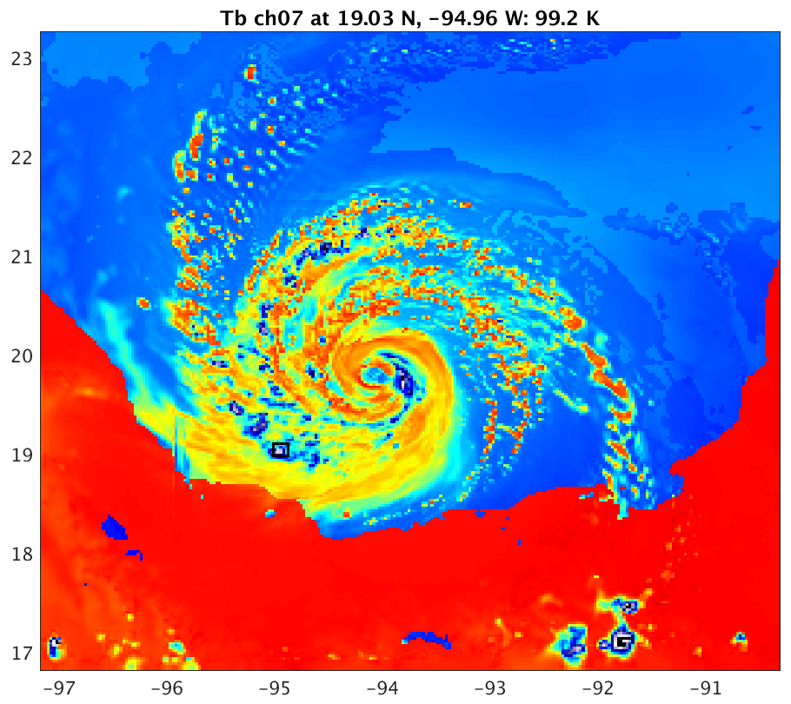
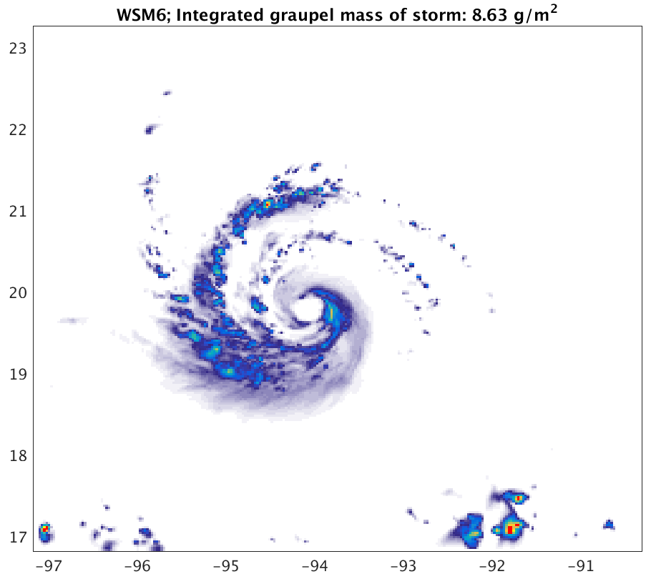
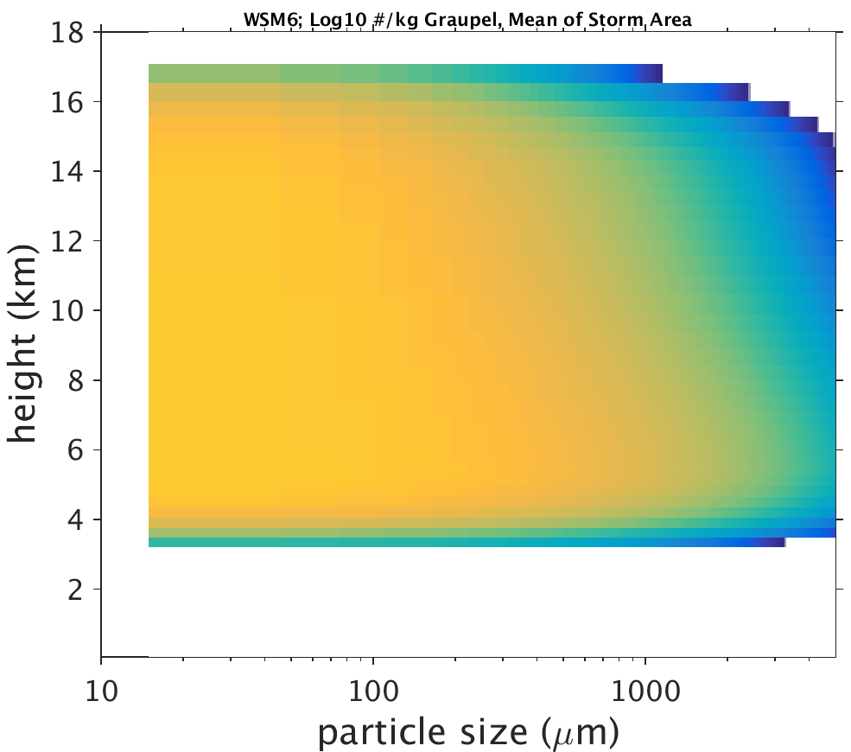
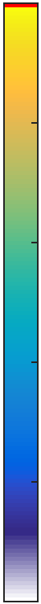
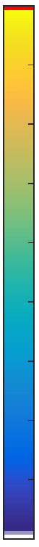
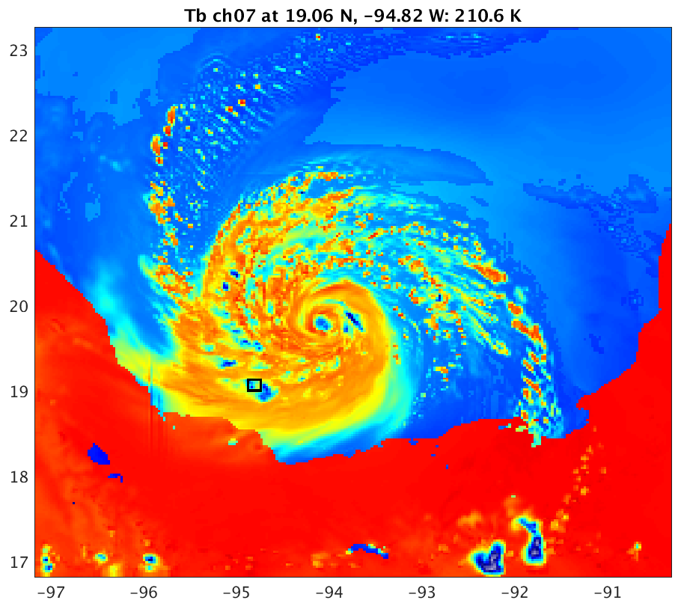
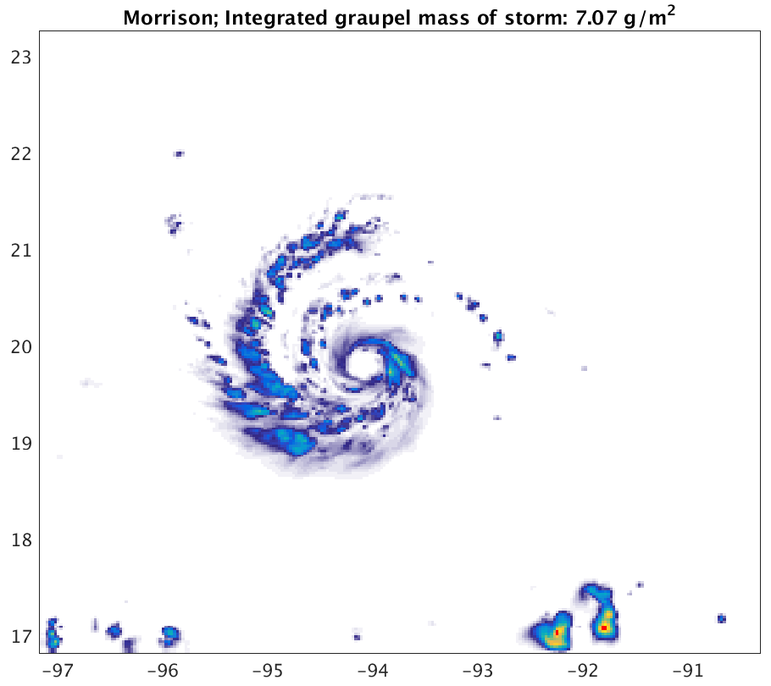
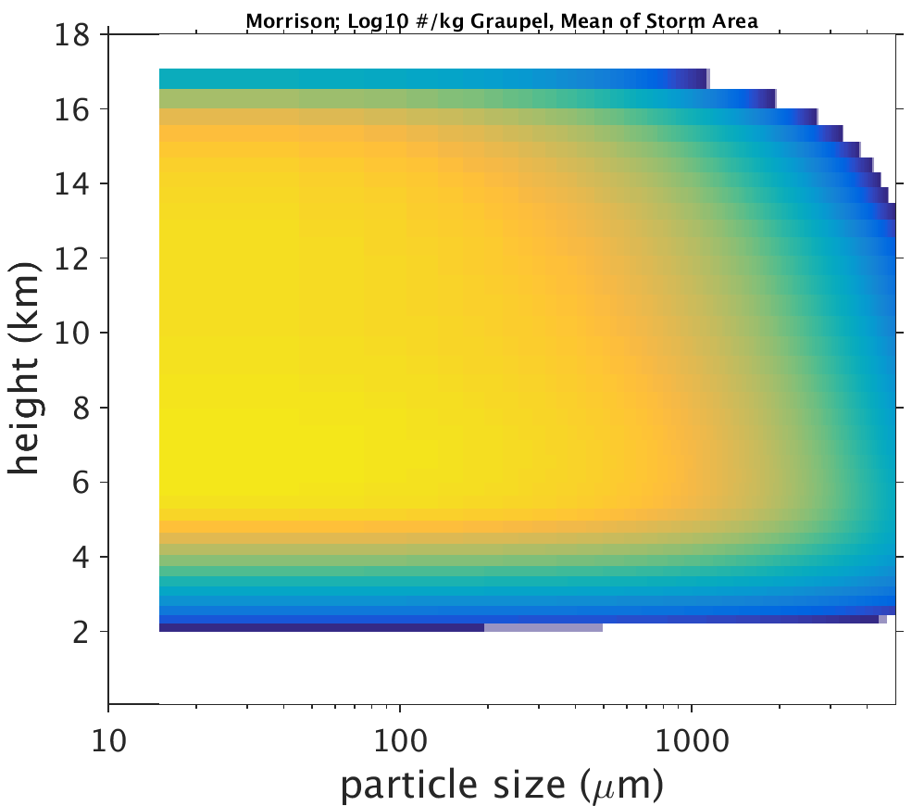
Graupel
Graupel particle concentration (Log₁₀ #/kg), height vs. particle size in the storm area
CRTM T_{B} (K) 36.5-H GHz, Only Cloud Liquid, Rain and Graupel
Graupel water path (g m⁻²)
WSM6
300
Storm area average: 8.6 g m⁻²
250
3
2
260
200
1
0
220
150
-1
180
-2
Morrison
Storm area average: 7.1 g m⁻²
100
-3
140
-4
50
-5
100
0
-6

Slide 19
Results and Discussion
Using scheme-specified cloud optical properties: too low of brightness temperatures, too much scattering
  Consistent with many studies involving radar and passive microwave observations vs. simulated [Zupanski et al. 2011; Zhang et al. 2013; Han et al. 2013; Chambon et al. 2014]
  These studies used the Goddard-SDSU radiative transfer solver
Conclusion: too much or too big of snow and/or graupel in upper troposphere by microphysics schemes

Slide 20
Future Directions
Refining and adding modifications, working within the CRTM repository
  Non-spherical particle optical properties
  Automatic stream number estimation
  Revamp data structures, scheme selection interface
  Tangent linear, adjoint, K-matrix
  Antenna pattern convolution and slant path constructions (features in satellite simulators)
Uses for this tool:
  Ensemble parameter estimation
  Observing System Experiments (testing data assimilation)
    Simulated or real observations

Slide 21
References
Chambon, P., S. Q. Zhang, A. Y. Hou, M. Zupanski, and S. Cheung, 2014: Assessing the impact of pre-GPM microwave precipitation observations in the Goddard WRF ensemble data assimilation system. Quart. Jour. Roy. Meteor. Soc., 140, 1219–1235.
Han, M., S. A. Braun, T. Matsui, and C. R. Williams, 2013: Evaluation of cloud microphysics schemes in simulations of a winter storm using radar and radiometer measurements. J. Geophys. Res. Atmos., 118, 1401–1419.
Liu, Q., and F. Weng, 2006: Advanced doubling-adding method for radiative transfer in planetary atmospheres. J. Atmos. Sci., 63, 3459‒3465.
Skamarock, W. C., J. B. Klemp, J. Dudhia, D. O. Gill, D. M. Barker, M. G. Duda, X.-Y. Huang, W. Wang, and J. G. Powers, 2008: A description of the Advanced Research WRF version 3. NCAR Technical Note 475, http://www.mmm.ucar.edu/wrf/users/docs/arw_v3.pdf.
Weng, Y., and F. Zhang, 2012: Assimilating Airborne Doppler Radar Observations with an Ensemble Kalman Filter for Convection-permitting Hurricane Initialization and Prediction: Katrina (2005). Mon. Wea. Rev., 140, 841-859.
Wong, V., and K. A. Emanuel, 2007: Use of cloud radars and radiometers for tropical cyclone intensity estimation, Geophys. Res. Lett., 34, L12811, doi:10.1029/2007GL029960.
Zhang, S. Q., M. Zupanski, A. Y. Hou, X. Lin, and S. H. Cheung, 2013: Assimilation of Precipitation-Affected Radiances in a Cloud-Resolving WRF Ensemble Data Assimilation System. Mon. Wea. Rev.,141, 754–772.
Zhang, F., Y. Weng, J. A. Sippel, Z. Meng, and C. H. Bishop, 2009: Cloud-resolving Hurricane Initialization and Prediction through Assimilation of Doppler Radar Observations with an Ensemble Kalman Filter. Mon. Wea. Rev., 137, 2105-2125.
Zupanski, D., S. Q. Zhang, M. Zupanski, A. Y. Hou, and S. H. Cheung, 2011: A Prototype WRF-Based Ensemble Data Assimilation System for Dynamically Downscaling Satellite Precipitation Observations. J. Hydrometeor., 12, 118–134.

Slide 22
Extra Slides

Slide 23
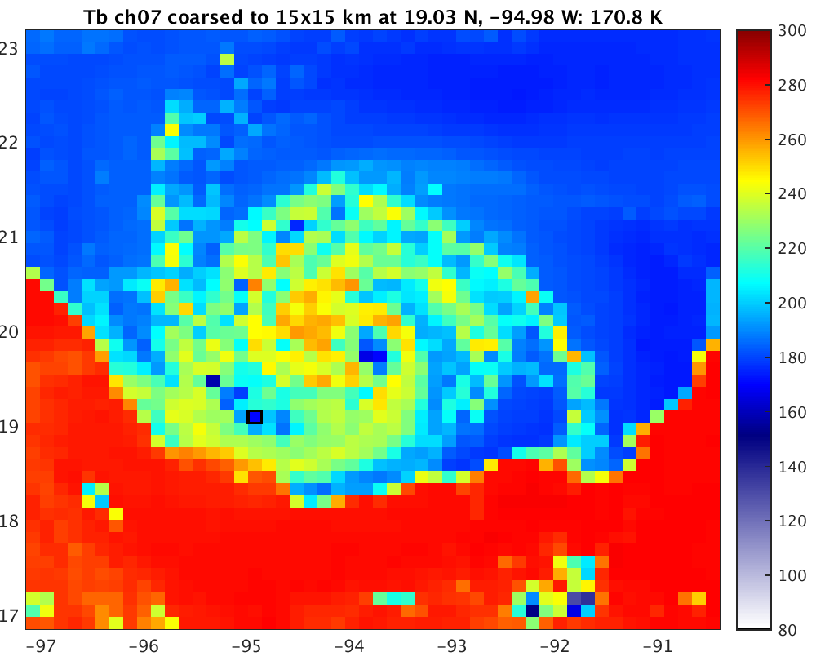
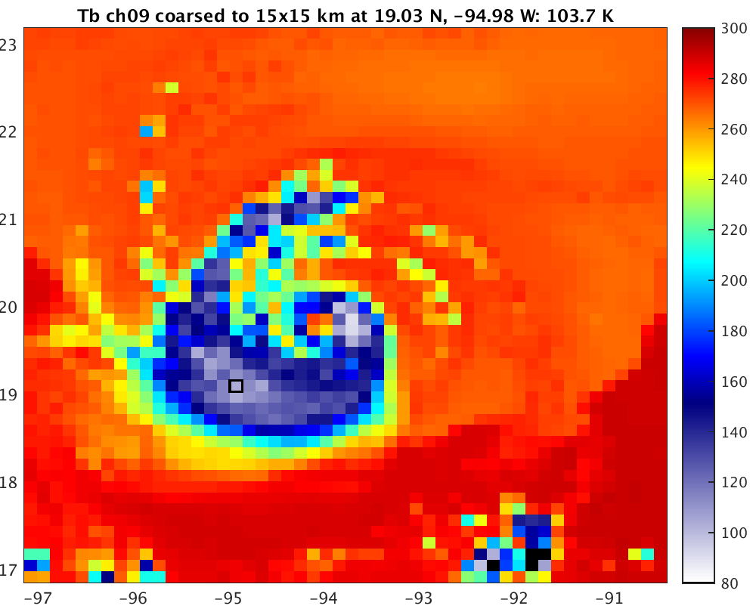
WSM6, New Look-up Tables
Coarsened to 15x15 km
36.5 GHz
89 GHz

Slide 24
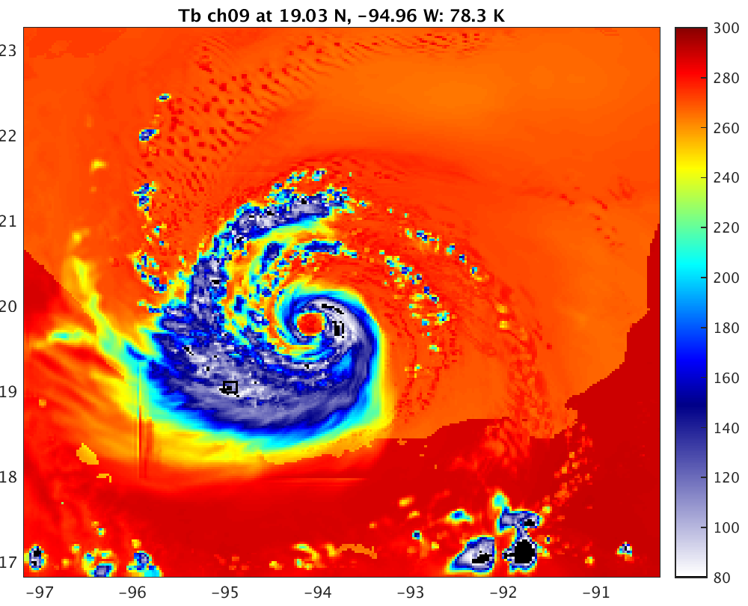
WSM6, New Look-up Tables
36.5 GHz
89 GHz

Slide 25
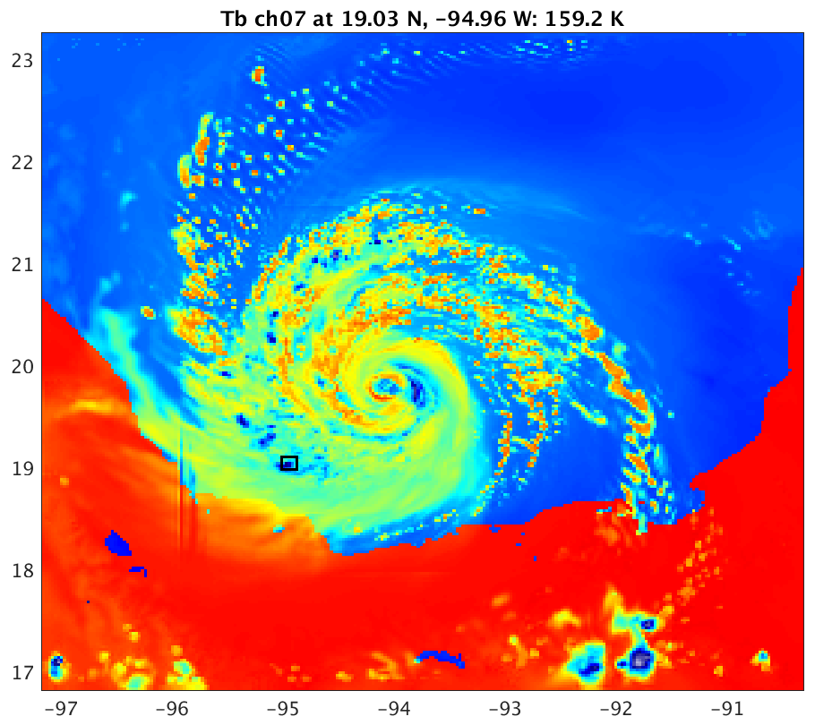
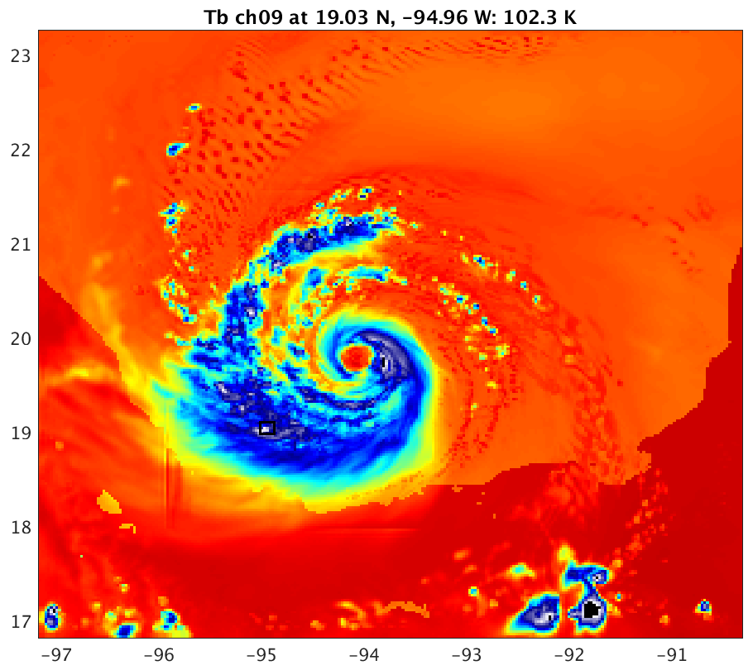
WSM6, Specified and Uniform CRTM Radii
Cloud: 15 μm Rain: 500 μm Ice: 50 μm Snow: 1000 μm Graupel: 1000 μm
Brightness Temperature (K)
300
280
260
240
220
200
180
160
140
120
100
80

Slide 26
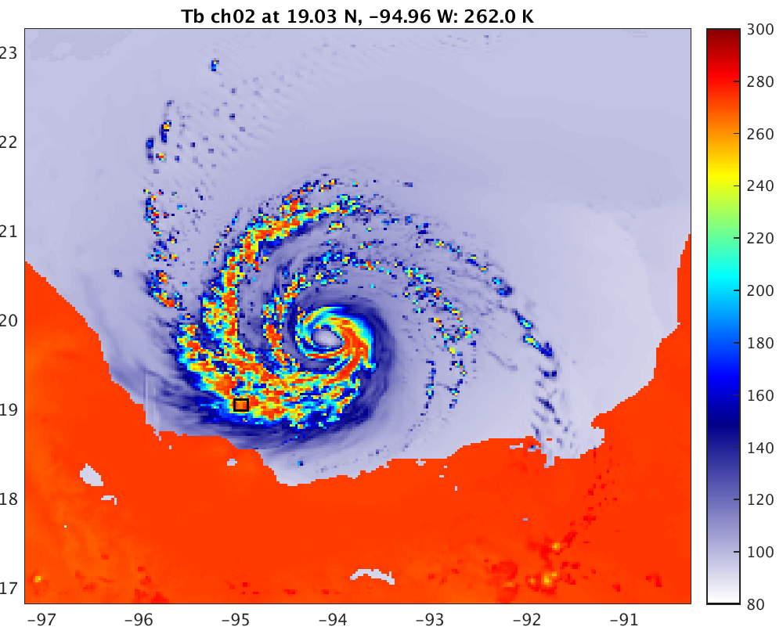
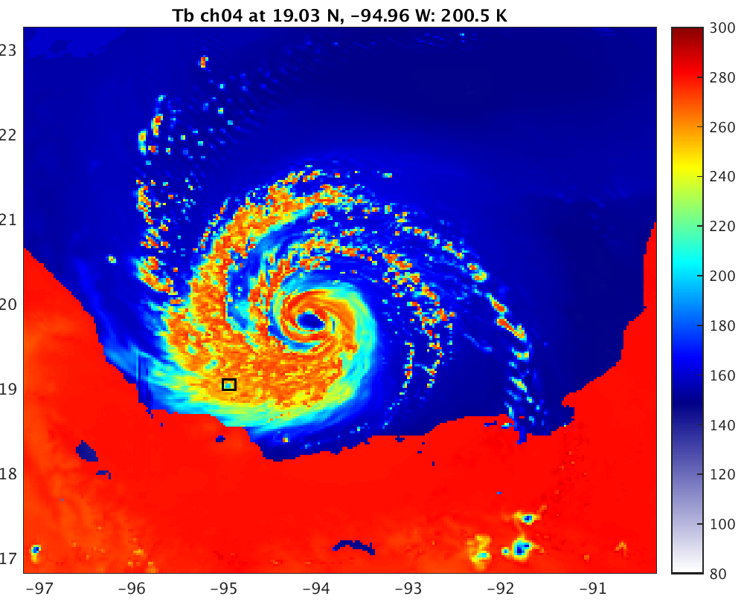
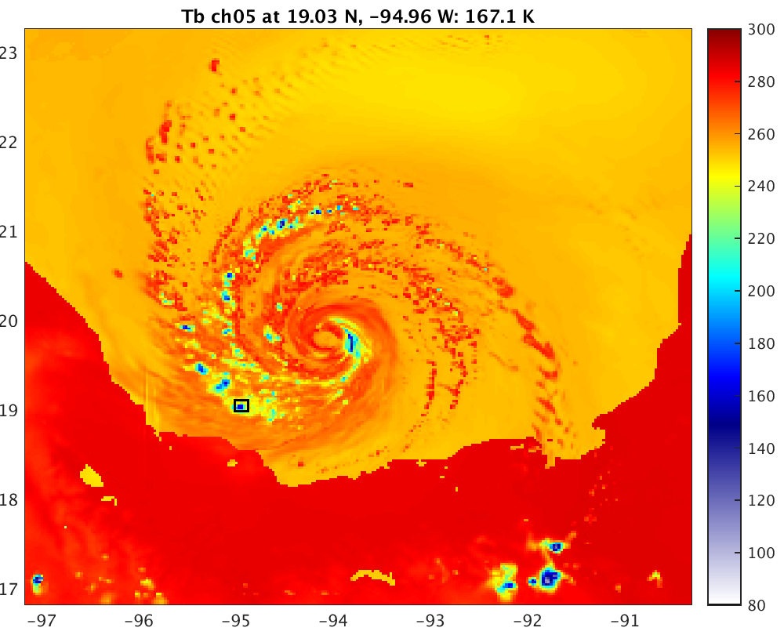
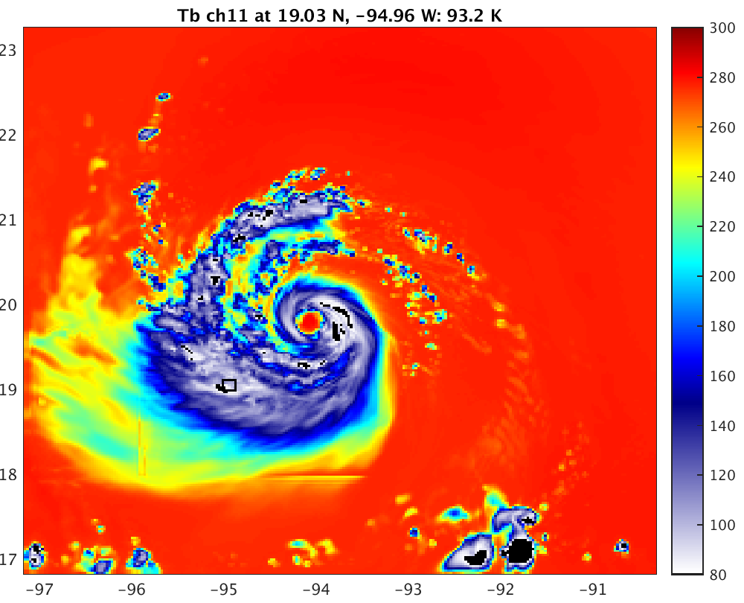
WSM6
10.65-H
18.7-H
23.8-V
36.5-H
89.0-H
165.5-H

