Slide 1
Previous work
850hPa
GPH
weak dynamic forcing
weak v wind
difference of hail days and non-hail day difference of the period before and after 1990.
v-wind composite

Slide 2
Impact of environmental factors and microphysics on hail production (real case simulation and sensitivity experiments using WRF)
Mingxin Li
Department of Atmospheric and Oceanic Sciences, Peking University, Beijing 100871

Slide 3
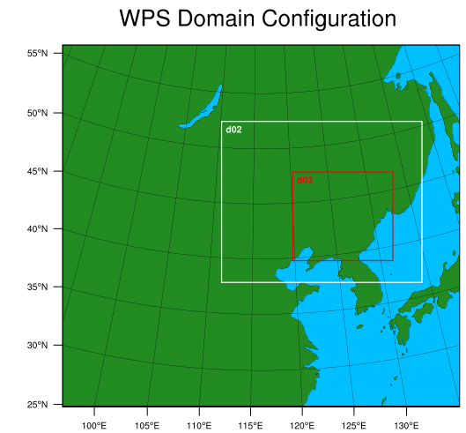
Sensitivity experiments
CTR 2 nested domain dx=dy=9km 3km 1km
Microphysics: Milbrandt 2-mom
2005-6-10 18:00:00---2005-6-11 18:00:00（UTC）
Reduce initial qvapor by 10% run1
Increase initial qvapor by 5% run2
Increase initial qvapor by 10% run3

Slide 4
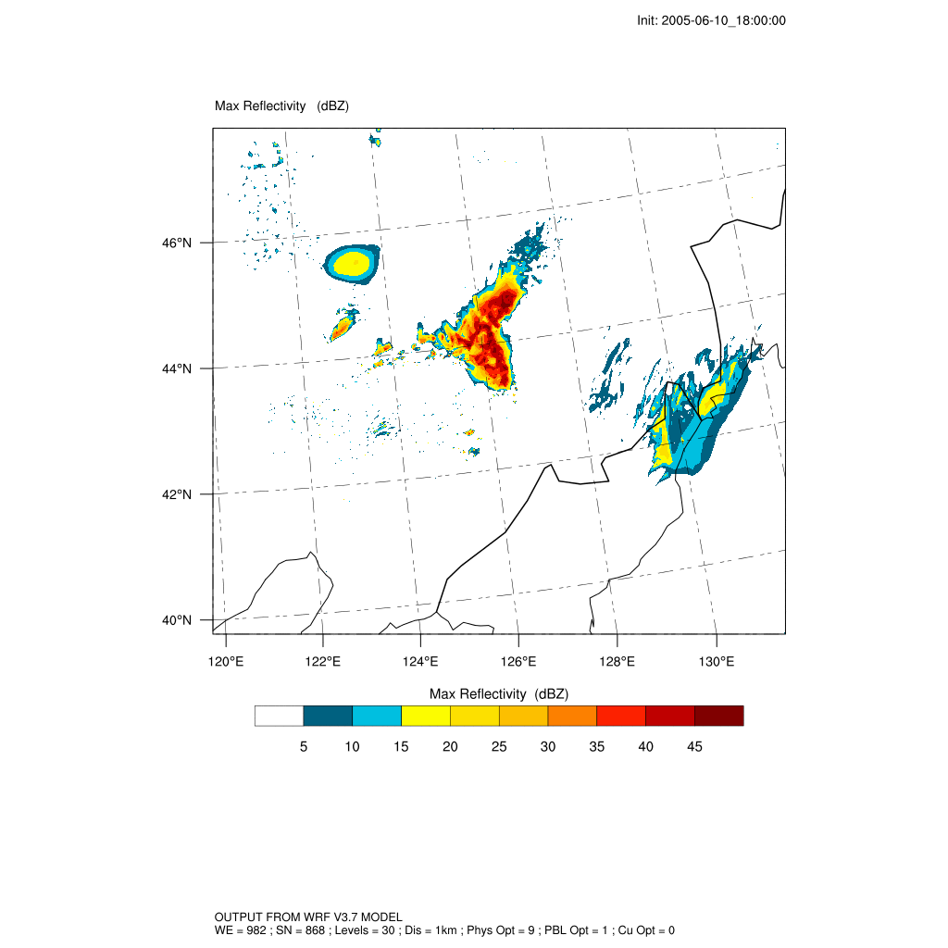
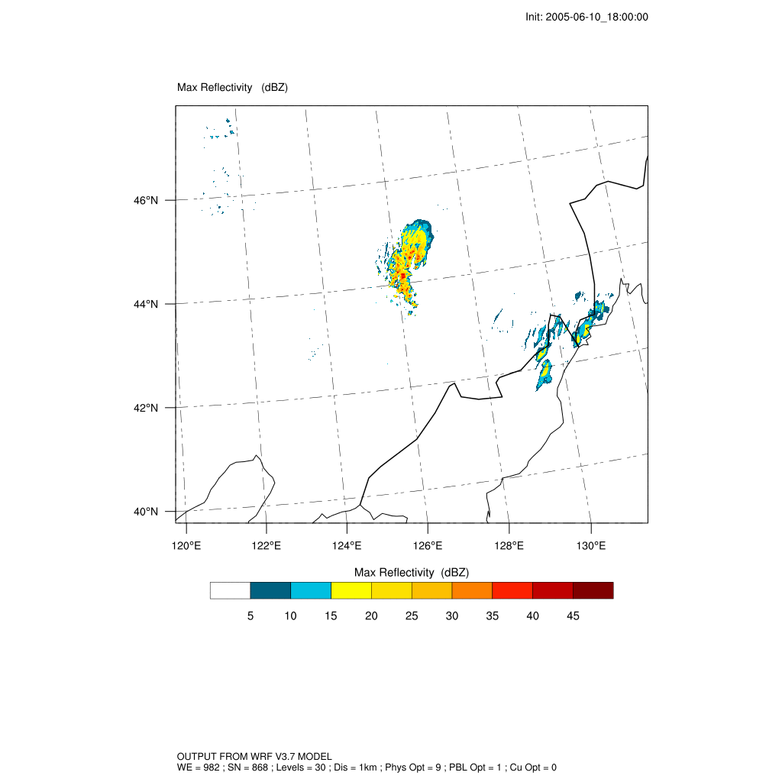
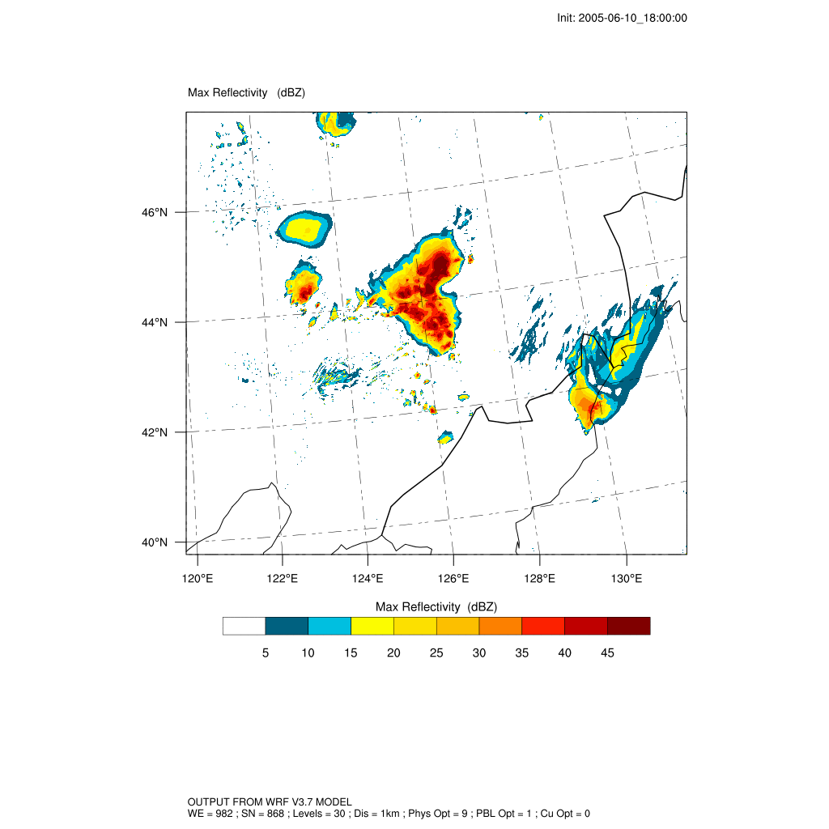
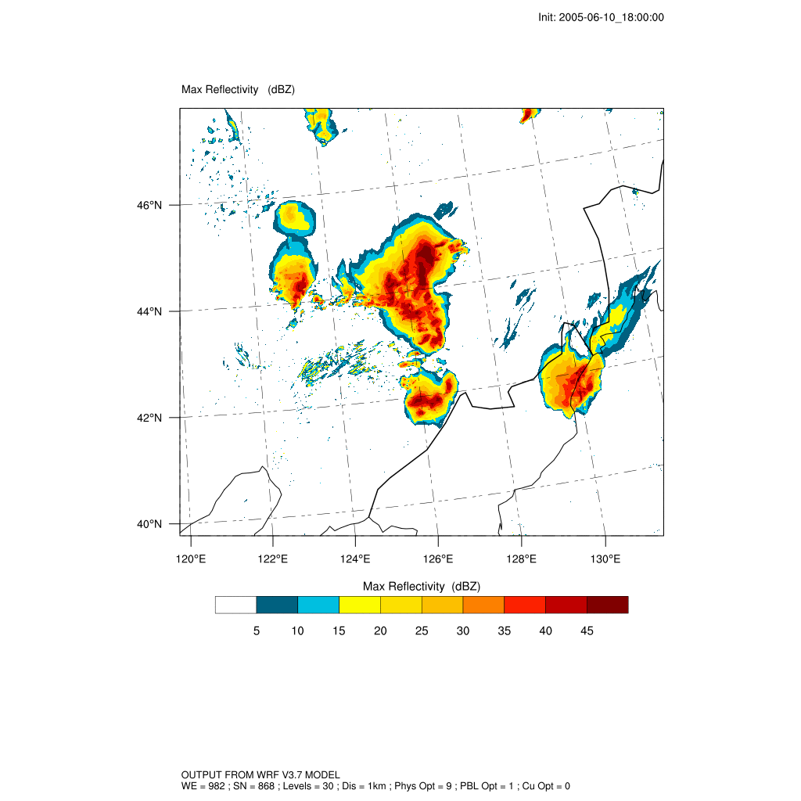
CTR
Reduce 10%
Increase 5%
Increase 10%

Slide 5
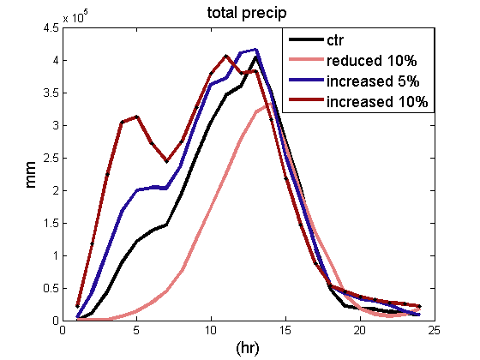
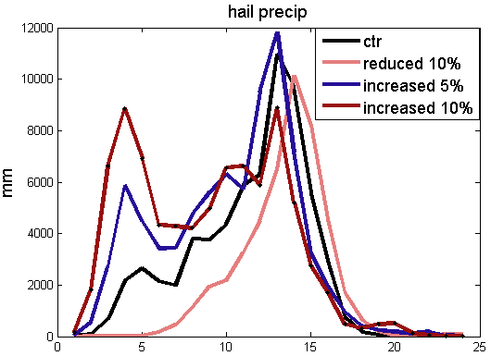
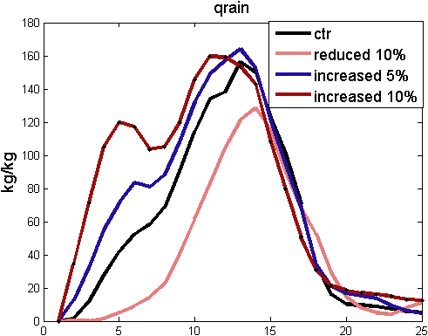
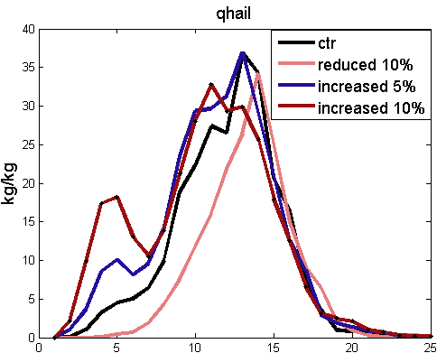
6-11_05:00:00
19 23 04 09 14
19 23 04 09 14
18 22 03 08 13 18
18 22 03 08 13 18

Slide 6
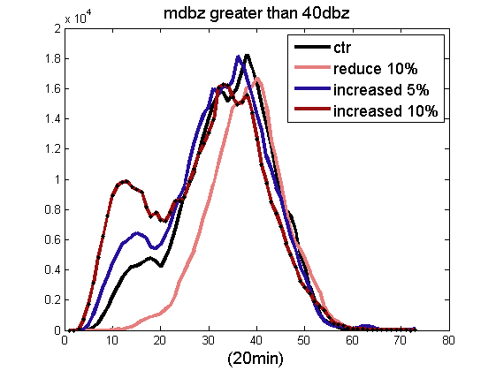
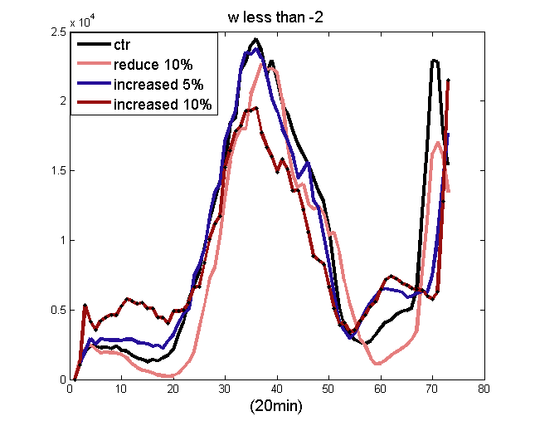
40
21:00 00:20 03:40 07:00 10:20 13:40 17:00
21:00 00:20 03:40 07:00 10:20 13:40 17:00
W<-2m/s

Slide 7
CTR | -10%
+5% | +10%
Color---- θ_{e} (2km)
Line ---- mdbz(25)
Arrow----10m wind
2005-6-11_01:00:00

Slide 8
CTR | -10%
+5% | +10%
2005-6-11_02:00:00

Slide 9
CTR | -10%
+5% | +10%
2005-6-11_03:00:00

Slide 10
CTR | -10%
+5% | +10%
2005-6-11_04:00:00

Slide 11
CTR | -10%
+5% | +10%
2005-6-11_05:00:00

Slide 12
nonlinear
Modify qvapor precipitation
Dynamic change structure
Microphysics
?

Slide 13
Next
Effects on microphysics

Slide 14
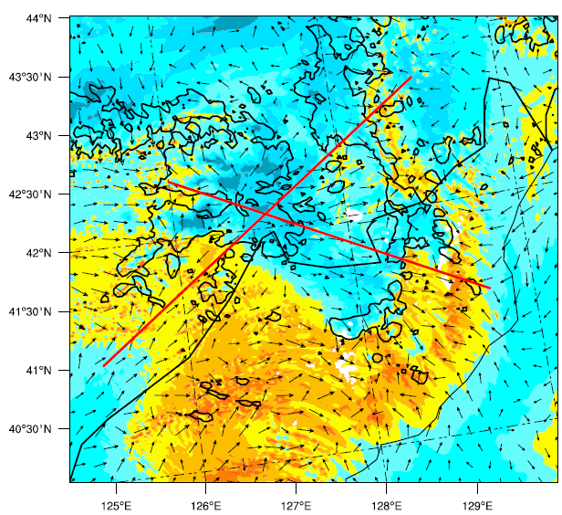
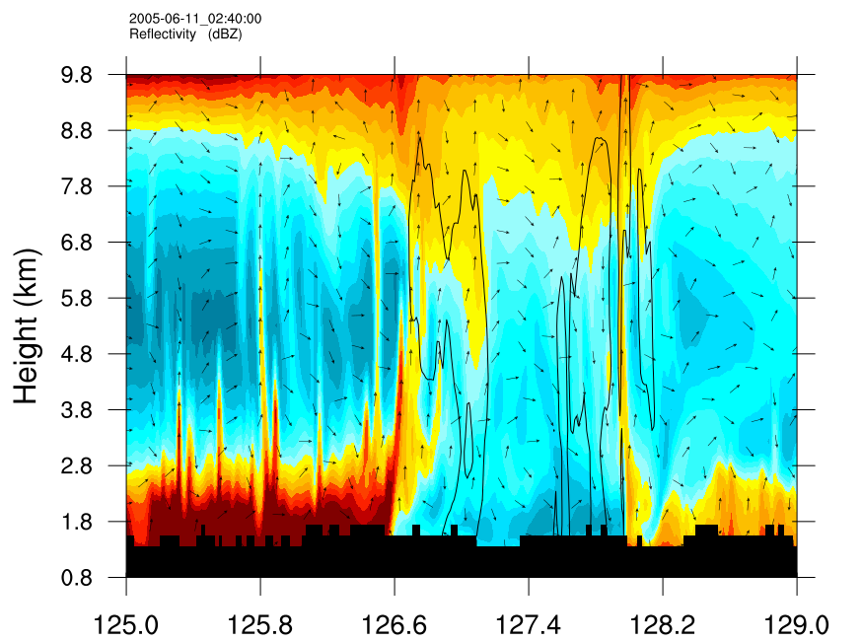
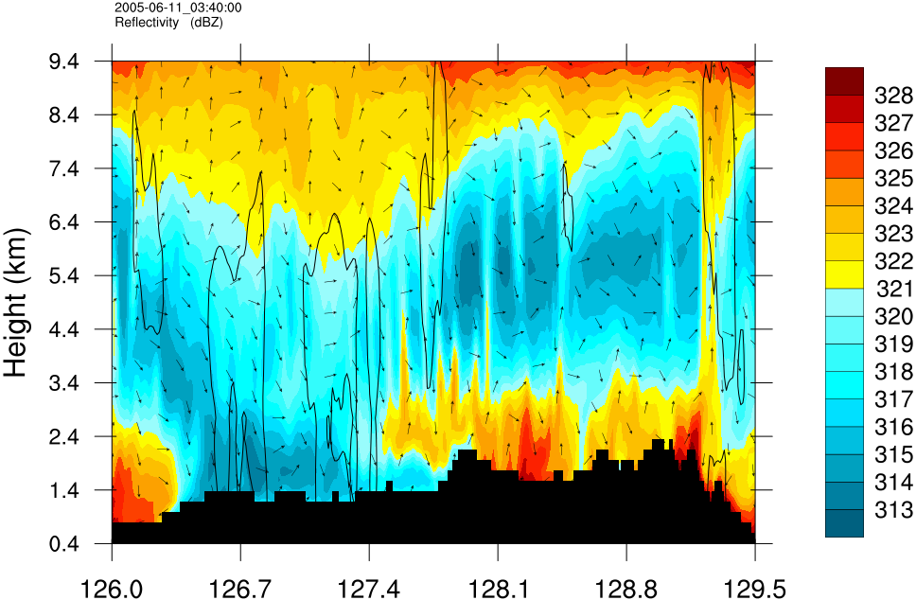

Slide 15
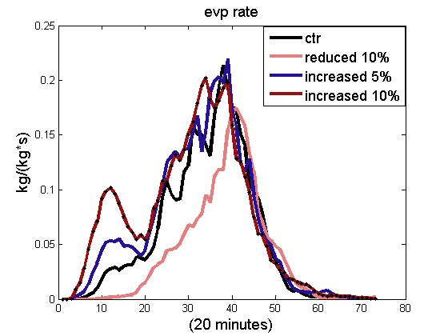
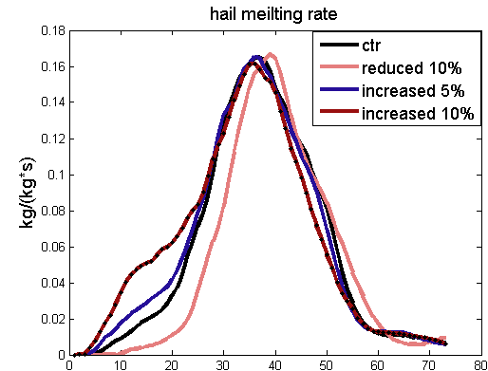
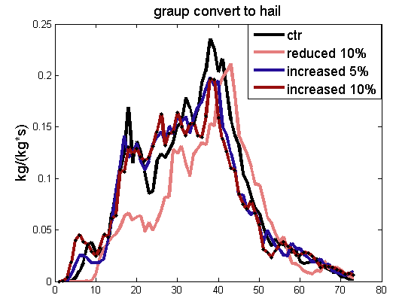
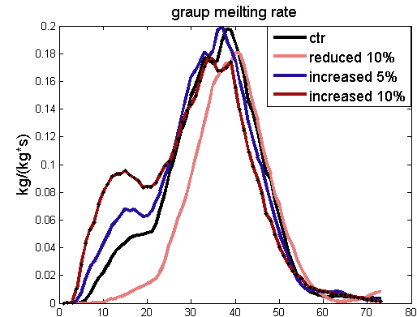

Slide 16
