Slide 1
Contributions of moist convection and internal gravity waves to building the atmospheric “-5/3” kinetic energy spectra
Y. Qiang Sun
End of Semester Groupmeeting
2015-12-11

Slide 2
Observed Power Spectra of Wind and Potential Temperature From Aircraft
Synoptic scale
mesoscale
Nastrom and Gage (1985)

Slide 3
Error Energy Growth Under Different Base-state Kinetic Energy Spectra
Rotunno and Snyder (2008)
The slope of kinetic energy spectrum is closely related to energy transfer process, both for the base-state and error energy.

Slide 4
Hypotheses for Kinetic Energy Spectrum
2D turbulence
Lily 1983
Tung and Orlando 2004
Most of the hypotheses are based on simplified models and are not verified by the full physics model.

Slide 5
Kinetic Energy Spectra in Baroclinic Jets: Dry vs. Moist
Simulated dry baroclinic Jets have a -3 slope, while moist experiments show a transition at mesoscale.

Slide 6
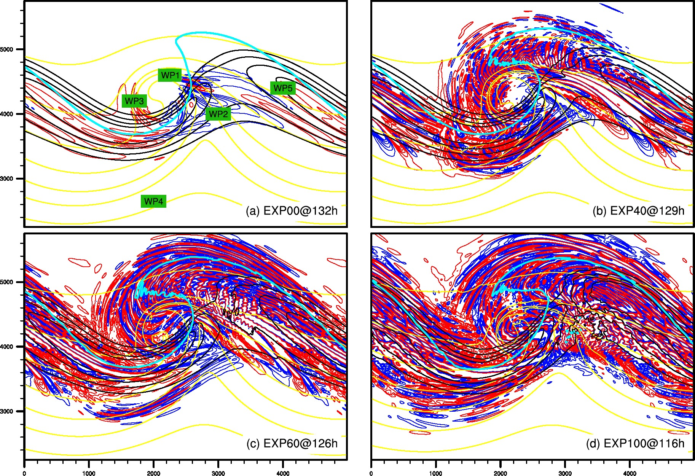
Gravity Waves in Baroclinic Jets: Dry vs. Moist
(Wei and Zhang 2014 JAS; 2015 JAMES)
Convection and gravity waves key to flatten the meso/small-scale spectral slope.
Adjustment and gravity waves likely play a key role in the error propagation across scales, as hypothesized in Zhang et al. (2007 JAS).

Slide 7
Research question:
Are convection and gravity waves generated by the convection enough to build a -5/3 slope?
If so, how does this happen?

Slide 8
20 Member WRF simulation of resolved convections
800km X 800km domain, horizontal grid spacing of 2km
Double periodic lateral boundary condition
No coriolis force
a)
b)
Initial wind profile and thermal environments.
Notes:
Figure 1.
Initial wind and Skew-T profile of our simulation.

Slide 9
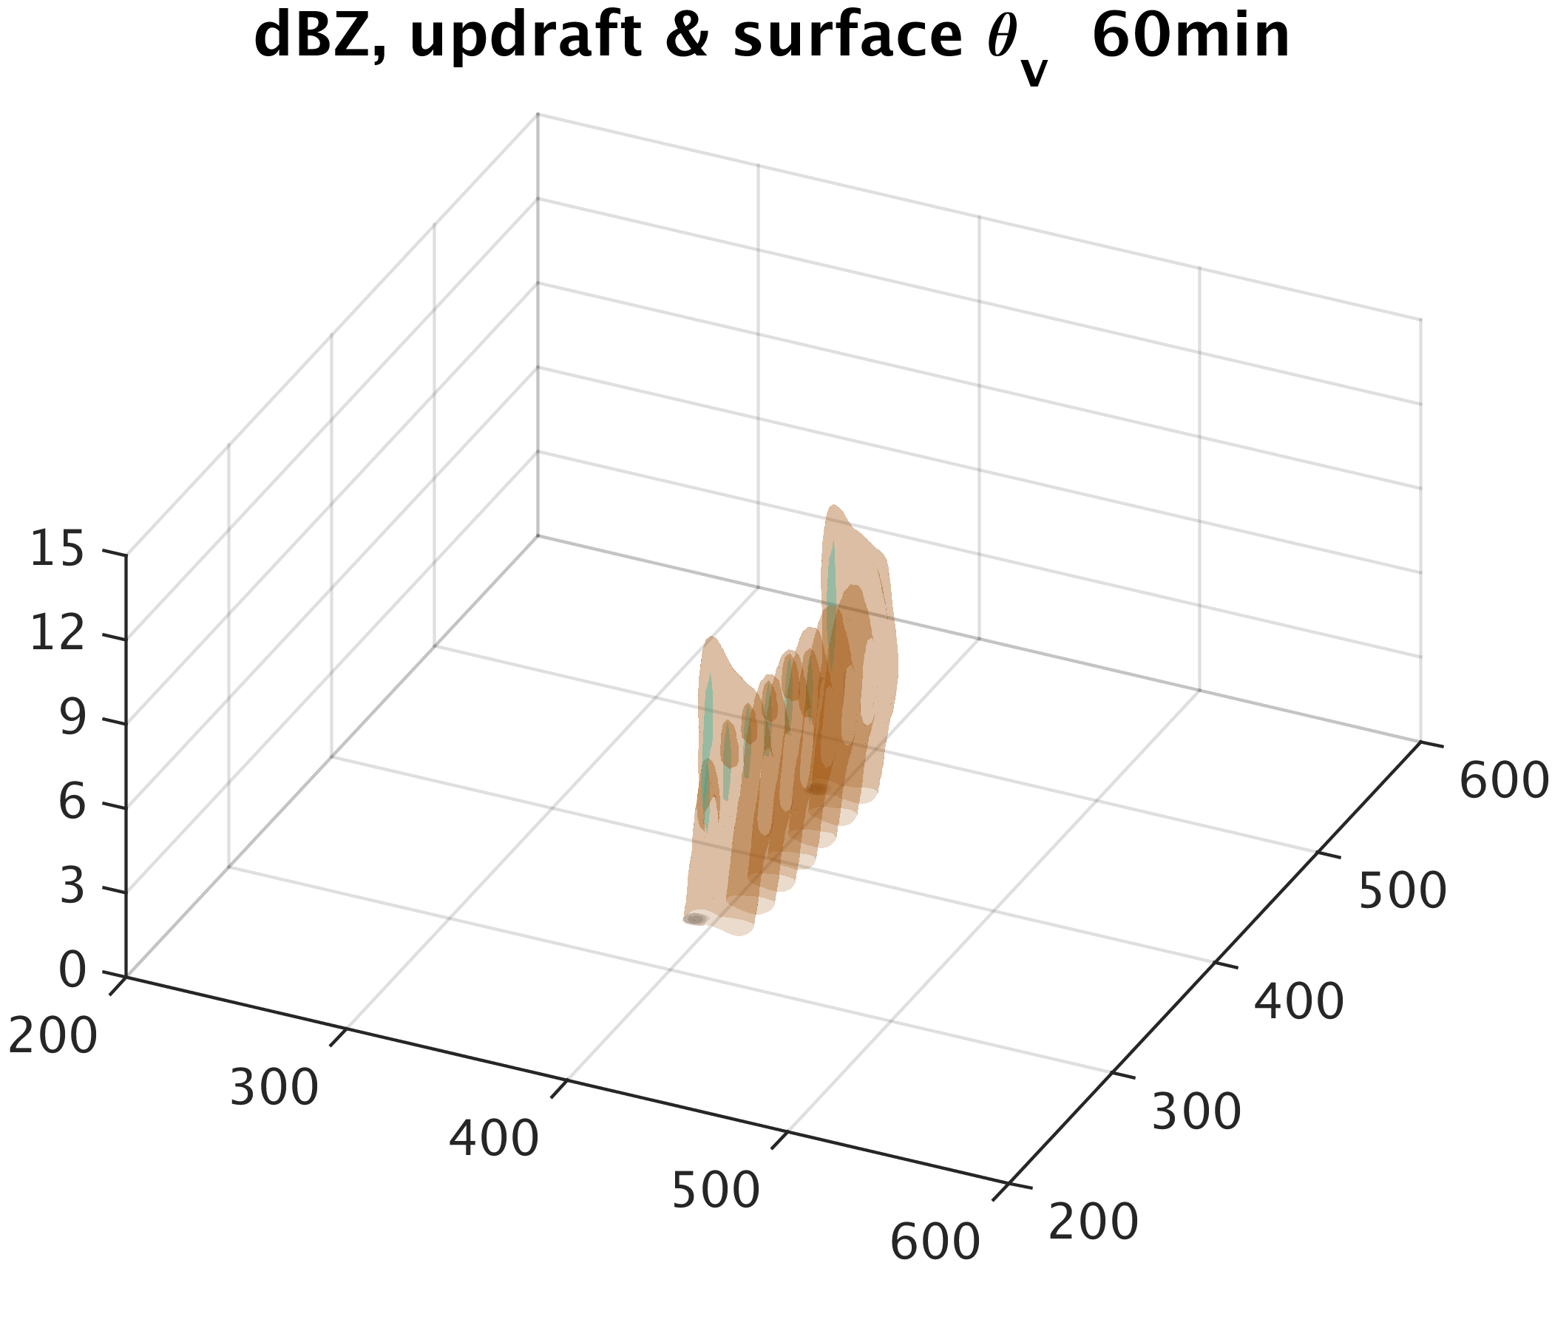
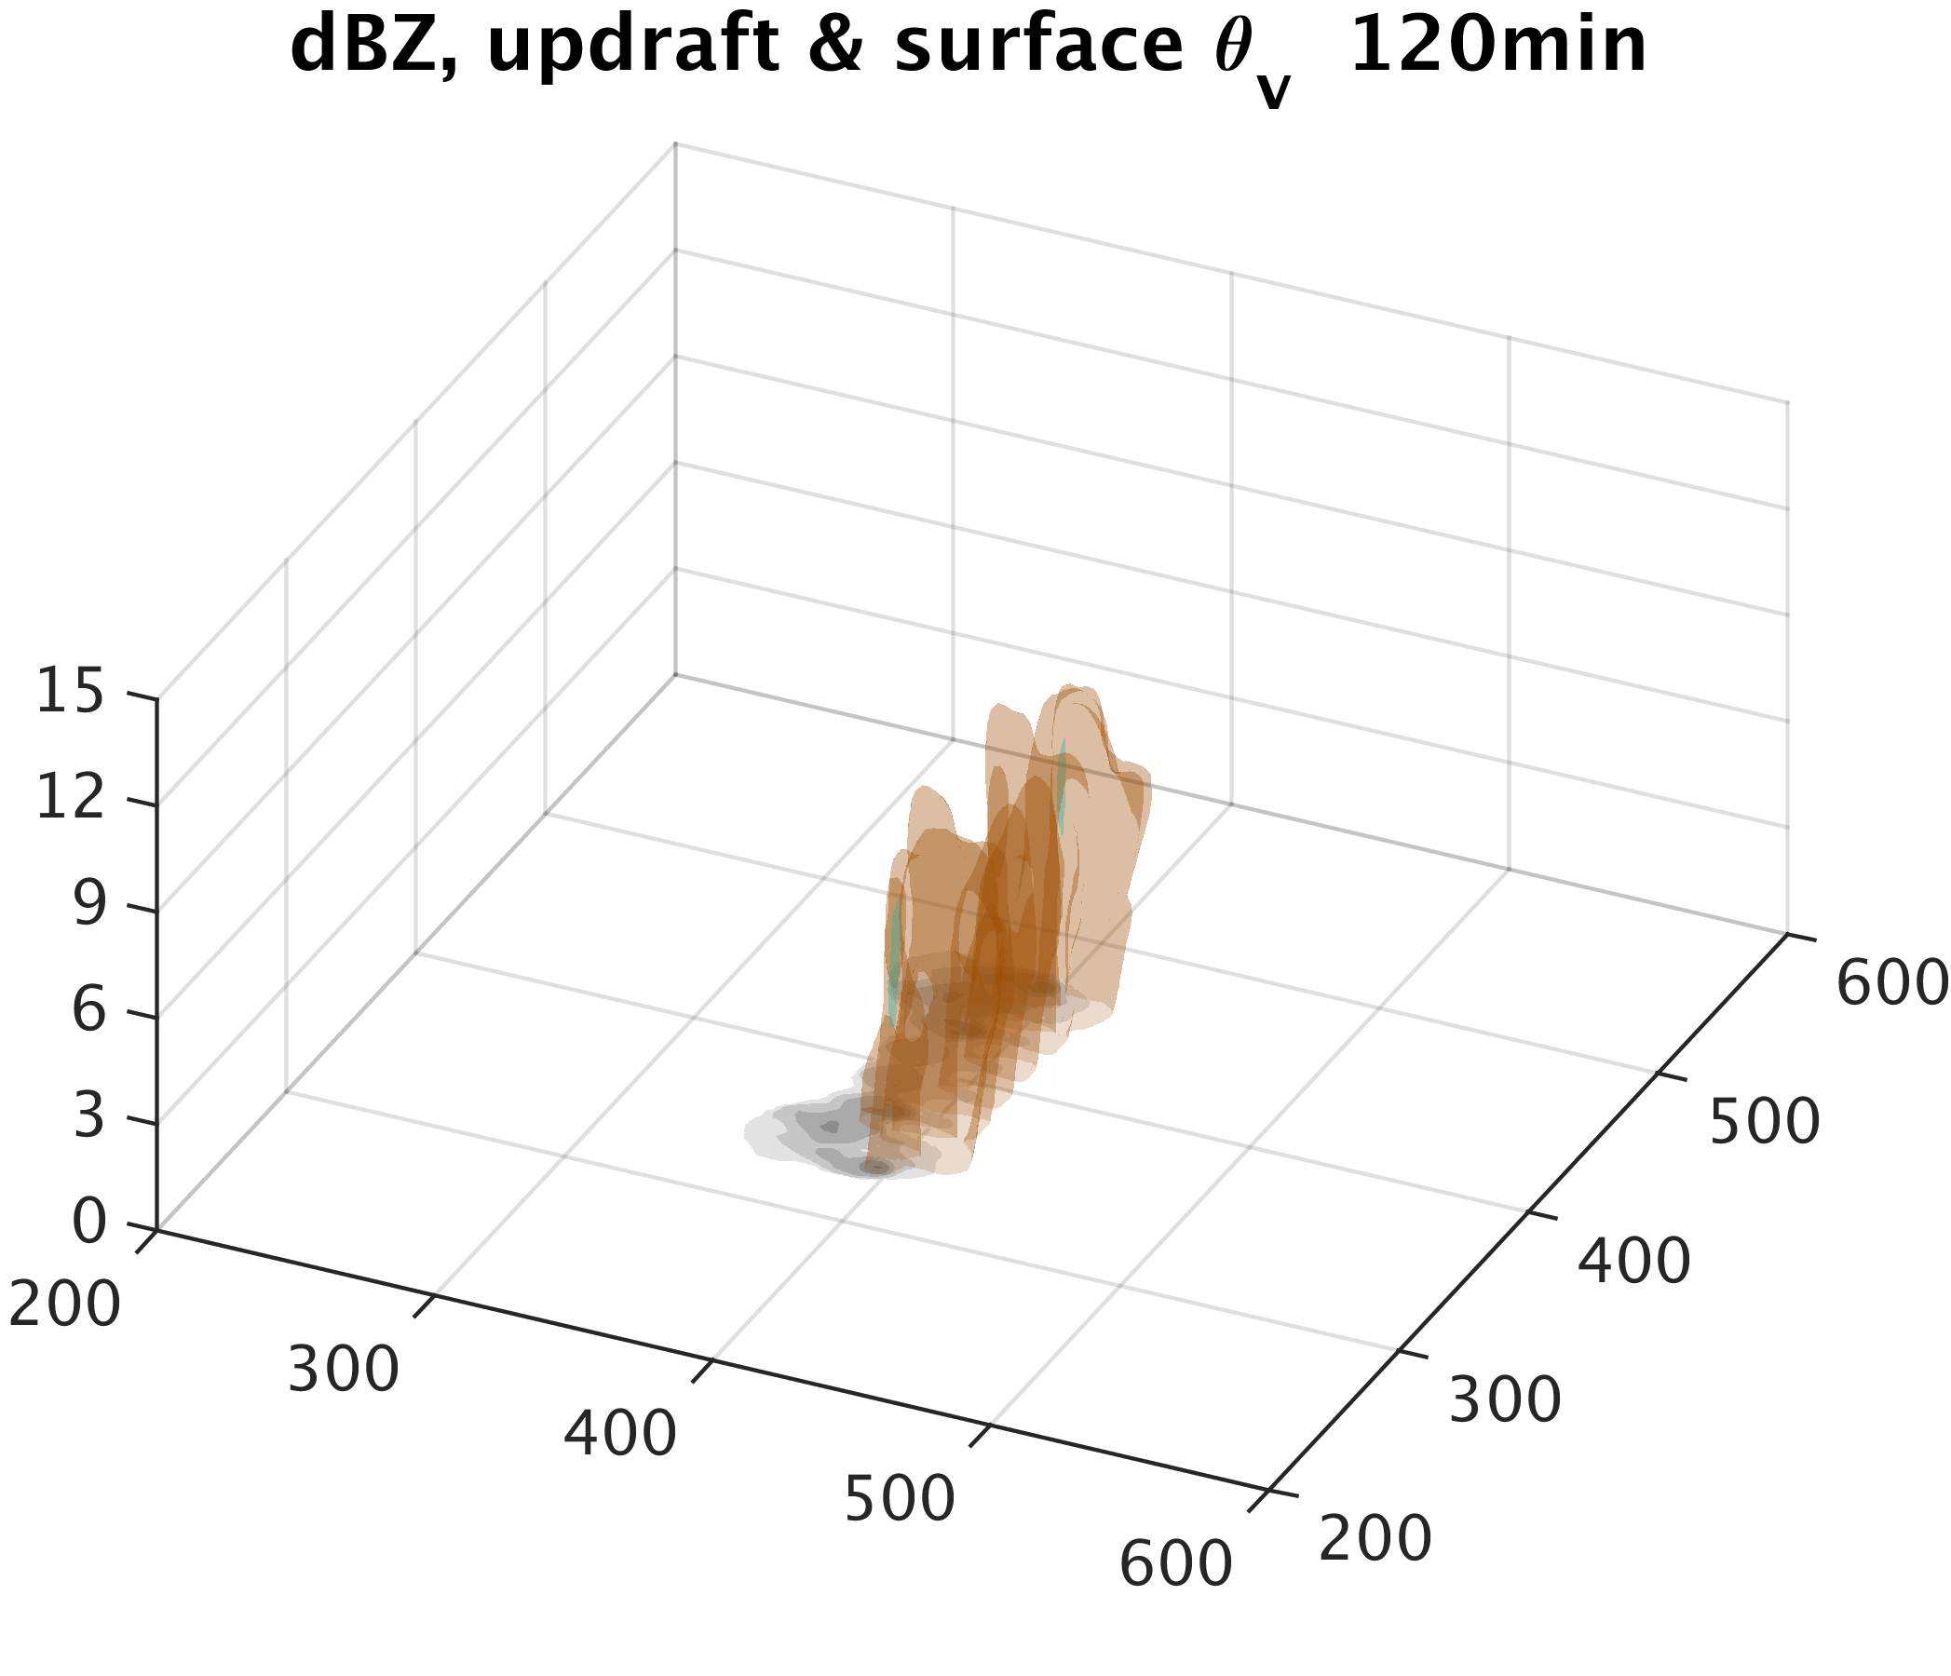
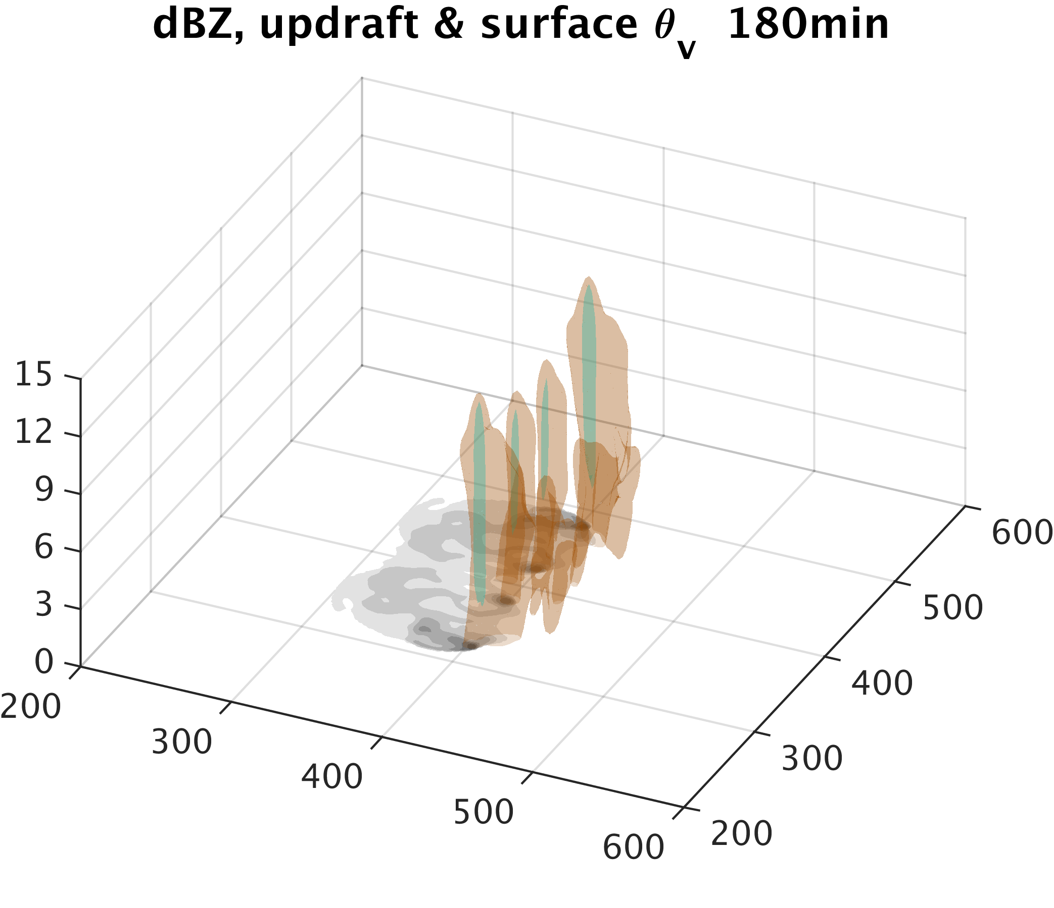
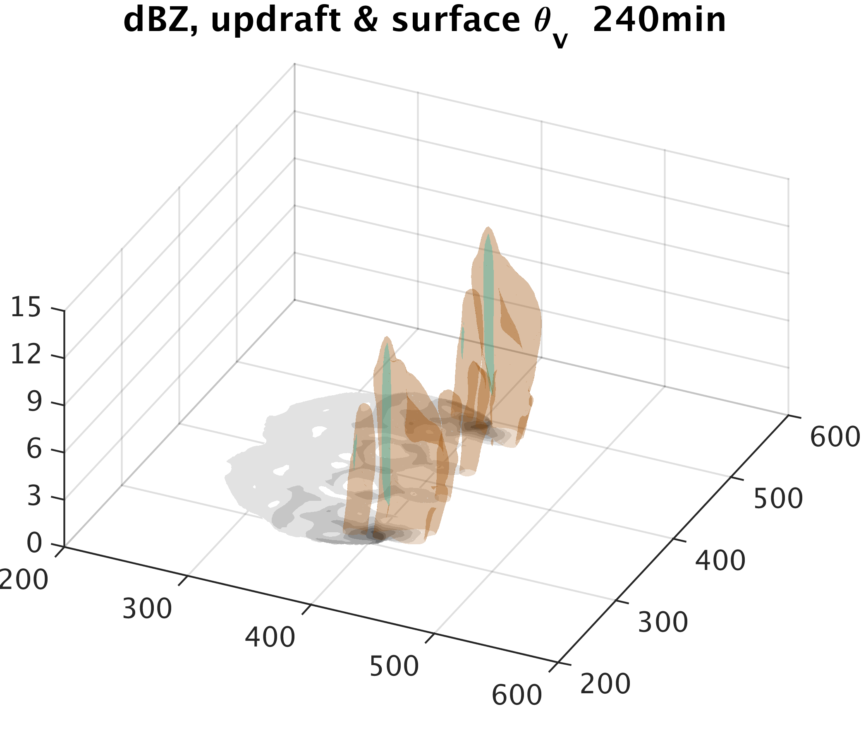
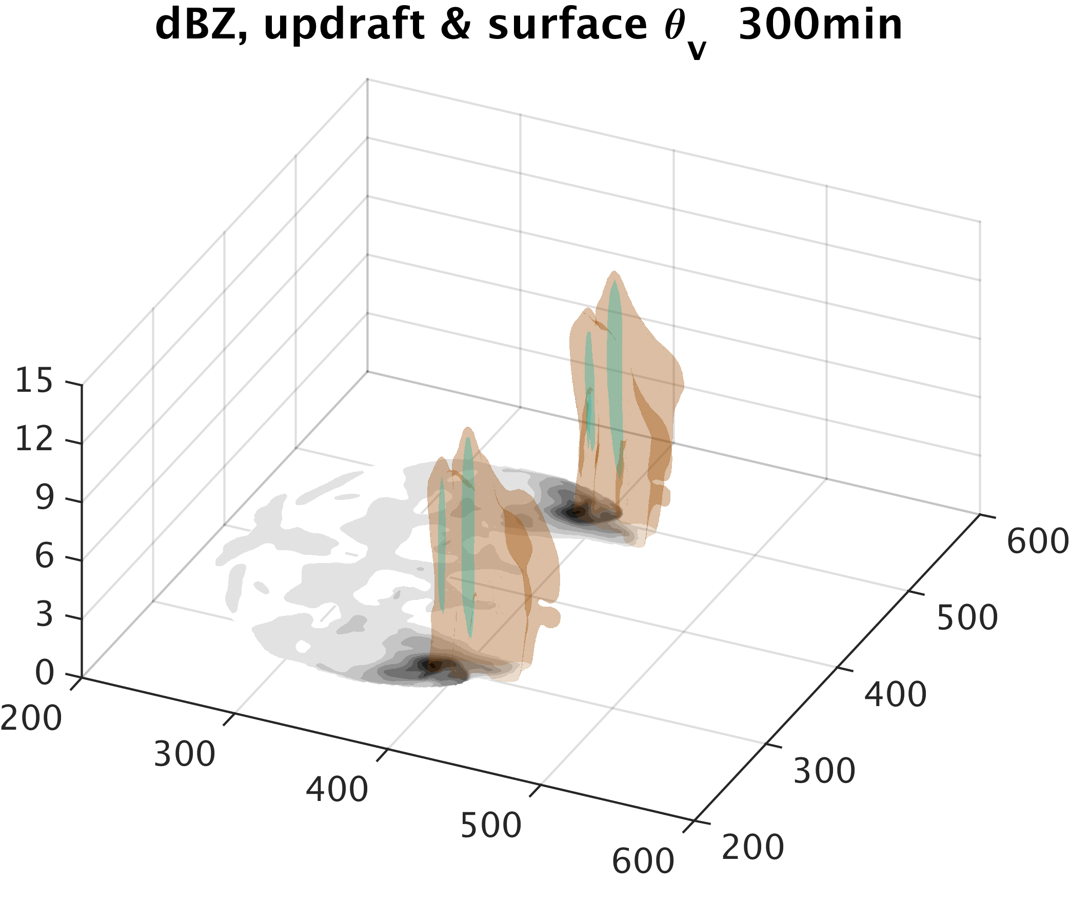
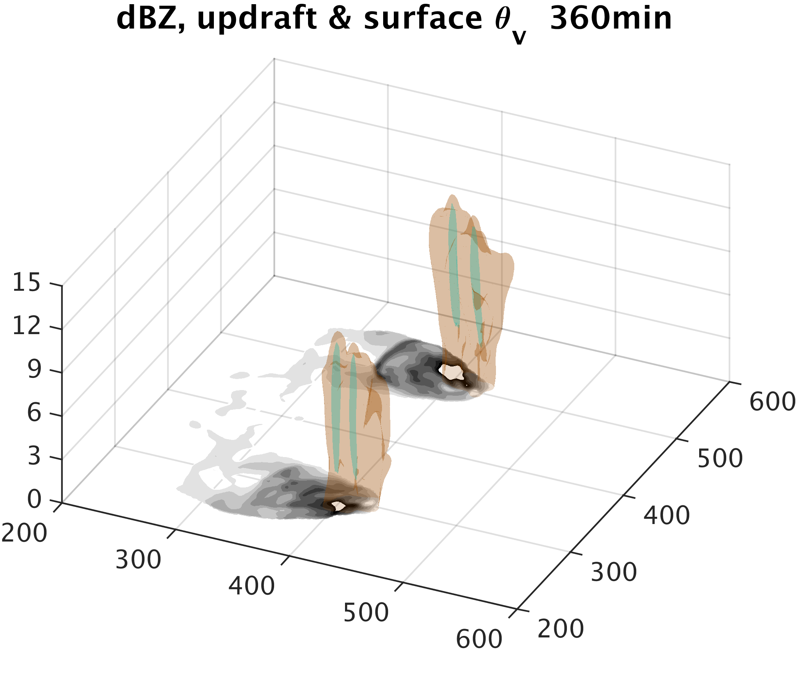
Time Evolution of our Simulated Squall Line.
Isosurface of vertical velocity (w = 10m/s, cyan), radar reflectivity (25dbz, brown), and surface cold pool (\theta_v anomaly < -0.5°C, gray) are plotted every hour.

Slide 10
Kinetic Energy Spectra in our Simulation
k^{-5/3}

Slide 11
Kinetic Energy Spectra At different vertical levels

Slide 12
Spectrum Budget Analysis for Kinetic Energy

Slide 13
Spectrum Budget Analysis for Kinetic Energy

Slide 14
Results for Different levels

