Slide 1
Data Assimilation of Haiyan
Yudong Gao
12/11/2015

Slide 2
Outline:
1 Data Quality Control
2 Assimilation cycle
3 Forecast

Slide 3
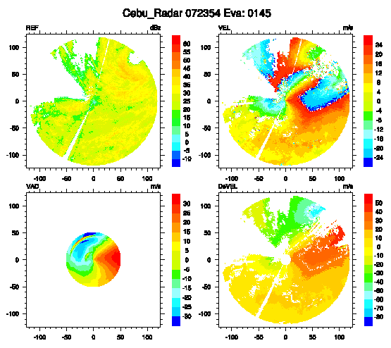
1 Data Quality Control

Slide 4
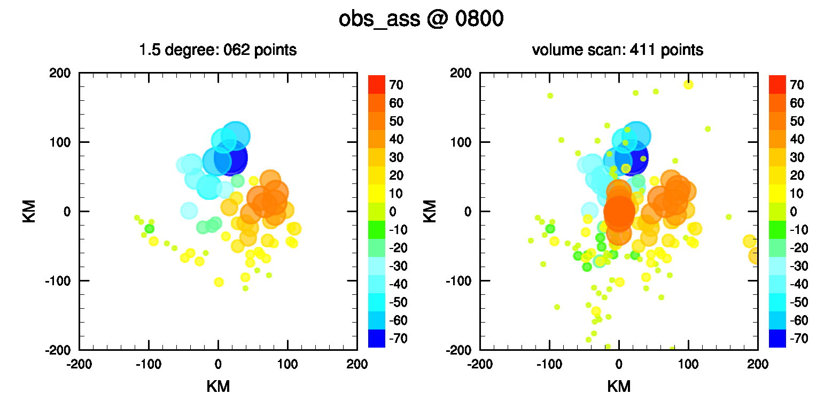
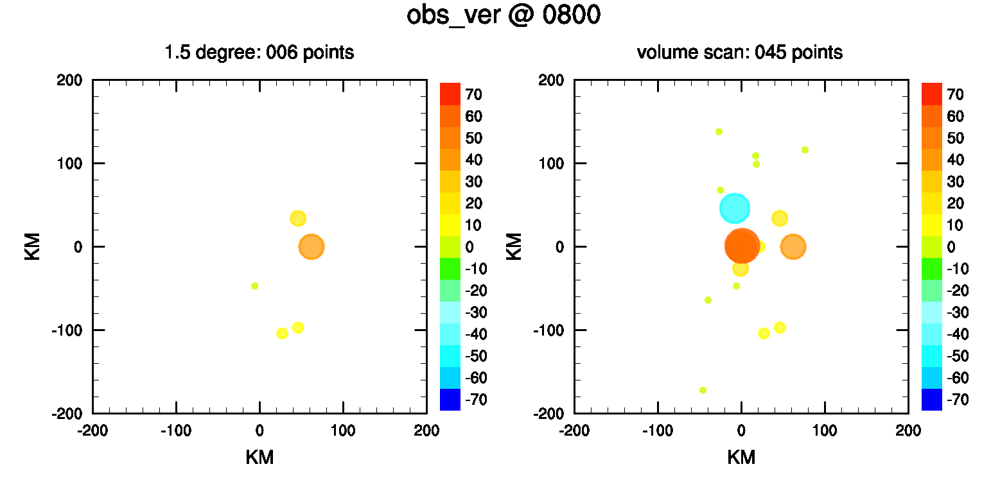

Slide 5
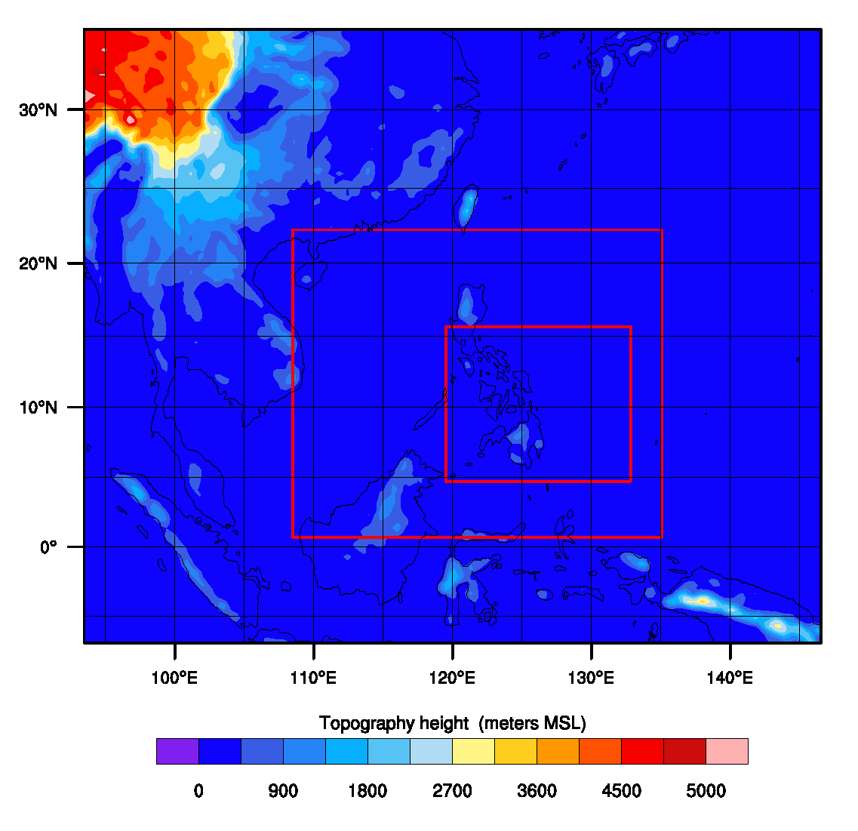
2 Assimilation cycle
Configuration of WRF:
dx: 27km/9km/3km
WSM6/slab/ysu
60 members
Exp_bst: assimilate best track data
Exp_rad: assimilate CEBU radar
Exp_rad_bst: assimilate radar & best track
initial
assimilation
12Z07
18Z07
00Z08

Slide 6
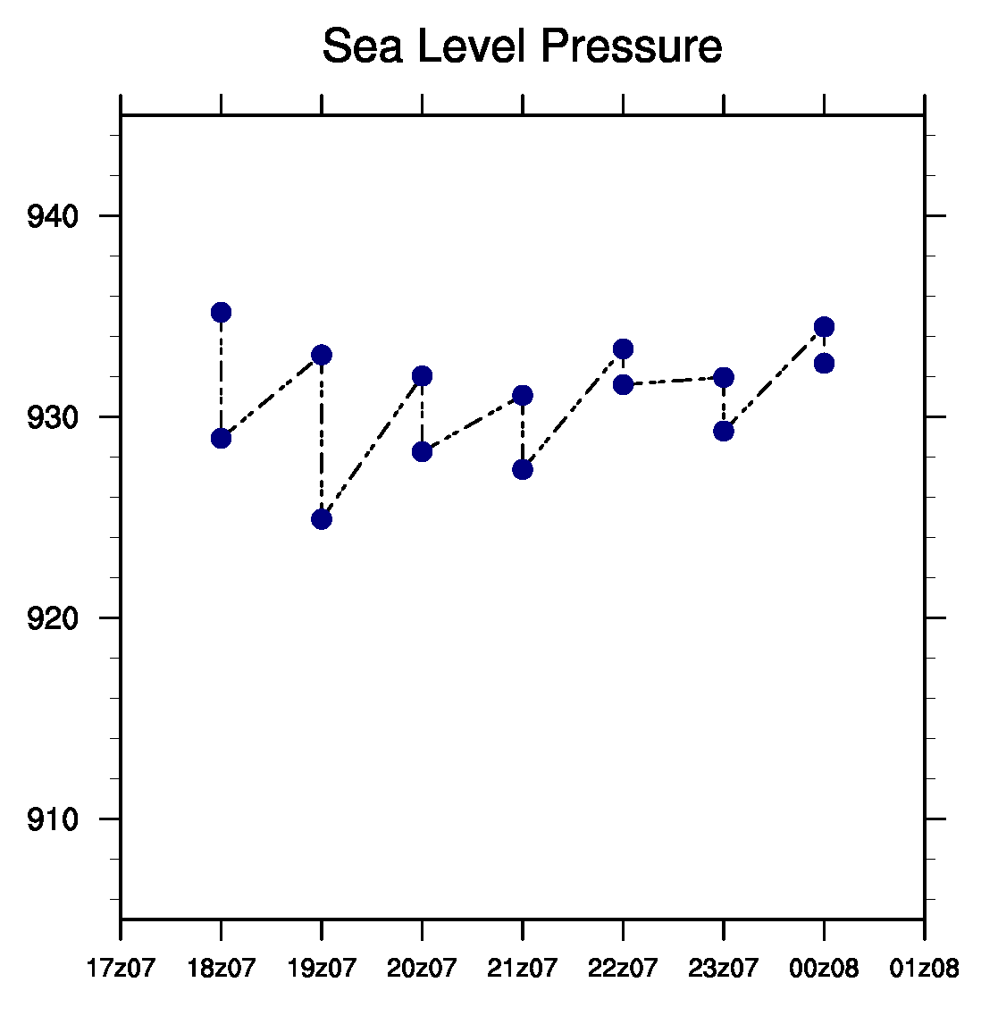
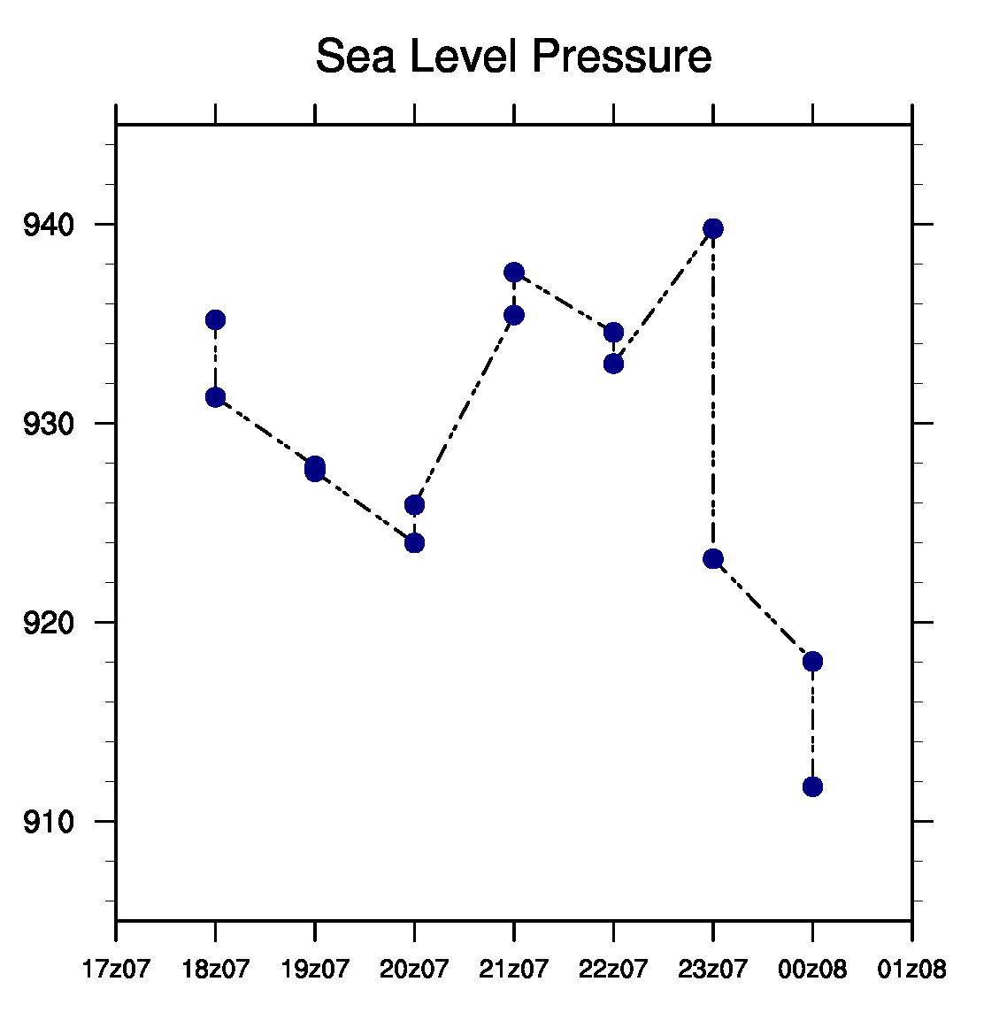
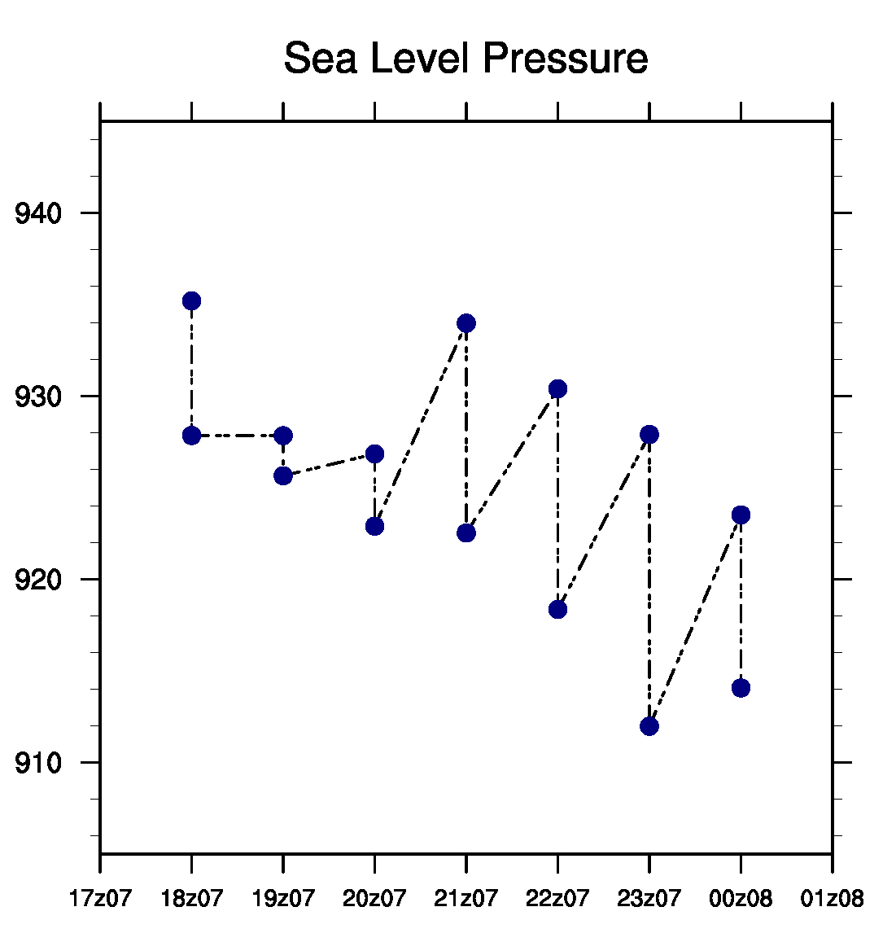
Evolution of SLP
Exp_bst
Exp_rad
Exp_rad_bst

Slide 7
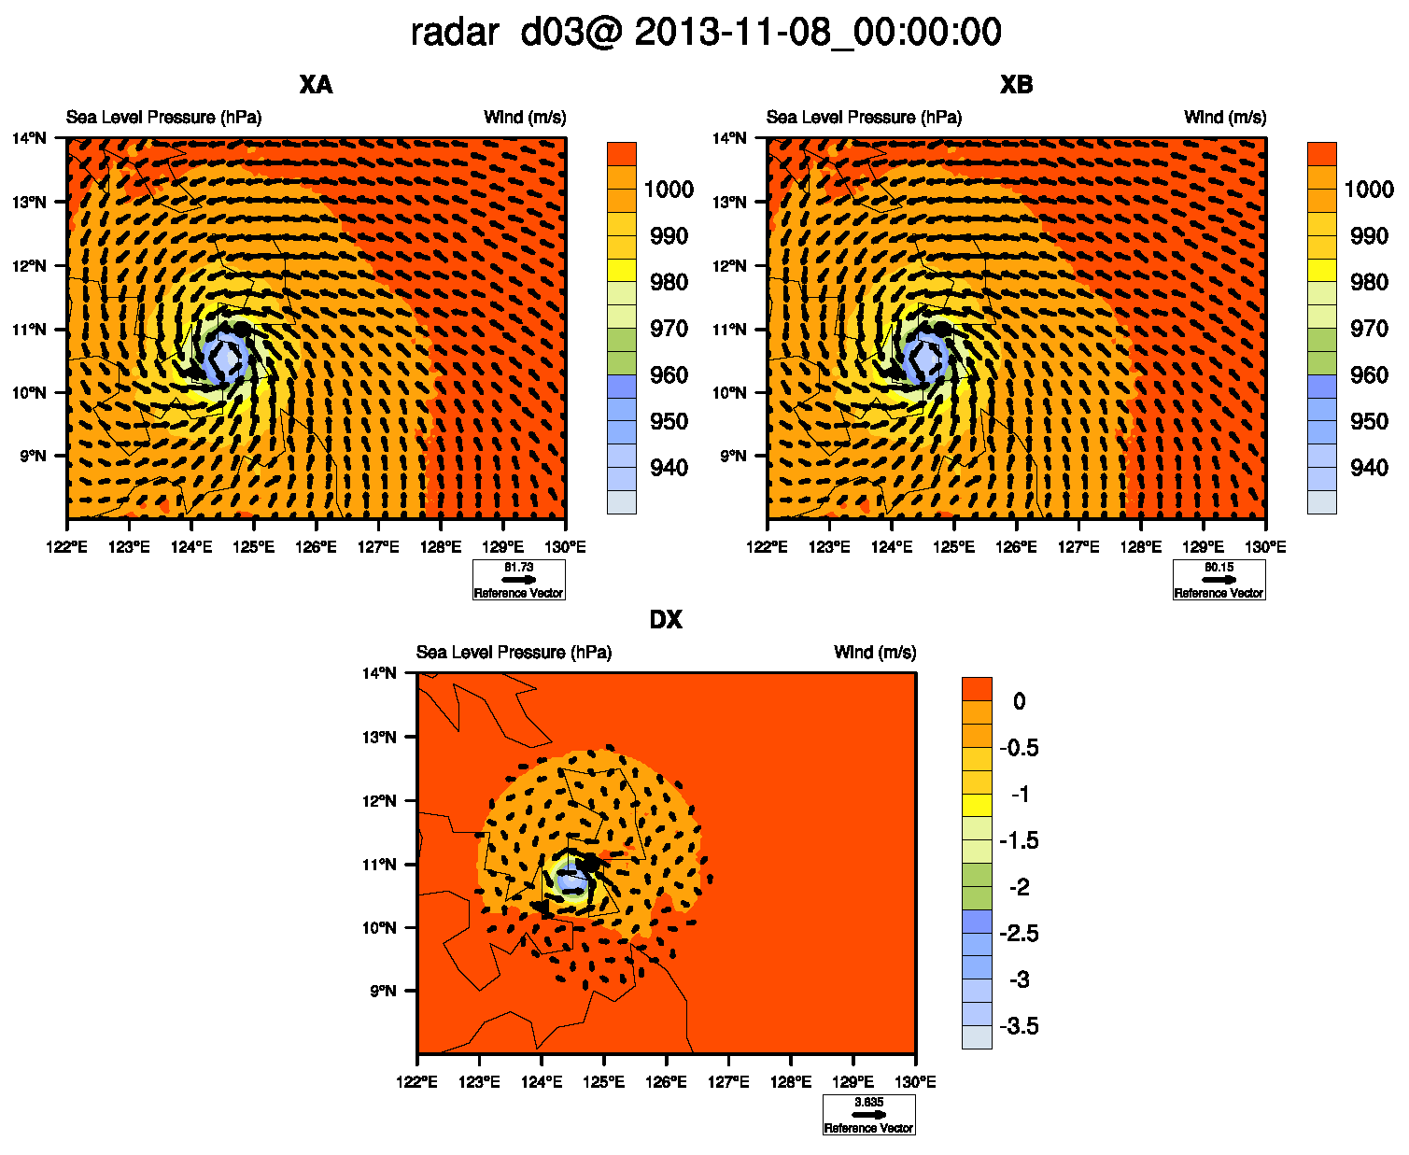
Increments of Exp_bst

Slide 8
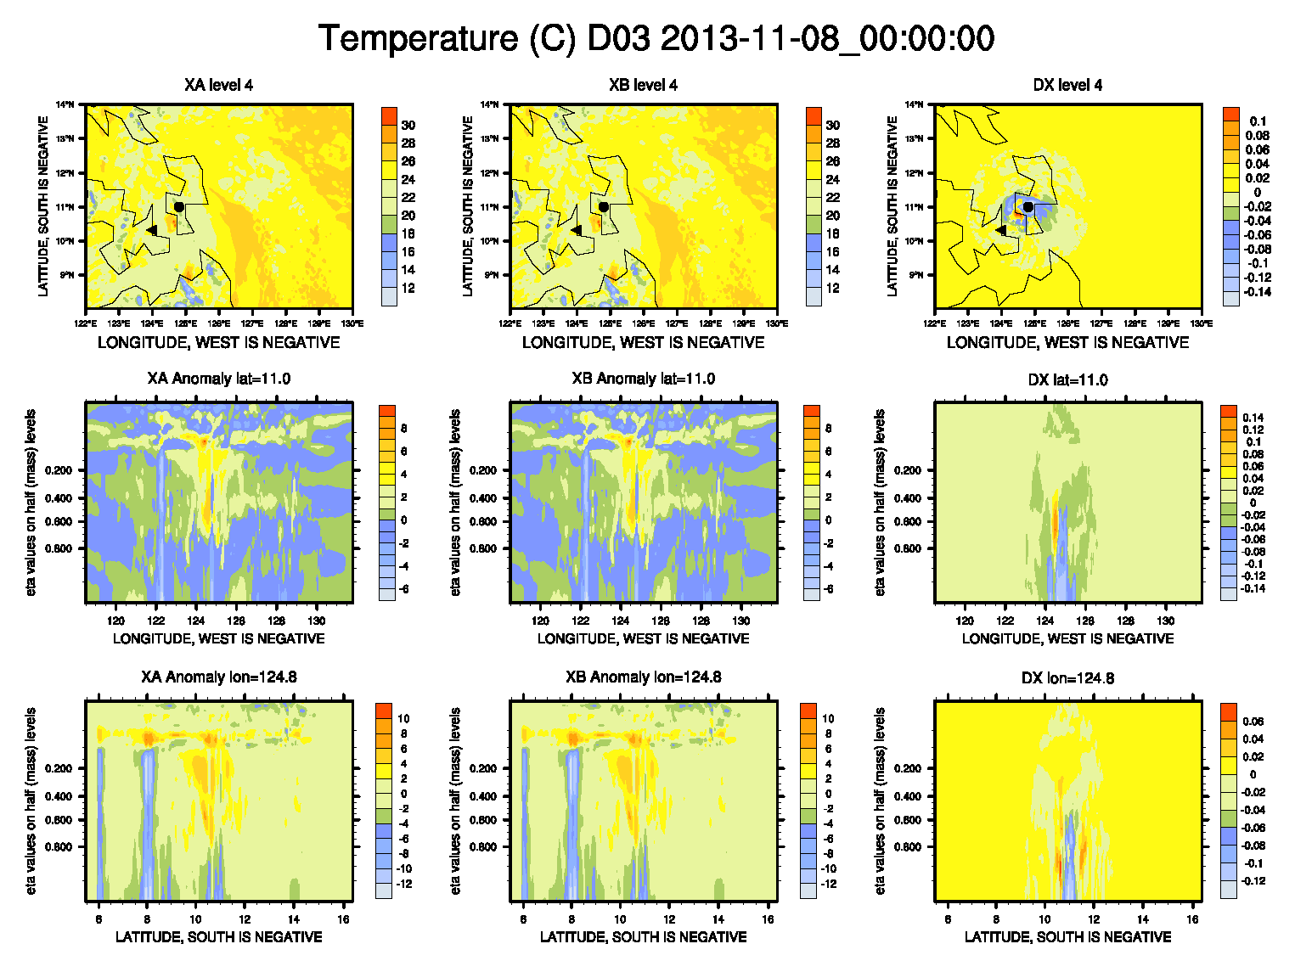

Slide 9
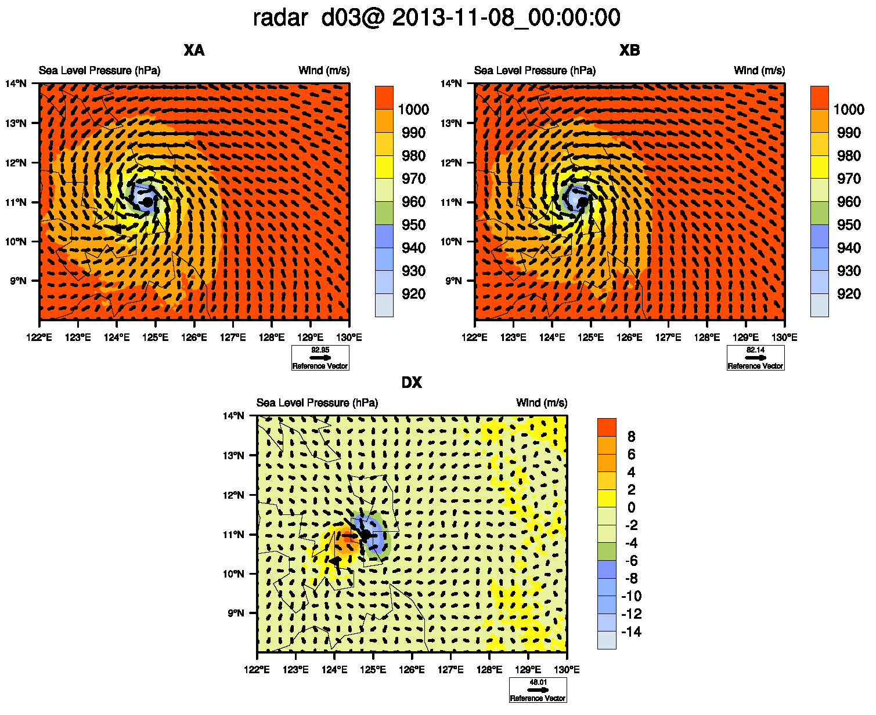
Increments of Exp_rad

Slide 10
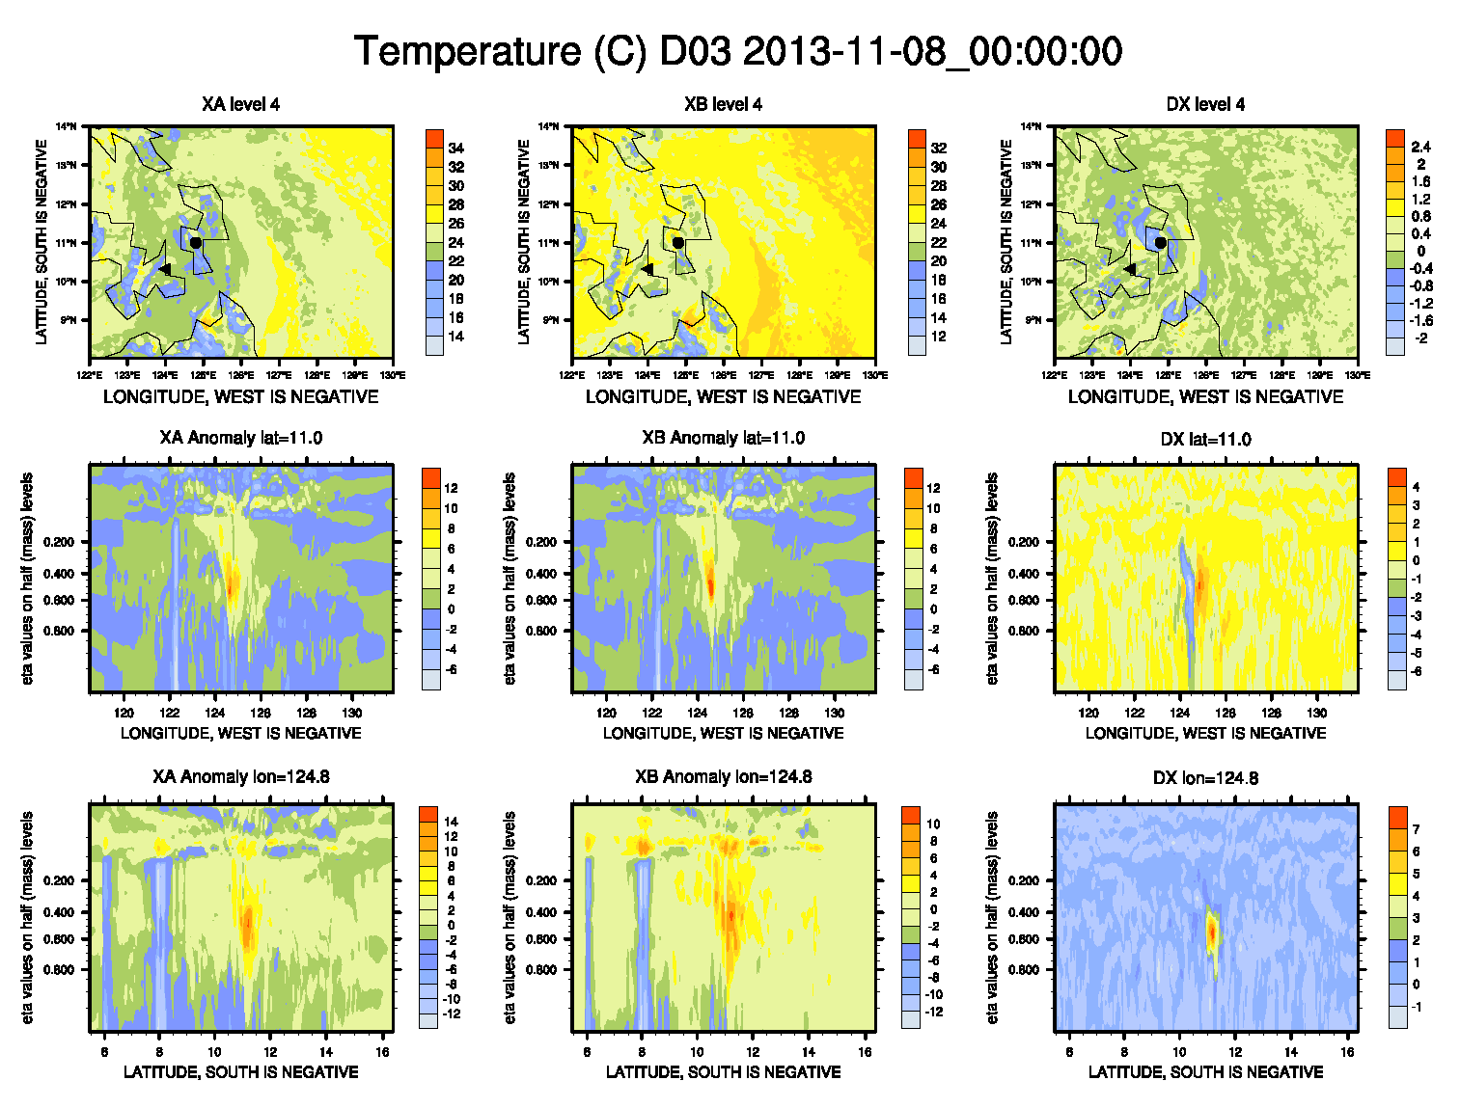

Slide 11
Increments of Exp_rad_bst

Slide 12
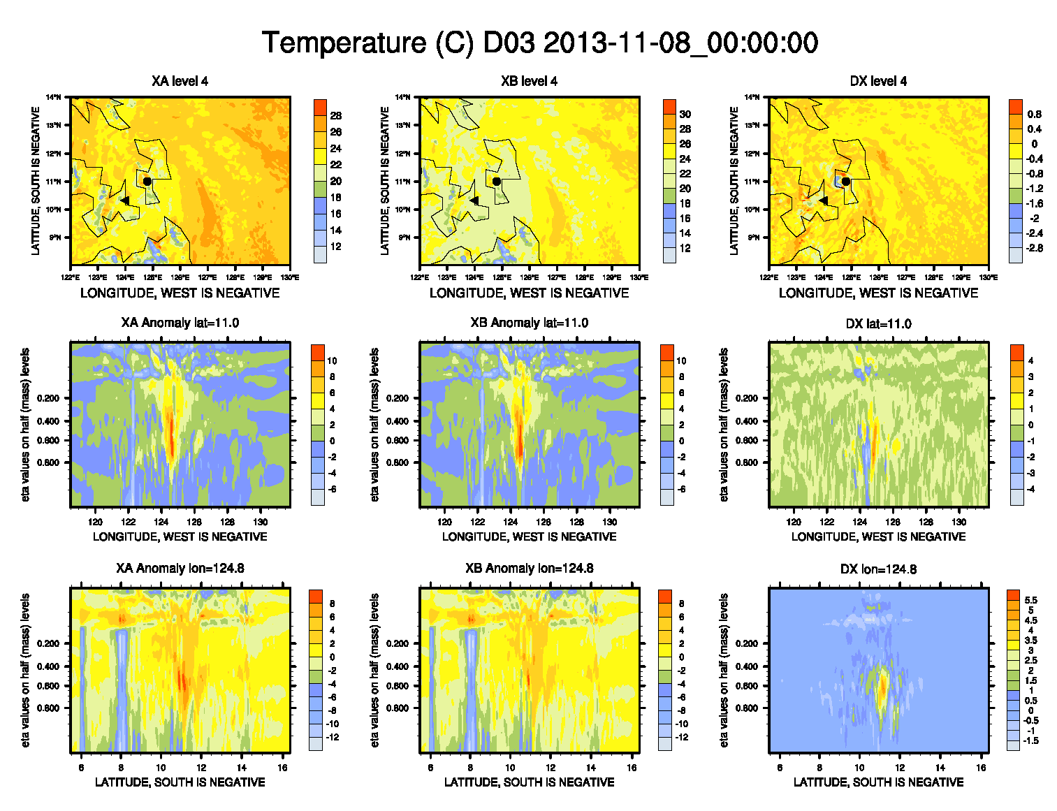

Slide 13
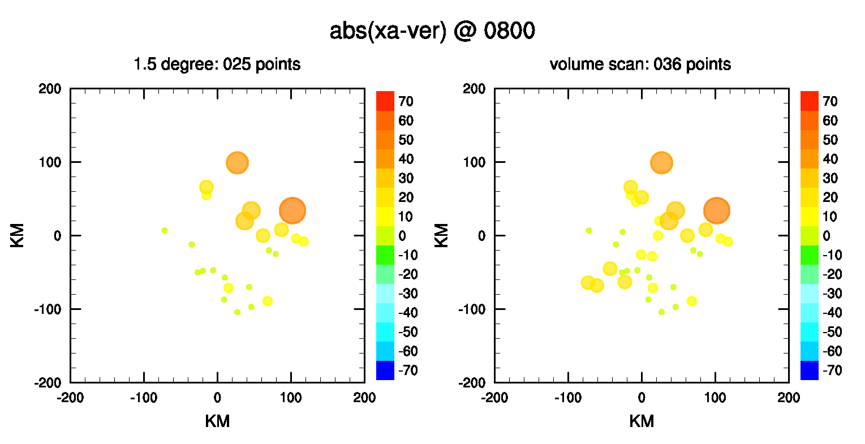
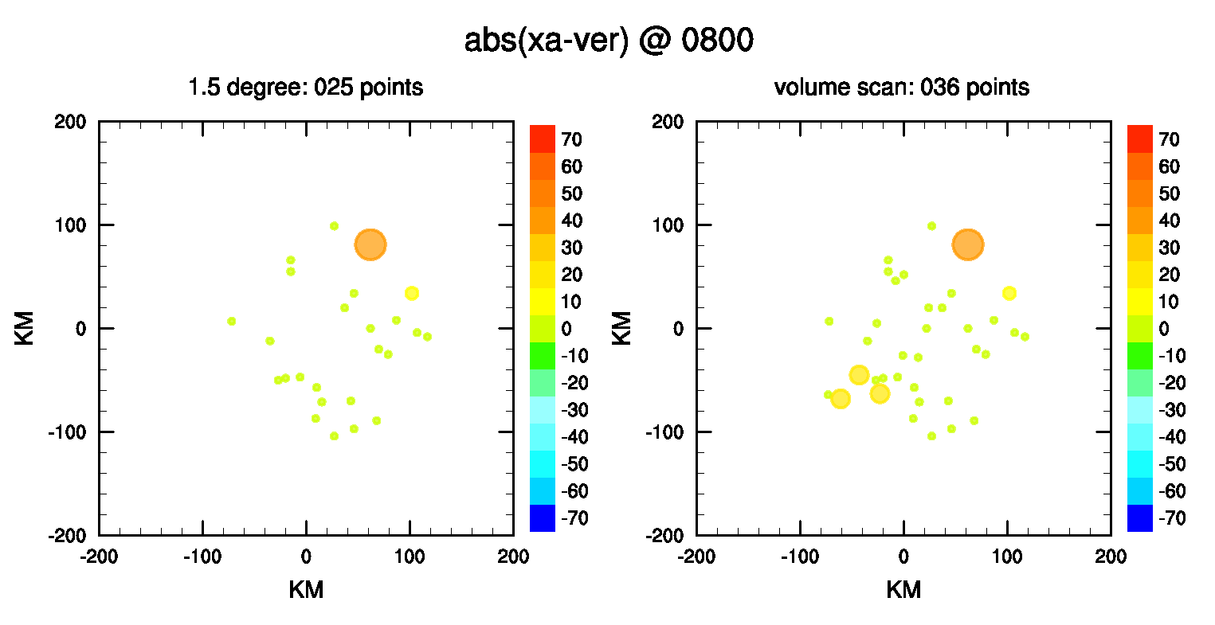
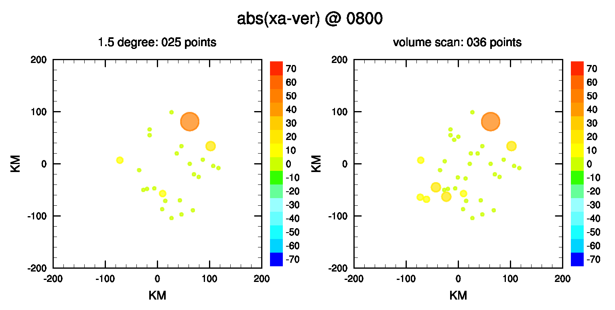
Verification by radar data
Exp_bst
Exp_rad
Exp_rad_bst

Slide 14
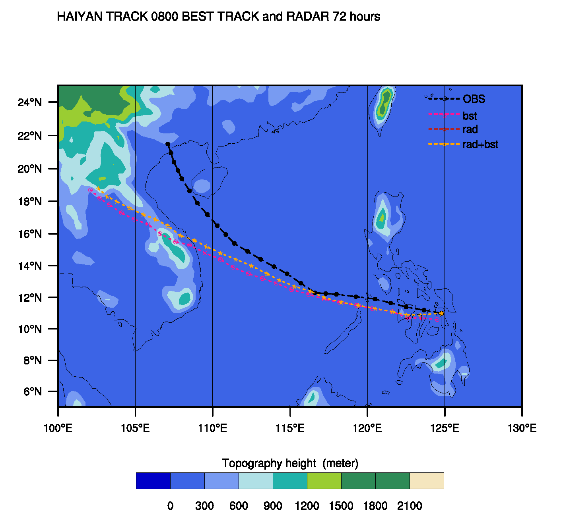
3 Forecast
Deterministic forecast of mean

Slide 15
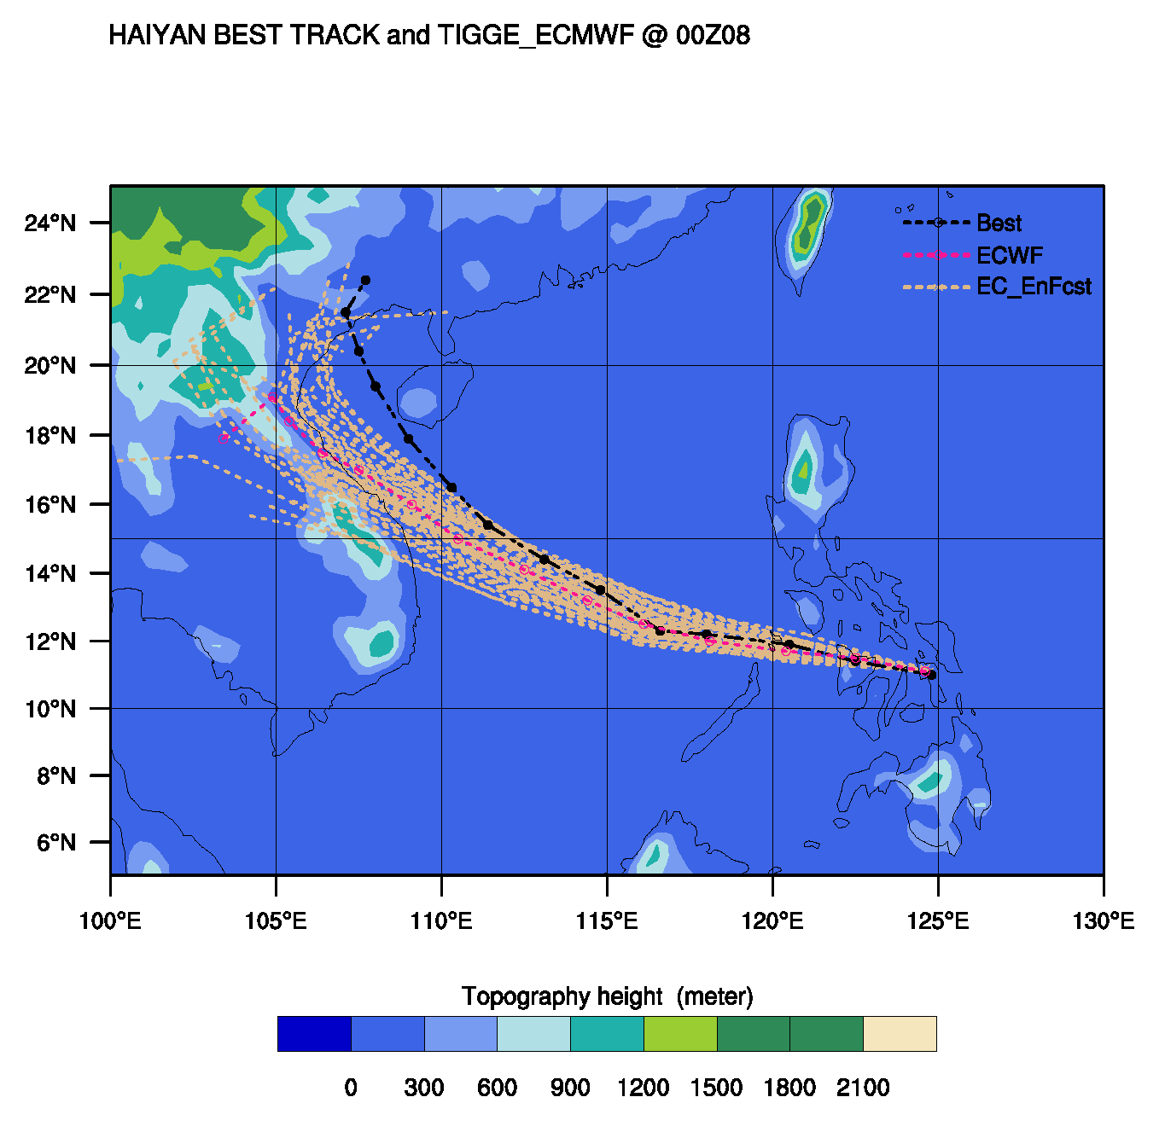
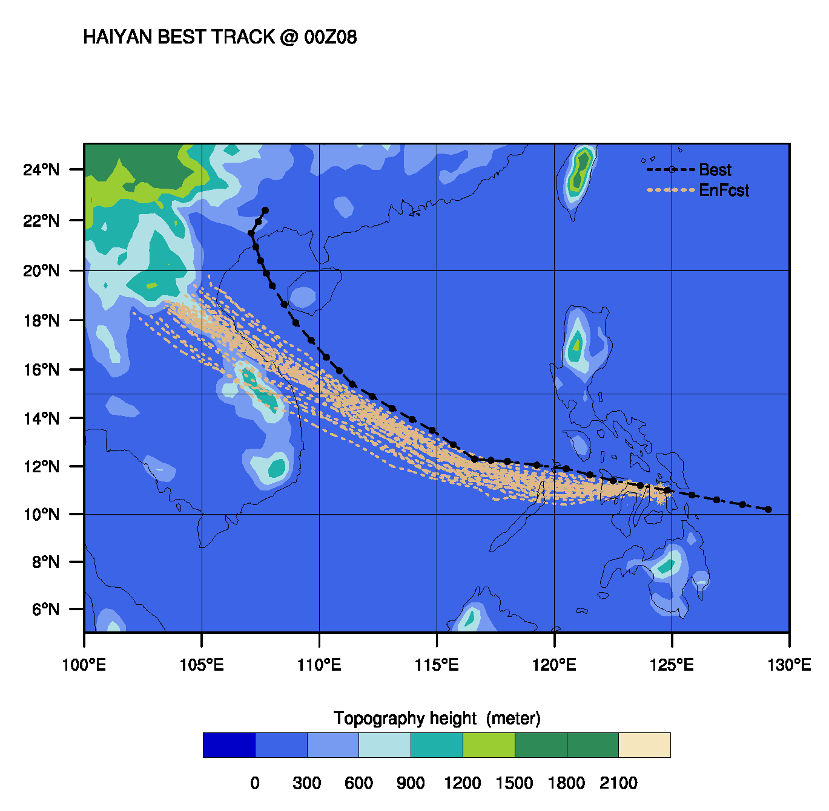
Ensemble forecast

Slide 16
4 Conclusion
1 Radar data has positive impacts on analysis and forecst
2 PBL parameterization or/and initial time or/and initial location could be responsible for the worse forecast than TIGGE

Slide 17
Thank you

