Slide 1
Simulation of the Arctic Mixed-Phase Clouds
Hui-Wen Lai
Fall 2015 Group Meeting
Dec. 11, 2015

Slide 2
Motivation
The Arctic, where radiative energy lost to space greatly exceeds the energy received from the sun, plays an important role in Earth’s atmospheric general circulation.
Clouds found in the lower troposphere have a dominant impact on the Arctic radiation budget, with layers of high water vapor content.
Precipitation events around the North Slope of Alaska site are characterized by mixed-phase clouds. Understanding of ice growth microphysics in these clouds is still lacking, because of a dearth of detailed observations.

Slide 3
Objective
Mixed-phase clouds
Mixed-phase clouds are composed of a mixture of supercooled liquid water and ice crystals.
The processes involved in ice particle formation are more complicated and less well understood than for water droplet formation.
Liquid
Mixed-phase
Ice
↑ Crystal nucleation

Slide 4
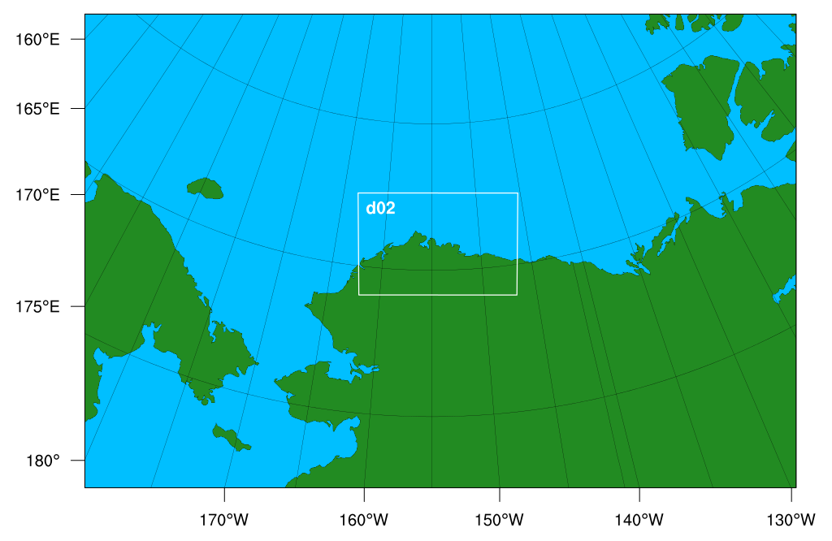
Model Setting
Domain :
D01 : 301 ×201 ×100 (9km)
D02 : 202 ×130 ×100 (3km)
CASE 1 :
2013/05/02 16UTC
CASE 2 :
2013/05/02 19UTC
CASE 3 :
2013/05/06 11UTC
Barrow
Physics Options in WRF :
Cumulus Parameterization: | Grell-Freitas ensemble scheme
PBL Schemes: | Yonsei University scheme
Radiation Schemes: | CAM
Surface Schemes: | Noah Land Surface Model
Cloud microphysics: | Morrison 2-moment scheme
Notes:
4
4
4

Slide 5
Simulation experiments
36-h forecast
24-h forecast
12-h forecast
05/01
0400UTC
05/01
1600UTC
05/02
0400UTC
05/02
1600UTC
Observation
The DOE-ARM X-band scanning precipitation radar (X-SAPR) at Barrow, Alaska
Plan Position Indicator (PPI)
Range Height Indicator (RHI)
PPI
RHI

Slide 6
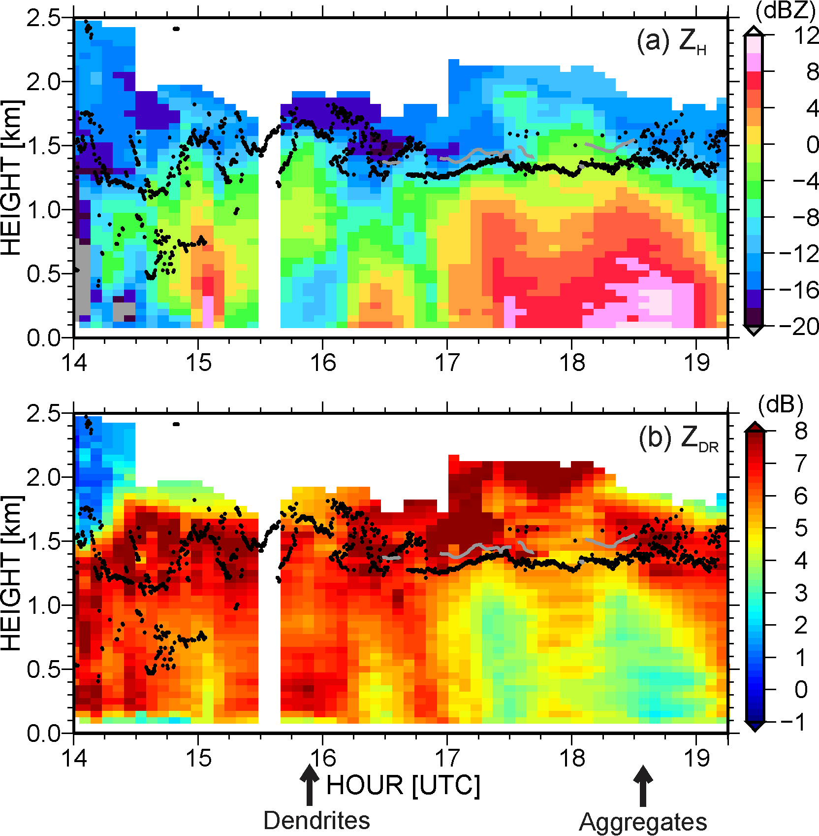
Case (I) Dendrites
Shallow boundary layer cloud system
1600 UTC 2 May 2013
A weak surface trough approached.
Ice particles from that cloud layer fell into the liquid-cloud layers in a seeder-feeder scenario.
(Oue et al, 2015)

Slide 7
Case (II) Aggregates
Shallow boundary layer cloud system
1900 UTC 2 May 2013
Precipitation particles from the top cloud layer fell into the liquid-cloud layers in a seeder-feeder scenario.
(Oue et al, 2015)

Slide 8
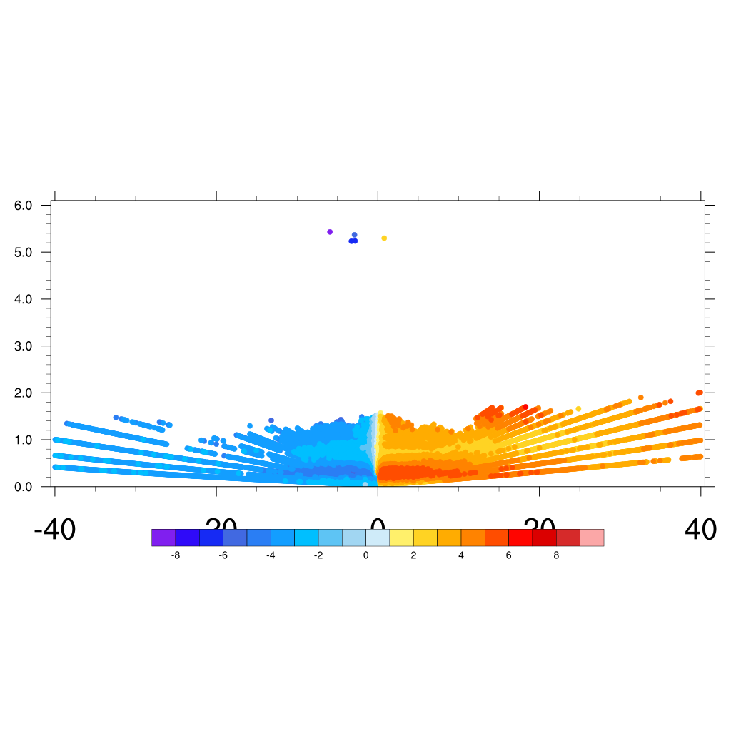
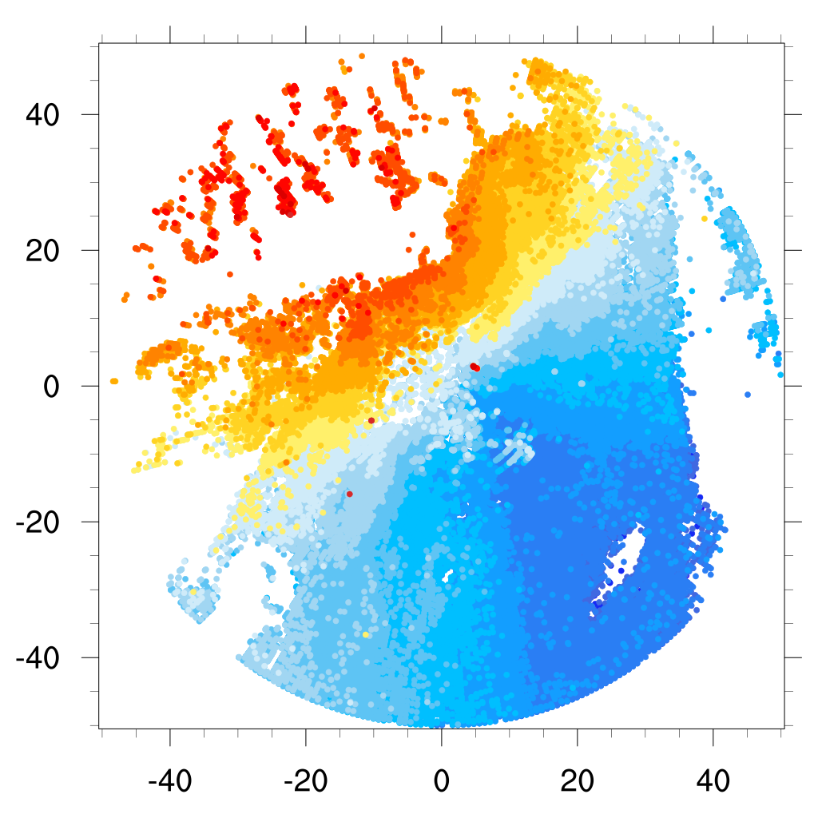
Case (I & II) Dendrites and Aggregates
Observation
Radial Velocity
Elevation 0.5°
Radial Velocity
Azimuth 7°
-40 -20 0 20 40
Simulation
Horizontal wind speed and direction
1000 hPa
12-h
24-h
36-h

Slide 9
Case (I & II) Dendrites and Aggregates
Temperature and Dew point vertical profile
Observation
Simulation
12-h
24-h
36-h
(Oue et al, 2015)
Shaded region: Supersaturation condition with respect to ice
Arrows: Liquid cloud tops for the pristine dendrites case (1.75 km) and aggregates (1.5 km)

Slide 10
Summary and future work
In these cases, ice particles from seeder-clouds at the top of the system fell into at least one liquid-cloud layer embedded in the ice precipitating cloud systems.
From the preliminary results, the model provided a consistent wind field between simulations and observations. However, it did not portray the different properties of the flows in the different layers due to the unclear thermodynamic process.
!------------------------------------------------------------------------------------------
Assimilating radar radial velocity/GTS into ENKF

Slide 11
Thank you

Slide 12
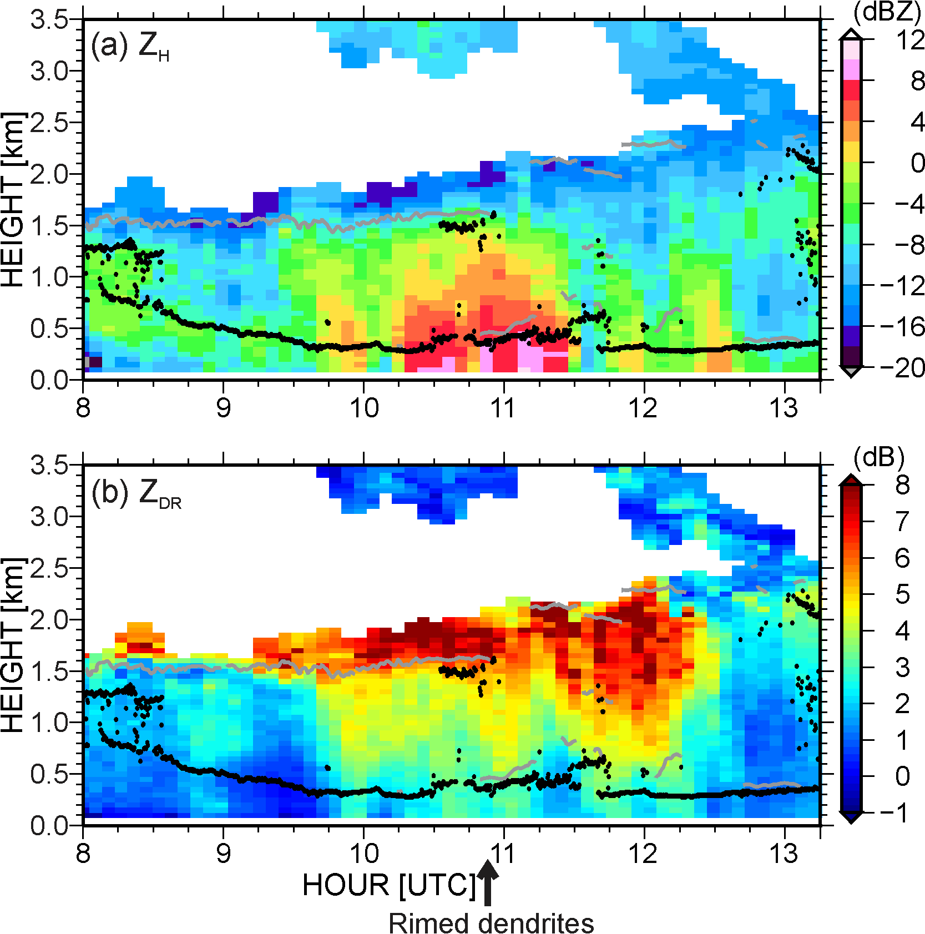
Case (III) Rimed dendrites
Frontal system
1100 UTC 6 May 2013
A slow-moving surface trough passed through Barrow from the southwest to northeast.
(Oue et al, 2015)

Slide 13
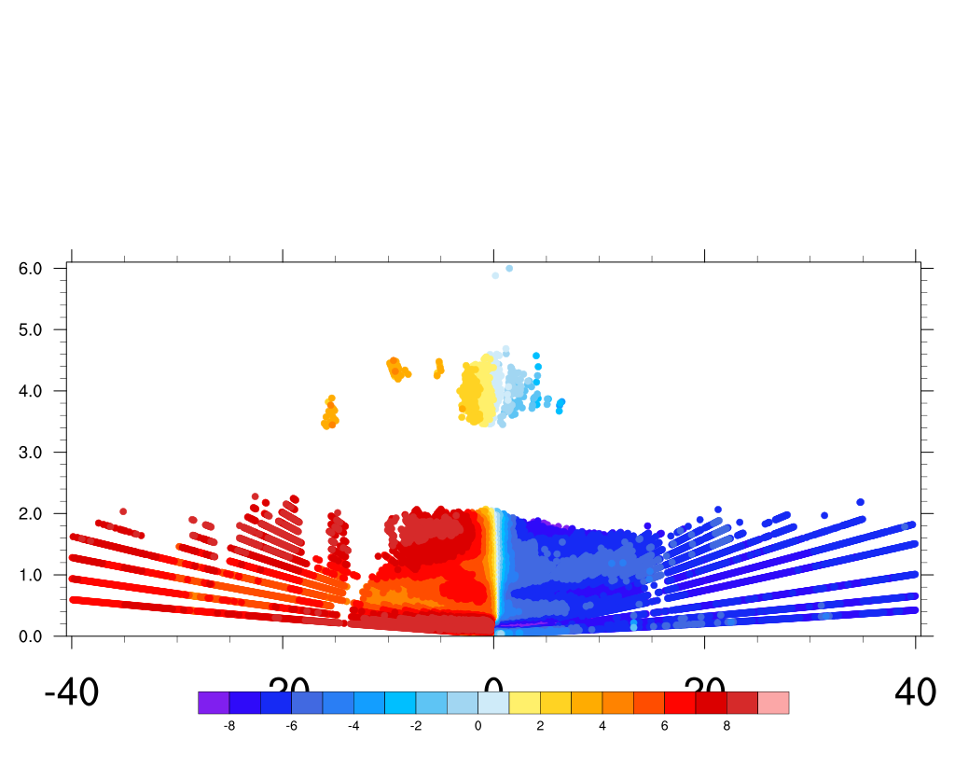
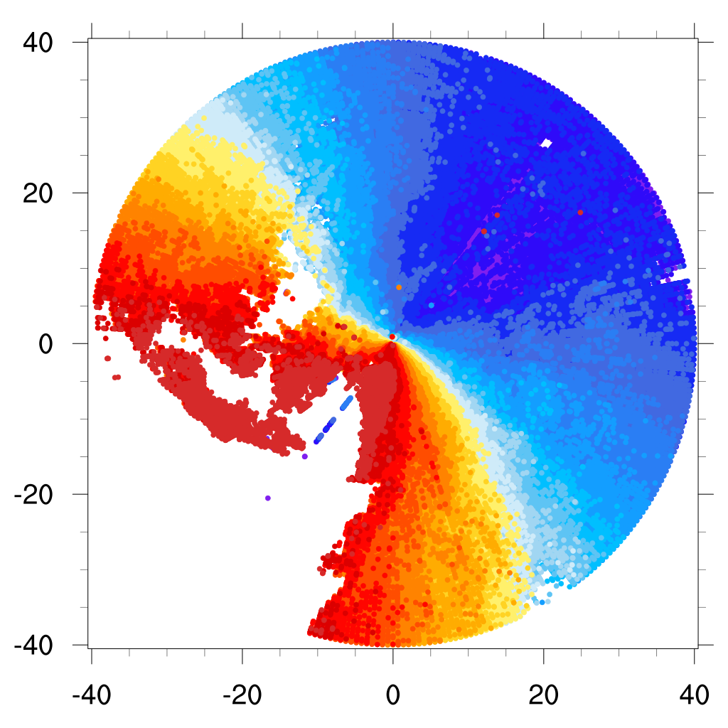
Case (III) Rimed dendrites
Observation
Radial Velocity
Elevation 0.5°
Radial Velocity
Azimuth 7°
-40 -20 0 20 40
Simulation
Horizontal wind speed and direction
1000 hPa
12-h
24-h
36-h

Slide 14
Case (III) Rimed dendrites
Temperature and Dew point vertical profile
12-h
24-h
36-h
Shaded region: Supersaturation condition with respect to ice
Arrows: Liquid cloud tops for the rimed dendrites case

