Slide 1
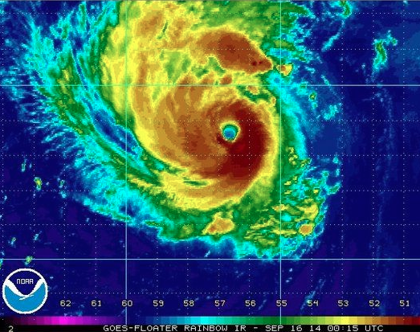

Dynamics and predictability of the rapid intensification of Hurricane Edouard (2014)
Erin Munsell
Fall 2015 Group
Meeting
December 11th, 2015

Slide 2
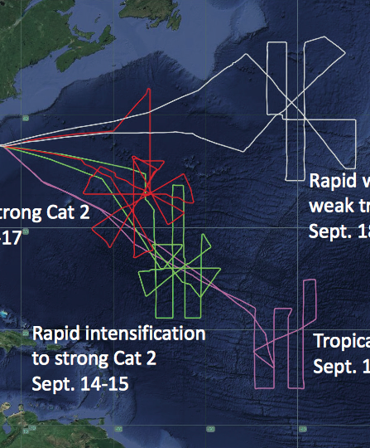
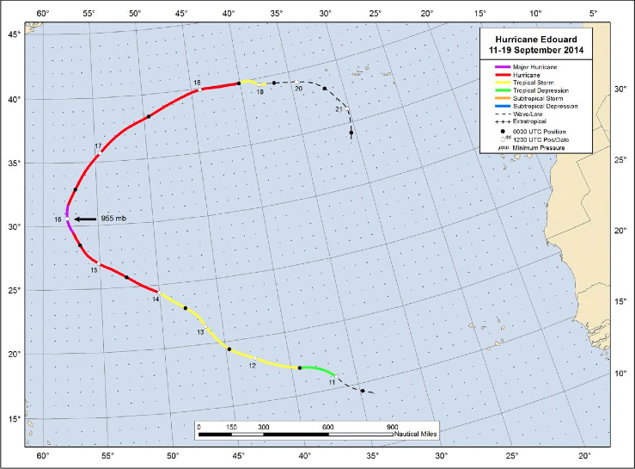
Hurricane Edouard (2014) Best Track and HS3 Flights
PSU WRF-EnKF initialized at 12Z on Sept 11th – TD 6 designation
Simulation ends on 18Z on Sept 16th – just after peak intensity (major hurricane, 1st of HS3!)

Slide 3
Ensemble Tracks classified by performance
SST’s contoured (constant amongst members)
Maximum 10-m Wind Speed (kts) classified by performance
Best Track – Black
GOOD – Blue
GOOD_EARLY – Green
GOOD_LATE – Magenta
POOR – Red

Slide 4
Deep-layer shear (850-hPa – 200-hPa) averaged over a 200-km to 500-km radius for the ensemble members of the composite groups

Slide 5
Idealized Experiments: Sensitivity to Increasing Magnitudes of Wind Shear
SH7.5-SST29 (GOOD_EARLY)
SH10-SST29 (GOOD or GOOD_LATE)
SH12.5-SST29 (POOR)
Zhang and Tao 2013, Tao and Zhang 2014

Slide 6
Mean deep-layer (850-hPa – 200-hPa) vertical wind shear of composite groups – time in relation to beginning of RI

Slide 7
Sensitivity Experiments – Set #1
Sensitivity to composited initial conditions
Thick Lines – Composited IC’s
Thin Lines – Mean of Composite Groups from Original Ensemble

Slide 8
Sensitivity Experiments – Set #2 and Set #3
Testing the strength of the GOOD_EARLY vortex
Testing the influence of the POOR environment
R = 300 km
R = 200 km
Linearly Blended
Thick Lines – GOOD_EARLY environment sensitivity
Thin Lines – Composited IC’s

Slide 9

Summary of Sensitivity on Inner-core vs. Environment
Environment
✓✓ - RI at 48 h
✓ - RI at 72 h
✗ - No RI
 | GOOD_EARLY | GOOD | POOR
GOOD_EARLY
GOOD
POOR
Inner-Core

Slide 10
Sensitivity Experiments – Set #4
Assessing the radii at which the POOR environment becomes detrimental
Radius (km) | EnvGoodTcPoor | EnvPoorTcGood
250 | ✓ | ✗
500 | ✓ | ✗
600 | ✓ | ✗
700 | ✗ | ✗
800 | ✓ | ✗
900 | ✗ | ½✓
1100 | ✗ | ✓

Slide 11
Sensitivity Experiment – Set #5: Moisture differences (ONLY!) in the sensitive region
0 h
0 h
800-hPa RH
500-hPa RH

Slide 12
Sensitivity Experiment – Set #5: Radar reflectivity (dBZ) and 985-hPa theta-e (K) composites at 51 h
51 h
51 h

Slide 13
Sensitivity Experiment – Set #5: Backward and forward trajectories released at 66 h and from 850-hPa colored according to RH

Slide 14
Summary and Conclusions
12 UTC 11 Sept ensemble initialization of Hurricane Edouard provides an excellent framework to assess the predictability of RI
Shear magnitude is strongest throughout the simulation for POOR; decreases in magnitude for GOOD_LATE, GOOD and GOOD_EARLY
Varying shear magnitudes impact the vortex tilt magnitude, location and the strength of the convection, and the subsequent precession and alignment process
Sensitivity experiments reveal that:
  GOOD and GOOD_LATE groups may be indistinguishable
  GOOD_EARLY vortex is initially stronger
  POOR environment is less favorable for development
    Sensitive region is somewhere between 800-km and 900-km
    Only varying moisture in this region causes divergence, but differences very difficult to trace
    1st observable difference: Stronger burst of convection at 51 h

